Slide 1
CONNECTING VISITORS TO GEOLOGY AT OREGON CAVES NATIONAL MONUMENT
Connor Newman
10/28/2013

Slide 2


B.A. Geology, 2011, University of Colorado, Boulder
Educational Earth Sciences Interpreter at Oregon Caves National Monument, Spring 2012
M.S. Geology (in progress), Expected completion August 2014, University of Nevada, Reno
Notes:
-introduce myself and talk briefly about future goals (work in gov’t)

Slide 3
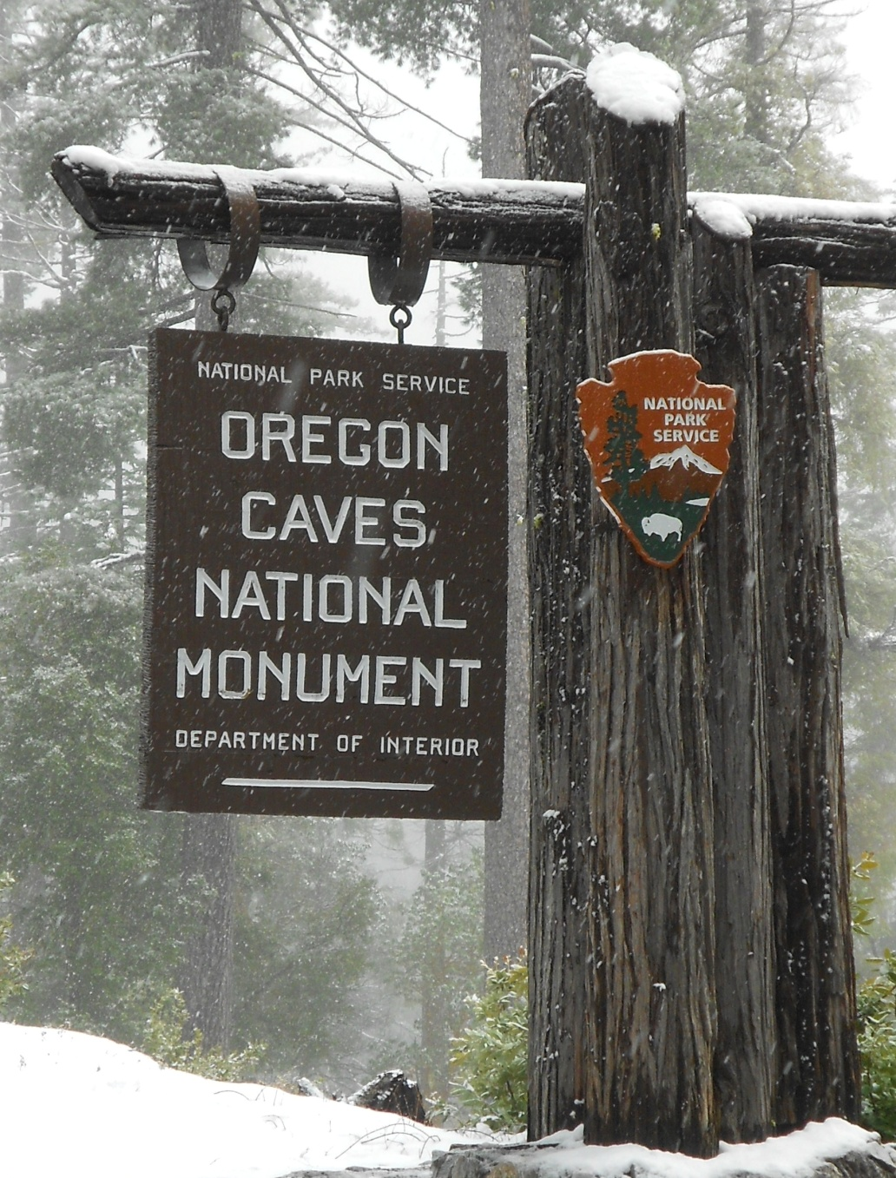
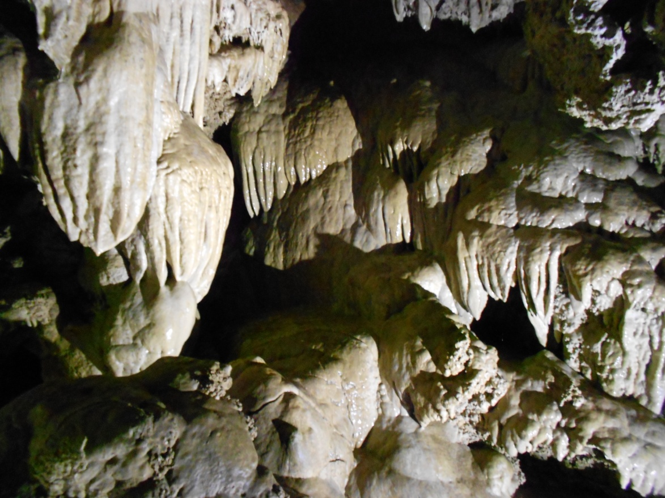
Notes:
-give outline for talk (overview of geology of monument, the GeoCorps and NPS missions, my job and goals at the monument, etc.)

Slide 4
Chronologic History
Seamount Formation ~250 Ma
Subduction related volcanism and intrusion ~170-145 Ma
Start of cave formation ~2.6 Ma
250 Ma
Present
Uplift of modern Siskiyous ~23-4 Ma
Accretion of Rattlesnake Creek Terrane ~168-164 Ma
Notes:
-seamount formation ~250 Ma
-accretion ~168-164 Ma
-volcanism coeval and following accretion until ~145 Ma
-uplift of modern Siskiyous ~23-4 Ma
-cave formation ~2.6 Ma-present

Slide 5
The National Park Service and GeoCorps
Goals of the NPS
Preserve park resources
Provide for public enjoyment
Geologists are specially equipped to fulfill these goals.
Notes:
-explain the goals of the NPS, and how each of these goals was achieved at ORCA
-preserve park resources by monitoring visitor interaction with the cave
-provide for public enjoyment by taking tours through and educating visitors
-explain how geologists (GeoCorps participants) are specially equipped to fulfill these goals
-many of us have an extra appreciation for the places the NPS protects
-because of our unique, specialized knowledge we have the ability to communicate to visitors in a way that will make lasting connections with the park, and with the natural world around them
-geologists in this position then have the chance to make lasting educational effects on the visitors they interact with
-I was an educational earth sciences interpreter at ORCA, the duties of my position were predominantly to guide tours through the cave, I also had the opportunity to create educational programs and to interact with visitors in more informal circumstances (roving, VC)

Slide 6
Facilitating Connections
Interpretive Development Program (IDP)
Human curiosity drives us to explore our world and to explain the things we see
Notes:
-give basics of IDP (connecting the resource to universal concepts, which enhance the visitors connections with the resource)
-IDP includes aspects such as central relevant idea (CRI) which is the essence of what the visitors should take away
-each ranger was allowed to create their own which was based on their strengths
-my cave tour was designed to focus on the geology of the cave
-this main end to this goal was to encourage scientific thought and understanding
-I attempted to facilitate my visitors to make observations of their surroundings, and then apply those observations in an attempt in understand the processes at work within a given area

Slide 7
General Tour Outline
Safety and logistics
My background
Introduction to rock types
Tour with teaching opportunities at specific stops
Notes:
-safety and logistics was necessary to ensure that the first NPS goal (protection of the resource) was maintained
-necessary to remind visitors that touching of the cave is prohibited, and about safety precautions such as staying together as a group, watching their heads and steps, etc.
-I then introduced my background as both a preface to what the tour was to focus on (geology) and also as a way to be more personable and approachable to the visitors
-it was my goal to have visitors ask all the questions they liked/had, and thus I needed to be an approachable figure
-I introduced the three rock types and how they were formed, and told the visitors that we would be seeing all three in the cave
-We then set off on the tour, where I used specific stops to teach geological concepts, at most stops I would encourage visitors to tell the group their observations, and what they interpreted those observations to mean
-I will now show you some photos of specific stops, and explain how they were explained to visitors

Slide 8
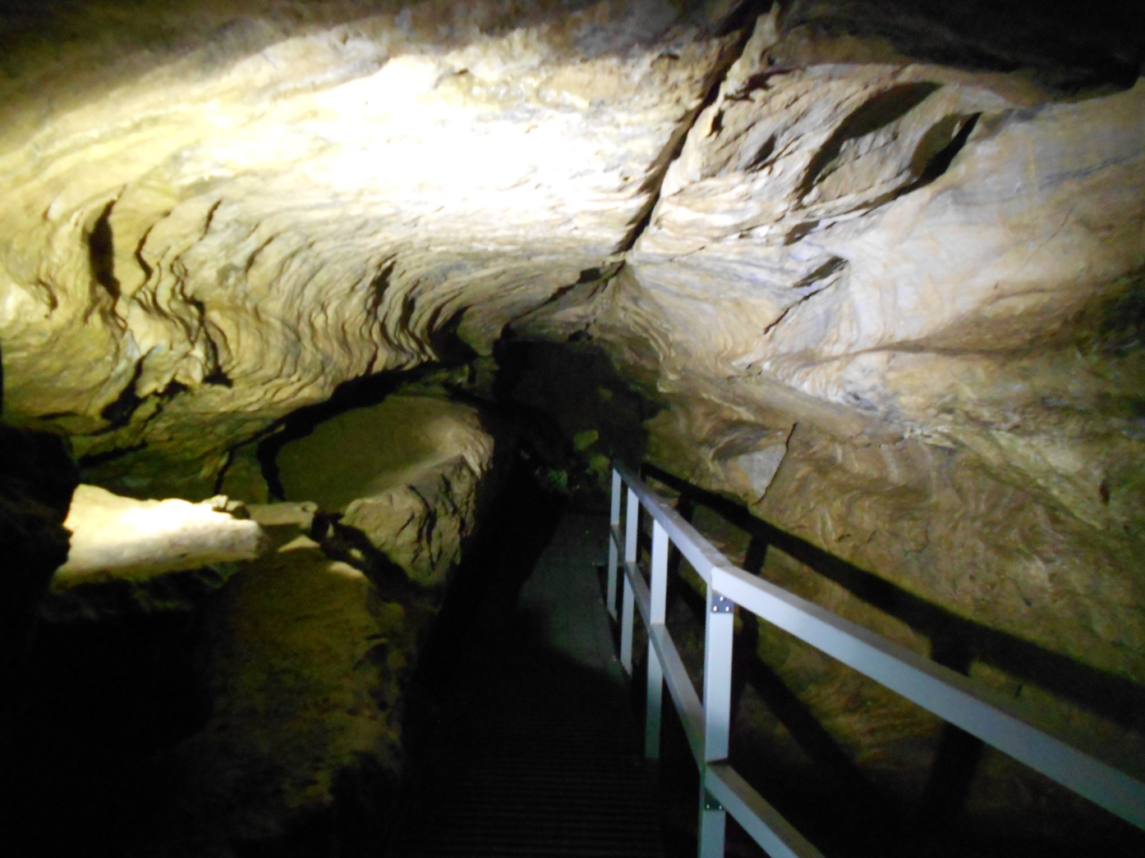
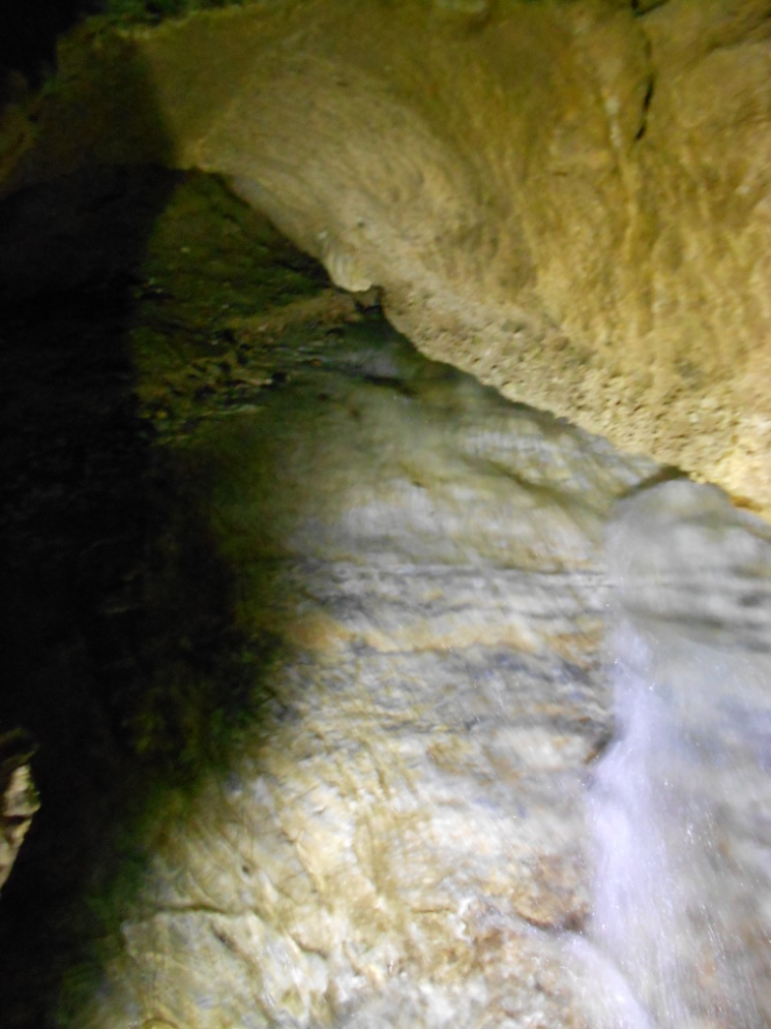
Figure 1: The Belly of the Whale passageway (left) and a view of Cave Creek and polished marble from beneath the bridge (right).
Notes:
-these pictures illustrate the way in which cave passages are formed, by water
-at this stop I explained the different terraces seen in the Belly of the Whale, and also pointed out the fact that the creek is still eroding in this area, causing further cave passage formation
-this stop served to exemplify the power which water has over the surface of the Earth

Slide 9
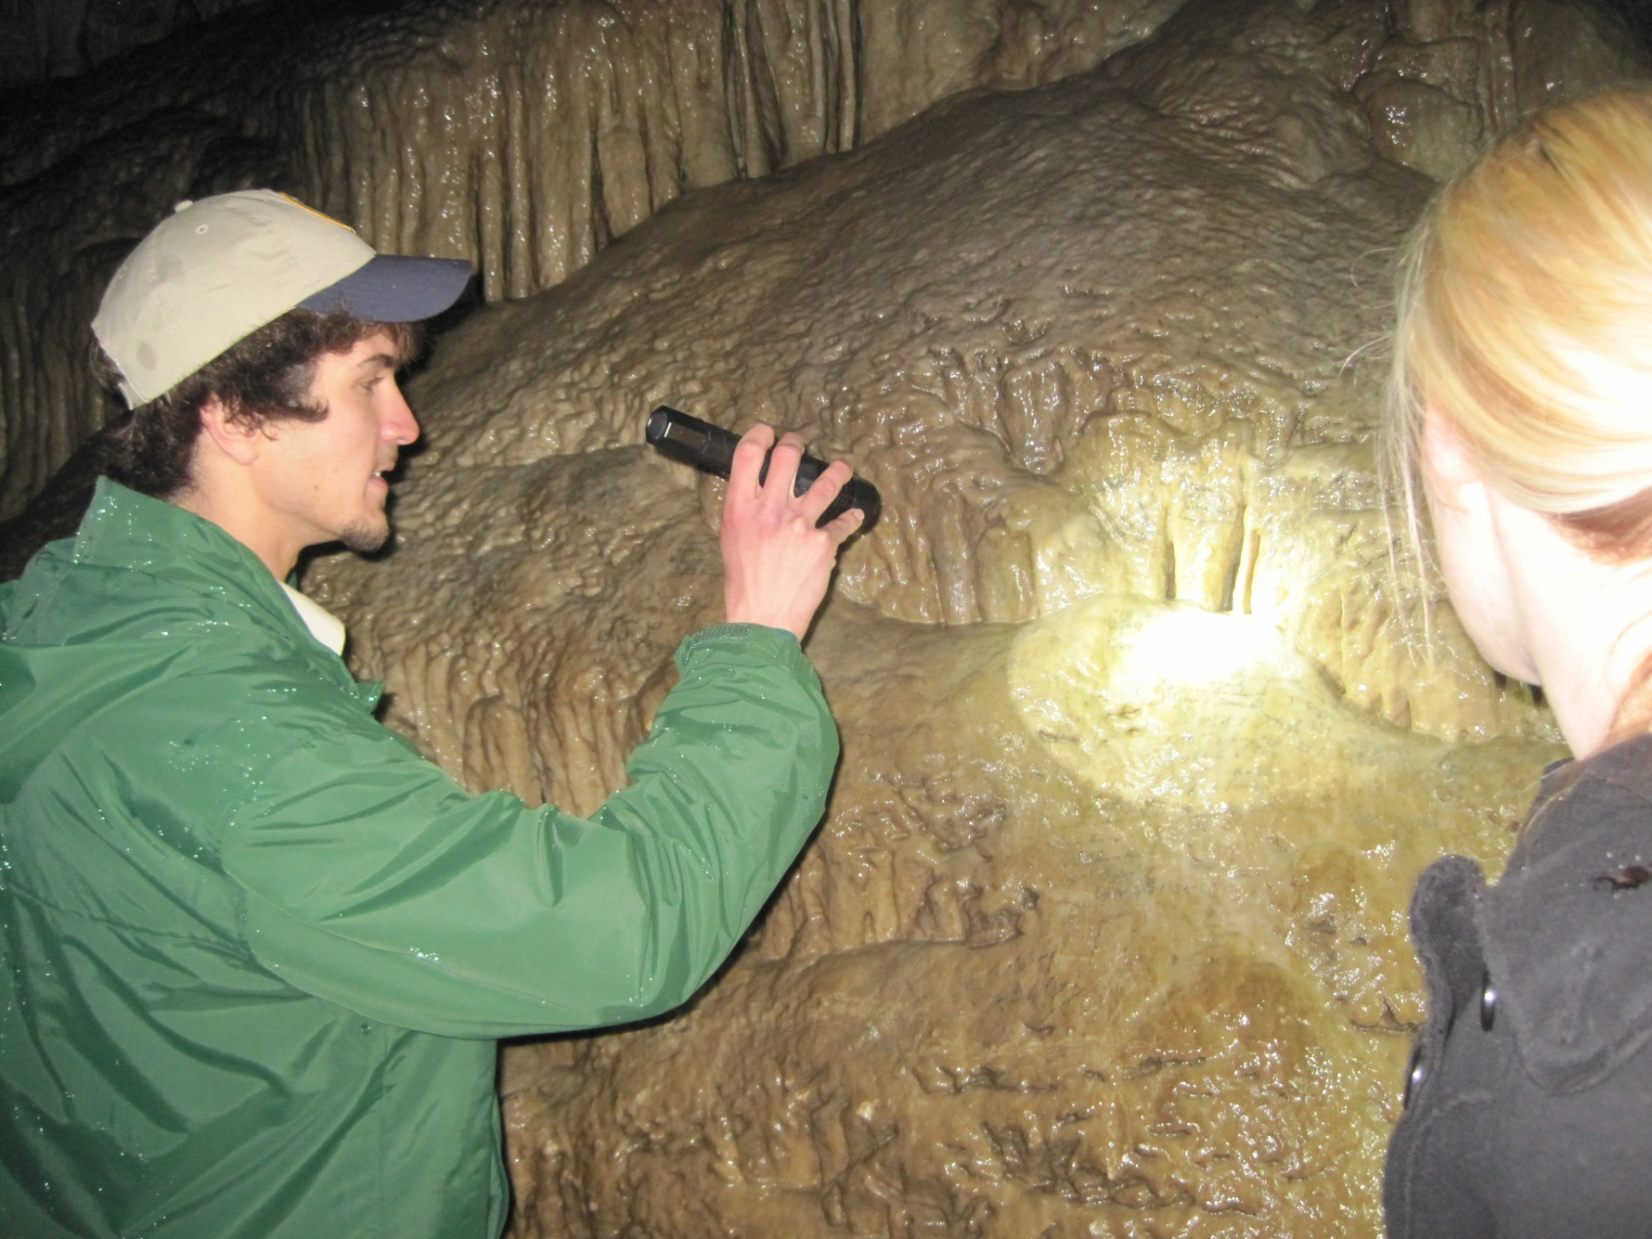
Figure 2: Showing flowstone and human impacts to visitors at Niagara Falls.
Notes:
-at one of the first stops in the cave I took this opportunity to explain to visitors how calcite is deposited in caves (via evaporation and CO_{2 degassing)}
-this flowstone is known as Niagara Falls, and it is covered with the signatures of early explorers of the cave
-at this point I lamented at the historic lack of respect for natural wonders that many early explorers had, often times visitors voiced their agreement, thus showing that they valued the resource of the cave, and fulfilling the NPS goal for inspiring visitor connections

Slide 10
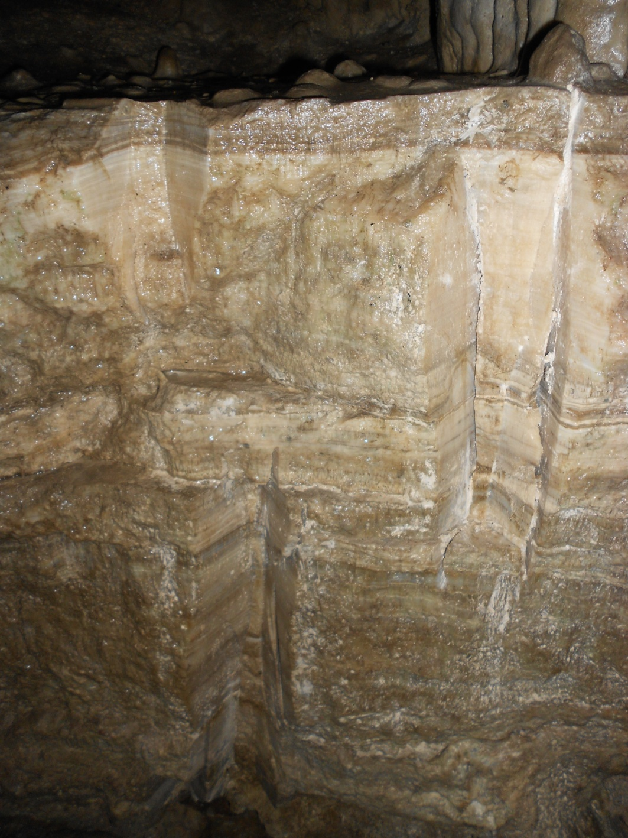
Figure 3: Cross section through flowstone layers.
Notes:
-this photo shows a cross section through flowstone created by a tour route tunnel
-I used this stop to illustrate the point of stratigraphic succession, and to give visitors a sense of geologic timescales

Slide 11
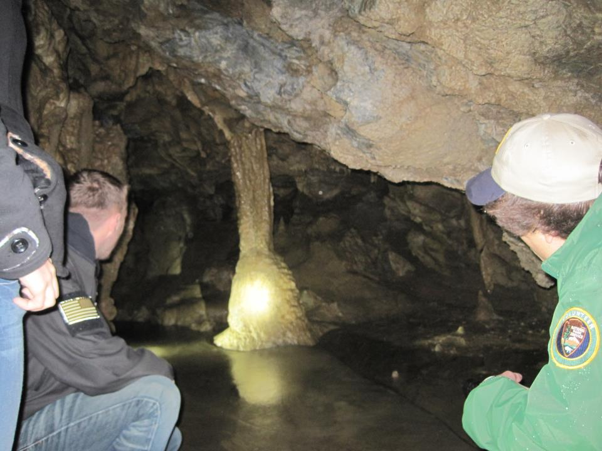
Figure 4: Explaining column formation to visitors at the Grand Column.
Notes:
-this photo shows the grand column, the largest speleothem of it’s type in the cave
I used this opportunity to teach how columns are formed (from the joining of a stalactite and stalagmite)
I also encouraged visitor participation at this point by asking visitors to point out where they thought the stalactite and stalagmite that formed the column has met, visitors normally were able to do this correctly
This stop was noted by my superior as being one of the most effective teaching moments on my tour

Slide 12
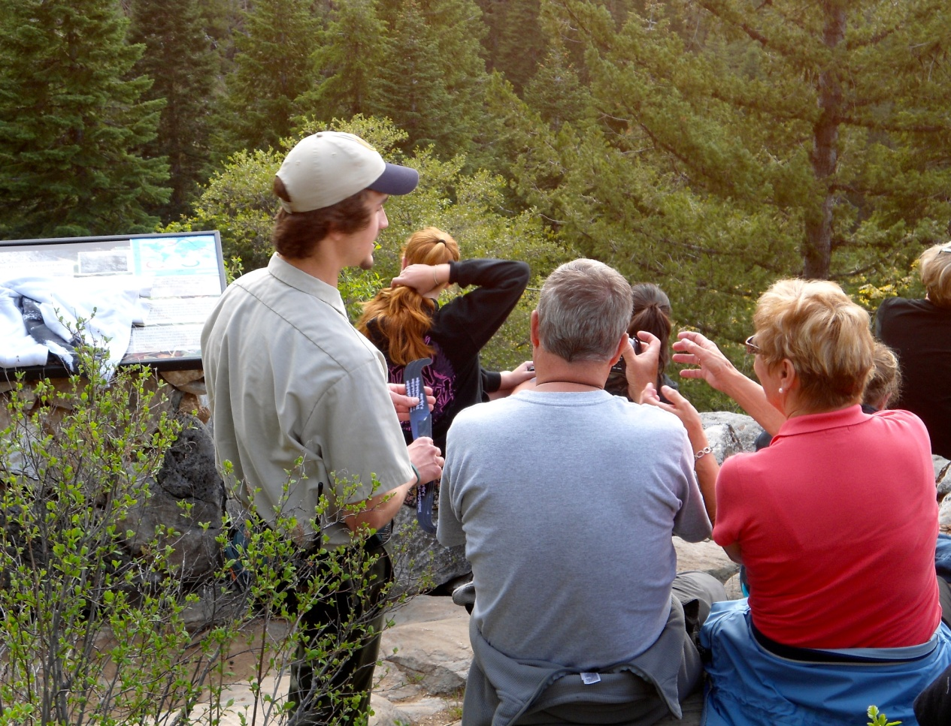
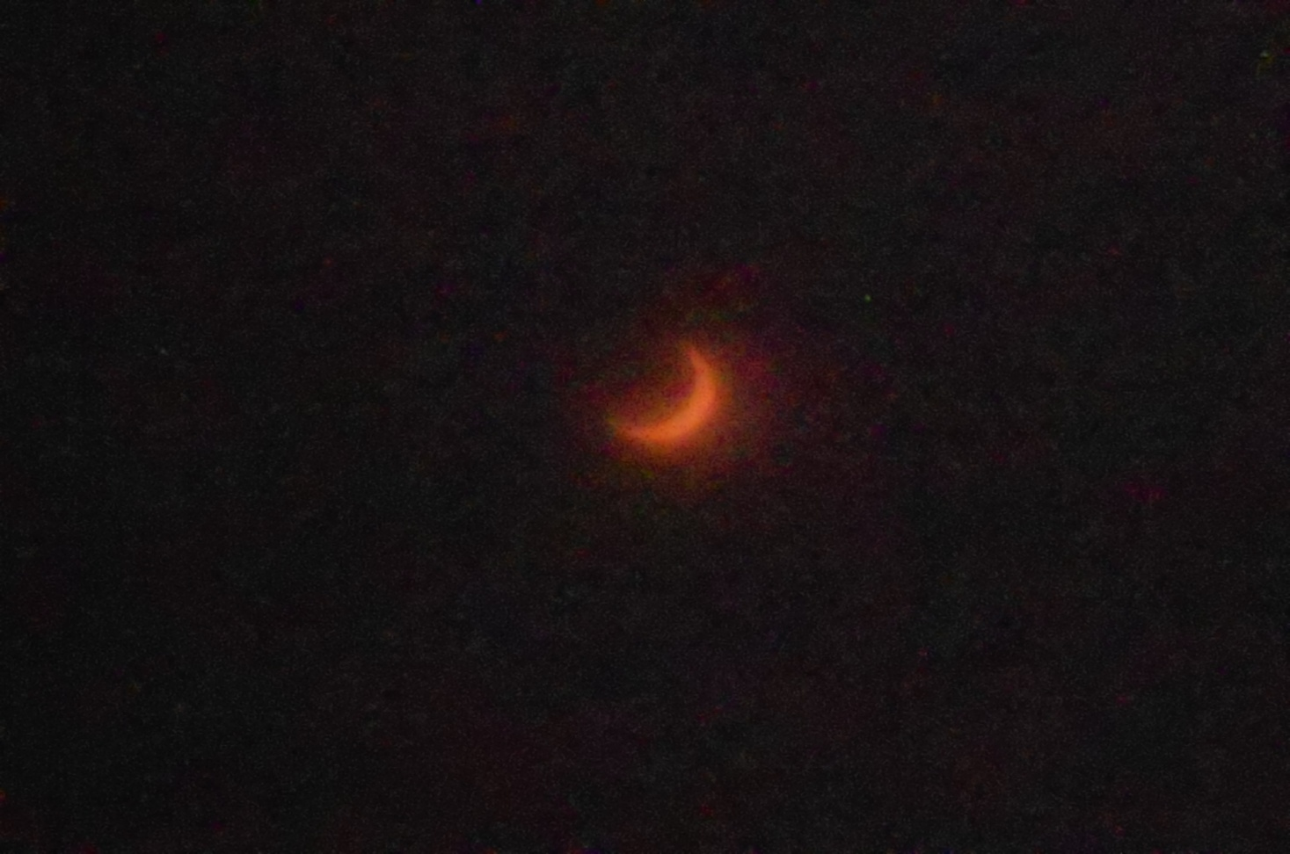
Figure 5: Explaining an annular eclipse to visitors (left) and the annulus of the May 20, 2012 annular eclipse (right).
Notes:
-in addition to leading cave tours and teaching visitors about geology I was also allowed to create educational programs on other topics
-one such topic was the annular eclipse which occurred on 5-20-2012, in which I supplied solar viewing glasses to visitors and explained about the physics and scientific significance of the eclipse

Slide 13
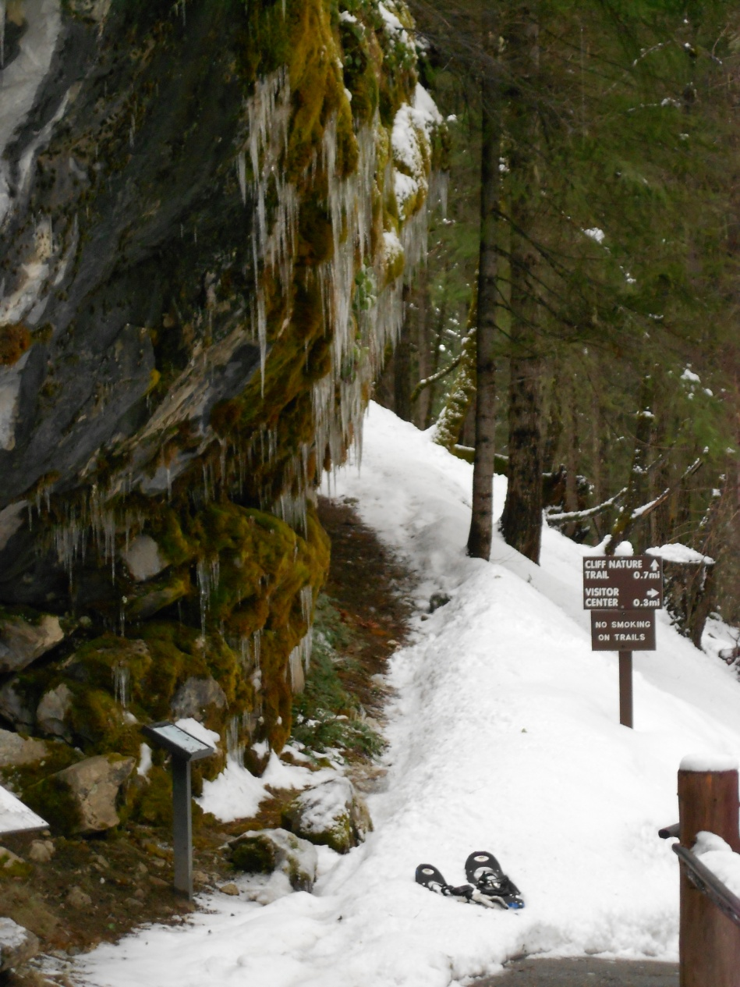
Troubles Encountered
Dynamic nature
Unwilling visitors
Injuries
Adverse conditions
Figure 6: Cave tour exit after spring snow storm.
Notes:
-while many tours went smoothly, others encountered some setbacks or issues
-because of the wide range in visitor age, background, and physical abilities it was commonly necessary to adjust the tour content
-this was done to enhance visitor satisfaction and comprehension
-for example I once took a tour comprised of just 3 people, two of which were geologists, thus the tour for that group was significantly more advanced than for most
-it is unfortunate but true that some visitors to national parks simply do not wish to learn, they are only interested in the aesthetics of the area
-on several occasions visitors clearly did not listen to what I was telling them, and talked amongst their group the entire tour
-on several occasions it was necessary to stop a tour due to an injury (normally bumped heads)
-tours were also affected by the weather on the surface

Slide 14
Success Stories
“Today was my eighth trip through the cave, and it was fantastic, again! But today was exceptional- we had Connor as our tour guide and I’ve learned more today than all the other trips put together. He was fantastic, very knowledgeable, and informational” -Anonymous
“Great tour. Connor was both very organized and very technically knowledgeable!” -Anonymous
Notes:
-here are two of the visitor comments which I received on my tour, I believe that experiences such as these vastly outweigh the number of visitors with negative experiences
-I considered my work a success if people walked away with a new found appreciation and knowledge of the natural world, and with the tools to observe their surroundings and think critically about them

Slide 15
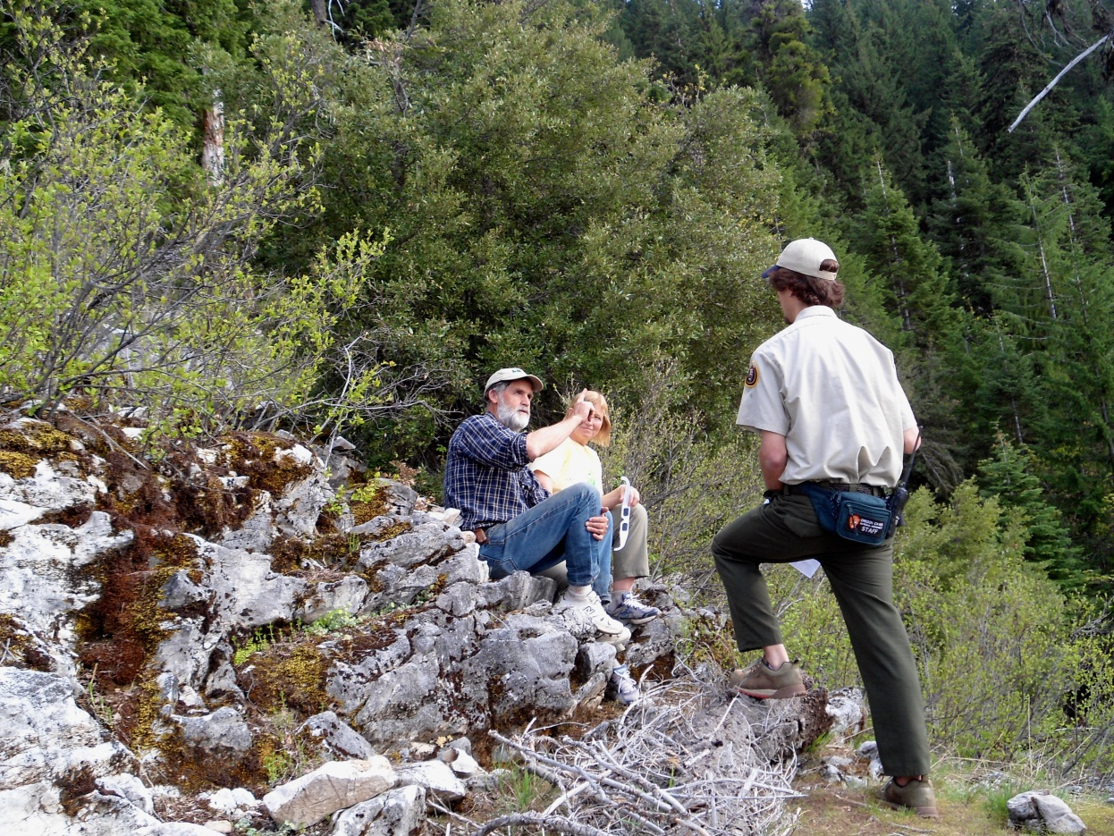
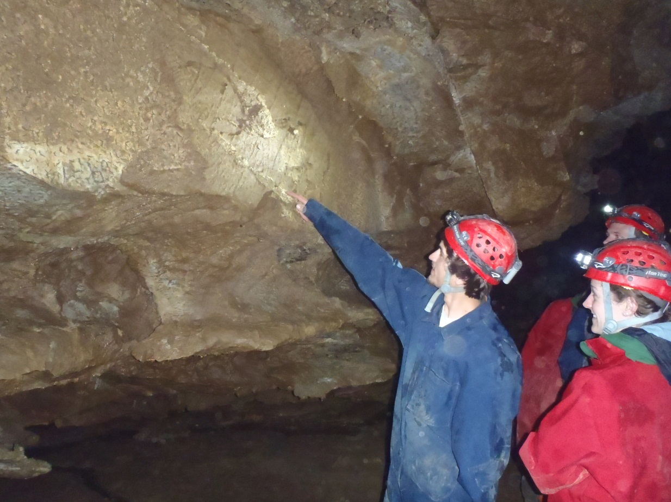
Figure 7: Explaining folding to SCA interns on the off trail tour route (left). Discussing the May 20, 2012 annular eclipse with visitors (right).
Notes:
-I believe that the GeoCorps program benefits all the parties involved because the park in question gains experienced, enthusiastic staff members; the GeoCorps participant gains real world experience and has the opportunity to positively affect the lives of visitors; and the GSA is able to reach a broader audience to bring the message of geoscience awareness
-I had an excellent experience as a GeoCorps intern, I hope to participate in the program again as a guest scientist, and I hope this experience eventually helps me to become a geologist in the NPS or similar agency

Slide 16


Thank You
I wish to thank Sandra Gladish and George Herring, my supervisors at Oregon Caves National Monument; Jason Bracken, my fellow GeoCorps intern; and the GSA and the National Park Service for creating and facilitating the GeoCorps program.

Slide 17
References
Eakin, C. et al., 2010. Seismic Anisotropy beneath Cascadia and the Mendocino Triple Junction: Interaction of the Subducting Slab with Mantle Flow. Earth and Planetary Science Letters, v. 297, n.3-4, p. 627-632.
Johnson, K., and Barnes, C., 2006. Magma Mixing and Mingling in the Grayback pluton, Klamath Mountains, Oregon, in Snoke, A.W., and Barnes, C. G., eds., Geological studies in the Klamath Mountains province, California and Oregon: A volume in honor of William P. Irwin: Geological Society of America Special Paper 410, p. 247-267. Geological Society of America, Boulder, Colorado.
Kearey, P. et al., 2008. Global Tectonics, Third Edition. John Wiley and Sons Ltd. West Sussex, United Kingdom.
KellerLynn, K., 2011. Oregon Caves National Monument: Geological Resources Inventory Report. Natural Resource Report NPS/NRSS/GRD/NRR-2011/457. National Park Service, Fort Collins, Colorado.
McNutt, M., 1983. Influence of Plate Subduction on Isostatic Compensation in Northern California. Tectonics, v. 2, n. 4, p. 399-415. American Geophysical Union. Washington, D.C.
Roth, J., 2012. Oregon Caves: A Natural History. Oregon Caves National Monument Staff Training Binder, Spring 2012. Oregon Caves National Monument, Cave Junction, Oregon.
Wright, J. and Wyld, S., 1994. The Rattlesnake Creek Terrane, Klamath Mountains, California: An Early Mesozoic Volcanic Arc and its Basement of Tectonically Disrupted Crust. Geological Society of America Bulletin, v. 106, p. 1033-1056. Geological Society of America, Boulder, Colorado.
Wells, M., and Hoisch, T., 2008. The Role of Mantle Delamination in Widespread late Cretaceous Extension and Magmatism in the Cordilleran Orogen, Western United States. Geological Society of America Bulletin, v. 120, n. 5-6, p. 515-530. Geological Society of America, Boulder, Colorado.
Xue, M., Allen, R., 2007. The Fate of the Juan de Fuca Plate: Implications for a Yellowstone Plume Head. Earth and Planetary Science Letters, v. 264, n. 1-2, p. 266-276.

Slide 18
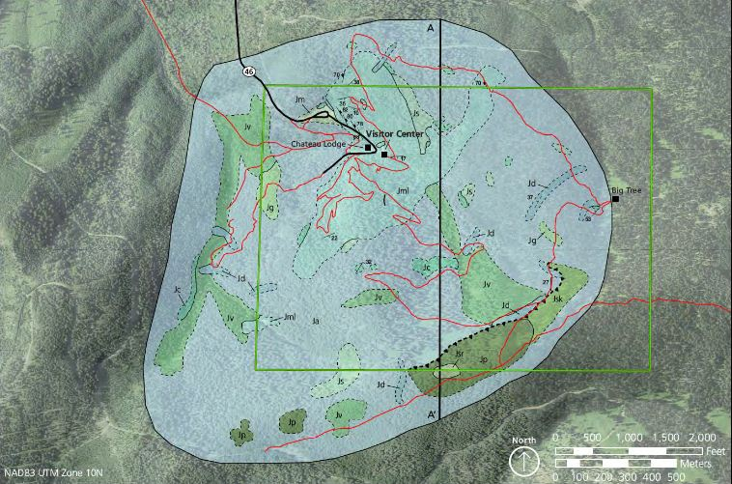
Figure 8: Generalized geologic map of the Oregon Caves National Monument region. From Keller-Lynn (2011)
Notes:
-this is a generalized geologic map of the area surrounding ORCA
-this map shows some of the complexity found at the monument, the most prominent rock types are on this figure are metasediments and metavolcanics, with some intrusives as well.
-I will give a brief overview of the geologic history of the caves and surrounding area

Slide 19
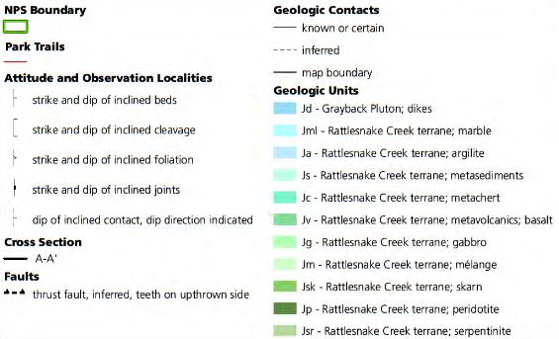
Figure 9: Map key for geologic map of Oregon Caves National Monument. From Keller-Lynn (2011).

