Slide 1
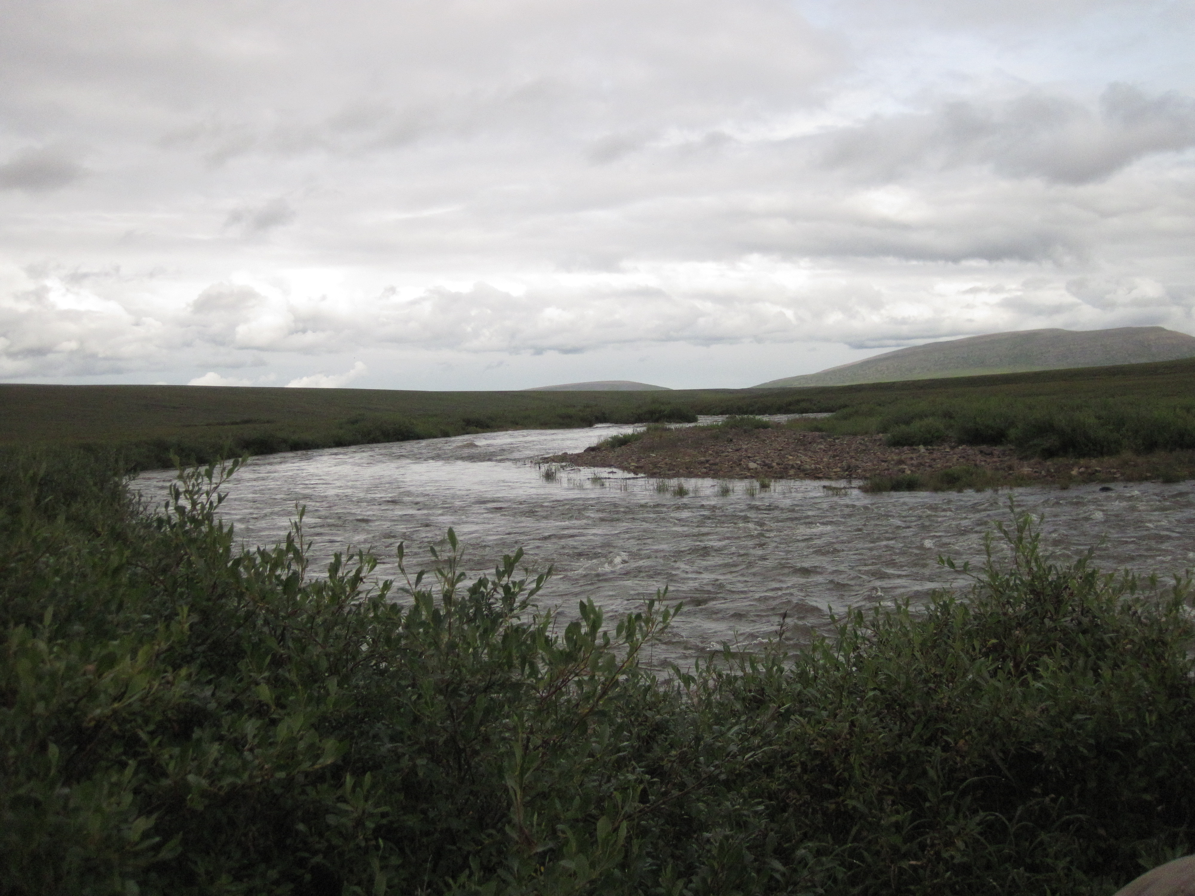
One-Dimensional Solute Transport Models: Parameter Uncertainty Implications for Quantifying Biogeochemical Cycling in Stream Networks
E.M. Smull
A.N. Wlostowski
M.N. Gooseff
Department of Civil & Environmental Engineering
Colorado State University
W.B. Bowden
Rubenstein School of Environment & Natural Resources
University of Vermont
W.M. Wollheim
Department of Natural Resources and Environment
University of New Hampshire

Slide 2
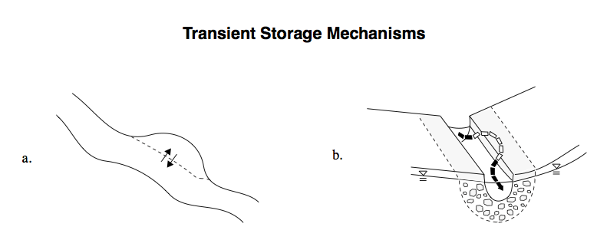
Transport studies can be used to understand transient storage and potential for biogeochemical cycling
Runkel, 1998

Slide 3
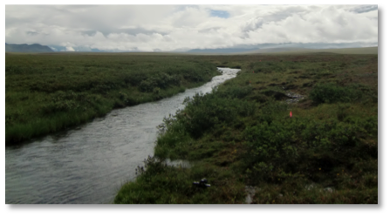
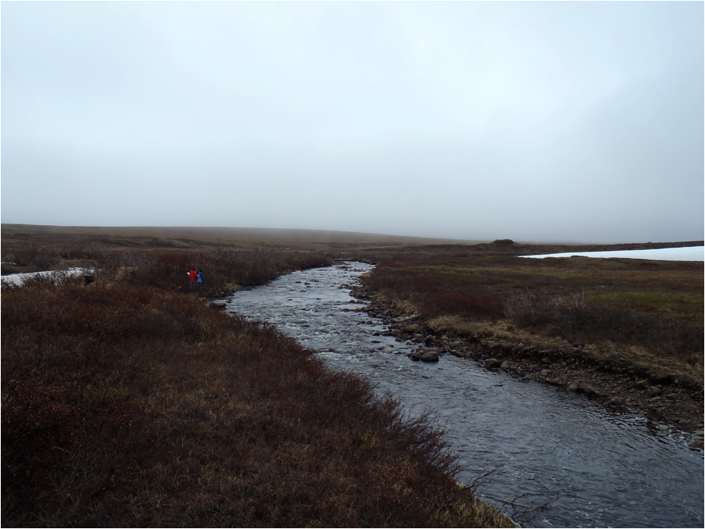
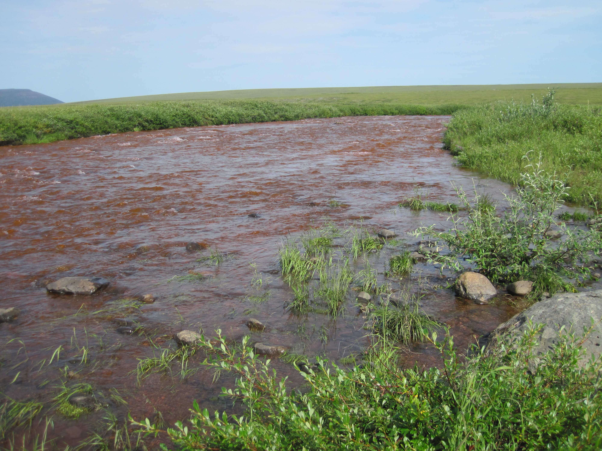
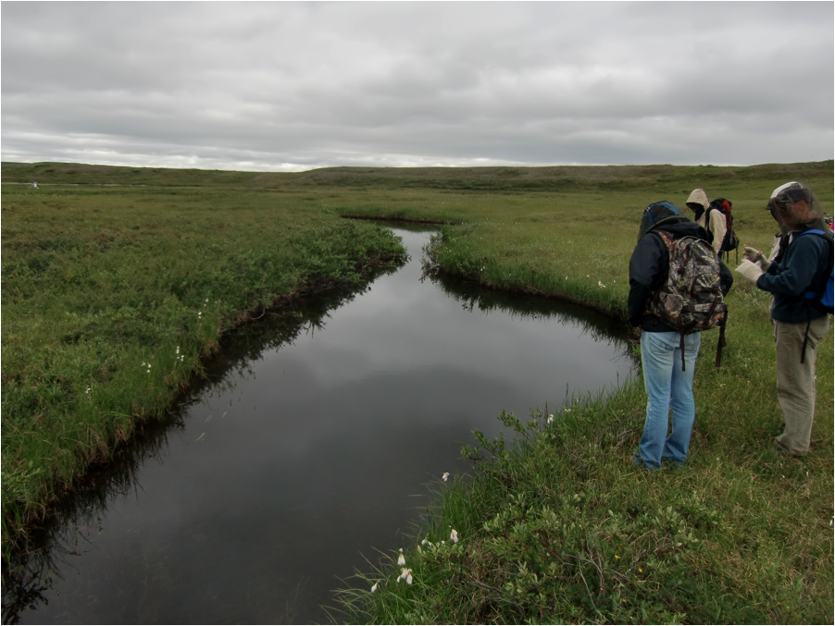

Slide 4
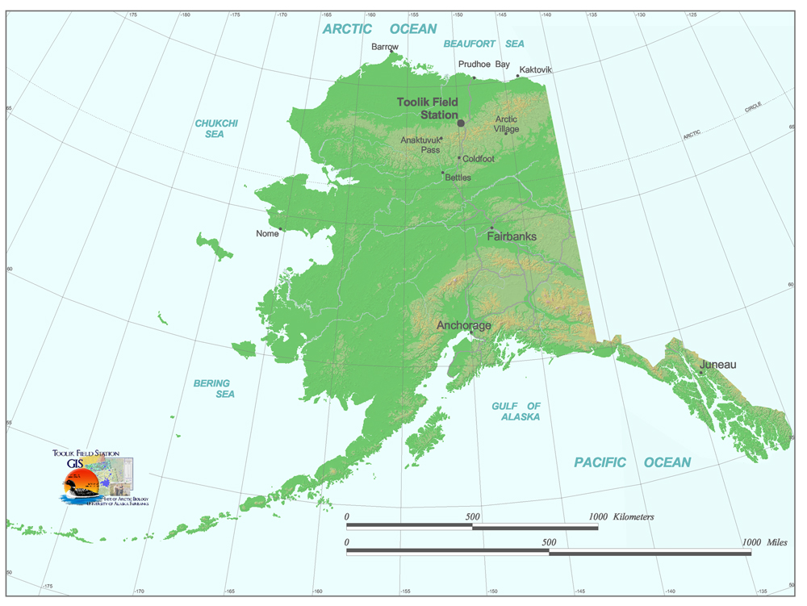
Toolik Field Station
68° 37’ 39” N
149° 35’ 51” W

Slide 5
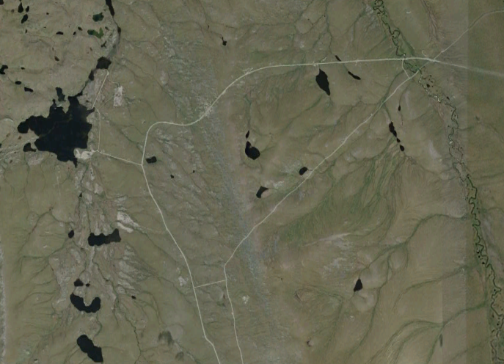
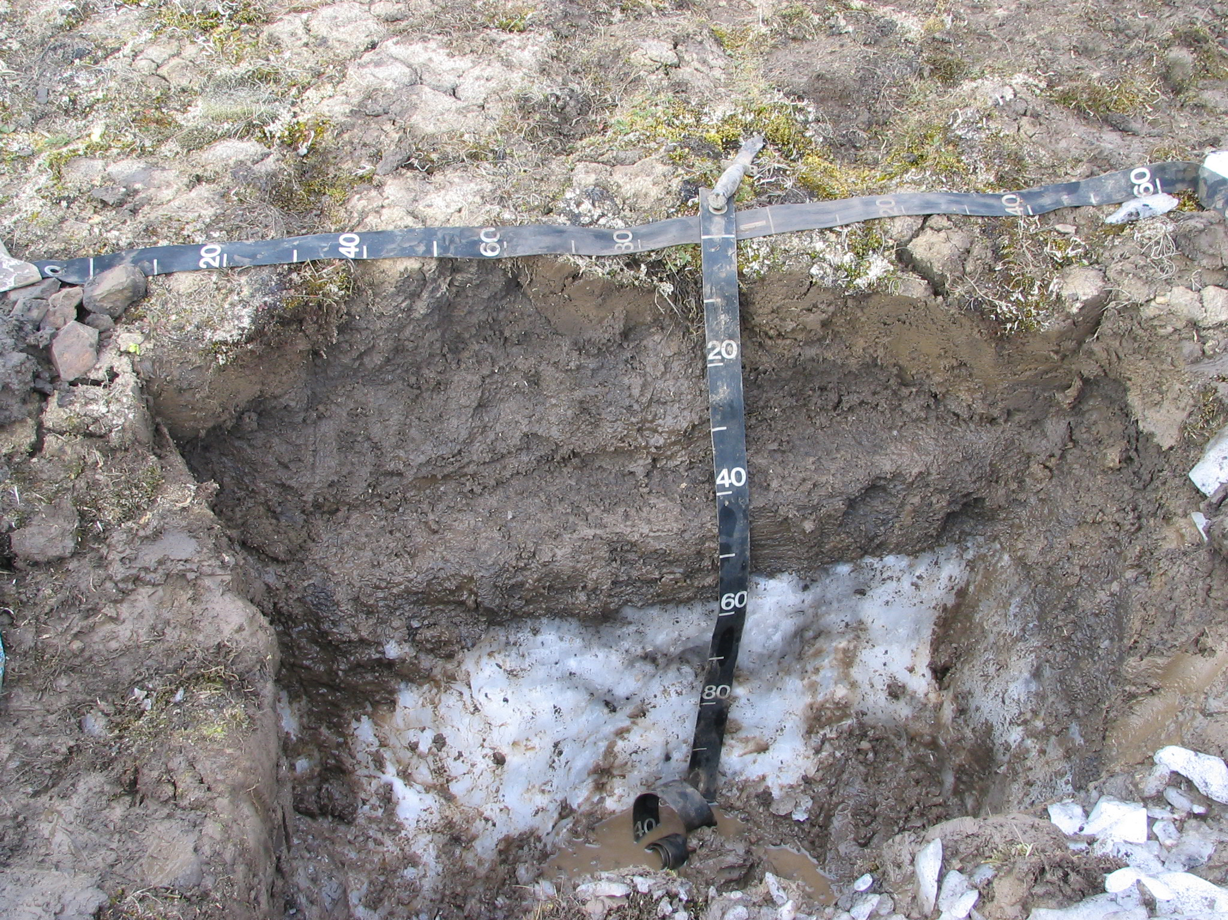
N
Kuparuk River
Toolik Field Station
68° 37’ 39” N
149° 35’ 51” W
I8 Outlet
I8 Inlet
Peat Inlet
2.64 km
Google Earth 2013
Photo from US Permafrost Association

Slide 6
N
I8 Inlet
2.64 km
Google Earth 2013

Slide 7
N
2nd order
Cobble substrate
Upstream of I8 Lake
Relatively low gradient (0.97 %)
I8 Inlet
2.64 km
Google Earth 2013

Slide 8
N
I8 Outlet
2.64 km
Google Earth 2013

Slide 9
N
2nd order
Cobble substrate
Downstream of I8 Lake
Relatively high gradient (1.18%)
I8 Outlet
2.64 km
Google Earth 2013

Slide 10
N
Peat Inlet
2.64 km
Google Earth 2013

Slide 11
N
2nd order
Peat substrate
Beaded
Unaffected by lakes
Peat Inlet
2.64 km
Google Earth 2013
Notes:
Due to that peaty substrate we expect transient storage to be surface transient storage

Slide 12
N
Kuparuk River
2.64 km
Google Earth 2013

Slide 13
N
Kuparuk River
4th order
Cobble substrate
Discharge major mass transfer mechanism
2.64 km
Google Earth 2013

Slide 14
Two main questions:
Given contrasting morphologies, can we use OTIS to highlight differences in transient storage dynamics?

Slide 15
Two main questions:
Given contrasting morphologies, can we use OTIS to highlight differences in transient storage dynamics?
Are certain transient storage metrics less influenced by insensitive and non-identifiable parameters?

Slide 16
Regional Sensitivity Analysis is used to visualize the parameter space
The parameter space is the set of all possible combinations of parameter values
Φ₂
Φ₁

Slide 17
Regional Sensitivity Analysis is used to visualize the parameter space
The parameter space is the set of all possible combinations of parameter values
Φ₂
Φ₁

Slide 18
The model’s parameter space is mapped to the objective space
O.F.
O.F.
Φ₁
Φ₂

Slide 19
The model’s parameter space is mapped to the objective space
O.F.
O.F.
Φ₁
Φ₂

Slide 20
The model’s parameter space is mapped to the objective space
O.F.
O.F.
Φ₁
Φ₂

Slide 21
The model’s parameter space is mapped to the objective space
O.F.
O.F.
Φ₁
Φ₂
Objective Function:

Slide 22
Now we have a measure to determine behavioral solutions
O.F.
Φ₁

Slide 23
Now we have a measure to determine behavioral solutions
O.F.
(RMSE)
We wish to minimize
Φ₁

Slide 24
Good solutions can be visualized in the CDF, with steeper slopes indicating identifiability
O.F.
CDF
Φ₁
Φ₁

Slide 25
How does an upstream solute move through space and time?
L
C
t
Q
A
As

Slide 26
One-Dimensional Transport with Inflow and Storage (OTIS):
L
Q
A
C
As
t

Slide 27
One-Dimensional Transport with Inflow and Storage (OTIS):
L
Advection
Q
A
As

Slide 28
One-Dimensional Transport with Inflow and Storage (OTIS):
L
Advection & Dispersion (D)
Q
A
As

Slide 29
One-Dimensional Transport with Inflow and Storage (OTIS):
L
Advection & Dispersion (D)
Q
A
α
As
Runkel, 1998

Slide 30
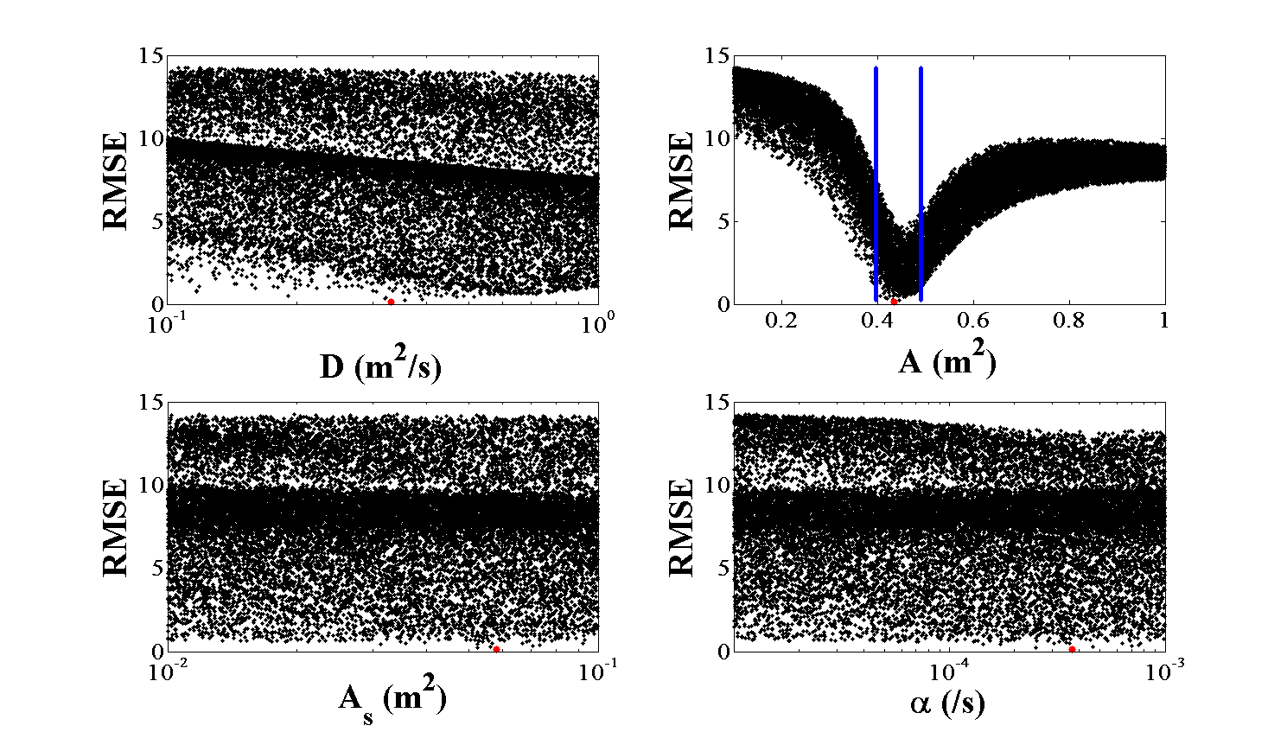
Let’s begin our analysis with I8 Inlet
I8 Inlet
6/6/11
Q = 62 L/s

Slide 31
Parameter space ~1 order of magnitude above and below optimal points (from previous analysis)
Red points indicate optimal solution for reference

Slide 32
The first round of Monte Carlo simulations indicate a highly sensitive channel area parameter
C
t

Slide 33
The first round of Monte Carlo simulations indicate a highly sensitive channel area parameter
C
t

Slide 34
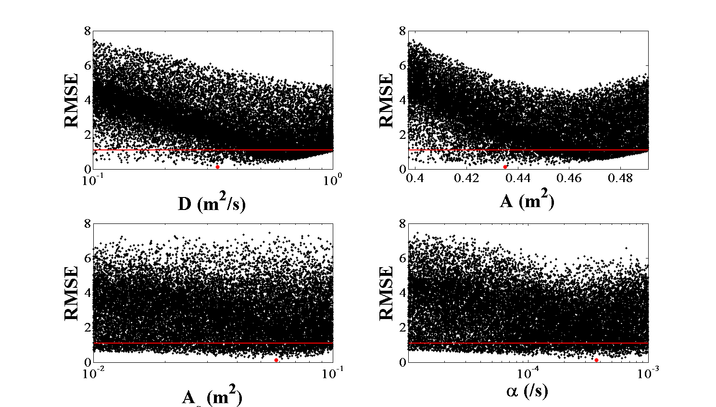
Thus area was narrowed accordingly
The red lines indicate the behavioral threshold (best 10%)

Slide 35
The constrained area simulations show slightly more identifiability in dispersion

Slide 36
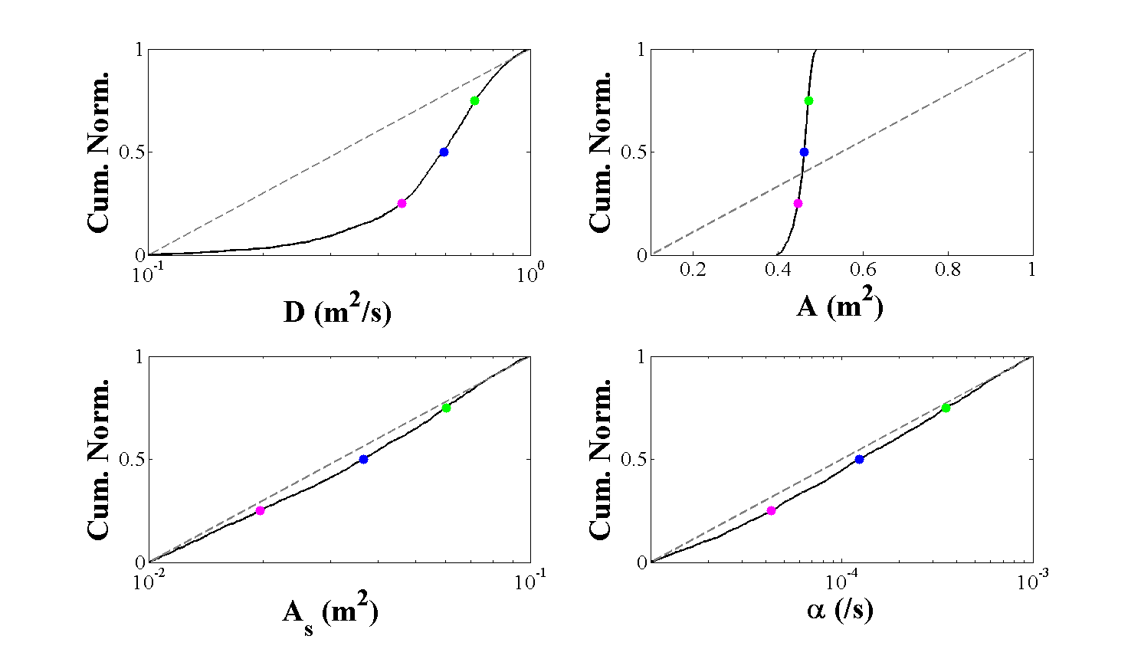
Transforming the behavioral space into CDF’s, differences in identifiability are apparent for each parameter
25th percentile
50th percentile
75th percentile

Slide 37
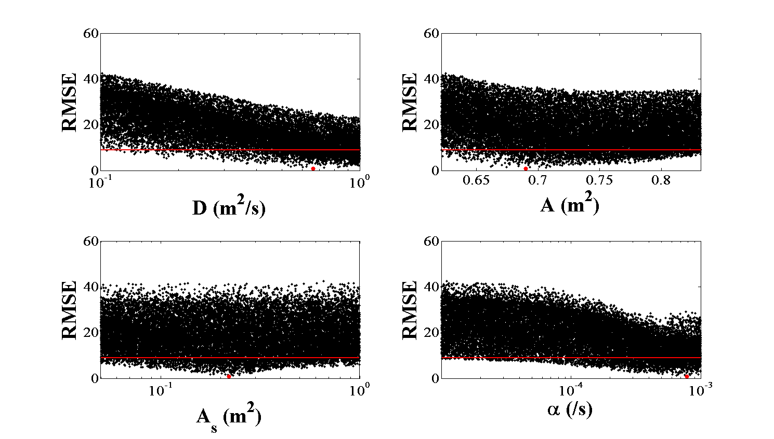
Moving on to I8 Outlet…
I8 Outlet
6/16/11
Q = 133 L/s

Slide 38
There is increased identifiability in the transient storage parameters relative to the inlet

Slide 39
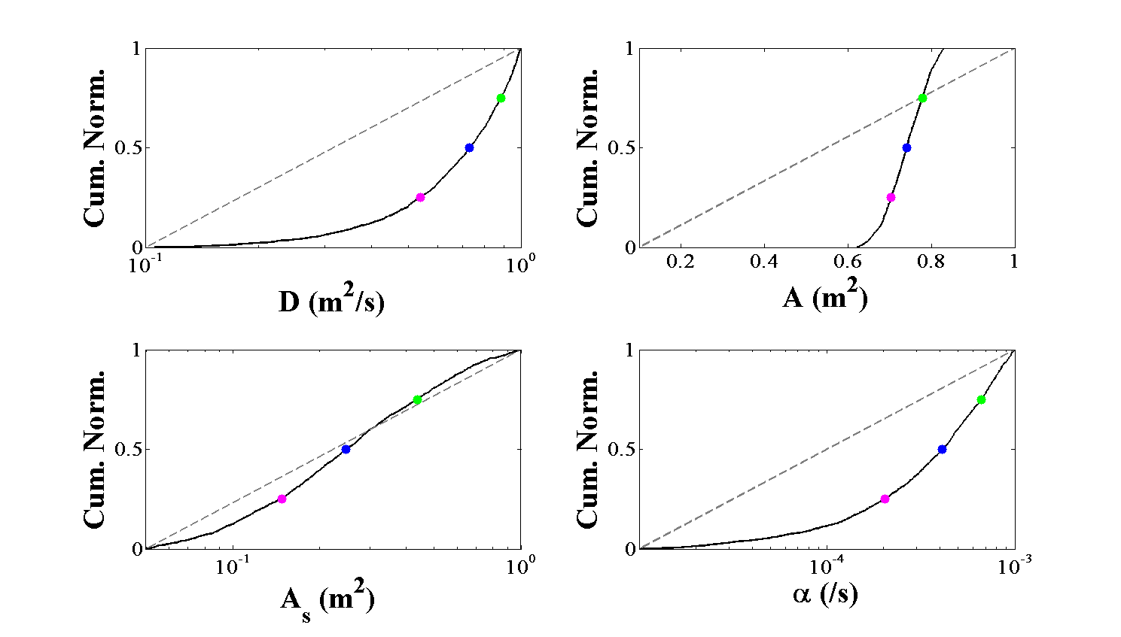
The CDF’s show some identifiability in storage zone exchange rate in addition to channel area and dispersion
25th percentile
50th percentile
75th percentile

Slide 40
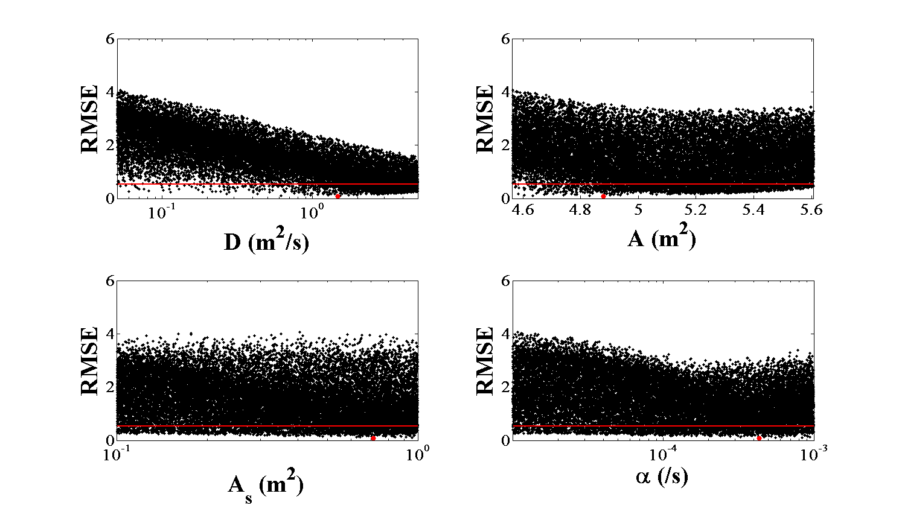
The Kuparuk River is the largest stream in this study
Kuparuk
7/28/12
Q = 2000 L/s

Slide 41
Scatter plots for the Kuparuk look similar to I8 Inlet

Slide 42
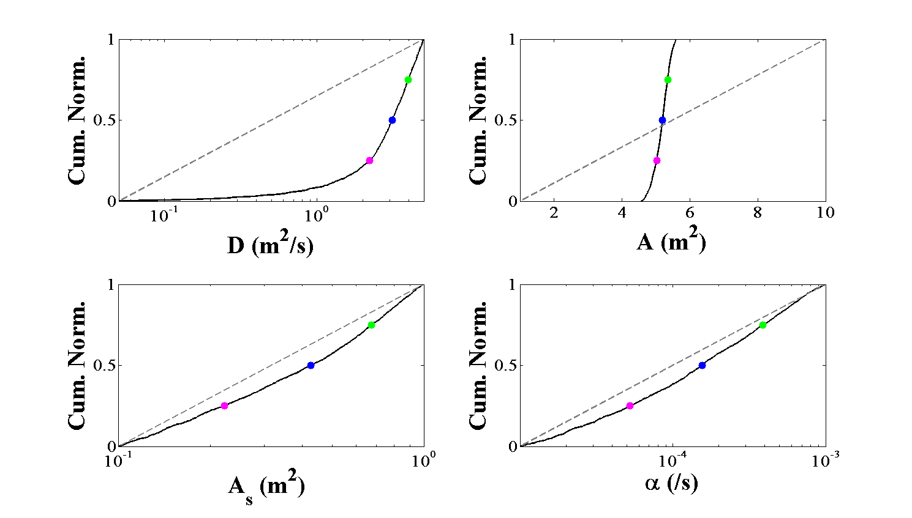
Similar to I8 Inlet, there is little identifiability in storage zone area and storage zone exchange rate
25th percentile
50th percentile
75th percentile

Slide 43
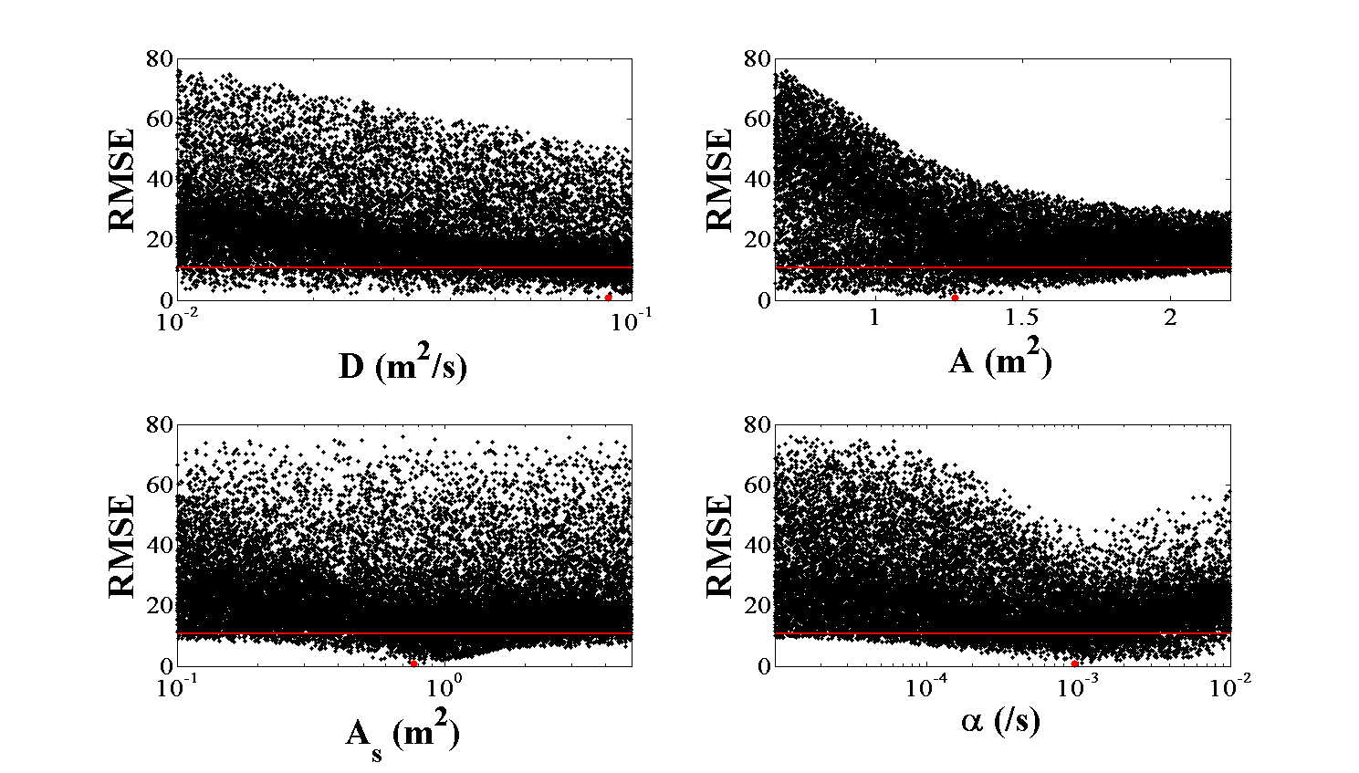
And finally Peat Inlet, the most unique stream in the study
Peat Inlet
6/14/11
Q = 62 L/s

Slide 44
Scatter plots for Peat Inlet look similar to I8 Outlet

Slide 45
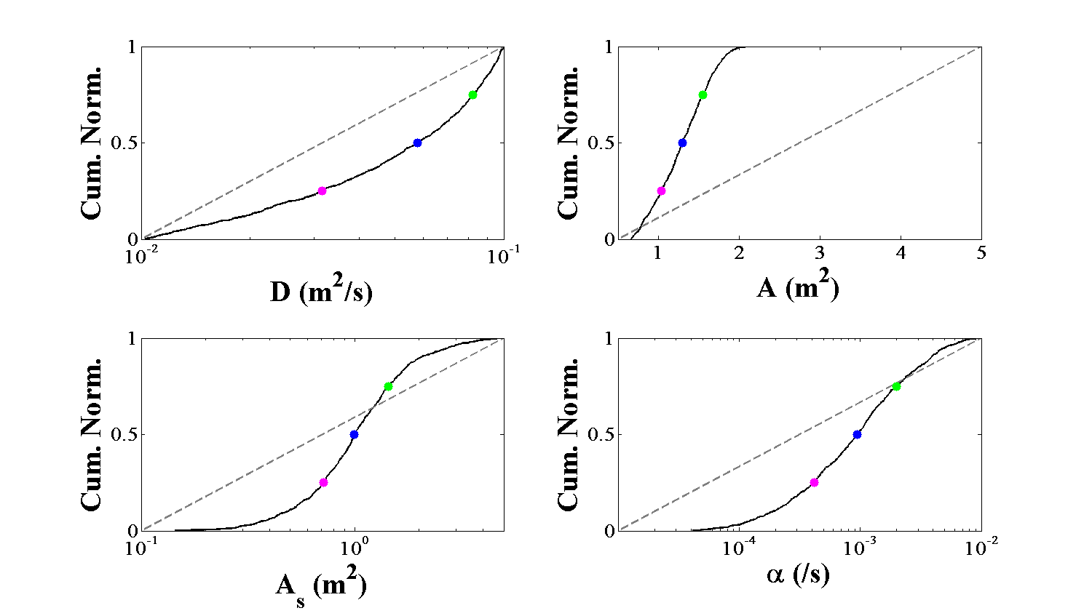
Peat Inlet shows the most identifiability for storage zone area and storage zone exchange rate
25th percentile
50th percentile
75th percentile

Slide 46
Three transient storage metrics:
Main channel residence time
Storage zone residence time
Fraction of median
travel time due to
transient storage
Thackston and Schnelle, 1970
Runkel, 2002

Slide 47
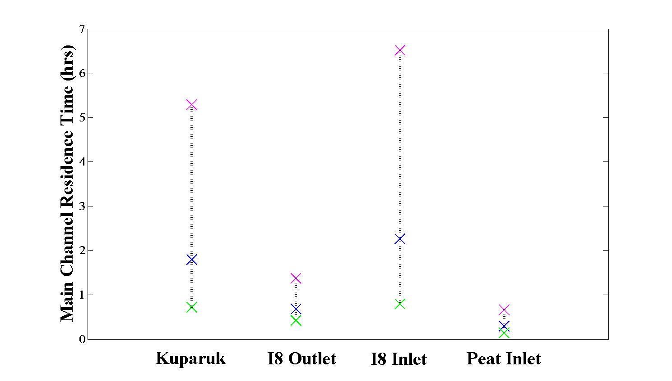
We see a general trend of larger main channel residence times in the Kuparuk and I8 Inlet relative to I8 Outlet and Peat Inlet
X 25th percentile
X 50th percentile
X 75th percentile

Slide 48
Large error bars indicate uncertainty in α as determined by the regional sensitivity analysis
X 25th percentile
X 50th percentile
X 75th percentile

Slide 49
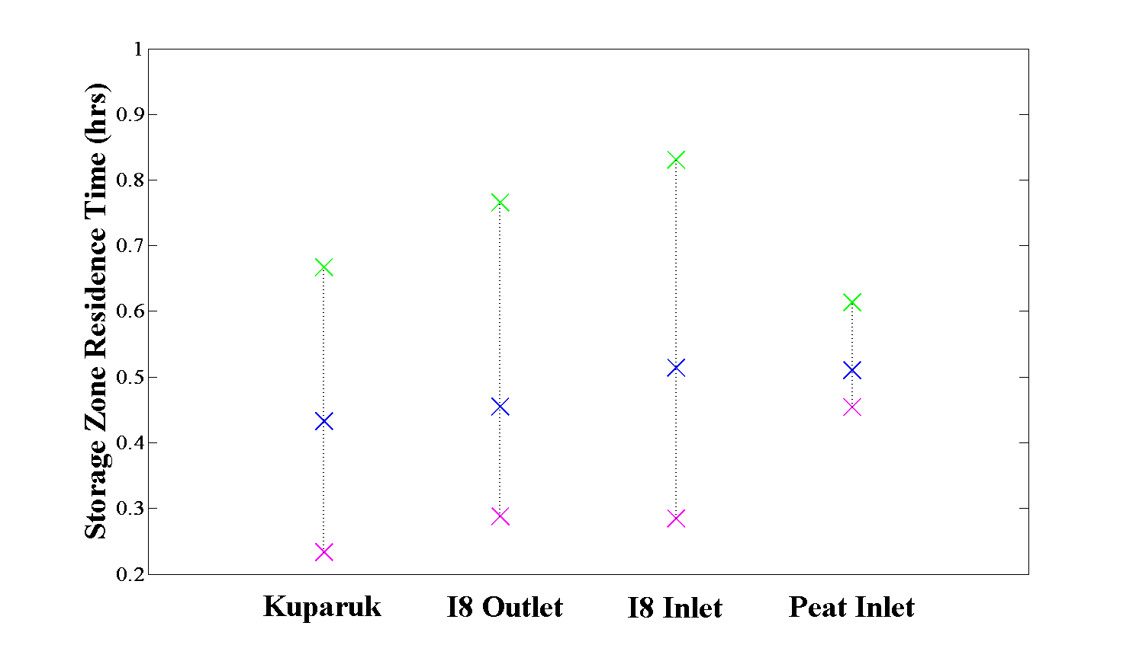
Looking at the median values, there is little difference in storage zone residence times across each stream
X 25th percentile
X 50th percentile
X 75th percentile

Slide 50
We have the least uncertainty for Peat Inlet
X 25th percentile
X 50th percentile
X 75th percentile

Slide 51
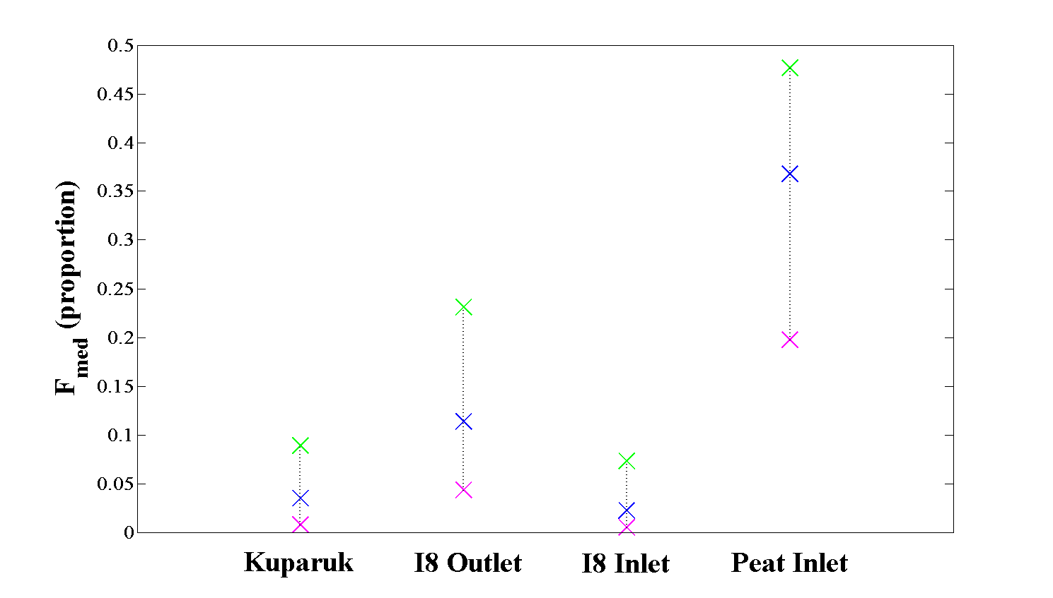
f_{med} shows the most distinct relative difference between the four streams
X 25th percentile
X 50th percentile
X 75th percentile

Slide 52
Aligning with our expectations, Peat Inlet’s travel time is most affected by transient storage
X 25th percentile
X 50th percentile
X 75th percentile

Slide 53
Does OTIS highlight differences in transient storage dynamics that align with geomorphological differences?

Slide 54
Does OTIS highlight differences in transient storage dynamics that align with geomorphological differences?
Larger t_{str} values in the Kuparuk and I8 Inlet compared to I8 Outlet and Peat Inlet

Slide 55
Does OTIS highlight differences in transient storage dynamics that align with geomorphological differences?
Larger t_{str} values in the Kuparuk and I8 Inlet compared to I8 Outlet and Peat Inlet
Largest f_{med} value in Peat Inlet

Slide 56
Does OTIS highlight differences in transient storage dynamics that align with geomorphological differences?
Larger t_{str} values in the Kuparuk and I8 Inlet compared to I8 Outlet and Peat Inlet
Largest f_{med} value in Peat Inlet
Little difference in t_{sto} values

Slide 57
Does OTIS highlight differences in transient storage dynamics that align with geomorphological differences?
Larger t_{str} values in the Kuparuk and I8 Inlet compared to I8 Outlet and Peat Inlet
Largest f_{med} value in Peat Inlet
Little difference in t_{sto} values
Depends on our degree of reliance on uncertain parameters

Slide 58
Which transient storage metrics are less influenced by non-identifiable parameters?

Slide 59
Which transient storage metrics are less influenced by non-identifiable parameters?
Highly insensitive α and A_{s}

Slide 60
Which transient storage metrics are less influenced by non-identifiable parameters?
Highly insensitive α and A_{s}
t_{str} can be subject to large uncertainties
t_{sto} does not highlight transport differences

Slide 61
Which transient storage metrics are less influenced by non-identifiable parameters?
Highly insensitive α and A_{s}
t_{str} can be subject to large uncertainties
t_{sto} does not highlight transport differences
f_{med} provides the most information of transport differences

Slide 62
Which transient storage metrics are less influenced by non-identifiable parameters?
Highly insensitive α and A_{s}
t_{str} can be subject to large uncertainties
t_{sto} does not highlight transport differences
f_{med} provides the most information of transport differences
f_{med} is an integrated metric and can best help us understand retardation of water and the potential for biogeochemical cycling

Slide 63
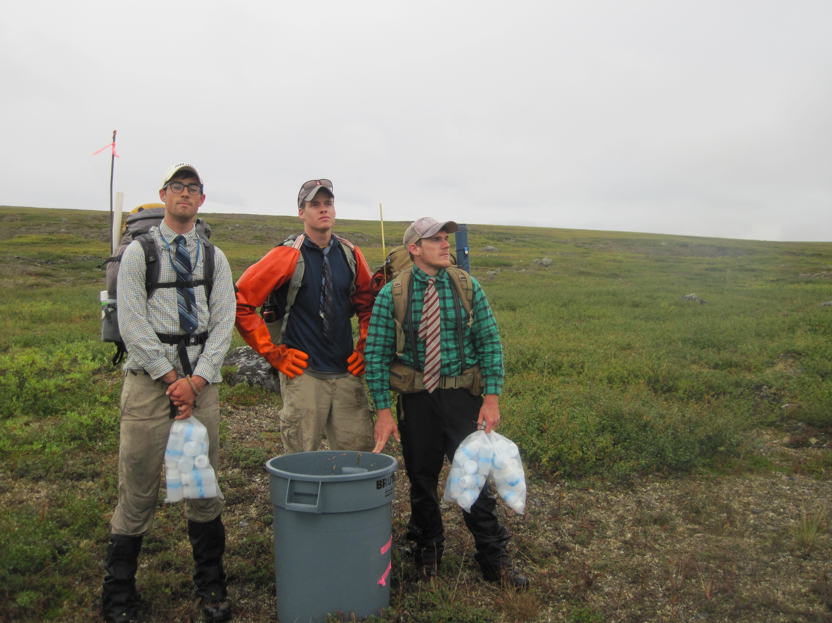
Acknowledgements:
NSF Grant Nos. 0902029, 0902113, and 0902106
Toolik Field Station and University of Alaska Fairbanks
Penn State University, Colorado State University
Field Assistants in Summers of 2011 & 2012

