Slide 1
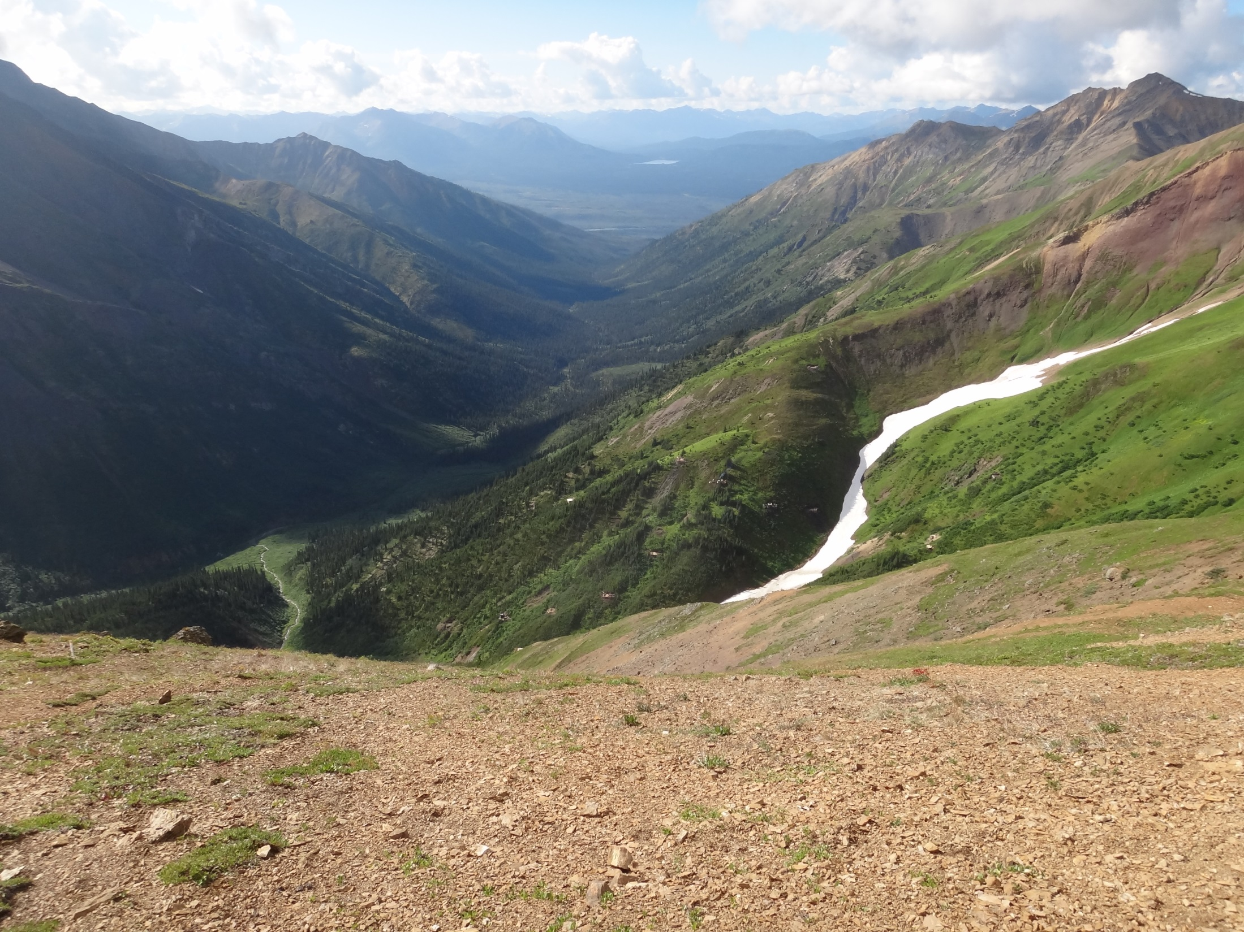


Structural Controls on Carlin-type Mineralization in the Conrad Zone of the Nadaleen Trend, Rackla Gold Belt, Yukon Territory, Canada
Justin C. Palmer, Yvette D. Kuiper
Department of Geology and Geological Engineering
Colorado School of Mines
GSA Annual Meeting
October 28th, 2013

Slide 2
Purpose and Questions
Structures typically exert a fundamental role in the formation and distribution of sediment hosted, Carlin-type Au deposits.
Cline et al., 2005
What controls the deposit morphology in the Conrad Zone, part of Canada’s only Carlin-type Au deposit?
Structure?
Stratigraphy?
Both?
Take home message:
Structures and stratigraphy both influence the morphology of the Conrad Zone, however,
their influence varies with depth

Slide 3
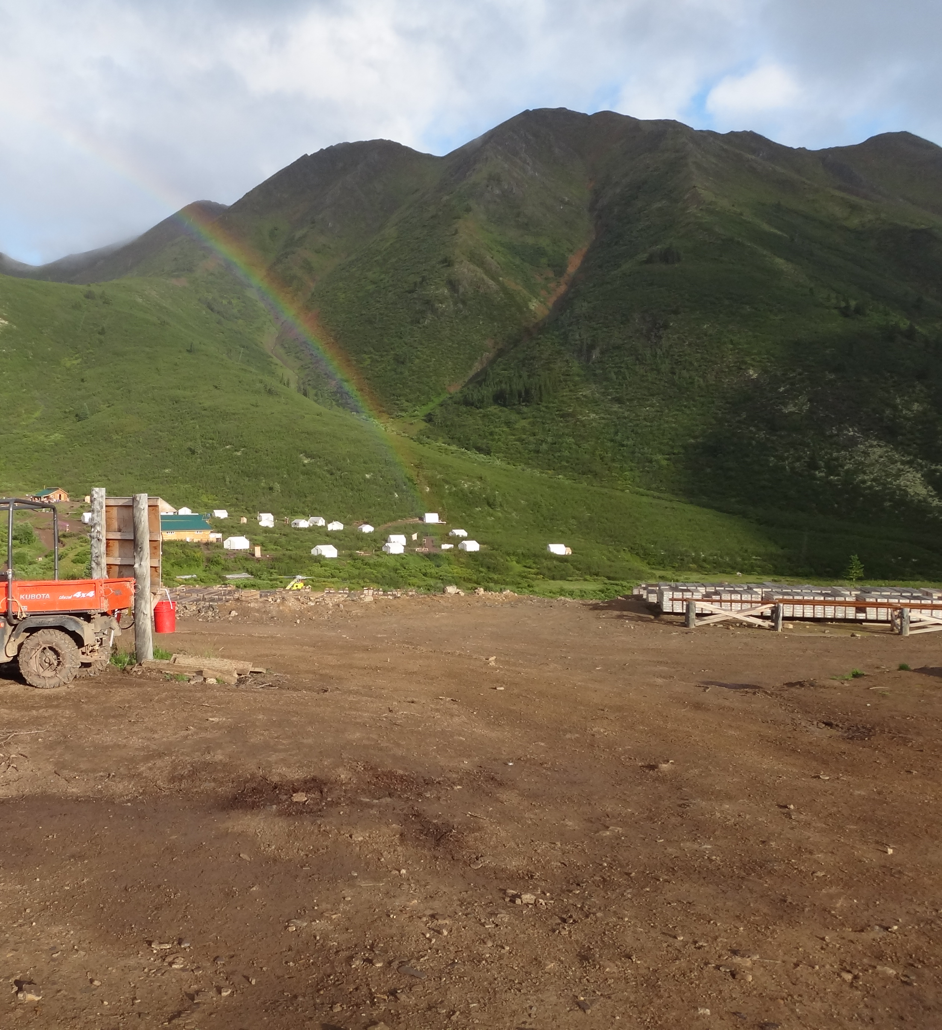
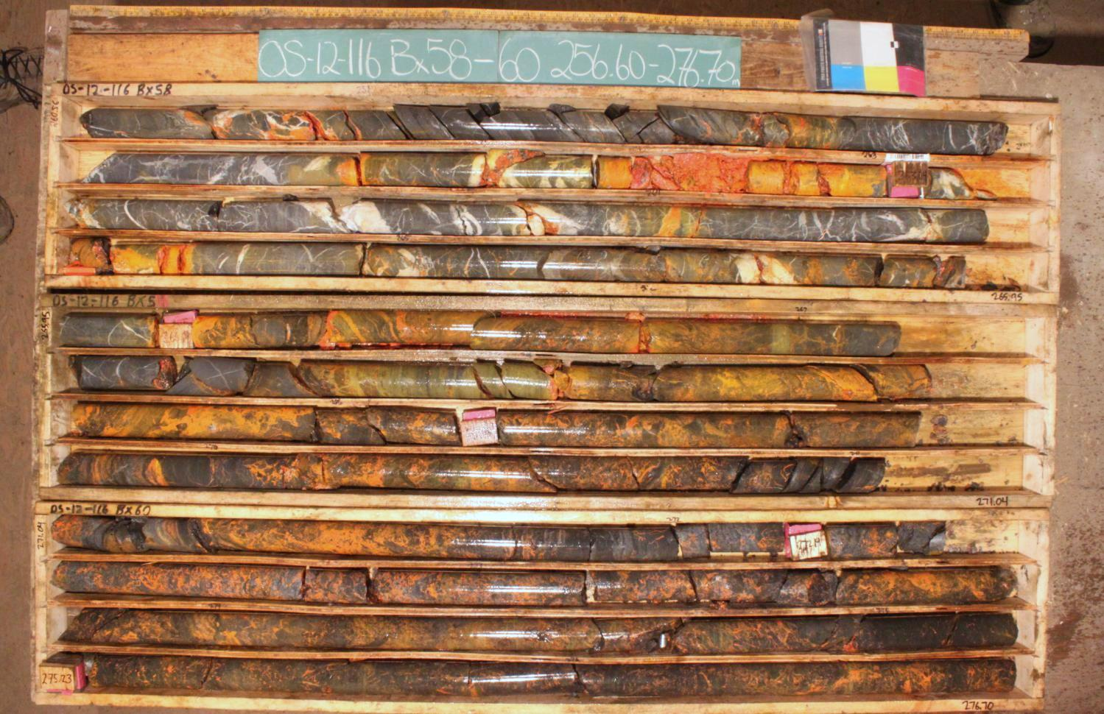
Outline
Location and Regional Geology
Stratigraphy
Surface Mapping Results
Drill Core Results
Summary and Conclusion
Structures affecting deposit morphology:
N-dipping Nadaleen Fault
S-plunging Conrad anticline

Slide 4
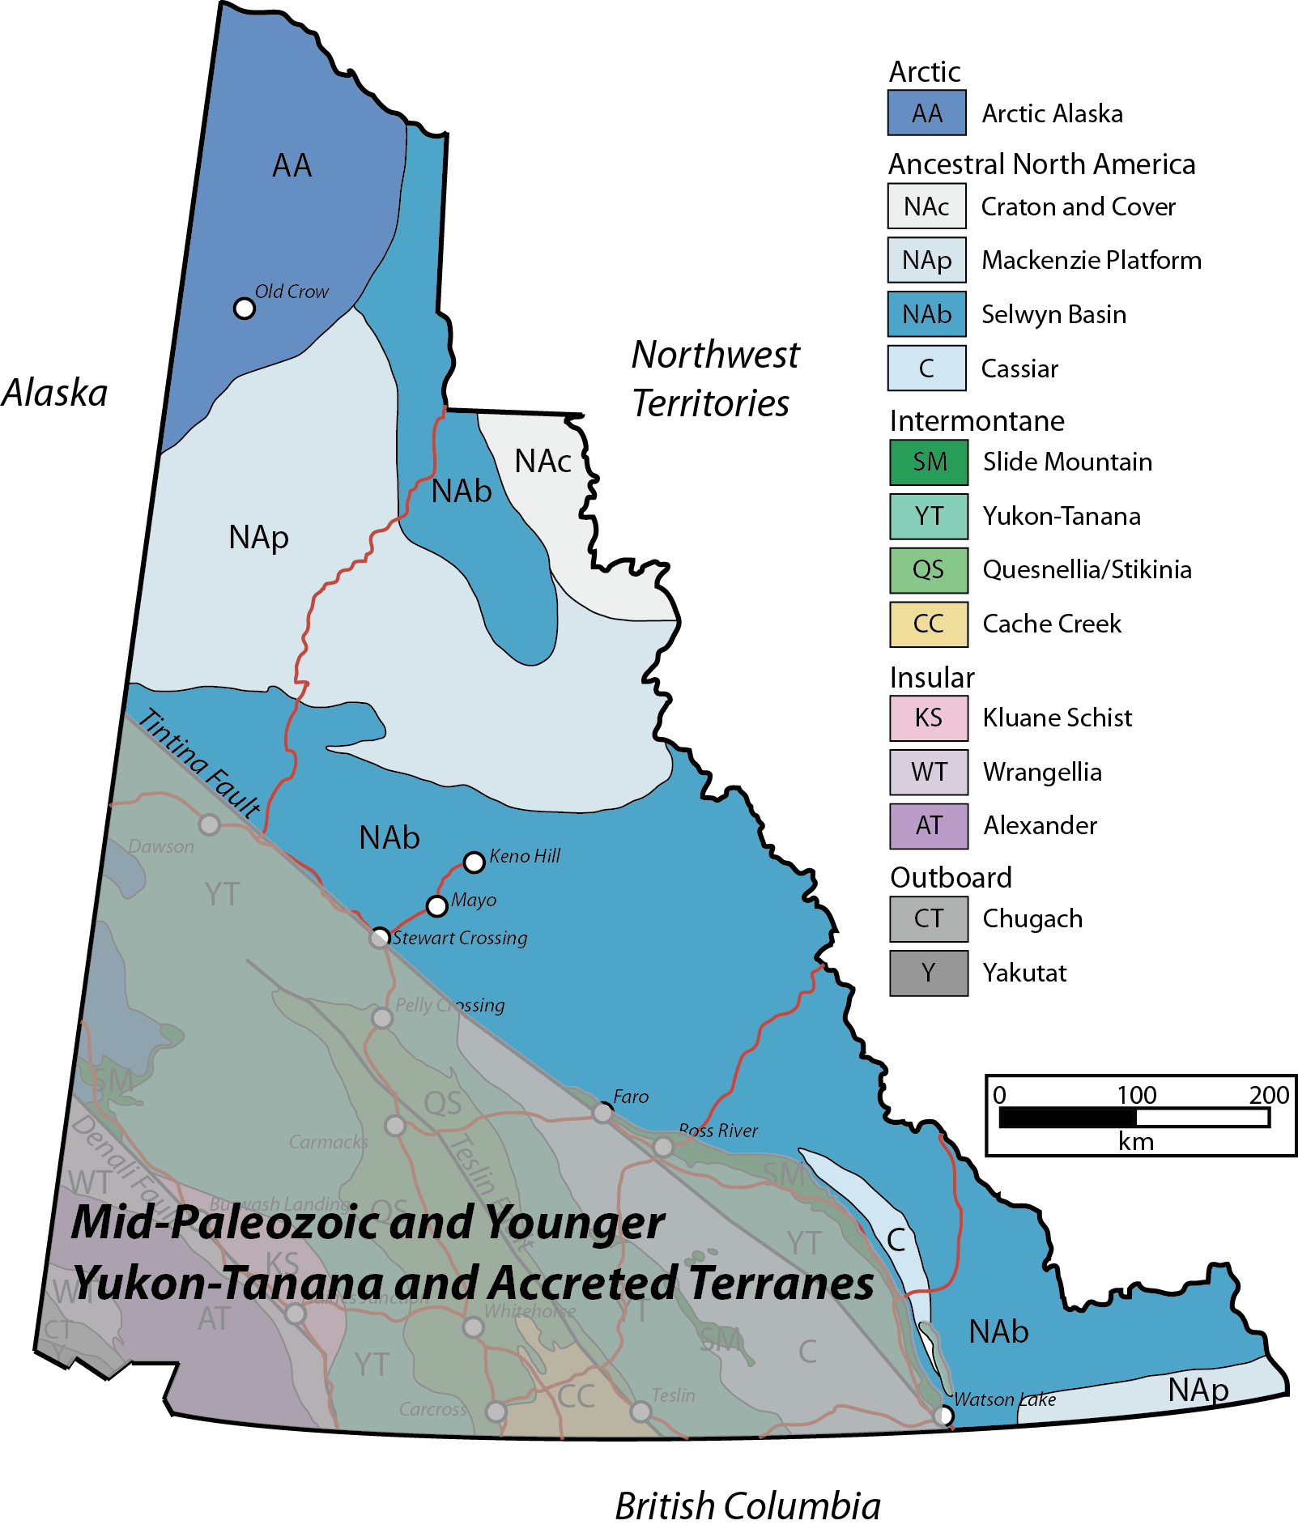
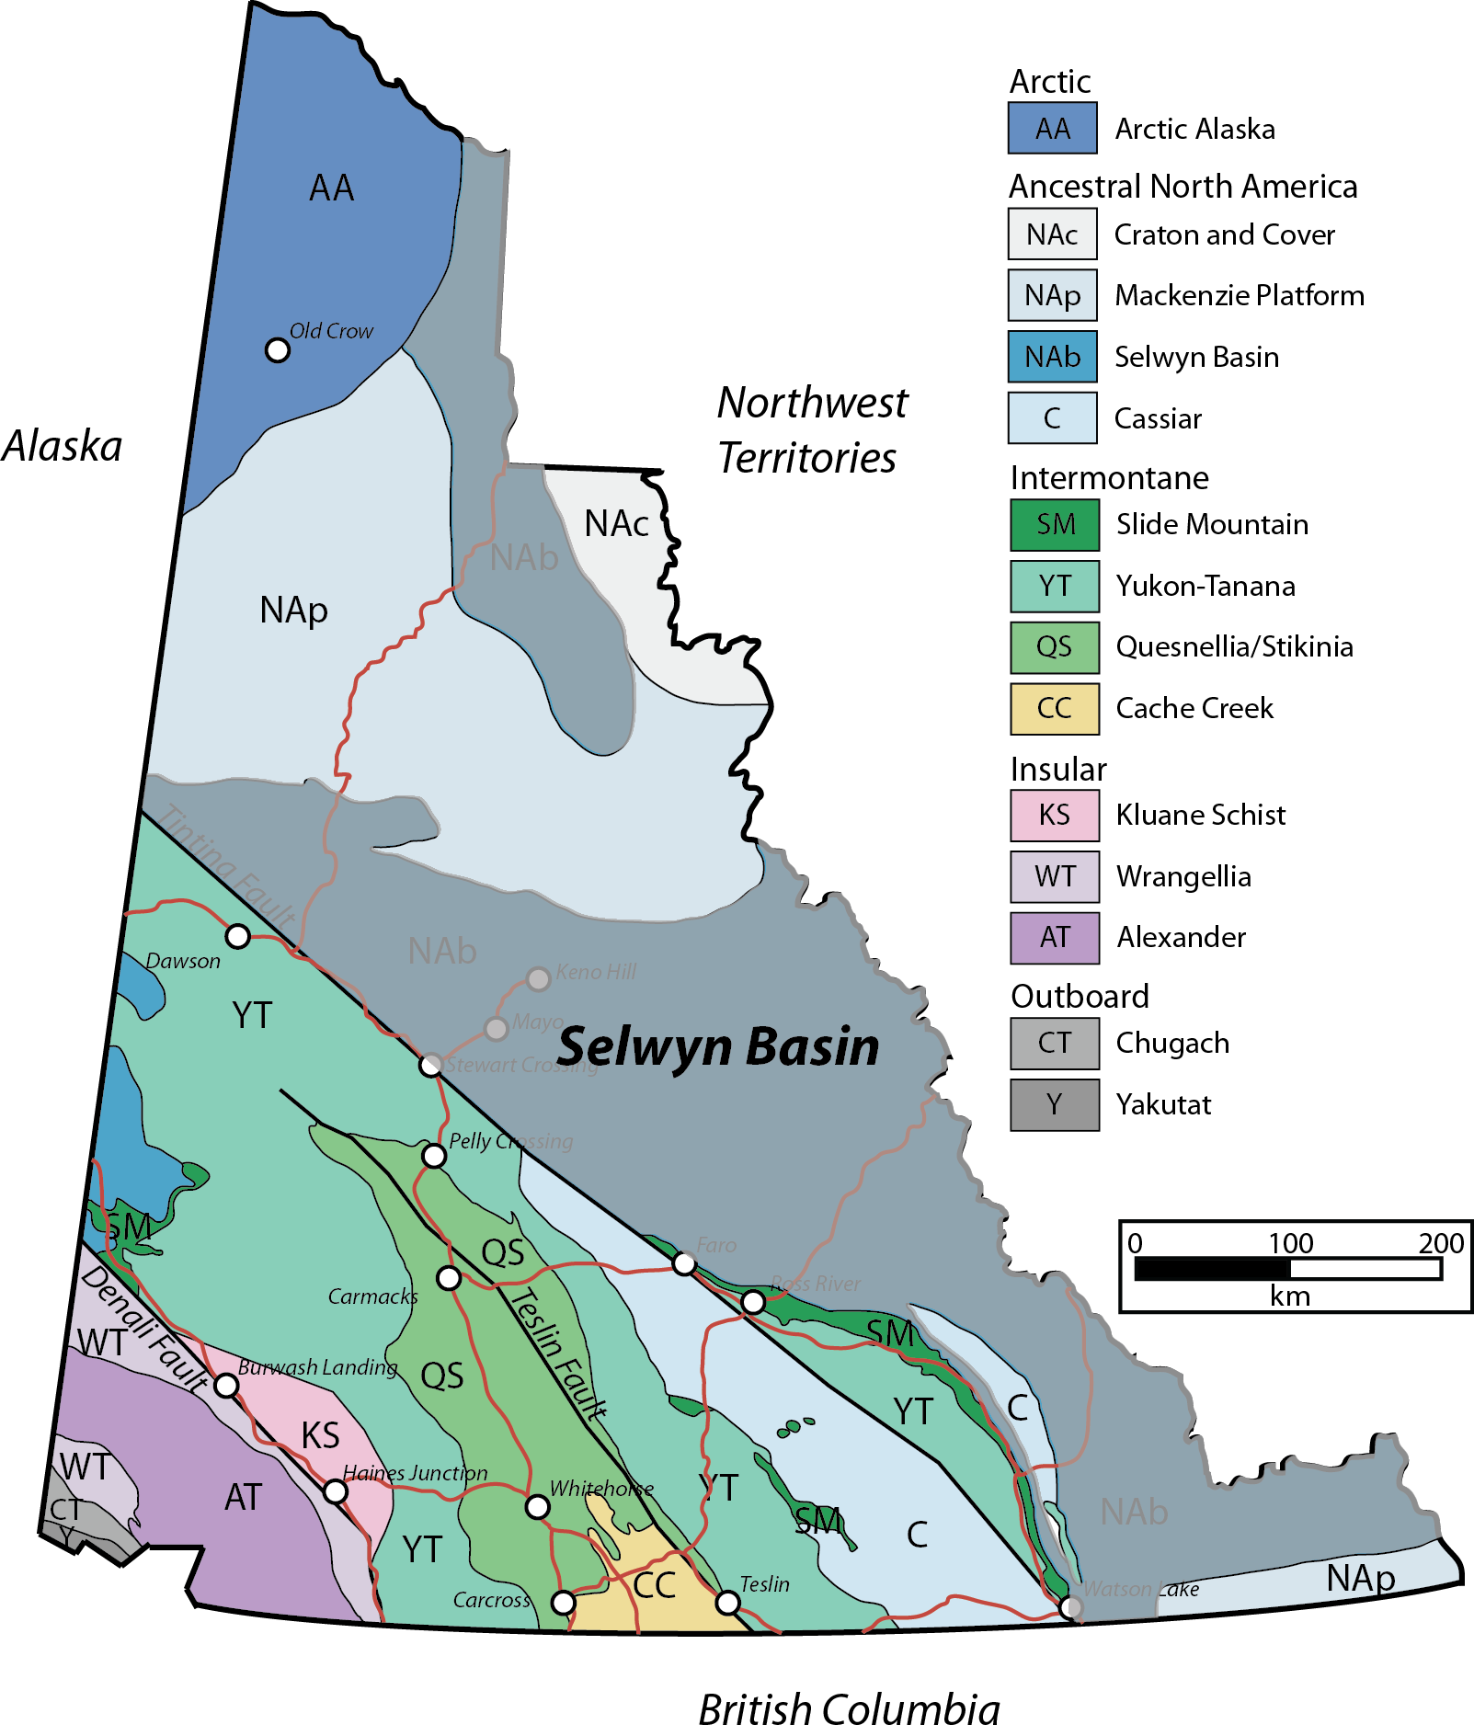
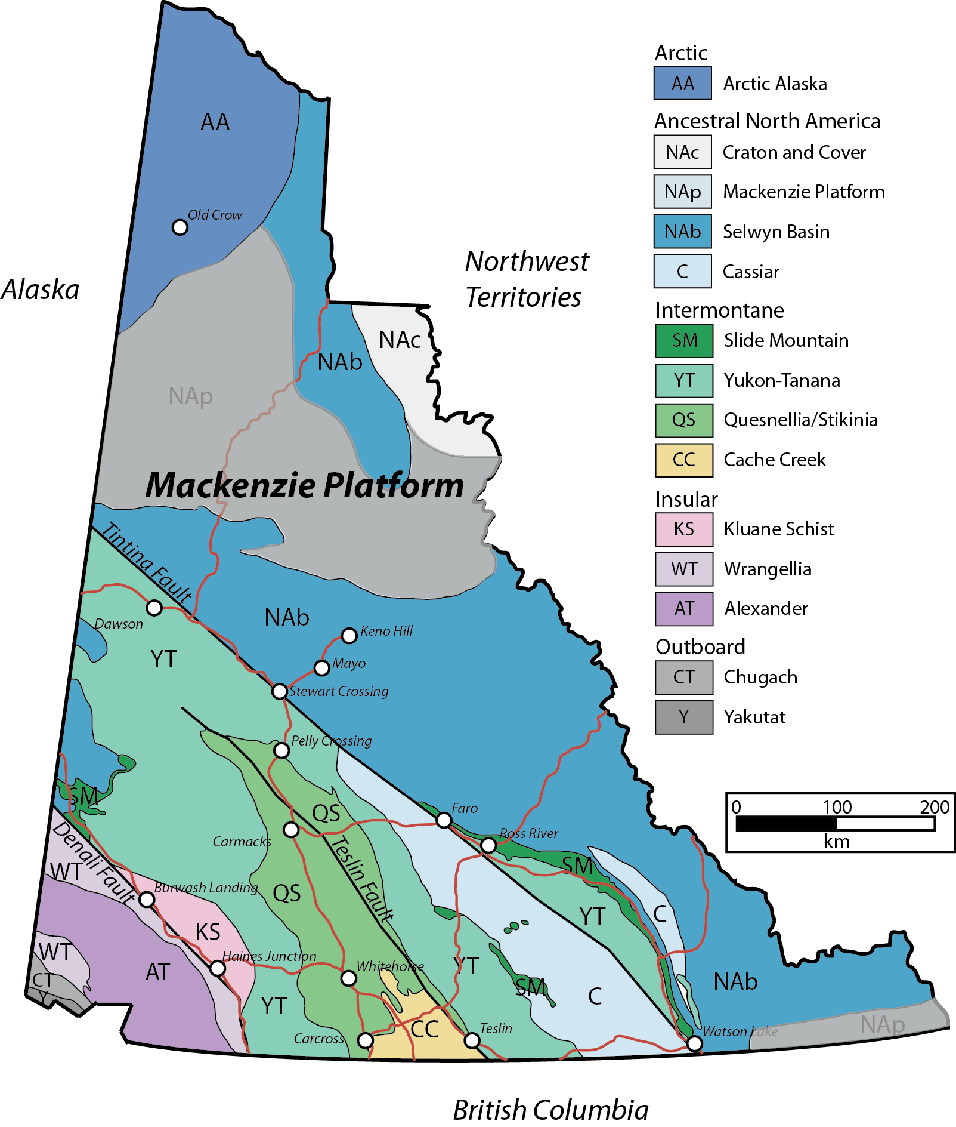
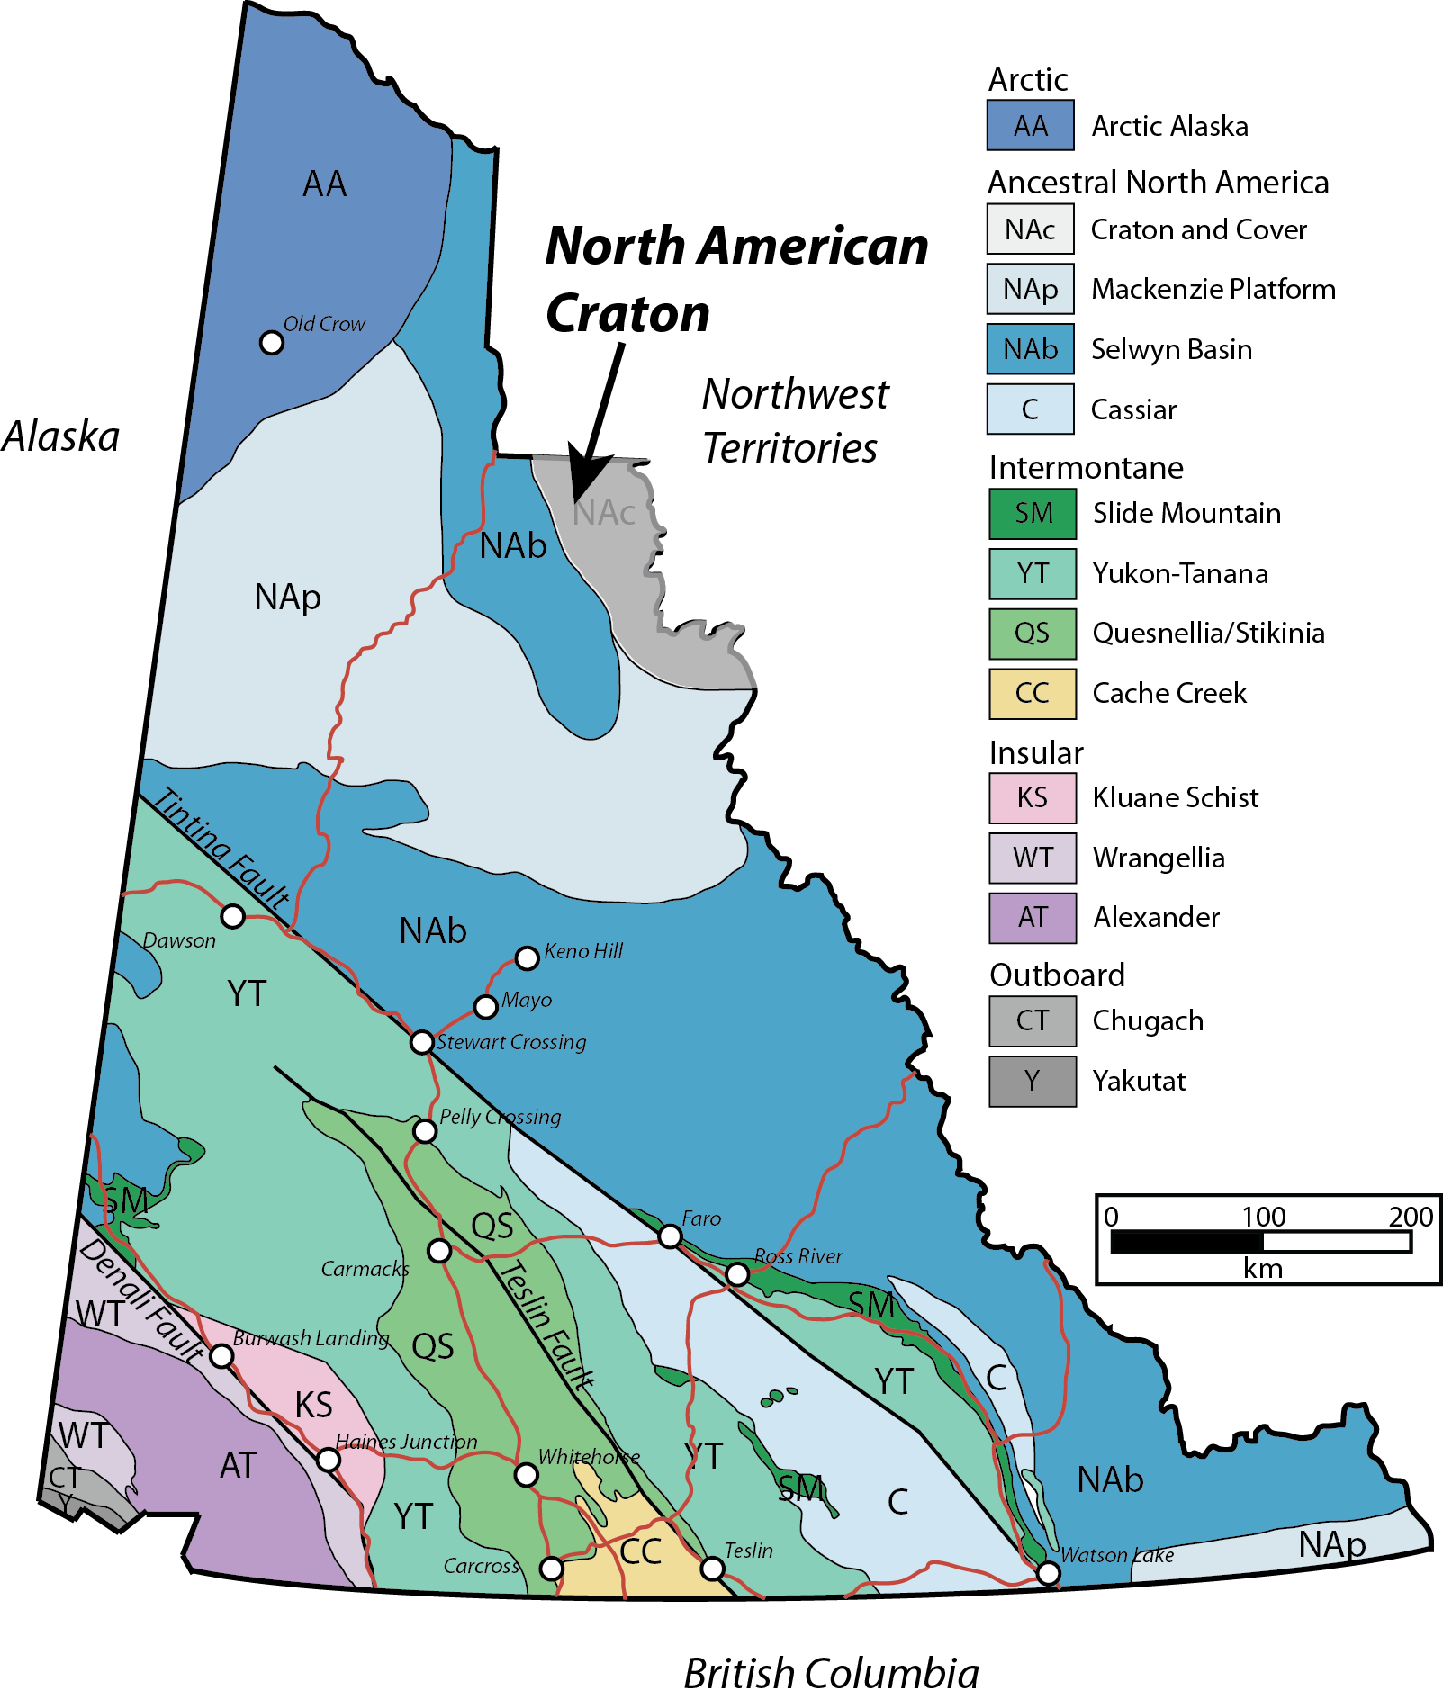
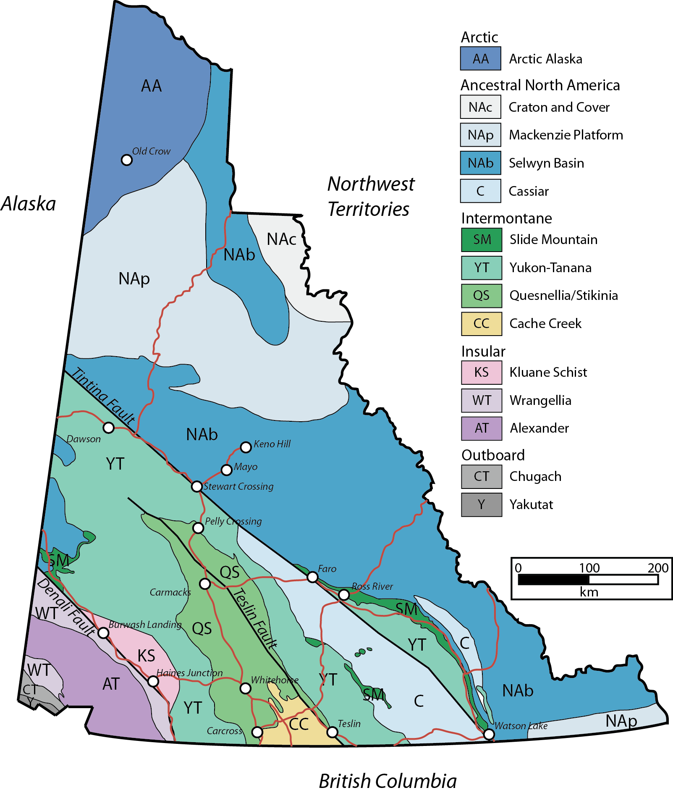
Conrad Zone Location
Yukon Territory, Canada
110 km ENE of Keno Hill, YT
100% owned by ATAC Resources Ltd.
Classically known for SEDEX Zn-Pb-Ag deposits
Conrad
Zone
Regional Geology
SW Yukon – Cordilleran-style accreted terranes of mid-Paleozoic and younger age
NE Yukon – Neoproterozoic passive margin rocks of Selwyn Basin and Mackenzie Platform
Modified from YGS, 2011

Slide 5
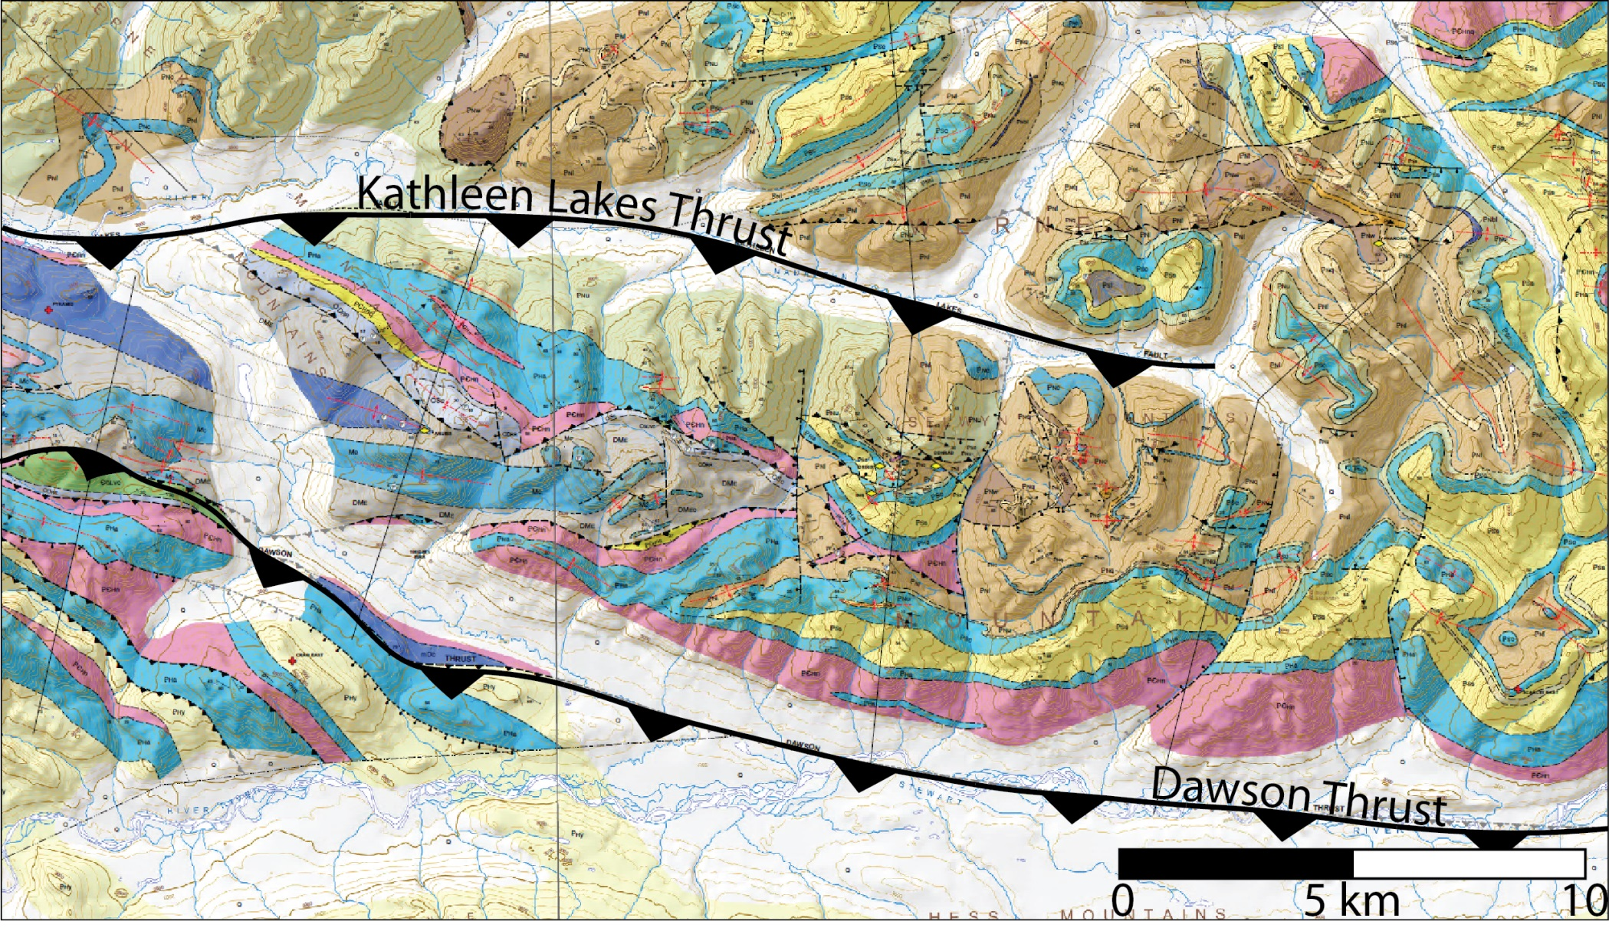
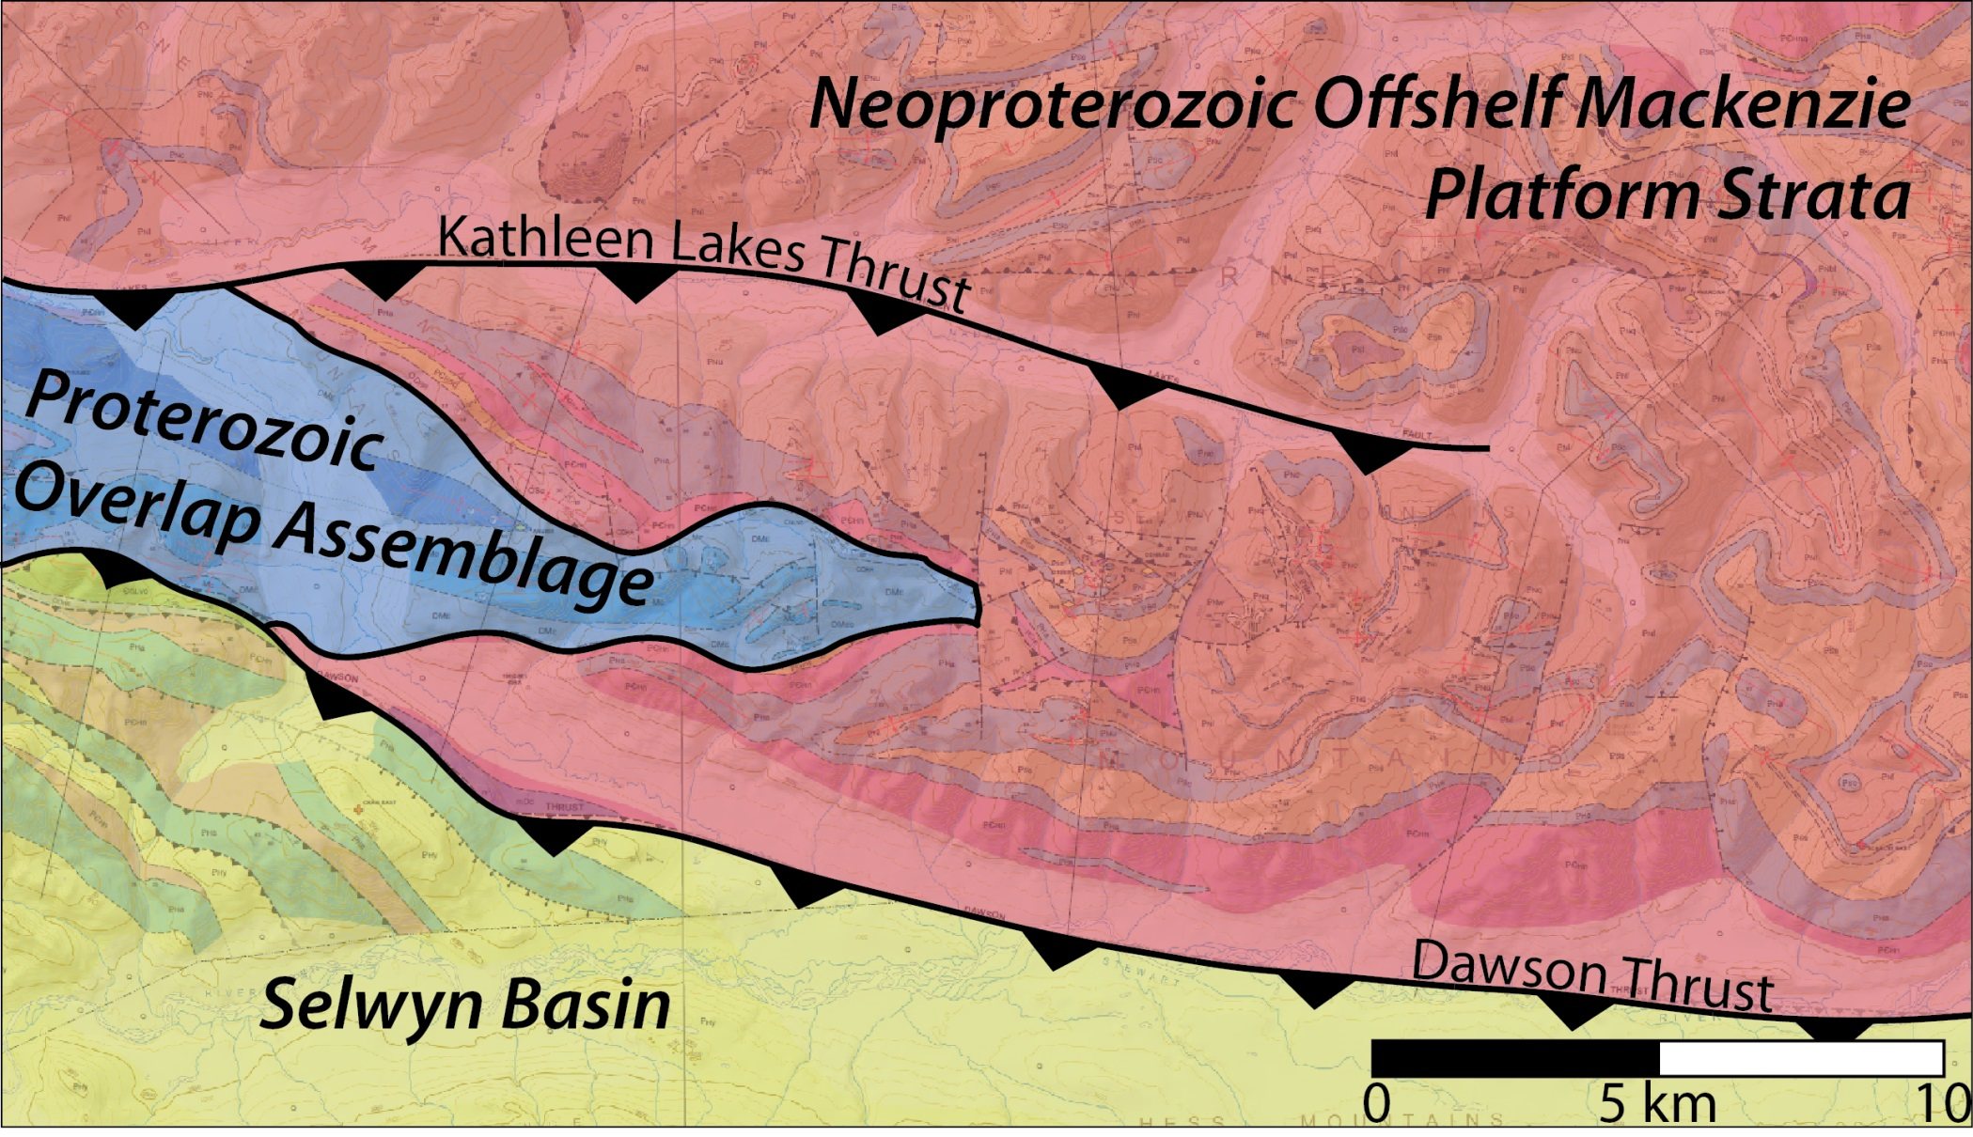
Regional Geology
Modified from Colpron et al., 2013

Slide 6
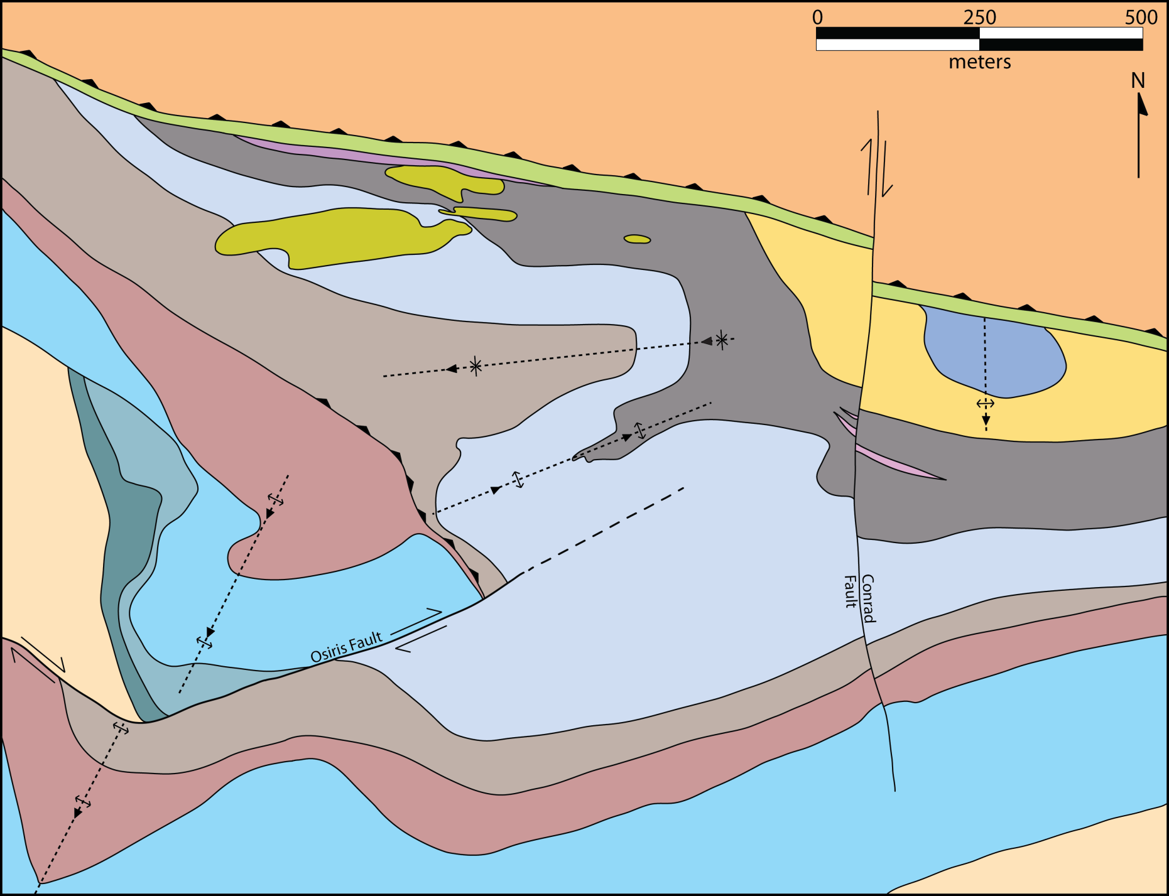
Local Gold Zones
Conrad
Osiris
Sunrise
Isis East

Slide 7
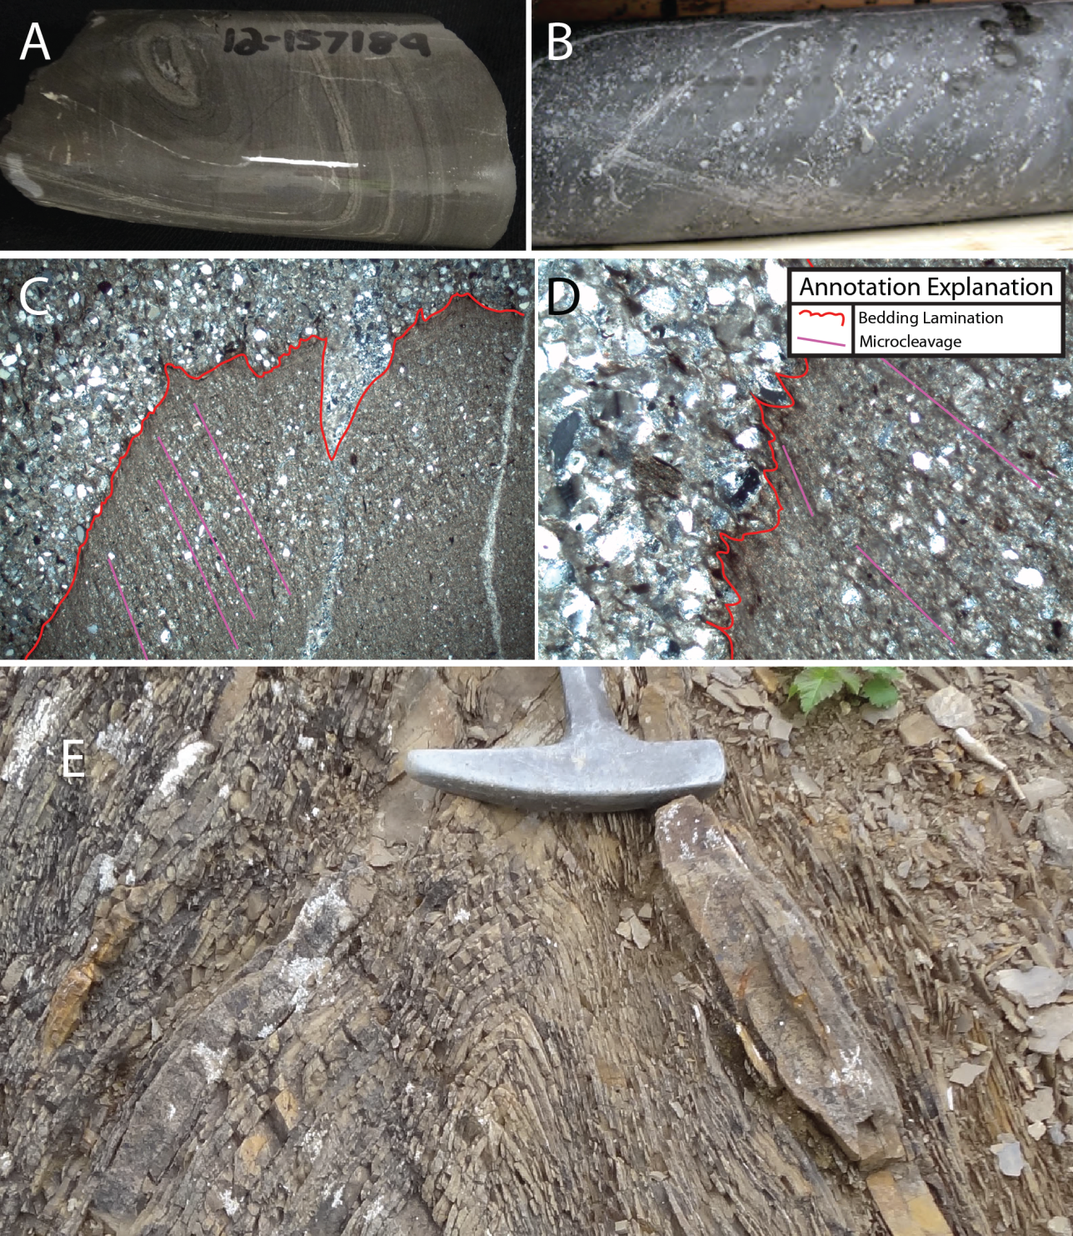
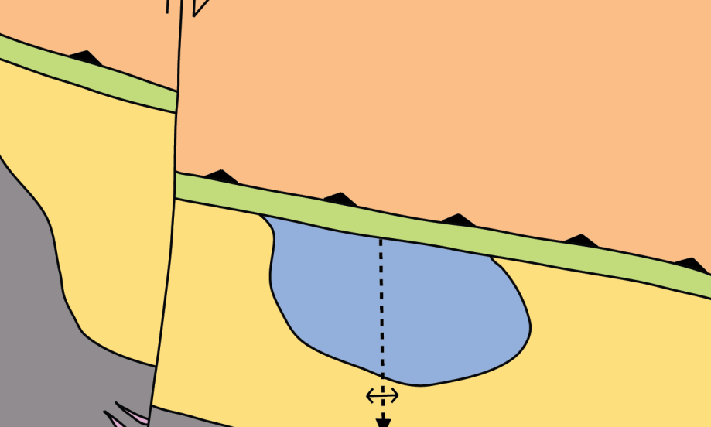
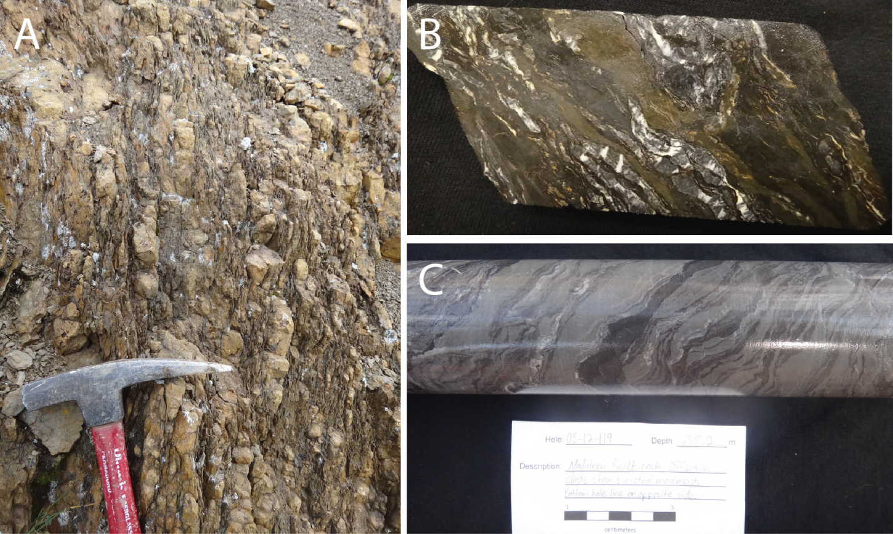
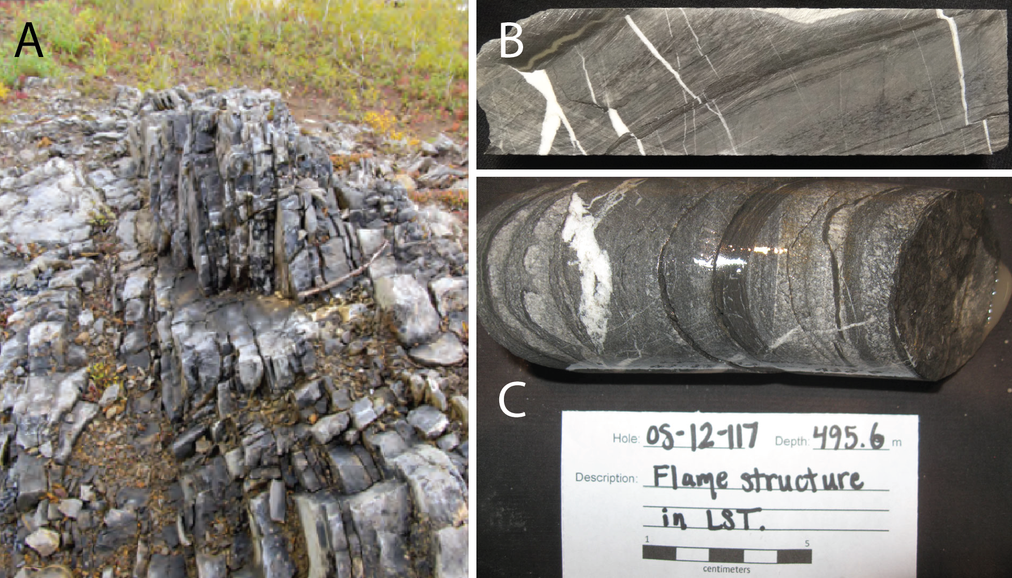
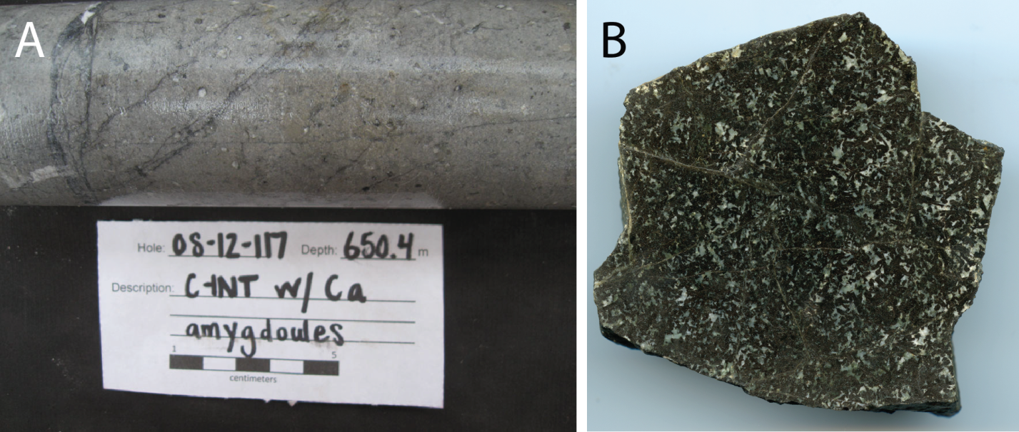
Stratigraphy
250m
Nadaleen Fault Rocks
N-dipping (~70) brittle fault zone up to 50 m wide composed of sheared and faulted clasts of all proximal units. Foliation is common.
Conrad Limestone
Light-grey weathering, massive to
laminated silty limestone with strong
calcite veining and stylolitization.
Northern Siliciclastic Rocks
Gabbro
Grey-green phaneritic gabbroic dikes with common calcite amygdules. Commonly oriented sub-parallel to the Nadaleen Fault
Nadaleen Fault Rocks
Conrad Limestone
Conrad Siliciclastic Rocks
Rusty-weathering, thinly
bedded pyritic siltstone with interbedded quartz-
pebble conglomerate.
Conrad Siliciclastic Rocks

Slide 8
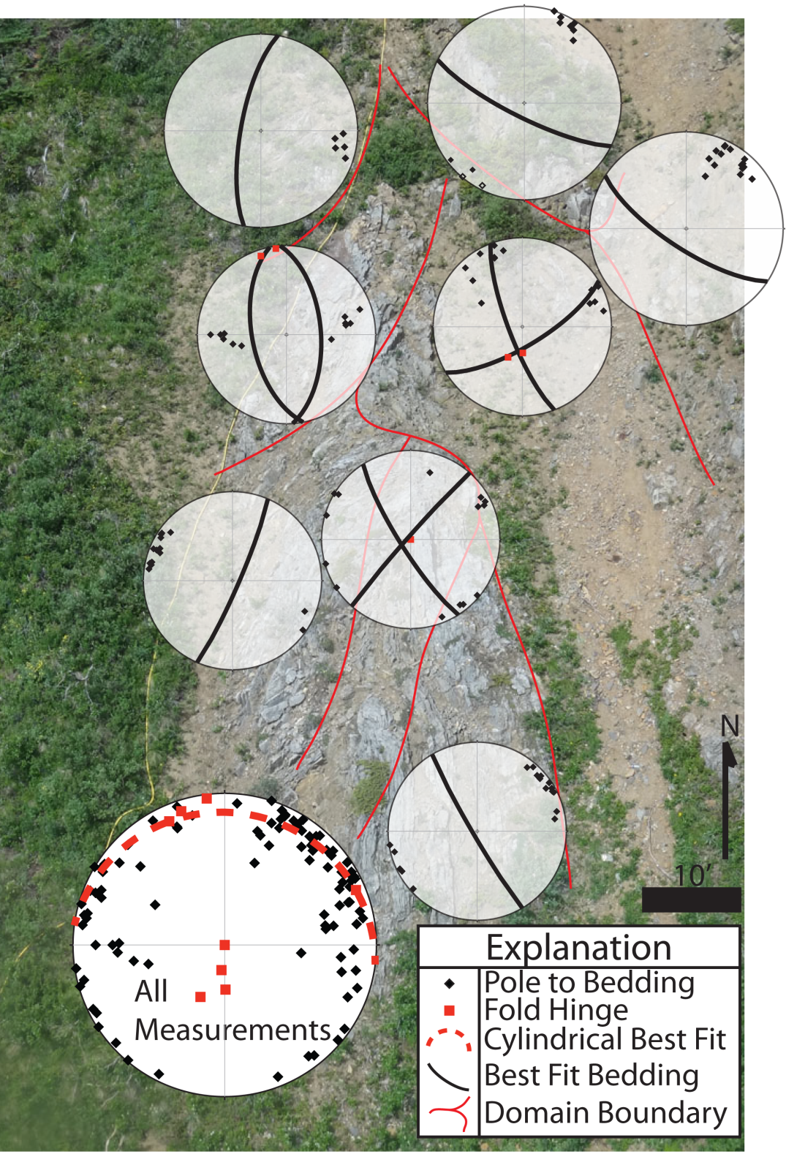
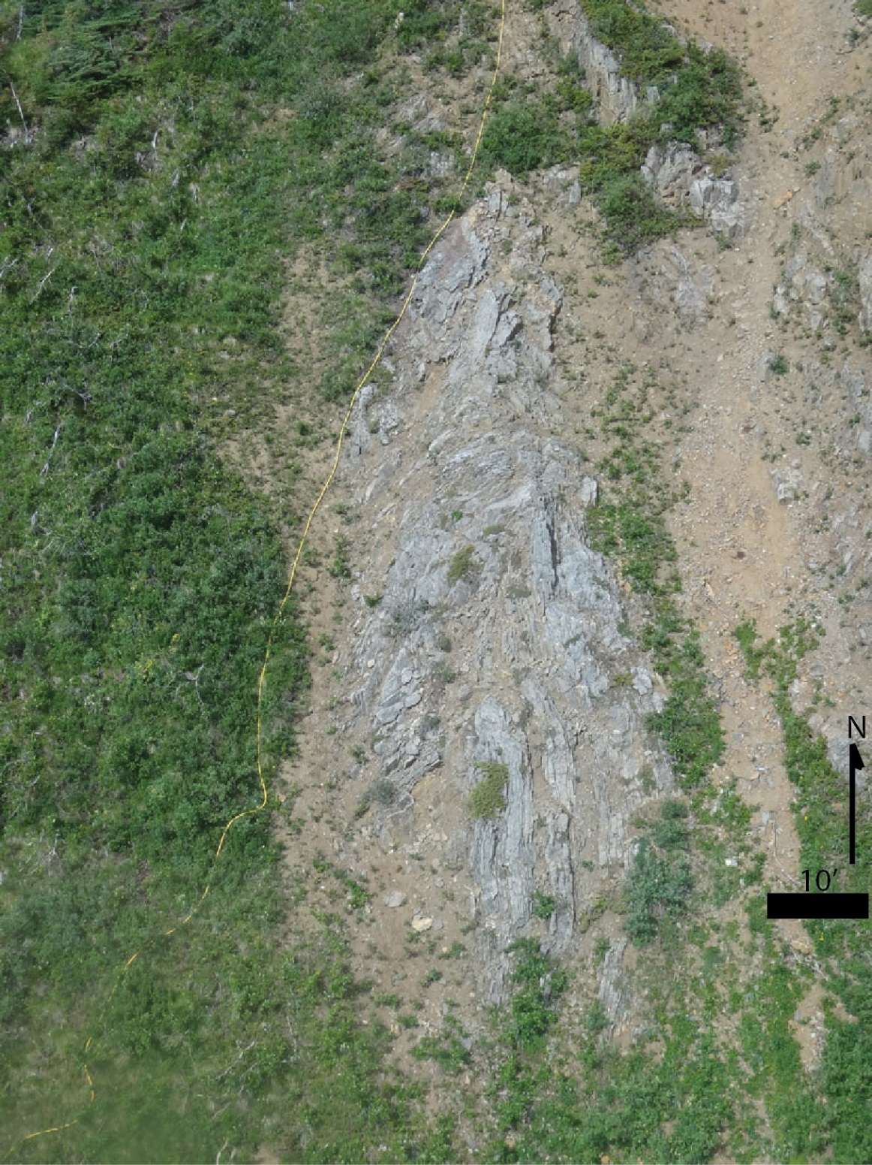
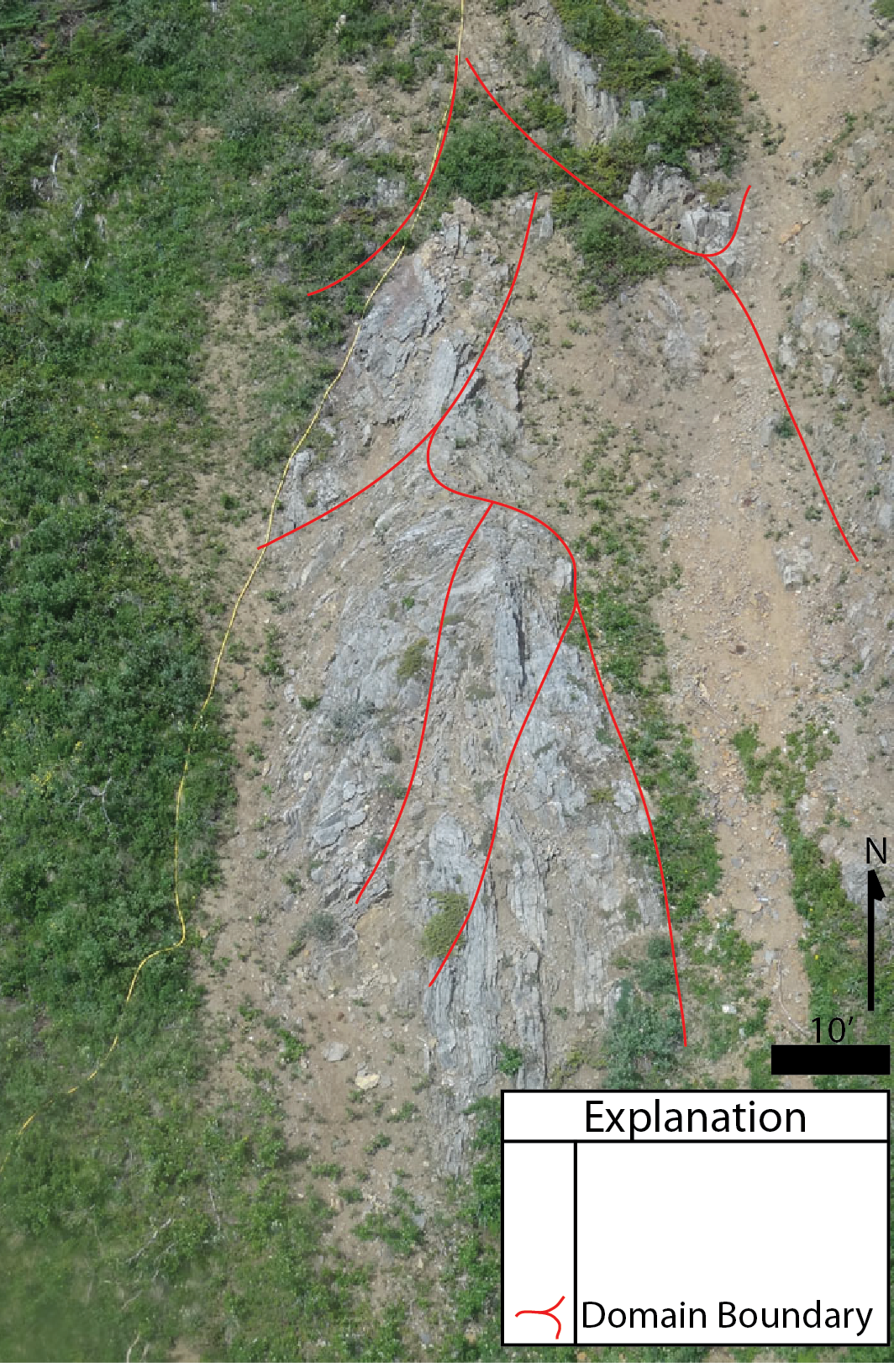
Surface Mapping Results
Parasitic Fold in E-limb of Conrad Anticline
3 domains – E-limb of fold
2 domains – W-limb of fold
2 domains – fold hinge similar to the orientation of Conrad anticline
1 domain – anomalous
Overall stereonet similar to other surface measurements in Conrad Anticline

Slide 9
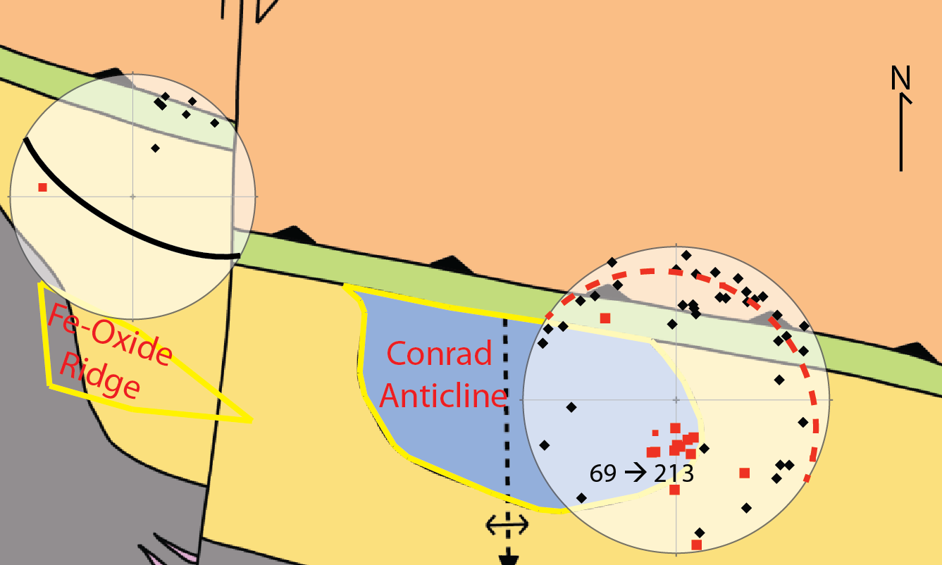
Surface Mapping Results
250m
Steeply S- to SSW-plunging
Conrad Anticline
Steeply SW-dipping W limb
of Conrad Anticline

Slide 10
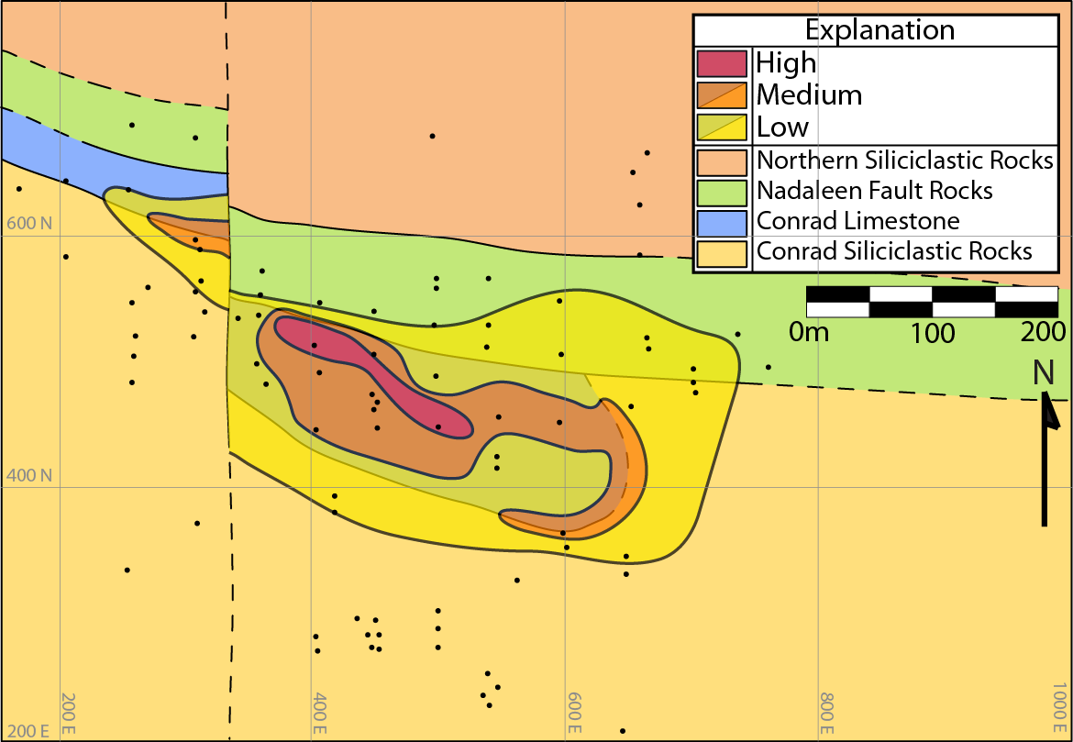
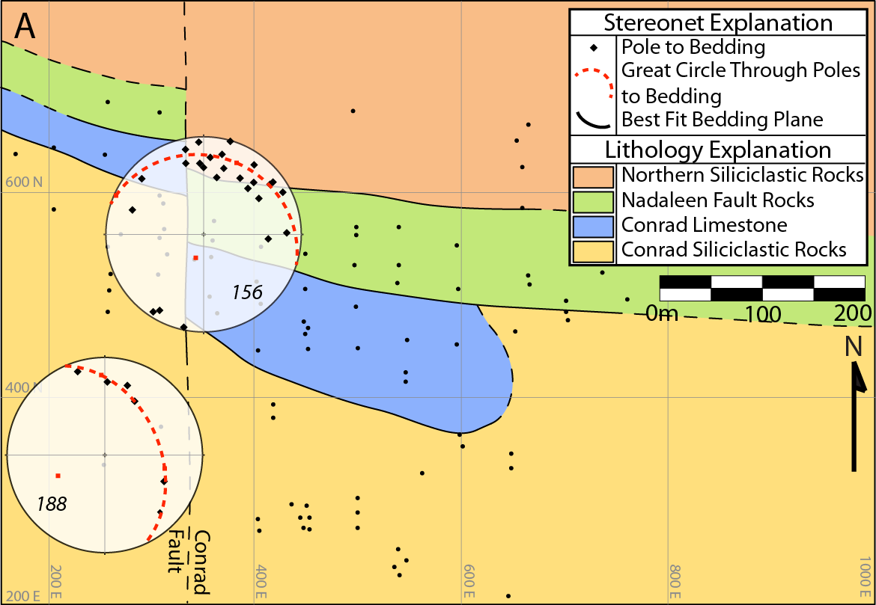
200m Plan View
Fold hinge of
Conrad Anticline
Conrad
Fault

Slide 11
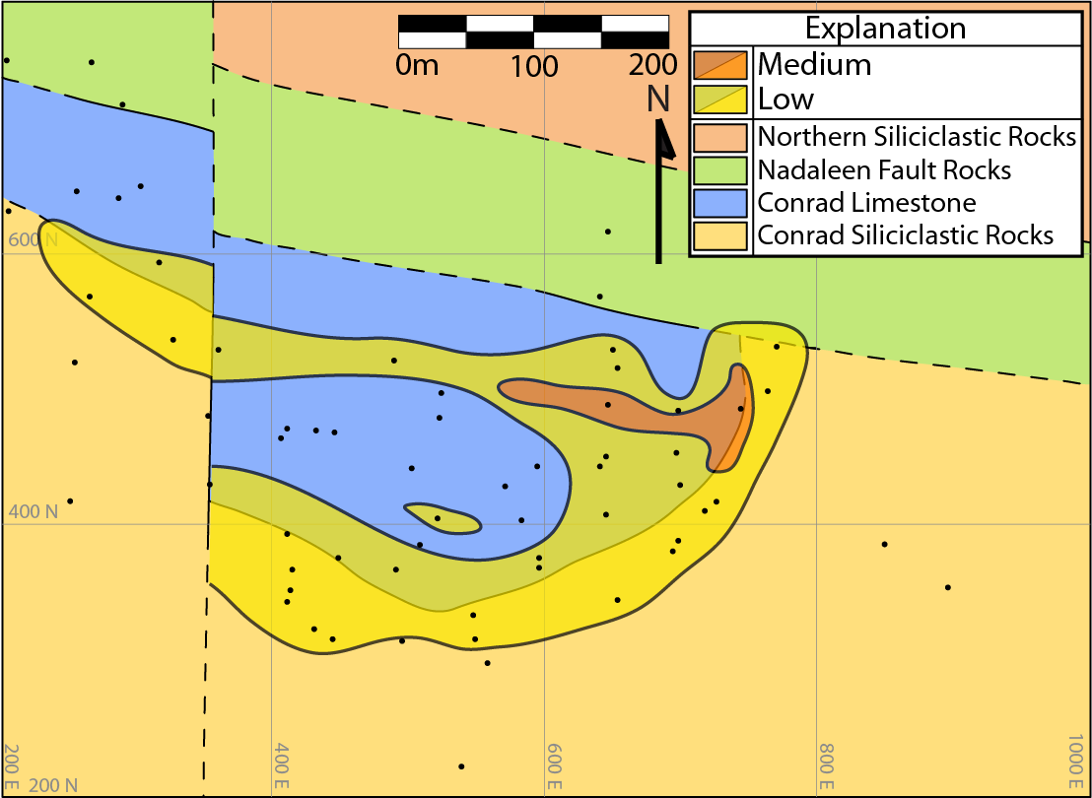
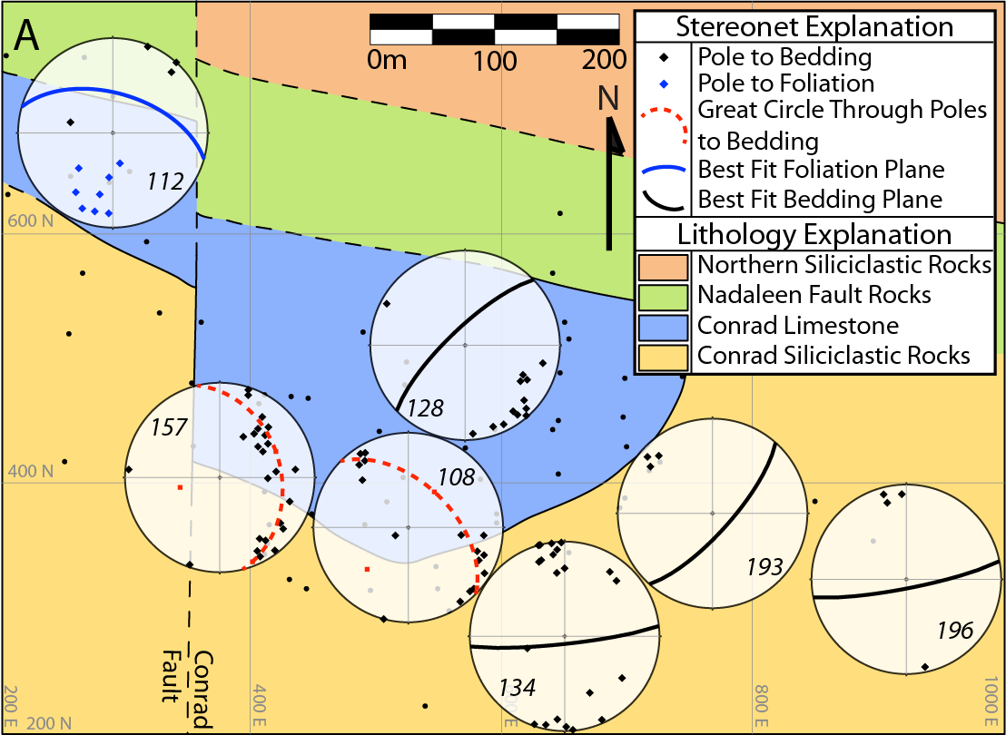
400m Plan View
Conrad
Fault
N-dipping foliation
along Nadaleen Fault
Fold hinge of
Conrad Anticline
Variable E-limb of
Conrad Anticline

Slide 12
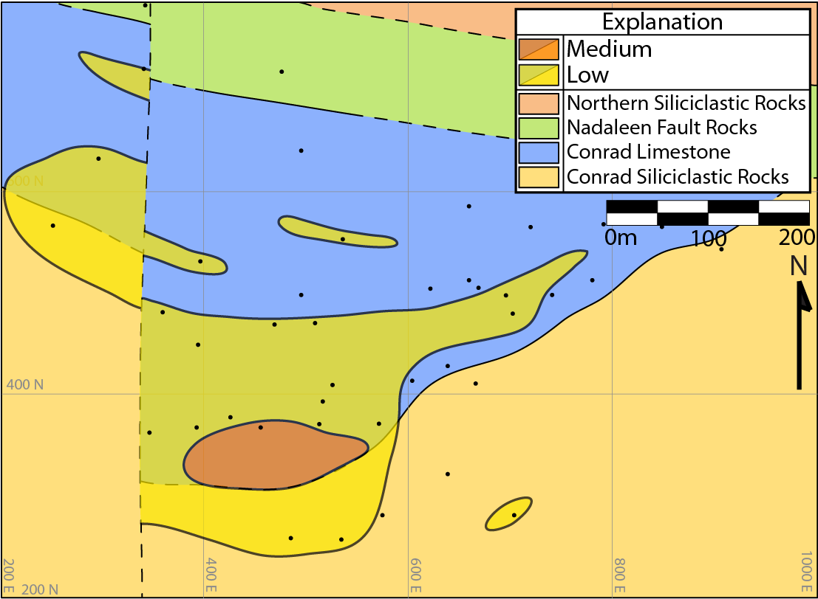
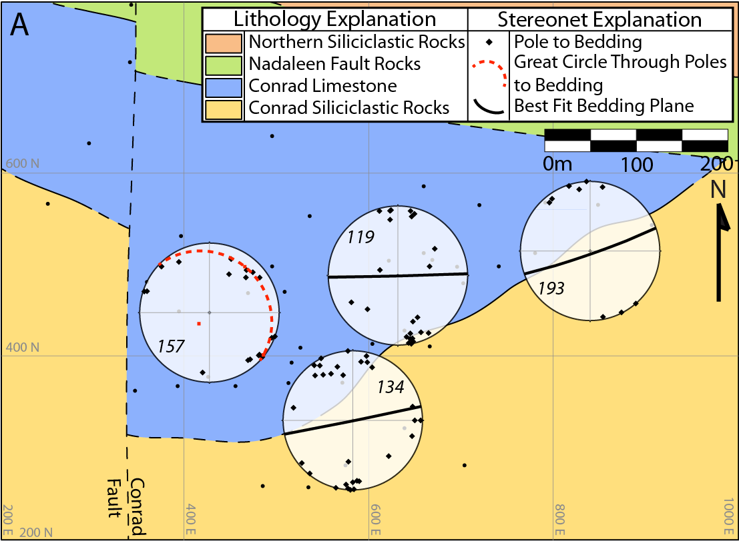
600m Plan View
Fold hinge of
Conrad Anticline
E-limb of
Conrad Anticline
Conrad
Fault

Slide 13
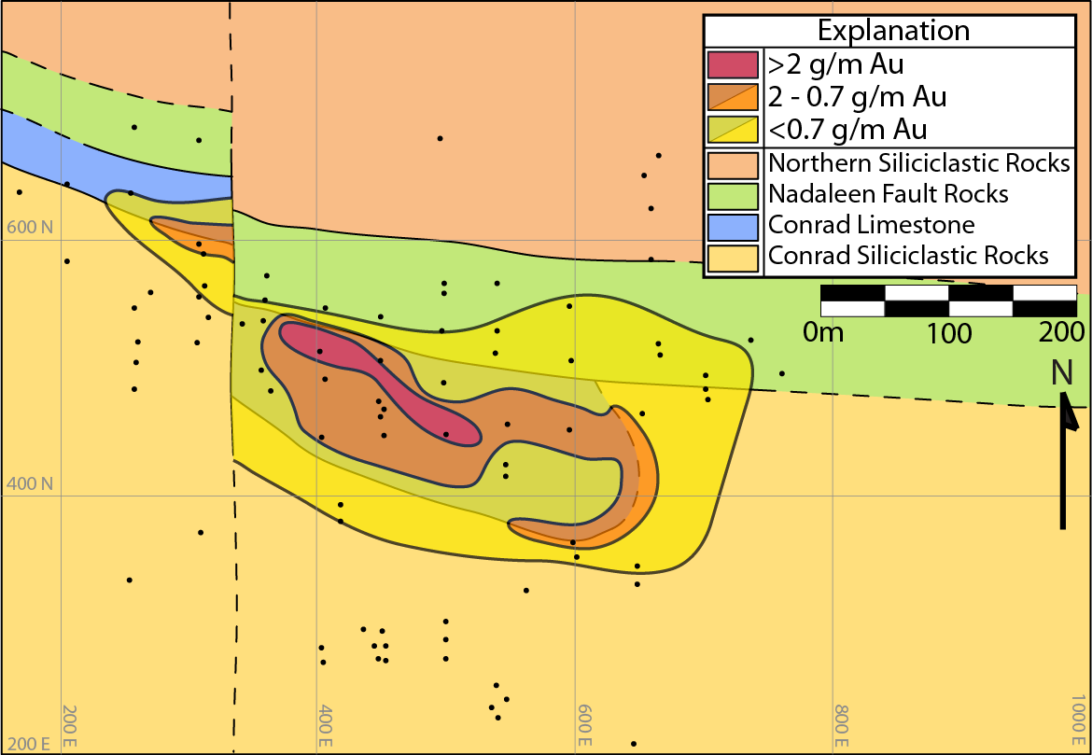
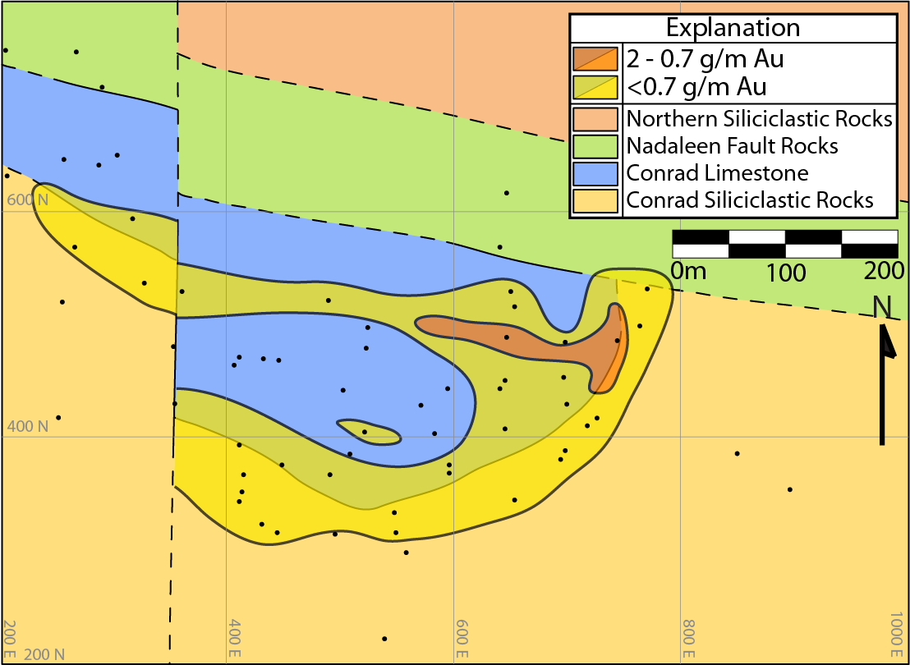
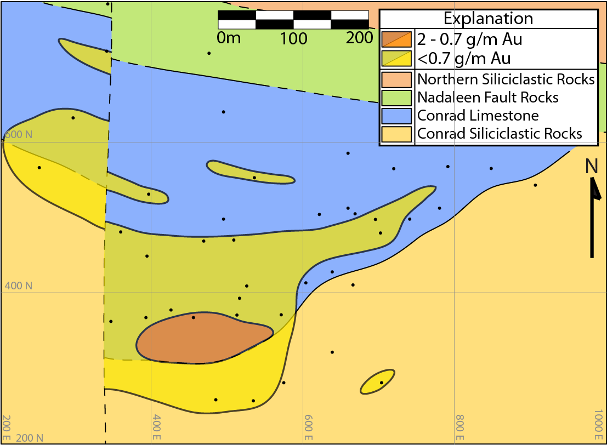
Grade Summary
400m
200m
Conrad
Fault
Conrad
Fault
Shallow Controls
Nadaleen Fault Damage Zone
Stratigraphic Contact
Intermediate Controls
Fault Splay/Anticline Hinge
Stratigraphic Contact
Deep Controls
Anticline Hinge
Stratigraphic Contact
600m
Conrad
Fault

Slide 14

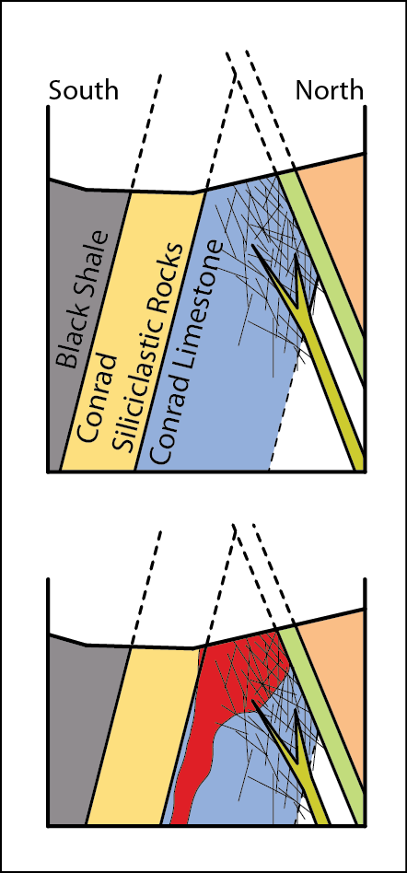



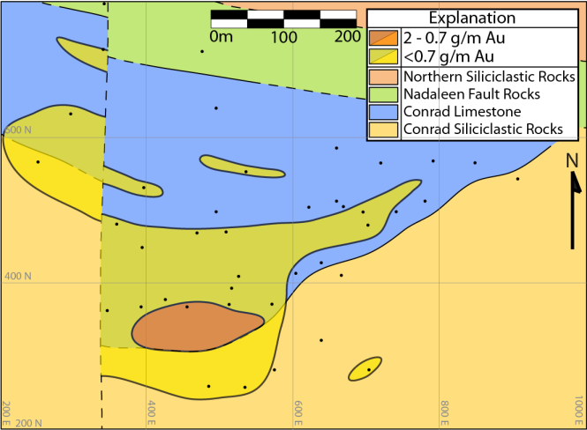
Controls on Deposit Morphology
Cross Section
Plan View
Shallow (200m)
Damage Zone
Stratigraphic
Conrad
Fault
Intermediate (400m)
Fault Splay/Fold Hinge
Stratigraphic
Conrad
Fault
200m
Deep (600m)
400m
Anticline Hinge
Stratigraphic
600m
Conrad
Fault

Slide 15
Conclusion
Controls on Morphology
Shallow – Damage zone and Stratigraphy
Intermediate – Fault and Stratigraphy
Deep – Anticline Hinge and Stratigraphy
Endowment
The damage zone of the Nadaleen Fault led to higher permeability in the Conrad limestone, permitting more ore-fluid-rock interaction that resulted in higher grades.
Rackla Gold Belt Exploration Focus
Carbonate stratigraphy in S- to SSW-plunging anticlines and near large faults, or, ideally, near the intersection of these two
By understanding deposit morphology in the Conrad zone, ATAC Resources can focus exploration in other areas of the Rackla Gold Belt to carbonate stratigraphy hosted in S- to SSW-plunging anticlines, near large faults, or at the intersection of these two
Prescription: MAP THE ROCK!

Slide 16
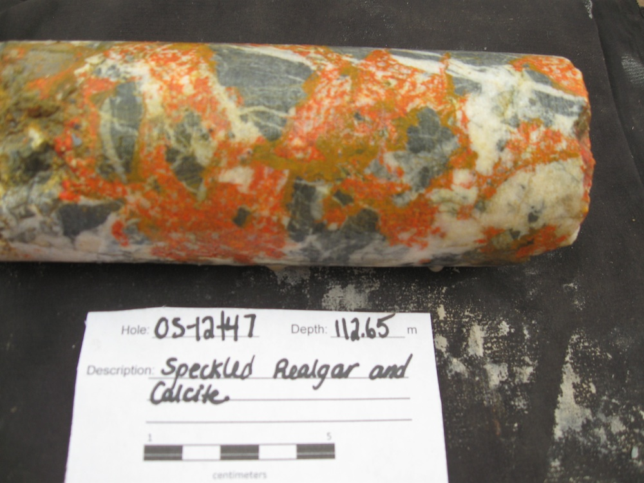
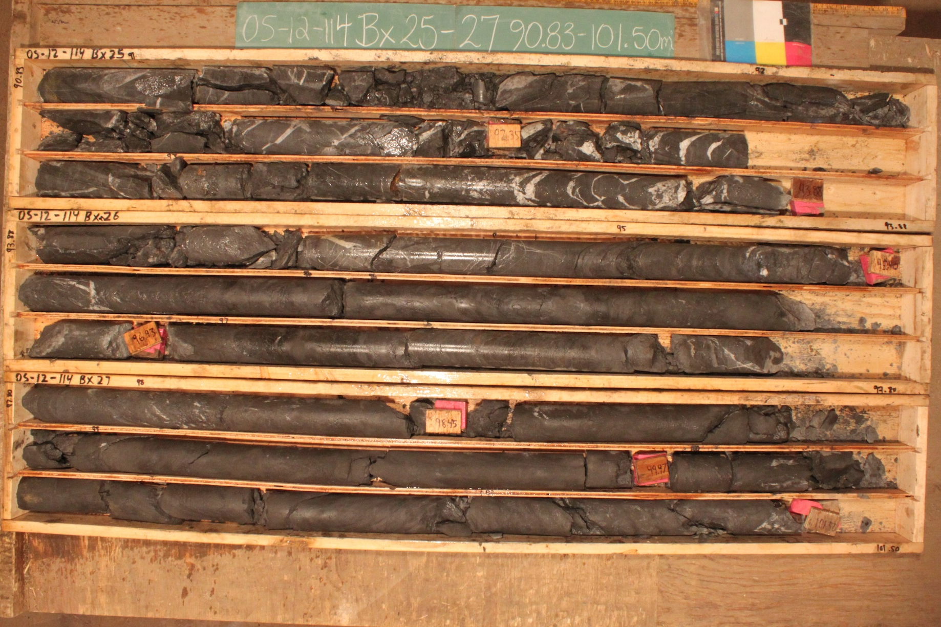
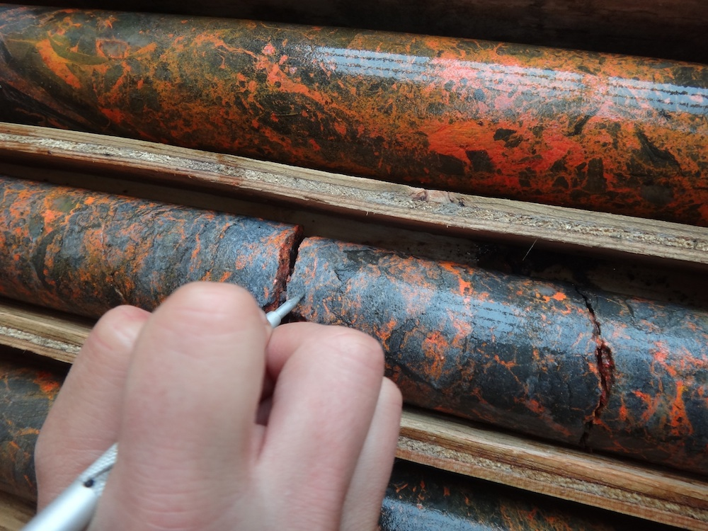
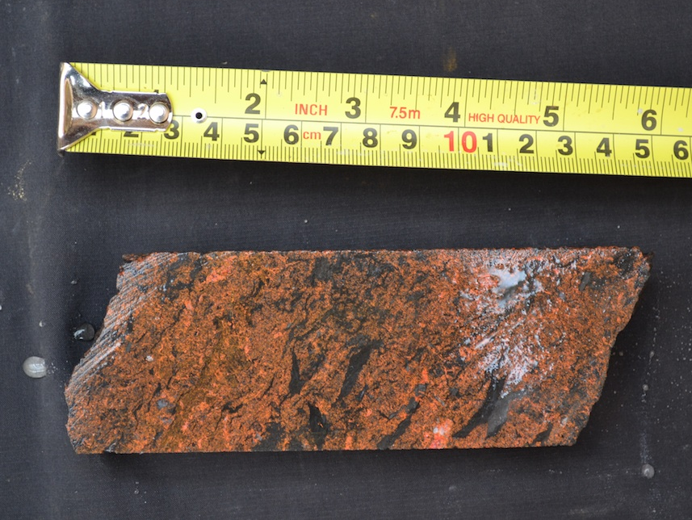
Thank You!
Murray Hitzman, Thomas Monecke, Rob and Joan Carne, Julia Lane, Odin Christensen, Venessa Bennett, Archer Cathro & Associates (1981) Ltd., ATAC Resources Ltd., and SEG.

Slide 17
Conrad Zone Characteristics
Fine-grained, “invisible” gold
Hosted in off-shelf to basinal sediments
Mineralization through sulfidation of Fe in host rock
High (~100 g/t) and disseminated grades
Structural and stratigraphic control
Alteration includes decarbonatization, decalcification, silicification
Strong association with arsenic, thallium, and antimony
Associated minerals include realgar, orpiment, fluorite, calcite, and stibnite
Tectonic setting similar to Nevada
May represent a Carlin-type end member

Slide 18
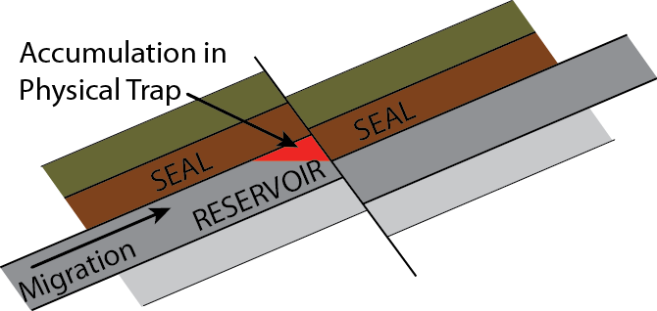
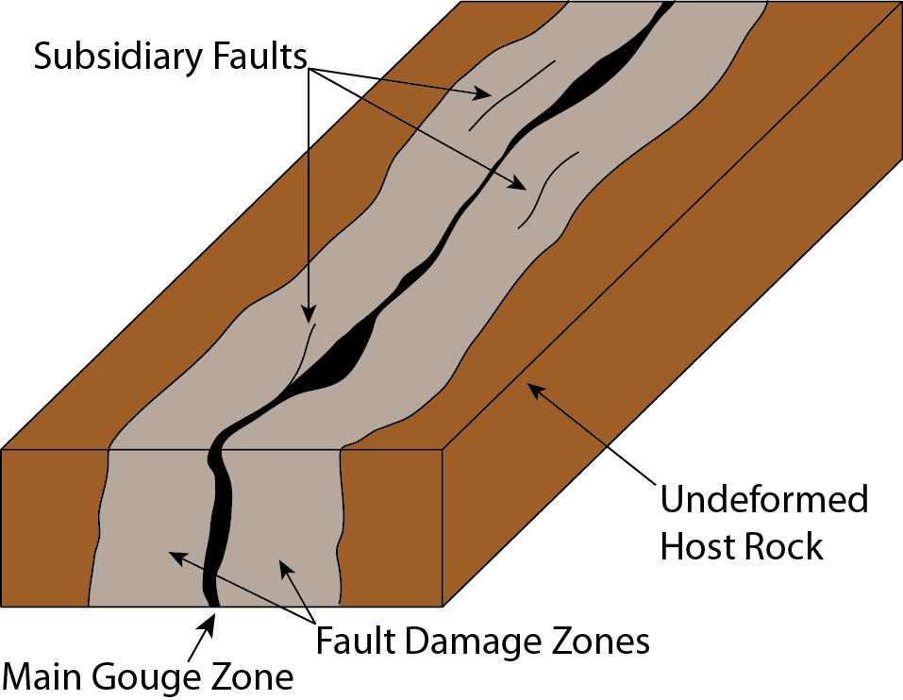
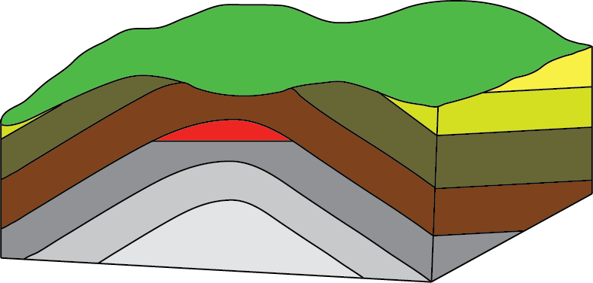
Controls on Morphology of the Deposit
Controls on Fluid Migration
Controls on Permeability
Faults & Stratigraphy
Fault Damage Zone
Anticlines

