Slide 1
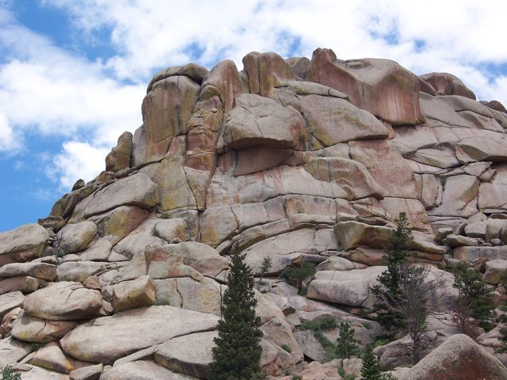
Mesoproterozoic Ferroan Magmatism in the Southwestern USA
by
B. Ronald Frost and Carol D. Frost
Department of Geology and Geophysics
University of Wyoming
With many thanks to J. Lawford Anderson

Slide 2
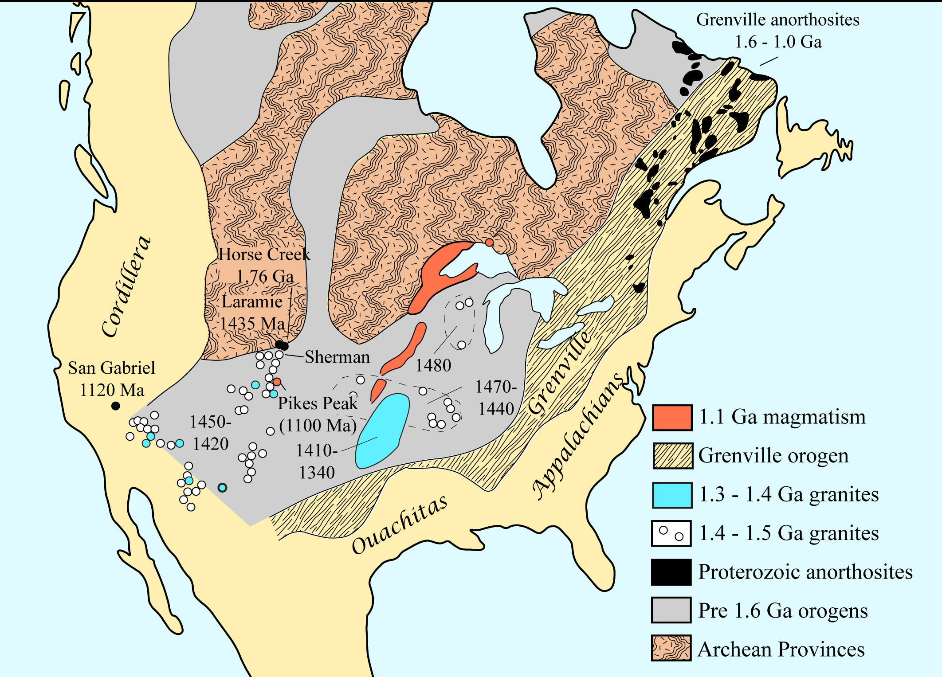

Slide 4
The Mesoproterozoic igneous event in North America occurred between 1.76 to 1.0 Ga over a distance of more than 5,000 km.
The rocks range from anorthosite to ferroan granite, with the granitoids showing a wide range in composition, from alkalic to calc-alkalic and from metaluminous to peraluminous.
The range δ¹⁸O values indicate that some granites contained significant component from melted sedimentary rocks, where others have not.

Slide 5
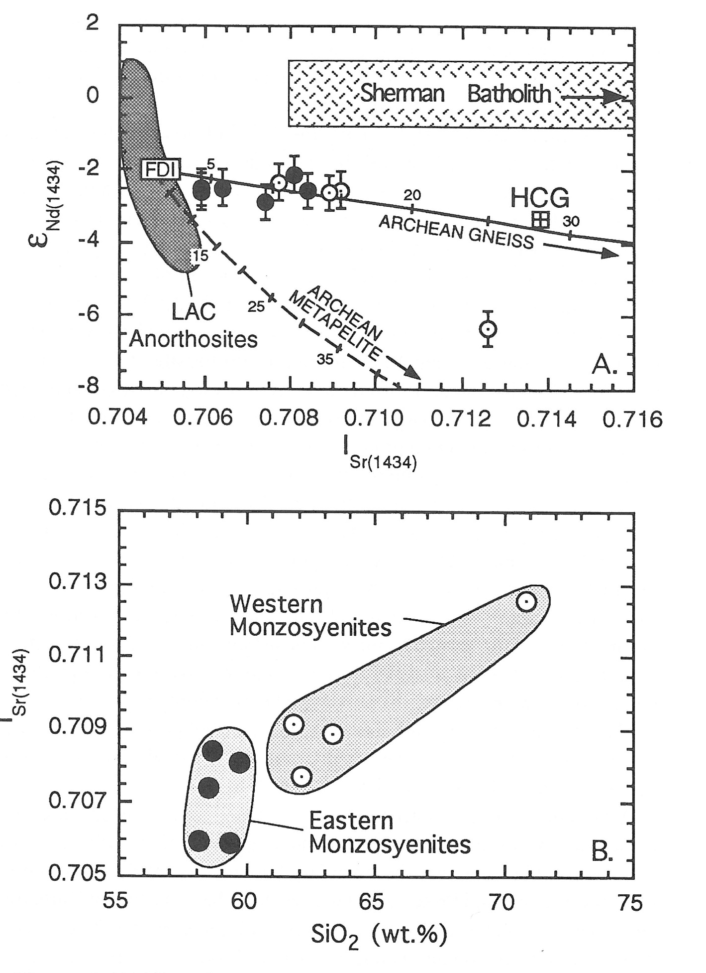
The Sybille monzosyenite can contain no more than 15% crustal gneiss and the amount of crustal material increases with increasing silica content.

Slide 6
The monzonitic plutons associated with the LAC are mostly products of extreme differentiation of basaltic magma, although the most siliceous components probably have a component of crustal melt.

Slide 7
Experiments indicate that melting of granodioritic to tonalite crust can produce ferroan, calc-alkalic peraluminous melts>

Slide 9
The Wolf River batholith ranges in MALI from alkalic to calc-alkalic with increasing silica. The high-silica rock are peraluminous and all rocks have a uniform low δ¹⁸O.
These relations suggest that the Wolf River batholith formed from a combination of differentiated tholeiitic basalts and melts derived from crustal rocks that never saw atmospheric oxygen (granodiorite or tonalite).

Slide 10
Peraluminous leucogranites
Peraluminous leucogranites, which are formed from melting of pelitic rocks, range from ferroan to magnesian and from calcic to alkalic

Slide 12
The small range in silica contents, strongly peraluminous nature, and the presence of some rocks that are magnesian, instead of ferroan, combined with the range of δ¹⁸O values suggests that the St. Vrain and Silver Plume batholiths formed primarily from partially melted sediments with an admixture of of mantle sources.
The highly ferroan composition of evolved magmas may explain why the St. Vrain and Silver Plume batholiths have a much smaller range in Fe-index and MALI than other peraluminous leucogranites.

Slide 13
We identify three sources for the Proterozoic ferroan granitoids in Southwestern US.
1) Extreme differentiation of tholeiitic (and minimal amounts of transitional) basalt.
2) Partial melting of granodioritic or tonalitic crust.
3) Melting of sedimentary (or metasedimentary) rocks.

Slide 14
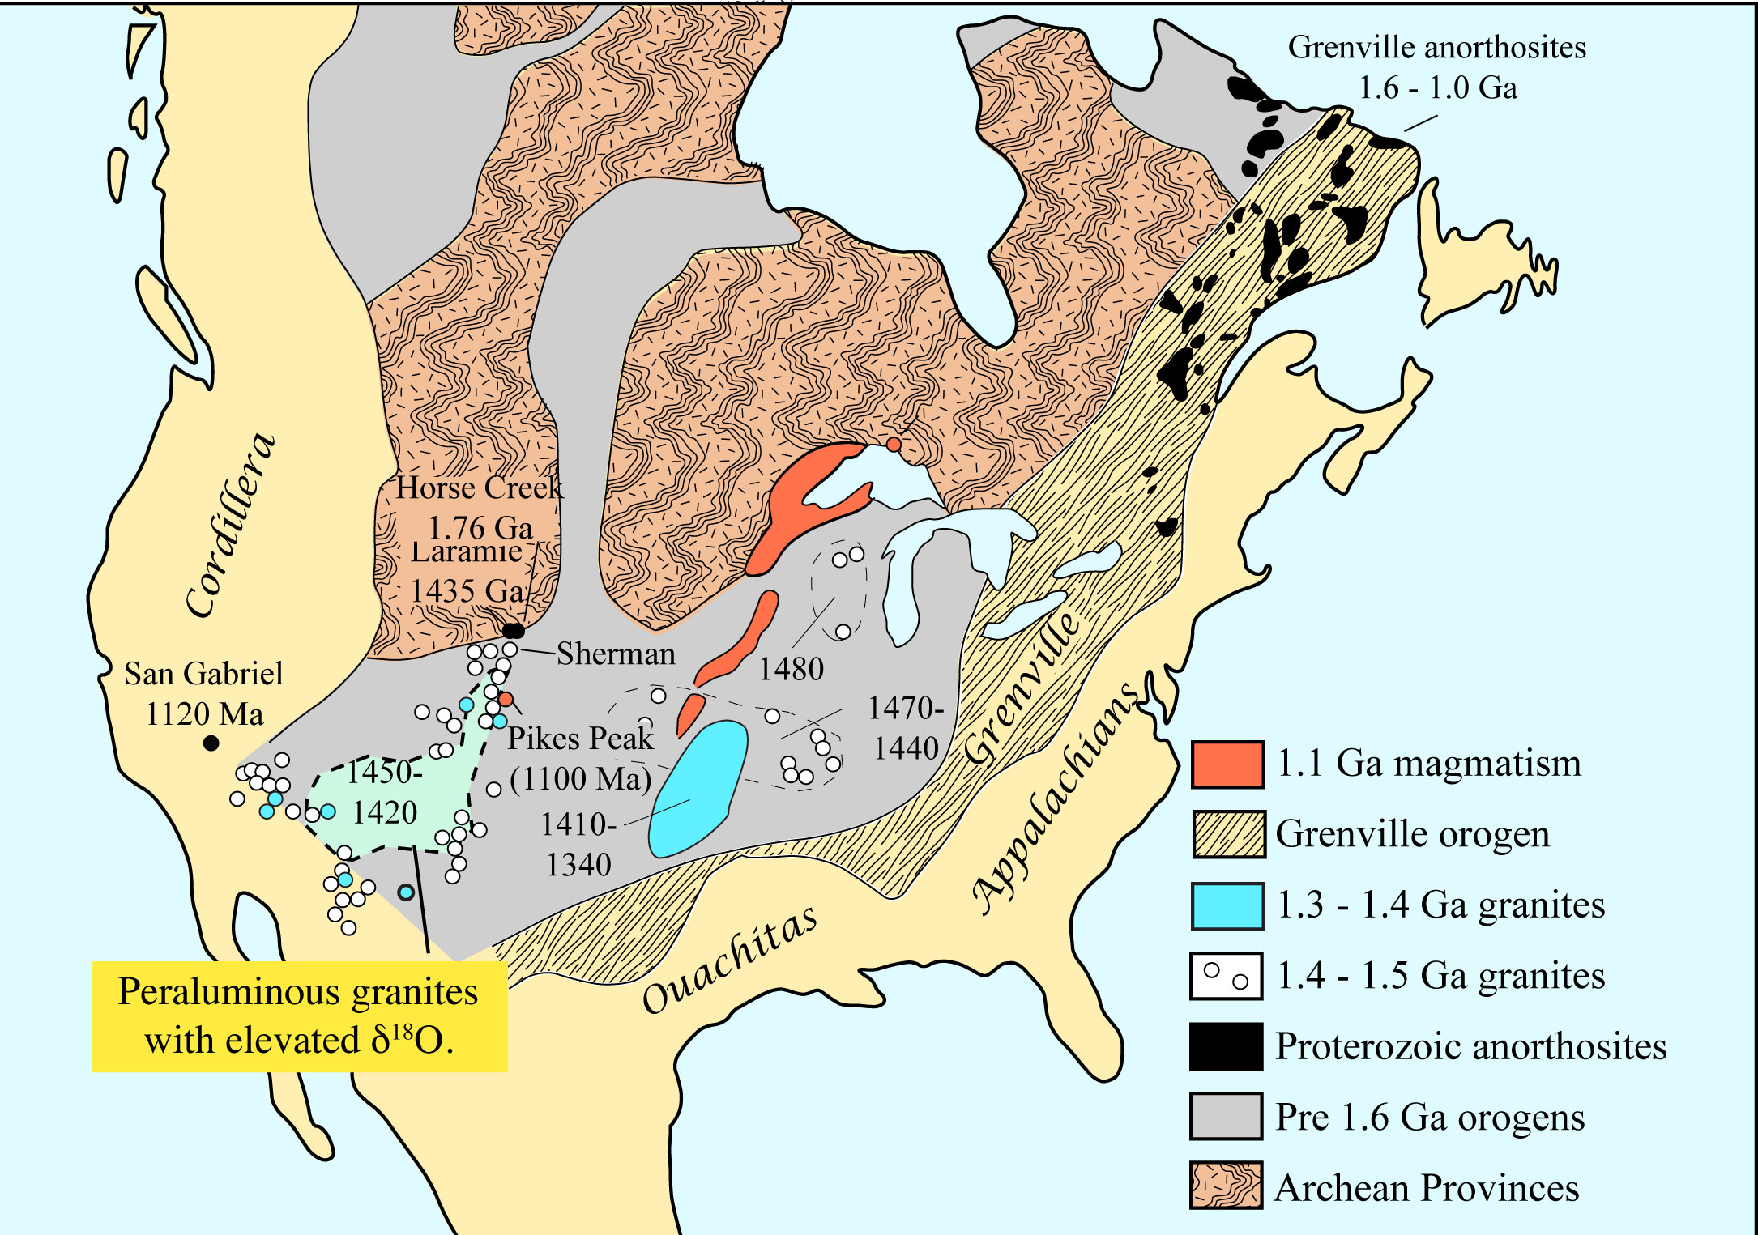

Slide 15
What was the tectonic environment of the Mesoproterozoic magmatism?
Three points are critical in answering this question.
The magmatism occurred from 1.78 to 1.1 Ga, a time scale of more than 600 million years.
The ferroan magmas of these granitoids are characteristic of modern rift-type environments.
Coeval rift sediments are exceedingly scarce across North America.
Although plutons of a given age do tend to be clustered, there is no progression of age across North America, nor is there any progression in composition with age.

Slide 16
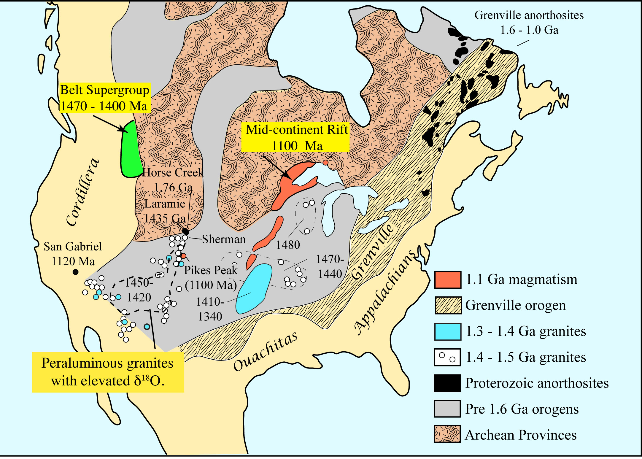
The only major Mesoproterozoic rifts in North America are the Belt basin and the Mid-Continent Rift.

Slide 17
Hoffman (1989) proposed that the Proterozoic magmatic event was associated with the formation of the Nuna supercontinent.
Throughout the Paleoproterozoic the precursor to North America was assembled by collision of Archean Cratons and accretion of Proterozoic Arcs.

Slide 18
Growth of Nuna in the Proterozoic

Slide 19
According to Hoffman, the large size of Nuna and its thick continental crust insulated the mantle.
This caused thermal instabilities that caused periodic upwelling events.
These plumes behaved like modern failed rifts. Tholeiitic magma pooled at the base of the crust producing cumulates that formed anorthosites and highly differentiated magmas that were major contributors to the ferroan granites.

Slide 20
This model can explain the compositions of the magmas in the Proterozoic ”event”, the episodic nature of the “events” and the paucity of the coeval rifting sediments.
However, it does not explain how the mantle “instabilities” interacted with known Proterozoic tectonic events, including the 1.47 – 1.40 Ga rifting in the Belt basin, the 1.1 Ga Mid-Continent Rift, and the 1.1 Ga Grenville orogeny.

