Slide 1


Coastal Topographical Change Analyses Associated With Superstorm Sandy at Miller Field, Staten Island, New York
Carlos P. Carvajal
Randall Fullmer
Andrea Spahn
William Schmelz
Norbert Psuty
Geological Society of America - Mosaics in Science Program
Institute of Marine and Coastal Science - Rutgers University

Slide 2
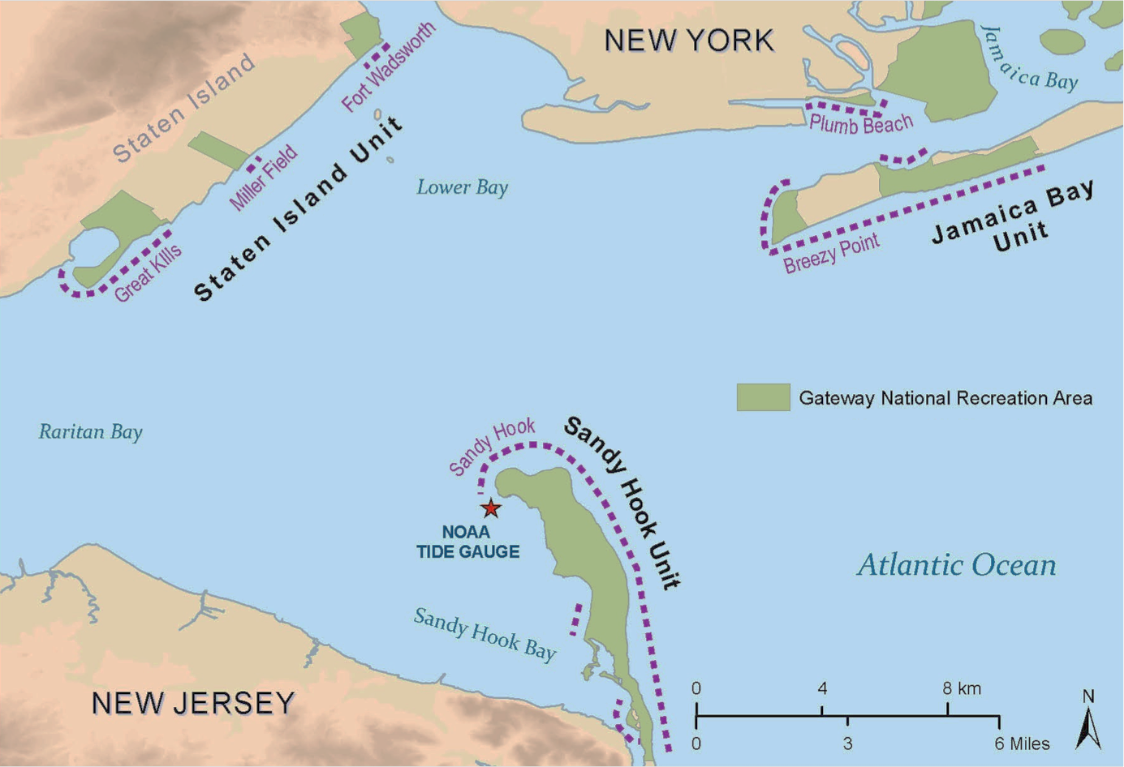
Gateway National Recreational Area
Figure 1
Produced by Andrea Spahn (1-D Annual Report 2013)
Notes:
how much influence did Superstorm Sandy had on Miller Field’s regular trend and how can this influence be quantified?
So, first we need to look at data prior to Superstorm Sandy to understand its regular trend.
We can then see how the effects of this meteorological event fits.

Slide 3
Northeast Coastal and Barrier Network (NCBN)
Goals
Geomorphological Monitoring Protocol methodology
Comparable Regional Data
National Database for National Park Services and Wild life refugees use
Available reports for general public use
http://science.nature.nps.gov/im/units/ncbn/
Notes:
As part of the monitoring projects of the NPS, the NCBN provides information to park managers and the public for a better understanding of the dynamics of coastlines. The better comprehension of these areas leads to an efficient and objective management of historical, natural, and recreational resources.
Therefore, if we want to provide valuable and comparable data we need well established protocols and Standard Operating Procedures that answer to quality controls.

Slide 4
Protocols
Three programs to monitor geomorphological change primarily caused by sea level rise, storm events, and changes in sediment supply.
1D Shoreline Change
Monitors the Spring and Fall high-tide, neap tide swash line.
2D Coastal Topography
Datum based monitoring
Monitors the elevation of the beach relative to a specific datum (NAVD88).
3D Volume - Areas of Special Interest
Datum based monitoring
Collect a high density points to produce a Digital Elevation model
LIDAR – complementing tool
Edited from Spahn
Notes:
Each protocol address its own objectives and has specific requirements, instruments, and software requirements. However, they cannot tell the whole picture by themselves because not all changes happen in the same dimension.
Superstorm Sandy brought attention to the fact that we cannot underestimate the changes that a storm can bring to an area. For instance: NO 3D surveys for Miller field.

Slide 5
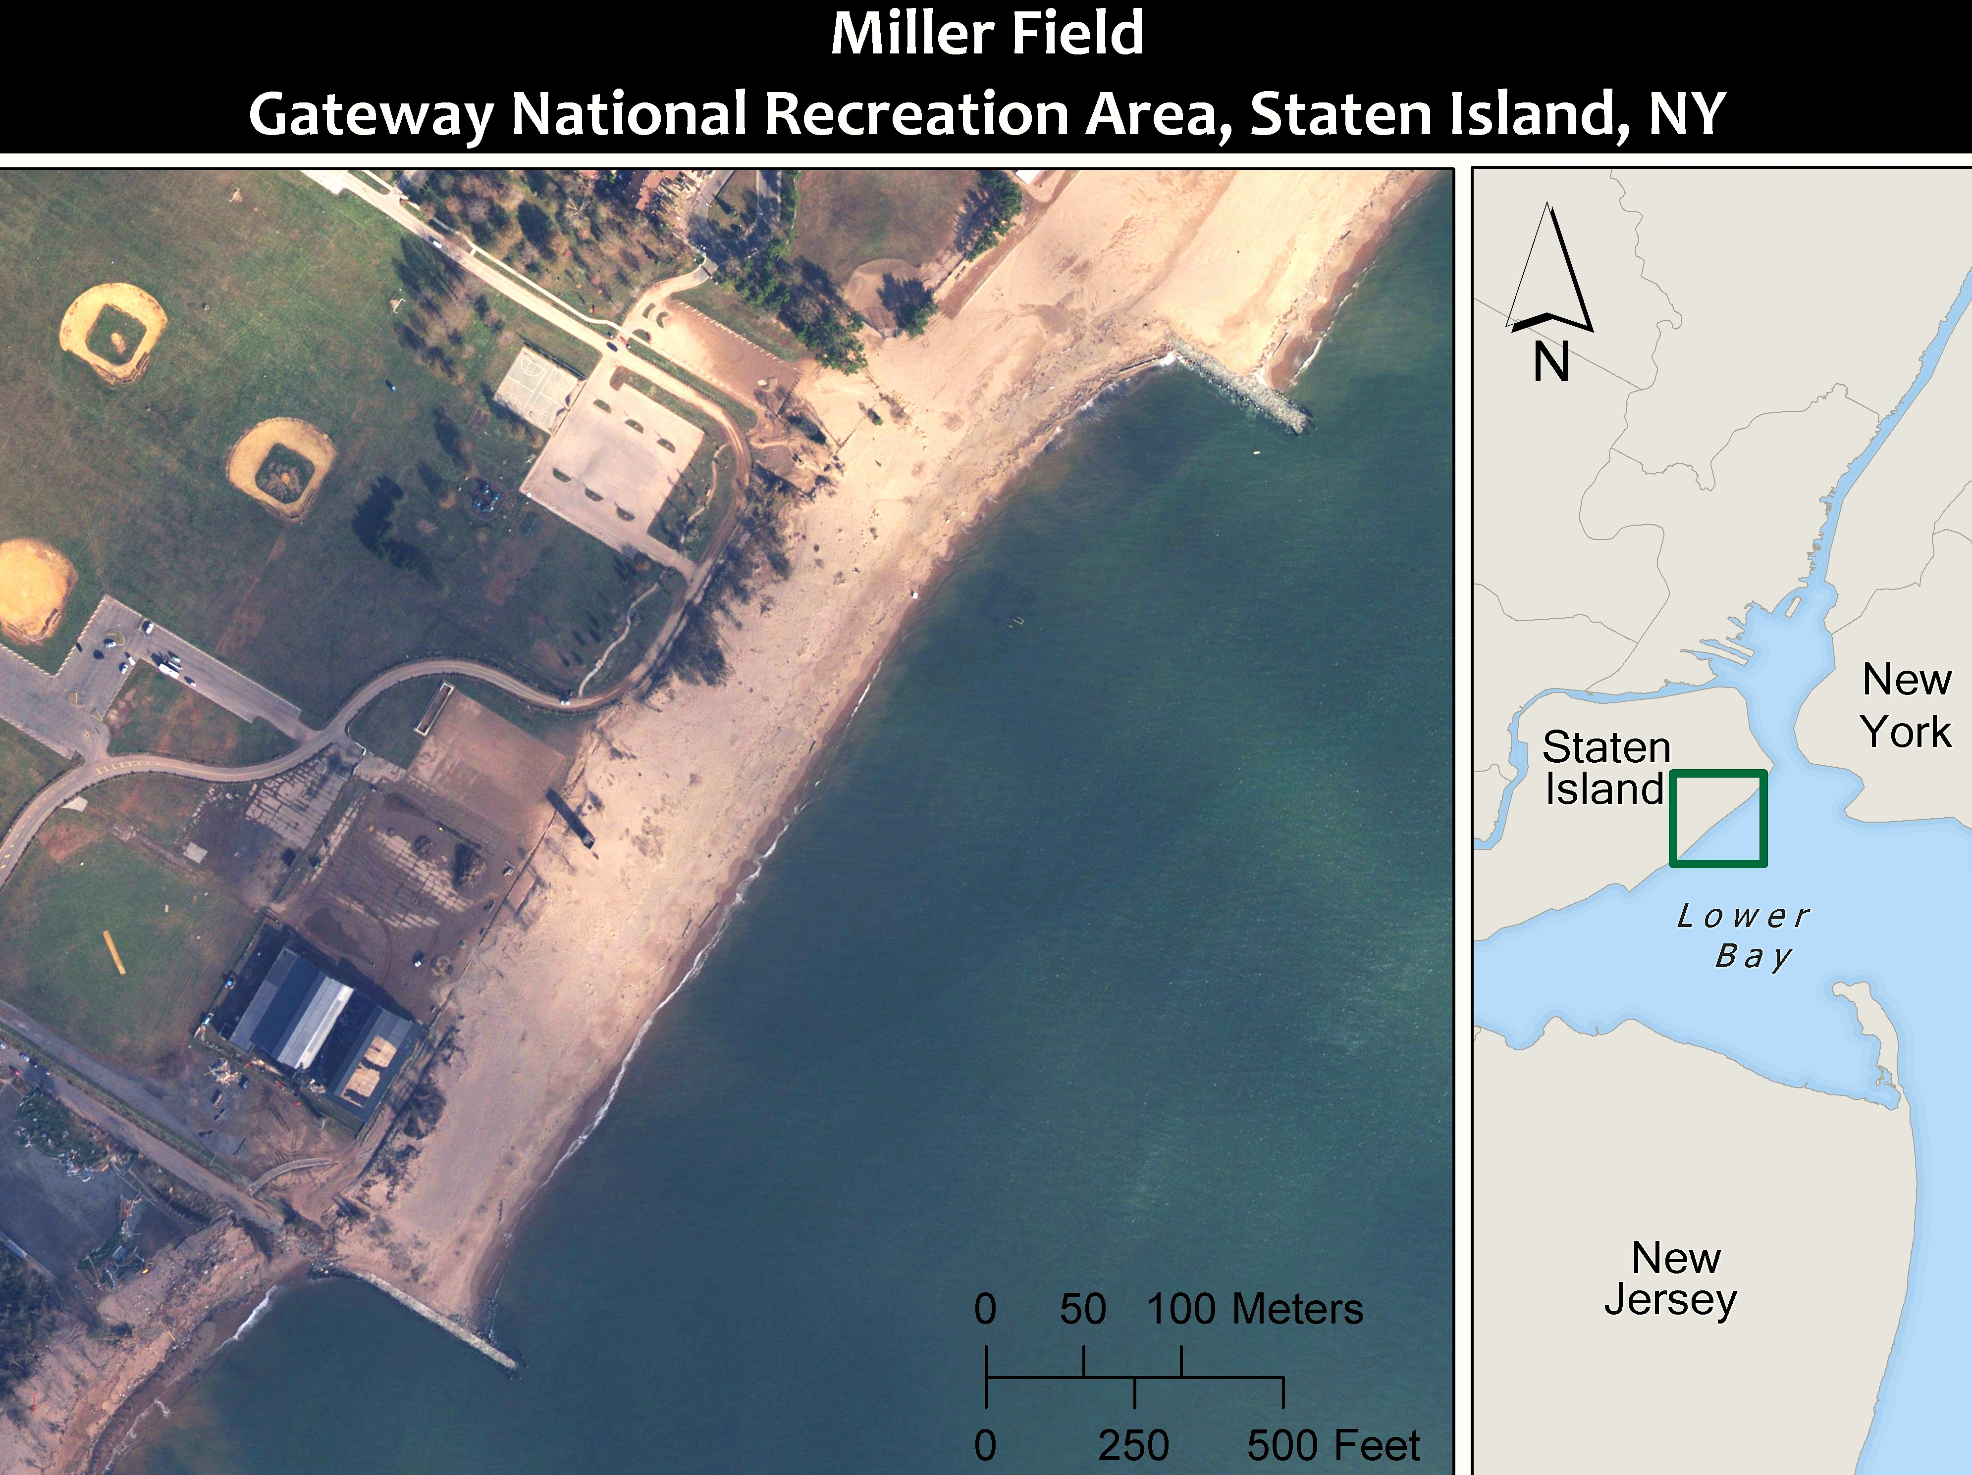
Map Produced by Randall Fullmer, Aerial photo from NOAA 11/02/2012
Figure 2
Notes:
Aerial picture showing the basic yet central characteristic of Miller field:
Miller Field beach is enclosed by two groins making it an compartment of sand which has different responses to storms and seasonal variations.
It is important to note the direction of longshore currents are from NW to SE
Also, a City Beach which is constantly replenishing its beach with sand is located NW from MF. This is MF main source of Sand.

Slide 6
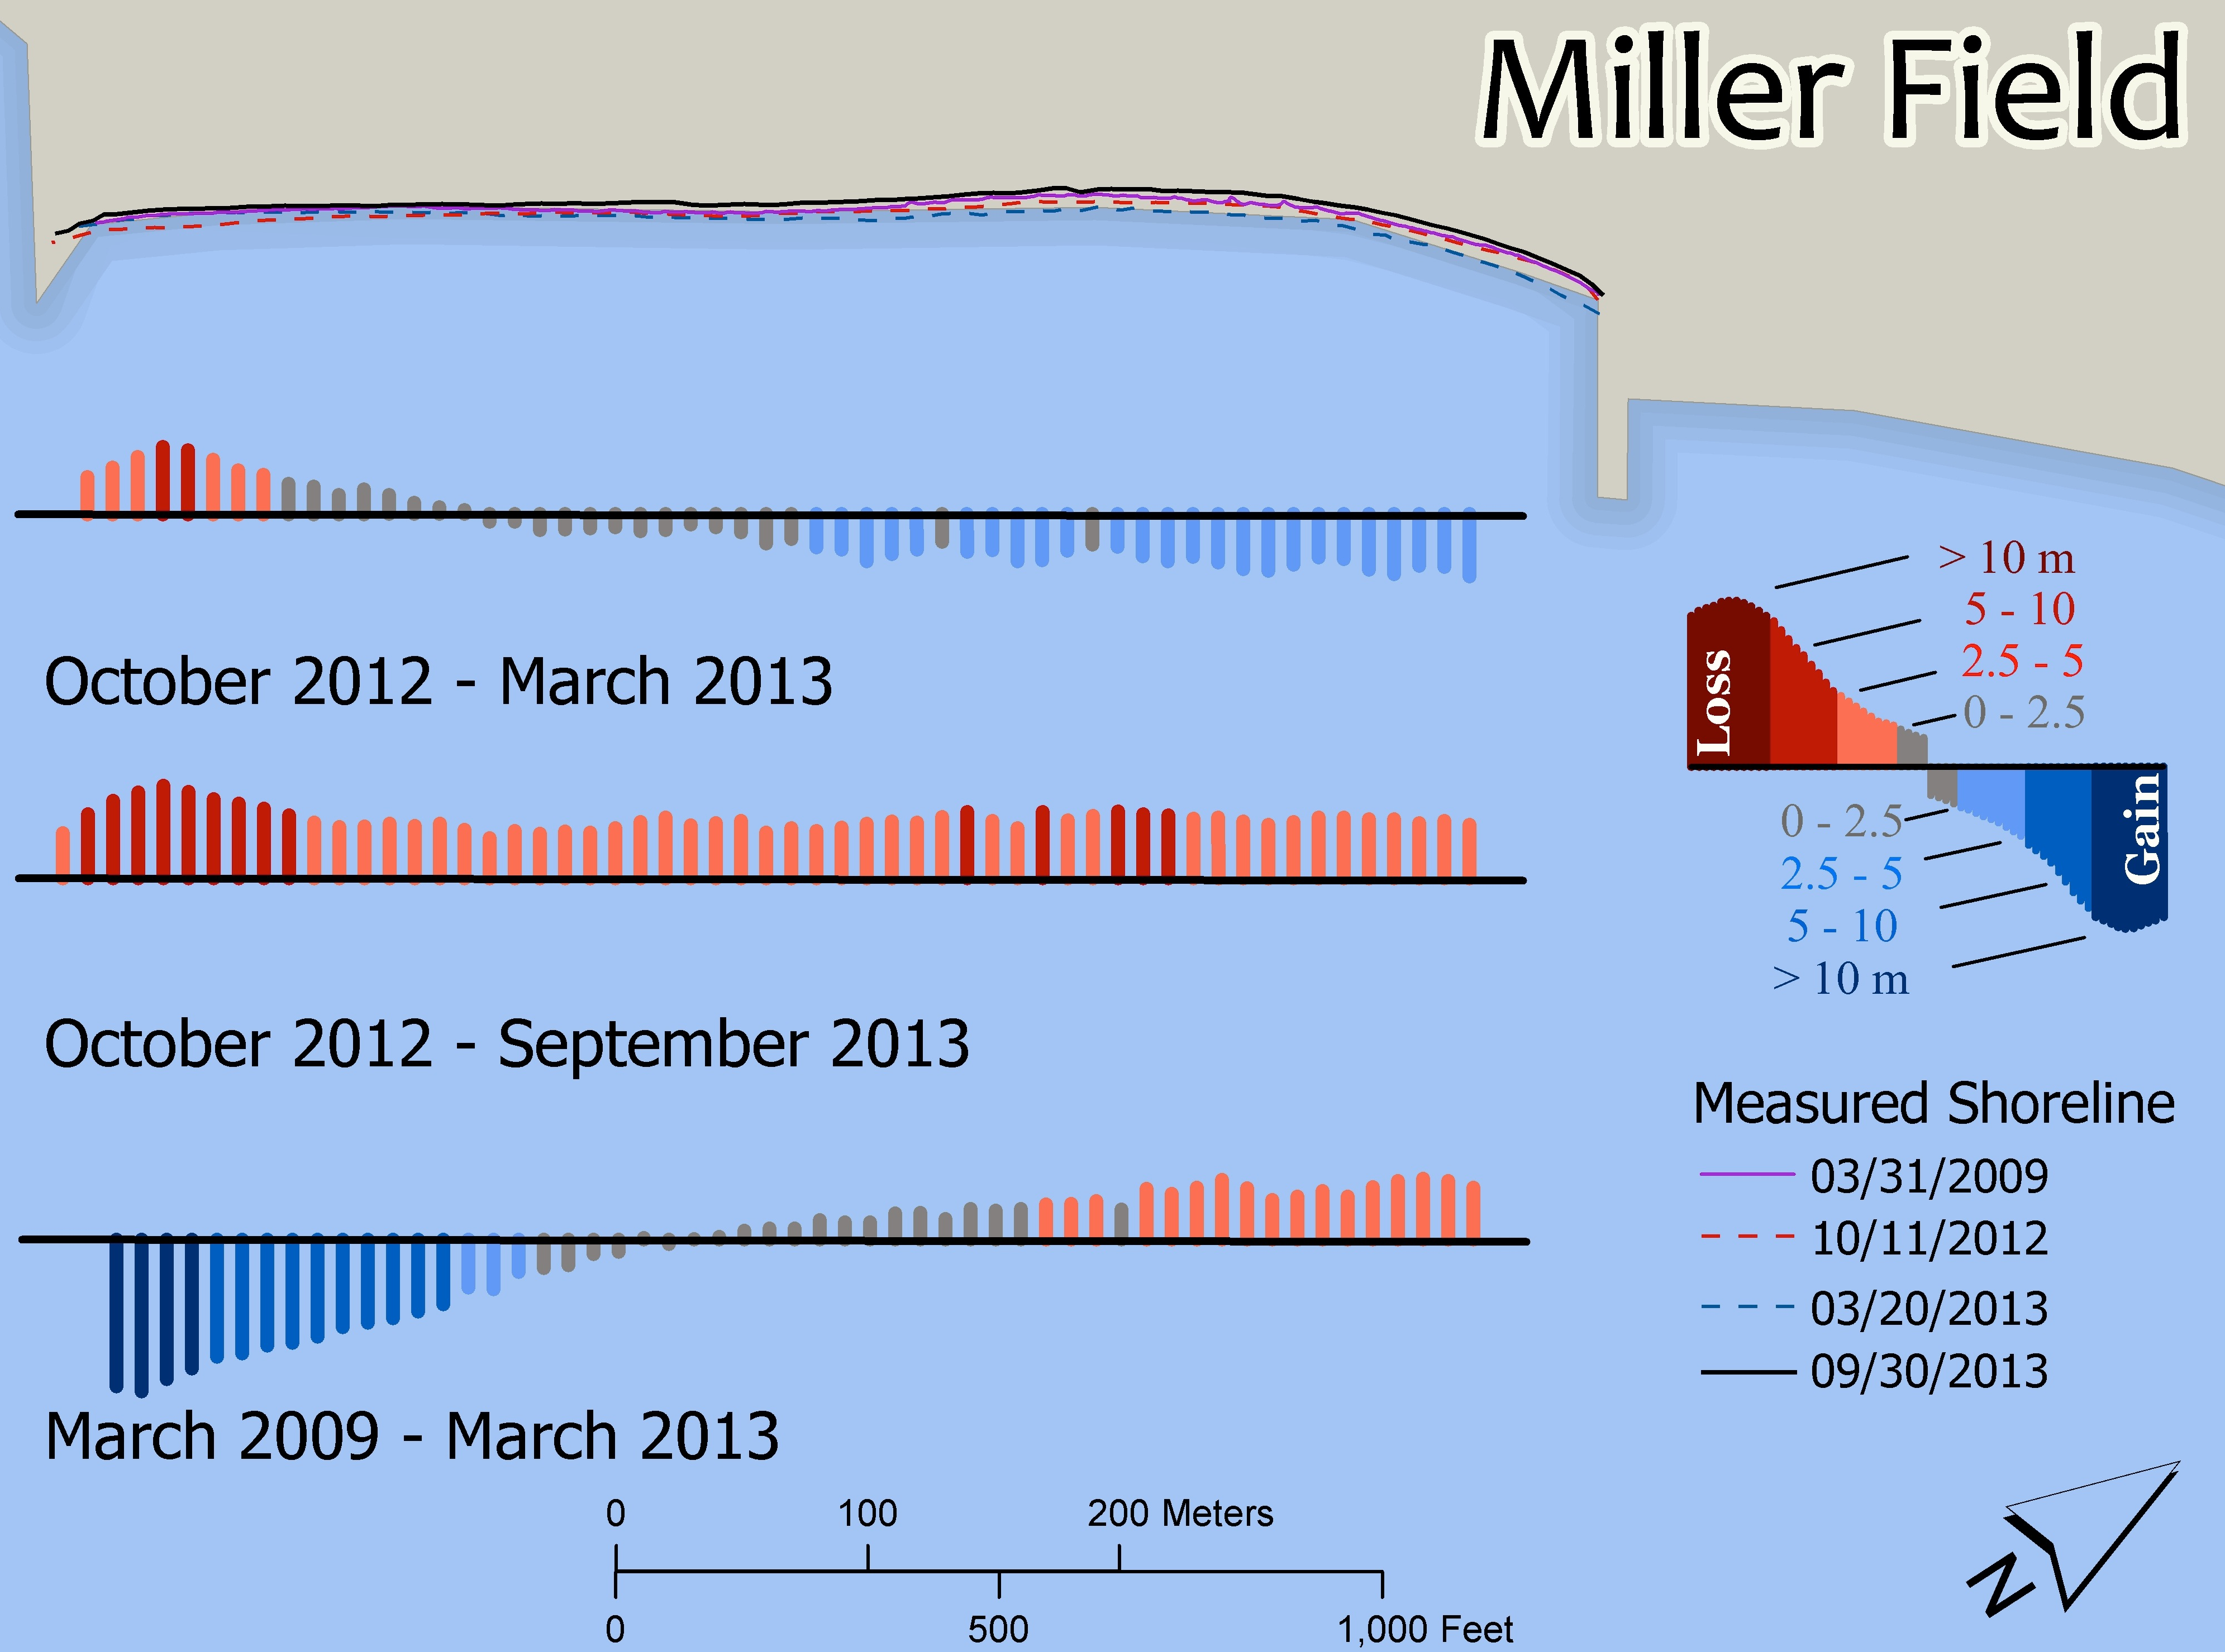
Figure 3
Map Produced by Randall Fullmer
Notes:
Miller Field shows a interesting shifting mechanism in both end. That is, while in one year one end will lose (moving landwards) the other end will gain (moving seaward). The following year the mechanism will revert.
This occurs because Miller field is a sand compartment enclosed between two compatments
October (before Sandy) to March 2013 shows displacement landwards on the SE end.
In the 5 year trend taking only Spring shorelines no evidence that Sandy actually influence the regular trend of MF

Slide 7
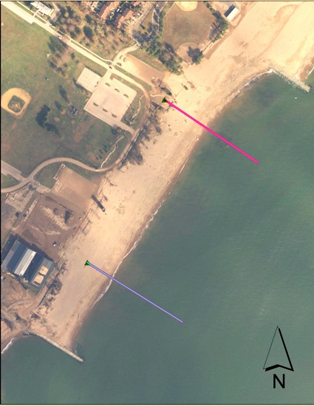
MF 1 - Profile
Dune Area
Fall 2009 – 56.53 m²
Fall 2010 – 50.54 m²
Fall 2011 – 53.35 m²
Fall 2012 – 75.40 m²
Post Sandy – 54.10 m²
Spring 2013 – 45.22 m²
Total Area
Fall 2009 – 241.75 m²
Fall 2010 – 236.70 m²
Fall 2011 – 241.73 m²
Fall 2012 – 267.85 m²
Post Sandy – 240.17 m²
Spring 2013 – 228.54 m²
Notes:
Major Dune Feature displaced and modified by Sandy

Slide 8

MF 2 – Profile
Dune Area
Fall 2010 – 15.15 m²
Fall 2011 –17.40 m²
Fall 2012 –29.15 m²
Post Sandy – 28.09 m²
Spring 2013 – 36.74 m²
Total Area
Fall 2010 – 103.05 m²
Fall 2011 – 107.85 m²
Fall 2012 – 136.87 m²
Post Sandy – 129.88 m²
Spring 2013 – 147.53 m²
Figure 5
Notes:
Beach progressing seawards and showing a increase in Total area.

Slide 9
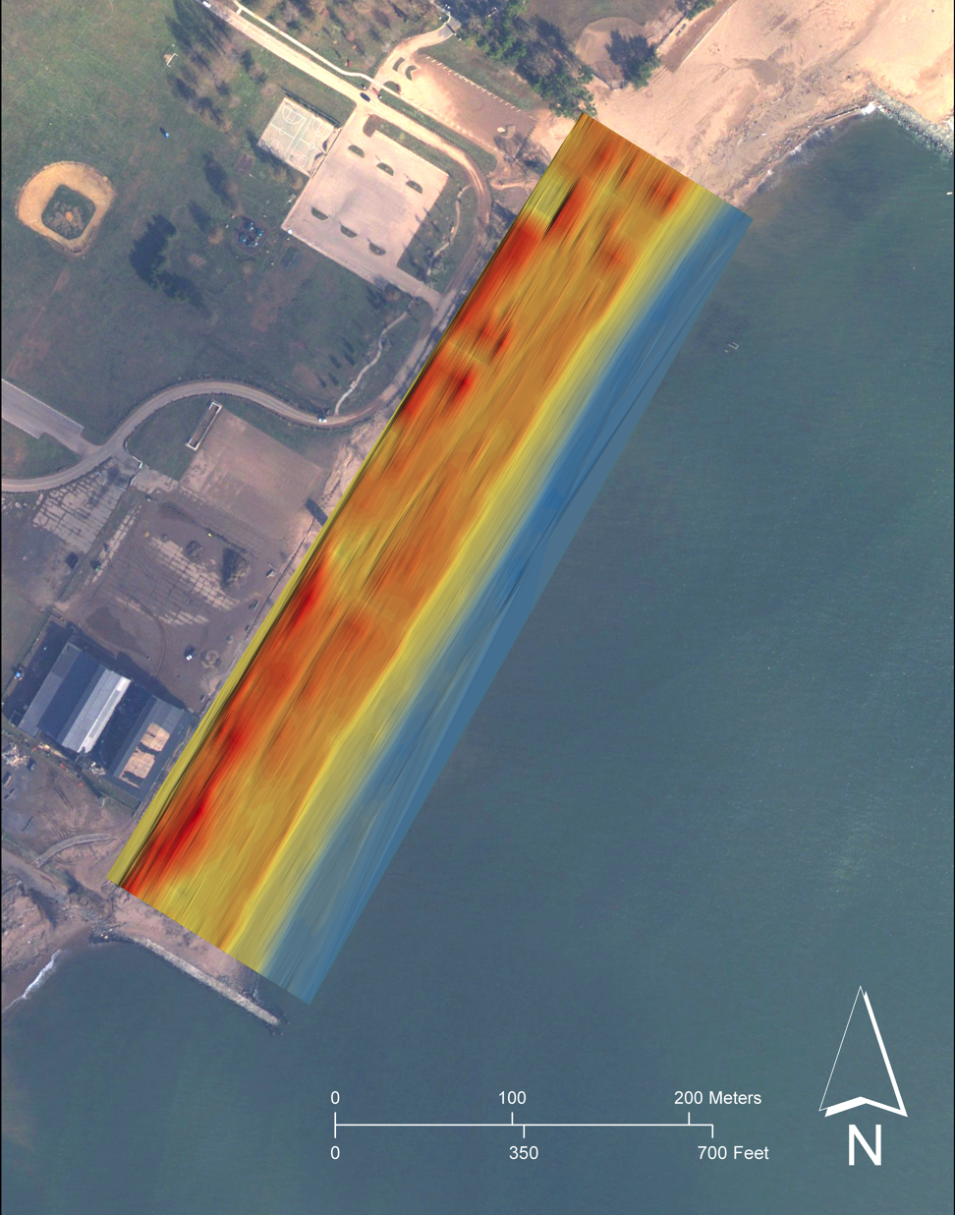
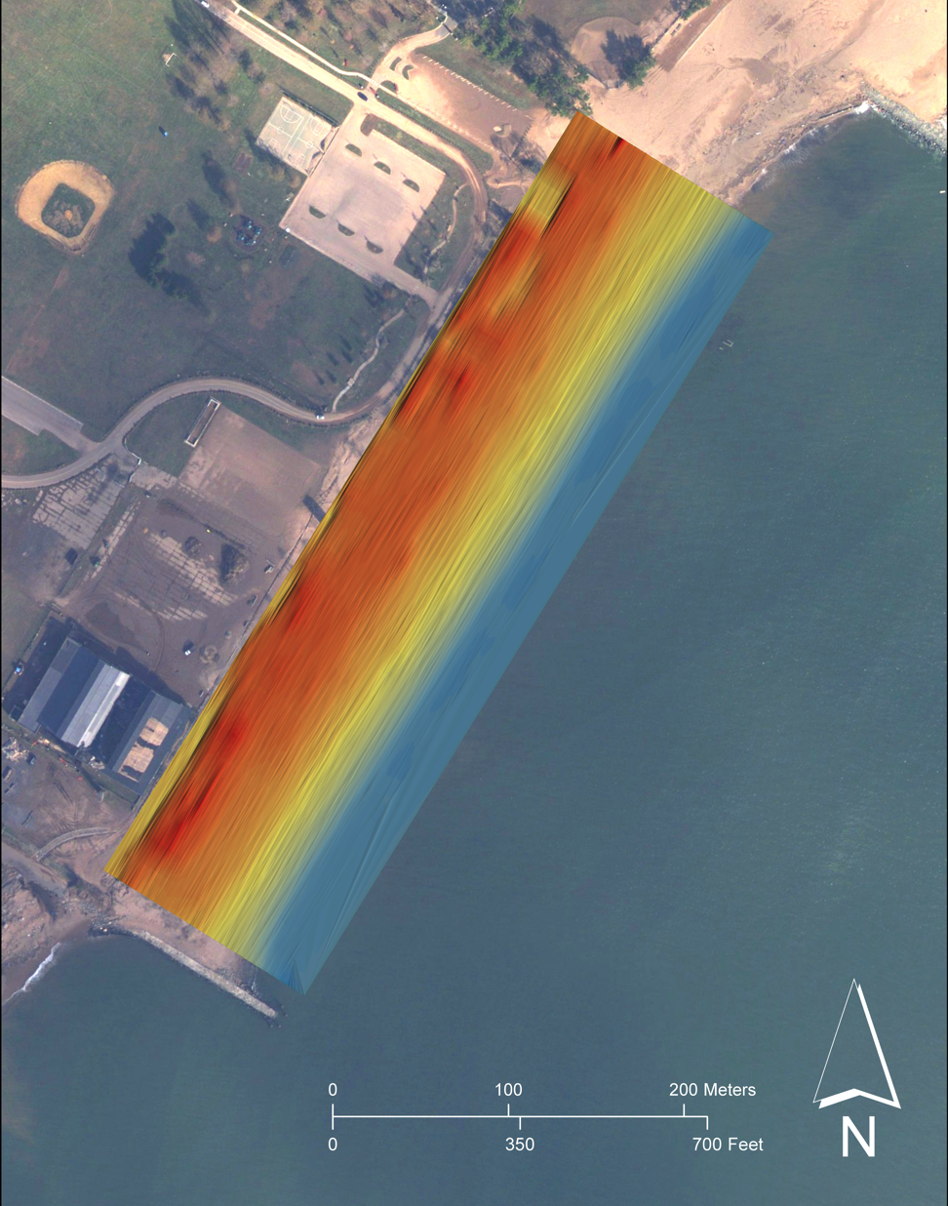
Geomorphological Changes
Observation
Tower
Observation
Tower
LIDAR 2010
LIDAR 2012
Figure 6
Notes:
Superstorm Sandy made us reevaluate the constancy in our surveys. NO 3D data for MF.
However, we can use Lidar to generate Digital Elevation Models to look at geomorphological features.
Dune feature shows modification after sandy.

Slide 10
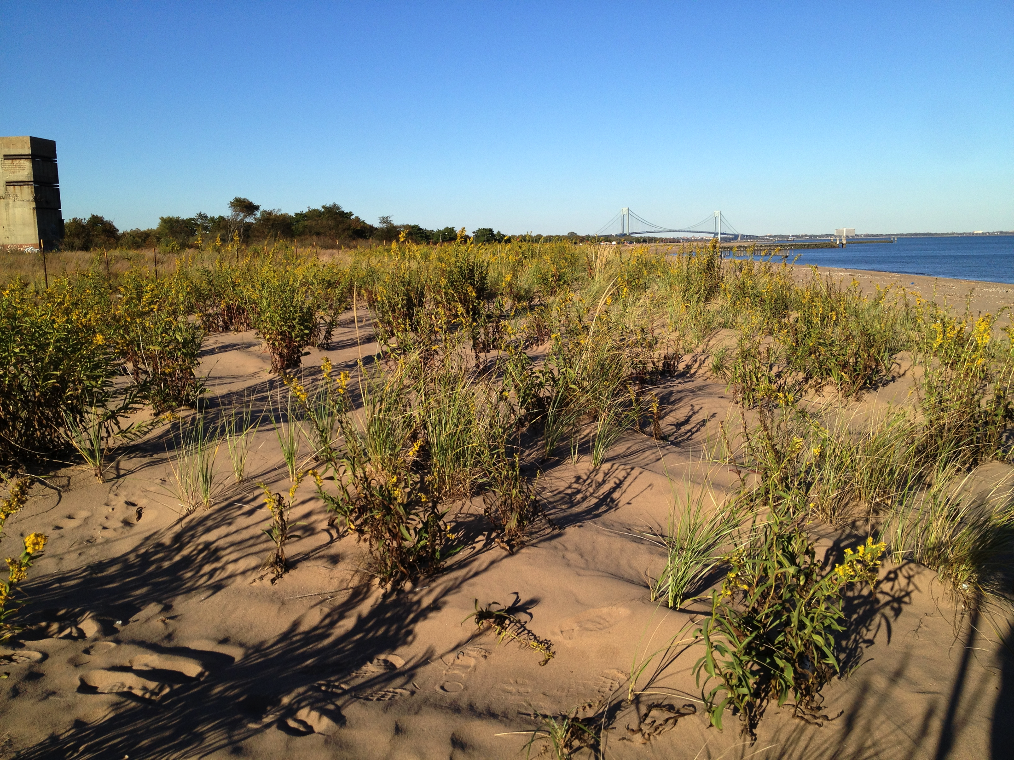
Observation
Tower
October 16, 2012

Slide 11
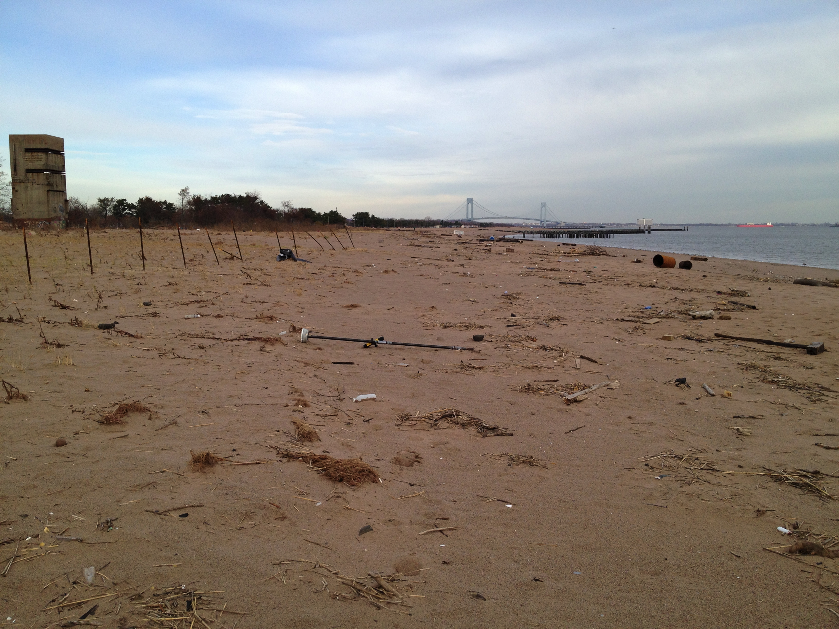
Observation
Tower
November 16, 2012

Slide 12
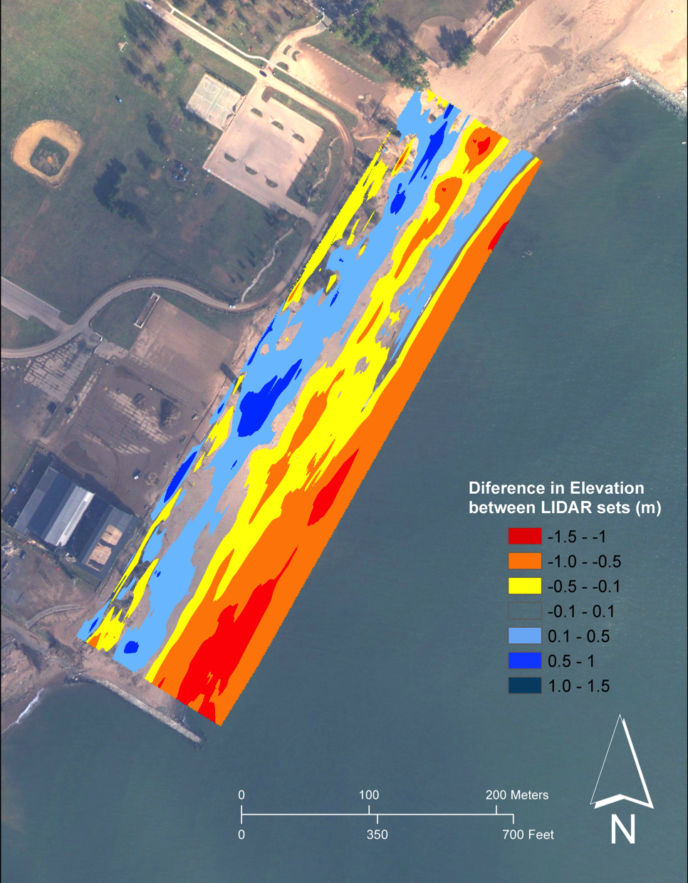
Net Volume Changes
Accretion LIDAR 2010-2012 [m³] | Erosion LIDAR 2010-2012 [m³] | Net Volume Change [m³]
3405.22 | 8110.18 | -4704.95
Figure 7
Notes:
Small accretion on the dunes.
Also, intense erosion on the SW end which is explained by the especial nature of Miller Field.
The sand coming from the City Beach is captured in the SW growing of Miller field to a point of overflow in which erosion kicks in. Then, the process of erosion and accumulation cycles.

Slide 13
Summary
So, how much of an impact did Superstorm Sandy have on Miller Field’s regular trend?
Minimal shoreline displacement
Modification of major beach features

Slide 14
Acknowledgements
Mosaics in Science Program and its partner organizations
Matt Dawson
Northeast Coastal and Barrier Network of NPS
Coastal Geomorphology Group at the Institute of Marine and Coastal Sciences, Rutgers University
Norbert Psuty
Andrea Spahn
William Schmelz
Randall Fullmer
Notes:
Their sponsorships, assistance, patience, advice and collaborations have made this presentation possible and my job a great learning experience

