Slide 1

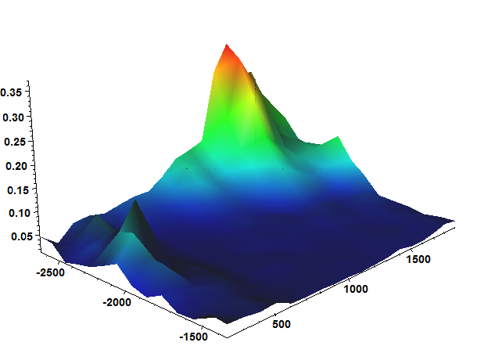
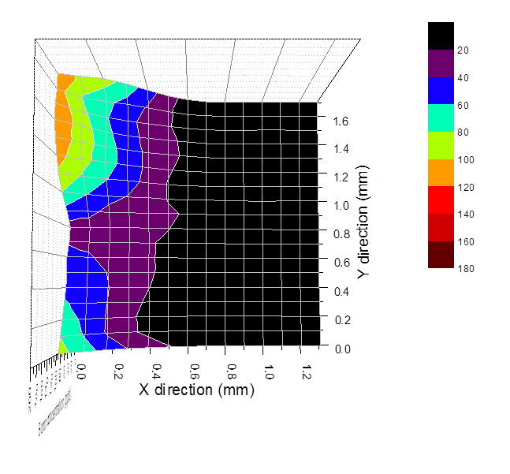

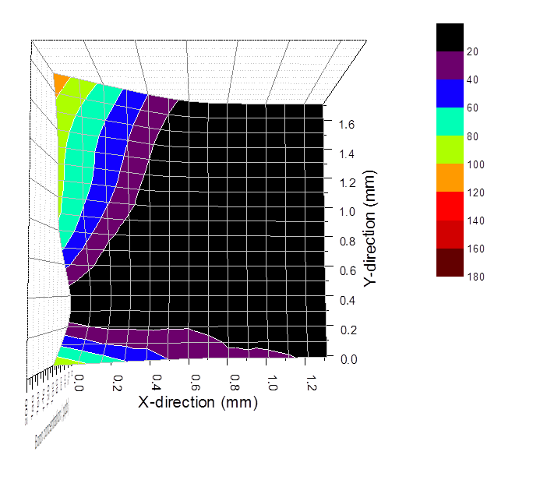
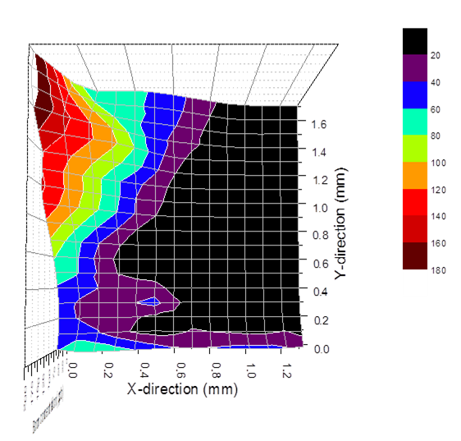
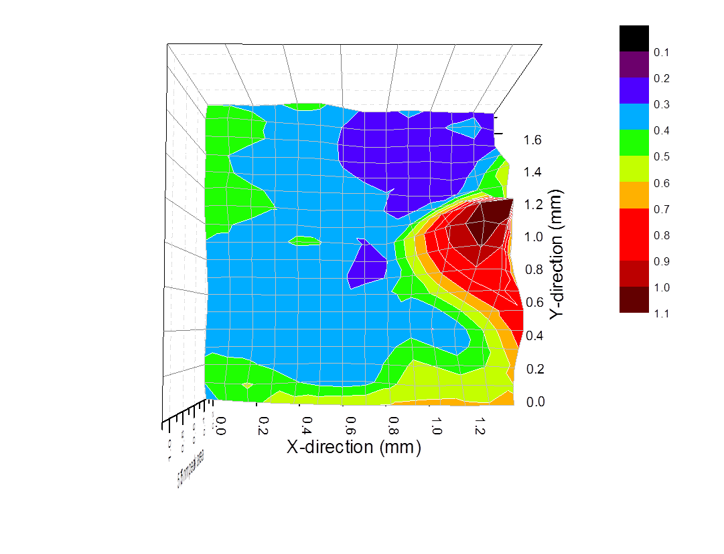
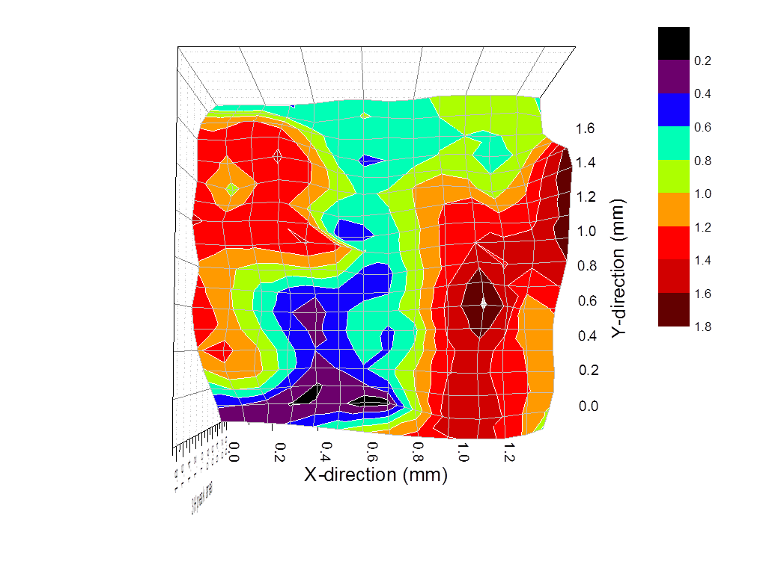
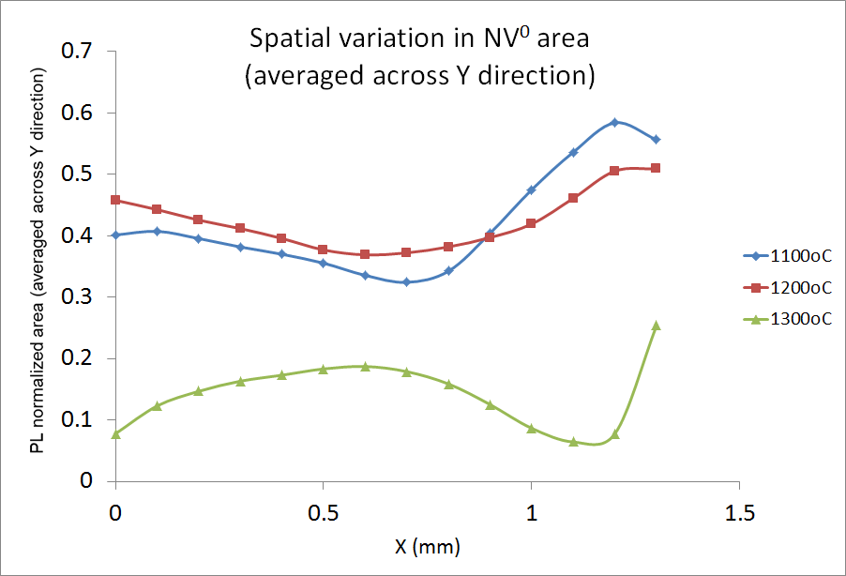
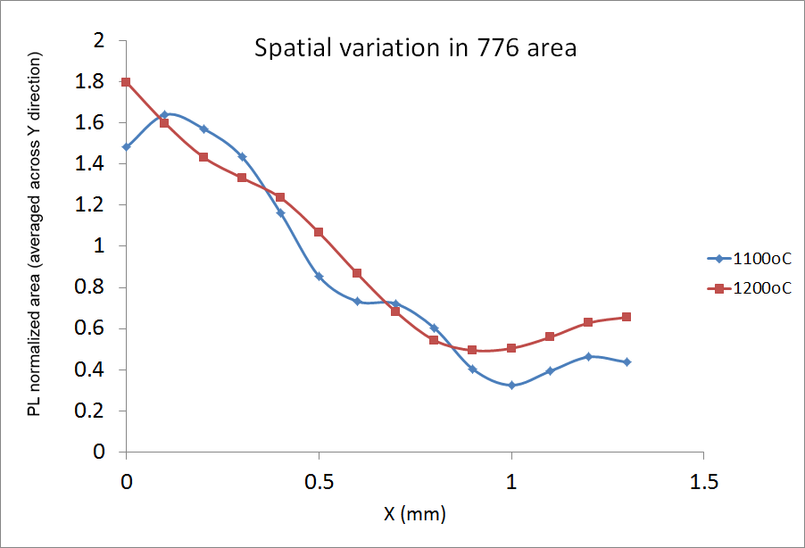
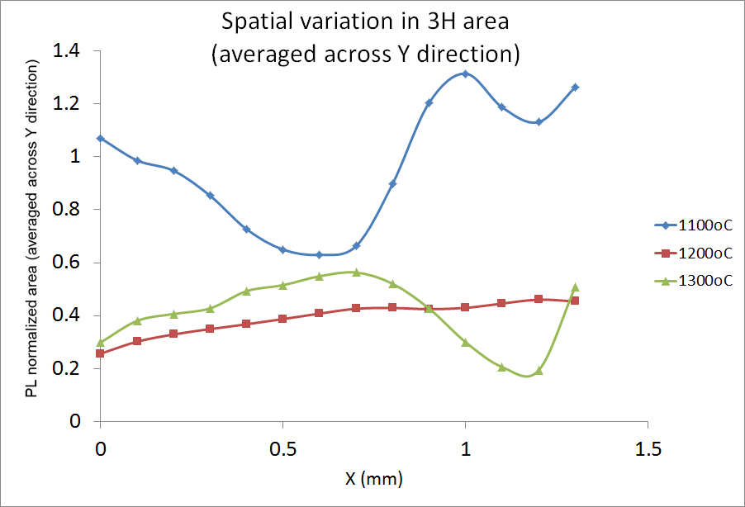
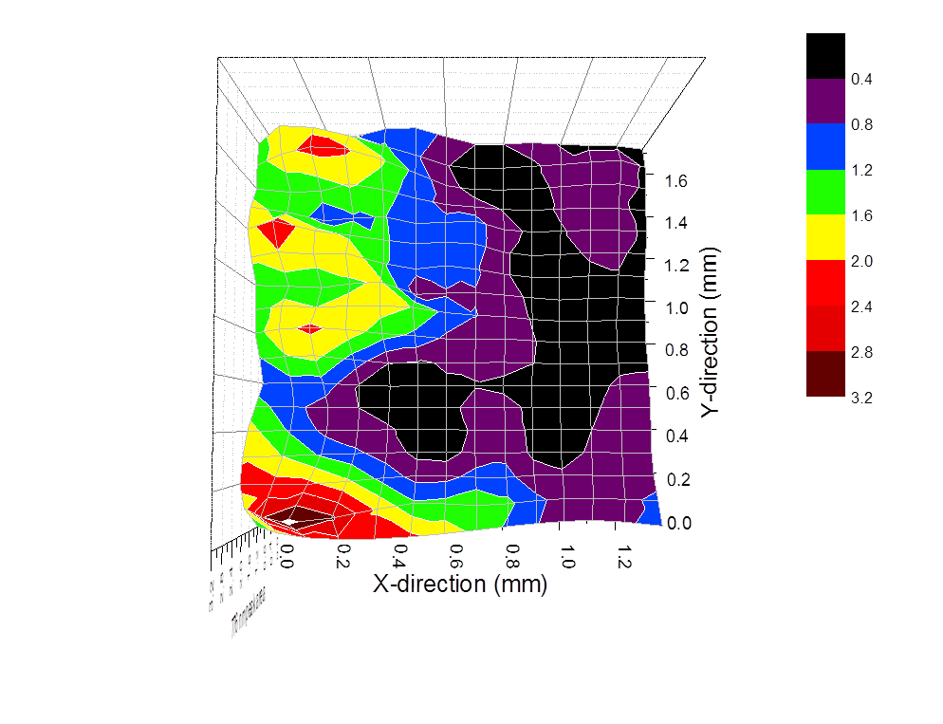
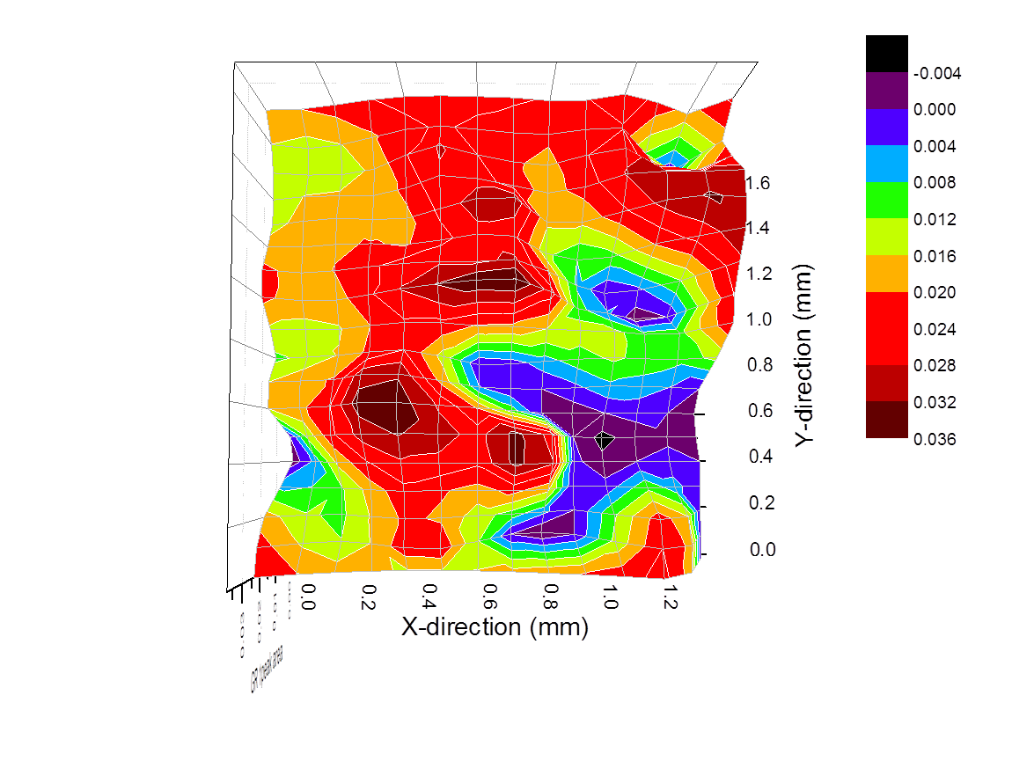
Spatial Distribution of Boron and PL Optical Centers
in Type IIb Diamond
Troy Ardon and Sally Eaton-Magaña
Gemological Institute of America, Carlsbad, California
This study gives a detailed analysis of the spatial distribution of optical centers within a IIb diamond. Using the mapping functionality of an infrared microscope, we profiled the boron distribution of a rough type IIb diamond. The thin plate allowed transmission IR spectra to be collected at 100 μm intervals across a 1.3 mm X 1.7 mm area. Photoluminescence (PL) spectroscopy using 488 nm and 514.5 nm lasers was also collected at analogous locations so that PL-activated centers including the 3H (503.5 nm), NV⁰ (575 nm), GR1 (741.2 nm) and the currently unknown peak at 776.4 nm could be chronicled as well. Visible features on the rough diamond along with a scale bar on the PL microscope helped coordinate data collection from PL at identical locations as FTIR. A high temperature annealing study was also done to see the changes in concentrations. The sample had been previously annealed to 1100ºC, so the study started from that point. The sample was annealed twice and the spectral maps recollected to see the effects on distribution of defects. The FTIR microscope proved to be a powerful tool for correlating known defects with known and unknown PL peaks. The advantage of using different points on a single sample is that one is assured that all the points have been through roughly the same set of conditions.
Initial Mapping
Annealing
1100ºC
1200ºC
1300ºC
To the left is the initial map of boron concentration taken. An area of 1.3 mm X 1.7 mm was chosen that allowed the best transmission of infrared light. The FTIR microscope took 252 evenly spaced spectra on a grid with 100 microns between adjacent points. Analysis of the boron peak at 2804 cm⁻¹ allowed the concentration of uncompensated boron to be determined using an established method.¹ As can be seen, a noticeable gradient of high concentration on the left to low concentration on the right is present.
PL spectra was collected along the same map to attempt to find correlations. The color bars indicate peak areas, which indicates concentration.
Boron Concentration (ppb)
Shown above are the boron concentration maps after periods of annealing. As stated, 1100ºC was a previous annealing temperature and considered the starting point. The sample was heated to 1200ºC for one hour, data was collected, and then the sample was heated to 1300ºC for one hour and data was recollected. In the upper-left of the sample region, one can see that the concentration profile decreased slightly from 1100ºC to 1200ºC. However, when heated to 1300ºC, the concentration increased from 120 ppb to over 180 ppb. It is important to note that this does not speak to the concentration of boron alone, but of uncompensated boron. Boron exists as a p-type defect, and could be compensated by any number of negatively charged defects. The uncompensated boron defect concentration changes for two competing mechanisms, the diffusion of boron through the lattice and the annealing out of compensating defects.
575 nm peak area (normalized to Raman area)
3H peak area (normalized to Raman area)
The 575 peak is known to be a neutral N-V defect. It can be seen to have an inverse concentration gradient to boron concentration.
The 3H peak is accepted to be an interstitial carbon defect and has a valley-type concentration gradient. This may be due to the 3H correlating with vacancy related defects like the 575 and 776.
776 nm peak area (normalized to Raman area)
GR1 peak area (normalized to Raman area)
The PL data was recollected over the map after each annealing. As the boron concentration and PL features tend to vary (in this instance) more significantly in the x-direction, a useful analytical procedure was to average the data over the y-direction, as above. The NV⁰ center showed an inverse gradient to the boron concentration, and the data above shows the preservation of that gradient after heating to 1200ºC. Upon heating to 1300ºC, the gradient was deformed and the overall area of the NV⁰ center was decreased. The 776 defect showed little change in either gradient or overall peak area from 1100ºC to 1200ºC, but was completely annealed out after 1300ºC. Whether the annealing of this peak is related to the increase in uncompensated boron is unknown. The 3H shows the unique valley structure at 1100ºC, then seems to even out 1200ºC, and then shows further annealing at 1300ºC. The GR1 was mostly annealed out at 1200ºC, and fully annealed out at 1300ºC. The GR1 spatial variation is not shown.
The 776 peak has a similar concentration gradient as boron. The 776 peak is suspected to be a
[B-V] complex.
The GR1 is a single vacancy and since this sample has been previously annealed it is not present in high concentration. It does appear to have an inverse spatial relationship with the 3H peak.
References
Fisher D., (2009) Brown colour in natural diamond and interaction between the brown related and other colour-inducing defects. J. Phys,: Condens. Matter 21 pp. 1-9

