Slide 1
The Public Health Implications of Hydraulic Fracturing
David O. Carpenter, MD
Institute for Health and the Environment
University at Albany

Slide 2
What Are the Risks?
Risks to human health:
a. Air contamination with volatile organic compounds (VOCs).
b. Respiratory disease from particulates in diesel exhaust
c. Radioactive materials in flow-back fracking fluid
d. Chemical contamination of ground and drinking water
e. Noise and light pollution.
Risks to society:
a. More HIV and sexually-transmitted disease.
b. Pressure on housing, schools and culture.
c. More crime likely.
Risks to the environment:
a. Harm to roads and bridges from truck traffic.
b. Depletion and/or contamination of drinking and other water resources.
c. Increase release of methane promoting climate change

Slide 3
Occupational Risks to Workers
Inhalation of silica particles
Inhalation and dermal absorption of VOCs
Inhalation of diesel exhaust particulates
Exposure to fracking chemicals
Exposure to ionizing radiation
Damage to hearing from excessive noise

Slide 4
Gaseous Releases with Natural Gas
Volatile organic compounds (VOCs): Many including methane, benzene, methylbenzenes, ethylbenzene, xylene, pentane, hexane, toluene, 1,3-butadiene and a variety of aliphatic hydrocarbons.
Formaldehyde.
Hydrogen sulfide.
Radon.
All of the above have adverse health effects on humans.

Slide 5
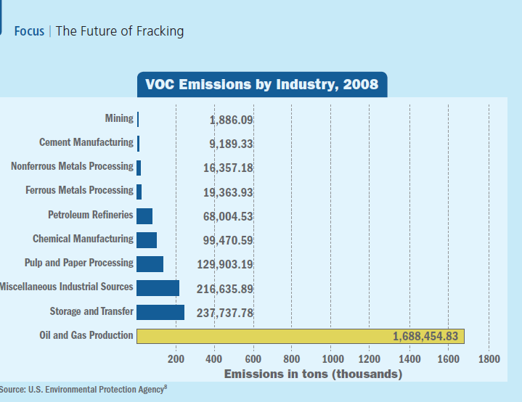

Slide 6
Air Pollution Causes Cancer!
The World Health Organization has just declared outdoor air pollution to be a Group 1, known human carcinogen.
Benzene , formaldehyde and radon are already identified as being Group 1, known human carcinogens.
Even if health effects are known for exposure to one environmental contaminant, the effect of being exposed to multiple contaminants is uncertain. Co-exposure may have an additive effect or even a synergistic effect.
Cancer has a long latency and effects may not appear for years.

Slide 7
Air Pollution Causes Other Diseases as Well
Both particulate and VOC air pollution cause increased risk of asthma, respiratory infections and chronic obstructive pulmonary disease.
Immediate health effects include headaches, dizziness, eye, nose and throat irritation, visual disorders, memory problems, fatigue, nosebleeds
Silica causes silicosis, a restrictive lung disorder.
Some VOCs are endocrine disruptors.
Others cause liver or kidney damage.

Slide 8
Other Human Health Effects of VOCs
Occupational studies report three levels of severity of VOC exposure on the brain and behavior:
Organic affective syndrome: Depression, irritability
Mild chronic toxic encephalopathy: Fatigue, mood disturbances, memory and attention complaints.
Severe chronic toxic encephalopathy: Loss of intellectual abilities, impaired judgment and memory, personality changes

Slide 9
Formaldehyde
Monitoring at a pipeline compressor station in Lake Arlington, Fort Worth, TX measured very large short-term concentrations of formaldehyde
Formaldehyde is a carcinogen that causes nosebleeds, vomiting, skin irritation, and respiratory effects
Formaldehyde exposure increases risk of asthma in young children
It can also contribute to rapid ozone formation

Slide 10
Ozone
Studies have shown that ozone cause inflammation of the respiratory tract and increases risk of asthma attacks.
Ozone combines with VOCs to form smog.
Colorado, Wyoming, Texas and Utah have all recorded ozone levels that exceed federal limits.
Wyoming and Utah have ozone measurements higher than the worst days in Los Angeles.
May be difficult for some areas to meet the federal limits until new regulations go into effect limiting flaring and requiring “green completion” technology.

Slide 11
Particulate Matter
Particulate matter (PM) comes from diesel exhaust from machinery and trucks, dust from gravel roads.
Prenatal exposure to PM has been associated with low birth weight.
Exposure during pregnancy and first year of life has been associated with increased risk of autism.
Elevated PM increases risk of asthma and respiratory symptoms, such as coughing, difficulty breathing, and respiratory infections.
People with underlying cardiovascular disease are at greater risk of death on days with elevated particulate air pollution.

Slide 12
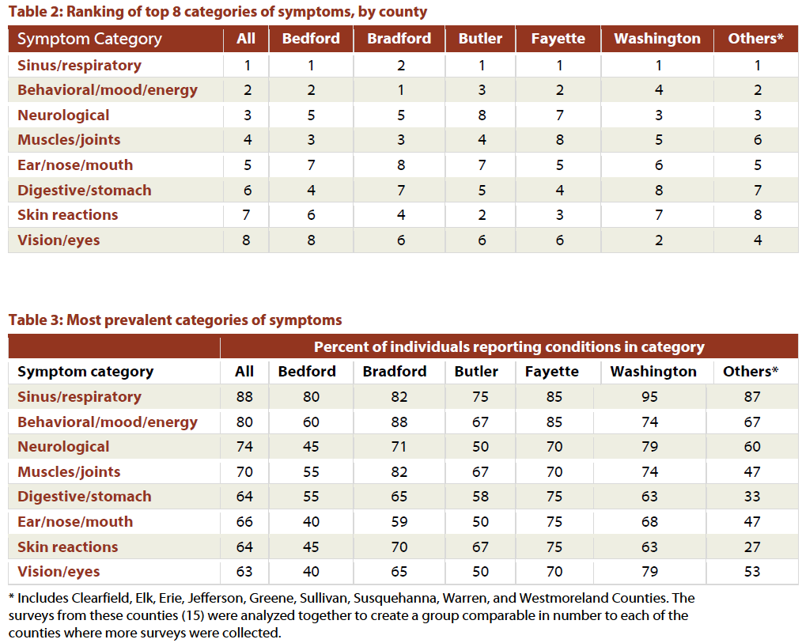

Slide 13
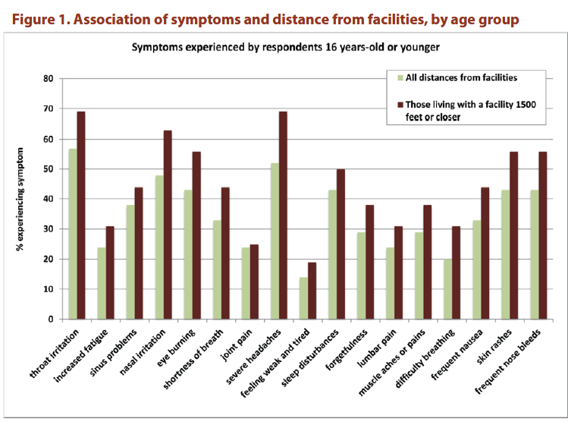

Slide 14
Radium 226 and 228
Radioactive elements like uranium, thorium and radium occur naturally in rock, but are at higher concentrations some places than others. This is a particular concern in the Marcellus Shale.
While radium is water soluble, thorium and uranium are less soluble but can come to the surface as drilling waste during fracking and concentrate in pit sludge.
Radium behaves similarly to calcium, and can bioaccumulate in human bones and teeth and can lead to bone and other cancers like leukemia.
Radium decays to radon gas which can be inhaled and result in lung cancer.

Slide 15
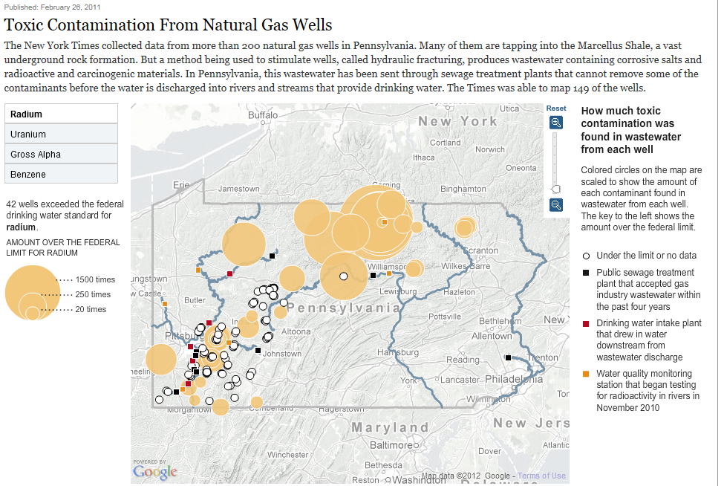

Slide 16
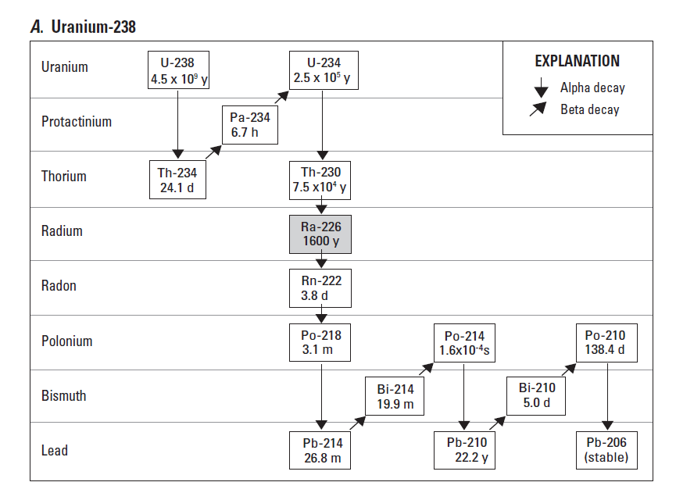

Slide 17
Radioactivity in Flowback Water
In 2011 the NY Times reported that of more than 200 gas wells in Pennsylvania, more than 170 were producing wastewater with high levels of radioactivity, with levels more than 100 times the federal drinking-water standard in 116, and more than 1,000 times higher in 15.
Some fracking brine has been found to be 300 times more radioactive than the NRC limit for industrial discharge to water from nuclear power plants.
Under federal law radioactivity is tested only in drinking water, but in Pennsylvania that is required only once every six or nine years!

Slide 18
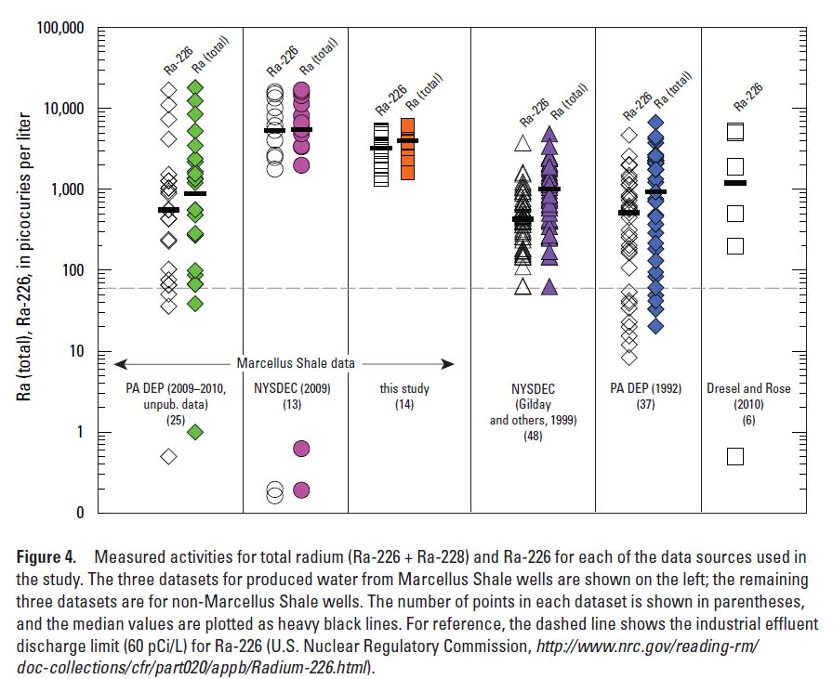

Slide 19
What is Being Done With Radioactive Fracking Fluids?
In Pennsylvania it is being spread onto roadways to reduce ice, since it contains high concentrations of salts. In most cases the level of radioactivity is not even being determined! The radioactivity will wash off the roadway into waterways and be partially retained by soils.
Some goes to waste water treatment plants.
Some is stored in containment ponds.
Some is injected into the earth.

Slide 20
Dangers to Humans from Wastewater Discharges
Some sewage treatment plants in Pennsylvania accepted fracking fluid with 2,122 times the radioactivity allowed in the drinking water standard. But they are not even required to test it.
Even if the radioactivity doesn’t get into drinking water, if discharged it can get into fish that people eat.

Slide 21
Radon as a Contaminant
Radon is a gas, and a product of decay of Ra-226. It has a half-life of 3.8 days. Radon levels in Pennsylvania gas samples ranged from 1-79 pCi/L (median 32 pCi/L), which is 8x higher than the EPA standard for indoor air.
M. Resnikoff calculated that radon from Marcellus Shale gas pipelines and being released by natural gas burned in homes in New York may result in between 1183 and 30,484 new cancer cases.
Smokers are at higher risk of lung cancer due to synergistic effect of radon and smoking.
One solution is to store natural gas for a period before sending it down the pipe.

Slide 22
Regulations - Radioactivity
Neither EPA nor NRC regulate radioactivity coming from the oil and gas industries. The only federal regulations is by DOT which governs transport of radioactive materials.
NORM are exempt under the Resource, Compensation and Recovery Act, which results in their not being listed under the Comprehensive Environmental Response Compensation and Liability Act.
EPA does regulate radioactivity in drinking water, but does not regulate radionuclide emissions generated by the oil and gas industries.

Slide 23
How Likely is Ground Water Contamination?
The fracking is done much deeper than ground water. But the danger lies in damage to the concrete linings of the well.
There are high levels of hydrogen sulfide in fracked gas. Hydrogen sulfide degrades concrete in addition to being toxic to humans.
Sooner or later that concrete will degrade and leaks will occur at depths associated with ground water. The result will be contamination with chemicals and radiation.
We don’t even know what the chemicals used are. Colborn et al. (2011) identified 632 different chemicals used at different sites.

Slide 24
Noise and Light Pollution
In interviews with residents in areas where fracking is ongoing one of the most common complaints is noise and light pollution. Drilling a mile down through rock is very noisy, and goes on 24/7. When operation is ongoing there are diesel trucks 24/7. There are bright lights 24/7 during this whole period.
Noise and light pollution cause stress, increase risk of heart disease and cause sleep disruption.

Slide 25
Summary:
There are a number of serious potential adverse health effects associated with fracking if it is not done safely.
The most serious long term danger is cancer from VOCs like benzene and formaldehyde and from radioactivity.
VOCs at concentrations seen even at some distances from franking wells have serious effects on the nervous system, and alter other physiological functions as well.
Radium pollution poses long-term health hazards.
Drinking water supplies, while not greatly threatened, must be protected from chemicals and radi0activity.

Slide 26
