Slide 1
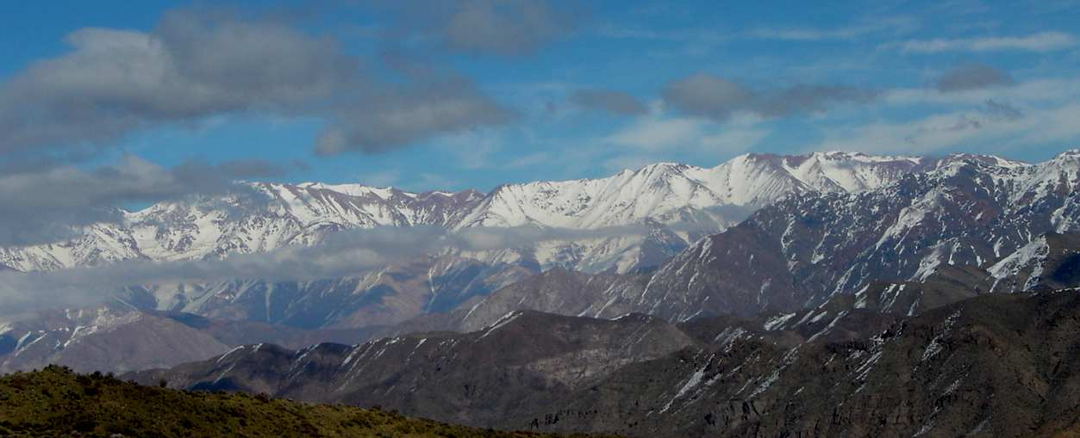


Connection between deep and shallow deformation during the upper Cenozoic tectonic evolution of the Southern Central Andes:
Insights from kinematic models with thermomechanical constraints
Laura Giambiagi
José Mescua
Andrés Tassara
Mendoza, Argentina
Concepción, Chile

Slide 2

IGCP 658Y “Geodynamic processes in the Andes of central Chile and Argentina”
Alvarez, Pamela (TEHEMA, Chile)
Bechis, Florencia (Universidad Nacional de Río Negro-CONICET, Argentina)
Carretier, Sebastian (IRD-Universidad de Toulouse, Francia)
Farías, Marcelo (Universidad de Chile , Chile)
García, Víctor (Universidad Nacional de Río Negro , Argentina)
Giambiagi, Laura (IANIGLA-CONICET , Argentina)
Godoy, Pirzio (TEHEMA, Chile)
Hoke, Greg (Syracuse University USA)
Jara, Pamela (Universidad de Chile , Chile)
Lossada, Ana (IANIGLA-CONICET, Argentina)
Mahoney, Brian (Wisconsin –Eau Claire- USA)
Mescua, José (IANIGLA- CONICET , Argentina)
Moreiras, Stella (IANIGLA- CONICET , Argentina)
Naipauer, Maximiliano (Universidad de Buenos Aires , Argentina)
Pérez, Daniel (Universidad de Buenos Aires , Argentina)
Pinto, Luisa (Universidad de Chile , Chile)
Porras, Hernán (Universidad de Chile , Chile)
Rodríguez, María Pia (Universidad de Chile , Chile)
Sagripanti, Lucía (Universidad de Buenos Aires , Argentina)
Sepúlveda, Sergio (Universidad de Chile , Chile)
Spagnotto, Silvana (Universidad Nacional de San Luis , Argentina)
Suriano, Julieta (Universidad de Buenos Aires , Argentina)
Tapia, Felipe (Universidad de Chile , Chile)
Tassara, Andrés (Universidad de Concepción , Chile)
Toural, Rafael (IANIGLA- CONICET , Argentina)
Tunik, Maisa (Universidad Nacional de Río Negro-CONICET) , Argentina
Yagupsky, Daniel (Universidad de Buenos Aires-CONICET , Argentina)
International Geoscience Programme IUGS
Cortical and
Lithospheric
deformation
]
Modeling
Topographic
uplift
Surface
processes

Slide 3
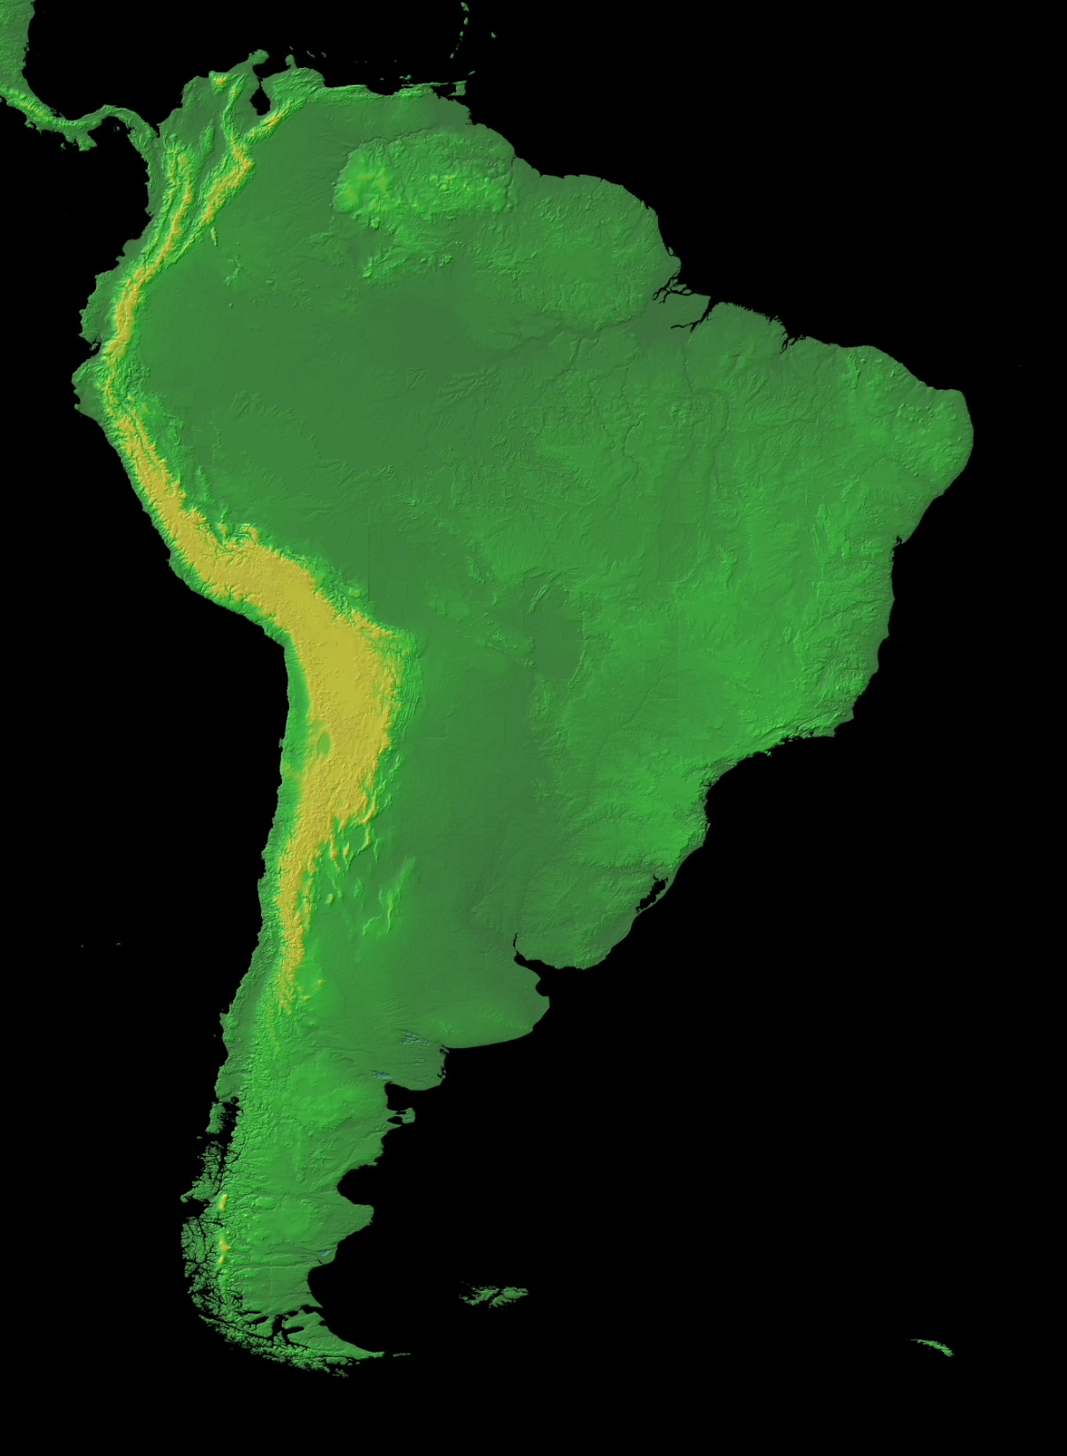
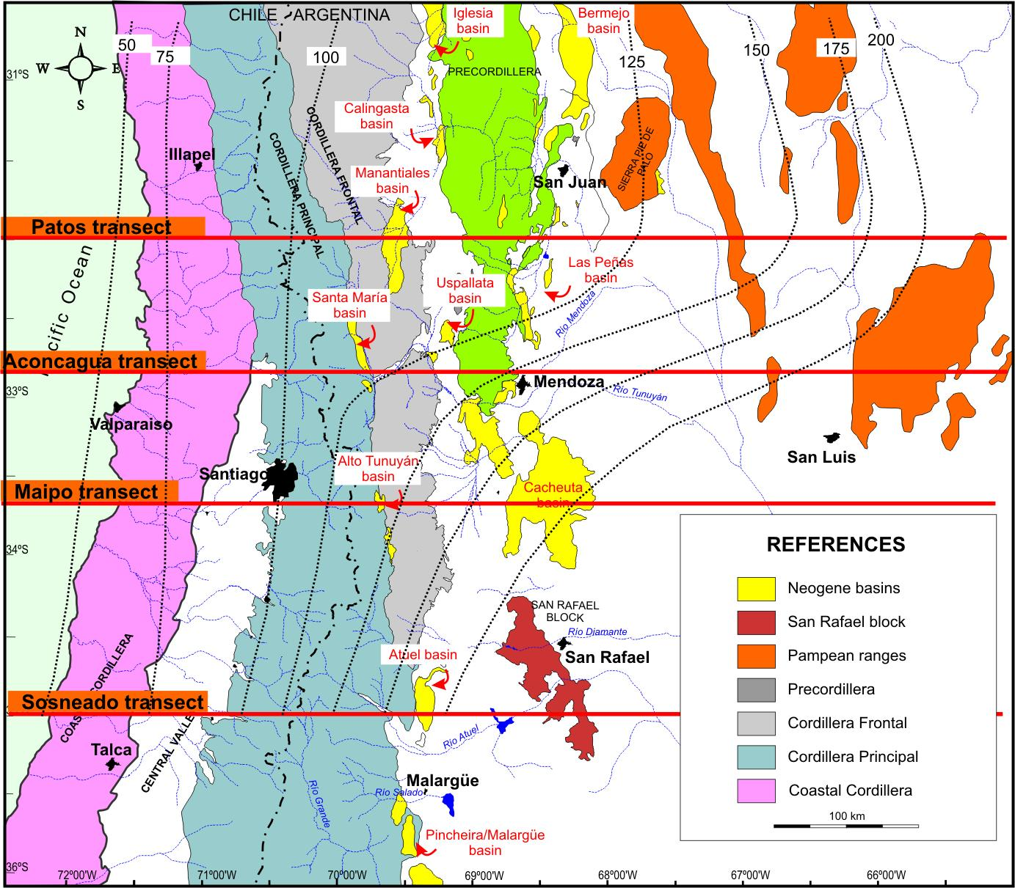
Purpose: to propose integrated kinematic models with thermomechanical constrains for the Southern Central Andes (30°-36°S), that accounts for the great amount of geological and geophysical studies carried out by numerous authors
The southern Central Andes

Slide 4
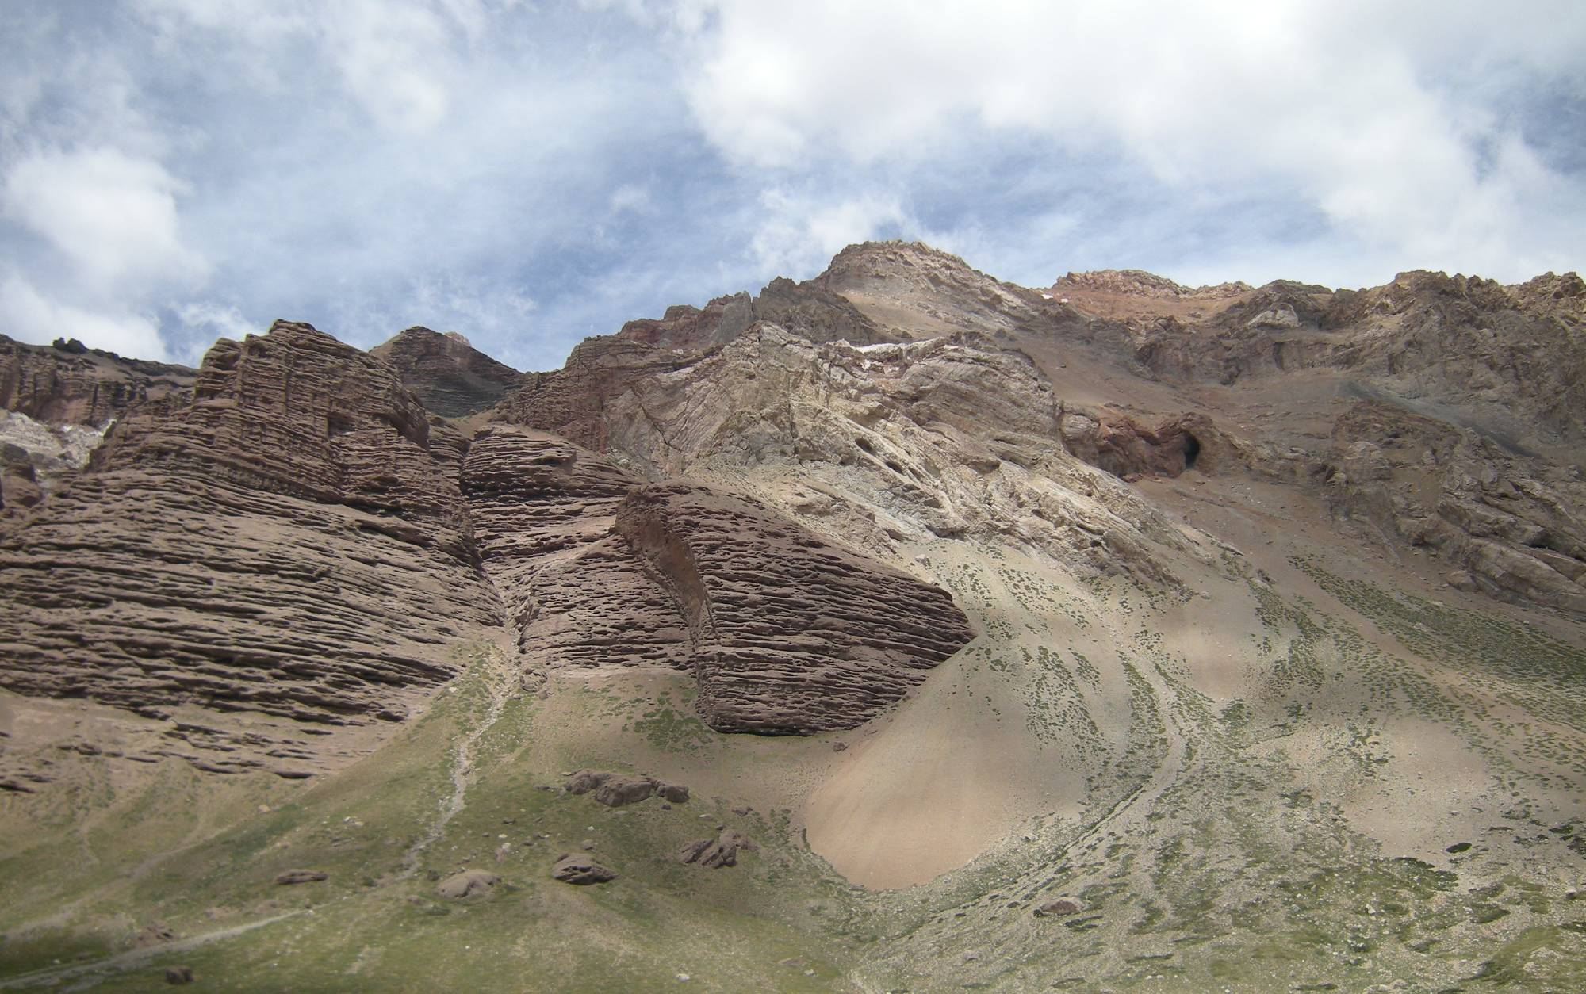
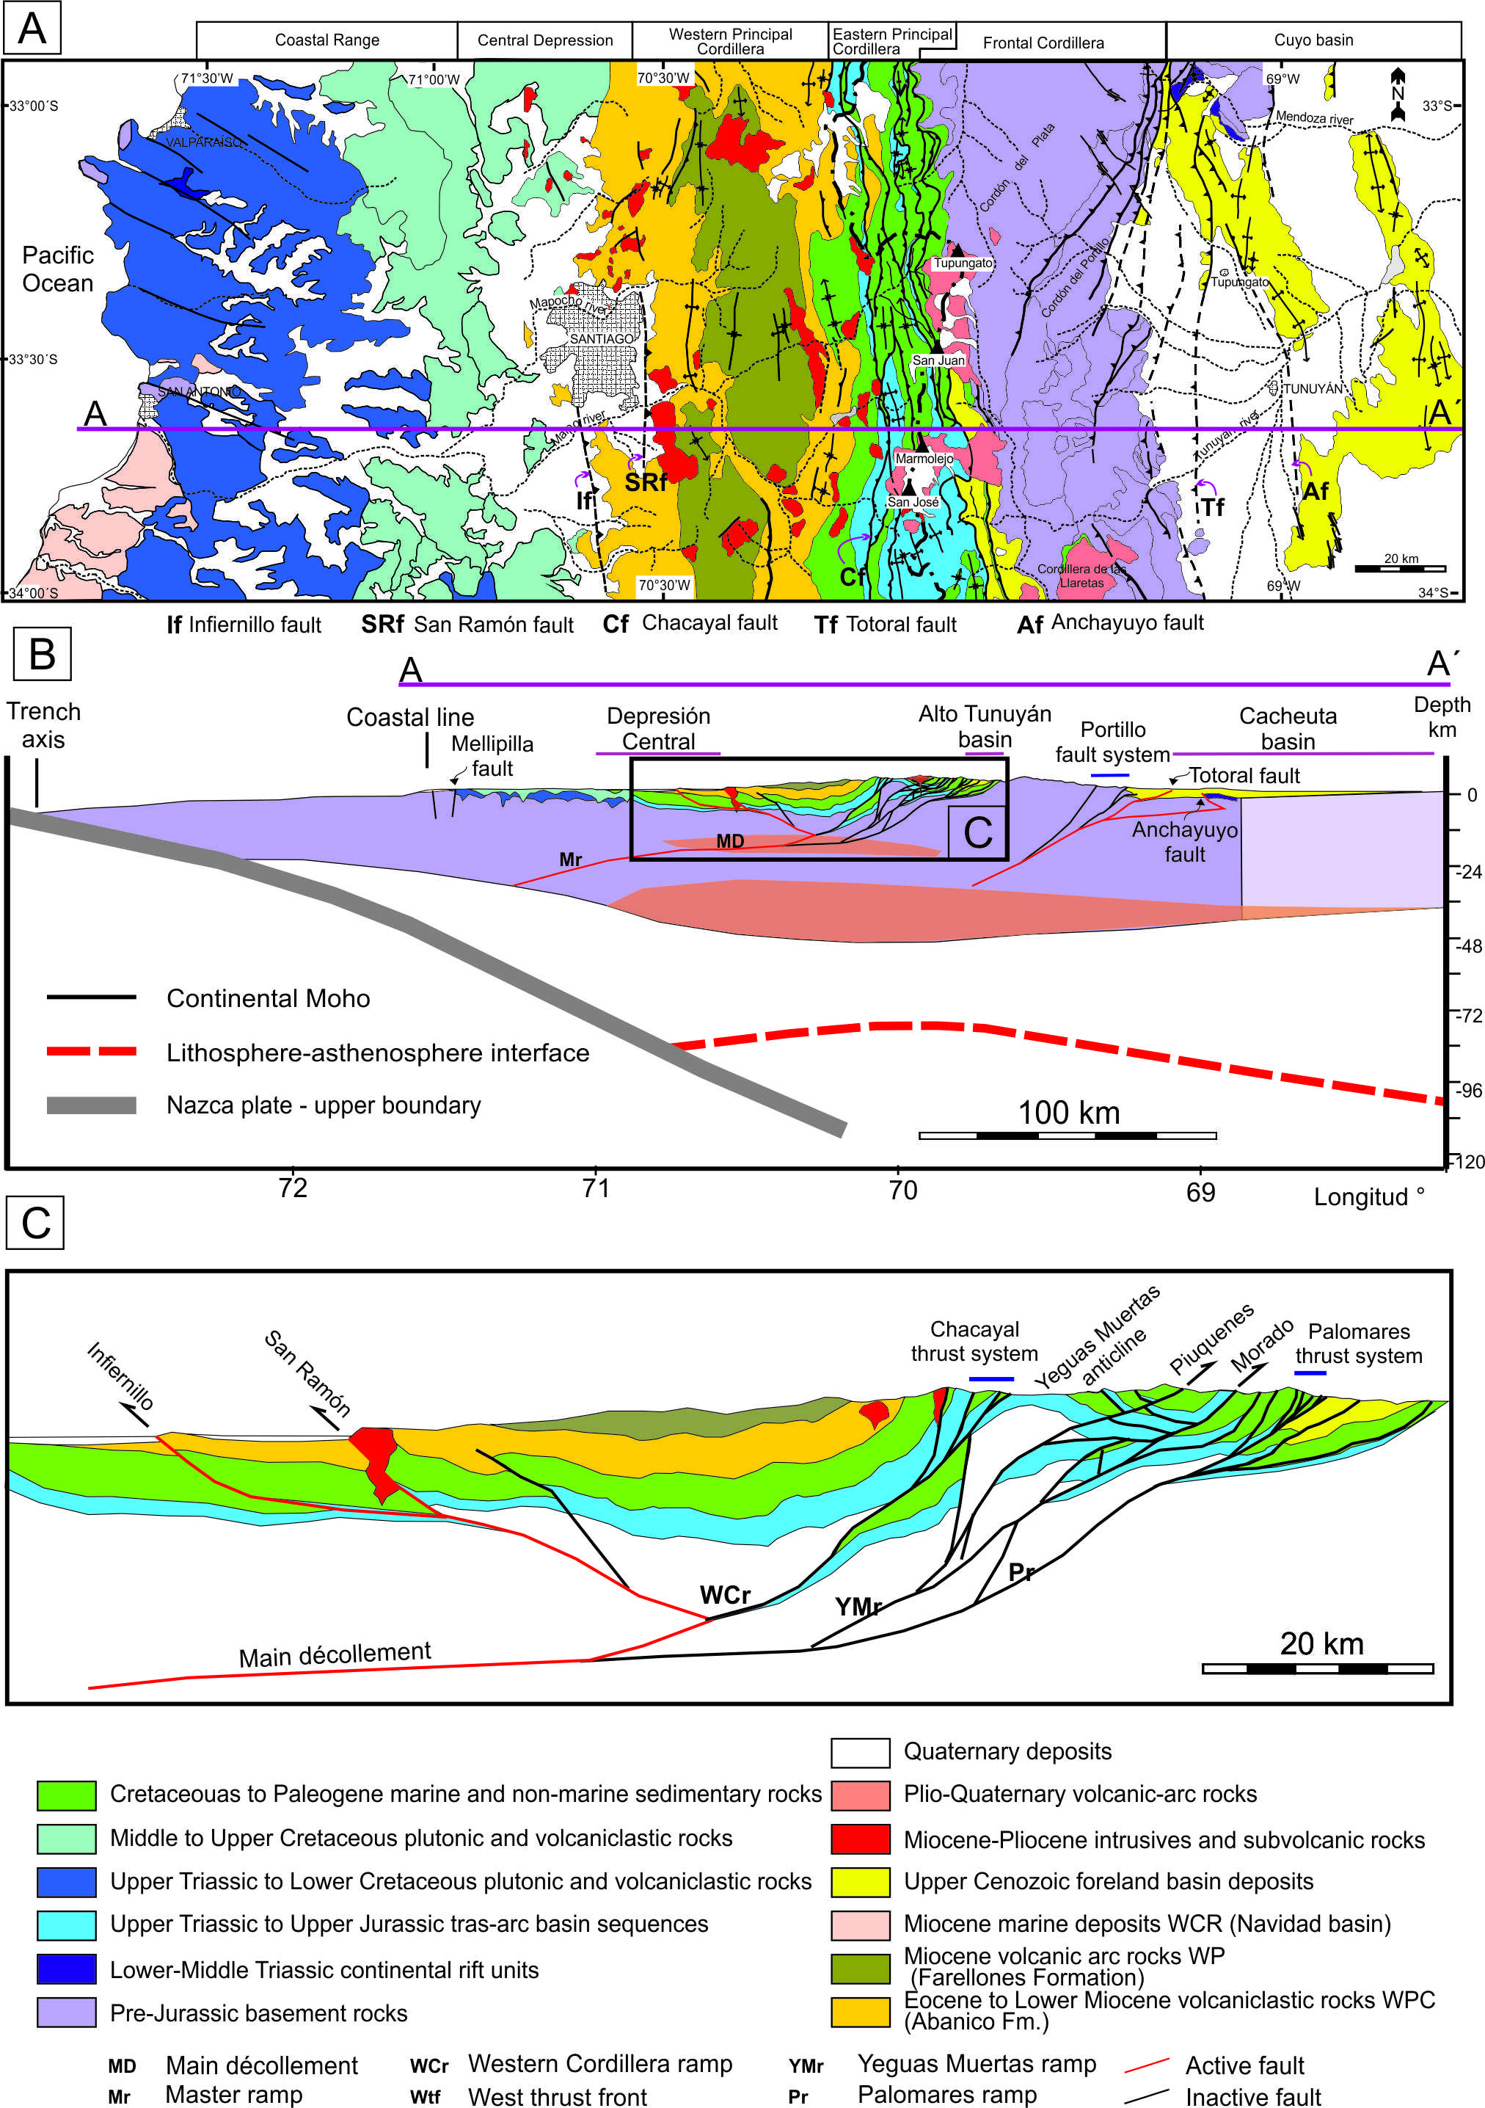
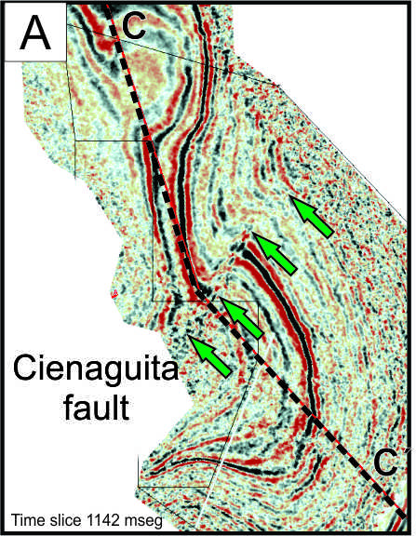
Methodology
Geological & Structural mapping
Sub-Surface data

Slide 5
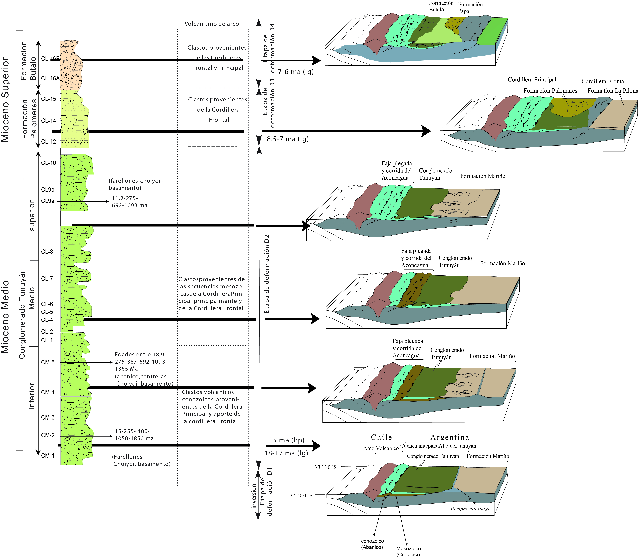
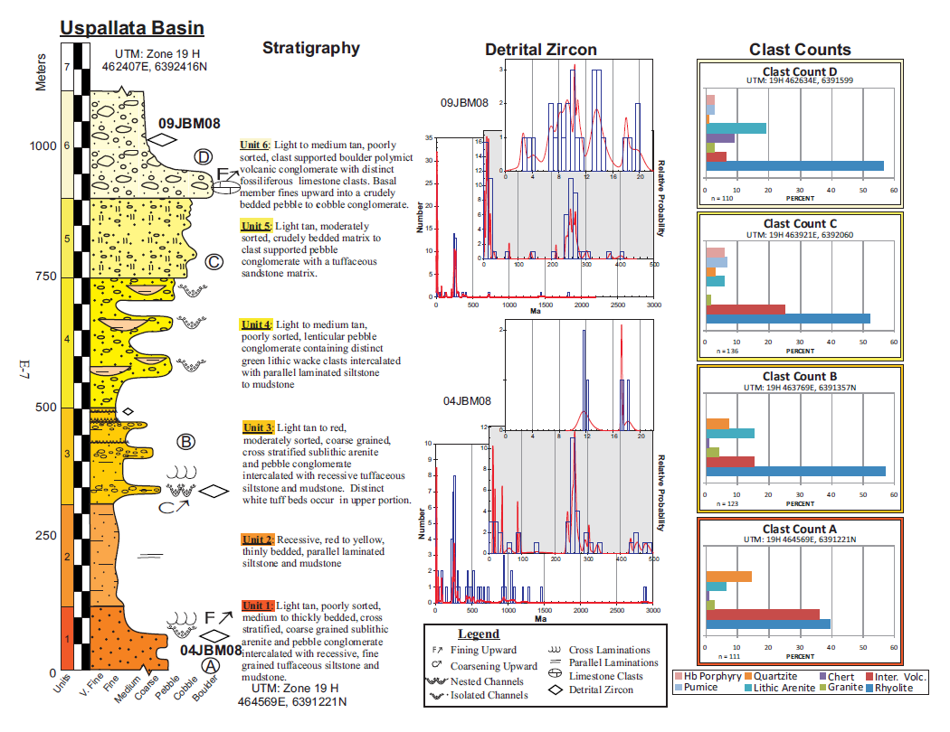
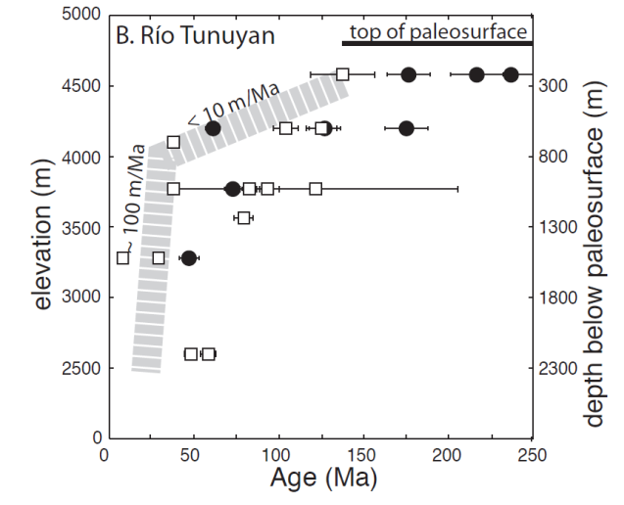
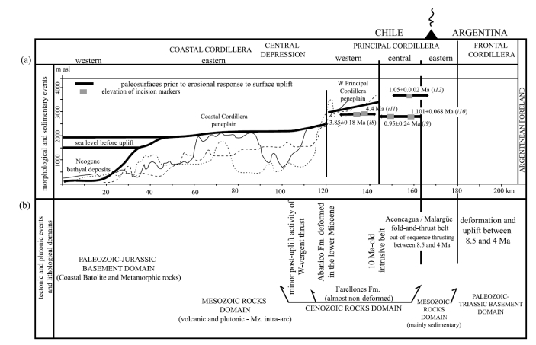
Alto Tunuyán intermontane basin
provenance studies (conglomerates & sandostones); geochemistry of sediments
heavy minerals analysis/ detrital Zircon analysis
Radiometric dating
U-Pb/He- AFT thermochronology
Cacheuta foreland basin
Mahoney and coworkers
(NSF project)
Porras (2013) &
Giambiagi (2000)
Farías et al (2008)
Hoke et al (in press)

Slide 6
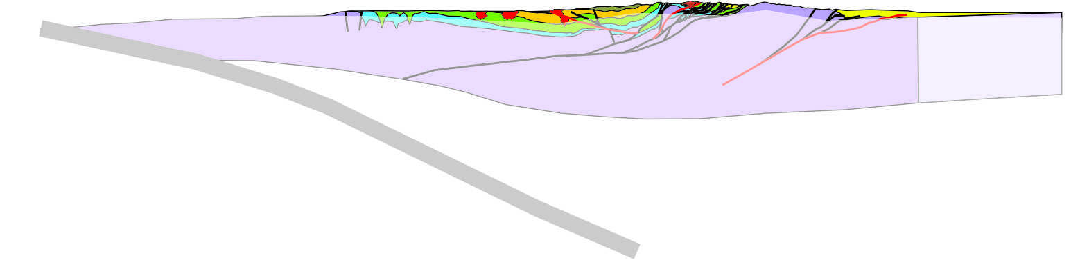
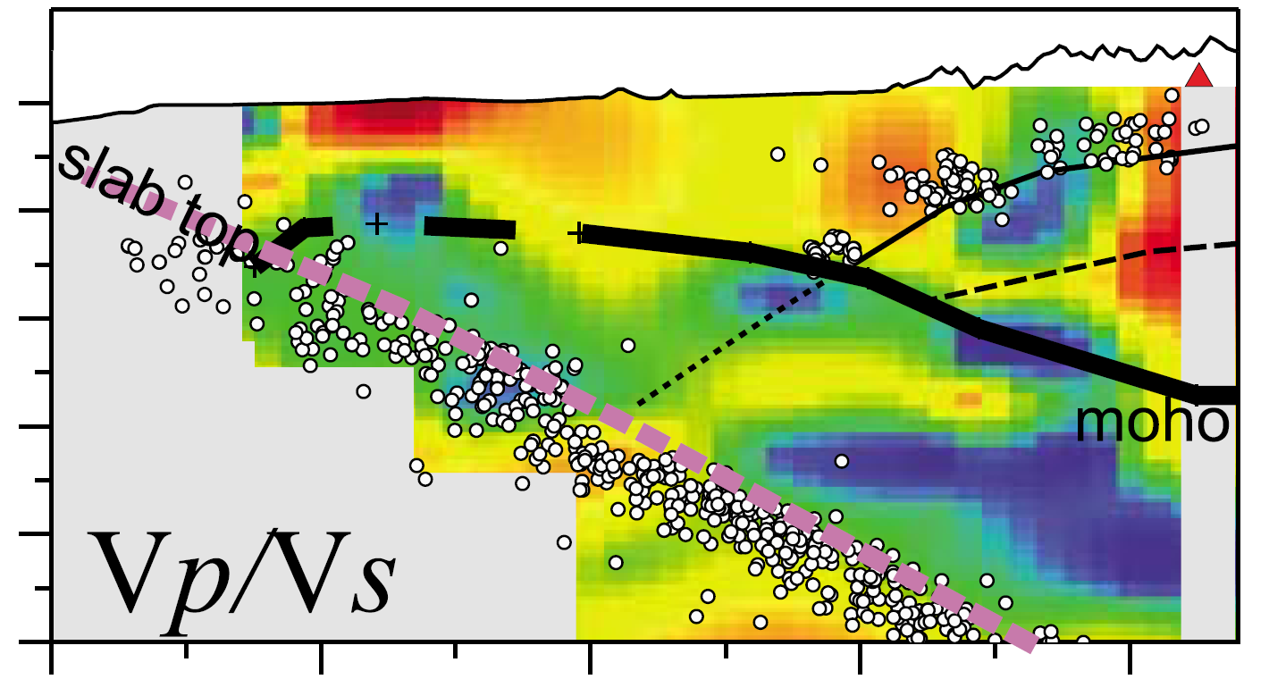
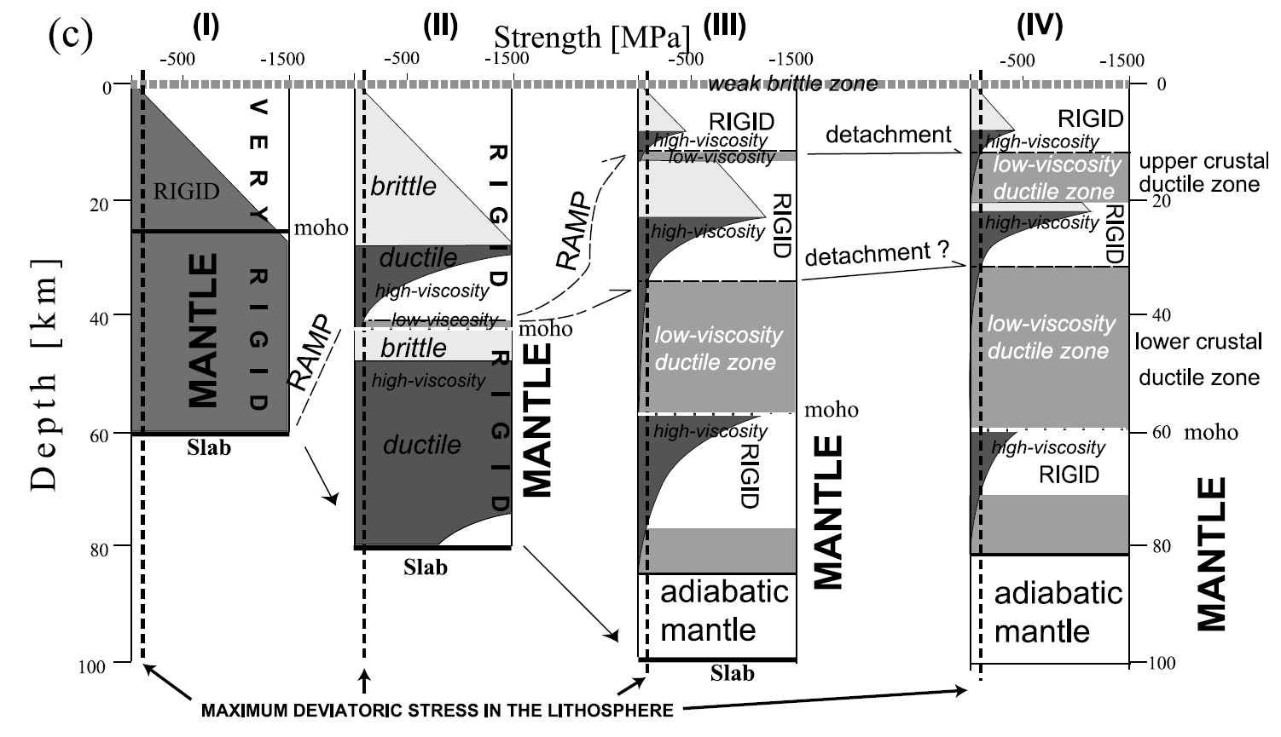
Methodology
Seismic tomography
Mechanical modeling with yield strength envelope
Farías et al. (2010)

Slide 7
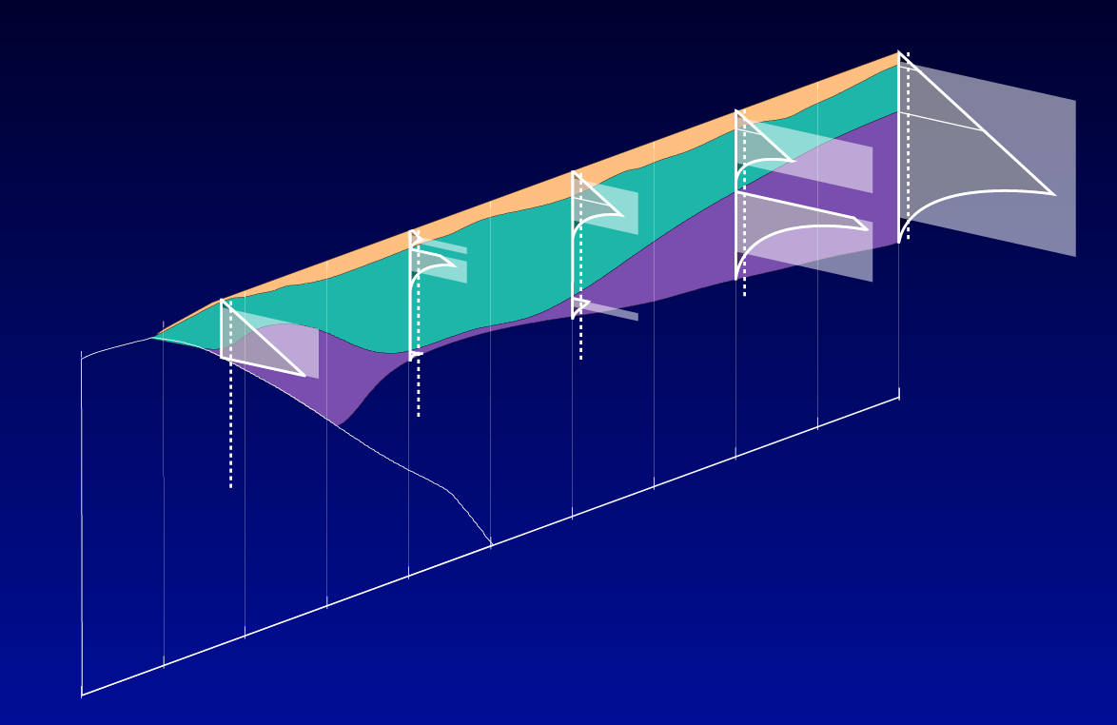
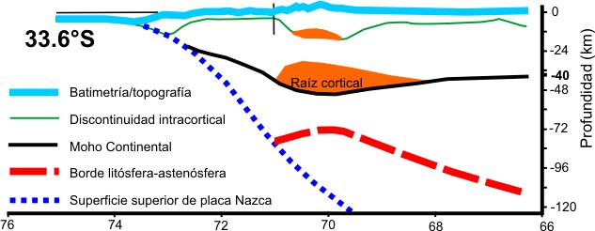
Methodology
+ constant compressive stress (250 MPa) = Rheological model
Identify ductile zone
Thermomechanical modeling
Based on 3D density model of Tassara y Echaurren (2012)
+ 3D thermal model of Tassara y Morales (2013)
Ductile zones
Constrain the expected mechanical structure of the lithosphere

Slide 8
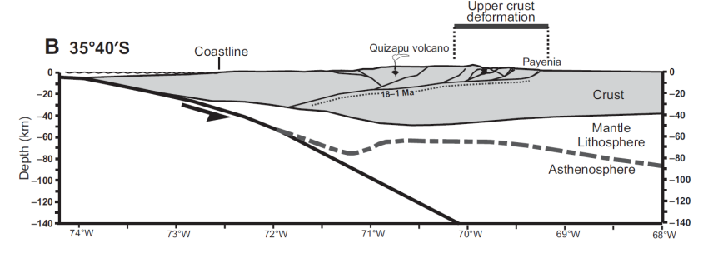
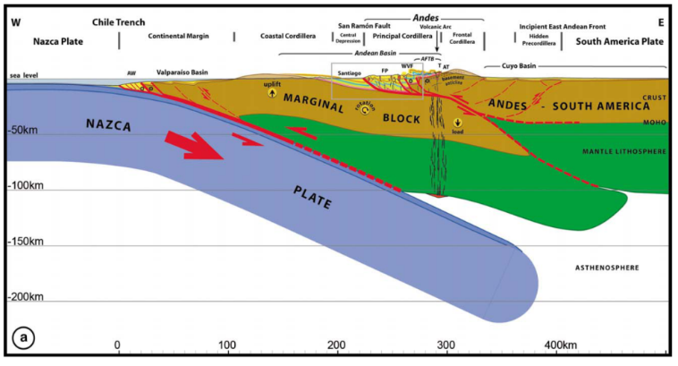
Kinematic modeling: problems
Proposed models Southern Central Andes (30-36°S)
33°30´S
32°S
Farías et al (2010)
Cristallini et al. (1997)
35°30´S
33°S
Giambiagi et al. (2012)
Ramos et al., 2004
33°30´S
All models – except Armijo´s - proposed
the existence of a west-dipping
master detachment
Armijo et al. (2010)

Slide 9
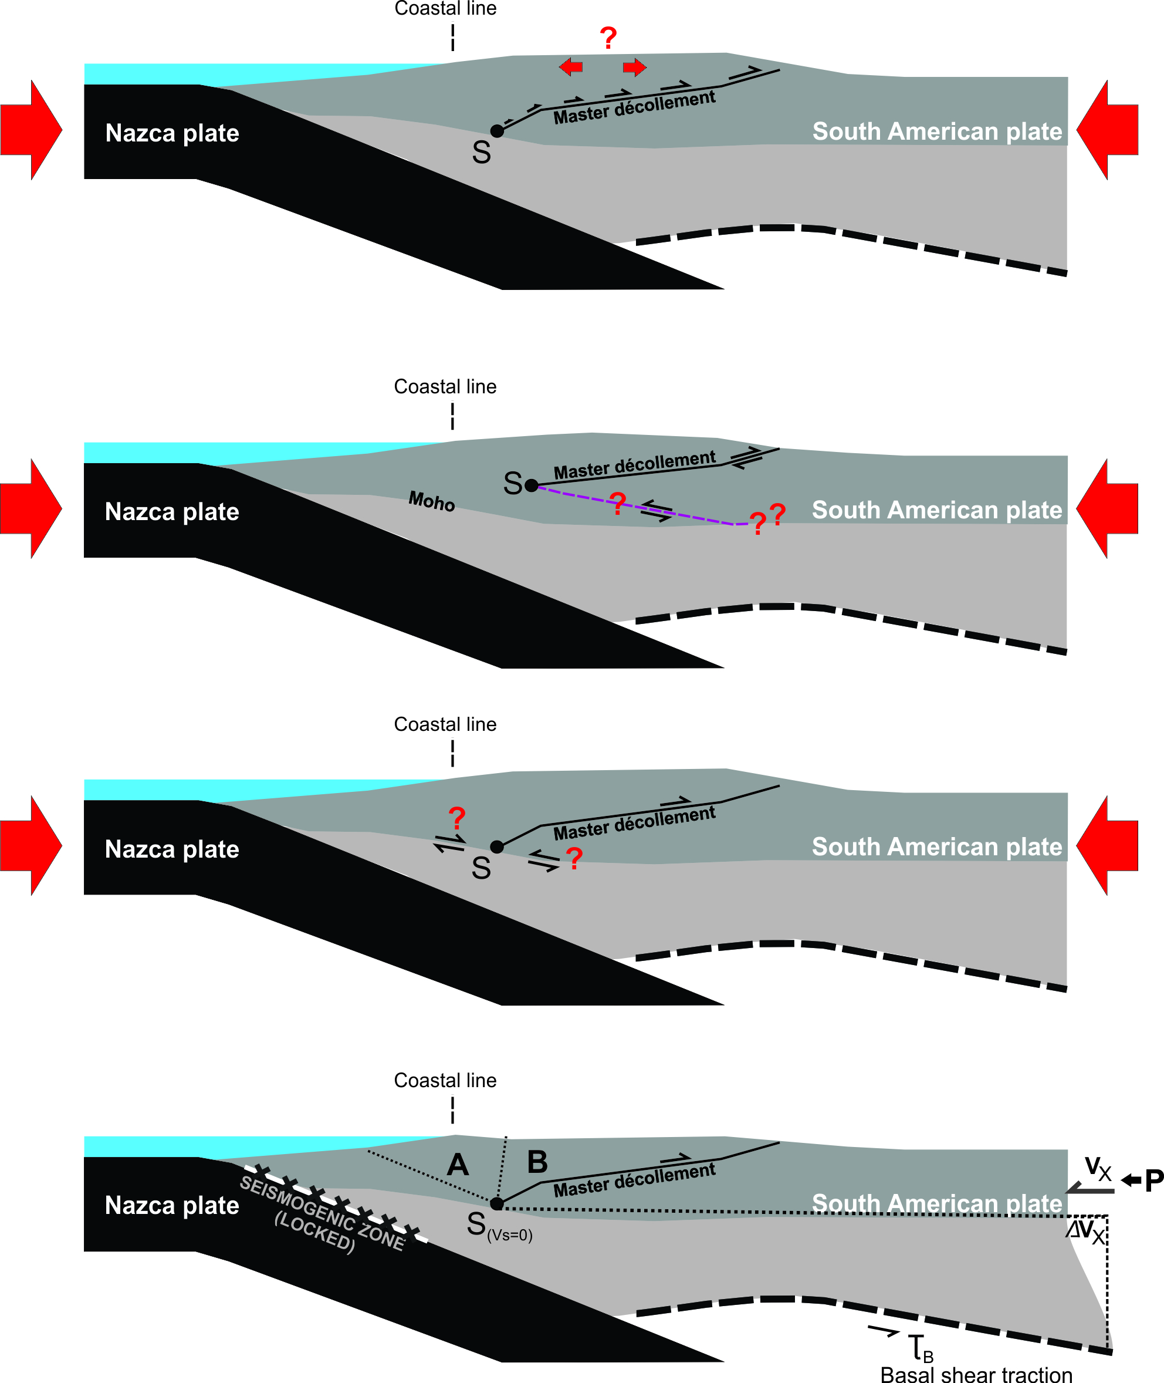
Kinematic modeling: problems
Proposed models
32°}s
32°S
Are they kinematically and mechanically feasible?
Cristallini et al. (1997)
33°S
Ramos et al., 2004

Slide 10
Kinematic modeling: problems
Proposed models
Farías et al (2010)
Giambiagi et al. (2012)

Slide 11
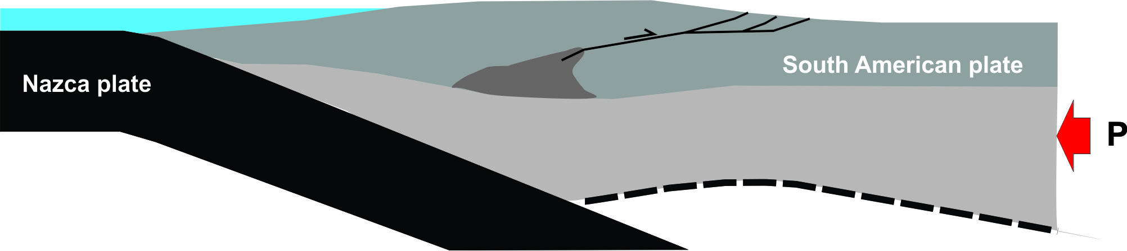
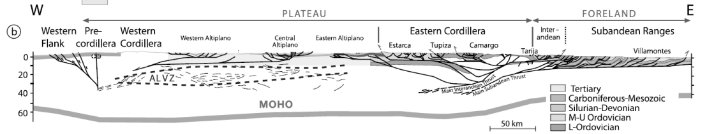
Kinematic modeling: problems
Another option, not proposed for the study latitudes, where the master decóllement roots into a ductile shear zone in the lower crust
Elger et al. (2005)
Lamb (2011)

Slide 12
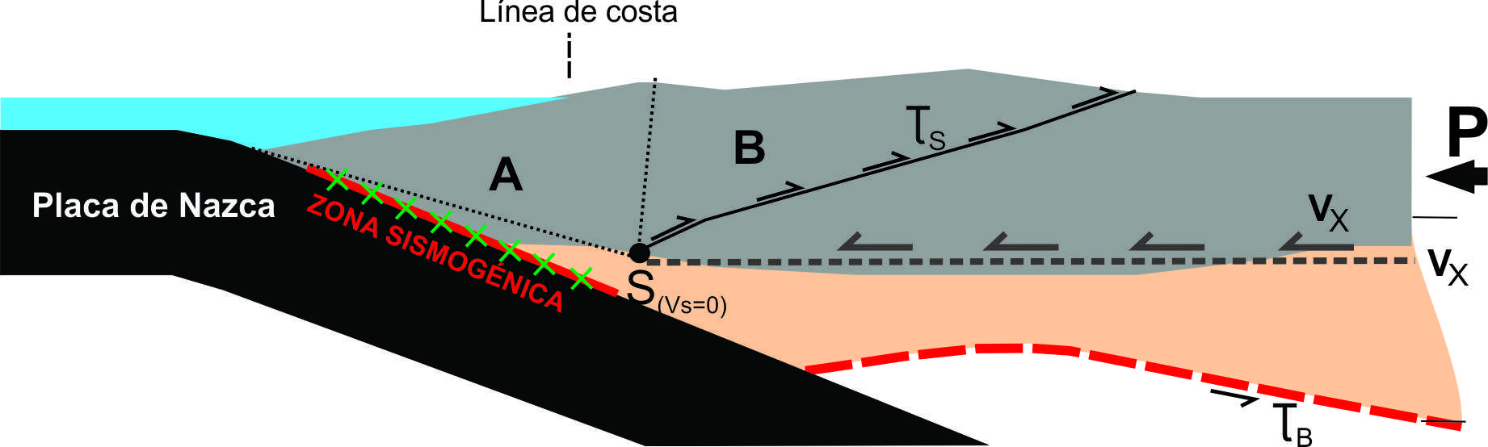
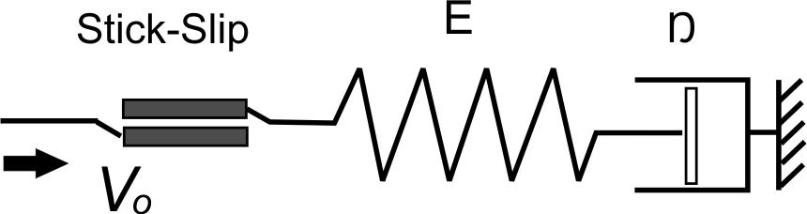
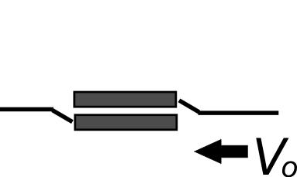
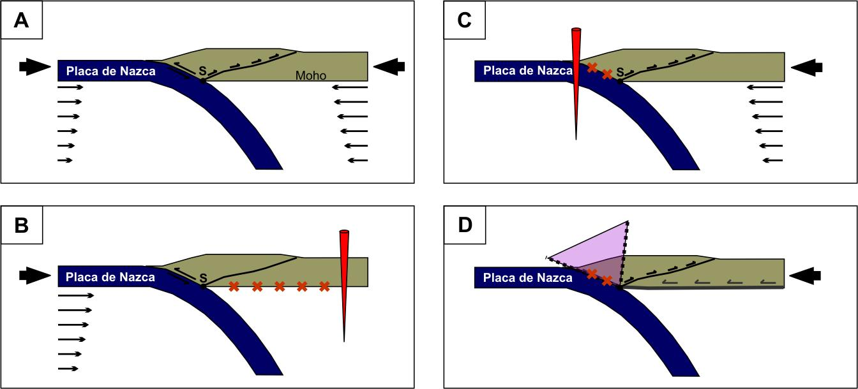
Conceptual model
Conceptual model
~ 70 mm/yr
~ 35 mm/yr
Plates displaced towards the trench driven by slab pull and ridge push
Modified from Liu et al.
(2000-GRL)
Brittle (plastic) deformation in the UC
and ductile (viscous) deformation in the LC
=
+
~ 30 mm/yr
+
~ 70 mm/yr
~ 35 mm/yr
~ 5 mm/yr
~ 35 mm/yr
Visco-elastic strain energy stored at the forearc

Slide 13
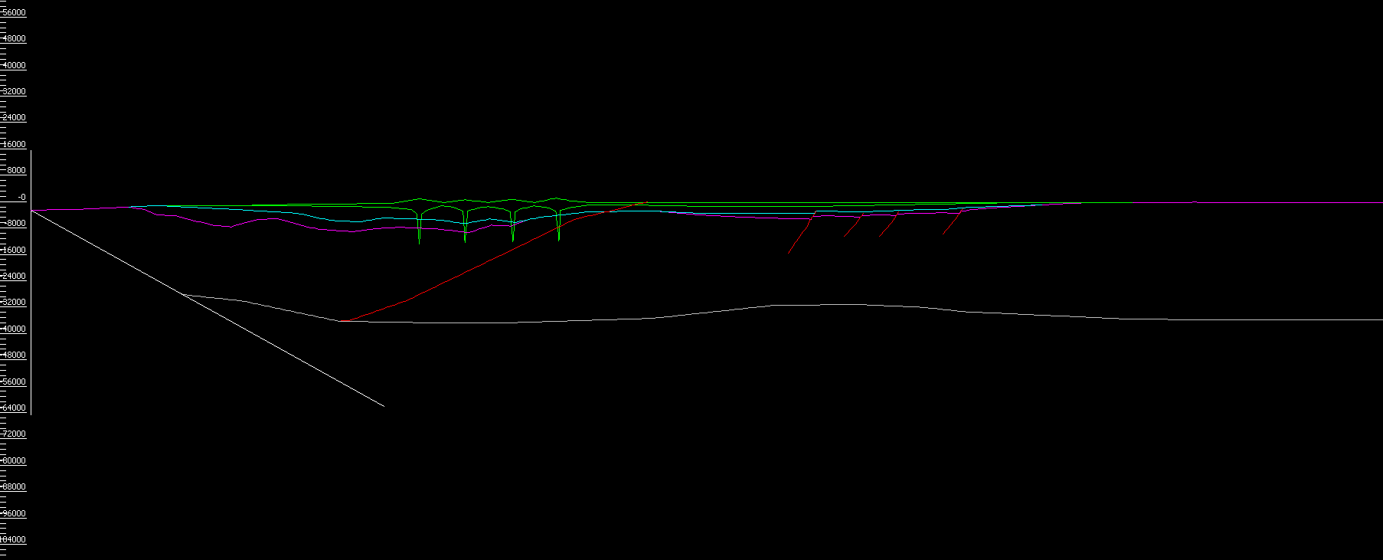
Kinematic model
Move software
Academic licence
65 steps
35 steps: 1 to 3 km of shortening each
16 steps: Elasto-isostatic compensation for tectonic load
14 steps: Addition and subtraction of material (deposition/erotion)

Slide 14
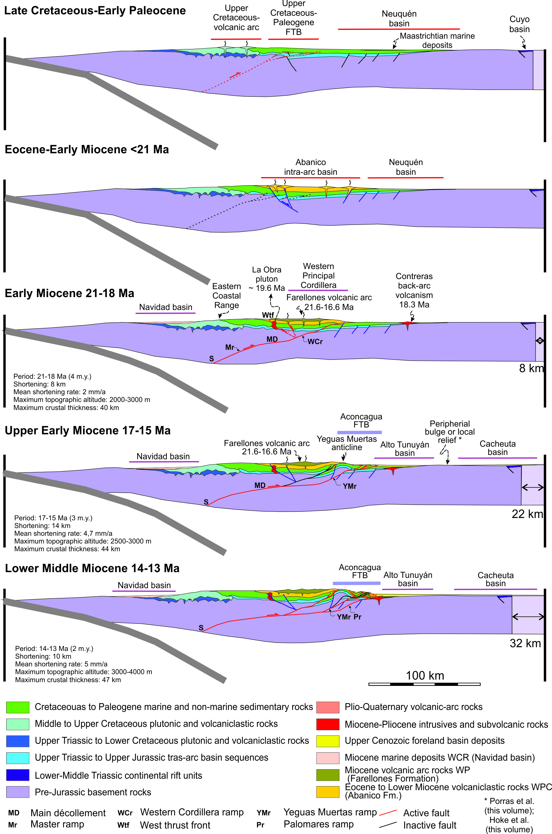
Kinematic modeling
> 21 Ma
Average T₀=40 km at the end of the Eocene-Oligocene extensional period

Slide 15
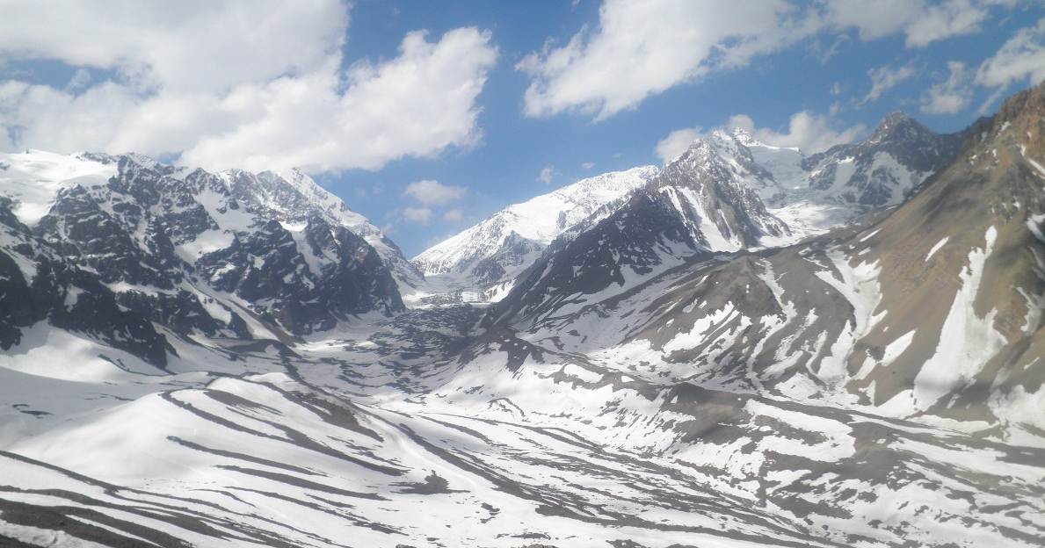
Kinematic modeling
Early Miocene 21-18 Ma
Onset of deformation: low-K Abanico Formation tholeiites to calc-alkaline dacites of the Teniente Volcanic Complex (Kay et al. 2005, 2006)

Slide 16
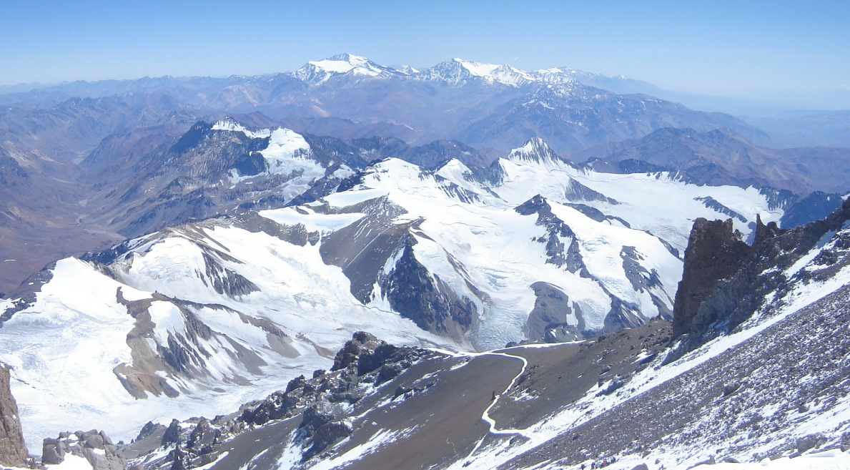
Kinematic modeling
Upper Early Miocene 17-15 Ma
Inversion of pre-existing Jurassic normal faults

Slide 17
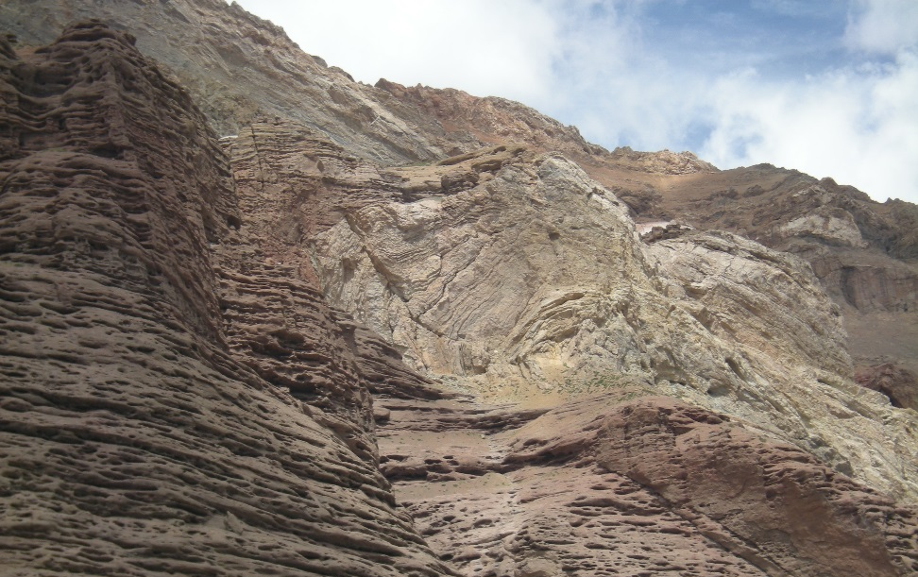
Kinematic modeling
Lower Middle Miocene 14-13 Ma
Cyclic activation-desactivation of basal ramps

Slide 18
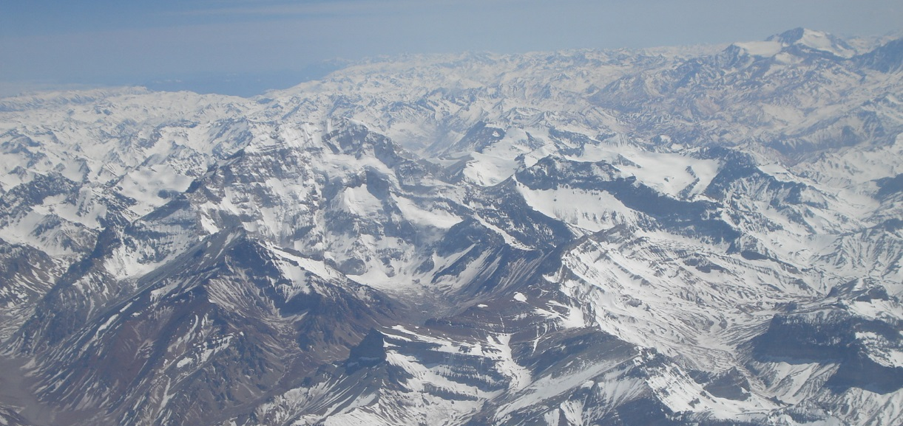
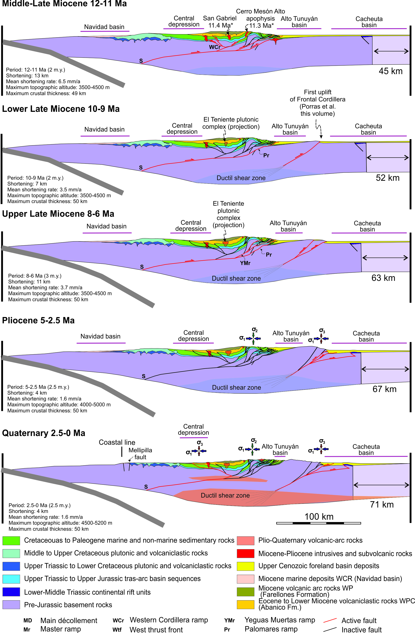
Kinematic modeling
Middle-Late Miocene 12-11 Ma
Slow migration of S point generates a propagating wave of surface uplift in the CR

Slide 19
Kinematic modeling
Lower Late Miocene 10-9 Ma
Volcanic activity practically wanes
The crust achieves its present Tmax of 50 km (Kay et al. 2005)
and viscosity of the LC begins to drop (Ouimet & Cook 2010)
Driving forces cannot supply the energy needed to thicken the crust
Crustal root grows in width instead of increasing depth

Slide 20
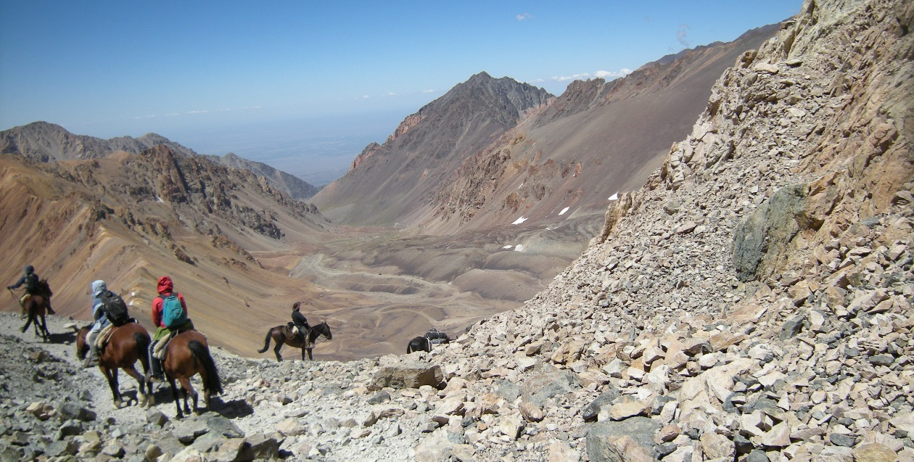
Kinematic modeling
Lower Late Miocene 8-6 Ma
Widthening of the root

Slide 21
Kinematic modeling
Pliocene 5 – 2.5 Ma
Widthening of the root

Slide 22
Kinematic modeling
Quaternary 2.5 - 0 Ma
?
?
Shallow seismicity distributed along WPC and EFC

Slide 23
Conclusions
W propose a kinematic model with thermomechanical constrains for the construction of the Southern Central Andes
Propose the existence of a east-vergent detachment active from the lower Miocene to at least 6 Ma (with Quaternary reactivations)
A passive uplift of the Coastal Range
A deep detachment uplifting the Frontal Cordillera

Slide 24
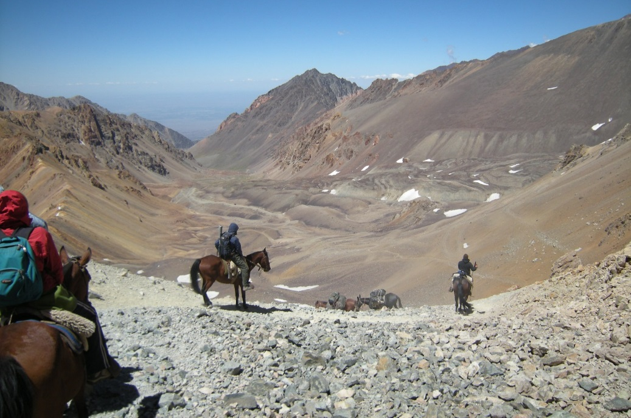
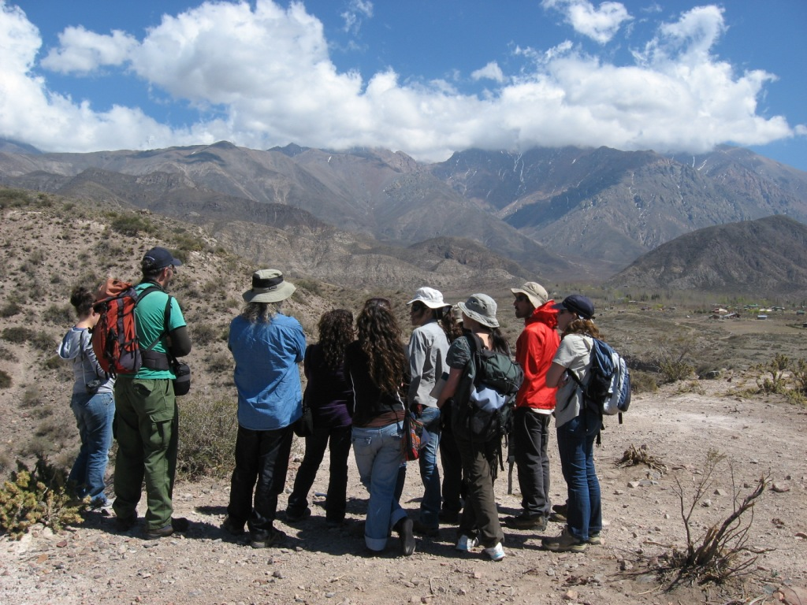
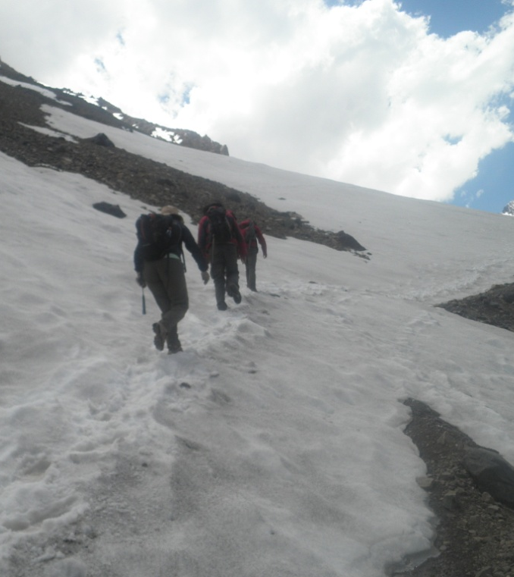
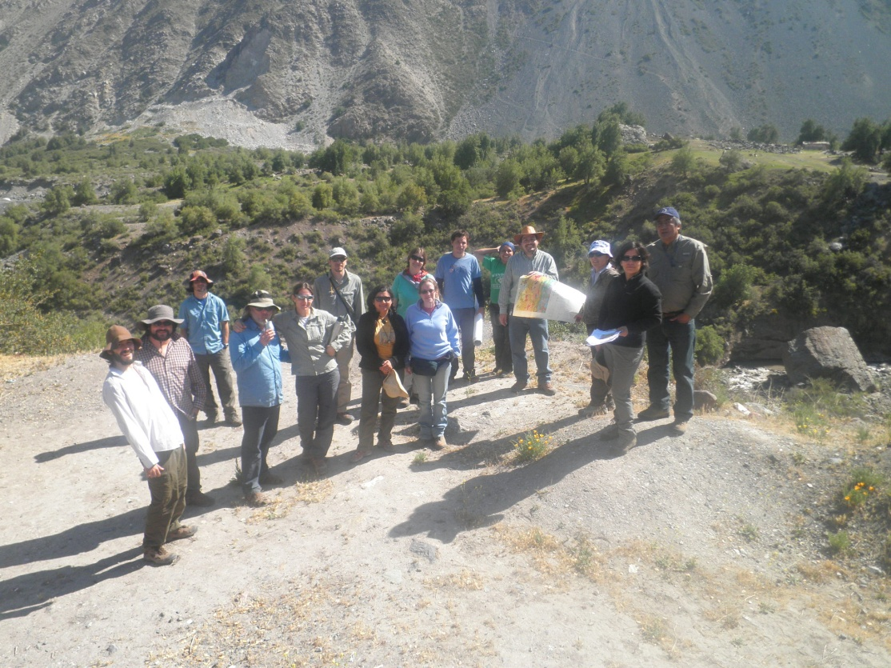
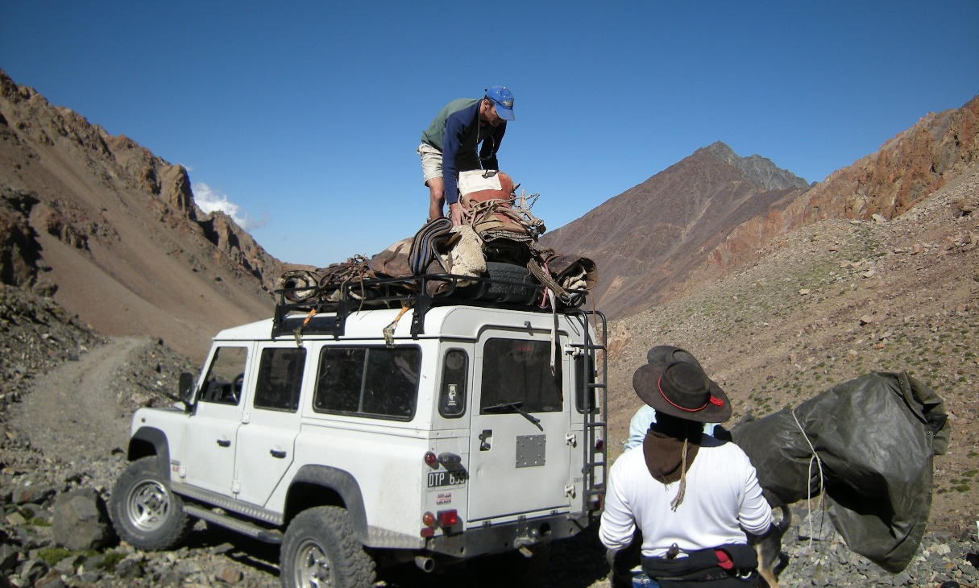
Many thanks!

