Slide 1
Competency-Based Geosciences Teacher Education at Western Governors University
GSA Session T117: Developing and Sustaining Thriving Geoscience Programs and Departments:
Strategies and Examples from Two-Year and Four-Year Colleges and Universities
Suzanne T. Metlay, Ph.D.
Teachers College
Western Governors University
Geological Society of America – Denver, CO
27 October 2013

Slide 2
What is Competency-Based Learning?
Traditional Semester Structure:
15 week terms
Sometimes shorter time structures: quarters, short courses, etc.
Still fixed time length
Instructors determine course schedule: lab deadlines, exam dates, etc.
Student learning varies
Student 1 earns a “C” while Student 2 earns a “B”
Competency-Based Structure:
24 week terms
Sometimes 12 weeks to demonstrate academic progress
Students choose when to submit work or take exams
Many students pass courses in 6 weeks or less
No limit on how many courses a student takes per term if academically proficient
Some exams, such as Praxis II content knowledge, are national standardized tests
Student learning is consistent
All students must earn equivalent of “B” or better to pass course
Competency Units not Credit Hours
Time varies, learning is more consistent
Notes:
Thanks for letting me introduce you to competency-based geosciences teacher education at WGU! Competency-based learning involves a different relationship to seat time – that is, the time a student spends in a seat learning from an instructor, website, fellow student, whatever. At traditional colleges, minimum seat time is fixed – the course schedule guides the student. At competency-based schools, the student determines the schedule (within limits – students must demonstrate academic progress within a certain period of time). At many universities, there is a range of grades – some students earn “A”s while others earn “C”s. At WGU, students must earn the equivalent of a “B” or better to be deemed competent in that subject. So learning is measured in competency units and students are not allowed to move forward without objectively demonstrating that competency.

Slide 3
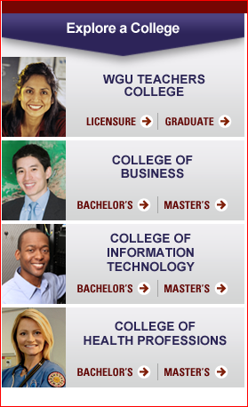



What is Western Governors University?
WGU is:
Fully online
Except for field experience (3-6 months)
Accredited
Private & Nonprofit → low tuition
Limited to certain programs
BA & MA in Geoscience Teacher Education
but no degrees in geoscience disciplines
WGU is NOT:
Open admission
MOOC-based
MOOC = Massive Open Online Course
Personalized instruction => anti-MOOC
Notes:
WGU is fully online, except for required field experience of 3 to 6 months. This applies to all students at the undergraduate level – regardless of discipline, students must intern or apprentice in an actual workplace. For example, nursing students are placed in hospitals while teaching students are assigned to K-12 classrooms. Host facility staff as well as WGU faculty supervise and report on student compentence in the workplace. Graduate students in the Teachers College are required to implement a project in their classrooms, followed by a written presentation and oral defense.
WGU is fully accredited, private, and nonprofit – tuition rates have stayed the same for the past 6 years at $6000/year. Not $6000 per course or per term but per 12-month calendar year. Since $500/month is still a lot for many students, the majority are on financial aid or receive other tuition assistance.
WGU is limited to certain programs – a student may earn a degree in geoscience education, not training to become a geoscientist.
WGU is not open admission – unlike most community colleges and state colleges or universities, WGU screens applicants and may refuse to accept them. WGU is definitely not MOOC-based. MOOC stands for massive open online course, often with hundreds or thousands of students to one instructor. At WGU, the emphasis is on personalized instruction with each student receiving an education tailored specifically to his or her needs, including one-on-one discussion time with faculty.

Slide 4
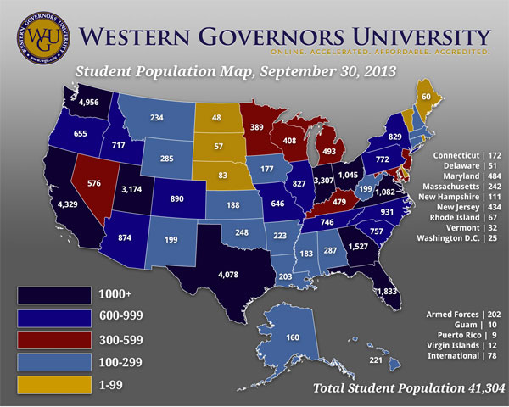
Where WGU Students are:
Notes:
Most WGU students are older (average age is 37), lower income, and first-generation college students. As of September 30, WGU students are in all 50 states, 4 territories, and many military bases around the world. Other than Canada, international students are not allowed at this time. Current enrollment is more than 41,000 and climbing by about 800/month. There is actually a cap on the number of new students admitted based on the number of faculty available to support them.

Slide 5
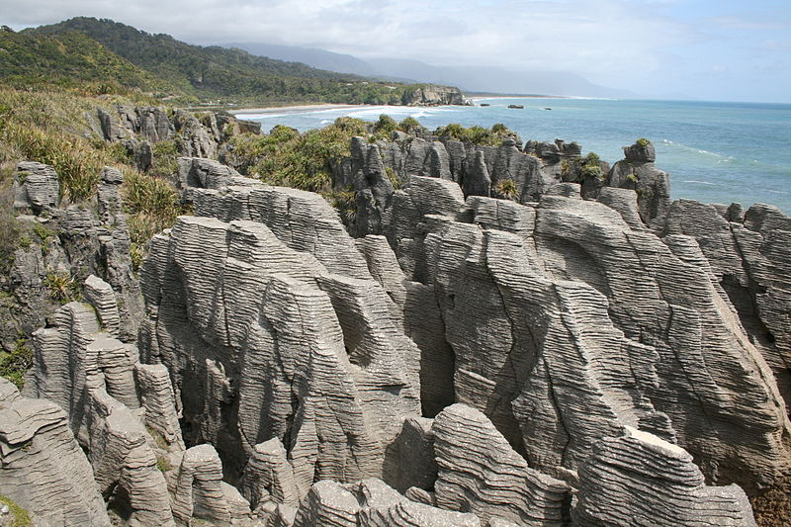
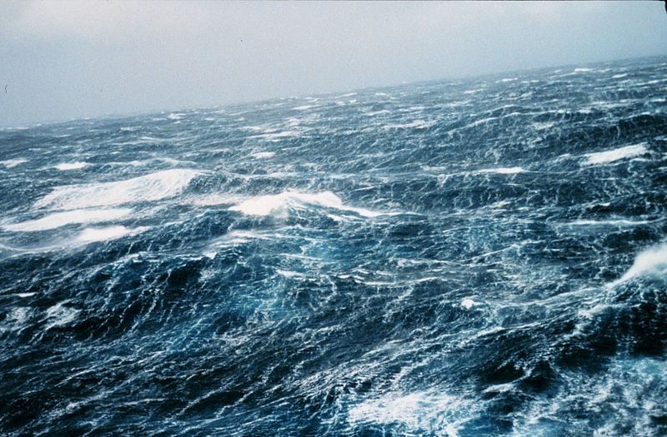


What are Geosciences?
Pancake Rocks, New Zealand
Wikimedia Commons
Geology
Earth Science
Oceanography
Meteorology
Atmospheric Science
Astronomy
North Pacific Ocean, Storm Waves
NOAA
Cirrus & Cumulus Clouds
Wikimedia Commons
Galaxies M51 & NGC 5195
STScI-NASA-ESA
Notes:
At WGU, geosciences includes geology, oceanography, meteorology (also known as atmospheric science), and astronomy.

Slide 6
Examples of Geoscience Competencies
The graduate understands the:
Competency 205.2.1: Earth Systems Structure and Function
… structure and function of Earth systems, including the closely coupled subsystems: geosphere, hydrosphere, atmosphere, and biosphere.
Competency 205.2.2: Earth Systems Equilibrium
… Earth's history and that the Earth exists in a state of dynamic equilibrium that evolves over geologic time.
Competency 205.2.3: Solar System
… components and properties of the solar system, and understands that the major components are in a state of regular and predictable motion.
Competency 205.2.4: The Universe
… composition, history, and properties of the earth and the universe, and the scale of the universe in space and time.
Competency 205.2.5: Oceanographic Concepts
… oceanographic concepts: global plate tectonics, the origin of the oceans, air/sea interactions, and human interactions with the oceans.
Notes:
Here is an example of the 5 competencies required for the Interdisciplinary Geosciences course. This is not an introductory course, and many students come to it after having passed courses in algebra, integrated physical sciences, and/or chemistry.

Slide 7

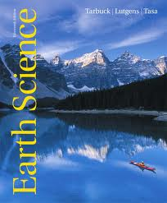

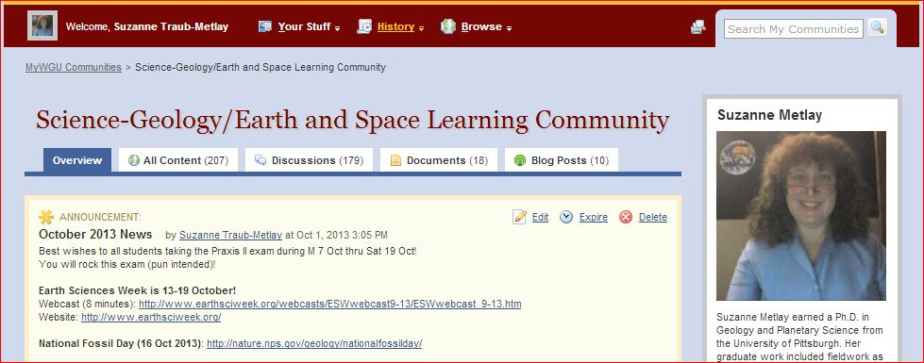
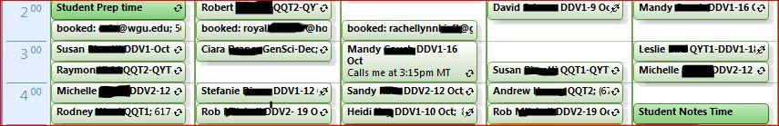
How to address competencies? Learning Resources
External:
eText =Textbook
Hands-On Labs
Interactive website
Internal to WGU:
Learning Community
Virtual Classroom
Live webinars,
Cohorts, Q&A
Faculty interaction
30-minute phone calls
Generally every week
Knowledge Base – articles & videos
Peer-to-
Peer
Learning
Notes:
The remainder of this presentation concerns how to address these competencies. Students start with external learning resources, such as the textbook and lab kit. Geosciences at WGU uses mainly Pearson products such as this Earth Science eText and the affiliated website, MasteringGeology. Students order their own Geology LabPaq from Hands-On Labs so they may use and keep their own mineral and rock hand samples and other materials, such as mineral ID scratch plates. The students do not pay any additional cost for any of these items -- WGU includes these learning resources as part of student tuition.
As geosciences faculty, I help develop internal resources for my students. These include a learning community where common info is shared and students may post items for each like a community bulletin board, and a virtual classroom where students can meet with each other at specific times to engage in face-to-face peer learning. The vast majority of my time is direct interaction with each geoscience student – that is, at a scheduled time, I call each student to discuss talk for an average of 30 minutes each week. This is one-on-one personalized instruction where we discuss content, test-taking strategies, academic progress, and so on. The students and I develop real bonds during the weeks or months that we work with each other. During Cohort weeks, we discuss specific topics in addition to student concerns. Obviously not every geoscience students wants to talk each week; some students prefer email only. But I contact each student by phone call or by individual email on a regular basis for the duration of their enrollment in my courses.
Starting in November, we will implement an in-house Knowledge Base (sort of like an internal wiki) for students to use during asynchronous learning – that is, at 3:00am. So I will spend a lot time over the next few months writing brief articles and making short videos for students to access when they cannot reach me.

Slide 8

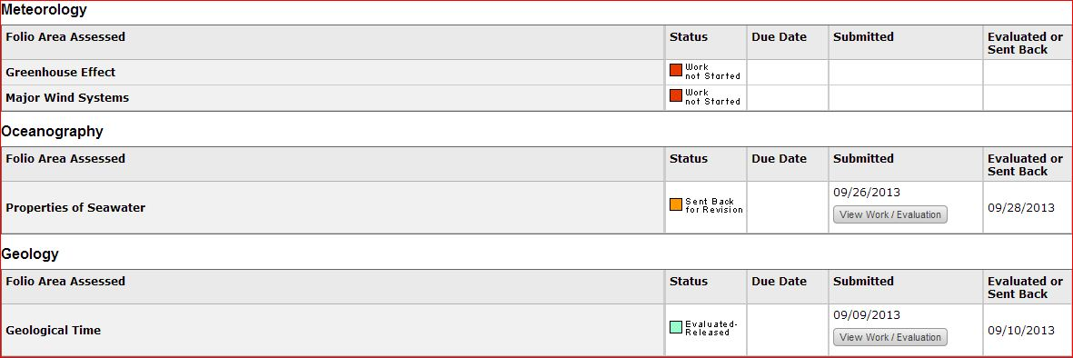
How to address competencies? Tasks
Tasks = Performance Assessments = Homework/Labs
Personal field trip
Experiments & lab write-up
Essays
Evaluators determine competency of student work
Revisions are frequently required before the student can pass the course
Notes:
You know the value of hands-on activities, labs, and field trips. Among the work WGU students do in their Courses of Study are performance assessment known as tasks that include a personal field trip to a nearby site of geologic interest, lab experiments with a formal write-up, and essays on a variety of topics. Students submit their work through an online program called TaskStream. Evaluators are subject matter experts who grade the work and report back on what, if any, revisions must be made before the student submission demonstrates competency. Evaluators are the only part-time faculty employed by WGU – they are frequently part-time faculty at other colleges or universities as well, where they actively teach these subject as well. Strict separation is maintained between faculty like me, who get to know the students on a personal level, and the evaluators, who never speak directly with the students. This is to avoid bias during grading.

Slide 9


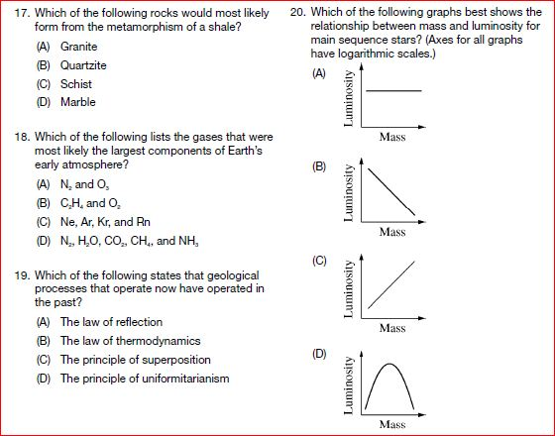

How to address competencies? Objective Exams
Praxis II: Earth & Space Science Content Knowledge Exam
Required for Bachelor’s and Master’s Degree candidates at WGU
Minimum score set by state or by WGU, whichever is higher
Some states require Praxis II in General Science or Middle School Science instead
Administered and scored by Educational Testing Service (ETS)
Proctored at professional testing centers , even for online exams
State exams in
Earth & Space Science content:
CalTPA = California Teacher Performance Assessments
GACE = Georgia Assessments for the Certification of Educators
WEST-E = Washington Educator Skills Test – Endorsements
Praxis II and state exams must be passed before WGU students are allowed to do student teaching or graduate project in K-12 classroom
ETS Praxis Study Companion for
Earth and Space Sciences: Content Knowledge, 2013
Notes:
Welcome to the bane of my students’ existence – standardized national and state exams on Earth & Space Science content knowledge. “Praxis “ refers to professional practice and the Praxis series of exams from Educational Testing Service is a required component of nearly every teacher education program in the U.S. Depending on grade level and subject the candidate wants to teach, the required exam is different and passing scores vary by state.
Many states require their own exams, such as the GACE which is another ETS product or the WEST-E from another vendor. At WGU, all necessary exams must be passed before undergraduate or graduate students are allowed to set foot in the classroom to continue their degree program. Multiple attempts to pass these rigorous exams are common.

Slide 10


Thank You!!
Questions?
Suzanne T. Metlay, Ph.D.
Teacher Education: Geosciences
Western Governors University
385-428-4961
suzanne.metlay@wgu.edu
Notes:
I am happy to answer questions. If the following slides do not address your concerns, feel free to contact me for further discussion. Thank you for your attention!

Slide 11
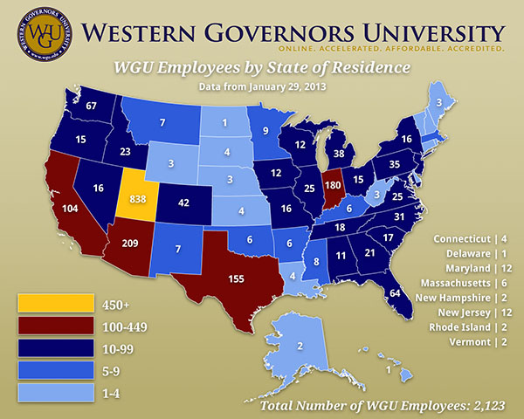
Where WGU Faculty & Staff are:
Administrative
offices in Utah and
Arizona
State Institutions
Public-Private
partnerships
(virtual campuses)
WGU-Indiana
WGU-Missouri
WGU-Tennessee
WGU-Texas
WGU-Washington
Distributed faculty
responsibilities
Corporate model
Notes:
This map of WGU faculty & staff is already outdated, with the number of employees as of Sept 30 closer to 3000. An increasing number of faculty are affiliated with virtual campuses in Indiana, Missouri, Tennessee, Texas, and Washington State. All others affiliate with the main office in Utah.
At WGU, faculty responsibilities are distributed. For example, in a traditional college, the same instructor would write an exam, proctor the exam, and grade the exam. At WGU, each of these functions is performed by a different faculty member to maintain objectivity.

Slide 12
WGU Timeline – Teachers College
1995: Idea born at bipartisan meeting of Western Governors Association
19 governors of western states
1996: WGU chartered
1997: Incorporated as private, nonprofit university
1999: First students accepted
2003: Accredited by Northwest Commission on Colleges and Universities
Teachers College founded
2006: 1st exclusively online university to earn accreditation for degree programs that lead to teacher licensure from National Council for the Accreditation of Teacher Education (NCATE)
2007: Faculty divided into:
Course Mentors (subject matter experts)
Student Mentors (student service experts with degrees in subject matter)
2008-2013: Various awards in online education, such as from United States Distance Learning Association (USDLA)
2012: Survey of Employers by Harris Interactive reveals strong employer satisfaction with WGU graduates, including Teachers College grads

Slide 13
2011 National Comparisons
Science Education
#1 Master’s Degrees awarded in Earth Science Education, Biology Education, Chemistry Education
#1 Bachelor’s Degrees awarded in Earth Science Education, Biology Education
#2 Master’s Degrees awarded in Physics Education
#3 Master’s Degrees awarded in General Science
Math Education
#1 Master’s Degrees awarded
#4 Bachelor’s Degrees awarded
Notes:
This slide came from WGU President Bob Mendenhall’s 2012 address to faculty & staff. Note that the Teachers College, founded in 2003, was less than 10 years old at this time.

Slide 14
