Slide 1







Advance Simulation Capability for Environmental Management
Presenter: Velimir (monty) V Vesselinov (LANL)
Paul Dixon (Multi-Laboratory Project Manager, LANL), Mark Freshley (PNNL), Tim Scheibe (PNNL), David Moulton (LANL), Susan Hubbard (LBNL) Stefan Finsterle (LBNL), Carl Steefel (LBNL), Roger Seitz (SRNL) and Justin Marble (DOE-EM ASCEM Lead)
Presented at The Geological Society of America Meeting
Denver Colorado, October 30, 2013

Slide 2
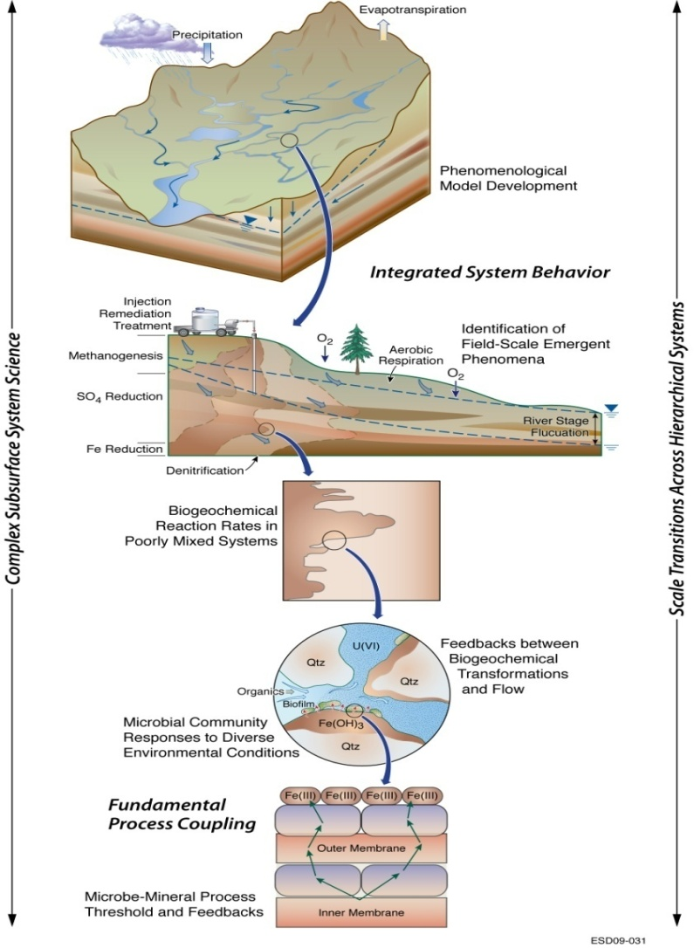
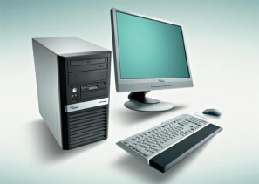
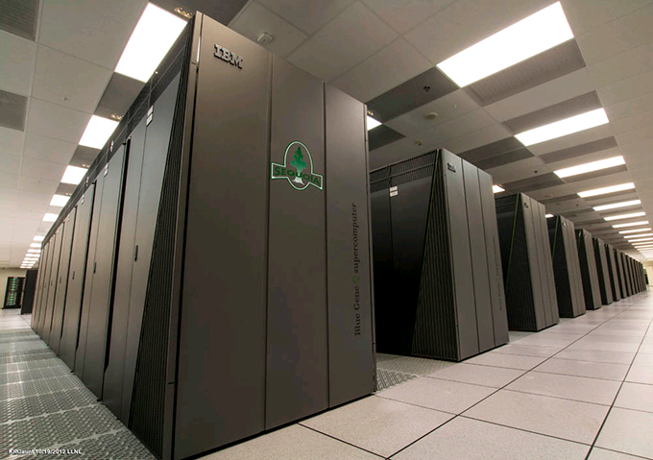

Advanced Simulation Capability for Environmental Management (ASCEM)
Next-Generation approach for environmental management of groundwater contaminant sites
Integrates key tools under one umbrella
Model setup: data management, visualization, model design, documentation
Model simulation: predicting contaminant flow and transport
Model analysis: parameter estimation, uncertainty quantification, risk assessment and decision support
High Performance Computing
Linked closely with EM’s and OSc’s Field Research Initiatives
Community code similar to climate code that takes advantage of existing capabilities
Wide Range of Complexity
Wide Range of Platforms

Slide 3
ASCEM Approach to Development
Goals: (1) standardized and consistent model-based analyses (2) model support for decision making
Flexible: easy to apply to a range of problems
Complex: sufficiently complex to capture site conditions
Extensible: users can extend the code to meet their specific needs
Accessible:
Readily downloaded, updated, and built
Well commented and documented code
Common coding standard
Efficient: Does not require but can use (parallel, multicore) advanced/emerging computational architectures
Leverages existing open-source capabilities
Graded and well documented QA

Slide 4
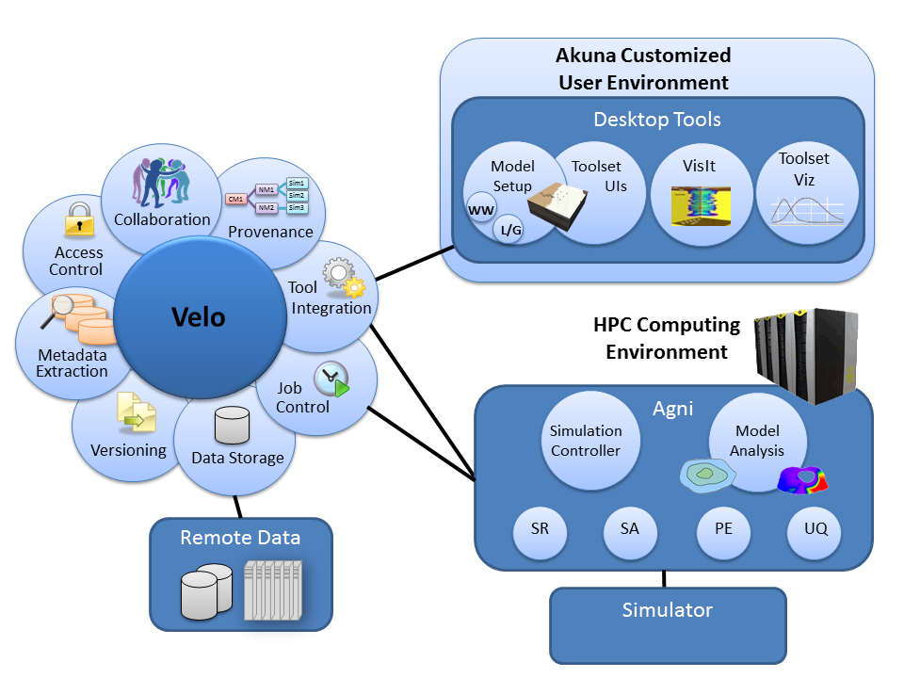
ASCEM Integrated Modeling Workflow Environment
Amanzi
Open-source, platform-independent user environment to facilitate modeling process

Slide 5
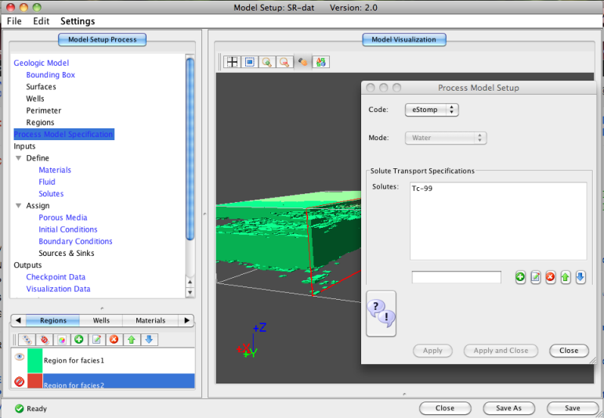
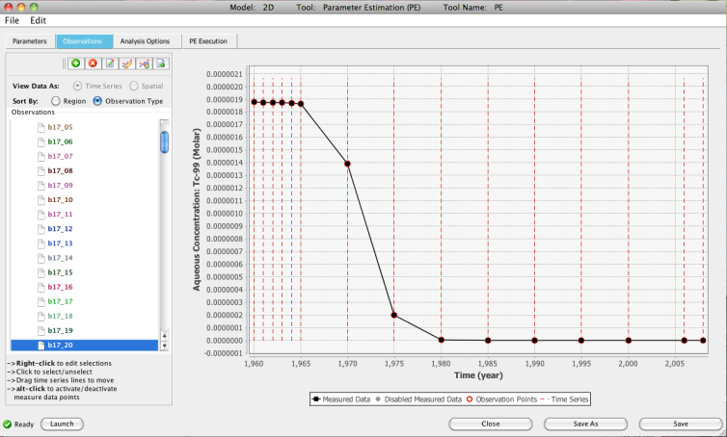
Akuna: Desktop Graphic User Interface (GUI)
Akuna is a set of modular and extensible Java-based desktop graphical user interfaces (GUIs)
Enable users to easily:
Setup conceptual and numerical models
Execute simulations, running on laptops to supercomputers
Visualize and analyze simulation results
Full lifecycle data management, from site data to modeling results
Primary support for Amanzi
Interface through a joint XML specification and schema for automated file consistency checking
Support other simulators, e.g. STOMP, TOUGH2, FEHM,…

Slide 6
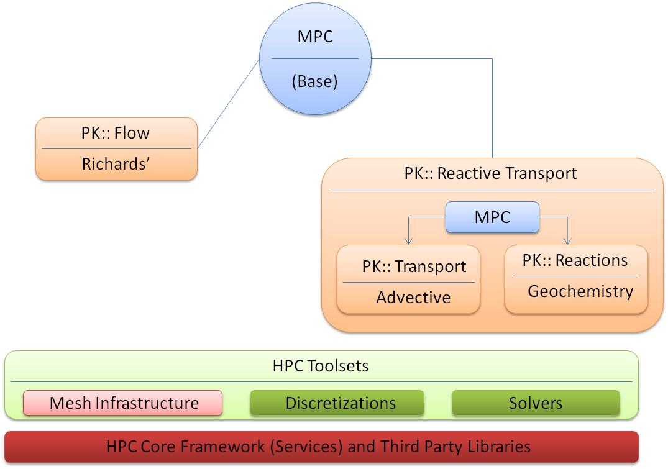
Amanzi: Flow and Transport Simulator
Process Kernels
Transient unsaturated flow with Richards equation, including options to steady-state initialization.
Transient single-phase flow with specific storage/yield
Volume based sinks/sources
Reactive-transport, with operator splitting for reactions.
Support for a wide range of chemical reactions.
Framework and Infrastructure:
Unstructured meshes with polyhedral cells, block-structured AMR, and internal generation of hexahedral meshes in rectangular domains.
Designed to integrate with Akuna/Agni model setup and toolsets.
Flexible and extensible MPC/PK APIs.
Parallel I/O: visualization & restart
Designed “parallel” from the start. Amanzi is a
Flexible/Extensible Multi-Physics Code

Slide 7
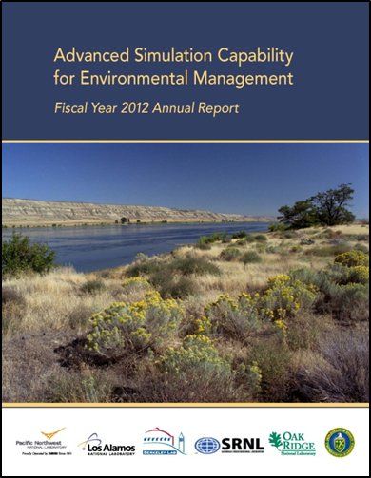
ASCEM Phase II Demonstration Report Highlights (Phase II Demonstration, ASCEM-SITE-2012-01, OSTI ID # 1055500)
Significant advancement of ASCEM capabilities was achieved in FY12 and highlighted in demonstrations:
End-to-end demonstration of a complete modeling ASCEM workflow at the BC Cribs deep vadose zone environment at Hanford
Amanzi HPC simulations of governing processes in a physically and geochemically complex subsurface environment at the F-Basin site on the Savannah River Site
Adaptive Mesh Refinement (AMR) to enhance waste tank performance assessment
UQ analysis
Notes:
End to end modeling workflow – significance is that everything is “under one roof.” Platform capabilities enable management of modeling workflow and documentation of important things like data provenance – where data came from, and documenting simulation parameters, all aspects of quality assurance for a modeling job. Evaluated baseline conditions at a site being remediated with soil desiccation or drying.
F Area a humid environment. Demonstration at F Area demonstrates use of ASCEM for assessing the technical basis of cleanup, a reactive barrier protecting a surface water body. Use reactive transport modeling and data generated by a DOE Office of Science project at the site – ASCEM allowed application of increased model complexity in an uncertainty framework. Note: Akuna also linked with TOUGHREACT and eSTOMP for validation and benchmarking
Waste tank performance assessments a key need across the DOE EM complex. Adaptive mesh refinement will allows representation of key features such as material interfaces and fracture flow in performance assessments.

Slide 8
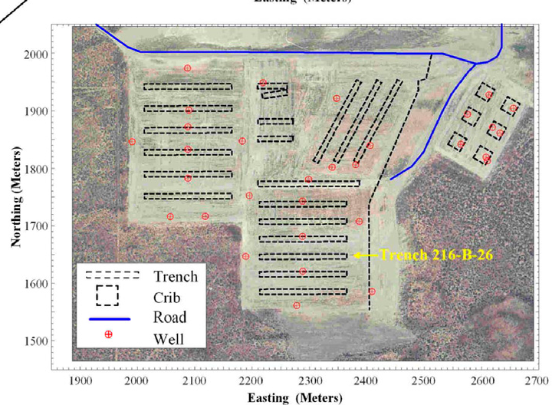
Site Applications Demonstration: Hanford Deep Vadose Zone (DVZ)
BC Cribs in Hanford Central Plateau Science Goals:
Establish baseline predictions for ⁹⁹Tc in absence of proven remediation technologies
Evaluate innovative remediation technologies for recalcitrant Tc-99 in the deep vadose zone
Phase II Demonstration end-to-end linkage of Akuna and Amanzi toolsets
Data management
Model setup and execution
HPC Model Simulation (Amanzi and eSTOMP)
Parameter estimation (model calibration)
Uncertainty quantification
Visualization

Slide 9
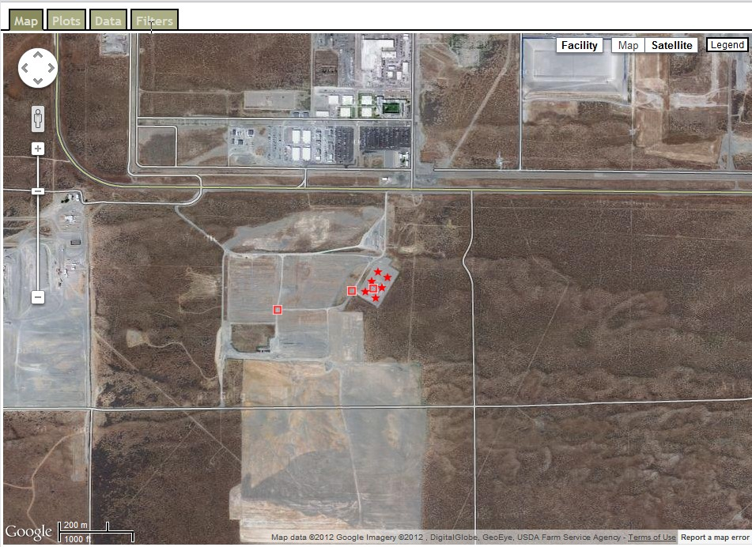
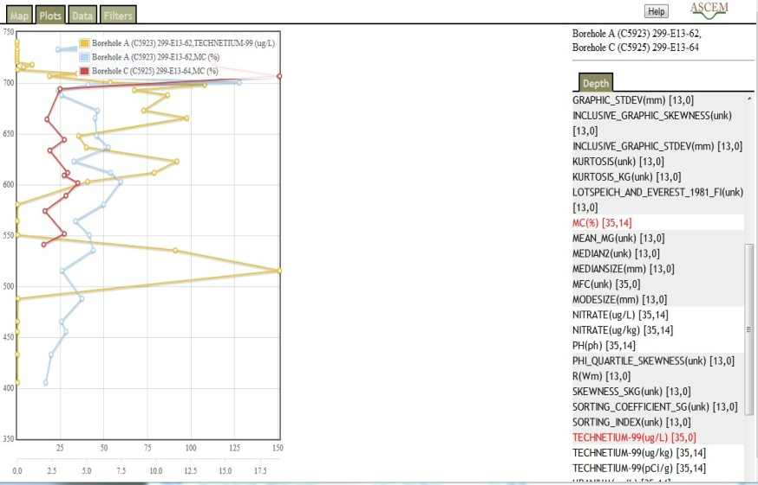
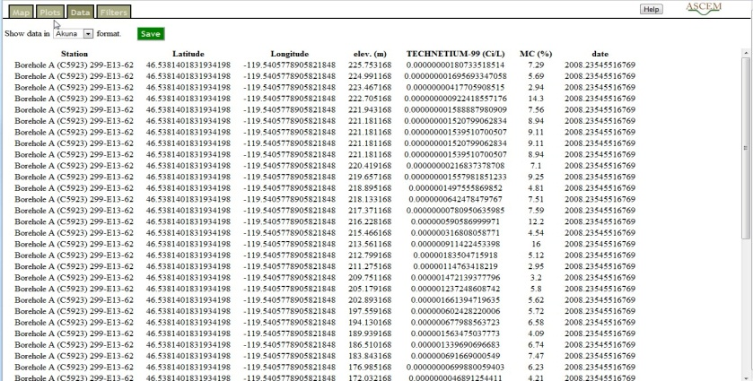
1. Database Management
1) Click on boreholes
1)
2) Plot vertical profiles
3) Export data (for model input)
2)
NASA World Wind 3D Graphic
3)

Slide 10




2. Model Setup
File read on materials:
(geostatistical geologic conceptual model; 3 lithofacies; generated 100 realizations of conceptual model)
The tool illustrates the heterogeneities in the Lithofacies distribution of the model domain
Notes:
Need to explain:
Stochastic lithofacies vs. modal lithofacies

Slide 11
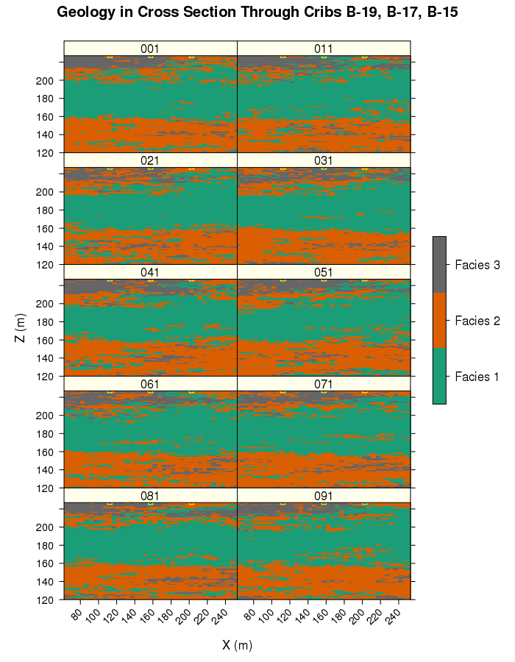
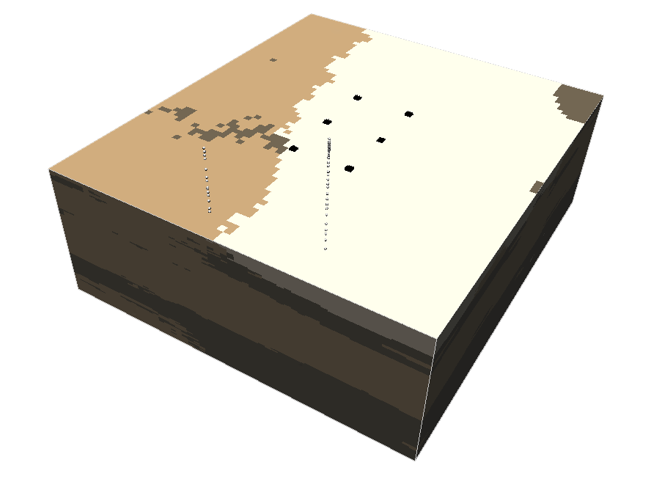
3. Parameter Estimation (PE)
Cribs
> 10 million gallons liquid waste released at 6 cribs
1956 – 1958
Simulated flow and solute transport (⁹⁹Tc)
Estimated porosity and permeability from bore holes
Examined different conceptual models
Boreholes
Water Table

Slide 12
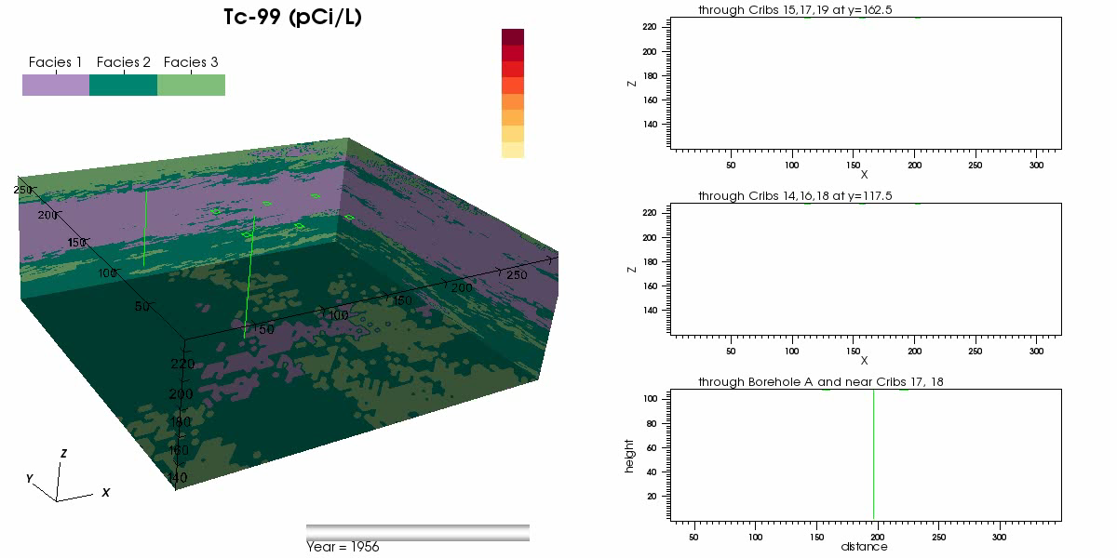
4. Simulation Results - Visualization
Simulated Tc-99 Plume Evolution Over Time

Slide 13
5. Uncertainty Quantification (UQ)
Varied rainfall rate for 100 simulations for 2012 – 3000
Rates represent management actions
Metrics
Travel times to water table
Peak concentration and arrival time
Time at which a threshold concentration is exceeded
Time period of exceed regulatory levels
Mean and 95% confidence intervals for the ⁹⁹Tc breakthrough curves beneath Boreholes A and C

Slide 14
ASCEM 2010 to 2015 Program Plan
2010 Prototype: Demonstration of individual ASCEM modules
Impact: Engage end users in development of prototype integrated, open source PA capability
2011-2012 ASCEM Version 1: Integration of ASCEM Modules
Impact: First prototype of an integrated, open source simulation capability for EM demonstrated
2013-2014 ASCEM Version 2: Applied Phase and End User Engagement
Impact: Version 2.0 of an integrated, open source simulation capability released to science and EM community for application
2015 ASCEM Version 3: Applied Phase and Initiation of Regulatory Quality Assurance V&V Testing
Impact: Version 3.0 of integrated, open source simulation capability demonstrated
2016 ASCEM Version 4: Regulatory Code Release and Training
Impact: Fully integrated, open source simulation capability released and maintained

Slide 15
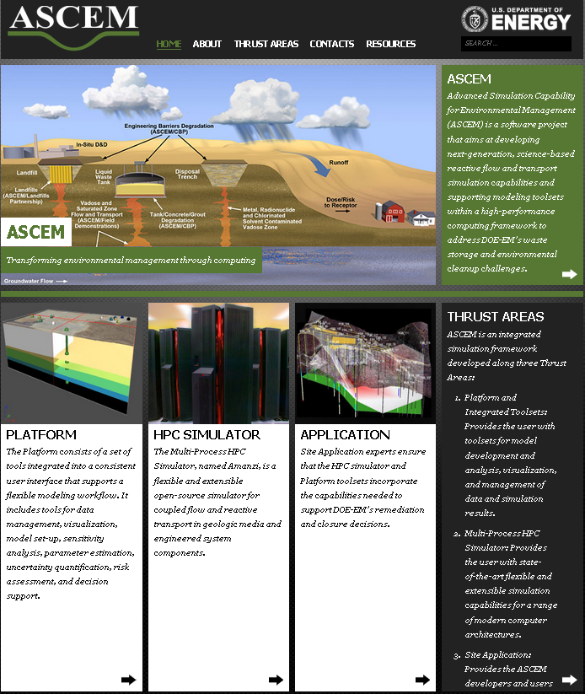
Advanced Simulation Capability for Environmental Management (ASCEM)
ASCEM represents a next-generation agile, open source, and modular HPC framework that can updated to include new theoretical methods and tools that have utility to all DOE energy and environmental missions
The framework design is motivated by and aligned with DOE directions of developing advanced, interoperable community tools
References
Mathematical Formulation Requirements and Specifications for the Process Models; ASCEM-HPC-2011-01, 2011
High-Level Design of Amanzi: The Multi-Process High Performance Computing Simulator; ASCEM-HPC-2011-03, 2011
2011 ASCEM Platform Thrust Design Document; ASCEM-PIT-2011-01, 2011
ASCEM User Needs Report – FY 2011; ASCEM-SITE-2011-02, 2011
ASCEM Phase I Demonstration; ASCEM-SITE-102010-01, 2010
Advanced Simulation Capability for Environmental Management (ASCEM): An Overview of initial Result; Technology and Innovation, Vol. 13, pp. 175–199, 2011.
ASCEM Phase II Demonstration; ASCEM-SITE-102913-01, 2013
Advance Simulation Capability for Environmental Management, Fiscal Year 2012 Annual Report
http://ascemdoe.org/

Slide 16
Thank you!

Slide 17
BACKUP

Slide 18
How is ASCEM Organized?
DOE-EM ASCEM Management Team
Kurt Gerdes, Director EM-12
Justin Marble, Manager
R. Patterson, Deputy
DOE Interaction Team
Office of Science: (BER/BES) & (ASCR)
Office of Nuclear Energy: (NEAMS) & (UFD)
Office of Fossil Energy: (NRAP)
User Steering
Committee
Roger Seitz, Lead
Applied Field Research Initiative:
Attenuation Based Remedies for the Subsurface
ASCEM Multi-Lab
Management Team
Paul Dixon, Multi Lab Program
Applied Field Research Initiative:
Deep Vadose Zone
Applied Field Research Initiative:
Remediation of Mercury and Industrial Contaminants
Platform and Integrated
Toolsets
Tim Scheibe, Mgr
Stefan Finsterle, Deputy
Multi-Process HPC
Simulator
David Moulton, Mgr
Carl Steefel, Deputy
Site Applications
Mark Freshley, Mgr
Susan Hubbard, Deputy
Roger Seitz, User Interface
2
ascemdoe.org
Notes:
The ASCEM project is organized to have strong ties the other EM-12 efforts in GW&S.
In addition, we will be leveraging and collaborating with the HPC modeling efforts in NE/RW, SC, and FE

Slide 19
User Interactions Focus ASCEM Development
Regulatory
Public Interface
Reviews
Decision Support
Programmatic
Project Management
Oversight
Decision Support
User interactions helped shape development efforts through requirements documents
User interactions ongoing with site contractors, regulators, stakeholders, Tribal Nations, and oversight groups
Focus shifting from large-scale demonstrations to ASCEM engagement in specific problems at EM sites (you can describe our efforts to parallel performance assessments and begin providing underpinning calculations)
Practitioners
Model Setup and Execution
Decision Support
Notes:
ASCEM is listening to its users!
Seeking input from three different perspectives: regulators (reviewers, decision making, public interactions), programmatic (budget, schedule, modeling oversight, prioritization of activities, decision making), and practitioners more interested in use of the tools
We should reference any documentation we have on how the recommendations were used in the requirements document.

Slide 20
ASCEM Project Timeline
Phase I Deliverable Complete
Phase II Deliverable Complete
Develop Design and Requirements Documents
External Peer Review
Phase III to be redefined
Phase IV ??
User Training
ASCEM Concept Presented to EM Management
Revise Design Documents
Phase I Defined
2009 2010 2011 2012 2013 2014 2015
Project Start
Phase I Development
(3 months)
Phase II Development
Implementation Plan Developed
Final Phase II Goals Defined
ASCEM Initial User Release
ASCEM V2.0 User Release and Workshops
ASCEM V3.0 Full QA
Notes:
Note as far a program reviews: September 2010 did an external review of the ASCEM plan/proposal in DC, and the EMTEG reviewed ASCEM during the summer of 2011 in addition to technical peer review in August 2011.
Completed Phase I Demonstration at Savannah River Site F Area December 2010
Engaged a broad spectrum of end users for input to requirements and design
Developed significant capabilities for implementation and completed Phase II Demonstration September 2012
Leveraged DOE computational science programs and executed simulations on supercomputers at NERSC
ASCEM will sequentially develop and test capabilities
End result will be a regulatory accepted code to enable robust and standardized risk and performance assessments
Support efficient and cost effective implementation of site closure and achievable end states

Slide 21
ASCEM Development Timeline (2010-2015)
Regulatory Code
Community Code
ASCEM Model Capabilities
R&D Code
ASCEM
Phase I
Demo
ASCEM
Phase II
Demo
ASCEM
v 1.0 User Release
ASCEM
v 2.0 User Release
ASCEM
v 3.0
Full QA
CY10
CY12
CY13
CY14
CY15
Notes:
Testing is an important part, confirm that it works, compare with other codes, … regulatory means it has met all the necessary QA requirements
2010 Prototype: Demonstration of individual ASCEM modules
Impact: Engage end users in development of prototype integrated, open source PA capability.
2011-2012 ASCEM Version 1: Integration of ASCEM Modules
Impact: First prototype of an integrated, open source simulation capability for EM demonstrated.
2013 (planned) ASCEM Version 2: Applied Phase and End User Engagement
Impact: Version 2.0 of an integrated, open source simulation capability released to science and EM community for application.
2014 (planned) ASCEM Version 3: Applied Phase and Initiation of Regulatory Quality Assurance V&V Testing
Impact: Version 3.0 of integrated, open source simulation capability demonstrated .
2015 (planned) ASCEM Version 4: Regulatory Code Release and Training
Impact: Fully integrated, open source simulation capability released and maintained.

