Slide 1


Authentic Undergraduate Research …and the need to know Robert C. Thomas Environmental Sciences Department The University of Montana Western r_thomas@umwestern.edu

Slide 2



what motivates your desire to know stuff?
FEAR

Slide 3

…maybe it’s the lectures?
66.3% of students skip lecture “frequently”
Based on 38,538 first-year students at 144 campuses (ERI, 2005)

Slide 4





…you just need the notes?

Slide 5
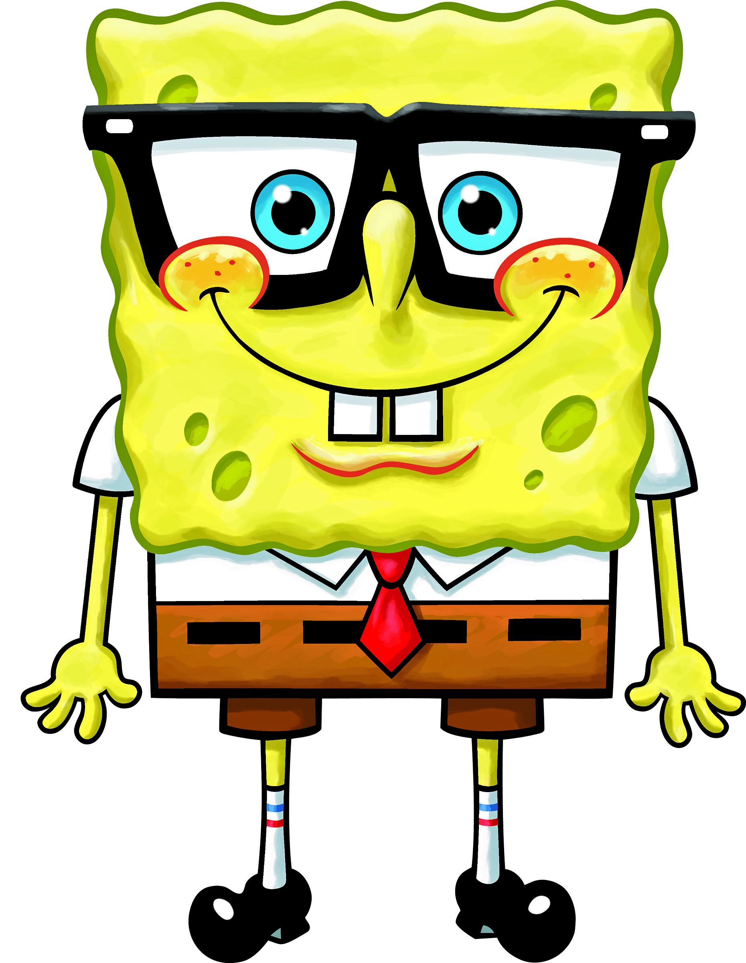
…you’re a highly motivated person?
I’m ready!

Slide 6
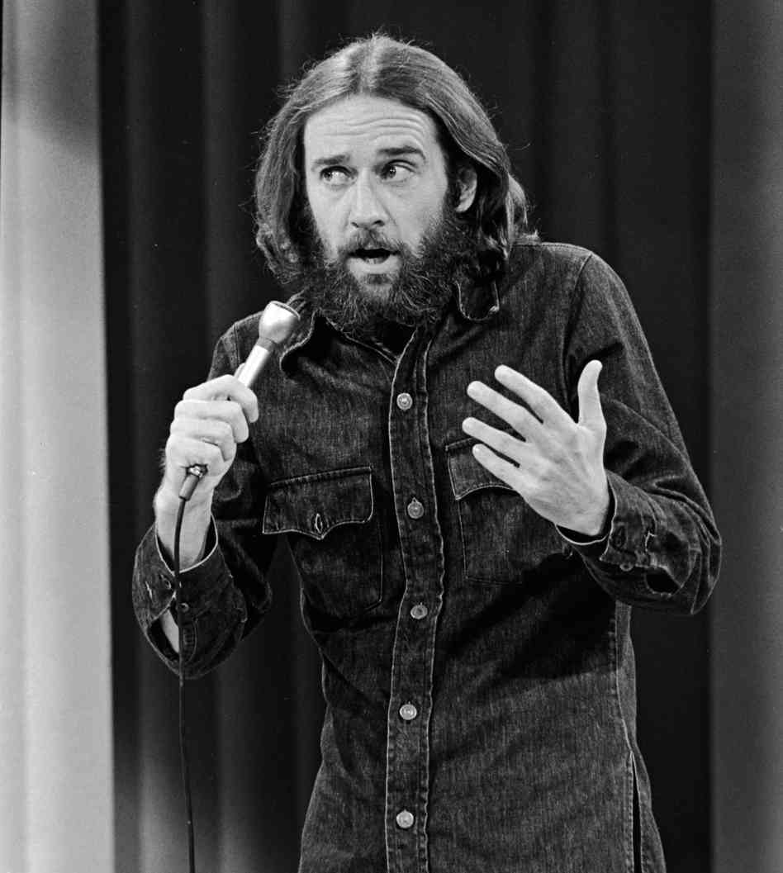
all of the above, but…
You Must Touch the Paint!
Tell people that there’s an
invisible man in the sky who
created the universe and the
vast majority will believe you.
Tell them the paint is wet, and
they have to touch it to be sure.
…George Carlin

Slide 7
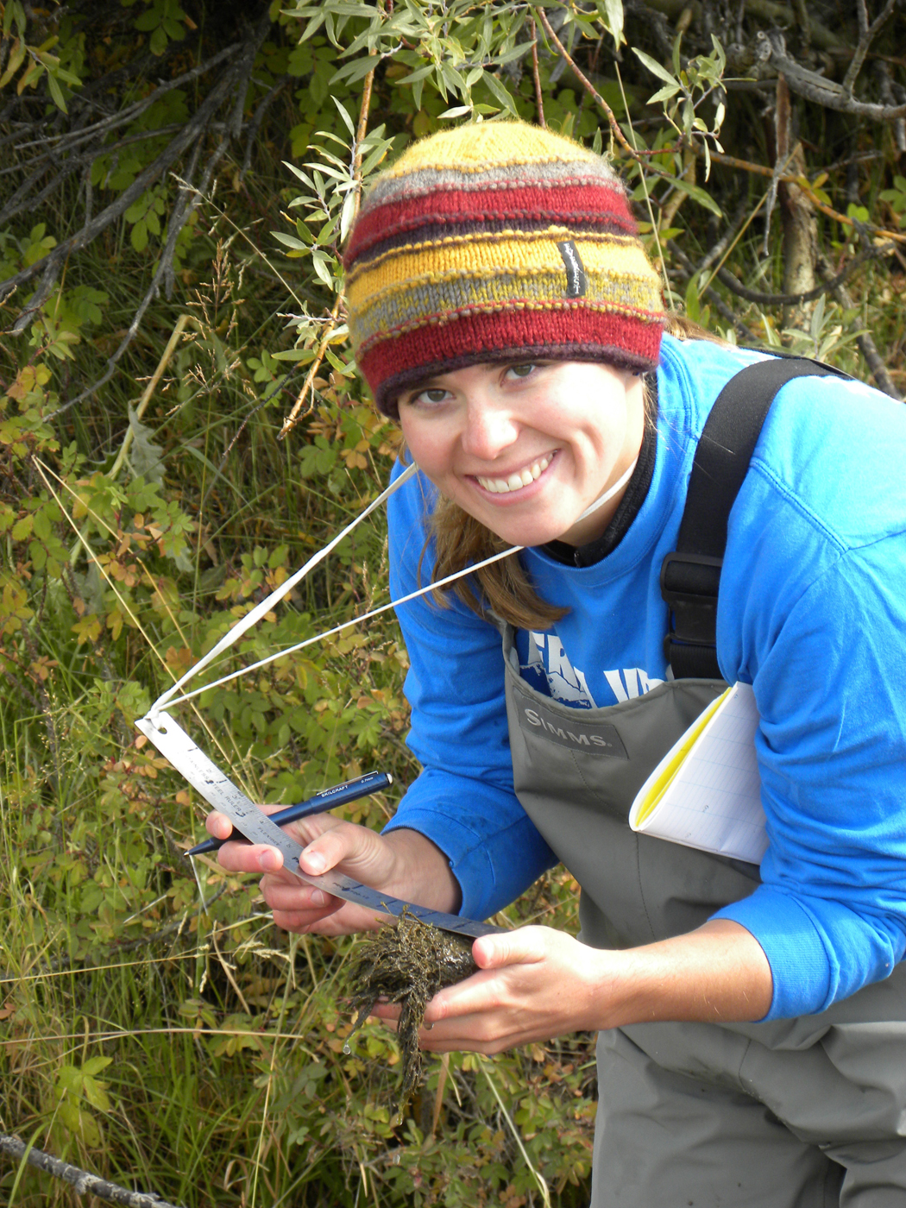
how to get people to want to touch the paint?
Authentic Practice in the Discipline
Aboriginal Learning:
Learning with a mentor (me) through research
The research should cover the core processes (not terminology) of the discipline
The research should make a contribution to the discipline and/or society
Student performance should be evaluated based on work ethic and product quality
Lecture should be limited to the need-to-know information related to the research

Slide 8
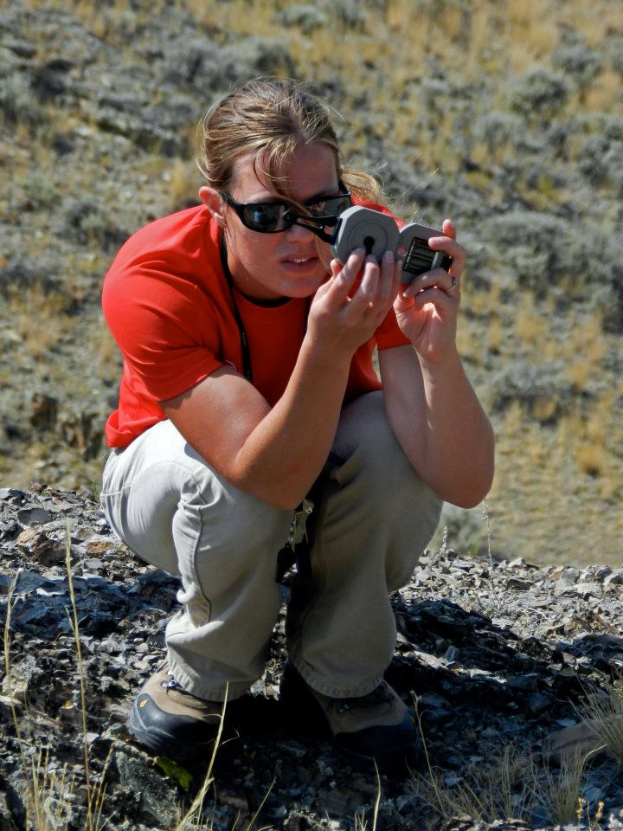
what does it take to get this done?
Core Requirements
Be willing to give up the pulpit and textbooks as central to teaching
The student must be willing to match the passion and commitment level of the instructor
Small class sizes, because large classes are made for lecture and mass-production education
Large blocks of time, because research doesn’t happen in 50-minute increments
Contractual and administrative support making this approach central to tenure and promotion

Slide 9
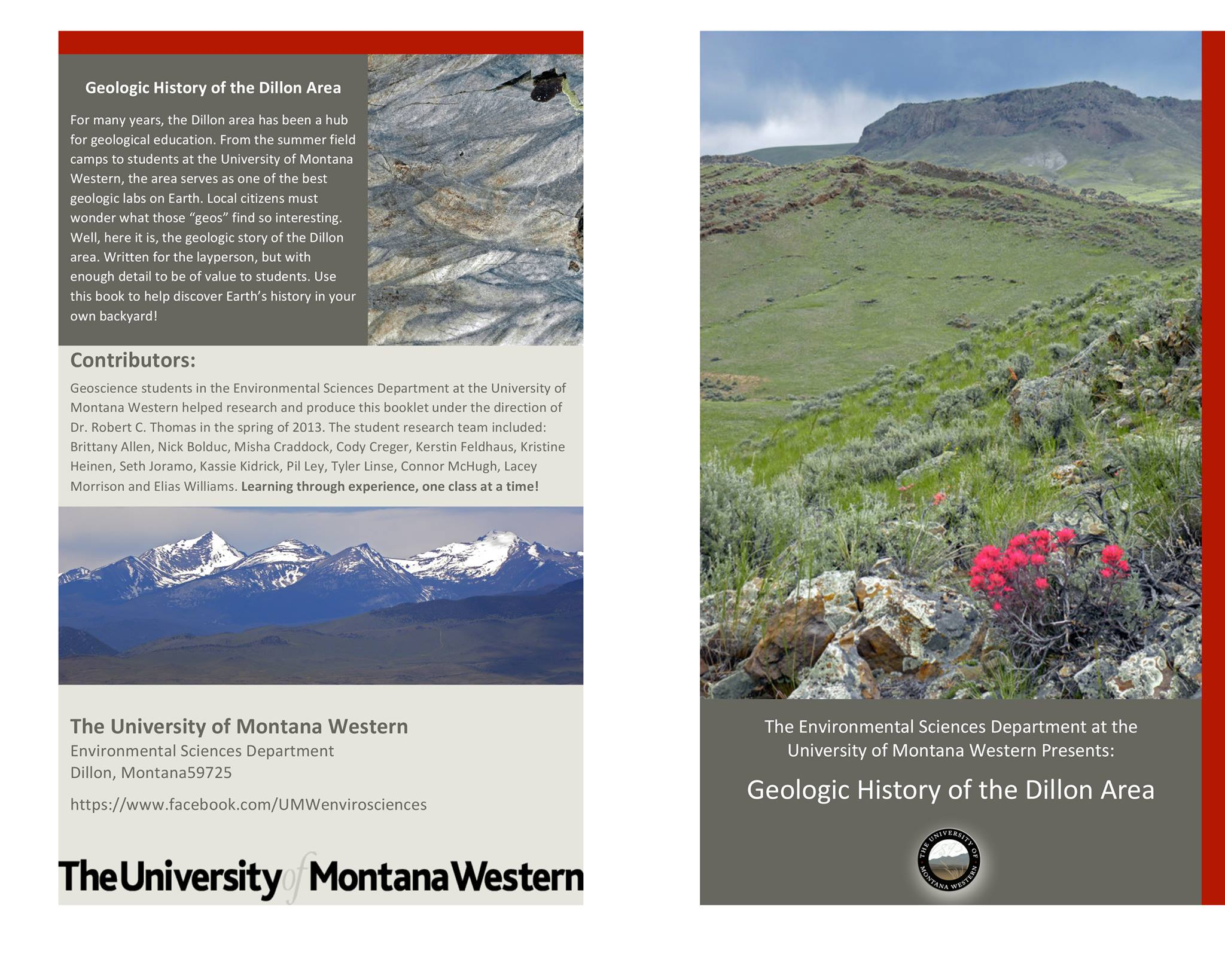
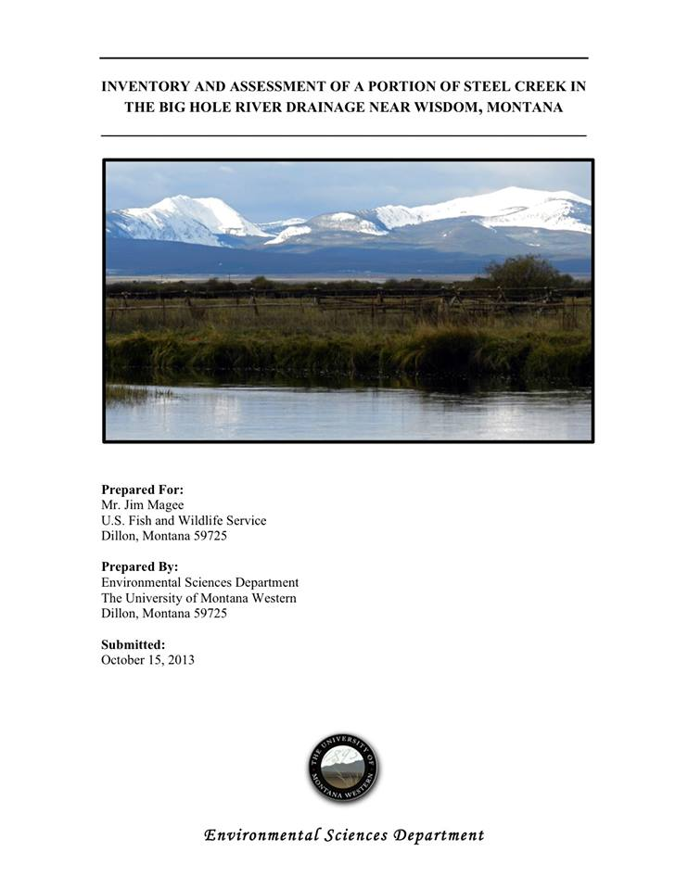
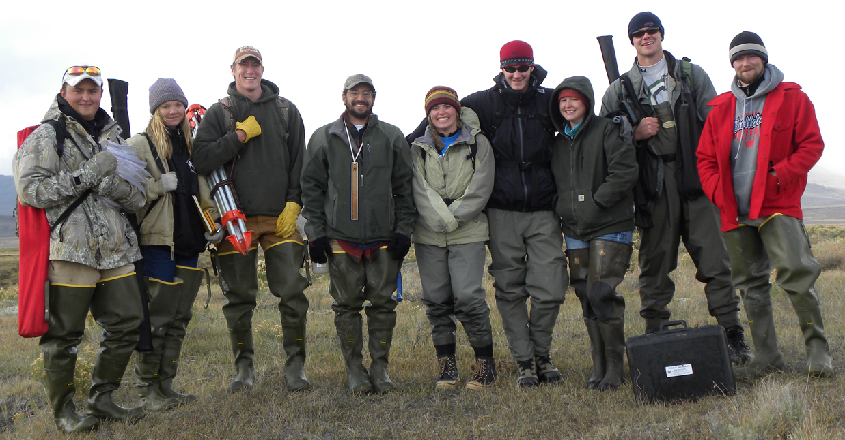
examples of how it works in the geosciences

Slide 10
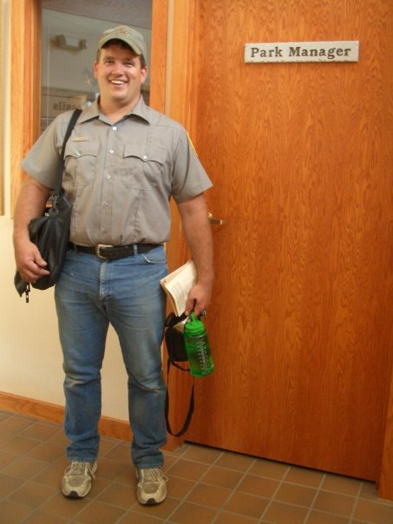
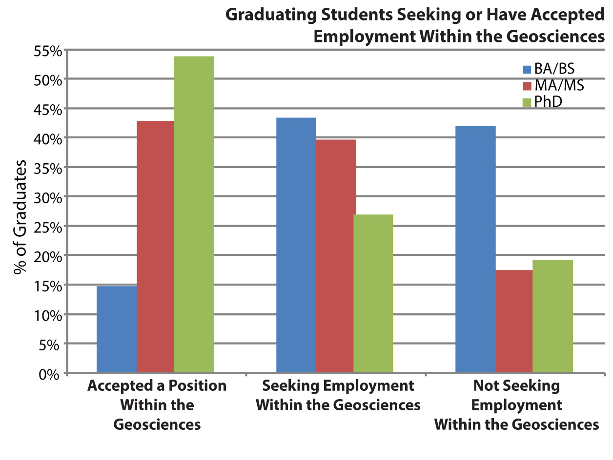
what are the outcomes for students?
Wilson, 2013
92% of Environmental Sciences
students at UMW land work in
the discipline within two years
of graduation – UMW Assessment

Slide 11
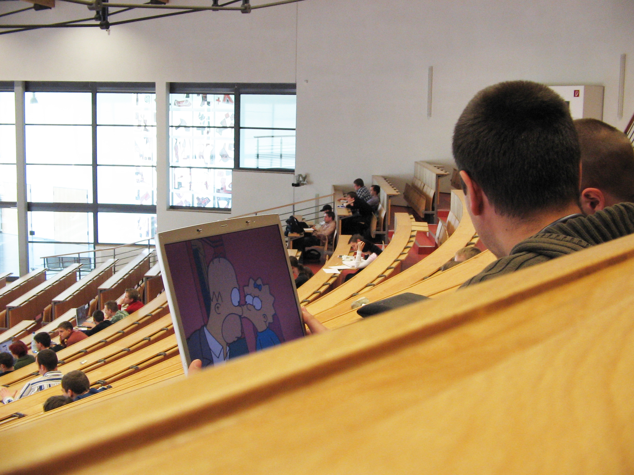
any questions?

