Slide 1


Starting to flip the class:
Quality of student’s pre-class
work improves with the use of
Online Just-in-Time teaching methods
Hayley Joyell Smith
Dr. David McConnell and Katherine Ryker
Marine, Earth, and Atmospheric Sciences

Slide 2


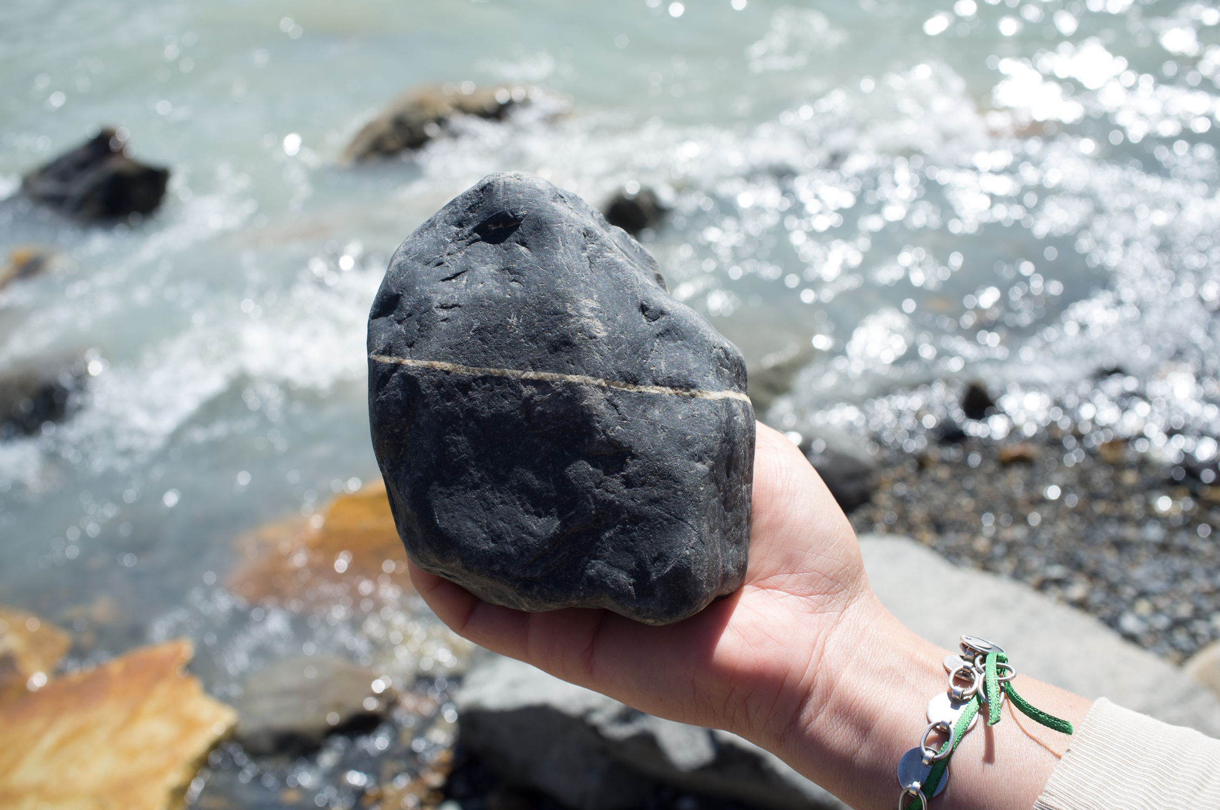
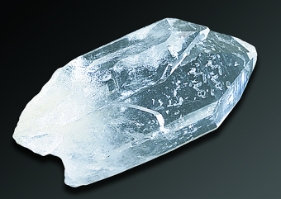
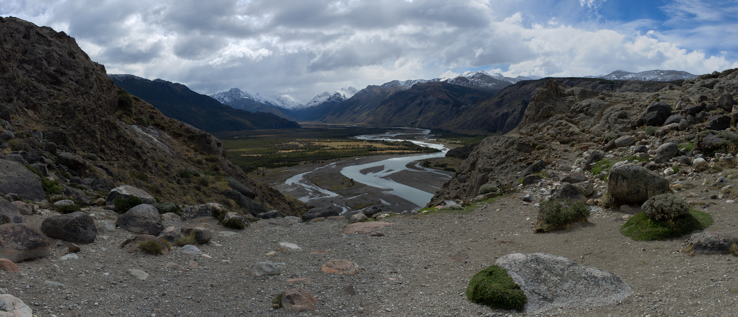
Introductory Class Conundrum
Copious amounts
of material
to teach
Limited time in the classroom
￼
Students need to
learn the basics
Build conceptual framework
Rock vs.
Mineral
Interpreting a landscape

Slide 3
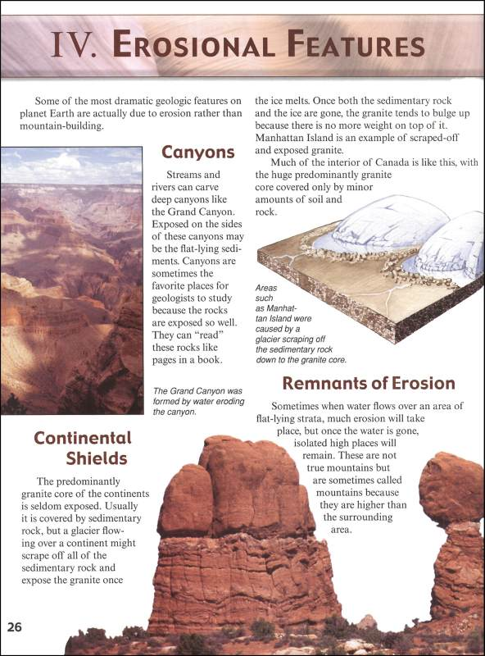
Shift some of the responsibility for mastering basic content outside of the classroom onto the student.
Reading
Assignments
13%
of students read the book¹
Podolefsky, N., & Finkelstein, N. (2006). The perceived value of college physics textbooks: Students and instructors may not see eye to eye.
The Physics Teacher, 44, 338.
Notes:
Podolefsky and Finkelstein (2006) reported that only 13% of students in various introductory physics classes reported that they “often” (>80% of the time) read the book before class. In contrast, most students appear to consider their textbook as a reference source to be dipped into to support preparation for exams rather than a resource to be used as a primer for in-class learning (Podolefsky and Finkelstein, 2006).

Slide 4
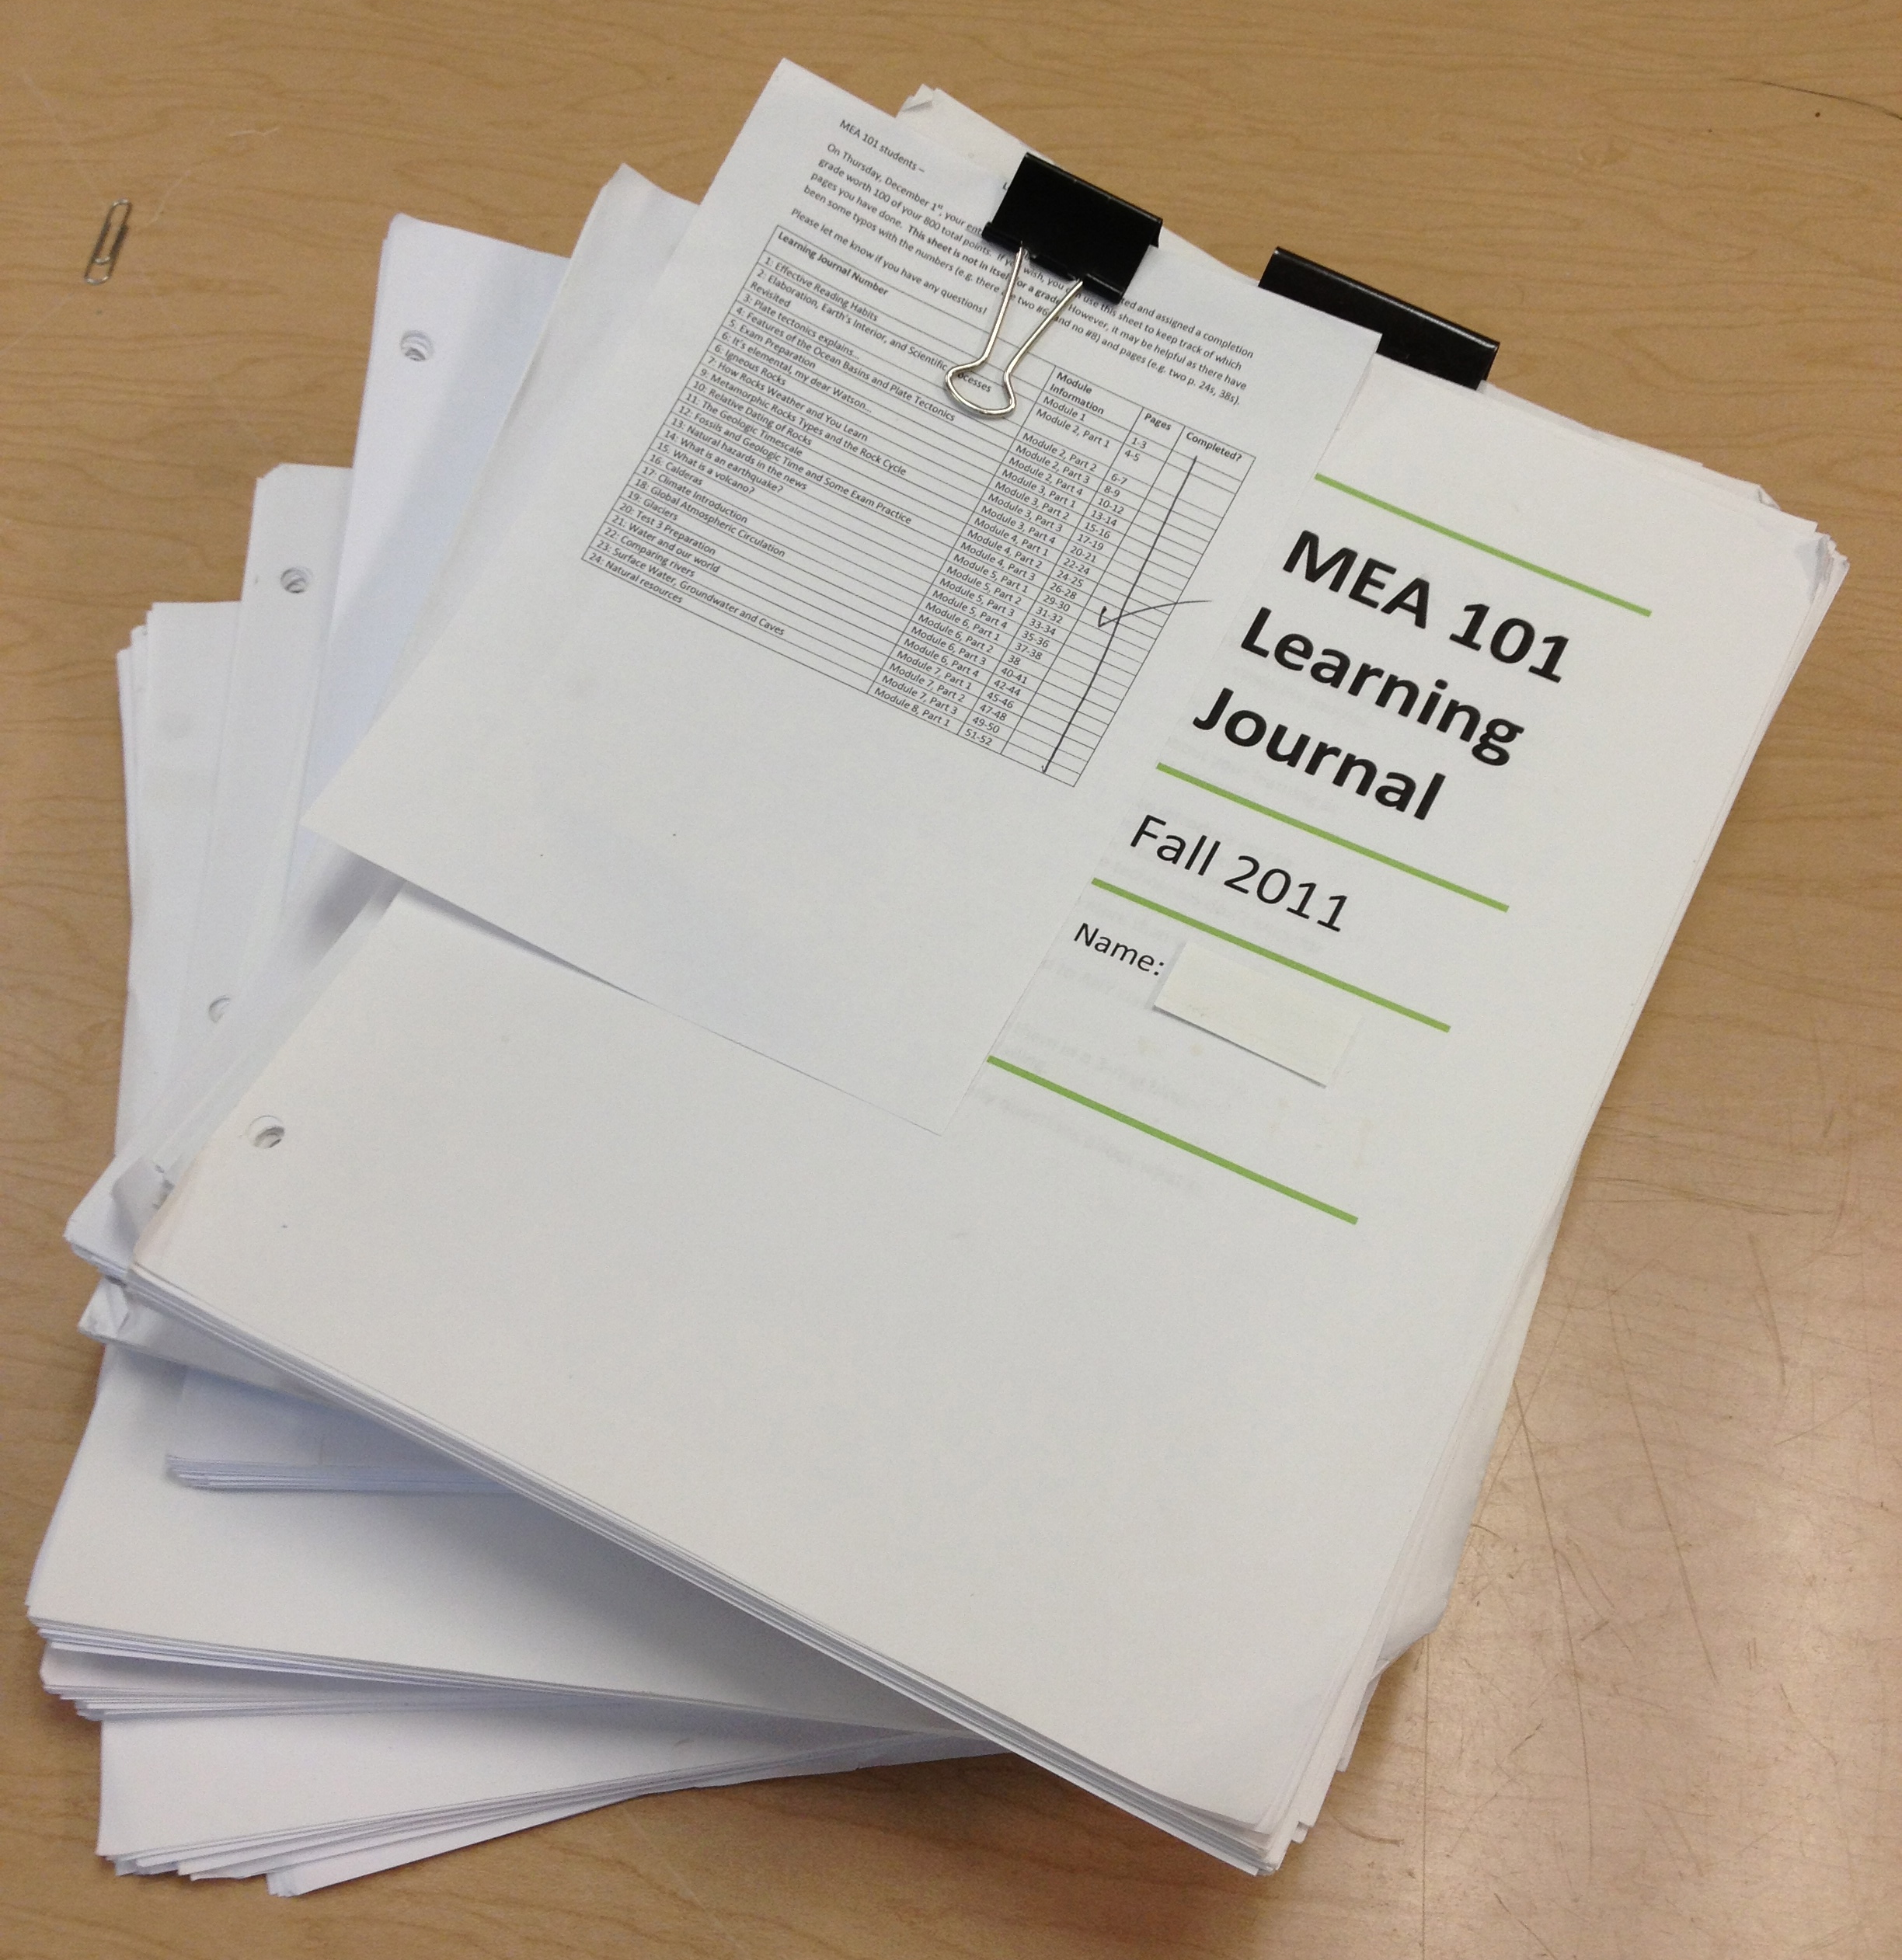
Starting to Flip the Class
Create a structure for learning basic
content outside of the class to allow time
for student-centered lessons.
Assignments that accompany daily readings
Learning Journals
Paper Format
Sporadically submitted
Graded after lesson
Online Format
Regularly submitted
Graded before lesson
Informs instructor of student
performance prior to class
Just-in-Time Teaching

Slide 5
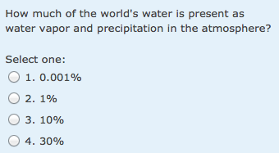
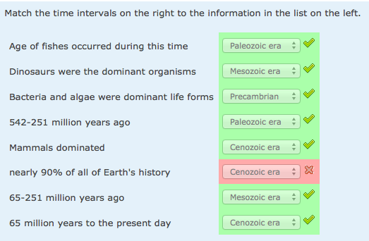
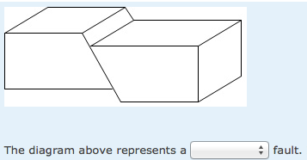
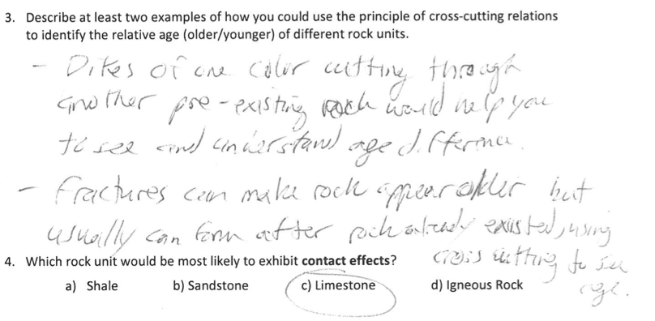
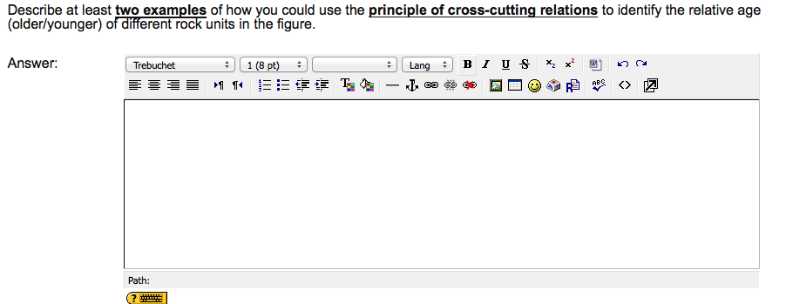
Learning Journal Example Questions
Multiple Choice
Matching
Diagrams
Paper Format Short Answers Online Format
When fractures cut across layers of rocks you can then determine that the rock already existed
before the fractures which can help knowing the age. Second sometimes, dikes crosscut through a rock. The dikes for example could be a lighter
color than the rock it cut through telling you that
the surrounding rocks are older than the dikes.
Notes:
These examples best represent the average A Student response (number of words and score) from both the paper and the online versions.

Slide 6
Population of Study
Undergraduate Students in Introductory Geology Courses at NC State University
Semester 1 Fall of 2011 N=48
Semester 2 Spring of 2012 N=48
Semester 4 Spring of 2013 N=45
Semester 3 Fall of 2012 N=48
Paper
Online
Stratified Sample
End of Semester Grade
Each Semester
B Students
C Students
A Students
Total
n = 189
Notes:
These undergraduate students are mostly freshman taking the course to full-fill the University general science education requirement.

Slide 7
Procedure
Selected 4 Learning Journal Short-Answer Questions
Learning Journal 8
Learning Journal 10
Learning Journal 14
Learning Journal 18
Applied a Rubric to Short-Answer Responses
Quantity – No points assigned
Number of Words
Quality
Articulation – 3 possible points
Accurate Explanation – 4 possible points
Use of Appropriate Content – 3 possible points
708 Short Answers Assessed
Notes:
Articulation
Clearly develops and communicates complete thought(s) that correctly answers the question. Pieces of the answer follow a logical order.
Accurate Explanation
Answer is correct. There is an explanation as to why the answer is correct. There is reference to the original question. You can predict the concept of the learning journal question by reading the answer.
Appropriate Evidence or Example
Provides applicable supportive evidence or example(s) that are directly
related to correctly answering the question. The response illustrates how the
supportive evidence or example validates the answer.

Slide 8
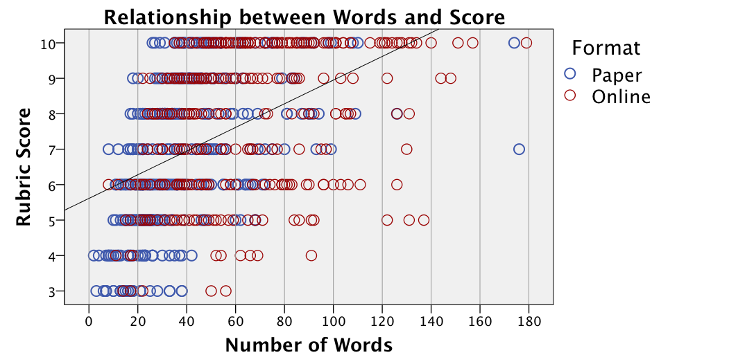
Results: Quantity and Quality
n = 708
r² ⁼ 0.21
p < 0.001

Slide 9
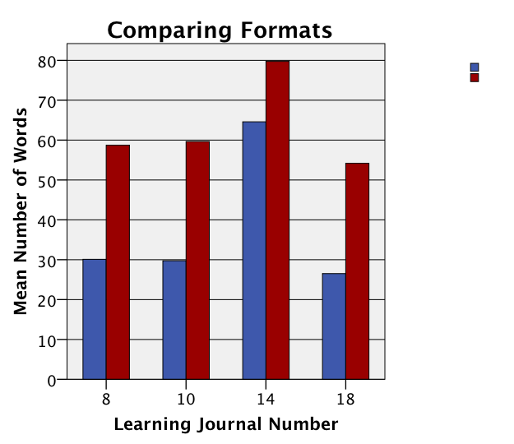
Results: Quantity of Words
Format
Paper
n=364
Online
n= 344
= p < 0.001
*
*
*
*

Slide 10
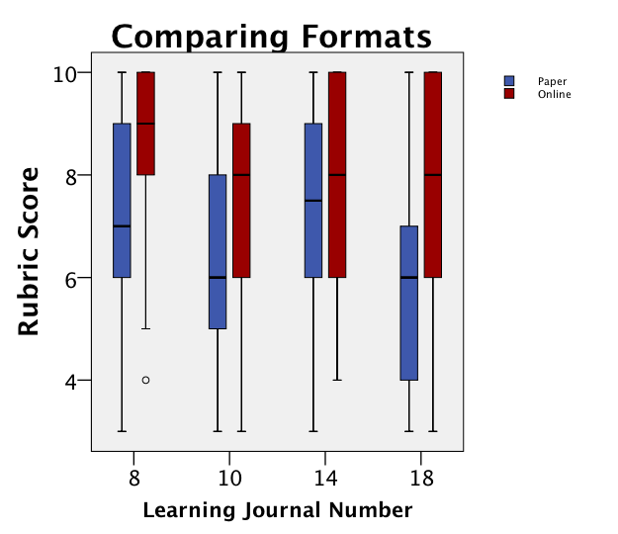
Results: Quality of Response Rubric Score
Format
Paper
n = 364
mean = 6.7
Online
n = 344
mean = 7.9
= p < 0.001
*
*
*
*
*
*
Notes:
Top quartile of of the scores from the paper format are equal or less than the median of scores for the online format. As far as overall means, we report that

Slide 11
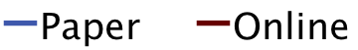
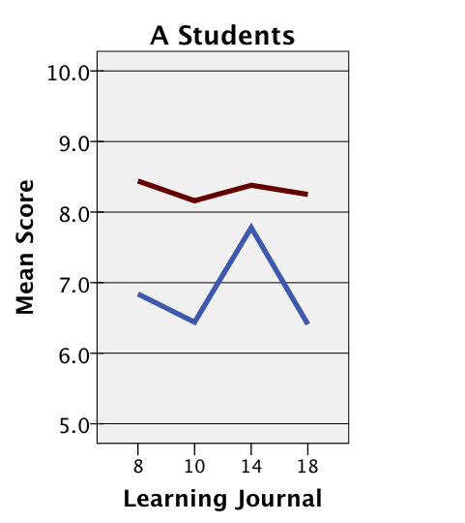
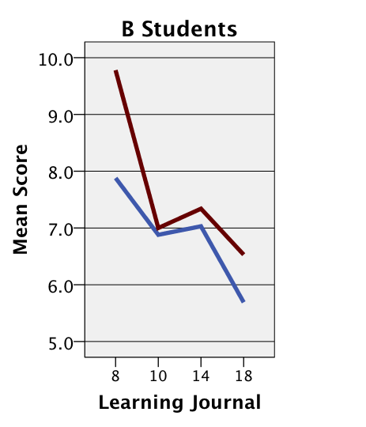
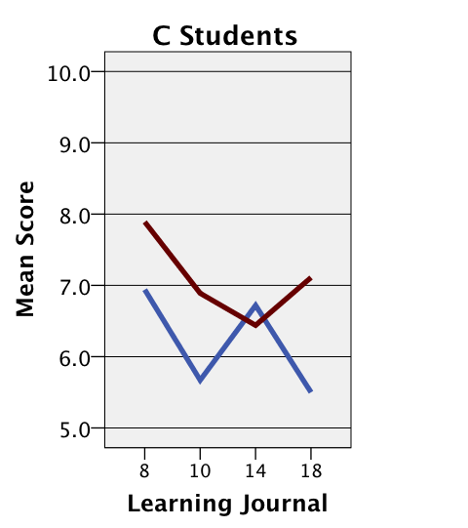
Results: Stratified Sample Average Rubric Score
Notes:
C Students are preforming

Slide 12
Format Impact on Exam Performance
Over the course of a semester,
81 multiple choice exam questions
related to Learning Journals were assessed.
Semesters worth of Multiple Choice Exam Questions related to Learning Journal Questions
Semesters worth of Multiple Choice Exam Questions related to Learning Journal Questions
Fall 2011 and Spring 2012
Fall 2012
Correctly Answered
75%
Correctly Answered
81%
N = 144
N = 46

Slide 13
What Students Think
Fall of 2012
n = 63
Notes:
Students were asked to give two specific examples that the instructor did that helped them learn the material for class. 19 Students mentioned the learning

Slide 14
Conclusions
Facilitating mastery of basic content outside of the
classroom is an effective strategy for making time
for active learning lessons that help promote conceptual framework.
Students wrote more and composed higher quality
answers with online Just-in-Time teaching format.
Performance on exam questions linked to
Learning Journals improved with the online format.
Students acknowledge that Learning Journals
help them learn.

