Slide 1
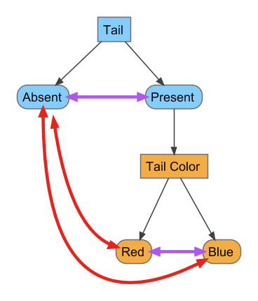
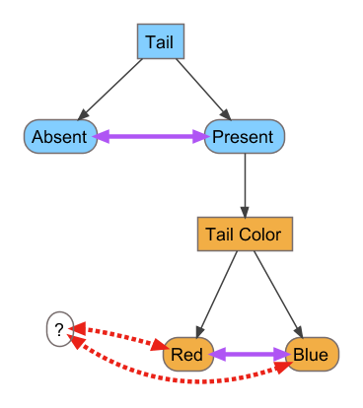
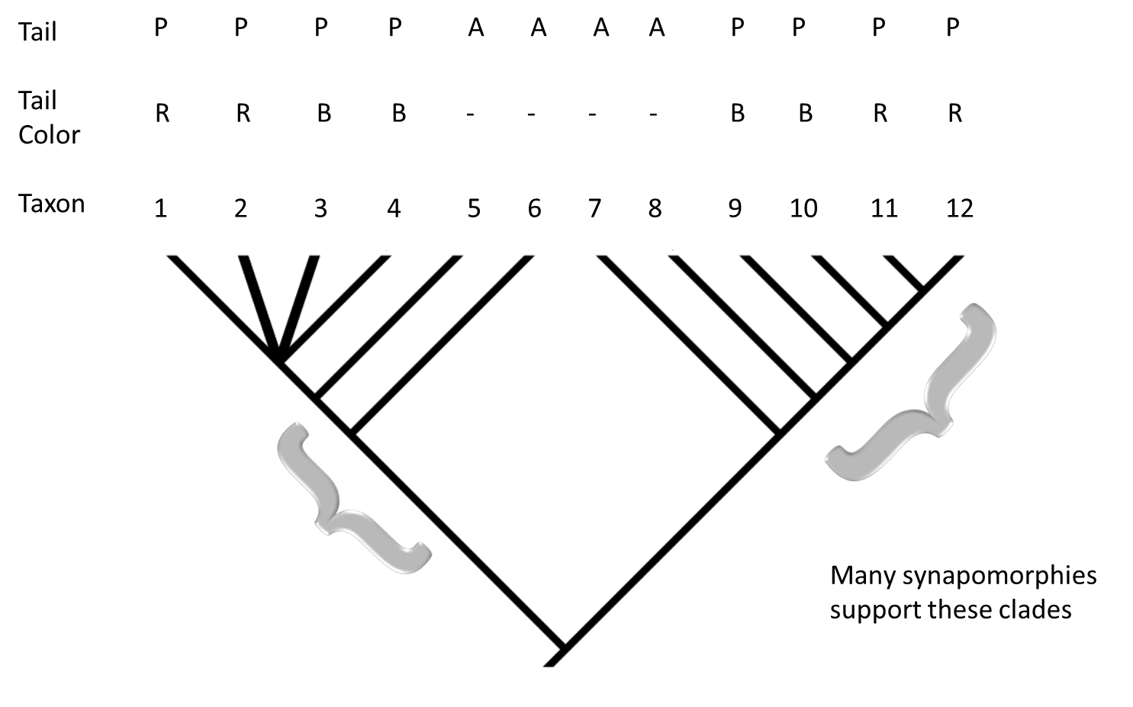
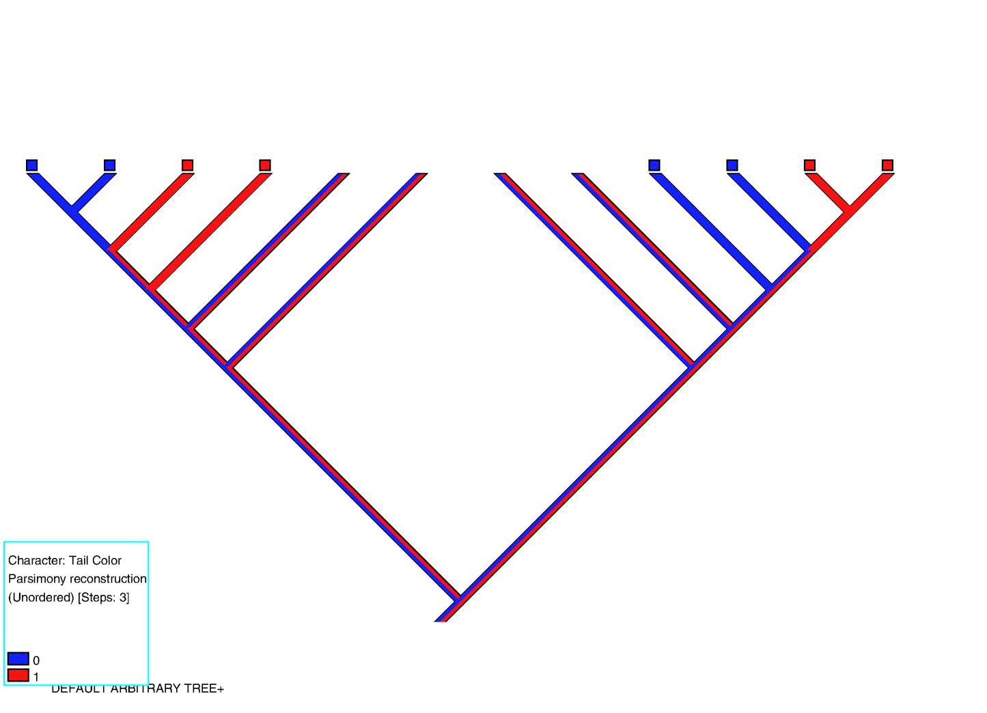
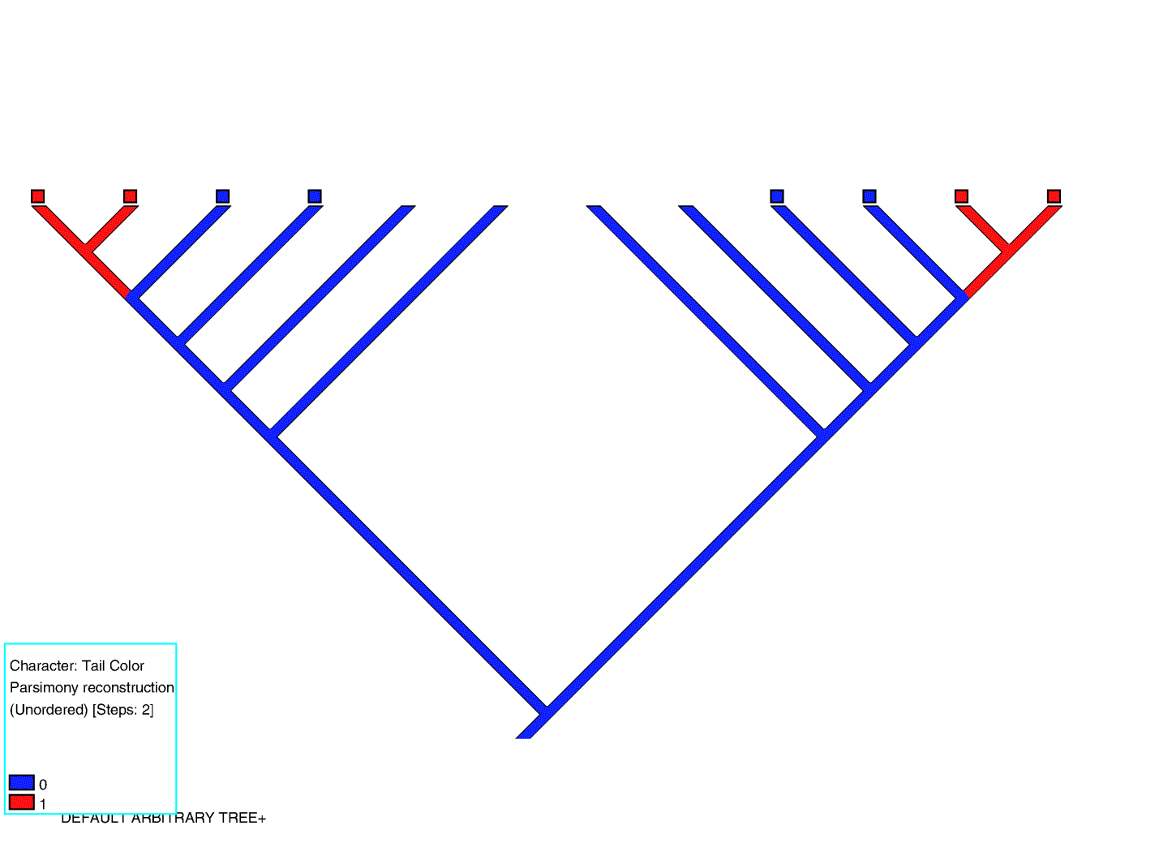
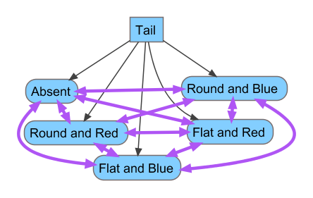
Not Applicable? Not a Problem for Parsimony
Troy Fadiga¹ and Ann F. Budd²
¹Department of Earth and Planetary Sciences, University of Tennessee, 1412 Circle Drive, Knoxville, TN 37996
²Department of Geoscience, University of Iowa, 121 Trowbridge Hall, Iowa City, IA 52242
The Problem with Not Applicable Characters
Absence Coding of Not Applicable Characters
When describing and delineating characters for phylogenetic analyses, the characters should aim to be biologically independent, but some desirable characters are logically dependent on the observed condition of other characters (Sereno 2007). The classic example, given by Maddison (1993), deals with the presence and absence of a tail and the color of the tail --if it is present. When dealing with a tailless taxon, additional characters dealing with aspects of the tail would be considered not applicable (NA).
The problem with these types of characters was elaborated by Maddison (1993). Traditionally NA character state codings were treated the same way as missing/unobserved characters. This resulted in equally parsimonious trees being erroneously scored for longer tree lengths.
Absence coding , one suggestion for overcoming the NA problem, treats the unobservable condition as a character state. This means in our example that the tail color will be coded as red, blue, or tail absent.
This is problematic in several ways: it makes the “absent” tail state redundant with the unobservable tail color condition and it asserts a homology based not on an observed attribute but the tautology that no observable difference can be observed among unobservable phenomena. In the tail example, the redundancy imposed by this method would automatically give the observation that a tail is absent twice the weight of observing the presence of the tail. In fact, the weight of the absent tail can be further inflated by adding more characters that describe the tail, such as tail shape.
While this approach is rightly rejected by researchers, there are two improvements over the traditional treatment of NA coding: it places the transitions at the correct places on the trees and its treatment of newly applicable characters is consistent.
Purple arrows depict transitions we want to include when figuring out the number of steps in the most parsimonious trees. The solid red lines depict incorrect transitions that are consistently counted when figuring out the number of steps in a phylogenetic tree.
This diagram depicts the logical relationship between characters (in rectangles) and character states (in rounded boxes) with black arrows. Purple arrows depict transitions we want to include when figuring out the number of steps in the most parsimonious trees. The red, dashed lines depict incorrect transitions that are intermittently counted when figuring out the number of steps in a phylogenetic tree.
P- present, A- absent, R- red, B- blue
The above tree summarizes our knowledge about a hypothetical clade. Below are two trees that are both equally consistent with the above tree and equally parsimonious. The lower trees have reconstructed the tail color, mistakenly predicting the tail color for taxa that have no tails. Even though both trees below are equally parsimonious, current algorithms mistakenly retrieve different numbers of implied transitions for the tail color character.
Composite Coding
Composite coding takes every logical combination of character states from a set of characters and yields a single character with each logical combination as a character state.
Strong and Lipscomb (1999) critiqued the use of composite coding when there are secondary losses of the feature which other characters describe, but the critique is mistaken. Their argument was based on a failure to consider all possible character state mappings on a particular tree and should be dismissed.
4 3 2 1 5 6 7 8 9 10 11 12
1 2 3 4 5 6 7 8 9 10 11 12
Three inferred changes in tail color
Two inferred changes in tail color
The above diagram depicts the relationship between three characters: Tail (present/absent), Tail color (red/blue), and Tail shape (round/flat). Note that transitions between a flat ,blue tail and a round, red tail is the same as changes implying only a change in tail color or tail shape.
Both of the above trees show the two independent acquisitions of tails. The inferred changes in tail color should count the same number of steps in both trees. Because one clade with tails is well supported and originally had blue tails, the algorithms are going to penalize trees where the other independent acquisition of tails start off as red.
This results in treating newly applicable characters inconsistently and causing what should be equally parsimonious trees to have different tree lengths. The inconsistent treatment originates from the current algorithms’ (Fitch and Sankoff) progressive serial sweeps along the nodes of proposed trees which fail to detect inappropriate influences from more distant parts of the tree.
Real data sets are not always amenable to manual inspection for the “accidental assumptions” introduced by this treatment of NA coding, making this traditional treatment for NA characters an unacceptable option. For some sets of taxa numerous NA codings are required, meaning those groups are poorly served by current software.
Composite coding can work, but it depends on the particular relationships between characters (see next panel). In the diagram above, three characters are composite coded and transitions that should be considered multiple transitions are reduced to a single implied transition.
A step matrix is a matrix of costs that applies different tree lengths to different inferred transitions. If the maximum number of transitions between any two combinations of character states is two, then a step matrix can be used to preserve the correct number of transitions. If the maximum number of transitions between any two combinations of character states is more than two, then the step matrix can violate triangular inequalities and provide undercounts of the number of transitions implied by a given tree.

Slide 2
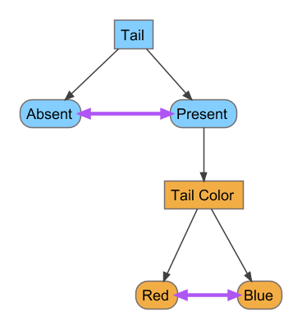
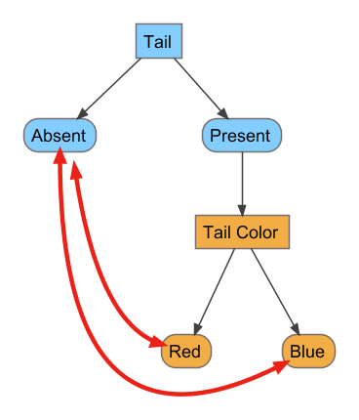
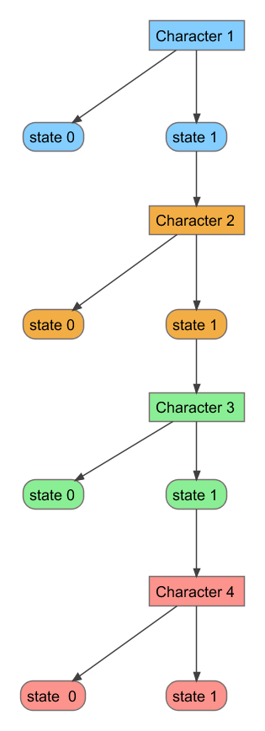
The Solution
The solution is a radically simple subtraction problem that includes the use of two matrices to count the proper number of implied transitions. The original matrix gets decomposed into two matrices. The first matrix is the absence coded version of the original matrix. This first matrix is going to take advantage of the fact that the absence coded matrix recovers all of the inappropriate transitions between a NA condition and an applicable condition along with all of the appropriate transitions. The traditional treatment might retrieve some or none of the inappropriate transitions. The second matrix only encodes whether the character is applicable or not applicable for each taxon. This matrix, when optimized on a tree will retrieve all inappropriate transitions and none of the appropriate transitions. The difference between the number of transitions in the absence coded matrix and the applicability matrix gives the number of true transitions implied for a tree by the original character matrix . This approach allows the continued use of either the Fitch or the Sankoff algorithms for determining the number of transitions implied by each matrix.
 | Char 1 | Char 2 | Char 3 | Char 4 | Char 5
Taxon 1 | 0 | 1 | 1 | NA | NA
Taxon 2 | 0 | 0 | 0 | NA | NA
Taxon 3 | 0 | 1 | 1 | NA | NA
Taxon 4 | 1 | 1 | 0 | 0 | 1
Taxon 5 | 1 | 1 | 0 | 0 | 0
Taxon 6 | 1 | 0 | 1 | 1 | 1
Taxon 7 | 1 | 0 | 1 | 1 | 1
Taxon 8 | 1 | 1 | 1 | 1 | 0
 | Char 1 | Char 2 | Char 3 | Char 4 | Char 5
Taxon 1 | 0 | 1 | 1 | 2 | 2
Taxon 2 | 0 | 0 | 0 | 2 | 2
Taxon 3 | 0 | 1 | 1 | 2 | 2
Taxon 4 | 1 | 1 | 0 | 0 | 1
Taxon 5 | 1 | 1 | 0 | 0 | 0
Taxon 6 | 1 | 0 | 1 | 1 | 1
Taxon 7 | 1 | 0 | 1 | 1 | 1
Taxon 8 | 1 | 1 | 1 | 1 | 0
 | Char 4 | Char 5
Taxon 1 | 0 | 0
Taxon 2 | 0 | 0
Taxon 3 | 0 | 0
Taxon 4 | 1 | 1
Taxon 5 | 1 | 1
Taxon 6 | 1 | 1
Taxon 7 | 1 | 1
Taxon 8 | 1 | 1
This matrix records the original observations and indications of which characters are not applicable for which taxa.
This matrix encodes the original matrix and changes the NA codings to a character state that will be treated the same as other character states.
This matrix only indicates whether a character is applicable or not applicable for a taxon. Note that characters 1-3 were dropped because they were applicable to all taxa and would be uninformative in this matrix
These diagrams show the logical dependencies between the characters and character states (black arrows), all of the appropriate transitions (purple arrows), and inappropriate transitions (red arrows) detected by each matrix. The method takes advantage of absence coded matrices implying a knowable number of inappropriate transitions for a given tree.
Actions for Analyses
While the procedure is implemented in R and can be done with Mesquite (Maddison and Maddison 2011), no current software can search for trees that maximizes the difference in tree length of two matrices in a time-appropriate manner that does a reasonable job of exploring tree space. If the most parsimonious trees all have the NA characters applicable for a monophyletic group, then the tree length calculated by the traditional method is correct. Unfortunately this can’t be known a priori. When assessing which approach to use, a diagram of all of the logical dependencies between characters is very valuable. Groups of characters with logical dependencies are called character complexes.
When to use composite coding
Use composite coding when the number of transitions implied by any combination of character states in a character complex is one. While this seems very restrictive, it is very frequently met. Most instances of NA coding occur in one character that is logically dependent on the presence of one piece of anatomy. Use composite coding and conventional software will return the correct trees and tree length. If the character complex is more elaborate, the condition can still be met. If all the NA characters are only immediately logically dependent on one character and all characters have at most one character dependent on it, then composite coding and current software will work correctly.
When to use a step matrix
A step matrix can be applied to a composite coded character if the step matrix that would preserve the appropriate number of transitions between composited states maintains triangular inequality– meaning that the total tree length implied by transitions from A to B and B to C are never less than the tree length implied by the transition from A to C. This condition is usually met in the literature when two, but not more, NA characters are dependent on the same character.
When neither of the above conditions are met, current software will not be guaranteed to return the correct trees and tree length. Mesquite can calculate and filter trees based on the difference in tree length from two matrices. Use this software and the needed two matrices to see if the most parsimonious trees returned by current software all have the same tree length. When a fast implementation of the proposed method is written, the advantages will be that it will work regardless of the nature of the logical dependencies within a character complex.
This diagram shows the logical dependencies between the characters and character states (black arrows). All character complexes which show this pattern (the number of characters can vary) can be composite coded and used with current software to avoid NA related miscalculations of tree length and tree searches.
Acknowledgements and Literature Cited
This work was supported by the NSF grant DEB-0343208.
Maddison, W. P. 1993. Missing data versus missing characters in phylogenetic analysis. Systematic Biology 42, no. 4: 576.
Maddison, W. P., and D. R. Maddison. 2011. Mesquite: a modular system for evolutionary analysis. Version 2.75 http://mesquiteproject. org/mesquite/mesquite. html.
Sereno, Paul C. 2007. “Logical Basis for Morphological Characters in Phylogenetics.” Cladistics 23 (6): 565–587.
Strong, E. E, and D. Lipscomb. 1999. Character coding and inapplicable data. Cladistics 15, no. 4: 363–371.

