Slide 1
The Kraken’s Back: New Evidence Regarding Possible Cephalopod Arrangement of Ichthyosaur Skeletons
Mark A. S. McMenamin
Dianna L. Schulte McMenamin
Department of Geology and Geography
Mount Holyoke College
2013

Slide 2
Triassic Kraken
Explanation for a puzzling accumulation of bones in Nevada.
Overflow audience at the 2011 Minneapolis GSA annual meeting.
When we were made aware of a second cephalopod geoglyph, we made immediate plans to return to Nevada for more data.

Slide 3
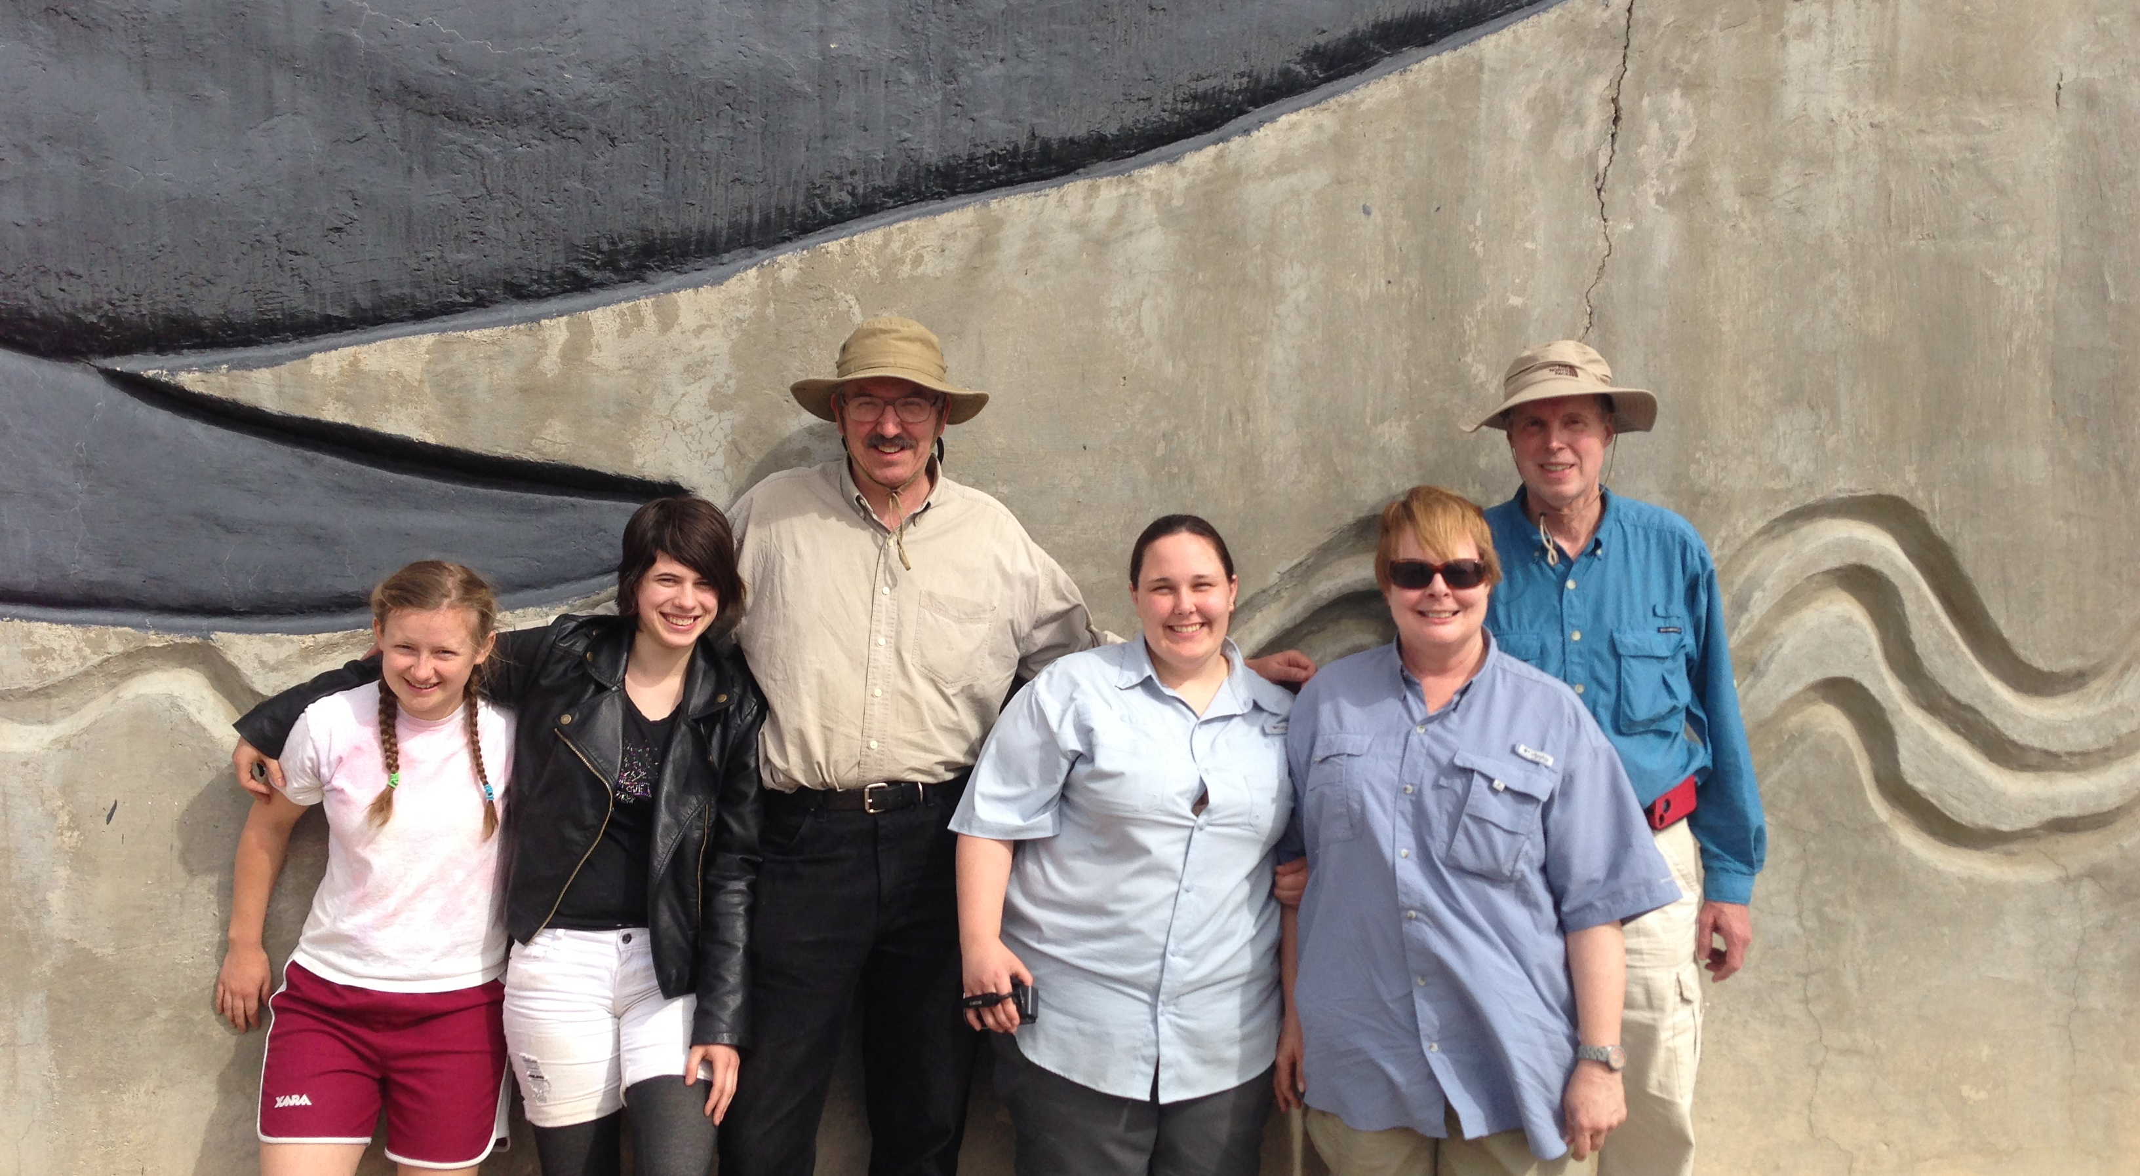
Triassic Nevada Field Work, May 2013
Photo Credit: Ranger Todd Wheeler

Slide 4
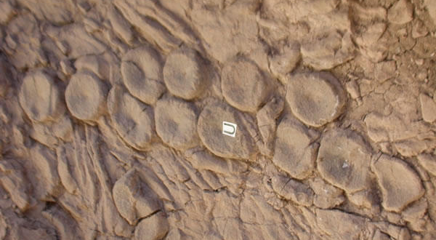
Cephalopod Geoglyph

Slide 5
Hydrodynamic Considerations
Ref.: M. A. S. McMenamin, 2012, 21st Century Science and Technology 24(4):56

Slide 6
Hydrodynamic Considerations
Probability of Displacement (PD) = tendency to displacement in a random current suite.
Case A: PD = 17%
Case B: PD = 89%
Case C (Specimen U): PD = 100%
The probability that currents formed the geoglyph is zero.

Slide 7
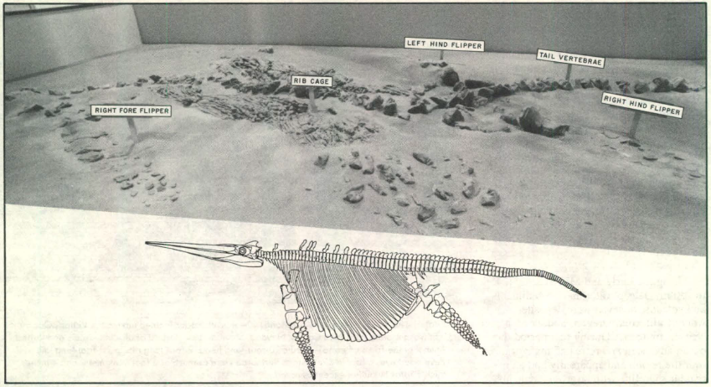
Don Dupras, California Geology (1988)

Slide 8
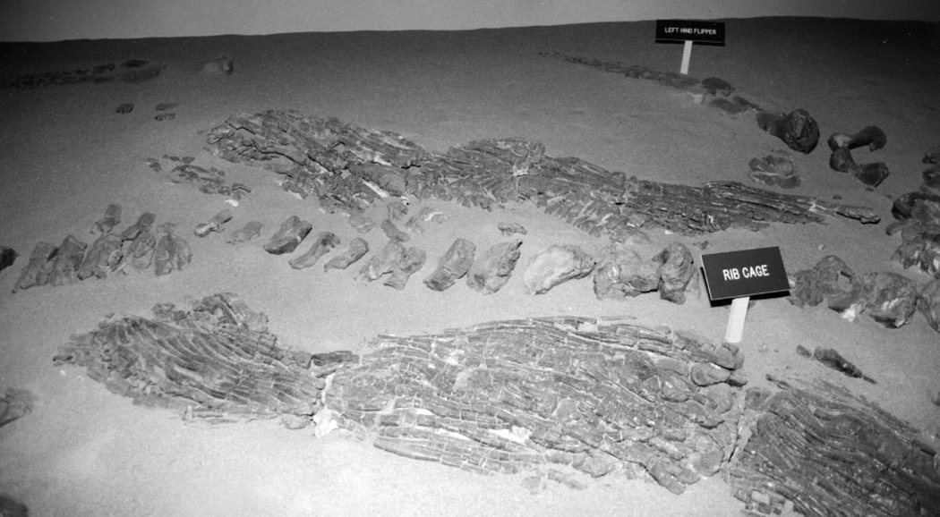
Strange Rib Cage Constrictions

Slide 9
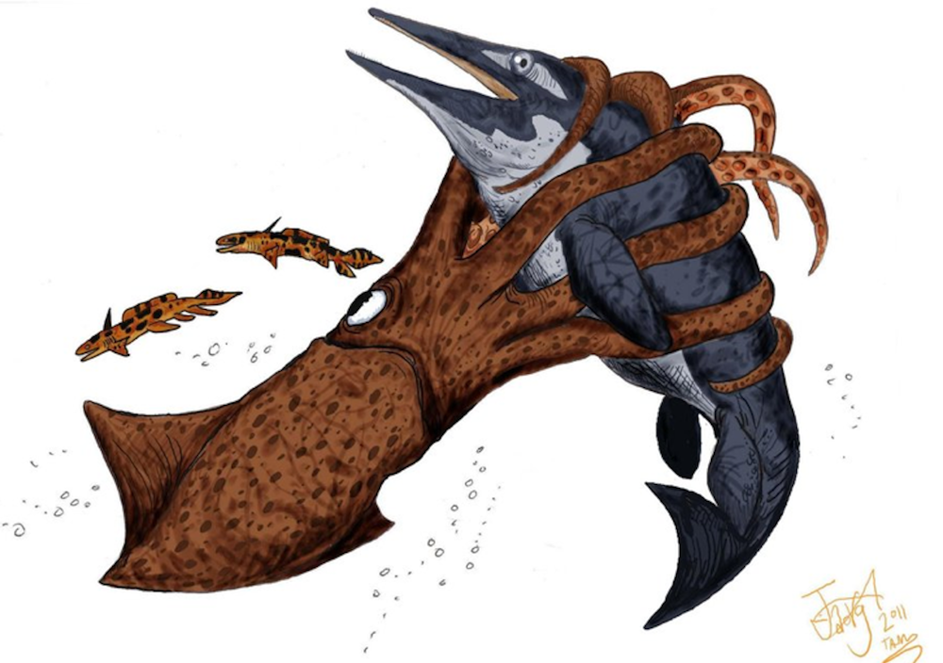
Tentacular Constriction
Artwork: Hodari Nundu

Slide 10
Broken back, Discard pile, Geoglyph

Slide 11
Ichnofossil Evidence
Multiple geogyphs
Geoglyph PD = 100%
Constrictions to rib cage
Discard pile plus broken back
Mix of centra with differing taphonomy
Curious halved and slivered (bitten?) centra
Composite geoglyph element

Slide 12
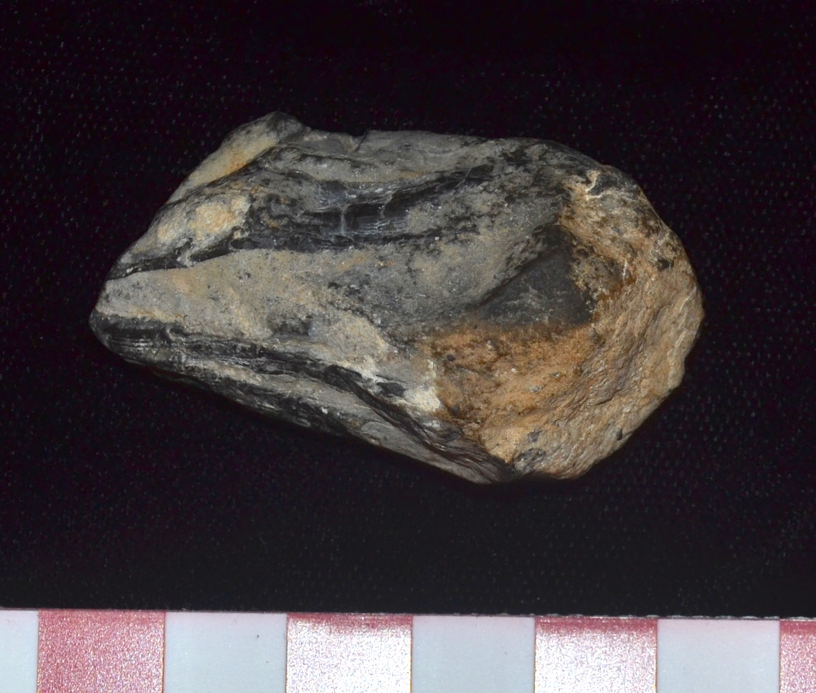
Is this the Beak of Triassic Kraken?

Slide 13
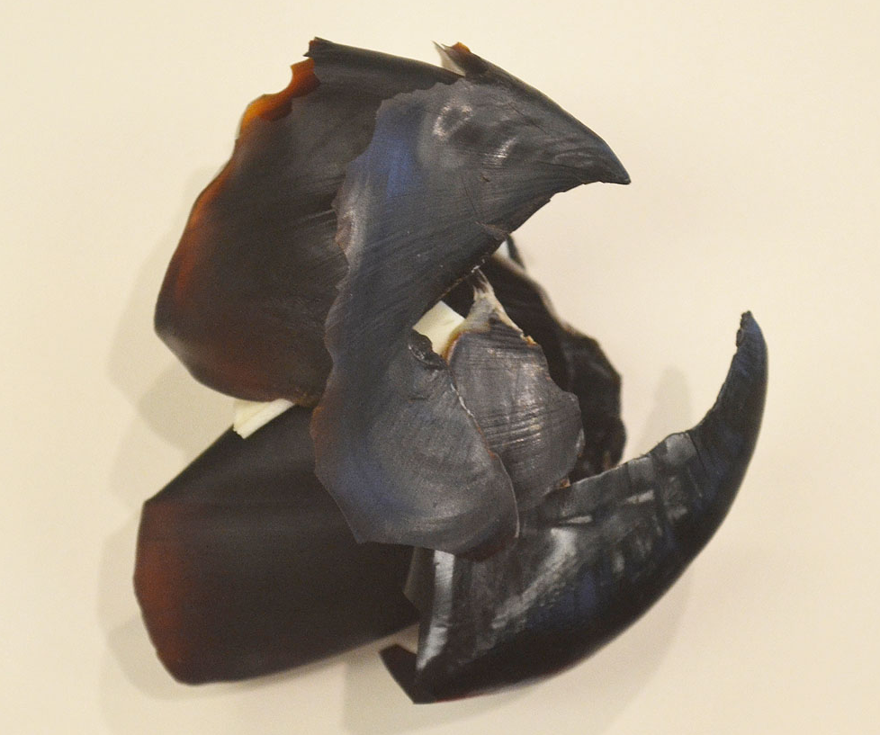
Humbolt Squid Beak

Slide 14
Features in Common
First-order spall fractures
Second-order spall fractures
Spall shelves become smooth
Converging striae
Tension fractures with offset
Tip of beak most durable

Slide 15
Converging Striae, Offset and Spall Fractures, Humbolt Squid Beak

Slide 16
Same Features, Triassic Beak

Slide 17
Shonisaurus scenario
Attack occurs at depth where cephalopod vision is superior
Crushing tentacles encircle the victim
Toxic injection via radular tooth
Evisceration and bone selection
Geoglyphs with composite elements
Midden scene illuminated by ghostly bioluminescence

Slide 18
Conclusions
Ichnological evidence led to initial recognition of the Triassic Kraken
Multiple, independent lines of evidence
Trace fossils (Seilacher’s “fossilized behavior”) provided at least twice as much evidence as did the body fossils

Slide 19
Mode of Scientific Advance
Hypothesis designed to absorb harsh criticism.
Indeed, that was partly the point of this research, to advance the science through heated discussion.
We can all hope for an improved next round of discussion on this topic.
Critical scrutiny and intelligent commentary is always welcome.

Slide 20
Implications
Primates and proboscidians were not the first groups on this planet with sufficiently high intelligence to manifest a type of artistic behavior.
Indeed, this is predicted by Teilhard’s Rule, of which Cope’s Rule is a specific example (McMenamin, 2011, pp. 33-45 in The Legacy of Pierre Teilhard de Chardin).

Slide 21
Composite Quotation
“Somewhere, something incredible is waiting to be known” (Carl Sagan) and we may find it by “coupling restless curiosity with a willingness to follow the evidence wherever it leads” (President Barak Obama, in his letter congratulating the GSA on its 125th Anniversary).
Well spoken, gentlemen!

