Slide 1
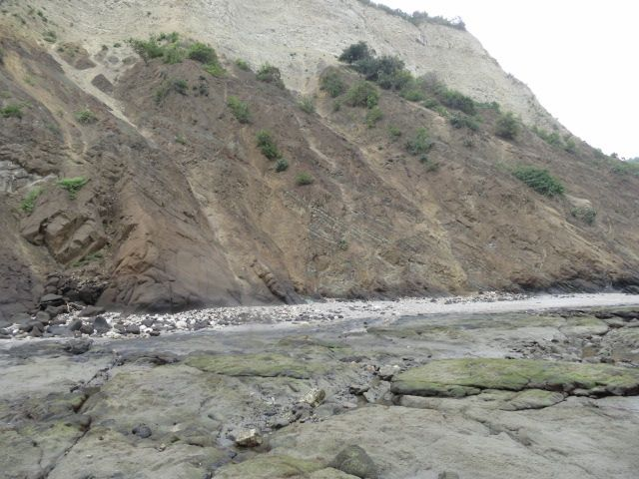
The Cretaceous Cayo Formation
at Puerto Cayo, Western Ecuador
Habte G. Churnet
Department of Physics, Geology, and Astronomy
The University of Tennessee at Chattanooga

Slide 2
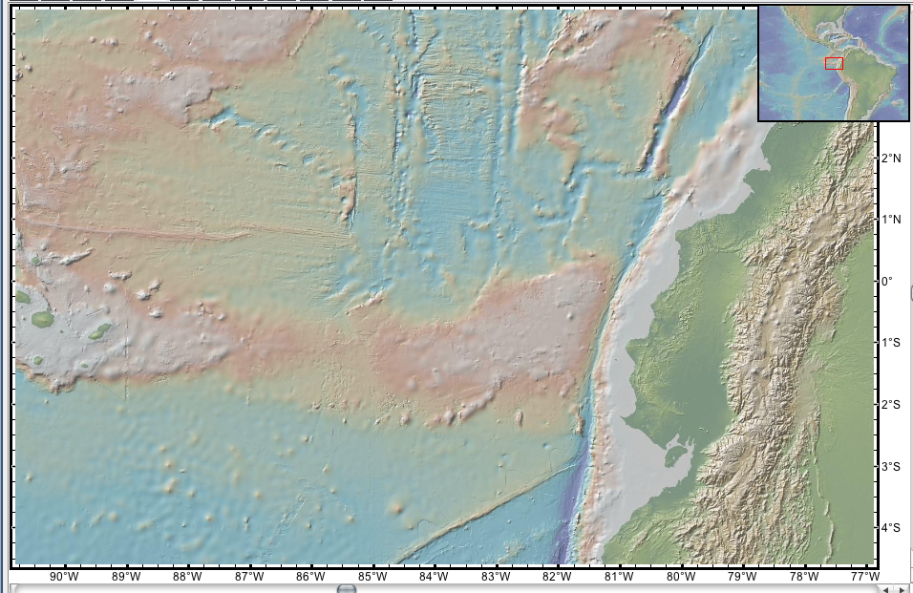
Location: Geologic Environment of Ecuador
Quito
Trench
o
Jonathan W. Mies
Department of Physics, Geology, and Astronomy
The University of Tennessee at Chattanooga
Forearc Ridge
Galapagos
Carnegie Ridge [aseismic]
cayo
o
Forearc basin
Magmatic arc
o
Backarc basin
Grijalva scarp
Trench
Grijalva scarp: south side is 700 meters below north side

Slide 3
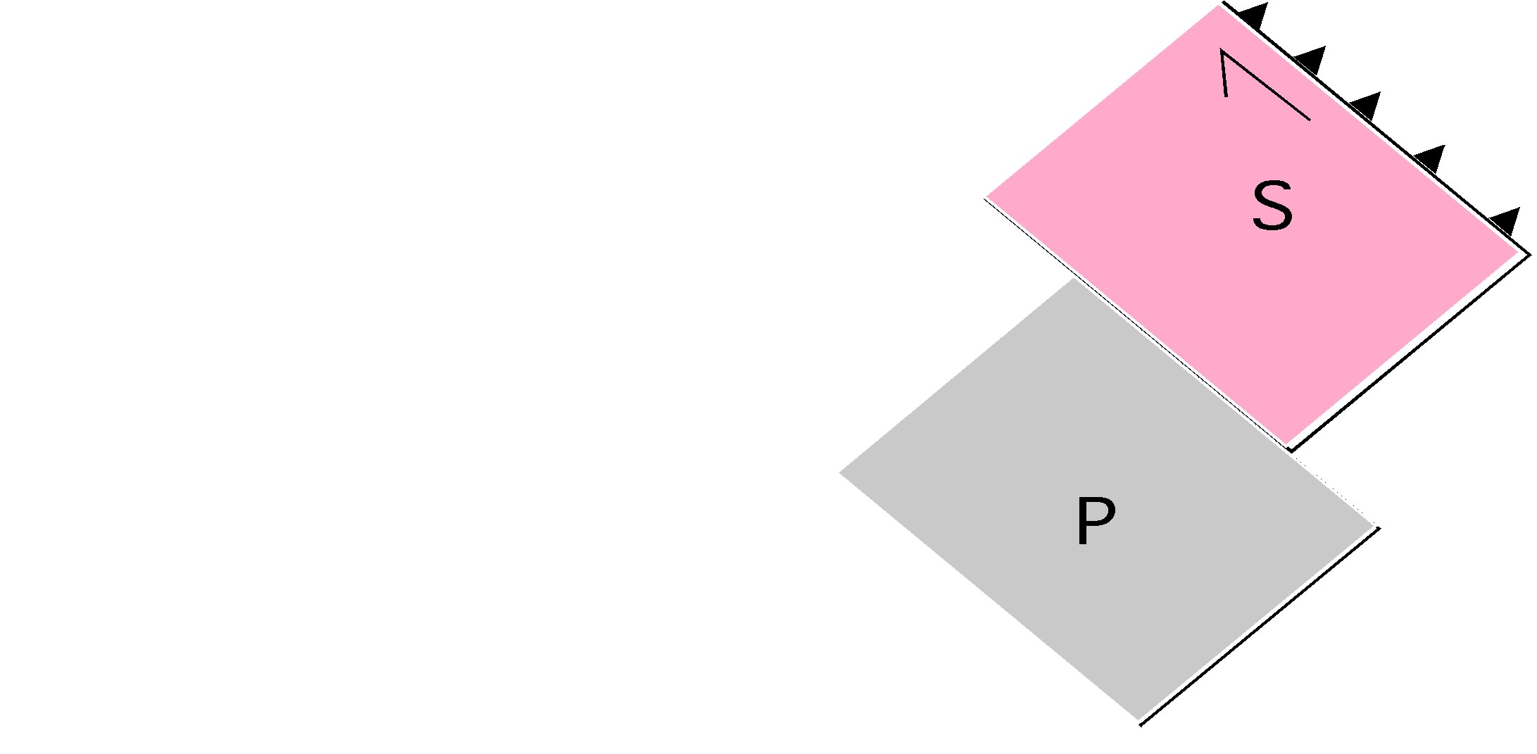
Objective
Review of tectonic and neo-tectonic setting of Ecuador
Show structures in the Cayo FM. and provide inferences.
new
REE
L
Igneous provenance from
discrimination diagrams,
e.g., Rare Earth Elements (REE)
B. Cretaceous, Farallon Plate
Two oceanic plateaus that were
appended to Ecuador since the Cretaceous, which
otherwise was mostly submarine.
S = San Jun Plateau- 1st ocean Plateau
P = Pinon Plateau – successor Ocean Plateau
Pinon Plateau was 100s km
south of its current position
In Ecuador.
D. South America has been rotating clockwise
E. Volcanic activity since the Eocene covered earlier terranes and formed
the Ecuadorian Andes.
Calc-alkaline
(e.g., Island arc)
H
Tholeiite
(e.g., oceanic Plateau)

Slide 4
Objective (continued)
new
F. Currently, the Nazca subduction zone is 150 km beneath the Ecuadorian Andes
G. Compression above the edge of the supra-subducting plate is associated with
generally NE-SW dextral faults such as the Jamie, and the Puertovijo, and E-W
Sinistral faults such as the Montecristi (Pedoja et al., 2004).
H. Subduction of the relatively hot, aseismic Carnegie Ridge is associated with
uplift of the continental margin of Ecuador, and reactivated faults. For example,
The Monticristi sinstral fault was reactivated into a north side up thrown
normal fault (Pedoja et al., 2004).
This uplift is apparently why cliffed coasts [secondary coasts in that waves and tides
have also shaped the coastline with sea stacks separated from mainland by erosion]
occur over miles on either sides of the Manta peninsula. Wave action erodes coastal
man made structures, roads, fences, houses in the current global-warming-related sea
level rise.
I. Uplift of the continental margin is punctuated with interglacial inundation,
and glacial coastal erosion. The punctuated uplift is marked by flat terraces present
on land as in the Manta peninsula, which is associated with 360 m uplift above
sea level, an on La Plata island that is uplifted 170 meters above sea level (Pedoja et al.)

Slide 5
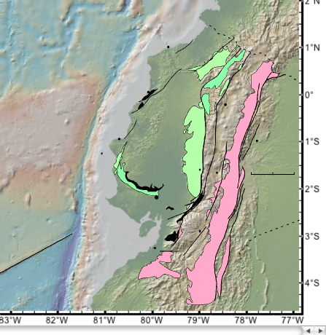
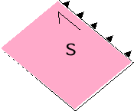
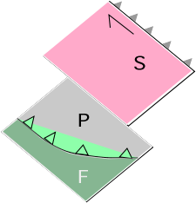
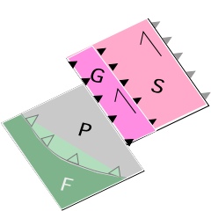
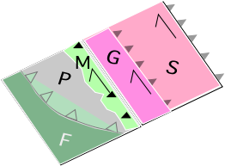
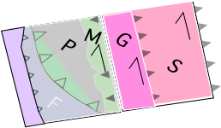
Geologic map ( adapted from Jaillard et al., 2009)
Cartoon: Farallon to Nazca
San Juan (S)
Late K
DGC
E
Cayo Formation
(C)
Late K
Late Eocene -Recent
Naranjal
C
Q
Guaranda
Terrnae (G)
M
San Juan
Guaranda
T
C
LP
Macuchi Island Arc
C
Pinon
0
100
Macuchi arc (M)
Northward movement
along the
Dextral
Guayaquil-
Carcas
Megashear
(DGC)
km
G
C
C
DGC
N
Nazca
Plate (N)
subducted
DGC
Calc-alkaline
REE
No magmatic arc from 140 to 40 Ma. Clockwise rotation of S America.
Tholeiite
Notes:
Cayo Fm formed at back arc DJC= dextral Guaquil-Caraca Megashear
San Lorenzo volcanincs have calc-alkaline sigfniature
San Juan accreted in ecudor
Pino –southern edge formed a suprasubduction edged

Slide 6
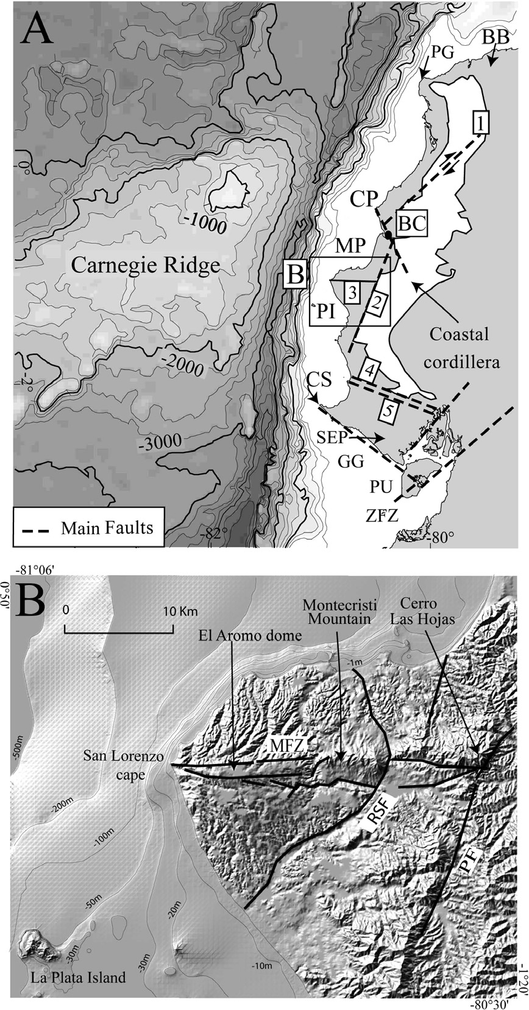
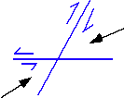
1, Jama;
2, Portoviejo; (dextral)
3, Montecristi; (sinisteral)
4, Colonche;
5, Carrizal.
C
Compression before 3 to 2 Ma
Uplift & extension since 3 to 2 Ma
Uplift –subducted Carnegie
Manta ~ 360 meters
La Plata ~ 170 meters
Marine terraces. 0.3 mmyr⁻¹
PG, Punta Galera;
CP, Cape Pasado;
BC, Bahia de Caraquez;
MP, Manta Peninsula;
C, Puerto Cayo
PI, La Plata Island;
CS, Cape Salinas;
SEP, Santa Elena Peninsula;
PU, PunaÅL Island;
GG, Gulf of Guayaquil;
ZFZ, Zambapala fault zone.
Plio-Quaternary Uplift from Pedoja et al., 2004. A. Bathymetry of Carnegie Ridge; B. DEM of Manta Peninsula & La Plata Island
Notes:
Fig. 2. Ecuadorian margin. (A) Bathymetry of the Carnegie Ridge off the Ecuadorian coast and main structures from the coastal margin. BB,
Borbon Basin; PG, Punta Galera; CP, Cape Pasado; BC, Bahia de Caraquez; MP, Manta Peninsula; PI, La Plata Island; CS, Cape Salinas; SEP,
Santa Elena Peninsula; PU, PunaÅL Island; GG, Gulf of Guayaquil; ZFZ, Zambapala fault zone. The main faults are: 1, Jama; 2, Portoviejo; 3,
Montecristi; 4, Colonche; 6, Carrizal. (B) DEM of the Manta Peninsula, La Plata Island, and upper continental shelf. MFZ: Montecristi fault zone,
RSF: Rio Salado fault.

Slide 7
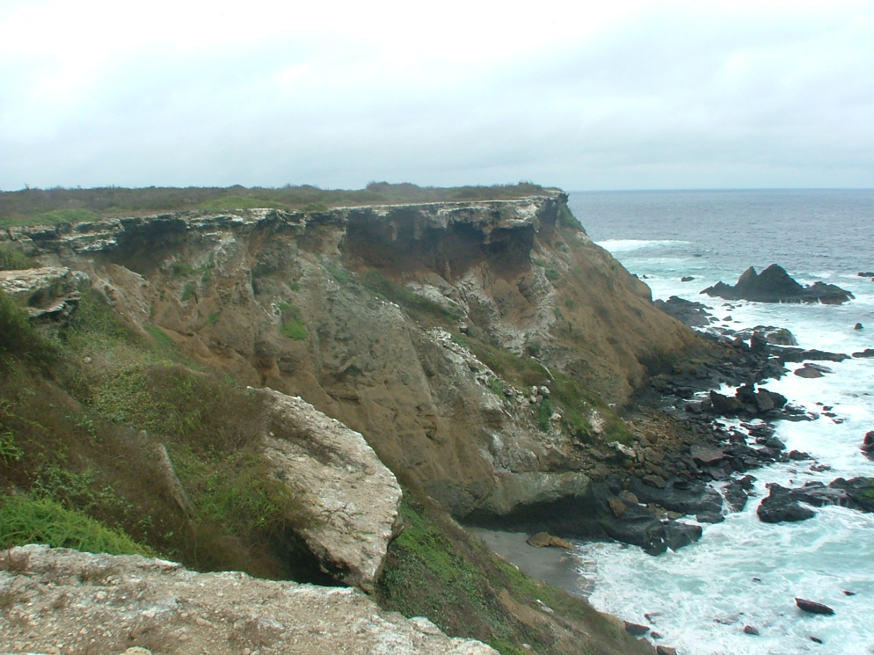
Cretaceous (Pinon?) pillowed lava, blue line shows bedding
Pre-3 Ma folding, west vergent
Post 3-2 Ma uplift.
Post 3k marine terrace, (T2? of Pedoja et al., 2004)
Marine terrace
Pillow

Slide 8
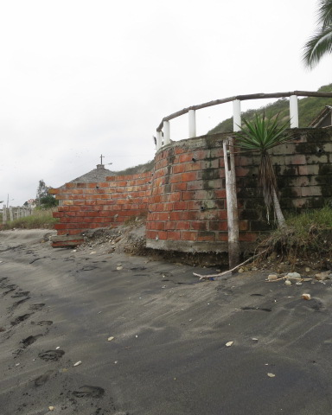
Puerto Cayo
sea level rise is outstrips
coastal uplift
Wave erosion of bottom
of fence.
Black sand is of
magnetite from eroded
Cayo Formation

Slide 9
unconformity
fault
faults
Algal mat
Notes:
Fig. 6. low tide. Inclined strata. Green algae. Thick beds, thin beds. Unconformity structures in dcc is not apparent in overlying light colored fossiliferous beds. DCC tilted, 25°SE. TECTONIZED

Slide 10
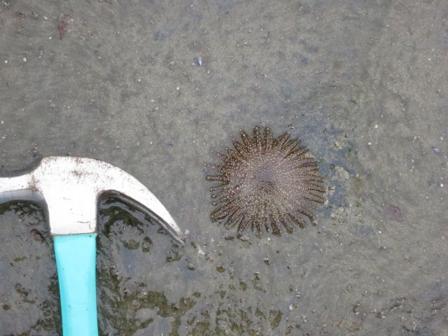
Heliaster starfish in lower intertidal. Reportedly the starfish is extinct at Galapagos

Slide 11
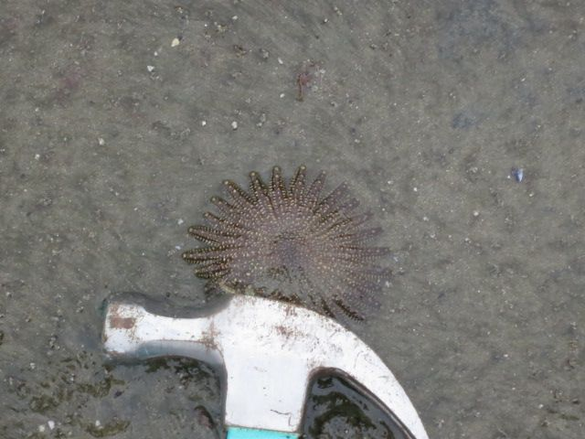
Heliaster starfish in lower intertidal. Reportedly the starfish is extinct at Galapagos

Slide 12
unconformity
fault
faults
meters
Algal mat
Notes:
Fig. 6. low tide. Inclined strata. Green algae. Thick beds, thin beds. Unconformity structures in dcc is not apparent in overlying light colored fossiliferous beds. DCC tilted, 25°SE. TECTONIZED

Slide 13
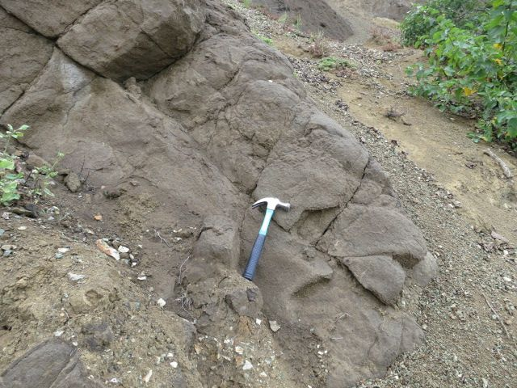
Grain flow deposit. Coarse grained featureless.
Notes:
Grain flow thick, featureless

Slide 14
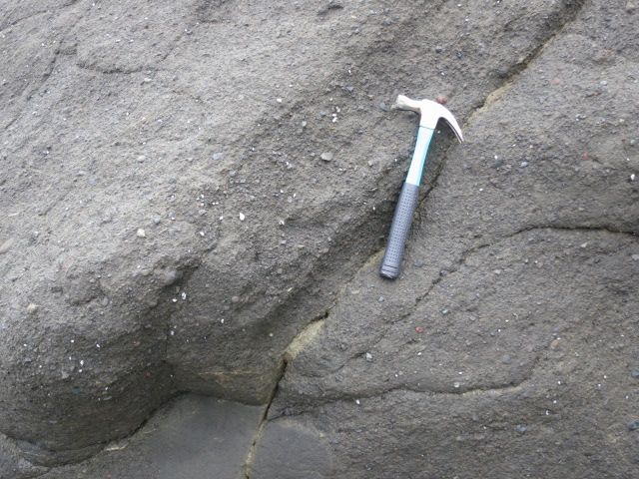
333
Debris flow deposit. Coarse grained. Granules, clasts. Periwinkles attached to rock
Notes:
Debris flow. Clasts, blue specks are periwinkles

Slide 15
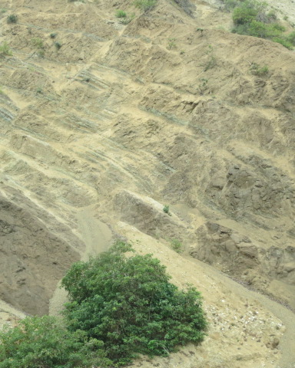
Faulted. NW down thrown, mostly
Notes:
Faulted, NW down thrown

Slide 16
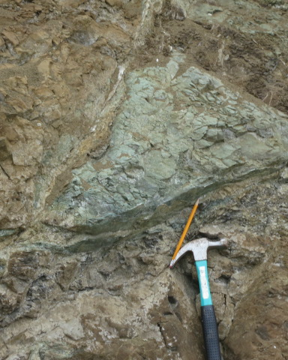
Triangular graben
down thrown
Pencil parallel
to slickenlines
Hammer for scale
Notes:
Faulted triangular block down thrown

Slide 17
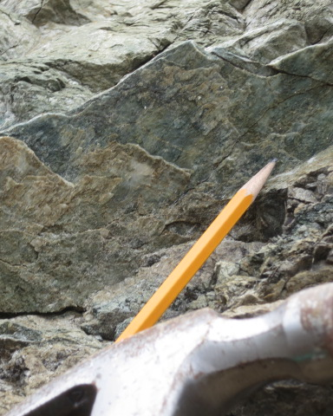
Zoom of previous picture, pencil parallel to slickenline.
Steps show block is down thrown

Slide 18
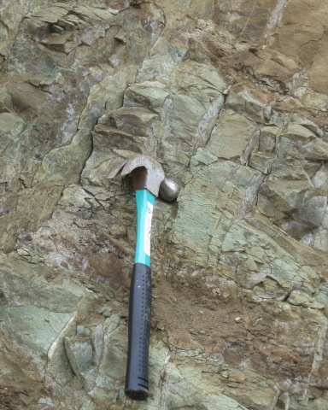
Close spaced
fracture and faulting
Trend E-W.
Broken zone
Notes:
Broken zone of a thrust fault. Thrust tt WNW

Slide 19
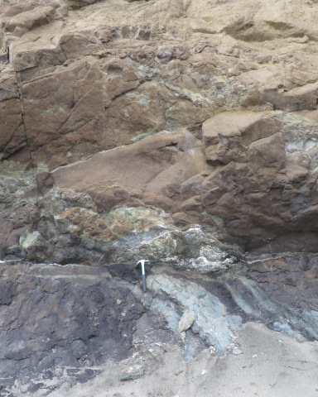
Hammer on up thrown
Block.

Slide 20
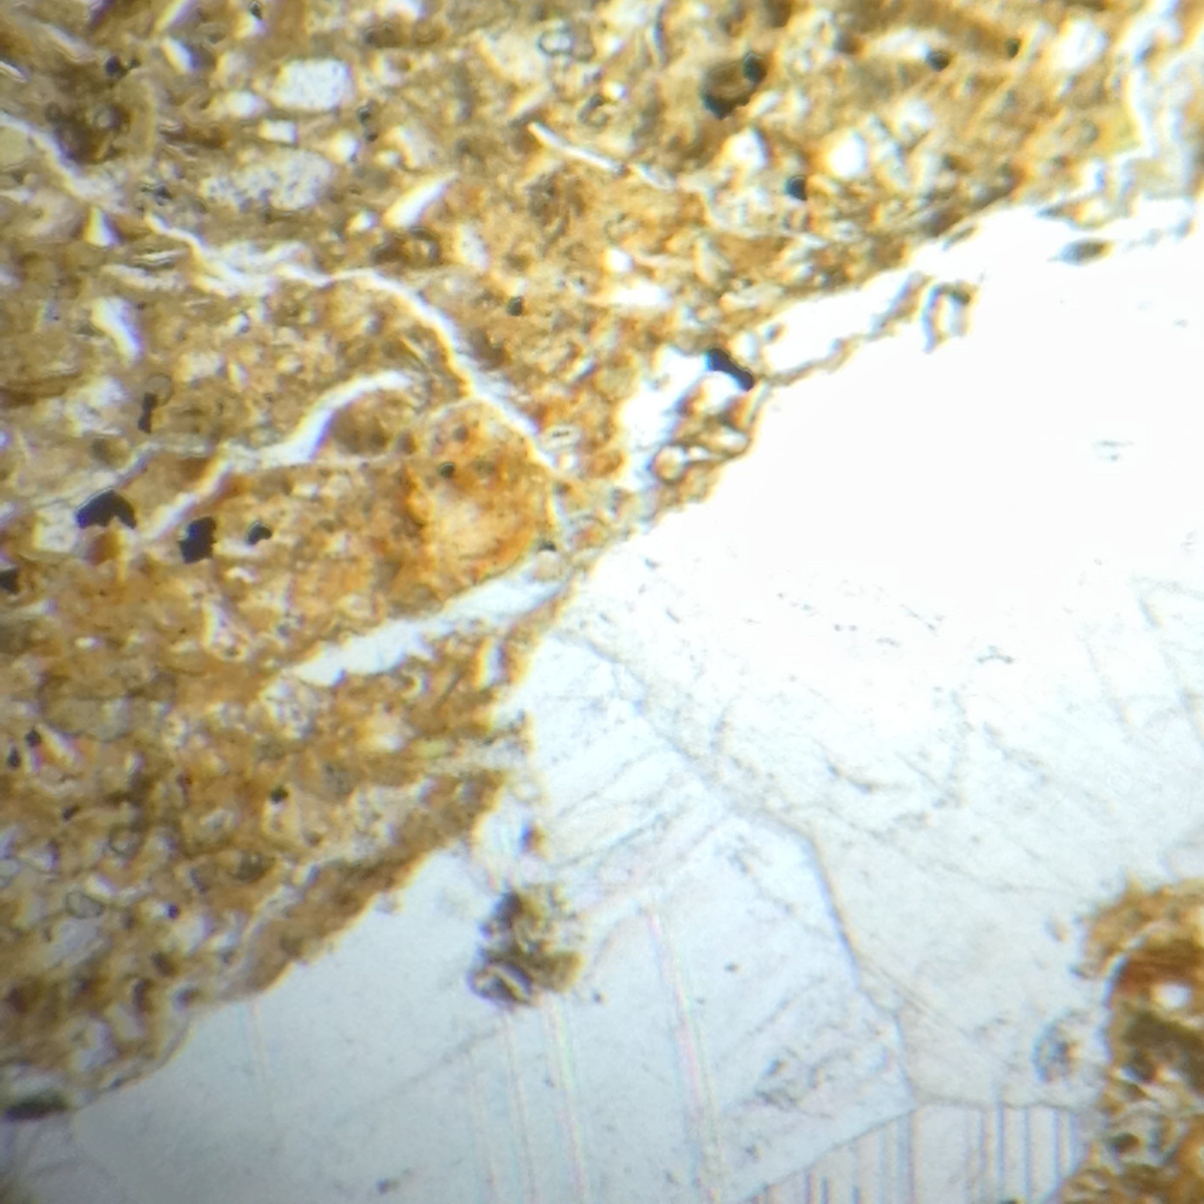
Dark Colored Cayo. Plane Polarized Thin Section. View 5 mm across
Calcite.
Zeolite
Plagioclase
Quartz,
Chlorite
Opaque
Most stained
Yellow by iron

Slide 21
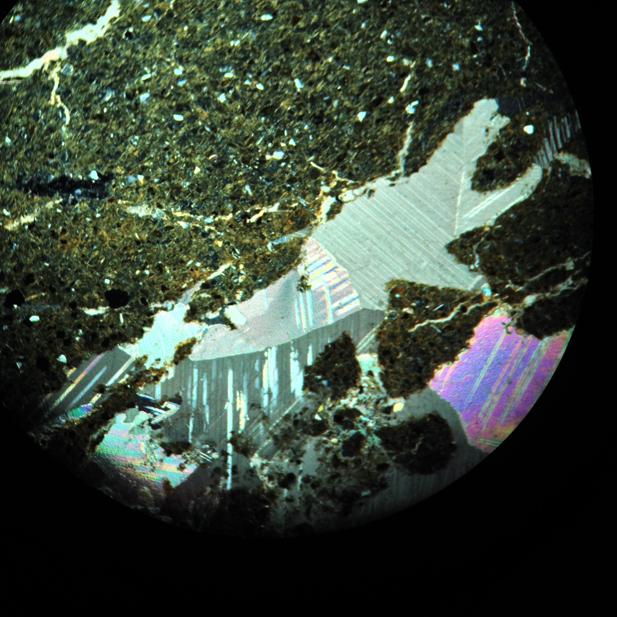
Dark Colored Cayo. Crossed Polaris Thin Section. View 5 mm across
Calcite.
Zeolite
Plagioclase
Quartz,
Chlorite
Opaque

Slide 22
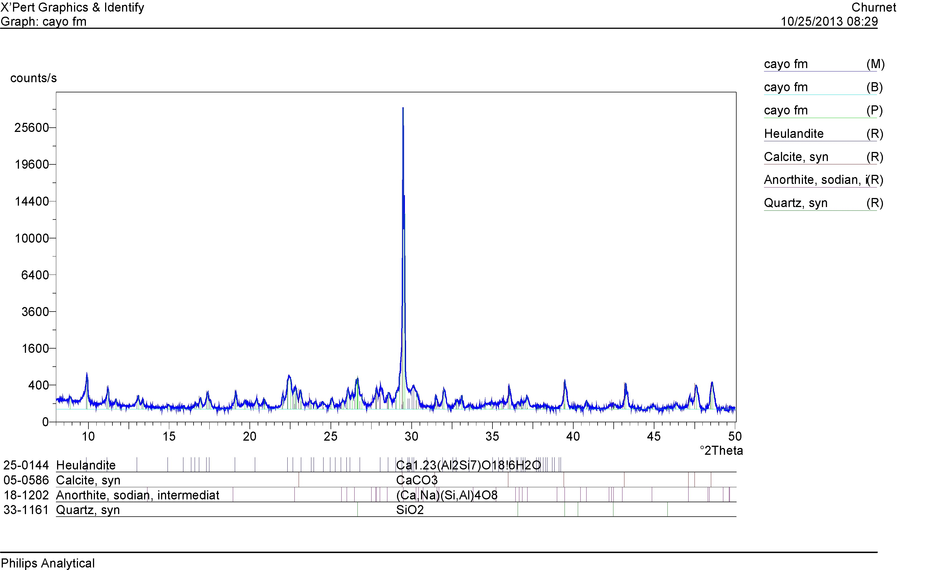
Dark Colored Cayo. XRD pattern

Slide 23
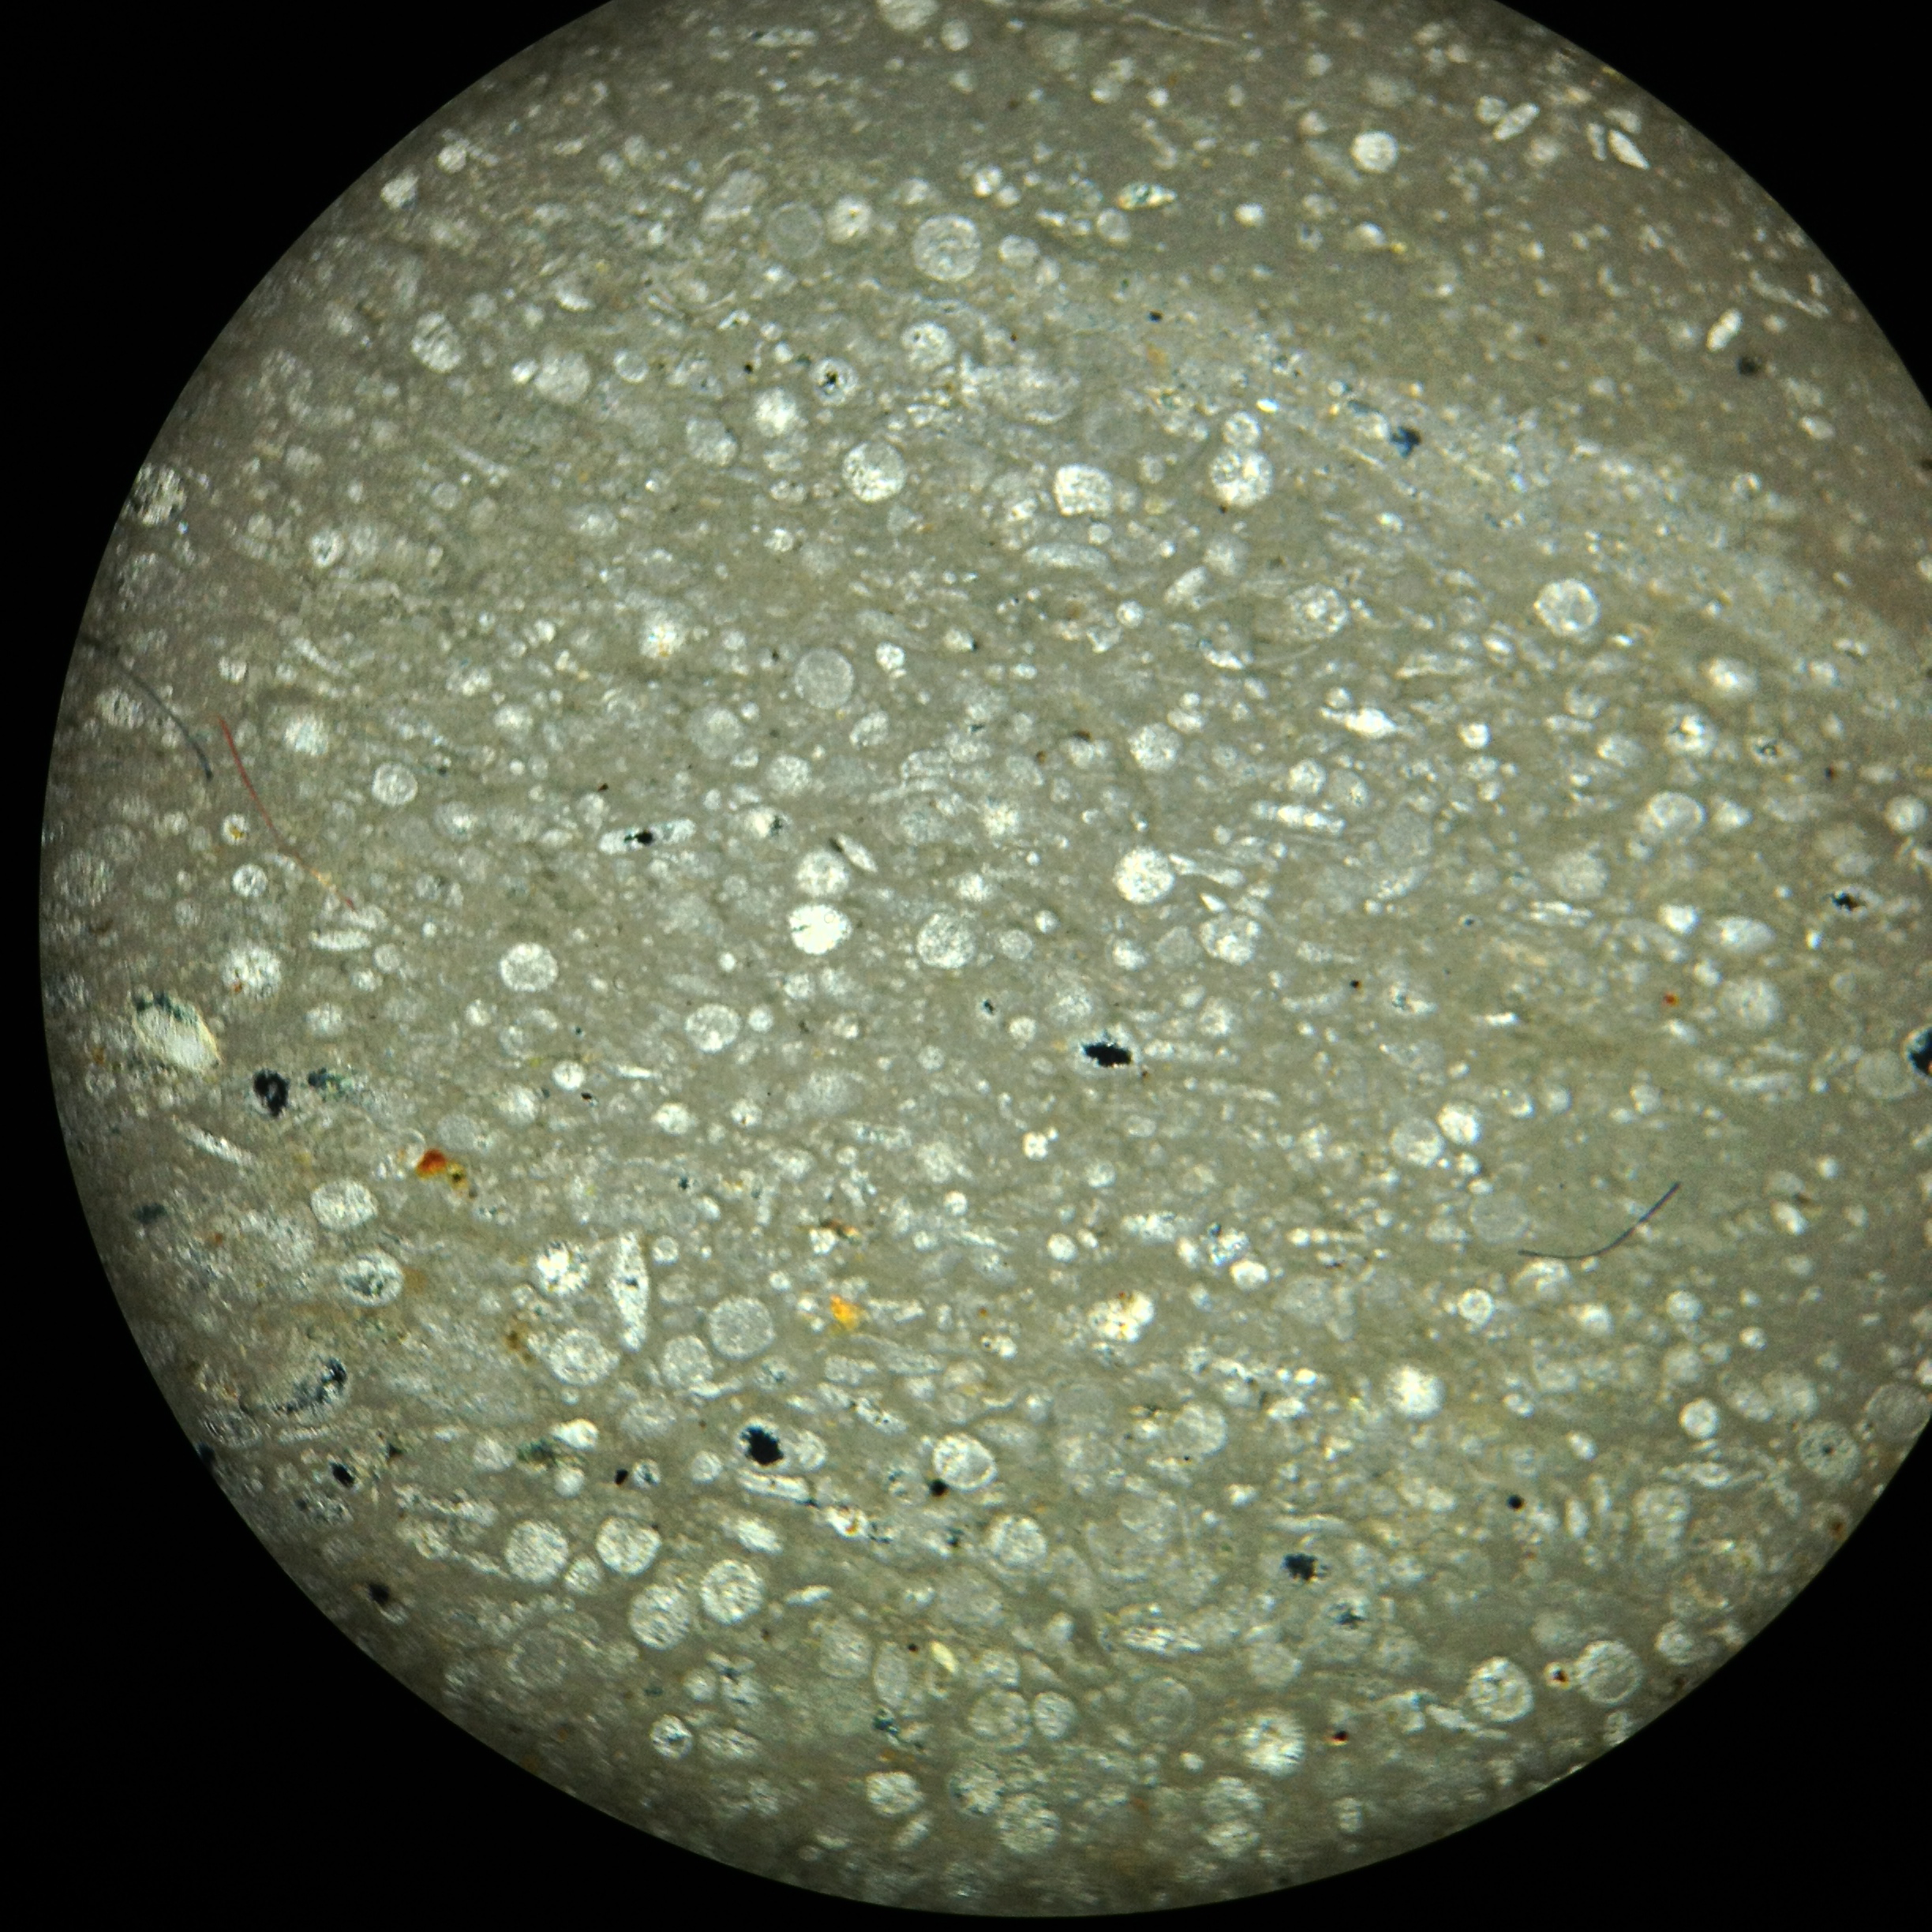
White Rock. Crossed polars- Biogenic Ooze, Forams, view 5 mm across

Slide 24
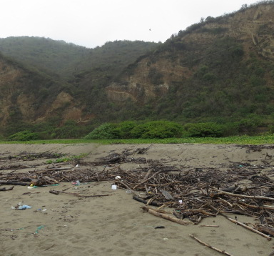
Puerto Lopez, North part. Gently dipping SE side

Slide 25
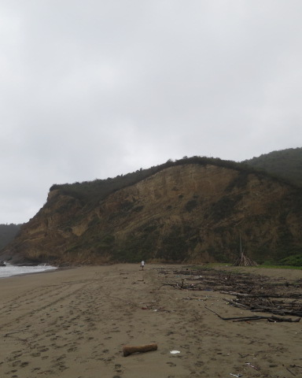
North part of Puerto Lopez. Steeper limb of anticlines dips west to the Pacific Ocean
West vergent anticline.

Slide 26
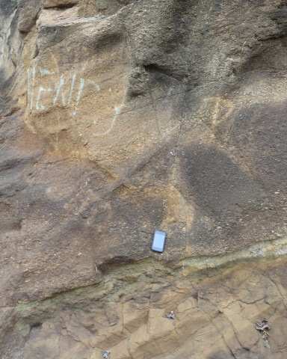
Puerto Lopez
Fining upward
grain-size graded
turbidite

Slide 27
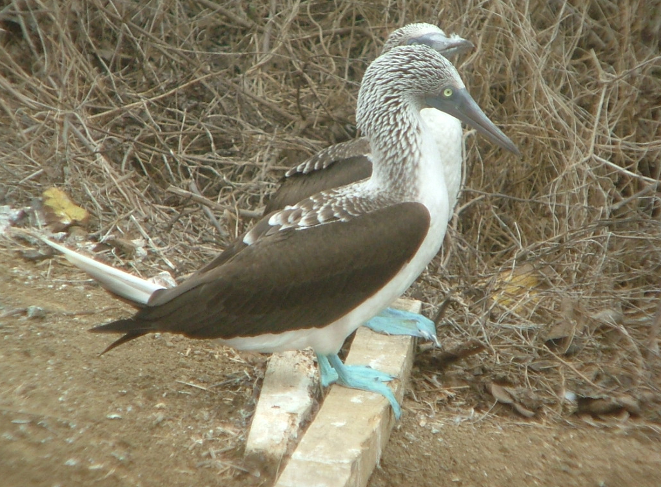
CONCLUSION
A. Two oceanic plateaus:
the San Juan and its successor
plateau, the Pinon
are significant Cretaceous Plateaus.
The San Juan was thrust northeastwardward and accreted on Ecuador
The Pinon was thrust southwestward in the Cretaceous before
the coastal margin was under thrust by the Nazca Plate.
B. At Puerto Cayo.
Grain flow and debris flow [high density turbidites?] volcaniclastics
dominate [minerals include: , heulandite, calcite, plagioclase, quartz
Magnetite and pyrite. Iron staining]
Blue footed Booby. La Plata Island

Slide 28
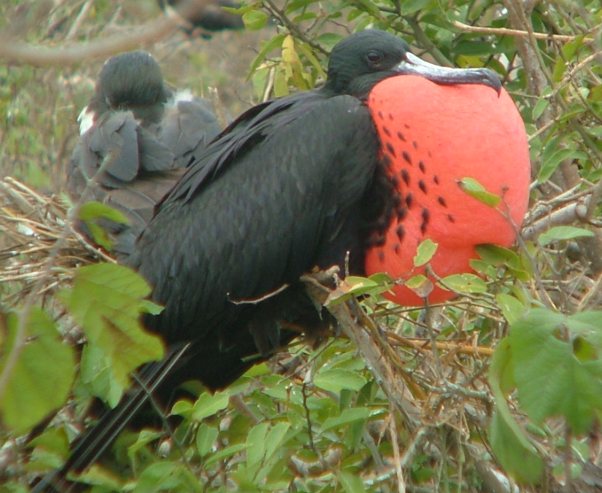
Conclusion continued
Frigate bird
at its nesting
site at La Plata
Island
C. Summary of structure
In the Cayo FM at Puerto Cayo
Formation declines at 25° to SE, different from the attitude in
overlying rock.
Therefore, tilting is likely Cretaceous.
Formation is broken up & faulting is post depositional.
3. Broken zone.
Did the faulting occur as a relaxation after the Carnegie Ridge
uplifted the area?
Or is the broken zone associated with westward thrusting
of the Cayo FM? I prefer the latter, though it might have been
reactivated later.

