Slide 1
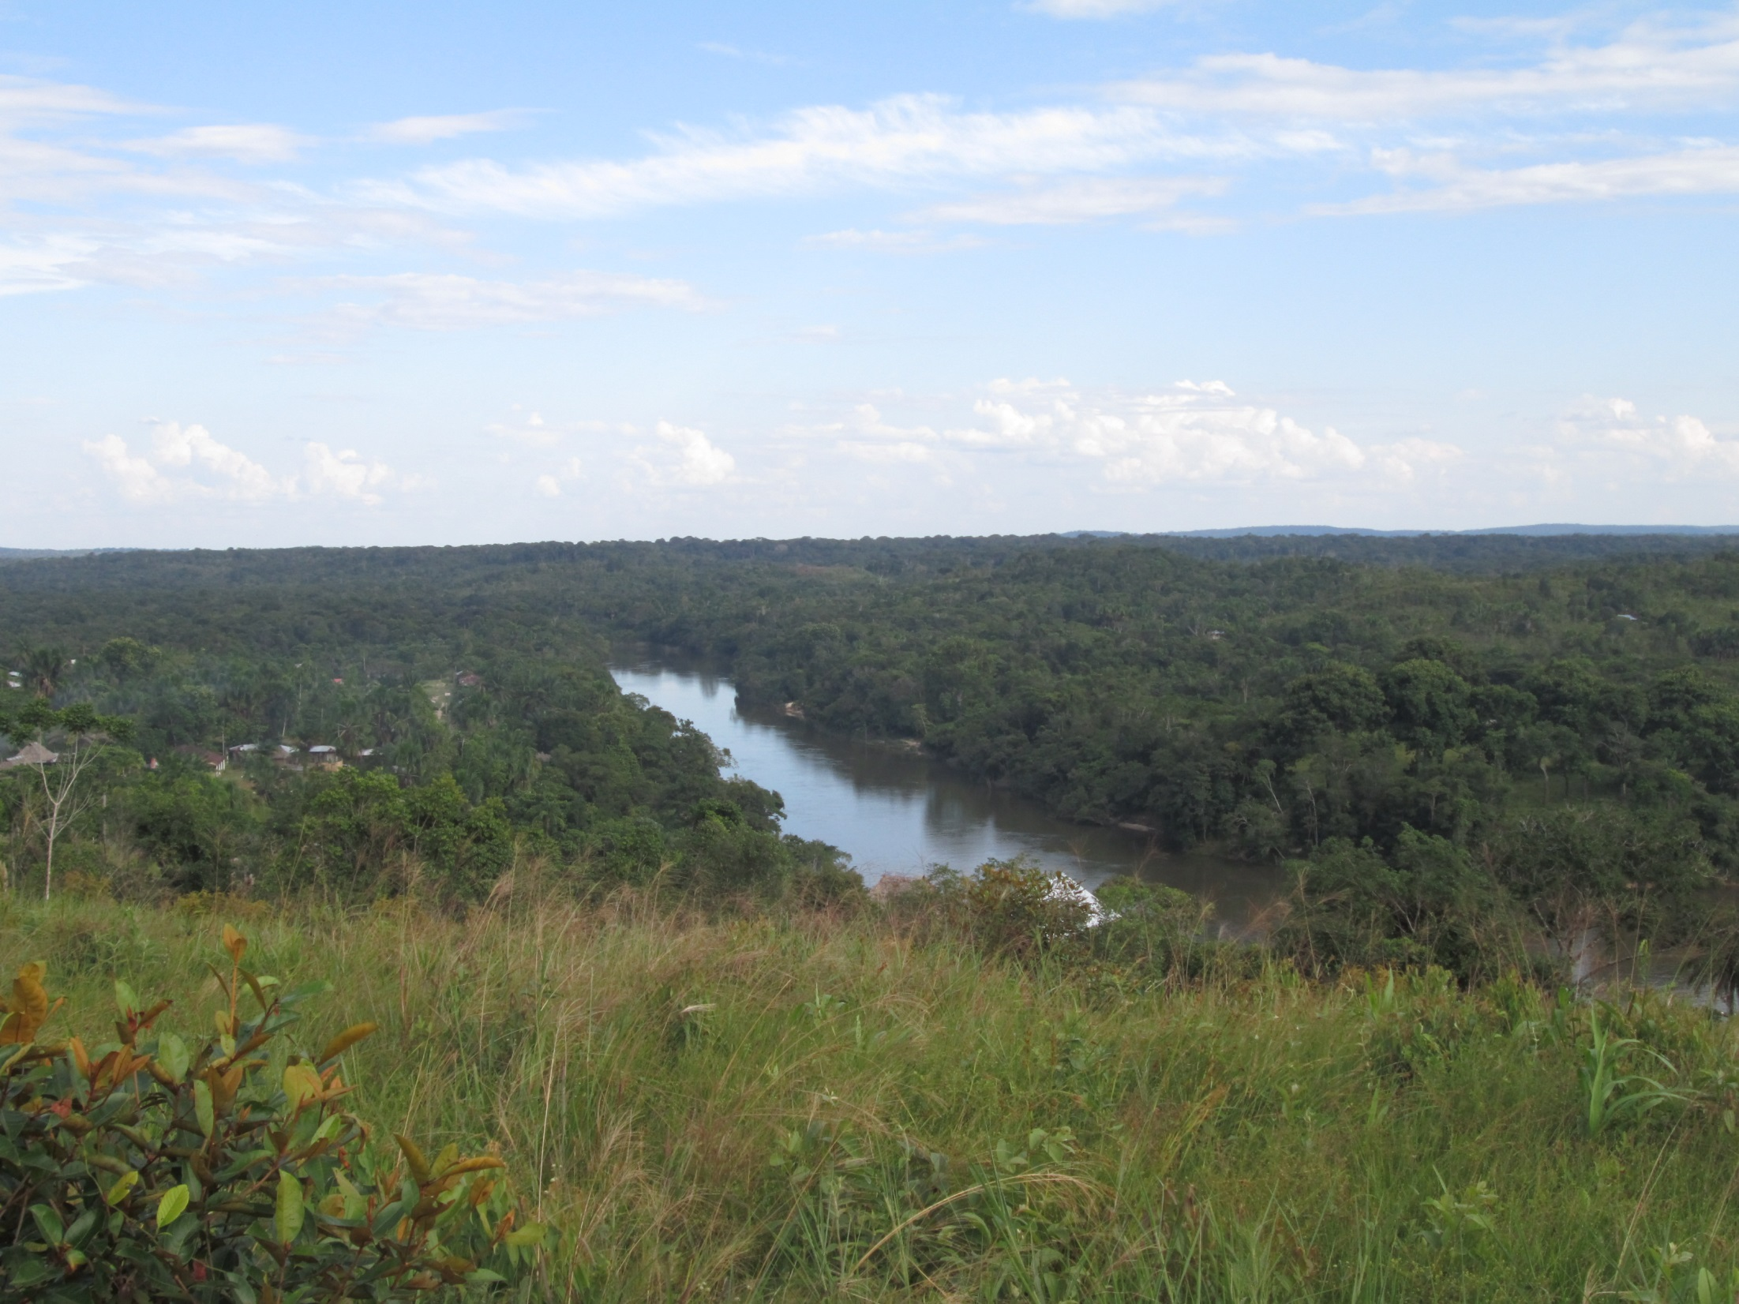



Ethnogeology applied to mapping and water resource management in the NW Amazon basin, Colombia
.
Londoño S.C*, Garzon N.C, Semken S., Brandt E.
Sandra.londono@asu.edu

Slide 2
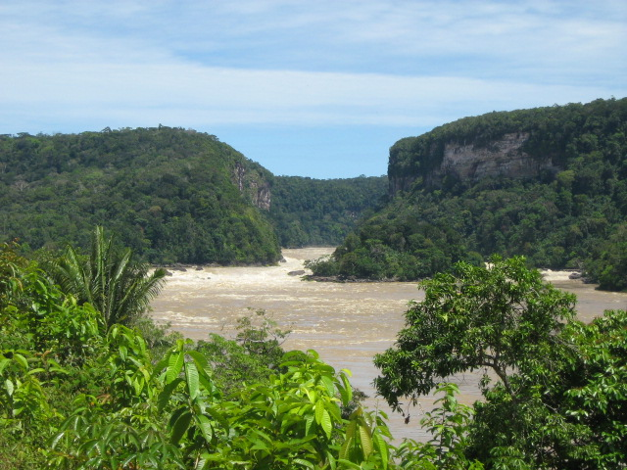
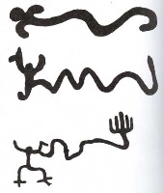
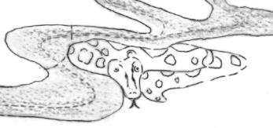
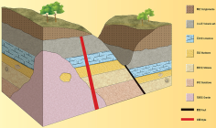
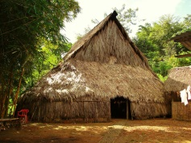

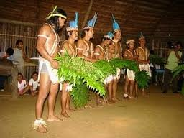
Ethnogeology
Study of cultural-based understanding, assessment, and use of geological knowledge.
Ethnography
Cañon de Araracuara, Caquetá, Colombia
Notes:
As geologist we know something. But there is people that have been living there, who’s home is there. They also have accumulated knowledge, empirical geological knowledge that we can explore. Ethnogeo is key when we are learning in environments that are not well known, or when we are dealing with resources located in indigenous lands.

Slide 3
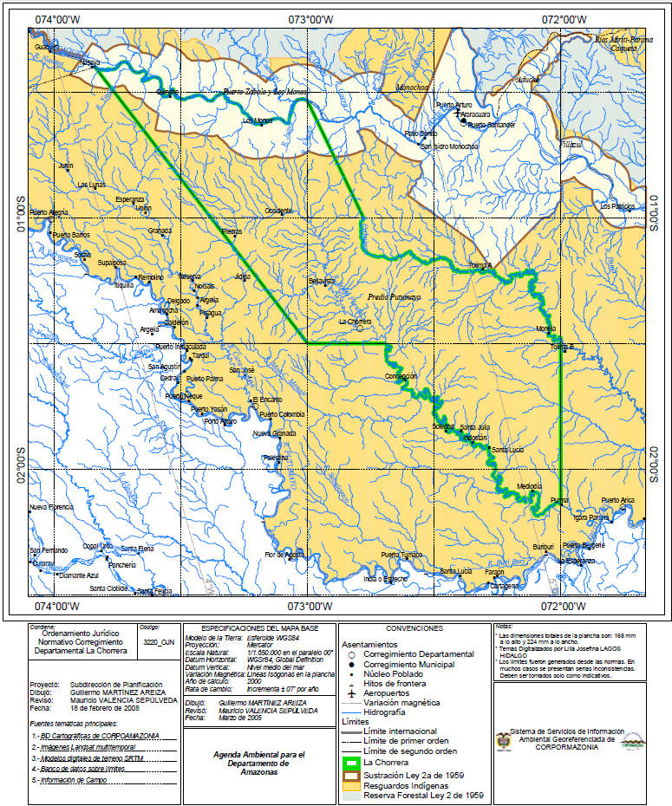
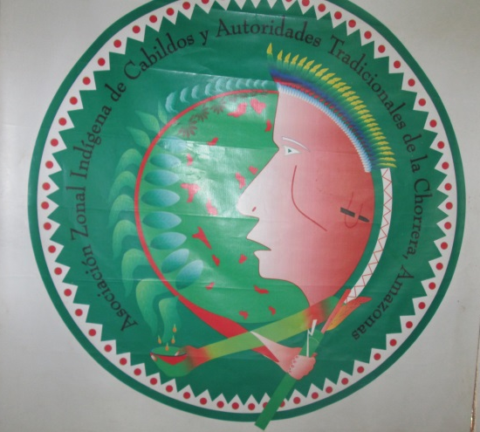
Ethnogeology applied to water resources in the NW Amazon basin
COLOMBIA
PERU
Our principal goal was to better serve needs and concerns of this native community in their homeland region.
Limits of the Predio Putumayo (Reservation)
Notes:
Decir lo de plan de ordenamiento territorial

Slide 4
Methods
Ethnography | Geology
Tribal permits and documenting Informed consent Field work: Collection of cultural data using PAR *Workshop *Interviews (informal and semi-structured) *Guided Field trips 3. Analysis of cultural data | General and local study of fluvial systems and geomorphology (Satelite imagery, Google Earth, literature review) Field geology methods: Observations and measurements Sampling. Georeference springs, water bodies. Data analysis and processing: Implementing GIS. Watershed analysis

Slide 5
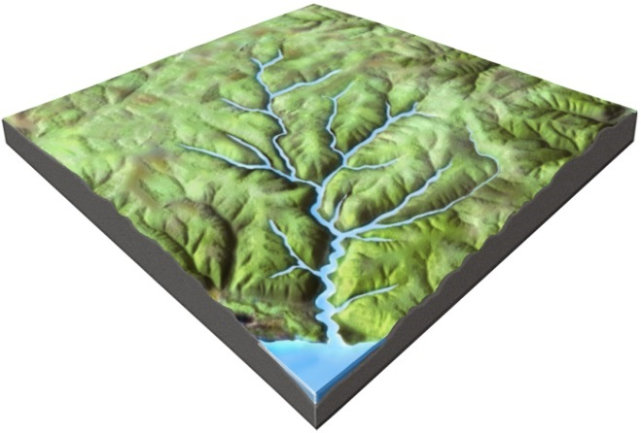
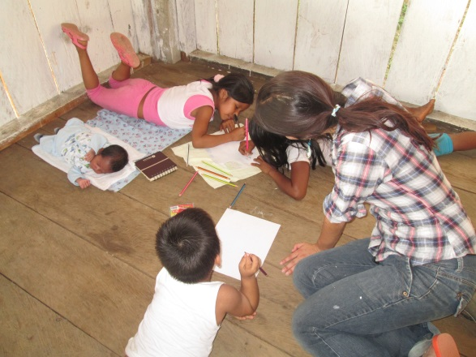
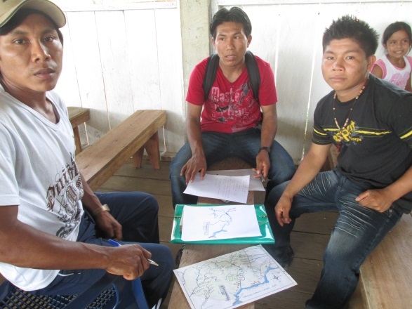
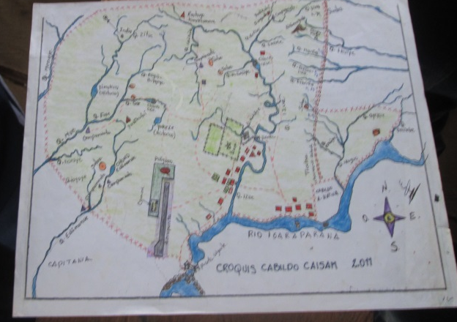
Workshop The Water World. –A dialogue between Native and Earth Sciences.
PAR Approach
Offer basic conceptual tools from geology to understand the study of water and fluvial systems.
Identify perceptions, problems and concerns related to the water resource.
Initiate a process of proposal writing.

Slide 6
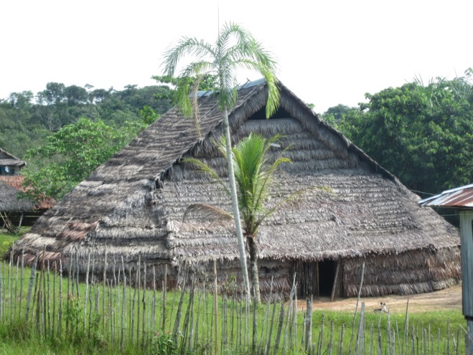
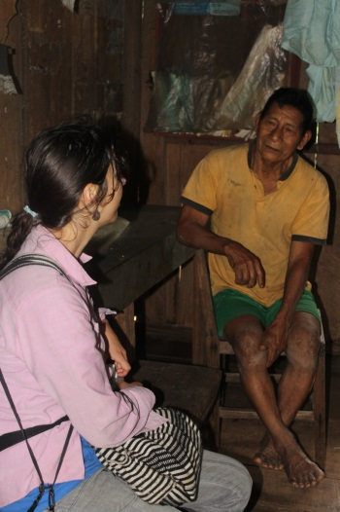
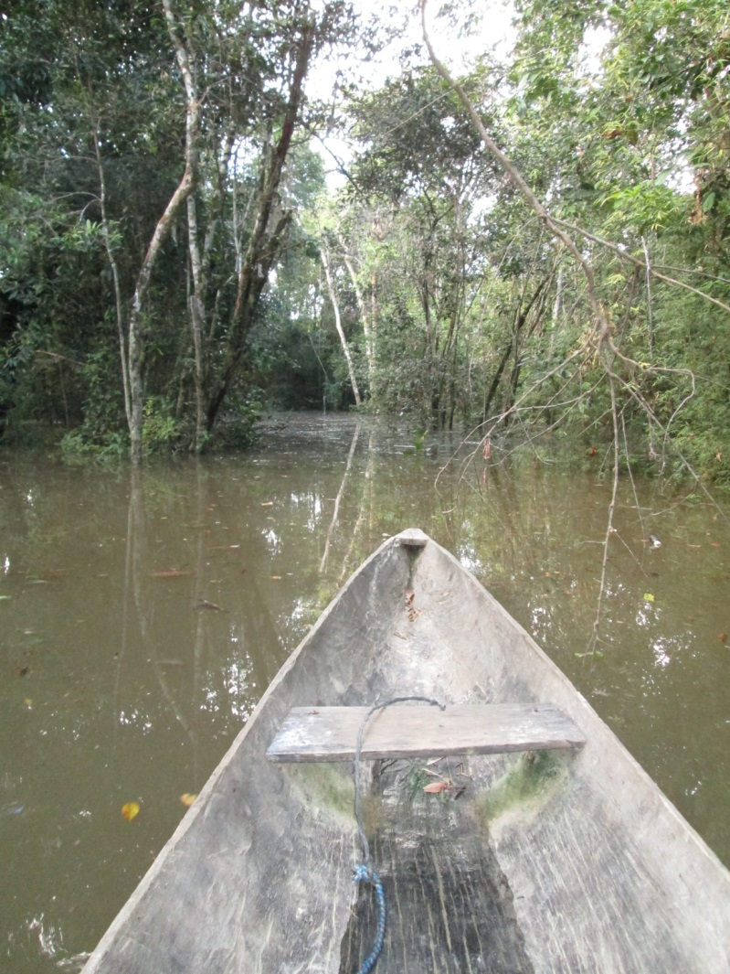
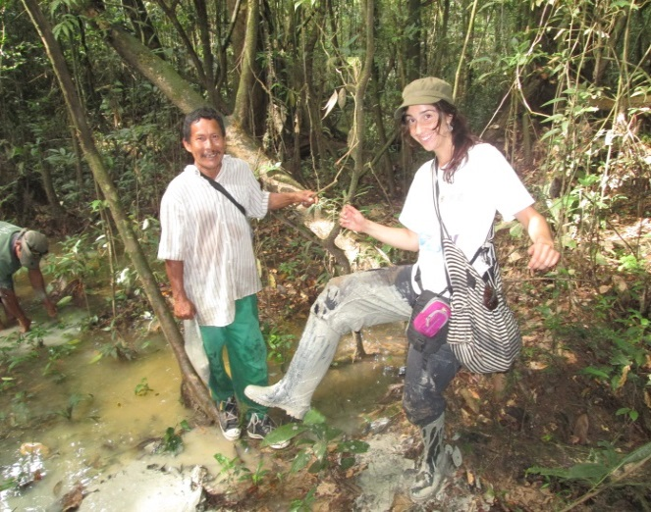
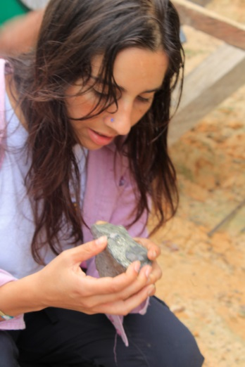
Field work

Slide 7
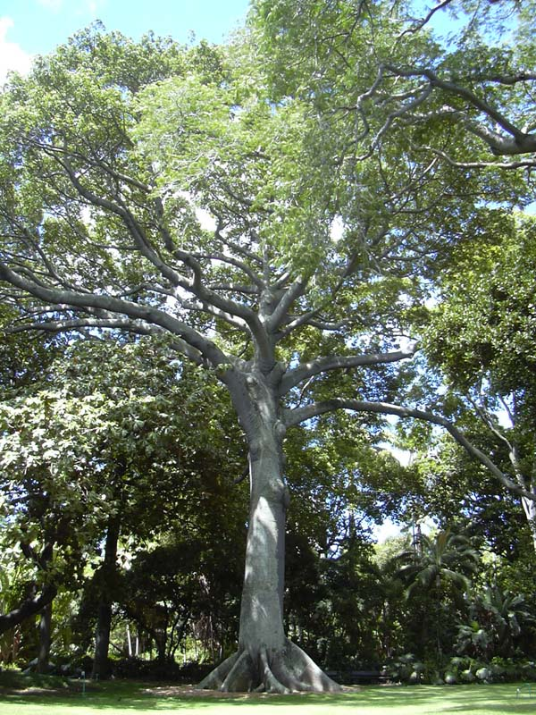
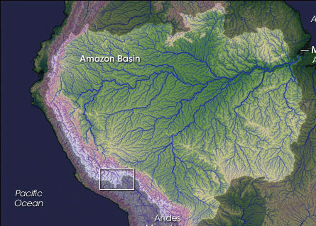
Moniya Amena. The Tree of Abundance.
“The giant tree fell, its base is the water of the dawn, the big water, trunk forming the Amazon, its big branches forming the main tributaries,. The fruits of the tree became fishes, some say the leaves became the forest. It is the origin of the rivers and its creatures”
Moniya Amena. Uitoto Myth
This transversal myth the tree metaphor is used to obtain relatively rich knowledge about the river environment.

Slide 8
The River is a Tree
Metaphor theory (Lakoff & Johnson, 1980).
The tree is an organizing principle.
Mapping of the source domain (tree) into the target domain (river system) produces relatively rich knowledge and understanding of the target domain.
Ex.
Explains drainage pattern.
Explains ecological relationships: fishes are fruits of the tree.
Reveals the native conception of the river as a mega-organism.
Notes:
Can I cut this slide and talk about it.

Slide 9
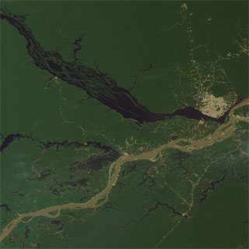
Types of Water
Native Science
Western science: Sioli 1984

Slide 10
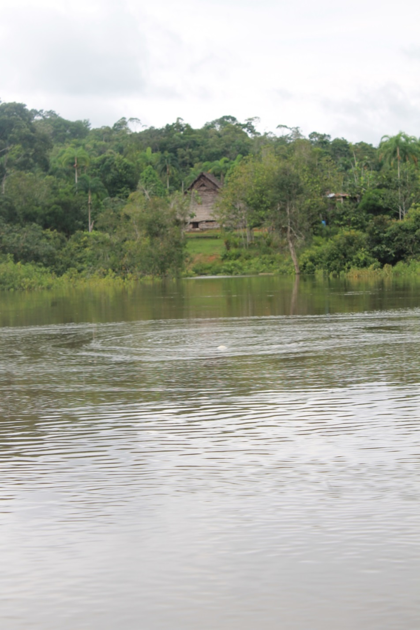
The Water World
For the Uitoto, the water is a world on its own. It has its own “people” (Buina Uruk+) that in turn, have their own fruits, medicines, and malocas (dwellings). The water malocas are located in rapids. The foam of the river are the clouds of the water world.
The shaman is the intermediary between the humans and the buinaimas so the two worlds coexist in a reciprocal relationship.
(=Sustainability)

Slide 11
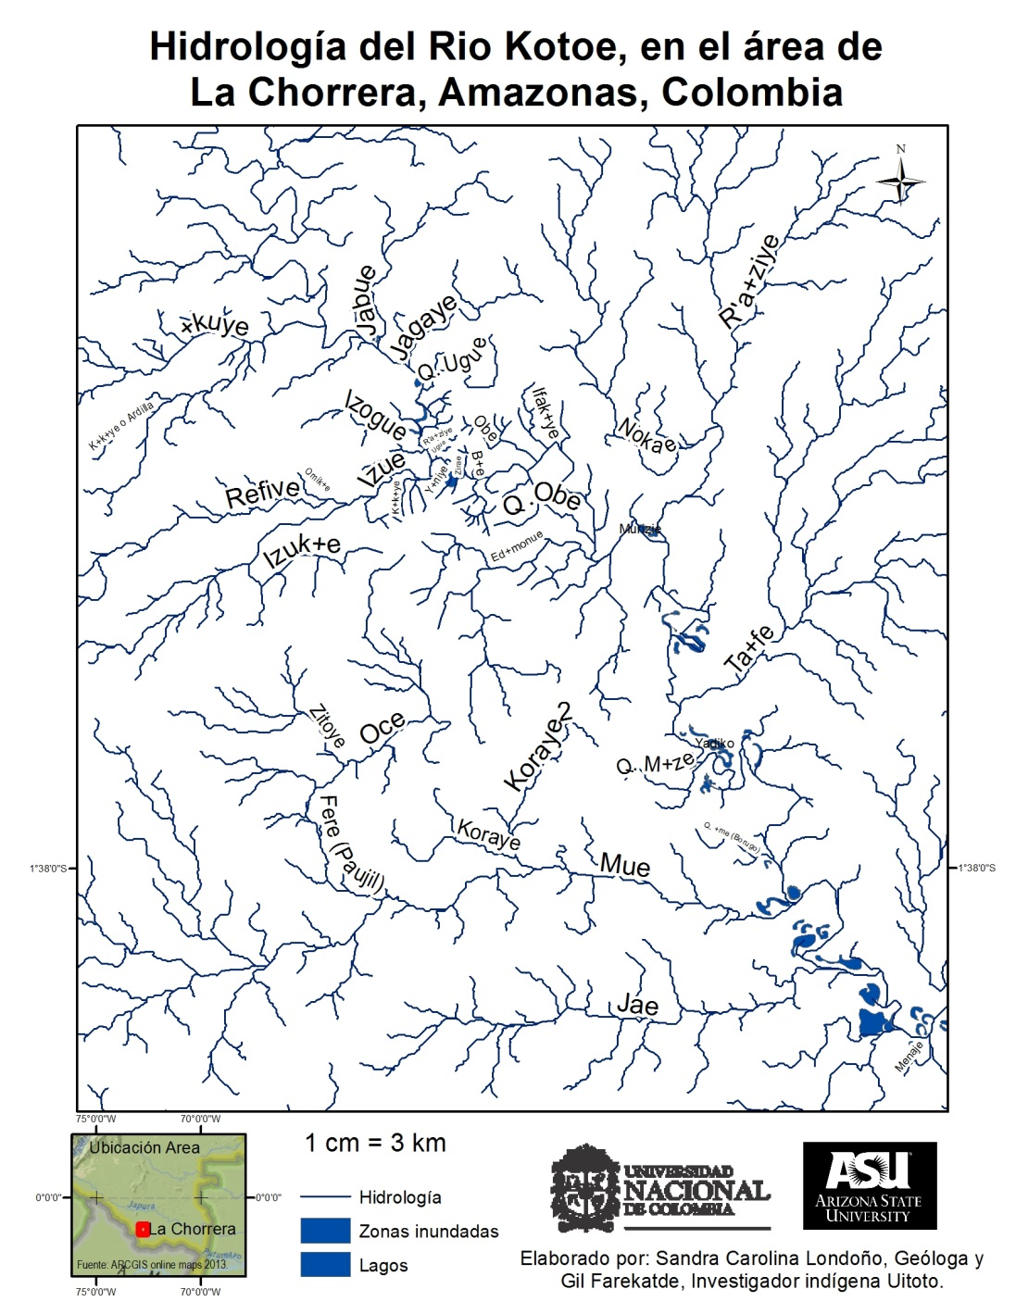
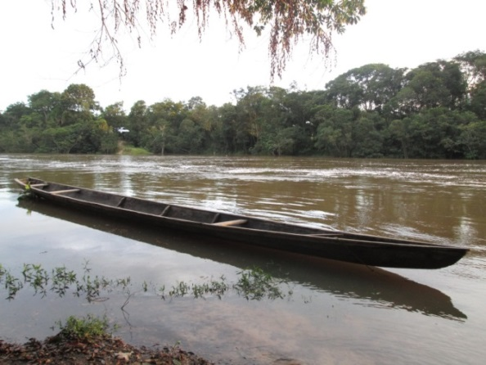
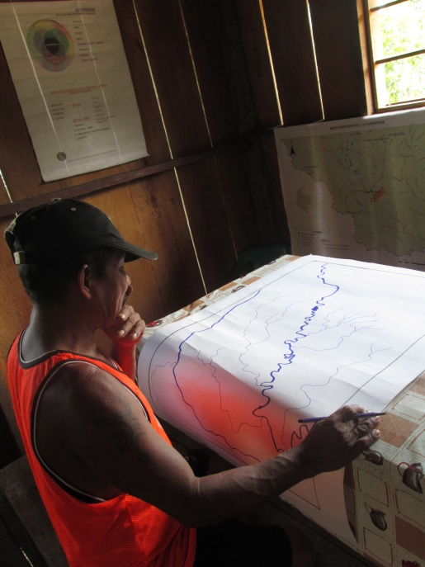

Slide 12
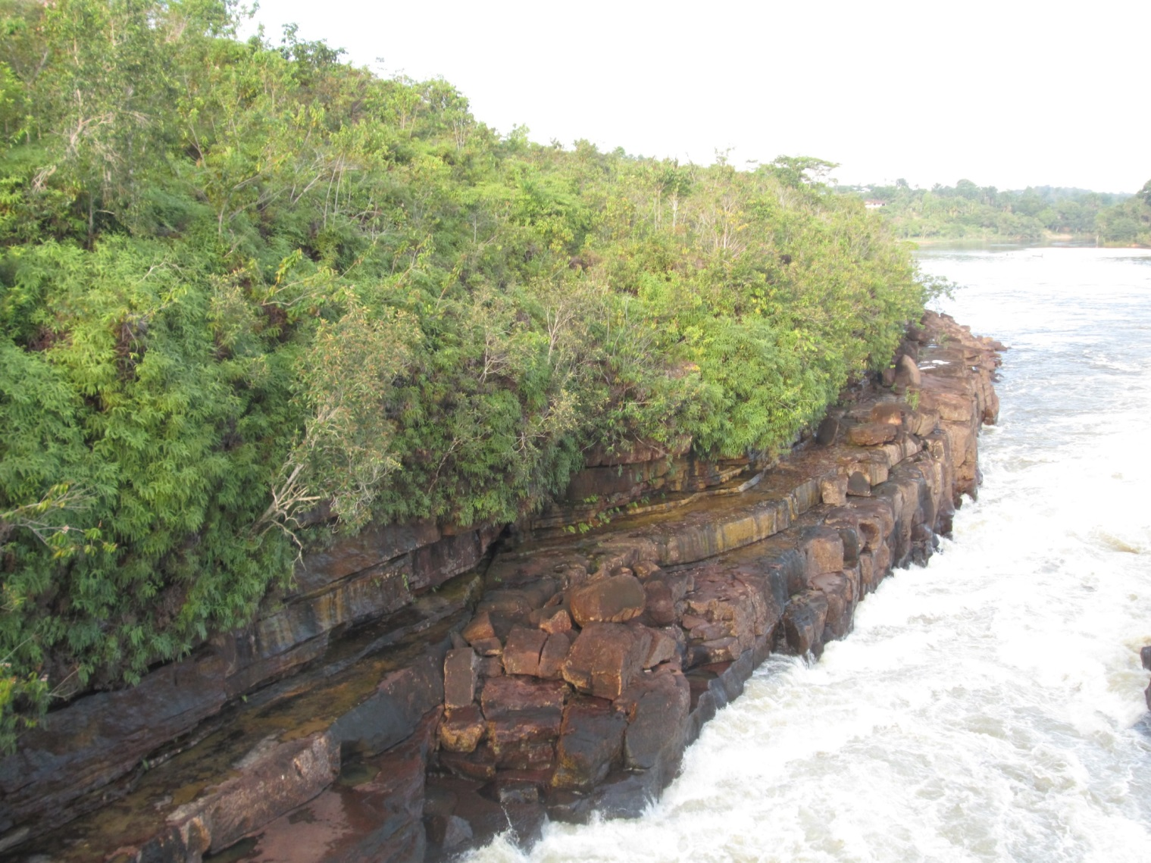
Geology

Slide 13
Recent alluvial deposits. Can be aquifer
Clay beds with ferric nodules. Sandstone beds with bioturbation. Equivalent to Pebas Fm. And Mariñame sand unit.
Conglomerates at the top.
Micaceous sandstones, red, yellow, colors intercalated with muddy sandstones and green arcillolites.
Basement: migmatites, paragneisses, schist, locally cut by doleritic and basaltic intrusions
Estratigraphic Column from Araracuara, North of the Area.

Slide 14
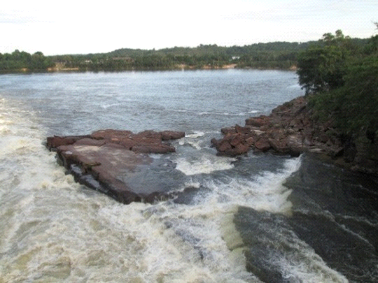
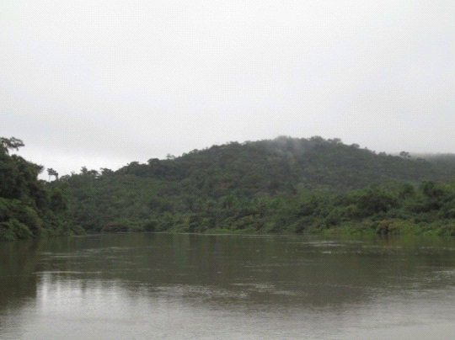
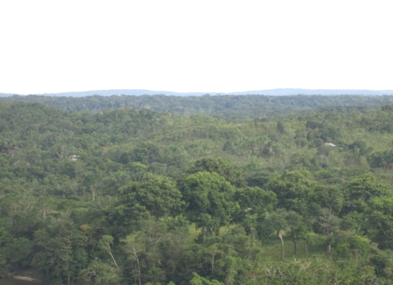
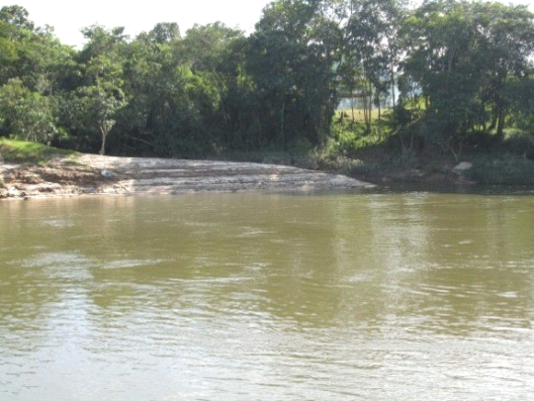
Geomorphology
Dominated by sedimentary dissected plains that give rise to an undulated plane.
Average height 90m above sea level.
Fluvial planes of black rivers, terraces systems.
Hard rock elevations to the North. Island-hills.
Rapids.
.
s
Juma Rapid
Isolated topographic heights
.
high plains
Low Terrace system
Dissected sedimentary plains

Slide 15
Watersheds
Identifying sub-basins can help determine the unit of analysis for the planing and management of the resource and territory
Sub-basin | Stream Order | Channel Length (m) | Length of all channels (m) | Sub-basin Area (m^2) | Perimeter (m) | Drainage density | Max Height (m) | Min Height (m) | Relief | Average Slope
Agarue | 1 | 2663 | 2663.48 | 1,146,563 | 14990.2 | 0.0023 | 170 | 127 | 43 | 4.32
B+e | 1 | 2457.65 | 2457.65 | 1,237,382 | 6009.95 | 0.00198 | 171 | 111 | 60 | 5.38
Ifak+ye | 1 | 4355.62 | 6204.99 | 7,208,901 | 15061.57 | 0.00086 | 180 | 111 | 69 | 5.54
Izue | 4 | 4522.08 | 477350.7 | 1.97E+08 | 90044.14 | 0.00242 | 199 | 112 | 87 | 3.91

Slide 16
Contributions to the “Plan of abundance, Plan of Life”
Maps of hydrology with traditional names
Geomorphology maps
Identification of sub-basins.
Considerations about ground water systems and the implications in land planning.

Slide 17
Conclusions
Knowledge exchange between natives and geologists can provide a sound basis for sustainable natural resource management in tribal lands.
There is a rich, interconnected and deep cultural Uitoto knowledge related to water that can enhance our understanding of natural processes in Amazonia
With an ethnogeology approach, support and coaching from education centers like National University can encourage cultural preservation while prommoting development and empowerment of indigenous communities in Colombia.
In places of high cultural diversity, ethnogeology offers an exciting area of research.

Slide 18
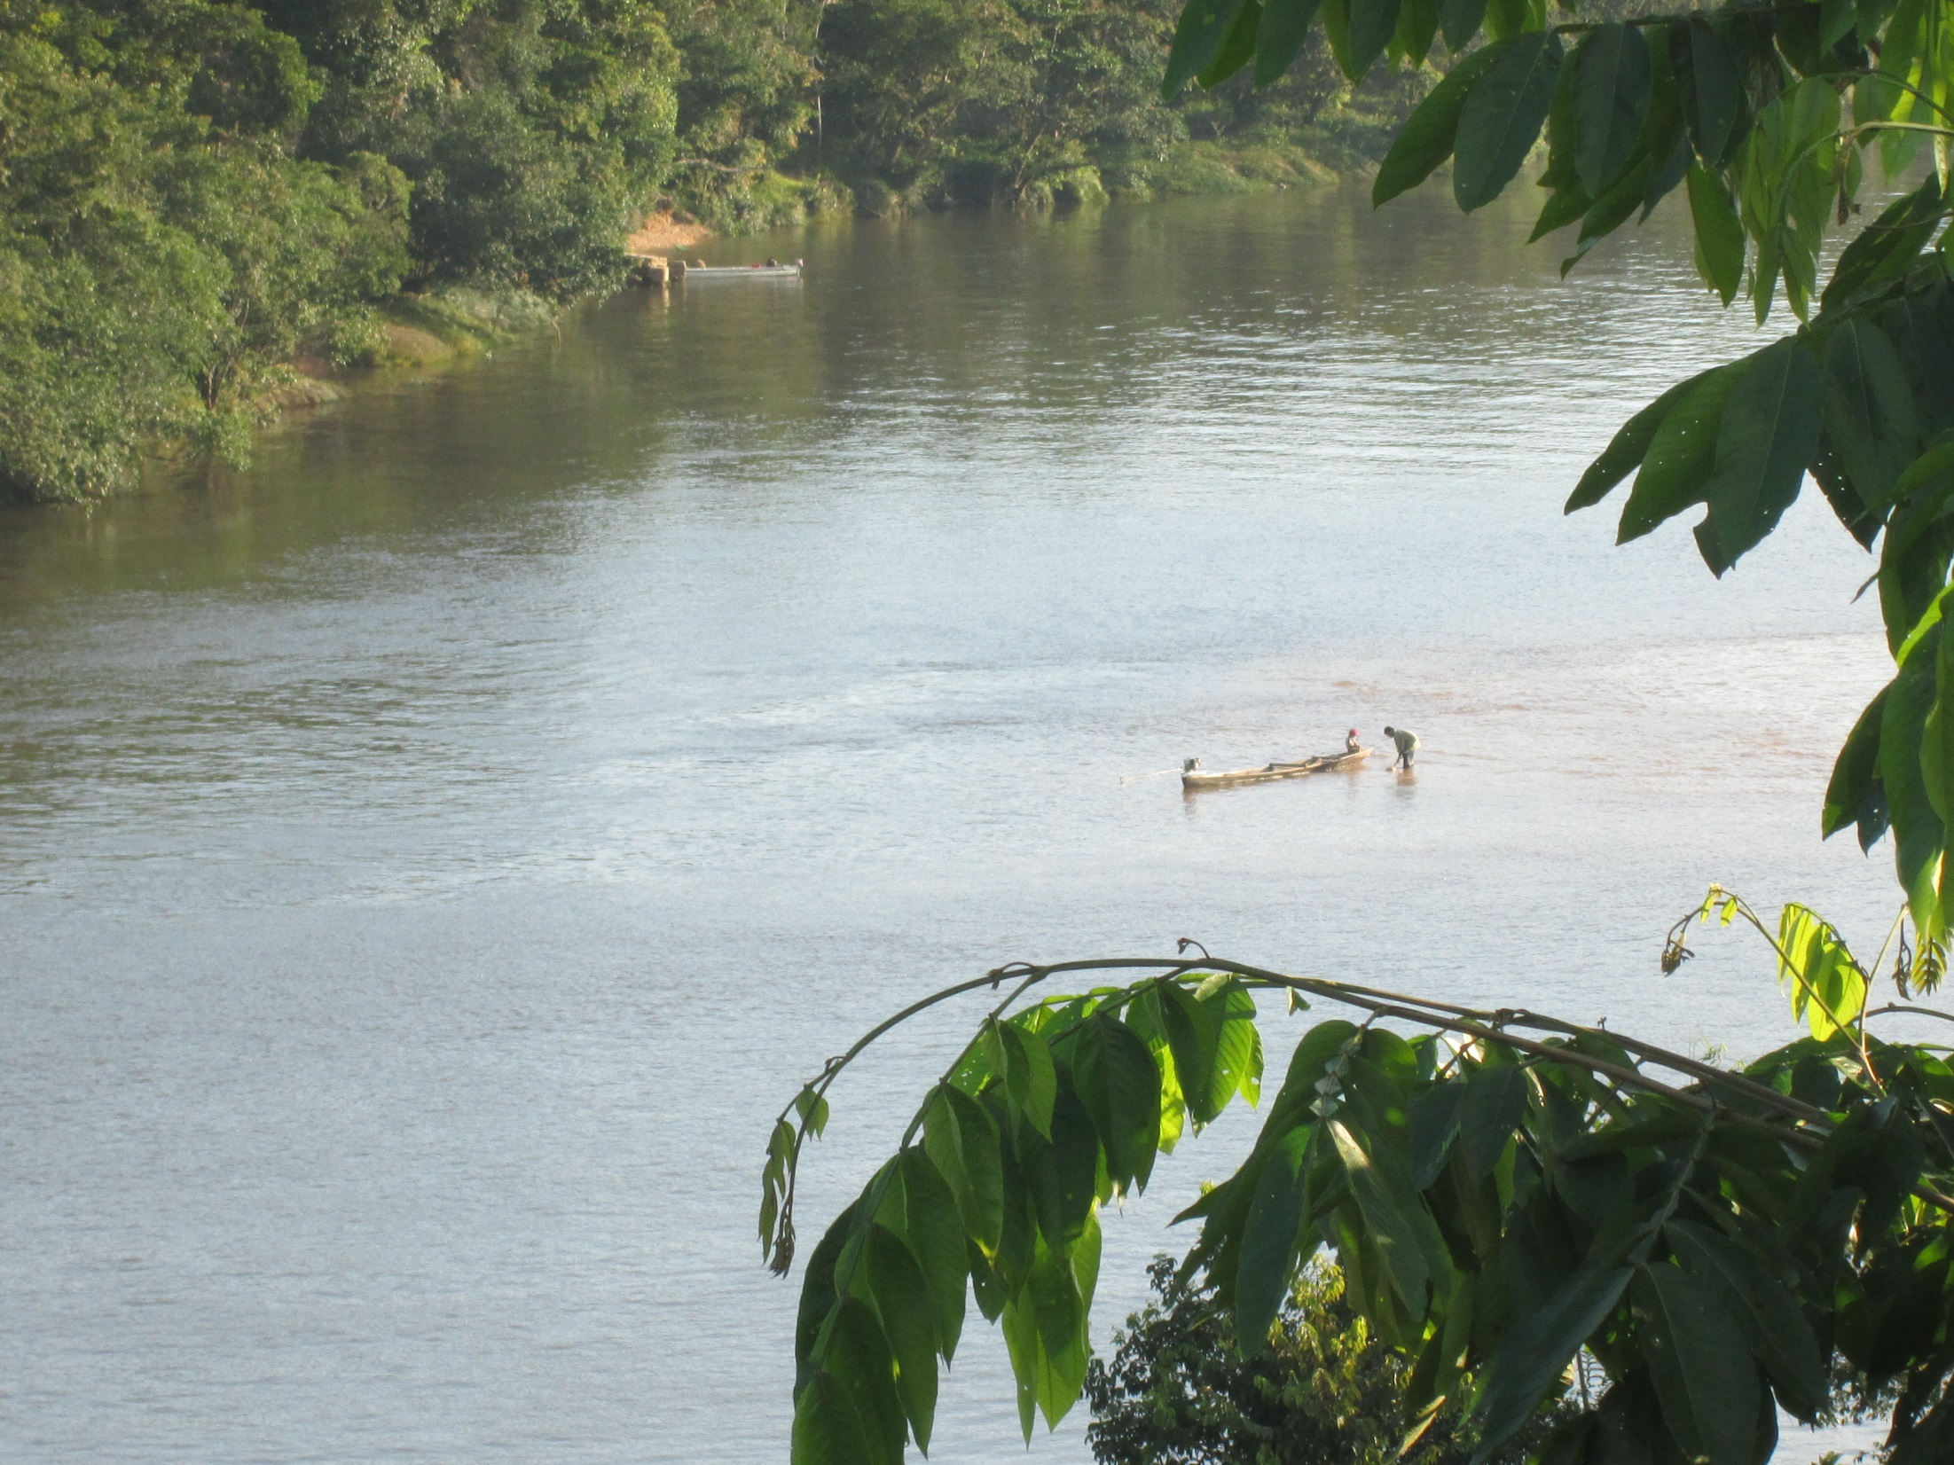
Acknowledgments
GPSA Independent Research grant 2012-2013
Gil Farékatde
AZICATCH

