Slide 1


Utilizing Spherical Panoramic Photography in a GIS Environment for Aggregate Resource Inventory and Assessment: Huron Manistee National Forests, MI
USDA Forest Service
Trevor C. Hobbs, GeoCorps America
Notes:
This particular project is just one of several that I’m working on at the Huron-Manistee. I’ve chosen to present this one probably because it has been the most fun to develop. It was quite open-ended when I started… the project description was to “create an inventory of potential gravel resources on the forest”. And as I dug into this, I realized that there are several possible approaches to the project, and that there are also several unknowns wrt the distribution of aggregate resources and the glacial geology of the area in general. So, my hope is that this work not only is helpful from a resource perspective, but also ultimately from a geologic mapping perspective, as this info can potentially be used as an impetus to reinvigorate the effort to map these areas.

Slide 2
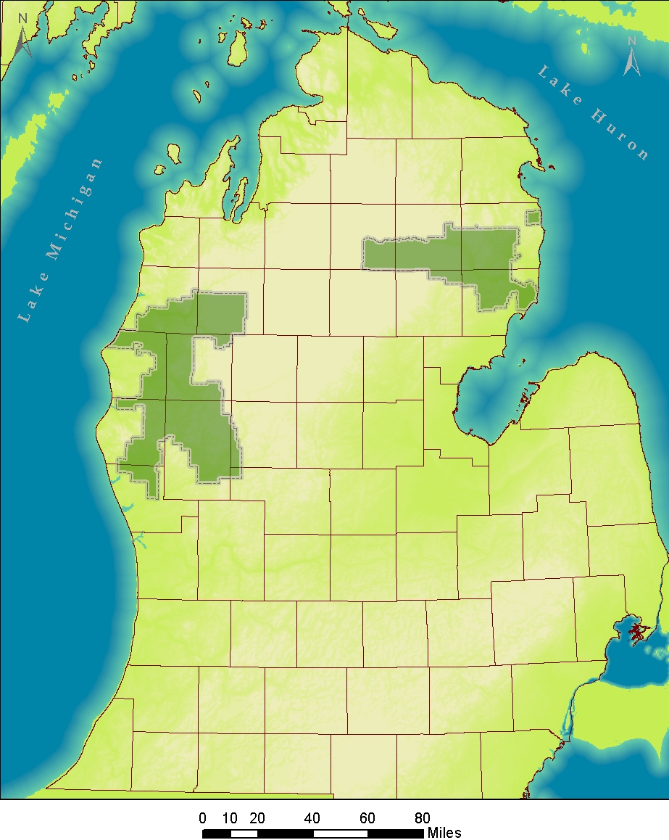
Huron-Manistee National Forests
~ 1 million Acres of public land
Mixed Use (resources, recreation, habitat)
Notes:
The Huron-Manistee is actually two separate forest units managed as 1, totaling about a million acres of public land in the Northern Lower Peninsula of Michigan. It operates under a mixed-use mandate, primarily for timber production, but also for habitat conservation and recreation.

Slide 3
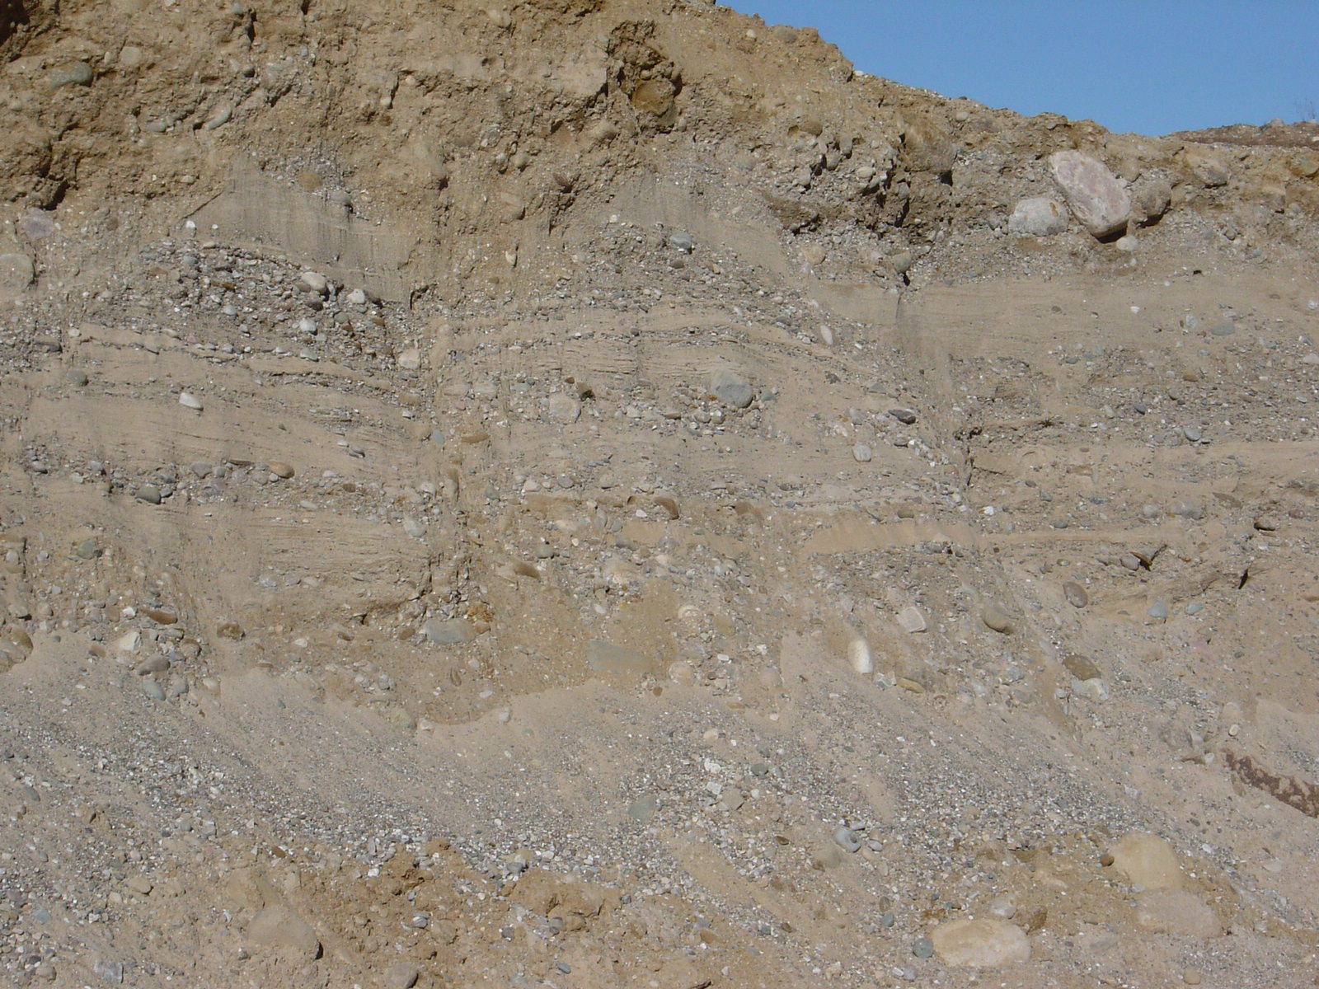
Notes:
In this part of the world, aggregate resources are primarily coming from glaciofluvial and till deposits

Slide 4
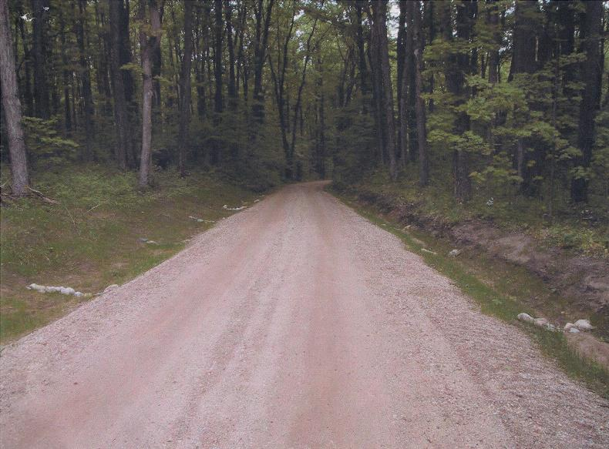
Photo courtesy of: Doug Gullekson
Road construction and maintenance

Slide 5
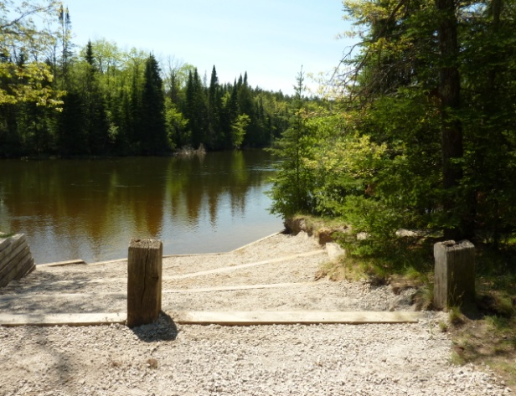
Photo courtesy of: Huron Pines
Canoe Landing Sites

Slide 6
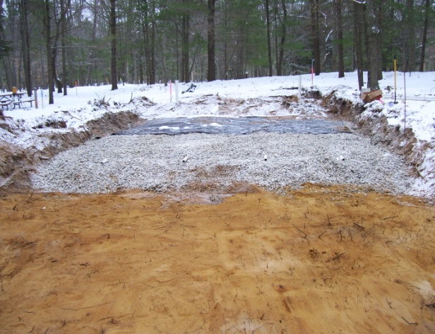
Photo courtesy of: Russ Sutton
Septic Drainage Fields

Slide 7
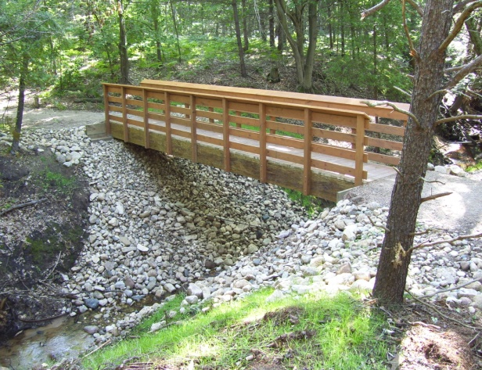
Photo courtesy of: Rich Corner
Stream Crossings/Channel Stabilization

Slide 8
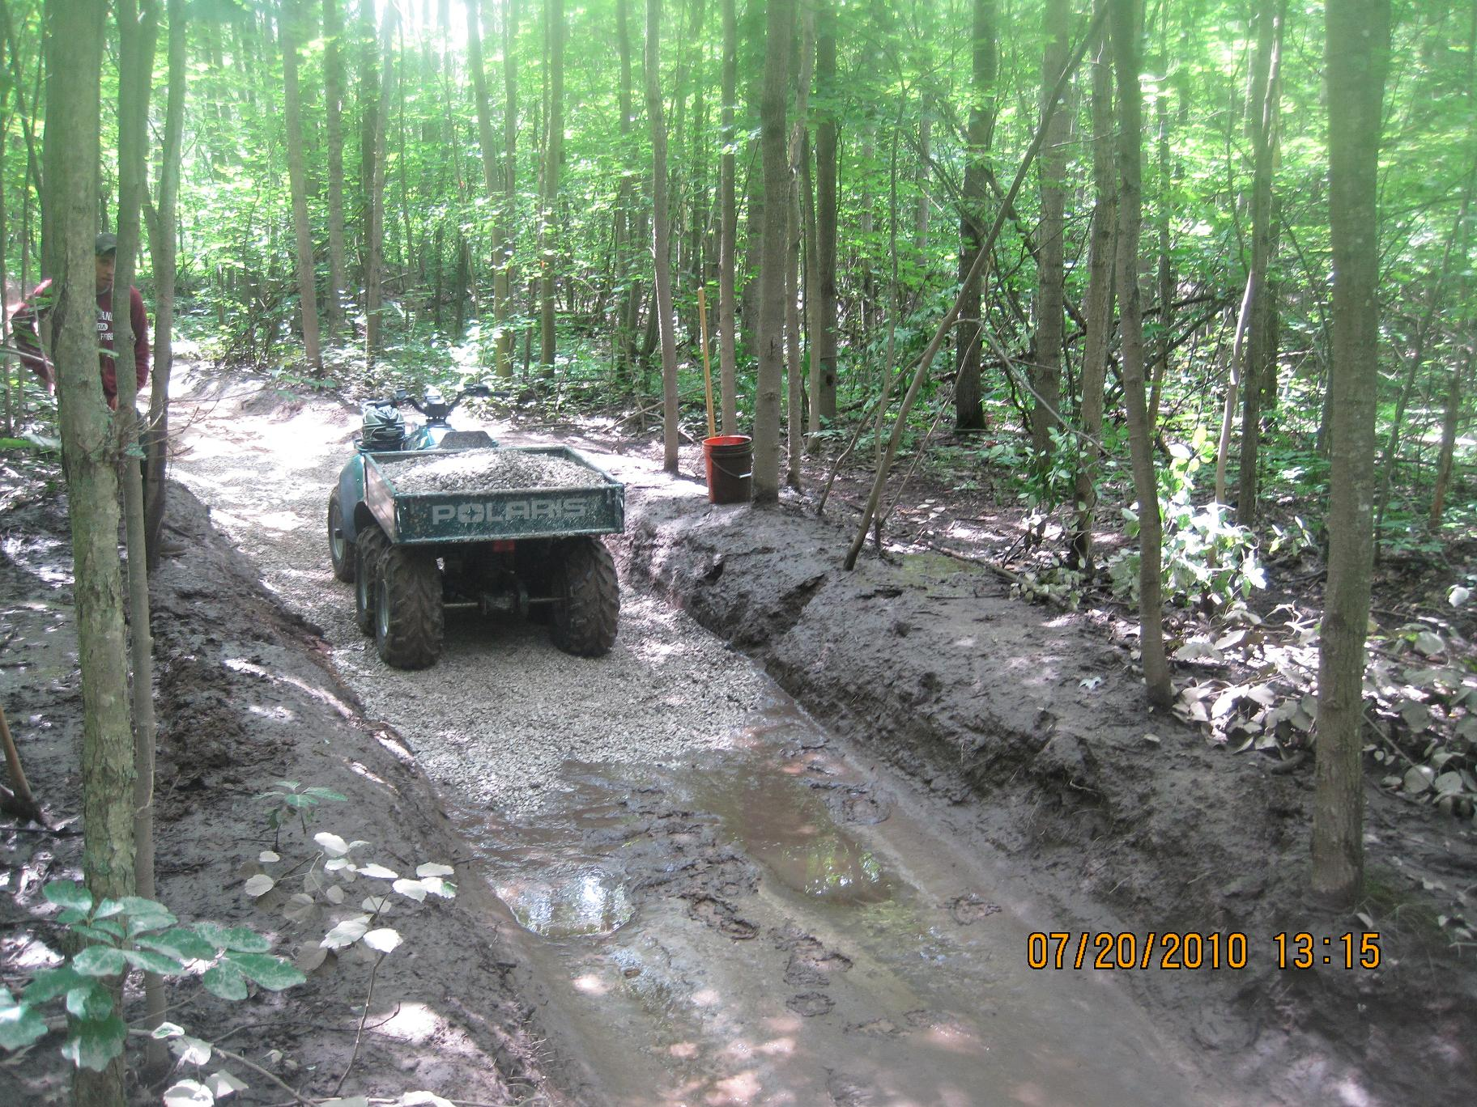
Photo courtesy of: Dave Jaunese
Trail Maintenance

Slide 9
$23,642
$22,086
Notes:
Despite the need for aggregate resources on the Huron-Manistee, the forest extracts very little, if any, directly from Federal lands. At the end of each year, every forest reports on the dollar amount spent on aggregate resources, including the value equivalent of the tonnage extracted from Federal lands. So what this graph really represents is the amount each forest saves each year by extracting directly from their own pits.

Slide 10
In typical year, HMNF spends estimated $30,000 per year on aggregate resources.
$23,642
$22,086
Notes:
Contrast the amount we save relative the amount we spend, and there’s a huge offset. In a typical year, the HMNF spends around 30K on aggregate resources, and this doesn’t include the amount spent on equipment time for spreading and shaping roadways.

Slide 11
Decline of sourcing materials directly from FS lands in recent decades…
…may be related to several complicating factors:
Abundance of private and commercial suppliers nearby.
Fragmented mineral ownership patterns (mixed surface/subsurface- Federal, State, and Private owners).
Lack of detailed geologic maps covering forest lands.
Uncertainty surrounding costs vs. benefits of developing pits for in-service use.
Notes:
Why the huge offset? Since about the 1980s there’s been a decreasing priority placed on development of sand and gravel resources. For one thing, there are now a large number of private and commercial suppliers within the proclamation boundary, which makes it easy to obtain materials. There’s anecdotal concerns that if we returned to a period of developing our own aggregate resources, we’d be competing directly with the local economy, which essentially looks bad. Another factor though is that mineral ownership patterns across the forest are fragmented and complicated by the fact that there’s mixed surface and subsurface mineral ownership by many parties. There’s also a lack of detailed geologic maps covering forest lands, so information about the quality, quantity, and distribution of resources is speculative or based incomplete knowledge. Probably the biggest factor, however, is that there is great uncertainty in the costs vs. benefits of developing aggregate resources for in-service use. Without a construction and maintenance crew, equipment to sort and move aggregate, and all the associated environmental compliance, the costs quickly rise.

Slide 12
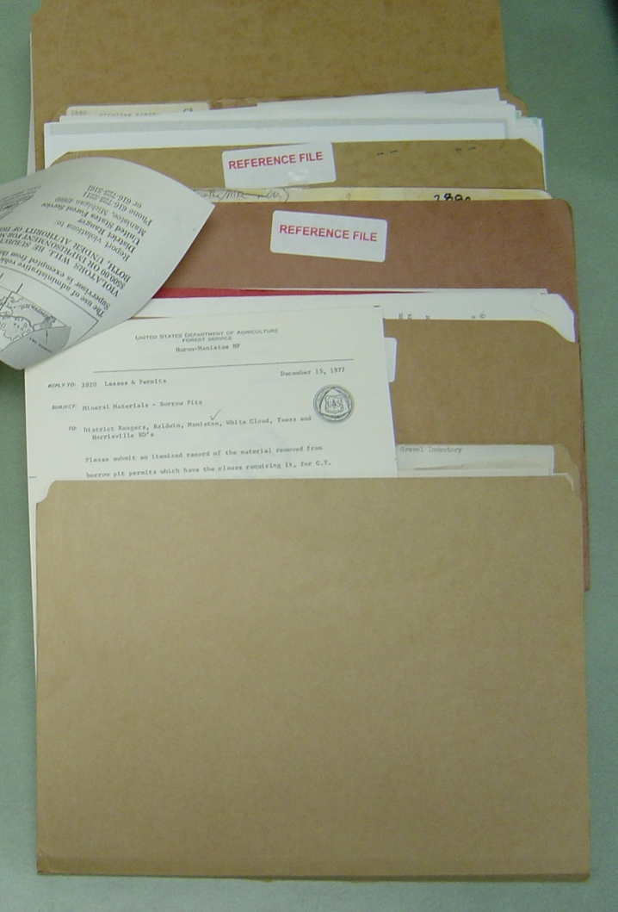
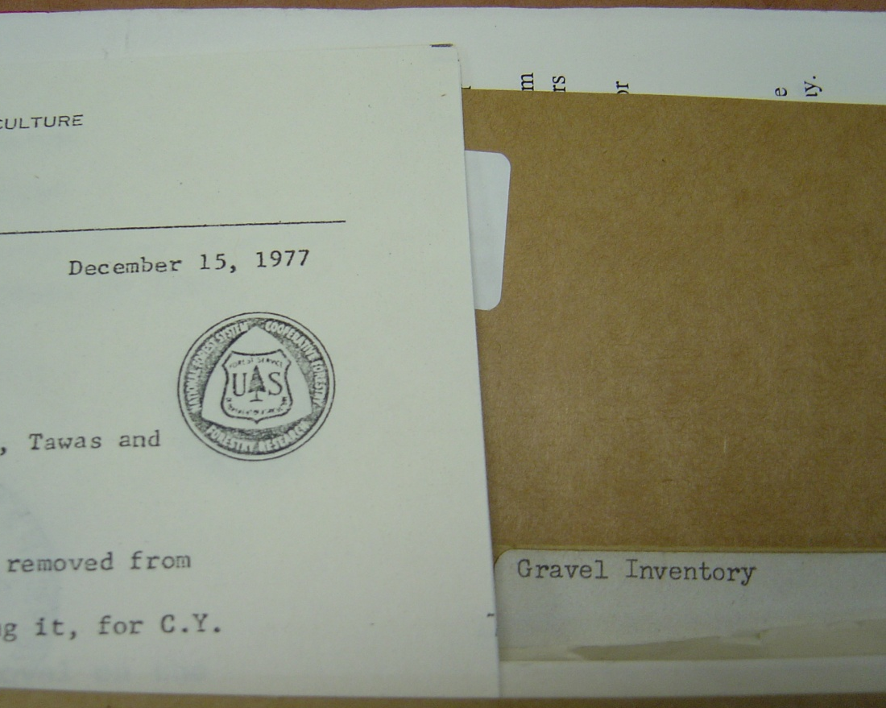
Information on Forest Service sand and gravel pits has become antiquated
Mostly historic/archival info
Files on individual pits are stored separately at each ranger district
Notes:
So, what this has meant is that a lot of pits that once existed have simply been forgotten about. Employees who worked on them back in the 70s are mostly retired now, and records of any extraction or reclamation activities are antiquated and dispersed throughout the forest in random file cabinets.

Slide 13
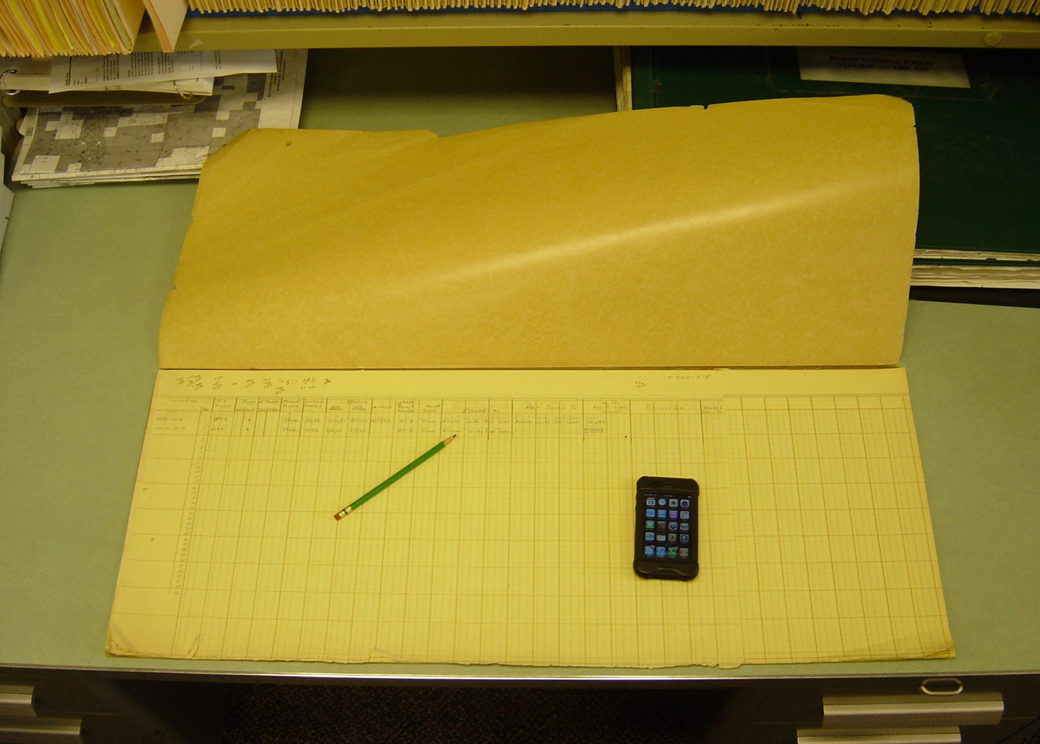
Book of tabular data on pits ~1950s…
Notes:
Here’s a tabular book on pits from the 1950’s I dug up in the warehouse- the iPhone there for juxtaposition…

Slide 14


PURPOSE: To gather relevant information about pits across the Huron-Manistee National Forest and store it in a manageable/useful geodatabase.
Geodatabase
Multiple users
GOALS
Map pit locations across the National Forest (Inventory).
Provide a foundation of accessible information for planning purposes (Assessment).
Increase awareness of pit locations, and availability of resources.
Notes:
There are three main goals associated with this project. The first, more mechanical goal to map the pit locations. With two other less tangible goals to increase the awareness of aggregate resources forest-wide and provide a foundation of accessible pit information for planning purposes.

Slide 15
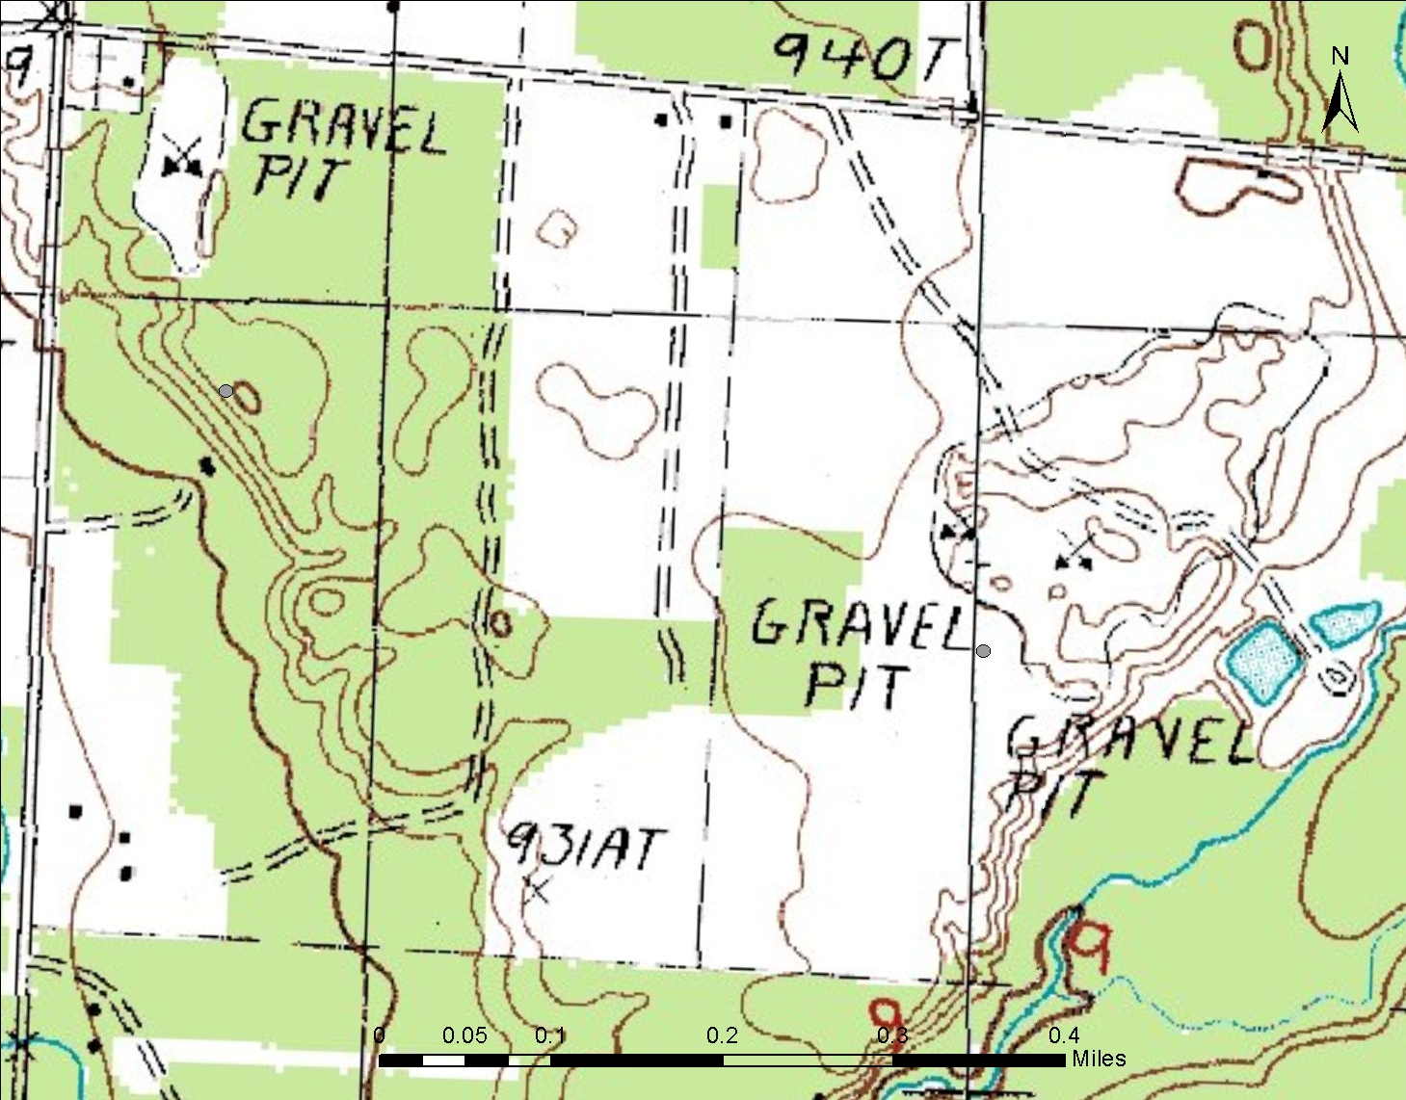
Notes:
The tricky thing about mapping gravel pits is that they show up in different places depending on the date of the map you are using for reference. Aggregate is a finite resource, with sometimes quite limited extent. So, for example, looking at a topo map dated 1983 shows pits in one place, and..

Slide 16
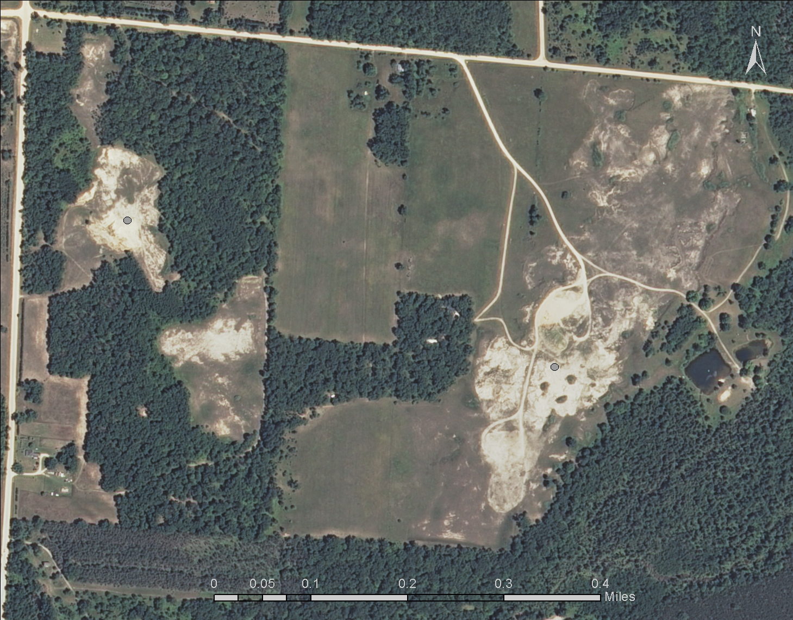
Notes:
Looking at an aerial photograph from 2012, they show up in entirely different places.

Slide 17
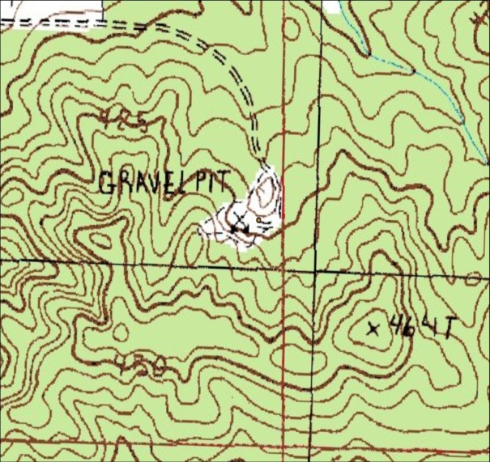
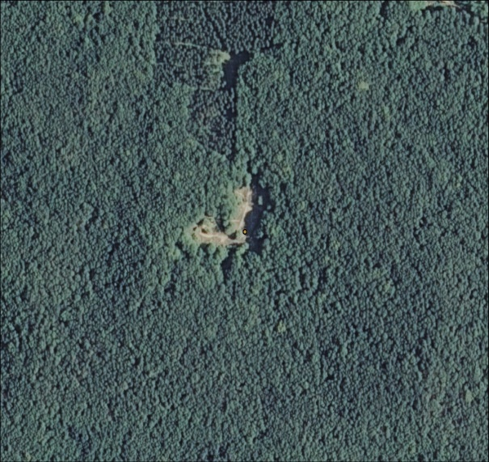
Mapping Pit Locations…
Manistee National Forest Map (1979)- paper map
1:24,000 scale USGS Topographic Quads (1983)
1:100,000 scale USGS Topographic Quads (date?)
Shapefiles provided by MDEQ (2000)
NAIP Aerial Photography (2010)- reference map to determine if pit still exists
Personal interviews with forest service personnel
Paper files of permits/contracts stored in Minerals and Geology office
Notes:
Part of the geodatabase design was to include an accurate record of historic pit locations, so a variety of different data sets was used to do the mapping. Essentially, the process involved comparing historic sources with current reference map. For this project, the current reference map is the 2010 NAIP Aerial photo (however, a 2012 one is now out- went online right at the end of mapping pits…).

Slide 18
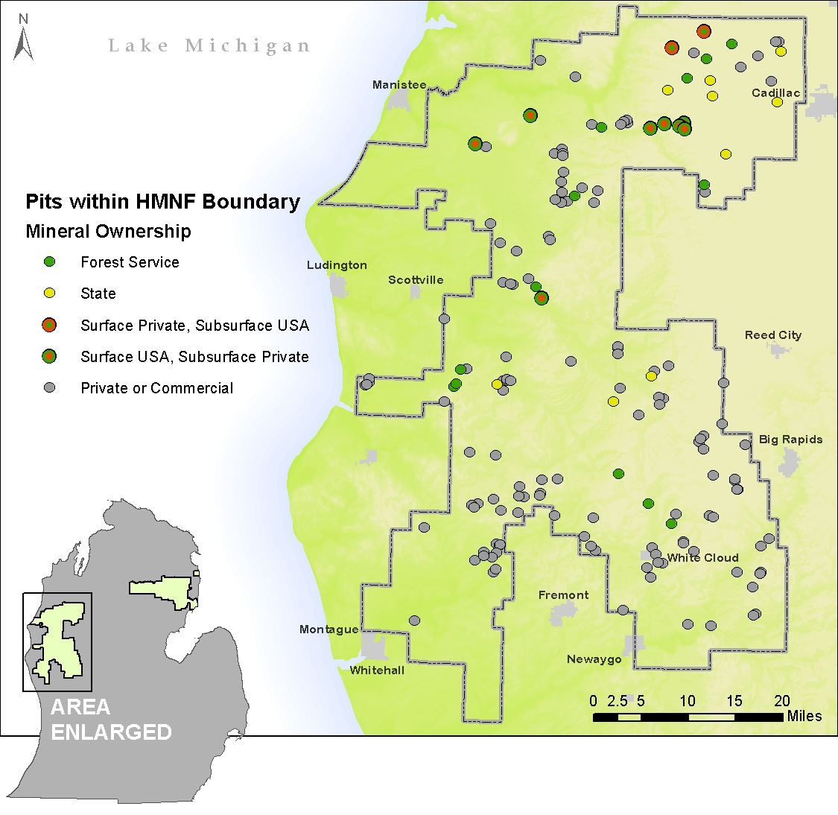
Manistee Side
F.S. Pits = 33
Private Pits = 128
Notes:
When the mapping was complete, I discovered about 33 forest service pits on the Manistee side that have been abandoned or reclaimed, and about 128 of such on private land.

Slide 19
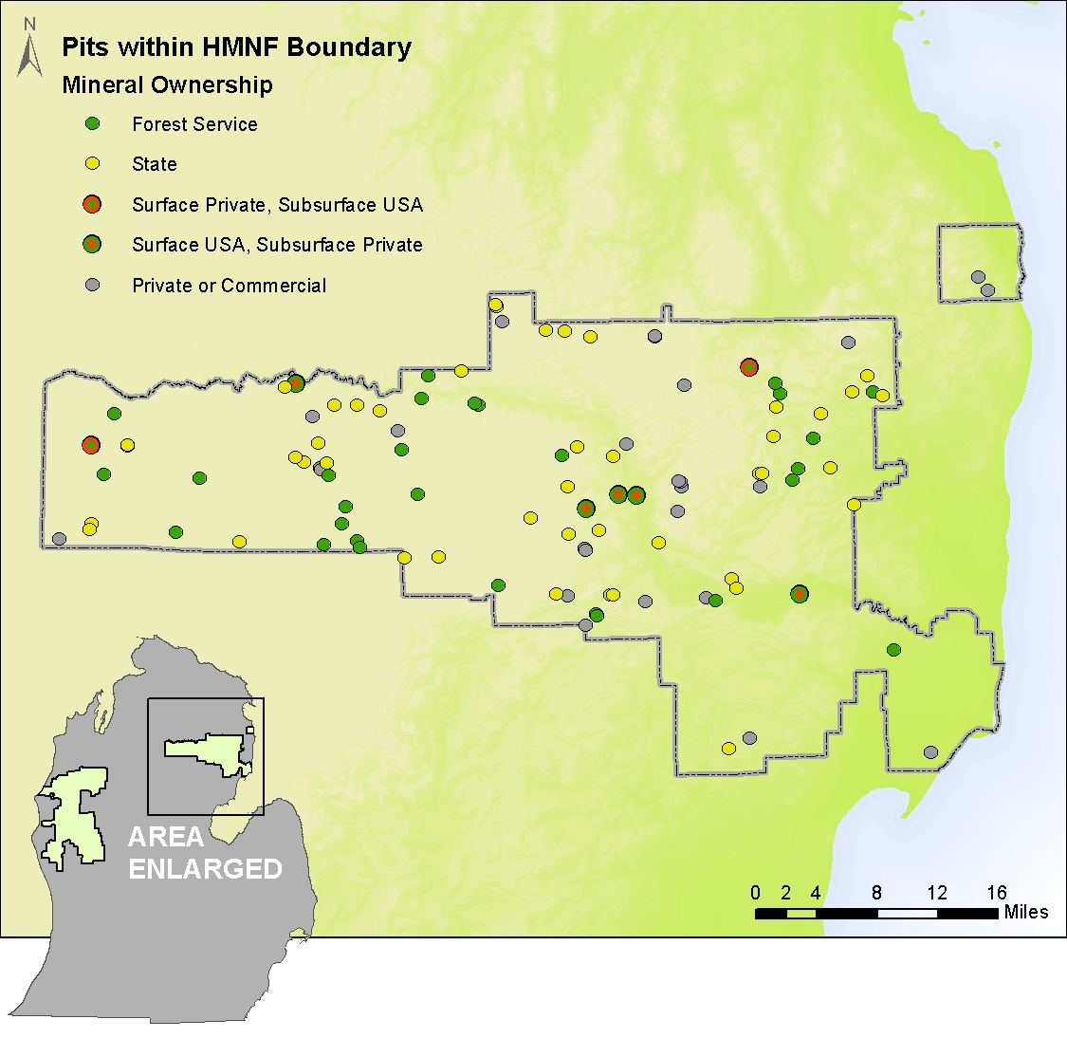
Huron Side
F.S. Pits = 79
Private Pits = 26
Notes:
One the Huron Side, the scales are tipped the opposite way, with 79 pits on federal land and 26 pits on private land.

Slide 20

Active Pits on FS land = 4
Notes:
With only 4 of them still active today. Essentially, these 4 pits serve both sides of the forest, and only 1 of these is being used right now, mostly by the county road commission.

Slide 21



Information useful for planning purposes…
Geodatabase
Pit Points
District
County
Legal Location
Latitude
Longitude
Operation Status
Mineral Ownership
Ownership Entity
Deposit Type
Map Source
Pit ID Key
USGS Name
Comments
Pit Areas
District
Pit Name
Shape Length
Shape Area
Longitude
Operation Status
Comments
Pit Photos
Permit Applications, Pit Abstracts, etc.
Notes:
Other information about the pits was gathered on the fly during the mapping effort. These include… Then, where they exist, I also attached photos and PDFs of permits or other relevant information to the pits.

Slide 22
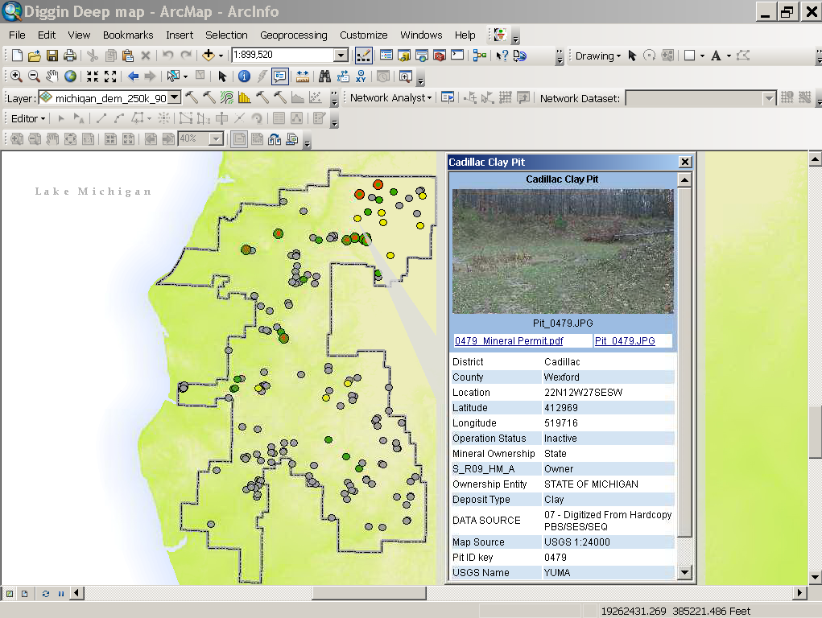
Notes:
Which can be accessed in ArcMap by using the HTML pop up tool and clicking on a pit.

Slide 23

Increase awareness of pit locations and availability of resources→
Spherical Panoramic Photography
Provides a scalable 360⁰ x 180⁰ panoramic view of a scene/landscape
Can be viewed using Google Earth→
Greater visual capabilities and easier to use the ArcGIS
Free
Photos can be served via the internet to minimize file size and maximize viewing performance
Notes:
The real impetus for this work though comes from documenting the condition of pits on the ground using spherical panoramic photography. This is the method that I chose to use to document these pits because it gives the most realistic sense for on the ground conditions of these abandoned pits. Essentially, what you are doing is creating a 360 x 180 degree panoramic view of the scene, and using Google Earth as the platform to display and share the photos. Why Google Earth? Well, to those of us who use it often, the answer is obvious- but, for land and resources managers, or those otherwise unfamiliar, it’s easier to use and has greater visual capabilities that ArcGIS, its free, and makes sharing content over the web simple.

Slide 24
Spherical Panoramic Photography Basic Workflow
Take a series of photos, using fisheye lens and panoramic tripod head
“Stitch” photos together to create seamless panoramic photo
“Tile” panoramic photo to allow on-demand download of relevant portions of scene
Store photos on web server
Generate KML (Keyhole Markup Language) to display photos in Google Earth
Notes:
The basic workflow for creating spherical panoramas is to take a series of photos using a fisheye lens and pano tripod head, stitch, etc…

Slide 25
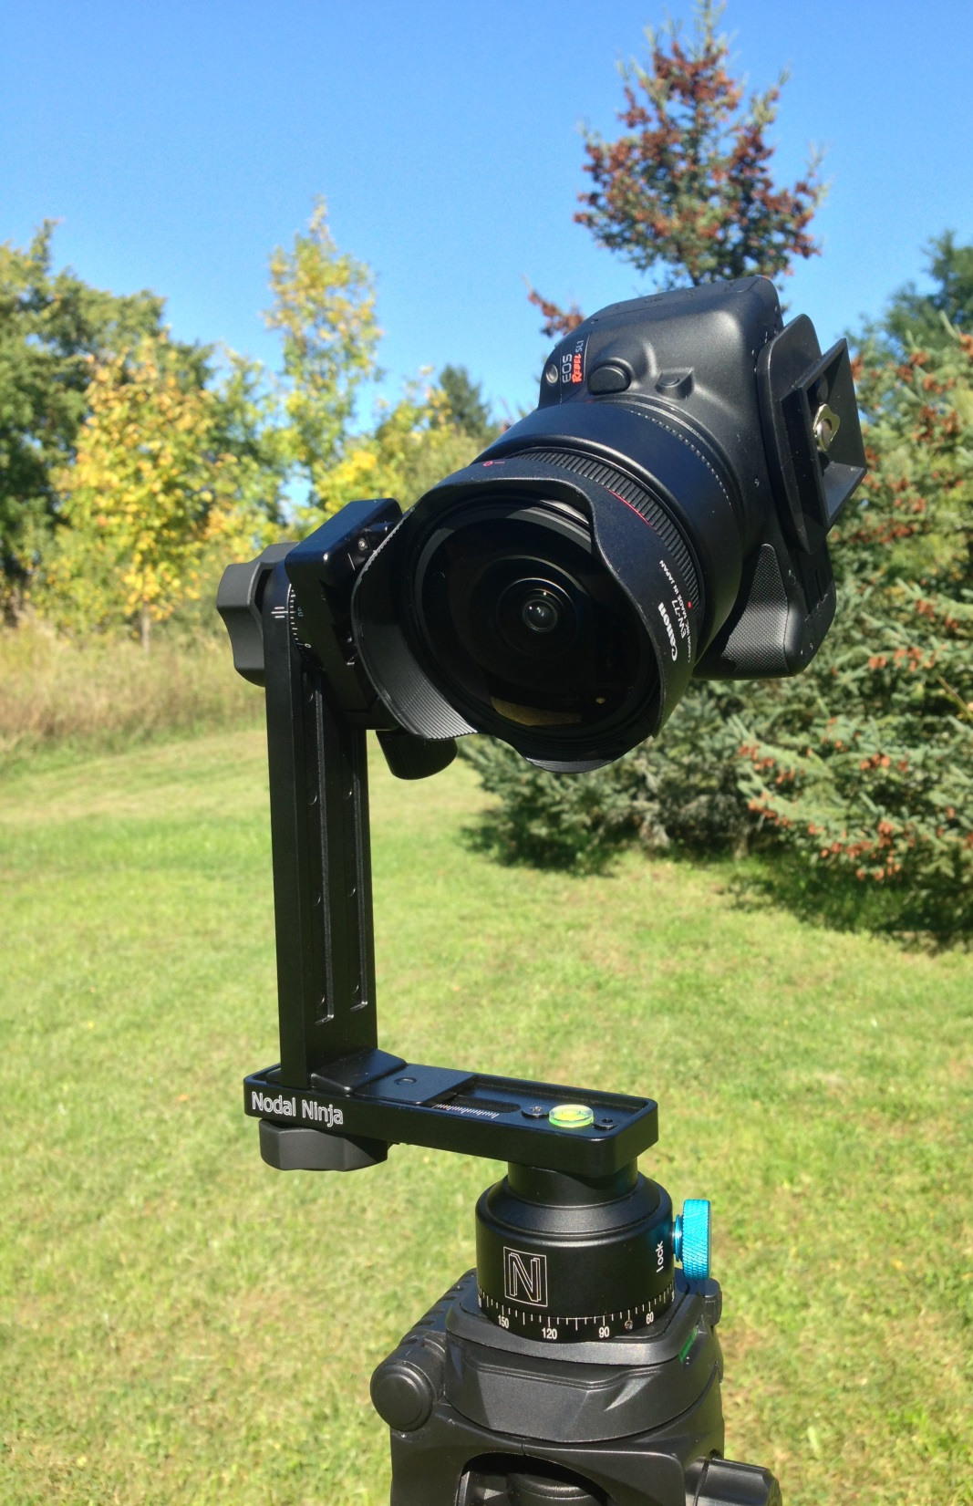
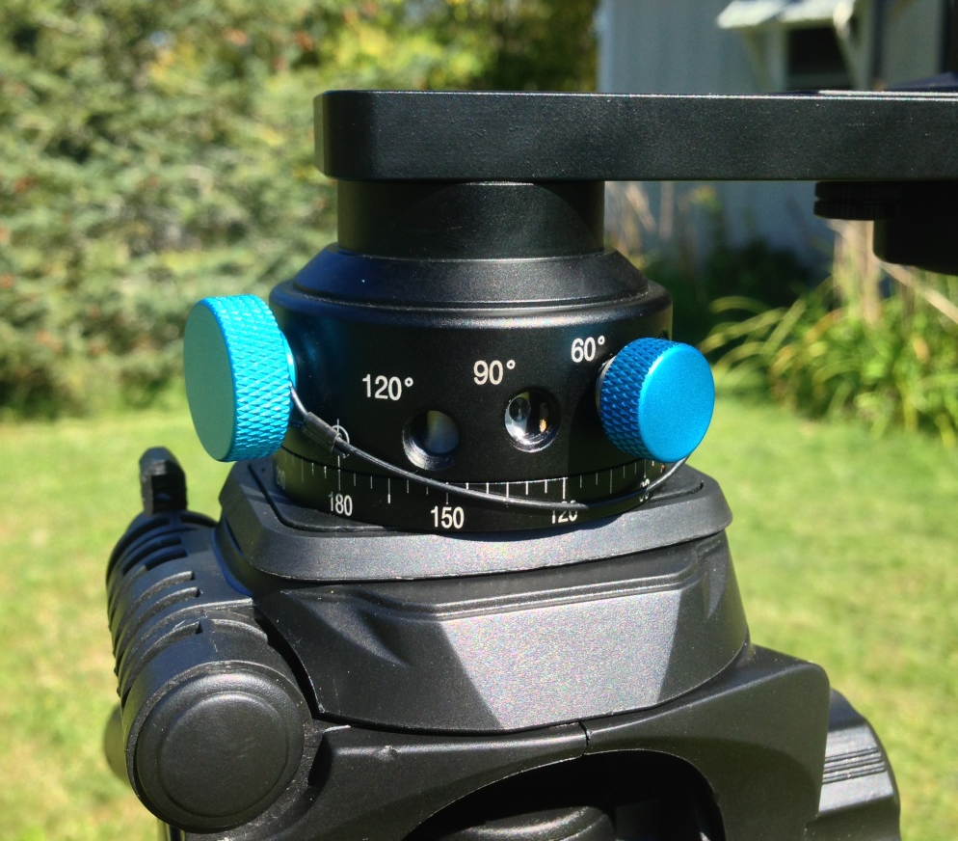
Panoramic Tripod Head & Fisheye
Panoramic Head allows for full rotation around No Parallax Point.
Define rotation intervals to ensure overlap.
Fisheye lens takes 180⁰ x 90⁰ view.
Notes:
The panoramic tripod head allow for full rotation around the No Parallax point, and also allows you to define your rotational intervals to ensure sufficient overlap, which depending on the lens is typically about 20-30%. So, with a fisheye lens that has a 180 X90 degree scene with portrait orientation, setting the rotation interval to 60 degrees is optimal.

Slide 26
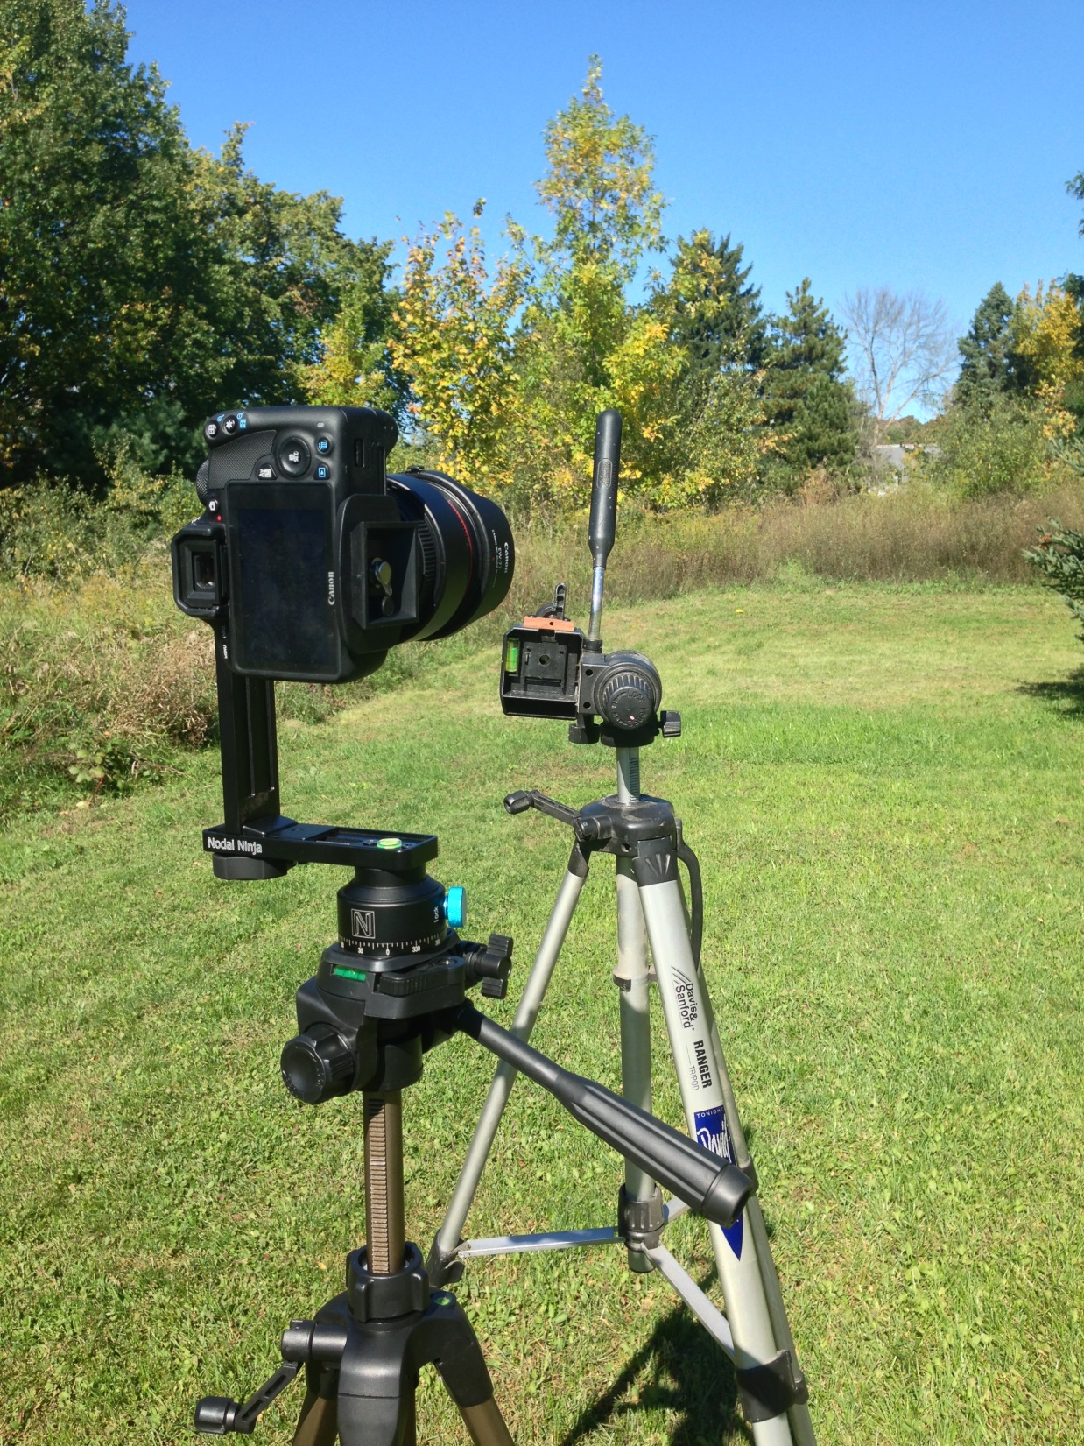
Finding the “No Parallax Point”
Set up reference point in immediate foreground (rod of 2nd tripod) to measure against background reference (Pine tree tips, red lines)…
Take photos from different angles.
Note any offsets of two reference points between photographs and adjustment lens position accordingly.
Notes:
Before taking photos you have to first situate the camera on the tripod in such a way that there’s no parallax between photos taken at different angles. To find the no parallax point, you set up a foreground reference (in this case the second tripod) and compare it to any background reference (in this case the two pine trees) and take photos at two different angles. By noting the offset between the foreground and background references in the two photos, and adjusting the lens forward or backward on the tripod you can eliminate most parallax.

Slide 27
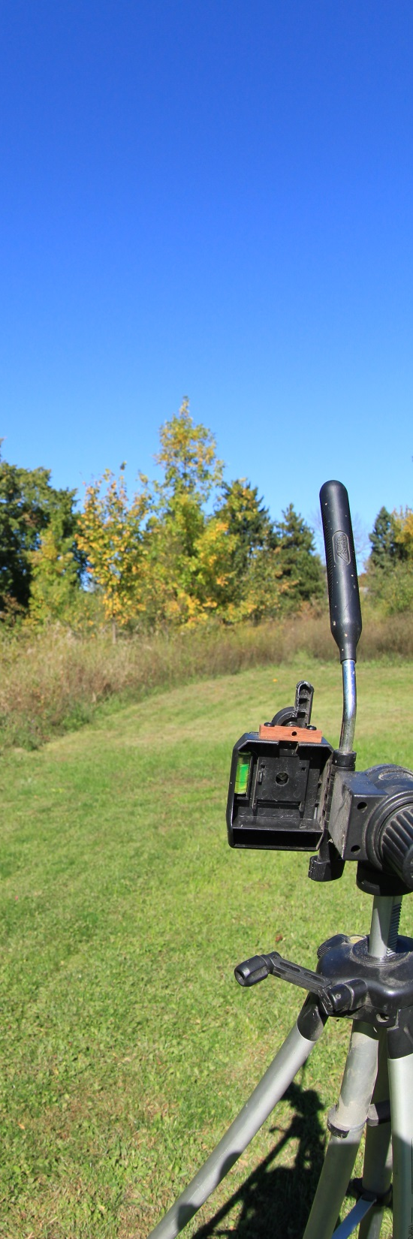
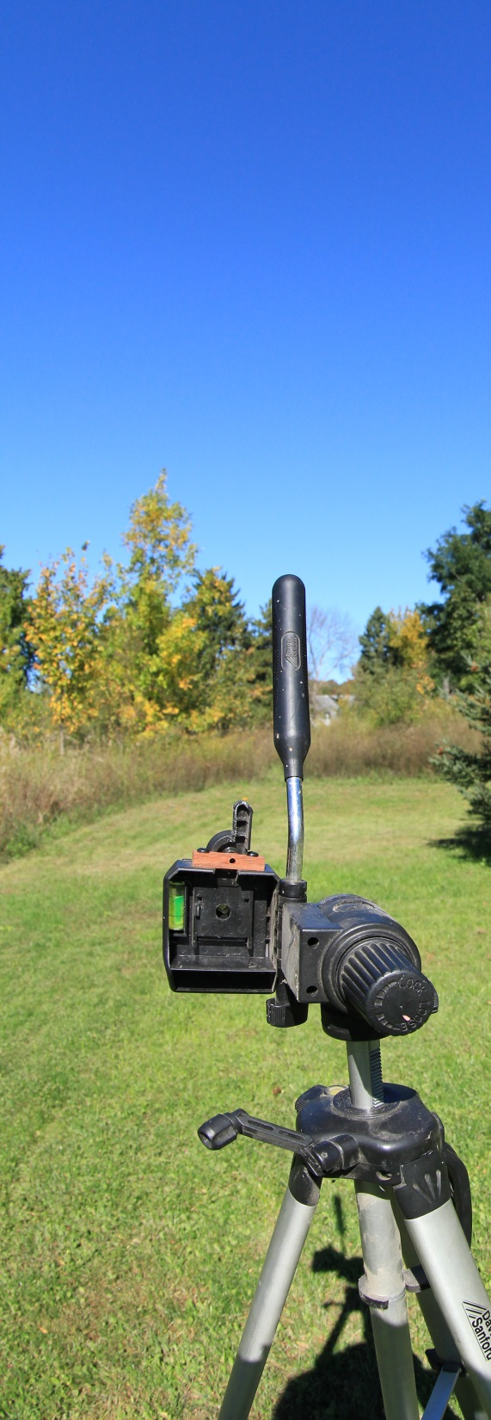
Example of Misalignment
Picture 1
Picture 2
Foreground reference (White) is slightly shifted compared to background reference (Red)
Notes:
So in these two pictures you can see that the foreground and background are misaligned when the camera is rotated. Therefore, the lens needs to be adjusted forward or backward until this is eliminated.

Slide 28

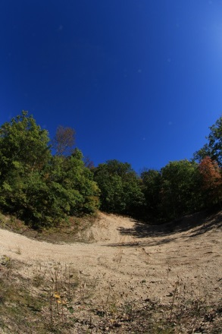
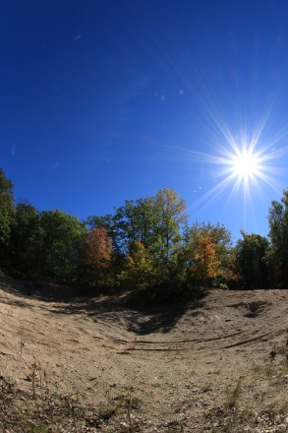
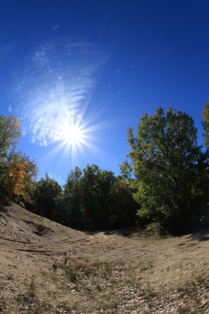
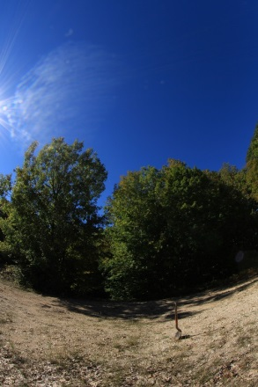
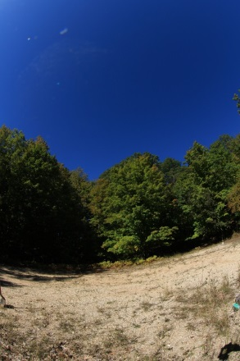
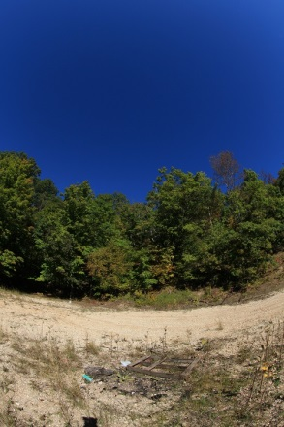
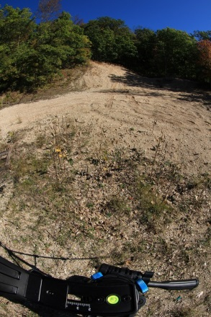
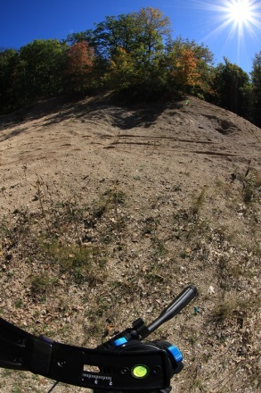
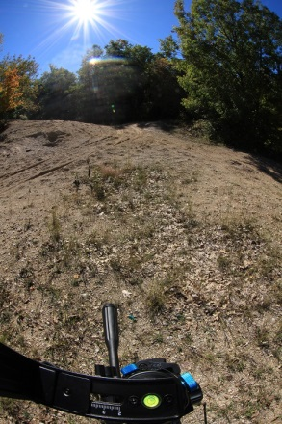
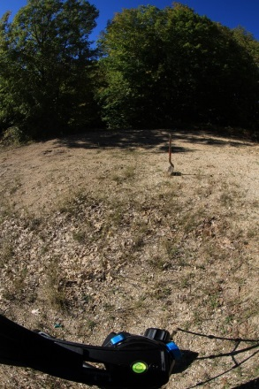
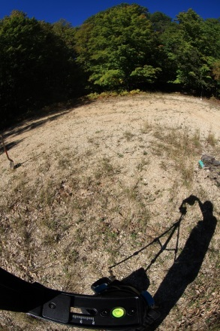
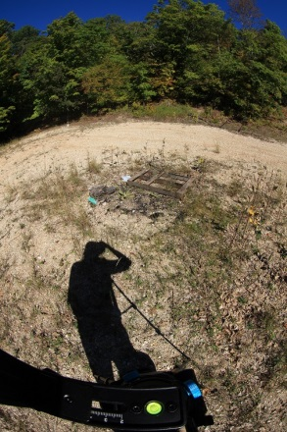
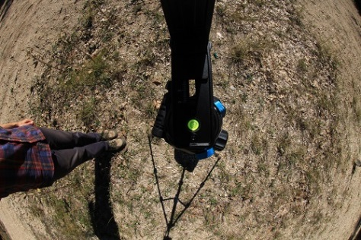
14 photos per gravel pit
1 Vertical Up
6 at 30⁰
Tilt, 60⁰
Rotation
interval
6 at -30⁰
Tilt, 60⁰
Rotation
interval
1 Vertical Down
Notes:
Another important pre-requisite is that you must make sure camera is set to Manual exposure, and that you set the exposure and white balance for your highest contrast scene. That way, the final photograph will appear seamless. At each gravel pit, I took 14 photos (1 vertical up, 1 vertical down, and 6 rotational at 30 degrees positive and negative).

Slide 29
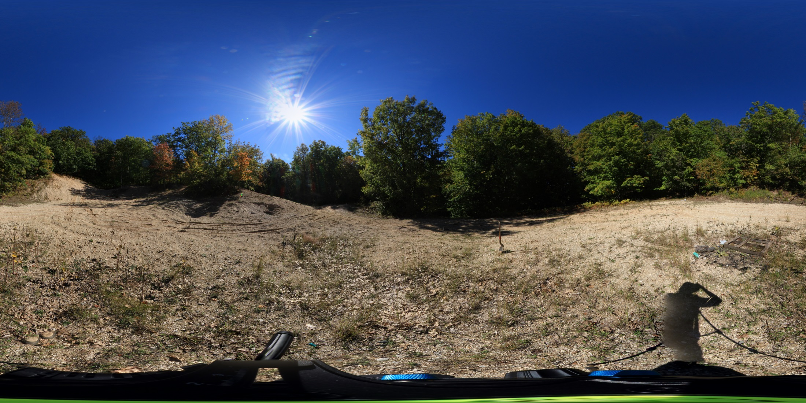
“Stitched” photo of gravel pit
Typical Stitched photo @ 18 Megapixels = 12,712 x 6,356 pixels
~90MB of data!
Notes:
There are several software apps available for stitching photos. I happen to use PT GUI, which is probably the most powerful and intuitive stitching software available right now. Once the photos are stitched together, the resulting image can be incredibly large, which presents a challenge when you want to integrate these into Google Earth. Especially if you want to do this for 10s or hundreds of sites. So, to improve the usability of the photos, they need to be broken up into smaller sections once again, a process called “tiling”

Slide 30

Tiling the panoramic photo…
256 pixels
256 pixels
Each “tiled” photo must be square (256 x 256 pixels)
Level 0
(Minimum Zoom)
Notes:
Tiling is exactly how it sounds- you break up the image into a series of smaller images to allow Google Earth to only call upon the resolution that is needed, which drastically improves performance and loading time. It is similar to creating image pyramids for rasters in ArcGIS. The standard Tile size that Google Earth likes to work with is 256x256 pixels.

Slide 31
Tiling the panoramic photo…
256 pixels
256 pixels
Each “tiled” photo must be square (256 x 256 pixels)
Photo and number of tiles doubles with each increasing level
Level 1
Notes:
As you increase the size of the image by 2, the number of tiles is squared. Any portion of a tile that does not contain part of the image by default is turned black.

Slide 32

Tiling the panoramic photo…
256 pixels
256 pixels
Each “tiled” photo must be square (256 x 256 pixels)
Each “tiled” photo must be square (256 x 256 pixels)
Photo and number of tiles doubles with each increasing level
Number of levels depends on storage space and desired level of detail
When finished, this example photo= 6 levels, 1074 individual tiles at full zoom
Level 2
Notes:
This particular photo happens to be a 2:1 ratio, so at a certain level some of the tiles will not contain any of the image- which is fine, they will not be requested by Google earth when the image is set to that particular zoom level. The number of levels ultimately depends upon the original image size and the level of zoom detail that you want to be able to achieve. Again, the challenge here is to balance quality with performance. I set this particular image to have 6 levels of tiles, resulting in 1074 individual tiles to store.

Slide 33




Numbering the tiles (file naming structure and storage)…
0,3
1,3
2,3
3,3
0,2
1,2
2,2
3,2
+
0,1
1,1
2,1
3,1
Panorama Tiles
KML for Google Earth
0,0
1,0
2,0
3,0
Google Earth Photo Overlay Tool from Digital Urban, The Bartlett Centre for Advanced Spatial Analysis, University College London…
Automatically generates photo tiles and associated KML for Google Earth- FREE!
Folder Stored on Web Server
Notes:
Without going into too much detail about the KML file, the way that Google Earth requests individual tiles depends on the viewing angle and the level of zoom, so there is a very specific naming structure that needs to be used for this to work. The naming convention of the tiles is similar to a simply Cartesian coordinate system in that the rows and columns are assigned sequential numbers. Now, to do this manually, even for a single stitched photo would take an incredible amount of effort and time, and the process would be prone to error and difficult to troubleshoot. Luckily, very smart people have developed tiling software that will do this for a photo in a matter of seconds, and even generate the KML file associated with the tiles. I use the Google Earth Photo Overlay tool developed by the Bartlett Center for Advanced Spatial Analysis- it’s completely free and easy to use, and they actually get back to you with support if you have questions. The only thing left to do is store these items in a folder, put them up on a server.

Slide 34
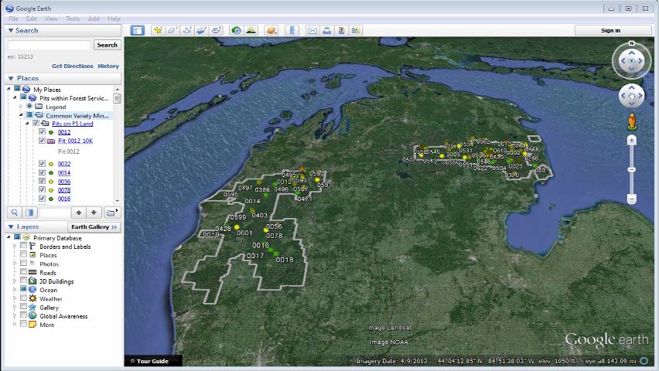
Notes:
So, the sand and gravel pit layer files were exported from ArcGIS to a KML, and they show up in Google Earth with the exact same symbology. One of the added benefits of using this geodatabase in Google Earth is the ability to customize the Pop-Up boxes to include custom insignia, such as a logo, titles, and insert descriptive content, and links. Also, the attribute table from ArcMap is inherited automatically, so you get all of the same important information when viewing each pit, giving essentially the same level of information access to those people in your organization or workplace who are not GIS savvy. Then, to see the spherical photo, you simply click on the icon and it flies you into the scene, with the photo perfectly projected onto a sphere. You can pan and zoom, looking in any direction at all, and even orient the scene so that it is geographically true. The correct tiles are requested and the speed with which the scene comes into focus just depends on your computing power. But, most computers that can handle basic panning in Google Earth will be able to handle photos of this resolution.

Slide 35
Recent example of using the Geodatabase/Google Earth
Grant to obtain funding to replant areas of forest…
Are there any areas of forest that need replanting? If so, how many acres should be planned for in the grant application?
Query the geodatabase for “pits in reclamation” or “inactive”.
Look up pits in Google Earth- observe spherical photos.
Discuss with District Rangers/Foresters/Silviculturist… What is the desired future condition for this particular pit?
Prioritize list of pits.
Go back into the GIS- summarize “Shape_Area” for those prioritized pits.
Notes:
Just before flying out, there was a perfect example of how this whole project can be used. Our forest silviculturist was filling out a grant application to obtain funding to replant areas of forest, and she needed to know if there were any areas suitable to replanting, and if so, how many acres should she plan for. So, I opened up the geodatabase in ArcMap, and queried those pits that are classified as “in reclamation”, or “inactive”. Looked up those individual pits in google earth, and observe spherical photos simultaneously while discussing what the desired future vegetative condition is for these areas. From that discussion, narrow down which pits could benefit from re-planting. Then, go back into the GIS and summarize the Shape_Area for those priority pits, and get a total number of acres to apply for in the grant.

Slide 36
Other ongoing projects at the Huron-Manistee…
Set up sediment lab to do particle size analysis for sand and gravel inventory/future engineering projects.
Developing geologic interpretive displays (physical and online content using ArcGIS Online Story Maps).
Assessing the effects of acid deposition on forest soils in impaired watersheds.
Impact of land use legacies on savanna soils in areas managed for Karner Blue Butterfly habitat; implications for management and restoration.
Next year- mapping groundwater dependent ecosystems in areas of future potential high-volume hydraulic fracturing oil/gas development.
Notes:
I have a number of other ongoing projects

Slide 37

Thank you for your input, help, resources, and support!
Terry Saarela, Rich Corner, Tracy Miller, Scott Peedle, Jessica Stuntebeck, Suzanne Johnson, Greg Knight, Russ Sutton, Kate Salm, Doug Gullekson, Dave Jaunese, Kristen Thrall, Paul Salvatore, Geological Society of America GeoCorps program, Huron-Manistee National Forests, and many others…
Questions?

