Slide 1

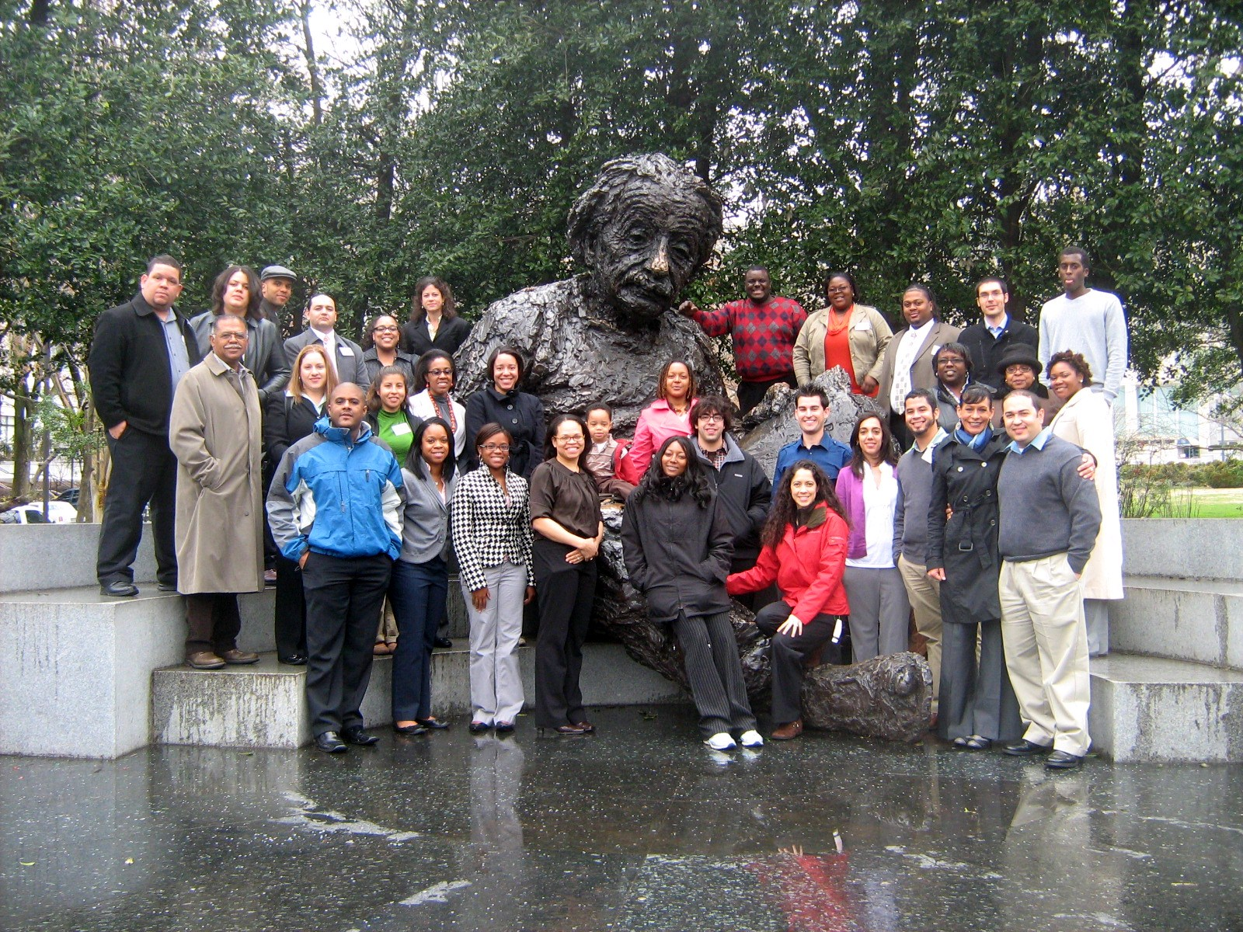
MS PHD’S: Diversifying the Earth System Science Community Through a Synergy of Mentoring, Community Building, and Professional Development Activities
Lois Ricciardi, Ashanti Johnson, Vivian Williamson Whitney, Warner Ithier-Guzman, LaTanya Braxton
Notes:
Good Morning! My name is Lois Ricciardi and I am the Project Coordinator for the Minorities Striving and Pursuing Higher Degrees of Success Professional Development Program or MS PHD’S as we call ourselves for short.

Slide 2
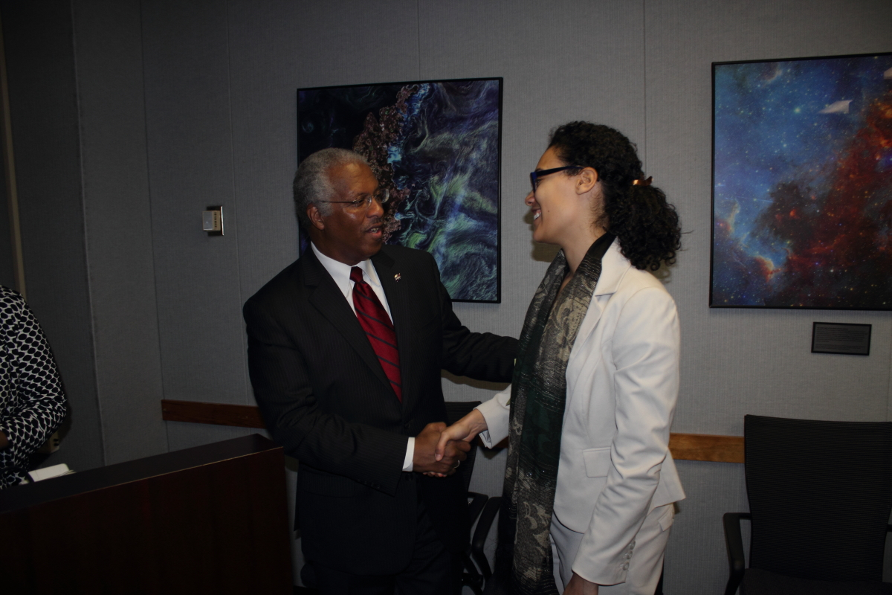
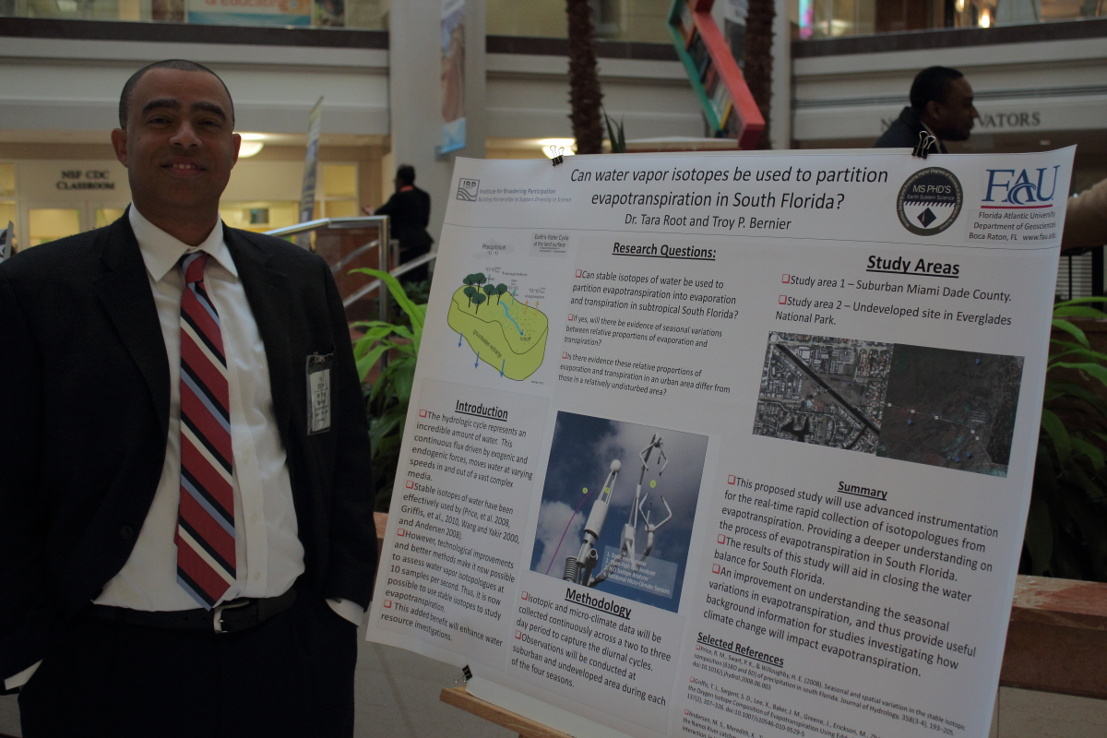
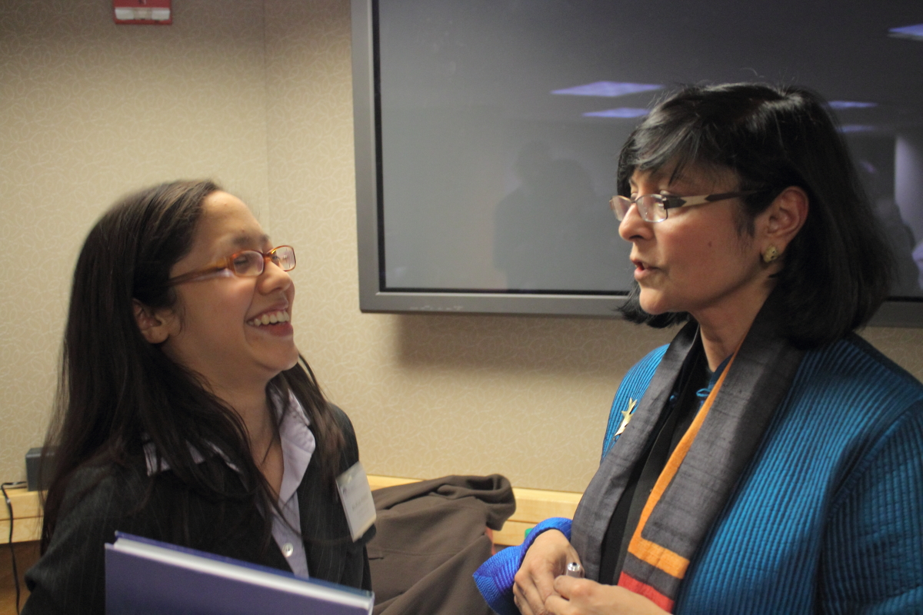
What is MS PHD’S?
Minorities Striving and Pursuing Higher Degrees of Success (MS PHD’S)
Professional Development Program
  Tiered Mentoring
  Successful URM Scientist Role Models
  Community Building
  Professional Development Training
  Networking Opportunities
  Virtual Community
Notes:
MS PHD’S is a professional development program designed to facilitate the recruitment and retention of underrepresented minorities in STEM. We do this through a 3 phase structure that includes Tiered Mentoring, Successful URM Scientist Role Models, Community Building Activities, Professional Development Training, Networking Opportunities, and a Virtual Community.
Our Goals are to increase exposure to and engagement in the Earth system science community for underrepresented minorities, enhance professional skills, grantsmanship, oral and written communication, provide resources regarding future funding, education and career opportunities, facilitate networking opportunities with established researchers and educators, and sustain on-going interaction, communication and support through our virtual community

Slide 3
Background
Launched in 2003, the pilot MS PHD’S Ocean Sciences Program is supported by NASA, JGOFS and National Academies
Designed to reduce gaps in recruitment and retention of URM students and correlation of underrepresentation within the Geoscience workforce
  Proportion of the U.S. ESS doctoral degrees awarded in 1998 (NSF, 1999)
 | African American | Hispanic | Native American
Life Sciences | 3.2 % | 4.0 % | 0.41 %
Physical Sciences | 2.2 % | 2.6 % | 0.45 %
Earth, Atmos. & Marine Sciences | 1.6 % | 2.8 % | 0.50 %
Notes:
The pilot program was the 2003 MS PHD’S in Ocean Sciences. It engaged 25 highly talented URM students during the Final Joint Global Ocean Flux Study Program Open Science Meeting. The idea for the program was based upon research demonstrating that in 1998, minorities received < 10 % of the 30,000 plus doctoral degrees awarded by U.S. institutions and that the number of ESS doctoral degrees awarded to minorities was even smaller.

Slide 4
MS PHD’S Today
In response to evaluation findings of the pilot program, MS PHD’S PDP is launched in 2005 with support from NASA and NSF
  Expanded from Ocean Sciences to broader Earth system sciences
  3 phase structure provides increased exposure to mentoring, networking, professional development and community building
  Addition of Virtual Community
552 URM students have applied to participate in MS PHD’S
  213 highly talented URM students across 9 cohorts
  33 states, D.C., Puerto Rico, Vancouver, Canada
  47 students have completed doctoral degrees
  Another 67 are enrolled in doctoral programs
Notes:
In response to evaluation findings, the program is expanded to include Earth system science disciplines beyond Ocean Sciences. It is set up as a 3-phase structure to increase the benefits for students. A virtual community is added to further support participant interaction and inclusivity. The program supports 213 participants from 33 states, D.C., Puerto Rico, and an American citizen who graduated from University of British Columbia in Vancouver, Canada. We currently have 47 alumni with doctoral degrees and another 67 participants are enrolled in doctoral programs.

Slide 5
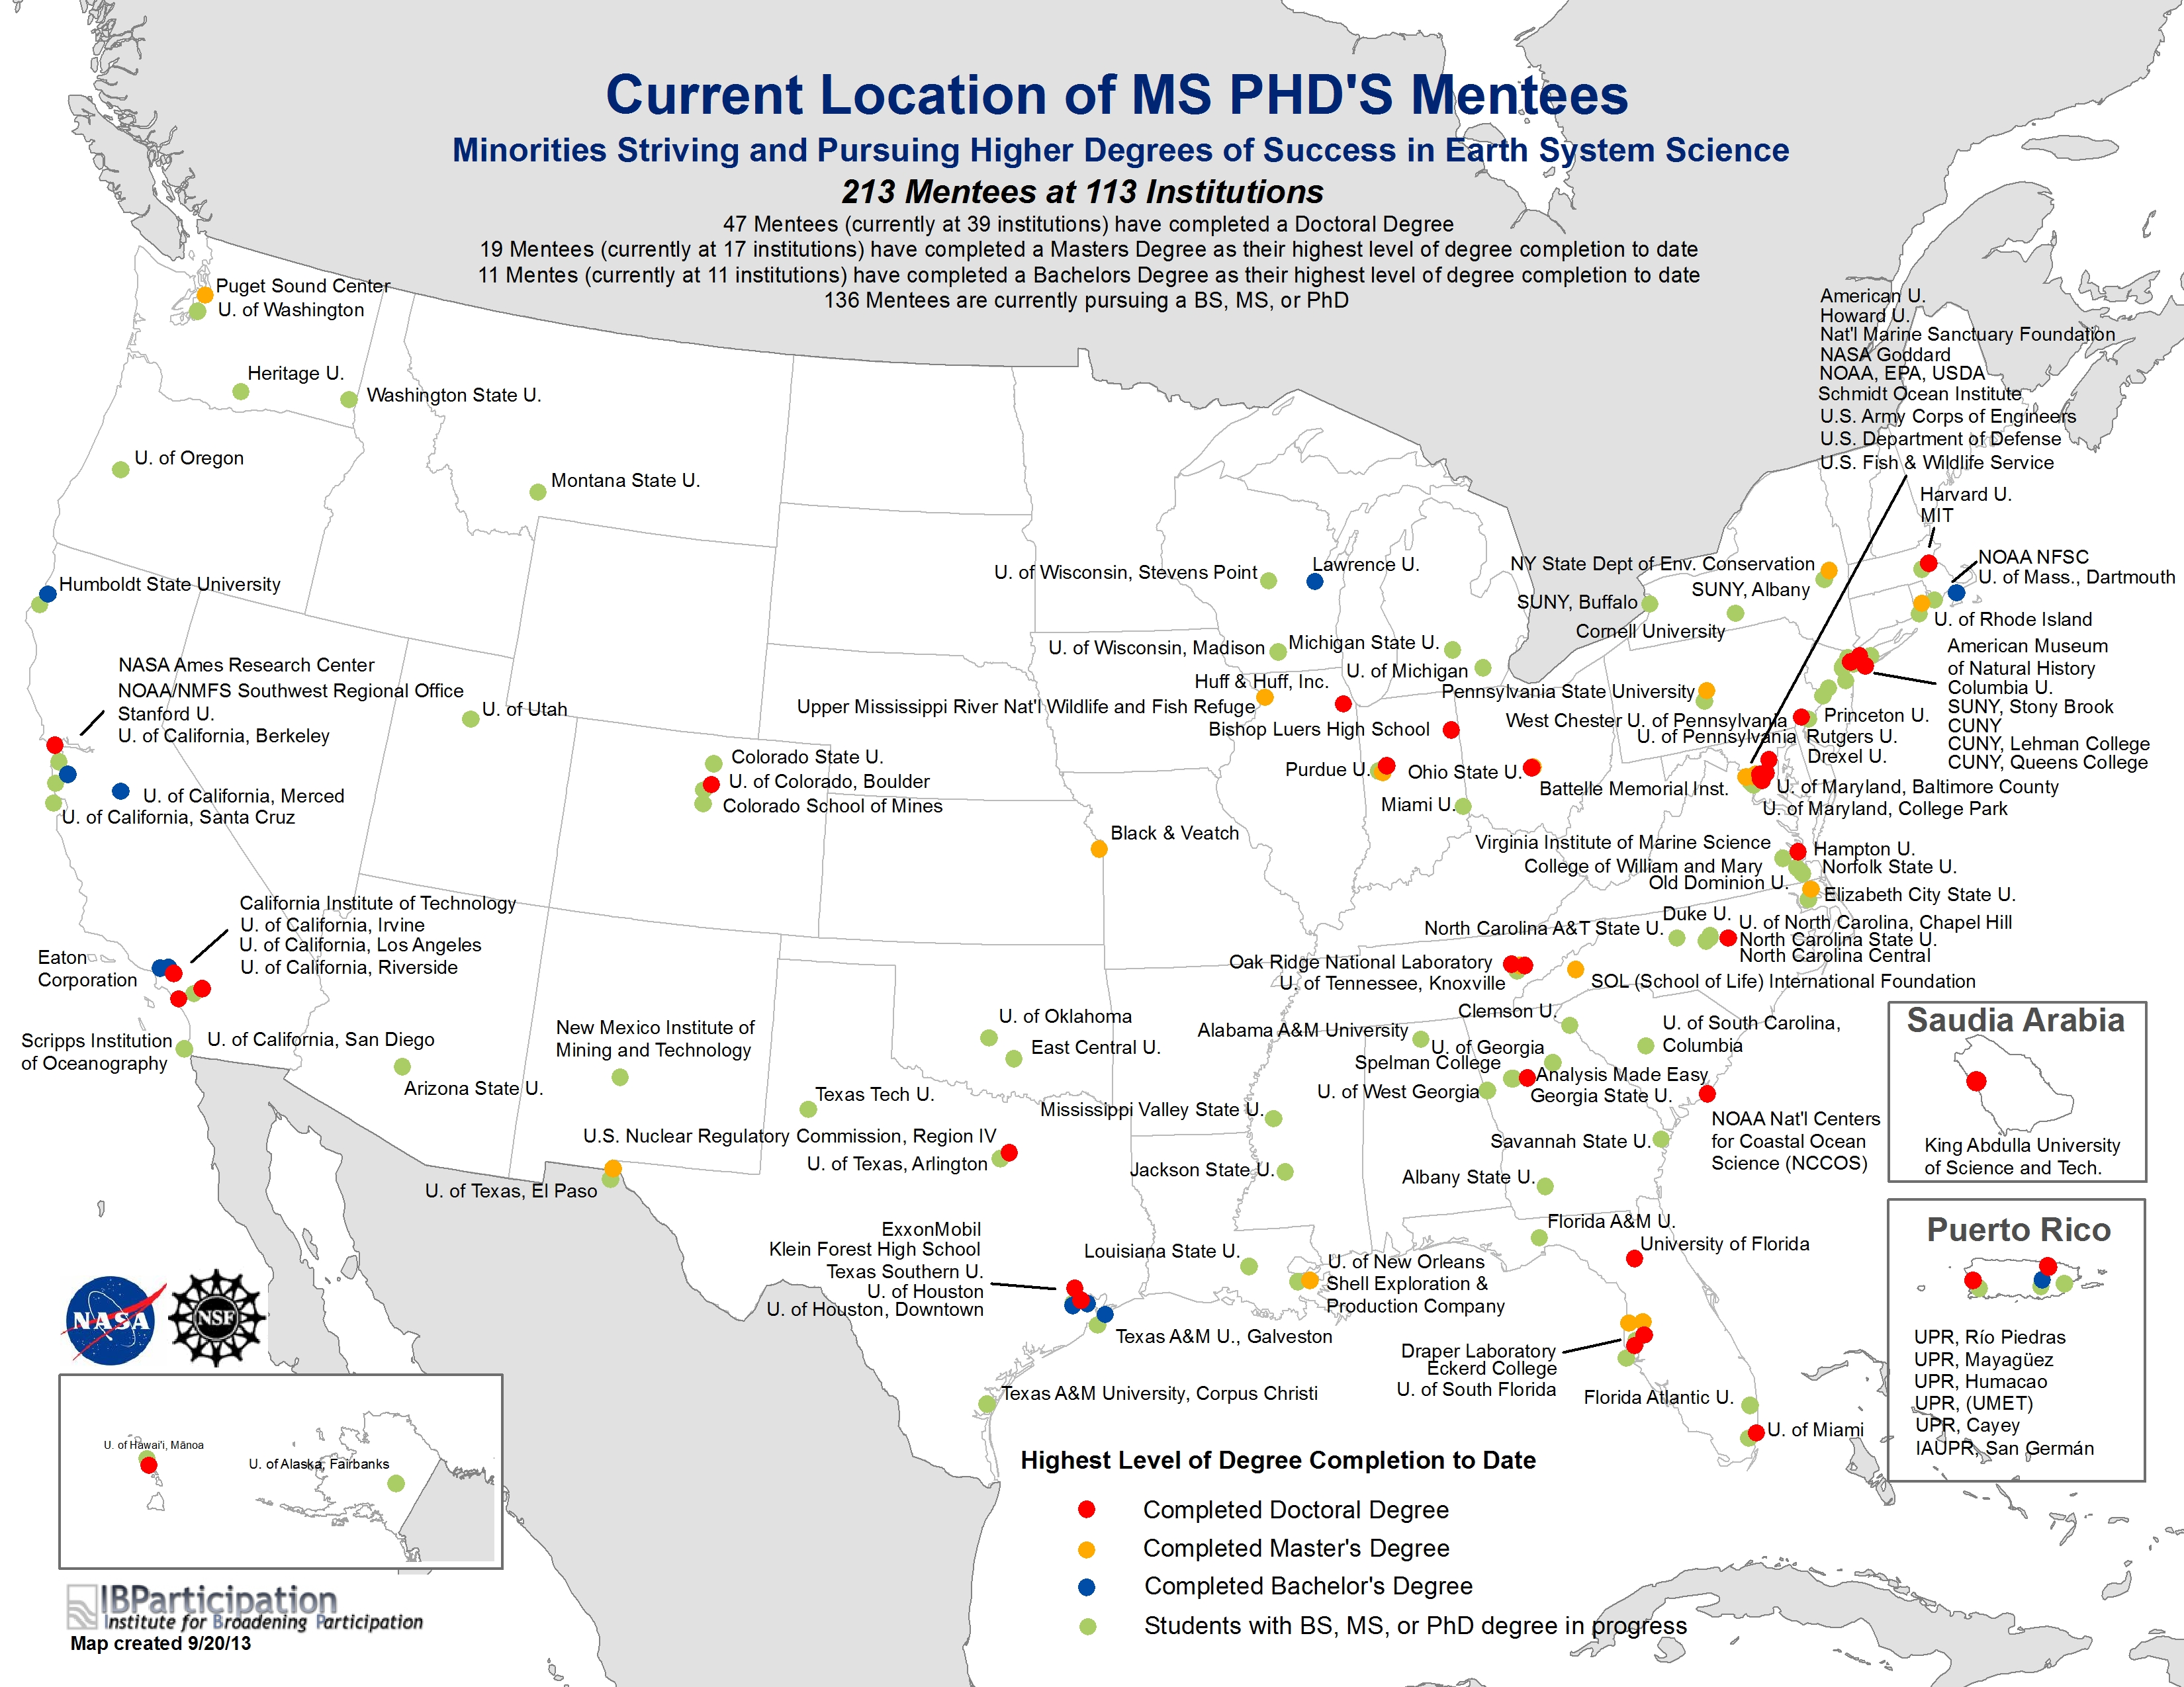
Notes:
Here you can see an overview of the geographic representation by state and cohort along with levels and numbers on degrees attained. This map is also available on our website – www.msphds.org

Slide 6
Benefits for Students
ESS Exposure
Participation in ESS meetings & conferences
Field trips to NSF, NASA & other ESS-focused facilities
Opportunities and Funding
Networking Opportunities
ESS researchers
ESS educators
Federal agency program officers
Professional society representatives
Peers & near-peers
Mentoring Relationships
Among peers, researchers & educators
Virtual Engagement
Among peers, researchers & educators
Virtual tools
  Online profiles
  Listserv
  Facebook
  LinkedIn
  Community Forum
  Web video conferencing
  VoIP technologies
Professional Development Opportunities
Academic/professional goal setting & strategic planning activities
Information regarding future funding, education opportunities, career opportunities, and resources
Brown bag discussions on academic & career-related topics
Actual and virtual mini-workshops
Notes:
As you can see, the program has many components that contribute to its success, and they are all focused on providing support for student needs. Overall, the program focuses on five majors areas: exposing students to earth system science through meetings and field trips, mentoring relationships, professional development opportunities such as goal setting and strategic planning, networking opportunities with researchers, educators, and peers, and ongoing virtual support
6

Slide 7
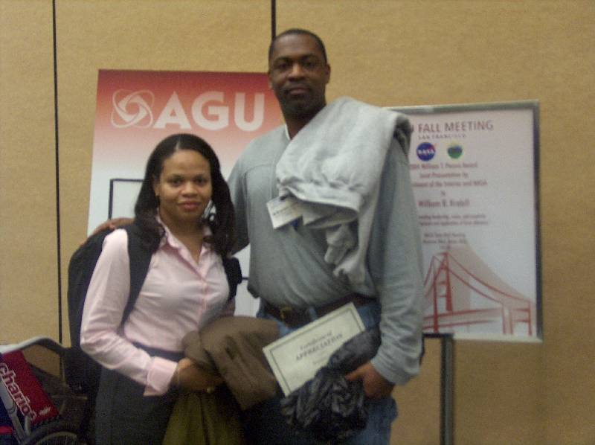
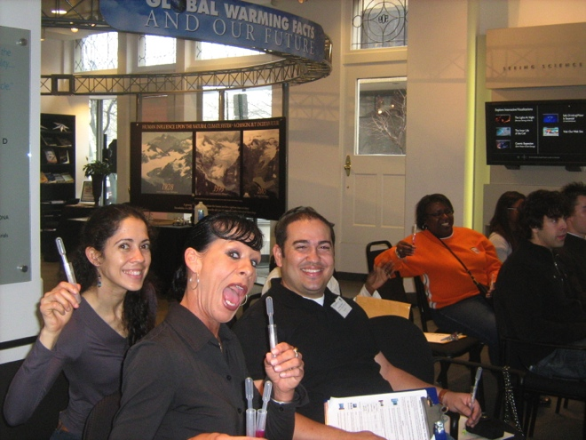
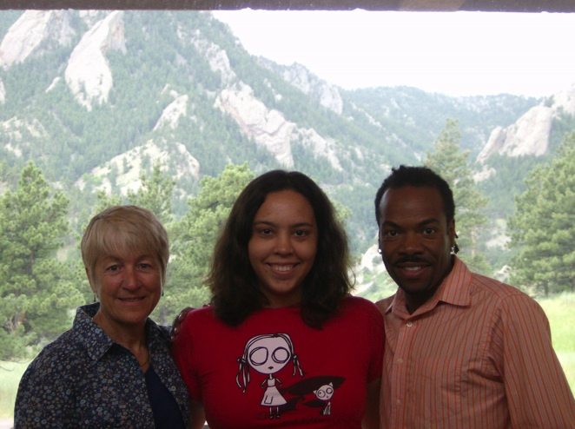
Benefits for Mentors
On‐going mentoring activities with highly talented minority students who are committed to achieving successful ESS careers
Participation in brown bag discussions
Professional and academic development of student participants
Virtual community dialog and topical discussions
Notes:
The program also benefits our mentors by facilitating mentoring and development of new talent and provides opportunities to engage new talent in their programs, labs and research initiatives.

Slide 8
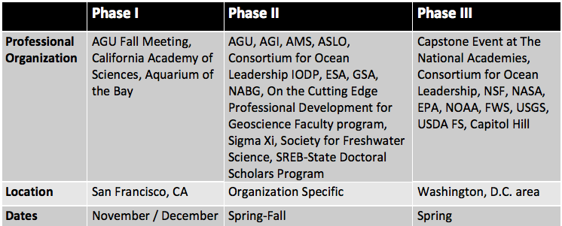
MS PHD’S Phases
Students participate in three phases of MS PHD’S activities designed to facilitate community building, professional development, and networking activities
Notes:
This is an overview of the 3-phase structure:
- Phase I provides exposure to a large and diverse conference. Mentees are introduced to mentors and participate in sessions on developing and maintaining effective mentor/mentee relationships. They enjoy community building and gain additional exposure to science and research with field trips to CAS and Aquarium of the Bay. In-house professional development activities include CV/resume development, poster and oral presentations, and learning to set career and academic goals.
- Phase II provides further networking and professional development by matching mentees to conferences and workshops that align with their academic and research goals. Our organizational partners support small groups of mentees through travel grants, scholarships and other types of funding support to attend their events. Discipline-specific mentors are recruited to provide one-on-one or small group interaction with students during these meetings. In most cases, at least 2 students attend each conference to sustain peer-to-peer collegiality and support.
- Phase III is the ‘capstone’ phase. It takes mentees on tours of federal agencies where they learn about career, funding, research and internship opportunities. Mentees hear presentations from and network with program directors and agency representatives. Mentees gain exposure to the legislative system and learn how it impacts funding for professional development programs for URMs in the STEM fields. Mentees fine-tune professional skills through in-house workshops focusing on CV/resume development, oral and poster presentations, career goals, and post-graduation planning. These workshops expand upon skills addressed during Phase I. Hosted by NSF, mentees prepare posters of their research and present to an invited group of representatives in STEM initiatives from the federal, state and private sector. At the conclusion of Phase III, each student receives a fellowship of up to $1,000 and designation of “MS PHD’S Fellow.”
8

Slide 9
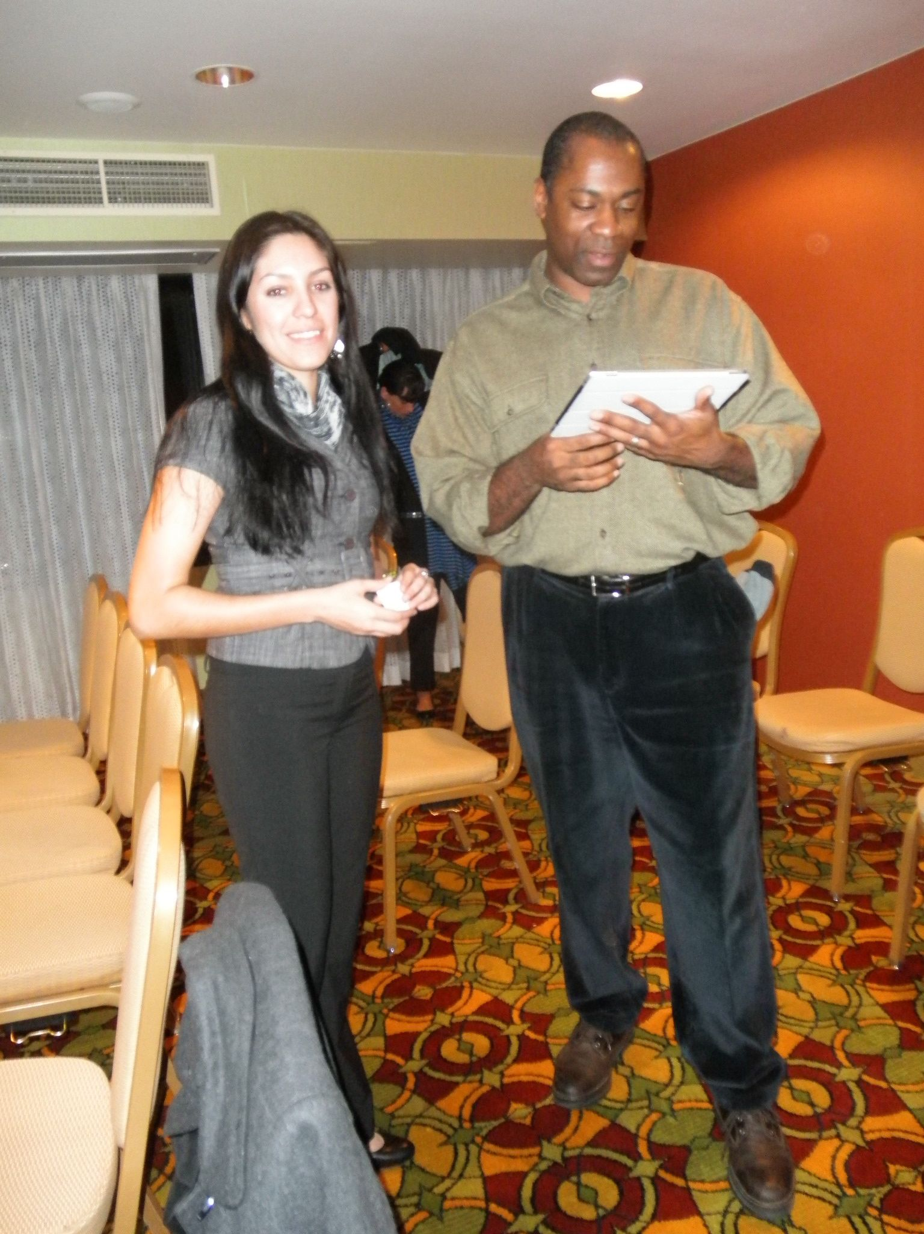
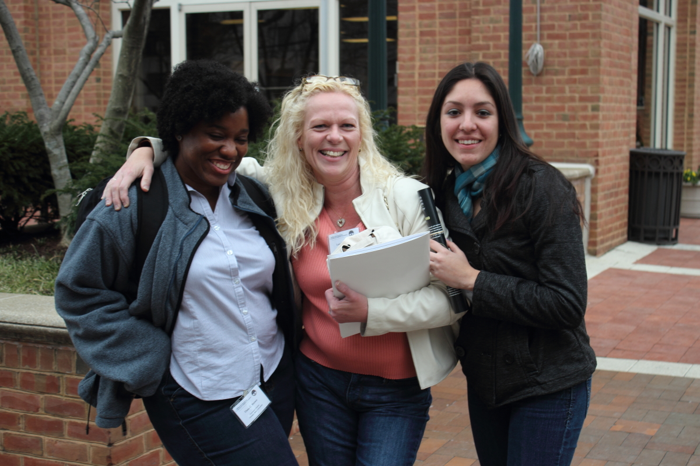
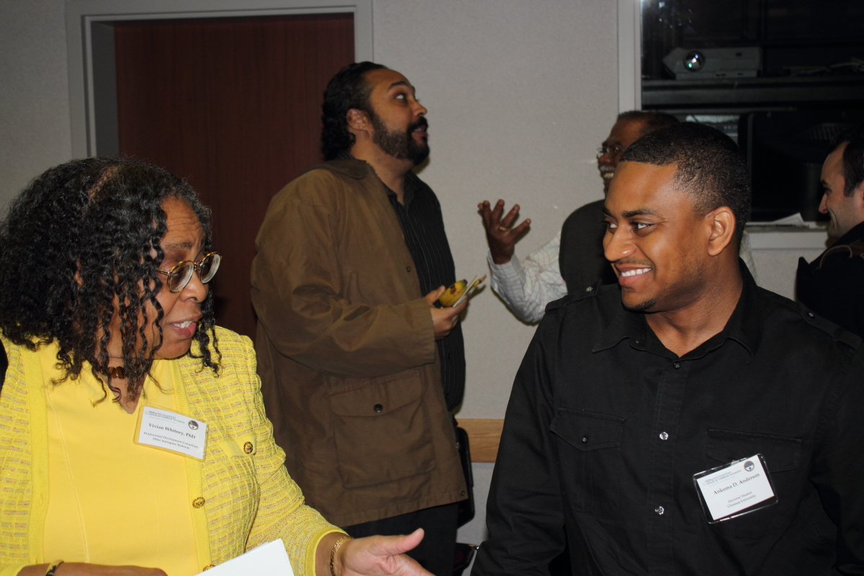
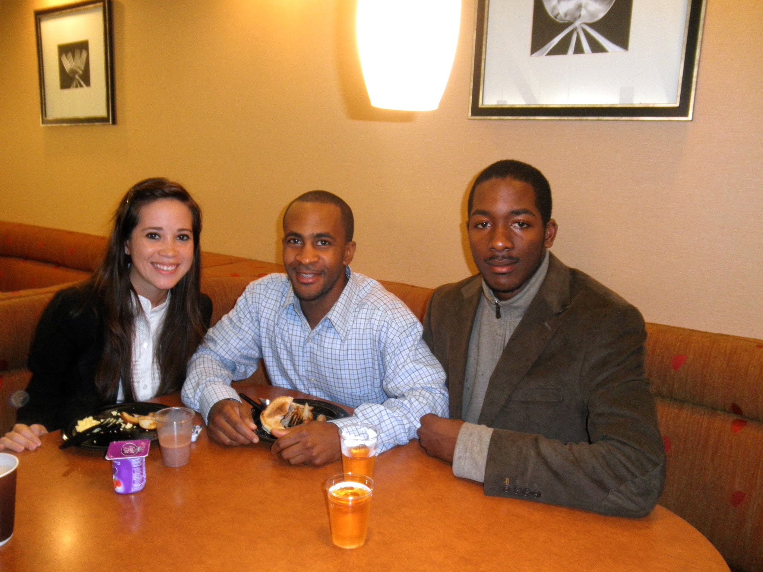
MS PHD’S Mentoring
Program Mentors
  Successful URM scientist role models
  Engage with mentees in all program activities
Meeting Mentors
  Successful URM and non-URM scientist role models
  Facilitate networking and professional development at scientific meetings and workshops
Dream Team
  Near-peer mentoring
  Leadership training
Staff
  Coordinate program opportunities
  Support professional and academic development
Notes:
MS PHD’S uses a tiered mentoring structure. We have Program Mentors who are successful underrepresented scientists and serve as role models. They remain engaged with students through all phases and beyond. They participate in all activities during Phase I and III. Meeting mentors are both URM and non-URM scientists. They support students by volunteering their time to share meeting/conference activities – attend sessions and debrief together – offer additional career/goal advice, networking – introduce students to their to colleagues - share information on program and research opportunities. The Dream Team are MS PHD’S alumni that are student or recent grads. They provide near peer mentoring, share experiences, develop leadership skills by working with mentees and helping facilitate program activities/logistics. The Staff coordinates program activities, identifies and facilitates outside opportunities for participants, helps students with applying to various opportunities by providing letters of recommendation, critiquing application materials, etc.

Slide 10
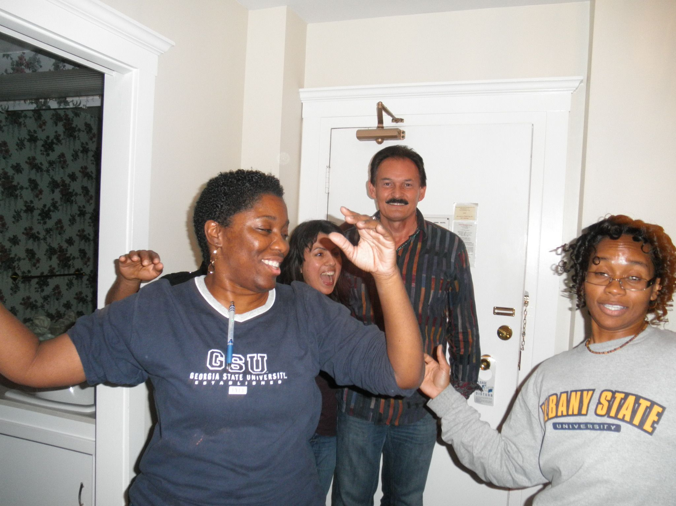
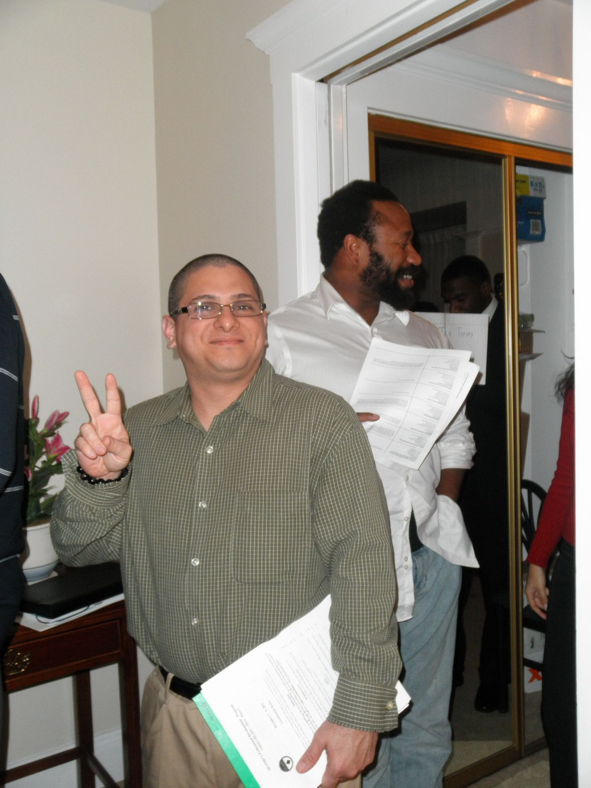
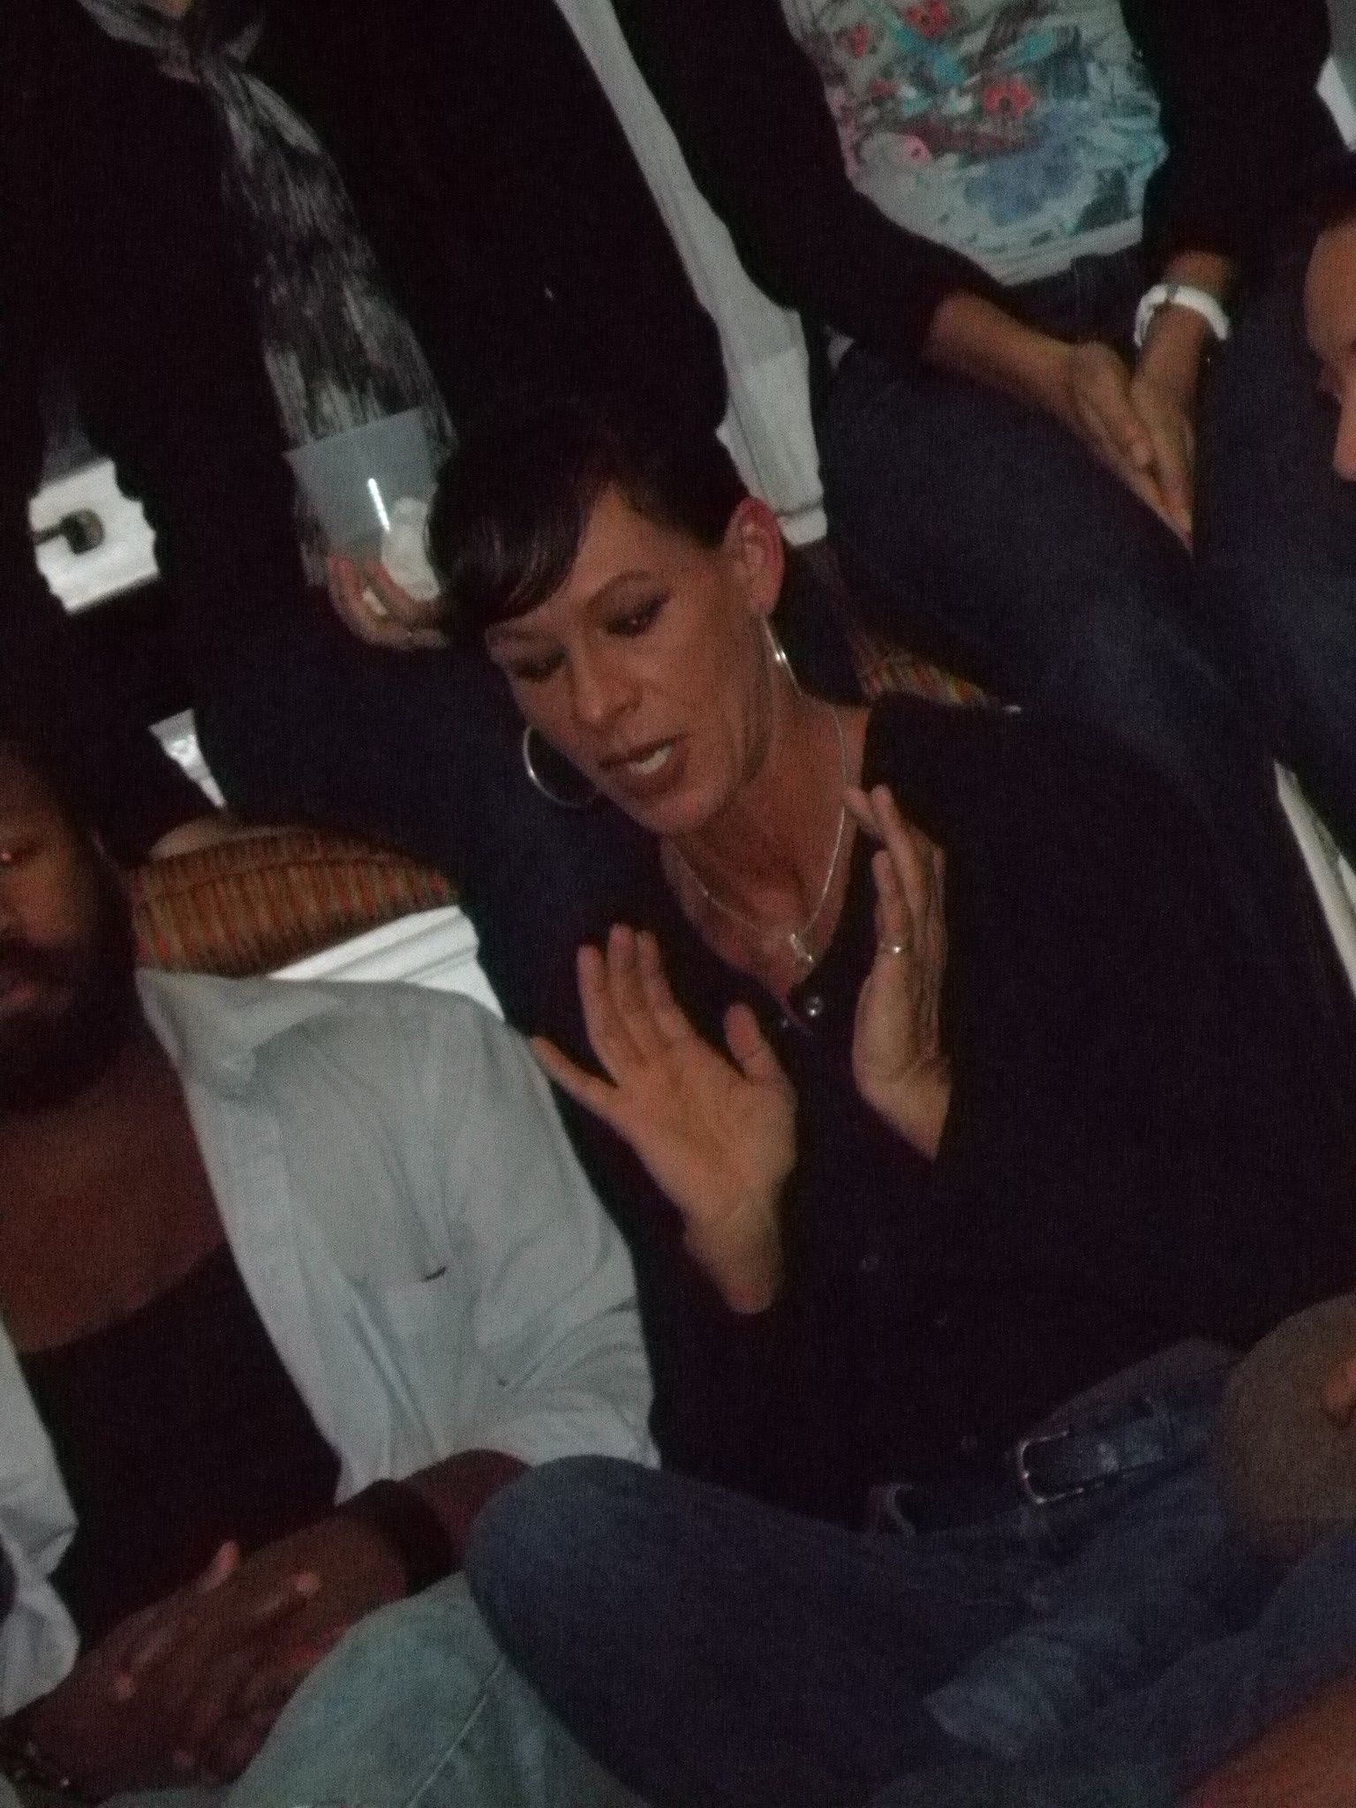
MS PHD’S Community Building
Community Engagement
  Peer Contact
  Mentor Contact
  Community Support
Field Trips
Multicultural Food Festival
Men and Women’s Discussion
  Our Voices: Affirming and Empowering Brothers
  Women’s Talking Circle
Notes:
Community building activities facilitate bonding and support between participants. They have an opportunity to have fun and bond with each other while also gaining science exposure and networking through field trips to places such as California Academy of Sciences, Aquarium of the Bay, Smithsonian museums, we even do a group photo at the Einstein statute. They have a multicultural food festival where each participant prepares a favorite dish representative of their cultural background. And lastly, we have two closed discussion groups – the men’s Our Voices: Affirming and Empowering Brothers and Women’s Talking Circle where they share their most private challenges, obstacles and fears and counsel each other on strategies to overcome.

Slide 11
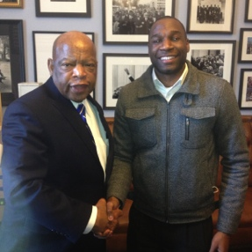
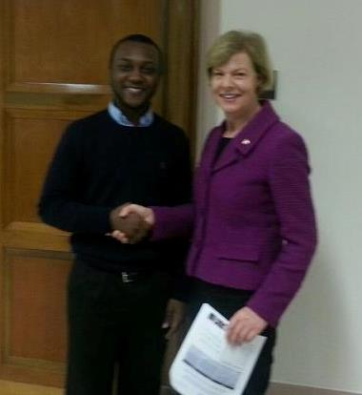
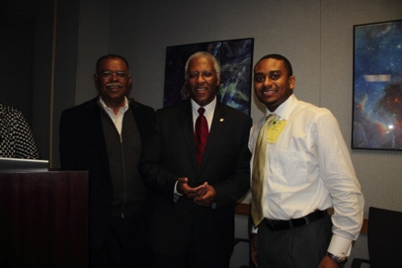
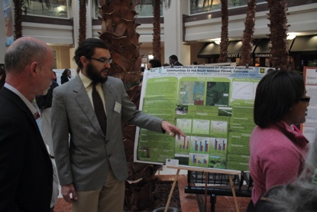
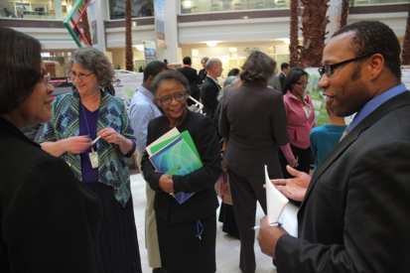
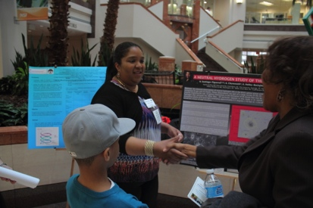
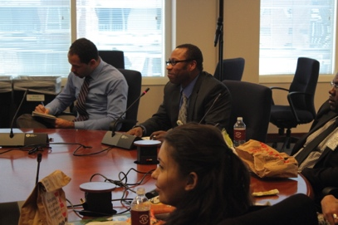
MS PHD’S Professional Development
Creation of Public Web Profile
Self-Introduction Presentations
Short, Mid and Long-Term Career Planning
Curriculum Vitae Development
Oral and Written Presentation Skills
NSF Hosted Poster Session
Individual Meetings with Congressional Representatives
Notes:
In addition to professional development opportunities afforded by participation in major scientific conference and professional society events, participants engage in program facilitated professional development activities. Mentees work closely with the program’s Professional Development Consultant, Program Mentors and Program Staff to develop and expand skills through these exercises.
- They set up a public profile to showcase research, goals, select pubs and presentations – useful when applying to opportunities.
- They give 5 minute self-introduction of background and goals to cohort members which they update at Phase 3
- They develop short, mid and long-term goals which are then refined through discussion with mentors
- They participate in brown bag discussions on creating a better CV/resume and strategies for better oral and written presentation skills
- At Phase 3 there is the NSF hosted poster session and individual meetings with congressional representatives

Slide 12
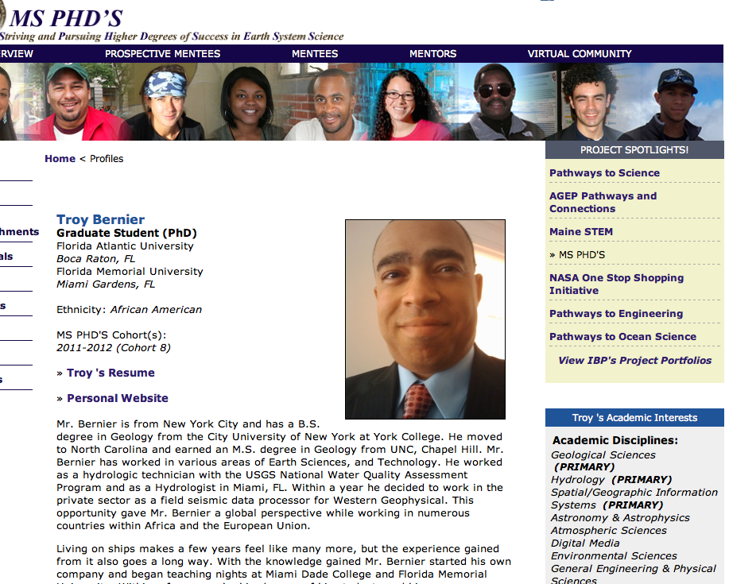
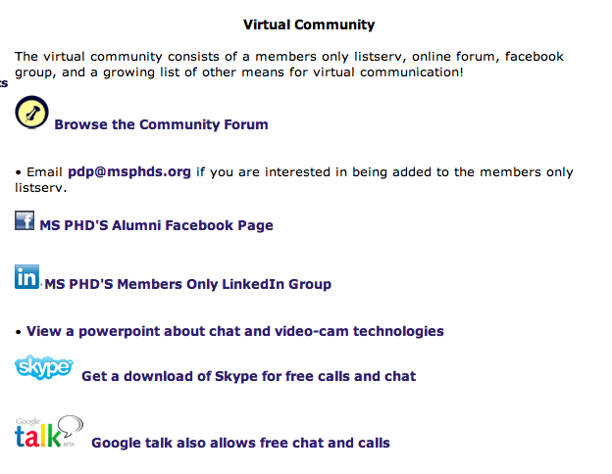

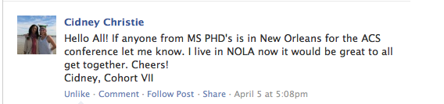

MS PHD’S Virtual Community
The virtual community is used to share successes, disseminate opportunities, provide ongoing mentoring and support, and maintain continuity of networks formed through the program
  Online profiles
  Listserv
  Facebook
  LinkedIn
  Community Forum
  Web video conferencing
  VoIP technologies
Notes:
The virtual community is used to share successes, disseminate opportunities, provide ongoing mentoring and support, and maintain continuity of networks formed through the program. We have various technologies and social media. We support the structure and moderation of the virtual community but it’s the participants who collectively keep it interactive and productive.

Slide 13
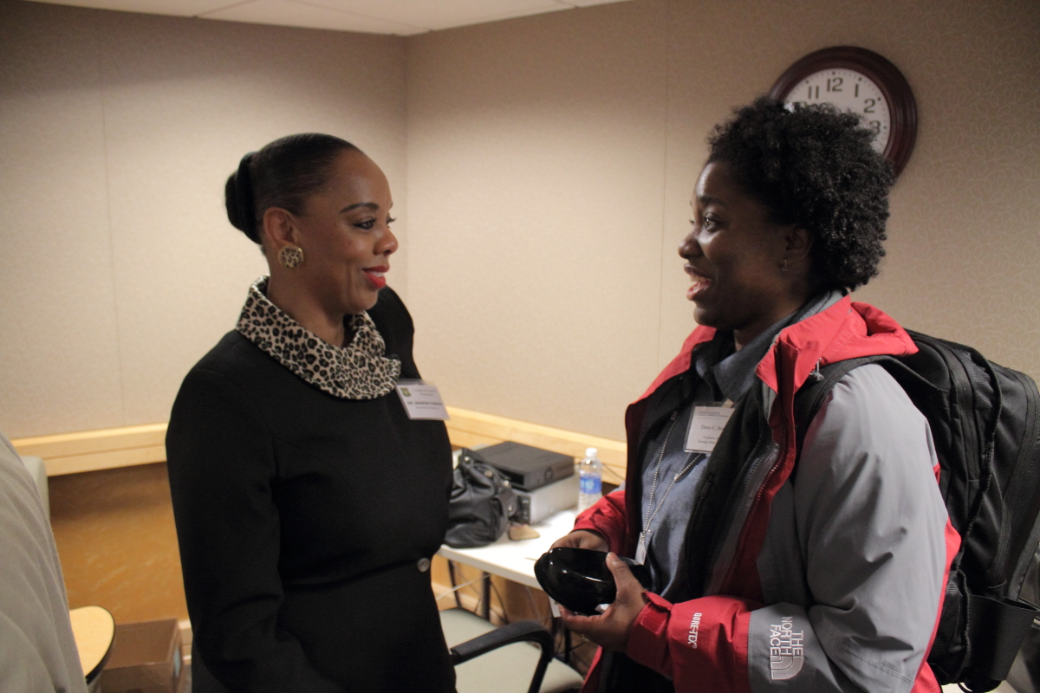
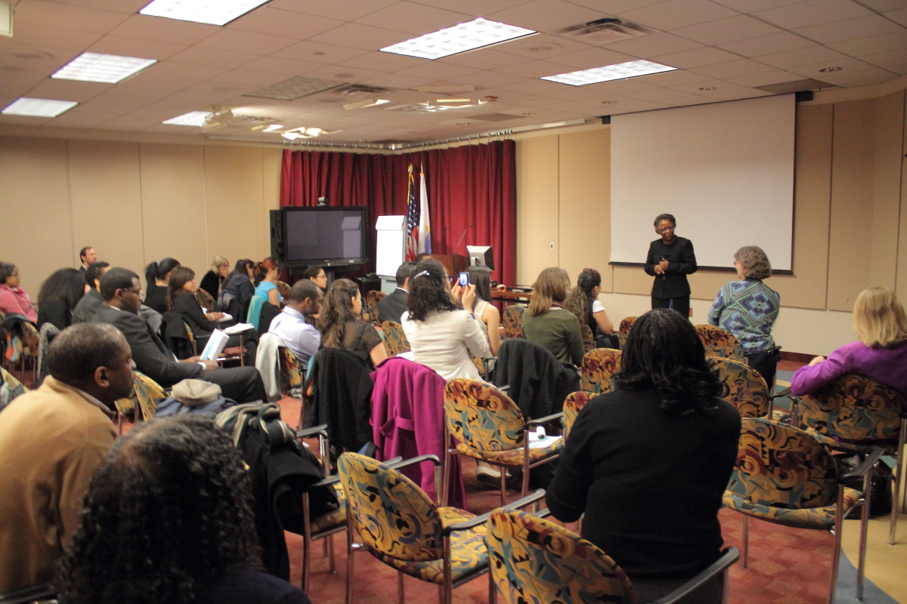
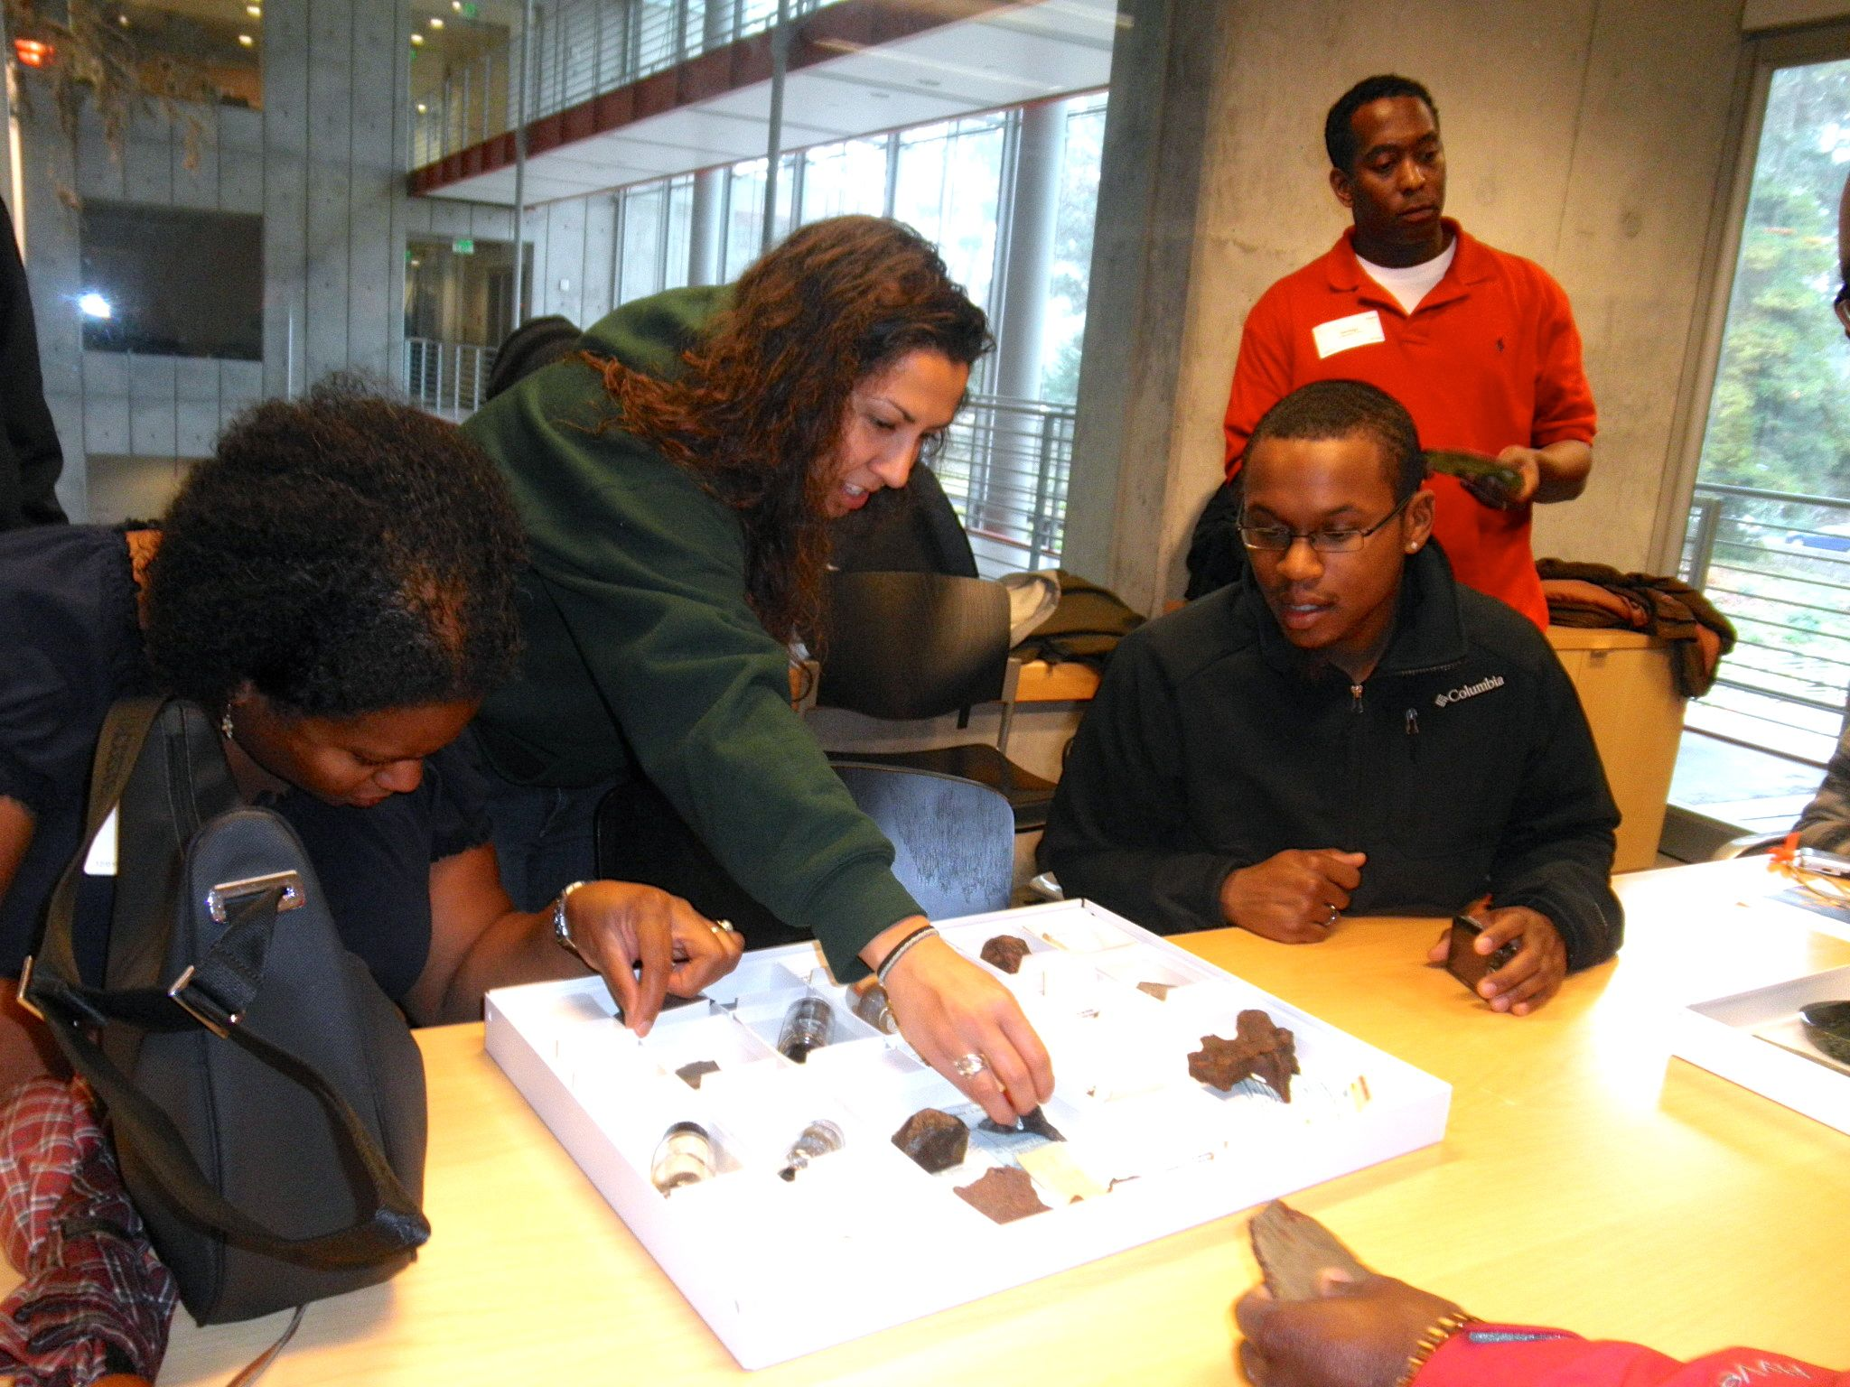
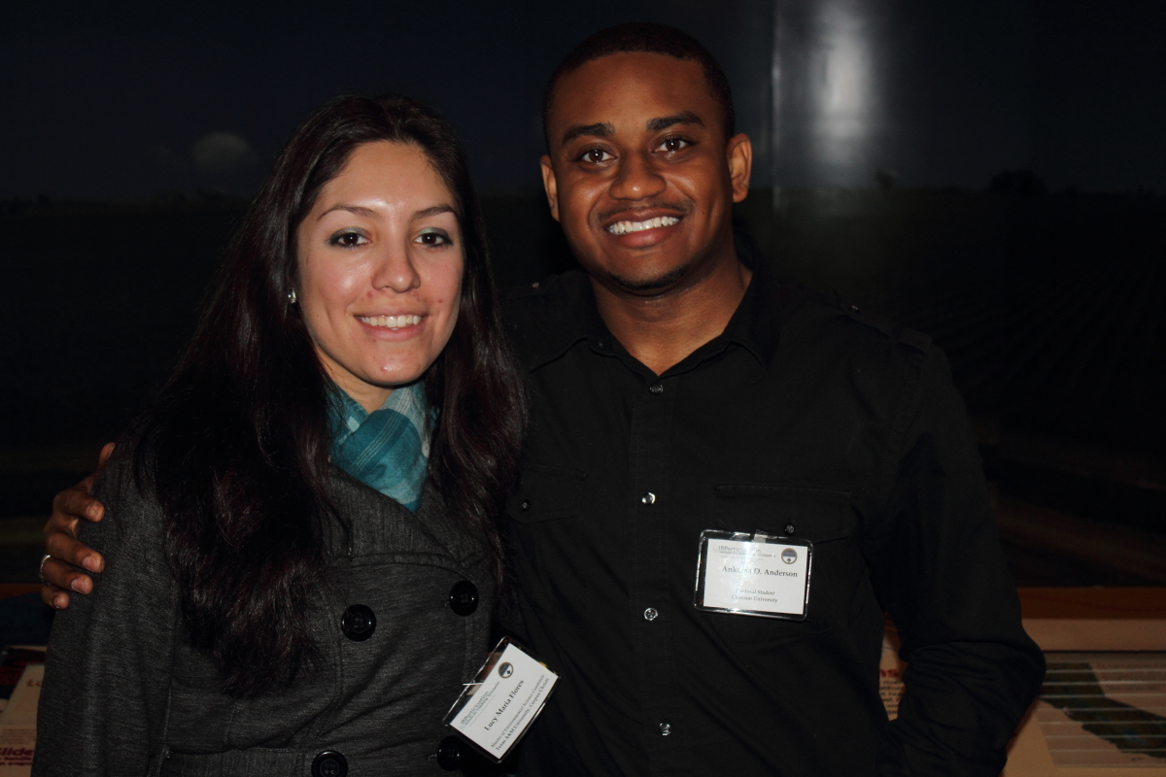
Impacts
Mentee surveys indicate a 96% agreement of need for the program.
Mentee appreciation of unique aspects of the MS PHD’S experience clustered around three central themes
  Community Engagement
  Networking
  Professional Development
Notes:
Overall 96% of mentee survey data indicates agreement on need for program. Benefits cluster around three central themes of community engagement and support, networking, and professional development.

Slide 14
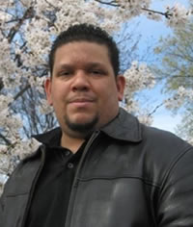
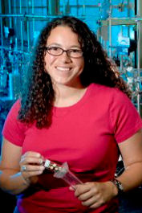
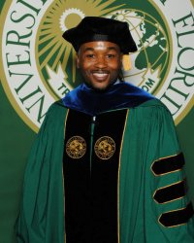
Impacts
Community Engagement
“The program has also provided me with outstanding mentorship that has helped me make better academic and professional decisions…[a] community of professionals that help each other, share information and help you achieve your maximum potential.”
- Jose Tirado, PhD Student, Howard University, Mentee: Cohort II, Dream Team: Cohort VII
Networking
“MSPHD's expanded my professional network. I have gained tremendous value from having a network of peers to interact with. This network helped me through the most difficult times of completing my PhD.”
- Holly Barnard, Assistant Professor, Geography, University of Colorado, Boulder, Mentee: Cohorts III & IV, Mentor: Cohort VIII
Professional Development
“MS PHD's taught me what interdisciplinary collaboration was all about. Additionally, it facilitated professional development that has been the gateway in preparation for becoming a global engineer.”
- Al-Aakhir Rogers, PhD, Engineer, Draper Laboratory, Mentee: Cohort II, Dream Team: Cohorts IV & VII
Notes:
After entering the MSPHD’S program, the relationships students form and the supportive networks they build last throughout their career! We’ve even had one marriage! Jose and Maria met in Cohort II – today they are married and starting a family while completing their PhD’s. Holly, a cohort 4 mentee, is now a professor at University of Colorado, Boulder and a Program Mentor. Al-Aakhir, a cohort 2 mentee, has served several times as a Dream Team mentor and is currently working as an engineer for a not-for-profit research and development laboratory.

Slide 15
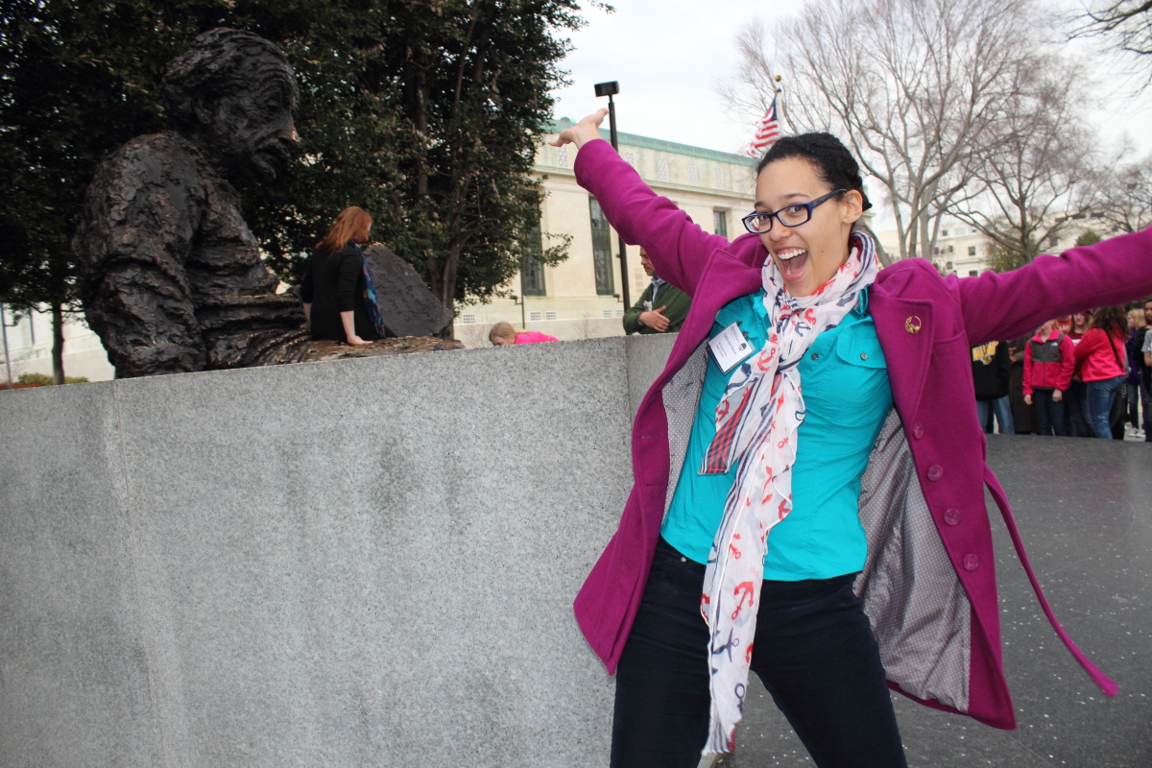
Outcomes
Recruitment and Retention
  213 URM participants
  47 Doctoral recipients
  67 Mentees enrolled in doctoral programs
Broadening Participations
  Advance to Dream Team, Program Mentors, and Staff
  Represent Diversity in STEM at Conferences, Meetings, Workshops
  Panelists
  Regional Specialists
  Webinar Speakers
Partnerships
  More than two dozen partner organizations facilitate student professional development and science exposure opportunities
    AGU, AGI, AMS, Aquarium of the Bay, ASLO, California Academy of Sciences, COL, EPA, ESA, FWS, GSA, NABG, NAS OSB, NOAA, On the Cutting Edge Professional Development for Geoscience Faculty, Sigma Xi, SFS, SREB-State Doctoral Scholars Program, USGS, USDA FS and others
Notes:
The program has facilitated the recruitment and retention of 213 URM students with 47 having obtained a doctorate and another 67 enrolled in doctoral programs. MS PHD’S fellows have opportunities to become “Dream Team” (peer) mentors, program mentors, and staff. They also have opportunities to engage in STEM community as speakers and presenters at conferences, meetings, workshops, panels and webinars. Our organizational partners play a major role in facilitating the success of our program goals through their support in providing opportunities to the students.

Slide 16
Outcomes
Dissemination
  Program activities facilitated dissemination of 399 participant products through September 2013
  12 additional abstracts accepted for 2013-2014 activities
Notes:
Through MS PHD’S activities, participants have produced 399 products as of September 2013. Another 12 abstracts have been accepted for upcoming 2013-2014 activities.

Slide 17
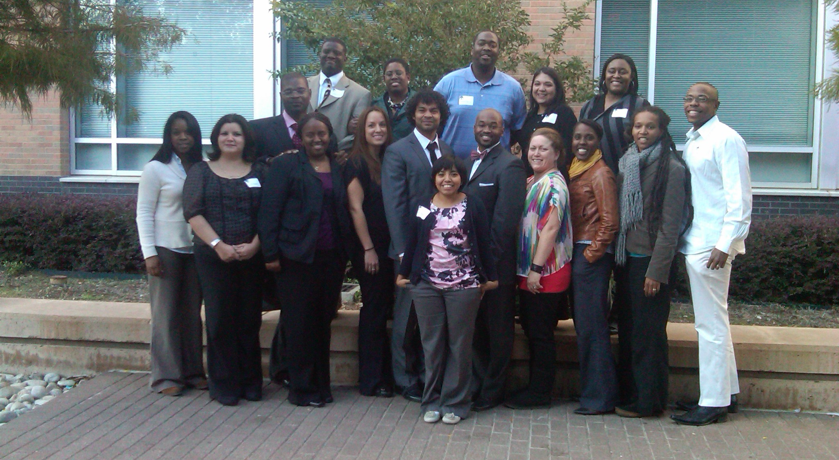
Outcomes
Beyond the PhD
  New initiative to support and advance URM scientists in the global workforce
    Networking and Communication
    Informed confidence
    Mentoring
    Career goal-setting
    Career possibilities
    Learning from failure
    Negotiation
    Work-life balance
Notes:
The program also facilitated a new initiative Beyond the PhD to provide continue support of early participants as they transition into the workforce. The pilot was a two-day workshop held at University of Texas, Arlington in November of 2011 and covered these topics. Pending funding opportunities, we hope to continue with future Beyond the PhD workshops.

Slide 18
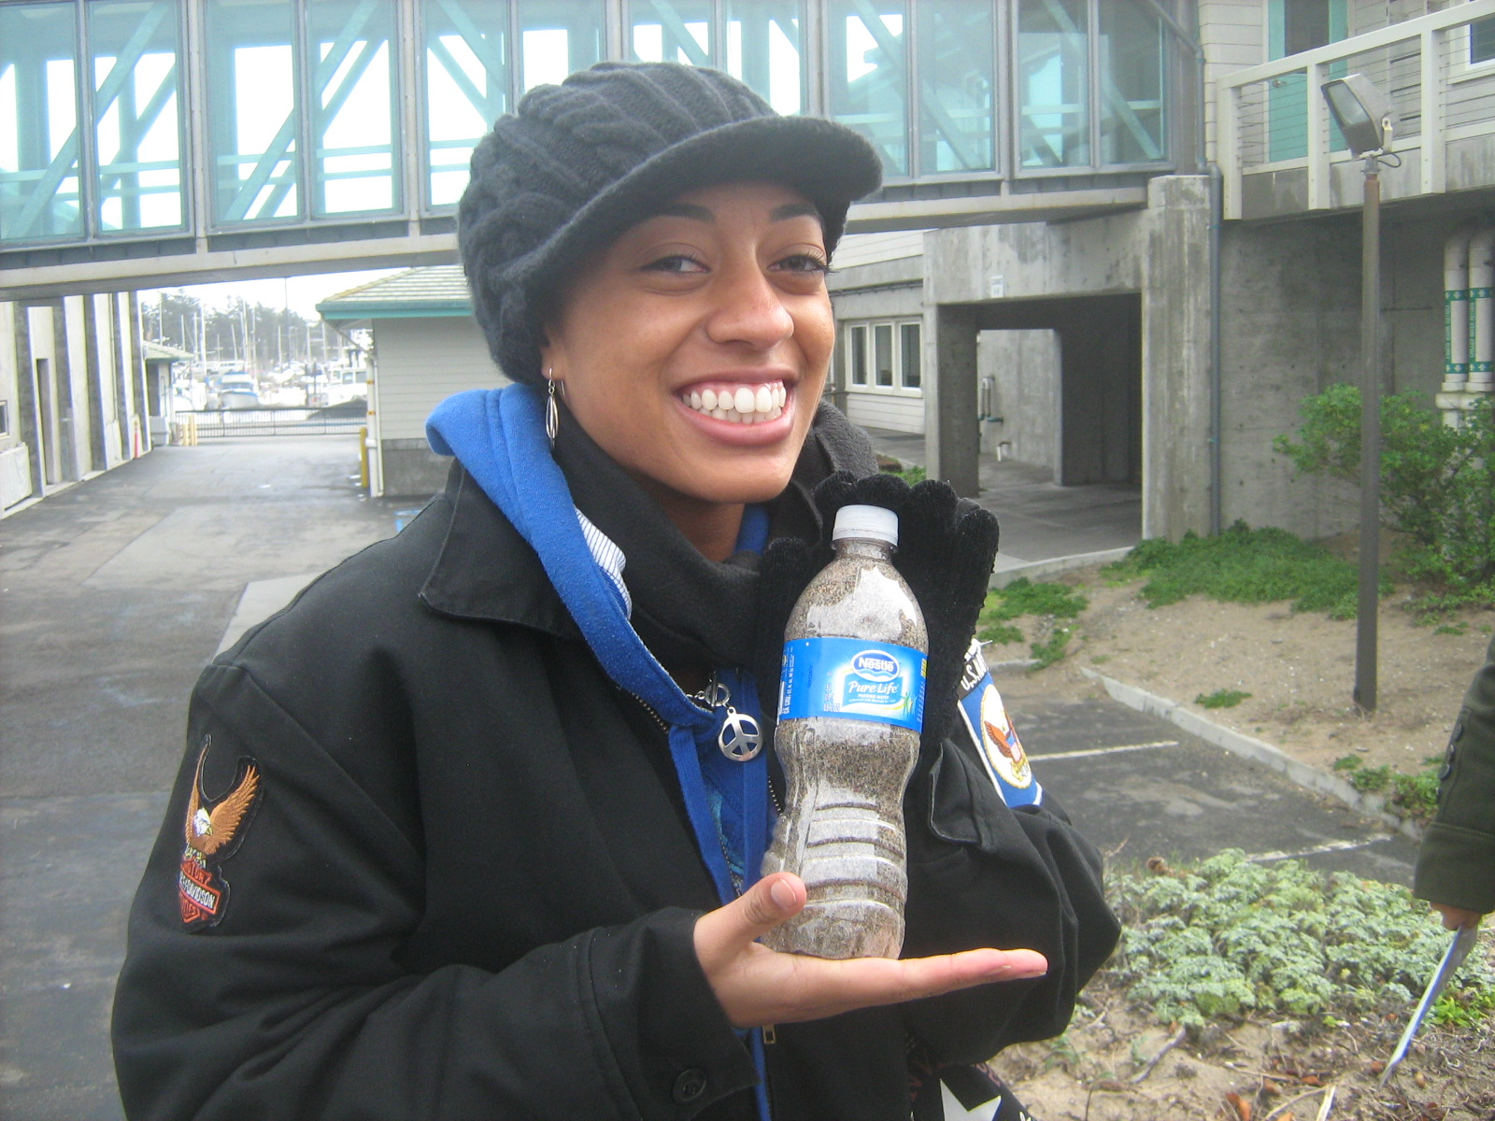
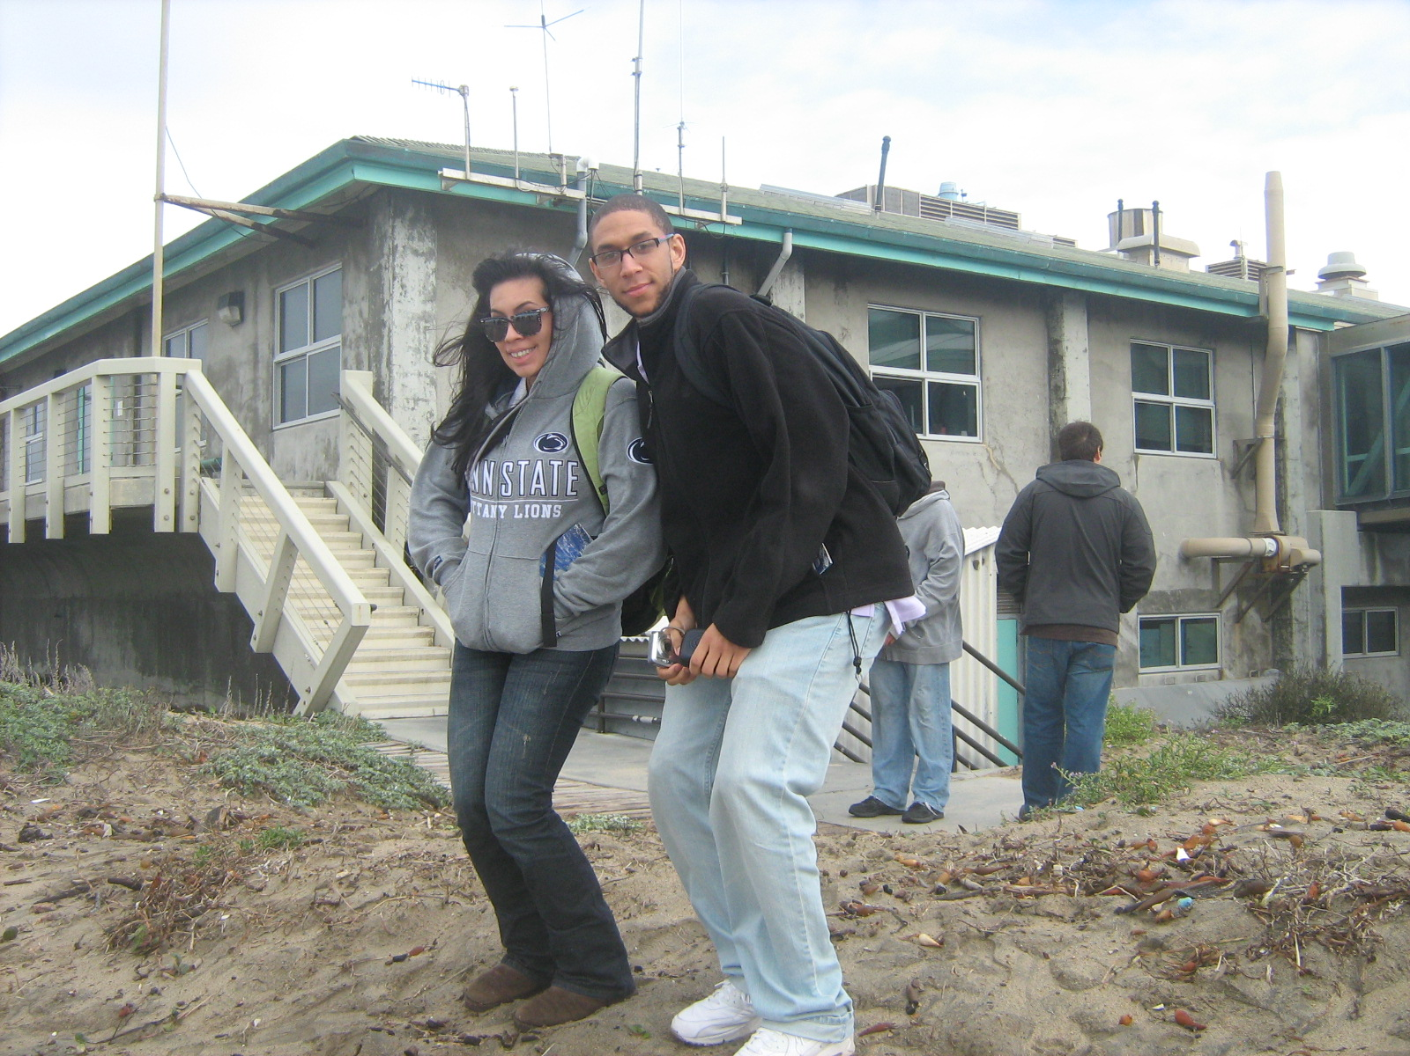
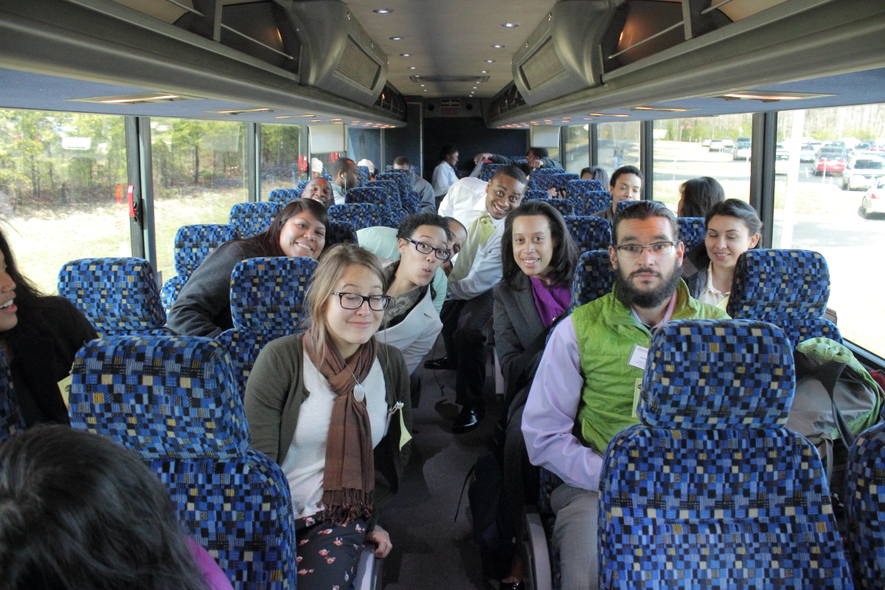
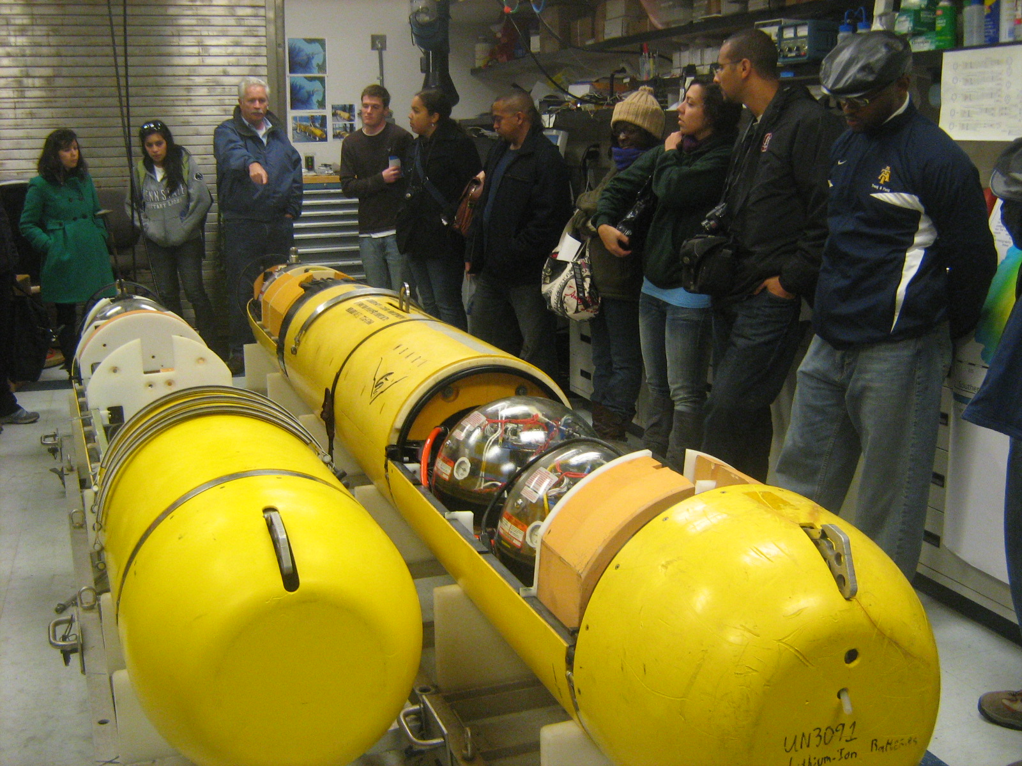
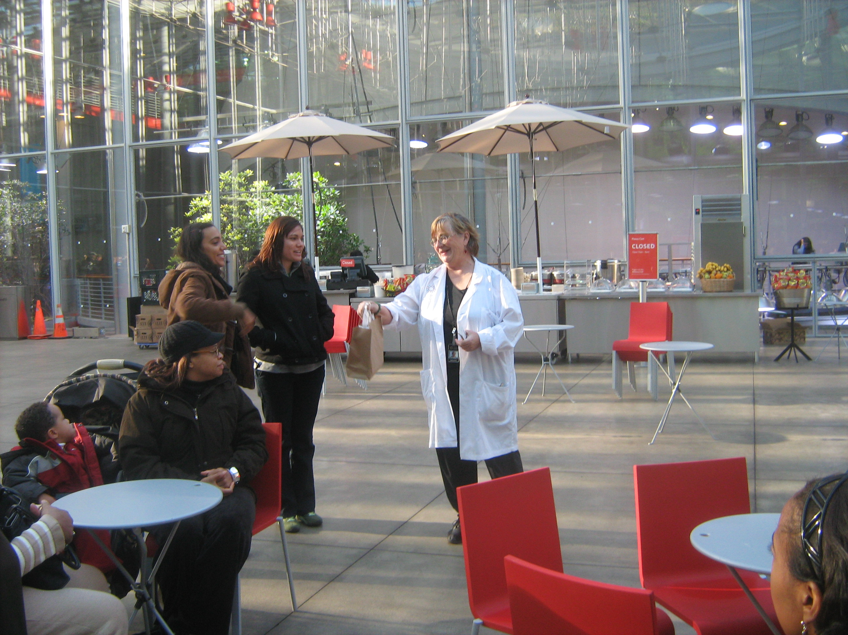
Thank You!
Questions?

Slide 19





Acknowledgments
Acknowledgements: This material is based upon work supported by the National Science Foundation (NSF) Geoscience Directorate Grants 0429048, 0503536, and 1139269, co-sponsored by the National Aeronautics and Space Administration (NASA) Headquarters Office of Earth Science Grant NAG5-12647. Additional support was provided by the following MS PHD'S Organizational Partners: American Geophysical Union, American Geosciences Institute, American Meteorological Society, Association for the Sciences of Limnology and Oceanography, Aquarium of the Bay, California Academy of Sciences, Consortium for Ocean Leadership (formerly Joint Oceanographic Institutions), Digital Library for Earth System Education, Ecological Society of America, Geological Society of America, Joint Global Ocean Flux Study program, National Association of Black Geoscientists, National Oceanic and Atmospheric Association, Ocean Carbon and Biogeochemistry program, On the Cutting Edge Professional Development for Geoscience Faculty program, Sigma Xi, Society for Freshwater Science, the Oceanography Society, the University of Texas at Arlington, and the Institute for Broadening Participation.

