Slide 1
How to grow a dinosaur: the histology and femoral ontogeny of the Middle Triassic dinosauriform Asilisaurus kongwe and implications for the growth of early dinosaurs
Chris Griffin, Cedarville University and Field Museum
Sterling Nesbitt, The Field Museum

Slide 2
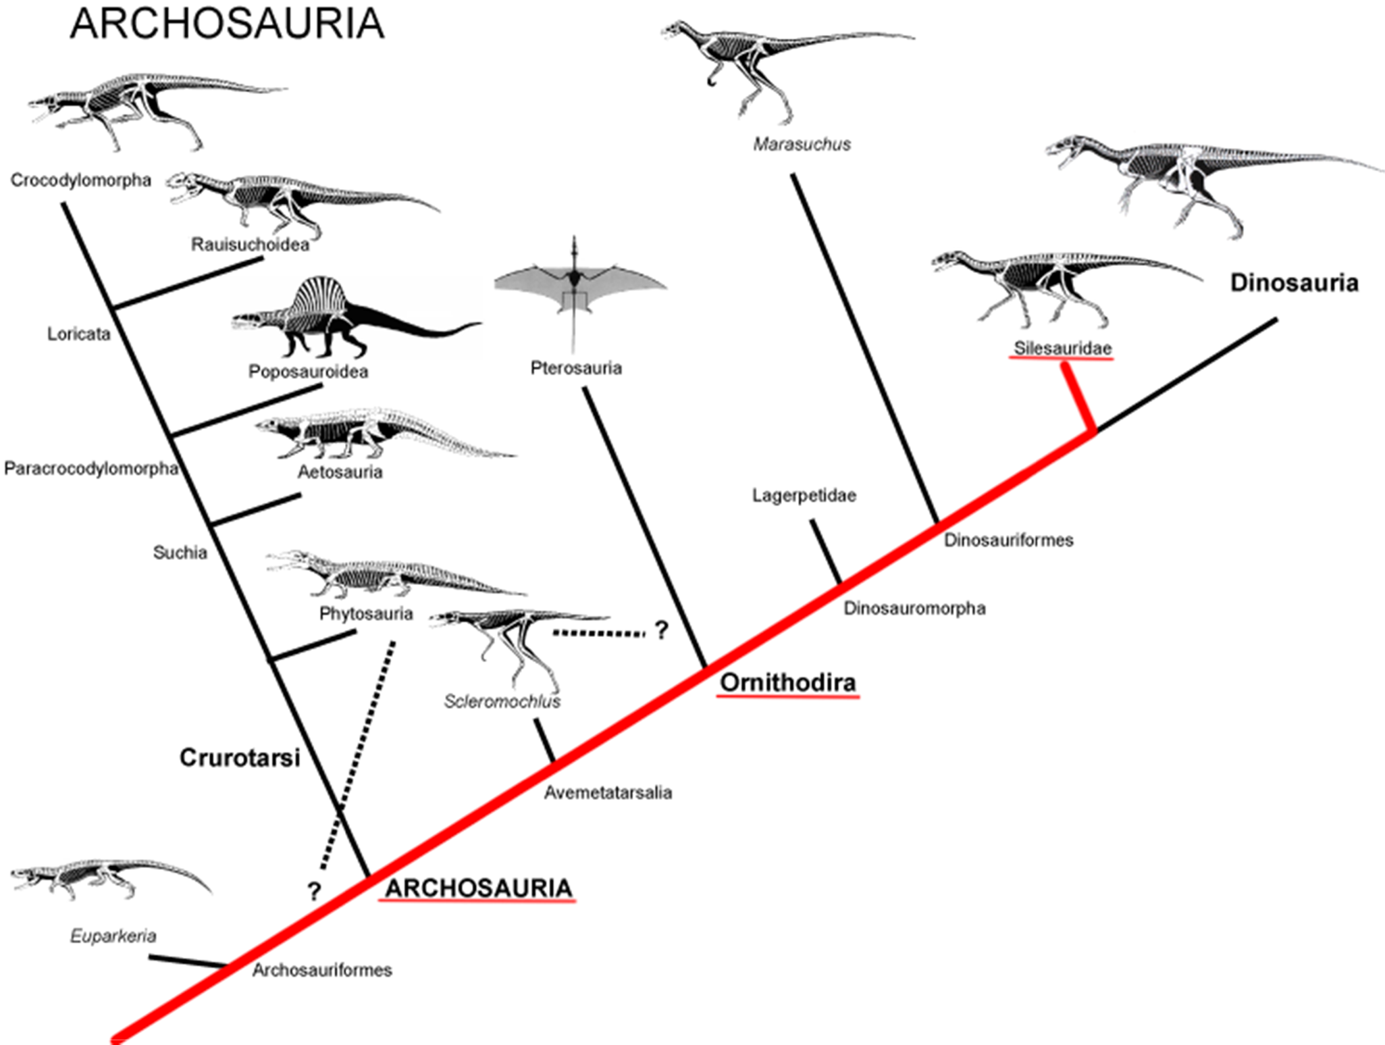
Notes:
Asilisaurus is a basal member of Silesauridae, the sister taxon to Dinosauria

Slide 3
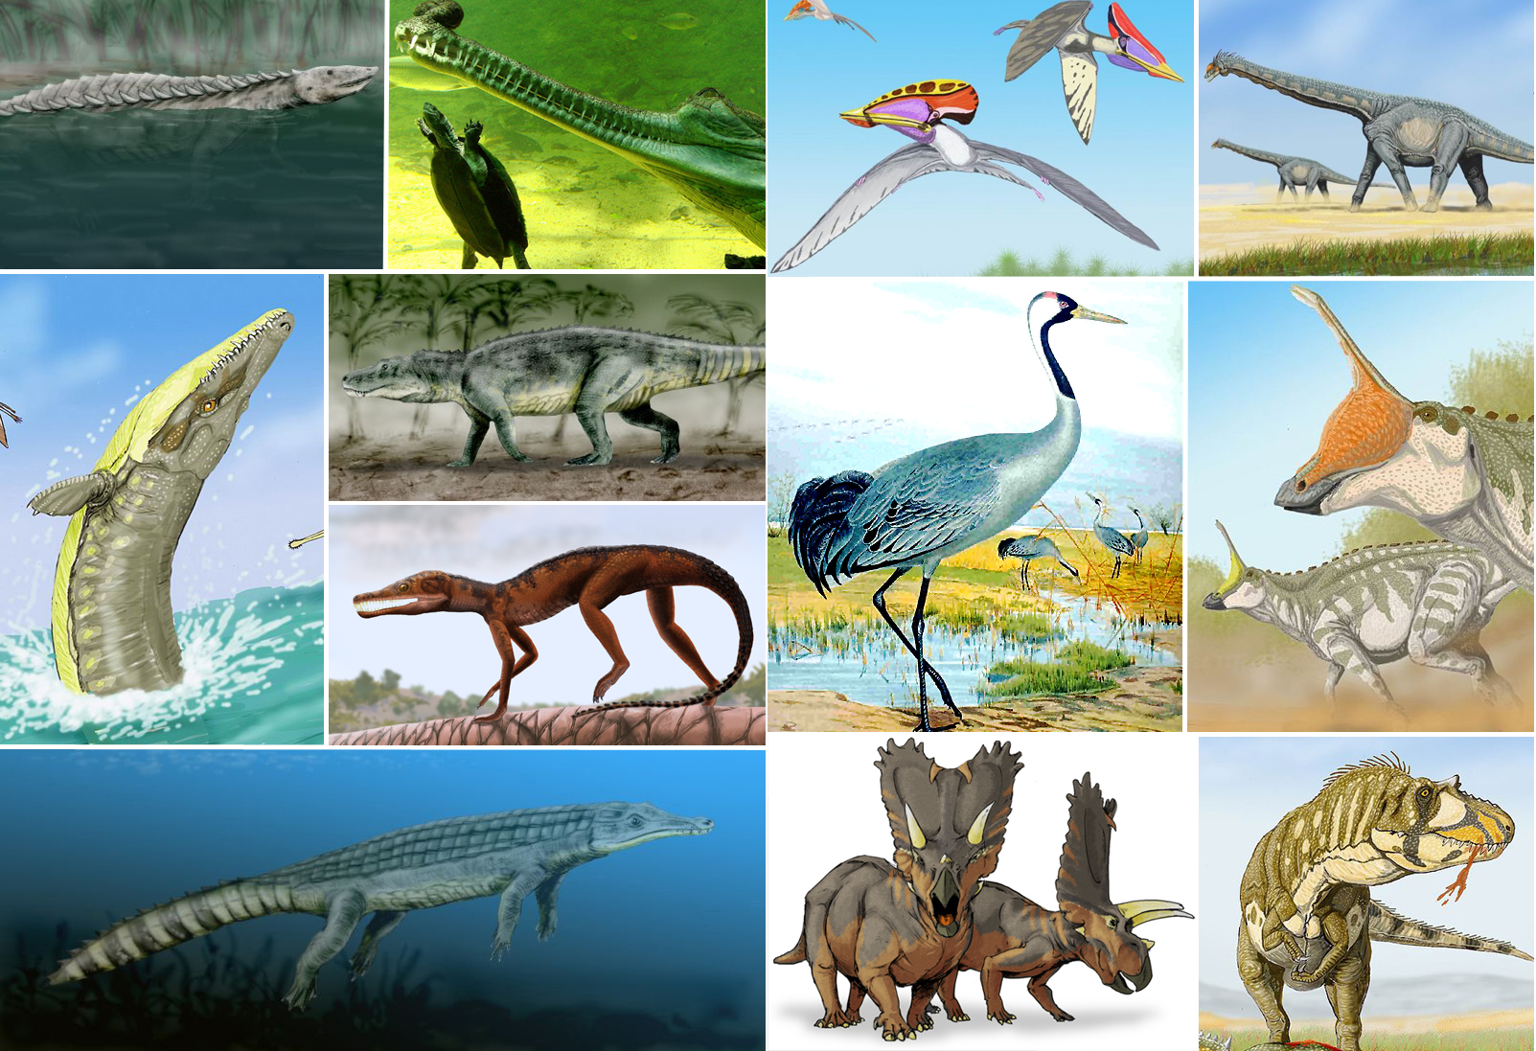
Notes:
Left: Croc-line archosaurs. Right: Bird-line archosaurs

Slide 4
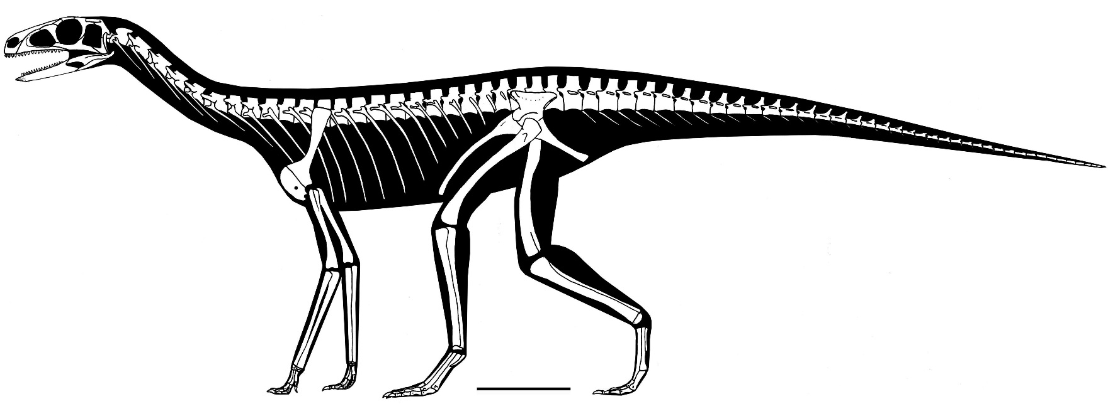
Introduction
Asilisaurus kongwe
“Ancient ancestor lizard”
Middle Triassic: 245 mya
Dinosaurs evolve ~230 mya
Notes:
Scale = 10 cm
Earliest Ornithodiran ever found, with exception of the recently described, coeval Lutungutali sitwensis (Peecook et al. 2013)

Slide 5
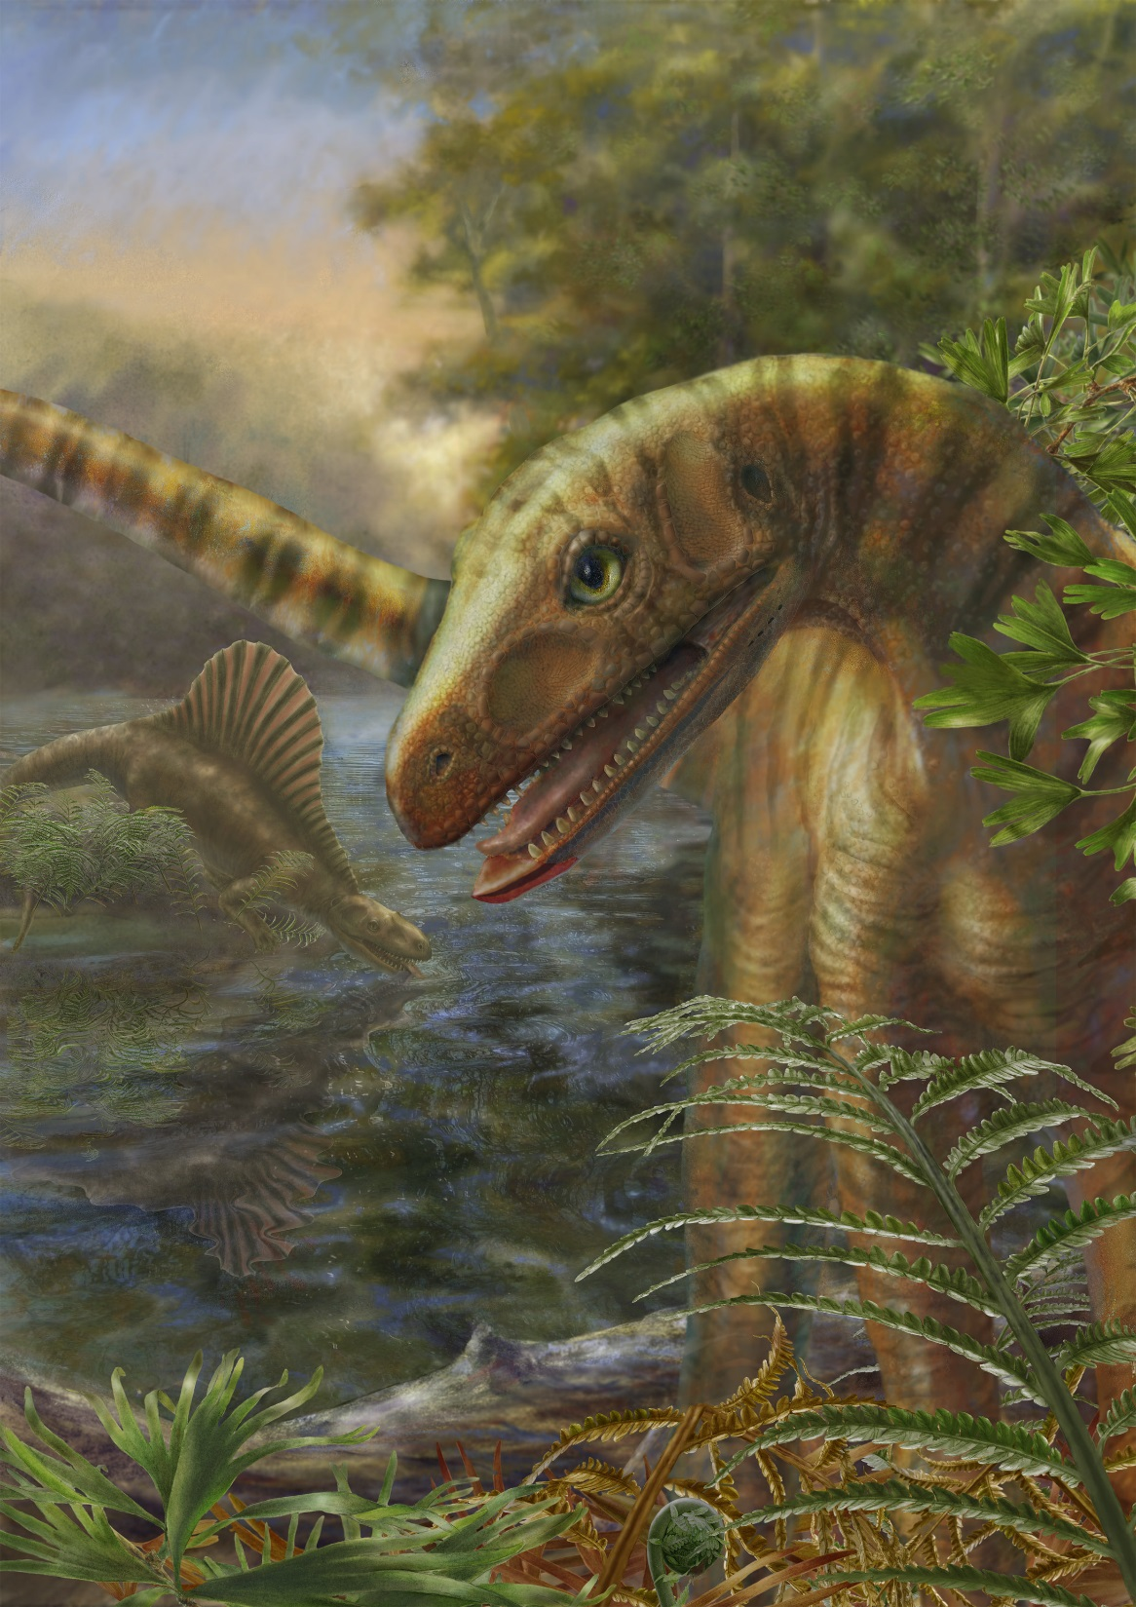
Notes:
Reconstruction in foreground

Slide 6
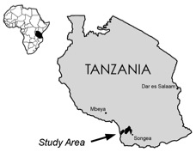
Introduction
Manda Beds
Ruhuhu Basin, Tanzania, Africa
Lifua Member
Fluvio-lacustrine mudstone-
sandstone sequence
?Late Anisian by comparison of tetrapod fauna
Bone bed
Notes:
Foundin bone bed with hundreds of elements

Slide 7
Purpose
Understand limb histology and developmental patterns in the muscle scars of the proximal end of the femur of A. kongwe
How does this developmental pattern relate to the ontogeny of early dinosaurs?

Slide 8
Methods
Prepared specimens
Acid-washed with sulfamic acid
Removed matrix with airscribe

Slide 9
Methods
Molded/casted
Thin-sectioned
Standard procedure

Slide 10
Methods
Measuring and estimating length
Cen-Tech™ six-inch digital caliper
Measured femoral length and width of femoral head in mm
Linear regression
Enabled ordering of all specimens by length

Slide 11
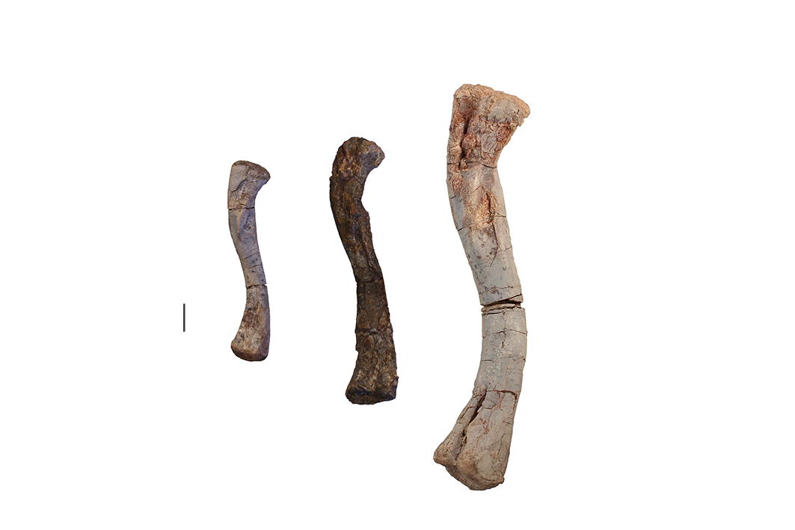

Slide 12
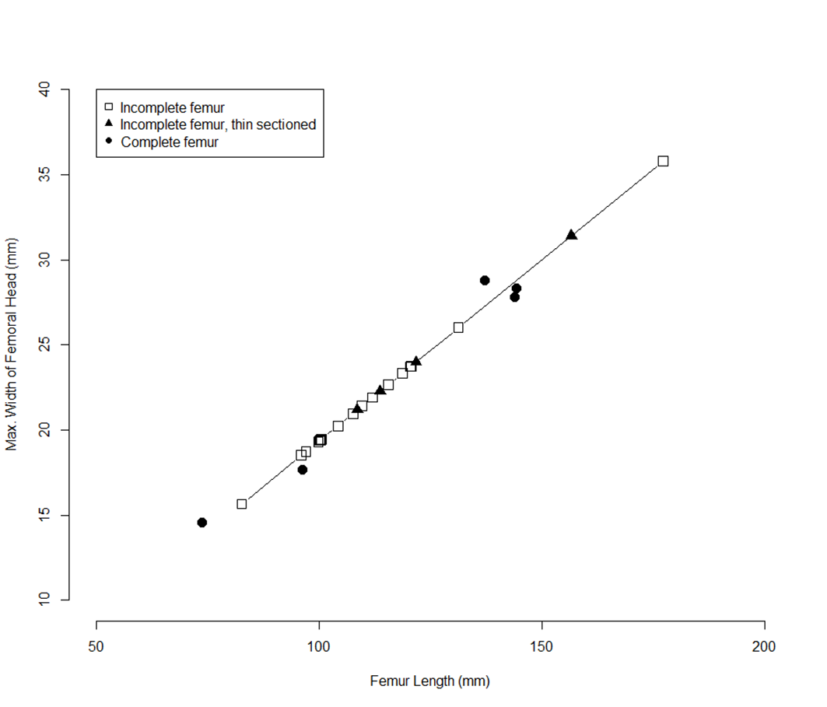
R² = 0.9919

Slide 13
Methods
Muscle scar identification
Compared muscle scars with crocodilian, avian, and dinosaurian scars to identify muscle attachments
Described muscle scar development throughout ontogeny

Slide 14
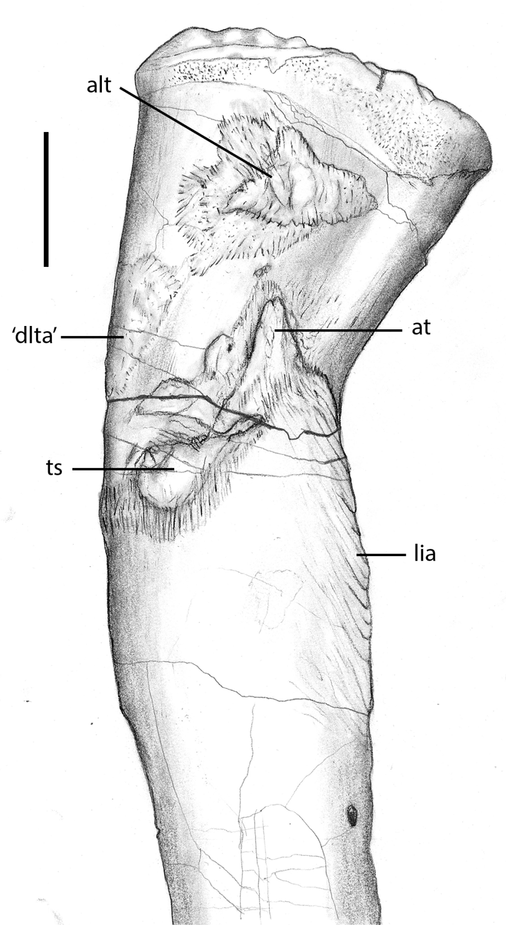
Notes:
Anterolateral trochanter—never described before, seems to be present in some other silesaurids. Anterolateral view. Scale bar = 1 cm

Slide 15
Notes:
“dorsolateral trochanter,” anterior portion. Anterolateral view. Scale bar = 1 cm

Slide 16
Notes:
Trochanteric shelf. Anterolateral view. Scale bar = 1 cm

Slide 17
Notes:
Anterior trochanter. Anterior trochanter and trochanteric shelf fuse later in ontogeny. Anterolateral view. Scale bar = 1 cm

Slide 18
Notes:
Linea intermuscularis crainialis. Anterolateral view. Scale bar = 1 cm

Slide 19
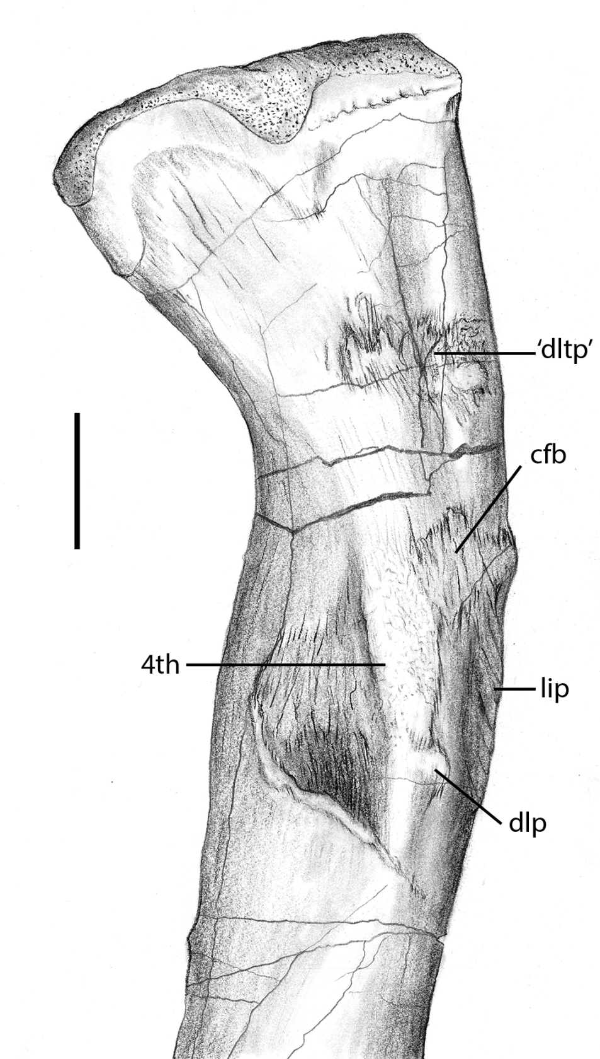
Notes:
“dorsolateral trochanter,” possible posterior portion. Posteromedial view. Scale bar = 1 cm

Slide 20
Notes:
Attachment of the M. caudofemoralis brevis. Posteromedial view. Scale bar = 1 cm

Slide 21
Notes:
Fourth trochanter. Is present in all specimens as either a gracile or robust morph, robust pictured here. Posteromedial view. Scale bar = 1 cm

Slide 22
Notes:
Distolateral protrusion on the fourth trochanter. Posteromedial view. Scale bar = 1 cm

Slide 23
Notes:
Linea intermuscularis caudalis. Posteromedial view. Scale bar = 1 cm

Slide 24
Specimen | cfb | at | lia | ts | dlp | lip | ‘dlta' | 4th | alt | ‘dltp' | ts+at | % of max. femoral length
NMT RB169 | 0 | 0 | 0 | 0 | 0 | 0 | 0 | ridge-like | 0 | 0 | 0 | 41.66
NMT RB221 | 1 | 1 | 1 | 1 | ? | 0 | 1 | ridge-like | 1 | 1 | 1 | 46.67
NMT RB220 | ? | 1 | 1 | 0 | ? | ? | 0 | ? | 0 | 0 | 0 | 54.22
NMT RB172 | 1 | 1 | 1 | 1 | 0 | 0 | 1 | ridge-like | 1 | ? | 0 | 54.39
NMT RB185 | 1 | 1 | 0 | 1 | ? | ? | 0 | ? | 0 | 0 | 0 | 54.8
NMT RB109 | 1 | 1 | 1 | 1 | 1 | 1 | 1 | ridge-like | 1 | 0 | 0 | 56.37
NMT RB19 | 0 | 1 | 1 | 1 | 1 | 1 | 1 | ridge-like | 1 | 0 | 0 | 56.53
NMT RB229 | 1 | 0 | 1 | 1 | ? | 1 | 1 | round | 0 | 0 | 0 | 56.63
NMT RB223 | 1 | 1 | 1 | 1 | 1 | 1 | 1 | ridge-like | 1 | 1 | 1 | 56.79
NMT RB219 | 1 | 1 | 1 | 1 | ? | 1 | 1 | ridge-like | 1 | 1 | 0 | 58.83
Notes:
Example of data matrix

Slide 25
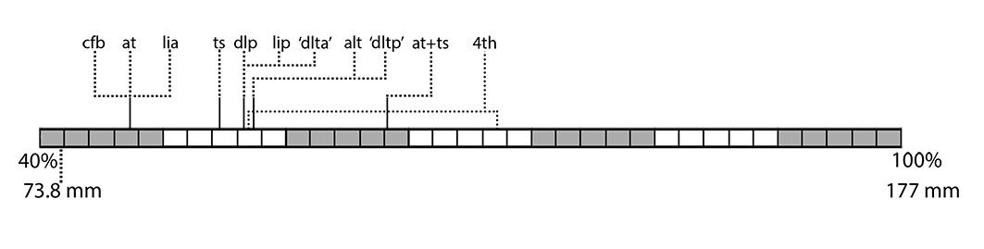
Notes:
Most common developmental sequence of A. kongwe

Slide 26
Results
Muscle scars develop at different times in ontogeny
There is polymorphism in the ontogeny of A. kongwe
No LAGs are present in any of the thin-sectioned specimens
Muscle scars develop in a variety of ways

Slide 27
Polymorphism
NMT RB221
NMT RB102
Notes:
NMT RB221 has almost all muscle features and a robust fourth trochanter, but is one of the smallest femora. NMT RB102 is a medium-sized femur, but lacks nearly all muscle features.

Slide 28
Polymorphism
NMT RB179
SAM-PK-1057
Notes:
NMT RB179 and SAM-PK-1057 both lack the anterolateral trochanter

Slide 29
Polymorphism
NMT RB179
Notes:
Trochanteric fusion is lacking in NMT RB179, when it becomes common earlier

Slide 30
Annual LAGs Not Present
Notes:
Growth similar to dinosaurs. LAGs not present.

Slide 31
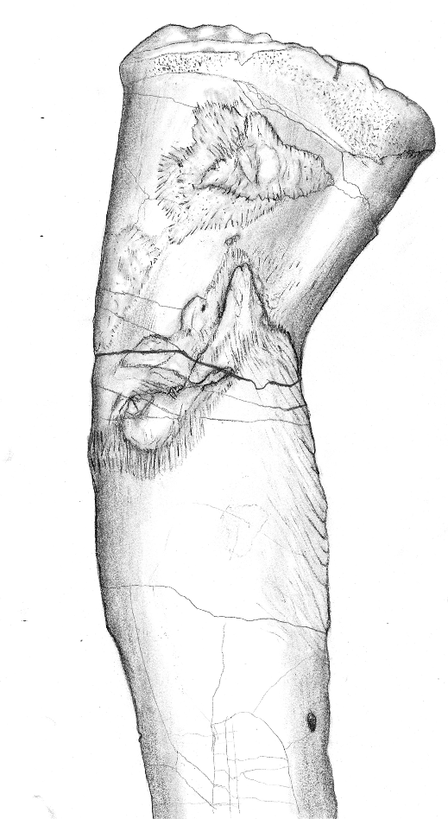
Notes:
Histology of different trochanters differs.

Slide 32
Discussion
Many studies of early dinosaurs (e.g., Coelophysis, ‘Syntarsus’) have hypothesized that the different robustness of the femur correlates with sexual dimorphism
Asilisaurus shows some developmental polymorphism, with gracile and robust forms
Suggests polymorphism in development is plesiomorphic to dinosauria

Slide 33
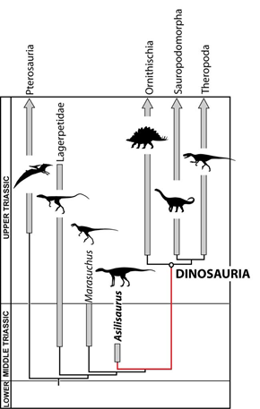
Notes:
The close phylogenetic position of Asilisaurus makes it an excellent “lens” to interpret early dinosaur ontogeny

Slide 34
Conclusion
Asilisaurus has a developmental trajectory that most individuals take
Asilisaurus displays some developmental polymorphism in the muscle features of the proximal femur
Can result in “gracile” and “robust” morphs, and this ontogenetic pattern may be plesiomorphic for both Silesauridae and Dinosauria
The muscle scars of the proximal femur have at least two ways of developing
In all likelihood, Asilisaurus did not lay down annual LAGs

Slide 35
Further Research
Methods other than counting LAGs to determine age
Histology/ontogeny of similar muscle scars in other silesaurids
Prevalence of similar developmental polymorphism in dinosaurs/other archosaurs
Ossification data useful for sequence heterochrony studies

Slide 36

Acknowledgements
NSF
Field Museum of Natural History
National Museum of Tanzania

