Slide 1
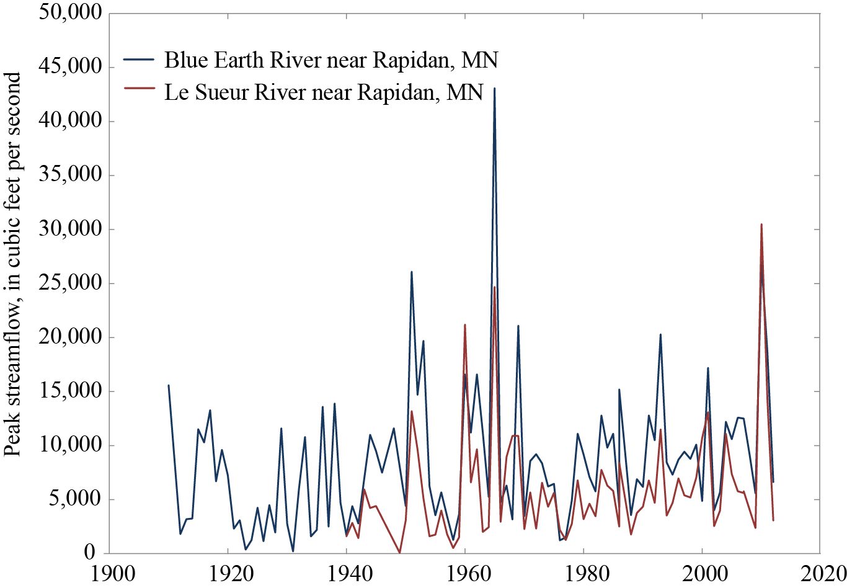
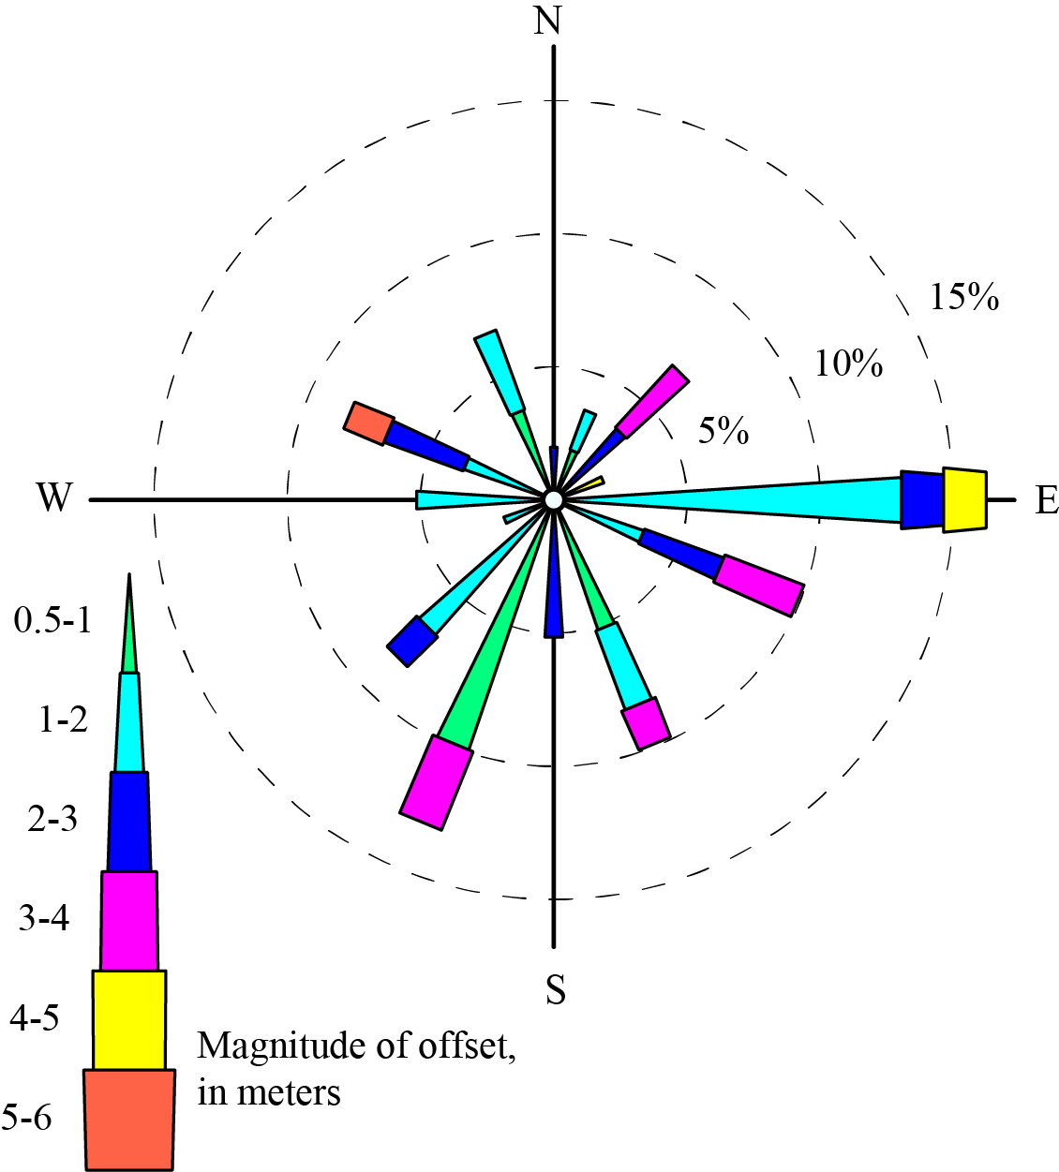
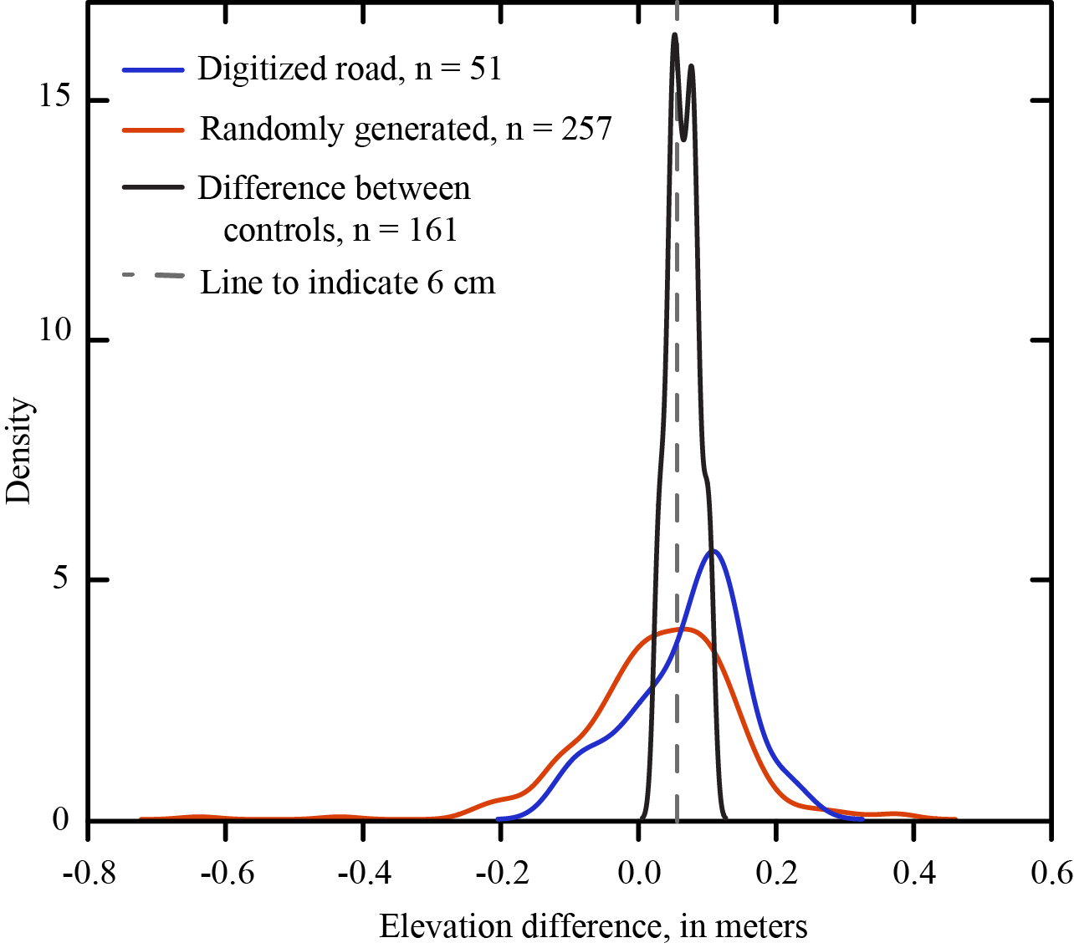
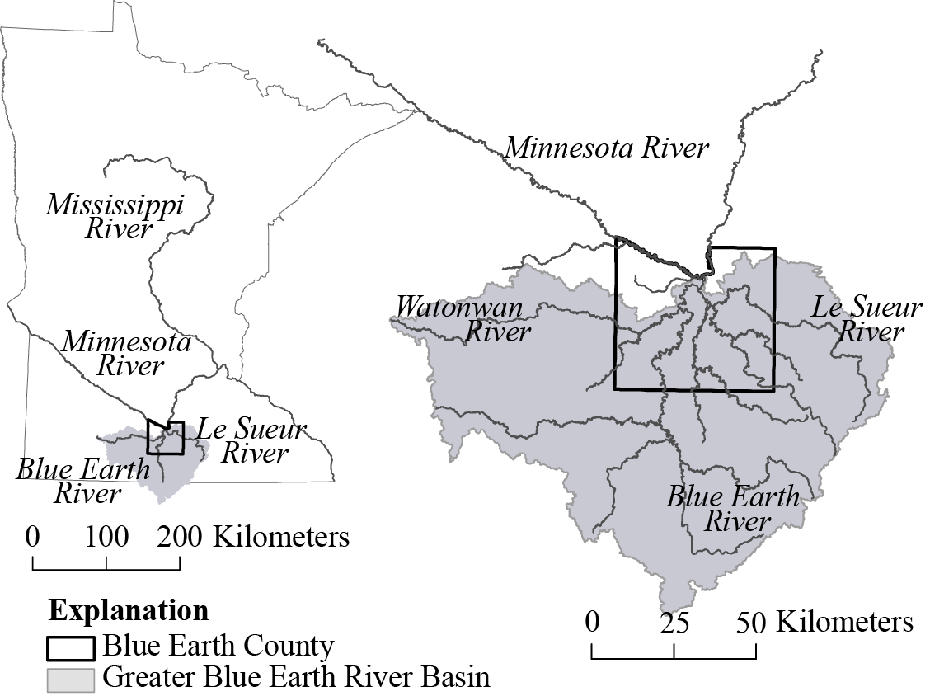
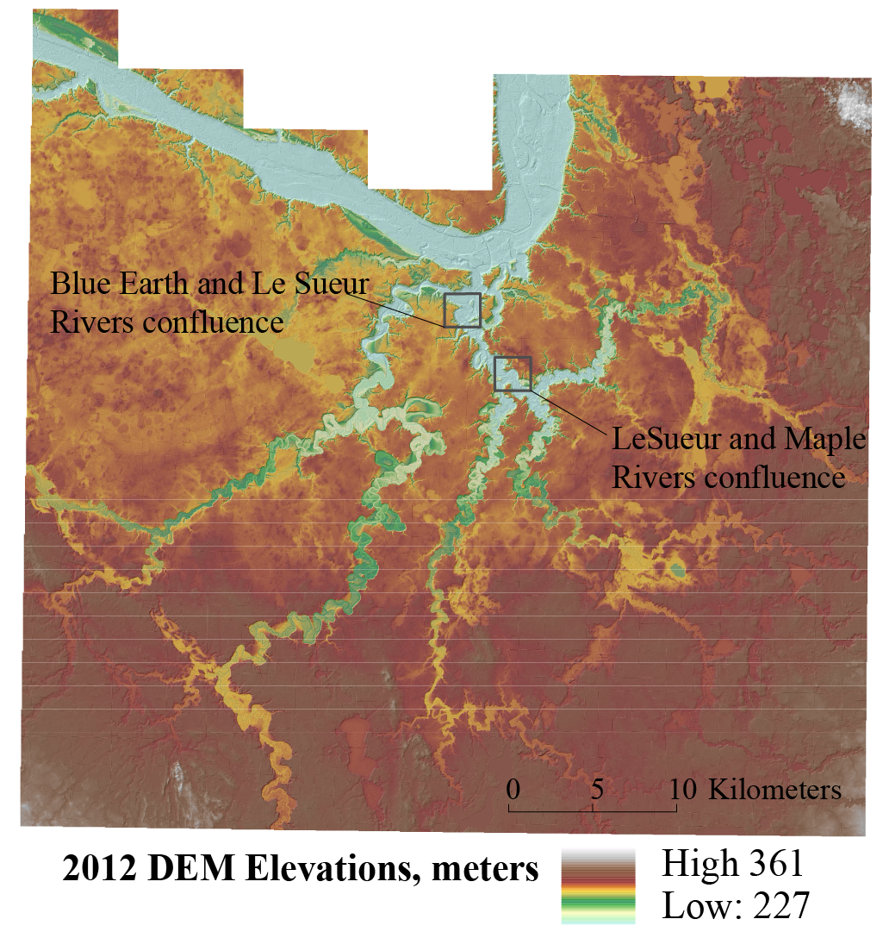
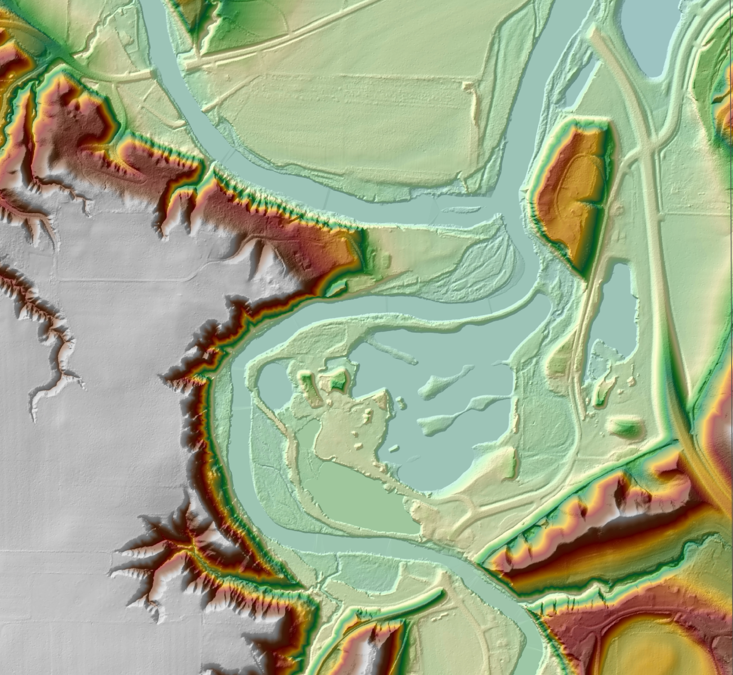
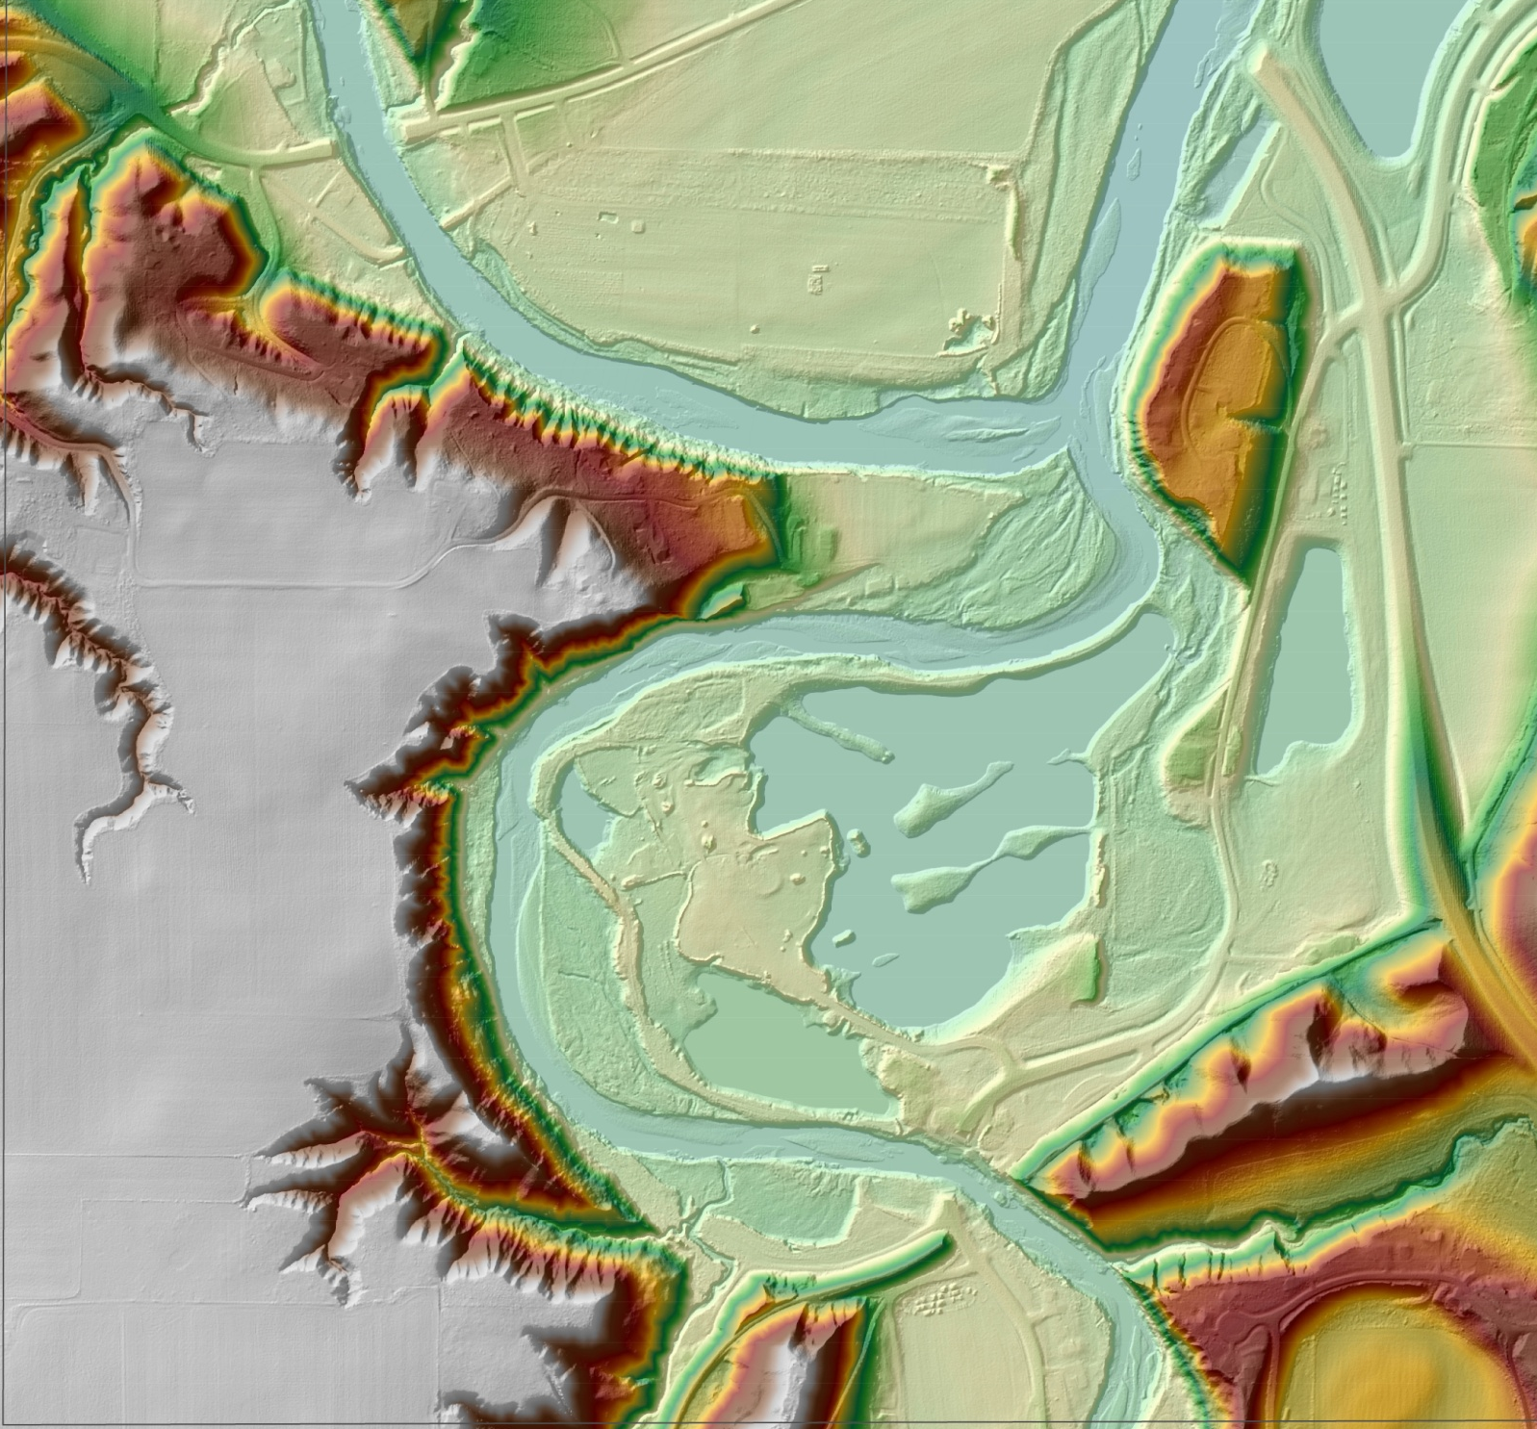
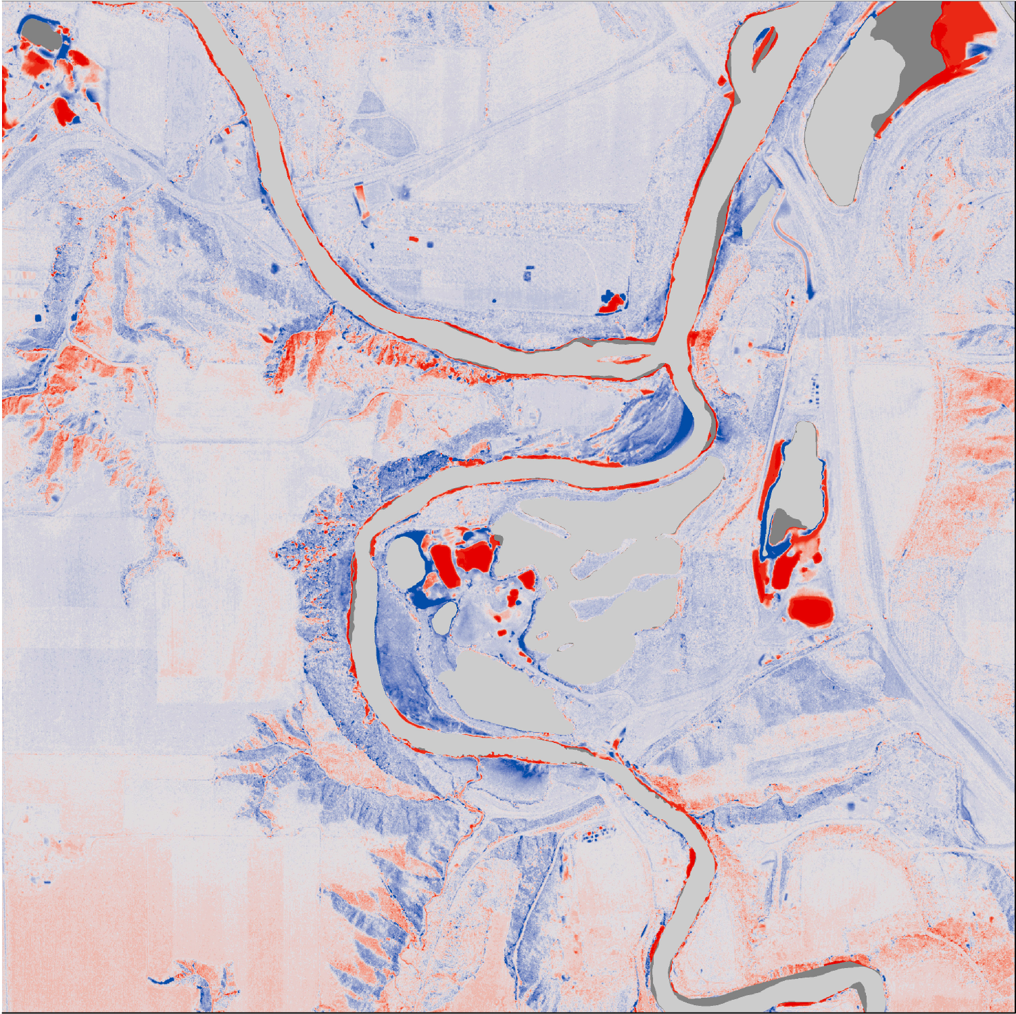
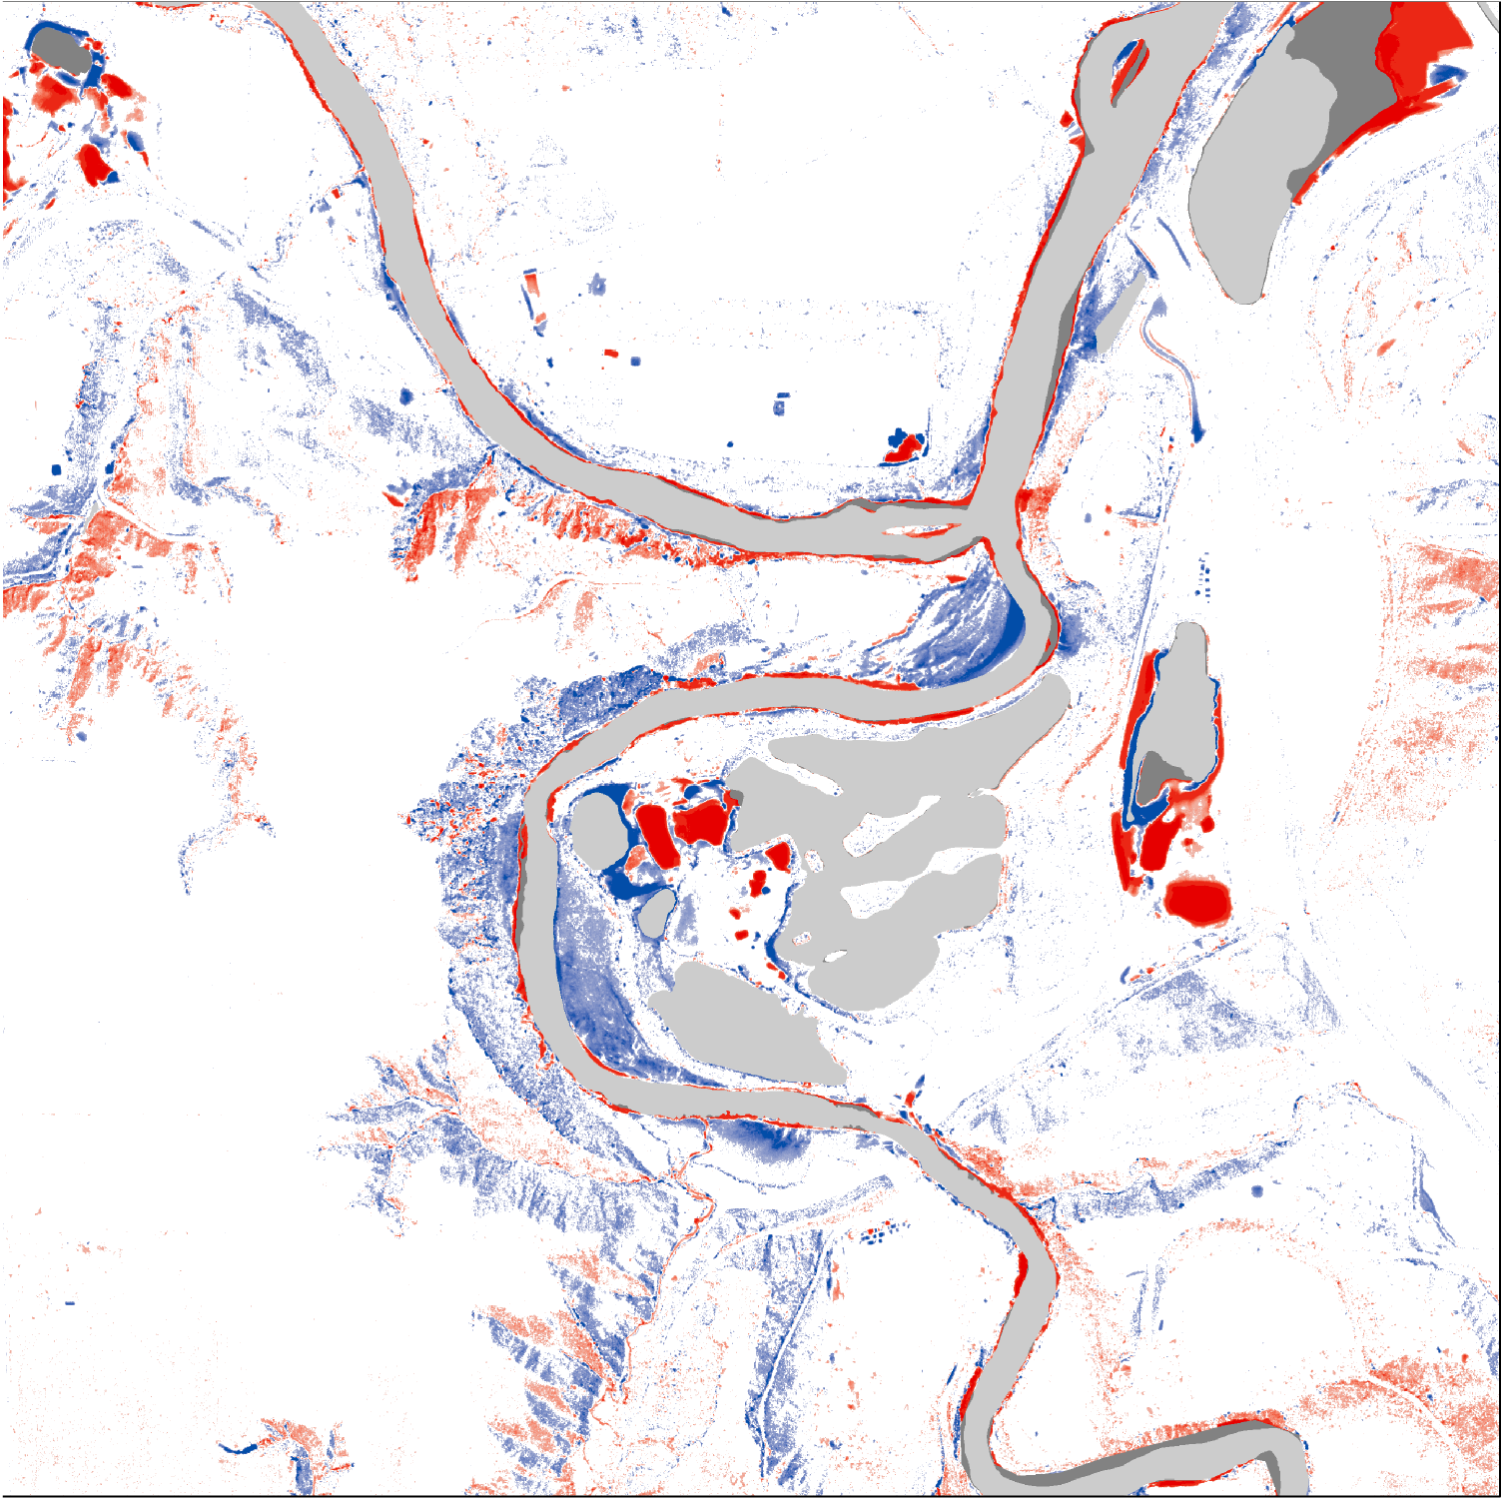
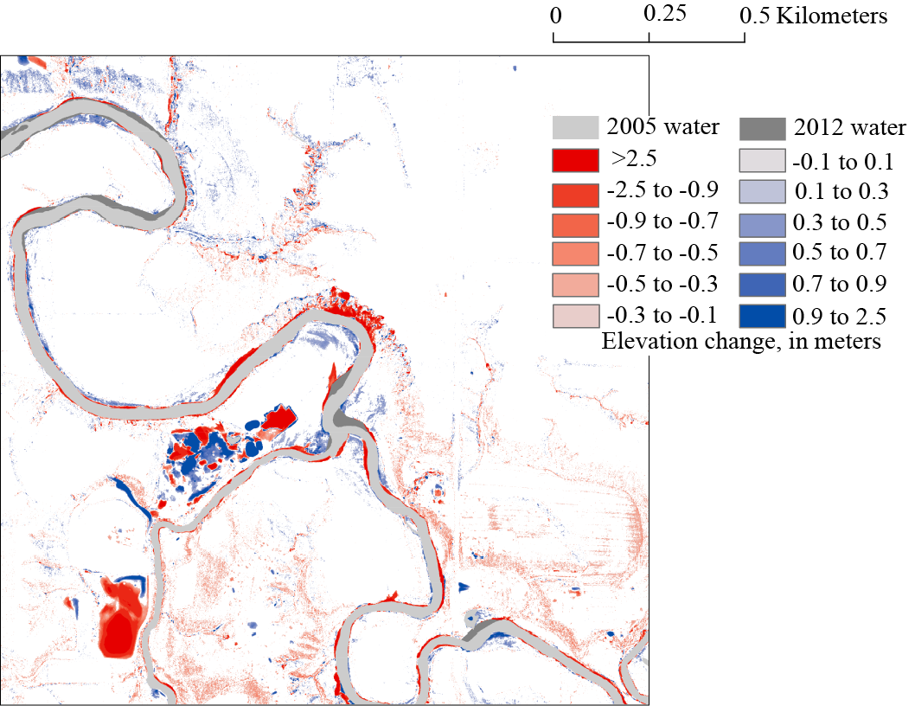
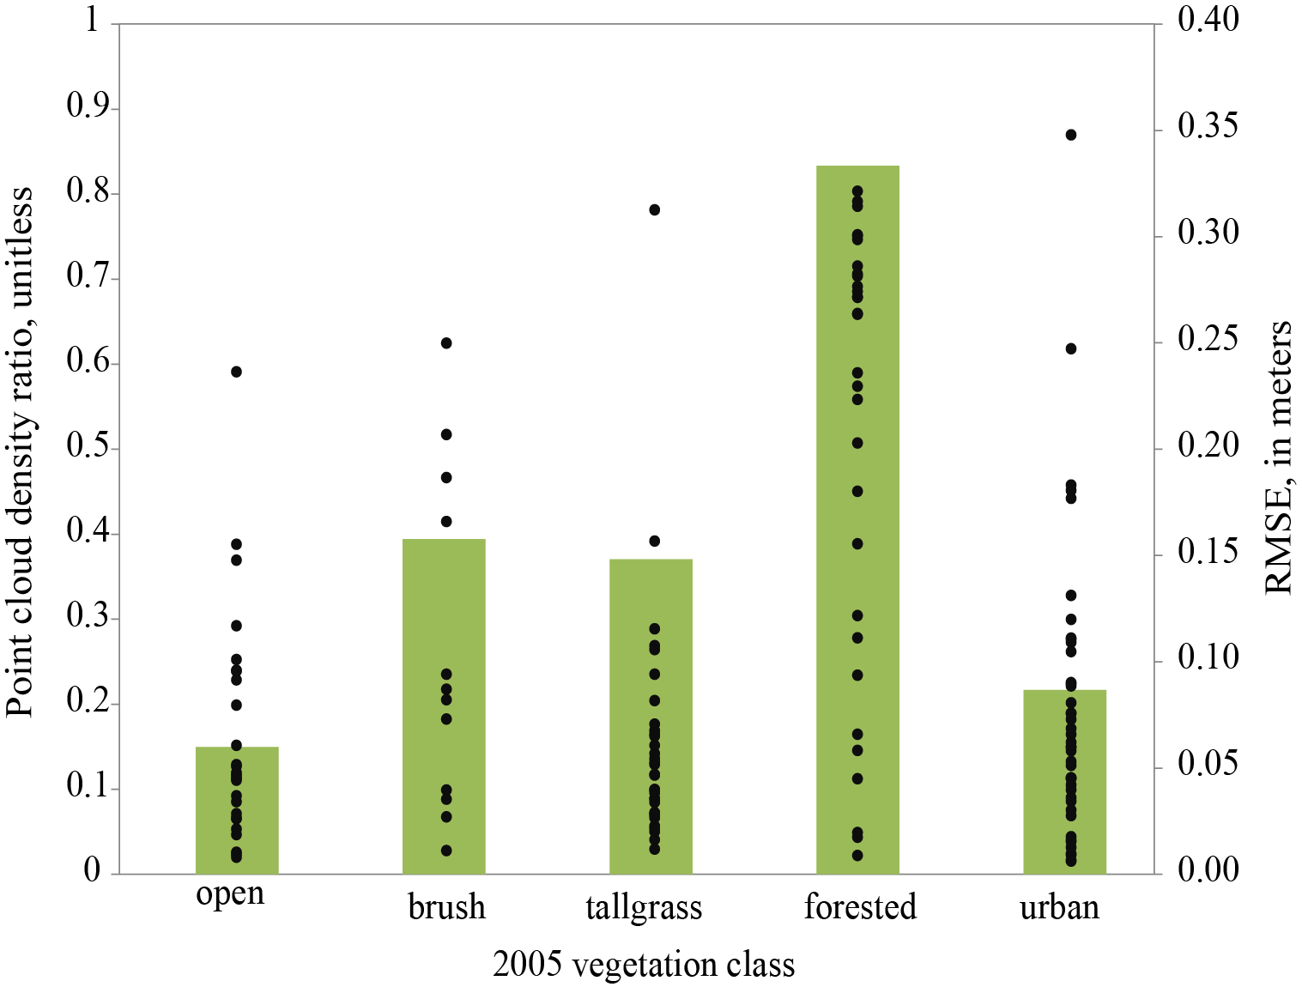
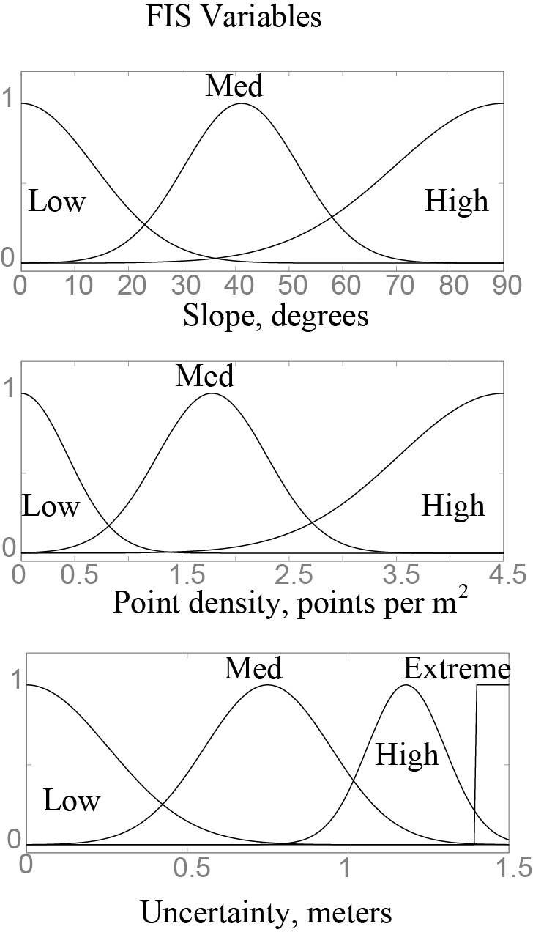
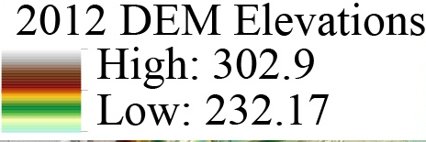
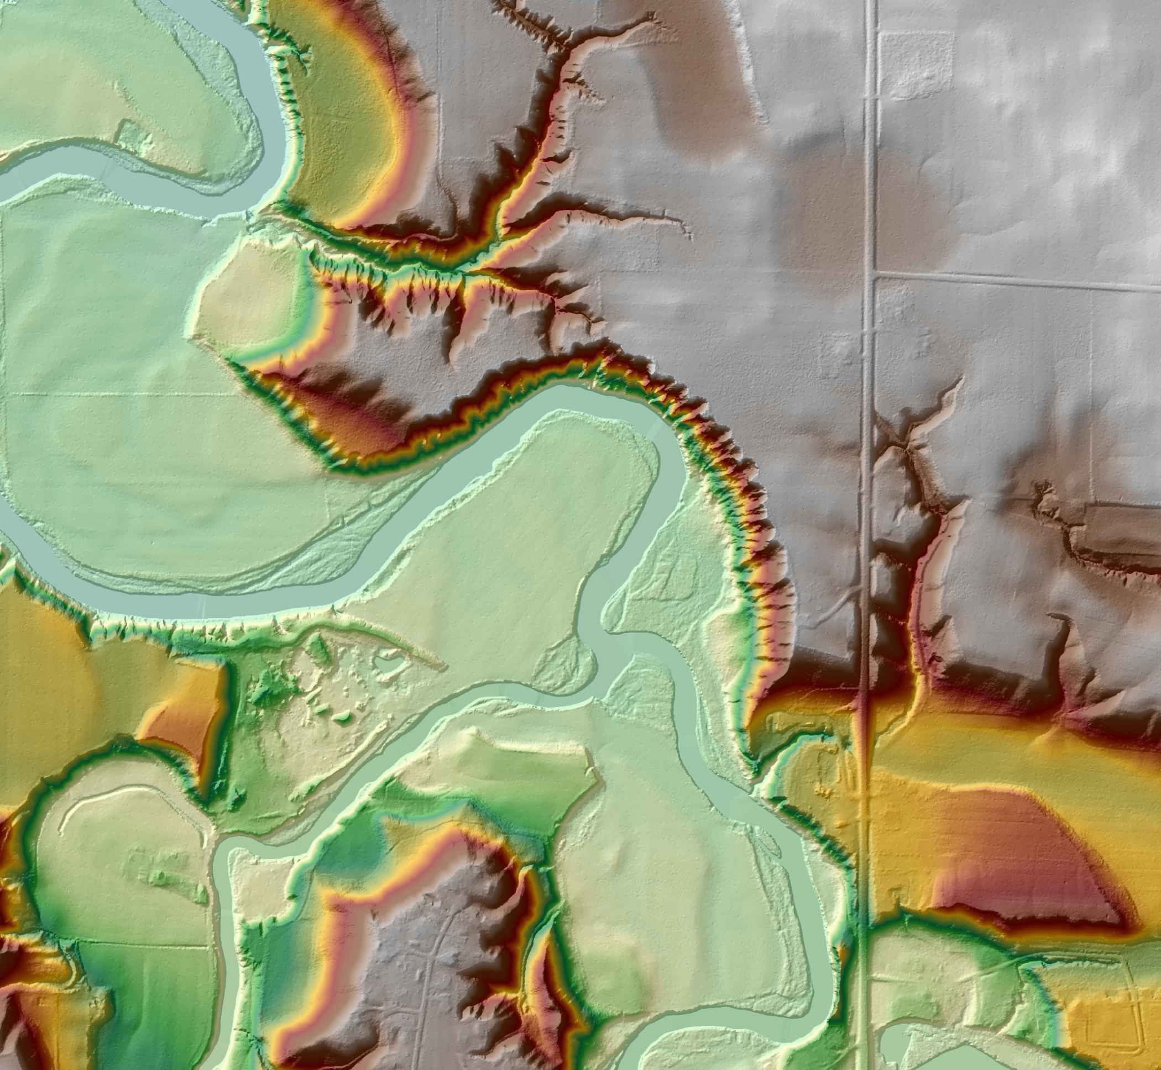
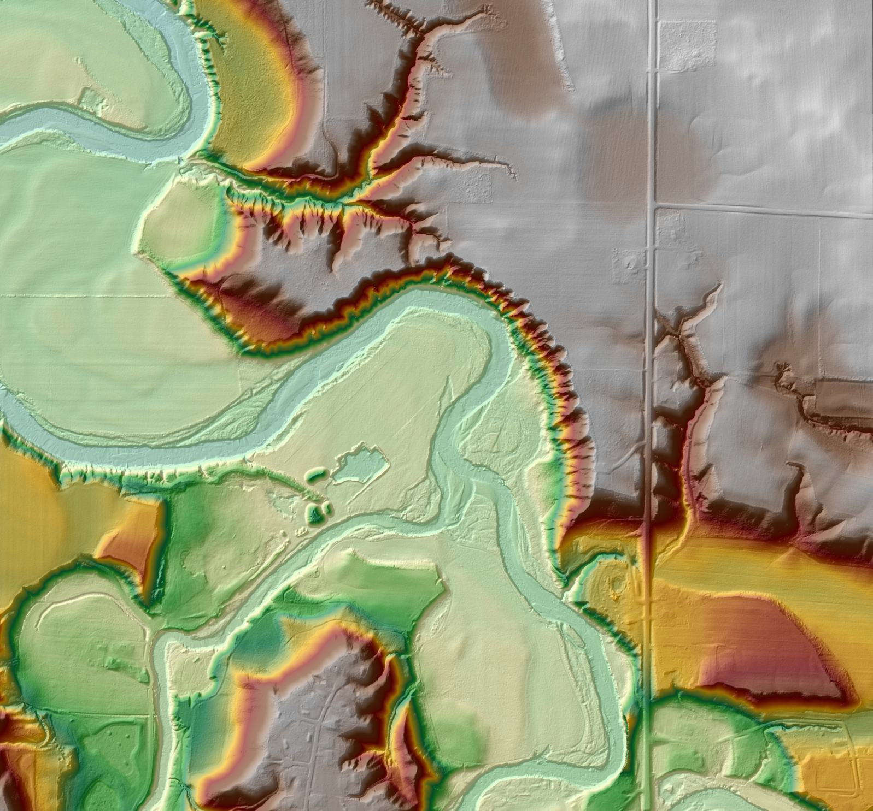
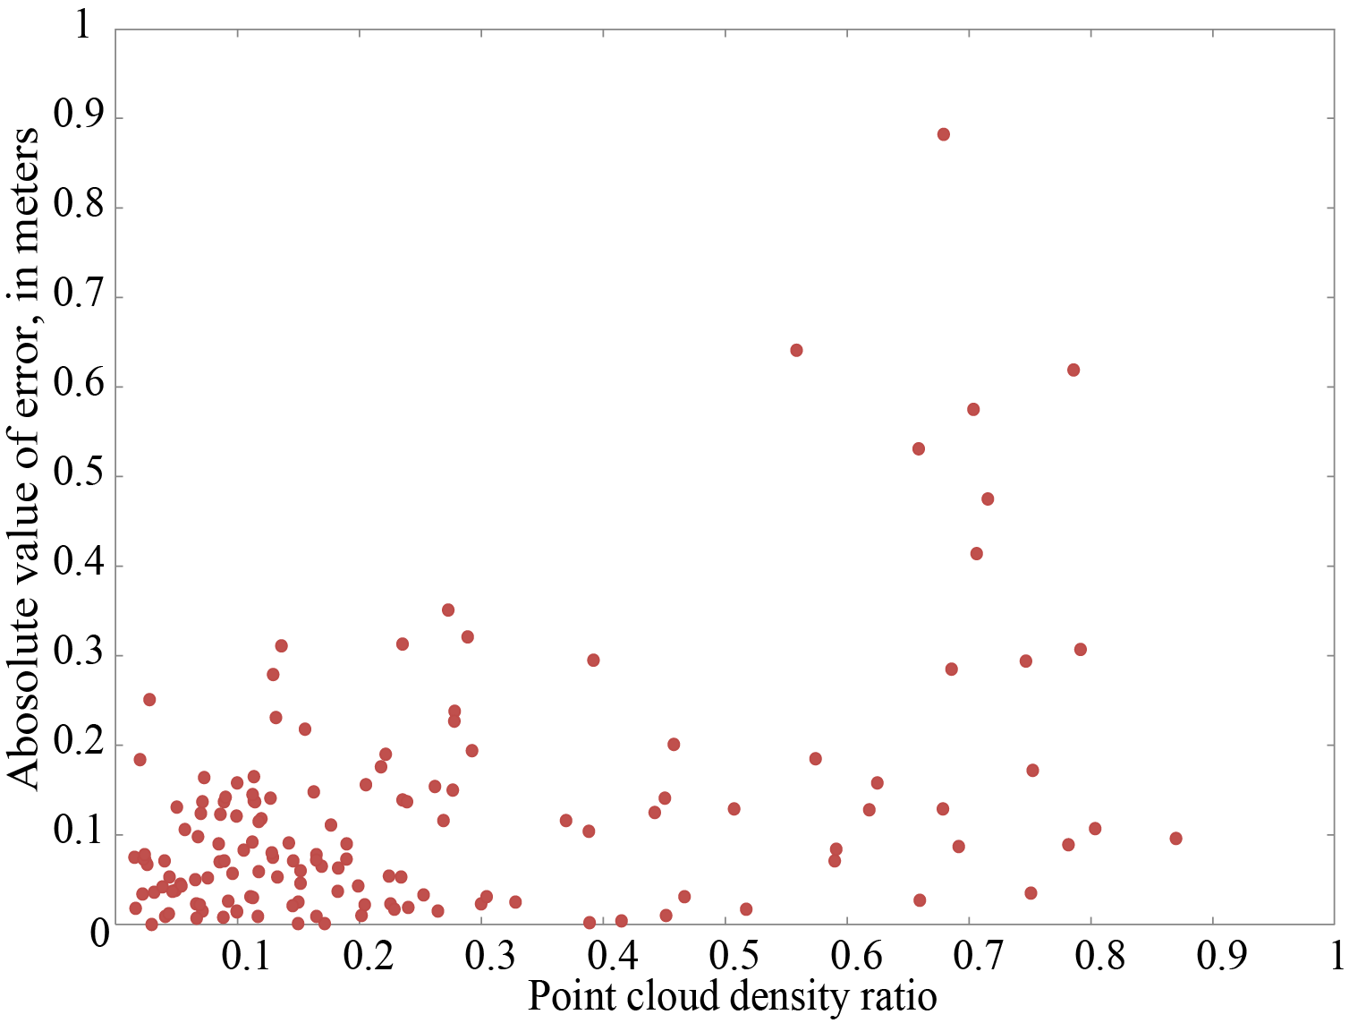
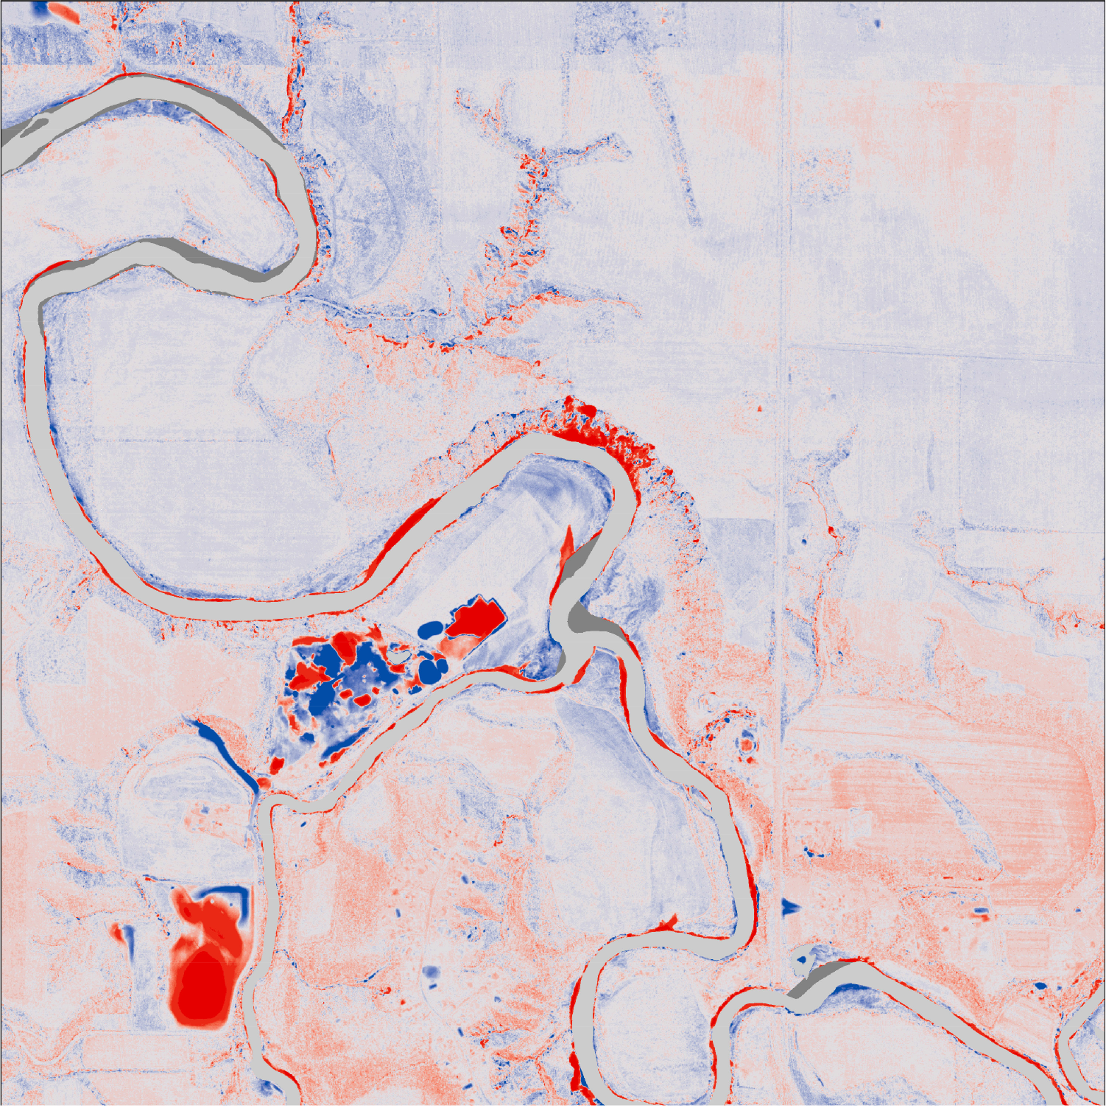
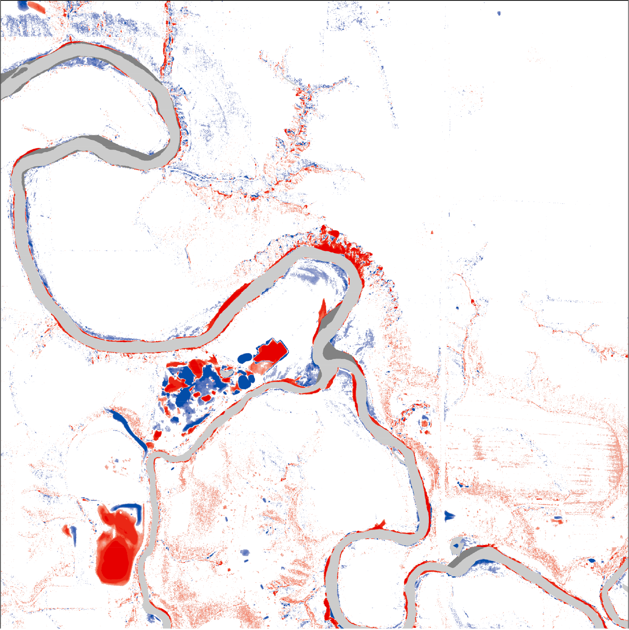
Respecting uncertainty in geomorphic change detection using repeat aerial lidar over a massive area: Blue Earth County, MN
Keelin Schaffrath¹, Dr. Patrick Belmont¹, and Dr. Joe Wheaton¹
^{1.} Department of Watershed Sciences, Utah State University, Logan, Utah: keelin.r.schaffrath@gmail.com, patrick.belmont@usu.edu, joe.wheaton@usu.edu
INTRODUCTION: High-resolution topographic models have become an integral part of Earth Surface Science. Applications and use of data from airborne laser scanning systems (e.g. lidar) have increased exponentially in the last decade (Glennie et al., 2013) as technological advances have increased our ability to acquire, store, and analyze substantially larger datasets. Detailed representation of geomorphic features over vast areas provides the opportunity develop and verify new and better models of water, sediment and nutrient transfer at the scale of large watersheds. Differencing of sequential topographic data through the analysis of 'Digital Elevation Models (DEMs) of difference (DoDs) can be used to detect and quantify geomorphic change (e.g. Brasington et al., 2003; Lane et al., 2003; Thoma et al., 2005; Wheaton et al., 2010a, 2010b) or to infer rates of sediment transport and channel morphology (Brasington et al., 2003; Wheaton et al., 2013). Additionally, estimates of erosion and deposition in the area surveyed can be used as one line of evidence to constrain watershed- and reach-scale sediment budgets.
Excessive sedimentation has been documented in the Minnesota River and many reaches of the main stem and tributaries (fig. 1) are listed as impaired under the Clean Water Act of 1972. An analysis of sediment cores from Lake Pepin, a naturally dammed lake on the Mississippi River downstream from the confluence with the Minnesota River, has shown that the majority of sediment is delivered from the Minnesota River and this has been true over the Holocene. The same analysis also indicated that, since the advent of agriculture in the mid- 1800’s, sediment delivery from the Minnesota River has increased tenfold. The Blue Earth River and its tributaries (Greater Blue Earth basin) have been identified as one of the main sources of sediment to the Minnesota River. A sediment budget for the Greater Blue Earth basin is being developed to inform strategies to reduce current sediment loads and also to better predict how the basin may respond to changing climate. (fig.. 2)Airborne lidar data were collected in 2005 and 2012 for the entire county. In 2010, the rivers in Blue Earth County experienced a record flood giving us the unique opportunity to analyze geomorphic change over a massive area.
Identifying, characterizing, and quantifying patterns of erosion and deposition at a landscape-scale is fundamental to our understanding of landscape denudation processes and stream-channel morpho-dynamics (Mueller and Pitlick, 2013). At this point, all studies involving DEMs of difference are on a reach- or small catchment-scale. With increasing spatial scale, there are increasing opportunities and a suite of additional challenges. The importance of responsibly quantifying and propagating uncertainty is of paramount importance as potential applications of differencing repeat lidar (4D or differential lidar) increase across disciplines and in terms of spatial extent.
SYSTEMATIC OFFSET: Initial differences between the two DEMs indicated a systematic bias between the two datasets. The raw, uncorrected, DoD indicated a small amount of deposition throughout the county, including in agricultural fields where no measurable change would be expected over a 7-year period. To determine whether there were systematic elevation differences and to quantify those differences, we took two approaches. First, we compared results from rtkGPS control points collected simultaneously with the lidar flight (black line in fig. 2). Second, we compared elevations of the two DEMs for two sets of points that we manually generated (blue and red lines in fig. 2).
Results from analysis of the control point and generated point data clearly indicate a positive bias in the 2012 dataset, relative to the 2005 dataset. Points collected for quality control indicate that lidar elevations are generally 7 cm higher than GPS elevations in the 2012 data. The median difference between elevations in the 2012 and 2005 DEMs was 9.6 cm for all points digitized on roads and 3.7 cm for all randomly generated points. Together, these results indicate that the 2012 DEM is systematically offset by 6 cm. To account for this bias, we subtracted 6 cm from each elevation in the 2012 DEM for the change detection analysis.
Horizontal error can introduce additional vertical error especially in areas of steep slope, such as bluffs or stream banks (James et al., 2012). To determine whether there was a systematic bias in the horizontal direction, we compared x and y coordinates of digitized points common in each dataset. X and y coordinates from 2005 were subtracted from 2012 x and y coordinates and the differences in northing and easting were used to calculate the angle (direction) and the magnitude of the vector between the two points. Magnitude of error varied from 0.40 m up to 5.4 m (fig.3). Magnitudes of horizontal offset were randomly distributed and the direction of offset was anisotropically distributed.
Figure 32: Annual peak streamflow for two gages in Blue Earth County, 1910-2012.
DoD Methods: To make meaningful interpretations of the differences between two digital elevation models (DEMs), total uncertainty must be accounted for between and within DEMs. In other studies differencing airborne lidar (Thoma et al., 2005; Young and Ashford, 2006; Kessler et al., 2009; Bull et al., 2010), uncertainty or error was only estimated by applying a minimum level of detection (Fuller et al., 2003). Specifying a minimum level of detection relies on the typically unsupported assumption that uncertainty is spatially uniform (Wheaton et al., 2010b). A minimum level of detection is used as a threshold where only elevation differences greater than the minimum level of detection are considered meaningful. To estimate volumetric change and identify sediment sources and sinks, I compared two lidar-derived DEMs that were collected in 2005 and 2012 for all of Blue Earth County. I differenced the two DEMs using a fuzzy inference system that quantifies and propagates uncertainty throughout the DEMs (Wheaton et al., 2010) Sources of uncertainty include the slope, point density, and whether there was water in the channel at the time of data collection. Vegetation is another source of uncertainty that will be included in future iterations of this analysis. To the right (fig. 4), I show a 2-input fuzzy inference system using point density and slope as uncertainty parameters. Below, I show the DEM of difference for four areas in Blue Earth County using different methods of quantifying uncertainty.
Figure 4: Rose diagram representing the magnitude and direction of horizontal offset between 2005 and 2012 digital elevation models. Colors indicate the distribution of magnitude of change in meters and percentages indicate the percentage of the error in that direction.
Figure 3: Probability density functions for differences between the lidar and rtkGPS data (black line), differences in elevations from 2012 and 2005 for points digitized on roads (blue line) and randomly generated points (red line). A dashed line 6 cm.
Figure 1: Above: Map of the state of Minnesota the location of Blue Earth County and the Greater Blue Earth River Basin. Right: Blue Earth County 2012 DEM and the 4 areas showcased below and in the results.
Quantifying uncertainty due to vegetation
using the point cloud
Raw DoD
Min. Level of Detection using RMSE
Blue Earth and Le233085 Sueur Rivers
Blue Earth and Le233085 Sueur Rivers
2005
2012
Figure 5: Point cloud density ratio with vegetation class above and relative to errors from control point measurements below
Figure 6: DEMs of Differences for two areas in Blue Earth County. On the left, uncertainty was not considered. On the right, a minimum level of detection was applied.
Le Sueur and Maple Rivers
Le Sueur and Maple Rivers
Figure 7: Two-input hypothetical fuzzy inference system to spatially quantify and propagate uncertainty in DEMs of Difference.
References: Brasington J, Langham J, Rumsby B. 2003. Methodological sensitivity of morphometric estimates of coarse fluvial sediment transport. Geomorphology 53 : 299–316. Bull JM, Miller H, Gravley DM, Costello D, Hikuroa DCH, Dix JK. 2010. Assessing debris flows using LIDAR differencing: 18 May 2005 Matata event, New Zealand. Geomorphology 124 : 75–84. Fuller IC, Large ARG, Charlton ME, Heritage GL, Milan DJ. 2003. Reach-scale sediment transfers: an evaluation of two morphological budgeting approaches. Earth Surface Processes and Landforms 28 : 889–903. Glennie CL, Carter WE, Shrestha RL, Dietrich WE. 2013. Geodetic imaging with airborne LiDAR: the Earth’s surface revealed. Reports on progress in physics. Physical Society (Great Britain) 76 : 086801. James LA, Hodgson ME, Ghoshal S, Latiolais MM. 2012. Geomorphic change detection using historic maps and DEM differencing: The temporal dimension of geospatial analysis. Geomorphology 137 : 181–198. Kessler a C, Gupta SC, Dolliver H a S, Thoma DP. 2009. Lidar quantification of bank erosion in Blue Earth County, Minnesota. Journal of environmental quality 41 : 197–207. Lane SN, Westaway RM, Murray Hicks D. 2003. Estimation of erosion and deposition volumes in a large, gravel-bed, braided river using synoptic remote sensing. Earth Surface Processes and Landforms 28 : 249–271. Mueller ER, Pitlick J. 2013. Sediment supply and channel morphology in mountain river systems: 1. Relative importance of lithology, topography and climate. Journal of Geophysical Research: Earth Surface. Thoma DP, Gupta SC, Bauer ME, Kirchoff CE. 2005. Airborne laser scanning for riverbank erosion assessment. Remote Sensing of Environment 95 : 493–501. Wheaton JM, Brasington J, Darby SE, Kasprak A, Sear D, Vericat D. 2013. Morphodynamic signatures of braiding mechanisms as expressed through change in sediment storage in a gravel-bed river. Journal of Geophysical Research: Earth Surface 118 : 759–779. Wheaton JM, Brasington J, Darby SE, Merz J, Pasternack GB, Sear D, Vericat D. 2010a. Linking geomorphic changes to salmonid habitat at a scale relevant to fish. River Research and Applications 26 : 469–486. Wheaton JM, Brasington J, Darby SE, Sear D. 2010b. Accounting for uncertainty in DEMs from repeat topographic surveys: improved sediment budgets. Earth Surface Processes and Landforms 35 : 136–156. Young AP, Ashford SA. 2006. Application of airborne lidar for seacliff volumetric change and beach-sediment budget contributions. Journal of Coastal Research 22 : 307–318.

