Slide 1


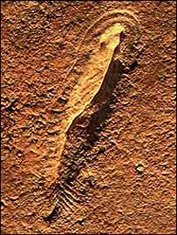
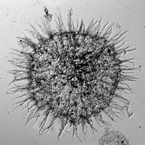
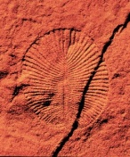
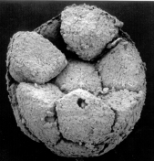
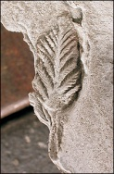
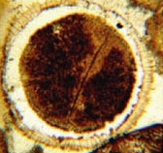
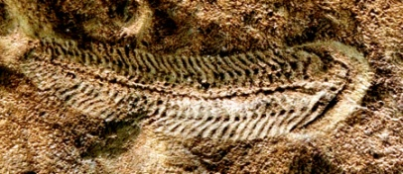
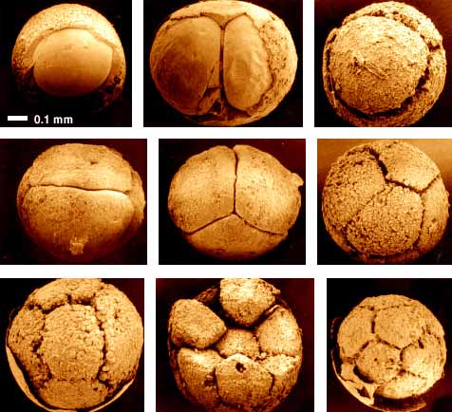
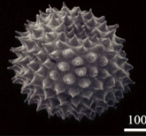
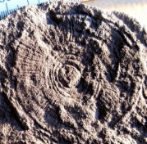
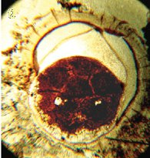
Turbulent Times for Early Animals?
By
Swapan Kr Sahoo
Ganqing Jiang, Noah Planavsky, Brian Kendall, Jeremy Owens, Ariel Anbar
And Timothy Lyons
^{125th} GSA
Annual Meeting
Denver, Colorado
30th October, 2013
Department of
GEOSCIENCE
University of Nevada, Las Vegas

Slide 2
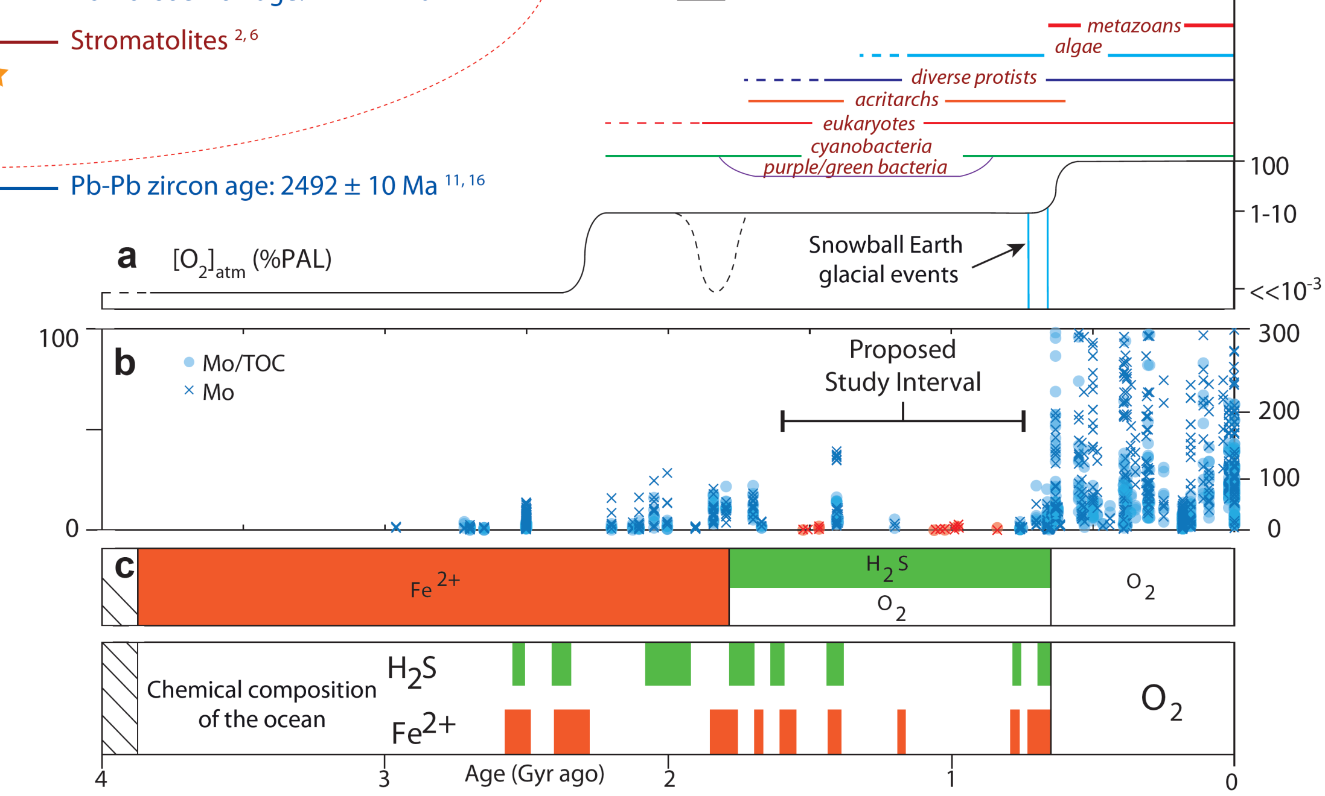
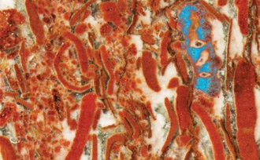
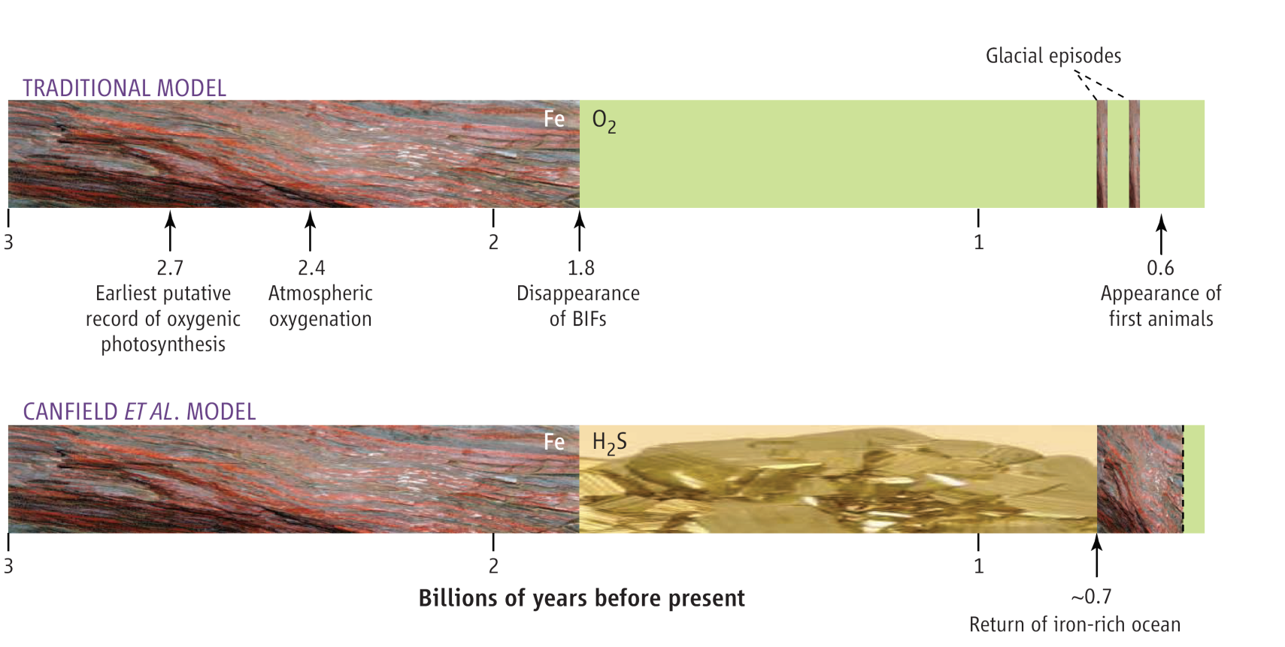
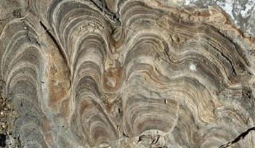
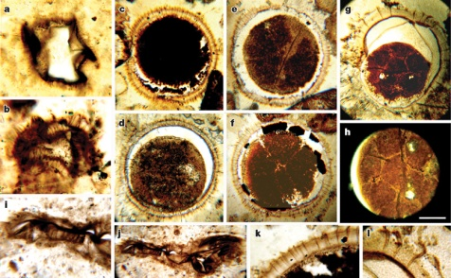
Rise of Atmospheric O₂
Early Metazoans–632 Ma, Early O₂ –2.3 Ga Fossil and Metal Record
Late Proterozoic ~551 Ma
Early Proterozoic - GOE ~2.4 Ga
Early Metazoans
~632 Ma
after Lyons et al., 2009, Elements
after Sahoo et al., 2012, Nature
after Sahoo et al., 2012

Slide 3
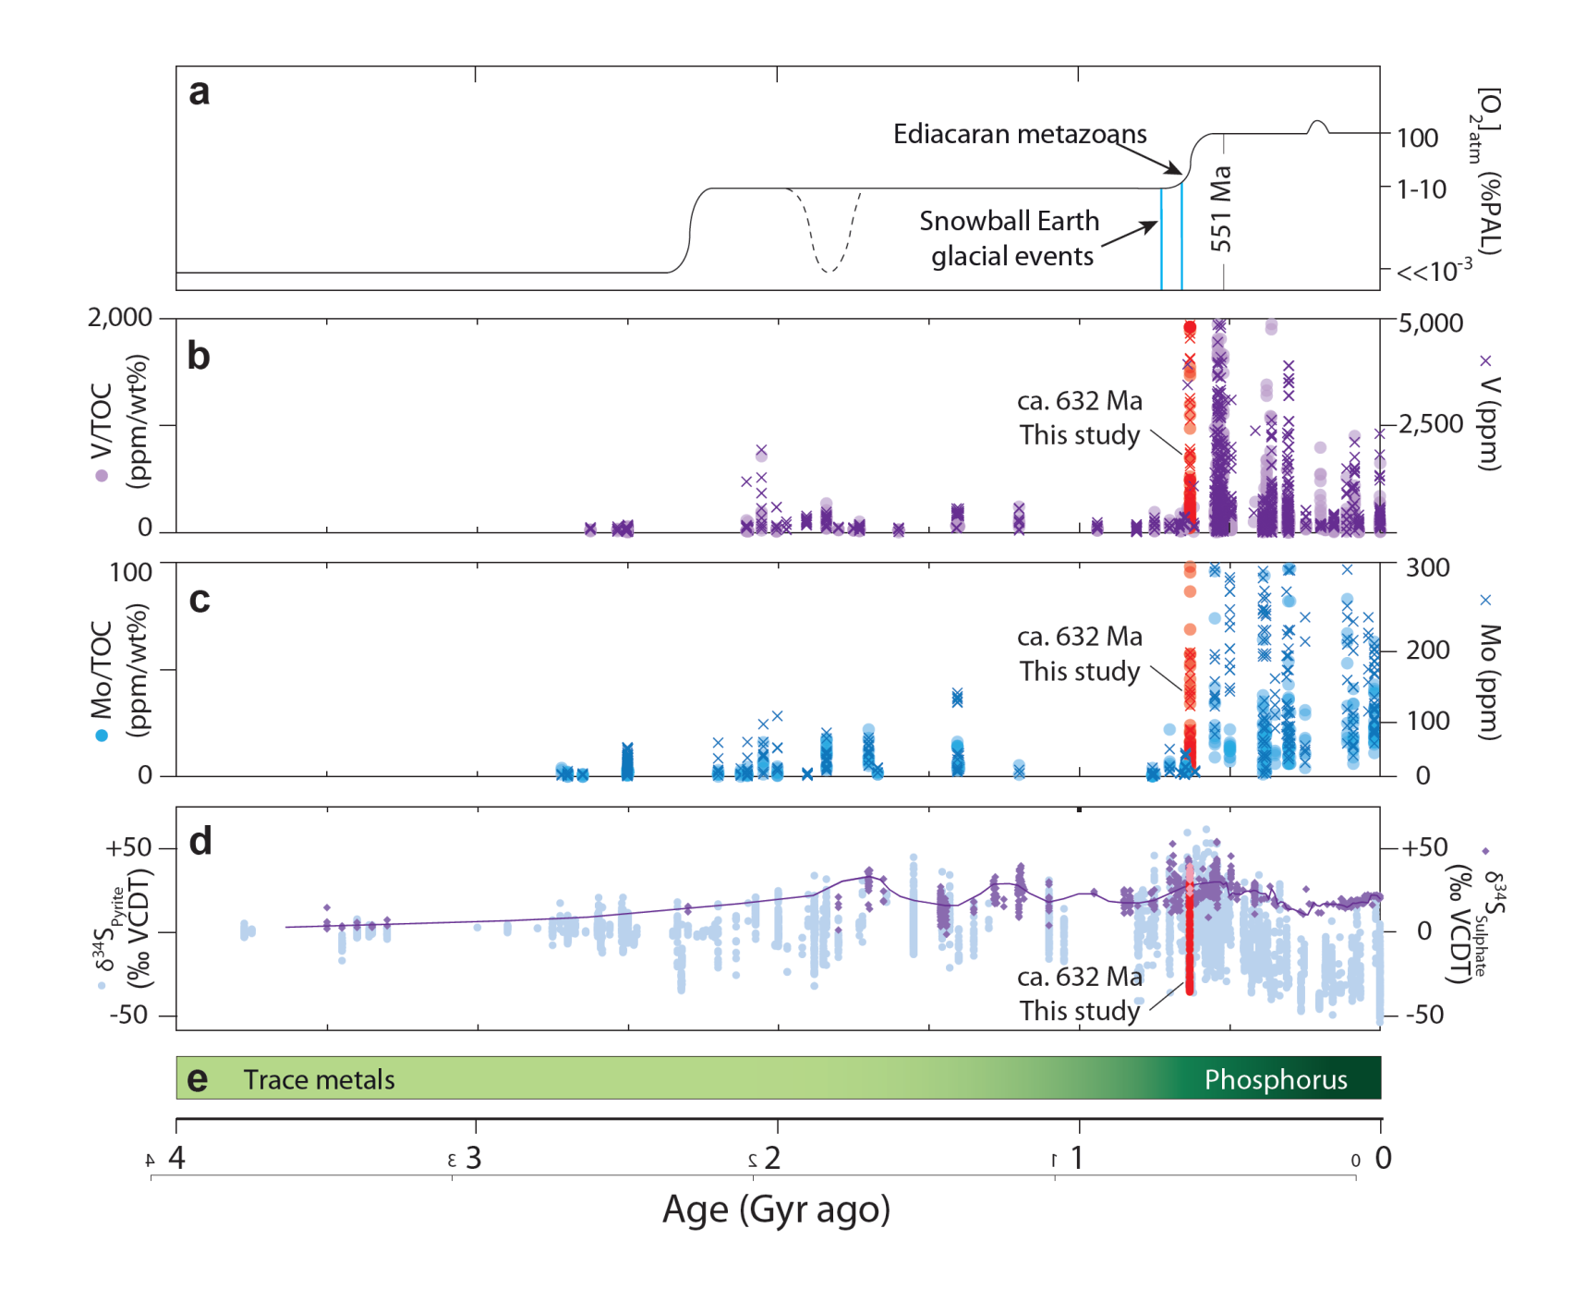
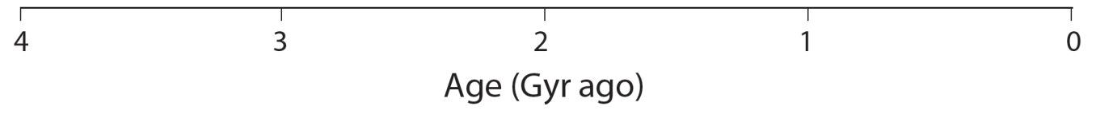
Trace Metals and Isotopes
Rise of Early Animals and O₂
Evidence from Redox sensitive Metals
after Sahoo et al., 2012, Nature

Slide 4
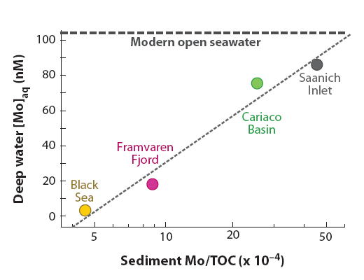
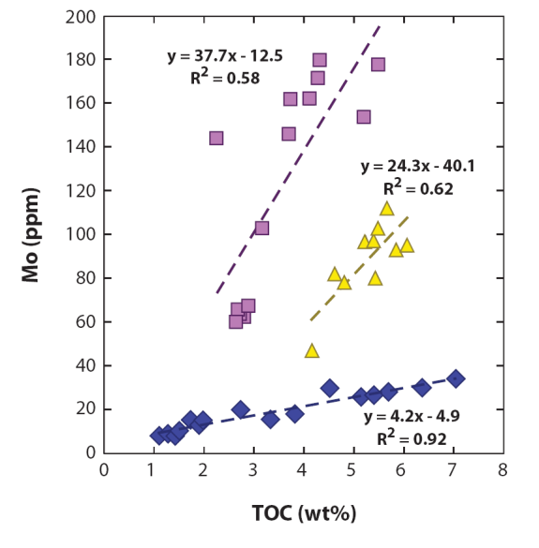
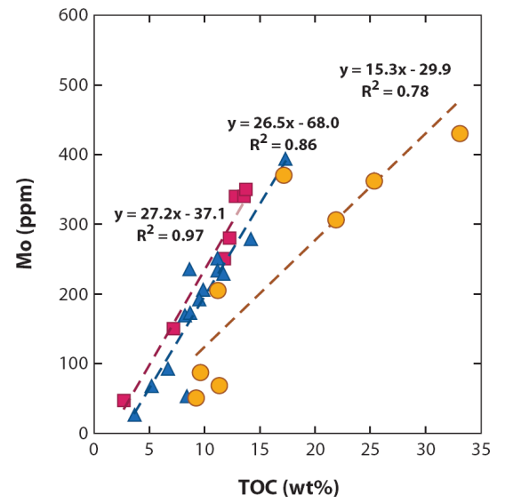
Trace Metals and Oxygen
Seawater Metals Record Redox
Metal/TOC Ratio’s Record Conc.
Modern Sediments
Seawater Trace metals records information about marine redox landscape.
Ancient
The sedimentary Metal/TOC* ratios track dissolved Metal concentration in seawater.
*TOC → Total Organic Carbon
after Lyons et al., 2008, ESR

Slide 5
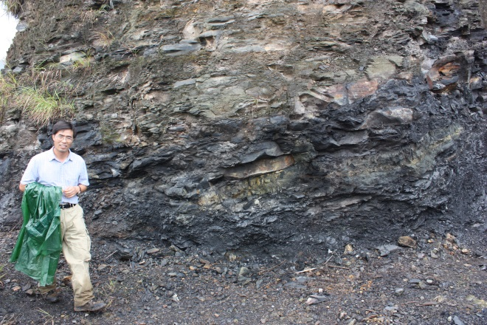
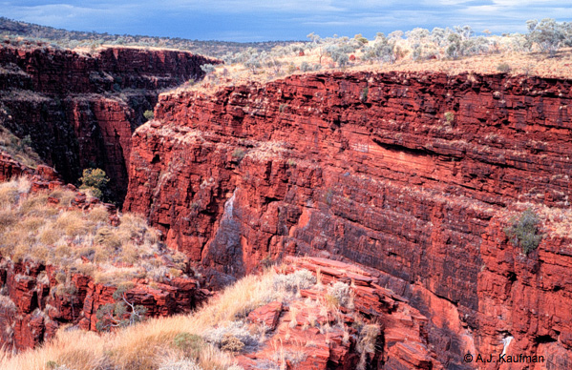
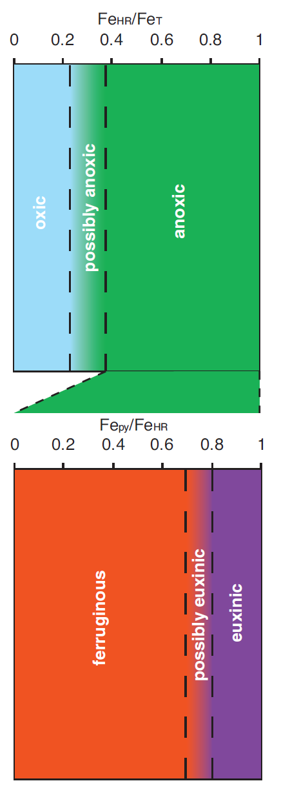
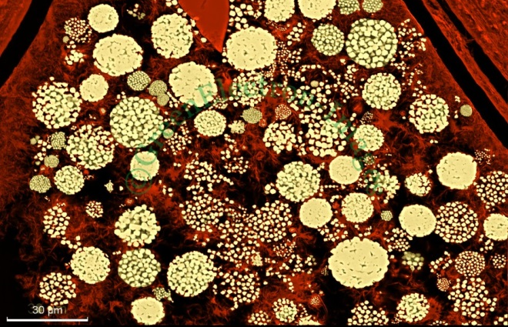
Redox Indicators
How to calculate the chemical condition of the ocean
=
Fe Oxide (Fe_{Oxide})
Highly Reactive Fe (Fe_{HR})
Fe Magnetite (Fe_{Mag})
Iron (Fe_{T})
Non Reactive Fe (Fe_{NR})
Fe Carbonate (Fe_{Carb})
Fe Pyrite (Fe_{Pyrite})
Oxic vs. Anoxic (Fe_{HR/}Fe_{T})
Ferruginous vs. Euxinic (Fe_{Pyrite}/Fe_{HR})
after Poulton and Canfield, 2011, Elements

Slide 6
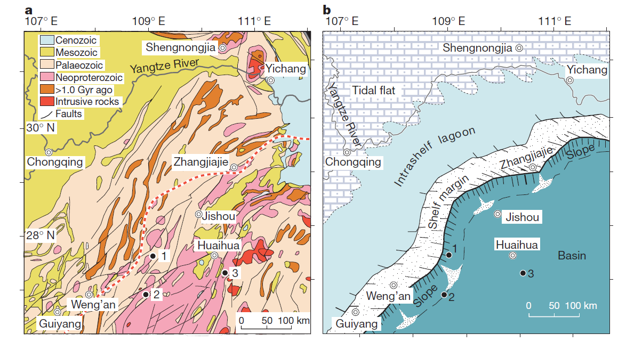
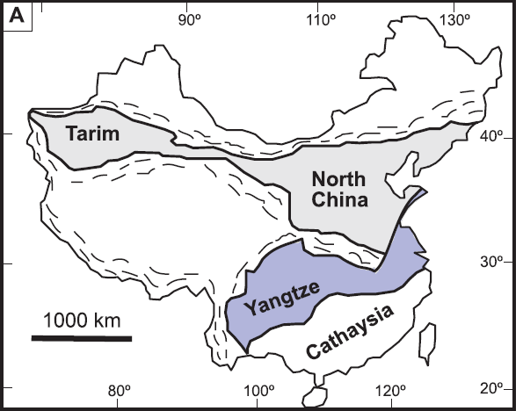
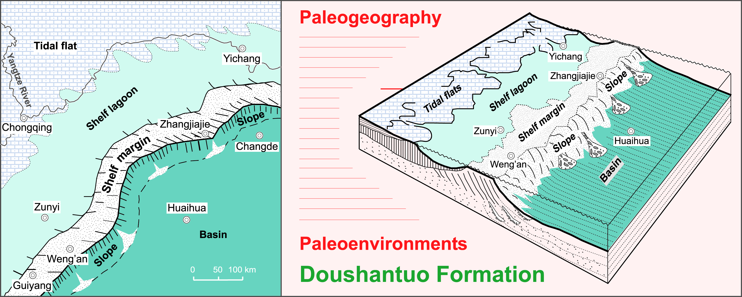
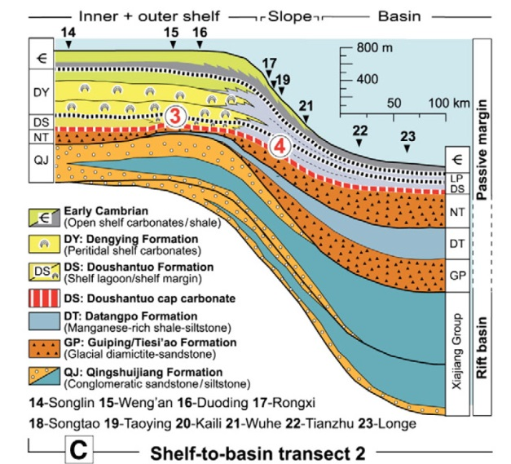
Geology-Rock Record
Study area, Location Maps and Age constrains for the Nanhua Basin
after Sahoo et al., 2012, Nature
and Jiang et al., 2011, Gondwana Research

Slide 7
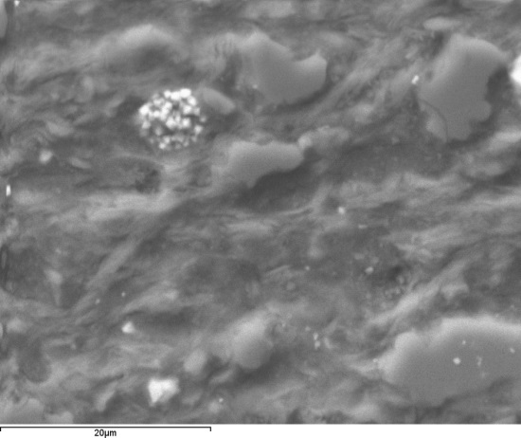
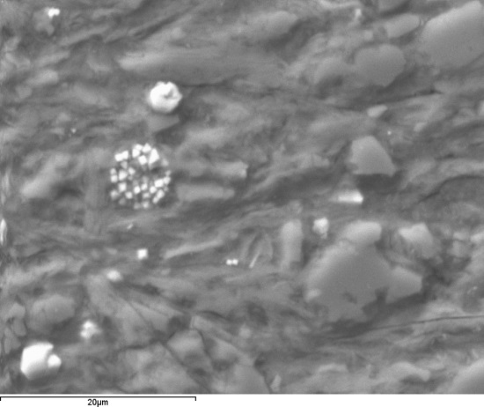
SEM Analysis
Pyrite Framboids - syngenetic depositional history
Backscattered electron (BSE) images of closely packed, typical pyrite framboids
The redox state of the ocean was euxinic, and record
original signature of the ocean chemistry
after Sahoo et al., 2012, Nature

Slide 8
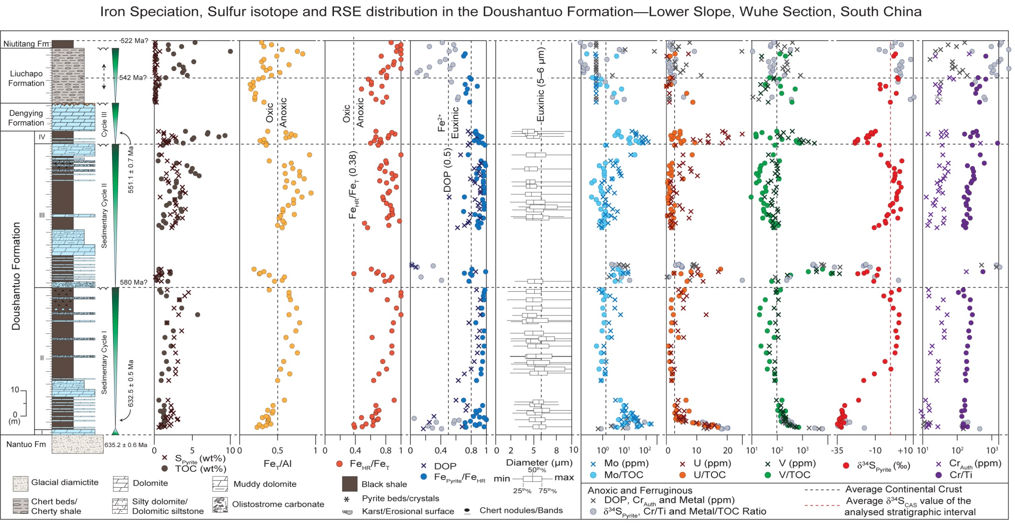
Multi-Proxy Geochemical Data
Rise and Fall of
Redox sensitive Metals
If no redox change across major boundaries, but metal enrichments: then
Either there are change in fluxes —weathering
Change in oxidative state of the ocean

Slide 9
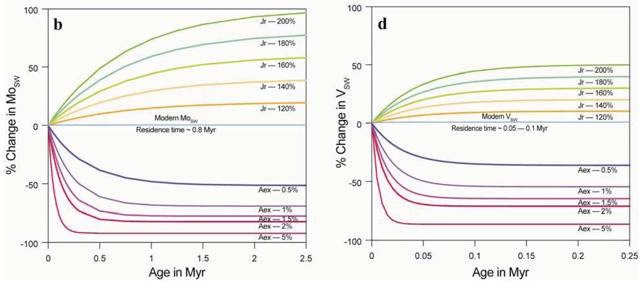
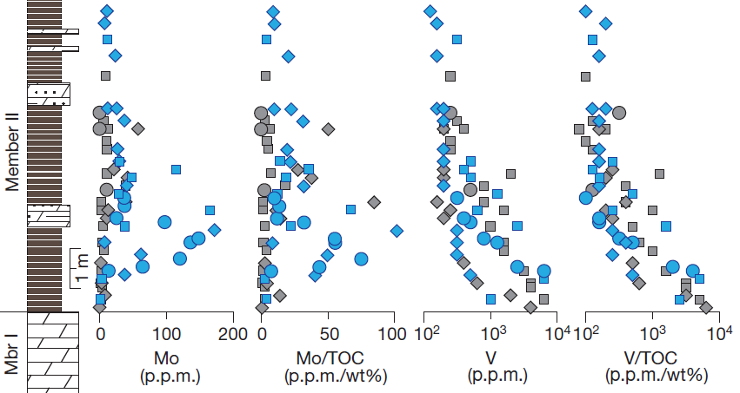
Geochemical Modeling
Weathering Alone is not the Driver
Oxidation is the key
Even 1% Anoxic/euxinic sediments can counter balance even
double the riverine flux.→ not the major driver
The oxidative state of the ocean was a primary driver for high Trace metals
after Sahoo et al., 2012, Nature

Slide 10
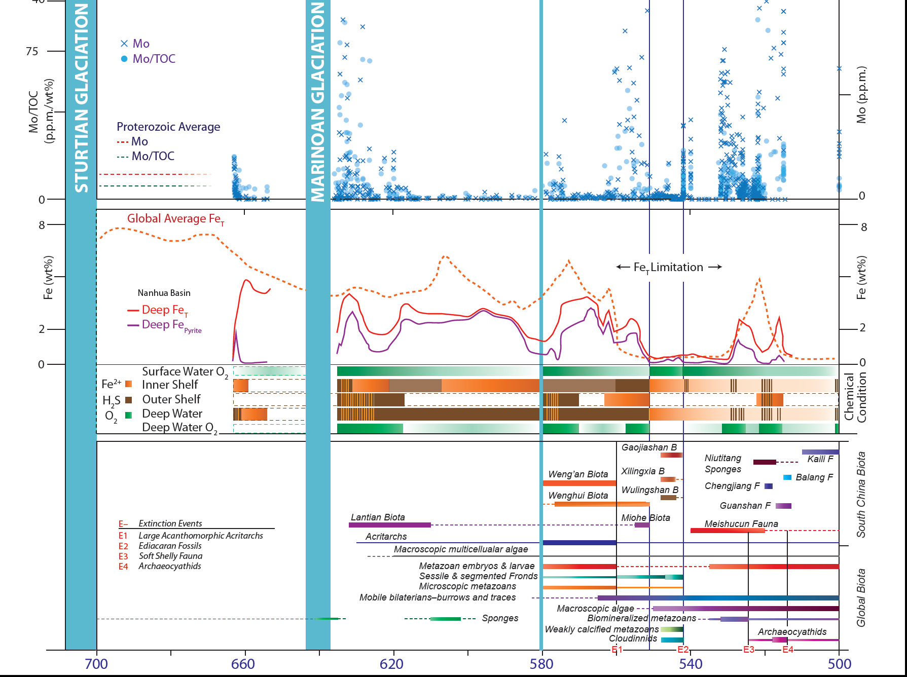
Animals, Nutrients and O₂
Diversification Limited to certain intervals. Rise and Fall of O₂?
The Precambrian/Cambrian boundary – ocean chemistry was very much like Phanerozoic
— Low Fe, P but high Mo, V, U, Co, Cd (Chalcophilic bioessential metals)
We should question our self with Late Ediacaran biospheric evolution
Nutrient limitation feedbacks at various redox regimes
The protracted nature of Earth’s O₂ rise

Slide 11
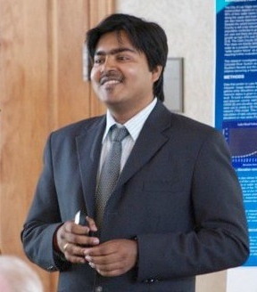
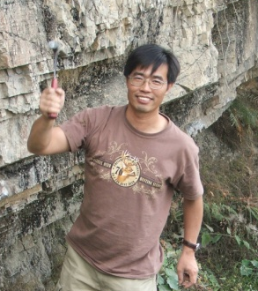
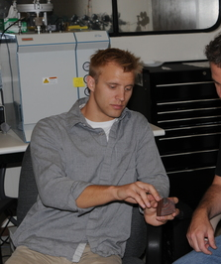


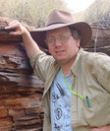
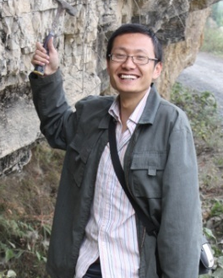
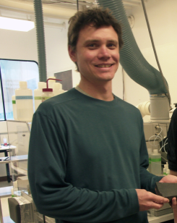
Acknowledgement
Lot of People to Thank
Friends and Colleagues
Thank You
National Foundation of Sciences
University of California, Riverside
Lyons Lab: Jeremy Owens, Chris,
Natasha, Megan and Steve Bates
Arizona State University, Tempe
Gwyneth Gordon, Steve Romanielo
China University of Geosciences
University of Nevada, Las Vegas
Carbonate Mafia Group and Jeevan Jayakody
S.K. Sahoo
G. Jiang
N. Planavsky
T. Lyons
C. Scott
B. Kendall
A. D. Anbar
X. Wang

