Slide 1
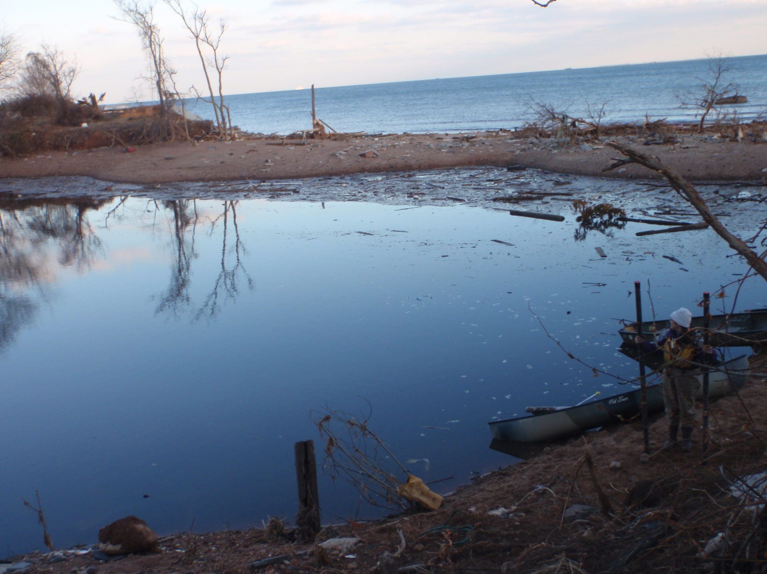
How unique was Hurricane Sandy? A comparison of the inundation deposits and surge heights from Hurricane Sandy and the 1821 hurricane
Christine Brandon & Jonathan Woodruff
University of Massachusetts Amherst
Jeff Donnelly
Woods Hole Oceanographic Institution

Slide 2
Importance of Work
Extend the record of flooding events in New York City
Sediment deposits can be used to compare storm inundation characteristics
More accurately determine the reoccurrence frequency of storms like Hurricane Sandy
Maximum Annual Water Levels at the Battery , NYC
Hurricane
Sandy
3.5
= Hurricane inundation
3
1960
4
2012
TS
Irene
3.5
2.5
1938
1944
1985
1788
1821
3
1893
2
Elevation relative to MSL (m)
2.5
1.5
Elevation relative to MSL (m)
2
1.5
1
1
0.5
0.5
0
0
1920
1930
1940
1950
1960
1970
1980
1990
2000
2010
1800
1820
1840
1860
1880
1900
1920
1940
1960
1980
2000
Notes:
Hurricane Sandy raised water levels to their highest recorded values at the Battery (southern tip of Manhattan), however, the tide gauge record only extends back to 1920. We need to examine the sediment record to get a better idea of how often a flood like that caused by Sandy occurs in this area. The flooding depths of the 1788, 1821, and 1893 storms are reported in Scileppi and Donnelly (2007) and were calculated using newspaper accounts of the extent of flooding in New York City (and referenced to today’s mean sea level).

Slide 3
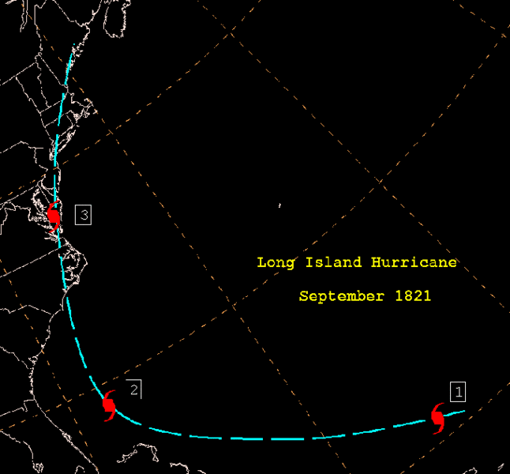
The 1821 storm
Hurricane track is well constrained due to eye passing over the East Coast, causing widespread damage from North Carolina to Connecticut
Storm hit NYC at low tide
"In one hour during the [hurricane] of Monday evening, the water was forced into the East River 13 feet 4 inches above low water mark. On the sudden shifting of the wind, the water went off in half the time that it came in.”
Wm. Redfield, 1831
Fun Fact: Due to the spatial pattern of fallen trees in Connecticut, William Redfield discovers that hurricanes have a rotating wind field.
Notes:
The only quantitative information about the 1821 storm surge comes from William Redfield’s “Remarks on the prevailing storms of the Atlantic coast of the North American States” written in 1831 in which he quotes a newspaper article from 10 years before. The same work compiles many accounts of this storm which, because the eye traveled up the East Coast, gives a pretty strong constraint on the timing and location of the storm.

Slide 4
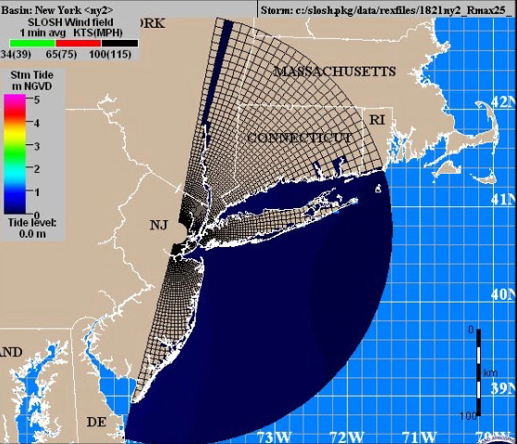
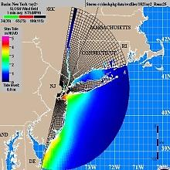
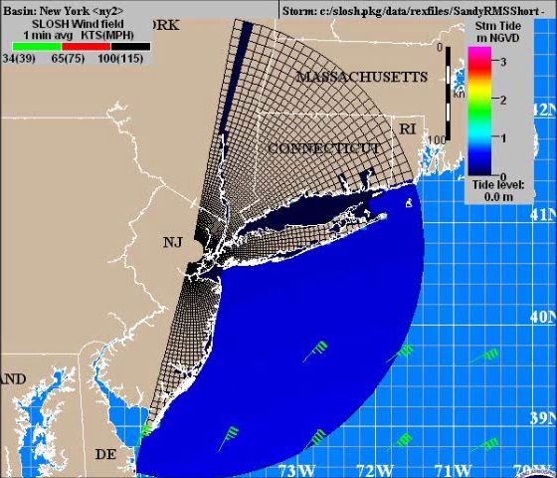
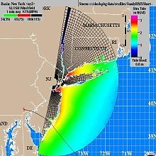
SLOSH model results of the 1821 storm
Hurricane Sandy inundation is longer, its forward velocity is slower, and its maximum wind speeds are lower
May lead to differences in the sediment deposits
1821 storm
Hurricane Sandy
Radius of Max. wind: 40 km (25 mi)
Max. wind speed: ~210 km/hr (130 mph)
Radius of Max. wind: 160-200 km (100-130 mi)
Max. wind speed: ~130 km/hr (80 mph)
Notes:
The 1821 storm was smaller (smaller radius of maximum winds), had a faster forward velocity, and had a higher wind speed at landfall than Hurricane Sandy. The inundation deposits of these two storms should reflect these differences. Also, note that the Lower Bay of New York Harbor experienced some of the largest surges from both storms (this is where our field sites are).

Slide 5
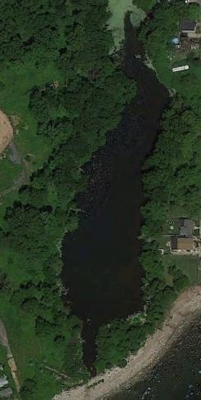
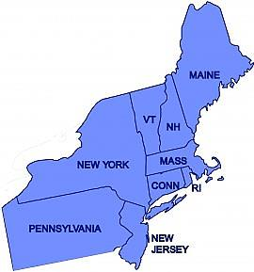
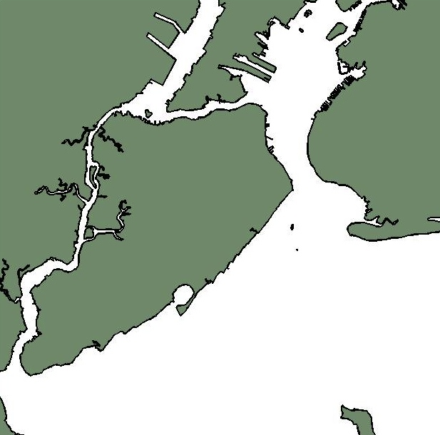
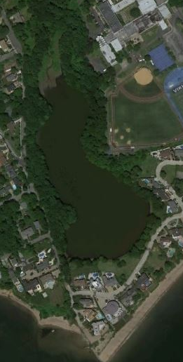
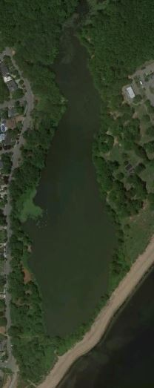
Staten Island Field Sites
Seguine
Poster 246-15 on Tuesday
New Jersey
Battery
Arbutus
Brooklyn
Staten
Island
50 m
Wolfe’s
Lower Bay
Seguine Pond
First Record from NY Harbor
50 m
Arbutus Lake
Wolfe’s Pond
10 km
50 m
Notes:
We visited 3 field sites on the southern coast of Staten Island and, as far as we know, this is the first paleotempest study from inside of New York Harbor. All three sites are coastal back-barrier ponds. This talk focuses on results from Seguine Pond, but I have a poster which presents results from the other 2 ponds.

Slide 6
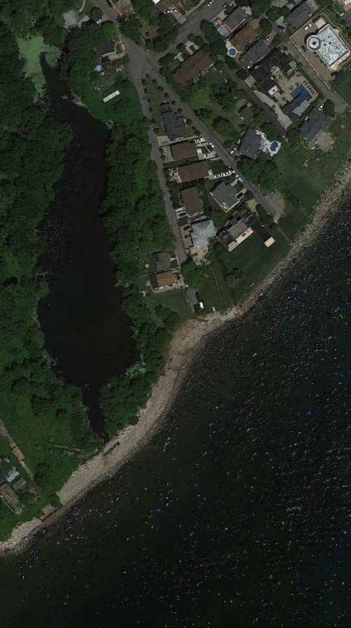
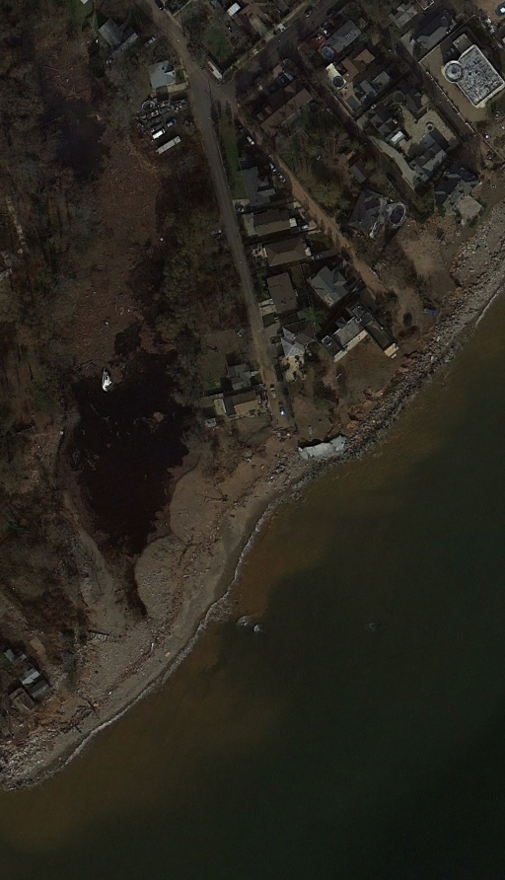
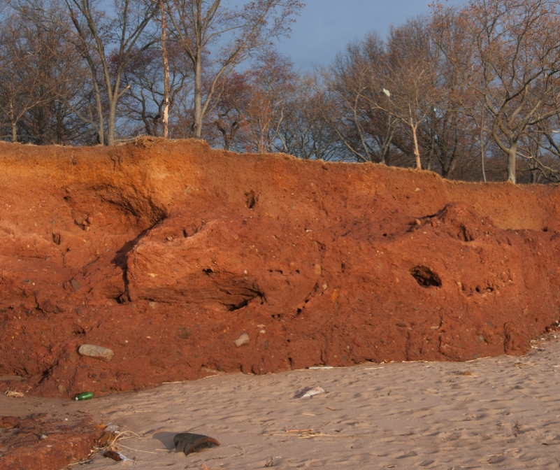
Seguine Pond and the Terminal Moraine
Before
Sandy
After
Sandy
New Jersey
Battery
Staten
Island
Brooklyn
Harbor Hill Terminal Moraine
Seguine Pond
10 km
Eroded
Cliff
Overwash
Fans
Sediment Plumes
Notes:
This is Seguine Pond from before (left) and after (right) Hurricane Sandy. Note the reddish tint in the “after” picture which comes from mobilized sediment. The sediment source is an old terminal glacial moraine deposited ~20,000 years ago. This moraine forms the barrier and stands ~3 meters high near Seguine Pond.

Slide 7
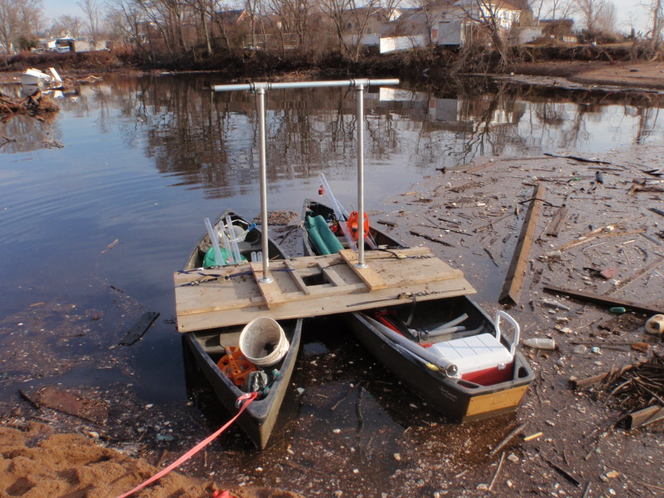
Core Collection and Processing
Collected 4 push cores including 1 multi-drive core
Radiometric dating using ¹³⁷Cs and rise in heavy metal concentration (~1850 AD)
Loss on Ignition (LOI) at 550 ᵒC to determine %coarse material
Grain size measured with a Retsch Tech Camsizer

Slide 8
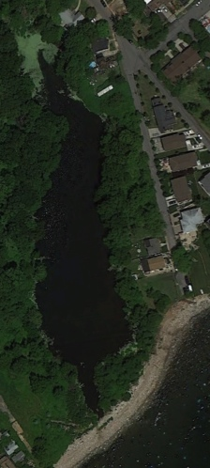
Hurricane Sandy Deposit
% coarse
D₉₀ (µm)
0
50
100
0
100
200
0
50
1963 AD
Depth (cm)
1954 AD
SG4
100
SG3
SG2
1850 AD
SG1

Slide 9
Hurricane Sandy Deposit
SG2
Median Grain Size
D₅₀ (μm)
Percent Coarse (%)
Photo
X-ray
0
25
50
75
100
63
200
0
Sandy
Sandy
50
1960?
1954 AD Cs-137 Onset
Depth (cm)
1850-1900 AD
Heavy Metal Horizon
100
1893?
1821
1821
150
1788?
> 63 μm
> 38 μm
200
Notes:
The inundation layer left by Hurricane Sandy is easily identifiable at the top of the core as a red layer (photo). The X-ray image shows density differences with white layers being denser than the surrounding material. These dense layers most likely correspond to other inundation layers. The Hurricane Sandy layer is composed of mostly coarse (grain size > 63 µm), inorganic material. The median grain size is ~100 µm or fine sand. The %coarse and median grain size for other dense layers in the core was examined and one was found that was more coarse than Hurrcane Sandy’s layer. We used ¹³⁷Cs (onset = 1954; peak = 1963) and the onset of heavy metals like Zn (1850 AD) to discover that this layer was emplaced before 1850. We think it most likely corresponds to the 1821 storm.

Slide 10
Transect of Hurricane Sandy and 1821 Deposits
Zn (XRF int)
Zn (XRF int)
Zn (XRF int)
Zn (XRF int)
0
2000
X-ray
X-ray
X-ray
X-ray
0
2000
0
2000
0
2000
0
Sandy
50
100
1821
Depth (cm)
150
Core SG1
Core SG2
Core SG3
Core SG4
200
250
Landward
SG4
SG3
300
SG2
SG1
Notes:
The Hurricane Sandy layer is easily identifiable in all 4 cores. We used the onset of Zn in the cores to help us identify the 1821 deposit, which we also found in all 4 cores.

Slide 11
Thickness of Hurricane Sandy and 1821 Storm Deposits
20
Landward
15
SG4
SG3
Thickness (cm)
SG2
10
SG1
5
SG1
SG2
SG3
SG4
Core location
Hurricane Sandy deposit thicker, consistent with longer inundation period
Notes:
The Hurricane Sandy deposit is thicker than the 1821 deposit in all 4 cores. We think this corresponds to Hurricane Sandy’s longer inundation period (more time to deposit sediment in the pond).

Slide 12
D₉₀ of Hurricane Sandy and 1821 Storm Deposits
Landward
0.5
Sandy
1821
1821
1821
0.4
1821
SG4
0.3
SG3
Grain size (cm)
SG2
Sandy
Sandy
Sandy
SG1
0.2
0.1
0
SG1
SG2
SG3
SG4
Core location
1821 storm has much larger D₉₀ grain size in 3 out of 4 cores, consistent with larger bottom shear stress (faster inundation)
Notes:
In 3 of the 4 cores, the 1821 storm has a larger maximum grain size. We think this corresponds to a faster inundation period and a larger storm surge. The Hurricane Sandy deposit probably had a larger grain size in core SG1 because this core was taken very close to the overwash fan and therefore may have included some bedload-transported sediment.

Slide 13
Summarize
1) the maximum grain size of the 1821 inundation deposit is larger than that of Hurricane Sandy’s deposit, suggesting that it was produced by a larger storm surge
2) SLOSH modeling results are consistent with Redfield’s reported change in water level
Landward
0.5
Sandy
1821
1821
1821
0.4
1821
0.3
Grain size (cm)
Sandy
Sandy
Sandy
0.2
0.1
0
SG1
SG2
SG3
SG4
Core location

Slide 14
Sandy not really unique
4
2012
3.5
1821
1788
1893
3
2.5
2
Elevation relative to MSL (m)
1.5
1
0.5
0
Long-Term
Sea-Level
Trend at Battery
(2.7 mm/y)
NOAA, 2013
-0.5
1800
1820
1840
1860
1880
1900
1920
1940
1960
1980
2000
1788, 1821 and 1893 water levels based on historical reconstructions by Scileppi and Donnelly, 2007
Notes:
If we take today’s sea-level rise rate (~2.7 mm/yr) and extend it into the past, then we see that the 1821 storm took place when the sea-level was ~0.5 meter lower than today. Including this in our calculation, we see that the 1821 storm produced a ~4 meter surge (relative to today’s MSL), the 1788 produced ~3.6 meter surge (about the same as Hurricane Sandy), and the 1893 produced a ~3.4 meter surge. Therefore, Sandy is not really unique when compared with these older storms.

Slide 15
Seguine Pond Cores
Zn (XRF int)
Zn (XRF int)
Zn (XRF int)
Zn (XRF int)
Photo
X-ray
0
2000
Photo
X-ray
0
2000
Photo
X-ray
0
2000
Photo
X-ray
0
2000
0
Sandy Deposit
50
100
1821?
Core SG3
Depth (cm)
150
Core SG1
Core SG4
200
250
300
Zn
Cs
Hg
SG4
SG3
SG2
SG1

Slide 16
Other inundation deposits compared with Hurricane Sandy
SG2
0
processed
20
raw
40
60
80
Depth (cm)
100
120
140
160
180
200
0
0.1
0.2
0.3
0.4
0.5
D90 (mm)

