Slide 1


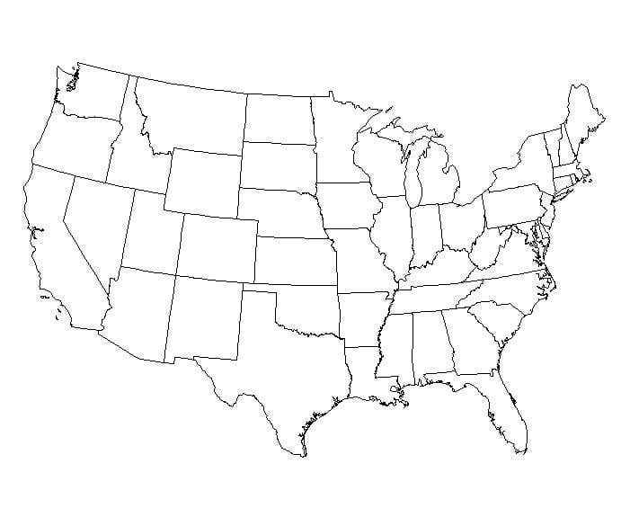
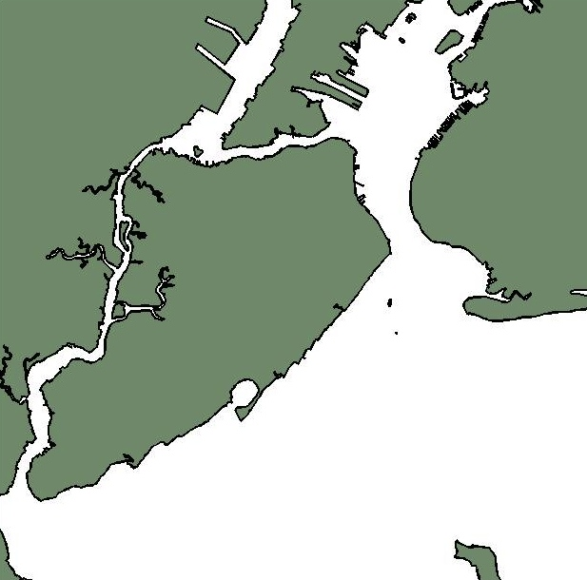
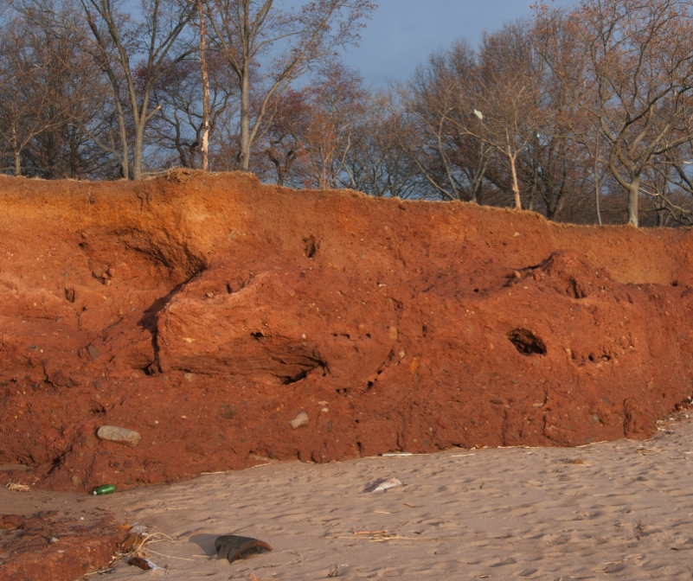

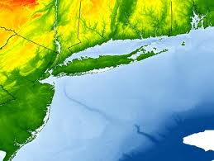

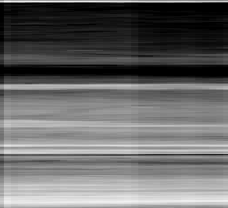

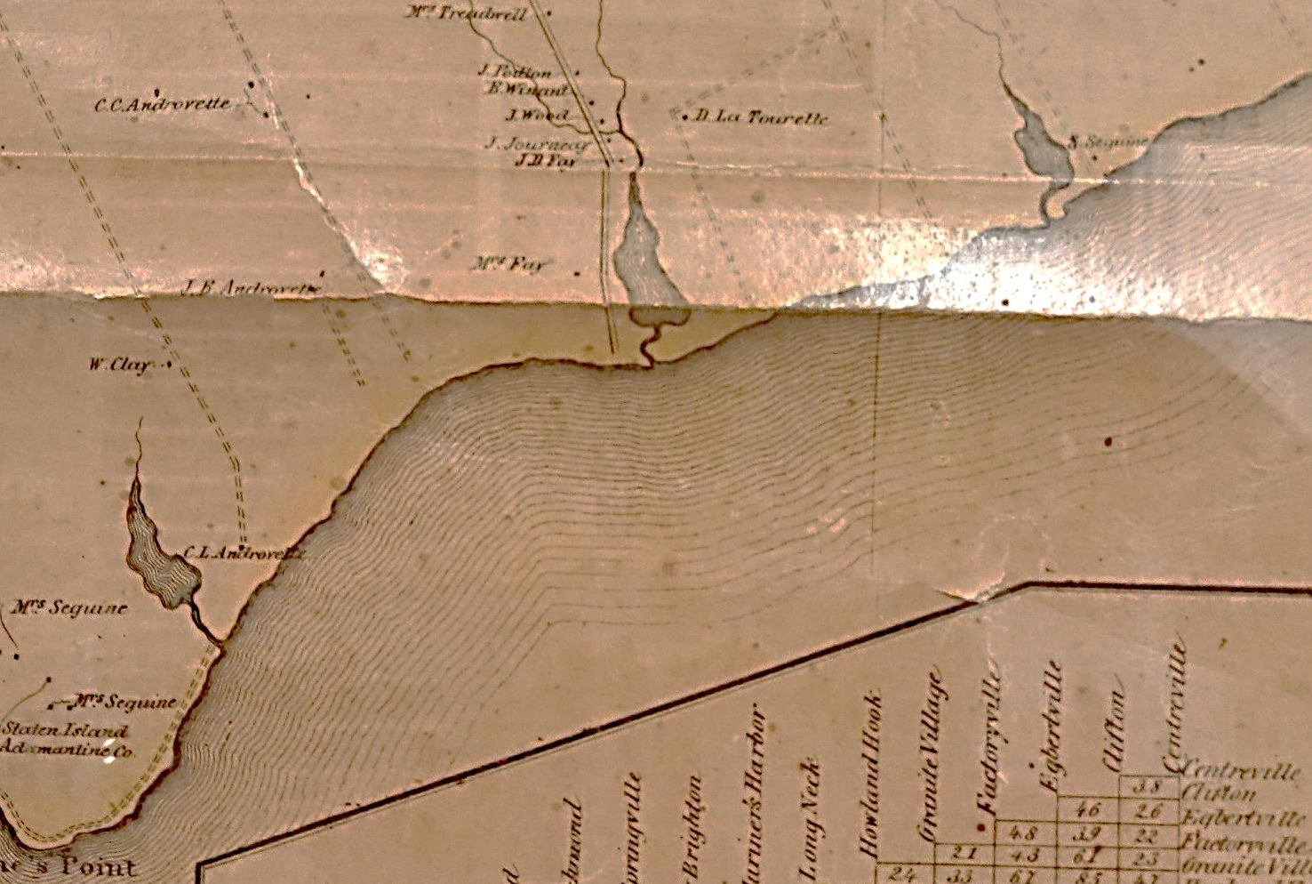



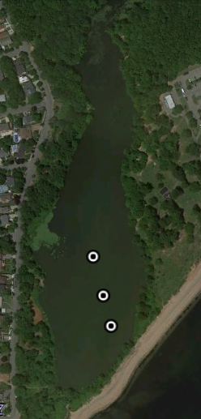
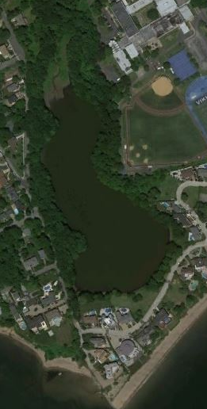
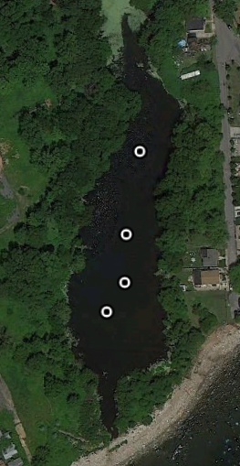
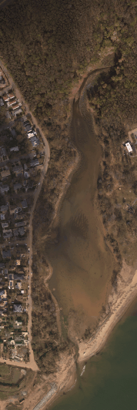
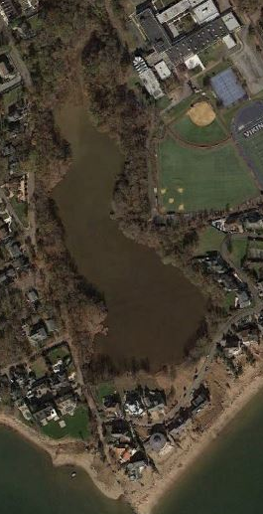
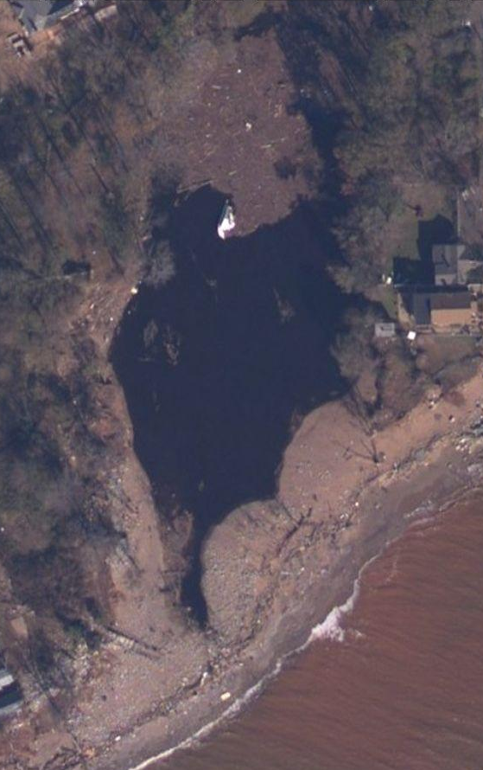
Using inundation deposits to constrain the storm surge heights of storms that affected New York City, NY:
How does Hurricane Sandy compare?
Christine M. Brandon, University of Massachusetts Amherst Email: cbrandon@geo.umass.edu
Jonathan D. Woodruff, University of Massachusetts Amherst Email: woodruff@geo.umass.edu
Jeffery P. Donnelly, Woods Hole Oceanographic Institution Email: jdonnelly@whoi.edu
#246-15
Regional Setting
Main Points
Contaminants
Several deposits have a maximum grain size larger than Hurricane Sandy’s deposit, suggesting that they were created by larger storm surges.
Sea-level rise is one cause of Sandy’s very high water levels relative to these older storms.
Inundation deposits show lower concentrations of heavy metals than the background sediment, suggesting that storms can sequester contaminated sediments.
WP2
Photo
WP2
X-ray
Zn (XRF int.)
0
Pb (XRF int.)
Hg (ppb)
New Jersey
Battery
0
0
1000
2000
200
400
600
0
200
400
600
Low
Staten
Island
Brooklyn
10
Hur.
Sandy
Deposit
Harbor Hill Terminal Moraine
High
NY
CT
Seguine Pond
20
NJ
Atlantic Ocean
Wolfe’s Pond
Arbutus Lake
10 km
Depth (cm)
?
100 km
Radiometric dating
30
Top left: The field area is located in the U.S. Northeast. Bottom left: Sites are located on Staten Island’s southern coast (red box). Right: Location of Wolfe’s Pond, Seguine Pond, and Arbutus Lake.
The Harbor Hill moraine on Staten Island’s southern coast, deposited during the Last Glacial Maximum (~20,500-18,000 years ago).
Background
Wolfe’s Pond
Seguine Pond
Arbutus Lake
40
WP2
Photo
WP2
X-ray
SG2
Photo
SG2
X-ray
AL4
Photo
AL4
X-ray
AL3
Photo
AL3
X-ray
Zn (XRF int.)
¹³⁷Cs (Bq/g)
0
WP2
Photo
WP2
X-ray
Zn (XRF int.)
¹³⁷Cs (Bq/g)
0
SG2
Photo
SG2
X-ray
Zn (XRF int.)
¹³⁷Cs (Bq/g)
0
0
0
2000
0
0.04
0.08
50
50
0
0
1000
2000
0
0.02
0.04
50
0
0
2000
0
0.02
10
Hur.
Sandy
Deposit
The presence of three industrially derived metals (zinc, lead, and mercury) in Core WP2. The concentrations are much lower in the Hurricane Sandy inundation layer and “cap” more contaminated fine-grained sediments below.
100
Depth (cm)
150
Hur.
Sandy
Deposit
100
Hur.
Sandy
Deposit
100
Geomorphic Change of the Ponds
200
10
150
20
1963 AD
200
200
1859
20
50
Depth (cm)
Depth (cm)
250
Core gap
Core gap
1963 AD
30
The Effect of Sea Level Rise
Depth (cm)
Depth (cm)
300
30
1954 AD
300
Depth (cm)
Seguine Pond
350
Erosional horizons?
100
40
1954 AD
4
2012
Arbutus Lake
400
40
1850 AD
400
50
3.5
1788
1821
1893
Maximum Yearly Water Levels at the Battery , NYC
450
1821 storm
A core from Arbutus Lake showing several inundation deposits (green arrows). The black arrows denote particularly thick deposits.
3
50
500
2.5
A core from Wolfe’s Pond showing a truncated historic record, possibly by erosion from inundation events. The Hurricane Sandy deposit has a red color, indicative of glacial fines.
A core from Seguine Pond showing several inundation deposits (green arrows). The Sandy deposit is again distinguished by a red color.
Elevation relative to MSL (m)
Wolfe’s Pond
1 km
2
600
1.5
An 1859 map of the three ponds. Note that all of the ponds had inlets to Raritan Bay.
1
0.5
Wolfe’s Pond
Arbutus Lake
Seguine Pond
Lateral Trends in the Hurricane Sandy deposit
Hurricane Sandy and other Coarse Deposits
0
1800
1820
1840
1860
1880
1900
1920
1940
1960
1980
2000
Year (AD)
Percent Coarse (%)
Median Grain Size
D₅₀ (μm)
Maximum Grain Size
D₉₀ (μm)
Hurricane Sandy produced the largest recorded water level by far (records from tide gauge at the Battery, New York City beginning in 1920). However, three reconstructed water levels show that past hurricanes may have produced similar or larger water levels than Hurricane Sandy.
Core SG1
Core SG2
Core SG3
Core SG4
SG2
Photo
SG2
X-ray
Percent Coarse (%)
63
200
0
100
200
300
400
500
0
0
25
50
75
100
0
25
50
75
100
0
25
50
75
100
0
25
50
75
100
0
0
25
50
75
100
Sandy
Sandy
SG4
Sandy
AL6
SG3
5
> 63 μm
> 38 μm
50
1960?
4
2010
WP3
AL4
SG2
1954 AD Cs-137 Onset
3.5
2012
AL2
10
1821
WP2
SG1
Depth (cm)
Depth (cm)
1850-1900 AD
Heavy Metal Horizon
3
1788
1893
WP1
15
100
1893?
1821?
1821?
2.5
2
50 m
50 m
50 m
Elevation relative to MSL (m)
Long-Term
Sea-Level
Trend at Battery
(2.7 mm/y)
NOAA, 2013
20
150
1788?
1.5
Median (D50) grain size
> 63 μm
1
> 30 μm
0.5
The percentage of coarse, clastic material (grain size > 63 µm) in the Hurricane Sandy deposit in the four cores collected from Seguine Pond (November 2012). The deposit decreases in both thickness and %coarse with increasing distance from the coast. Also shown is the percentage of material > 38 µm (gray areas) which exhibits the opposite trend as the coarse material.
200
0
Hurricane Sandy deposit compared with other historic inundation deposits. This deposit had the second largest median (D₅₀) grain size after the 1821 hurricane deposit, but among the smallest D₉₀ grain size.
-0.5
1800
1820
1840
1860
1880
1900
1920
1940
1960
1980
2000
2012
After accounting for ~2.7 mm of sea level rise per year (NOAA, 2013) Hurricane Sandy’s storm surge is just as large or slightly smaller than the surges produced by storms in 1788, 1821, and 1893.
Inlet opened by Irene
References
NOAA Tides and Currents (2013), available from http://tidesandcurrents.noaa.gov/sltrends/sltrends_station.shtml?stnid=8518750
Scileppi, E. and J. P. Donnelly (2007), Sedimentary evidence of hurricane strikes in western Long Island, New York, Geochemistry Geophysics Geosystems, 8, Q06011.
Walling, H.F. (1859), Staten Island, Richmond County, New York
Abstract
Overwash fan
The importance of extreme events in shaping ecosystems and governing sediment transport is in part determined by how often these events occur. By their very nature these events are rare, making it difficult to accurately assess their return frequency. On October 29, 2012 Hurricane Sandy inundated New York City, NY, raising water levels to 3.5 m above mean sea level at the Battery (located at the south end of lower Manhattan). Historical records indicate that this is the highest measured water level since records began at this location in the mid-1700s and simulated hurricane climatology ranks this storm as a 1-in-1000 year event. However, tide gauge data alone is generally too short to either obtain meaningful extreme value statistics, or evaluate the skill of flood probabilities derived solely from numerical simulations. Thus there is a real need for longer flood reconstructions of the New York City region. Further, questions remain with respect to whether extreme events like Sandy serve to mobilize contaminants (e.g. lead, mercury) within the harbor or cover these sediments with more pristine glacial material eroded from the surrounding landscape.
Sediment cores were taken from Seguine and Wolfe’s Ponds (back-barrier ponds) located on Staten Island’s southern coast, about one month after Hurricane Sandy impacted the area. Additional cores were taken from Arbutus Lake in September 2013. The cores contain several coarse grained deposits most likely associated with storm surge inundation of the ponds, including a surficial deposit associated with Hurricane Sandy’s surge. Age constraints on the inundation deposits are developed by using the Cs-137 radiometric dating method and the onset of industrially derived heavy metals. The grain size distribution is measured for the event deposits to help constrain flow conditions required for erosion and transport of sediment.
We find that 1) several deposits have a maximum grain size larger than Hurricane Sandy’s deposit, suggesting that they were created by larger storm surges, 2) sea-level rise is one cause of Sandy’s very high water levels relative to these older storms, and 3) inundation deposits show lower concentrations of heavy metals than the background sediment, suggesting that storms can sequester contaminated sediments.
Top: The field sites as they appeared in 2010. Bottom: The sites after Hurricane Sandy’s landfall (images taken on Nov. 3, 2012). Note the new overwash fans at Seguine Pond and the inlet in Wolfe’s Pond.
Notes:
Resize grain size section to compare between the Seguine and Arbutus cores
Reduce modeling section: show SLOSH and advective-settling
Add section comparing heavy metal contaminants in storm layers vs non-storm layers 32.78 29.25

