Slide 1
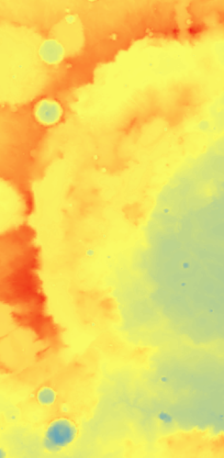
Mineralogical Mapping of Huygens Crater, Mars
Sheridan Ackiss
Kim Seelos
Debra Buczkowski
Johns Hopkins University Applied Physics Lab
Special thanks to the MDAP and ORISE programs and the CRISM Team for support.
GSA – Monday, October 28, 2013 Sheridan Ackiss - Mineralogical Mapping of Huygens Crater, Mars 1

Slide 2
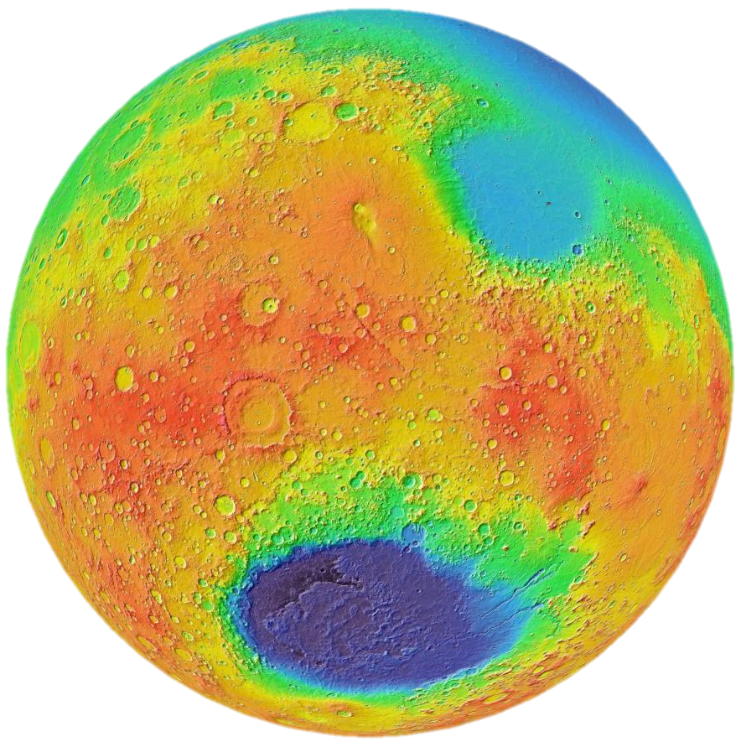
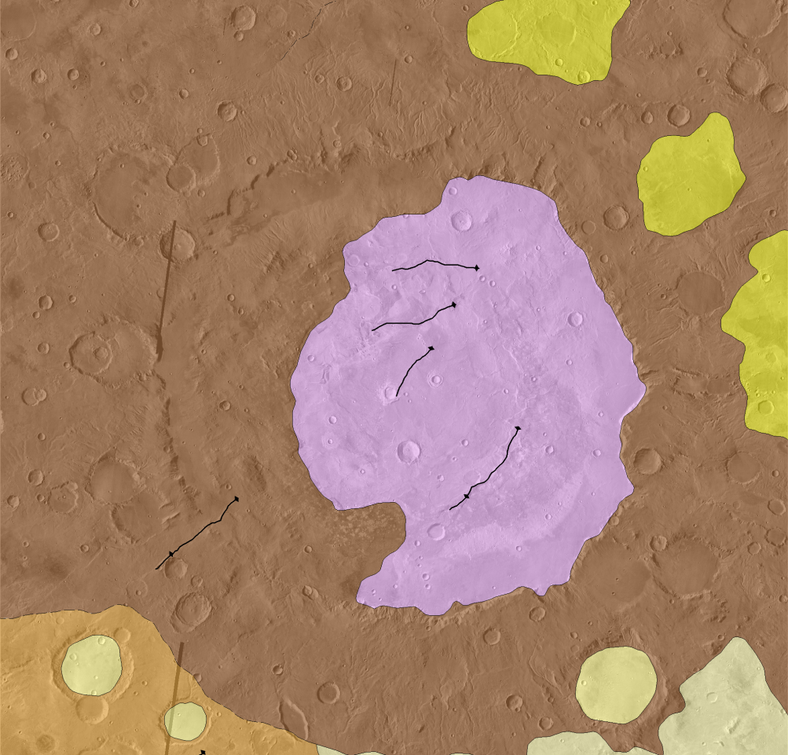
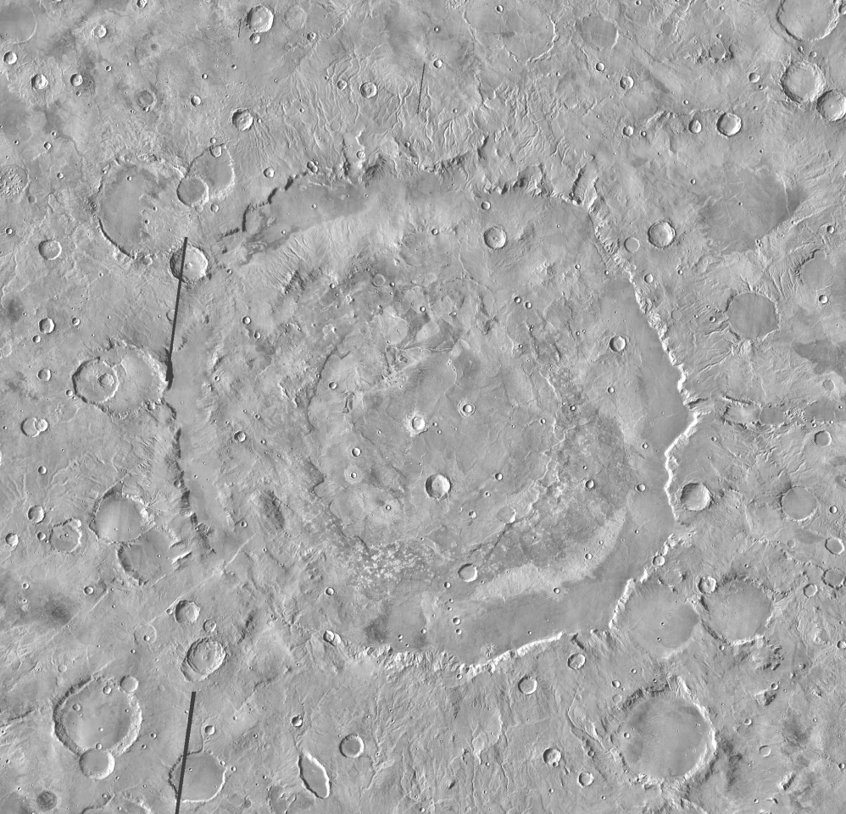
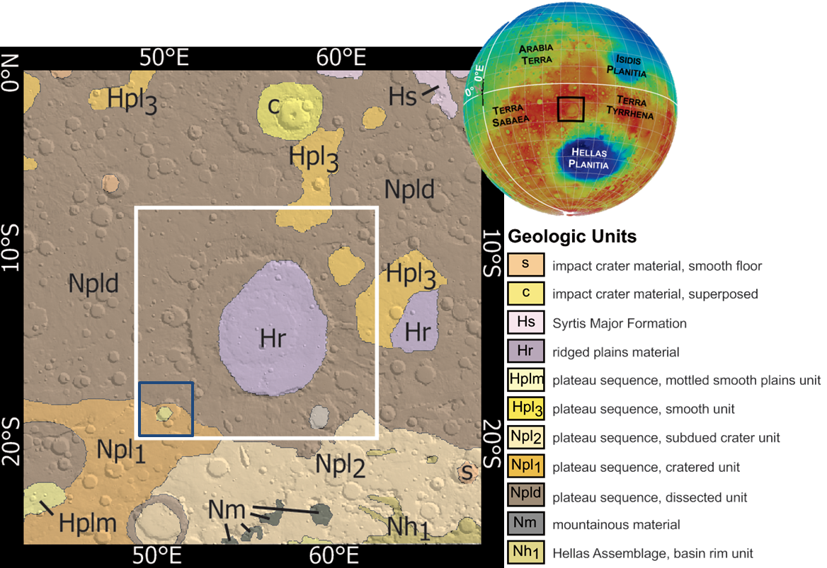
Global and Regional Context
Hpl3
Npld
Hr
Npl2
Npl1
THEMIS daytime IR Mosaic
Plateau sequence,
Cratered unit
Plateau sequence,
Subdued cratered unit
Google Mars oriented North
200 km
6 km
-6 km
Greeley and Guest, 1987 Map
Plateau sequence,
Dissected unit
Plateau sequence,
Smooth unit
Ridged Plains Material
GSA – Monday, October 28, 2013 Sheridan Ackiss - Mineralogical Mapping of Huygens Crater, Mars 2
Notes:
Huygens is a ~490km diameter peak ring crater.
It is a unique transect of the cratered highlands in the Hellas rim region, and is in fact transected by circumferential ring graben.
Hellas is the largest impact basin on Mars and extends 2300 km from east to west (that’s roughly the length of the US from North Dakota to the tip of Texas)
The crater is largely included with Noachian dissected terrain and has superposed Hesperian-aged terrains.
Add that this is the global geomorphic map by Greeley and Guest in 1987 (N denotes Noachian and H denotes Hesperian)

Slide 3
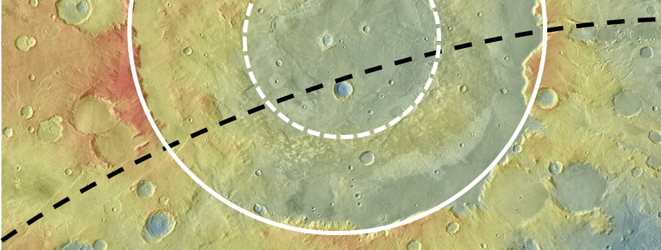
Intent
Better understand the stratigraphy of the region by:
  Determining the distribution of surface mineralogy in/around Huygens
  Using the mineralogy to help understand the history of the highlands crust and relationship or influence of Hellas
MOLA and THEMIS data showing peak ring (white dashed line),
crater ring (white line), and Hellas ring graben (black line).
GSA – Monday, October 28, 2013 Sheridan Ackiss - Mineralogical Mapping of Huygens Crater, Mars 3

Slide 4
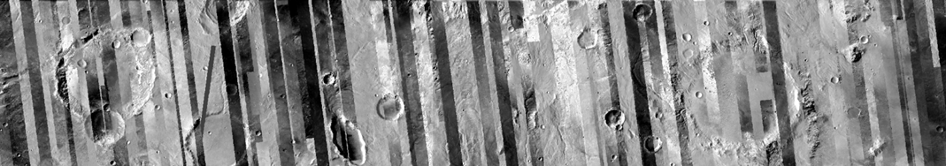
Methodolgy
CRISM is an imaging spectrometer on the Mars Reconnaissance Orbiter covering the 0.36-3.92 μm wavelength range (visible and infrared wavelengths).
We used CRISM multispectral map tiles to map regional geology (72 wavelengths at 200 m/pix data).
Targeted hyperspectral data was used to understand detailed mineralogy and relationships to morphology (544 wavelengths at 18 m/pix data).
CRISM 1300 nm albedo mapping data over THEMIS Daytime IR map showing the south portion of our study region.
GSA – Monday, October 28, 2013 Sheridan Ackiss - Mineralogical Mapping of Huygens Crater, Mars 4

Slide 5
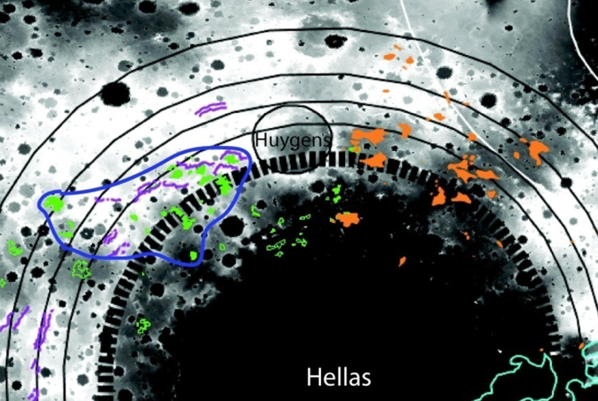
findings
Intra- and inter-crater plains showing high thermal inertia correspond to mafic materials.
Excavated phyllosilicates relating to the cratering process.
Massifs corresponding to low-calcium pyroxene found circumferentially inside the Hellas ring graben.
“Bedrock” olivine-bearing intercrater plains from Rogers and Nazarian, 2013
GSA – Monday, October 28, 2013 Sheridan Ackiss - Mineralogical Mapping of Huygens Crater, Mars 5

Slide 6
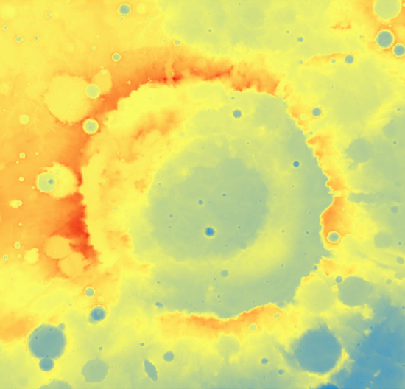
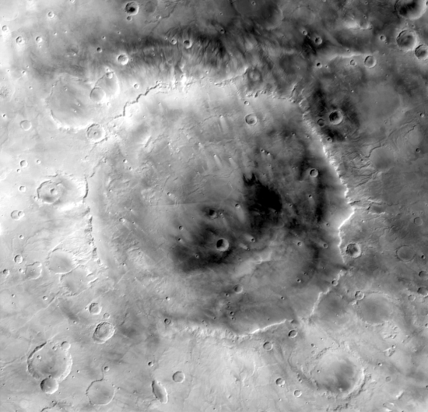
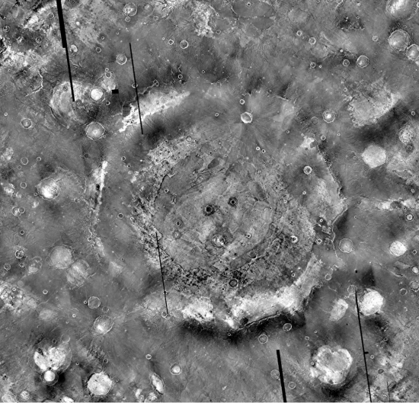
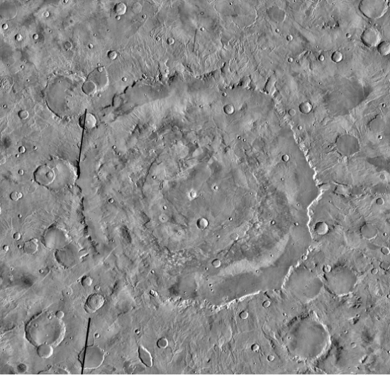
basemaps
MOLA
topography
MOC Wide angle
visible albedo
THEMIS
Nighttime IR
THEMIS
Daytime IR
GSA – Monday, October 28, 2013 Sheridan Ackiss - Mineralogical Mapping of Huygens Crater, Mars 6
Notes:
4 global datasets for the study
-Use primarily to show dustier regions
-Bright regions are warmer at night meaning theyre rockier and retain heat better at night… thermal inertia properties… consistant with bedrock based on thermal inertia
-Opposite is true for the daytime.
Play with this… looks weird
Look up MOC to see what the word is… not albedo… MOC WA mosaic description

Slide 7
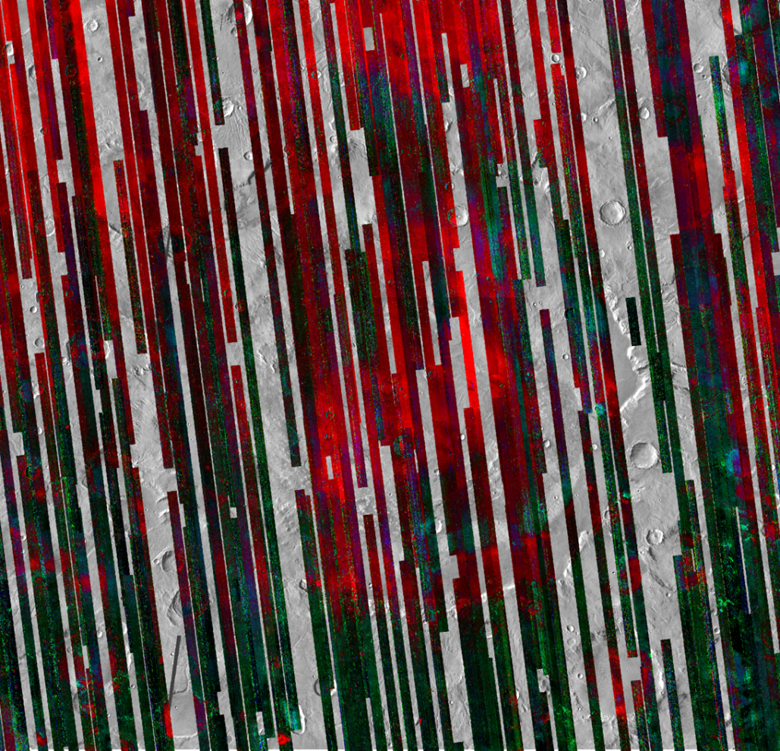
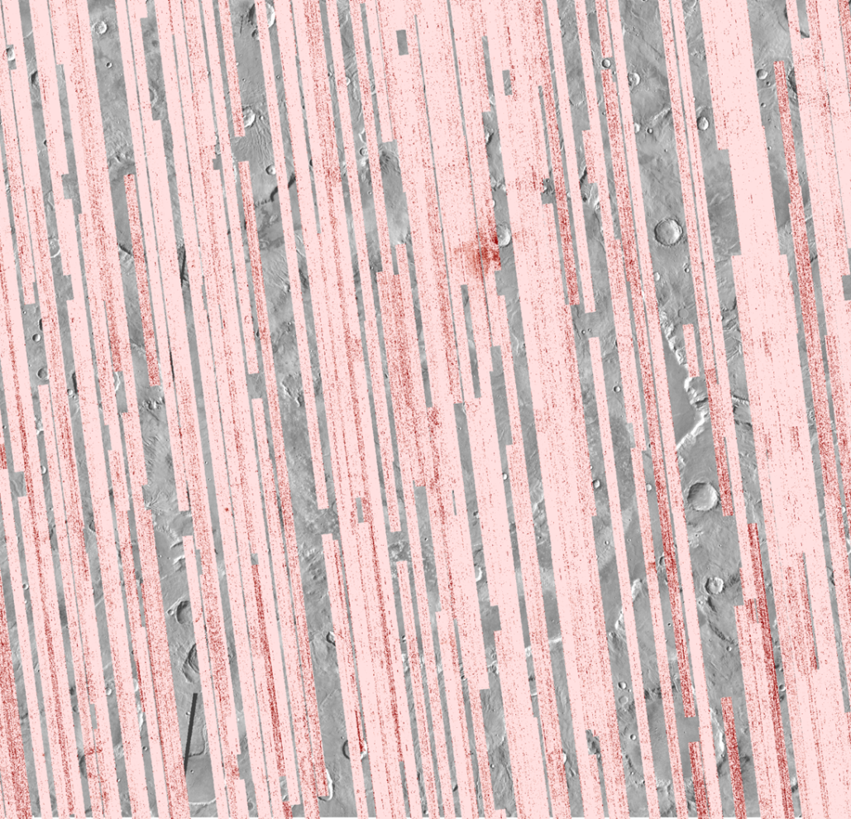
CRISM DATA
CRISM MAF Browse Product
CRISM D2300 Parameter Map
200 km
200 km
0 % - OLINDEX2 – 10 %
(olivine)
0 % - LCPINDEX – 10 %
(low-calcium
pyroxene)
0 % - HCPINDEX – 10 %
(high-calcium pyroxene)
0 % - D2300 – 10 %
(denotes the 2300 nm absorption band; partial to Fe/Mg phyllosilicates)
GSA – Monday, October 28, 2013 Sheridan Ackiss - Mineralogical Mapping of Huygens Crater, Mars 7
Notes:
-primary mapping sets
-type location later will be examples of hyperspectral data

Slide 8
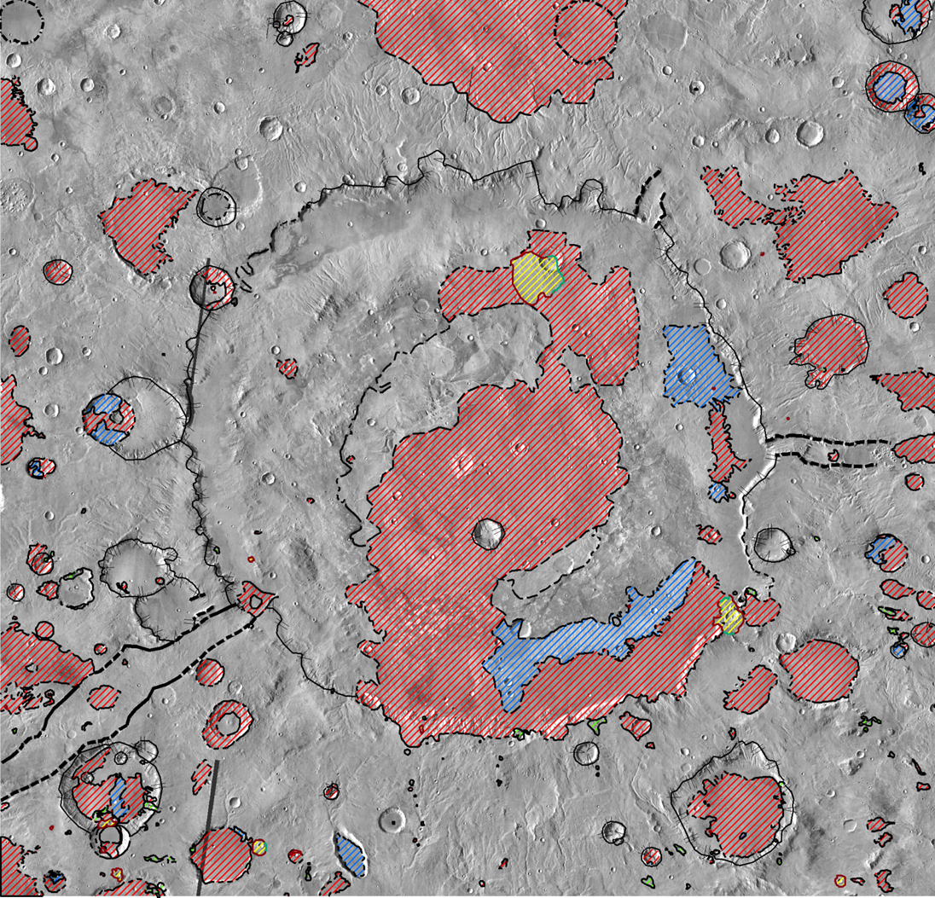
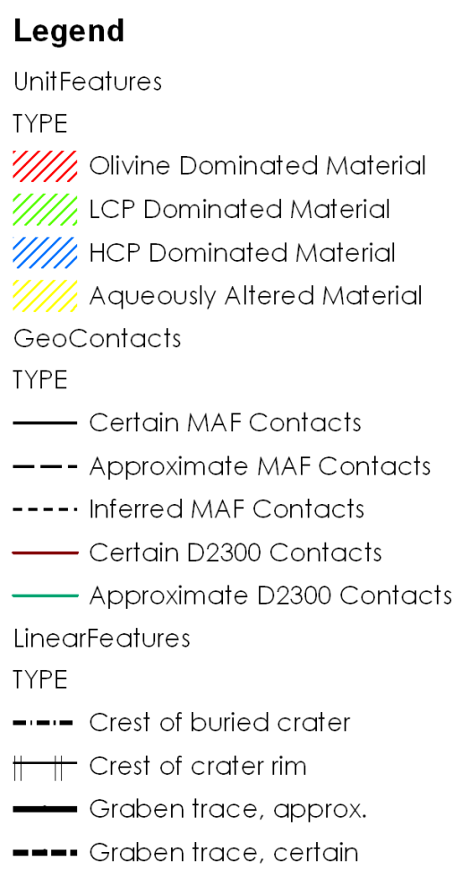
200 km
Finalized
map
Aqueously Altered Material
Mapped at the 1:1,000,000 scale
Map Legend:
High-Calcium Pyroxene Dominated
Low-Calcium Pyroxene Dominated
Olivine Dominated
GSA – Monday, October 28, 2013 Sheridan Ackiss - Mineralogical Mapping of Huygens Crater, Mars 8

Slide 9
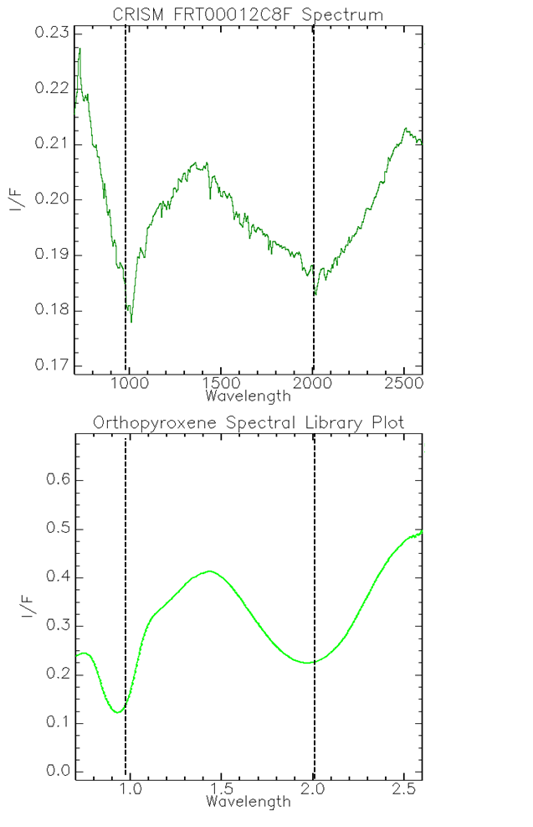
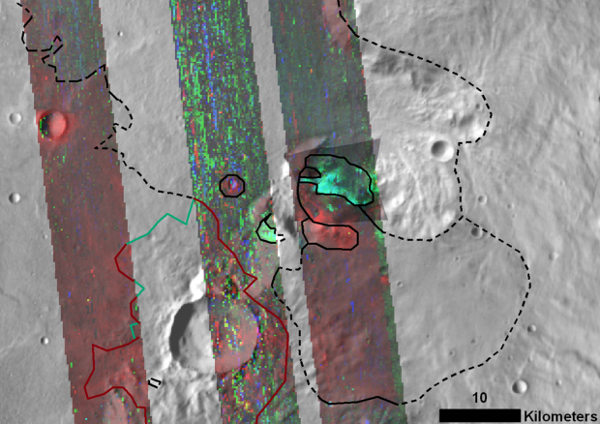
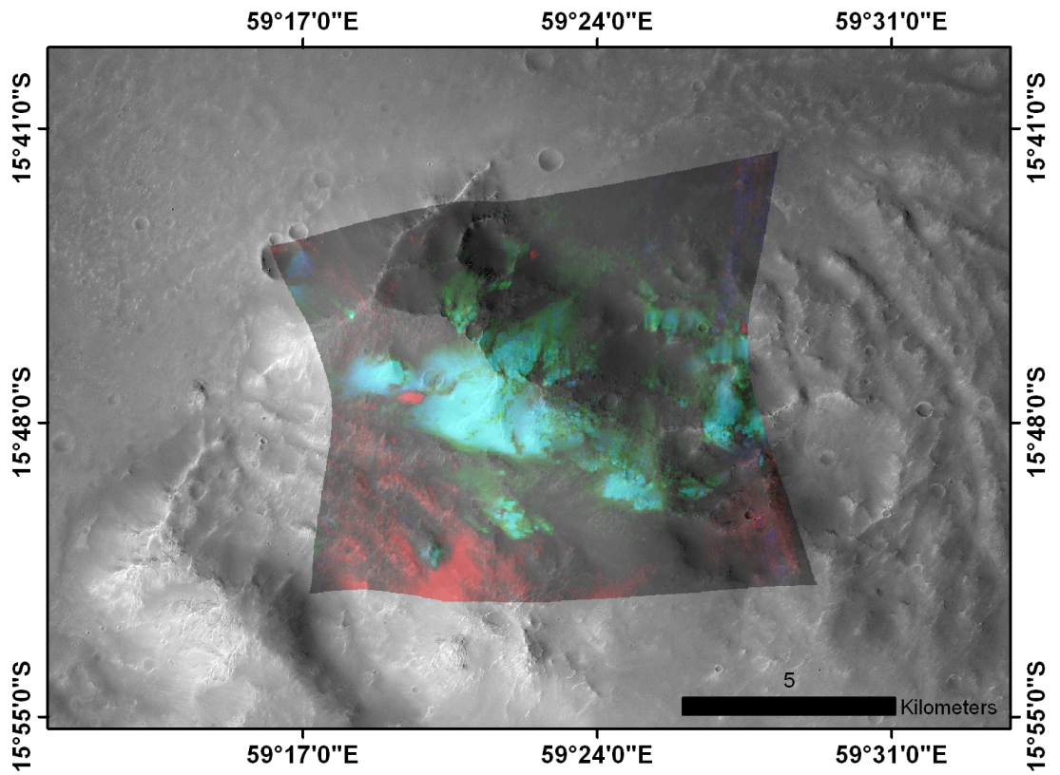
Low- calcium pyroxene dominated unit
Distinct, massif-forming outcrops.
FRT00012C8F (R: olivine; G: low-calcium pyroxene; B: high-calcium pyroxene)
over CTX image 07_003957_1658_xn_14S300W.
Absorptions show iron in the crystalline structure.
GSA – Monday, October 28, 2013 Sheridan Ackiss - Mineralogical Mapping of Huygens Crater, Mars 9
Notes:
-The spectrum is shifted because this is not a pure exposure of LCP.

Slide 10
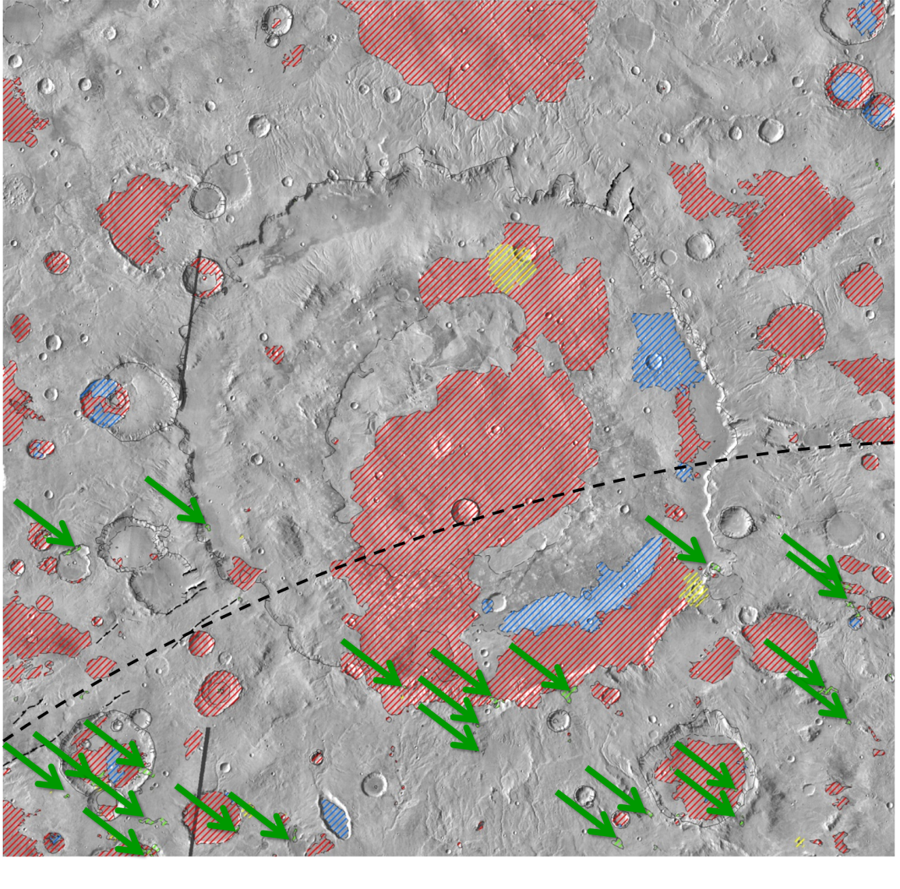
Low- calcium pyroxene dominated unit
Concentrated inside the Hellas ring structure implying that
200 km
low-calcium pyroxene (LCP) is associated with older, uplifted crust.
This is also consistent with findings from Buczkowski et al., 2007 where LCP-rich knobs are seen circumferentially inside the Argyre basin ring.
Key
LCP
Outcrops
You Are
Here
GSA – Monday, October 28, 2013 Sheridan Ackiss - Mineralogical Mapping of Huygens Crater, Mars 10

Slide 11
200 km
Aqueously Altered Material
High-Calcium Pyroxene Dominated
Low-Calcium Pyroxene Dominated
Olivine Dominated
GSA – Monday, October 28, 2013 Sheridan Ackiss - Mineralogical Mapping of Huygens Crater, Mars 11

Slide 12
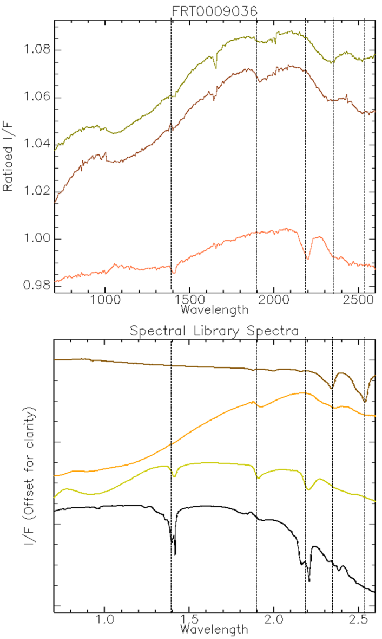
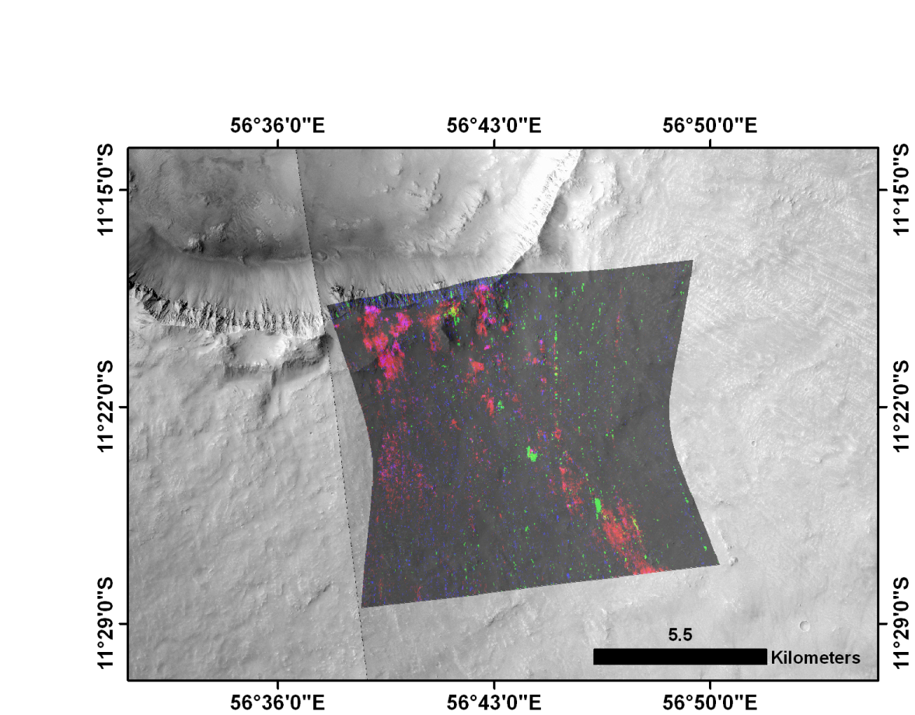
Aqueously altered unit
Exposed by impacts – crater rims, walls, and ejecta.
Variation includes Fe/Mg smectities, Al-bearing, and perhaps hydrated carbonates.
FRT0009036 (R: D2300 – hydrated minerals; G: BD2210 – Al-OH minerals; B: BD1900 - hydration)
over CTX image P12_005724_1678_xi_12S303W.
Calcite
Chamosite
Montmorillonite
Kaolinite
GSA – Monday, October 28, 2013 Sheridan Ackiss - Mineralogical Mapping of Huygens Crater, Mars 12
Notes:
EXPLAIN SPECTRAL ABSORPTIONS AT EACH LOCATION.
1.4 (hydration), 1.9 (hydration), 2.2 (Al-bearing), 2.35 (Fe/Mg bearing), 2.5 (potential carbonate factor – the combination of 2.3 and 2.5)
-Chamosite is a phyllosilicate mineral

Slide 13
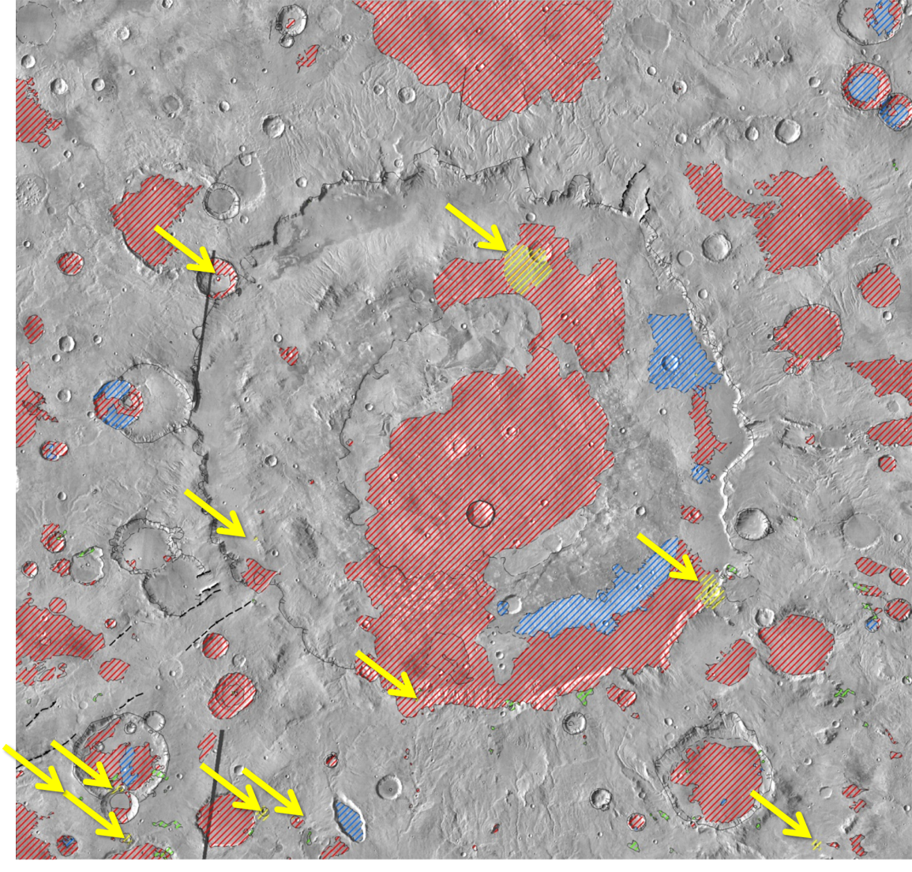
Aqueously altered unit
Found both inside and outside of Huygens associated with
200 km
impact-excavated materials consistent with other highlands phyllosilicate outcrops (Loizeau et al., 2012) that appear to originate from a variety of crustal depths.
May be spatial and compositional mixtures between one or more mineral phases.
Key
Aqueously Altered
Mineral Outcrops
You Are
Here
GSA – Monday, October 28, 2013 Sheridan Ackiss - Mineralogical Mapping of Huygens Crater, Mars 13

Slide 14
200 km
Aqueously Altered Material
High-Calcium Pyroxene Dominated
Low-Calcium Pyroxene Dominated
Olivine Dominated
GSA – Monday, October 28, 2013 Sheridan Ackiss - Mineralogical Mapping of Huygens Crater, Mars 14

Slide 15
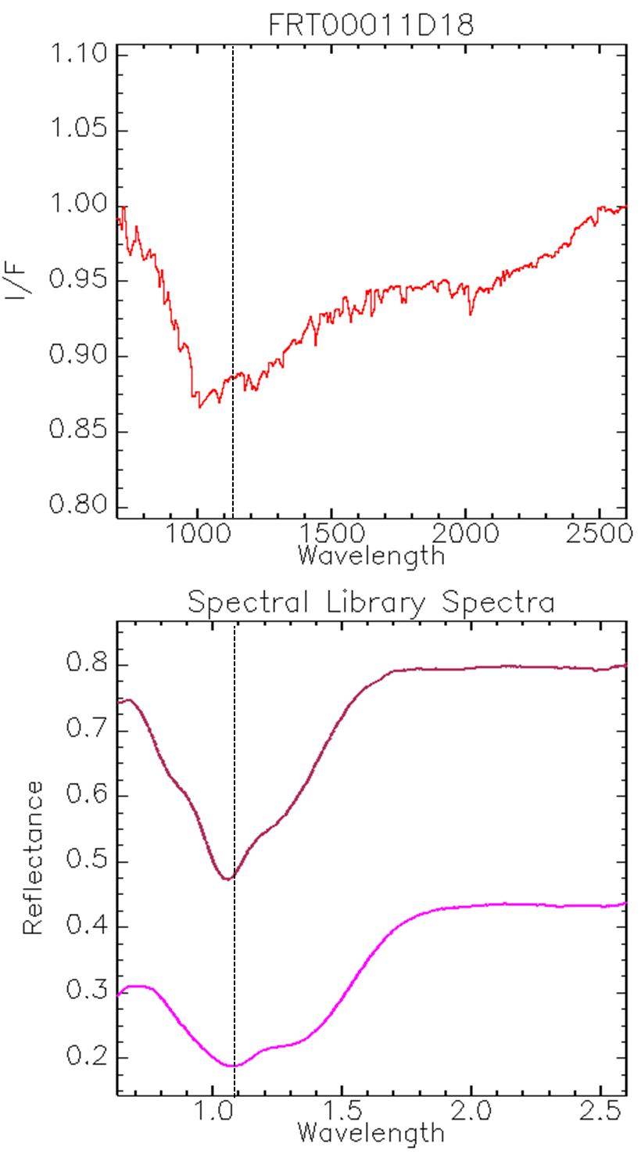
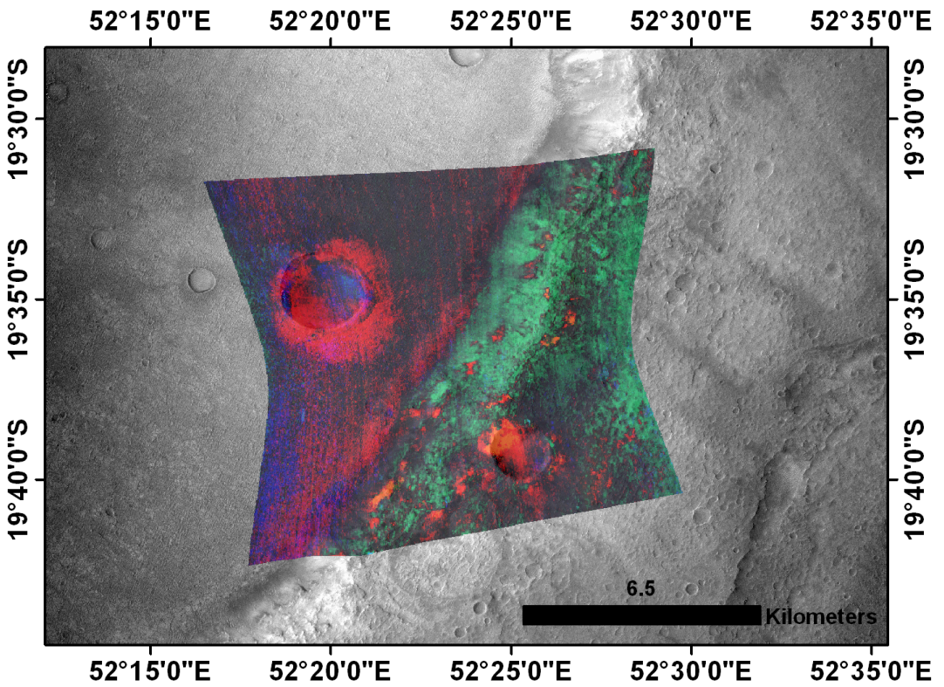
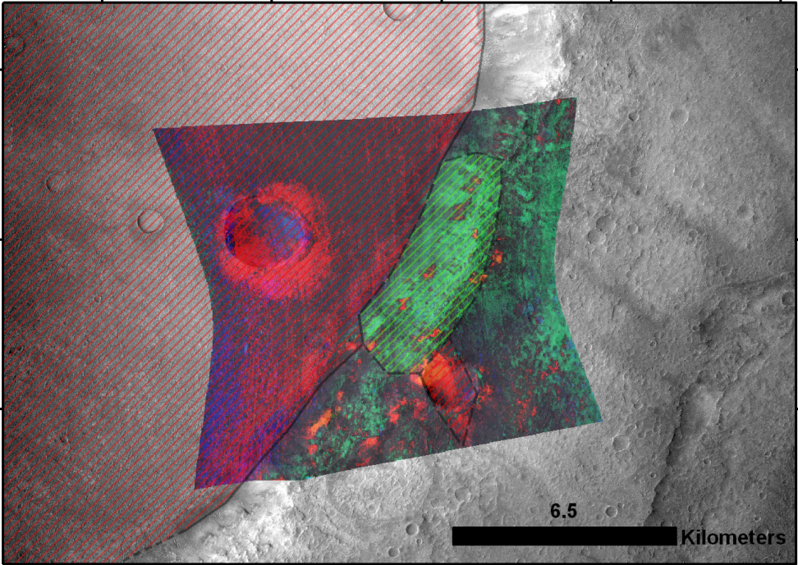
Olivine dominated unit
Associated with lower, flat-lying plains.
Forms much of Huygens floor and other small craters.
Olivine is the dominant material, although pyroxene is also present (gradational with High-Calcium Pyroxene Dominated Unit).
Correspond to two units of Greeley and Guest, 1987: superposed impact crater material (c) and Hesperian plains units (Hr and Hpl3).
FRT00011D18 (R: olivine; G: low-calcium pyroxene; B: D2300)
over CTX image B07_012541_1592_xn_20S307W.
Forsterite
This absorption shows iron in the crystalline structure
Fayalite
GSA – Monday, October 28, 2013 Sheridan Ackiss - Mineralogical Mapping of Huygens Crater, Mars 15

Slide 16
200 km
Aqueously Altered Material
High-Calcium Pyroxene Dominated
Low-Calcium Pyroxene Dominated
Olivine Dominated
GSA – Monday, October 28, 2013 Sheridan Ackiss - Mineralogical Mapping of Huygens Crater, Mars 16

Slide 17
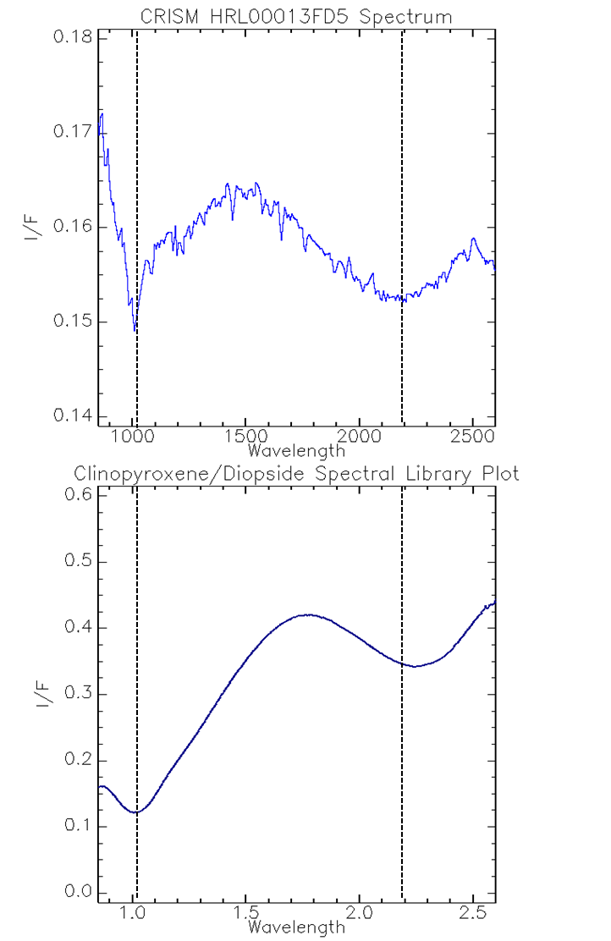
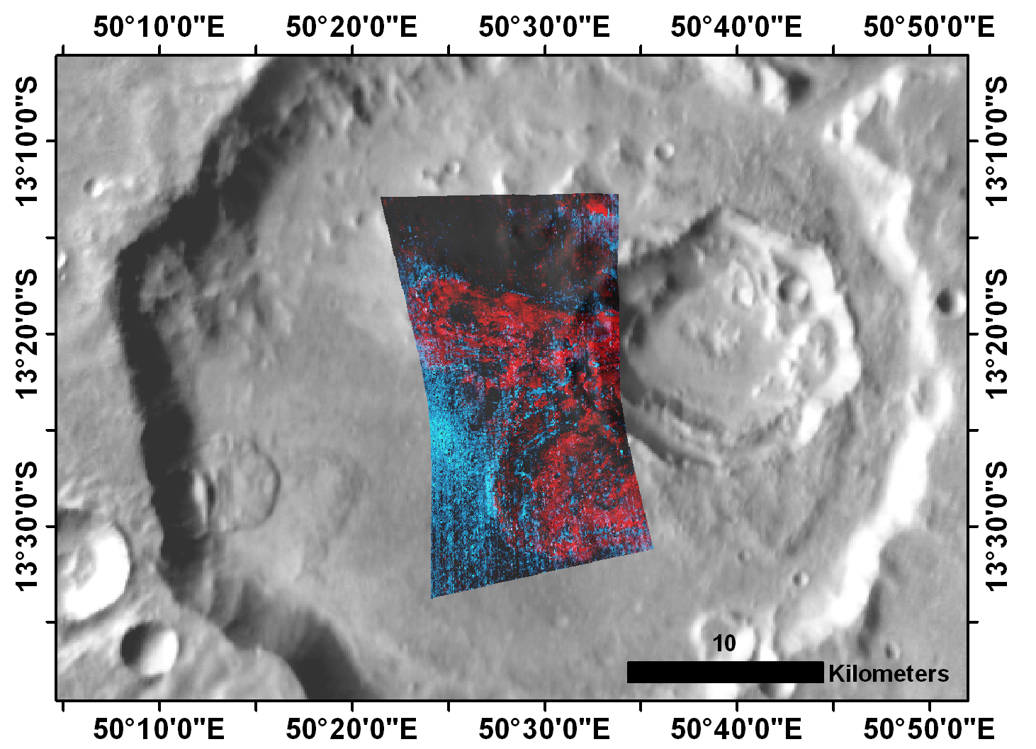
High calcium pyroxene dominated unit
Morphologically similar and gradational with Olivine Dominated Unit.
Spectra indicate greater proportion of high-calcium pyroxene (HCP) content.
HRL000166BD (R: olivine; G: high-calcium pyroxene; B: high-calcium pyroxene)
over CTX image D04_028628_1708_xn_09S298W.
These absorptions shows iron in the crystalline structure
GSA – Monday, October 28, 2013 Sheridan Ackiss - Mineralogical Mapping of Huygens Crater, Mars 17

Slide 18
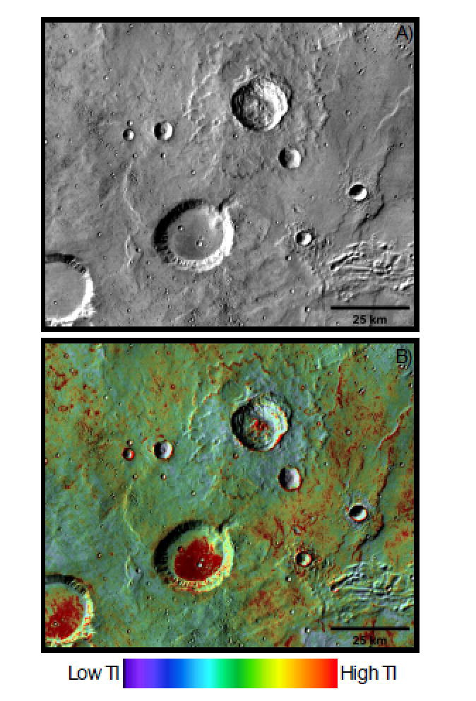
summary
Low-calcium Pyroxene Dominated Unit
  Associated with older, high-standing knobs
  Interior to Hellas Ring Structures
Aqueously Altered Dominated Unit
  Found inside and outside of Huygens associated with impact-excavated materials consistent with Loizeau et al., 2012.
  May be spatial and compositional mixtures between one or more mineral phases
Olivine and High-calcium Pyroxene Dominated Units
  Associated with extensive superposed inter- and intra-crater plains
  Consistent with previous research [Rogers and Fergason (2011); Rogers and Nazarian, (2013); Edwards et al. (2013)].
Infilled versus fresh craters showing high thermal inertia (red) from Edwards et al., 2013.
GSA – Monday, October 28, 2013 Sheridan Ackiss - Mineralogical Mapping of Huygens Crater, Mars 18
Notes:
-We also plan on expanding our study region to the E and W around the Hellas ring graben to see if the circumfirencial relationship holds true.

