Slide 1
A TEMPERATURE REGULATED
ORGANIC CARBON CAPACITOR
ON EARTH’S SURFACE
Gerald R. Dickens
Rice University
(and Nemanja Komar, Benjamin Slotnick,
Christopher Hollis, Richard Zeebe )

Slide 2
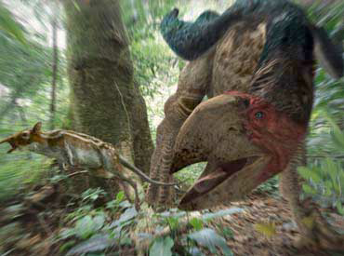

Slide 3
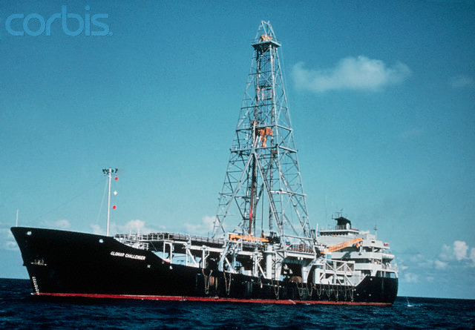
Glomar Challenger

Slide 4
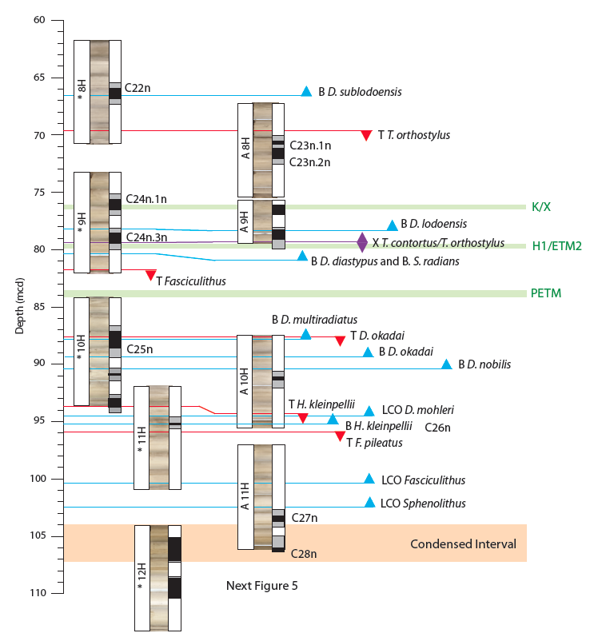
Lower Paleogene
DSDP Site 577
[Dickens & Backman,
News. Strat., 2013]

Slide 5
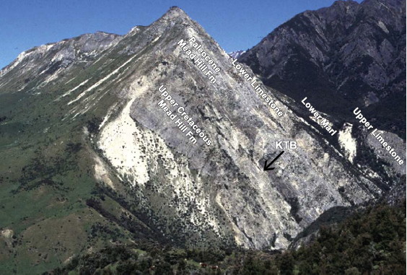
~100m
Mead Stream, New Zealand
[ Hollis et al., 2004 ]

Slide 6
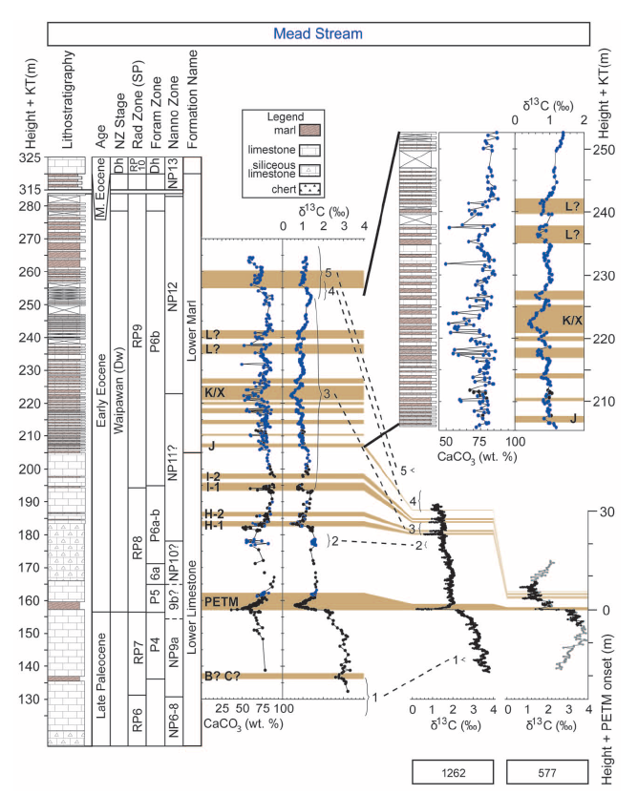
Late Paleocene-
Early Eocene
Carbon Isotope Records
[Slotnick et al.,
Journal of Geology, 2012]

Slide 7
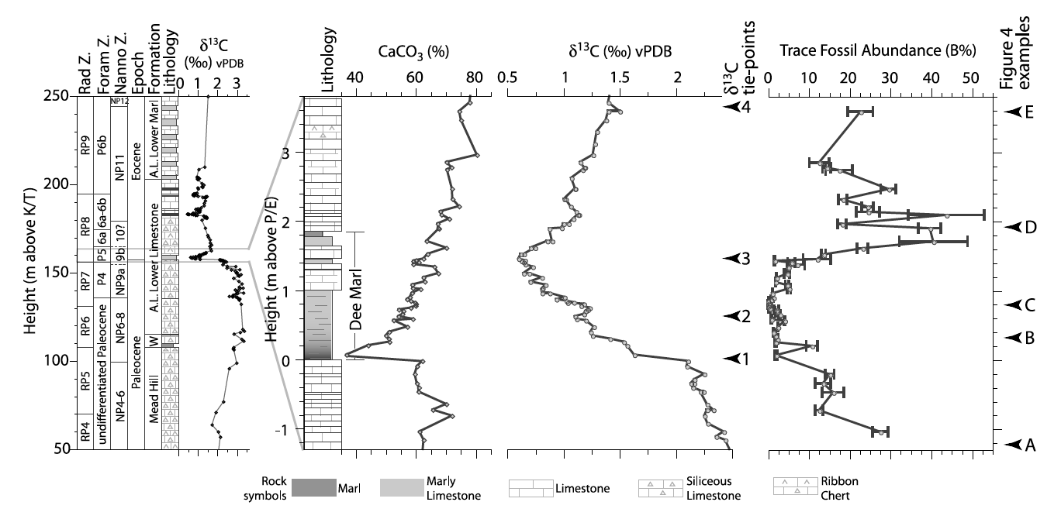
PETM at Mead Stream, New Zealand
[Nicolo et al., Paleoceanography, 2010]

Slide 8
A Carbon Input to the Phanerozoic Carbon Cycle
Anthropogenic
F
Ant
= 8.00
Inputs
δ
Ant
= -30.0
F
In
= 0.60
δ
In
= -5.0
M
Atm
= 1400
M
Bio
= 3400
δ
Atm
= -7
δ
Bio
= -28.5
Outputs
Volcanoes
Atmosphere
Biosphere
F
= 0.60
Out
F
Vol
= 0.072
δ
Out
= -5.0
δ
Vol
= -5.0
Organics
Weathering
F
Org
= 0.13
F
Weat
= 0.12
δ
Org
= -28.5
δ
Weat
= -22
Carbonate
Rivers
Ocean
F
Carb
= 0.47
F
Riv
= 0.408
M
Oc
= 51200
δ
Carb
= 1.5
δ
Riv
= 0.0
δ
Oc
= 0.5
M
Ex
= 56000
δ
Ex
= -1.45
[adapted from Kump & Arthur, Chem. Geol., 1999 ]

Slide 9
Theoretical Carbon Inputs for
Rapid, Global Negative δ¹³C Excursions
0
δ_{Add} = -5 ‰
δ_{Add} = -5 ‰
-1
100,000
δ_{Add} = -22 ‰
Exogenic Composition, δ_{Ex} (‰)
δ_{Add} = -22 ‰
-2
δ_{Add} = -60 ‰
Carbon Injection, M_{Ex} (Gt)
10,000
IPCC
δ_{Add} = -60 ‰
-3
1,000
-4
100
0
100
200
300
0
100
200
300
Time (kyr)
Time (kyr)
[ Dickens, Geol. Soc. London, 2001 ]

Slide 10
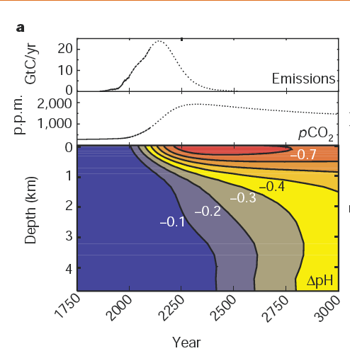
Ken Caldeira

Slide 11
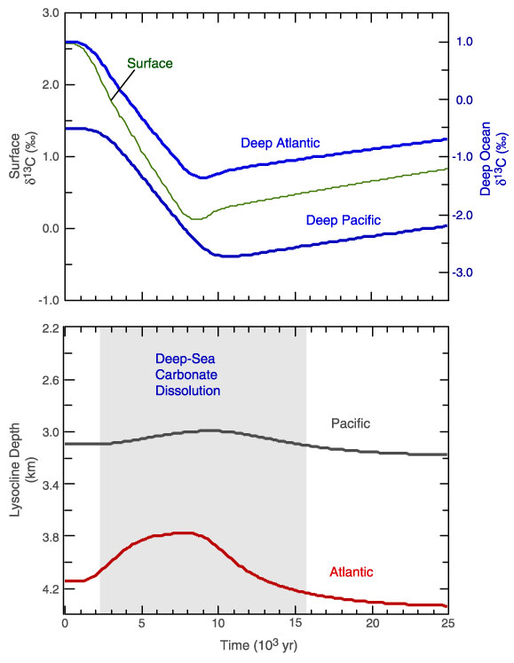
Dickens,
Bull. Soc. Geol. France, 2000

Slide 12
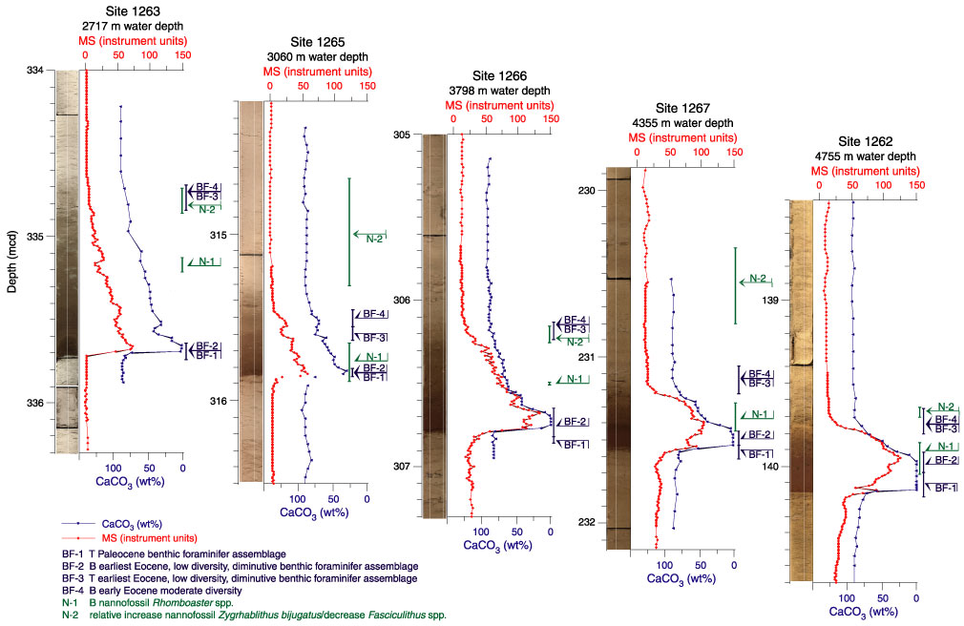
PETM at Walvis Ridge
Zachos et al., Proc ODP Inti. Repts., 208, 2004

Slide 13
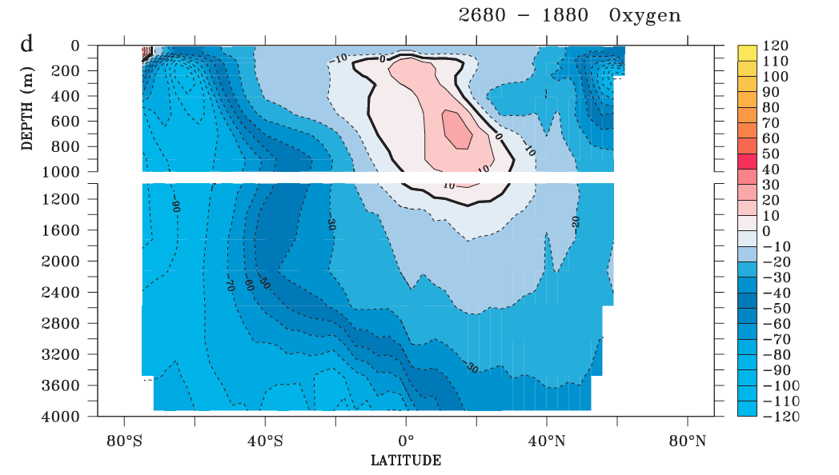
Predicted Change in Pacific Dissolved Oxygen by AD 2680
(μmol/km³)
[ Hollis et al., 2004 ]
[ Matear & Hirst, Global Biogeochemical Cycles, 2003 ]

Slide 14
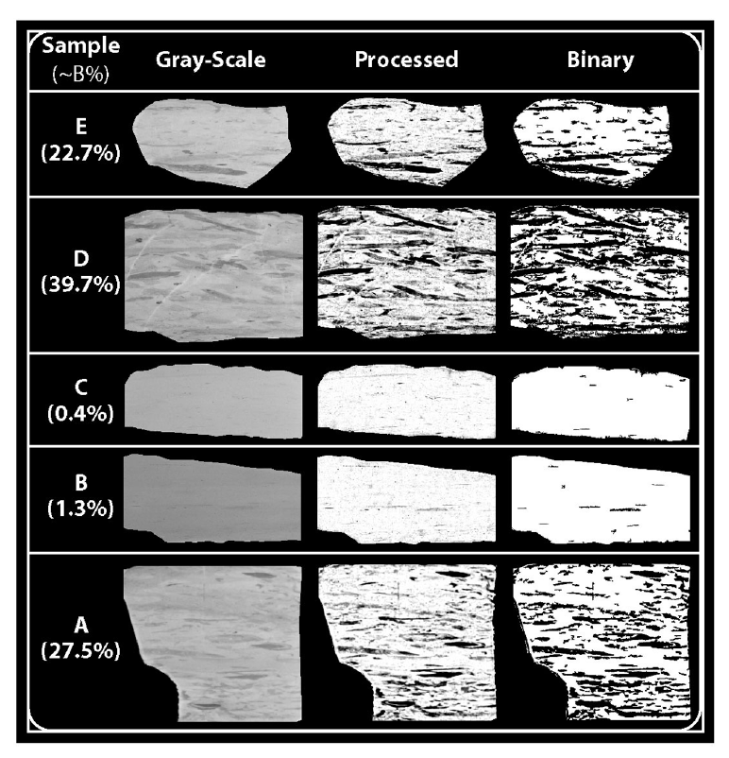
PETM at
Mead Stream
[Nicolo et al.,
Paleoceanography, 2010]

Slide 15
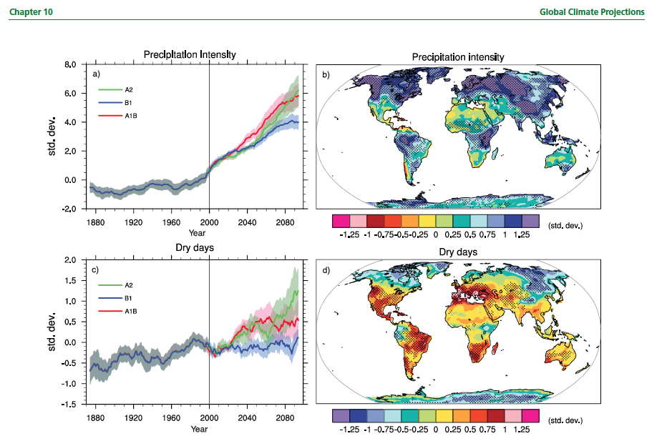
[ IPCC, 2007 ]

Slide 16
[Slotnick et al., Journal of Geology, 2012]

Slide 17
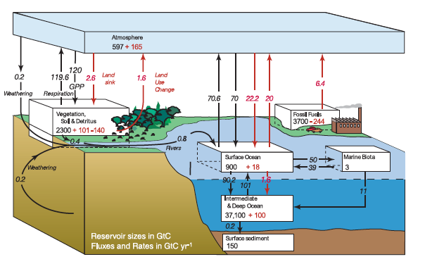
Figure 7.3: Global Carbon Cycle
[ IPCC, 2007 ]

Slide 18
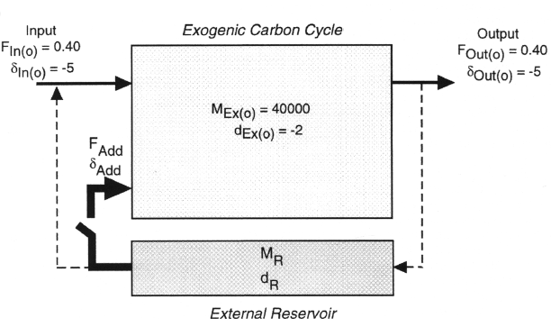
A Simple Capacitor for Global Carbon Isotope Excursions
Seafloor Methane (Peat/Permafrost)
[ adapted from Dickens, EPSL, 2003 ]

Slide 19
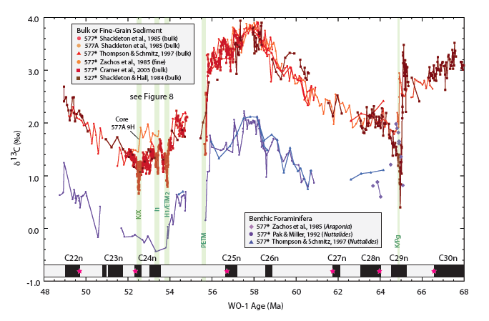
Carbon Isotope Records at DSDP Site 577
Carbon Release
(long-term & short-term)
Carbon Storage
(long-term)
[Dickens and Backman, News. Strat., 2013 ]

Slide 20
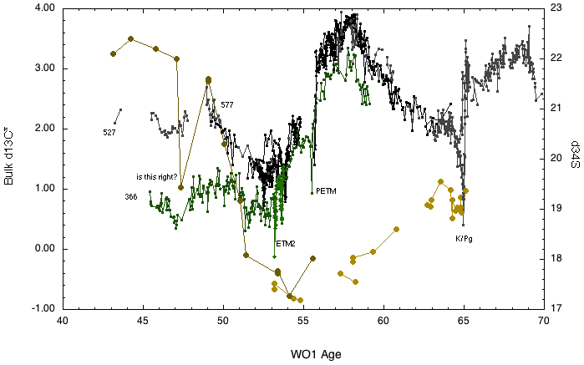
Sulfur Isotopes (Correct Age)
[original sulfur data from Paytan et al., 1996]

Slide 21
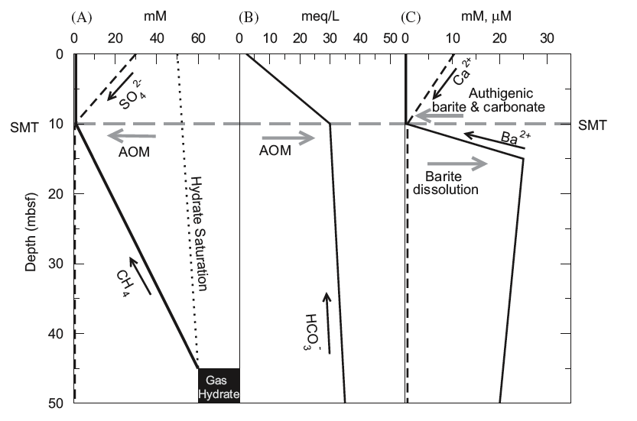
Gas Hydrate, AOM and Sulfur Cycling
¹²CH₄ + SO₄²⁻ --->
H¹²CO₃⁻ + HS⁻ + H₂O
2CH₂O --->
¹²CH₄ + ¹³CO₂
[ Snyder et al., Deep-Sea Res., 2007 ]

Slide 22
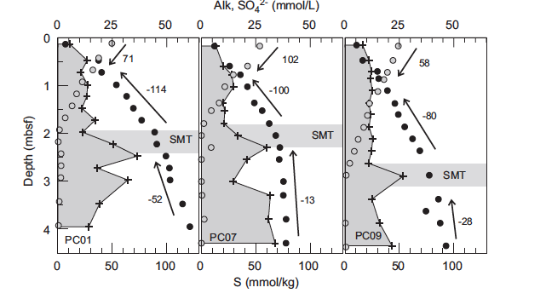
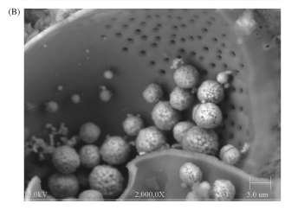
Alkalinity (HCO3-)
SO₄²⁻
Solid S
[ Snyder et al., Deep-Sea Res., 2007 ]

Slide 23
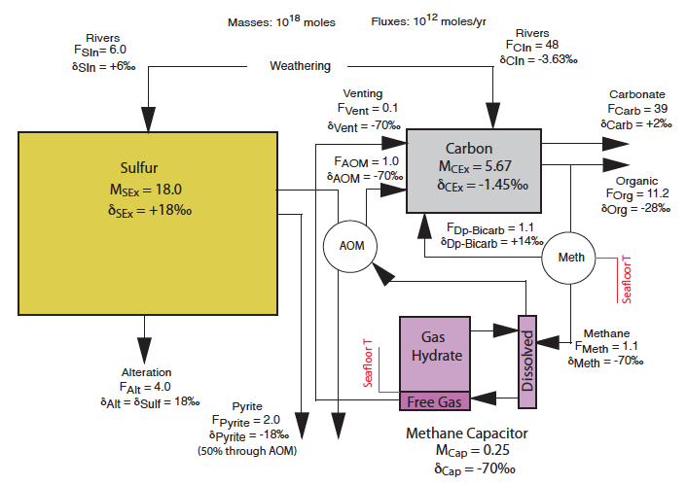
Welcome to the Dark Side: Lee’s Paleogene Machine
[Dickens, Climate of Past, 2011]

Slide 24
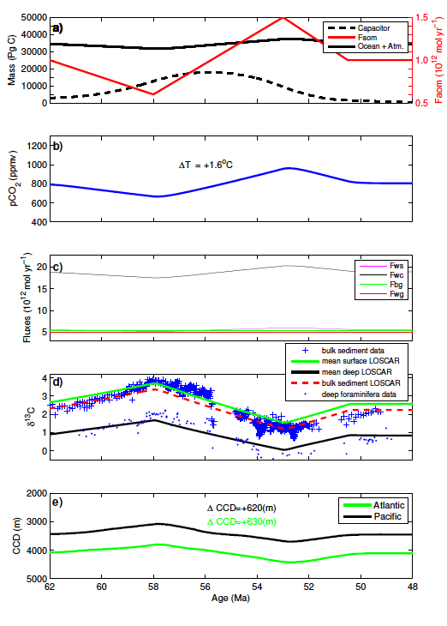
Long-term
Model Results
[Komar et al.,
Paleoceanography, in press ]

Slide 25
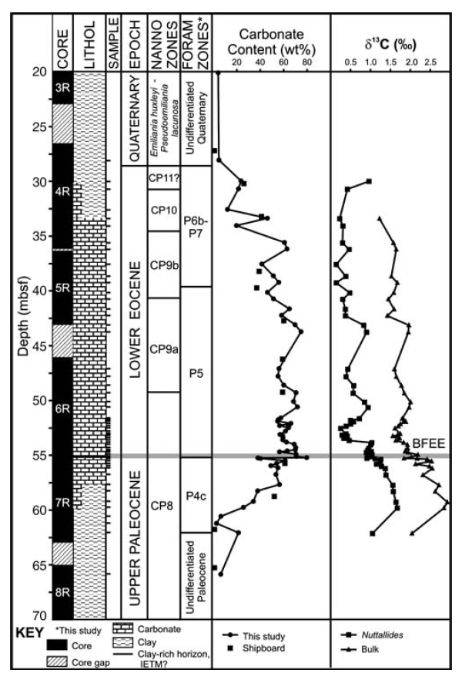
DSDP Site 259
(Indian Ocean)
[Hancock et al., 2007 ]

Slide 26
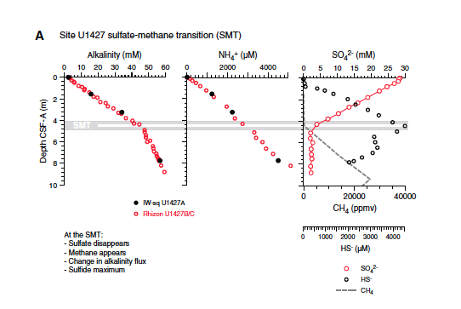
[Expedition 346 Scientists, 2014]

Slide 27
Back to the Future?
Absolutely. The Eocene is forcing
future science forward.

