Slide 1
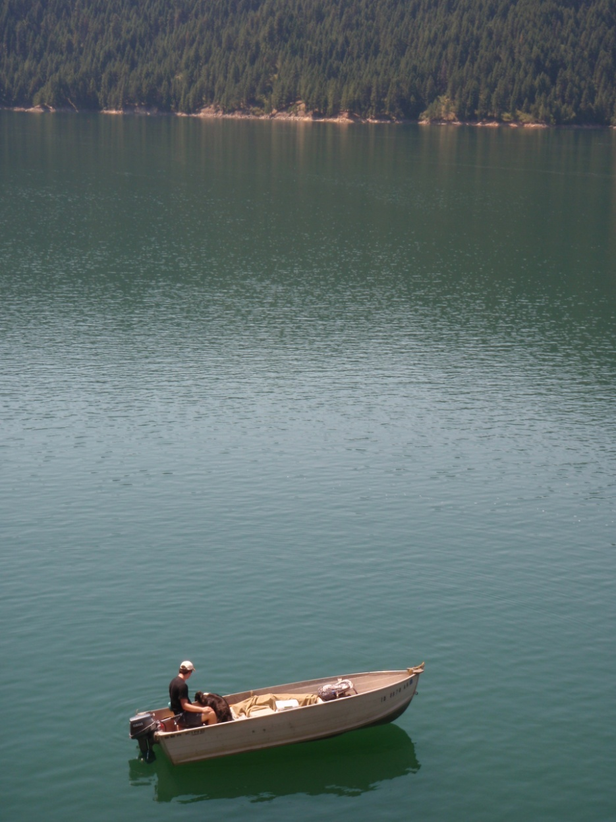
The Idaho Syntaxis
Dworshak Reservoir
Western Idaho Shear Zone deformation that has gone ‘round the Orofino Bend
Paul C., the field assistant
Lego, the dog
STETSON-LEE, Tor¹, TIKOFF, Basil¹, BYERLY, Ad¹, KELSO, Paul², and VERVOORT, Jeff D³
Department of Geoscience, University of Wisconsin-Madison, stetsonlee@wisc.edu
Department of Geology and Physics, Lake Superior State University
School of Earth and Environmental Sciences, Washington State University

Slide 2
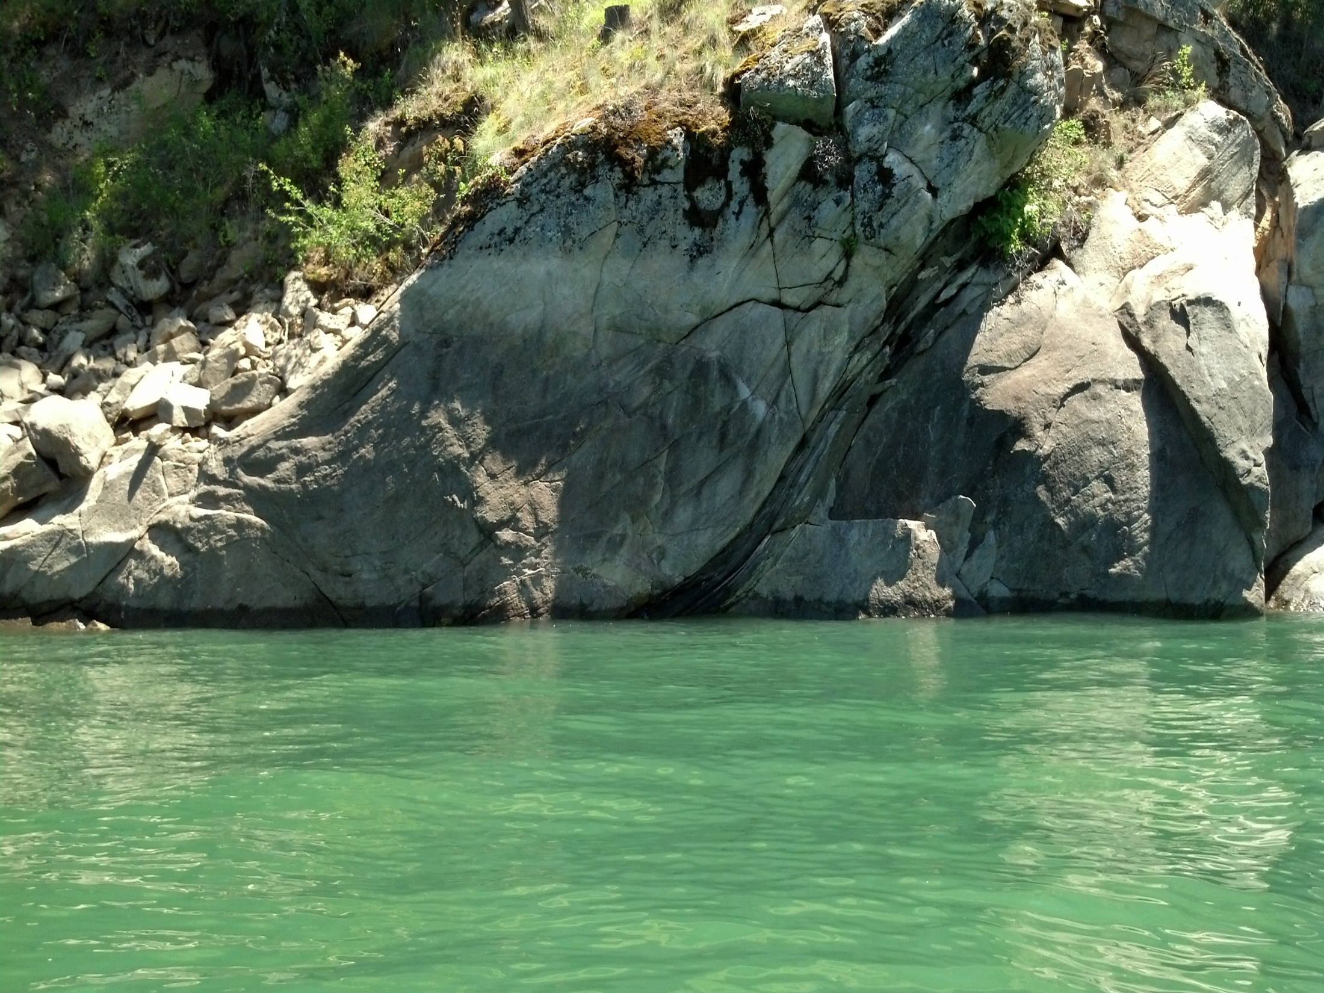
Outline
Geologic Background of Orofino Area
Kinematic Information From Field Observations
Previous Models for the Dog-leg (90° bend) Geometry
New Model: The WISZ Syntaxis
Notes:
I’d like to provide you with some insight into some new developments in our understanding of the western margin of ancient North America, specifically near Orofino, Idaho, where my own research is centered. I’ll describe the geology of the area, talk about previous models explaining a confusing bend in the continental-oceanic boundary, and present a new model based on my field observations and work done by my collaborators and other workers.

Slide 3
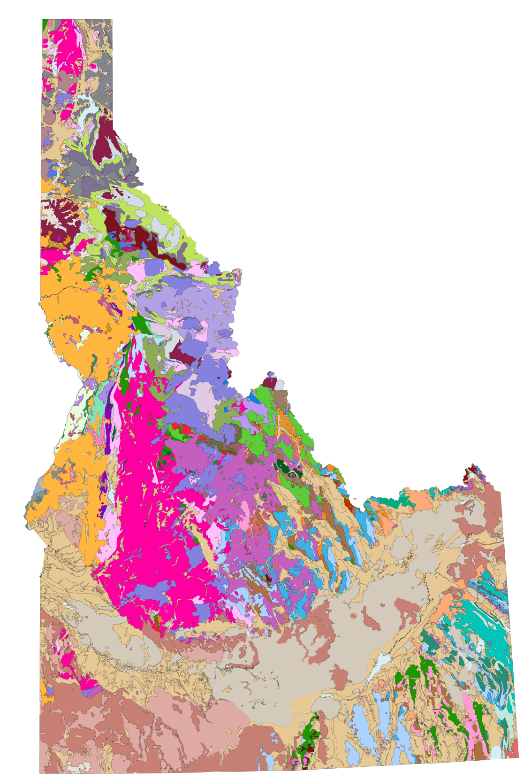
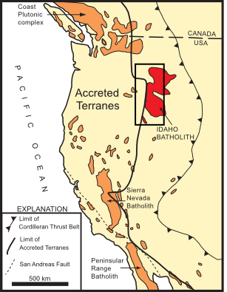
Location
Paleocontinental margin defined by ⁸⁷Sr/⁸⁶Sr 0.706 isopleth.
Western Idaho Shear Zone fabric co-located with 0.706 line near McCall.
Trans-Idaho Shear Zone (named after Trans-Idaho lineament) located northeast of Orofino.
Orofino
McCall
Modified from Tikoff et al. 2001
Modified from Lewis et al. 2012

Slide 4
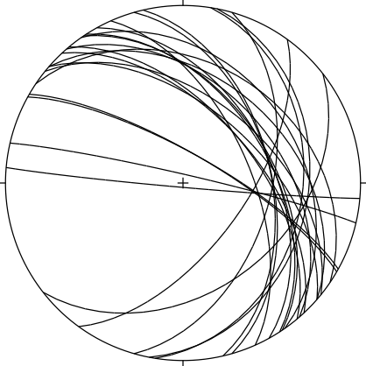
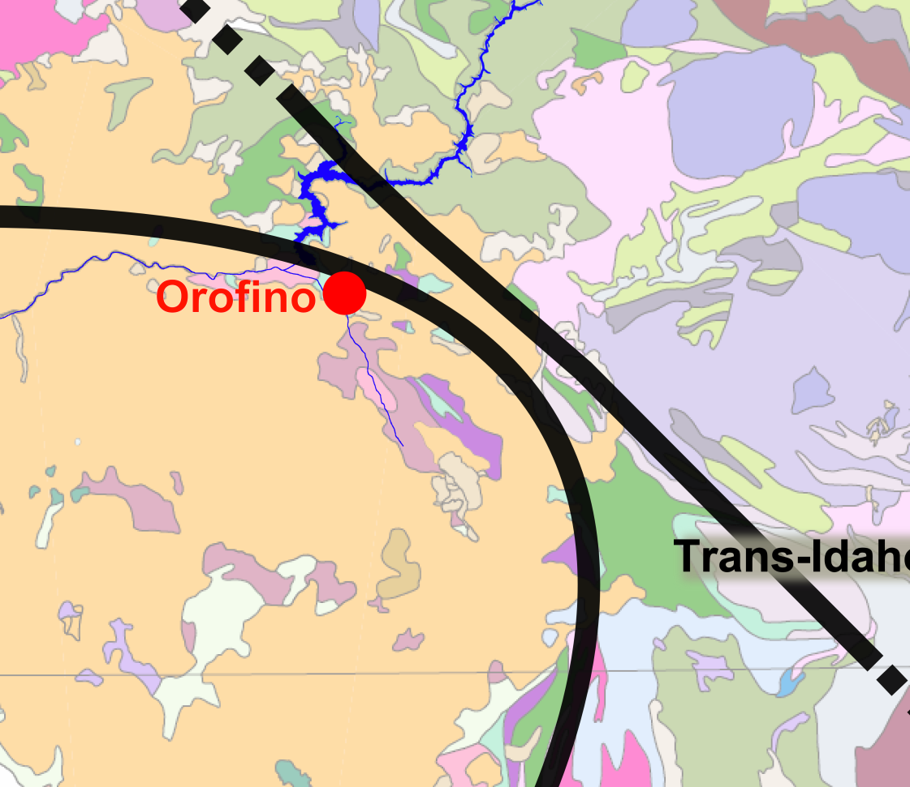
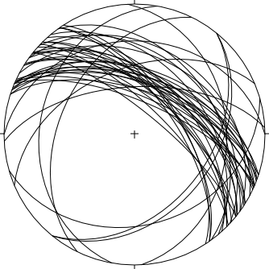

Distinct foliation defines the two shear zones in the field.
50 km
lower hemisphere equal area projections

Slide 5
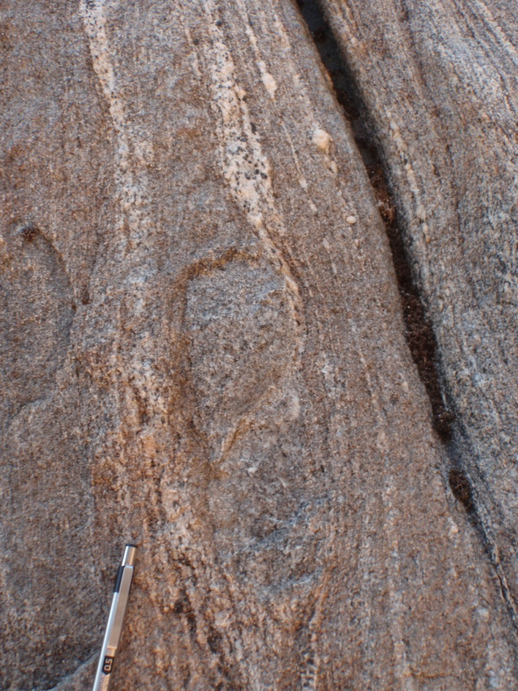
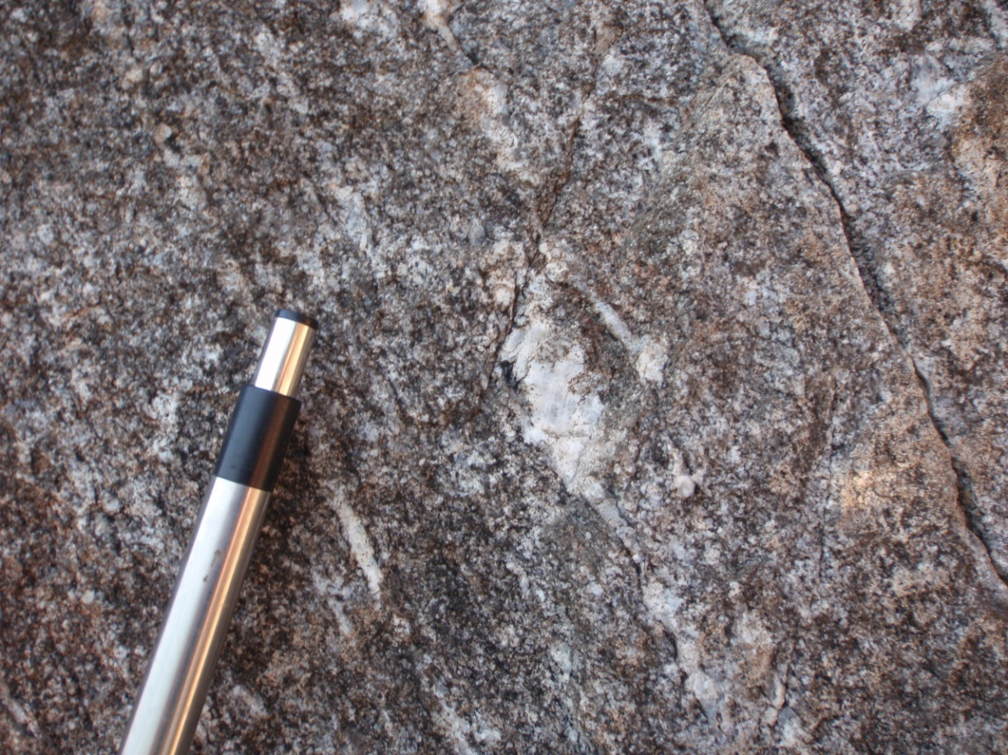

field observations
macroscopic fabric
N
N
Reverse indicators near Orofino.
Reverse sense of shear is consistent with study of Strayer et al. (1989).
view is towards the west, parallel to lineation and perpendicular to foliation

Slide 6
XPL
field observations
up
microscopic fabric
N
PPL
Reverse sense of shear near Orofino.
4 mm
view is parallel to lineation and perpendicular to and foliation and towards the west
4 mm

Slide 7
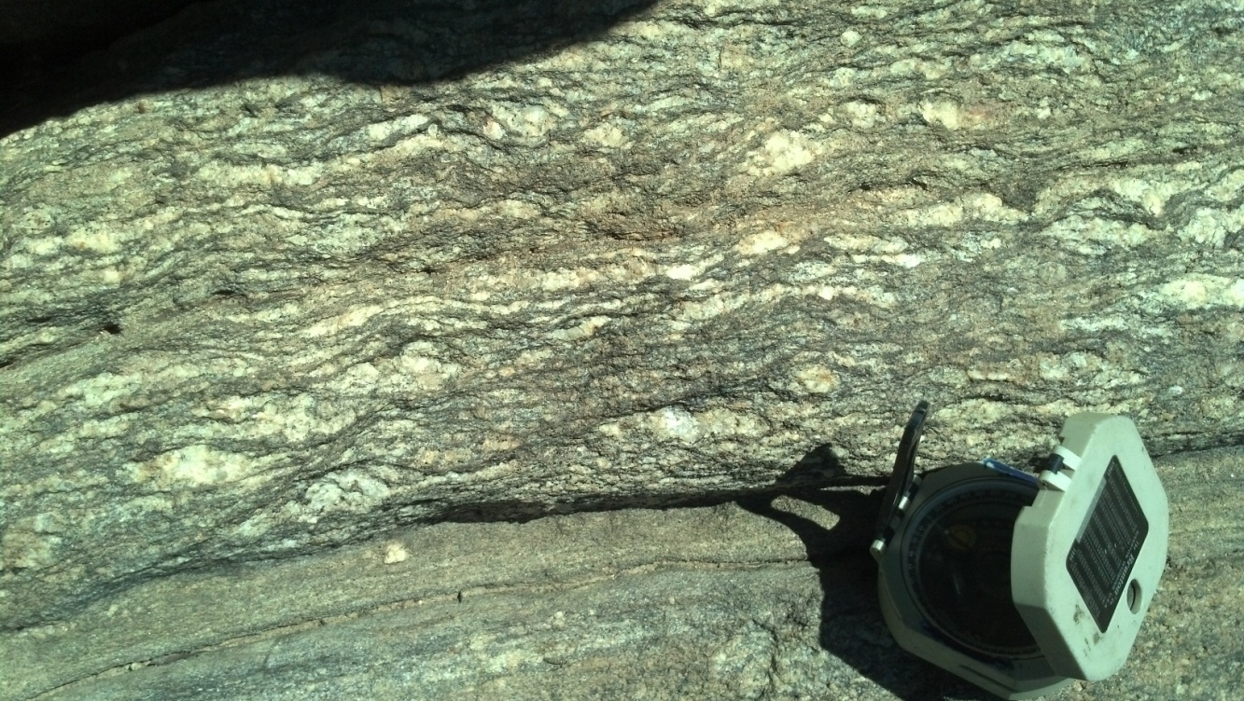
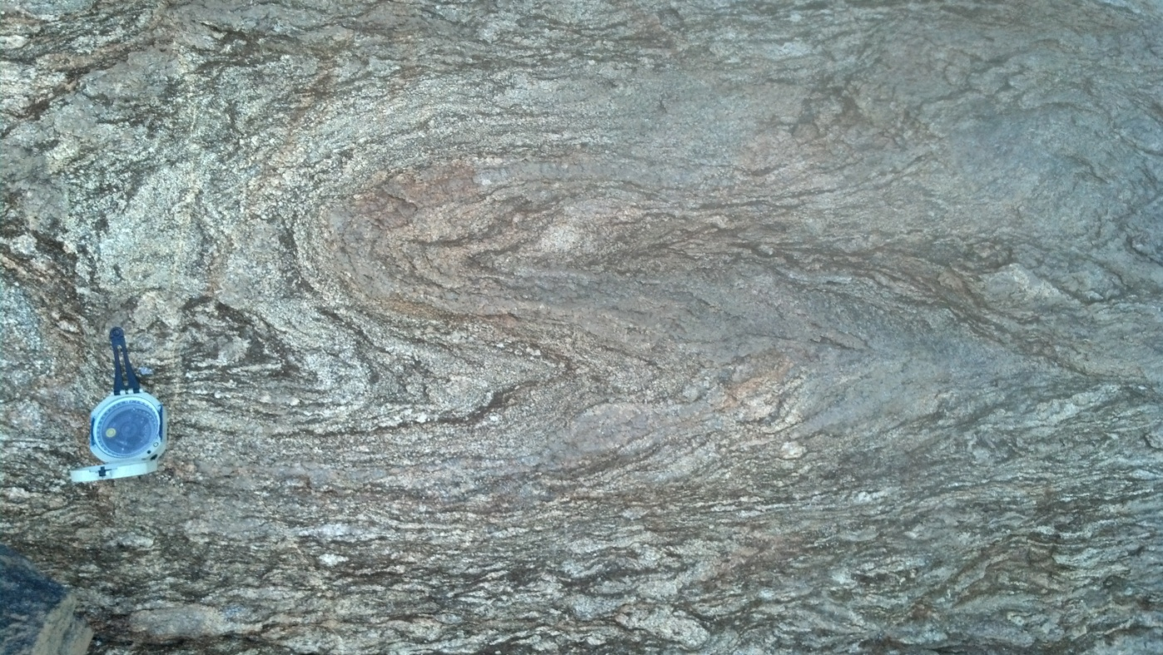
field observations
macroscopic fabric
Looking perpendicular to lineation, we also observed a consistent (sinistral) sense of shear.
Rock fabric near Orofino showing sinistral sense of shear.
view is perpendicular to lineation and foliation
compass points north in both photos

Slide 8
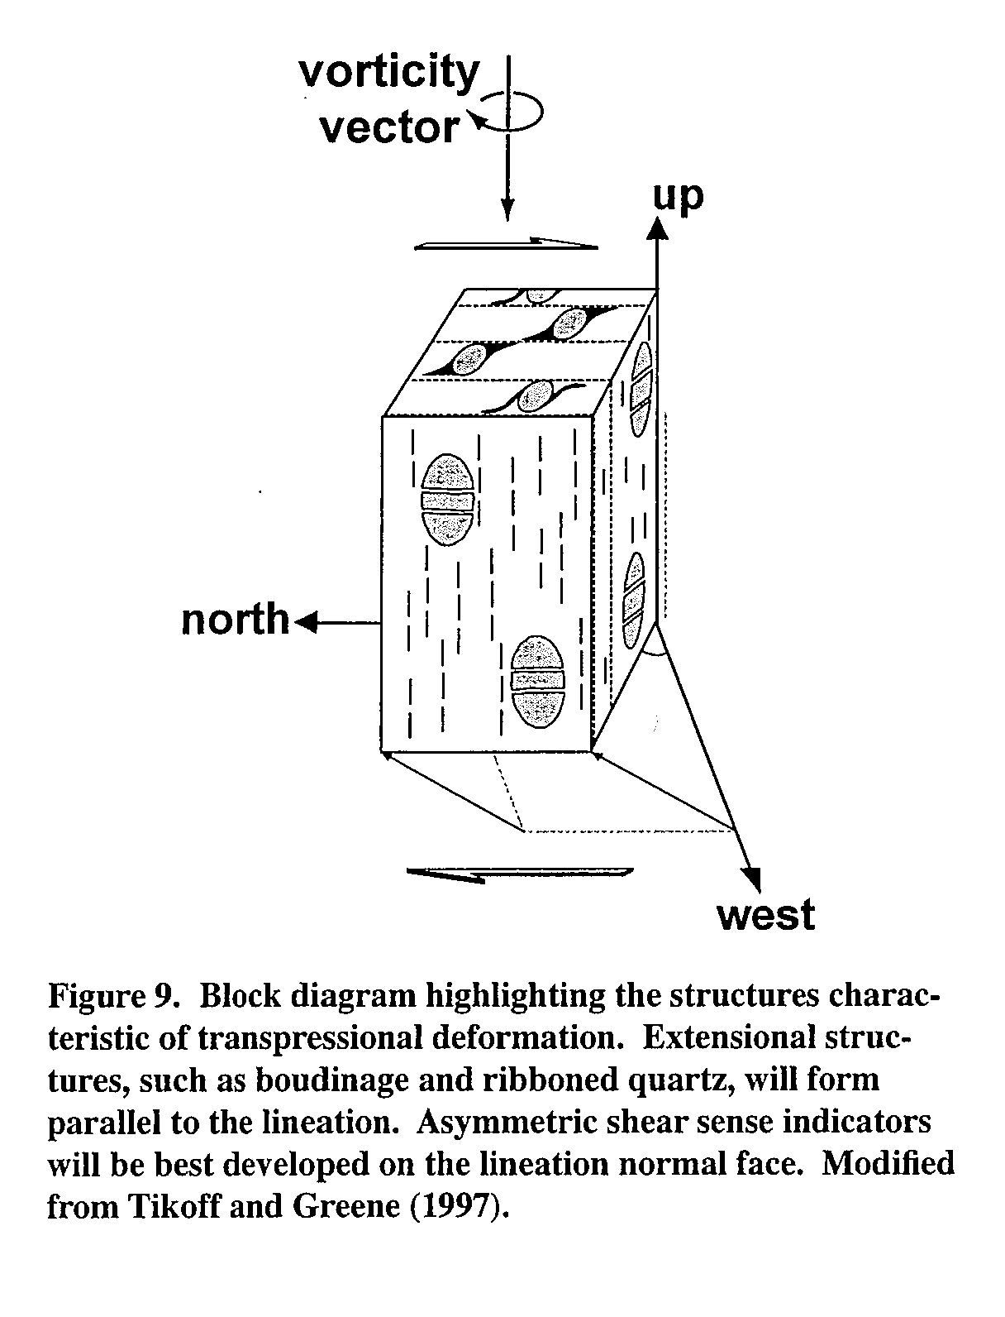
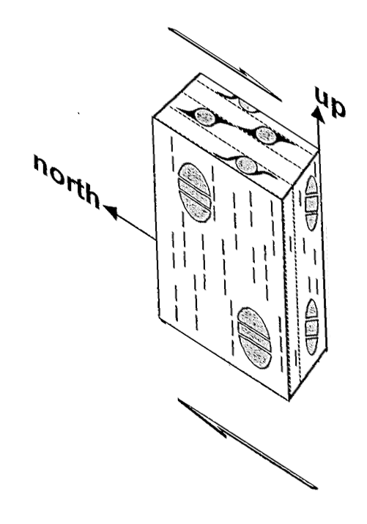
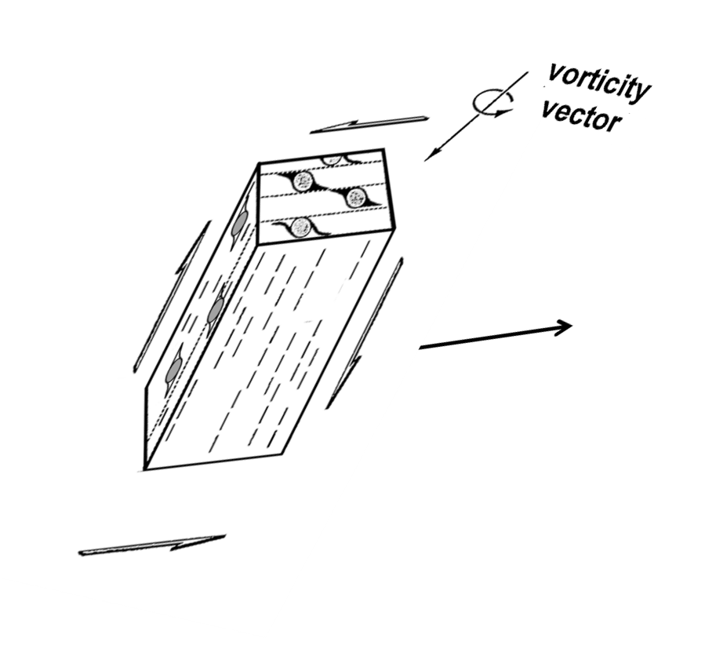
Orofino Area Vorticity
McCall Area Vorticity
The vorticity vector represents the axis around which the rock fabric is rotated during deformation.
triclinic deformation (or inclined transpsression); vorticity vector oblique to lineation
transpressional deformation (monoclinic); vorticity vector parallel to lineation
approximate possible range of angle of convergence (50°-85°)
east
west
Diagrams modified from Giorgis et al. 2006

Slide 9
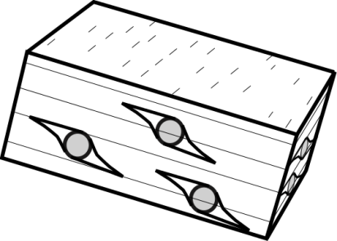
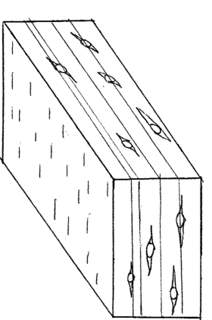
DEFORMATION ALONG 0.706 LINE
Orofino/Dworshak area: sinistral-reverse movement. At least 30 km of displacement across the shear zone here (Strayer et al. 1989).
Orofino
McCall
Western Idaho shear zone in
McCall area: dextral transpressive deformation.
Boise

Slide 10
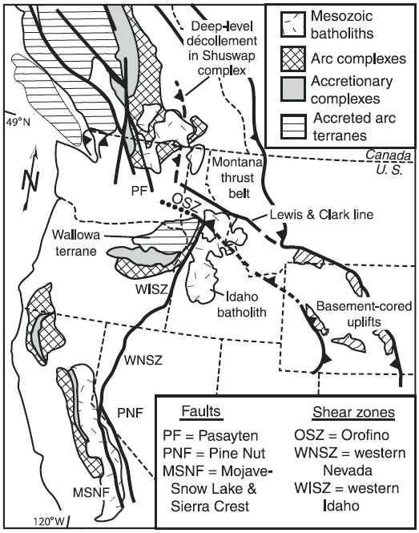
Truncation Model
NW-SE oriented shear zone cuts across Western Idaho shear zone
~70 Ma folded dike in Orofino shear zone corroborates truncation possibility (McClelland and Oldow, 2007)
N
From McClelland and Oldow, 2007

Slide 11
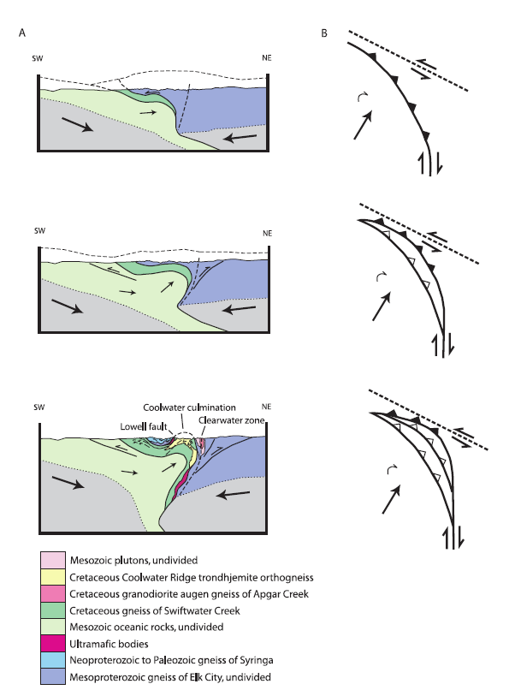
Progressive Rotation & Tightening Model
Tightening of the bend due to oblique dextral convergence and rotation of Blue Mountains terrane (Lund et al., 2008)
Accommodation of motion along second shear zone to northeast
From Lund et al. 2008
Notes:
Lund et al.2010 proposes that the bend is not original to the contrational geometry of the continental margin. Their model explaining the unusual bend in the .706 line/WISZ/SRSZ calls on a tightening-through-time model whereby oblique dextral convergence combined with clockwise rotation of the Blue Mountains Superterrane. Additional accomodation occurred along a second shear zone to the northeast and oriented NW-SE.

Slide 12
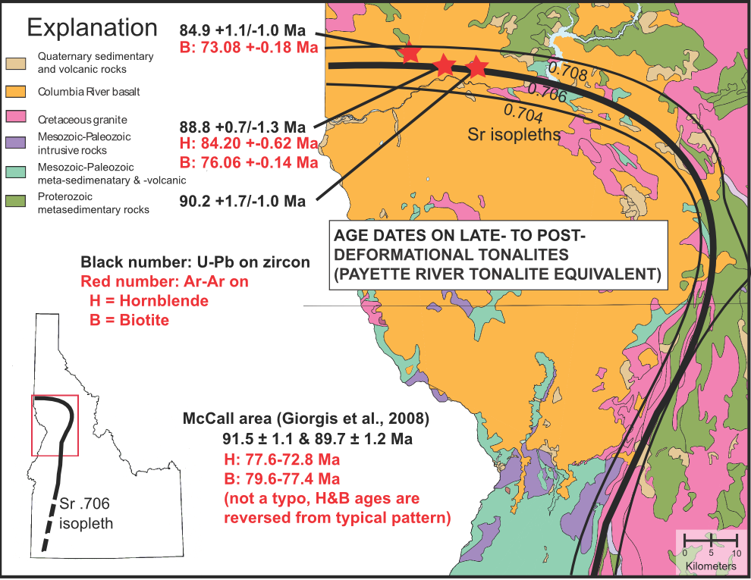
Age Constraints near Orofino
U-Pb crystallization ages AND Ar-Ar cooling ages are consistent with known ages of N-S oriented WISZ
Indicates that E-W striking fabrics at Orofino are part of Western Idaho shear zone
Western Idaho shear zone deformation goes ‘round the Bend!
Notes:
While the McClelland and Oldow model makes a lot of sense based on younger age constraints of the areas to the southeast of Orofino, newer calculated ages in deformed granitoids in the EW segment of the WISZ indicate that the full, bent extent of the WISZ is about the same age. In other words, the WISZ has not been truncated by a younger shear zone. This, then, begs the question: Is the bend an original feature.

Slide 13
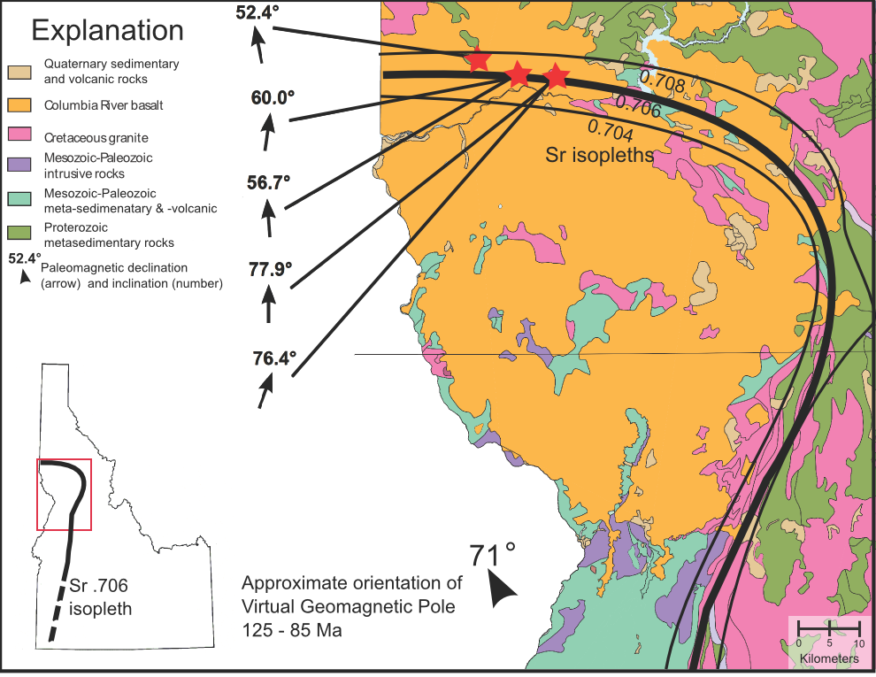
Paleomagnetic Data
Data presented by Byerly et al. (this meeting, Monday – T108)
Entirety of Western Idaho shear zone has rotated 30 degrees clockwise.
This data, combined with U-Pb data, support large scale rotation of the continental margin.
The entire western Idaho shear zone (& 0.706 line) is rotated 30 degrees after 90 Ma!
Notes:
Recently acquired paleomagnetic data provides evidence that doesn’t require any tightening of the bend. The takeaway message is that the basic geometry of the WISZ is original. It’s relative position and orientation have changed but the original continental margin was defined by a promentory from Orofino west along Highway 12. The five samples produced paleomagnetic orientations near current geographic north, however, the paleomagnetic pole was at 90 Ma was about 30 degrees west of north. This indicates that there has been approximately 30 degrees of clockwise rotation since 90 Ma and, since the paleomag data from both the EW section and the NS section of the WISZ agree, the WISZ has not changed shape—only orientation.

Slide 14
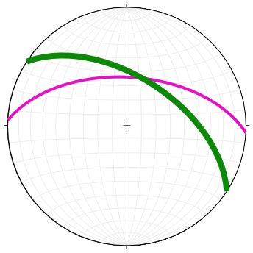
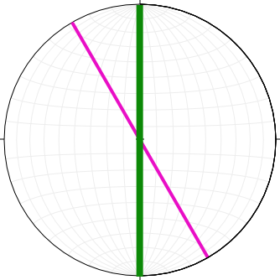
The original geometry of the WISZ
Orofino/Dworshak area: left-lateral oblique reverse sense of shear.
Orofino
original foliation orientation
rotation
modern foliation orientation
McCall
McCall area: right lateral transpressive sense of shear.
original foliation orientation
rotation
Boise
pre-Miocene foliation orientation

Slide 15
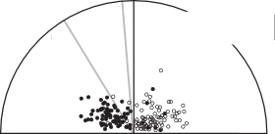
Accretionary Convergence
Vorticity analysis on the fabrics near McCall indicate a ~50 angle of convergence.
If this angle of convergence describes regional motion AND the bend pre-existed WISZ deformation…….
N
Orofino
clockwise rotated clast
counter clockwise rotated clast
McCall
85°
60°
50°
S
Boise
Modified from Giorgis et al. 2006

Slide 16
Same Shear Zone, Different Shear
…then it also explains the two senses of shear along the same shear zone boundary. A convergence angle of about 50 degrees leads to dextral transpression along the N-S oriented margin and sinistral reverse shearing along the E-W striking portion of the boundary zone.
Orofino
McCall
Boise

Slide 17
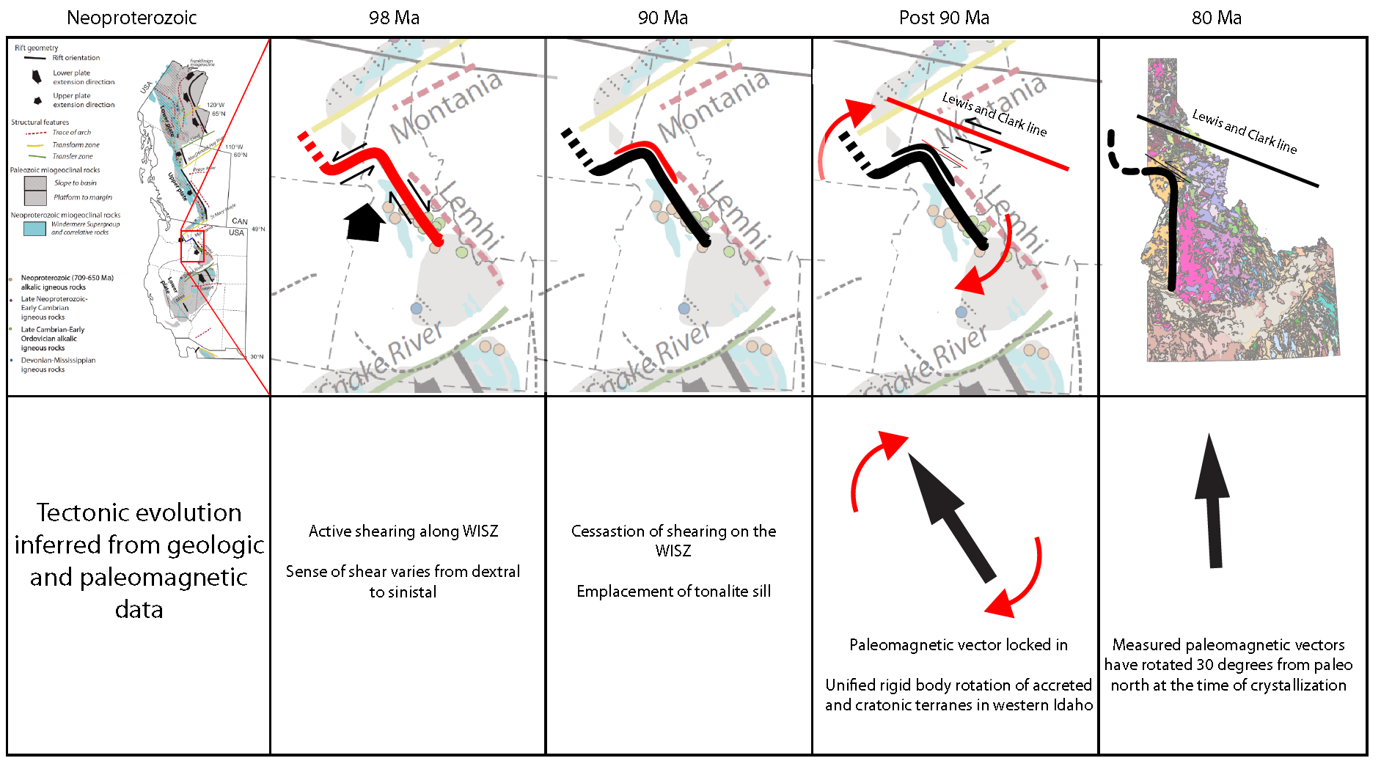
The Western Idaho Shear Zone Through Time
Modified from Lund 2008
Tectonic evolution inferred from geologic and paleomagnetic data.
Active shearing along WISZ
Sense of shear varies from dextral to sinistral—this geometry is a syntaxis.

Slide 18
The Western Idaho Shear Zone Through Time
Cessation of shearing on the WISZ
Emplacement of tonalite sill

Slide 19

Conclusions
The Orofino bend:
1. Is the edge of North America (cratonic margin);
2. Resulted from Proterozoic rifting (transform/ridge system);
3. Is deformed everywhere by the Western Idaho shear zone with different kinematics in different places;
4) Was rotated clockwise 30° sometime after 90 Ma, possibly related to Sevier thrusting.
The Western Idaho shear zone represents deformation in a syntaxis on the North American margin.

