Slide 1
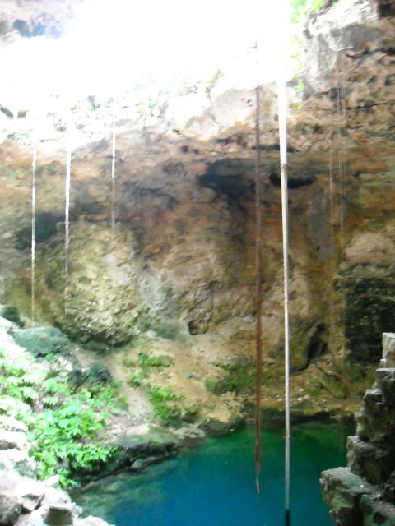



Microbes in the karst groundwater in Yucatan Peninsula, Mexico: which environmental factors influence the microbial communities most?
Anni Moore
Melissa Lenczewski, Melvin Duvall, Eugene Perry
*Northern Illinois University
Jack Gilbert, Sarah Owens
*Argonne National Laboratories
Rosamaria Leal Bautista
*Centro de Investigación Científica de Yucatán

Slide 2
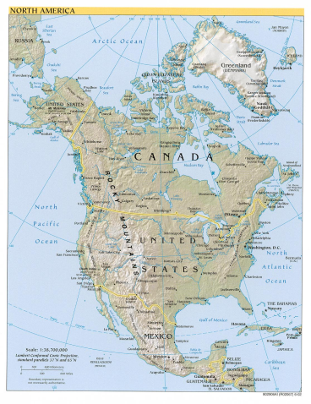
The causes of groundwater problems in Yucatan Peninsula: natural
Highly porous and fractured karst terrain: the Chicxulub meteor impact 65 Mya caused fracturing in the soft porous marine carbonate rocks, allowing saline water intrusion. The unsaturated mix of saline and fresh water result in further dissolution of the carbonate rocks, resulting in highly cavernous terrain.
Dearth of soil and deforestation: the average soil cover is naturally thin (average 7 cm, occasionally lacking completely), resulting in reduced filtering capacity and increasing the chances that contaminants will enter the groundwater. This situation is further enhanced by the loss of vegetation for suburban development.

Slide 3
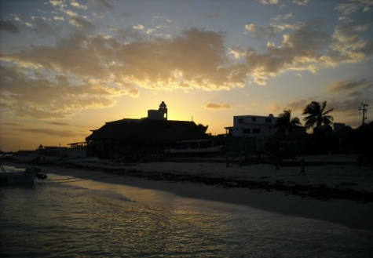
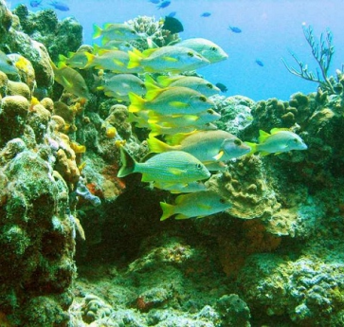
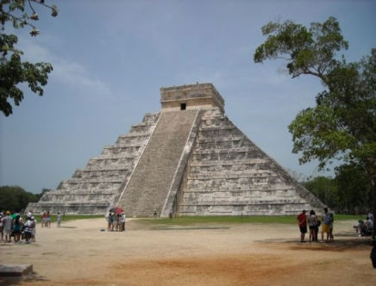
The causes of groundwater problems in Yucatan Peninsula: human induced
Planned development throughout the peninsula since 1970s has turned Yucatan Peninsula into a major international and domestic tourist destination, and led to explosive population growth.

Slide 4
The causes of groundwater problems in Yucatan Peninsula: human induced
Infrastructure has not kept up: modern wastewater treatment is available only in selected areas of the peninsula, and a lot of poorly treated sewage ends up in the aquifer or in the sea. The aquifer is the only source of freshwater in Yucatan, and in many places is completely undrinkable without excessive treatment.
Drinking water in Puerto Morelos is delivered into the houses by trucks from water purification centers.

Slide 5
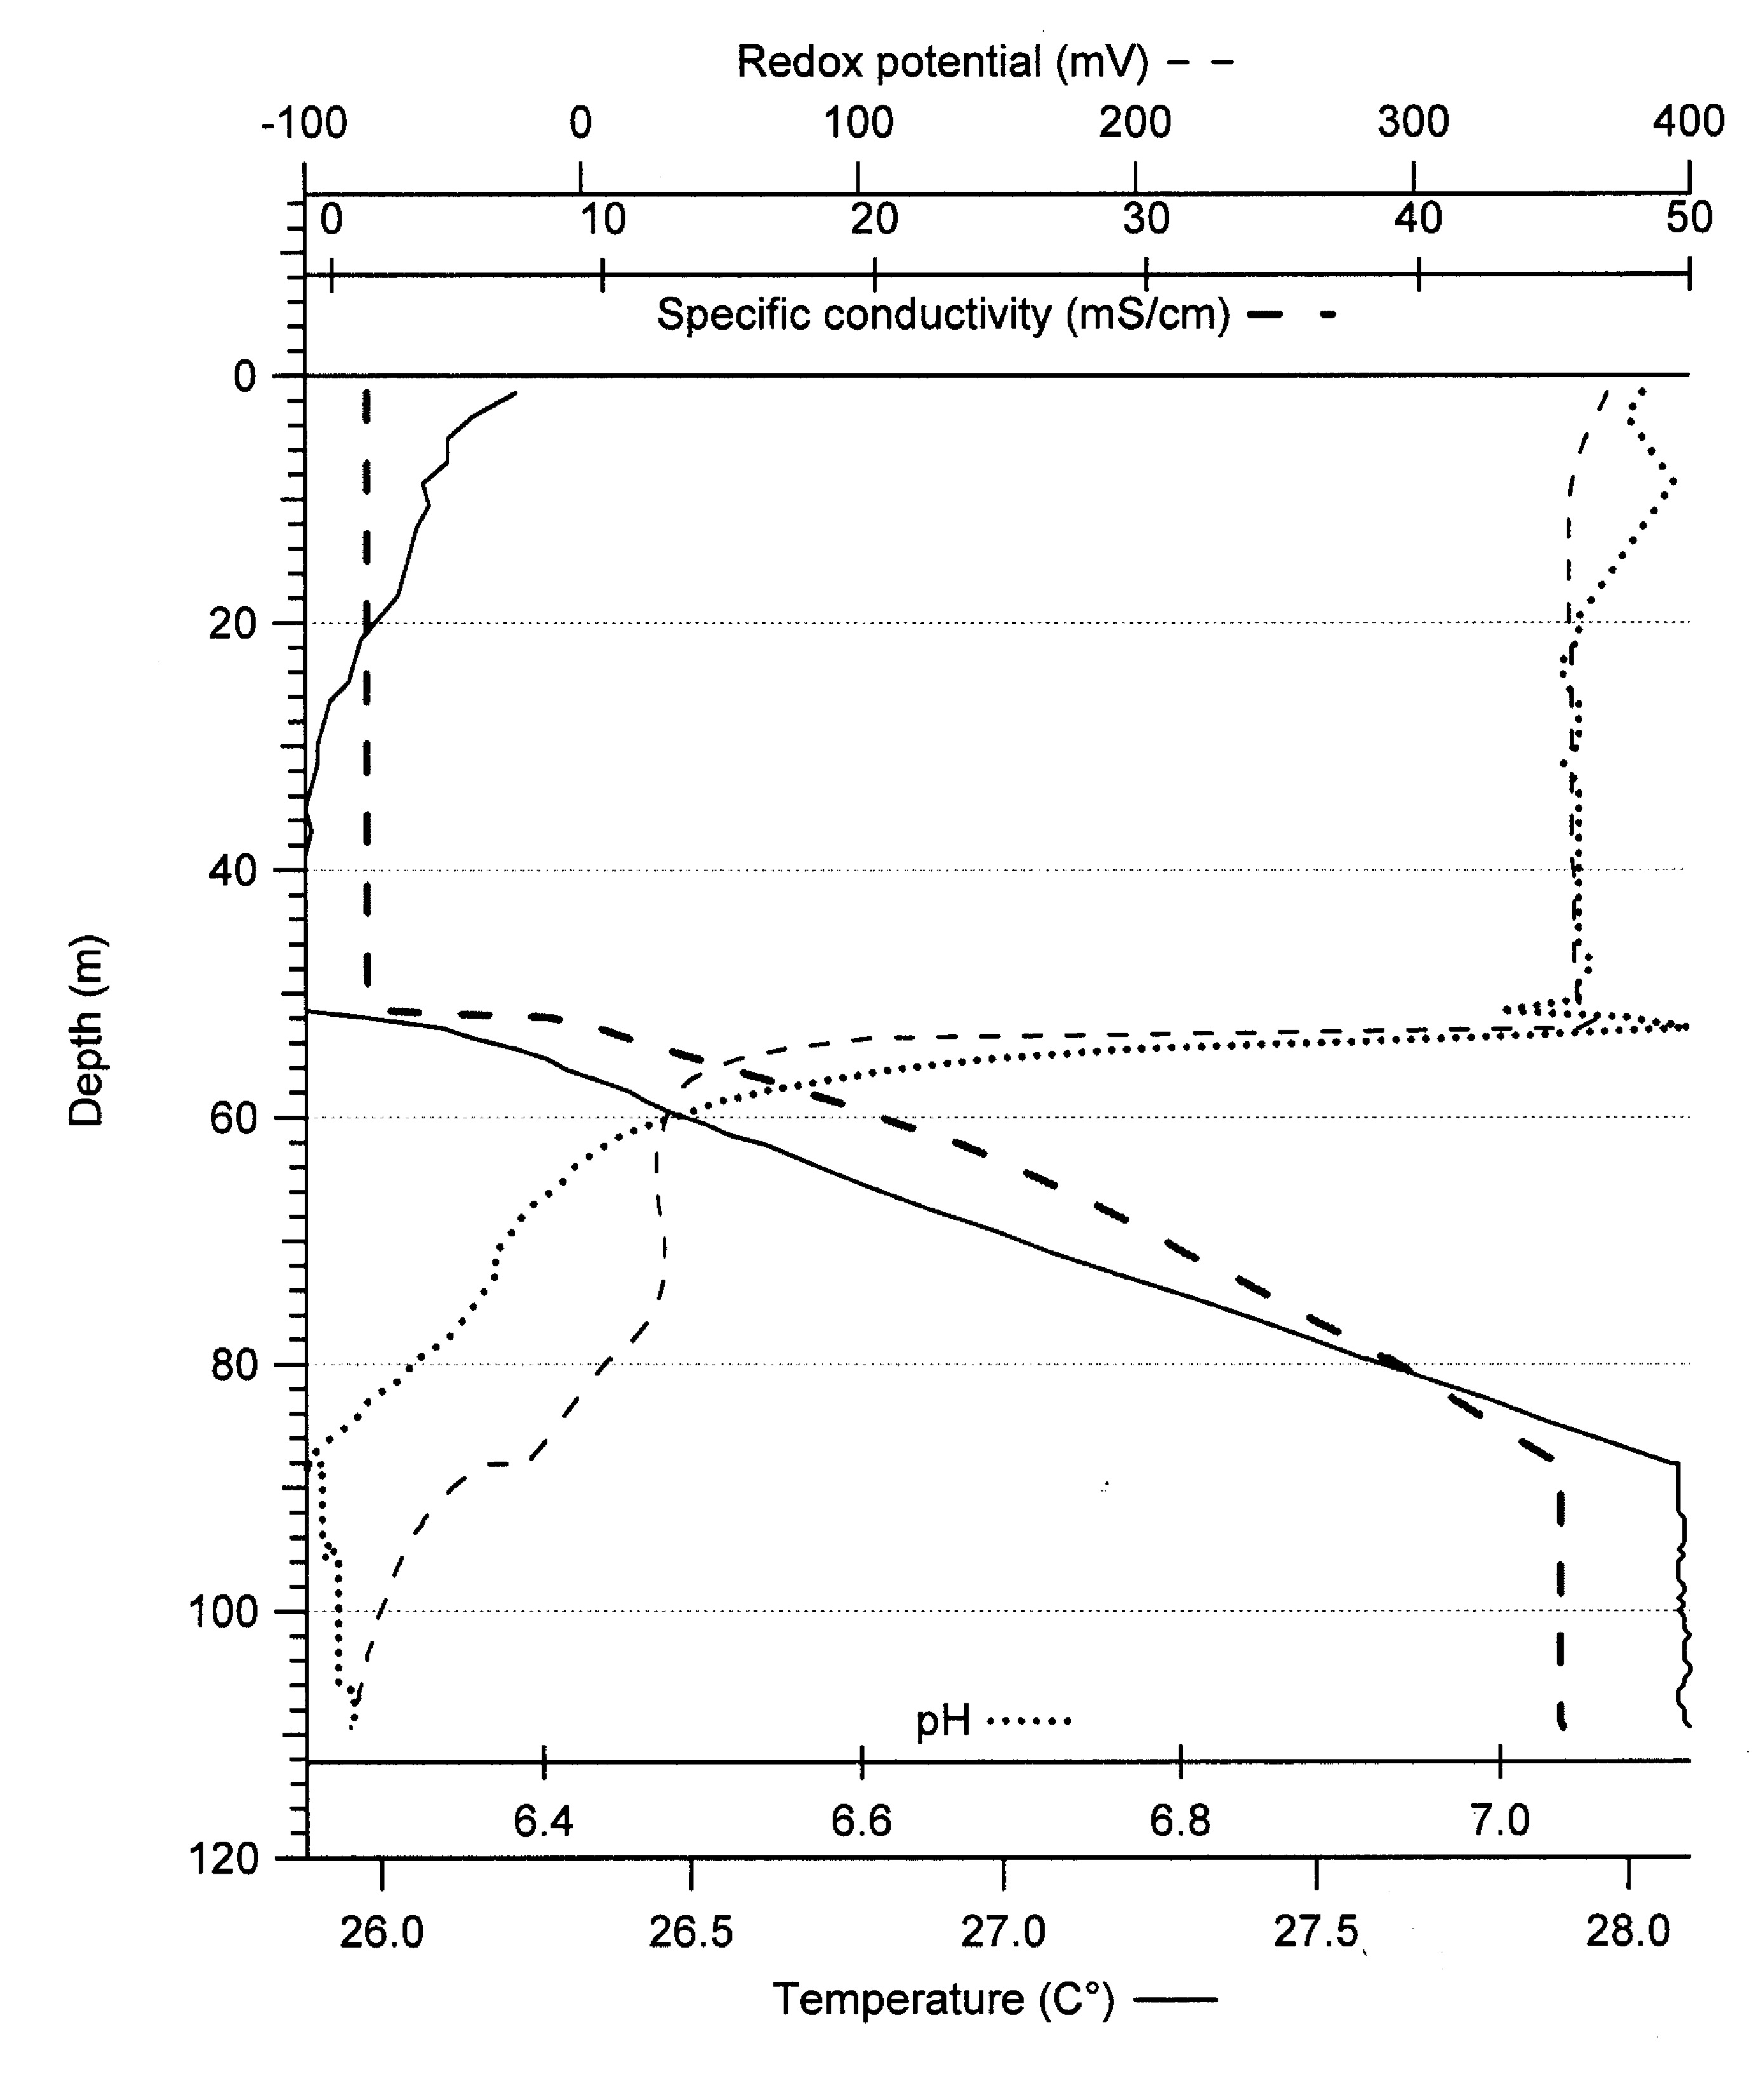
Groundwater geochemistry:
Cooler freshwater lens overlaying warmer saline groundwater with a thin mixing zone between them;
Stable warm temperatures (24-28°C) year round, and circumneutral pH (6.3-7.4);
These conditions are expected to support active diverse microbial communities that are expected to deal with the high nutrient influx from sewage.
Lack of metals: the groundwater lacks any heavy and transition metals (i.e. Fe, Cu)
High sulfur fractionation: sulfide-sulfate fractionation values (deviation from the normal ³²S and ³⁴S ratio) up to 63‰ have been measured in the groundwater.
Typical groundwater profile from Yucatan Peninsula

Slide 6
Research question:
Which environmental variables have most effect on the native microbial communities in the Yucatan groundwater?
Is there a sufficient and active microbial community present that could handle the high organic nutrient load?
Which of these variables has the biggest effect on microbial diversity?
How are the specific groups of microbes affected: sulfur cycling bacteria, methanogens, fecal bacteria, pathogens, cyanobacteria, etc?
Is there a significant difference between the microbial communities that would explain the high sulfur fractionation values of some areas, but not in the others?
These questions will be investigated by looking at two aspects of the microbial DNA samples: the V4 variable region of the 16S ribosomal RNA gene (identity based), and the shotgun metagenomic samples (genomic potential of the communities).

Slide 7
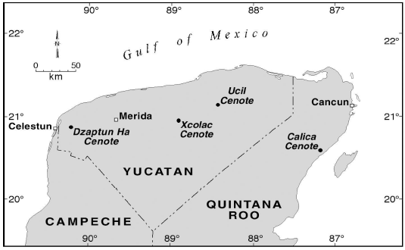
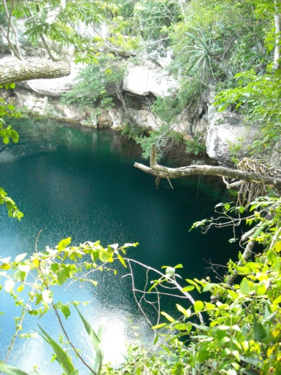
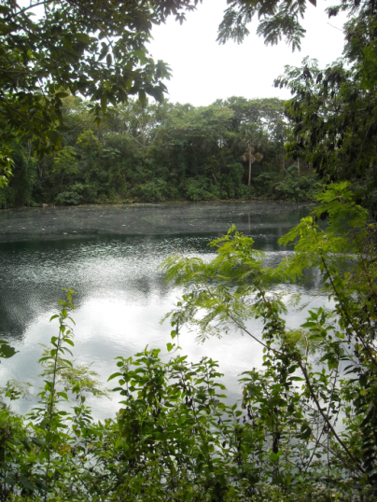
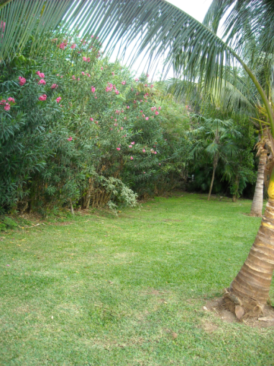
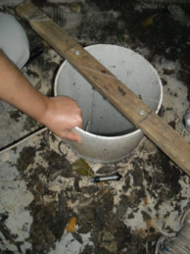
Research design: Sampling sites
Cenotes (deep water-filled karst sinkholes) allow easy access to the groundwater
Cenote Ucil
BPPT4 .
Cenote Calica
 | Xcolac | Calica | Ucil | Hotel well
Depth | 120m | 20m | 117m | 20m
Interface (approximately) | 50-70m | 13-16m | 68-78m | 9-20m
Vegetation carbon input | high | low | low | none
Light input | low | high | low | none
Anthropogenic influence | agriculture | minimal | agriculture | tourist
Cenote Xcolac
Abandoned drinking water well at a resort territory

Slide 8
Results: overall diversity
The overall diversity is rich – on phylum level only, 81 different groups were identified!
The abundance pattern of the 13 most numerous phyla (over 1% of total occurrence).

Slide 9
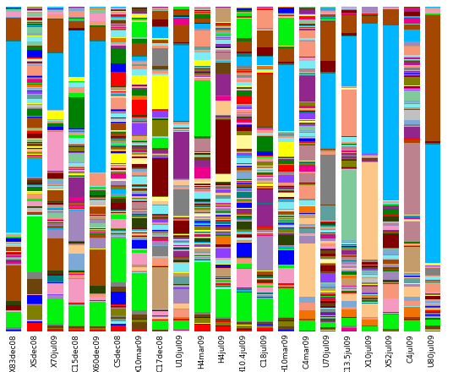
Results: overall diversity
On genus level, 1502 different taxonomic units were identified!
Acinetobacter
Pseudomonas
Rhodobacter
Brevundimonas
Sulfurimonas
Prochlorococcus
Erythrobacter
Desulfobacterium
Reinhemeria
Bacillus
Flavobacterium

Slide 10
Results: which factors influence this diversity?
*Alpha diversity (within sample diversity) was assessed as Chao1 index (estimated number of species), Phylogenetic Diversity (PD), and Shannon entropy.
Red squares indicate statistically significant increase,
the blue squares decrease.
The hotel well site with tourist impact has the highest diversity!
 | Chao1 | PD | Shannon
Site | Ucil | Xcolac Calica Ucil
Season | Dry | Dry
Substrate | Water | Water | Water
Location |  |  | coast
Salinity
Light |  | High light
Carbon | No vegetation | No vegetation | No vegetation
Impact | tourist | tourist | tourist
increase
decrease

Slide 11
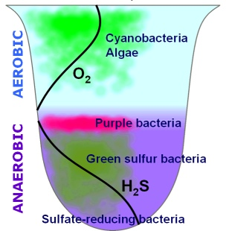
Results: which factors influence this presence of specific microbial groups - sulfur cycling microbes
The sulfate reducing bacteria (SRB) make up 3.92% of total microbes, and the sulfur oxidizing bacteria (SOB) 3.76%.
Overall, the SRB as a group were more prevalent during the dry season and in high vegetation carbon input samples (Xcolac).
Sulfur oxidizers as group did not show a prevalence towards any variable.

Slide 12
Results: which factors influence this presence of specific microbial groups - sulfate reducing bacteria
Overall, the SRB belonging to phylum Delta Proteobacteria were most common SRB. These organisms were significantly more prevalent during dry season.
The hotel well had higher amount of Sulfurospirillium and Thermodesulfovibrio. The Gram (+) SRB were only present at the hotel site and Xcolac dry season freshwater sample.

Slide 13
Results: which factors influence this presence of specific microbial groups - sulfur oxidizers
Of the different SOB, only purple sulfur bacteria show significantly greater prevalence towards high light environments (Calica). Three sites show explosive growth of green sulfur bacteria, although there is no trend towards observed variables.

Slide 14
... so what about the sulfur fractionation problem?
Xcolac (63‰)
Calica (44‰)
* More purple sulfur bacteria at the interface;
* More purple non-sulfur bacteria overall;
* More green sulfur bacteria at the saline layer
* Also, no significant difference between complete and incomplete carbohydrate oxidizers!
So, essentially, we still cannot explain it!

Slide 15

Results: which factors influence this presence of specific microbial groups – methanogens
Methanogens (all archaea) make up 0.02% of total organisms, and 0.8% of all archaea. The more oxygen tolerant methanogens (Methanocellales) are not more common. Methanogens are found in significantly higher amount in the sediment and in high vegetation carbon sites.

Slide 16

Results: which factors influence this presence of specific microbial groups – all fecal bacteria
All fecal bacteria (indicator organisms and exclusively fecal genera) make up 0.59% of the total bacteria – not as prevalent as feared!
All fecal bacteria are more prevalent at the hotel well site, and significantly less prevalent at Xcolac and Calica (Cenote Ucil falls in between).
Non-indicator fecal bacteria are significantly more prevalent in the hotel site than in all other sites.

Slide 17
Results: which factors influence this presence of specific microbial groups – all fecal indicator bacteria
The fecal indicator bacteria (as group) are more prevalent during rainy season.
The indicator bacteria are dominated by the coliforms (Enterobacteraceae) that also show significantly higher prevalence during the rainy season. However, the total coliform bacteria are often considered unreliable as indicators.

Slide 18
Results: which factors influence this presence of specific microbial groups – fecal indicator bacteria without coliforms
E. coli (fecal coliform) are more prevalent in the tourist affected site (hotel well).
Enterococcus is significantly more prevalent at the tourist affected site.
Bacteroides is significantly more prevalent at the hotel site.
Bifidobacterium is also more prevalent at the hotel site.
All of these bacteria are notably absent from several sites! Only hotel well freshwater and Calica sediment have all four groups present.

Slide 19
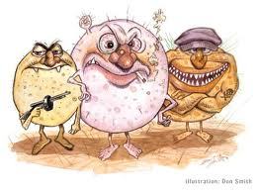
Results: which factors influence this presence of specific microbial groups - pathogens
Exclusively pathogenic genera make up 0.004% of total microbes. There is significantly higher percentage of pathogens in the hotel well site that is in the middle of tourist resort that disposes some of its sewage effluent into the injection well and uses the rest of it for irrigation.
Only exclusively human/animal pathogenic bacterial genera included: Gardnerella, Faclamia, Atopobium, Lepotricha, Aggregatibacter, and Treponema. Sources can be fecal and non-fecal.

Slide 20
Conclusions
The overall microbial diversity in Yucatan groundwater is huge – much like the diversity of the macro fauna and flora of the peninsula;
The alpha (within sample) diversity is most affected by the human impact (tourist-impacted site has higher) and the substrate (sediment has higher). There is no significant difference between the levels of salinity.
While the overall prevalence of SRB and SOB are about the same, the SRB were more prevalent at dry season, and the SOB at high light environments. No trend was discovered that would explain the higher sulfur fractionation values at Xcolac.
Methanogens are more prevalent in the sediment – as they should be!
Fecal bacteria are not as prevalent as feared and fecal indicator groups are notable absent from many sites. Overall, fecal bacteria are more common at the hotel well.
The minute fraction of exclusively pathogenic genera present are more common at the hotel well.

Slide 21
