Slide 1
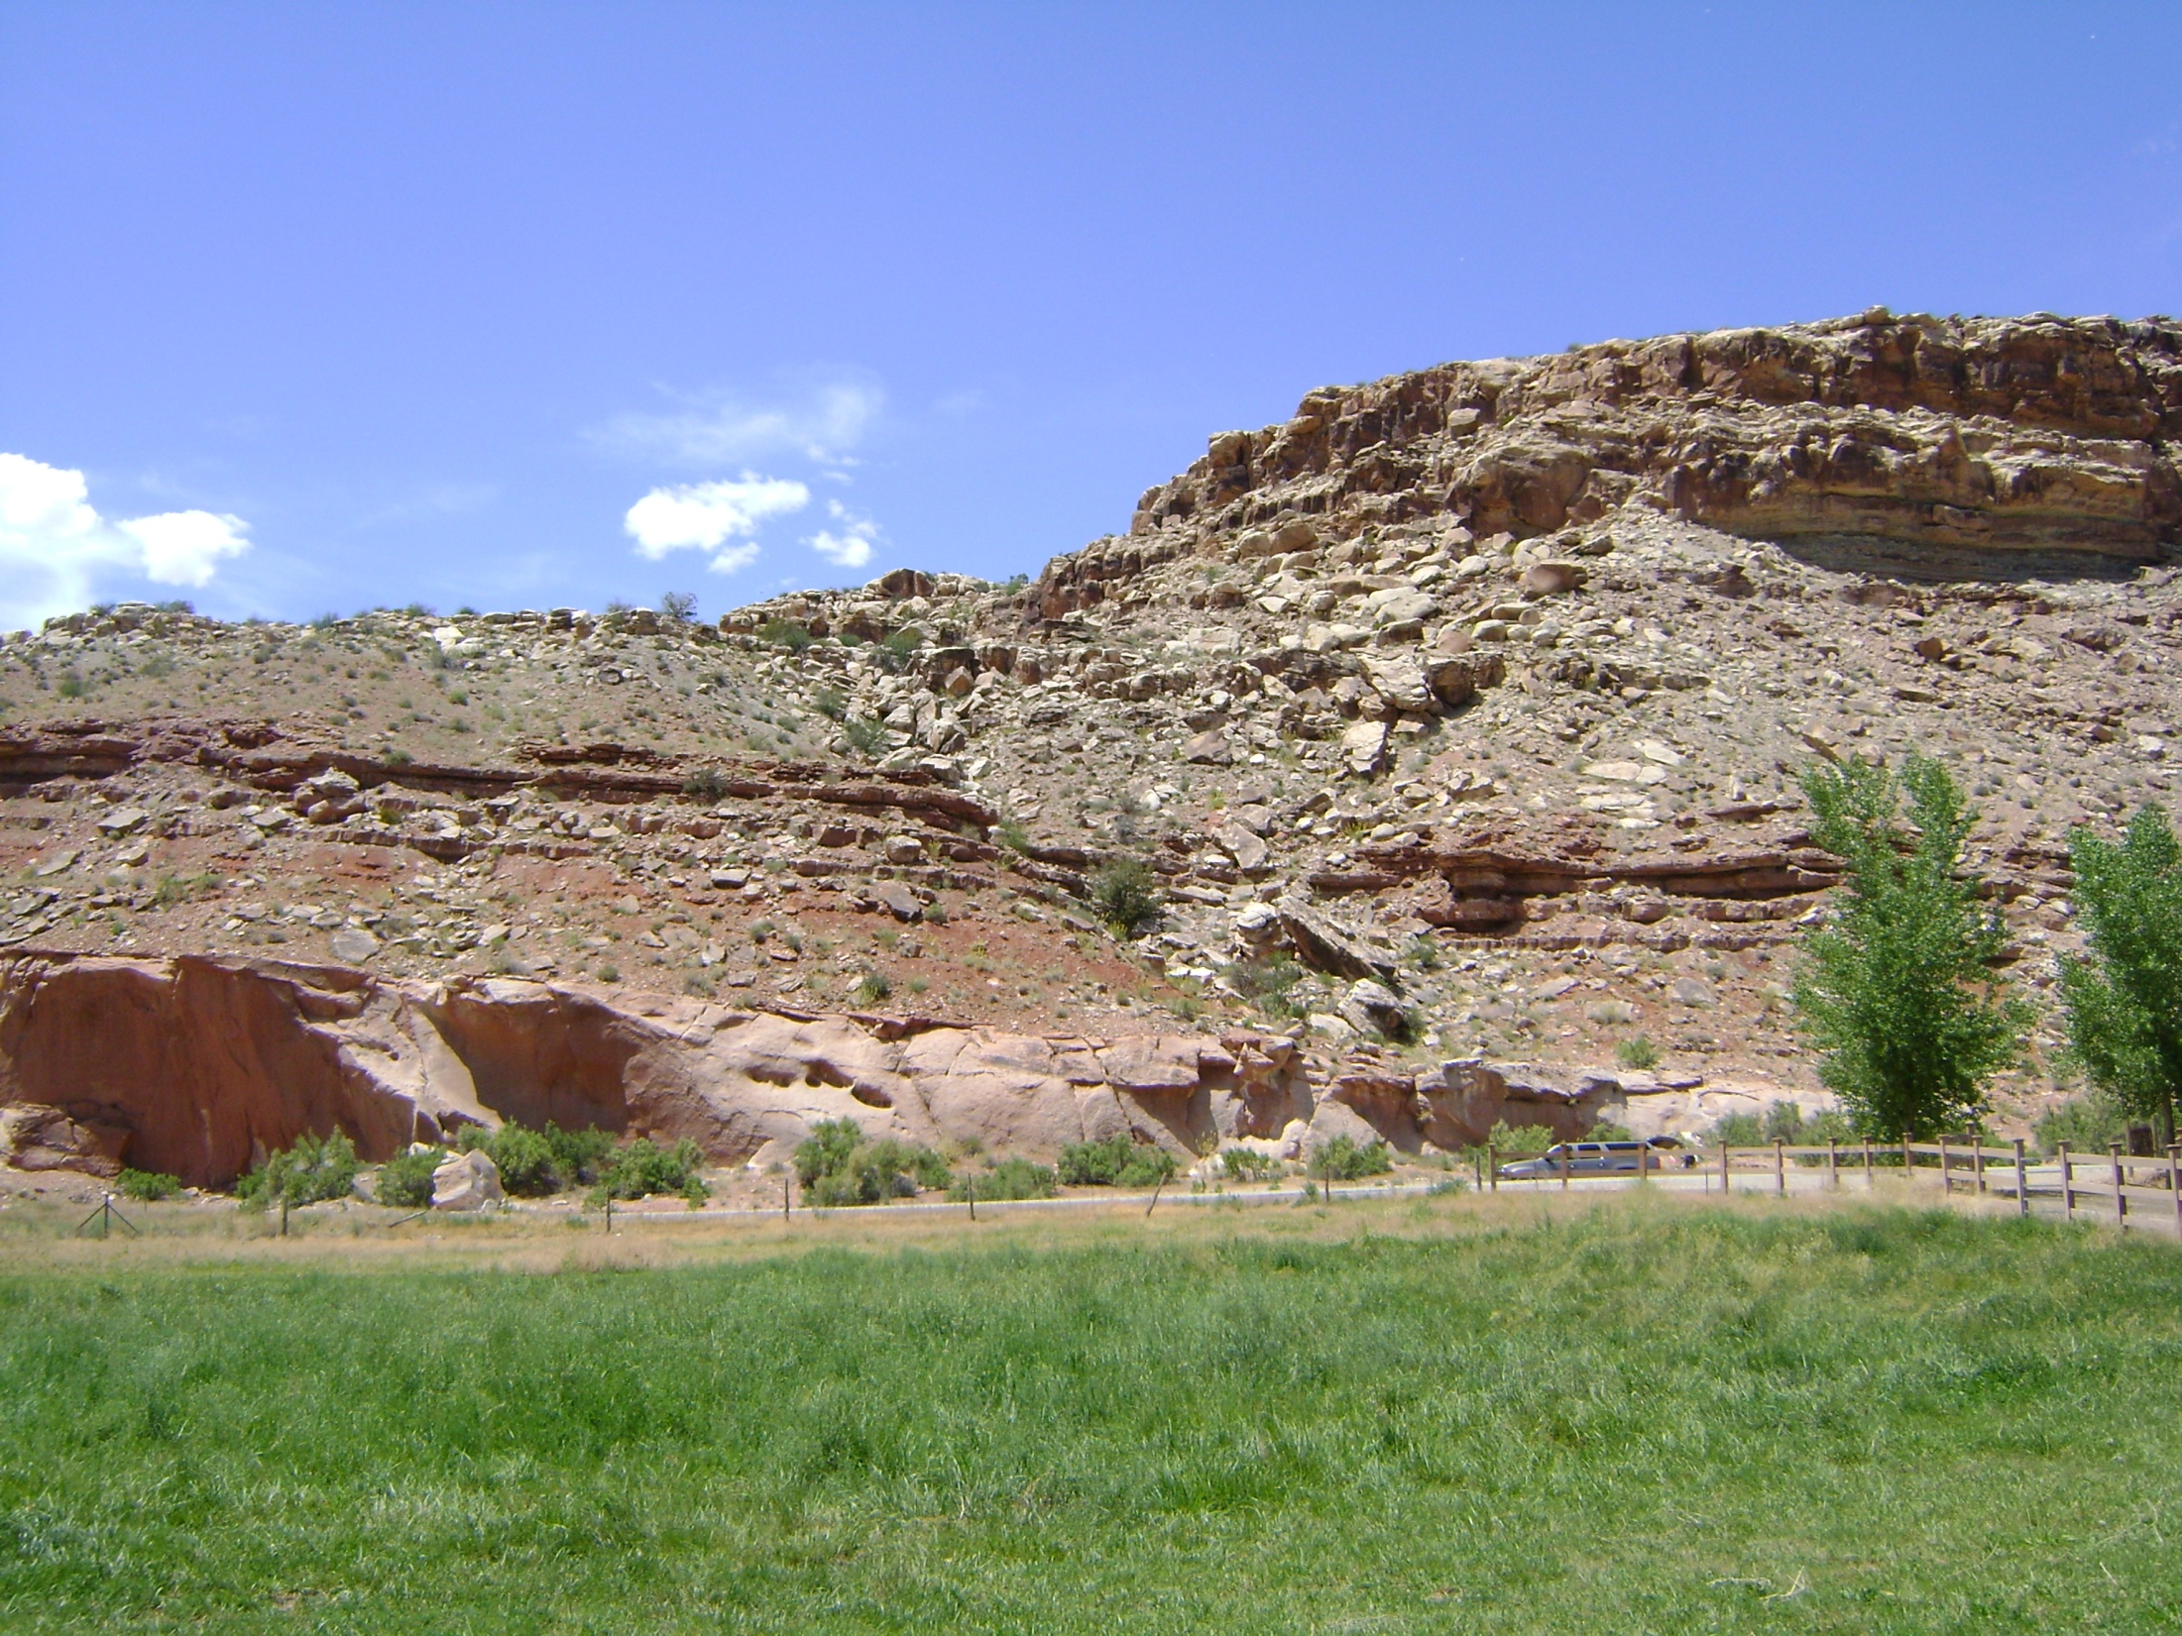


INITIAL PROVENANCE ANALYSIS OF THE LATE JURASSIC LACUSTRINE WANAKAH FORMATION, EASTERN UTAH AND WESTERN COLORADO
Marisa Boraas¹
Sally Potter-McIntyre²
Keegan DePriest¹
1 Dept. of Physical and Environmental Sciences, Colorado Mesa University, 1100 North Avenue, Grand Junction, CO 81501
2 Dept. of Geology, Southern Illinois University, Parkinson Lab, Carbondale, CO 62901

Slide 2
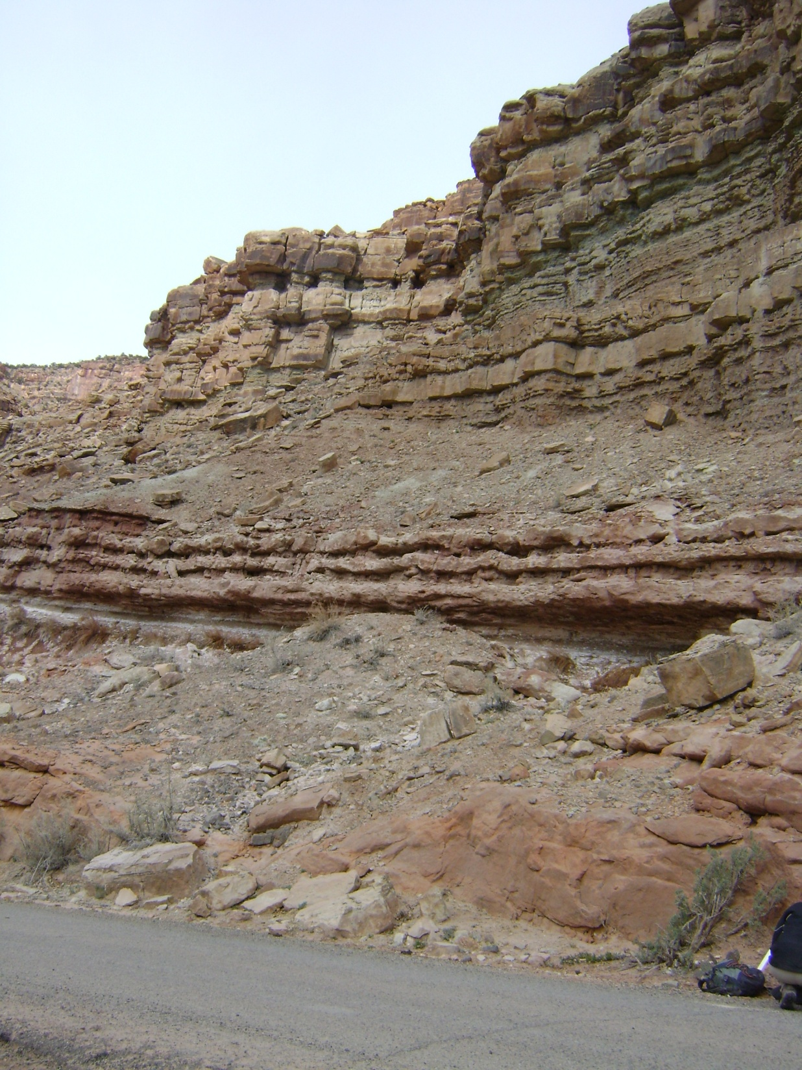
Outline
Introduction
Field Research
Detrital Zircon Data
Interpretations
Conclusions
Tidwell Member of the Morrison Formation
Wanakah Formation
Entrada Sandstone
Escalante Canyon

Slide 3
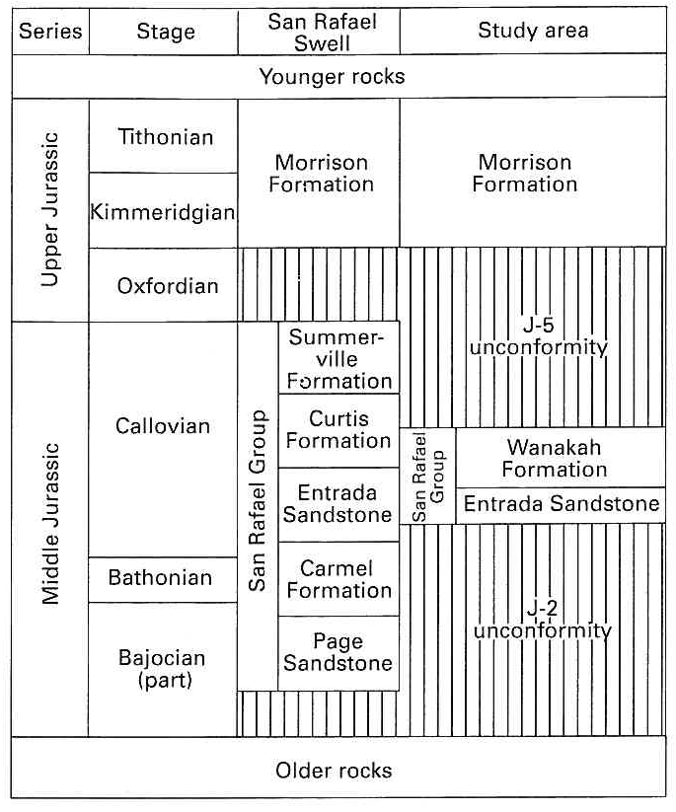
Stratigraphic Relations
Tidwell Member
J-5
Marker Bed “A”
J-2
From O’Sullivan 1992
Notes:
Keegan/Sally Poster Plug
Less wording-stratigraphy
Move hypothesis to after evidence

Slide 4
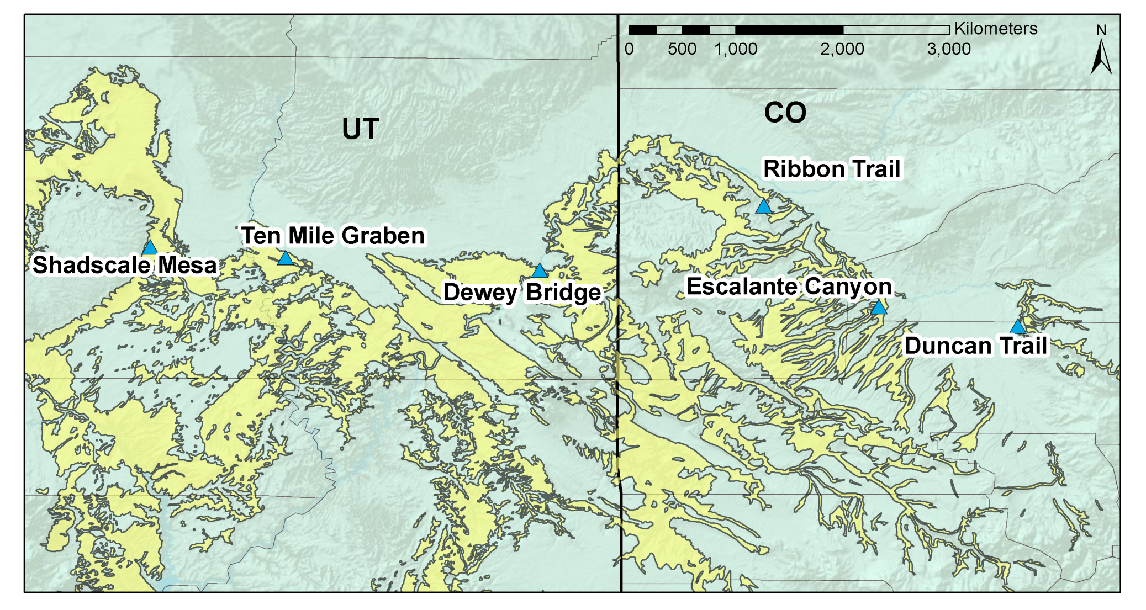

Study Areas
Book Cliffs
Grand Mesa
Location of Colorado Plateau

Slide 5
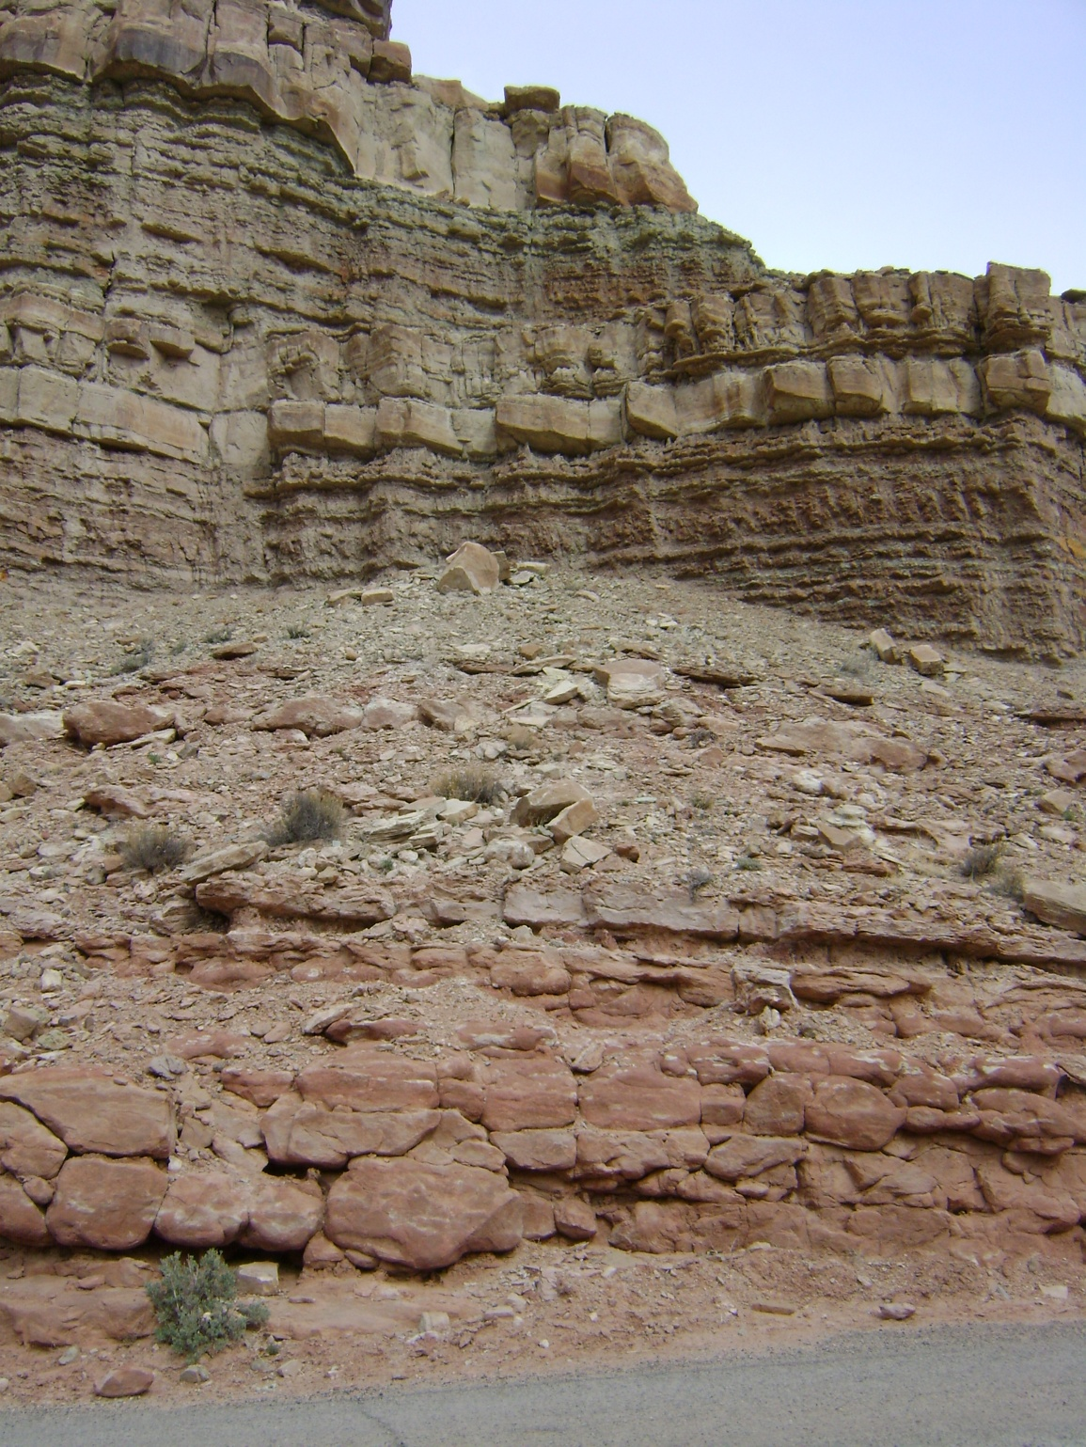
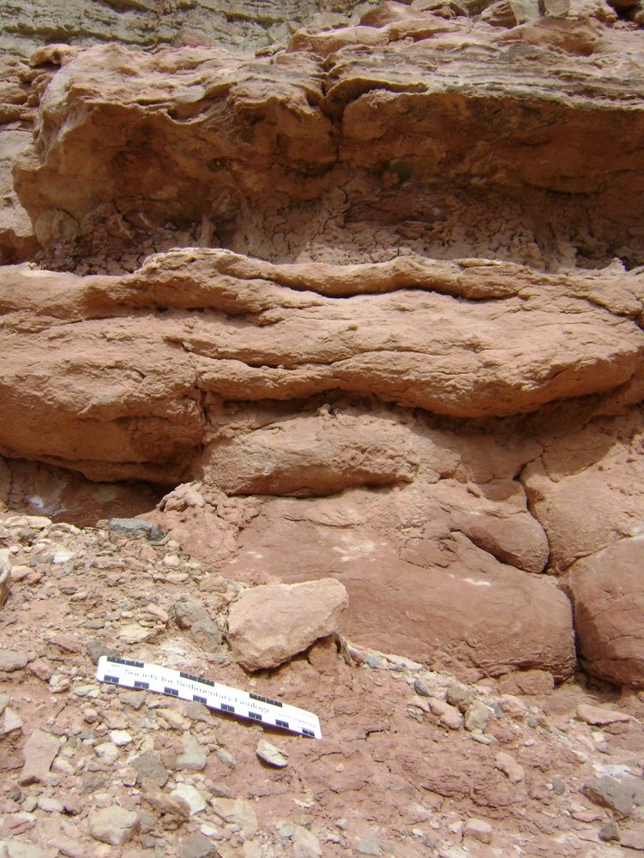
Field Evidence for New Placement of Unconformity
Jw
Je
Escalante Canyon, CO
Notes:
You need to show pictures of the section at Escalante with the scour surface between the Entrada and Wanakah and the Wanakah/ Tidwell to illustrate why we think there is an unconfomrmity between the Entrada and Wanakah.

Slide 6
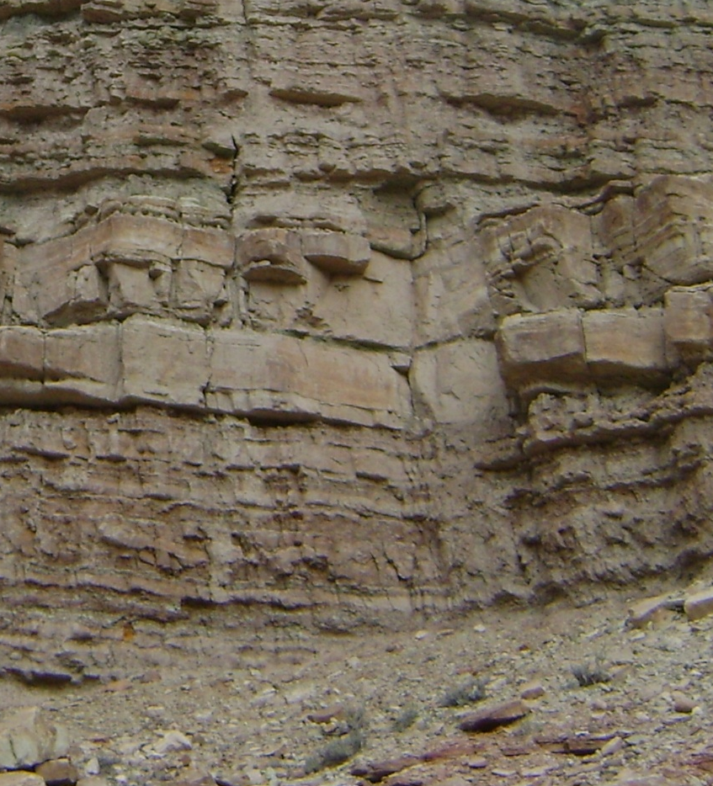
Field Evidence for New Placement of Unconformity
Jmt
Bed “A”
Jw
Escalante Canyon, CO
Notes:
You need to show pictures of the section at Escalante with the scour surface between the Entrada and Wanakah and the Wanakah/ Tidwell to illustrate why we think there is an unconfomrmity between the Entrada and Wanakah.

Slide 7
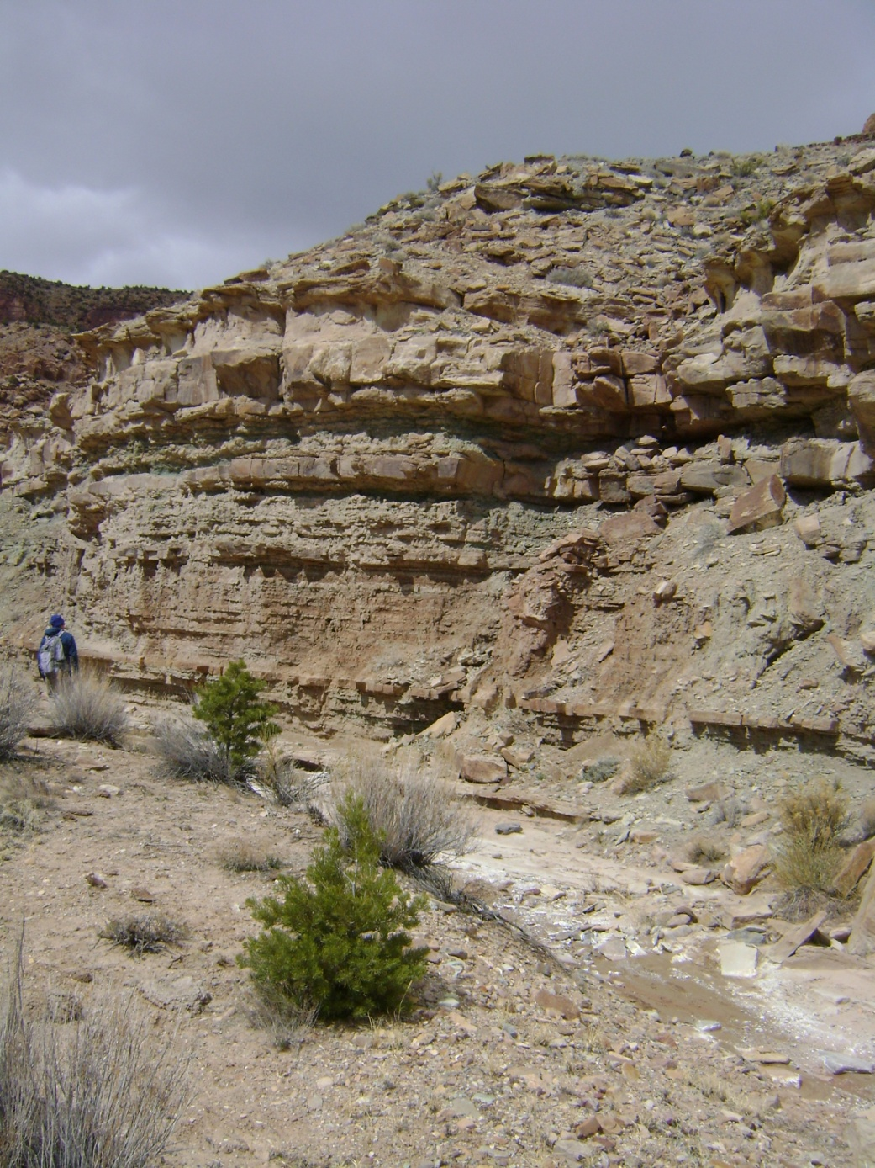
Research Questions
What is the provenance of the Wanakah Formation?
What ages are the formations?
Where should unconformities be placed?
Notes:
What should I add to this slide? Specific Image? Or make it part of the last slide (take out image and add hypothesis)

Slide 8
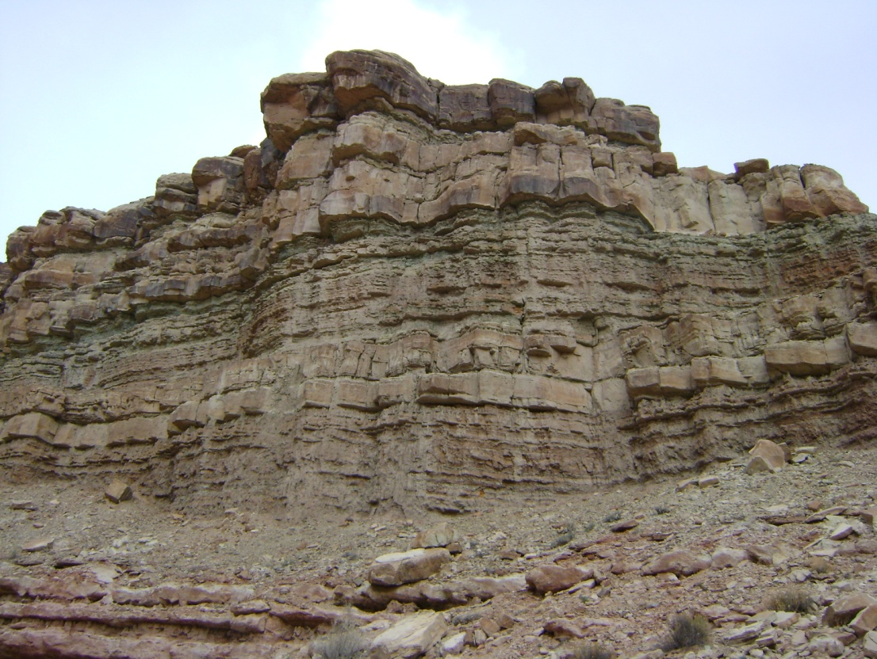
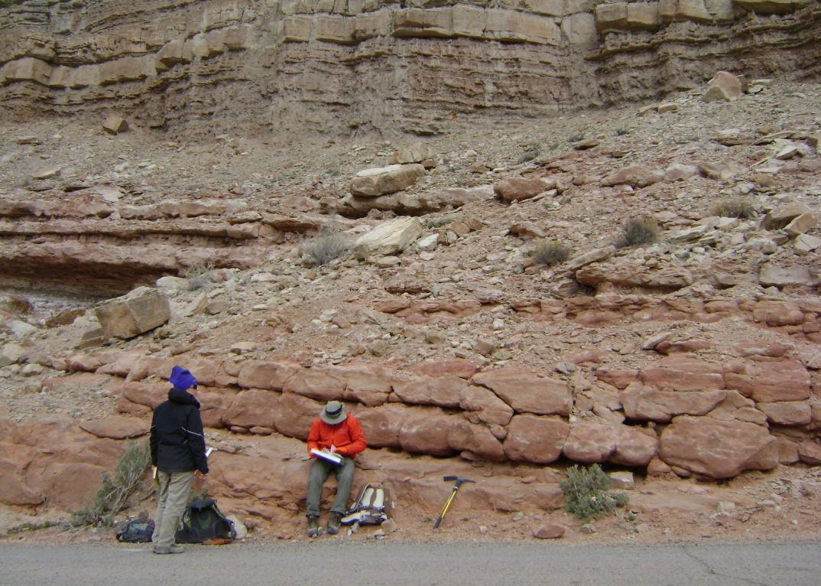
Research Applications for a Lacustrine Petroleum System
Paleogeographic history of basin
Provide a better Jurassic basin reconstruction

Slide 9
Methods
U-Pb Ages
Max Depositional Ages
Sediment Provenance
Notes:
Three bullets

Slide 10

Maximum Depositional Ages
Salt Wash Mbr. Maximum Depositional Age
164.4±4.3 Ma
Escalante Canyon
Tidwell Mbr. Maximum Depositional Age
164.9±2.7 Ma
Not enough grains in Wanakah Formation to form a robust maximum depositional age. Single grain at 162.4±3.1 Ma.
Entrada Fm. Maximum Depositional Age
162.9±5.3 Ma
Detrital Zircon Sample

Slide 11
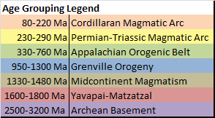
Salt Wash Member n=93
Tidwell Member n=199
526 Ma
Colorado Plateau Age Populations
Wanakah Formation n=307
Entrada Formation n=93

Slide 12
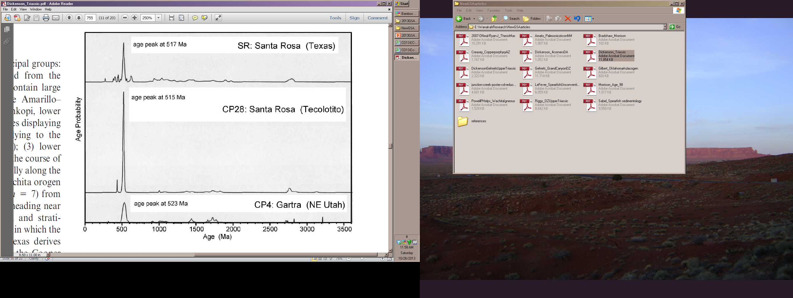
Sources
Reworked from Lower Chinle deposits in northern Colorado Plateau
From Dickinson and Gehrel 2008

Slide 13
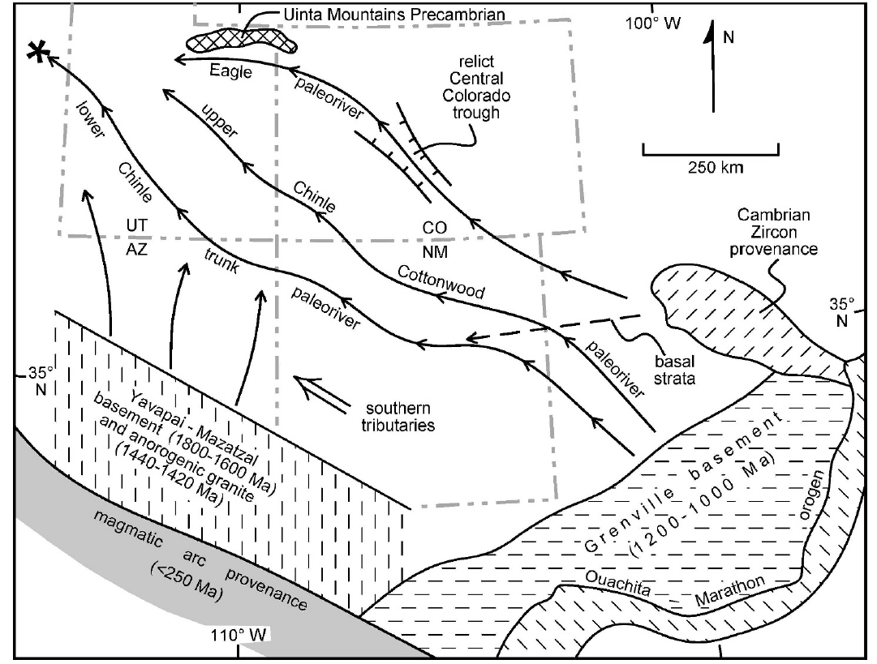
Sources
Grains from Amarillo-Wichita Uplift Texas/Oklahoma
Granite/Rhyolite 520-550 Ma (Gilbert 1983)
Amarillo-Wichita Provence
Proposed paleoriver from Dickinson and Gehrels (2008) draining the Amarillo-Wichita Provence
Notes:
Too wordy

Slide 14
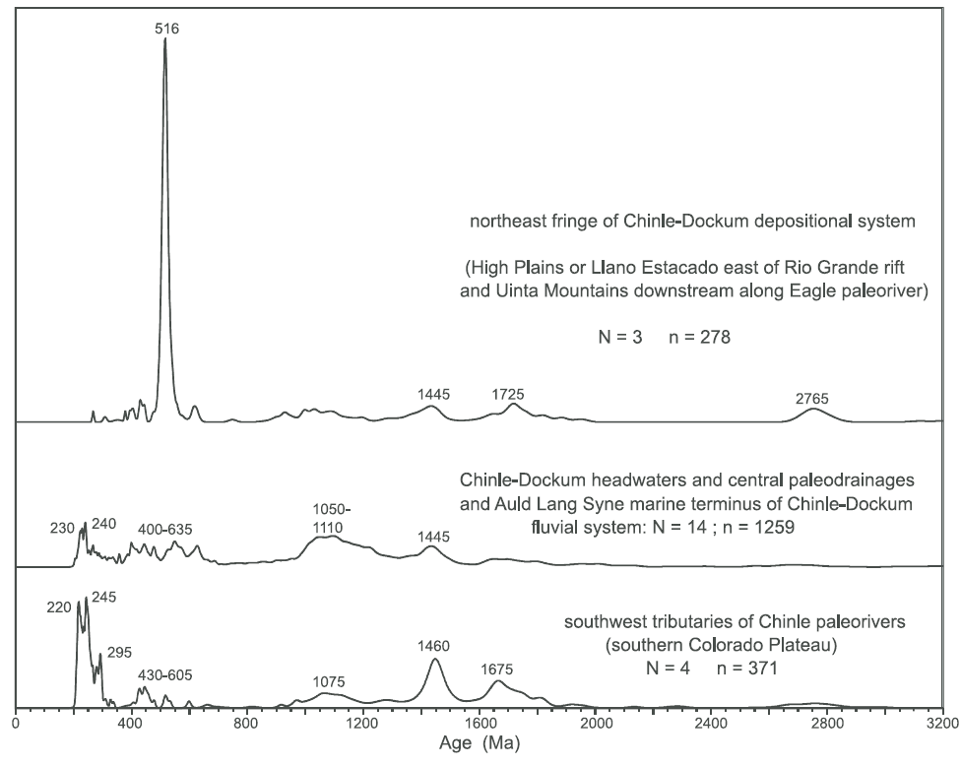
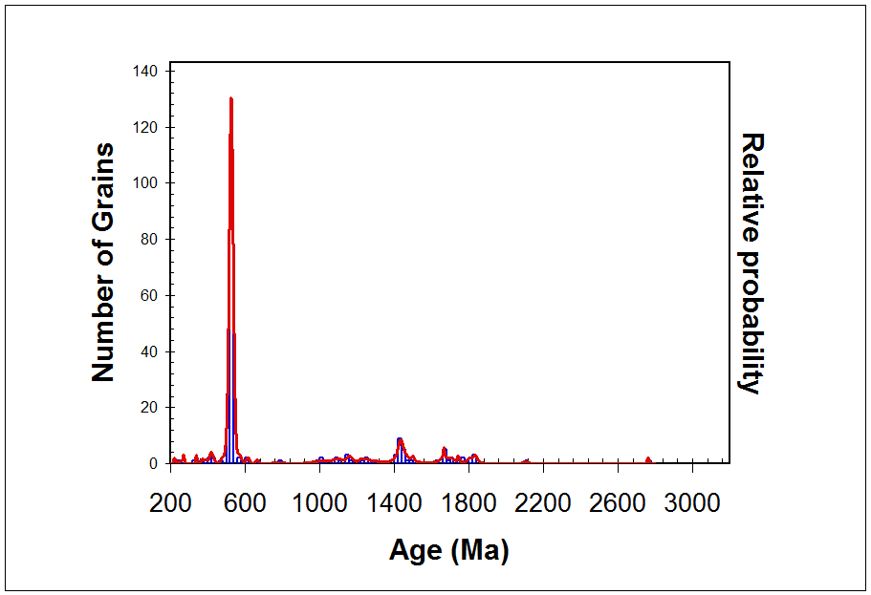
Sources
Composite Wanakah Formation
526
1443
2770
From Dickinson et al 2010

Slide 15
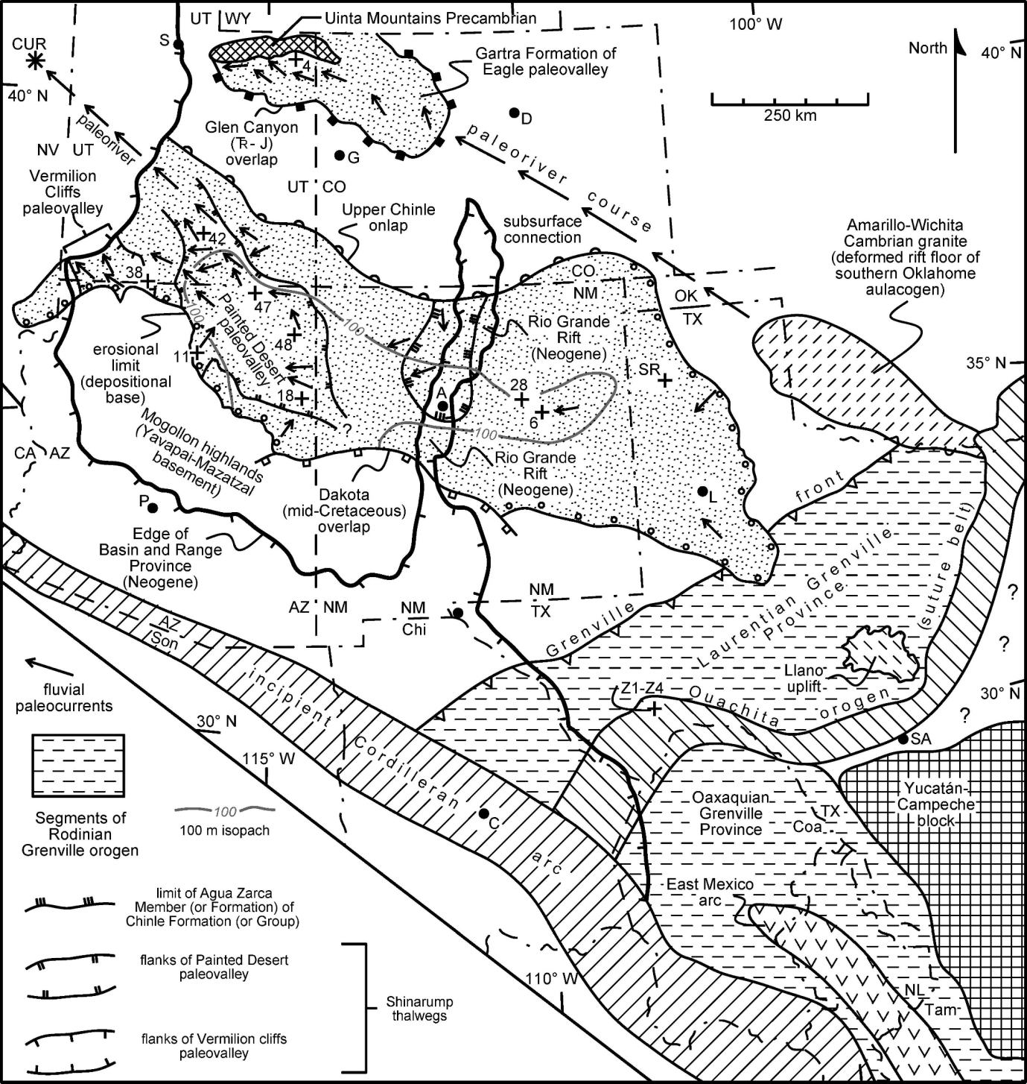
Interpretations
Reworking of Lower Chinle Formation
Lower Chinle Deposition
Wanakah Deposition
From Dickinson and Gehrel 2008

Slide 16
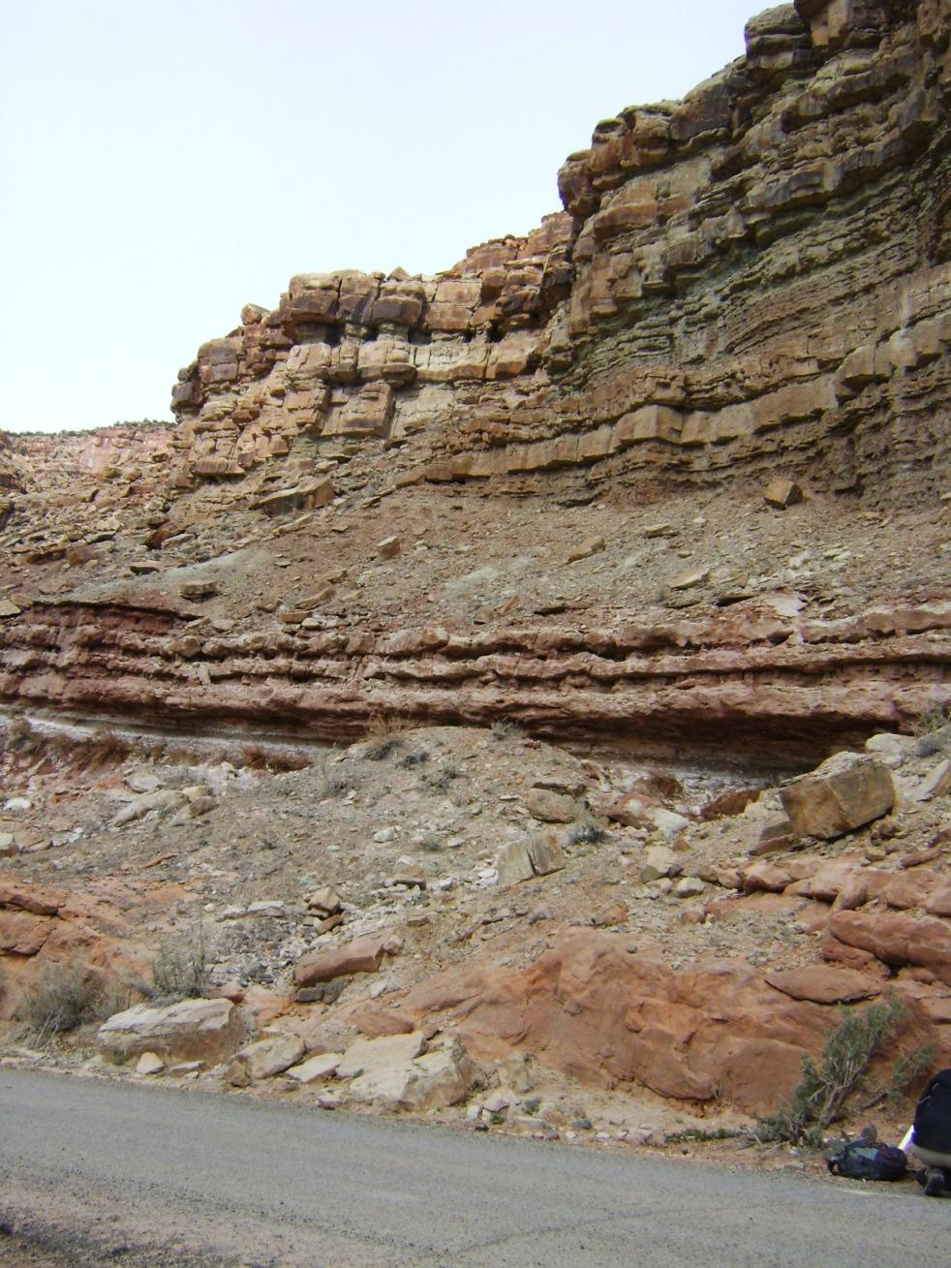
Conclusions
J-5 Unconformity between Tidwell Mbr. and Wanakah Fm.
Unconformity between Entrada Fm. and Wanakah Fm.
Uplift/Subsidence between 162.9 ± 5.3 Ma and 154.9 ± 0.5 Ma*
*Tidwell Mbr. ash age from Kowallis et al., 1997

Slide 17
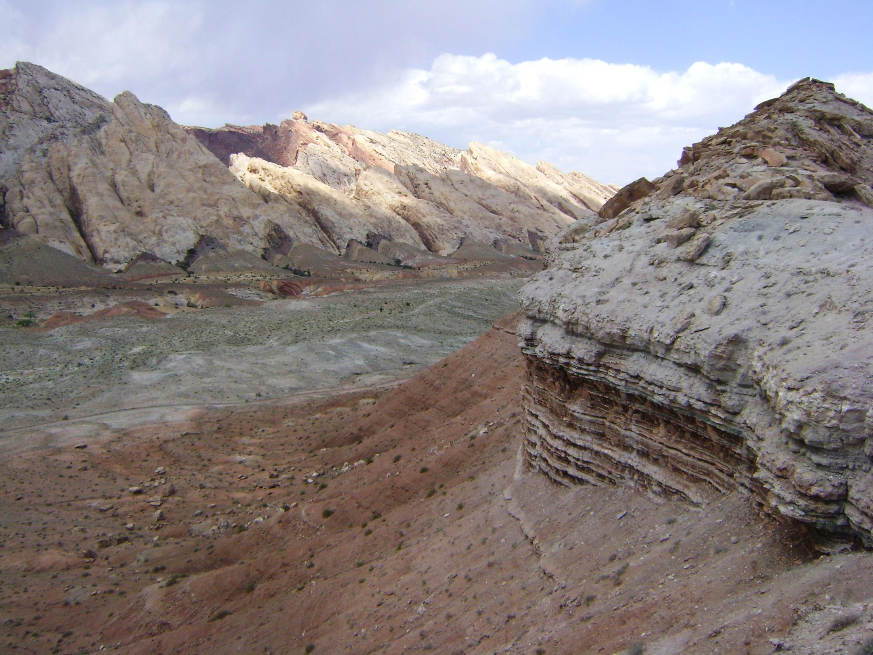
Acknowledgements:
Unconventional Energy Center for Applied Research at Colorado Mesa University grant (to Potter-McIntyre)
American Shale Oil Company grant (to Potter-McIntyre)
Arizona LaserChron Center-especially Mark Pecha and Nicky Geisler
Dr. Andres Aslan and the CMU Geology 202 students for their assistance with field work.

