Slide 1




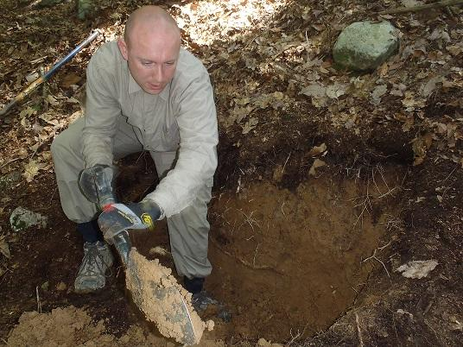
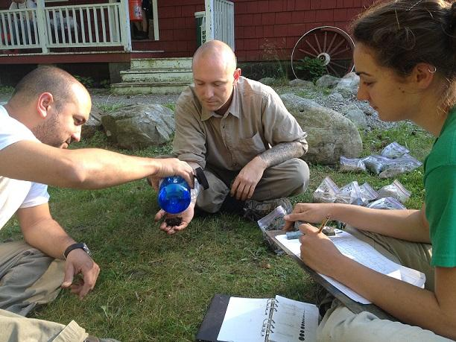
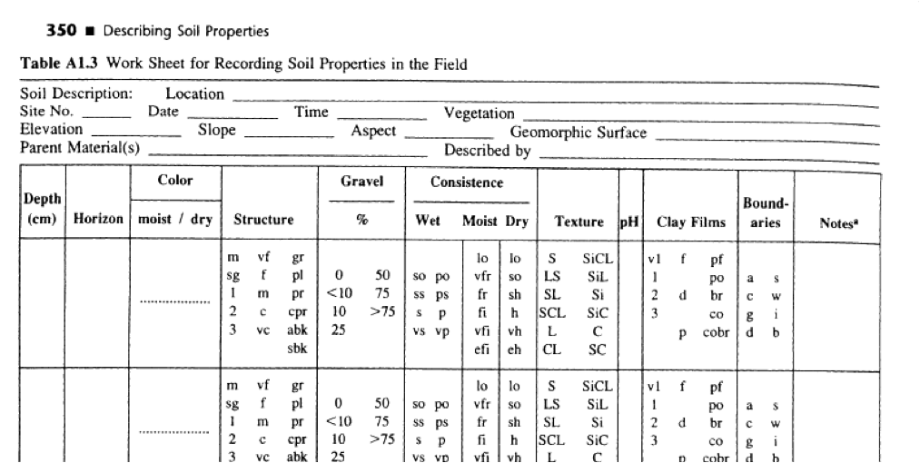
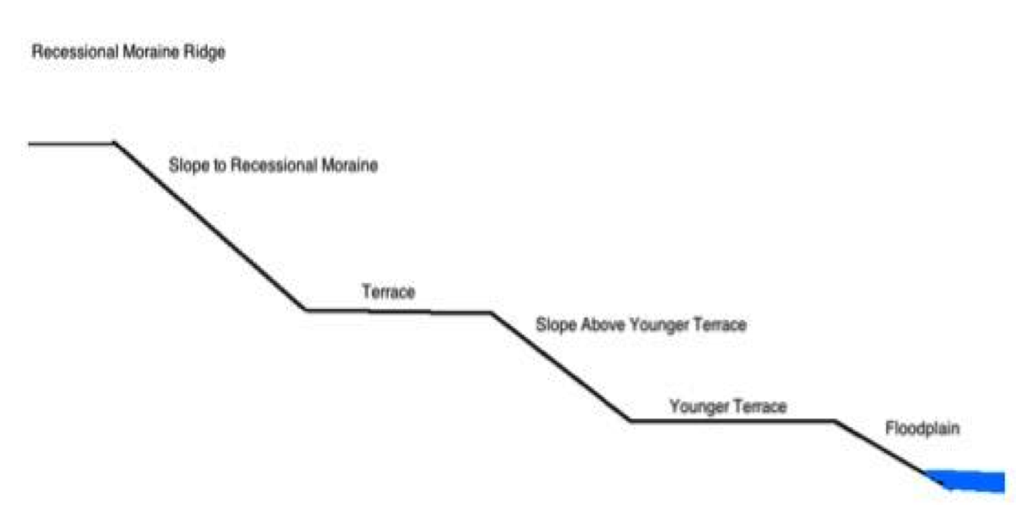
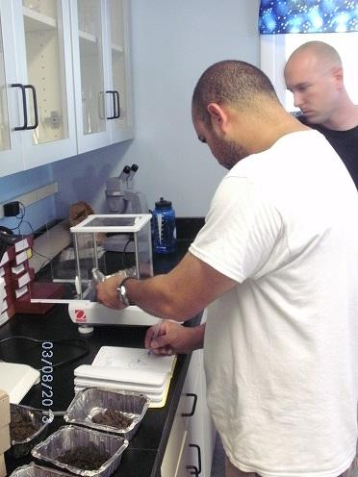
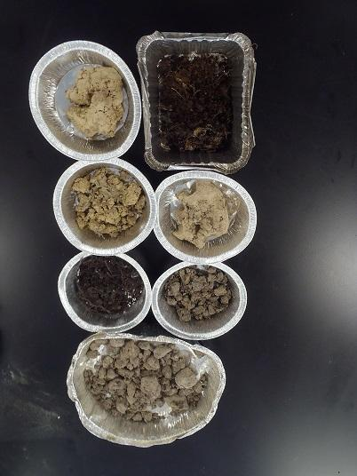
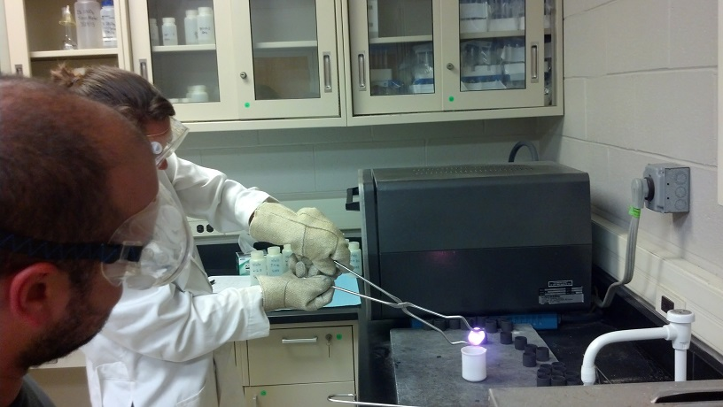
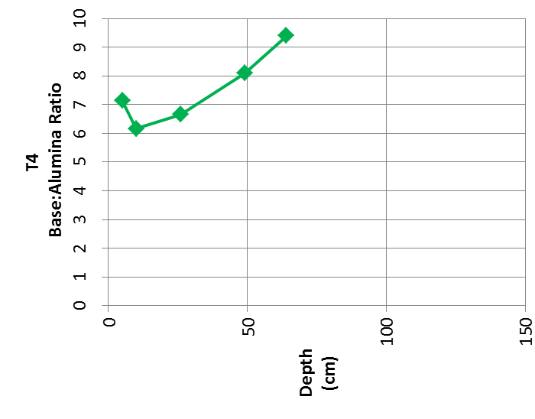
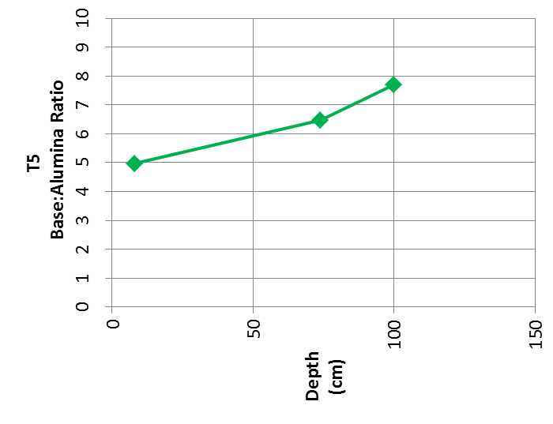
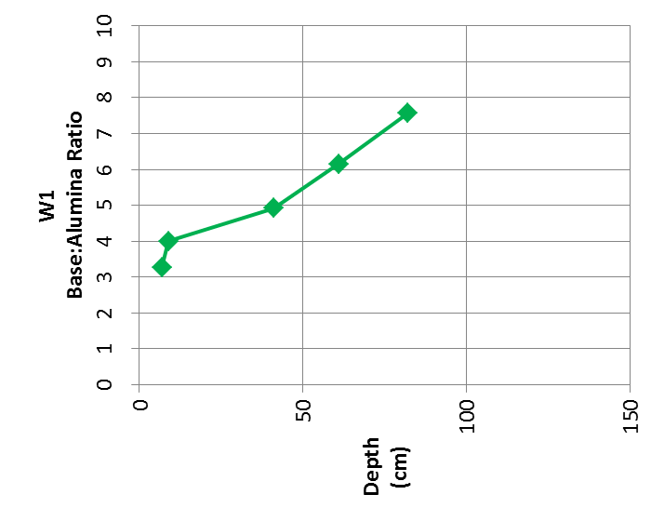
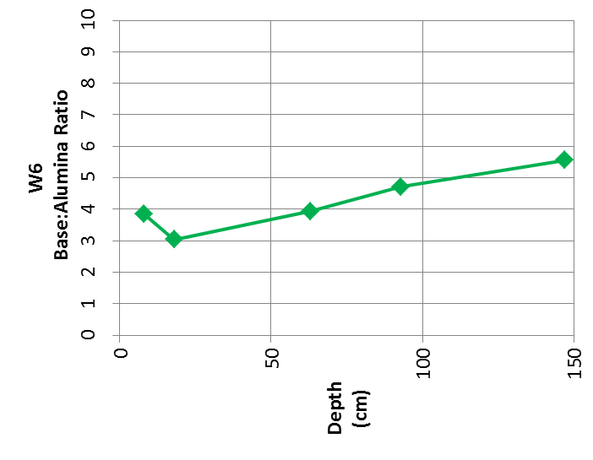
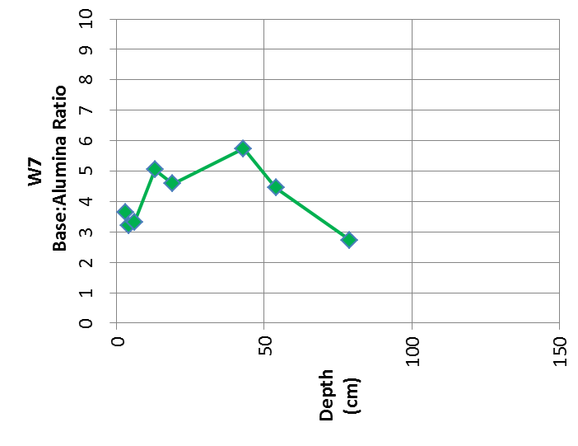
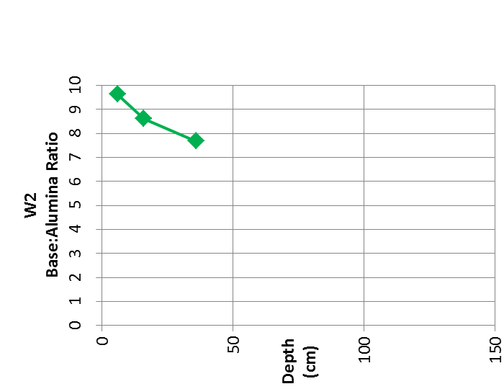
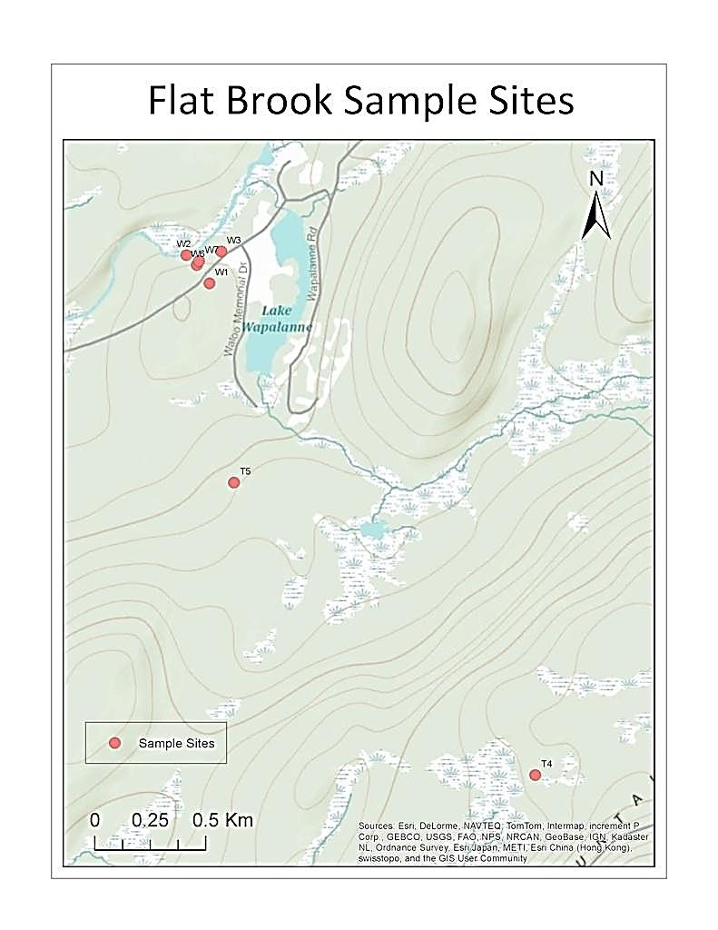
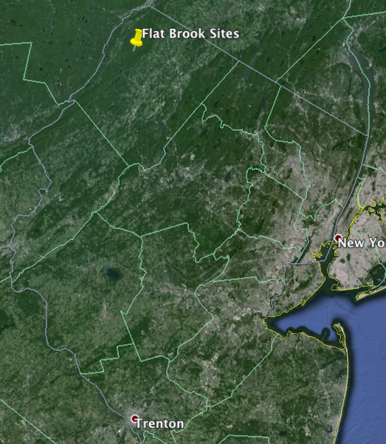
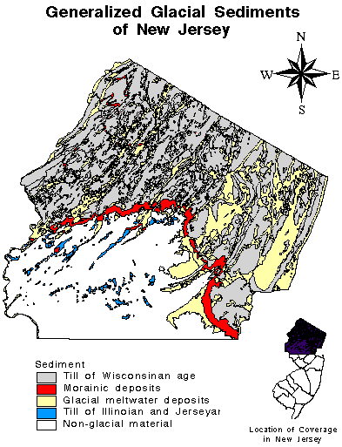
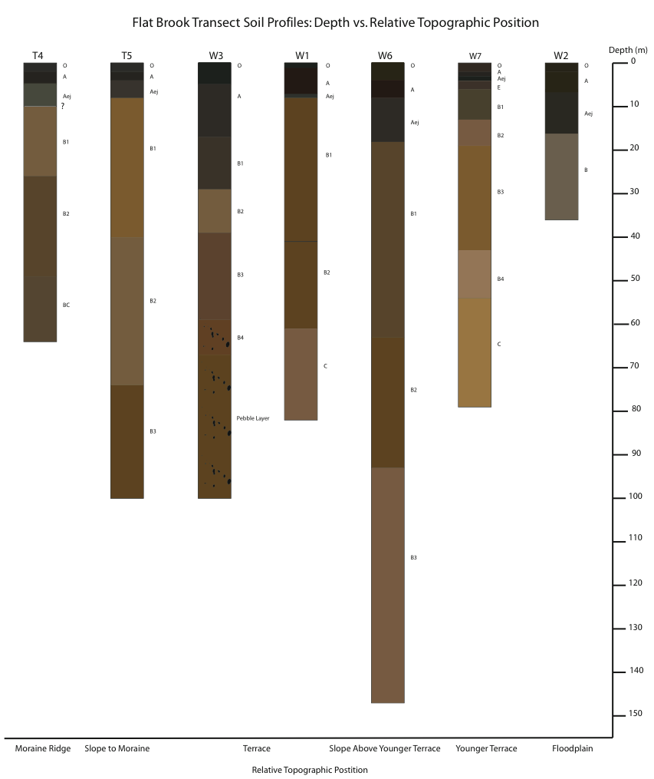
Field and Laboratory Methods Used to Assess Late Quaternary Pedogenesis
Liana M. Agrios², Miguel Loubriel Torres³, Salvatore Zerbo III¹, Gregory A. Pope¹ Joshua C. Galster¹, Meiyin S. Wu¹
Author contact information: popeg@mail.montclair.edu
¹Department of Earth and Environmental Studies, Montclair State University, Montclair, NJ 07043
²Department of Geology and Environmental Geosciences, Lafayette College, Easton, PA 18042
³Department of Geology, University of Puerto Rico at Mayagüez , Mayagüez , Puerto Rico, 00681-9000
Methods
Results
Abstract
8 weeks of field and lab work
Field Work
Excavate seven soil pits along a catena transect.
Soil profile analysis of physical properties: Birkeland’s (1999) worksheet, feel method, Munsell color test.
Vegetation cover analysis of 10m square around pits: tree density, plant cover.
_________________________________
Lab Work
A. Drying samples overnight in an oven at 85°C.
B. Loss on Ignition to determine organic carbon content: 550°C in furnace for 5 hours.
C. Soil hydrometer to determine precise percentages of sand, silt, and clay content in individual horizons.
D. ICP OES (Inductively Coupled Plasma Optical Emission Spectrometry) to determine bulk major and minor elements of individual horizons.
Soil profile descriptions provide an accepted means to assess pedogenesis, and the characteristics of pedogenesis reveal information of landscape evolution. However, soil profile field methods have limitations: inability to discern more detailed soil attributes such as particle size fractions (as opposed to texture), organic carbon content, and chemistry. Supplemental laboratory analysis provides particle size, organic carbon, and chemical composition. A combination of soil profile field methods and laboratory analysis was used to assess soil development in glacial sediments in Sussex County, Northwest New Jersey, part of a REU project based at Montclair State University in 2013. In the vicinity of the late-Wisconsin Ogdensburg-Culvers Gap recessional moraine (~18-19 ka), deposits of similar age allowed comparison of soil forming factors, as well as an assessment of field and laboratory methods used to characterize soil development.
Seven profiles were analyzes along a catena transect from moraine crest to moraine base, continuing to a terrace platform, terrace slope, and old floodplain. Horizon-specific data included horizon complexity, color (deriving melanization and rubification estimates), texture and consistency, and clast weathering. Compiled data were used to calculate horizon indexes and profile development index. Specific chemical composition employed ICP-OES for major elements, carbon content from loss on ignition, and particle size separation using a soil hydrometer. Individual parameters showed close relationships. Clay content was weakly but significantly correlated to leaching indexes across all profiles. Within profiles, element ratios corresponded as expected to horizons, more leaching with E-horizons, accumulations of Al and Fe in B horizons reflecting the degree of illuviation. The aggregate horizon index and the profile development index were poorly correlated with clay content and leaching indexes. Variation in profile environment and locally-derived parent material entered inconsistency in the calculations. Profile complexity appeared to associate with areas of greater moisture and organic input; definitive correlation will require additional data.
C↓
C↓
C↓
C↓
C↓
Introduction
This study was conducted through Montclair State University’s Research Experience for Undergraduates (REU) program. The program was divided into three teams that focused on Soil science, water ecology, and hydrology. Our team’s goal was to to assess soil development in glacial sediments in Sussex County, Northwest New Jersey through a combination of soil profile field methods and laboratory analysis. It is important to understand soil development because soil is the interface between the biosphere and the atmosphere, it can easily be compared one of the most vital human organs, the skin, for without it the Earth can not sustain life. Seven profiles were analyzed along a catena transect from a moraine ridge to a floodplain in the Flatbrook Watershed. Soil profile descriptions provide an accepted means to assess pedogenesis, however, soil profile field methods have limitations: inability to discern more detailed soil attributes such as particle size fractions (as opposed to texture), organic carbon content, and chemistry. Supplemental laboratory analysis provides particle size, organic carbon, and chemical composition. Results show that profile complexity appears to associate with areas of greater moisture and organic input; definitive correlation will require additional data. Within profiles, element ratios corresponded as expected to horizons, more leaching with E-horizons, accumulations of Al and Fe in B horizons reflecting the degree of illuviation.
Carbon % - Loss On Ignition
Clay % - Soil Hydrometer
Future Work
Re-run ICP-OES to determine the bulk chemistry of the soil in each horizon.
Excavate and analyze catenas in nearby watersheds, landscapes, and land uses.
Pursue relative and other age dating techniques. The current data set is a poor indicator of relative geomorphic age for this location.
Base:Alumina Ratio (Na+K+Ca+Mg/Al) – ICP-OES
Geologic Setting and Study Site
Acknowledgements
Valley and Ridge Province, Northwestern NJ
Alleghanian orogeny occurred ~320mya and created Appalachian Mountains and uplifted Valley & Ridge landmass from Paleozoic sediments.
Stream erosion carved valleys and left ridges.
Glaciation, including most recent Wisconsin Glaciation, reset the current geomrophic environment and set stage for soil development.
Supported by National Science Foundation Research Experience for Undergraduates, award EAR-1004829.
Dr. Matt Goring and Dr. Stefanie Brachfeld, Dept. of Earth & Environmental Studies, Montclair State U., ICP Laboratory analysis, and Kevin Olsen, laboratory support.
Dr. William Thomas and staff at the New Jersey School of Conservation for accommodations and field support.
Kelly Triece and Marco Finocchiaro, REU essential graduate assistants responsible for the day to day success of the project.
Discussion
References
The younger terrace soil (W-7) is the most developed. Using ClORPT as a theoretical function, we suspect that if weathering agents are strong enough, soil features will develop sooner than expected: Cl + O > T in pit W-7. Moisture and organic acids contribute to weathering and accelerate the process beyond what time alone can contribute.
The organic carbon content is showing expected results as the content reduces as the depth of the horizons increase. This is due to a highly organic litter layer. However, there are a few instances of higher organic carbon in deeper horizons, W-1 and W-7. W-7 was a wetter location, dissolved C could illuviate into the B horizons. At W-1, a wet, clayey weathered red bedrock may have trapped illuviating carbon in the B horizon.
Clay percentage however is interesting to analyze because there are no positive or negative trends. This is due to the complexity of weathering which develops soil. In certain profiles such as T-5 and W-1 we see clay content increasing with depth. This means there is more illuviation taking place at the lower horizons. But both W-1 and T-5 exist in different landscapes and microclimates. T-5 is on the slope to a recessional moraine and W-1 is on a terrace much closer to a stream.
Major element chemistry data is provisional, due to poor Si calibration in the ICP-OES analysis. Using a Base:Alumina ratio (Na+K+Ca+Mg/Al), several profiles (T4, T5, W1, W6) show increasing base elements with depth – bases are leached from the upper horizons, and/or accumulate in the illuvial B horizons. Profiles W7 and W2 are complex or reverse, with increasing bases deeper in the soil, when compared to the surface horizons. These results do not appear to correspond to the organic carbon or clay data.
Birkeland, Peter W., 1999. Soils and Geomorphology, 3rd ed., New York, Oxford: Oxford University Press.
Buol, S.W., Hole, F.D., McCracken, R.J., Southard, R.J., 1997. Soil Genesis and Classification, 4th ed., Ames, Iowa: Iowa State University Press.Determining Soil Texture by the Feel Method. Retrieved from http://hydrology1.nmsu.edu/Teaching_Material/soil350/soiltext.html on June 7, 2013.
Foth, Henry D., 1978. Fundamentals of Soil Science, 6th ed.: Michigan State University.
Jenny, Hans, 1994. Factors of Soil Formation, A System of Quantitative Pedology, 1st ed., Mineola, New York: Dover Publications, Inc.
Oliver, Heiri, Lotter, Andre F., Lemcke, Gerry. Loss on ignition as a method for estimating organic and carbonate content in sediments: reproducibility and comparability of results, Journal of Paleolimnology 25: 101–110, 2001. 101, Kluwer Academic Publishers. Netherlands.
Pope, Gregory A., Andrew J. Temples, Sean I. McLearie, Joanne C. Kornoelje, and Thomas J. Glynn, Department of Earth & Environmental Studies Montclair State University. THE NATURE OF BOULDER-RICH DEPOSITS IN THE UPPER BIG FLAT BROOK DRAINAGE, SUSSEX COUNTY, NEW JERSEY, Middle States Geographer, 2009, 42: 33-43 33.
Pope, Gregory A., Galster, Joshua C., Torres, Anthony J., Starks, Lizzie M., Feng, Huan E., Wu, Meiyin, 2012. Origin of stream bed sediments in northwest New Jersey: Factors of land use and source determined by trace element analysis, “Undergraduate Geoscience Research Highlights”, AGU Fall Meeting, San Francisco.
Quaternary Geology of the New York City Region. Retrieved from http://3dparks.wr.usgs.gov/nyc/moraines/quaternary.htm on June 7, 2013.
White, Ron W., Epstein, Jack B.(2005). New Jersey Geological Survey Geologic Map Series GMS 04-1
W1 = Terrace on south side of Wapalanne Rd.
W2 = Floodplain
W3 = Terrace on north side of Wapalanne Rd.
T4 = Recessional moraine ridge
T5 = Slope to recessional moraine
W6 = Slope above younger terrace
W7 = Younger terrace

