Slide 1

Microbe-Mineral Interaction:
How Indigenous Microbial Communities in Deep Karst Sinkholes Respond to Minerals that are Lacking from these Systems
Anni Moore
Melissa Lenczewski, Melvin Duvall, Eugene Perry, Andrew Krmenec
*Northern Illinois University
Rosamaria Leal Bautista
*Centro de Investigación Científica de Yucatán

Slide 2
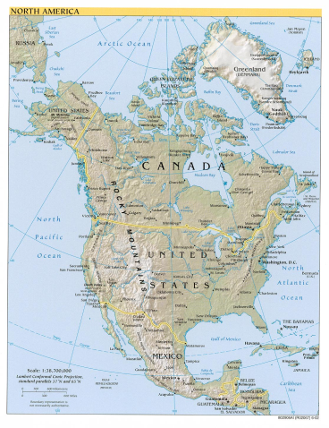
The causes of groundwater problems in Yucatan Peninsula: natural
Highly porous and fractured karst terrain: the Chicxulub meteor impact 65 Mya caused fracturing in the soft porous marine carbonate rocks, allowing saline water intrusion. The unsaturated mix of saline and fresh water result in further dissolution of the carbonate rocks, resulting in highly cavernous terrain.
Dearth of soil and deforestation: the average soil cover is naturally thin (average 7 cm, occasionally lacking completely), resulting in reduced filtering capacity and increasing the chances that contaminants will enter the groundwater. This situation is further enhanced by the loss of vegetation for suburban development.

Slide 3
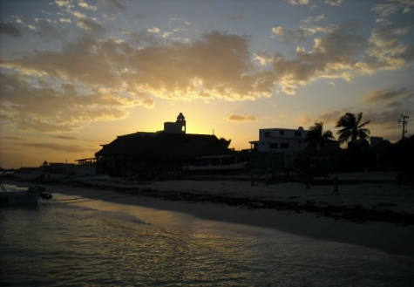
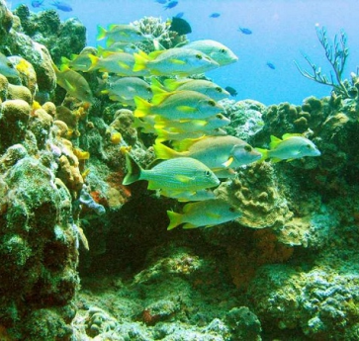
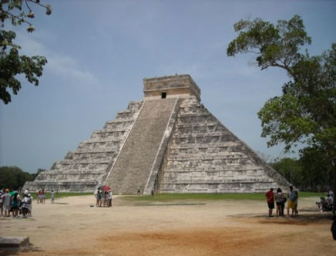
The causes of groundwater problems in Yucatan Peninsula: human induced
Planned development throughout the peninsula since 1970s has turned Yucatan Peninsula into a major international and domestic tourist destination, and led to explosive population growth.

Slide 4
The causes of groundwater problems in Yucatan Peninsula: human induced
Infrastructure has not kept up: modern wastewater treatment is available only in selected areas of the peninsula, and a lot of poorly treated sewage ends up in the aquifer or in the sea. The aquifer is the only source of freshwater in Yucatan, and in many places is completely undrinkable without excessive treatment.
Drinking water in Puerto Morelos is delivered into the houses by trucks from water purification centers.

Slide 5
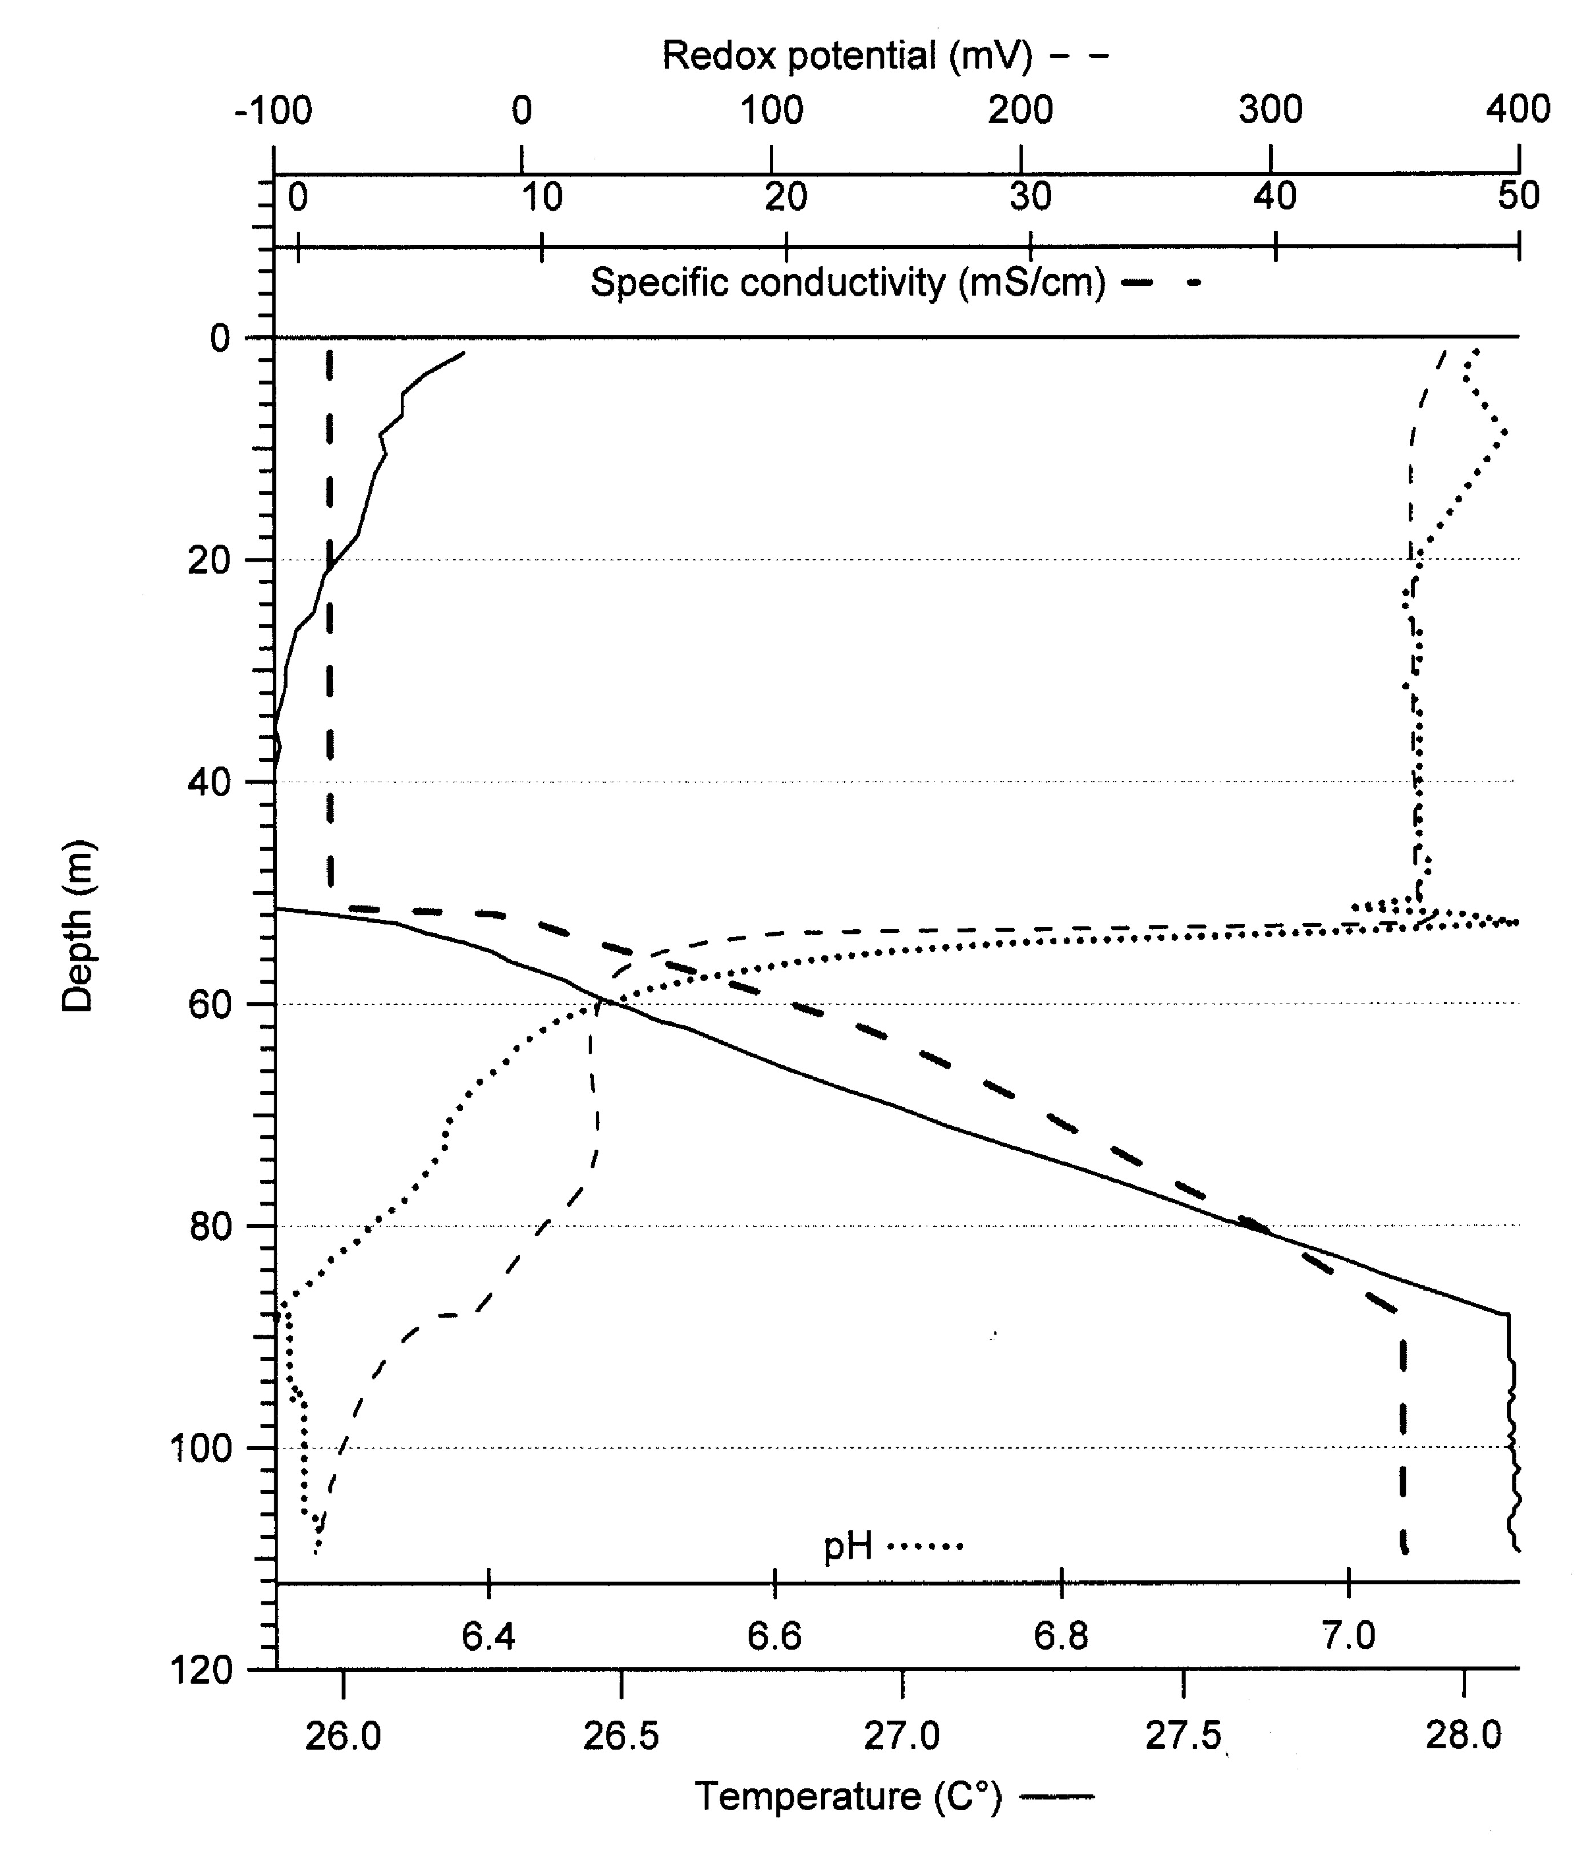
Groundwater geochemistry:
Cooler freshwater lens overlaying warmer saline groundwater with a thin mixing zone between them;
Stable warm temperatures (24-28°C) year round, and circumneutral pH (6.3-7.4);
These conditions are expected to support active diverse microbial communities that are expected to deal with the high nutrient influx from sewage.
Special issue: lack of metals; the groundwater lacks any heavy and transition metals (i.e. Fe, Cu), which results in high amounts of available sulfide/sulfate, but may hinder microbial metabolism.
Typical groundwater profile from Yucatan Peninsula

Slide 6
Research questions:
How do these native microbial communities respond to the metals that are lacking from the groundwater? Which of these minerals would attract a most diverse microbial community under given environmental conditions?
How do these microbial communities affect the mineral surface geochemistry under different environmental conditions?

Slide 7
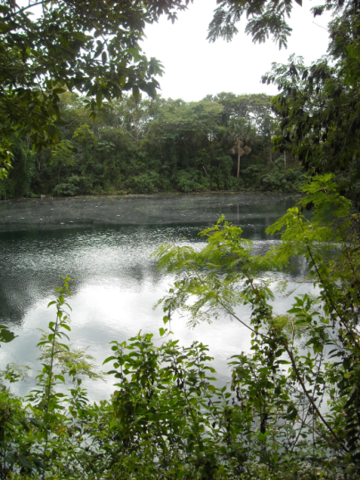
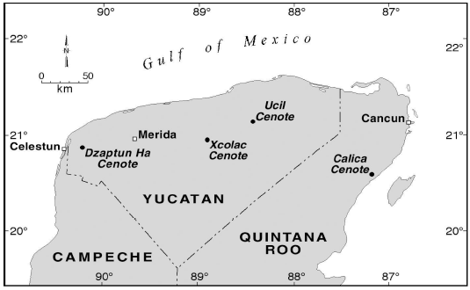
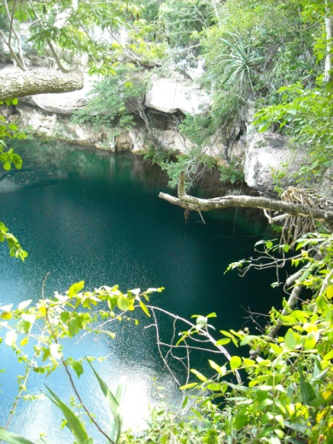
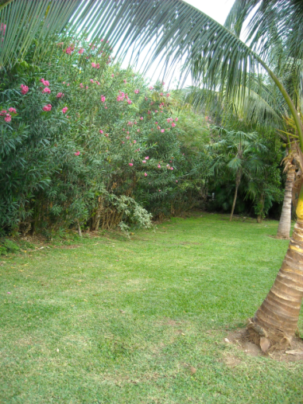
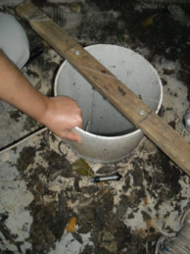
Research design: Sampling sites
Cenotes (deep water-filled karst sinkholes) allow easy access to the groundwater
BPPT4 .
Cenote Xcolac
Cenote Calica
 | Xcolac | Calica | BPPT4
Depth | 120m | 20m | 20m
Interface (approximately) | 50-70m | 13-16m | 9-20m
Vegetation carbon input | high | low | none
Light input | low | high | none
Anthropogenic influence | agriculture | minimal | tourist
Abandoned drinking water well at a resort territory

Slide 8
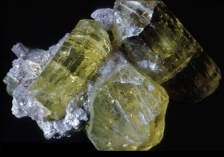
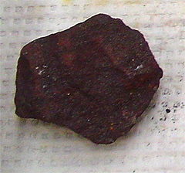
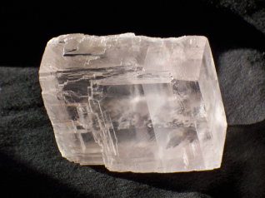
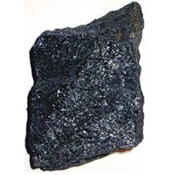
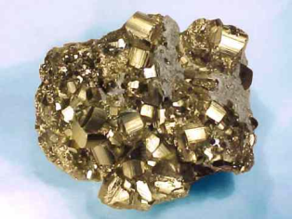
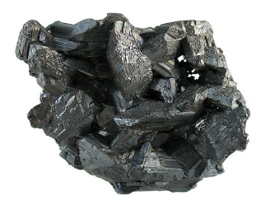
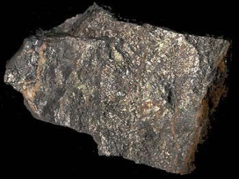
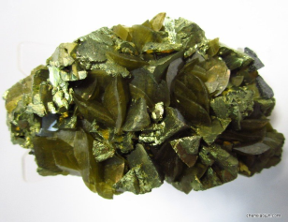
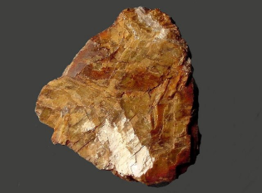
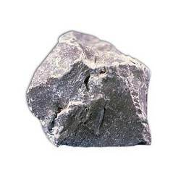
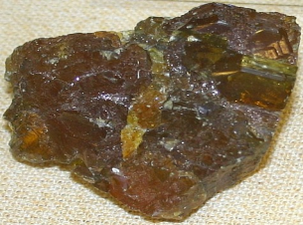
Research design: the minerals
Mineral | Chemical formula | Groups of interest | Type of mineral
Apatite (Ap) | Ca₅(PO₄)₃(F,Cl,OH) | PO₄³⁻ | Phosphate
Calcite (Ca) | CaCo₃ | control | Carbonate
Chalcopyrite (Ch) | CuFeS₂ | Cu²⁺, Fe²⁺ | Sulfide
Chalcocite (Cl) | Cu₂S | Cu²⁺ | Sulfide
Dolomite (Do) | CaMg(CO₃)₂ | Mg²⁺ | Carbonate
Hematite (He) | Fe₂O₃ | Fe³⁺ | Oxide
Magnetite (Ma) | Fe₃O₄ | Fe²⁺, Fe³⁺ | Oxide
Pyrite (Py) | FeS₂ | Fe²⁺ | Sulfide
Pyrrhotite (Pr) | FeS | Fe²⁺ | Sulfide
Siderite (Si) | FeCO₃ | Fe²⁺ | Carbonate
Sphalerite (Sp) | (Zn,Fe)S | Zn, (Fe²⁺) | Sulfide
Apatite
Hematite
Magnetite
Calcite
Pyrite
Chalcocite
Pyrrhotite
Chalcopyrite
Siderite
Dolomite
Sphalerite

Slide 9
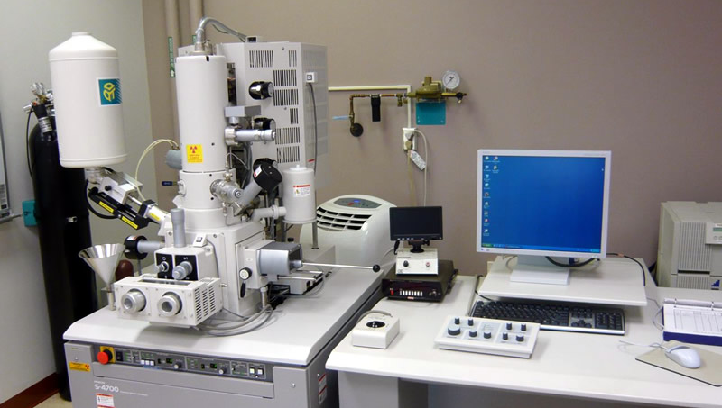
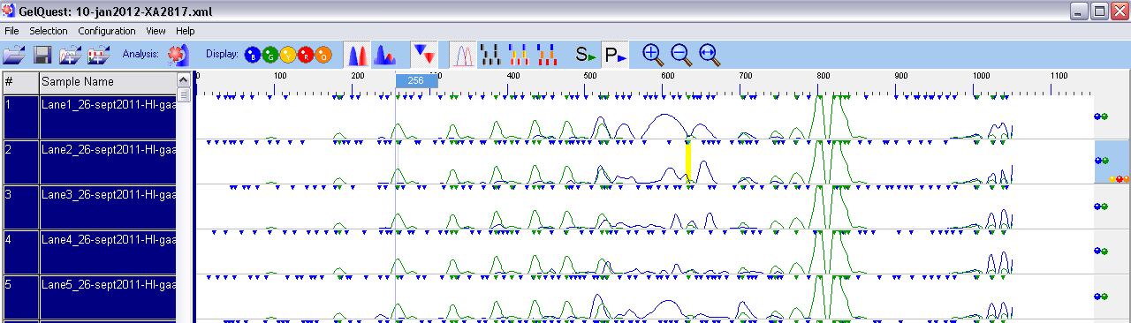
Research design: Sample processing
After 4 months in the water:
DNA extraction from biofilm-covered crystals
Vacuum coated with gold
RAPD PCR with extracted community DNA
SEM and EDS analysis
Banding pattern analysis for diversity and similarity

Slide 10
DNA Results: Diversity
* From the sequencing results of the previous studies, the overall diversity of the microbial communities is known to be large, on phylum level there are 82 different groups, on genus level 1500!
* Based on sequencing results, the only difference in alpha diversity (within sample diversity) values was between the hotel site (no light or vegetation input) had more than the other sites. There was no significant difference between the diversity values from fresh, interface or saline layers.
* Now we add minerals, and…

Slide 11
DNA Results: Diversity measured as Shannon entropy: all samples
Source | d.f. | Sum of Squares | Mean Square | F | p
Model | 15 | 2887.90488 | 192.52699 | 3.59 | <0.0001
Error | 120 | 6439.31280 | 53.66094
Total | 135 | 9327.21767
Variable | d.f. | Parameter estimate | Std. error | t value | p value
Intercept | 1 | 19.23 | 2.45 | 7.82 | <0.0001
Ap | 1 | 2.54 | 2.76 | 0.92 | 0.35
Ch | 1 | 7.34 | 2.89 | 2.54 | 0.012
Cl | 1 | 2.75 | 2.76 | 0.99 | 0.32
Do | 1 | -2.47 | 2.76 | -0.89 | 0.37
He | 1 | 1.17 | 2.76 | 0.42 | 0.67
Ma | 1 | 3.99 | 3.28 | 1.21 | 0.22
Py | 1 | 5.87 | 2.76 | 2.12 | 0.03
Pr | 1 | 6.94 | 2.76 | 2.51 | 0.013
Si | 1 | 6.77 | 4.27 | 1.58 | 0.11
Sp | 1 | 6.84 | 2.76 | 2.47 | 0.014
* No significant difference between the sites, salinity, carbon, or light input.
* Significantly increased diversity on 4 or the 6 Fe(II)-containing minerals: chalcocite, pyrite, pyrrhotite and sphalerite.

Slide 12
DNA Results: Diversity measured as Shannon entropy: salinity layers separately
Freshawater zone only:
Source | d.f. | Sum of Squares | Mean Square | F | p
Model | 11 | 1642.70927 | 149.33721 | 2.85 | 0.0113
Error | 30 | 1573.69013 | 52.45634
Total | 41 | 3216.39940
In comparison:
Interface (1) and saline zone (2):
Variable | d.f | Parameter estimate | Std. error | t value | p value
Intercept | 1 | 13.16 | 3.79 | 3.47 | <0.0001
Ap | 1 | 10.00 | 5.12 | 1.95 | 0.060
Ch | 1 | 13.24 | 6.37 | 2.08 | 0.046
Cl | 1 | 8.58 | 5.12 | 1.68 | 0.10
Do | 1 | 0.22 | 5.12 | 0.04 | 0.96
He | 1 | 6.33 | 5.12 | 1.24 | 0.22
Ma | 1 | 12.89 | 5.12 | 2.52 | 0.01
Py | 1 | 12.52 | 5.12 | 2.45 | 0.02
Pr | 1 | 15.66 | 5.12 | 3.06 | 0.004
Si | 1 | 12.84 | 5.12 | 2.51 | 0.01
Sp | 1 | 16.16 | 5.12 | 3.16 | 0.002
Xcolac | 1 | 6.59 | 2.29 | 2.88 | 0.007
1.
Source | d.f | Sum of Squares | Mean Square | F | p
Model | 11 | 7146.17692 | 649.65254 | 0.90 | 0.543
Error | 75 | 54040 | 720.53240
Total | 86 | 61186
2.
Source | d.f | Sum of Squares | Mean Square | F | p
Model | 9 | 185.35088 | 20.59454 | 0.28 | 0.9754
Error | 26 | 1933.36556 | 74.36021
Total | 35 | 2118.71644
* Significantly increased diversity on Fe(II) minerals: chalcocite, magnetite, pyrite, pyrrhotite, siderite and sphalerite. Also, at cenote Xcolac.

Slide 13
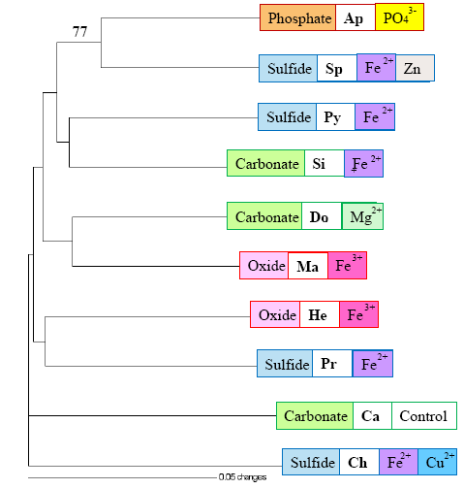
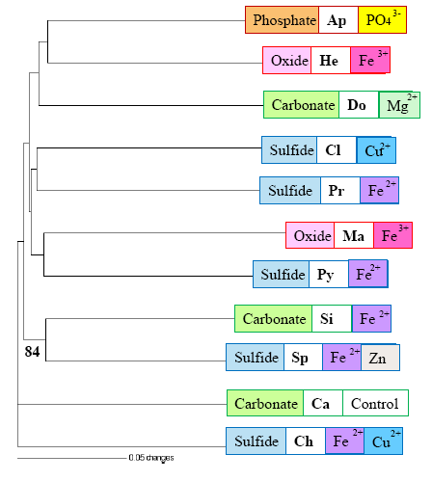
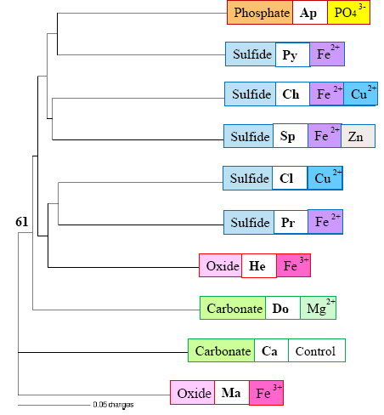
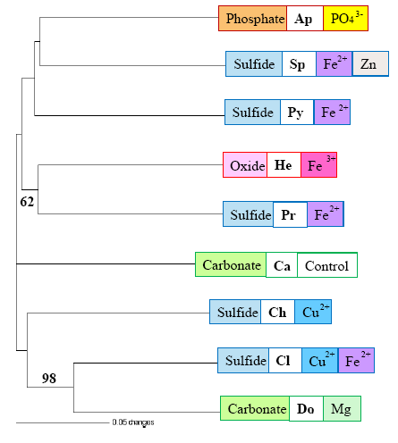
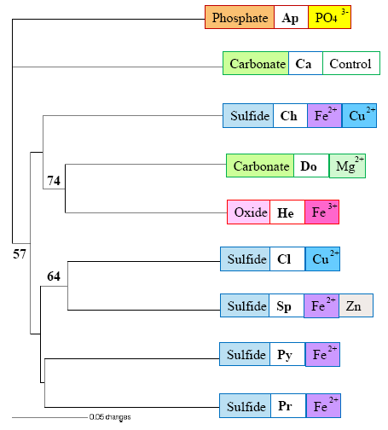
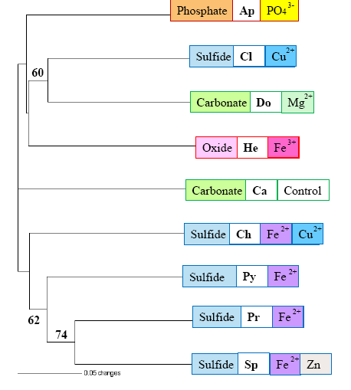
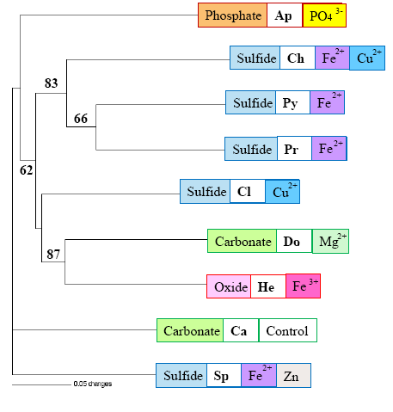
DNA Results: Similarity
UPGMA analysis on presence/absence data, support values by Jacknife
Xcolac
Calica
Hotel
Freshwater: Almost no clustering of similar minerals
Freshwater
Interface: Clustering of Fe(II) and sulfide minerals
Interface
Saline
Saline water: Clustering of Fe(II) and sulfide minerals

Slide 14
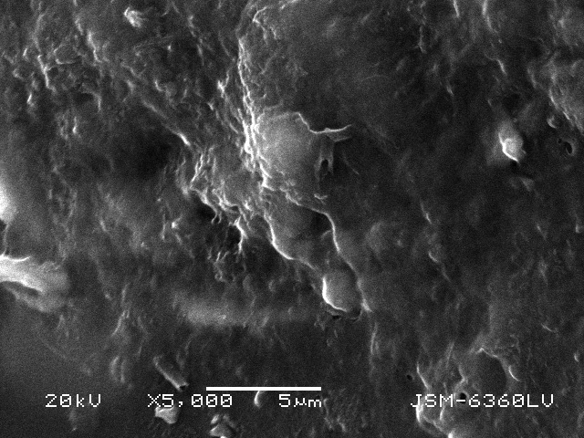
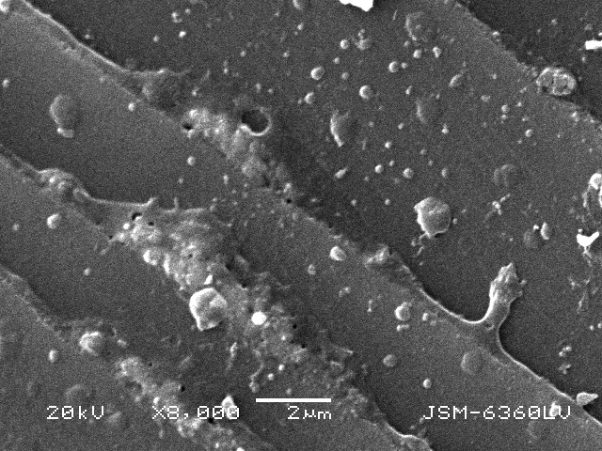
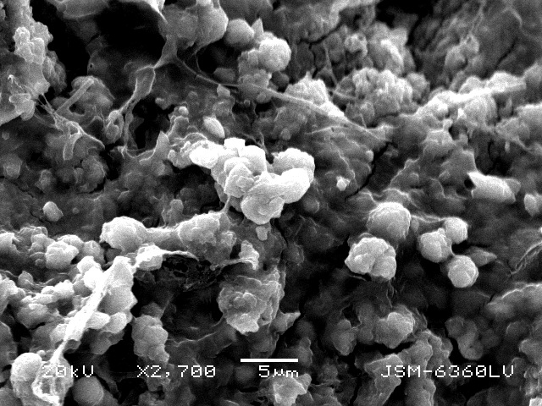
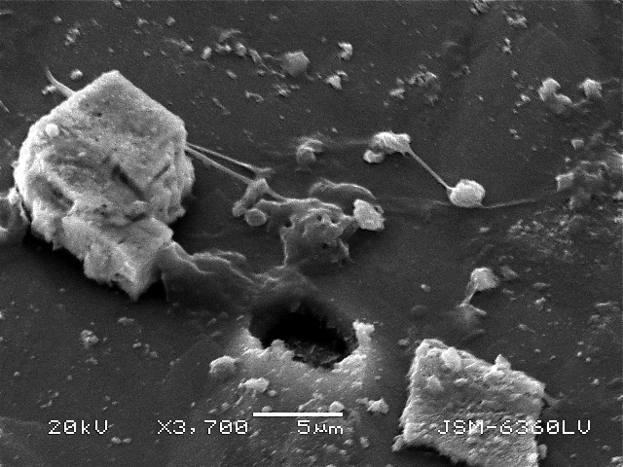
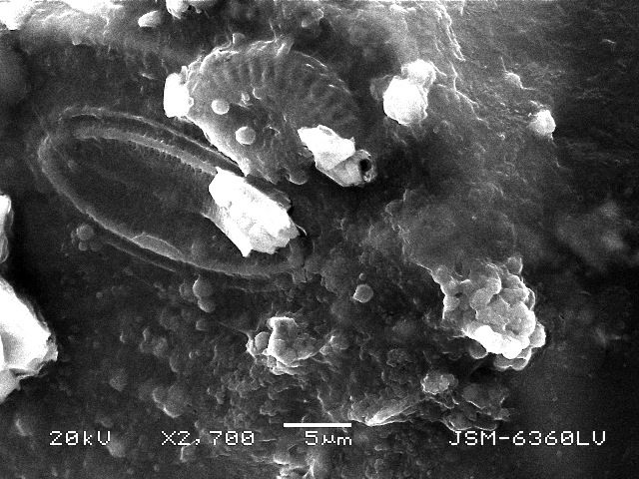
SEM Results: microbial presence
Exopolysaccharides (EPS – the microbial extracellular slime) is present on almost all minerals, on some minerals it has developed into a thick biofilm.
Individual bacteria (not associated with biofilm) most prevalent in Calica (high light environment), and least prevalent at the Hotel well, but difference not statistically significant.

Slide 15
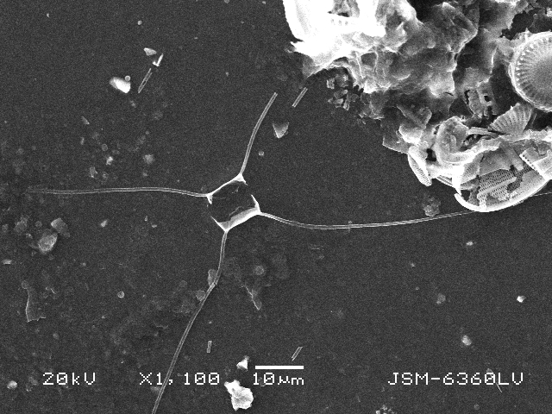
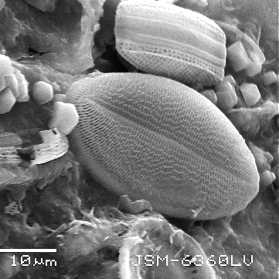
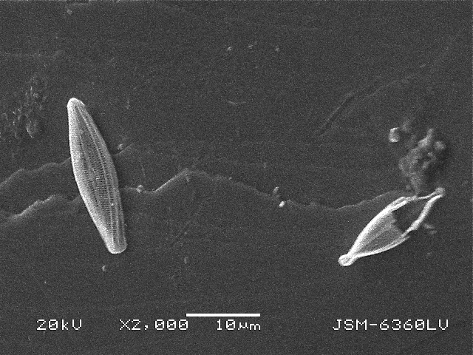
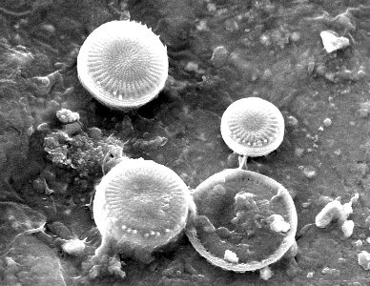
SEM Results: microbial presence
Four groups of diatoms identified: Chaetocerus, Cocconeis, Sauroneis, and Stephanodiscus/Cyclotella group. Diatoms most numerous in Calica (high light); no whole diatoms present at the hotel well (no light). Chaetocerus only present in Calica.
Chalcocite and Chalcopyrite have almost no whole diatoms present (only fragments); hematite, magnetite and pyrrhotite have almost none.

Slide 16
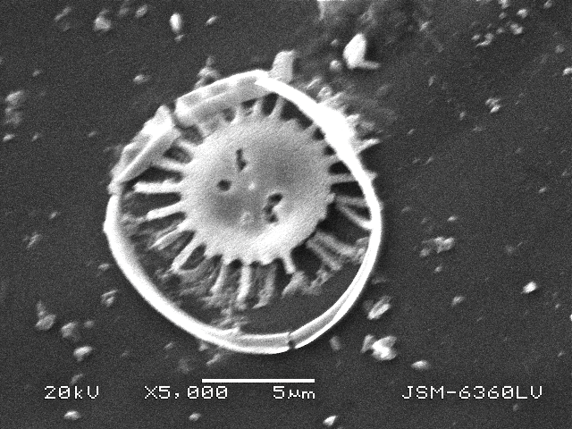
SEM Results: microbial presence
Four groups of diatoms identified: Chaetocerus, Cocconeis, Sauroneis, and Stephanodiscus/Cyclotella group. Diatoms most numerous in Calica (high light); no whole diatoms present at the hotel well (no light). Chaetocerus only present in Calica.
Chalcocite and Chalcopyrite have almost no whole diatoms present (only fragments); hematite, magnetite and pyrrhotite have almost none.

Slide 17
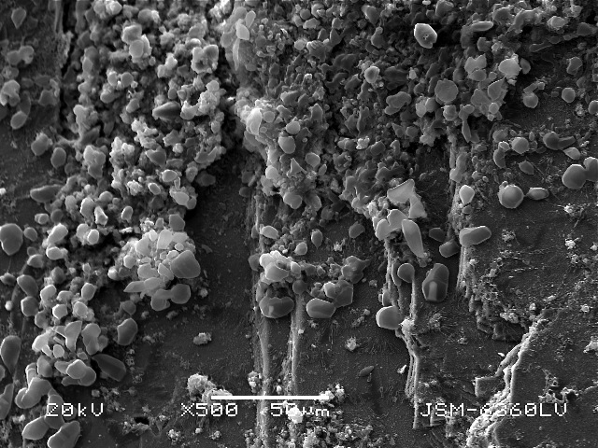
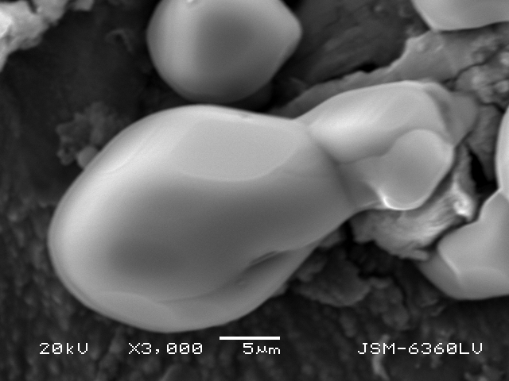
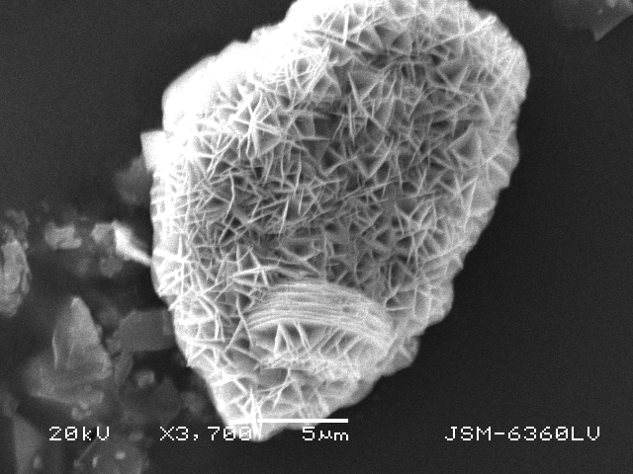
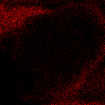
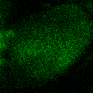
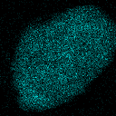
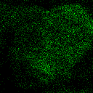

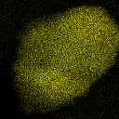
SEM Results: mineral precipitation
Results: Diversity
Precipitation of sulfur granules: only in deep saline anaerobic environment, on most iron-containing minerals, except Chalcopyrite and Pyrrhotite.
Xcolac, Saline: Siderite
Precipitation of copper sulfate crystals in Xcolac: On apatite and chalcocite.
Carbon
Calcium
Copper
Xcolac, Saline: Apatite
Oxygen
Phosphorus
Sulfur

Slide 18
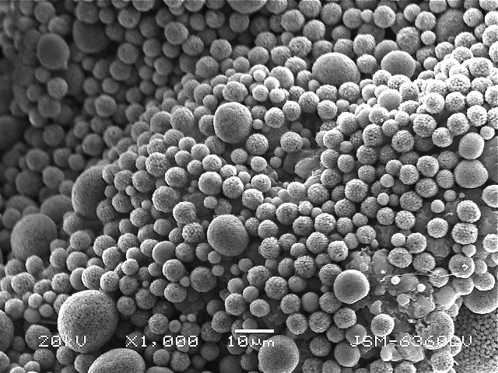
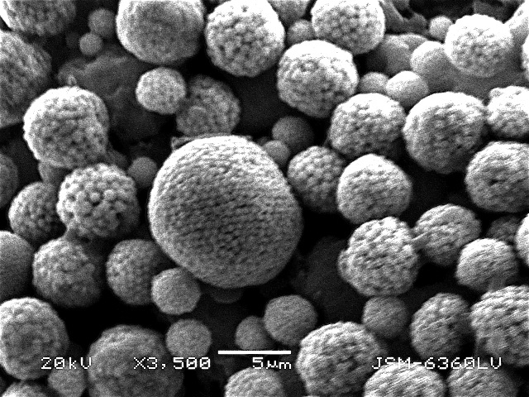



SEM Results: mineral precipitation
Results: Diversity
Framboidal pyrite formation: fresh-saline interface only, mainly on iron-containing minerals, but also observed on dolomite and apatite. Most numerous at the hotel well and on pyrrhotite.
Hotel, Interface: Siderite
Iron
Sulfur
Hotel, Interface: Apatite
Framboids on non-iron minerals are larger and often in fragments, and the individual crystals are bigger and less uniformly shaped.

Slide 19
Conclusions:
* Microbial communities in Yucatan groundwater respond to the addition of iron, but only in the freshwater zone, where the iron can be made available for their cellular needs.
* In the saline/interface layers, iron likely attracts microbes with similar physiological needs, resulting in more similar communities.
*Microbes influence the mineral surface chemistry, either by surface etching (aided by EPS layer), or by secreting metabolic waste products (i.e. sulfide) that will react with dissolved metal ions, precipitating new minerals on the surface of the original mineral.
*The mineral composition and the environmental conditions determine the hospitability of the mineral to particular microbes.

Slide 20
I will leave you with not just answers, but also a question:
What are these??
Carbon
Calcium
Iron
Sodium
Oxygen
Silicon

