Slide 1
GSA Northeastern Meeting
March 18 -20, 2013
Bretton Woods, NH
A Comparison between Runoff Trends in a Headwater Basin and More Developed Watersheds: A Case Study of the Merrimack Watershed, NH-MA
Rouzbeh Berton (rberton@syr.edu)
Charles T. Driscoll (ctdrisco@syr.edu)
David G. Chandler (dgchandl@syr.edu)
Civil &Environmental Engineering Dept., Syracuse University

Slide 2
Outline
Introduction
Study Site
Research Objectives
Methodology
Results
Conclusion
Future Work
Question/s?

Slide 3
Introduction
Increases in global mean air temp. up to 5°C - 21st century
Changes in timing, magnitude, and type of precipitation
Increases in temperature & precipitation in the Northeast
Earlier peak flows, lower snowpack accumulation, and higher base flows
Impoundment alters natural flow regime

Slide 4
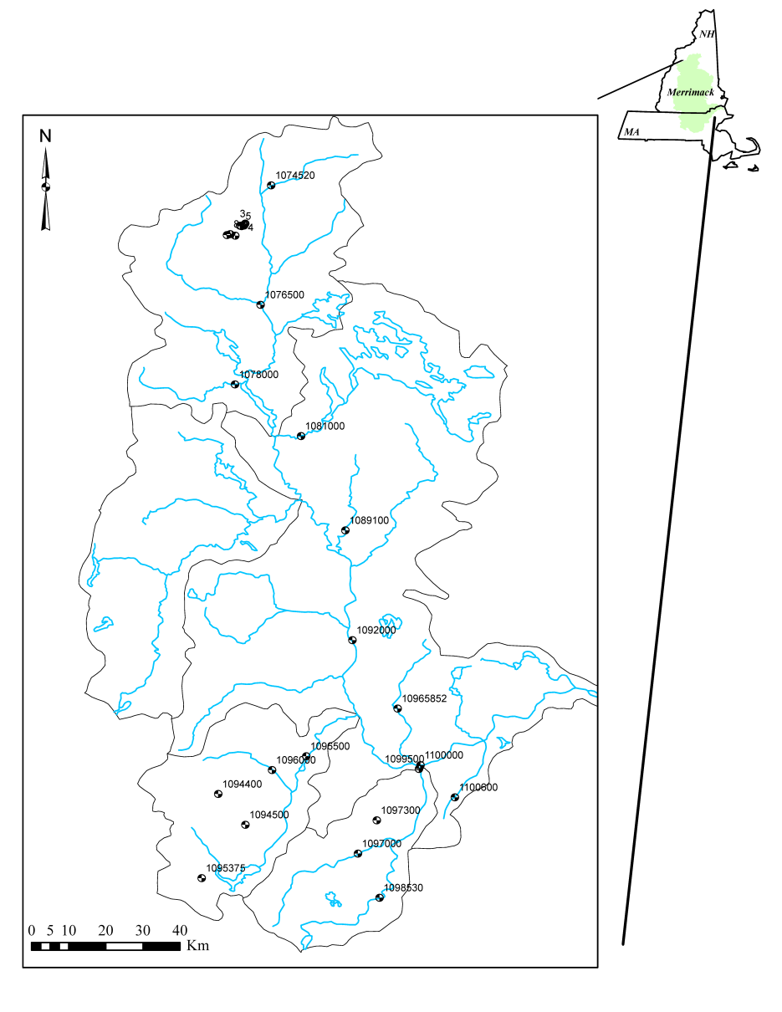
Study Site
Merrimack River Basin (NH-MA)
Area: 12976 km²
Ave. annual precipitation: 1000 mm
Elevation: 0-914 m ASL
Temperature: -34 (Jan.) - 41 (Jul.) °C
Ave. annual runoff: 508 mm
Land cover: 77% forested

Slide 5
Research Objectives
Compare and contrast streamflow trends in reference (natural) and non-reference (regulated) sites
Classify annual streamflow based on anomaly to distinguish observed trends between dry, average, and wet years

Slide 6
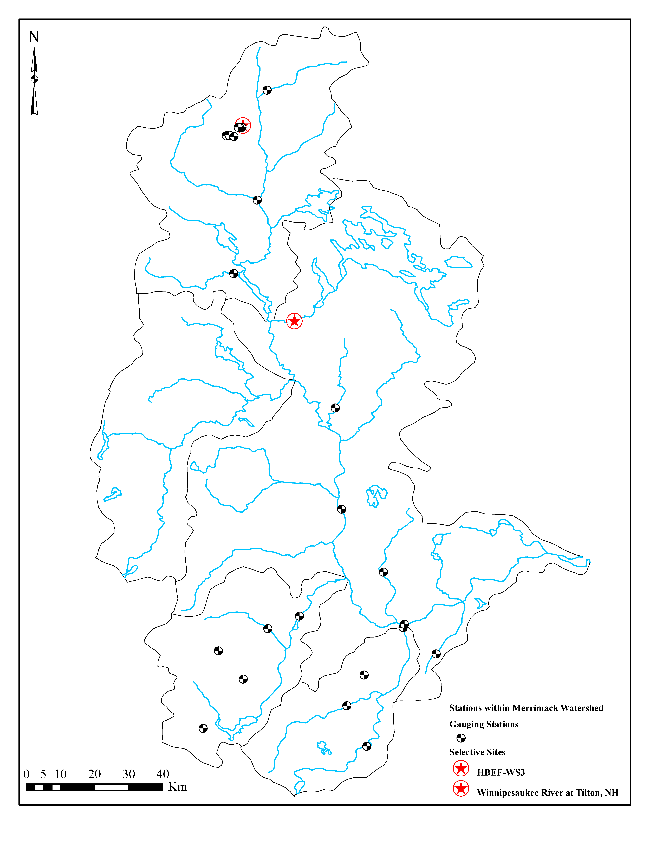
Methodology
27 sites (7 ref., 20 non-ref.)
Mann-Kendall trend analysis (WY, Oct 1st-Sep 30th)
Flow metrics
Annual, peak, monthly, seasonal
Timing 25%, 50%, 75%
Quartiles 1st, 2nd, 3rd

Slide 7
Methodology- Continued
Anomaly (Genz & Luz, 2012)
Flow duration/distribution curve
Classification of hydrologic condition based on the anomaly of annual average streamflow and 1σ
Limits | HyC Class
Anomaly < –1.5 | Very dry
–1.5 < Anomaly < –0.5 | Dry
–0.5 < Anomaly < 0.5 | Average
0.5 < Anomaly < 1.5 | Wet
Anomaly > 1.5 | Very wet

Slide 8
Results I
 | Ref. Sites (7) |  | Mean | Range
 | Increase | Decrease | (mm) | (mm)
Annual Flow | 7 (7) | 0 (7) | 6.3 | 1.0 to 18.6
Very Dry | 0 (2) | 2 (2) | -6.6 | -9.6 to -3.6
Dry | 1 (5) | 4 (5) | -1.6 | -4.7 to 1.6
Average | 6 (7) | 1 (7) | 2.6 | -3.5 to 6.9
Wet | 3 (6) | 3 (6) | -3.3 | -19.9 to 8.9
Very Wet | 2 (3) | 1 (3) | 6.2 | -13.3 to 24.4

Slide 9
Results II
 | Non-Ref. Sites (20) |  | Mean | Range
 | Increase | Decrease | (mm) | (mm)
Annual Flow | 20 (20) | 0 (20) | 4.6 | 0.8 to 22.1
Very Dry | 5 (12) | 7 (12) | -0.8 | -19.6 to 32.0
Dry | 10 (18) | 8 (18) | 0.8 | -10.7 to 8.7
Average | 18 (20) | 2 (20) | 1.1 | -8.0 to 6.3
Wet | 12 (19) | 7 (19) | 2.0 | -4.1 to 13.2
Very Wet | 6 (10) | 4 (10) | 9.4 | -33.0 to 53.8

Slide 10
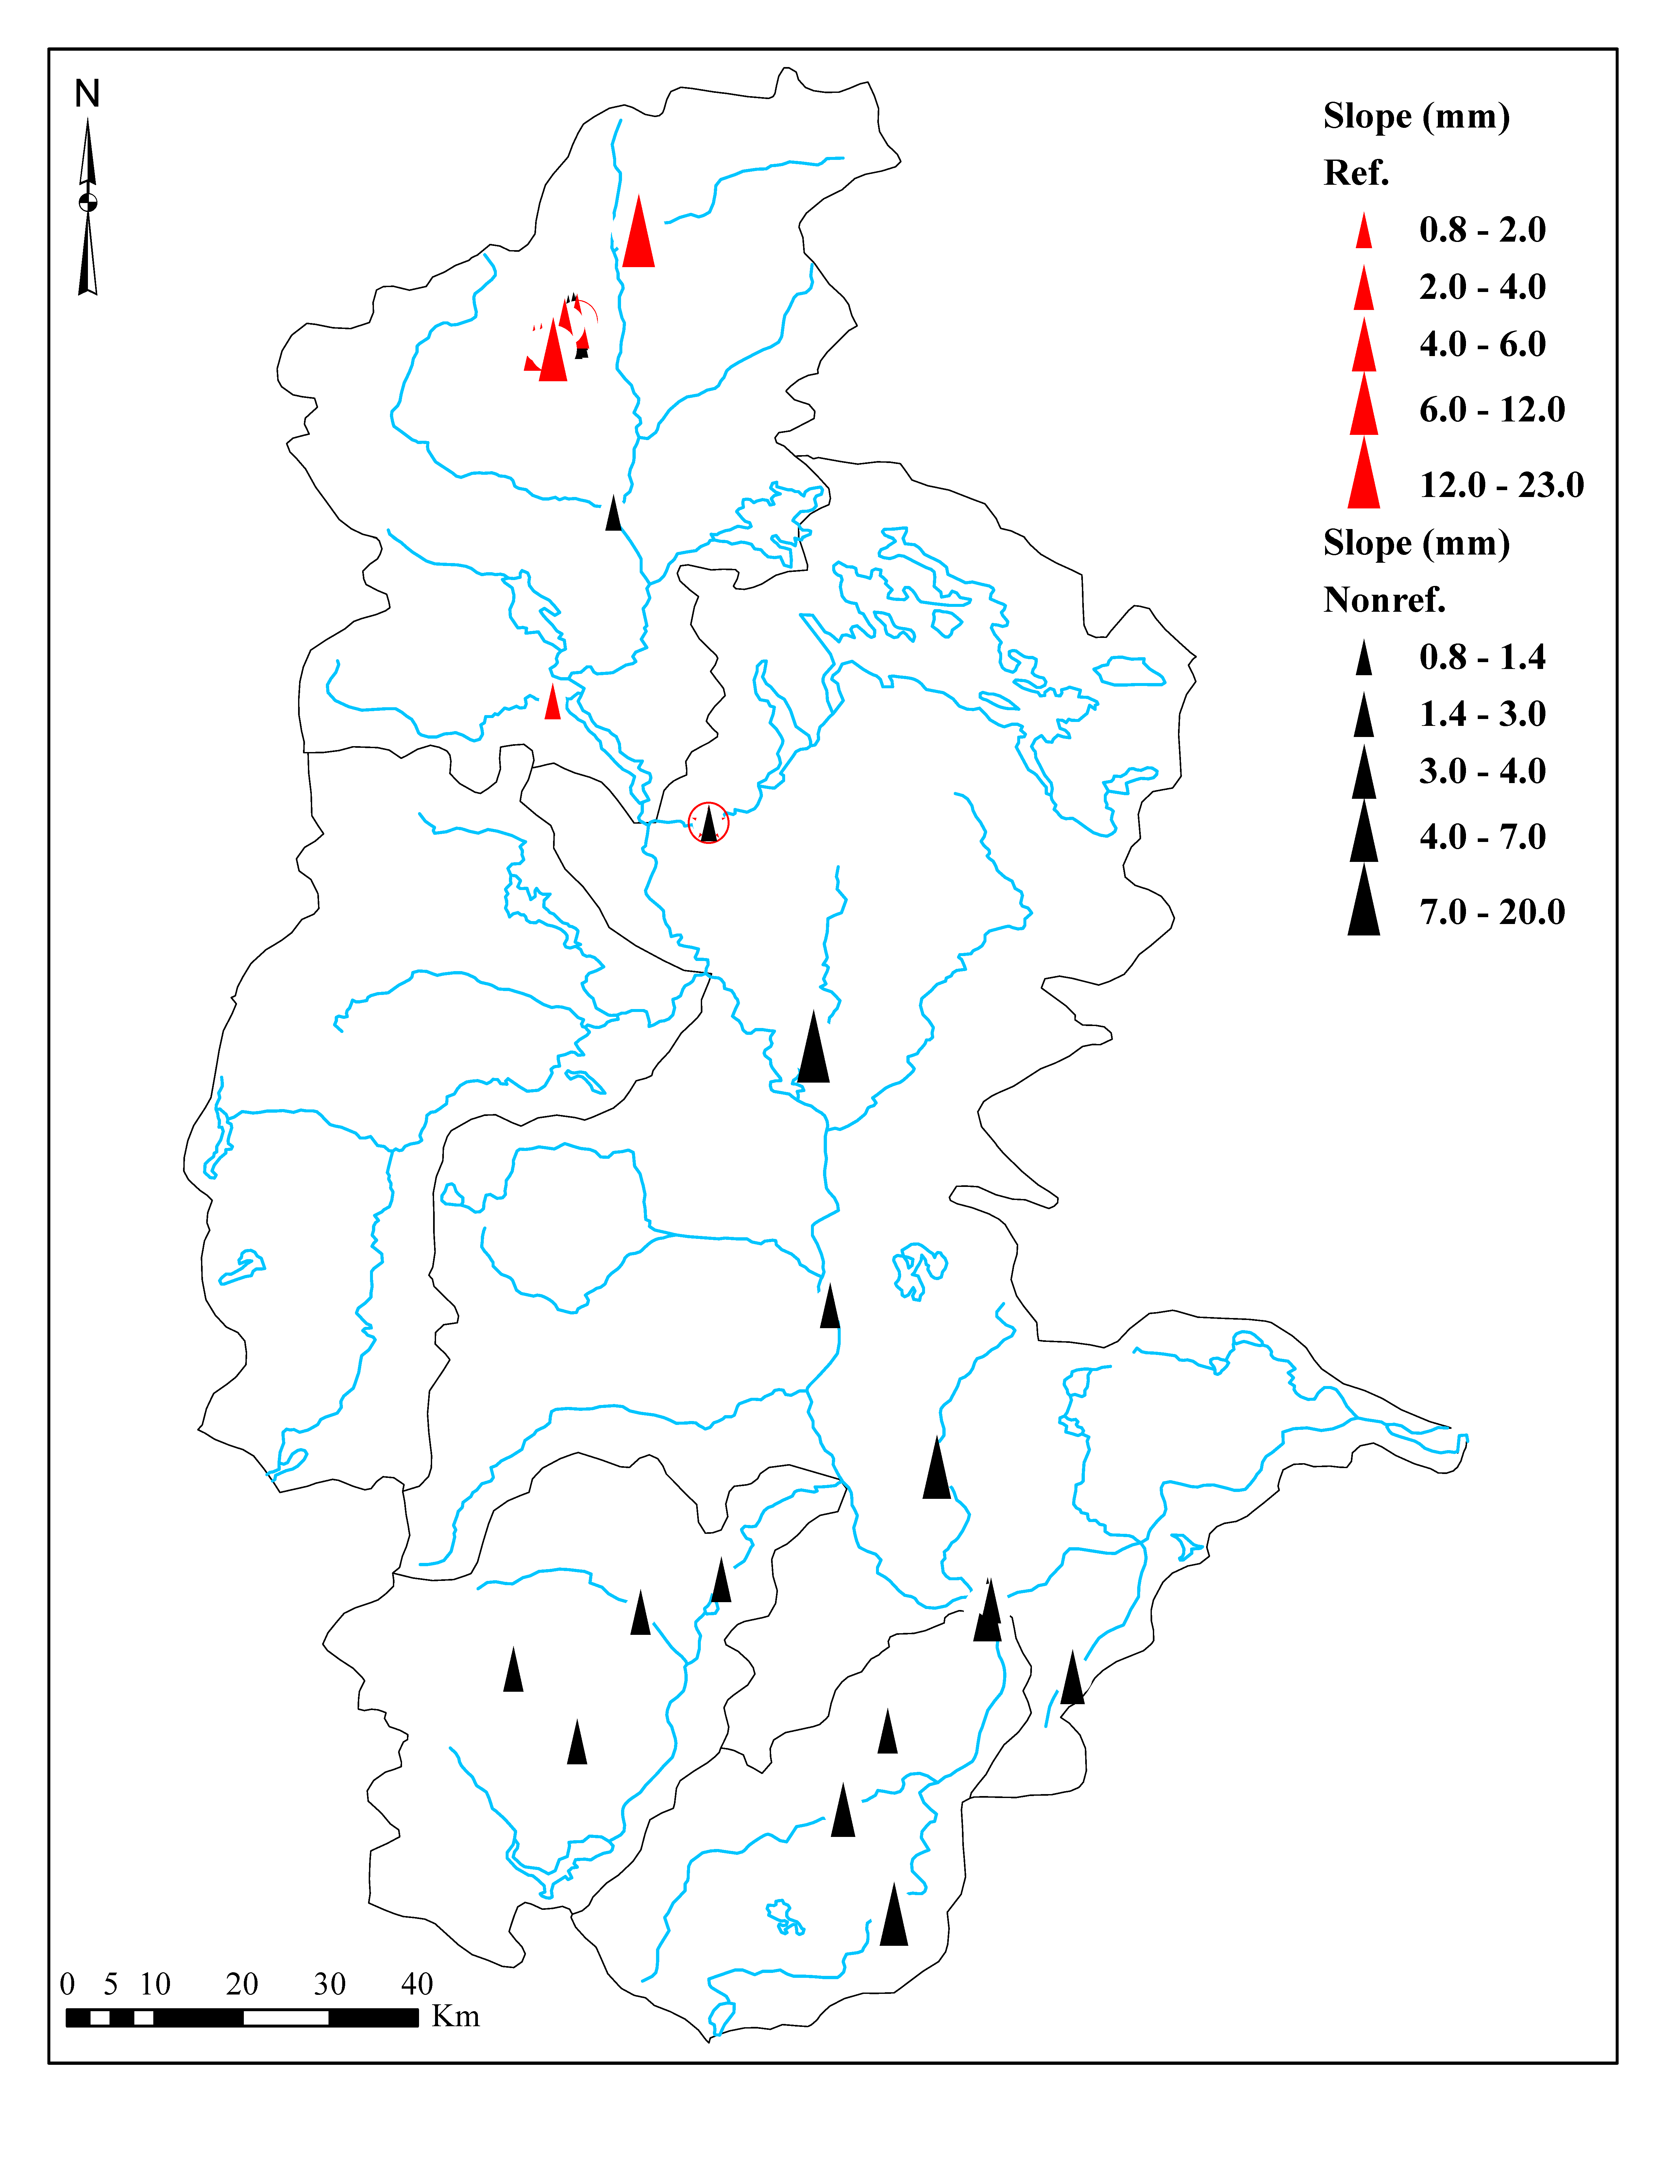
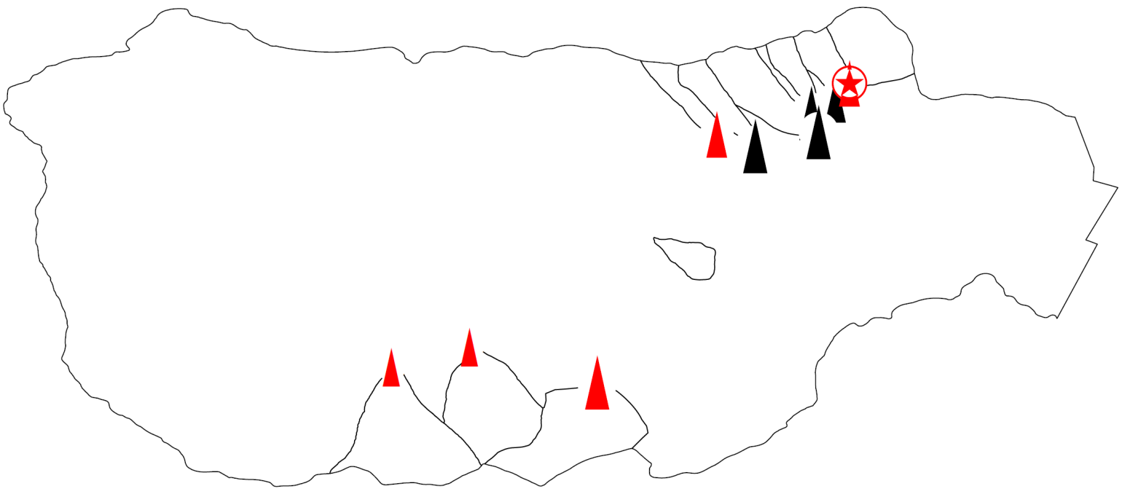
Results III
The overall trend for all ref. and non-ref. sites

Slide 11
Results IV
Precipitation: evenly distributed
Spring runoff: 30-50% of the annual streamflow
Warmer winter: shorter snowpack accumulation season
Increase in annual precipitation due to summer storms
More prominent results in wet years than dry years due to less impact of baseflow on the annual hydrograph

Slide 12
Results V
Flow more evenly distributed, same pattern as ref. sites
Impoundment attenuates the impact of summer storms on flow distribution

Slide 13
Results VI
Trend analyses show:
Increases in annual flow
Increases in very wet, wet, and average classes
Decreases in very dry and dry classes
Earlier flow timing associated with very wet and wet years

Slide 14
Conclusions
Increases in annual flow at all sites (natural & regulated)
Consistent with increases in precipitation
Alteration in the timing of discharge
Discharges occurring earlier associated with increases in very wet year hydrologic class and loss of snowpack
More extreme (dry or wet ) hydrologic events expected

Slide 15
Future/Current Work
Examine possible drivers of streamflow alteration, i.e. precipitation, temperature, AMO, NAO
Detect regime shift points for hydrologic variables
Re-evaluate trends based on regime shift points
Find correlation between simultaneous regime shift points in hydrological and climatological variables

Slide 16
Question/s?

