Slide 1
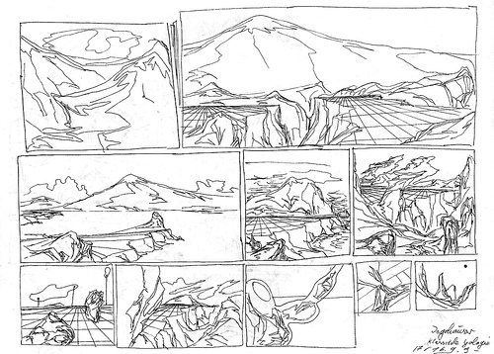
Teaching A Sense of Place GEOL 0399
Nobody can discover the world for somebody else. Only when we discover it for ourselves does it become common ground and a common bond... Wendell Berry
Tarin H. Weiss
Westfield State University
NE GSA 3/18/13

Slide 2
Nobody can discover the world for somebody else. Only when we discover it for ourselves does it become common ground and a common bond... Wendell Berry
Presentation Overview
Describe course
Students, outcomes, assignments, course activities
Present course positives & negatives (student questionnaire, n = 7)

Slide 3
A student wrote… My place is on planet Earth, on a piece of continental plate above sea level. More specifically, my place is located in an imaginary boundary called Westfield, MA. It is located on the edge of the Little River, which is a tributary connecting to the Westfield River. My place is very peaceful looking. It is home to many plants and animals. However, my place did not always look the way it does now, nor will it look the same in the near future. My place has been through many changes since it first formed, and it will never stop changing as long as Earth exists.

Slide 4
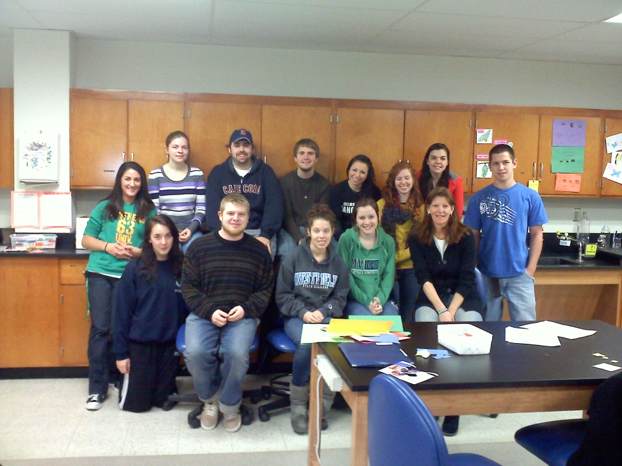
Students & Course Activity
2010: 13 sophomore, juniors, seniors
Honors seminar course
Diverse majors (environmental science, math, physical science, psychology, elementary education, criminal justice, sociology, communications)
Lecture, activity, guest speakers,
student presentations, conferences

Slide 5
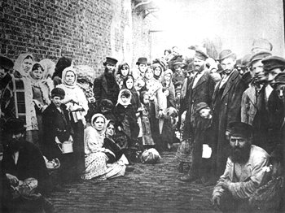
A Sense of Place, what does this mean?
Jews that fled Russian pogroms to Britain in late 19C
grossmanproject.net/pogroms.htm

Slide 6
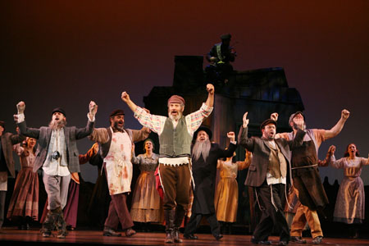
"After a lifetime... A piece of paper, an edict from the authorities, and we must all leave our homes." "Rabbi, we've been waiting for the Messiah all our lives... Wouldn't this be a good time for him to come?" "We'll have to wait for him someplace else. Meanwhile, let's start packing."
Anatevka
Fiddler on the Roof
- Tevye and his Daughters by S. Aleichem.

Slide 7
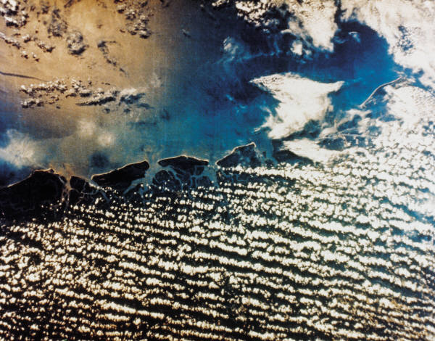
Place
A human concept that includes the human and physical/biological characteristics of a location
Physical/Biological: climate, geology, water, soils, flora, fauna
Human: the visions and activities of humans that alter the location
Source: NASA.org & adapted from D. Sallee at geog.unt.edu

Slide 8
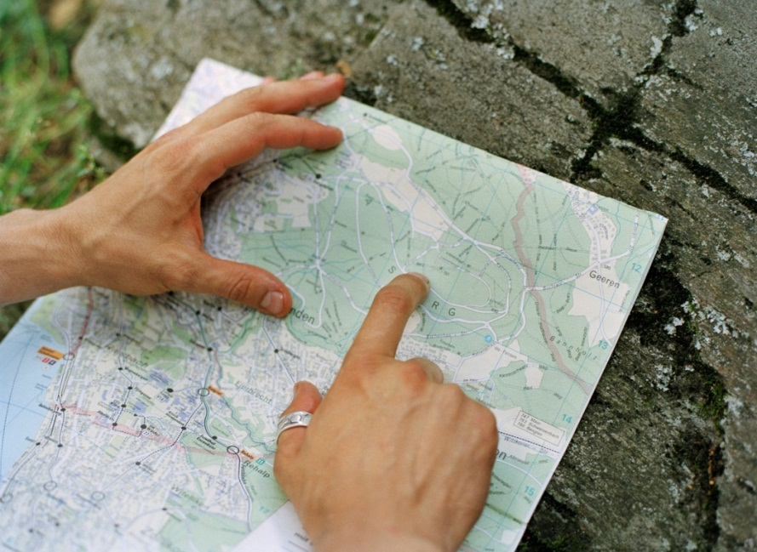
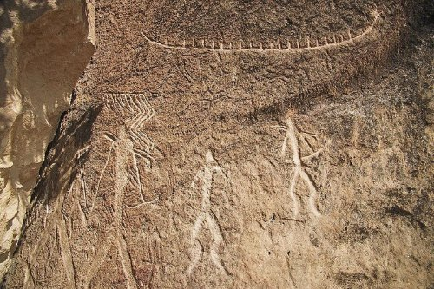
How we perceive & communicate about PLACE
We create mental/physical representations of place based on our experiences – which are biased
Gobustan Rock Art, Azerbaijan
Source: www.worldgreatestsites.com/gobustan-rock-art_azerbaijan.htm

Slide 9
At the end of this course, you should be able to:
research historical and scientific databases and literature
describe climate and weather
characterize local watersheds, geology, and soils
name plants, trees, insects, animals & endangered species
report on environmental health
construct maps/representations
summarize the human & land use history of a place
write a technical report
explore and explain why humans become connected to a place
creatively present about your sense of a place

Slide 10
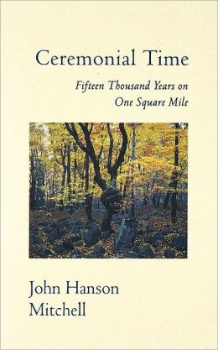
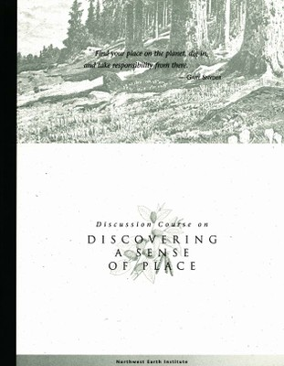
Readings
Mitchell, John Hanson. Ceremonial Time 15,000 Years on One Square Mile.
Excerpts from NWEI’s Discovering A Sense of Place

Slide 11
Assignments
Reading Response Questions
Website “Workshops”
Short Presentations
A Sense of Place: Written Summary of Research
Your final paper will present the findings of your research (scientific, human/land use history, current issues, attachment to place).
A Sense of Place: Creative Summary Presentation
~20 minute creative summary of your Sense of Place; may take the form of art, music, writing, dance, photography, video, sound recording, or…

Slide 12
Real-time data (Internet sources)
EPA’s Surf Your Watershed, Enviromapper, Environmental Scorecard, Safe Waters
Nature Conservancy and landscope.org’s Ecoregions
USGS On-line Spatial Data for mineral, geological, and geochemical resources
Natural Heritage and Endangered Species Program
USDA’s Web Soil Survey, Natural Resources Inventory (land use)
NOAA’s weather and climate data
Annenburg Foundations’ Learner.org’s Interactive History Map & video
Library of Congress historical maps
National Geographic mapping

Slide 13
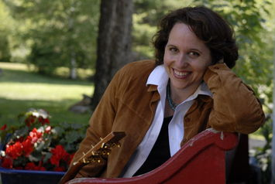

Guest speakers
Faculty from psychology, biology (forestry), history, philosophy
Soil conservationist
Art educator
Singer/songwriter Erica Wheeler
Field Trips: on campus
(Historical museum, community gardening program Nuestra Raices, Holyoke, MA)

Slide 14
Places Investigated
Leominster town center, MA
Stanley Park, Westfield, MA
Tulley Mt., Orange, MA
Becket woods, lake , island (Berkshires)
Ruder Island, Chesterfield, MA
Hampton Beach, NH
Grandparents farm in coastal ME
Mt. Tom Reservation, Easthampton MA
Trails along Westfield River, Westfield, MA
Neighborhood forest, Worcester, MA
Family property along Little River, Westfield, MA

Slide 15
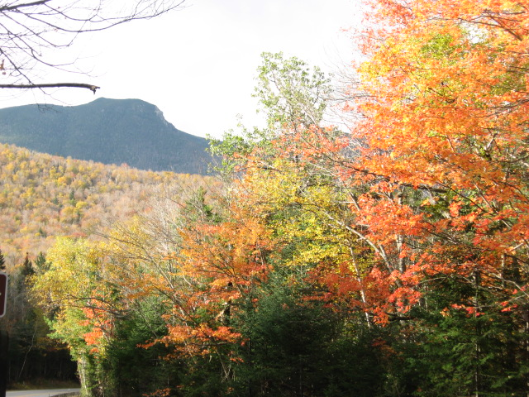
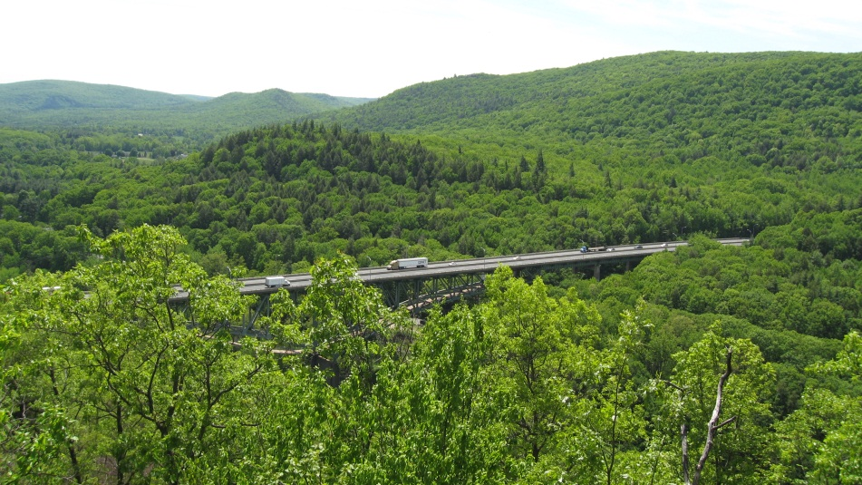
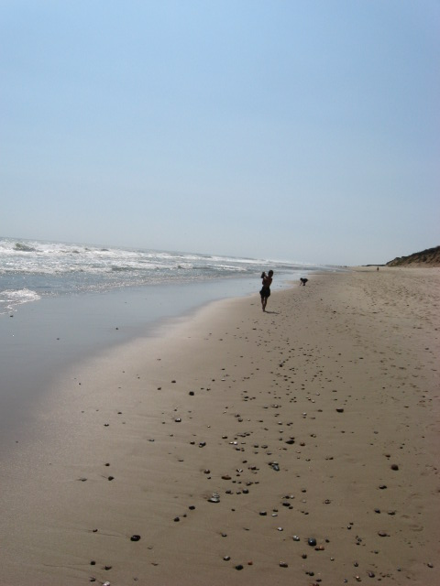
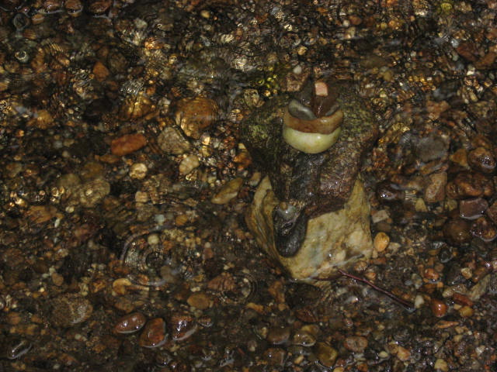
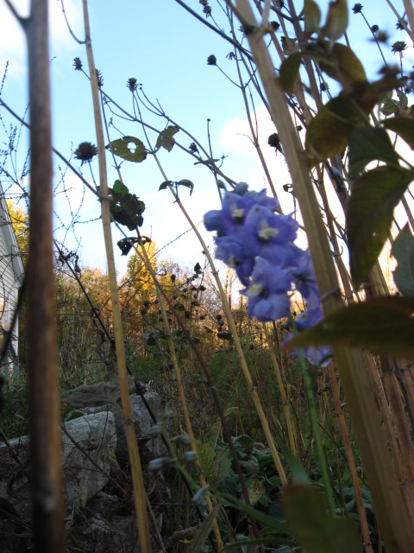
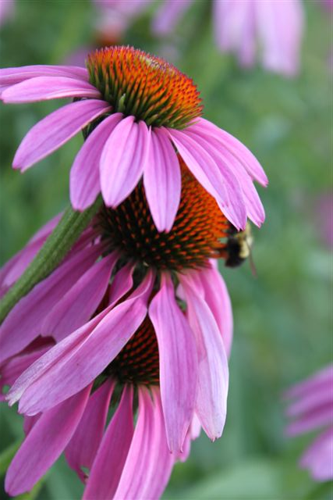
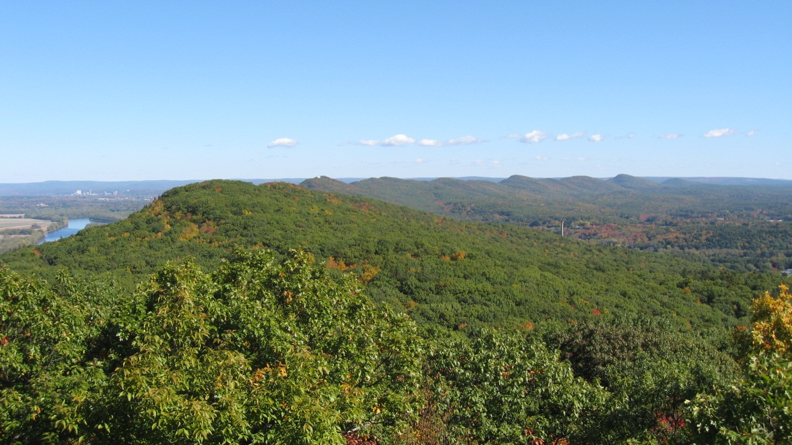
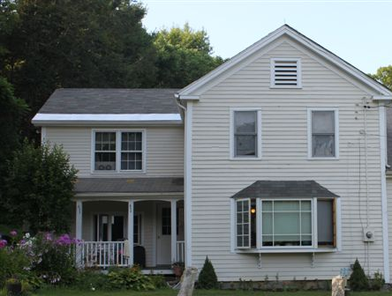
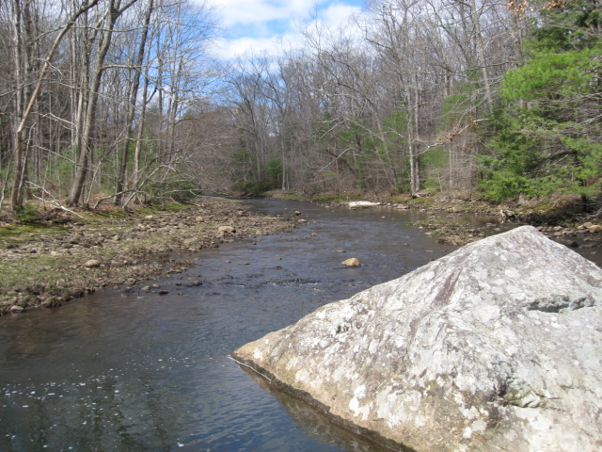

Slide 16
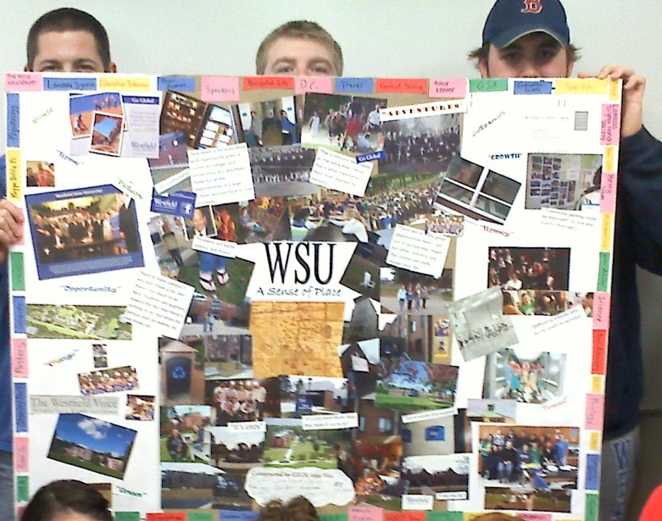


Creative summaries
Video montage & music & voice
Creative writing (story, prose)
Photo montage (book, slide shows)
Mixed media collage
Photographic mosaic
Children’s stories
Panoramic photo display
Sources: firelily.com, favecrafts.com

Slide 17
Positive Themes
Creative summaries
Ceremonial time book
NWEI readings
WSU sense of place poster
Guest speakers
Singer/songwriter
Working on sections of research at a time
Modeling/mapping/hands on (ex. Watersheds)
Conferencing about paper
Andrew Goldsworthy video

Slide 18
Negative Themes
NWEI readings
Ceremonial Time book (to an extent)
Ceremonial Time book quizzes
Forest Plot creation
Watershed mapping
Vegetation communities mapping
Identifying plant species – more time
Too much information – too little time to learn it all and apply to paper

Slide 19
Positives
I really did begin to think about place differently. I learned that one way or another, I personally affect the physical world. Ignoring environmental concerns is not really a passive state, but an active acceptance of perpetuated destruction. I need to think about the role I play in my environment, and I need to begin to think of small ways that I can create a positive interaction.
I have been able to think about place more scientifically, historically and psychologically. Possibly most importantly, I have been able to consider my social responsibility. I have realized that I have a lot of learning to do in order to understand all the places in my life. While working to learn more, I see that I need to start thinking of ways I can be more active in protecting and respecting these places.
Becket is a place that I have been traveling to on a regular basis for over 10 years now, and I learned more about the town and the islands over the past semester, than I had in all of the time that I had been traveling up there.

Slide 20
Nobody can discover the world for somebody else. Only when we discover it for ourselves does it become common ground and a common bond... Wendell Berry
Questions and Comments ?
I’m happy to share this presentation and/or my syllabus for GEOL 0399 A Sense of Place – please email your request
- Tarin Weiss
tweiss@westfield.ma.edu
Thank you

