Slide 1
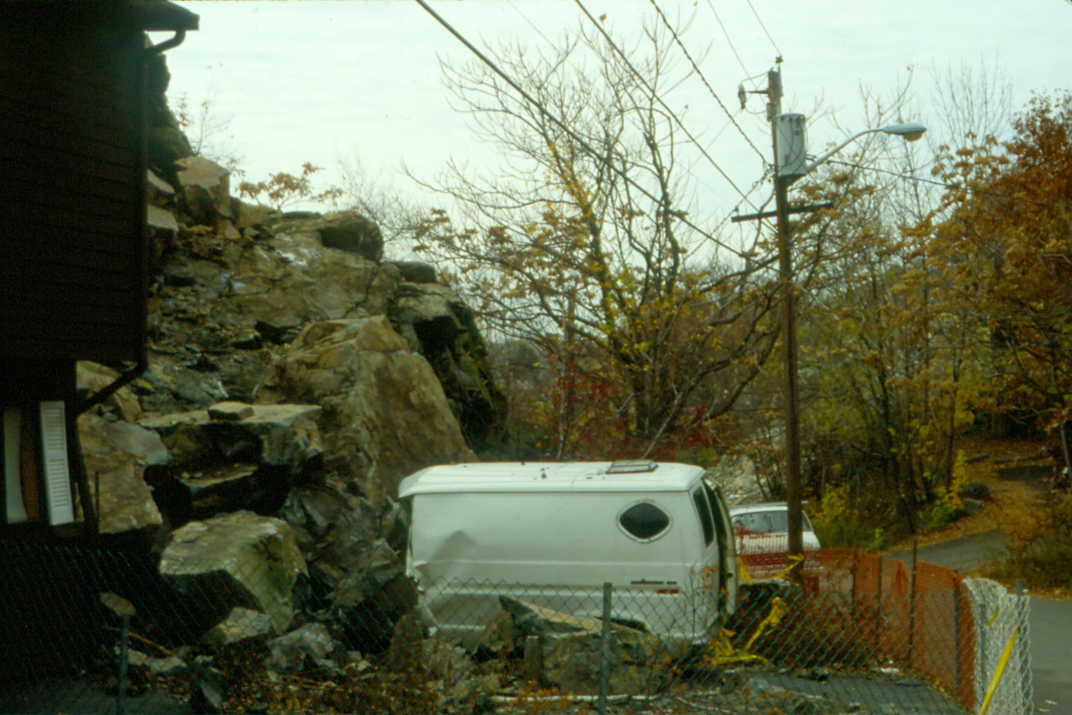
THE 1988 MALDEN, MASSACHUSETTS
LANDSLIDE: A CASE OF MULTIPLE HUMAN
CAUSES OVER A CENTURY IN THE MAKING.
Martin E. Ross
Dept. of Marine and Environmental Sciences
Northeastern University, Boston, MA

Slide 2
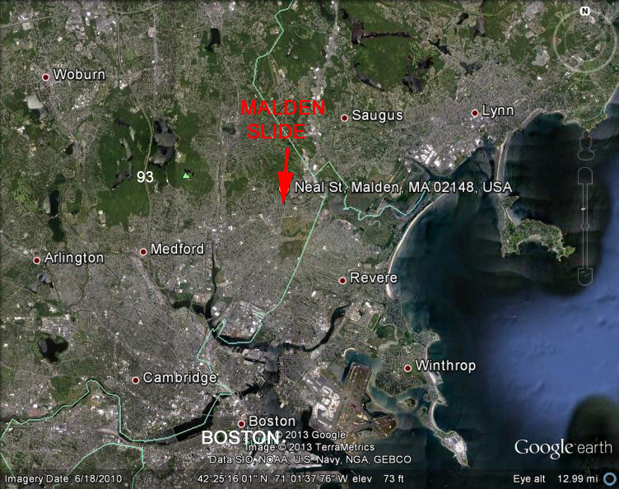
MALDEN LANDSLIDE, OCTOBER 8, 1988

Slide 3
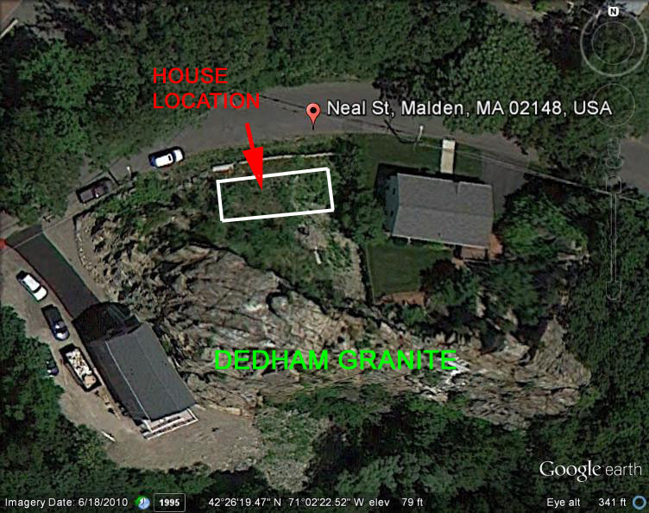
Greenish chilled border facies of Dedham Granite

Slide 4
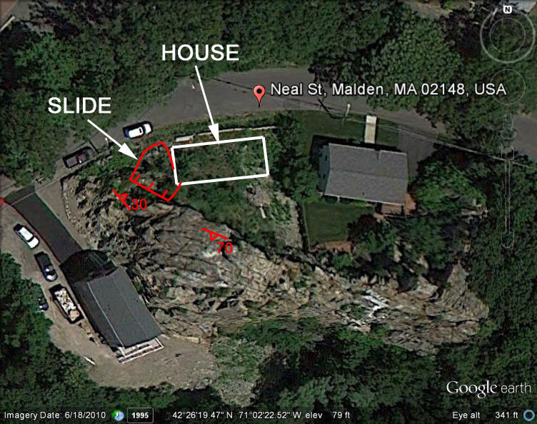

Slide 5
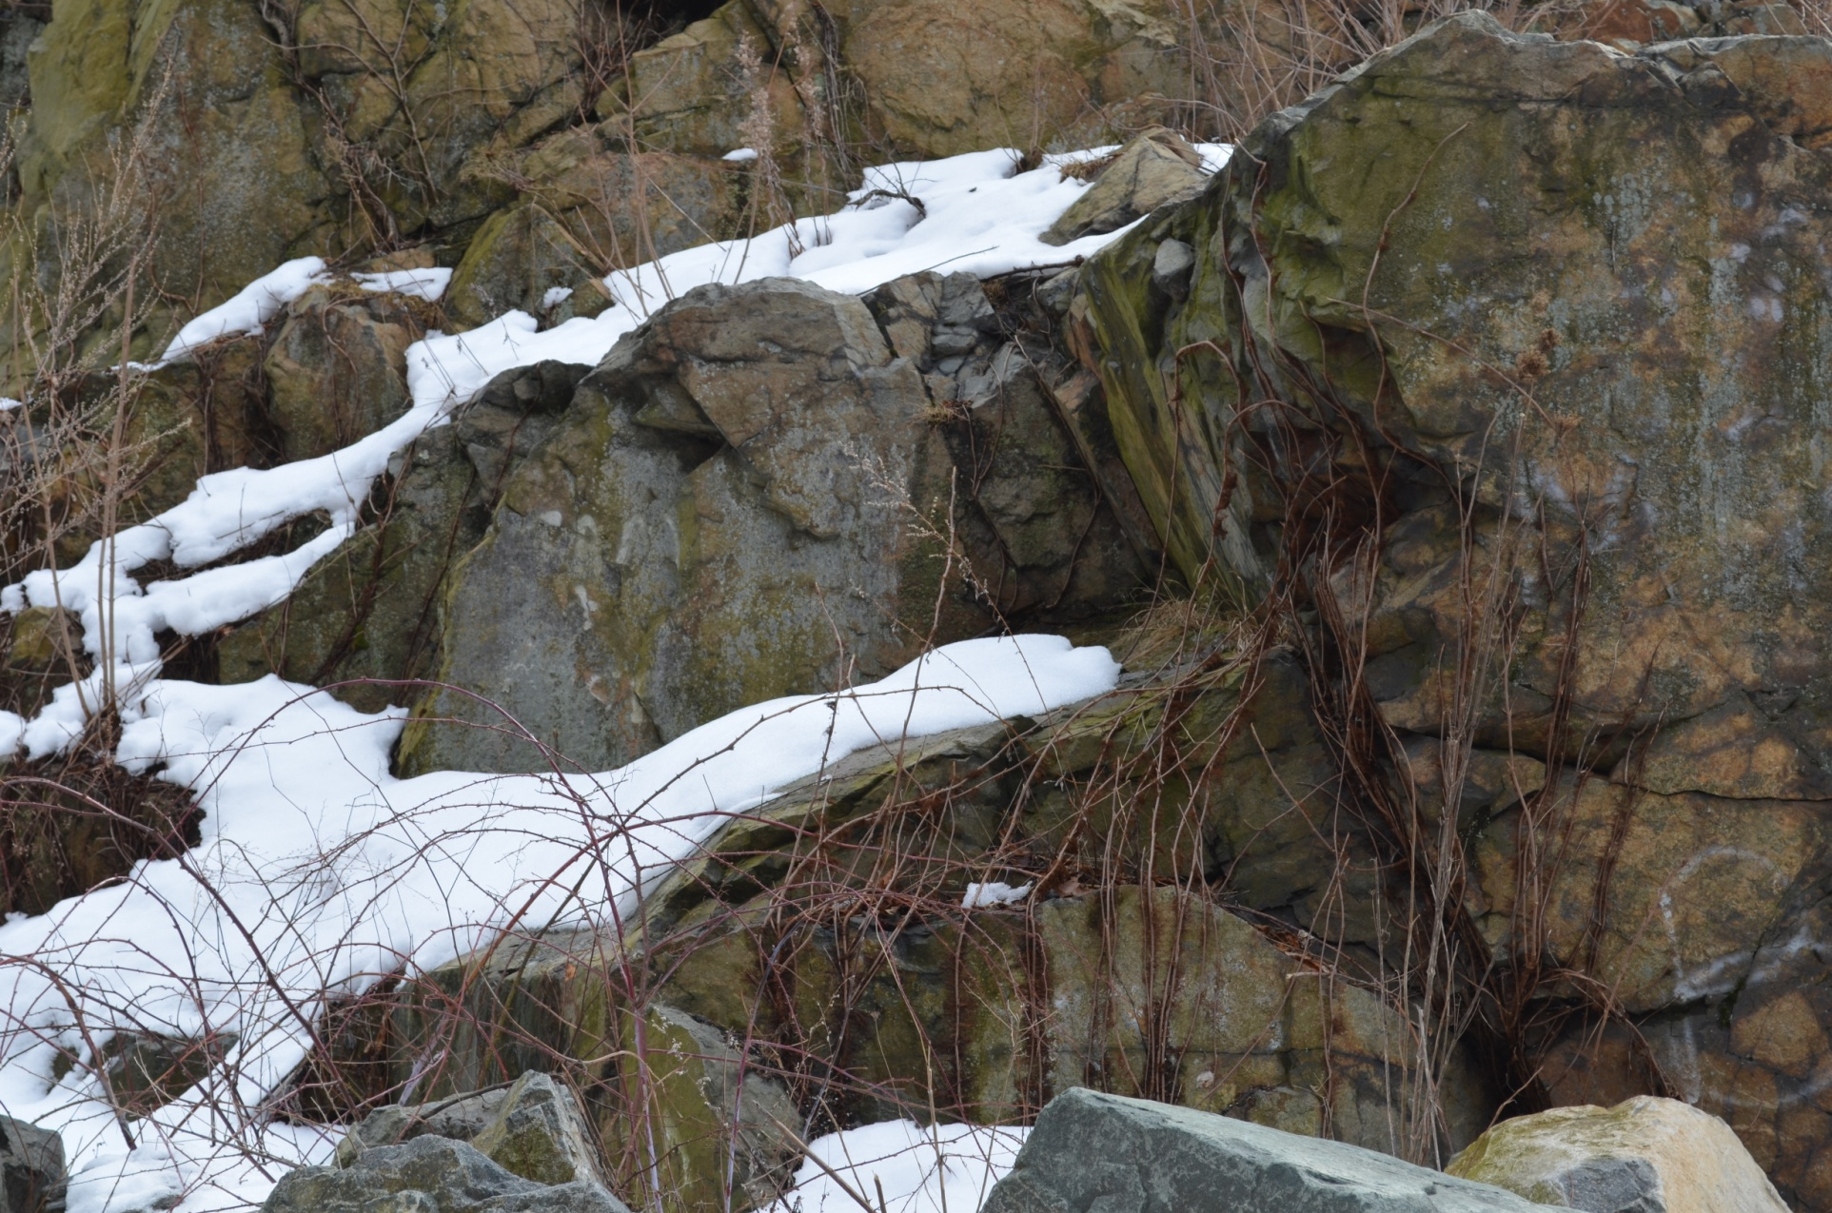
2 joint sets defined shape of slide blocks
o
o
S
70
Az 294
o
N
Az 320
o

Slide 6
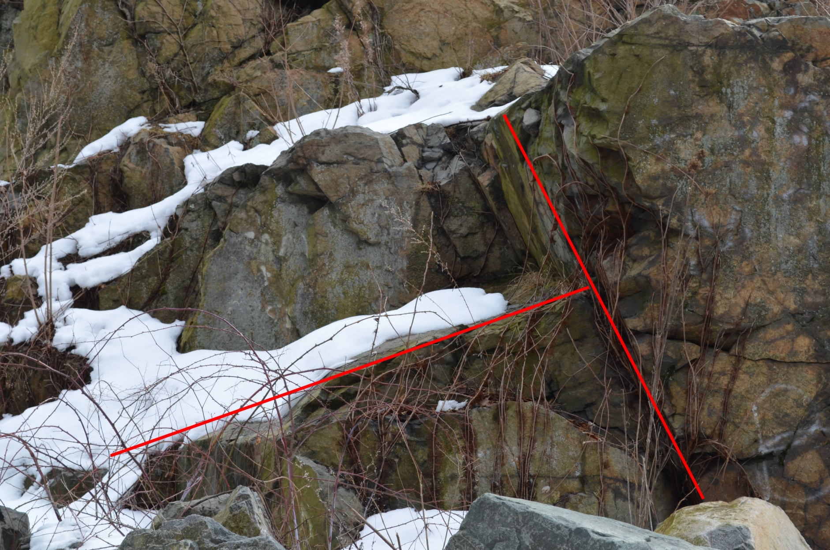

Slide 7
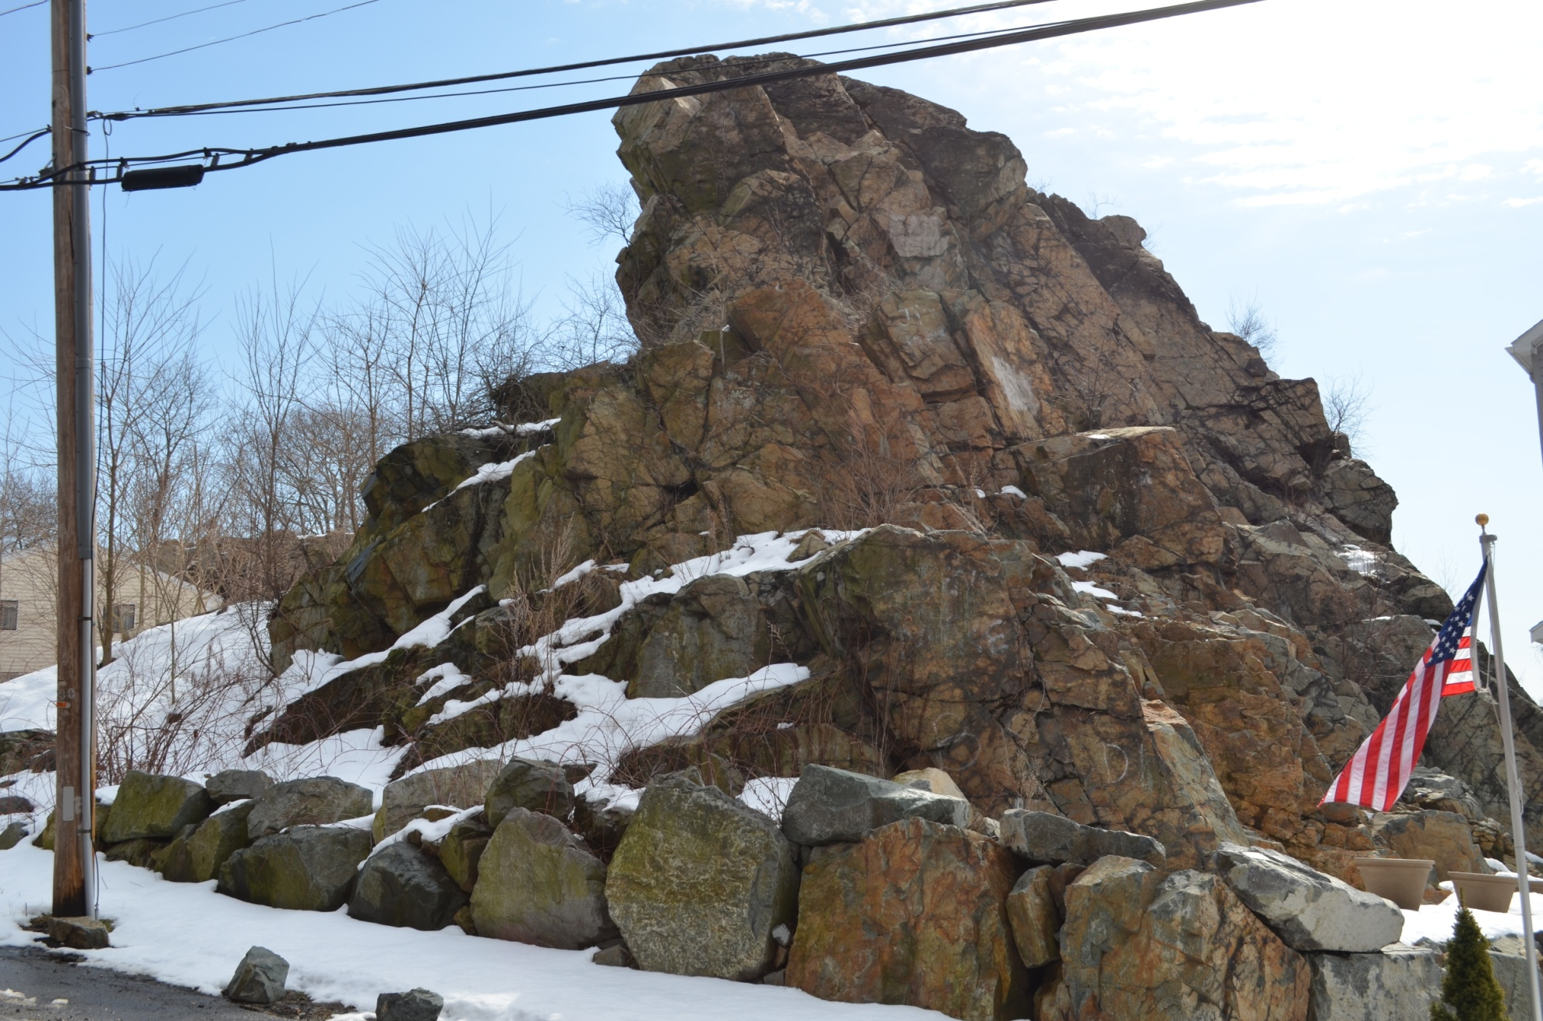

Slide 8
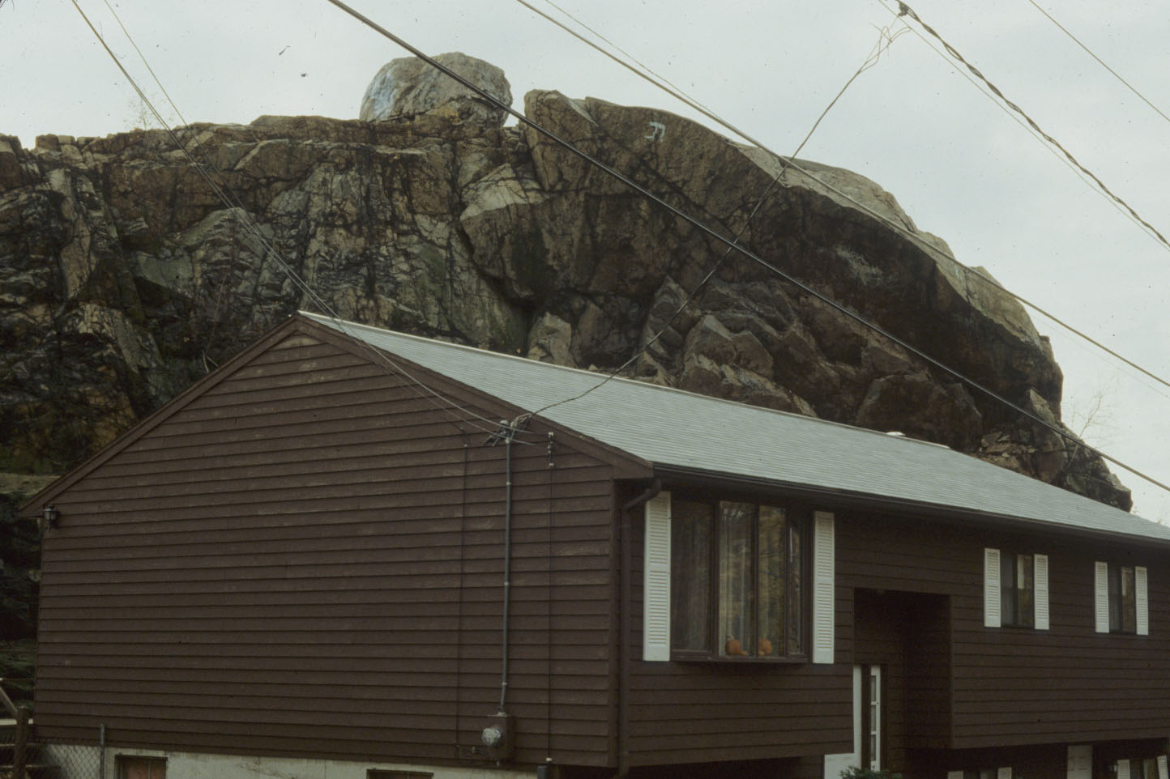
“I liked the nice private back yard”

Slide 9
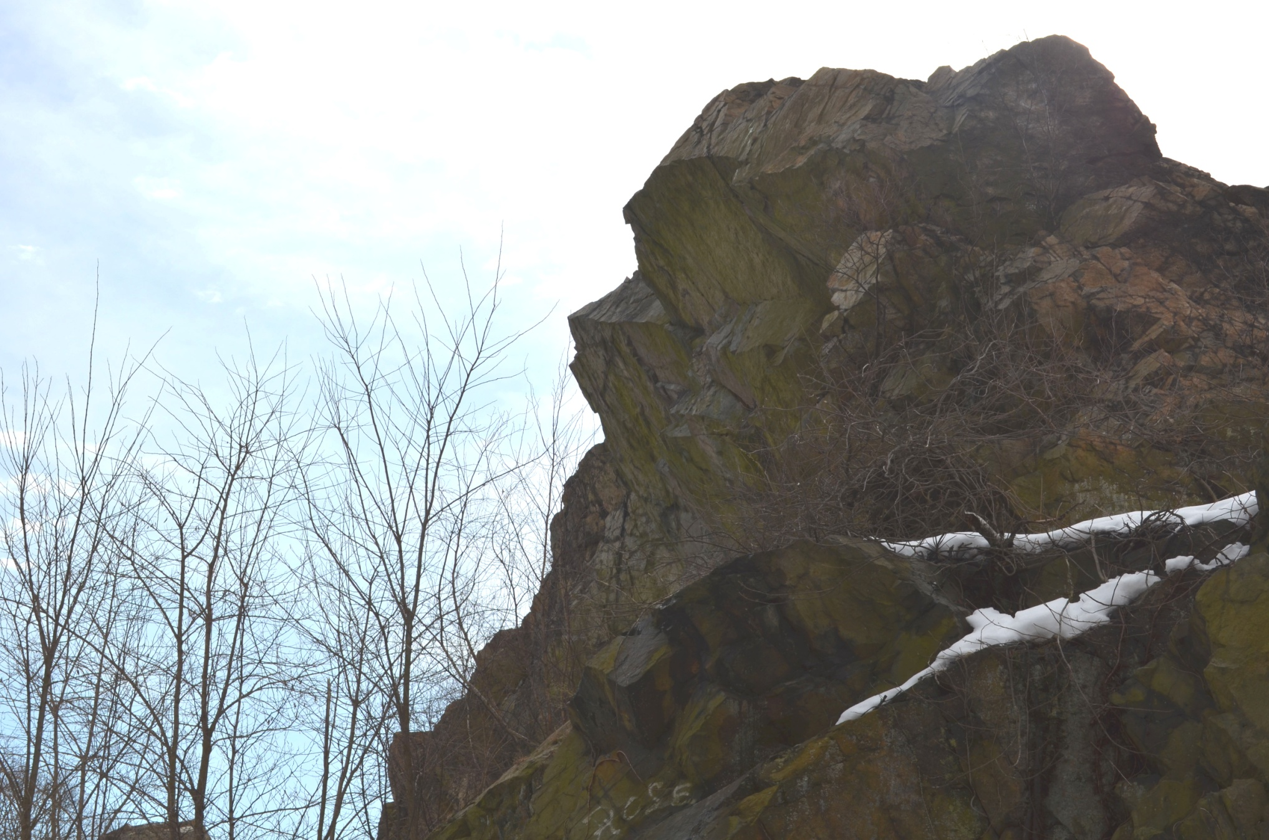

Slide 10
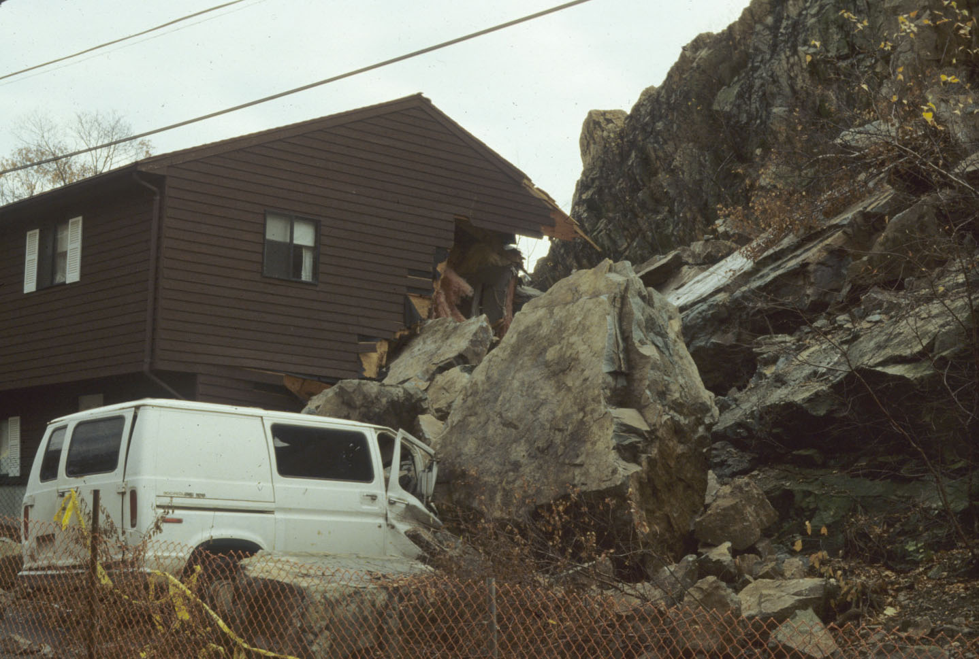
Rock topple-slide or rock fall-rock

Slide 11
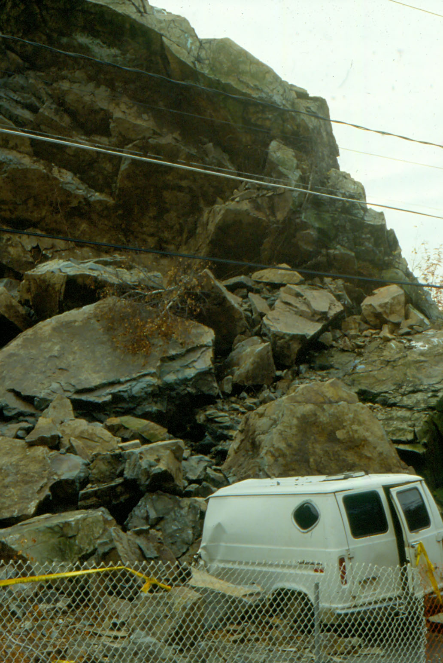

Slide 12
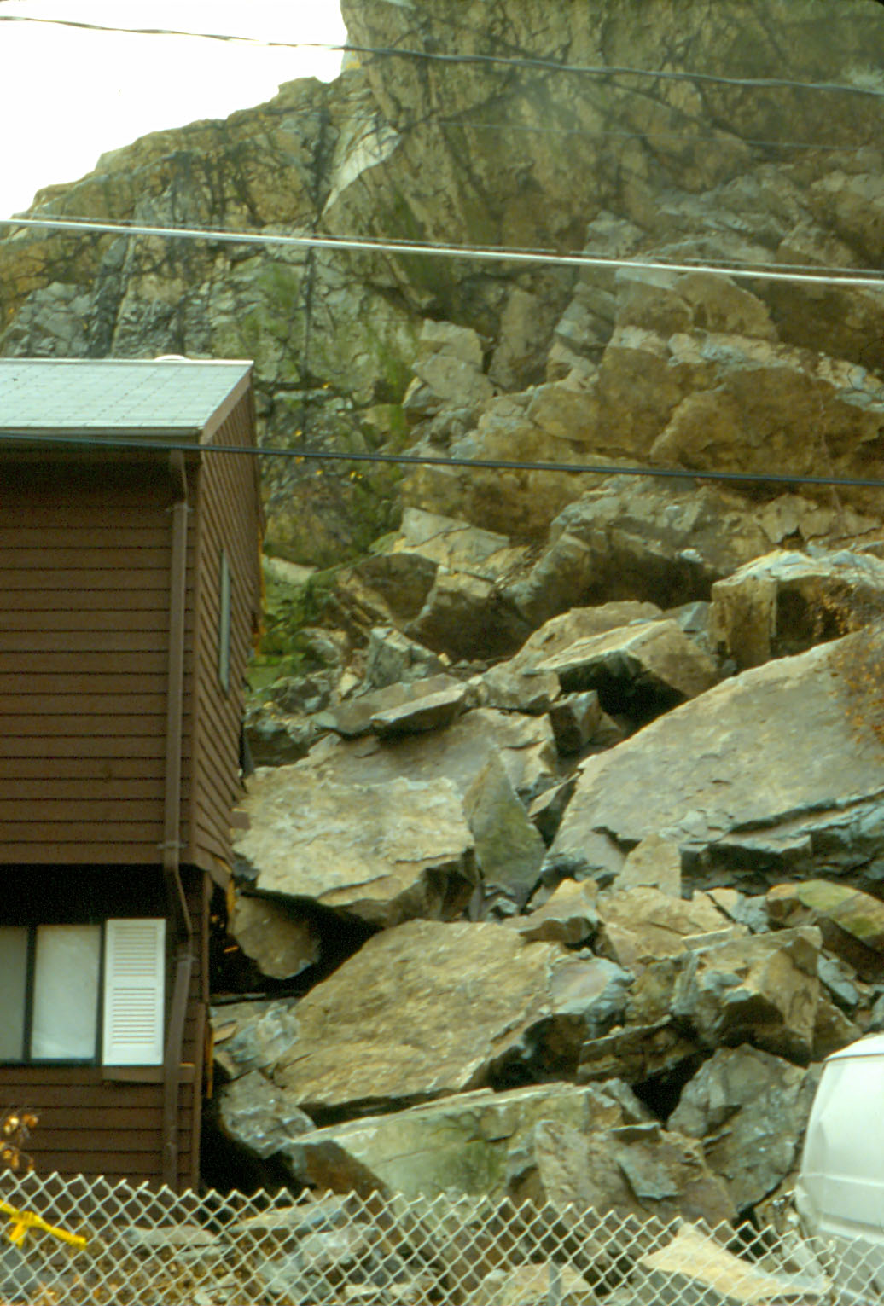

Slide 13
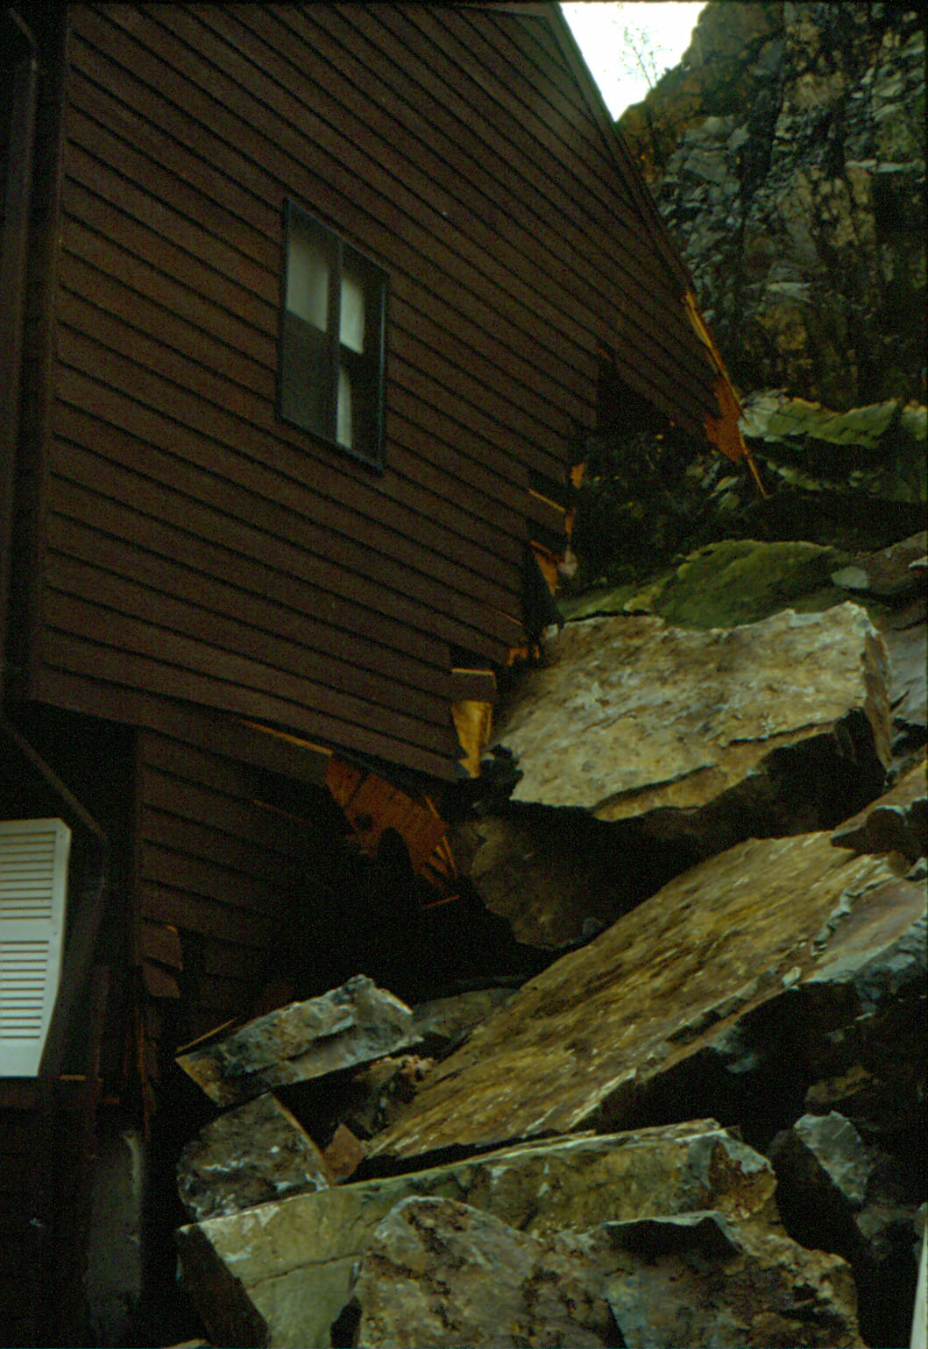

Slide 14
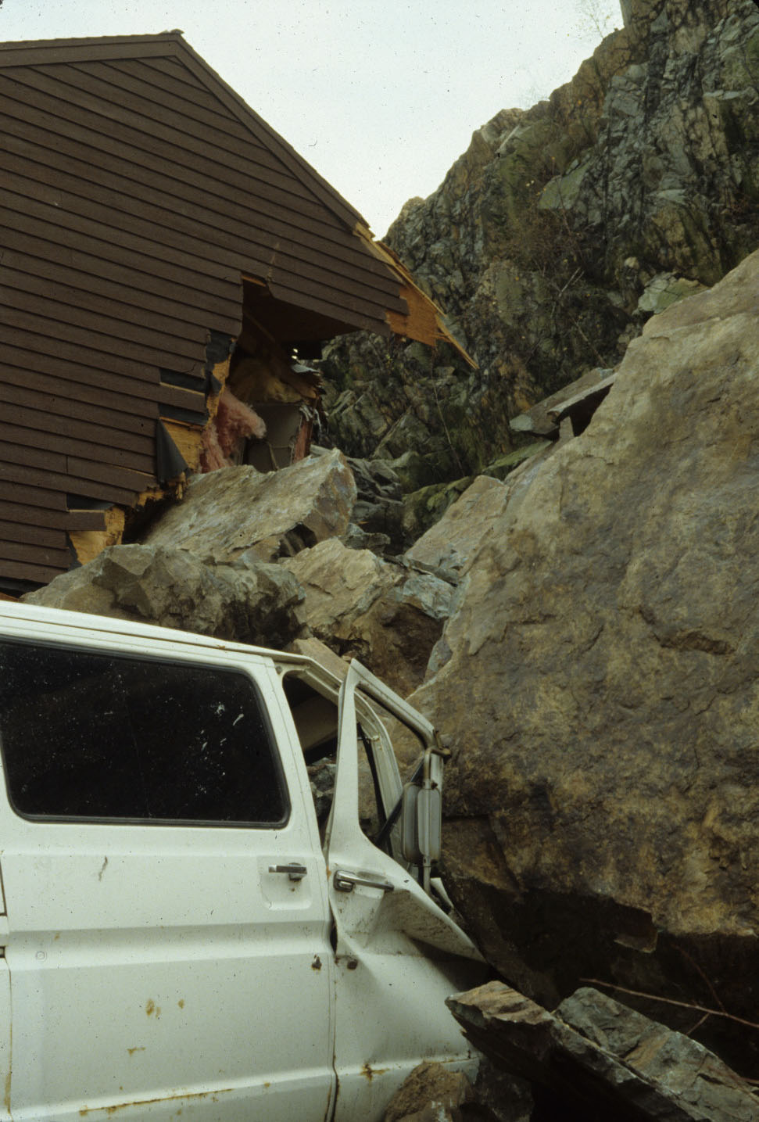

Slide 15
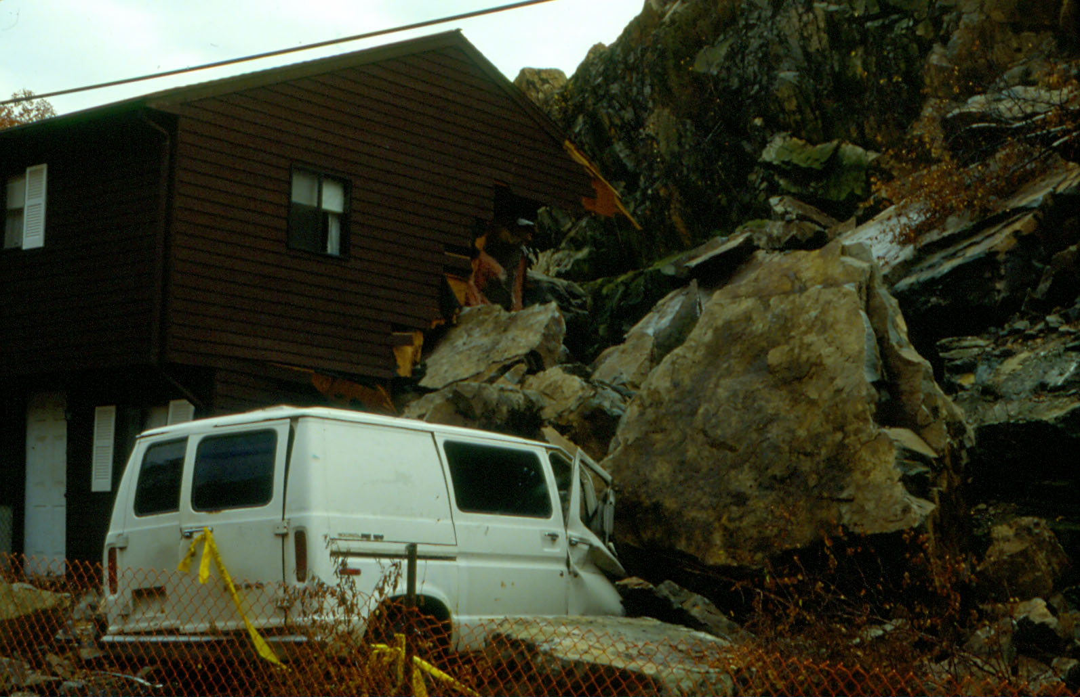

Slide 16
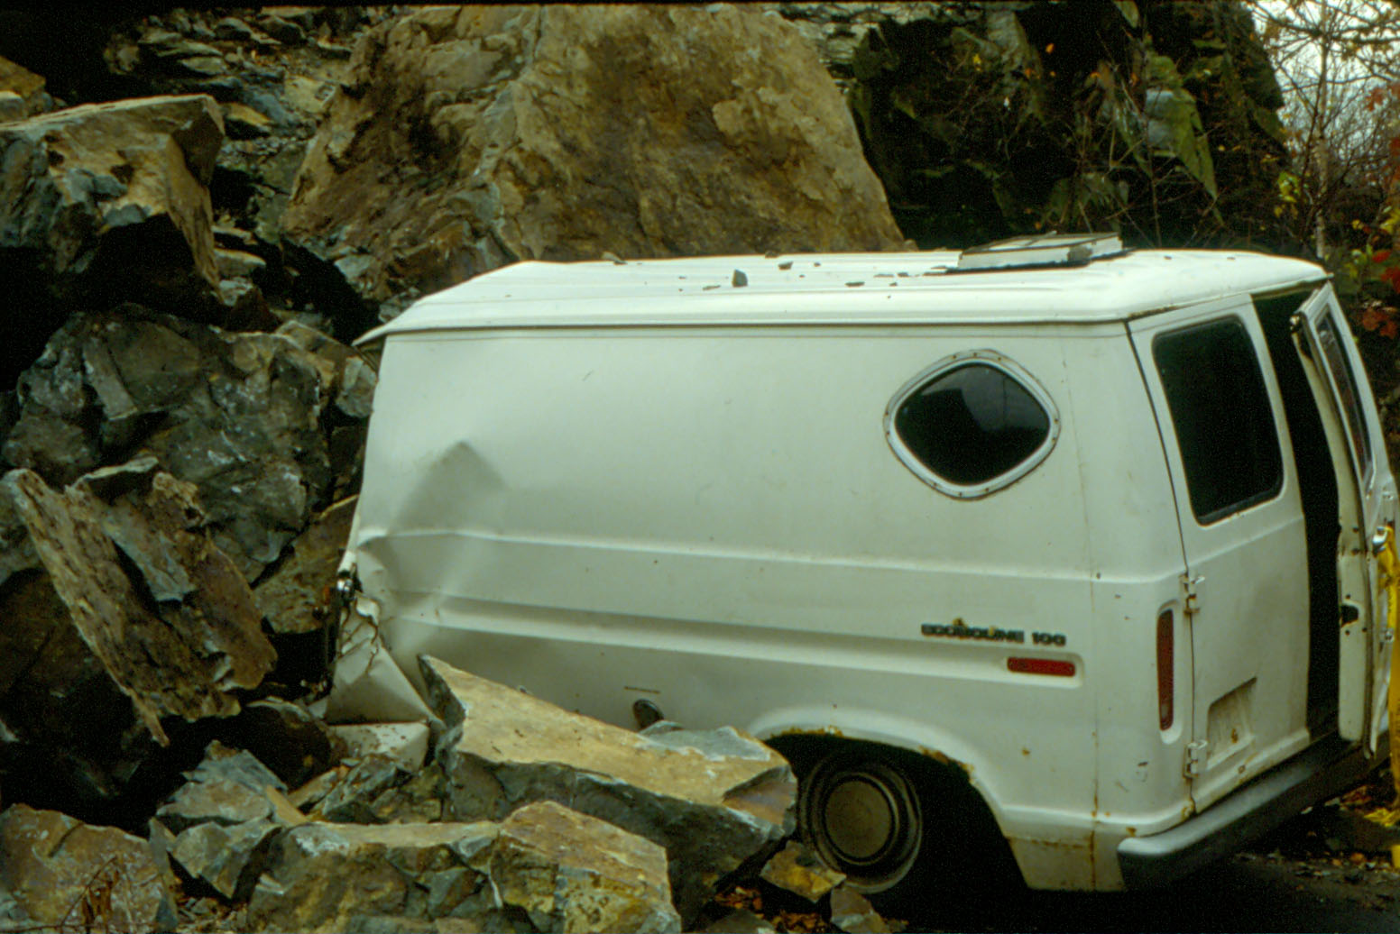

Slide 17
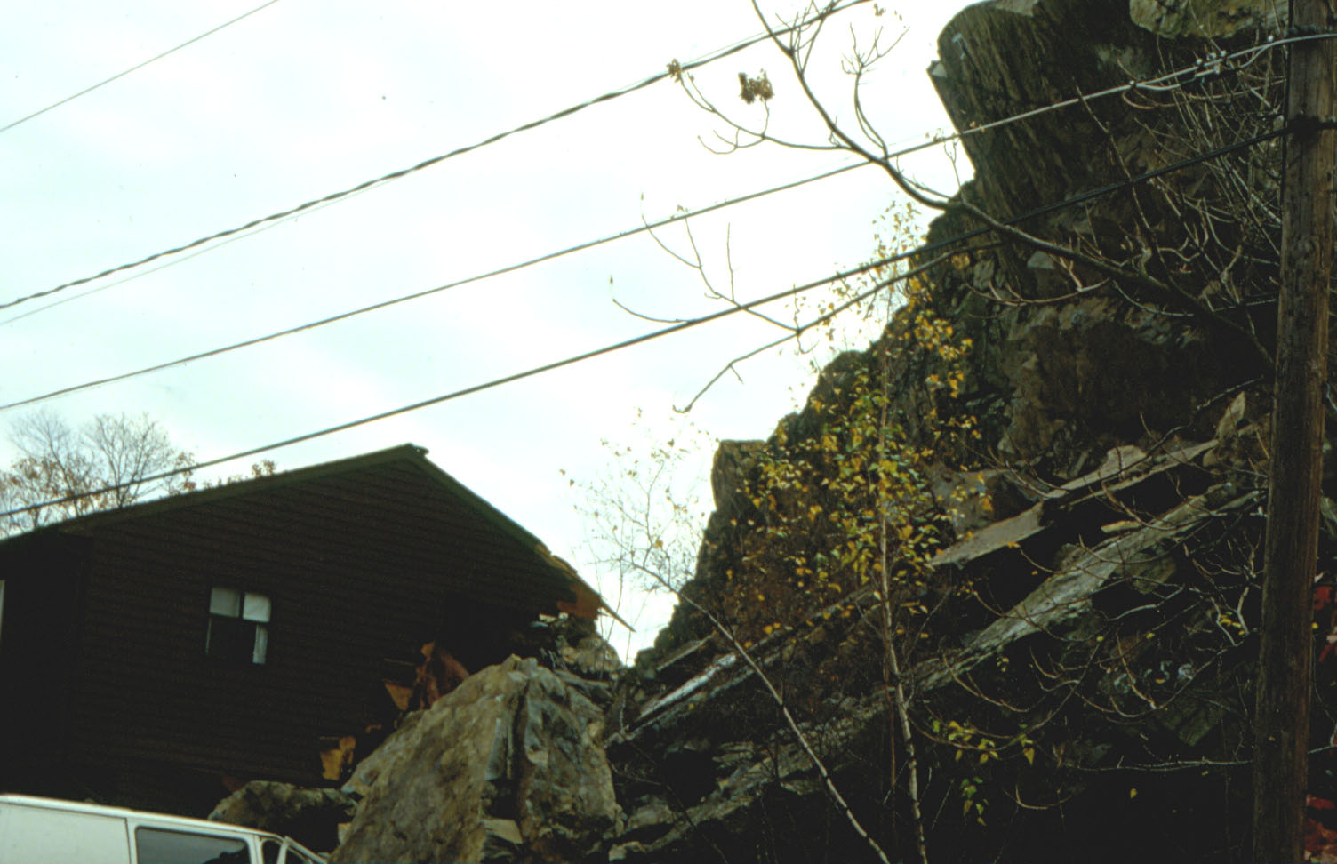
CONTRIBUTING LONG-TERM FACTORS
-over-steepened quarry face last worked in 1873
- joint sets dipping into and out of face
-frost wedging

Slide 18
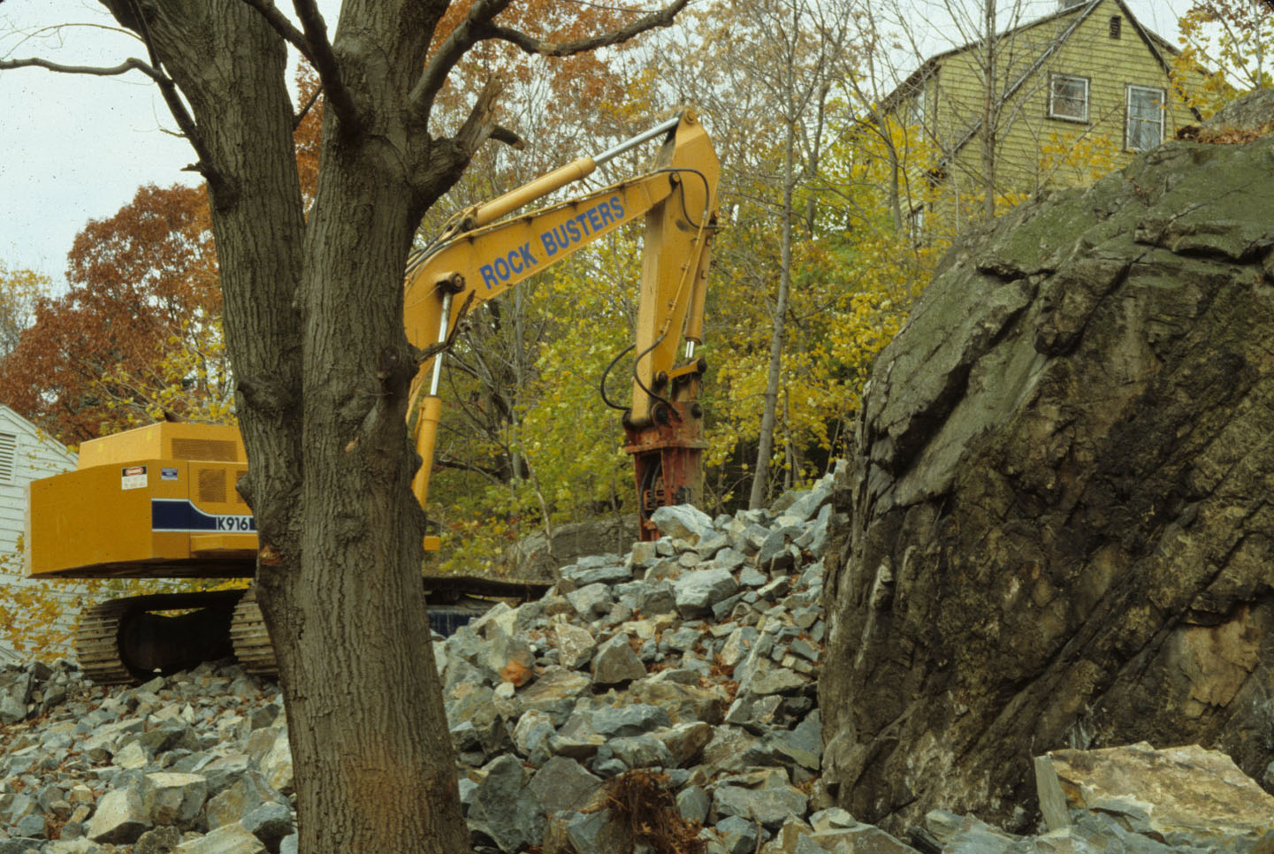
POSSIBLE TRIGGER: GROUND VIBRATIONS

Slide 19
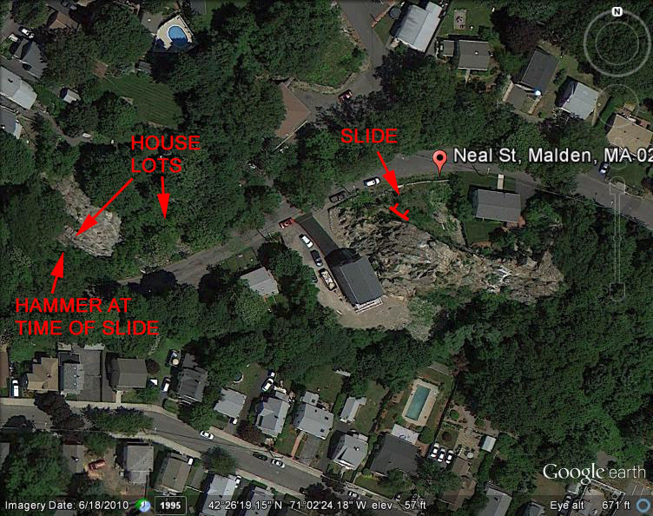

Slide 20
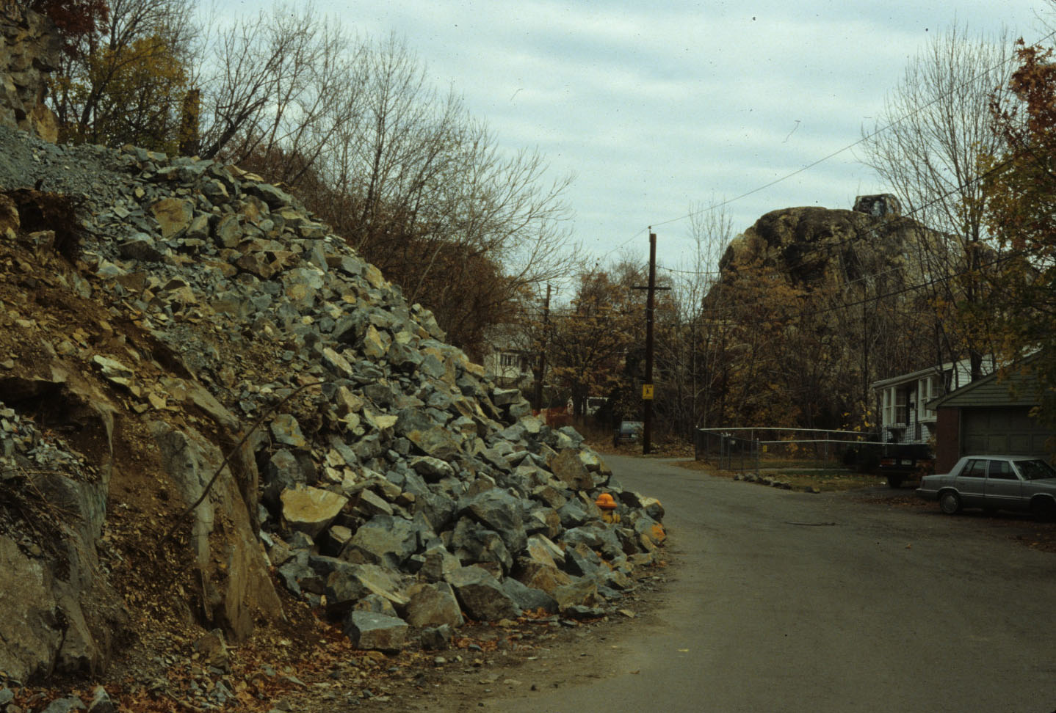

Slide 21
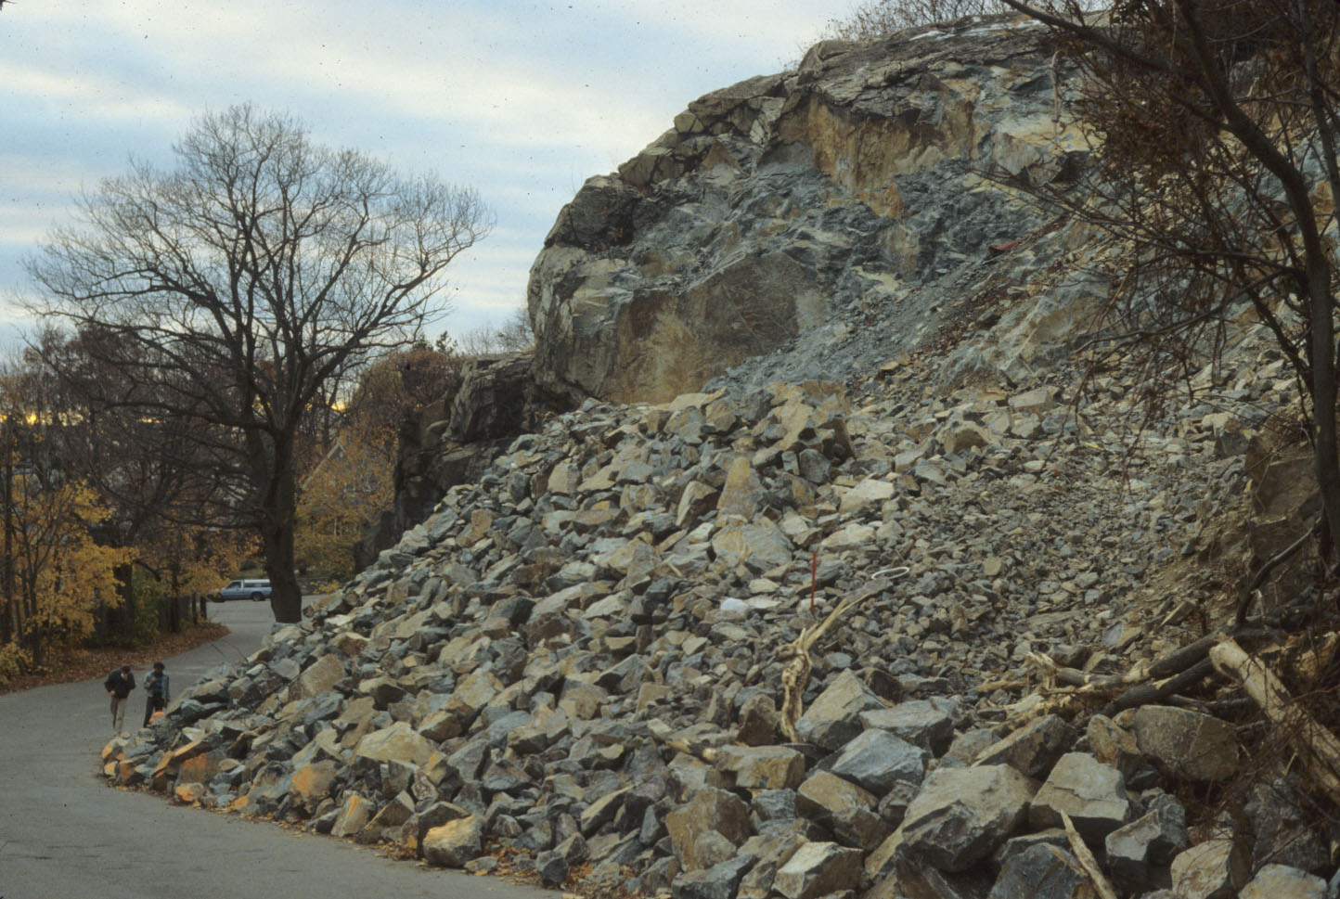

Slide 22
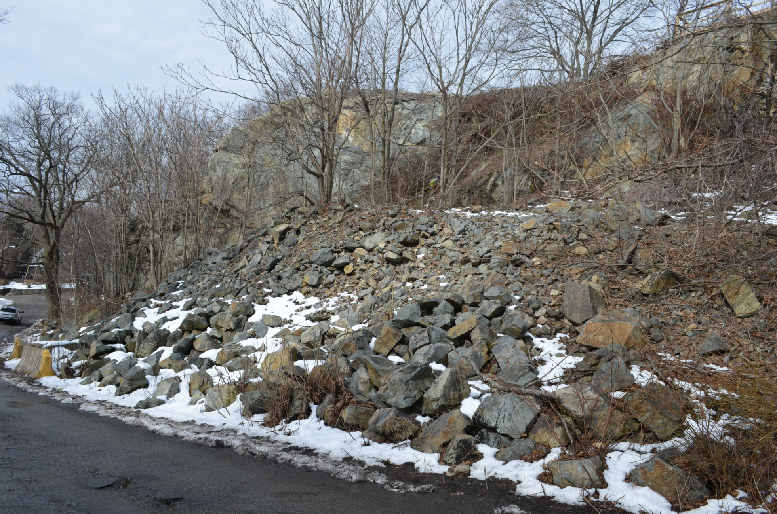
PRESENT CONDITIONS

Slide 23
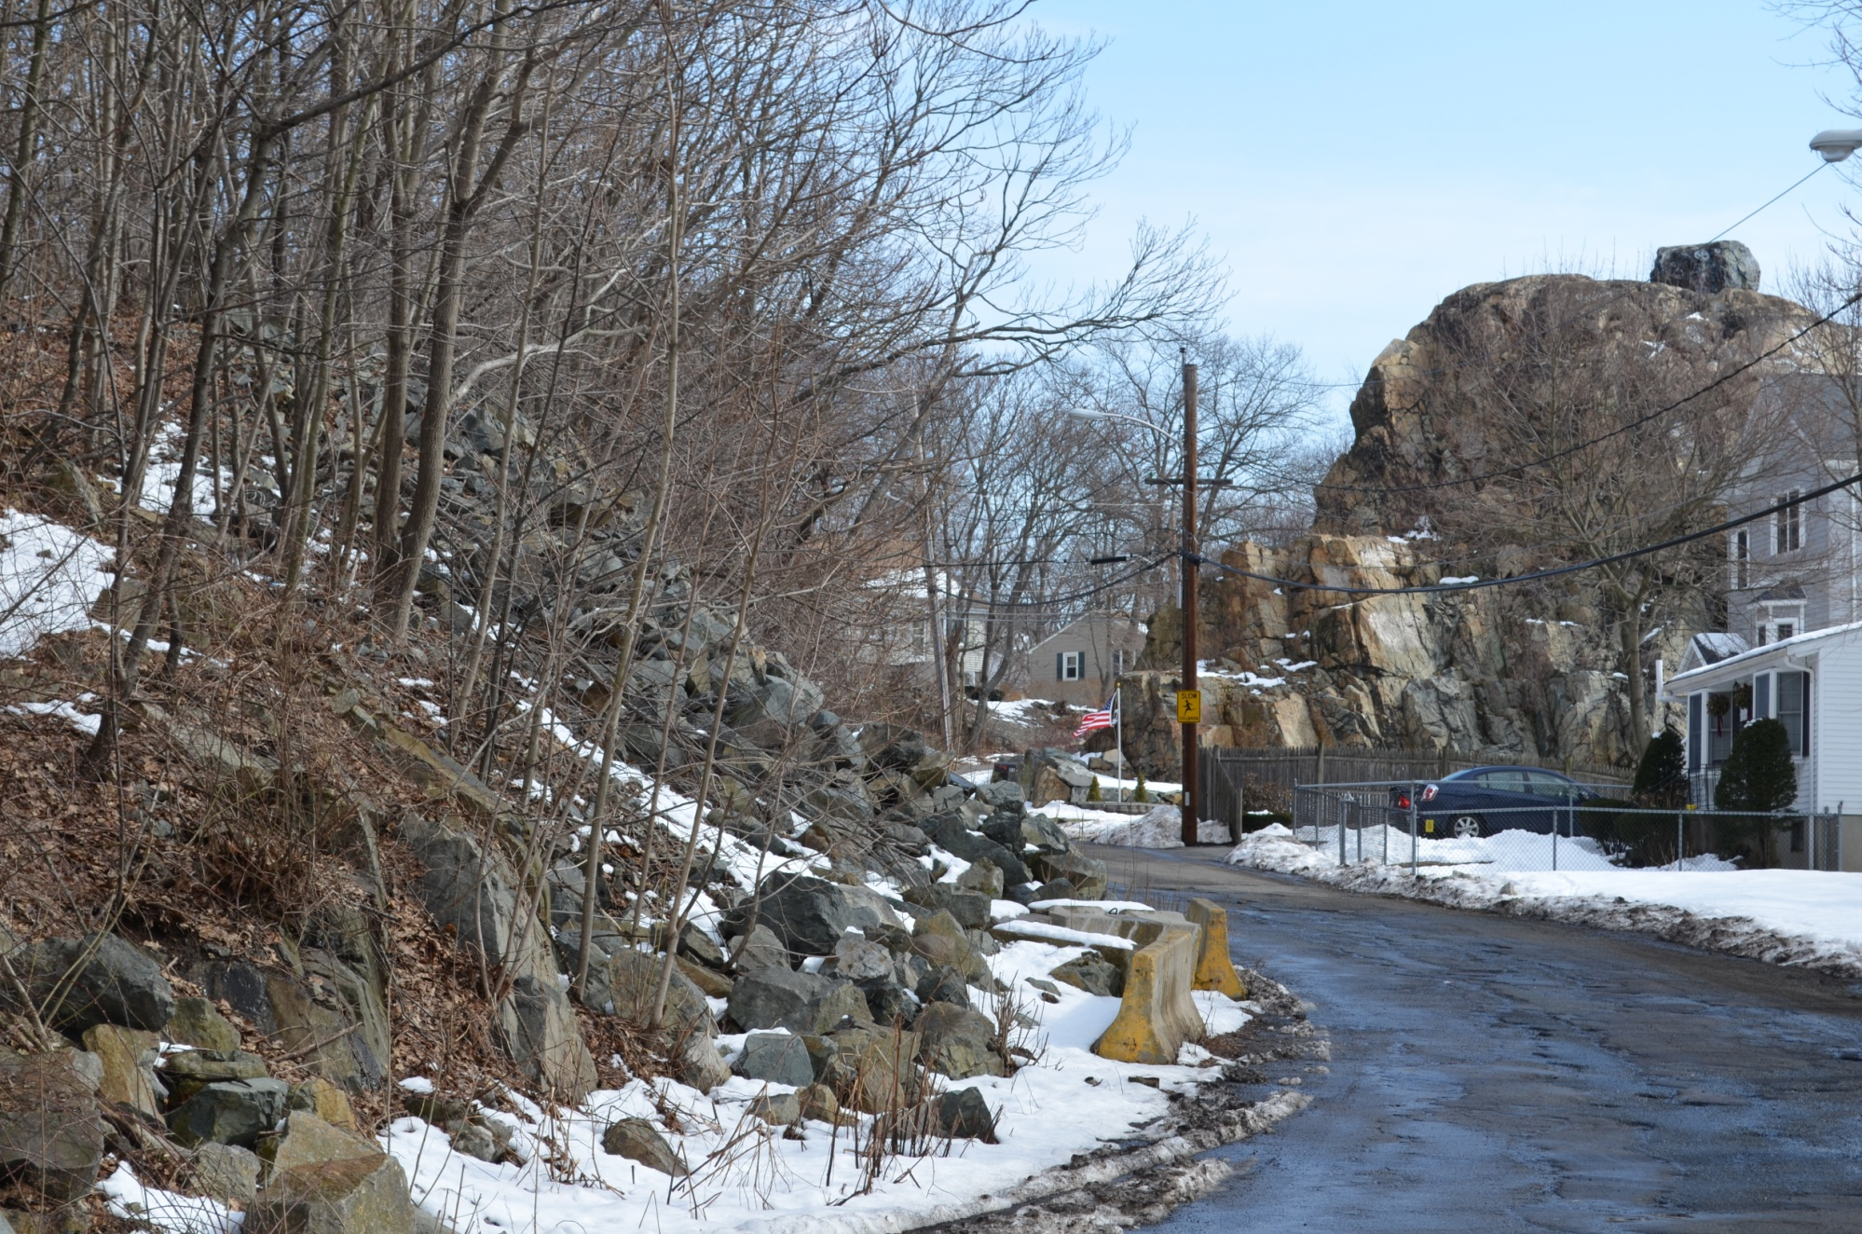

Slide 24
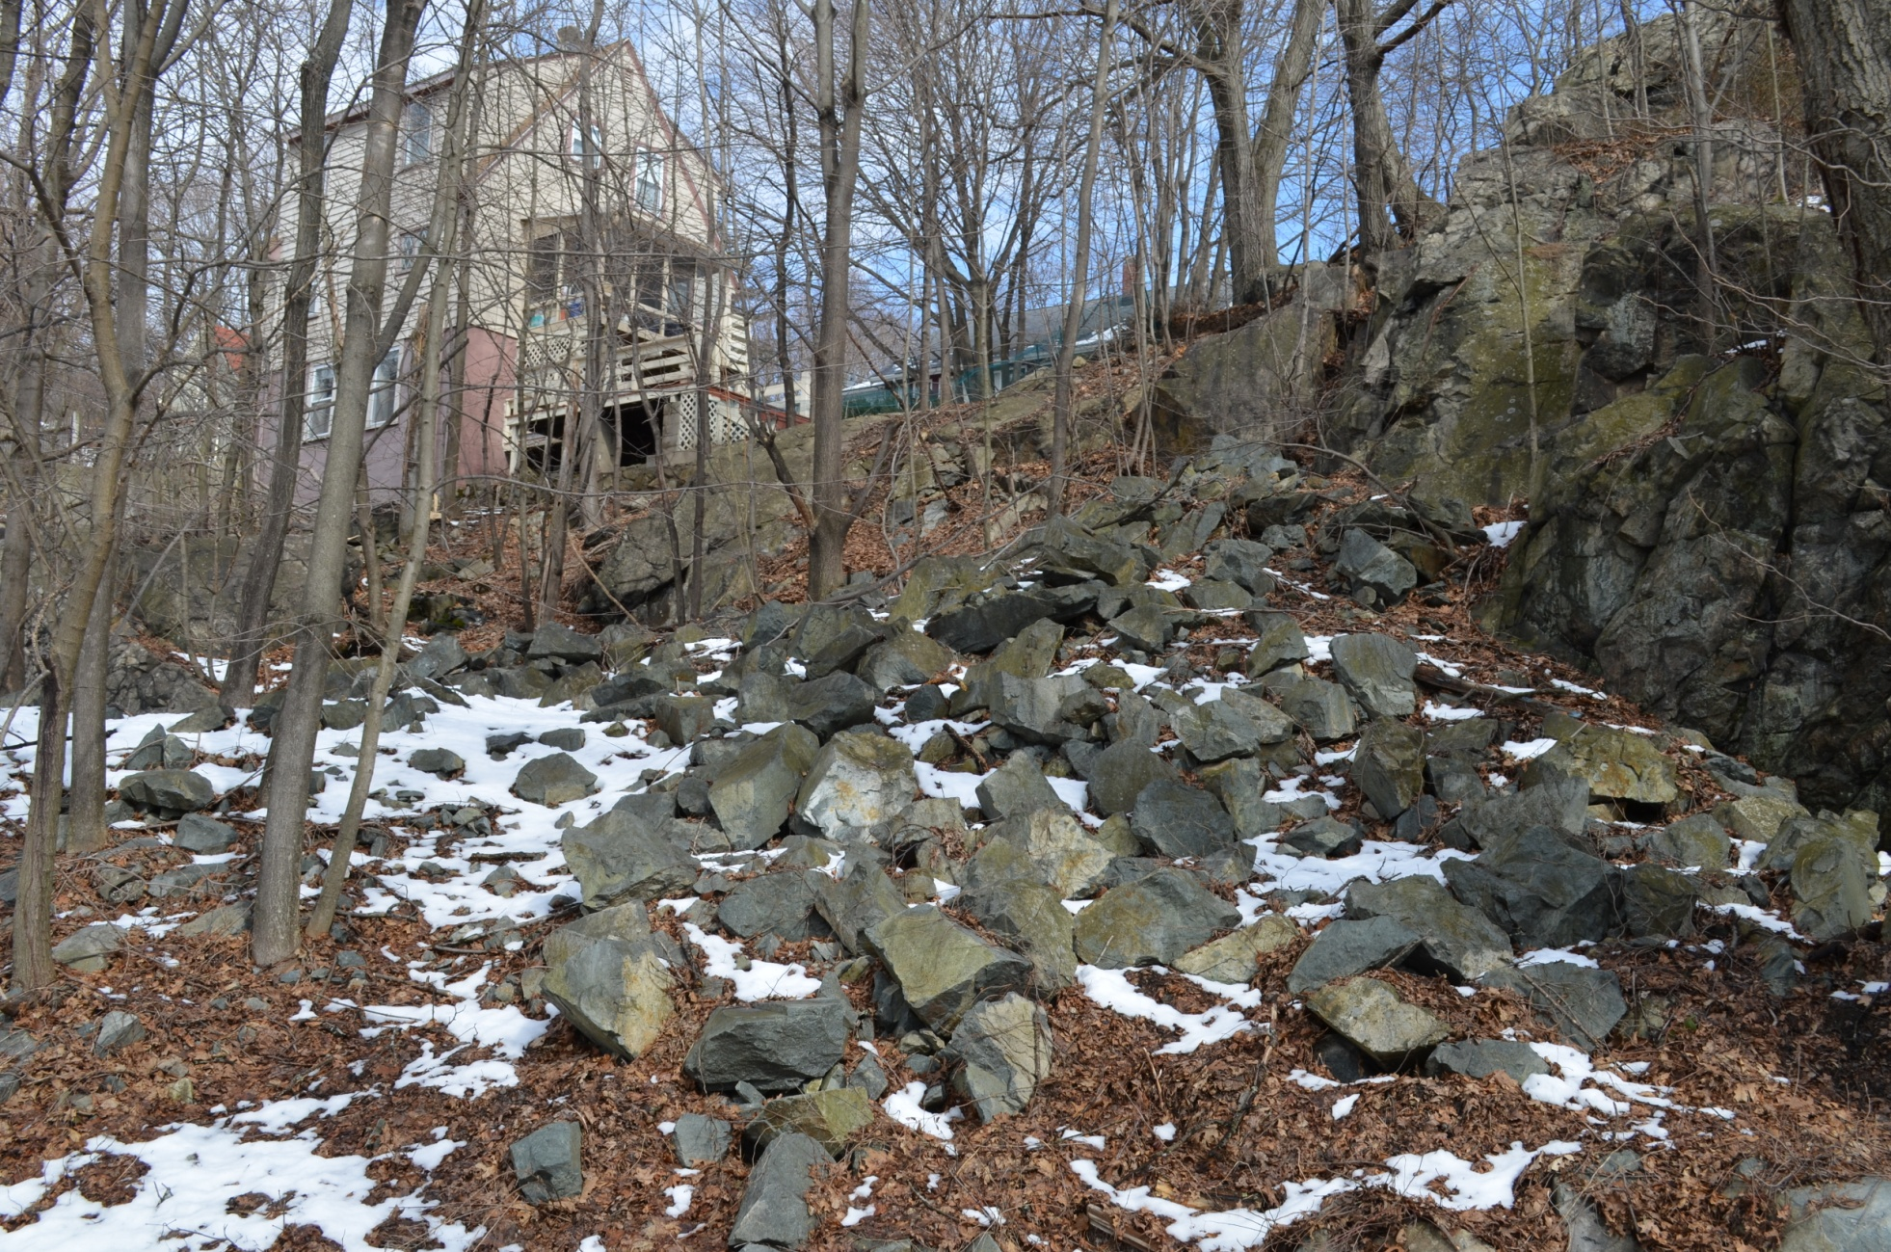

Slide 25
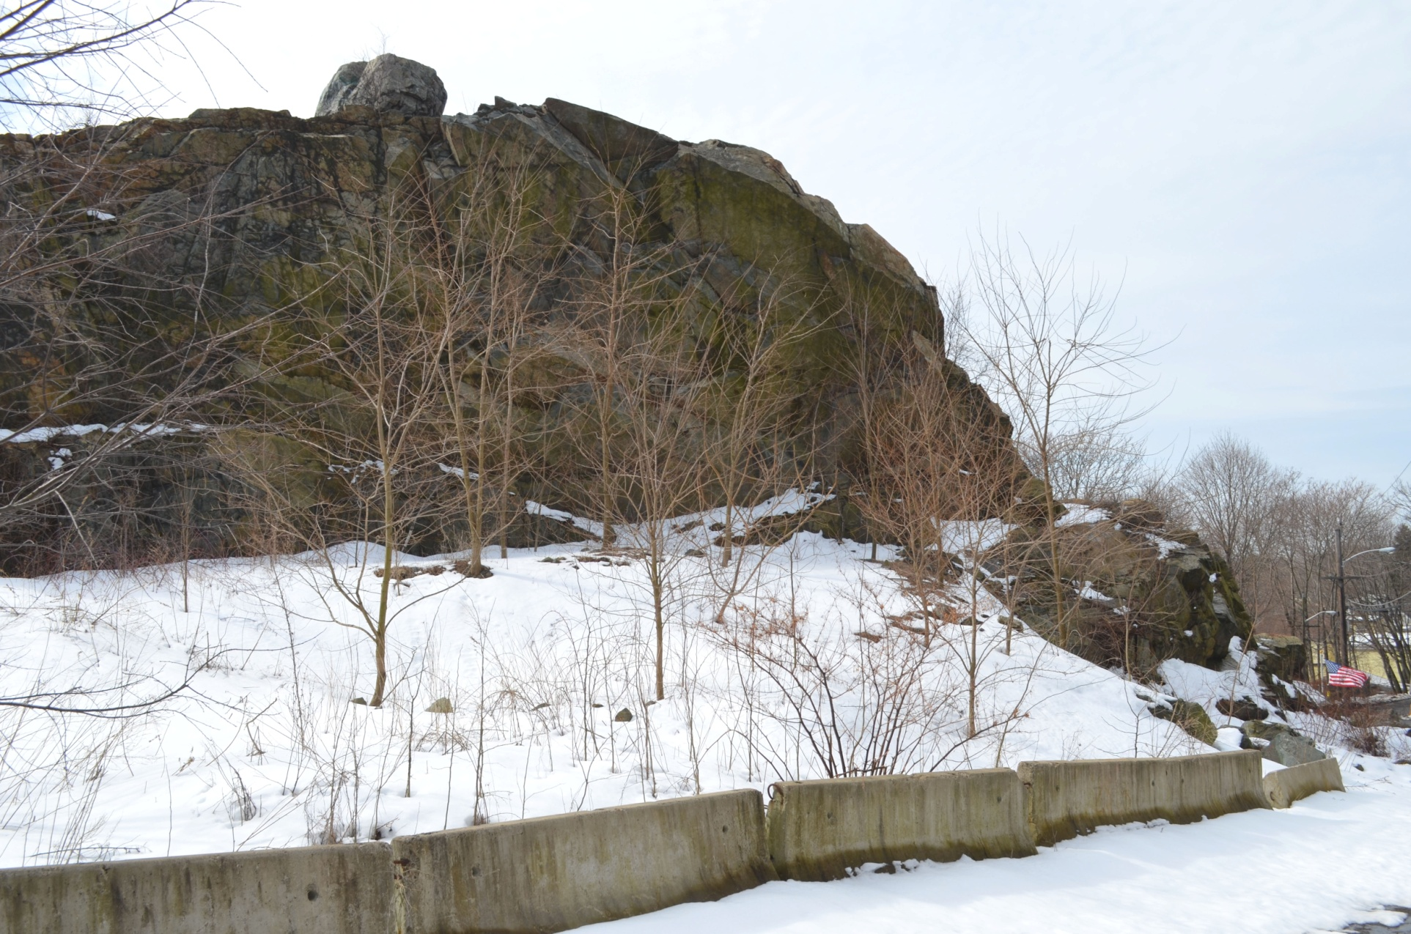

Slide 26
ULTIMATE RESPONSIBILITY?
City of Malden
-no geotechnical site-specific study required
when house was built ~1980.
-issued building permits for ridiculous lots
in 1988 requiring use of hydraulic hammer
-inadequate regulations on vibrations
-upgraded regulations after slide

Slide 27
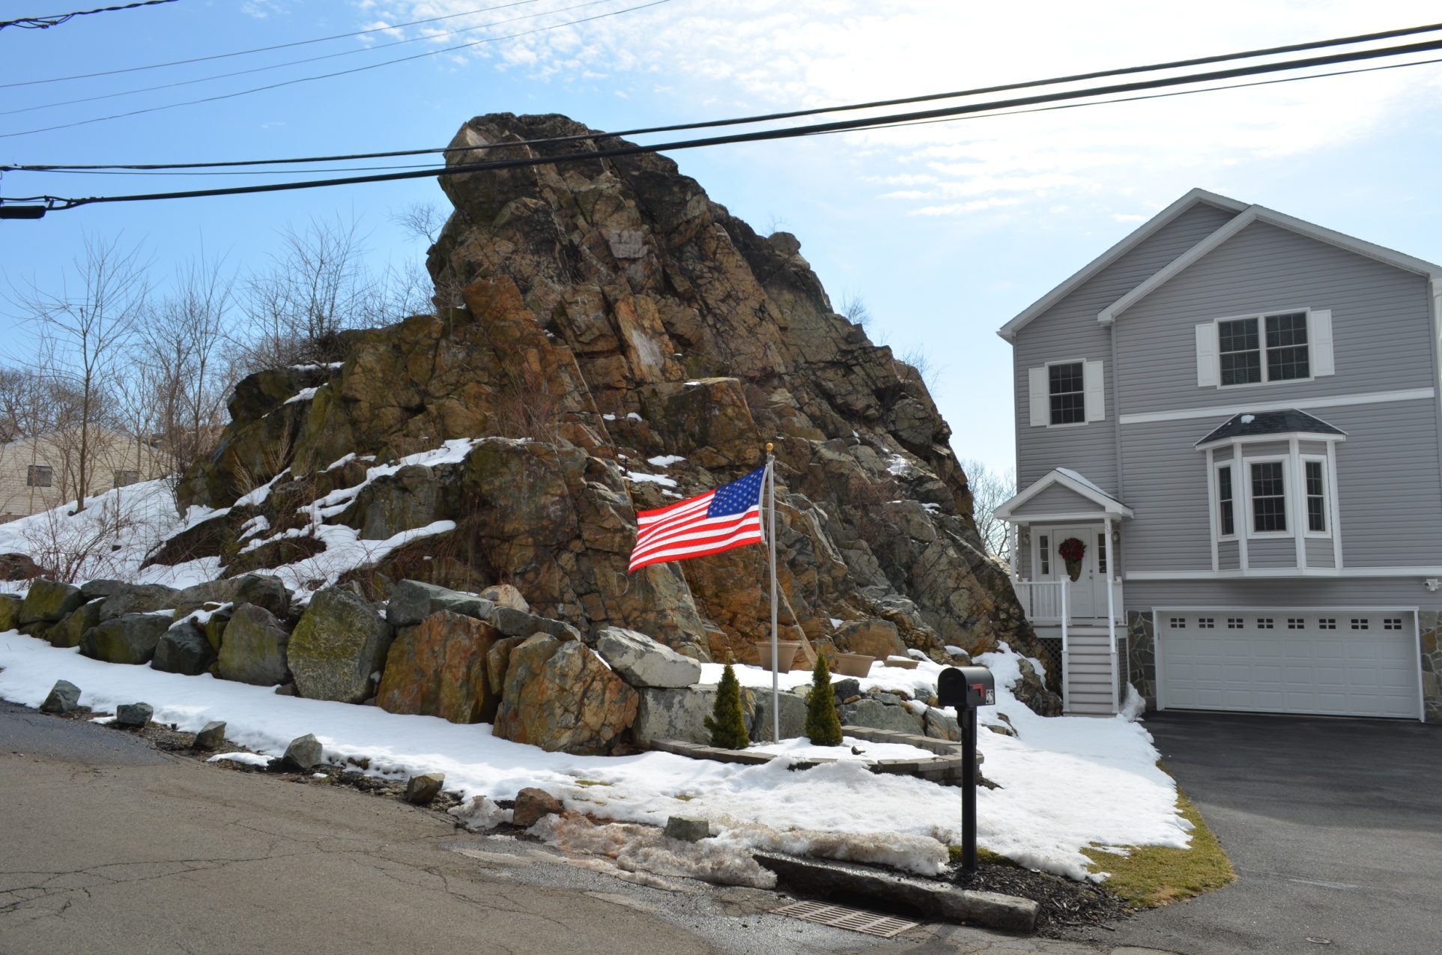
OOPS!

Slide 28
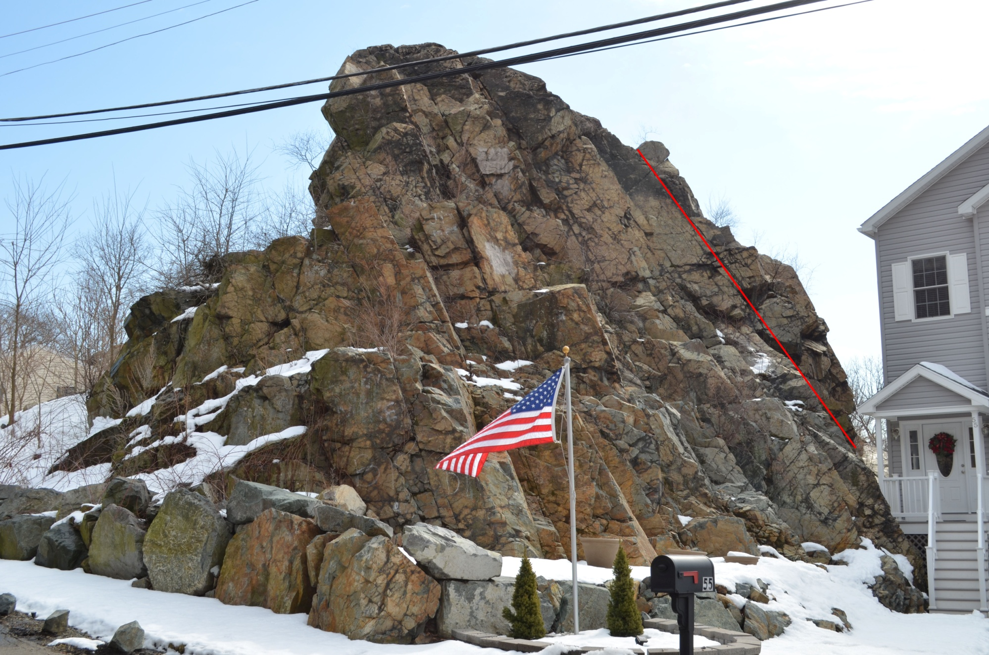
Another great field trip stop in the making!

Slide 29
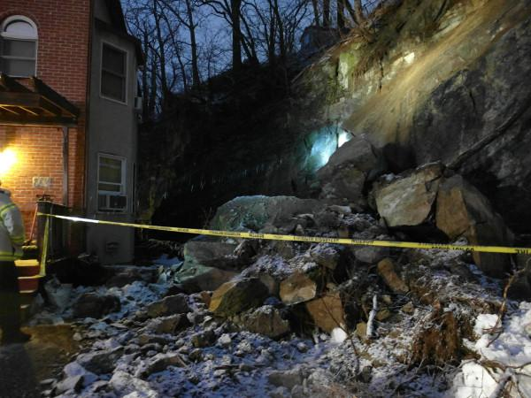
Brighton, MA rockslide Feb 24, 2013
6 Olive St.
Brighton Volcanics 0.53” rain + 0.45” on 20th
Boston Globe

