Slide 1
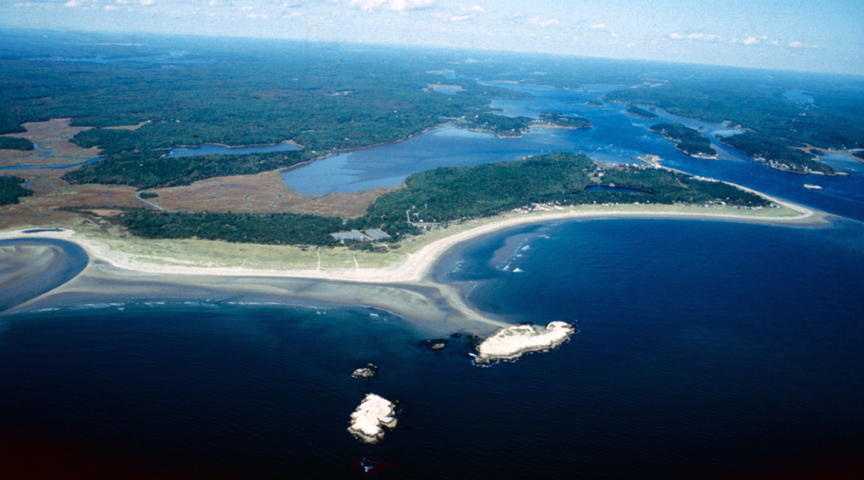
Popham Beach, Maine:
An Example of Engineering Activity that Saved
Beach Property Without Harming the Beach
Joseph T. Kelley
Department of Earth Sciences
University of Maine

Slide 2
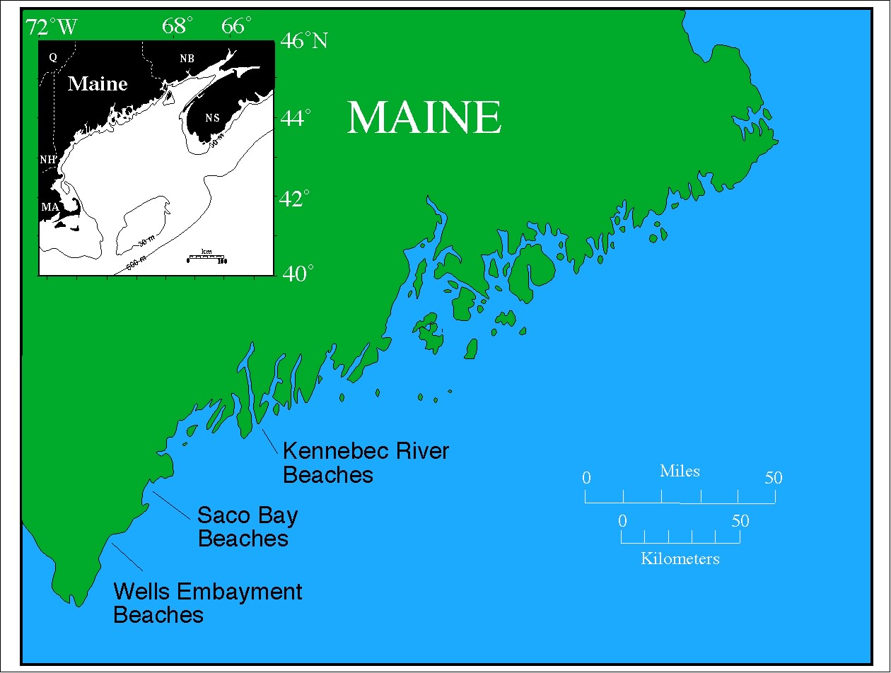

Slide 3
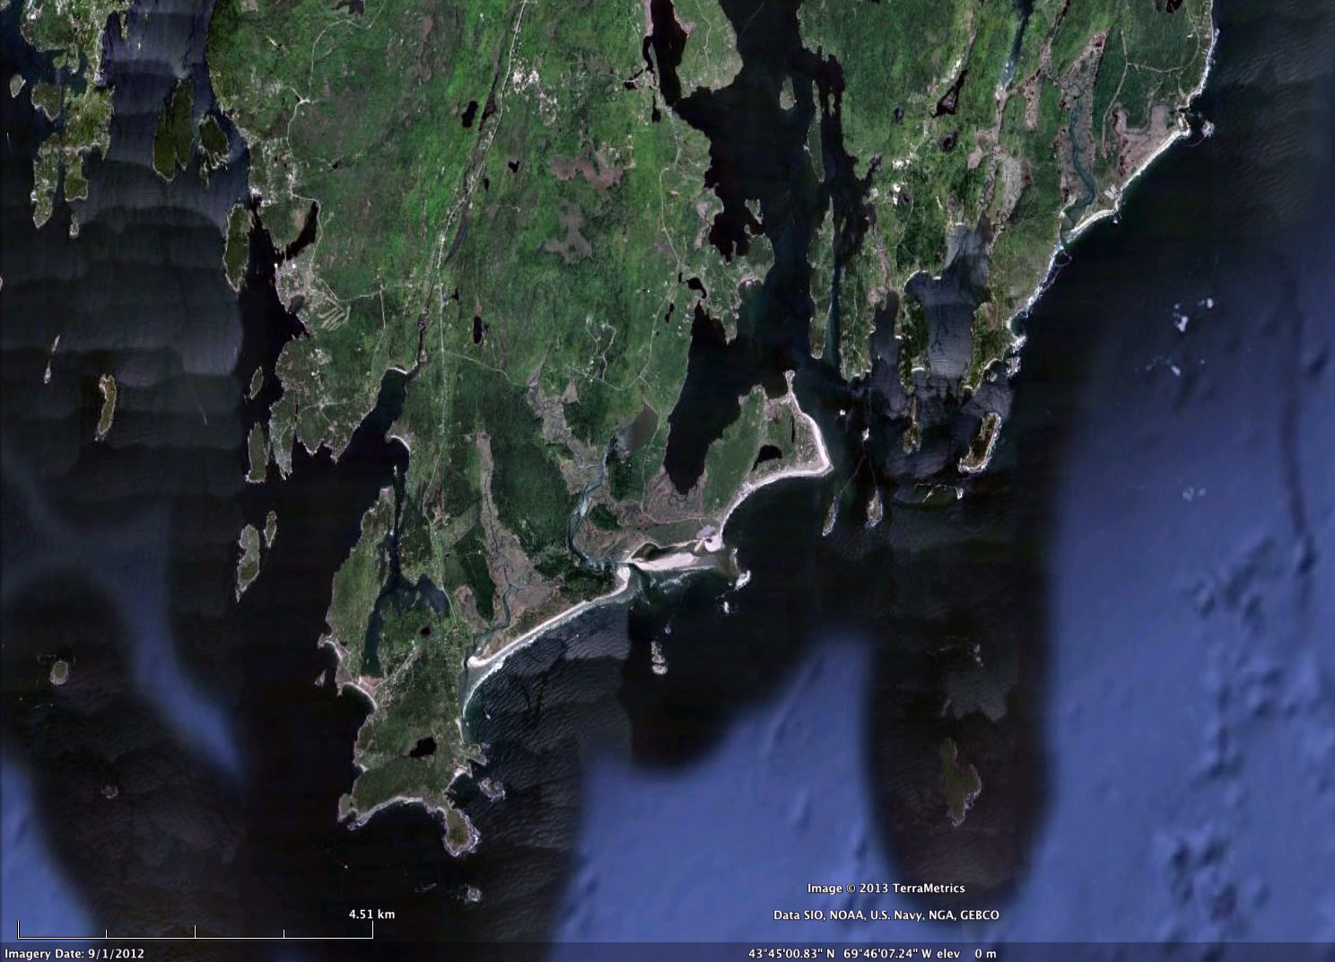
Kennebec
River
Estuary
Reid
Beach
State
Park
Coast Guard
Beach
Morse River
Inlet
Hunnewell
Beach
Head
Beach
State Park
Beach
Seawall
Beach
Mean Tide range = 2.6 m
Mean wave height = 0.6 m
FitzGerald et al., 2000
4.5 km

Slide 4
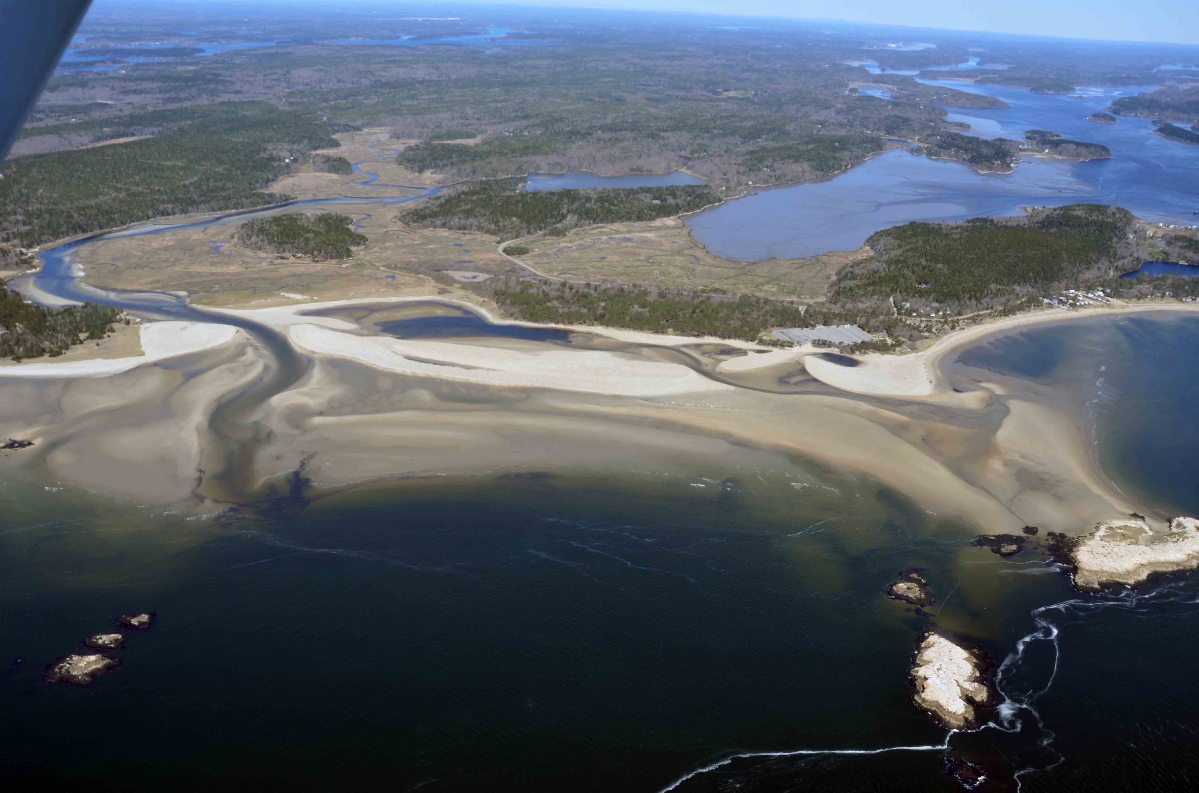

4/1995
4/2012

Slide 5
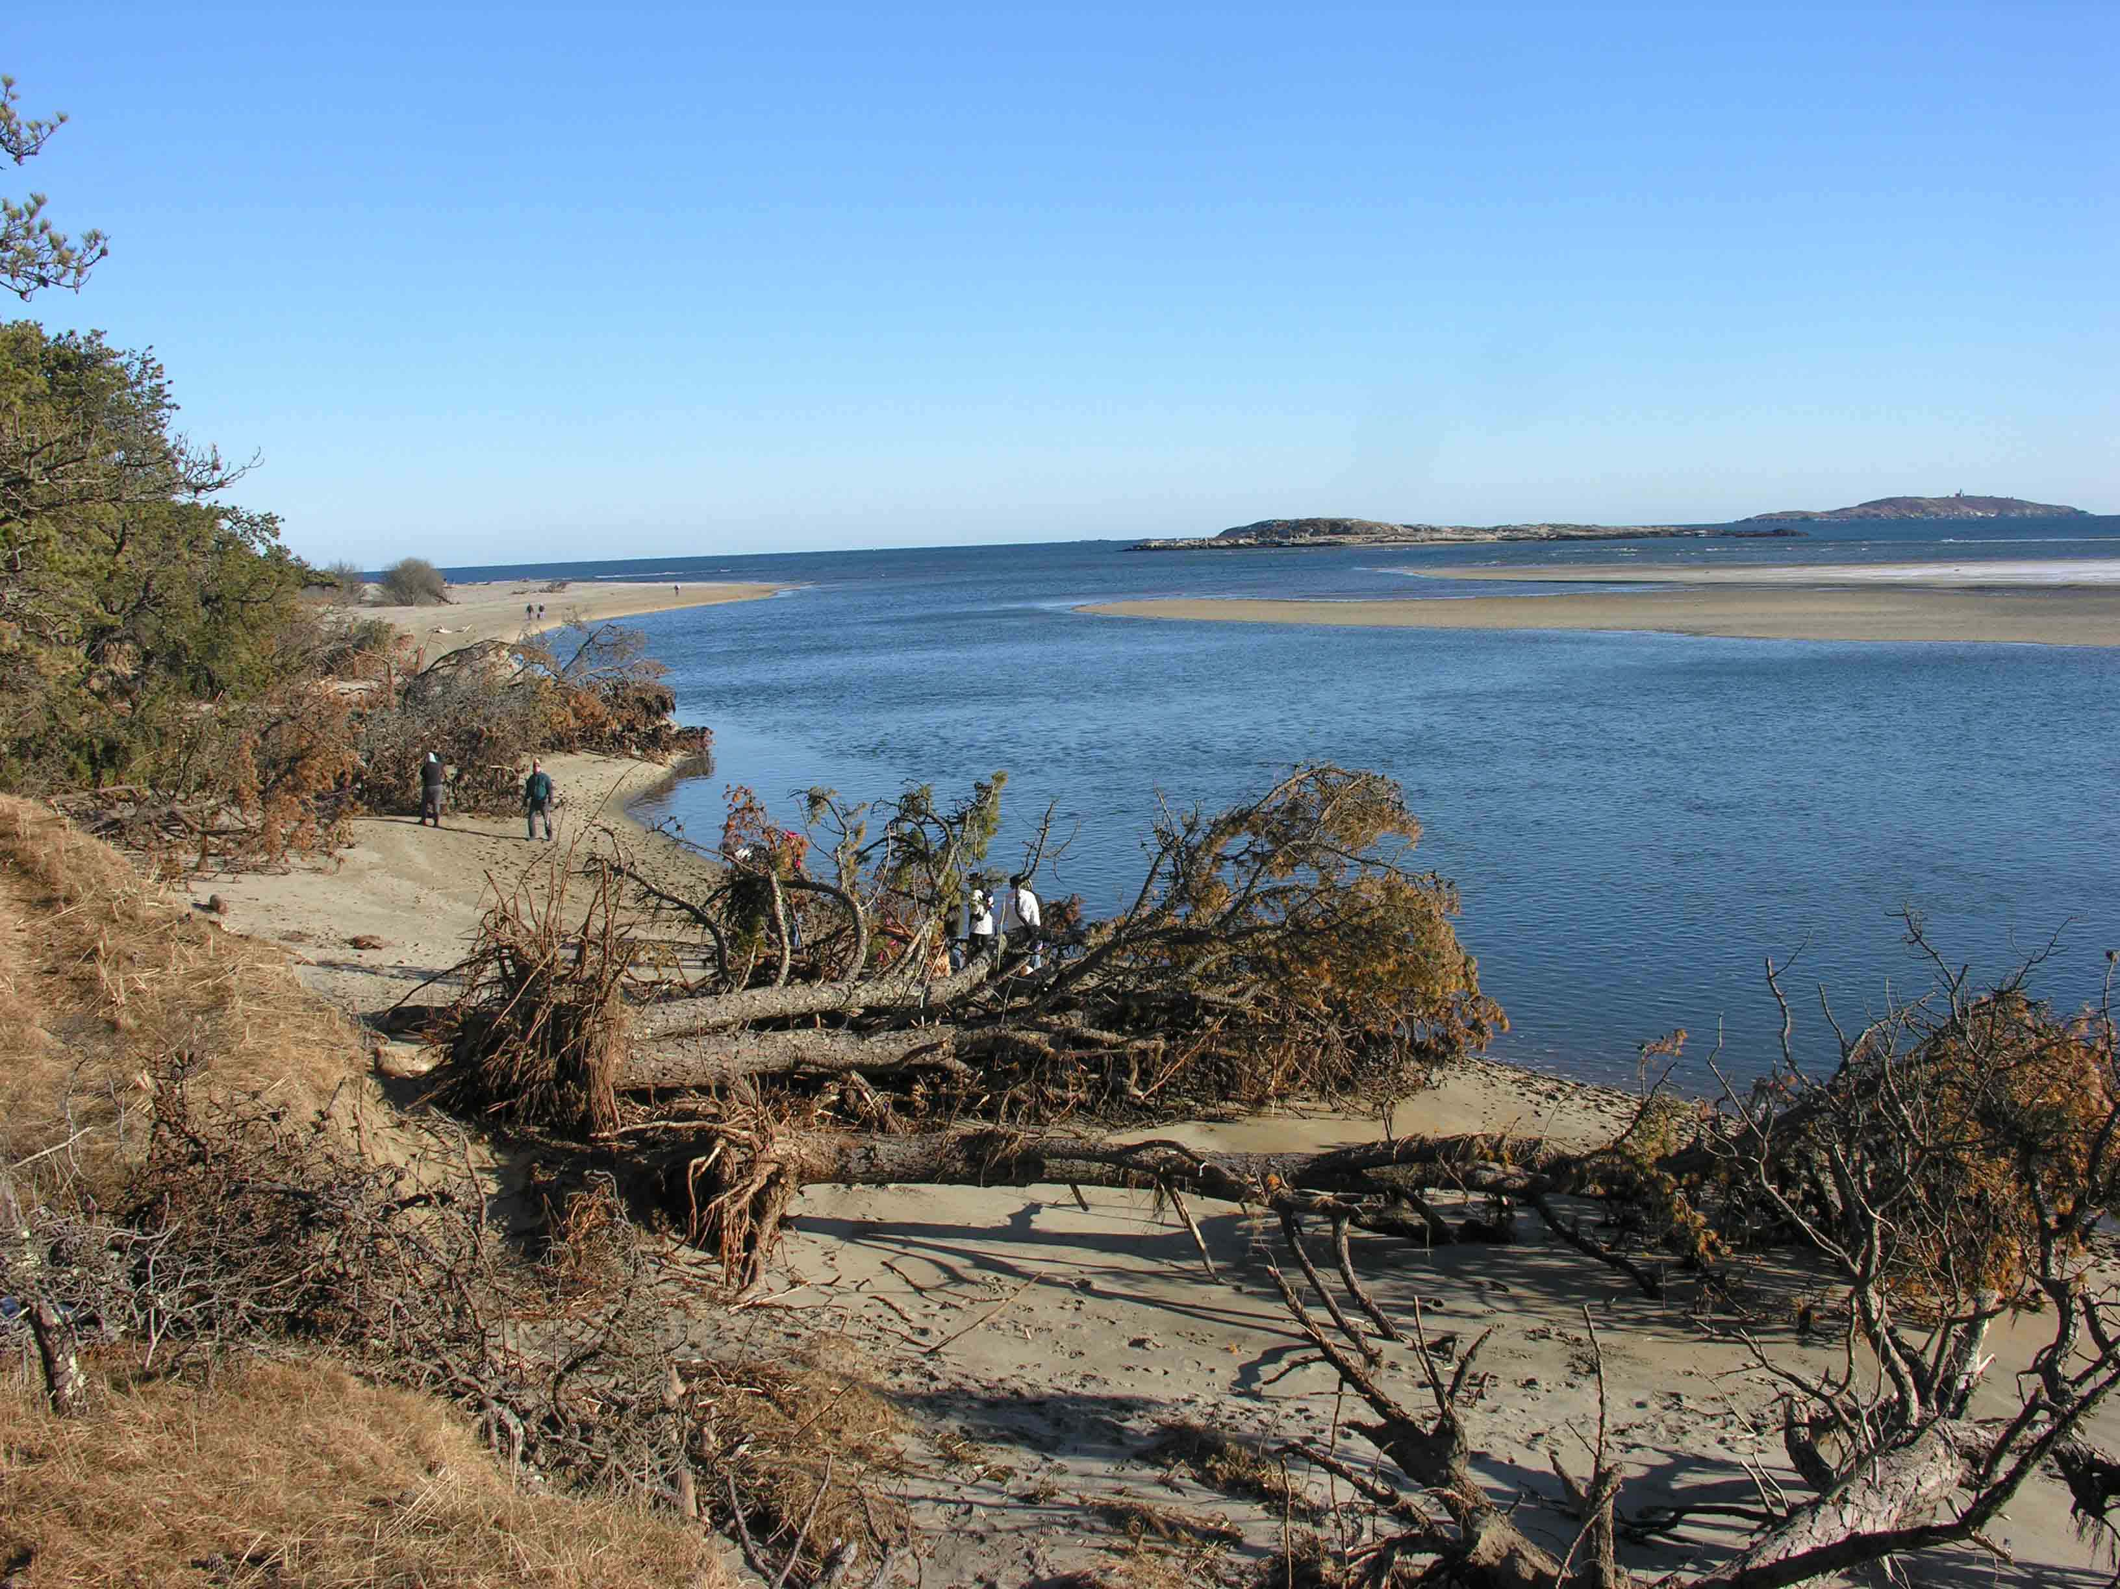
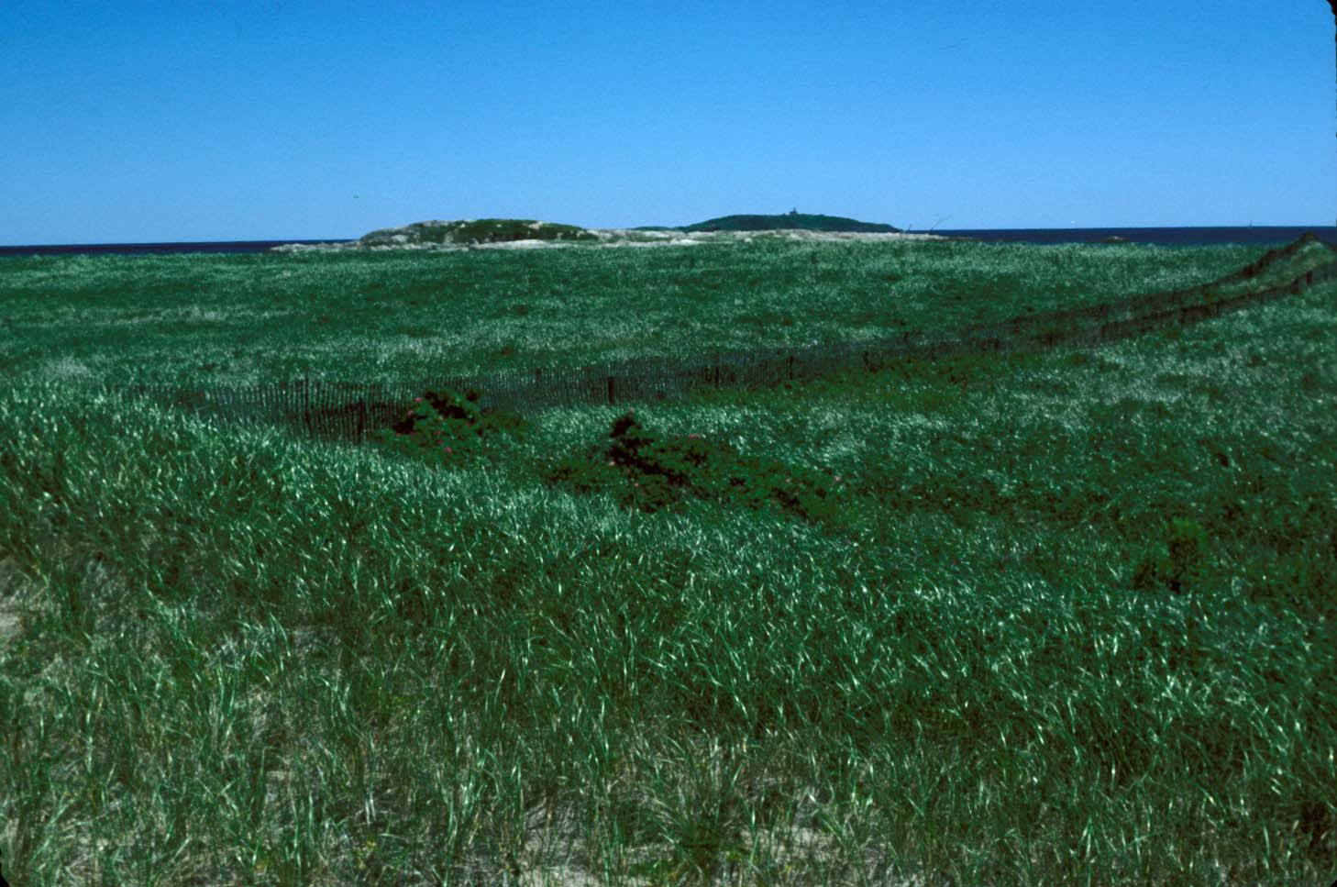
January, 2009
New Morse River
Inlet
Popham Beach Dune field
from 1953 shoreline
position
July, 1986
Kelley, 2013

Slide 6
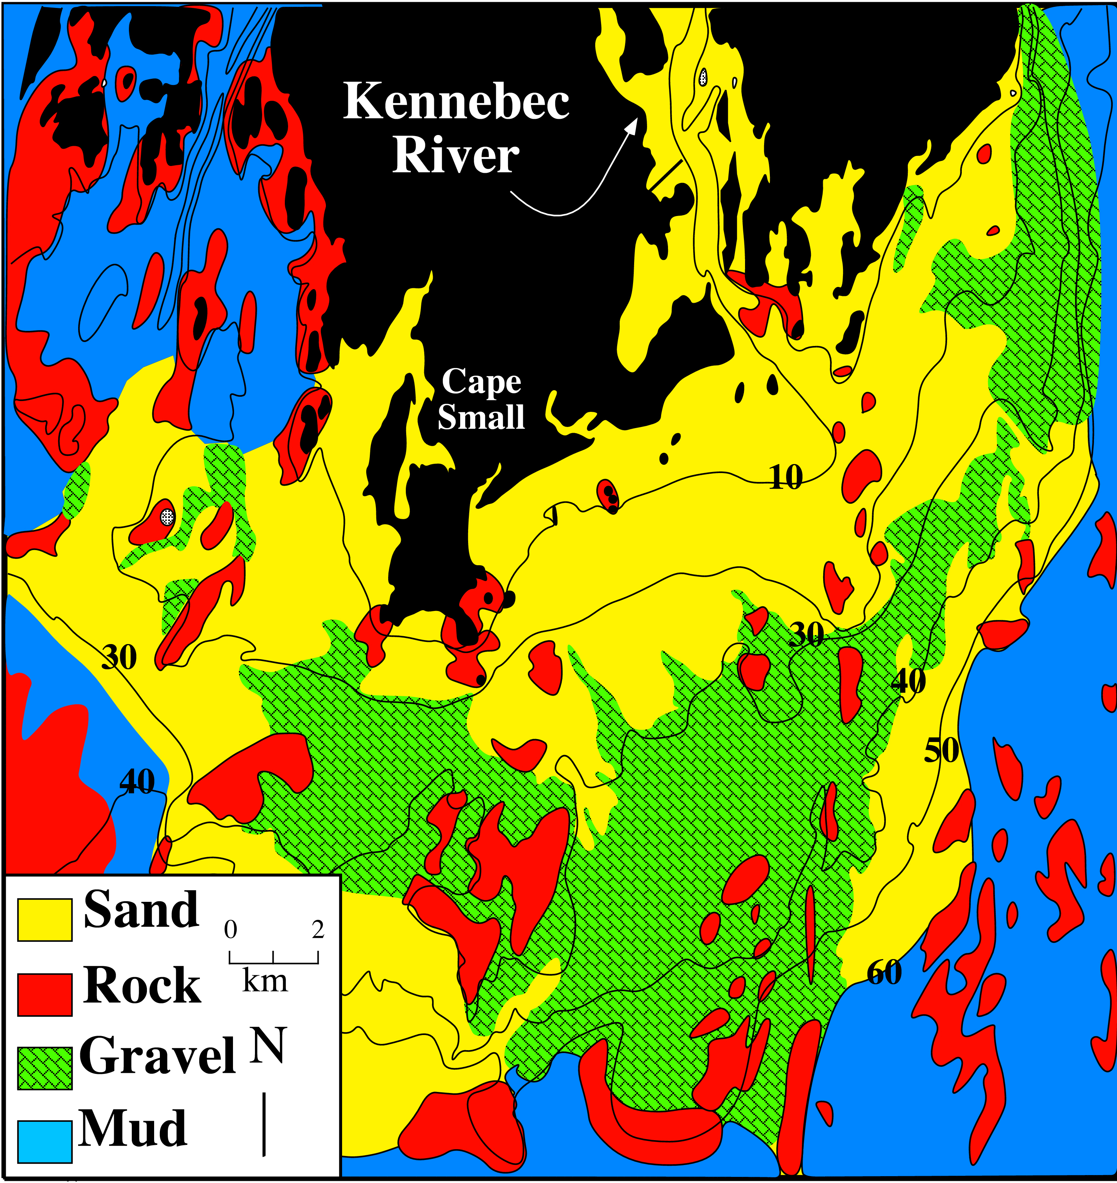
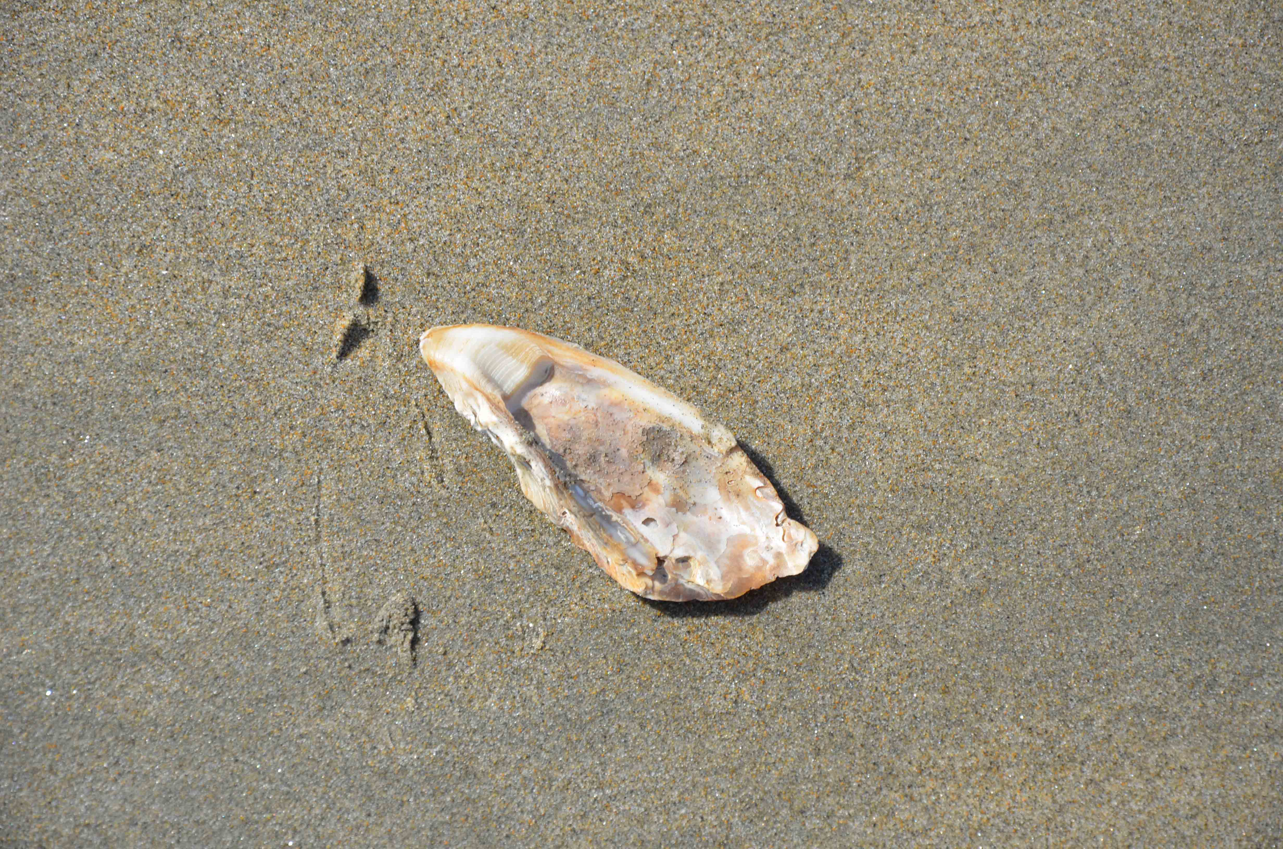
mid-Holocene Oyster on
Popham Beach, 3-10-13
Popham
Beach
Sediment Source 1:
Paleodelta contains
~ 330*¹⁰9 m³
of sand/gravel
Kelley et al., 2003

Slide 7
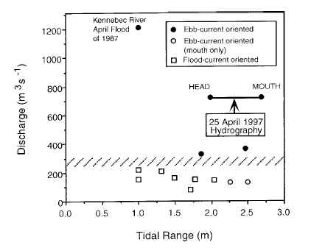
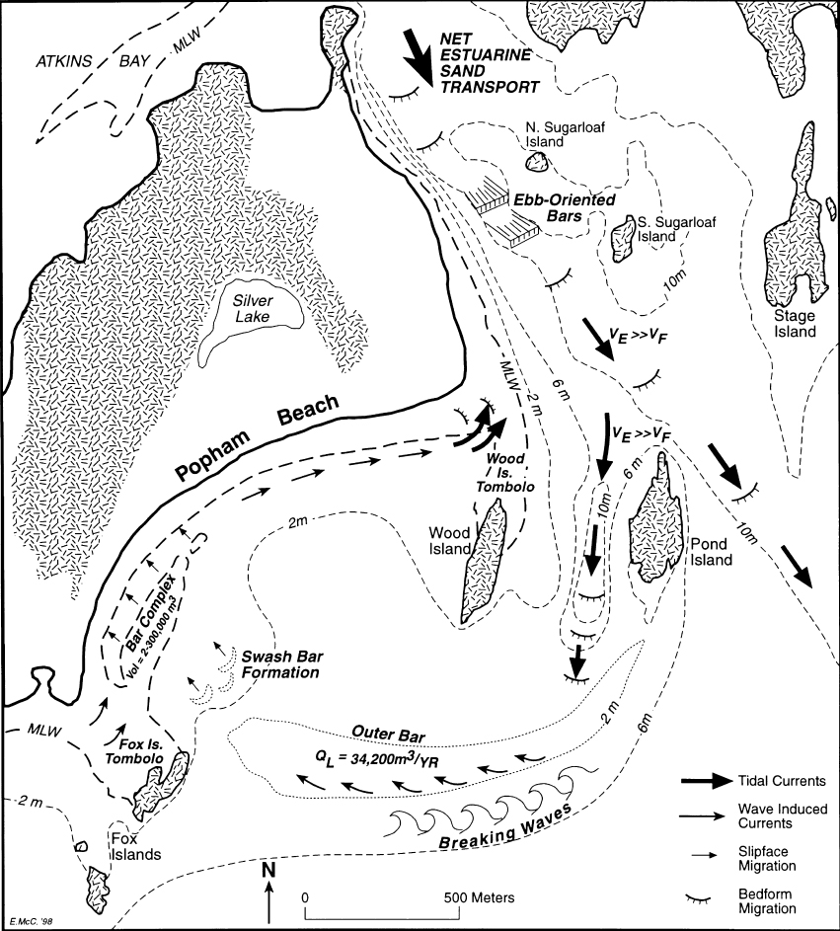
Fenster et al., 2001
FitzGerald et al., 2000

Slide 8
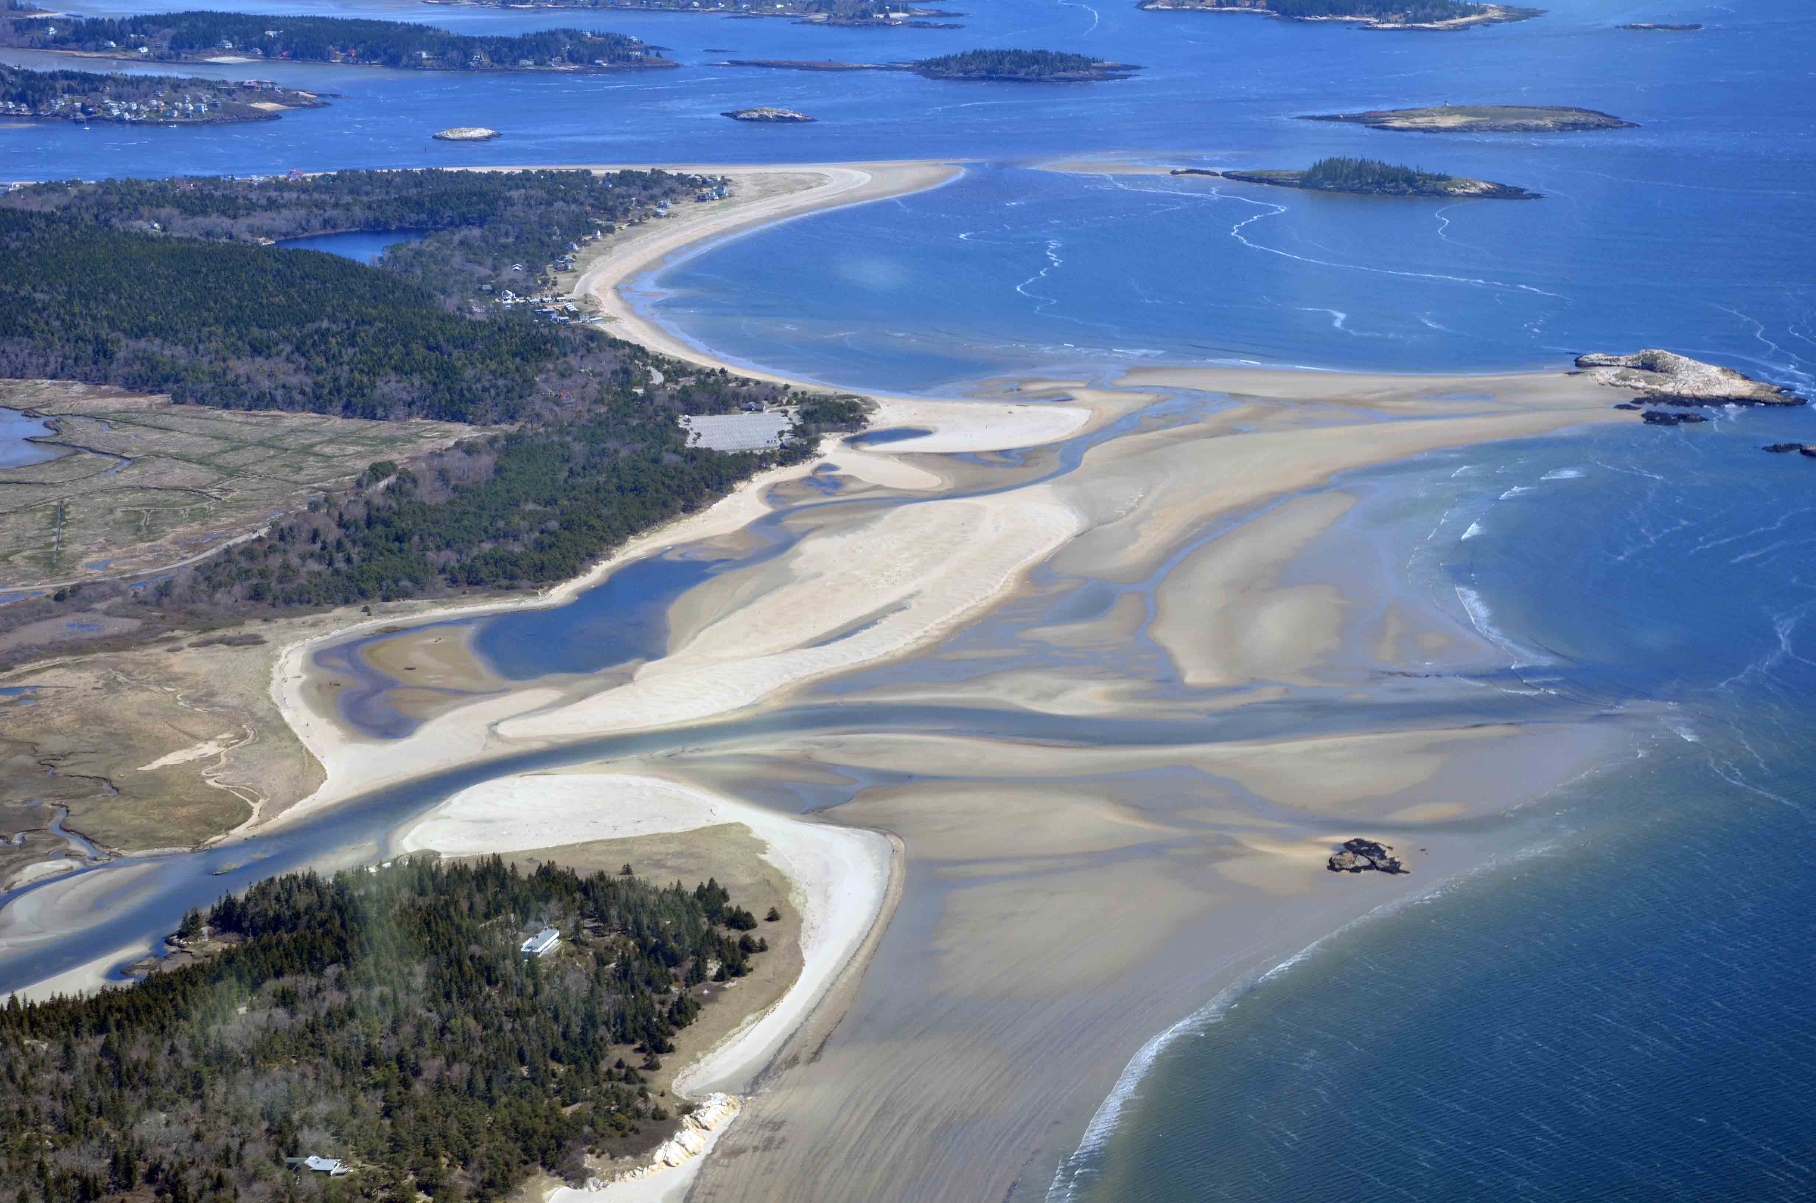
April 30, 2012
Kelley, 2012

Slide 9
Kelley, 2013

Slide 10
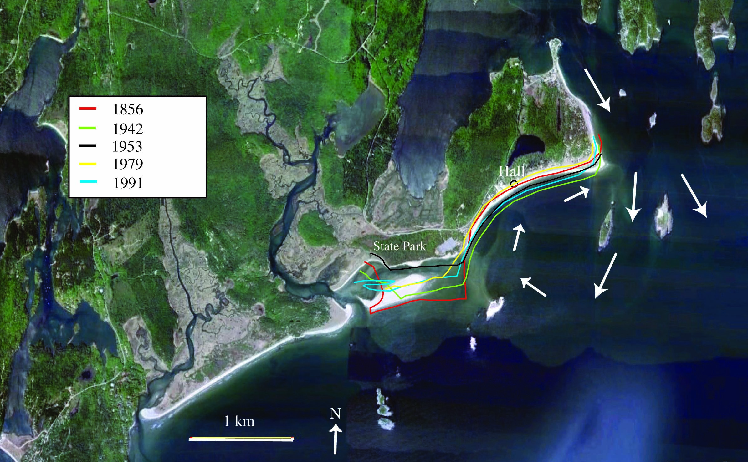
5/17/10
Kelley, 2013 modified from FitzGerald et al, 2000

Slide 11
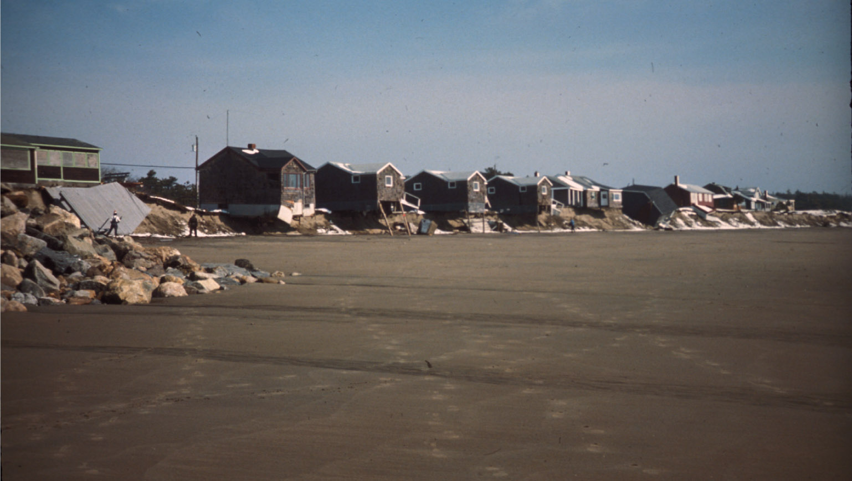
B. Timson photo, Kelley, 2013
15 properties destroyed, 4 moved by 1977

Slide 12
“new structures or additions…shall:
not be constructed in a V zone
not be constructed on or seaward of
a frontal dune”
“Projects shall not cause a flood hazard to any
structure during a 100 year flood or storm”.
Natural Resources Protection Act, Chap.355, Section 3, part A, Line 3
1993.

Slide 13
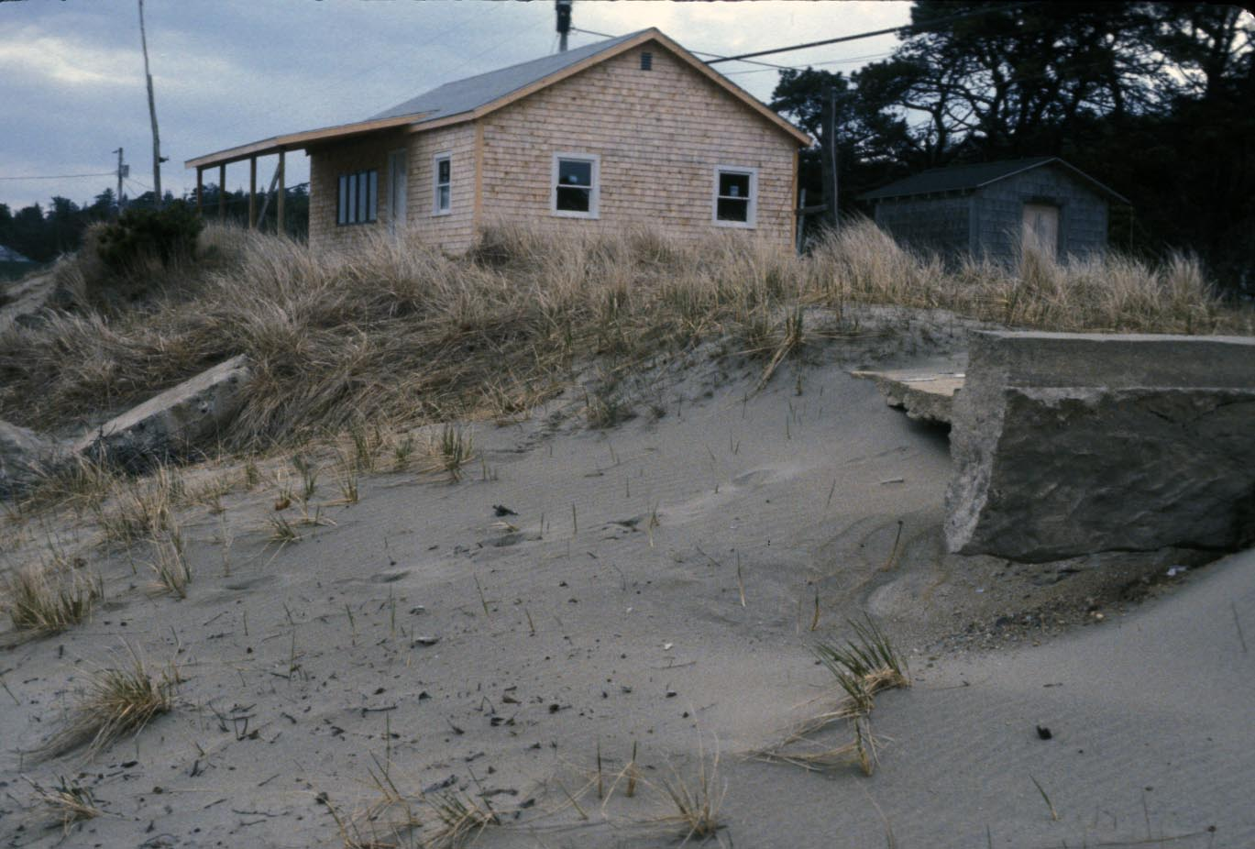
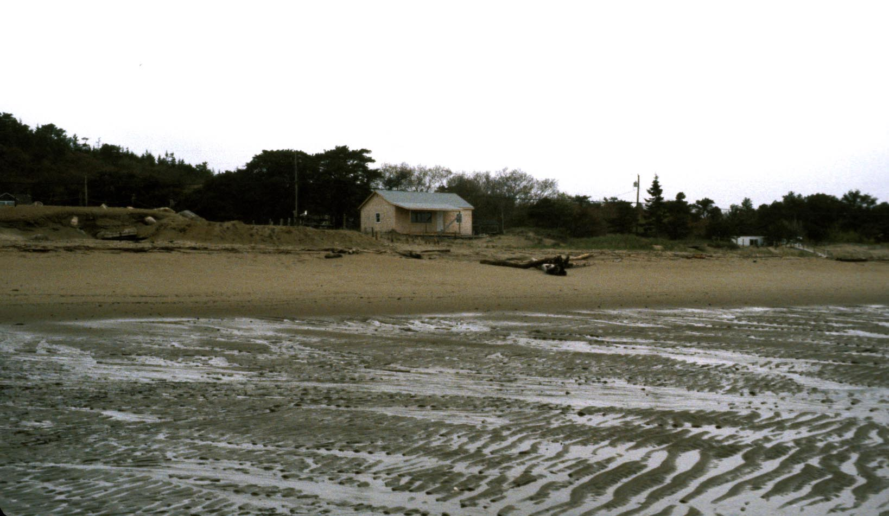
Hall property
rebuilt without a
permit
May, 1984
Ruins of
old house
May, 1983
Kelley, 2013

Slide 14
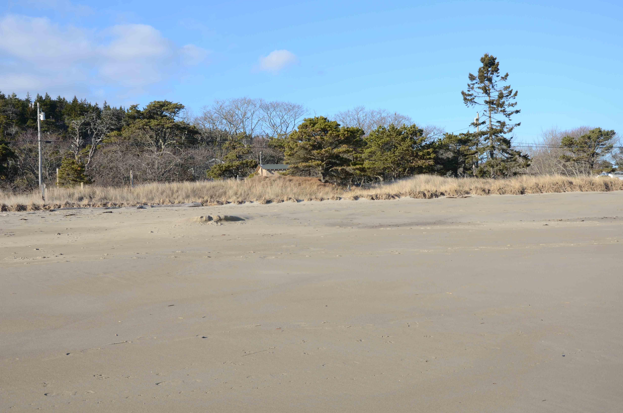
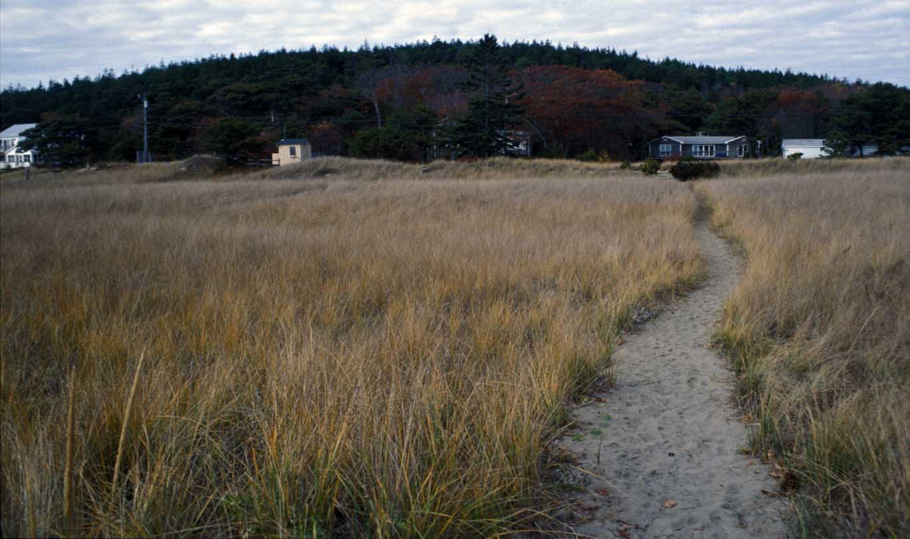
Hall Property
December, 2011
November, 2001
Kelley, 2013

Slide 15
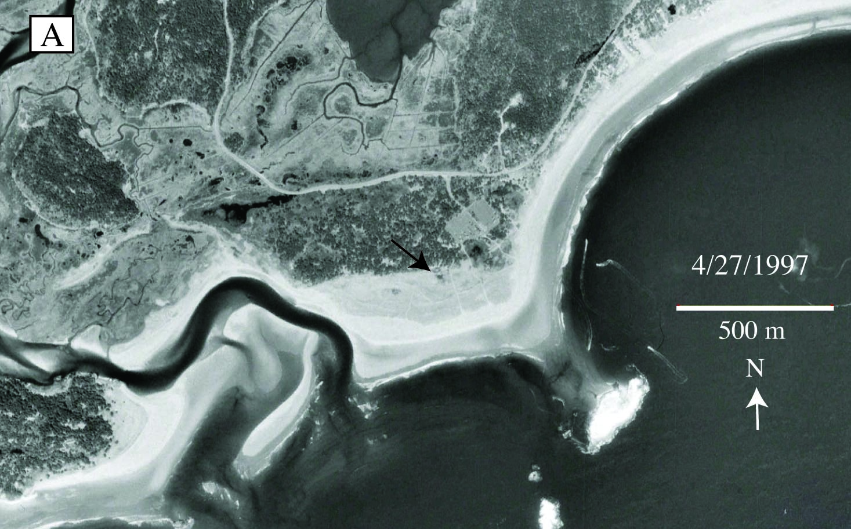
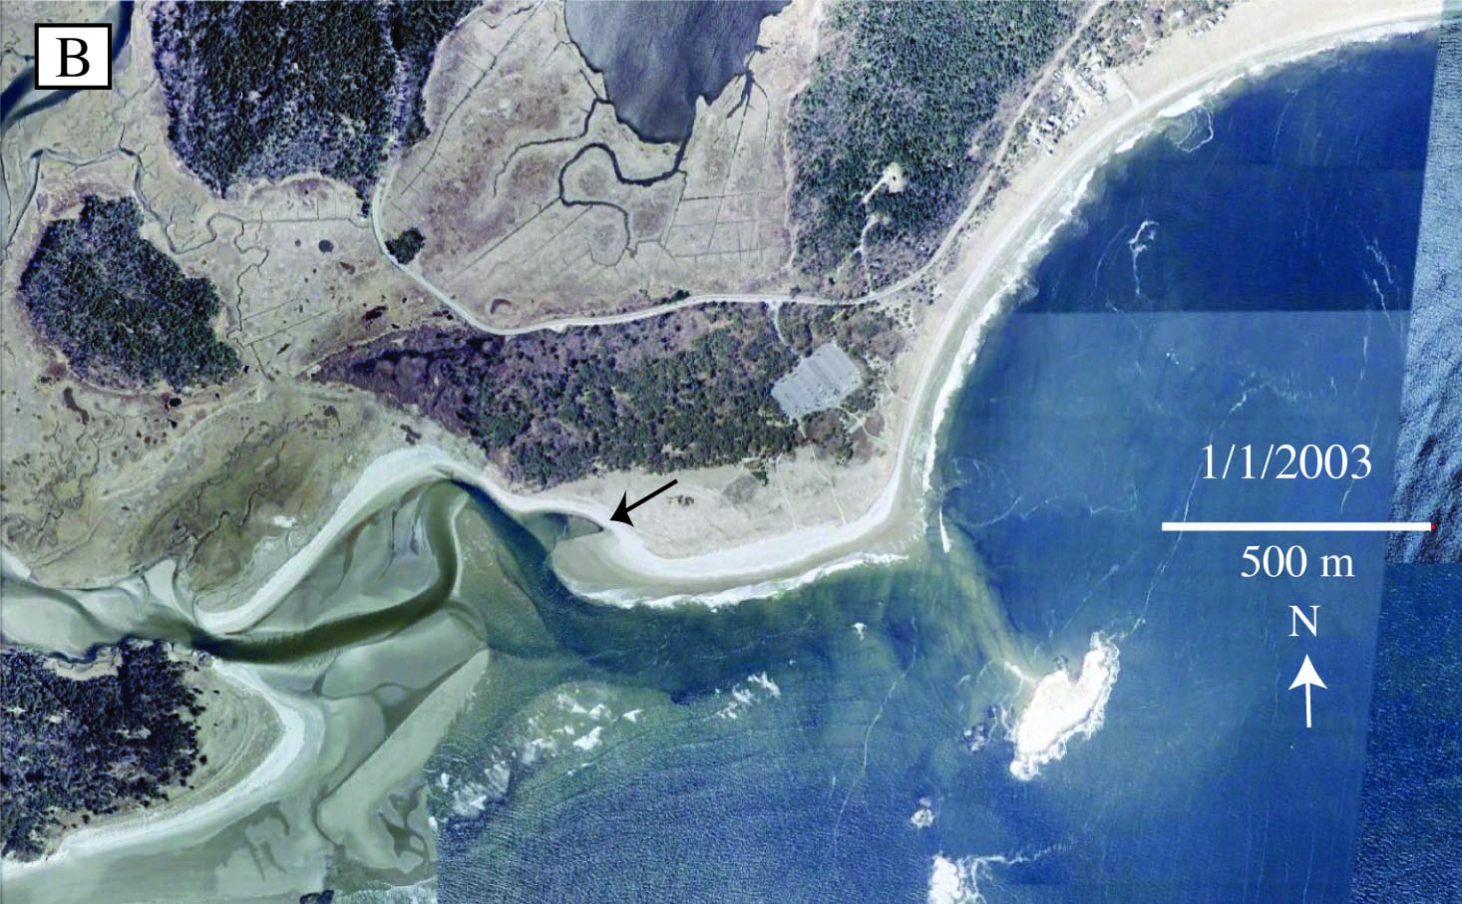
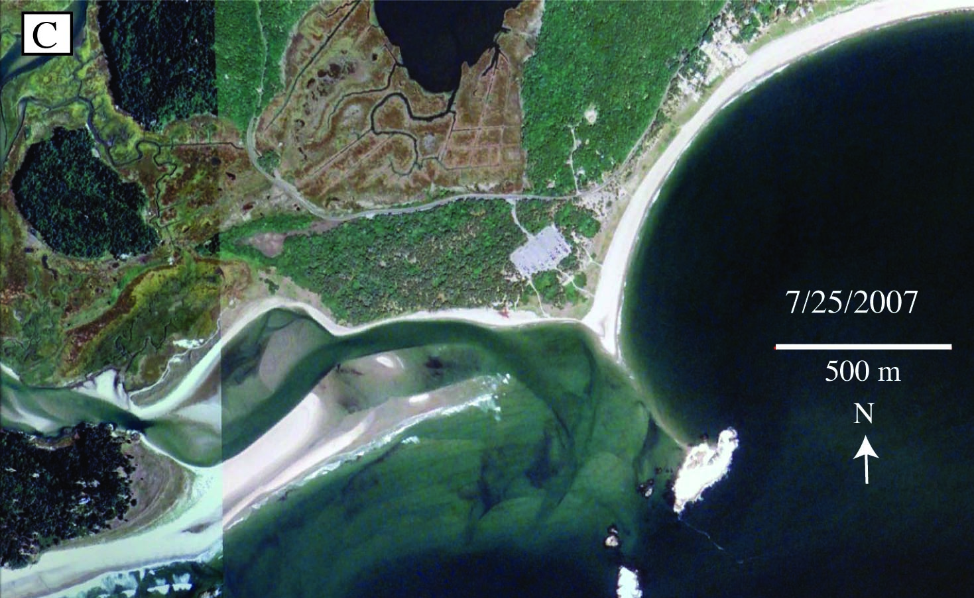
1953
Shoreline
4-27-97
1-1-03
7-25-07
Site of future
Bath house (2009)
Kelley, 2013

Slide 16
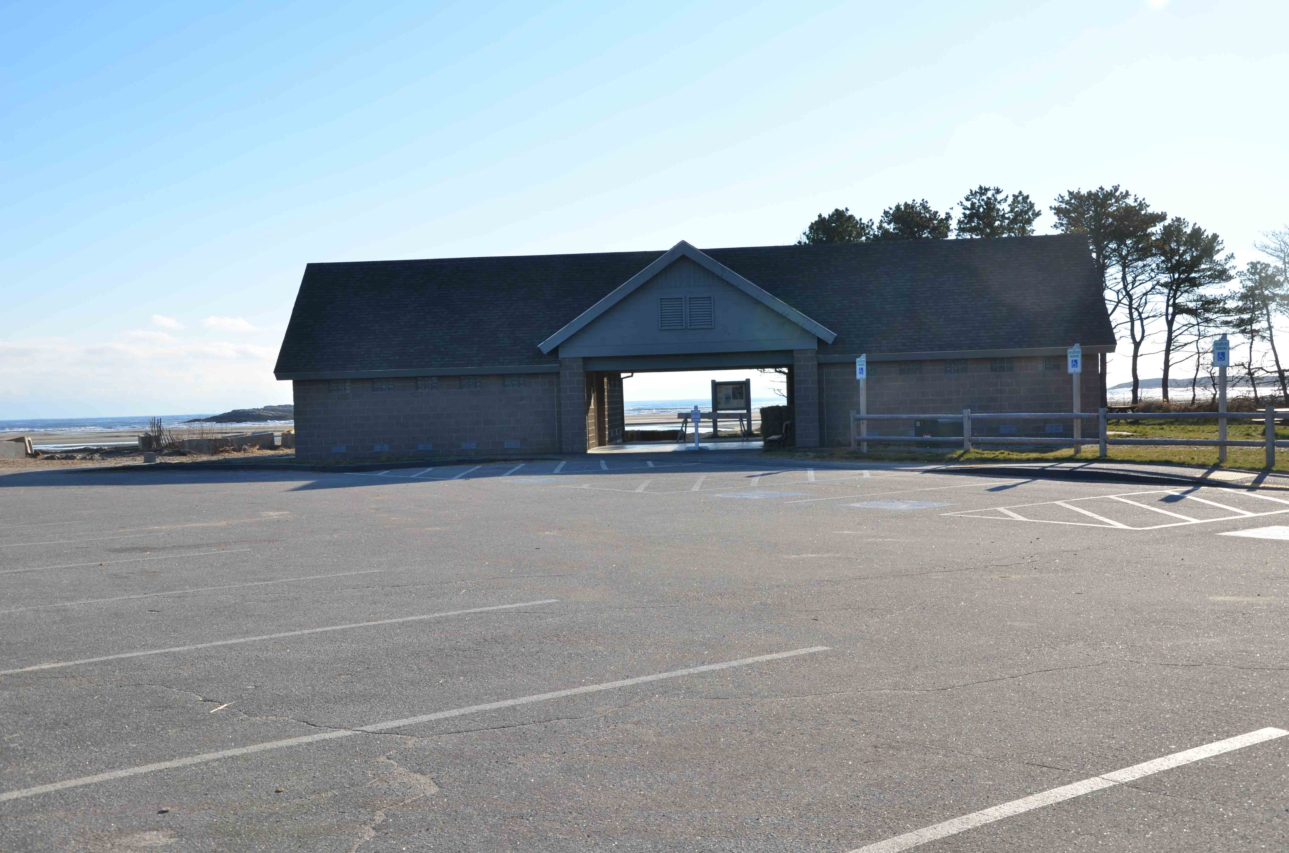
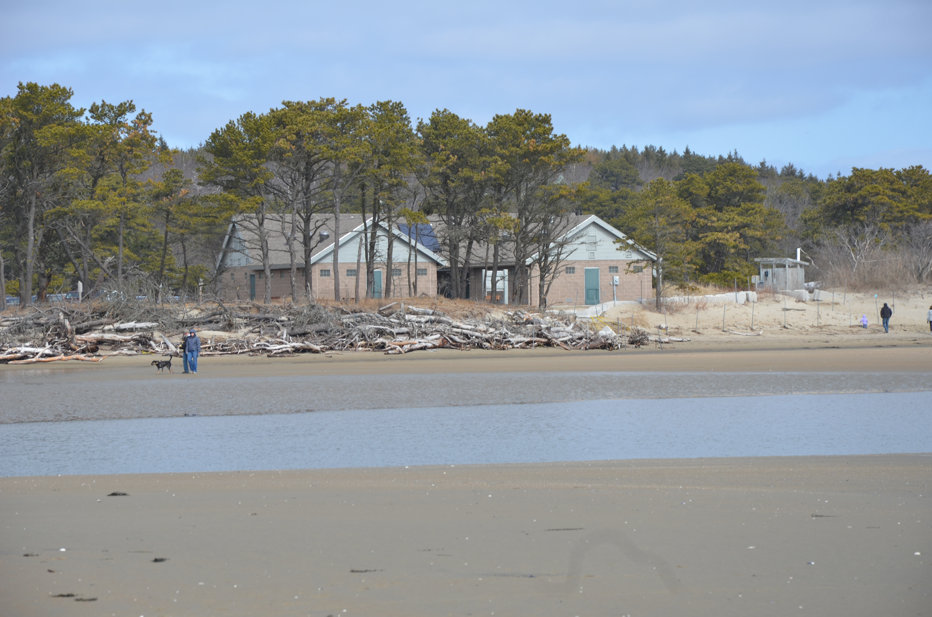
Bath House built
on ocean edge of
parking lot
in 2009

Slide 17
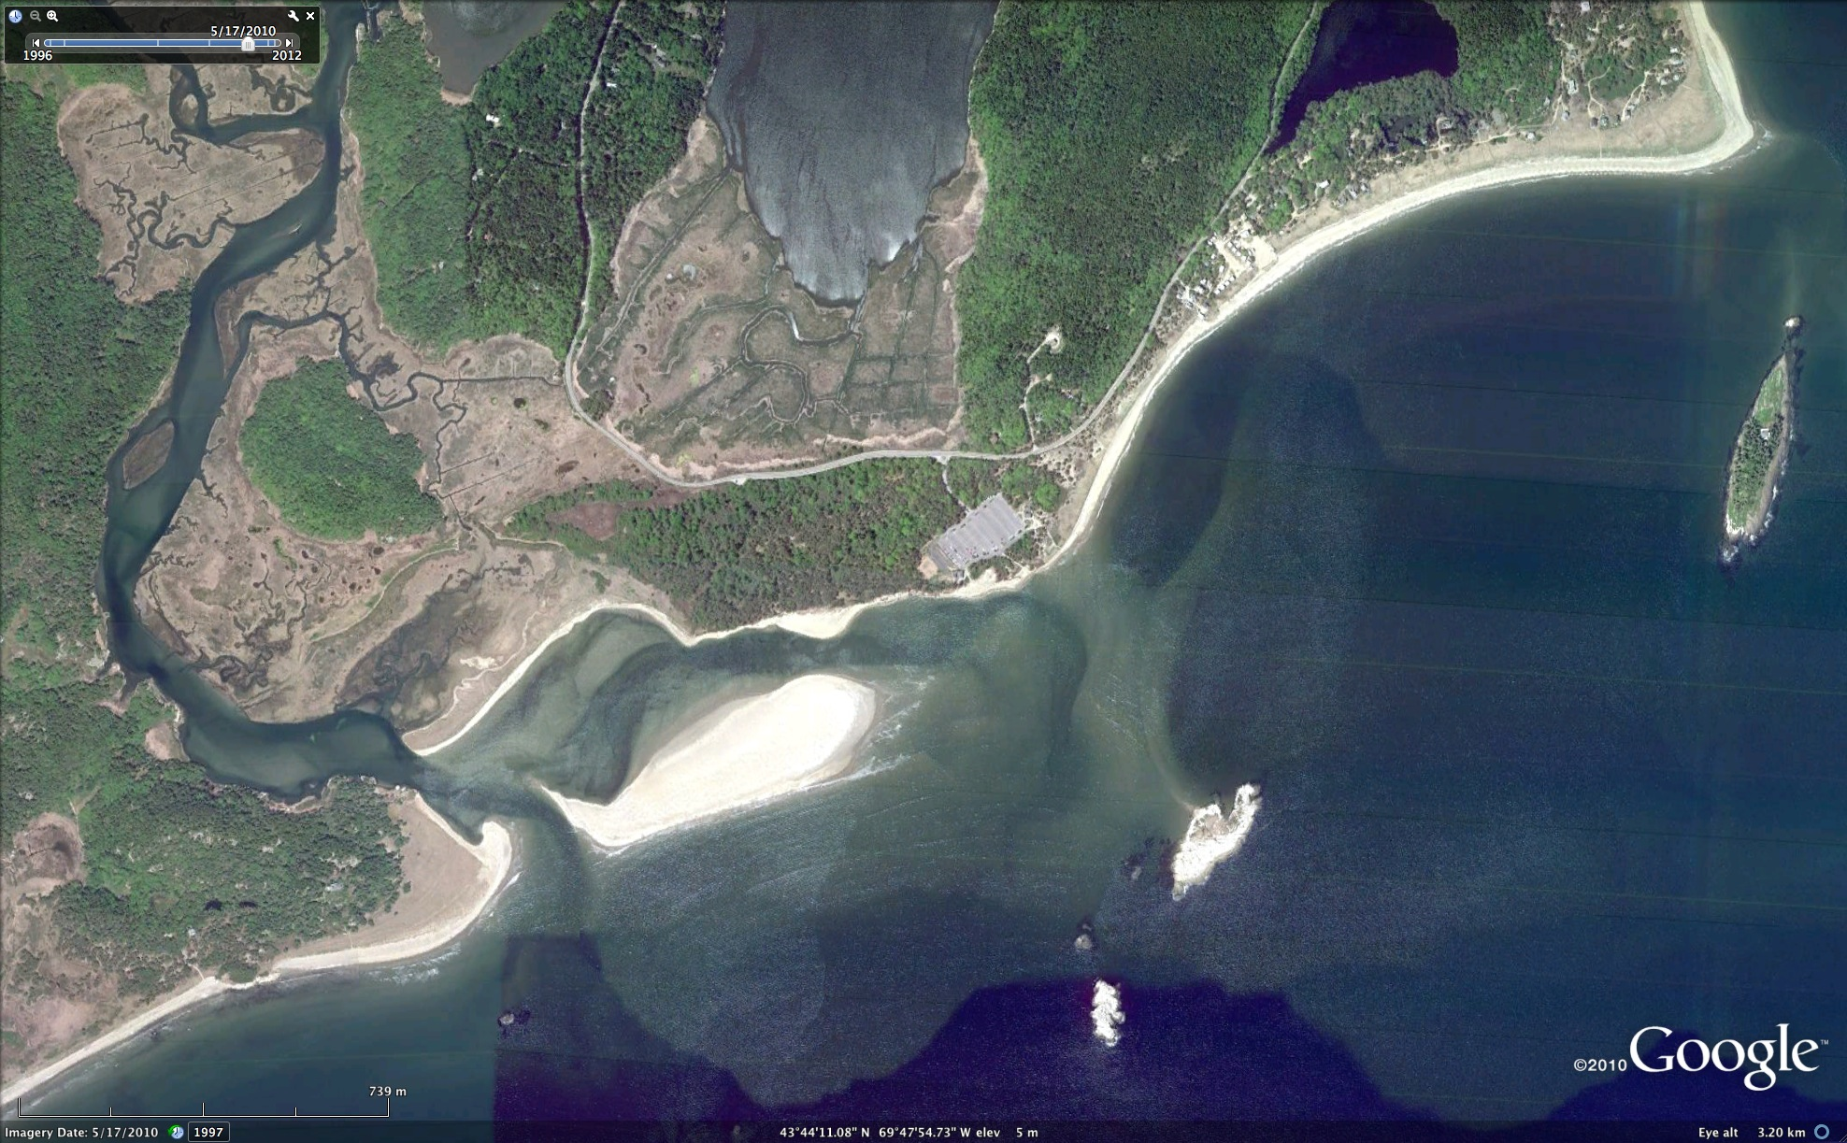
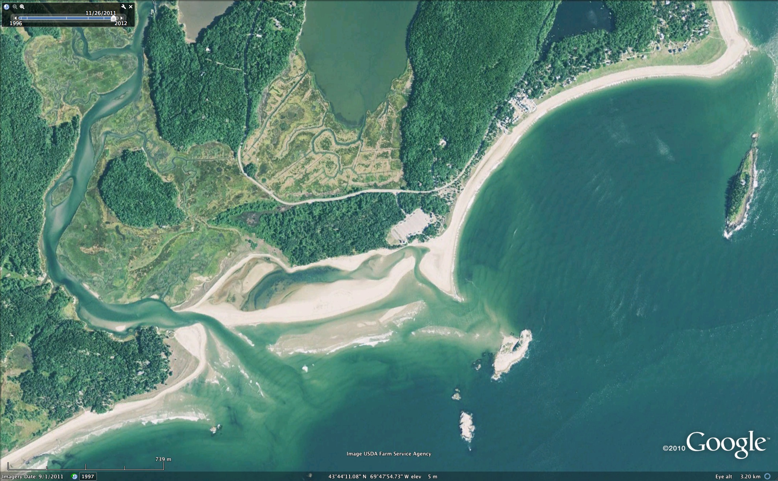
370 m
Tides in lagoon
now threatened
bath house
5-17-10
370 m
In 2010, a winter
Storm opened a new
Inlet channel…
Problem averted…
or maybe not!
9-1-11

Slide 18
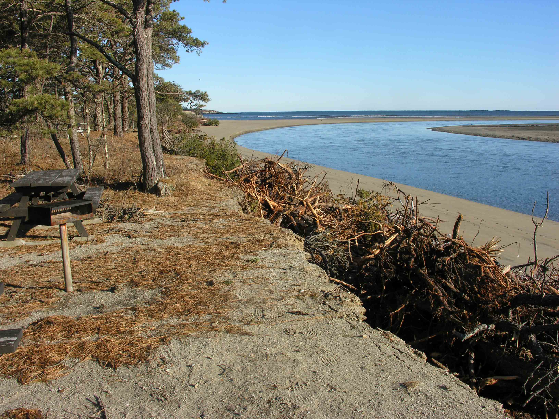
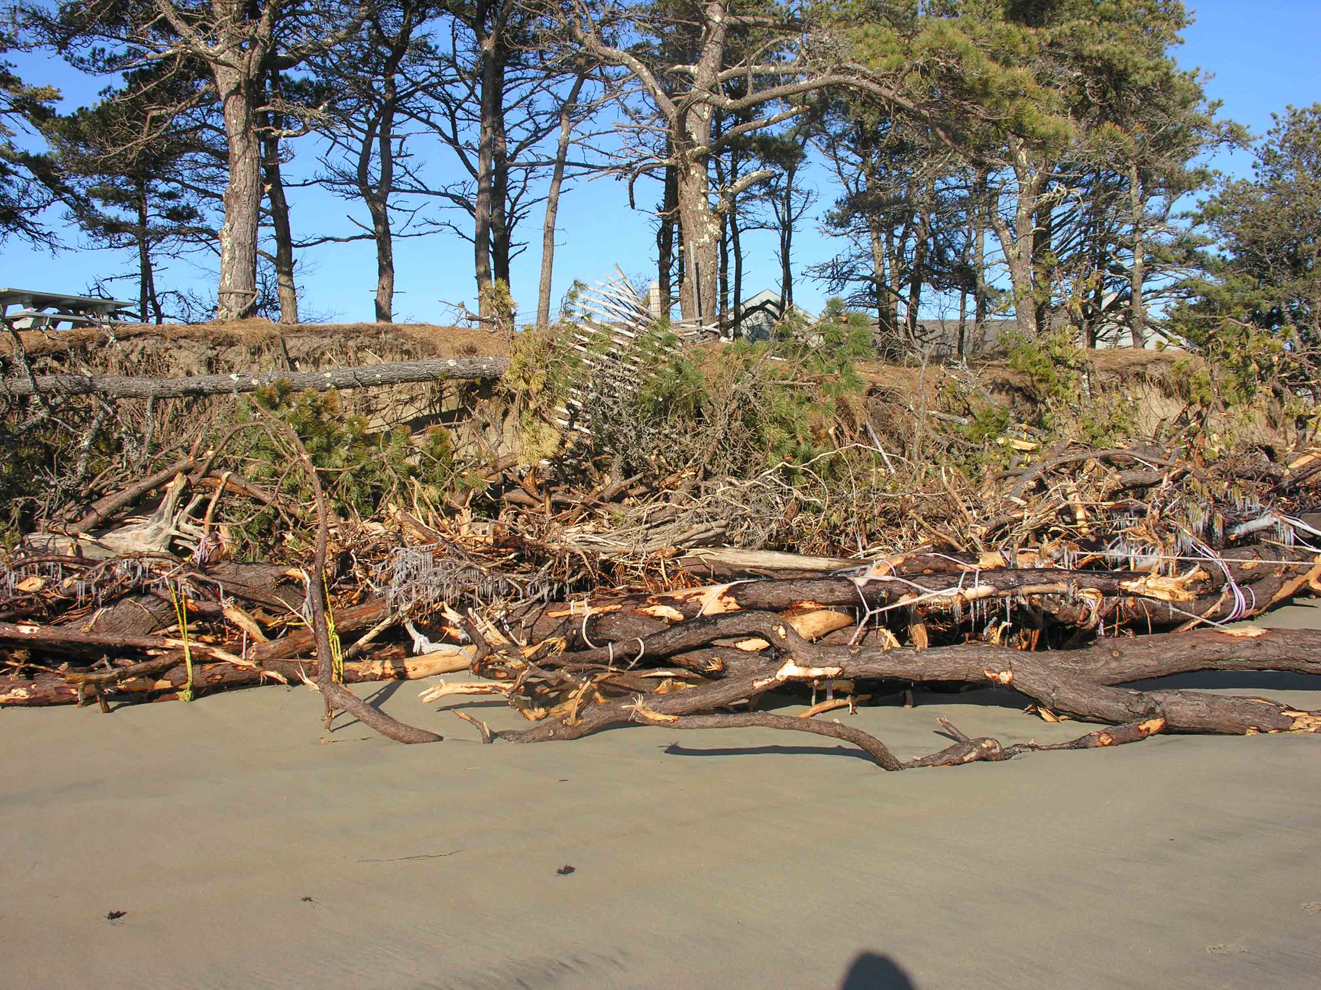
12-2009
“treewall” constructed
to reduce erosion
Eroded Pitch Pine trees
Eroded by Morse River;
Bound together as a
“treewall”

Slide 19
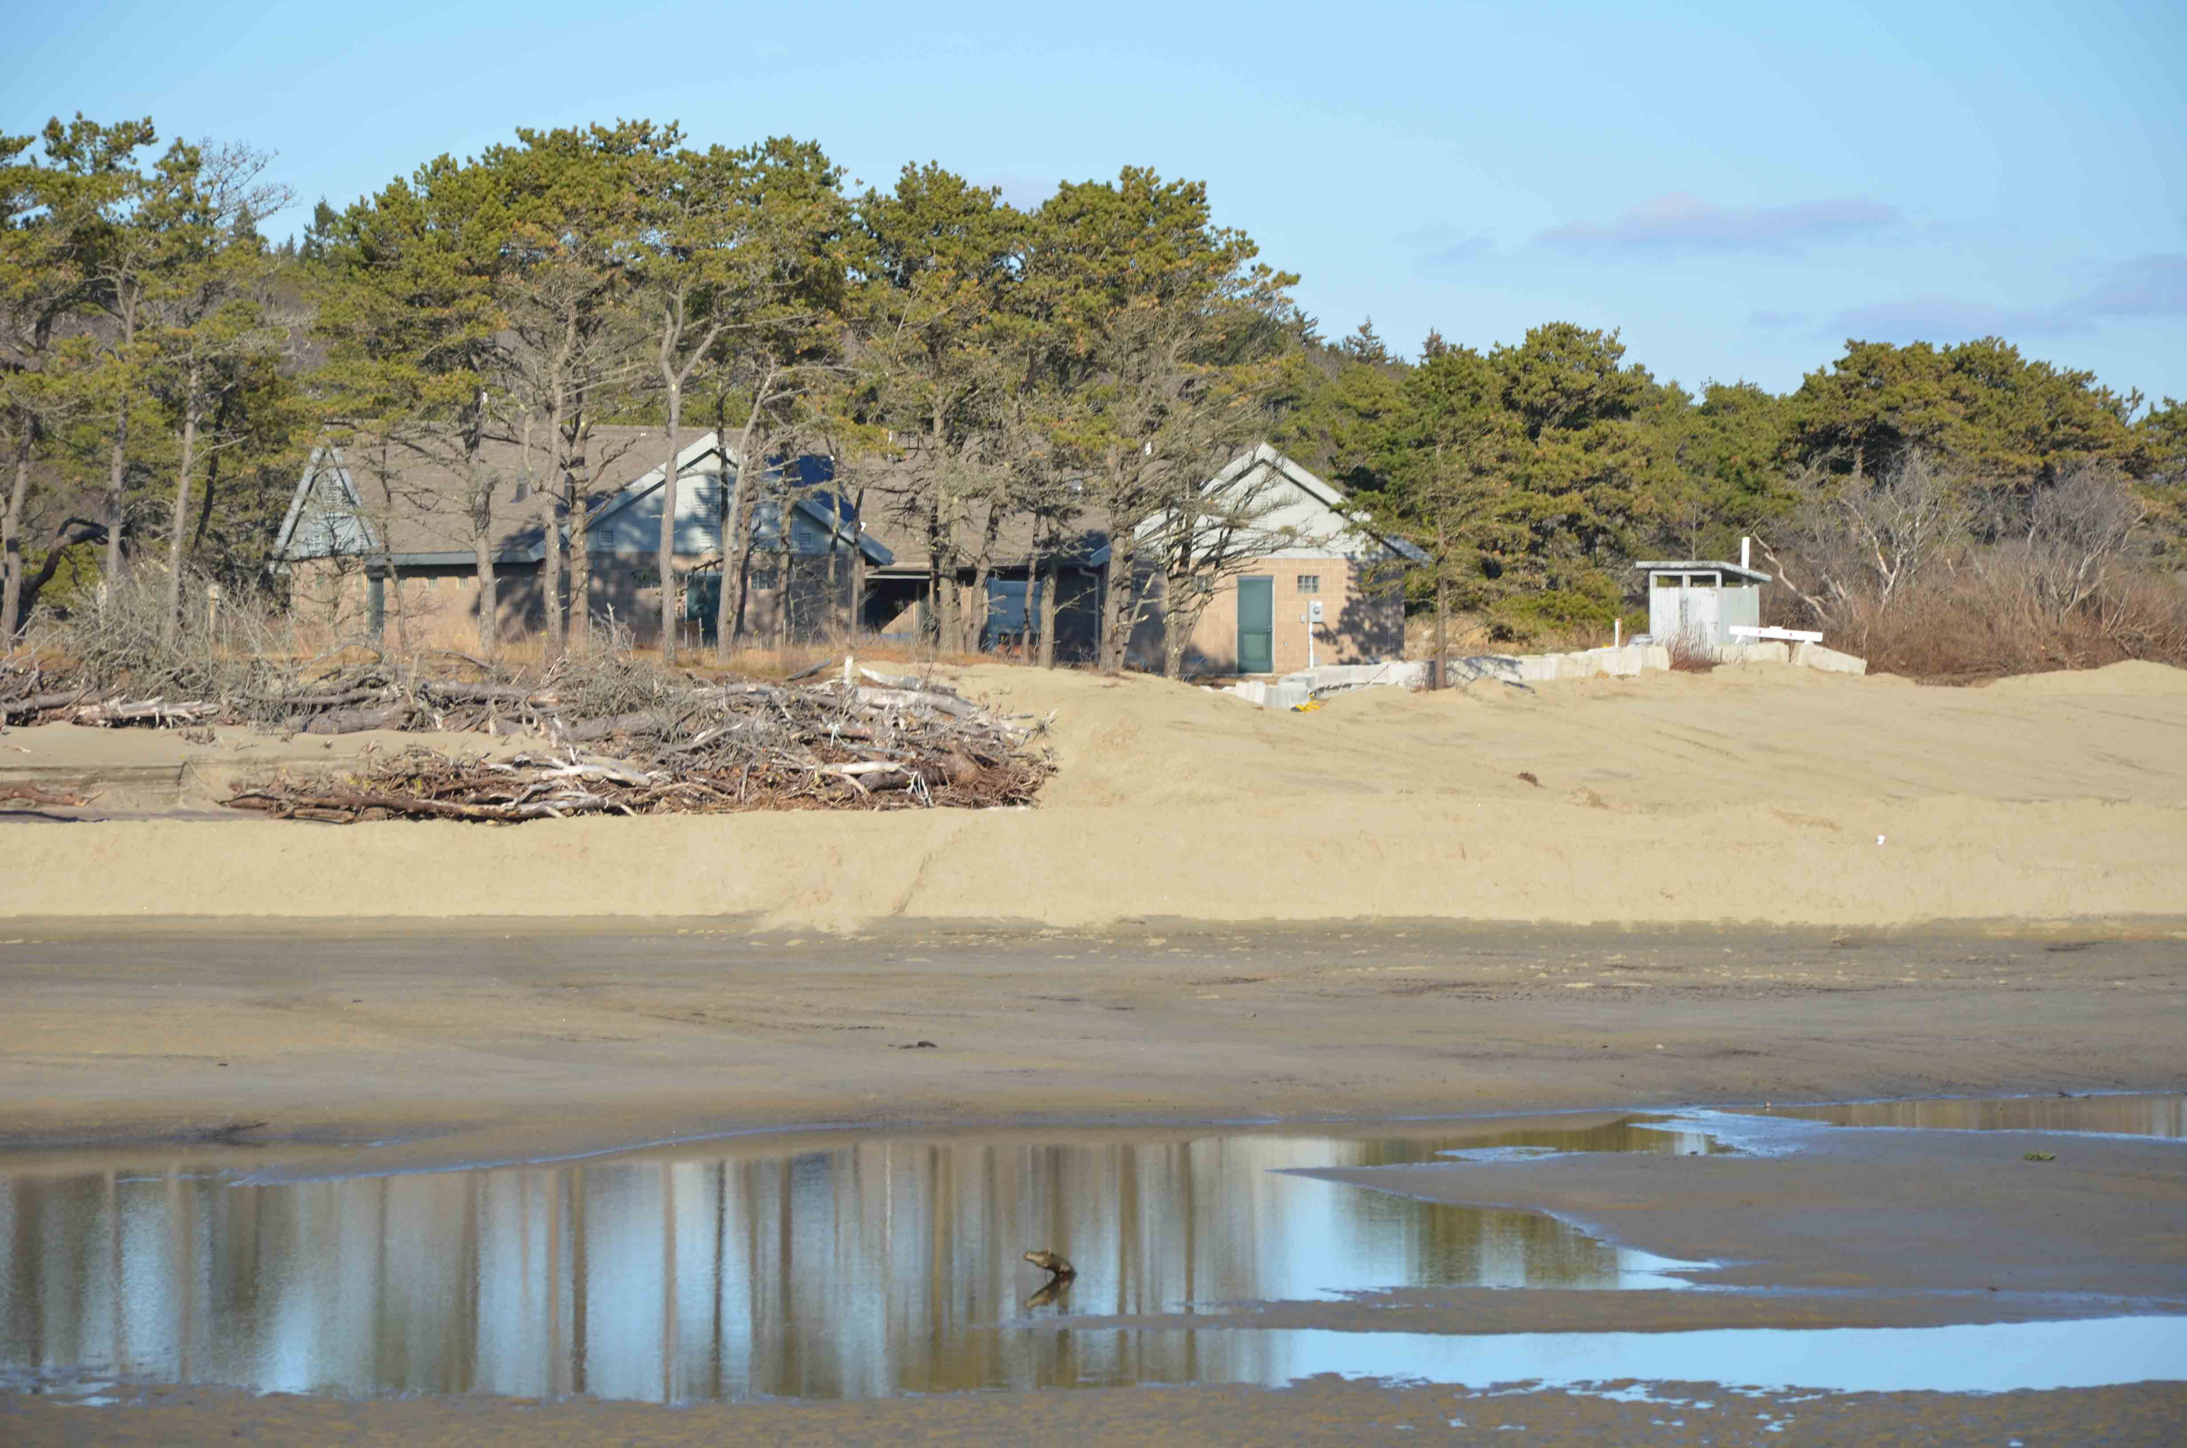
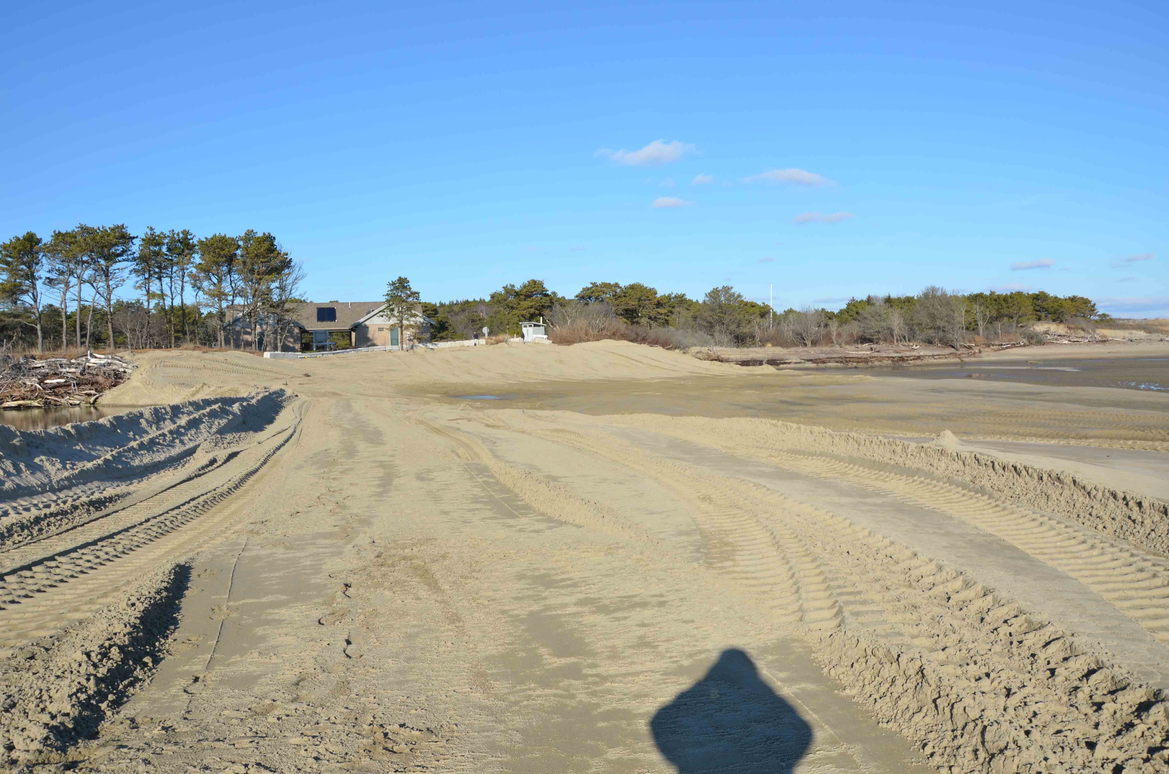
December, 2011
Sand bulldozed against
Bath house and lagoon
Channel was blocked
with scraped sand

Slide 20
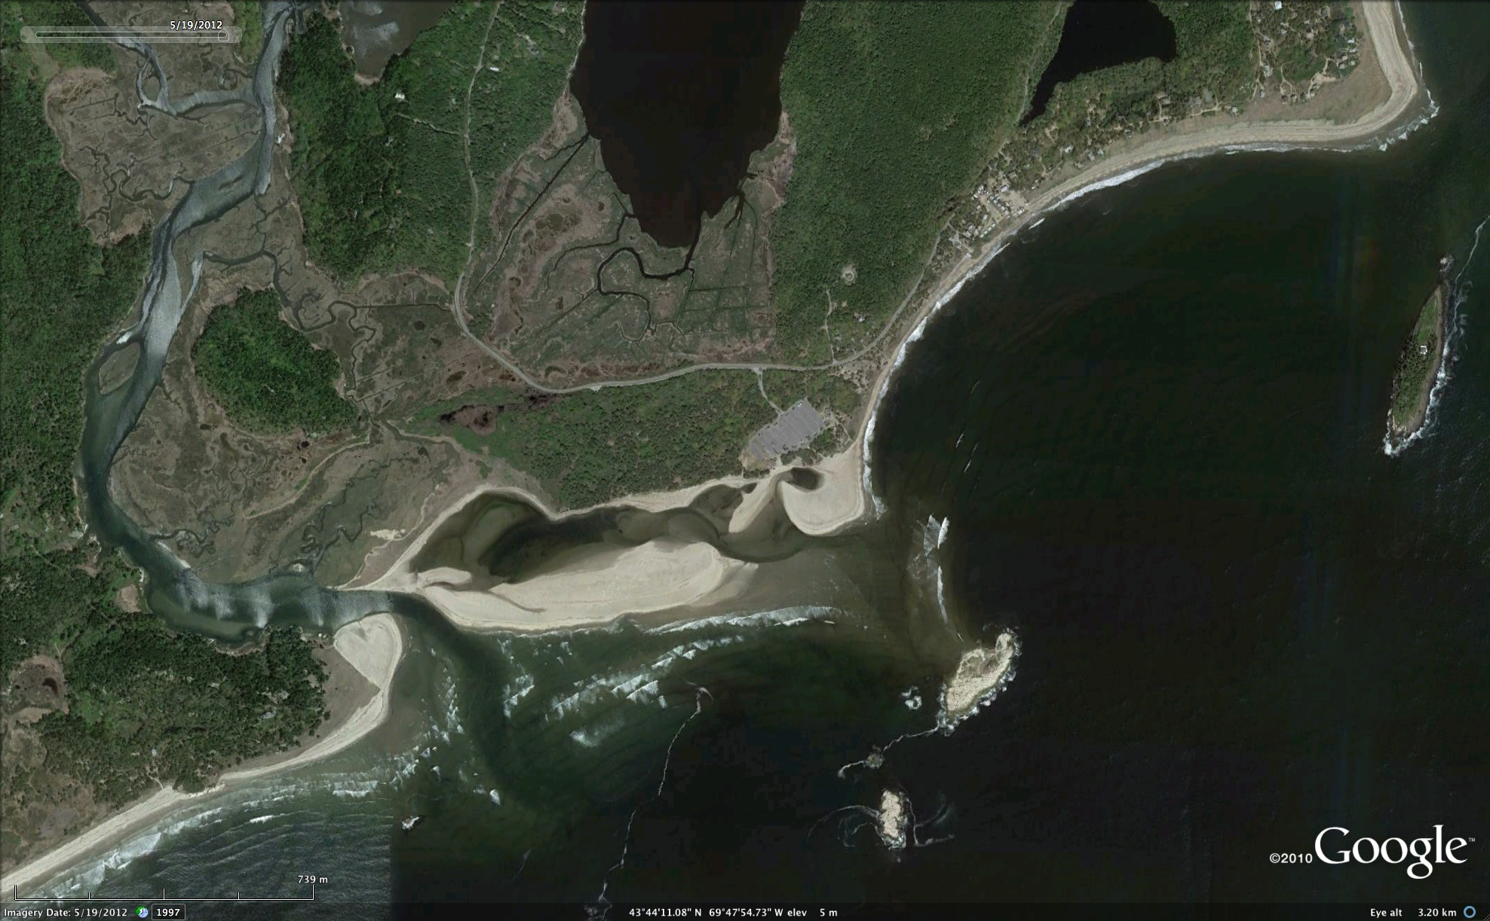
5-19-2012

Slide 21
4-30-12
Re-opened by 3-11-13

Slide 22
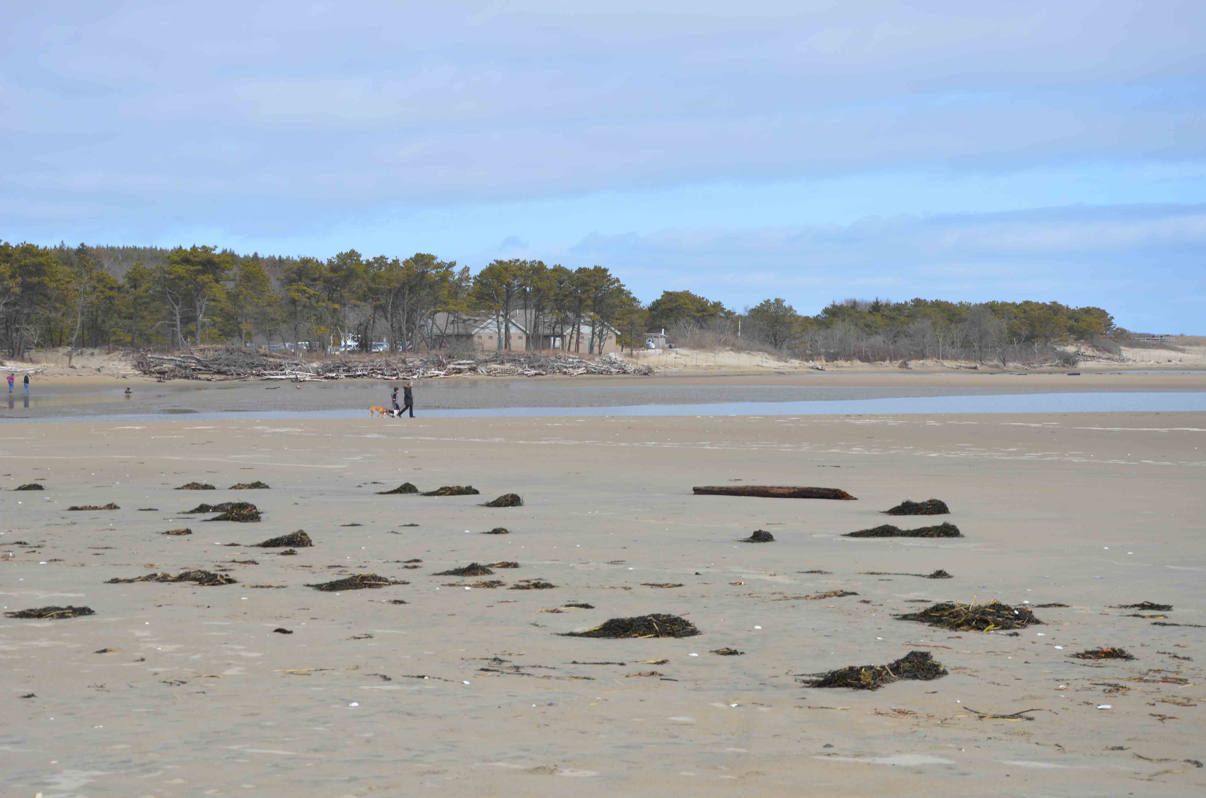
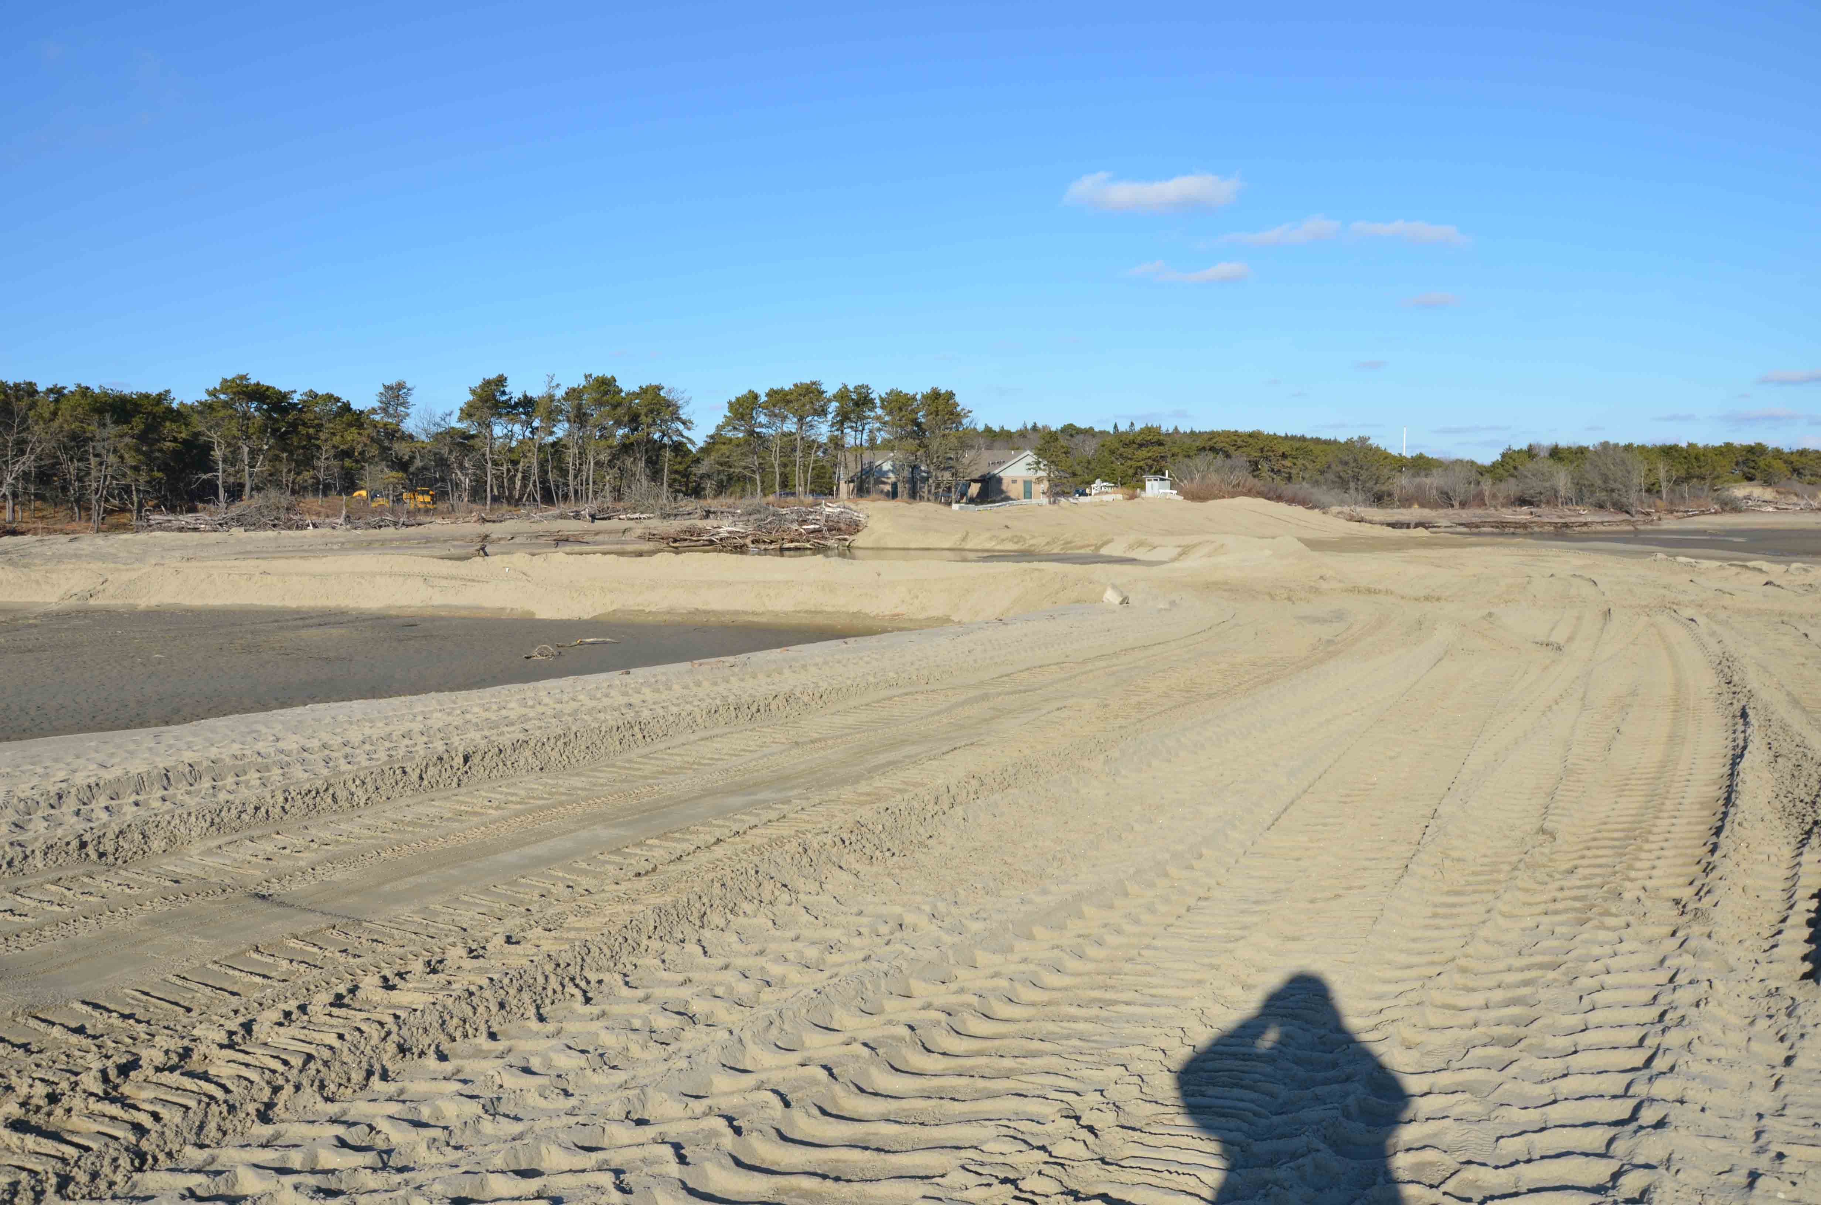
3-2013
12-2011

Slide 23
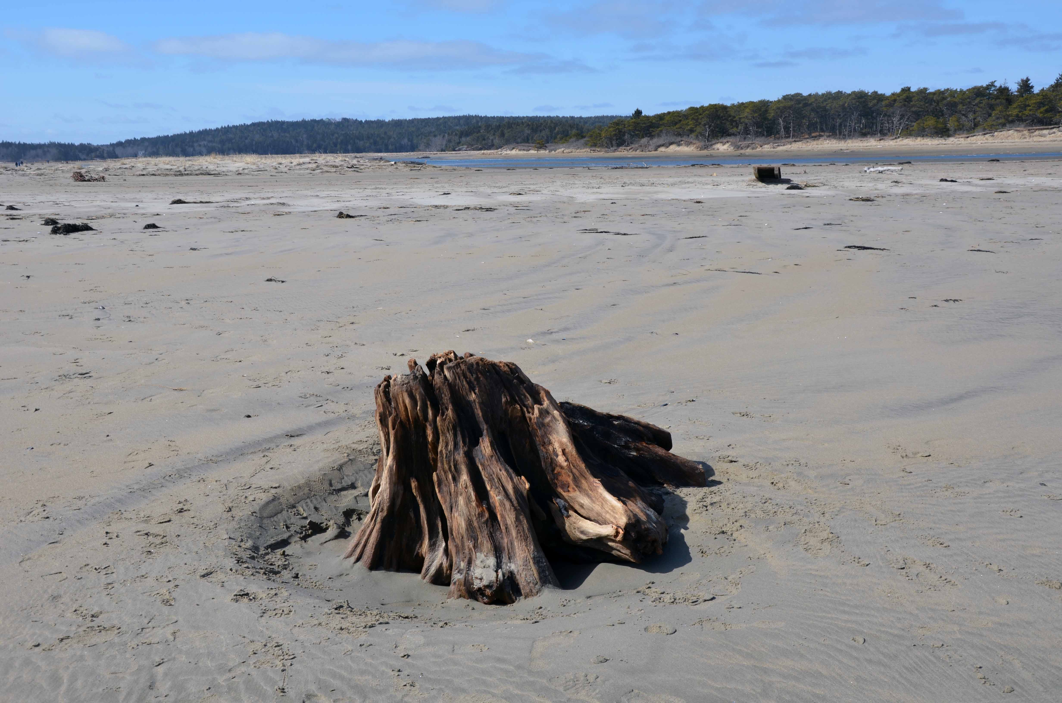
Conclusions
Inlets are extremely dynamic components of coastal barriers
Temporary “green” engineering techniques can save coastal property
Predicting shoreline changes accurately is not always possible
Acknowledgement: Maine Geological Survey websites provided detailed chronological information. Steve Dickson’s discussions were very helpful.

Slide 24

Conclusions
Inlets are extremely dynamic components of coastal barriers
Temporary “green” engineering techniques can save coastal property
Predicting shoreline changes accurately is not always possible
Acknowledgement: Maine Geological Survey websites provided
Detailed chronological information. Steve Dickson’s discussions
were very helpful.

