Slide 1
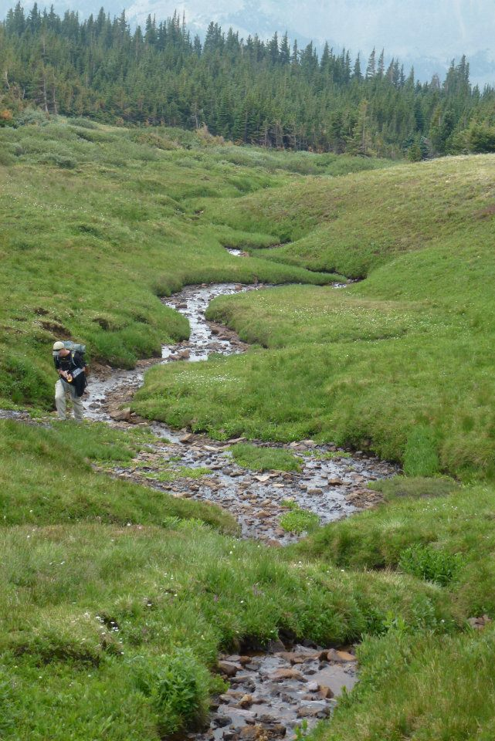
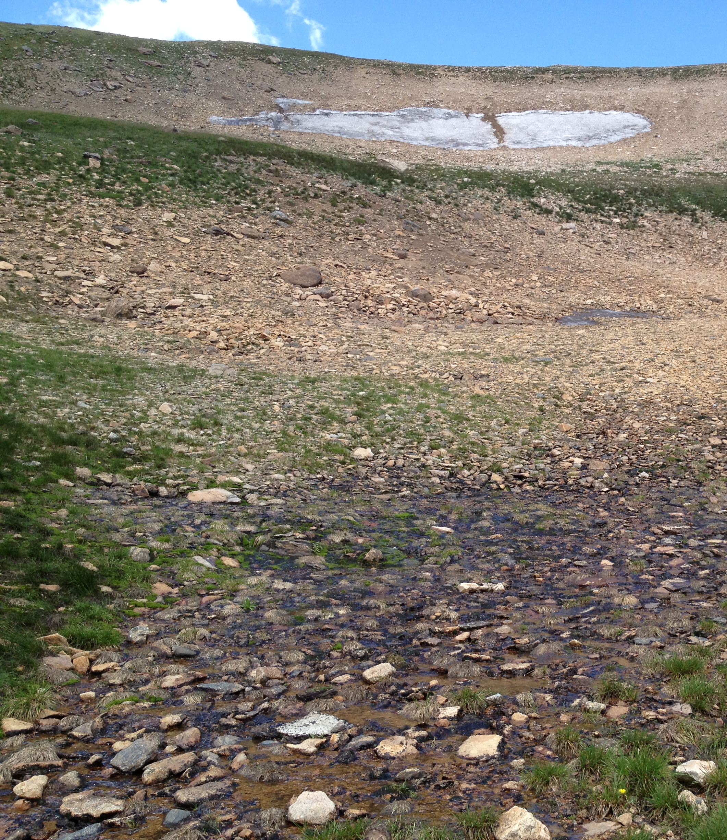




A comparative study of snowmelt-driven water budgets in two adjacent alpine basins, Niwot Ridge, Colorado Front Range
Ian M. Nesbitt David P. Dethier Department of of Geosciences, Williams College
Notes:
My name is Ian Nesbitt, and I’ll be presenting a comparison of water budgets for two adjacent alpine basins in the Front Range of Colorado which the critical zone played a large role in regulating. I was funded by NSF, and worked with the Institute of Arctic and Alpine Research at CU Boulder, the Boulder Creek CZO, and the KECK Geology Consortium.

Slide 2
Introduction
Water from alpine areas accounts for a large percentage of water use in the Western U.S. (Day, 2009; Miller and Piechota, 2011)
Water budgets in Rocky Mtn. alpine areas are not well known but are likely to be strongly affected by climate change (Miller and Piechota, 2011)
Measurement of surface water discharge is important, but locally affected by losses to groundwater (Liu et al. 2004)
(A cautionary tale)
Notes:
Run through first key points for research, then present the last as the problem

Slide 3
Hydrologic budgets of alpine basins
Precipitation
–
Evaporation
–
Sublimation
–
Evapotranspiration (ET)
±
Change in G.W. storage
Runoff
(yield)
=
Notes:
So, here’s a simple hydrologic budget of an alpine basin, starting with the depth of precipitation, and subtracting evaporation, sublimation, and evapotranspiration, and then plus or minus the change in groundwater storage

Slide 4
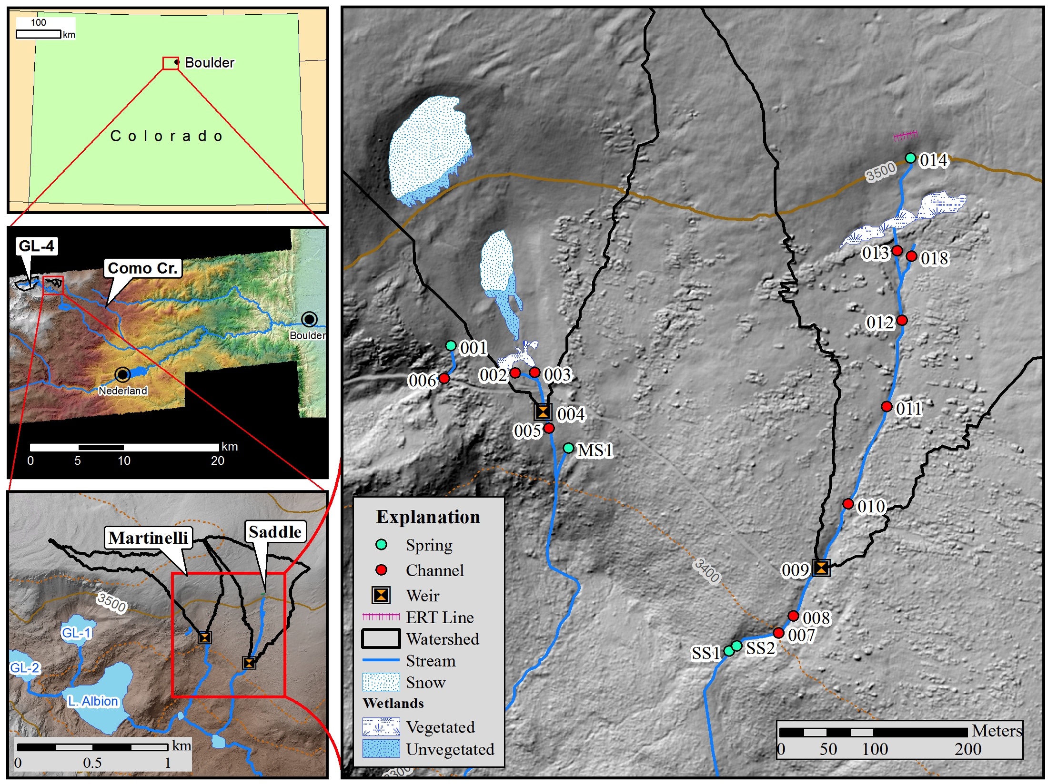
Location
Martinelli
LiDAR base: Anderson et al. (2012)
Saddle
Notes:
These are my measurement sites, in larger context on the left and blown up on the right. My synoptic measurement points are shown here in blue for springs, red for channel measurements, and an orange and black symbol for weirs. Saddle Stream is a good deal more linear than Martinelli, which in terms of my data will be easy to visualize, but Martinelli has two separate stream channels, one on the left here that seemingly leaves the calculated basin boundary, and a central stream here that feeds the weir.

Slide 5
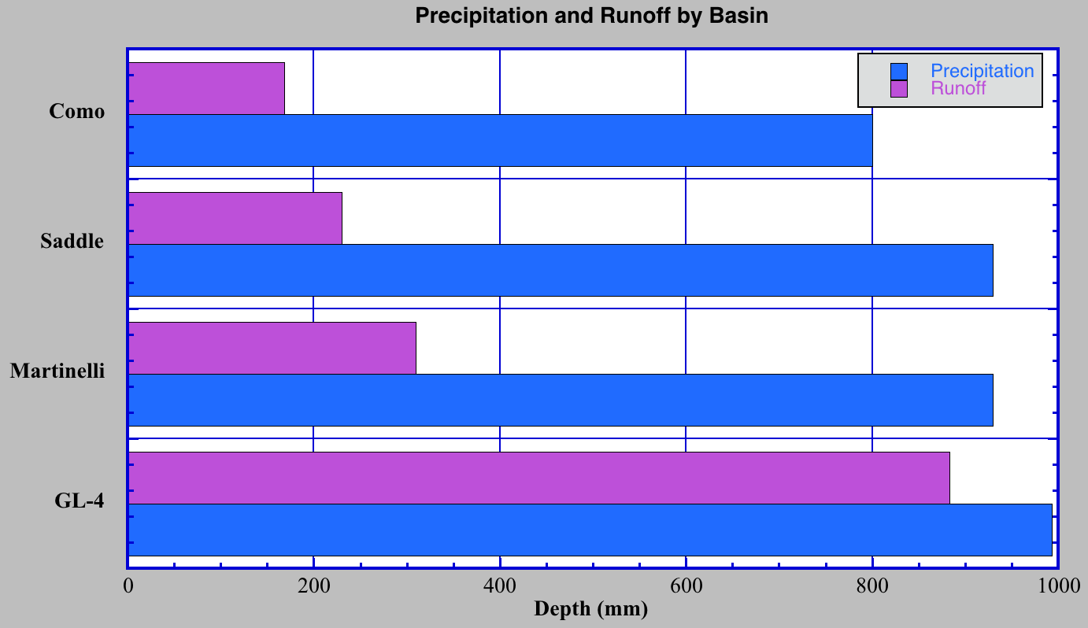
Annual hydrologic yield
6.64 km²
Runoff
Precipitation
0.24 km²
0.24 km²
2.3 km²
Como: Cowie (2011), Leopold et al. (2010); Saddle+Martinelli: NWTMET (2012), Caine (unpublished data); GL-4: Caine (1995); Greenland (1989)
Notes:
So to give some background, these are precipitation and hydrologic yield values published in other works, mostly by Nel Caine, that show a significant disparity between the yield values of unglaciated versus glaciated basins like GL-4. Sublimation hovers around 100-150 mm, according to various sources. Evaporation is difficult to quantify, but is probably not a factor on the slopes of Niwot Ridge where the water is running, which is the case for most of the basin area. Evapotranspiration is probably greater in the three unglaciated basins at the top there, but only the lower reaches of Como and Saddle are actually below treeline. That brings us to my own measurements

Slide 6
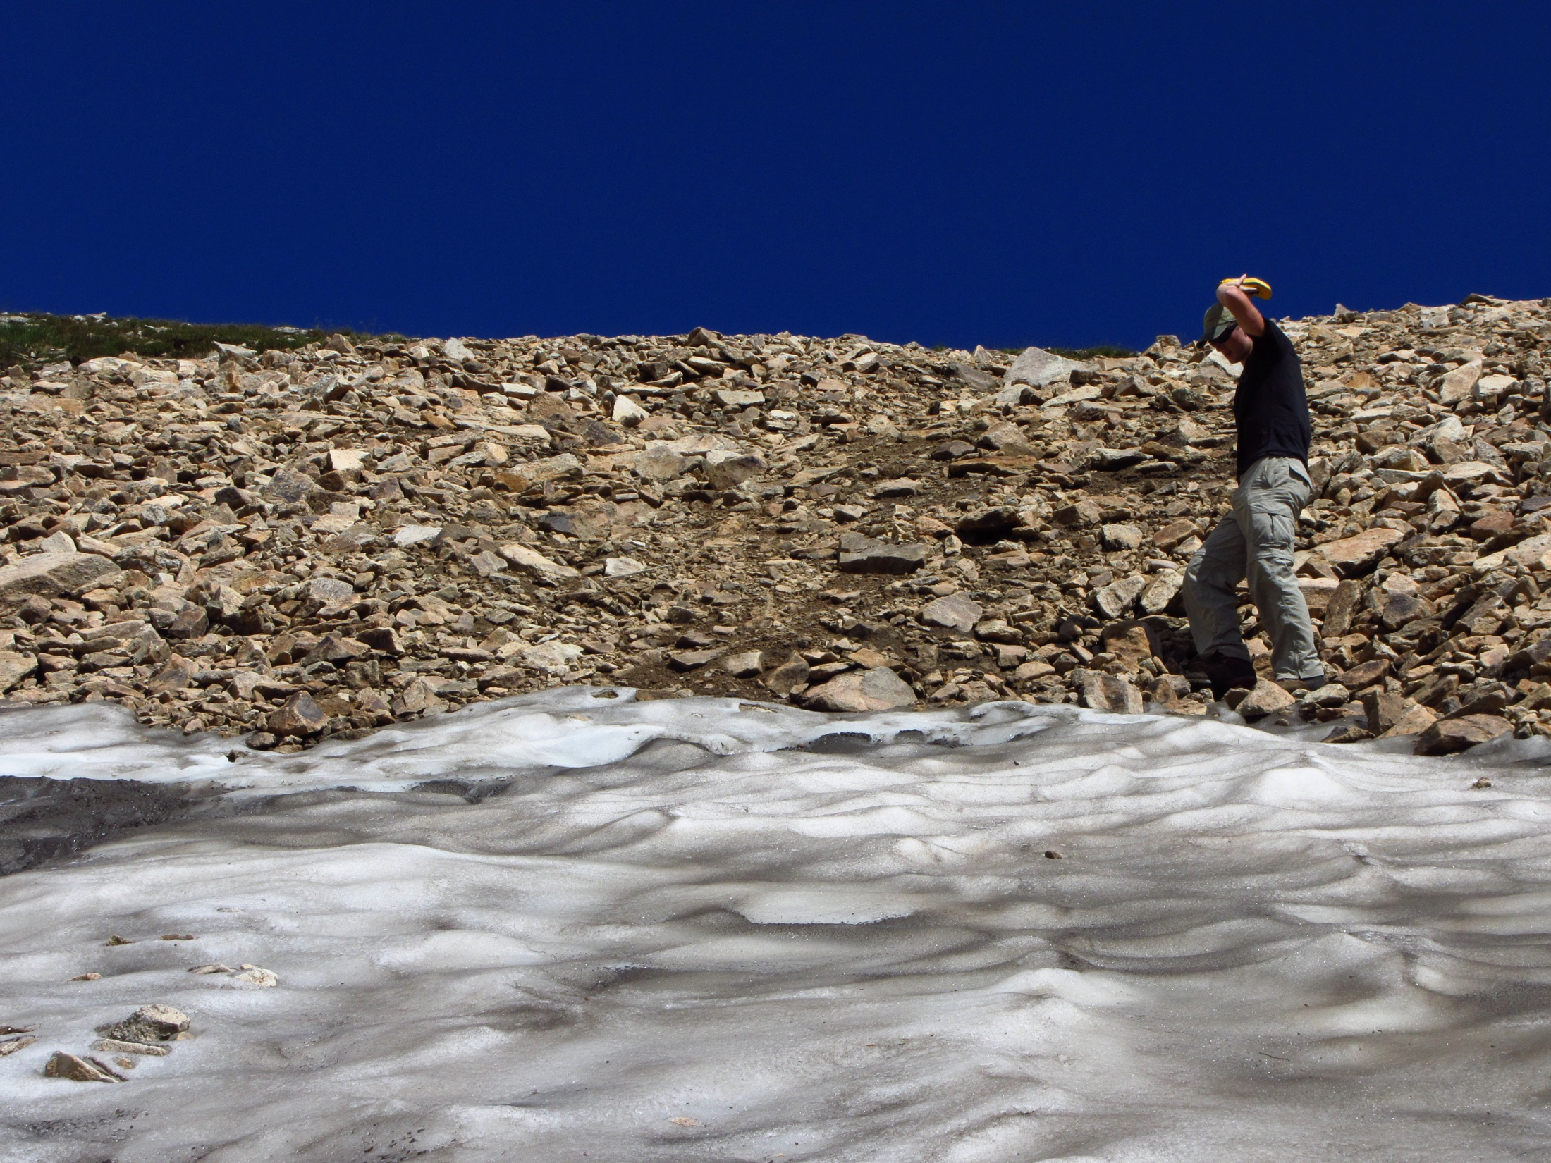
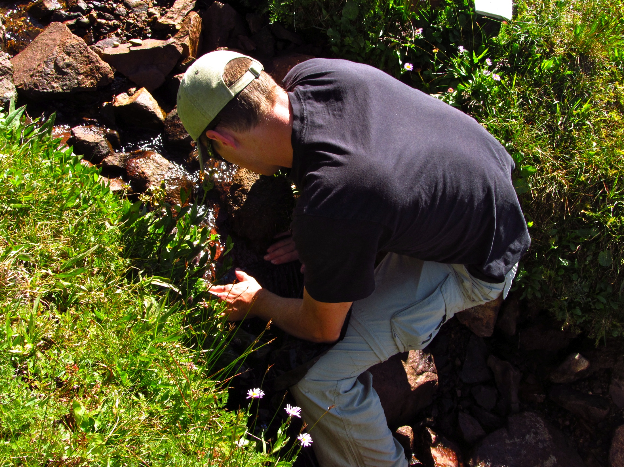
Synoptic measurements
Snowpack area
Discharge and stream temperature
Notes:
I measured snowpack area in Martinelli, plus discharge and temperature in both basins longitudinally down the stream channels during 9 different field days.

Slide 7
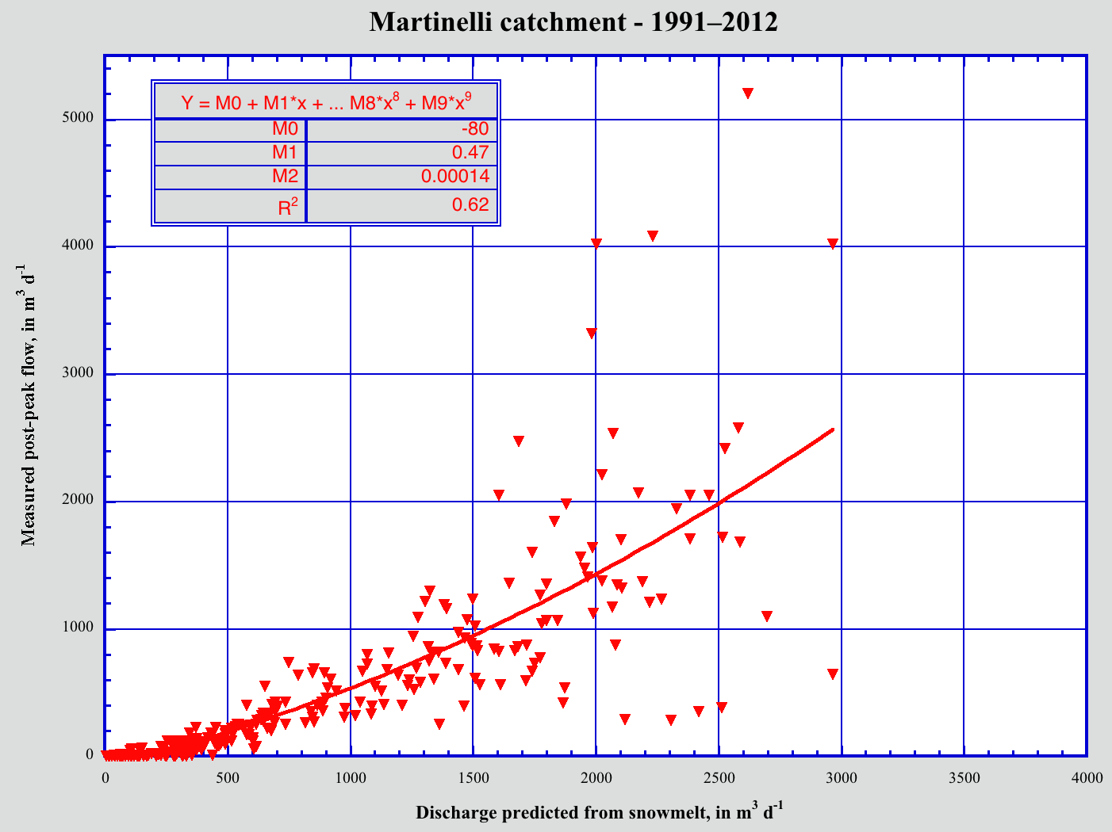
Results: calculated daily snowmelt and measured discharge
Martinelli 1991-2012
Caine (unpublished data)
Notes:
I used 21 years of snowpack area measurements taken by Nel Caine to calculate values of predicted discharge shown here on the X, and correlated them with daily discharge measurements from after the spring hydrograph peak taken at the weir here on the Y to create a model of Martinelli streamflow based on snowpack size. You can see here that even though this is a polynomial fit, Martinelli is still losing about 500 cubic meters per day of discharge. Keep in mind, this model doesn’t take precipitation into account, so the fact that the measured discharge is lower than the predicted is significant because it allows us to constrain the values seen at the weir below the values we would expect.

Slide 8
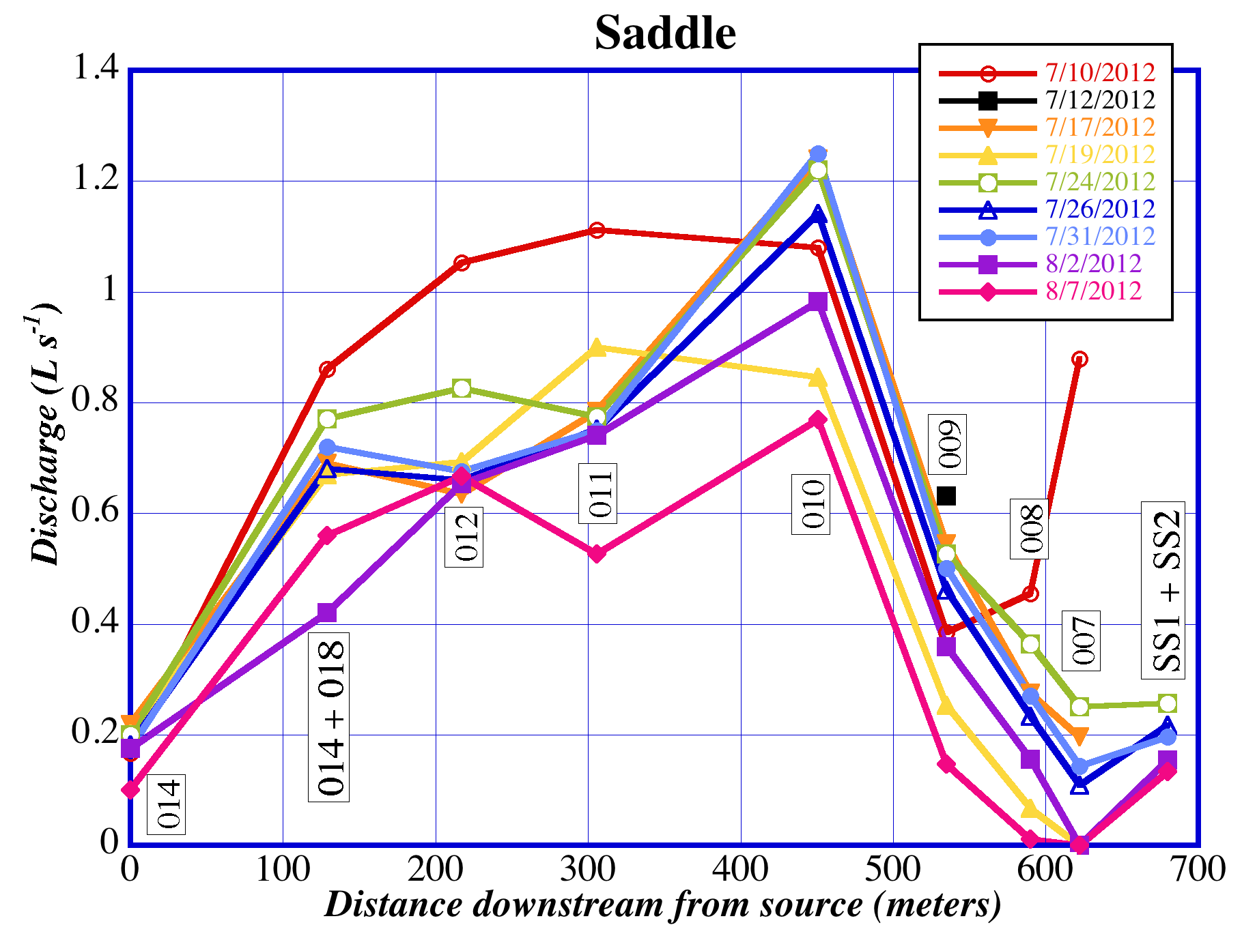
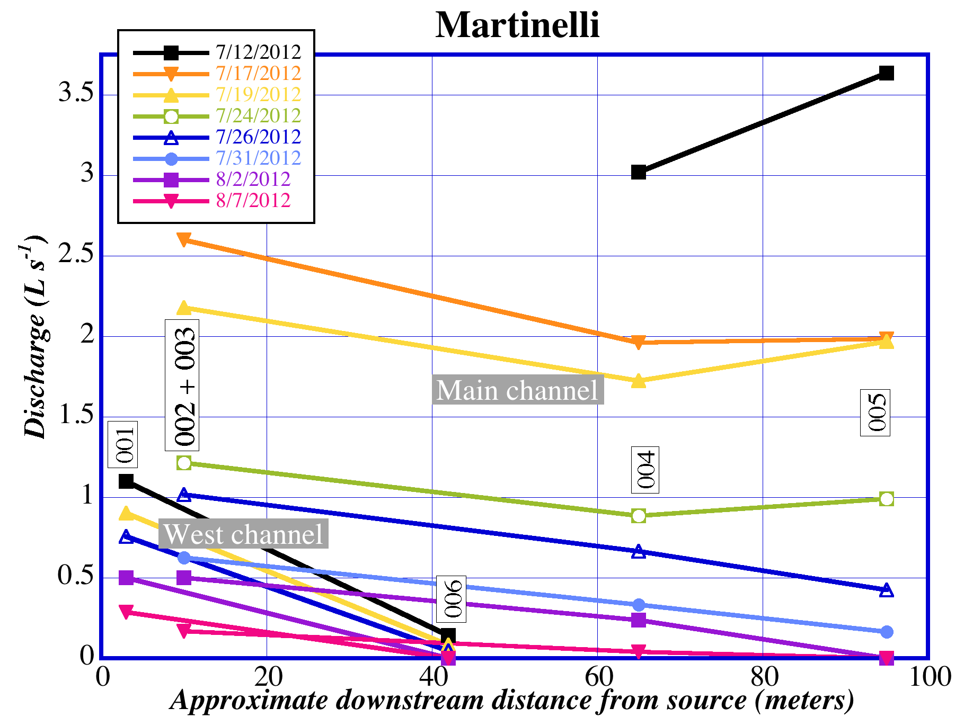
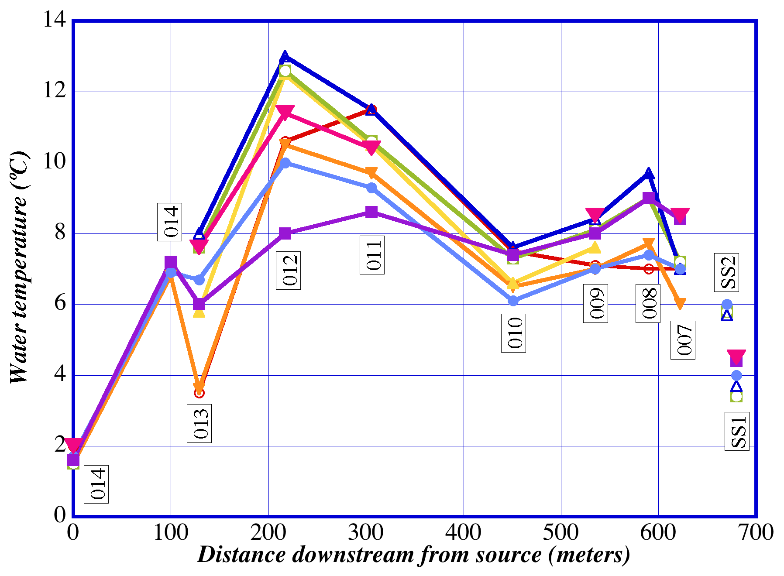
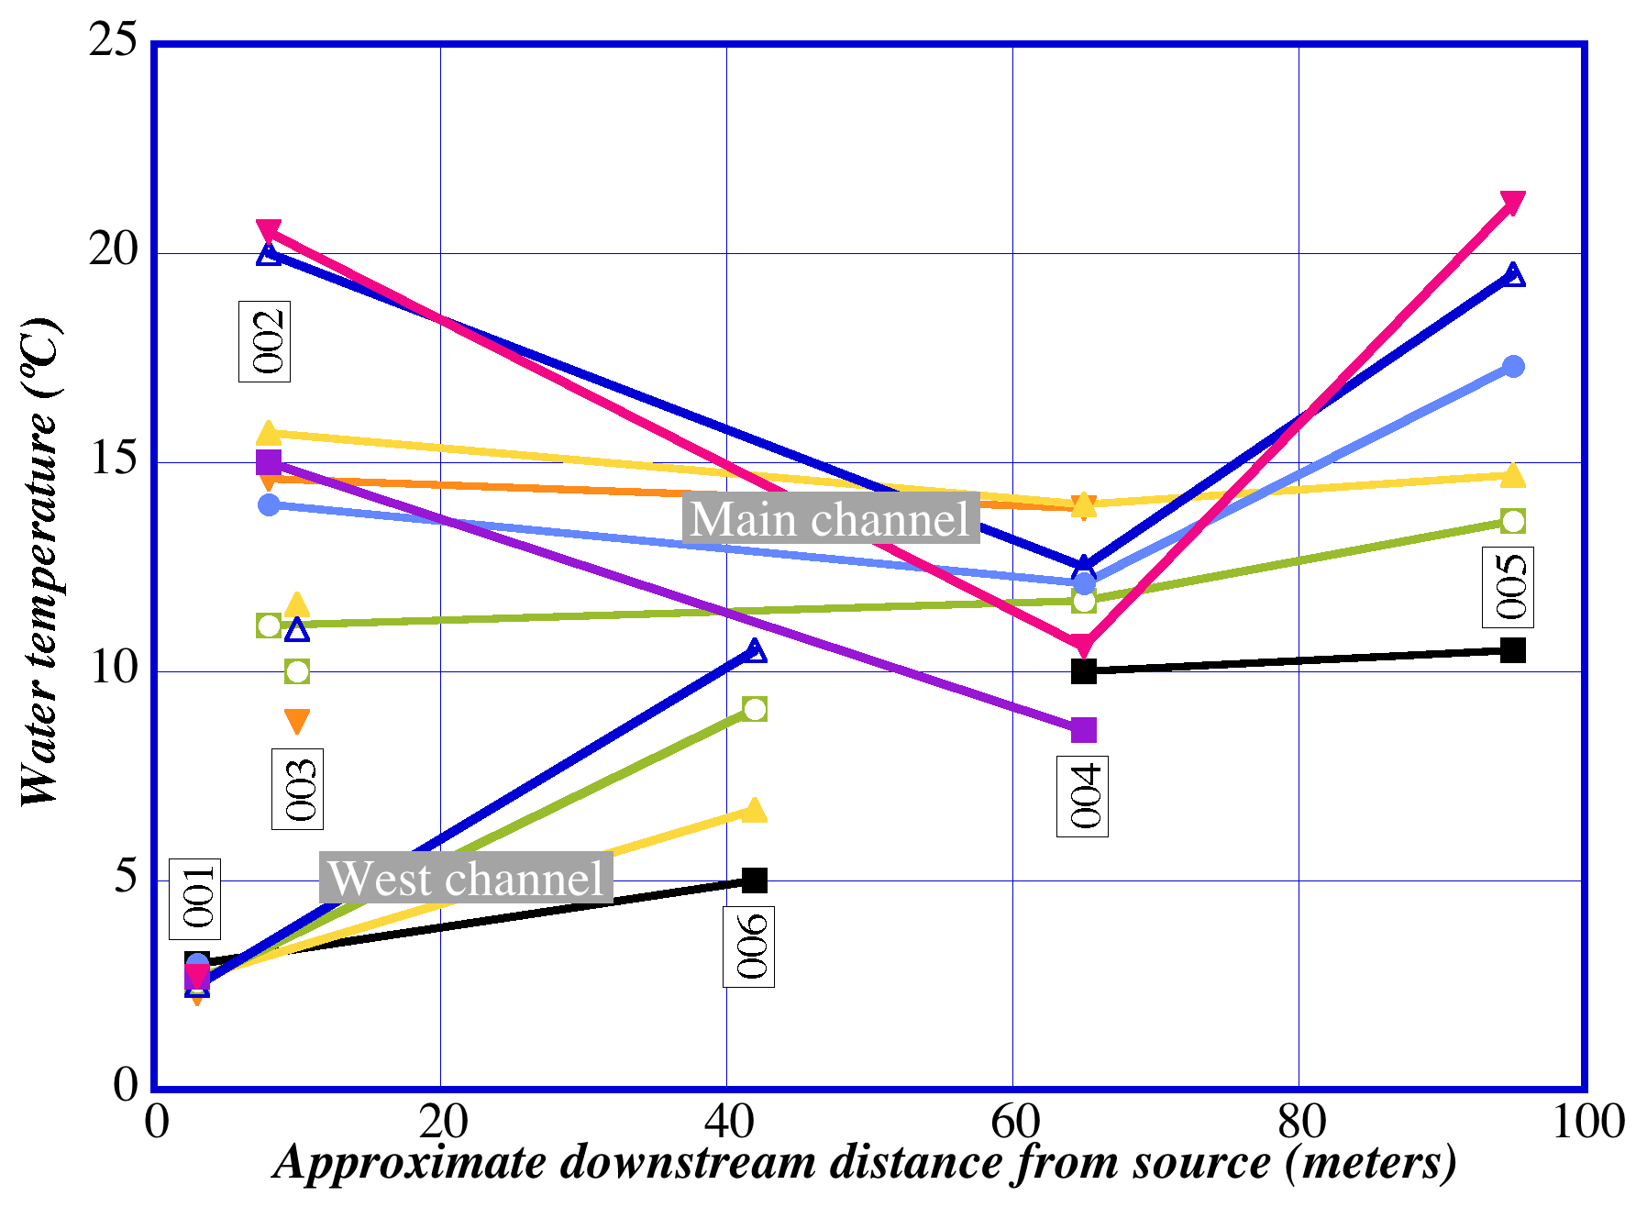
Results: synoptic discharge and temperature
Notes:
So switching gears, my own data collection showed a similarly interesting trend, especially for Saddle. Shown here is a discharge graph by downstream distance, and we see a characteristic gradual increase with increasing basin area, but then this sharp decrease on every single field day from location 010 to the weir at location 009. The complement to that is the temperature data, which show a similar temperature increase, followed by a decrease that corresponds with the increase in discharge, then a gradual rise again. Martinelli data is not as significant, and is just meant to back up the data from Saddle.

Slide 9
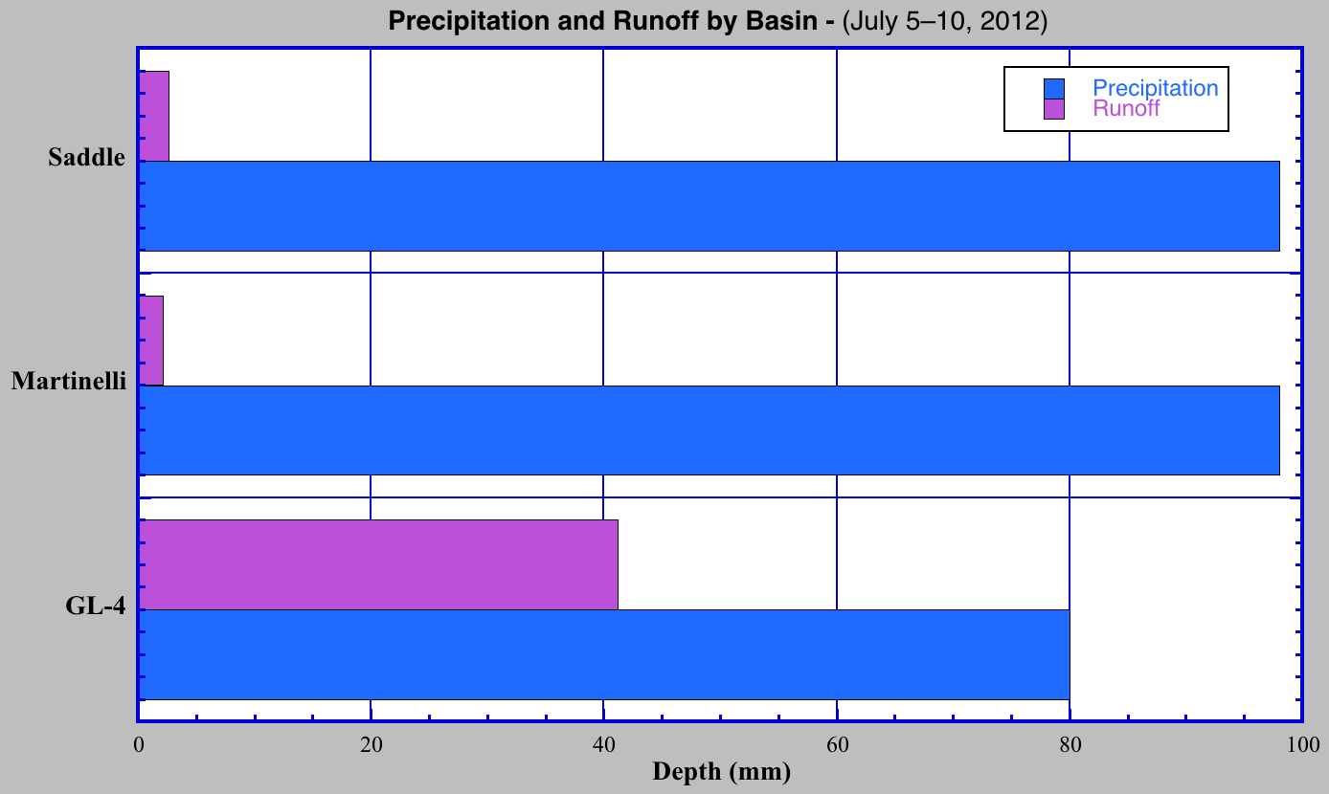
Short-term hydrologic yield
Runoff
Precipitation
Saddle: zero discharge before storm (baseflow=0)
Precipitation lasts 7/5–7/8, each basin’s runoff depth includes storm discharge (total Q–baseflow) through 7/10
(Estimated, linear rainfall-distance model)
Saddle+Martinelli: NRCS (2012), Caine (unpublished data); GL-4: Caine (unpublished data)
Notes:
Finally, we were lucky to be able to study a large short-term event that dumped about 100 mm of precipitation on the study area, but slightly less towards the continental divide. The fact that this event is short-term is significant because in the short-term we can essentially rule out ET as a possible source of water loss. Here we see even less discharge exiting the basin, especially compared to Green Lake 4 here at the bottom. The reason that GL-4 may have low short-term yield here is that there was a significant drought beforehand.

Slide 10
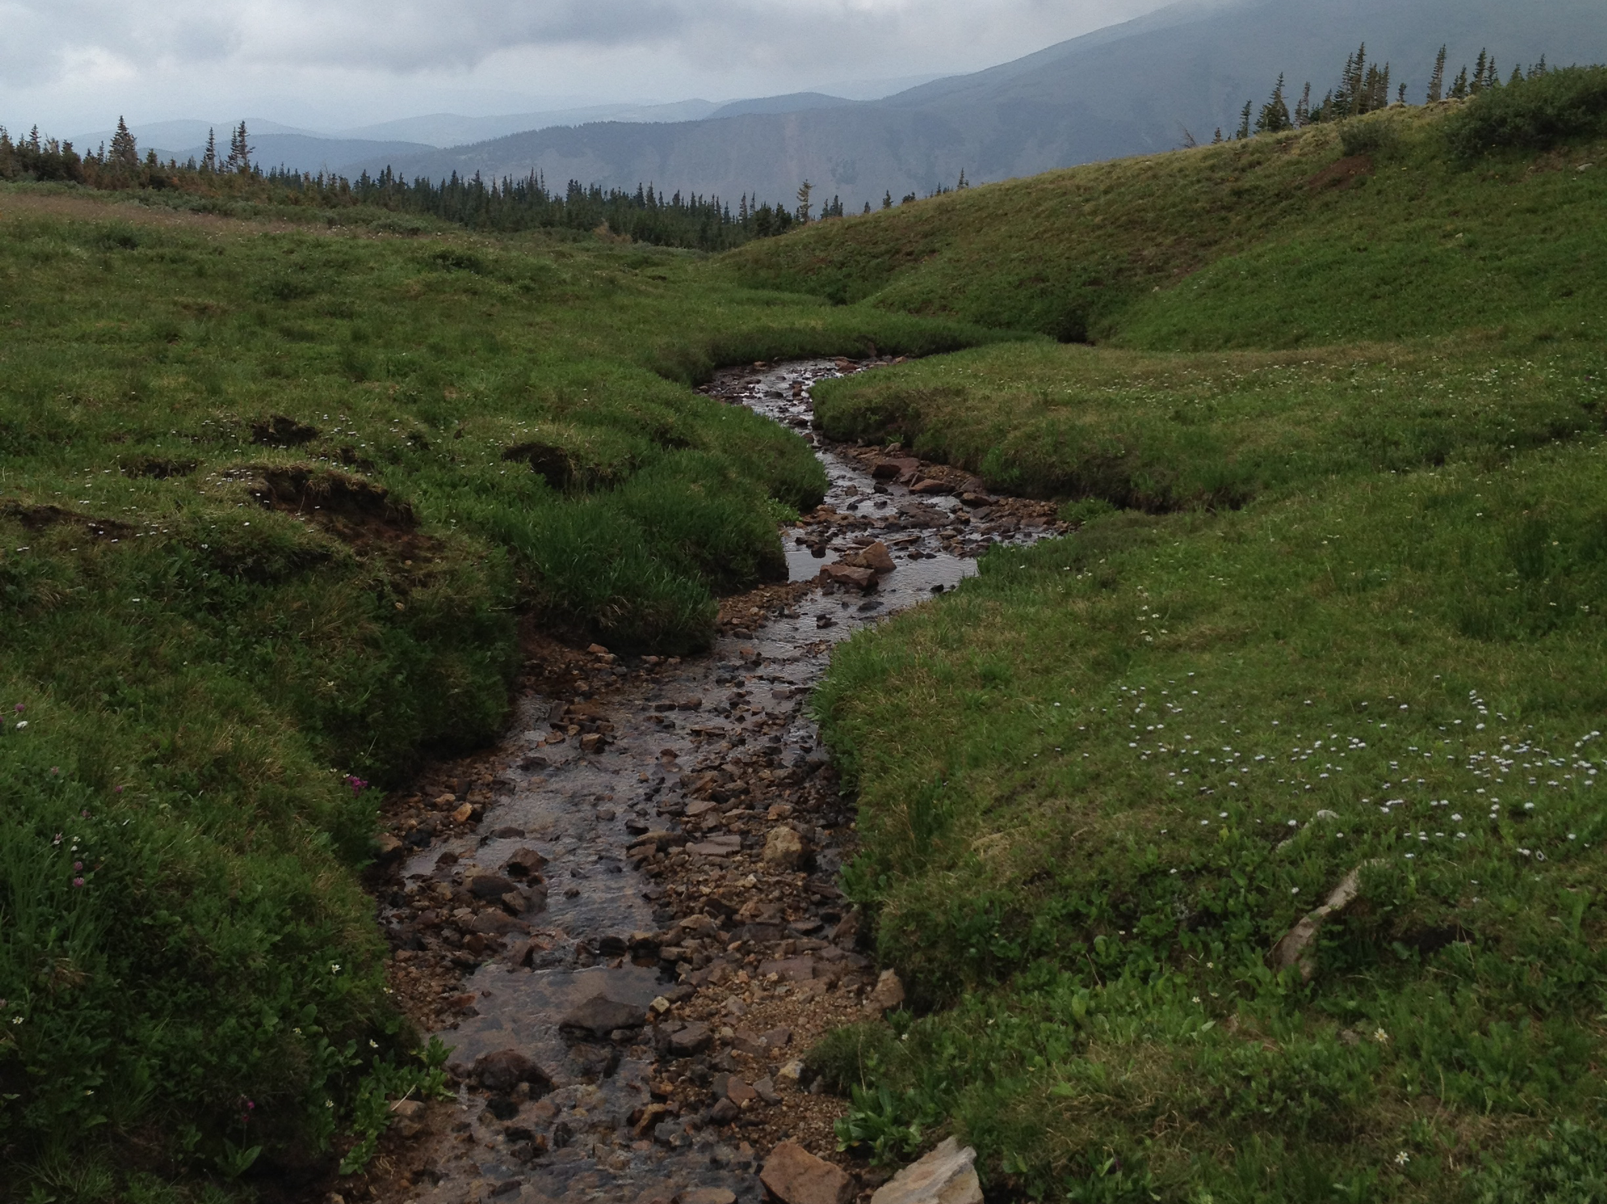
Conclusions I
Tracking discharge downstream clearly demonstrates that Saddle begins as a gaining stream, then loses water
Short-term and synoptic data show significant water loss due to underflow
Geophysical measurements suggest that coarse sediments underlie finer surface sediment in these catchments
Saddle Stream

Slide 11
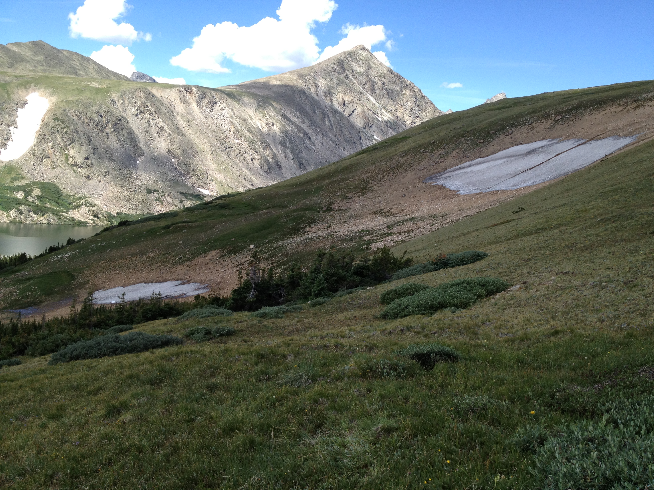
Conclusions II
Little to no surface flow downstream from snowfields
Measured discharge is on average 500 m³ d⁻¹ less than the modeled snowmelt
Local water losses are likely in other unglaciated upland catchments underlain by coarse layered debris
Martinelli Snowfields

Slide 12
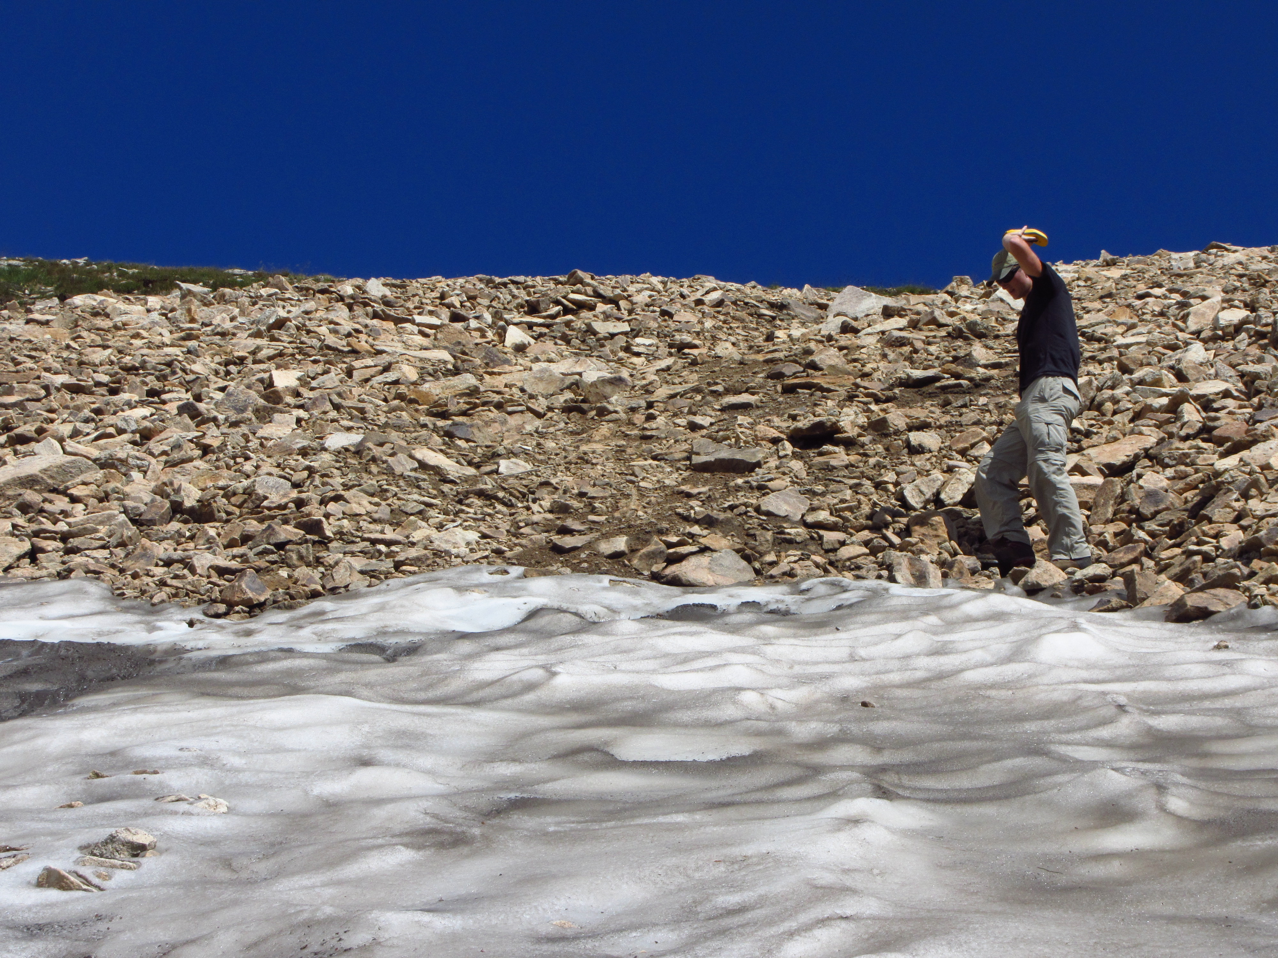
Acknowledgements
INSTAAR and Boulder Creek CZO
Dr. David Dethier (Williams, CZO)
Dr. Nel Caine (INSTAAR, CZO)
Dr. Mathias Leopold (Technische Universtät München, CZO)
Dr. Will Ouimet (Uconn, CZO)
Morgan Zeliff (CU Boulder)
James Winkler (UConn)
Jessica King (CU Boulder)
Claudia Corona (Williams, KECK)
Gabriel Lewis (Williams, NSF-CZO)
Hannah Mondrach (UConn, KECK)
Annette Patton (Whitman, KECK)
The rest of the Boulder Creek KECK 2012 crew

