Slide 1
Being a Geoscientist and Being Sustainable: The Water Cycle Connection
Tim Lutz
West Chester University, PA
tlutz@wcupa.edu

Slide 2
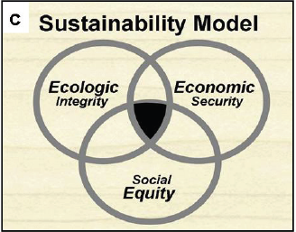
Brundtland Report, 1987
Sustainability – 1. meeting the needs of the present without compromising the ability of future generations to meet their needs.
Flint, 2010, Symbolism of Sustainability, Synesis, vol. 1, 25-37.

Slide 3
Brundtland Report, 1987
Sustainability – 1. meeting the needs of the present without compromising the ability of future generations to meet their needs.
2. a vague and uninspiring concept that confuses many people and turns off even more.
Flint, 2010, Symbolism of Sustainability, Synesis, vol. 1, 25-37.

Slide 4
Only connect! That was the whole of her sermon. Only connect the prose and the passion, and both will be exalted, and human love will be seen at its height. Live in fragments no longer.
E.M. Forster, 1910, Howards End
John Ehrenfeld proposes that the type of fragmentation we’ve experienced affects three critical domains of living.
A lost sense of our place in the natural world,
A lost sense of what it is to be a human being, and
A lost sense of responsibility for our actions and our relationships to others.
John R. Ehrenfeld, 2009, Sustainability by Design: A Subversive Strategy for Transforming Our Consumer Culture, Yale, p. 6

Slide 5
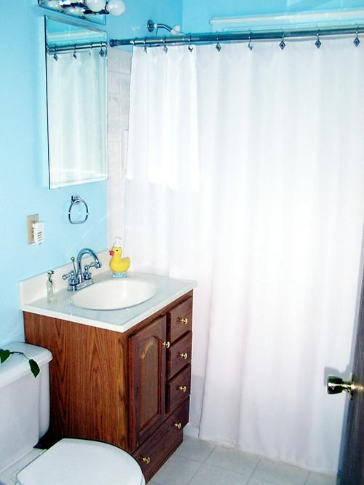
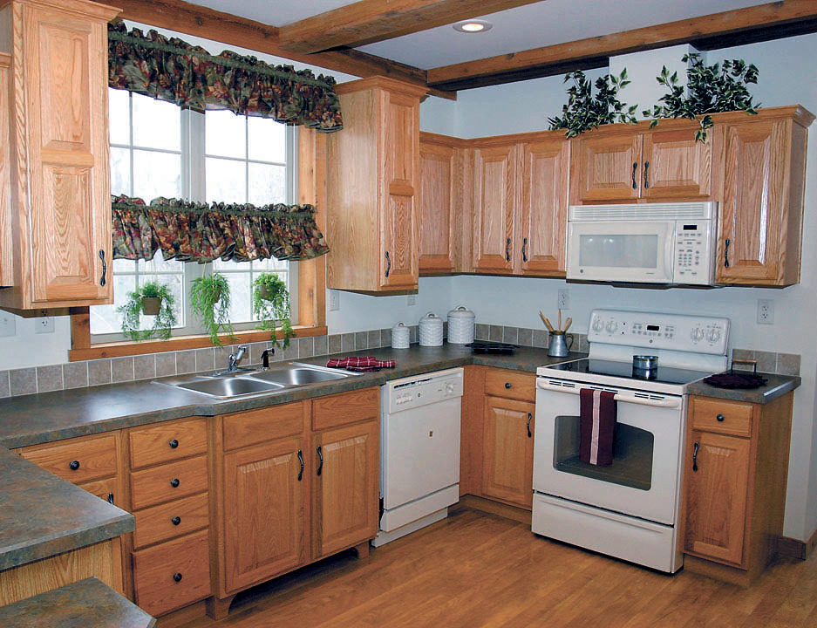
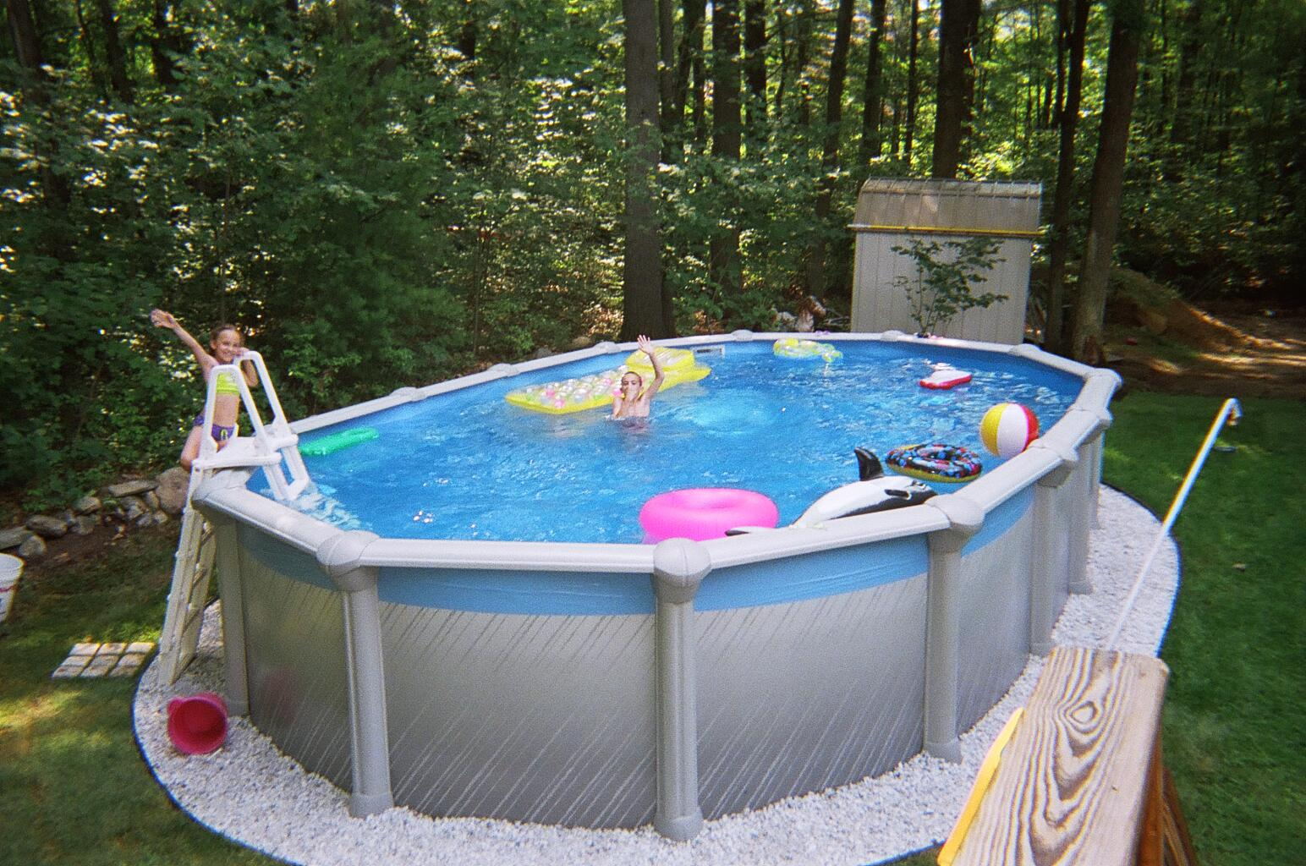
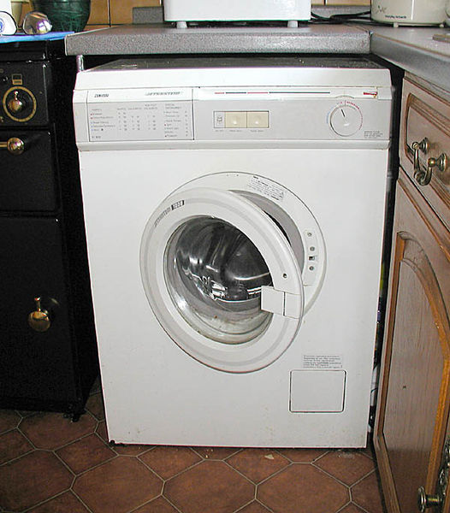
How do we connect with water as consumers?

Slide 6
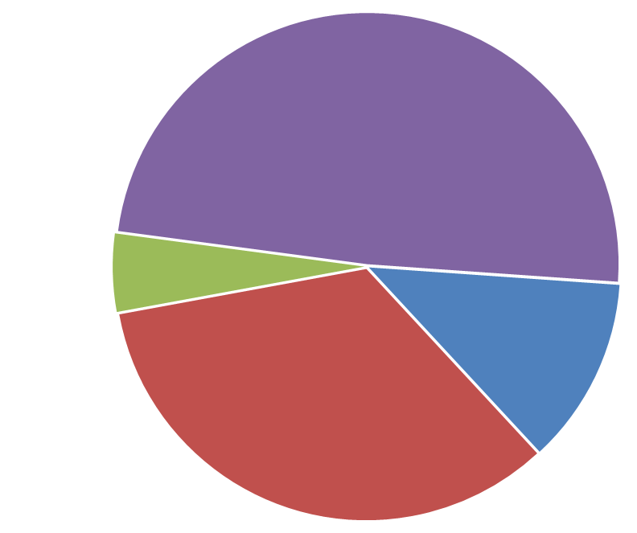
U.S. fresh water consumption (2005)
349 billion gallons/day
Domestic = 98 gal/d
Total = 1180 gal/d
Thermoelectric power generation
(fossil + nuclear)
Industry & mining
Public water supply incl. domestic use
Agriculture (crop irrigation, livestock, aquaculture)
http://water.usgs.gov/watuse/

Slide 7
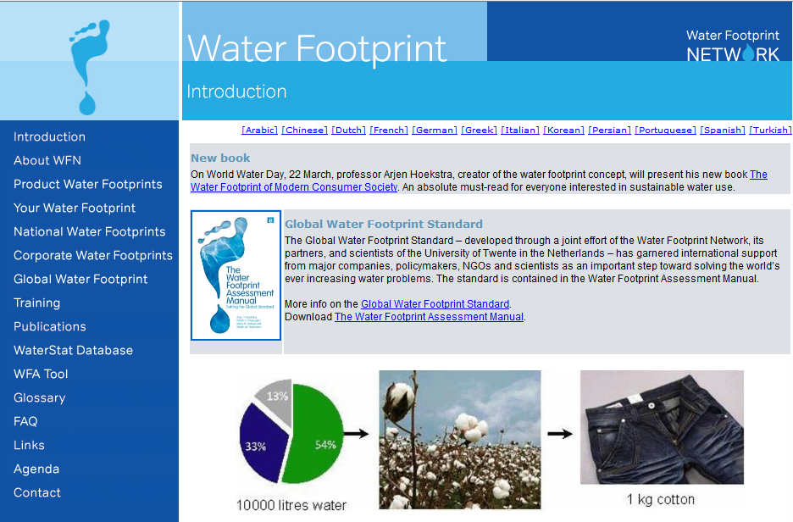
http://www.waterfootprint.org

Slide 8
U.S. fresh water consumption (2005)
349 billion gallons/day
Domestic = 98 gal/d
Total = 1180 gal/d
Thermoelectric power generation
(fossil + nuclear)
“Industrial”
footprint
Industry & mining
Public water supply incl. domestic use
“Food”
footprint
Agriculture (crop irrigation, livestock, aquaculture)
“Domestic”
footprint
http://water.usgs.gov/watuse/

Slide 9
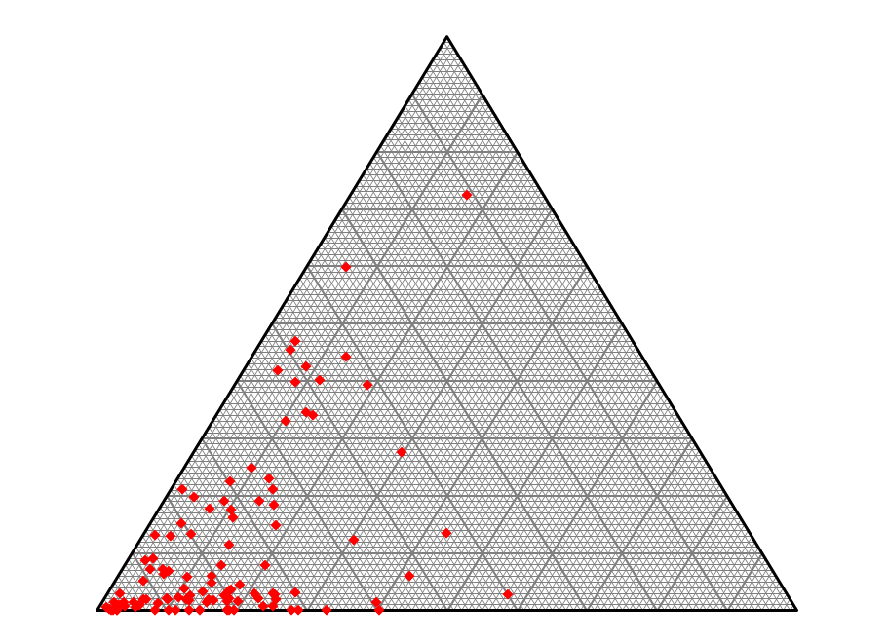
Industrial
Water footprint
ESS 102 students,
Fall 2012 (n = 106)
Food
Domestic

Slide 10
The approximate proportions that underlie the water footprint calculation:
4 ounces of vegetables/day= 1,680 gallons/year
4 “ “ fruit/day = 2,280 “ “
4 “ “ cereal/day = 6,480 “ “
4 “ “ dairy/day = 7,520 “ “
4 “ “ meat/day = 58,100 “ “
1 load of laundry/week = 1,850 “ “
1 10-minute shower/day = 11,500 “ “
Each $1000 gross income = 6,500 “ “
Food
Domestic
Industrial

Slide 11
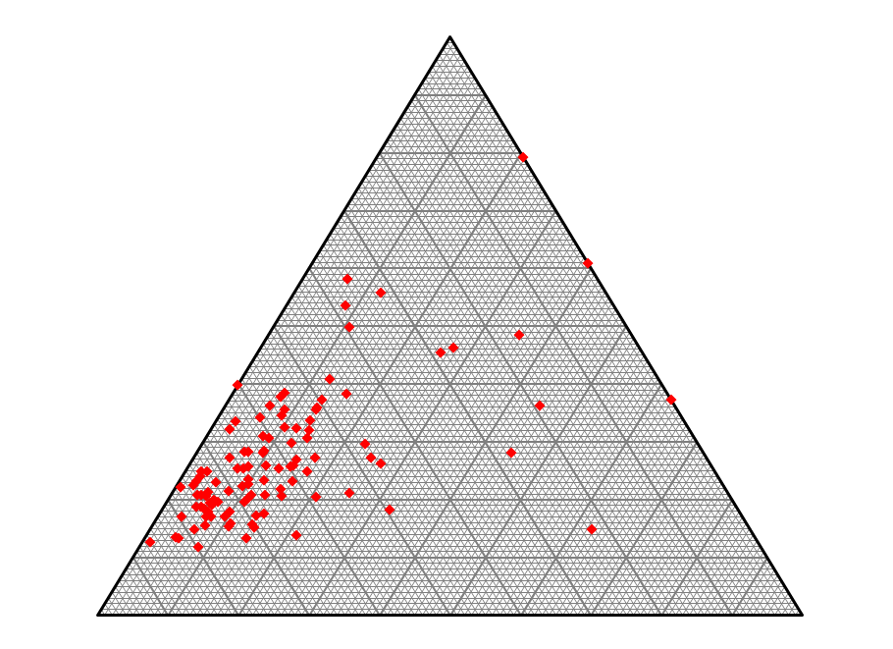
Other (cereals, fruits, vegetables, etc.)
Water footprint of food
ESS 102 students,
Fall 2012 (n = 106)
Dairy +
eggs
Meat

Slide 12
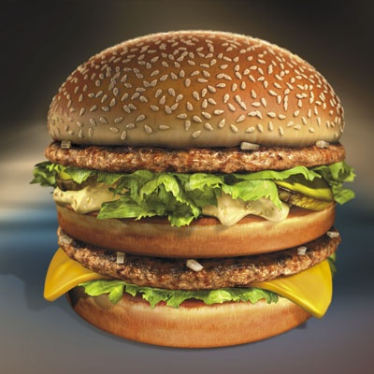
Hamburger
Water footprint: 634 gallons of water for one hamburger!
(634 gals. = 1” x 1000 ft²).
Most of the water is needed for producing the beef contained in the hamburger. In our hamburger we assumed there is about ⅓ pound of beef.
Adapted from www.waterfootprint.org
“…US per capita food waste has progressively increased by 50% since 1974 reaching more than 1400 kcal per person per day… Food waste now accounts for more than one quarter of the total fresh water consumption…”
Hall KD, Guo J, Dore M, Chow CC (2009) The Progressive Increase of Food Waste in America and its Environmental Impact. Plos ONE 4(11): e7940. doi10.1371/journal.pone.0007940

Slide 13
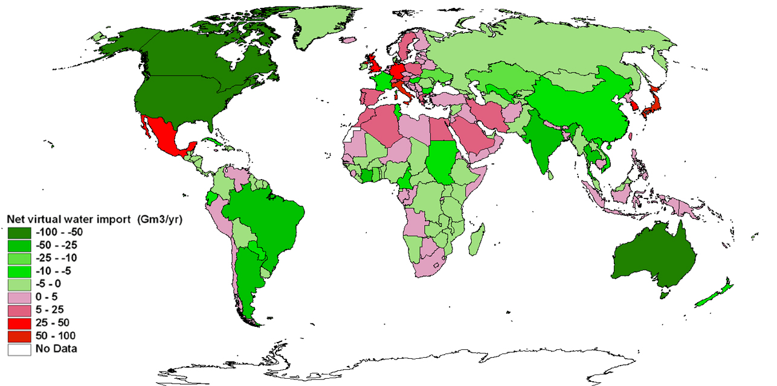
Net virtual water trade via products: exporters and importers
From www.waterfootprint.org

Slide 14
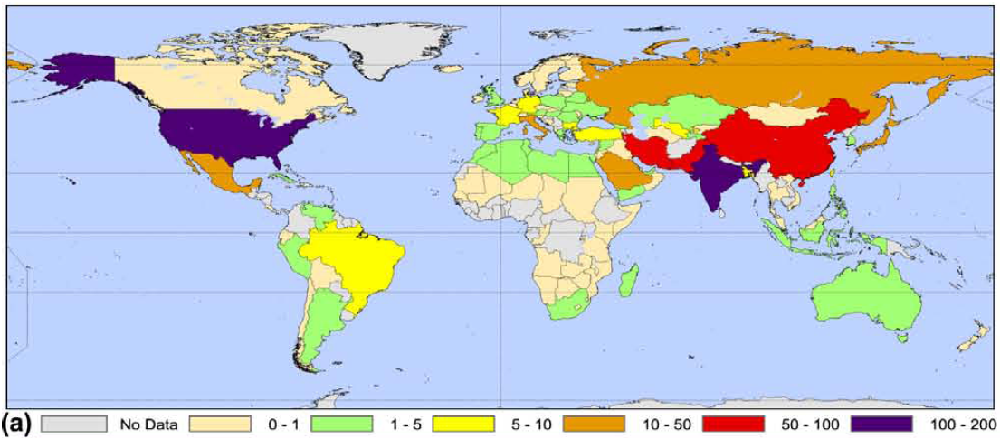
Groundwater abstraction = non-sustainable use
Groundwater abstraction (cubic kilometers/year)
[1 cubic kilometer = 264 billion gallons]
Wada et al., 2012, Nonsustainable groundwater sustaining irrigation: a global assessment: Water Resources Research, vol. 48, W00L06, doi:10.1029/2011WR010562, 2012.

Slide 15
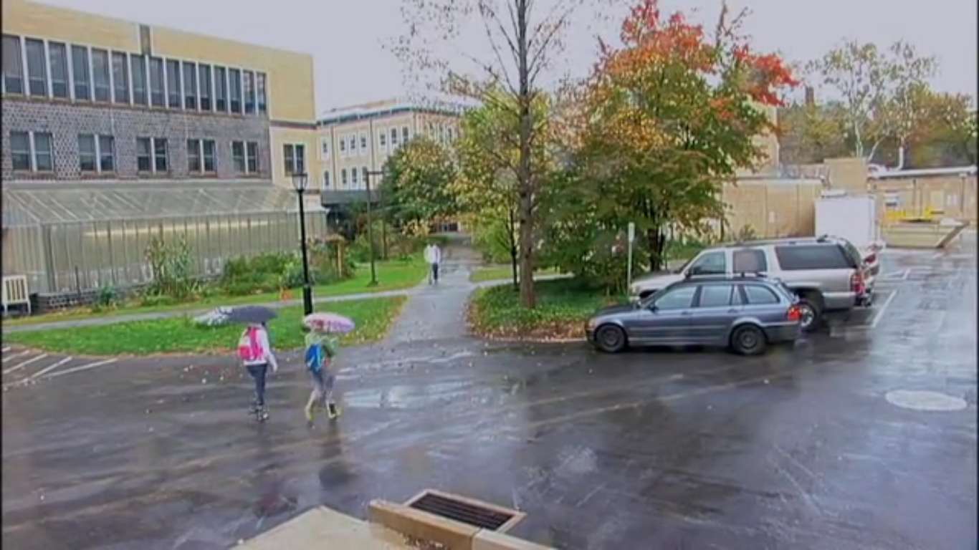
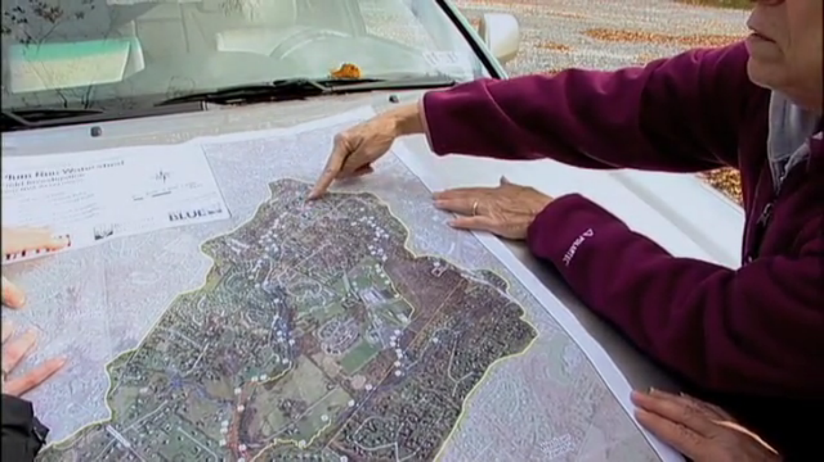
How do you connect with water as a watershed citizen?
Restoring Plum Run: Turning Red Streams to Blue, GreenTreks Network, Inc., http://vimeo.com/35766326

Slide 16
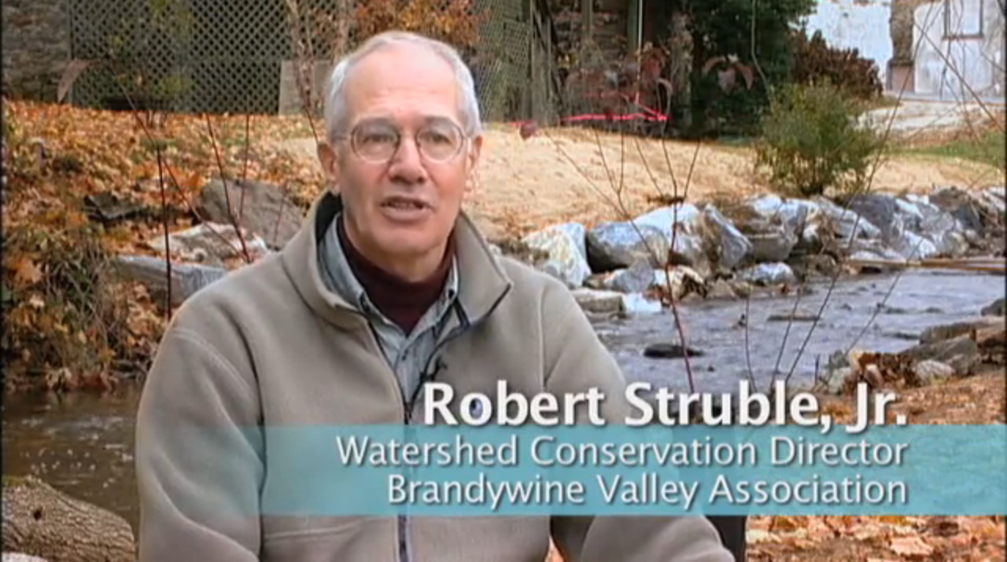
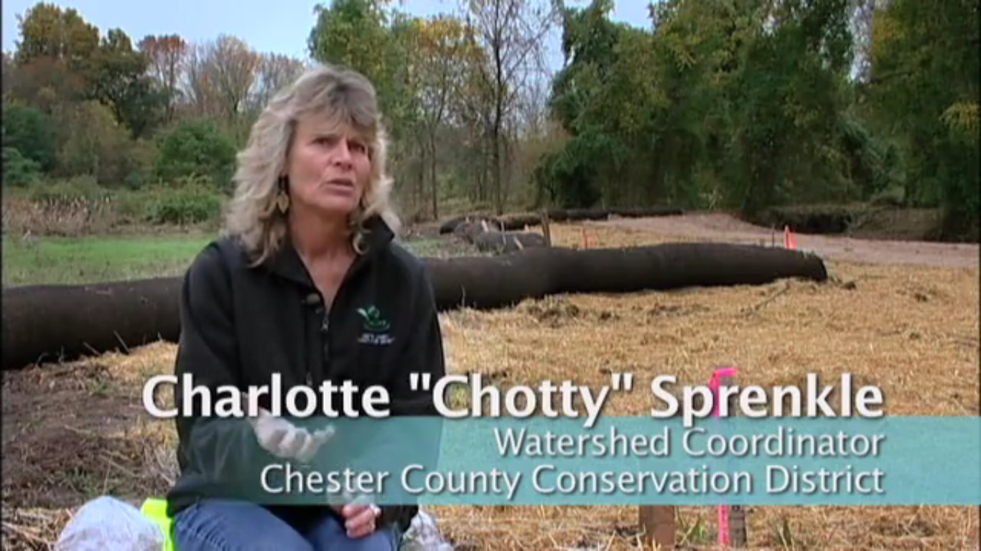
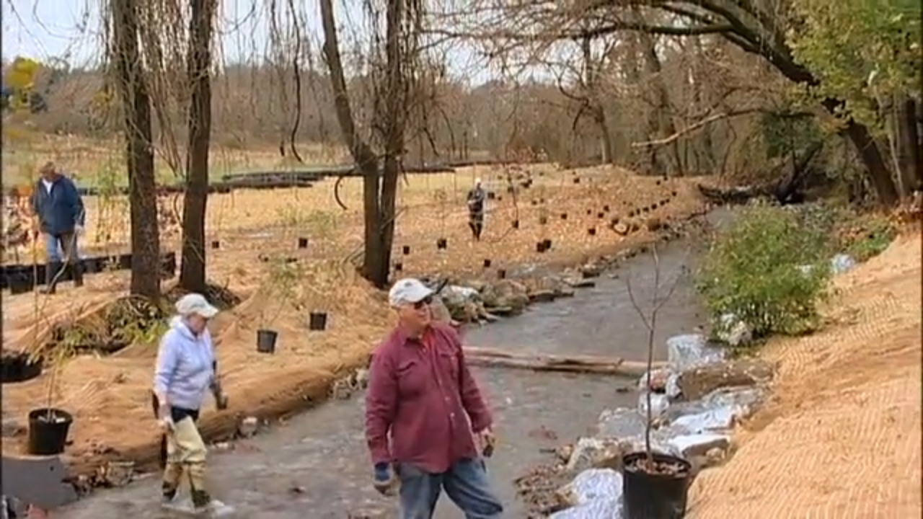
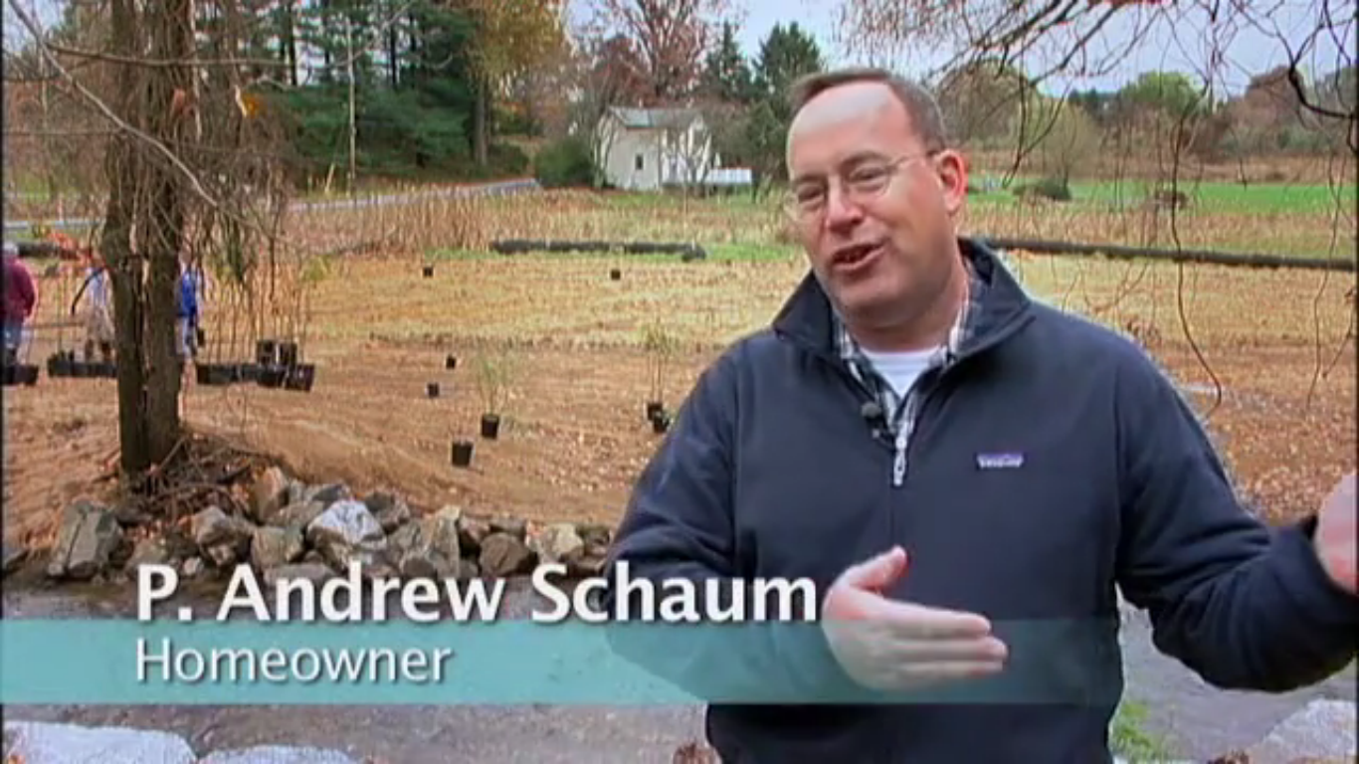
We all live in watersheds and thus have relationships with water in addition to consumption. A video about a local stream project emphasizes these citizen roles in water quality, water supply, and watershed livability.
Restoring Plum Run: Turning Red Streams to Blue, GreenTreks Network, Inc., http://vimeo.com/35766326

Slide 17
We all live in watersheds and thus have relationships with water in addition to consumption. A video about a local stream project emphasizes these citizen roles in water quality, water supply, and watershed livability.
Restoring Plum Run: Turning Red Streams to Blue, GreenTreks Network, Inc., http://vimeo.com/35766326

Slide 18
We all live in watersheds and thus have relationships with water in addition to consumption. A video about a local stream project emphasizes these citizen roles in water quality, water supply, and watershed livability.
Restoring Plum Run: Turning Red Streams to Blue, GreenTreks Network, Inc., http://vimeo.com/35766326

Slide 19
We all live in watersheds and thus have relationships with water in addition to consumption. A video about a local stream project emphasizes these citizen roles in water quality, water supply, and watershed livability.
Restoring Plum Run: Turning Red Streams to Blue, GreenTreks Network, Inc., http://vimeo.com/35766326

Slide 20
We all live in watersheds and thus have relationships with water in addition to consumption. A video about a local stream project emphasizes these citizen roles in water quality, water supply, and watershed livability.
Restoring Plum Run: Turning Red Streams to Blue, GreenTreks Network, Inc., http://vimeo.com/35766326

Slide 21
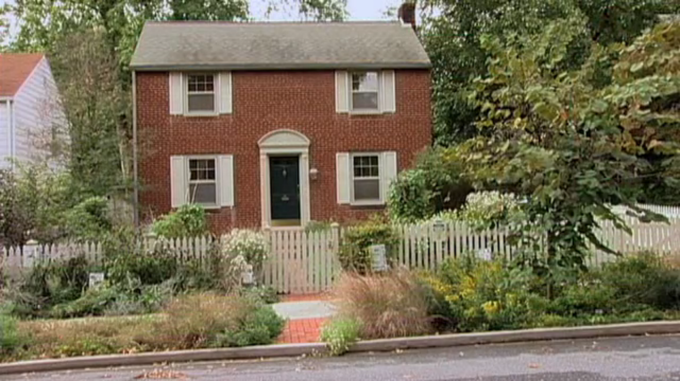
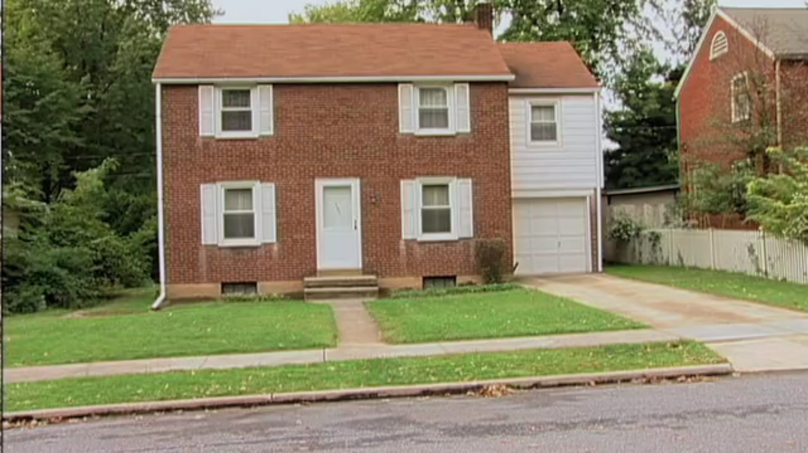
Restoring Plum Run: Turning Red Streams to Blue, GreenTreks Network, Inc., http://vimeo.com/35766326

Slide 22
The land ethic simply enlarges the boundaries of the community to include soils, waters, plants, and animals, or collectively: the land.
Aldo Leopold, “The Community Concept,” A Sand County Almanac.
The cowman who cleans his range of wolves does not realize that he is taking over the wolf’s job of trimming the herd to fit the range. He has not learned to think like a mountain. Hence we have dustbowls, and rivers washing the future into the sea.
Aldo Leopold, “Thinking Like a Mountain,” A Sand County Almanac (emphasis added).
The major problems in the world are the result of the difference between how nature works and the way people think.
Gregory Bateson

Slide 23
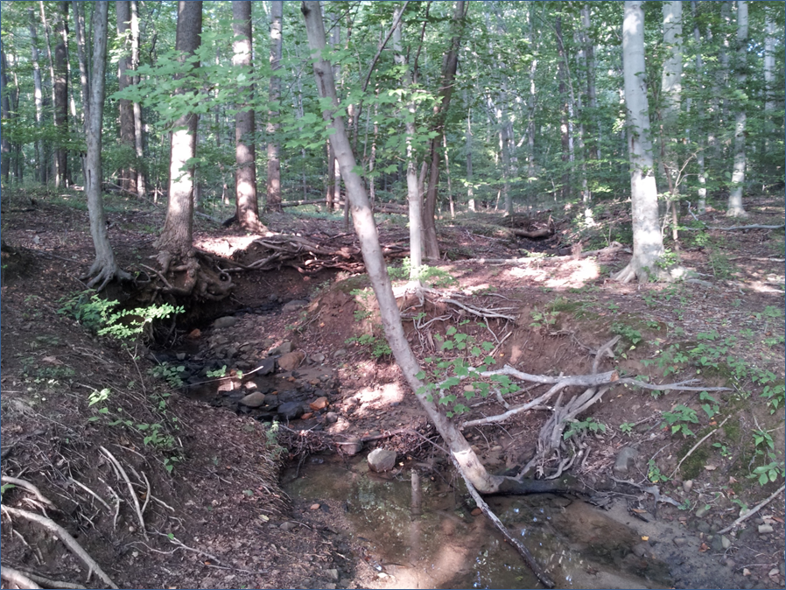
Connecting humans and nature by thinking like a watershed
CO₂, O₂, N₂, H₂O
Trees, shrubs, insects, deer
Slope
Climate & time
Soil, rock
Channel
Water, sediment

Slide 25
Odyssey by Aldo Leopold (Sand County Almanac)
“X had marked time in the limestone ledge since Paleozoic seas covered the land. Time, to an atom locked in a rock, does not pass.
“The break came when a bur-oak root nosed down a crack and began prying and sucking. In the flash of a century the rock decayed, and X was pulled out and up into the world of living things. He helped build a flower, which became an acorn, which fattened a deer, which fed an Indian, all in a single year.
“From his berth in the Indian’s bones, X joined again in chase and flight, feast and famine, hope and fear. He felt these things as changes in the little chemical pushes and pulls that tug timelessly at every atom. When the Indian took his leave of the prairie, X moldered briefly underground, only to embark on a second trip through the bloodstream of the land…”

Slide 26
Limestone
Soil
Oak & acorn
Deer
Indian
Gravity & streams
Soil
Bluestem
Mouse nest
Fungi
Soil
Side-oats grama
Buffalo
Buffalo chip
Soil
Spiderwort
Rabbit
Owl
Soil
Sporobolus
Fire
Air
Soil
Baptisia (legume)
Gopher
Fox
Eagle
Soil
Cottonwood
Beaver
Plate
tectonics
Sediment
Crayfish
Raccoon
Indian
Marine
sediment
Producers
Consumers
Solar energy – trophic level

