Slide 1
δD AND δ¹⁸O fractionation in groundwater in the vicinity of an arsenic contaminated landfill plume in central Massachusetts
Shakib Ahmed
Earth and Environmental Sciences
Boston College

Slide 2
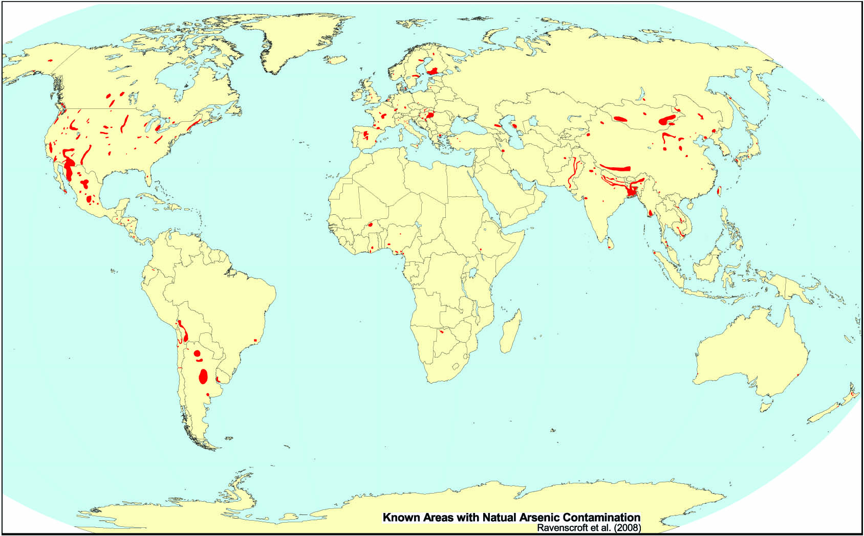
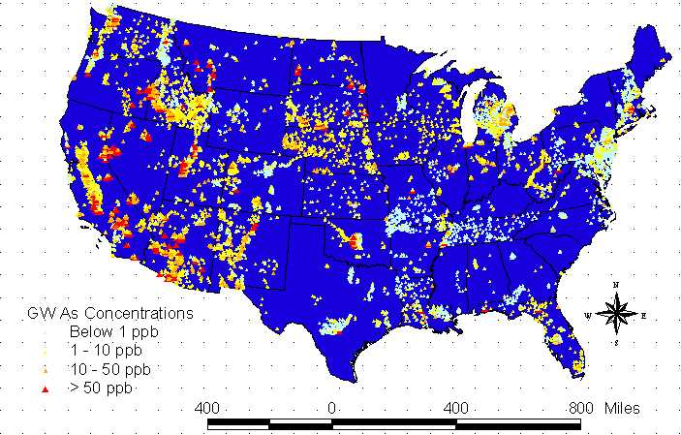
Arsenic Contamination
Ravenscroft et al., 2008
Hazim Tugun, University of Texas, 2000

Slide 3
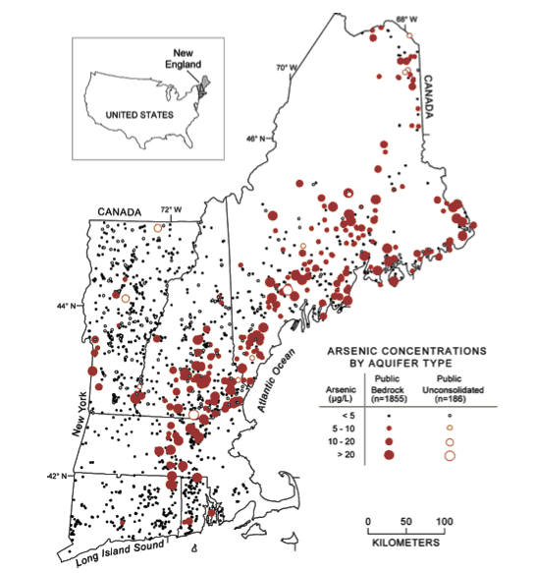
Arsenic near landfill leachate plumes
Poses two questions:
What are the main sources of arsenic in that particular region
How is it mobilized?
Landfill site
Arsenic occurrence in groundwater in New England (from Ayotte et al., 2003).

Slide 4
Objective
Compare the behaviors of δD and δ18O fractionation with groundwater composition to better understand the various geochemical processes that are involved in the mobilization of arsenic.

Slide 5
How will that be done?
Isotopic properties of GW
Arsenic Sources

Slide 6
How will that be done?
Geochemical processes and other groundwater properties
Isotopic properties of GW
Arsenic Sources
Indirectly Related

Slide 7
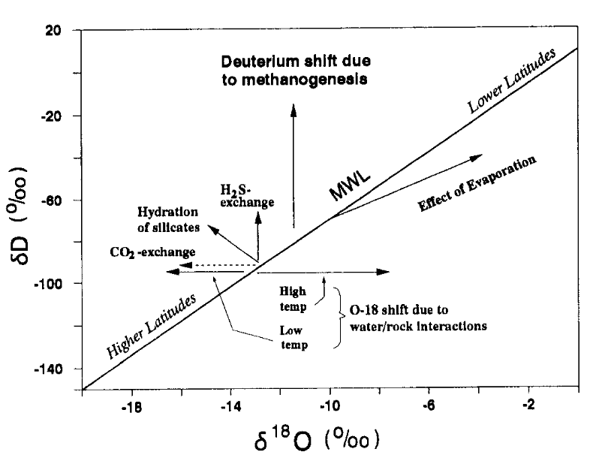
δ¹⁸O AND δD in Groundwater
(IAEA T.R.S. No. 228, 1983; Hackley et al., 1996)

Slide 8
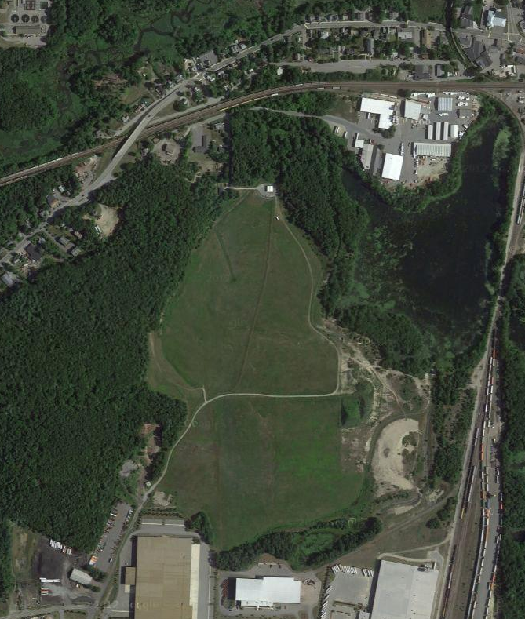
Shepley’s Hill Landfill (SHL)
Contoured and capped
Created on marshland
Hydrogeology
Part of Nashua River watershed
Consists Pleistocene glacial lake-bottom sediments
Google Maps,2012

Slide 9
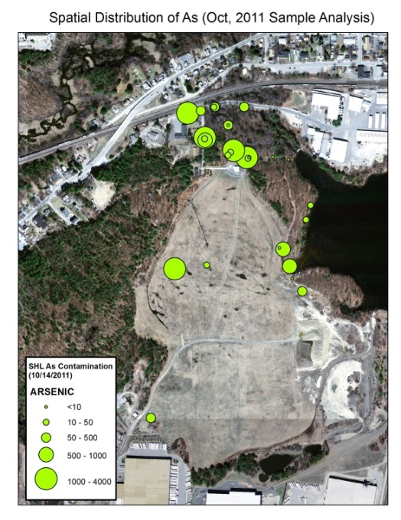
SHL Arsenic Contamination
Potential sources of As at SHL:
Waste deposits within the landfill
Peat layer below the landfill
Unconsolidated glacial lake sequences
Bedrock
(Xie, 2011)

Slide 10
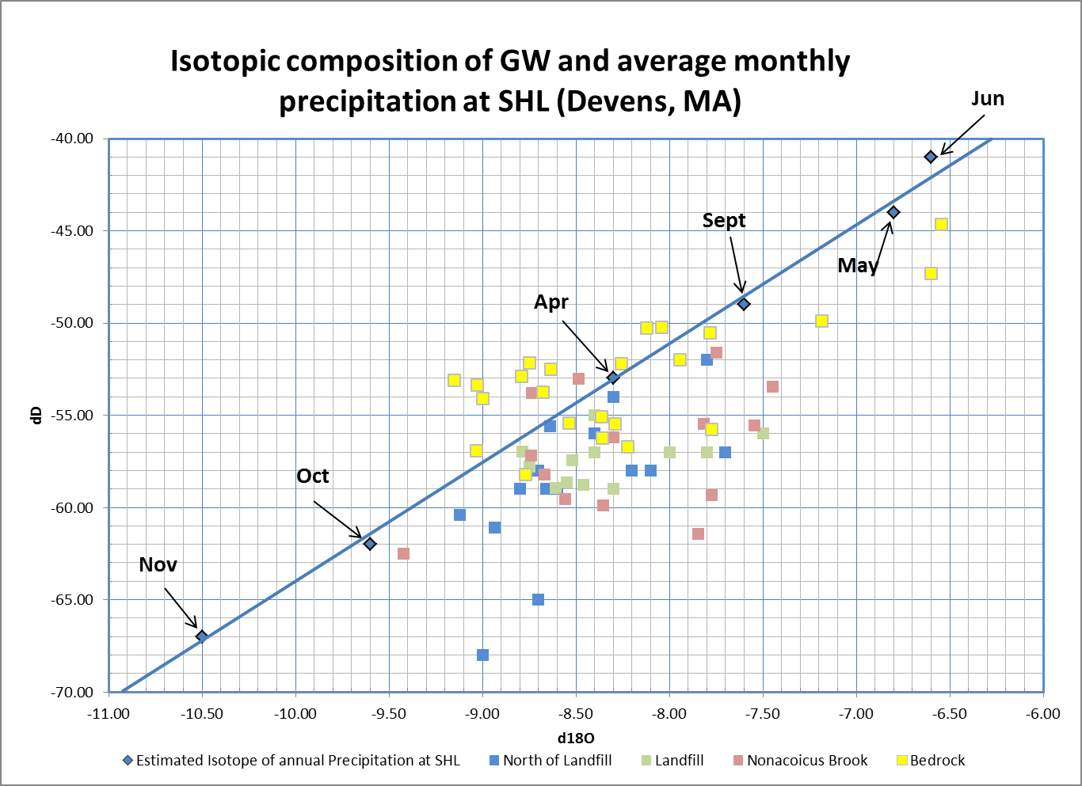
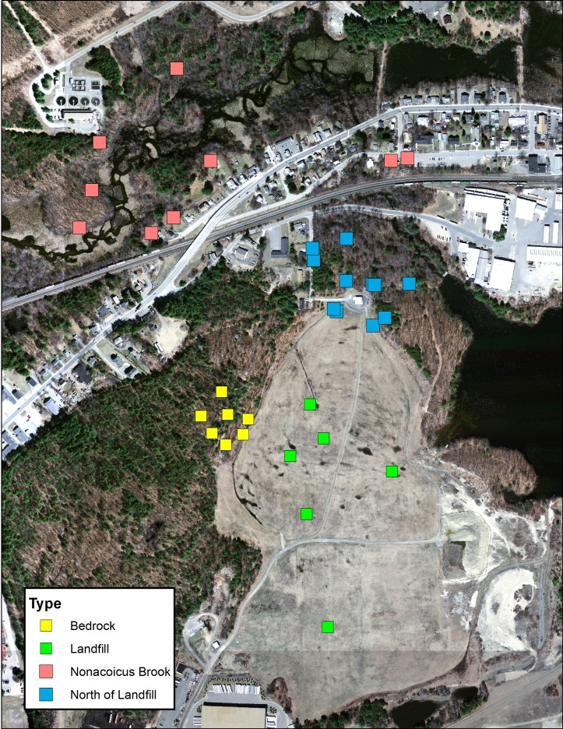
Preliminary Isotope Data

Slide 11
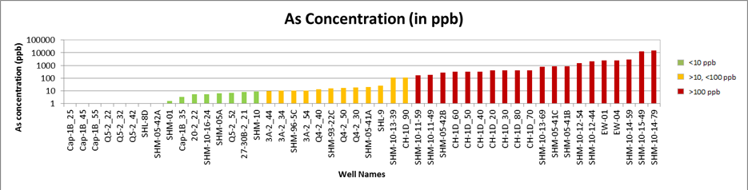
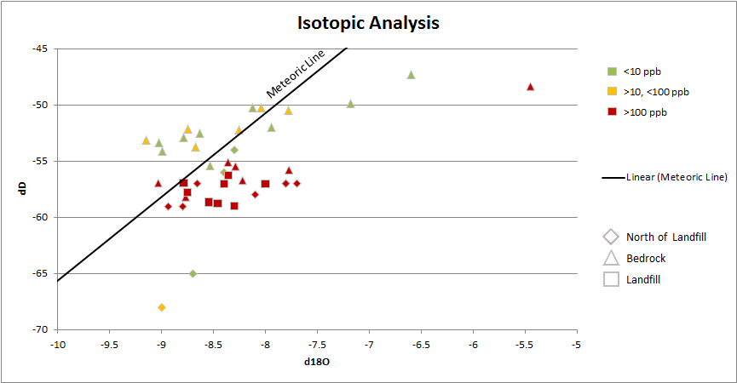
AS concentration vs. isotopic fractionation
(Log)
CH-1D @ 80ft

Slide 12

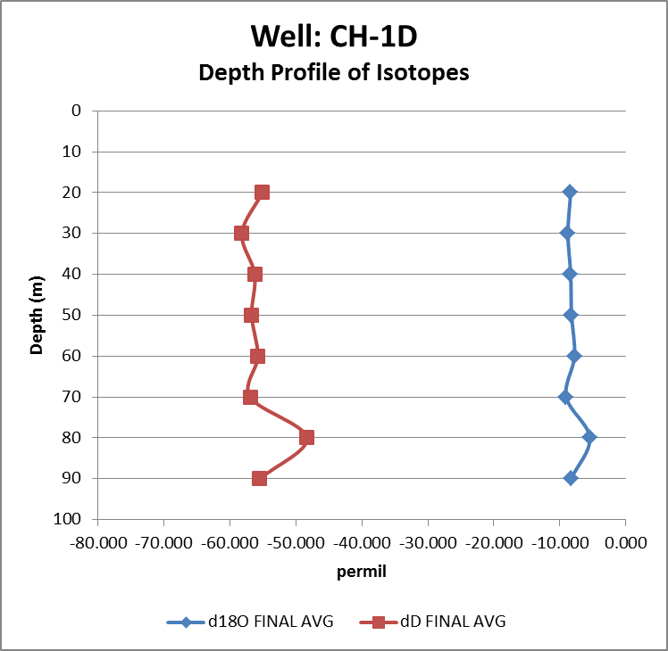
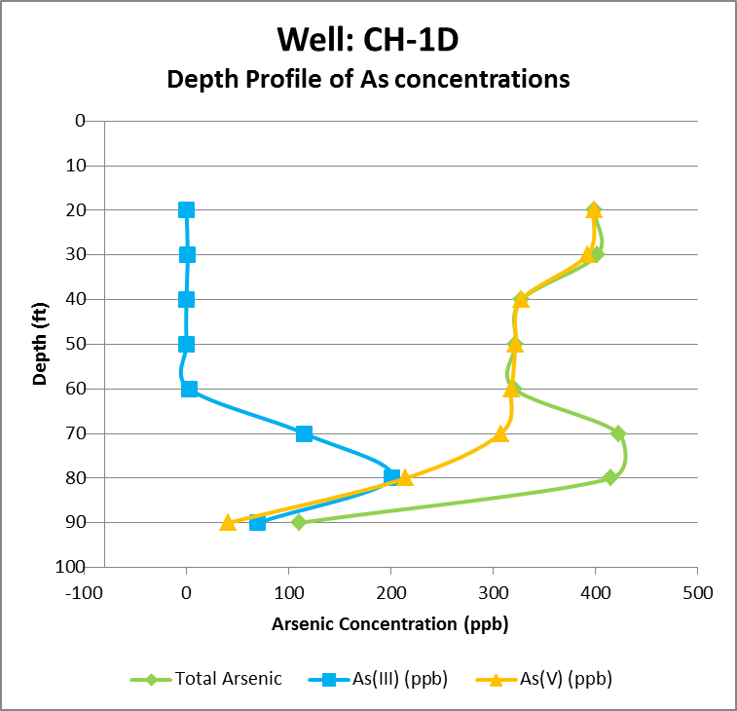
Well: CH-1D
(As concentration: Hildum, 2012)

Slide 13
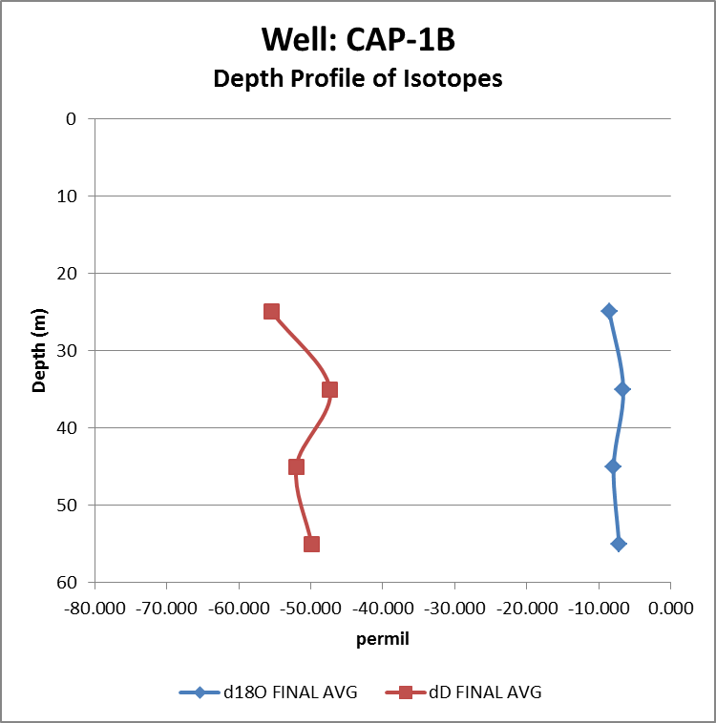
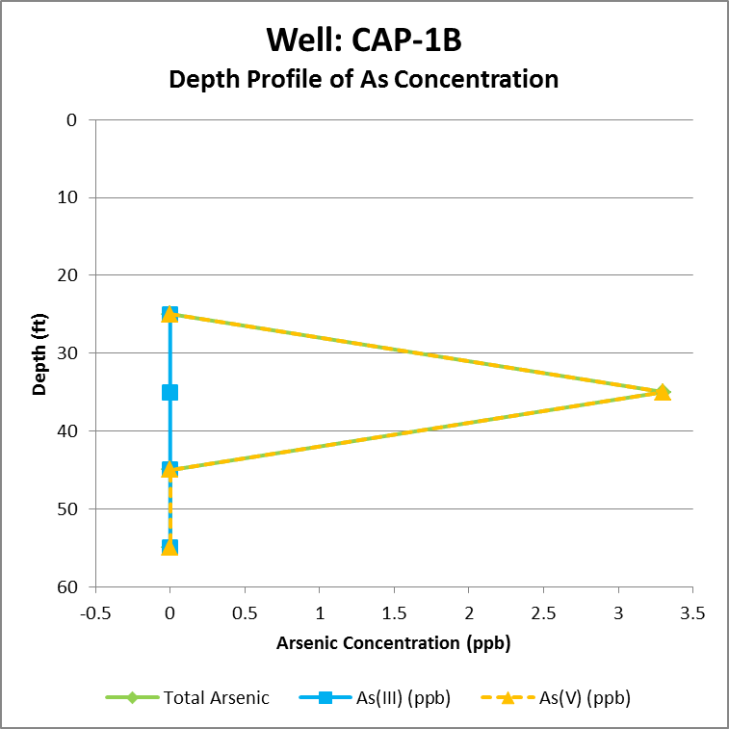
Well: cap-1b
(As concentration: Hildum, 2012)

Slide 14
Conclusion
SHL landfill contains multiple potential sources of As.
Isotopic data compared with groundwater composition data may show the dominant source of As.
This type of approach has not been previously explored.
This small scale research can be applied to bigger scale issues that are occurring around the world.

Slide 15
Acknowledgements
I’d like to thank:
My advisor: Professor Rudolph Hon
Others I’d like to thank:
Stable Isotopes Lab:
BU Stable Isotope Lab
Isotech Laboratories Inc.
UW Stable Isotope Facility
NAU Stable Isotope Laboratory
Wellesley College Chemistry Lab

Slide 16
References
Hackley K.C., Liu C.L., Coleman D.D. (1996) Environmental Isotope Characteristics of Landfill Leachates and Gases, Groundwater 34, 827-836.
Hendry M.J., Wassenaar L.I. (1999) Implications of the distribution of δD in pore waters for groundwater flow and the timing of geologic events in a thick aquitard system, Water Resources Research 35, No. 2, 1751-1760.
Hildum, Brendan (2012) Close association within the department, Earth & Environmental Science, Boston College.
International Atomic Energy Agency (1994) Environmental Isotope Data No. 1-10: World Survey of Isotope Concentration in Precipitation, IAEA. http://www.naweb.iaea.org/napc/ih/IHS_resources_gnip.html
Vuataz F.D., Goff F. (1986) Isotope Geochemistry of Thermal and Nonthermal Waters in the Valles Caldera, Jemez Mountains, Northern New Mexico, Journal of Geophysical Research 91, 1835-1853.

