Slide 1

Development of Glacial Event-Stratigraphy;
SE Quebec and N. New England
William W. Shilts, Ph.D.
Executive Director
Notes:
Final slide

Slide 2
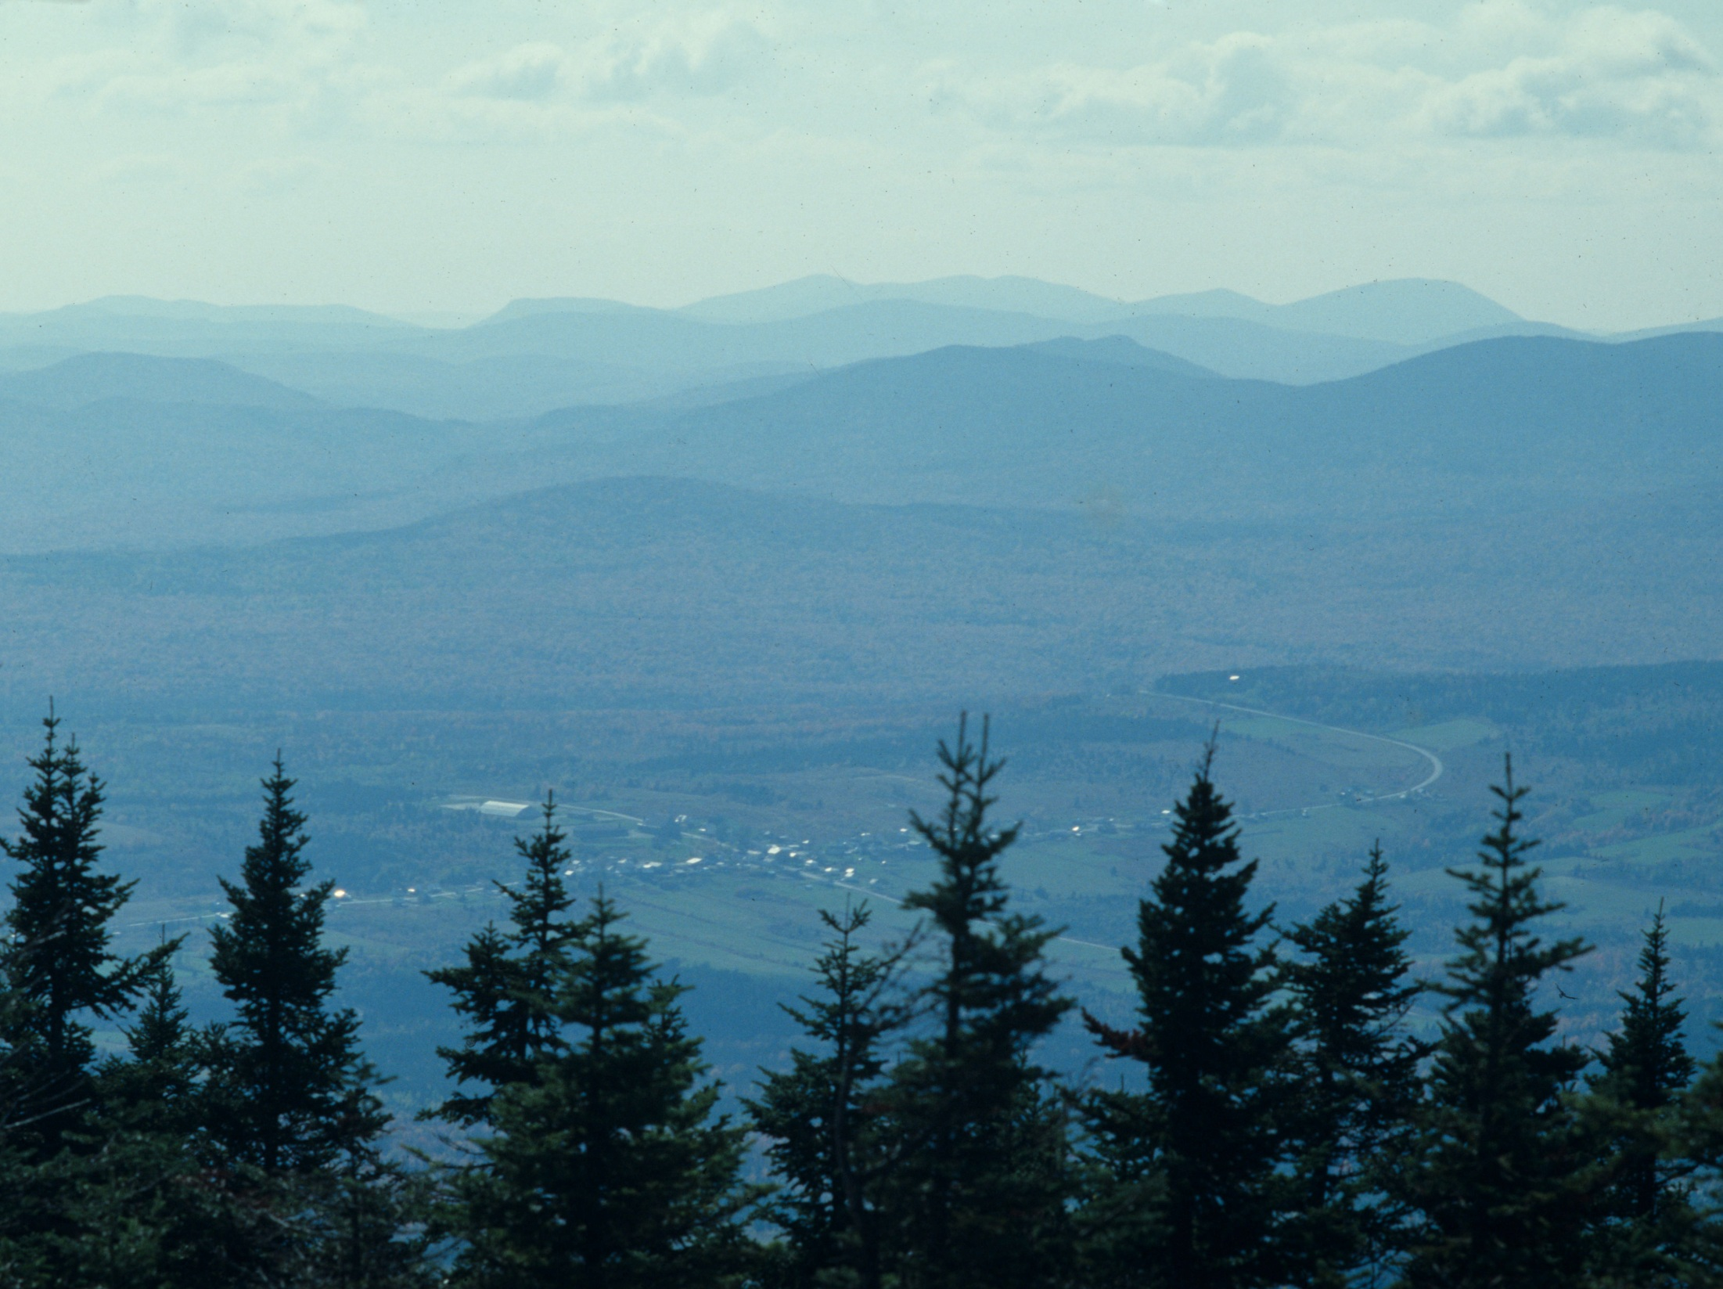

Slide 3
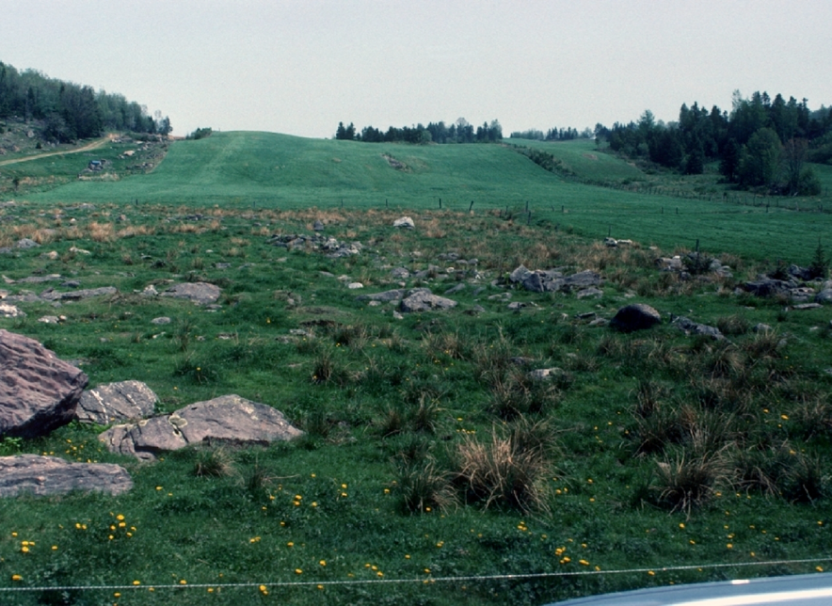

Slide 4
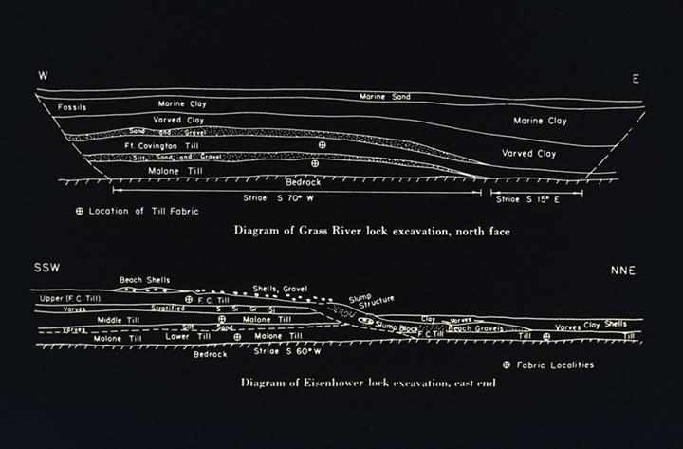

Slide 5
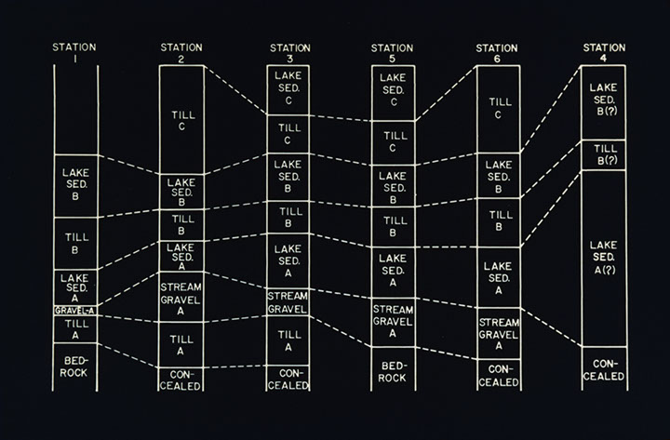

Slide 6
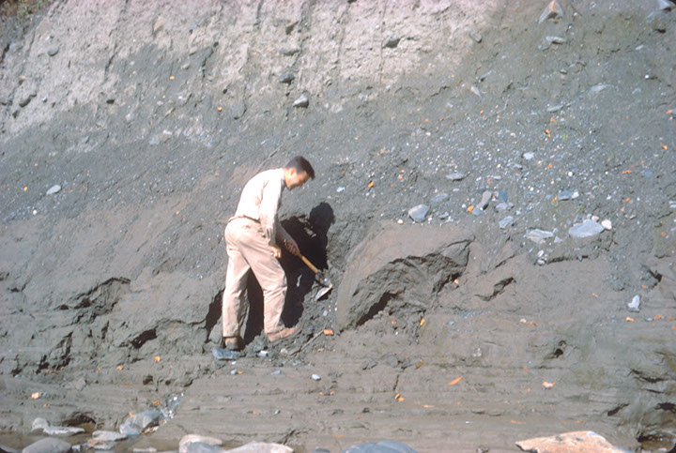

Slide 7
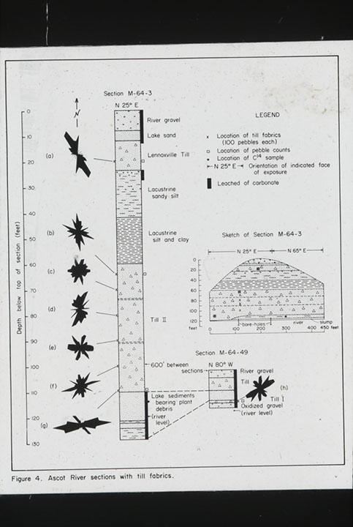

Slide 8
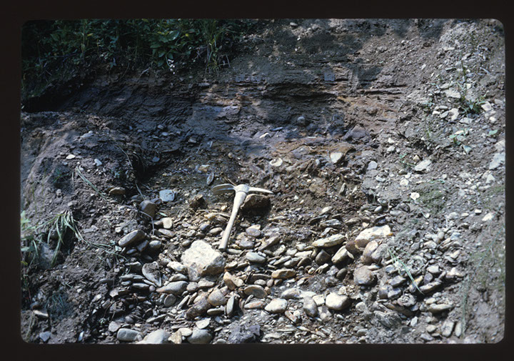

Slide 9
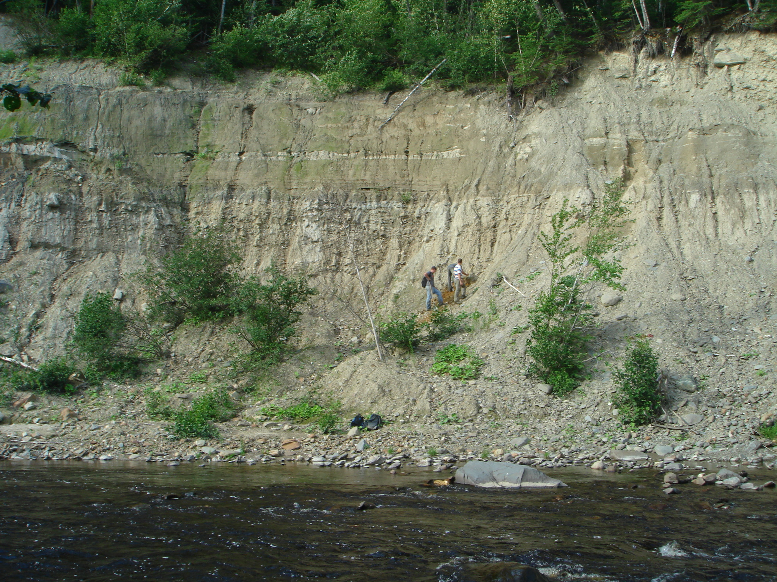

Slide 10
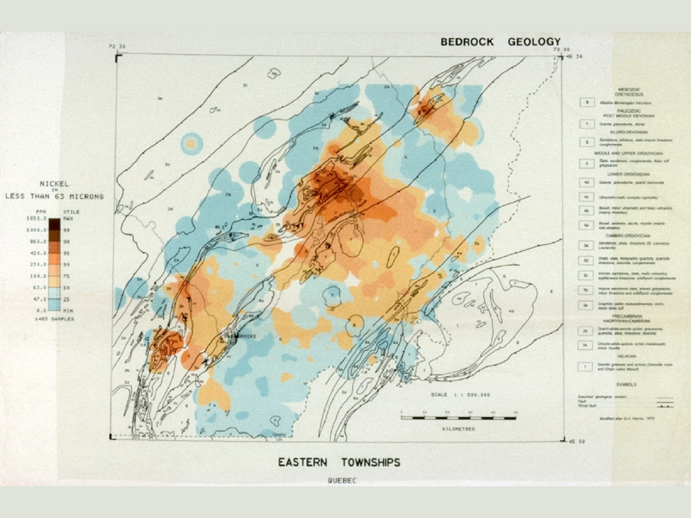

Slide 11
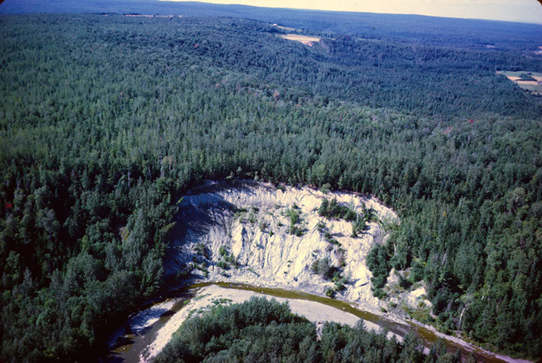

Slide 12
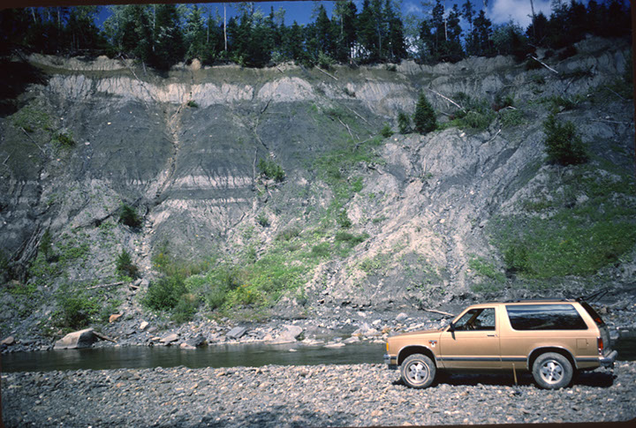

Slide 13
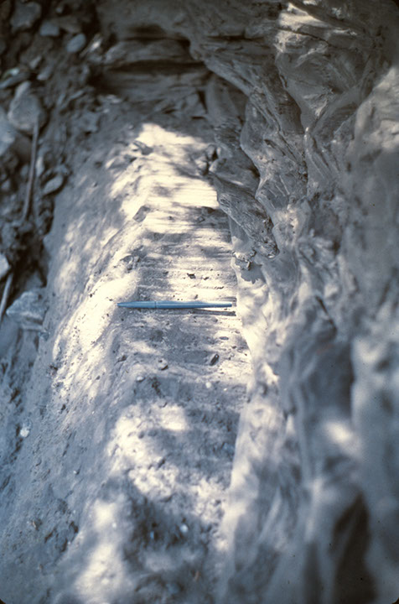

Slide 14
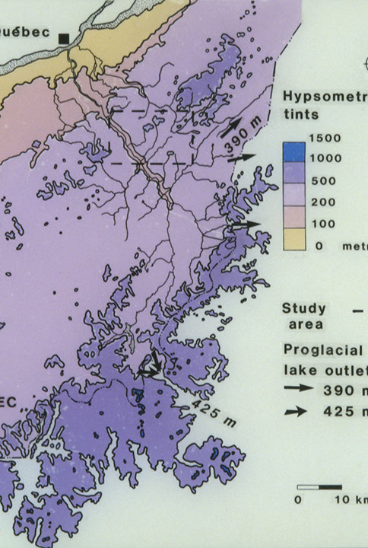

Slide 15
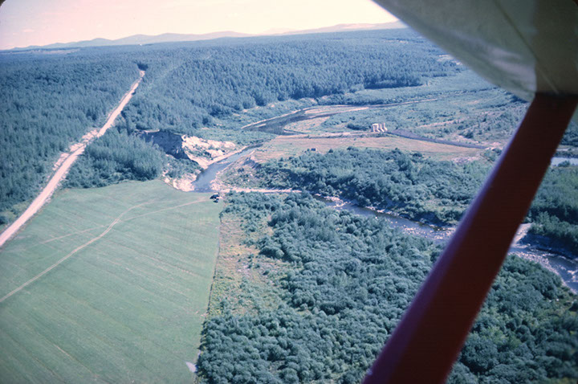

Slide 16
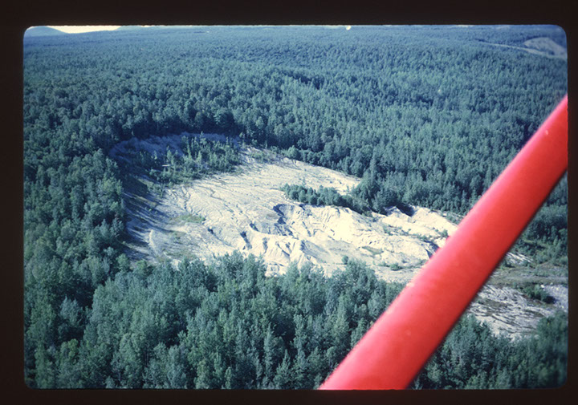

Slide 17
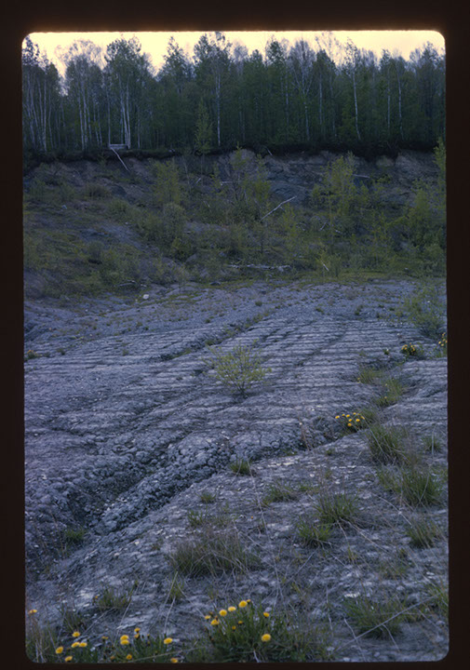

Slide 18
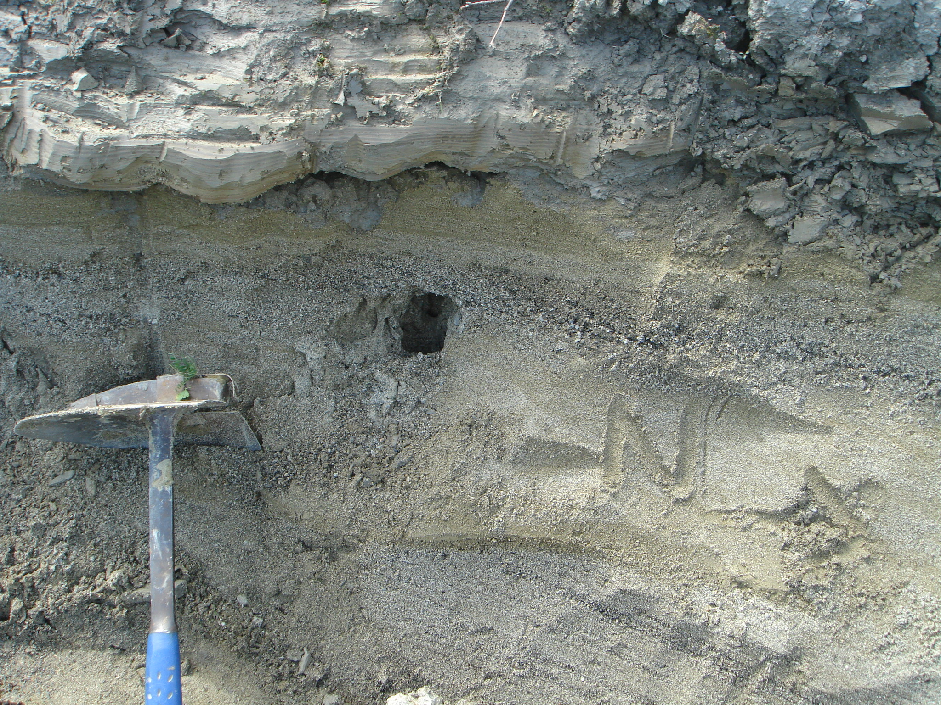
45 ± 5 ka

Slide 19
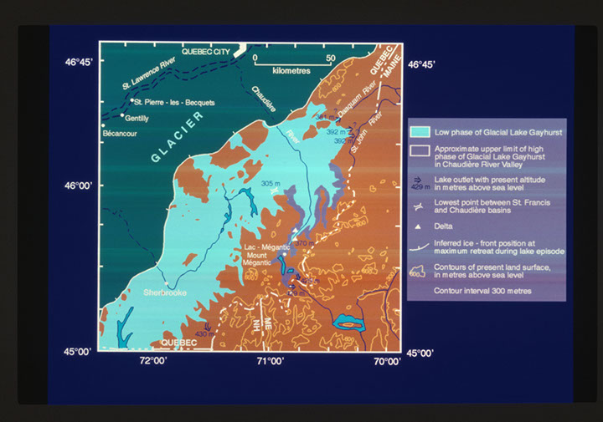

Slide 20
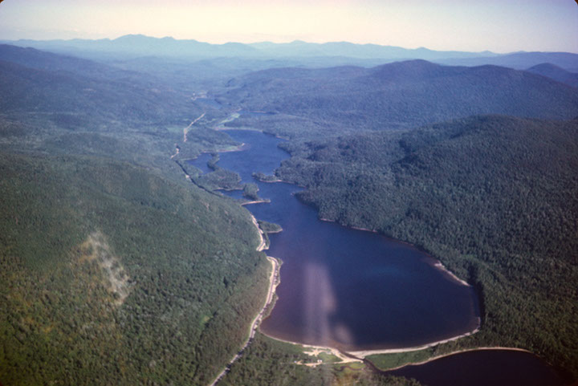

Slide 21
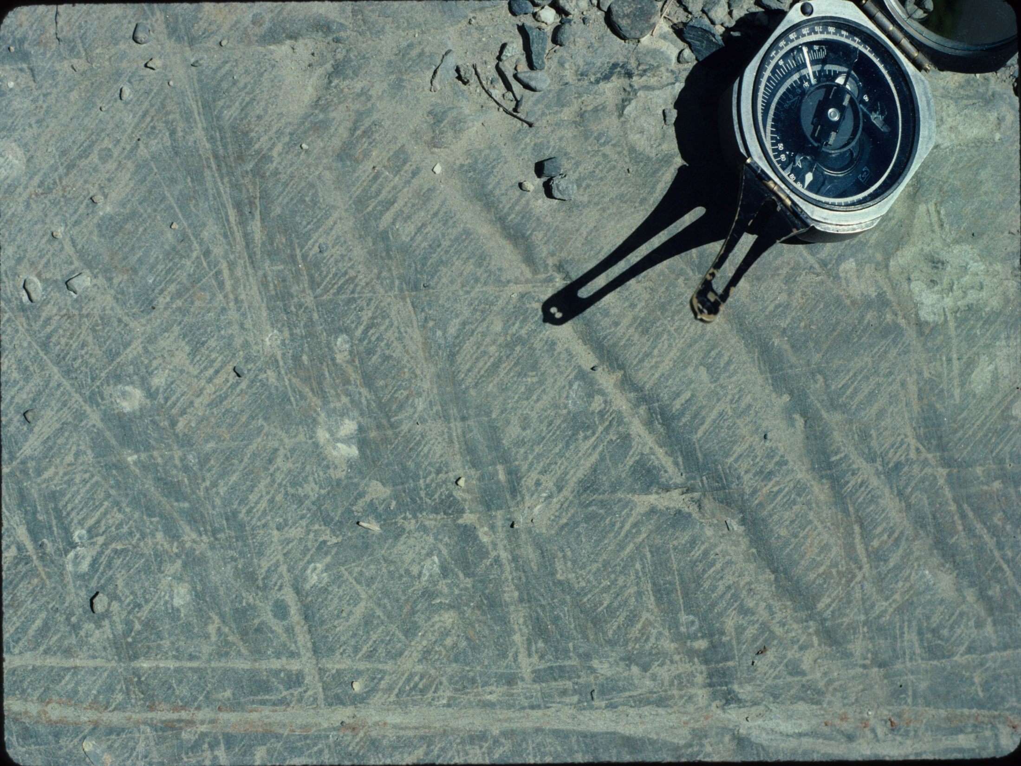

Slide 22
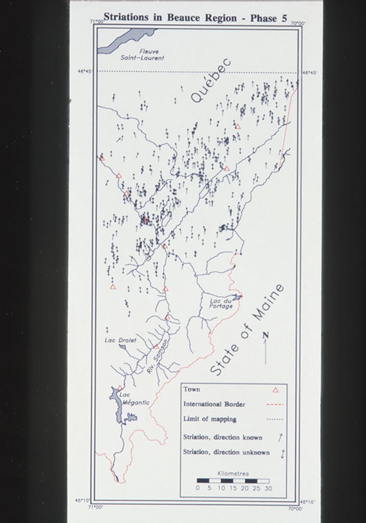

Slide 23
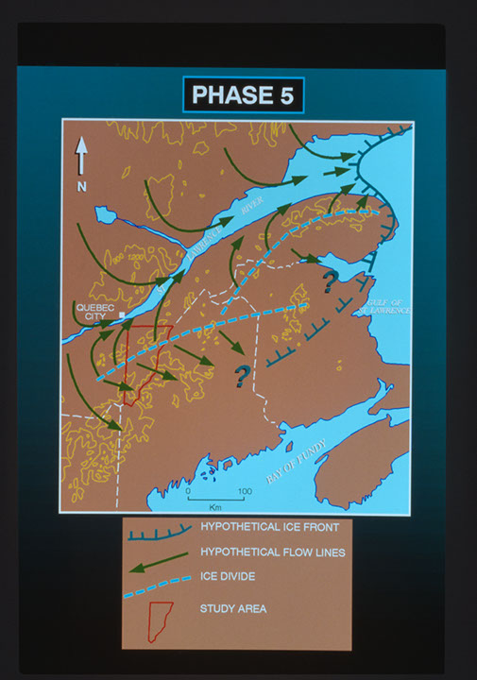

Slide 24
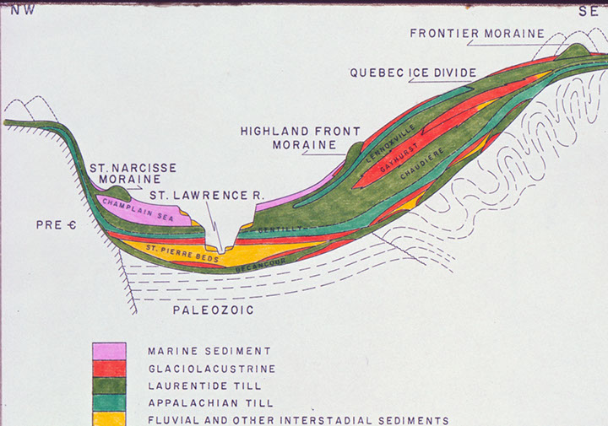

Slide 25
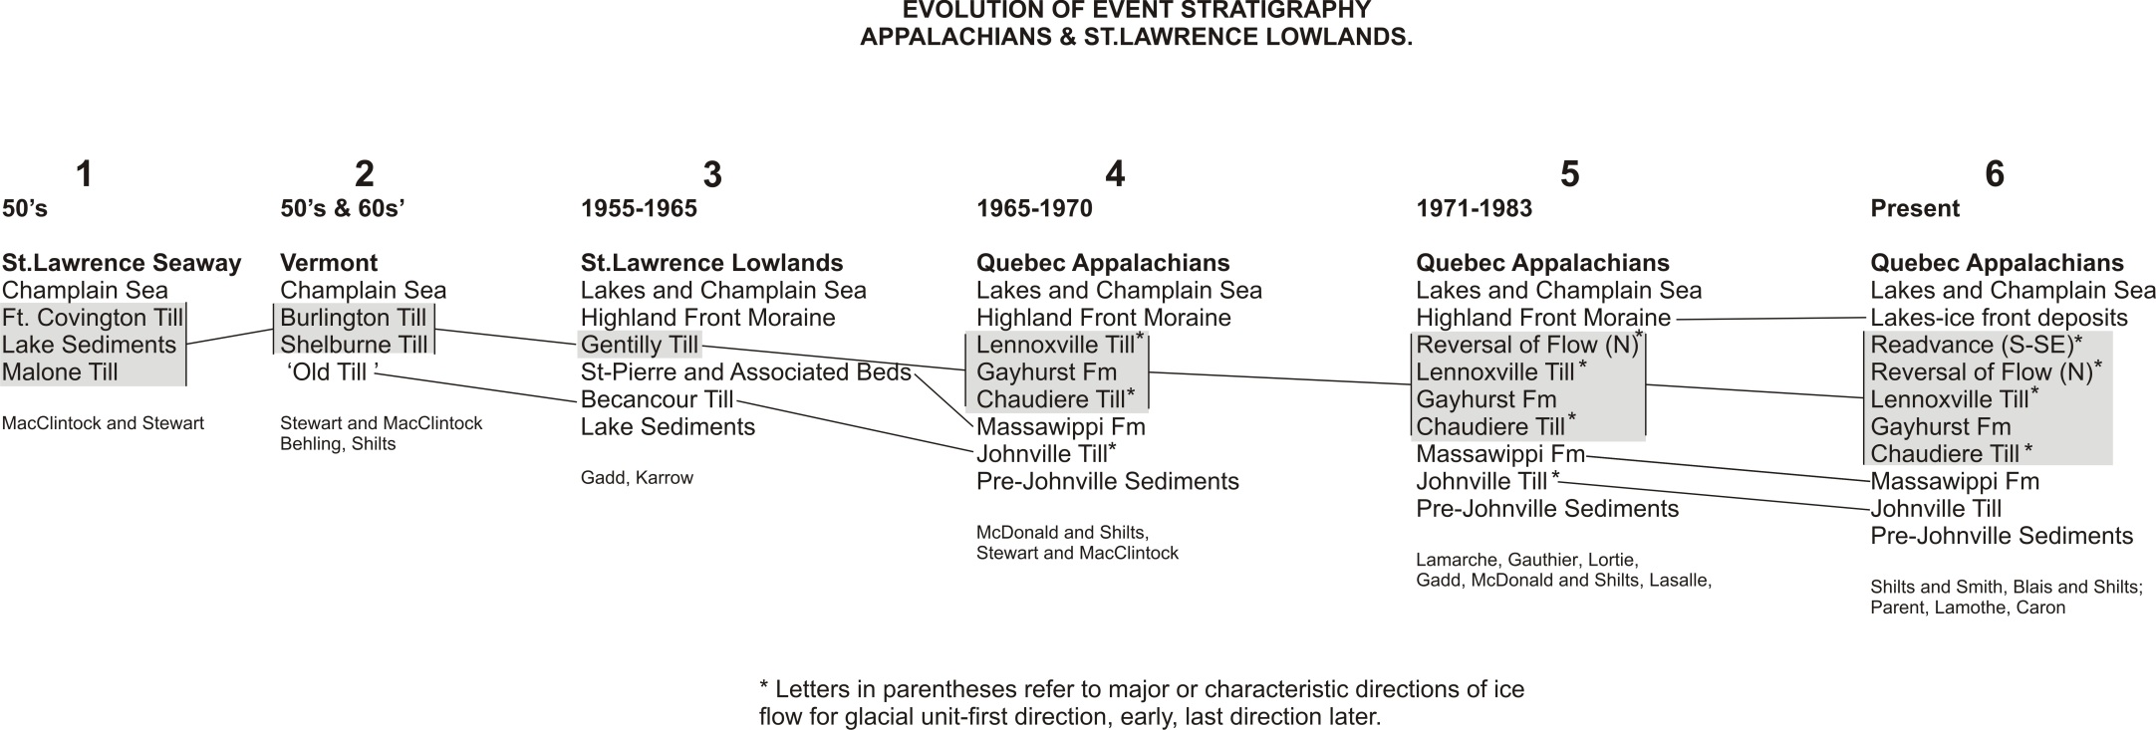

Slide 26
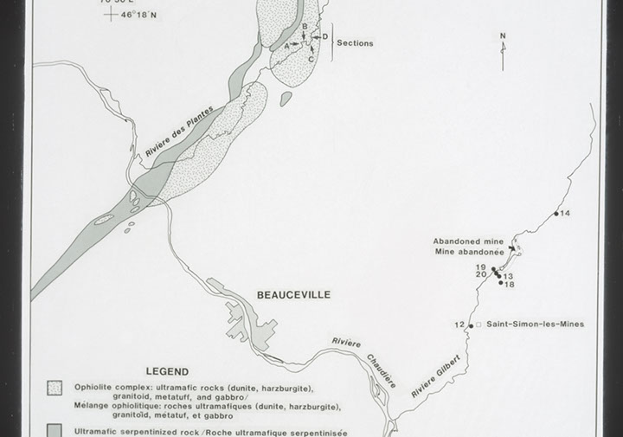

Slide 27
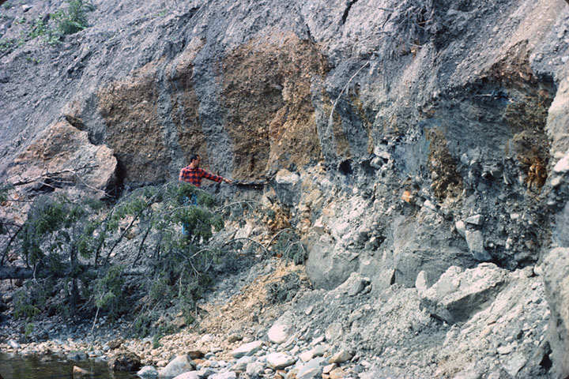

Slide 28
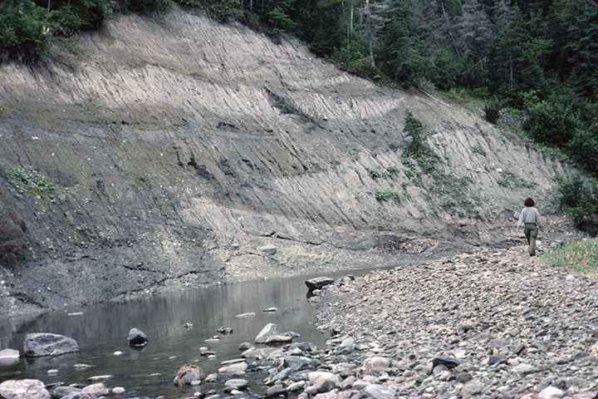

Slide 29
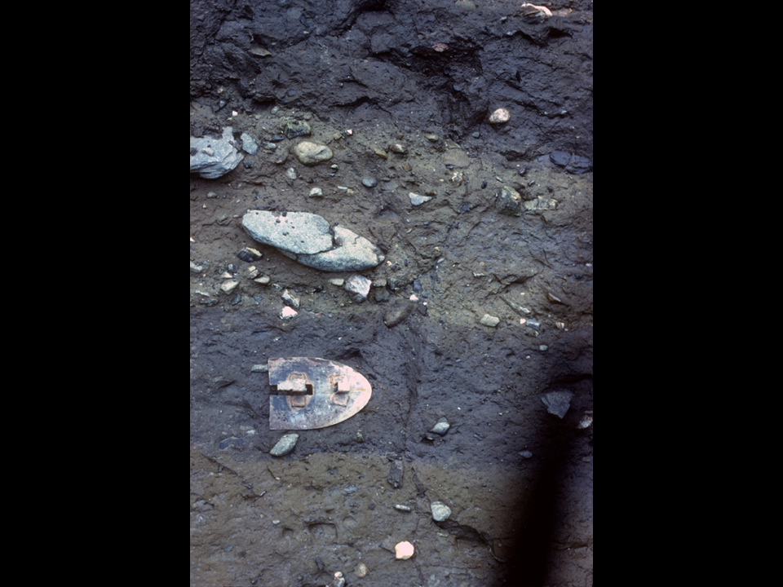
1250 ppm Ni
110 ppm Ni

Slide 30
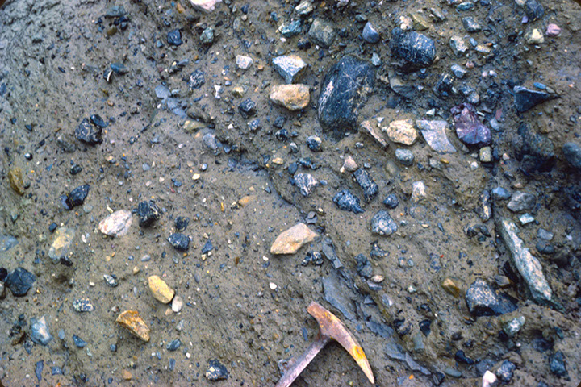

Slide 31
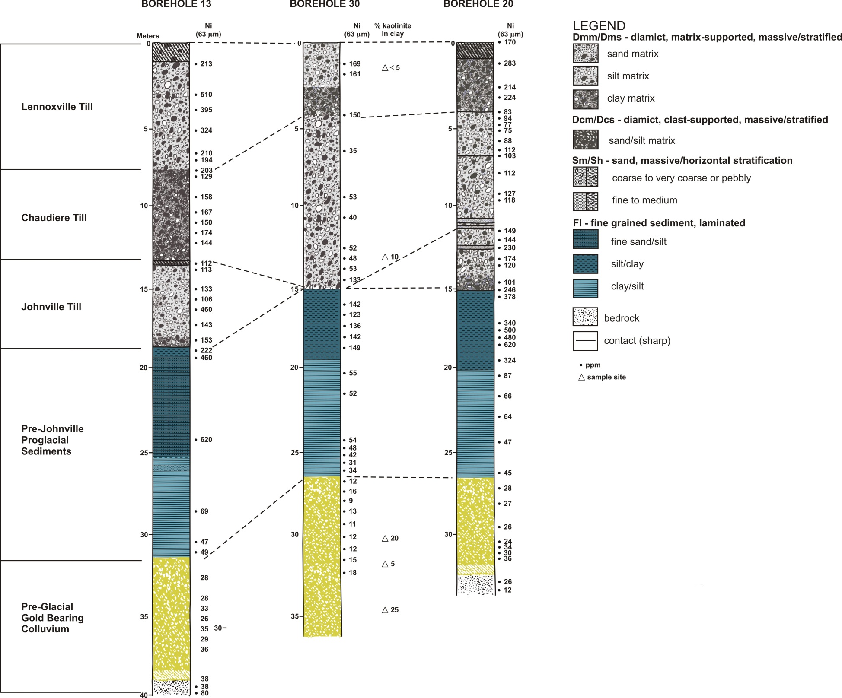

Slide 32
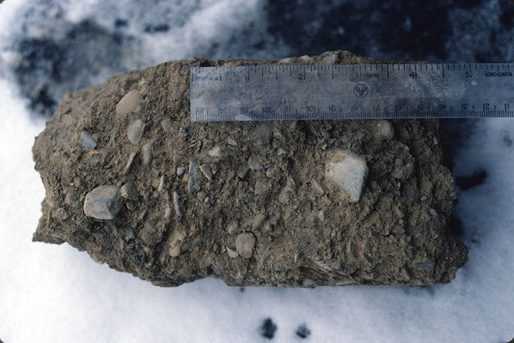

Slide 33
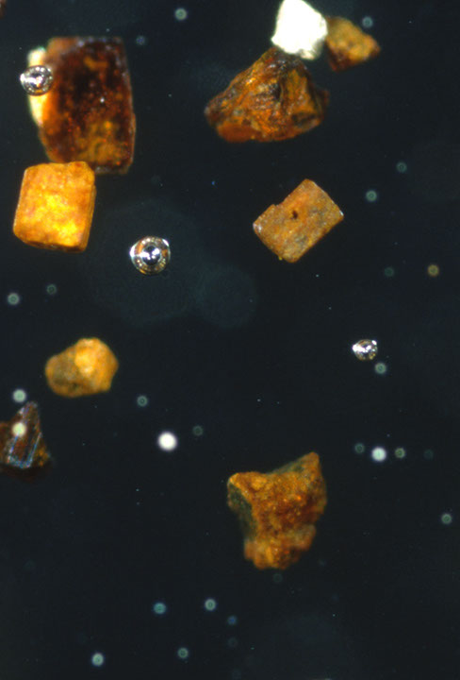

Slide 34
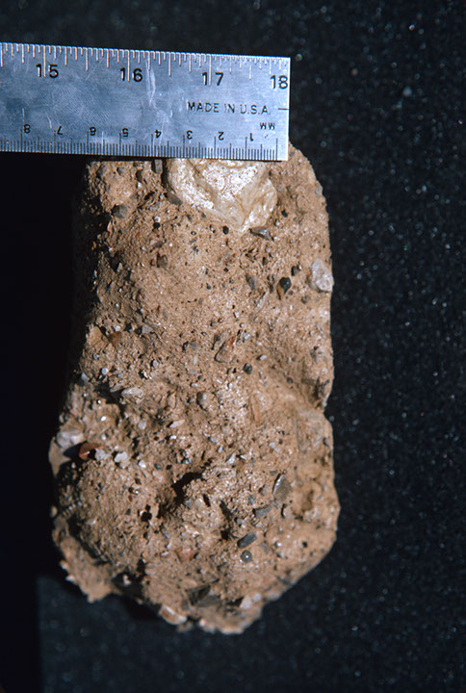

Slide 35
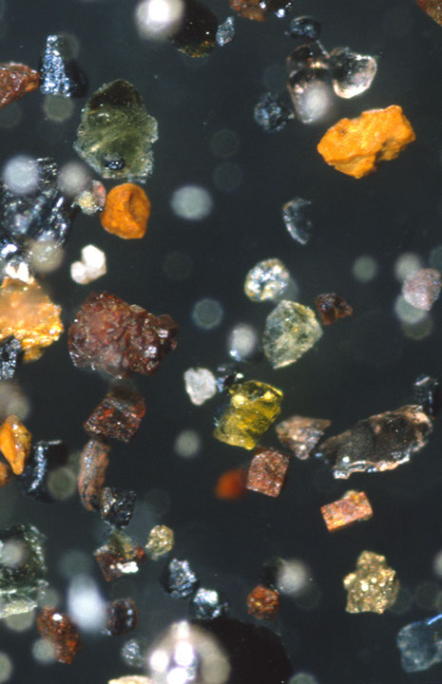

Slide 36
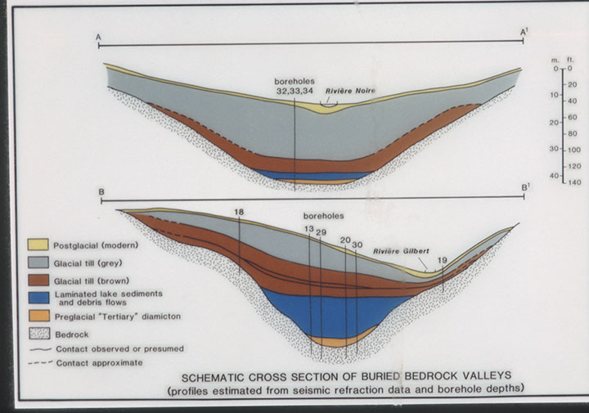

Slide 37
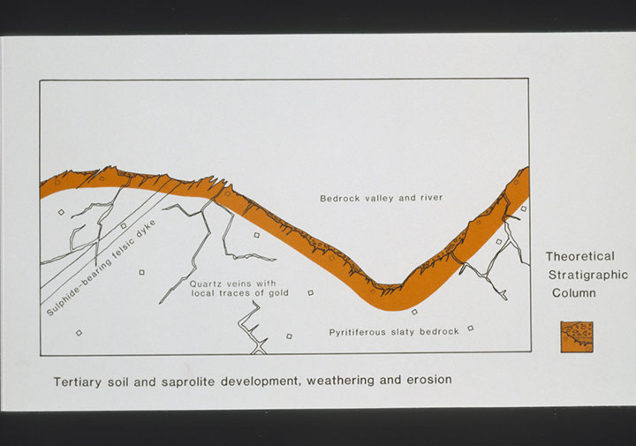

Slide 38
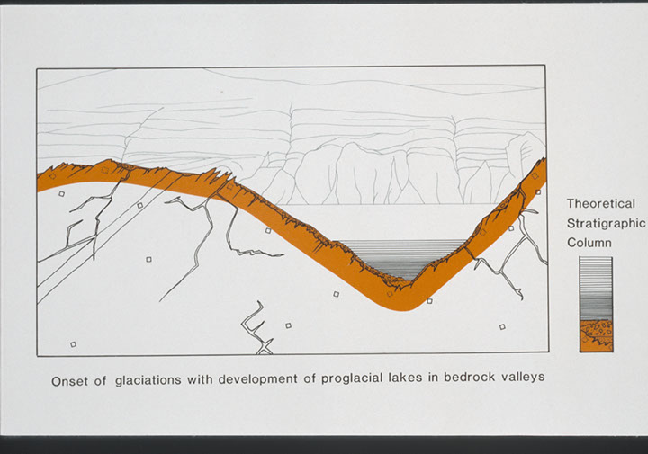

Slide 39
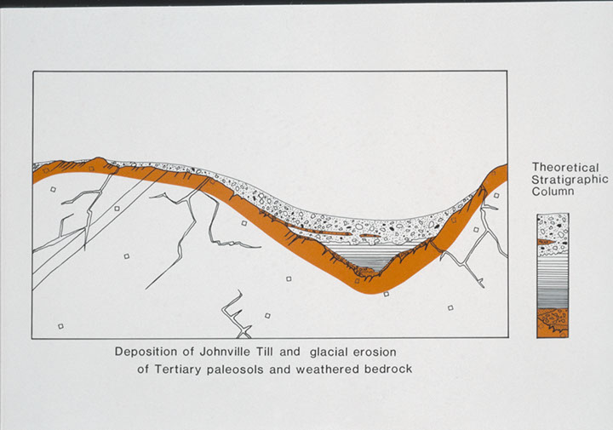

Slide 40
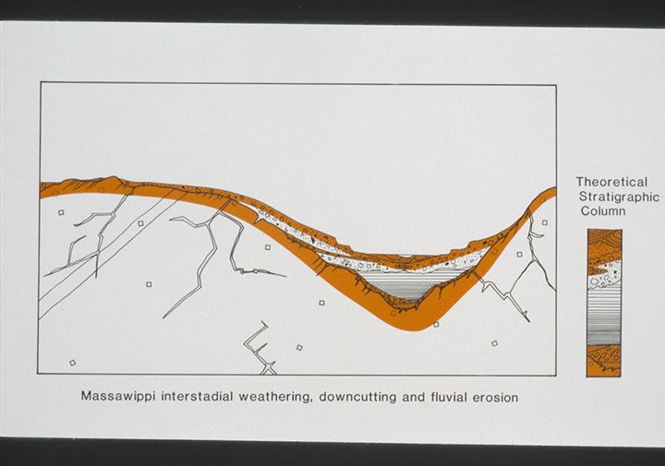

Slide 41
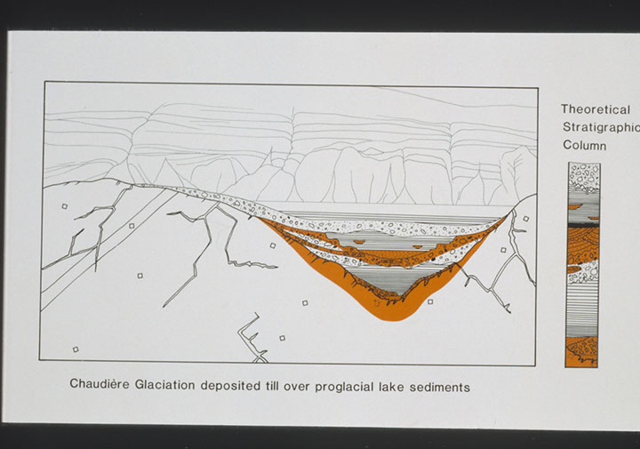

Slide 42
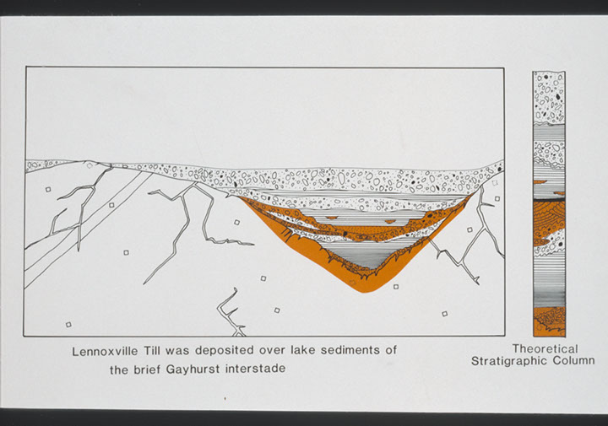

Slide 43
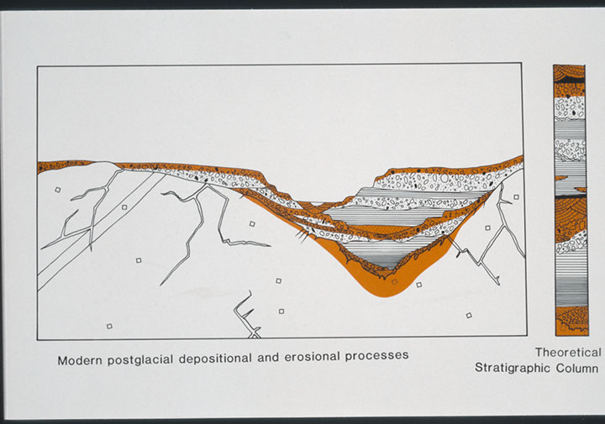

Slide 44
UNRESOLVED
Why are there no known pre-Illinoian deposits in Quebec/New England (compared to Midwest)?
Why no evidence of weathering or Lake Gayhurst draining between Chaudiere and Lennoxville glaciations?
How do multiple till sections in Southern Vermont relate to these in Northern Vermont and Quebec?

Slide 45
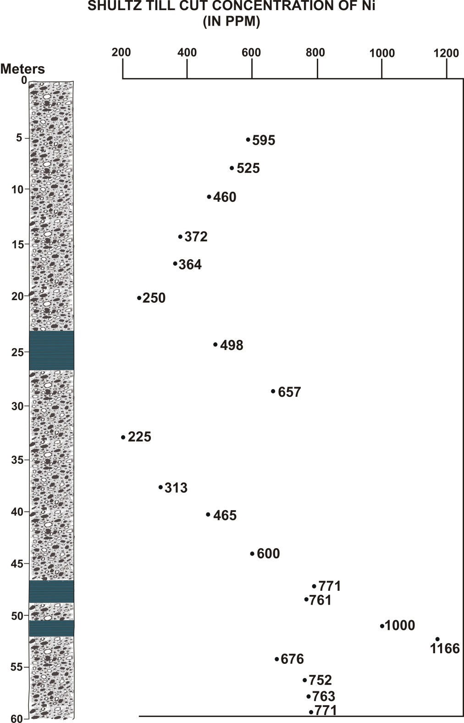

Slide 46
UNRESOLVED
Why are there no known pre-Illinoian deposits in Quebec/New England (compared to Midwest)?
Why no evidence of weathering or Lake Gayhurst draining between Chaudiere and Lennoxville glaciations?
How do multiple till sections in Southern Vermont relate to these in Northern Vermont and Quebec?

Slide 47
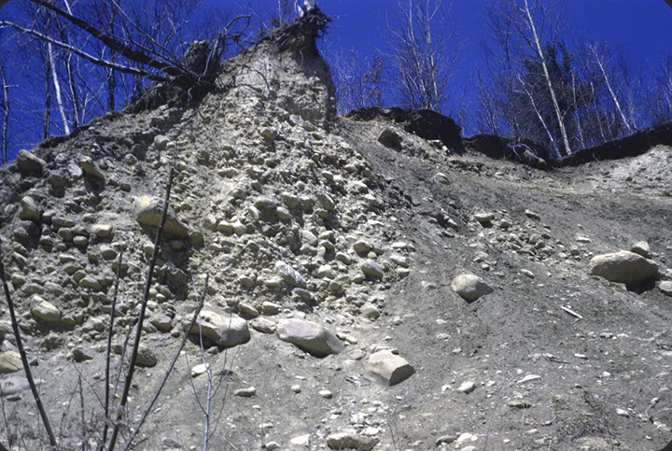

Slide 48
Thank You
William W. Shilts
shilts@illinois.edu
217 333-5111
Notes:
Final slide

