Slide 1





Hydrogeochemical control of arsenic, uranium, and radon in domestic wells from bedrock aquifers in central Maine, USA
GSA NE Section 48th Annual Meeting
March 18th, 2013
Qiang Yang
Charles W. Culbertson
Robert G. Marvinney
Paul E. Smitherman
Charles T. Hess
Yan Zheng

Slide 2
Outline
Introduction: study area, research questions and sampling
Arsenic in fractured bedrock aquifers
Uranium and radon in fractured bedrock aquifers
Summary

Slide 3
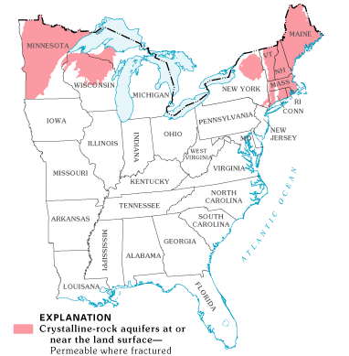
Introduction - study area
crystalline bedrock aquifers
important water supply aquifers, especially for rural population;
groundwater storage and transport mostly in fractures;
high heterogeneity of groundwater flow and solute transport.
(from USGS)

Slide 4
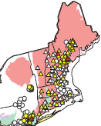
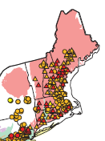
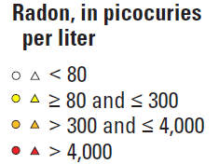
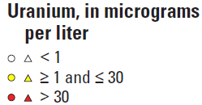
Introduction - research questions
(Wathen, 1987; Hall et al., 1987)
(Hess, et al., 1974-85)
(Lanctot, et al., 1985)
(Brutsaert et al., 1981)
(Colman, 2011)
(4%)
(30%)
(Ayotte, 2011)
(Ayotte, 2011)

Slide 5
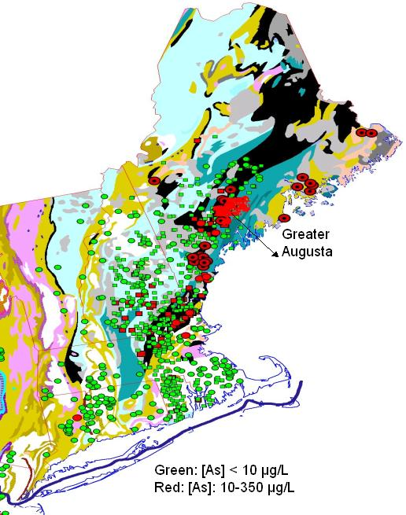
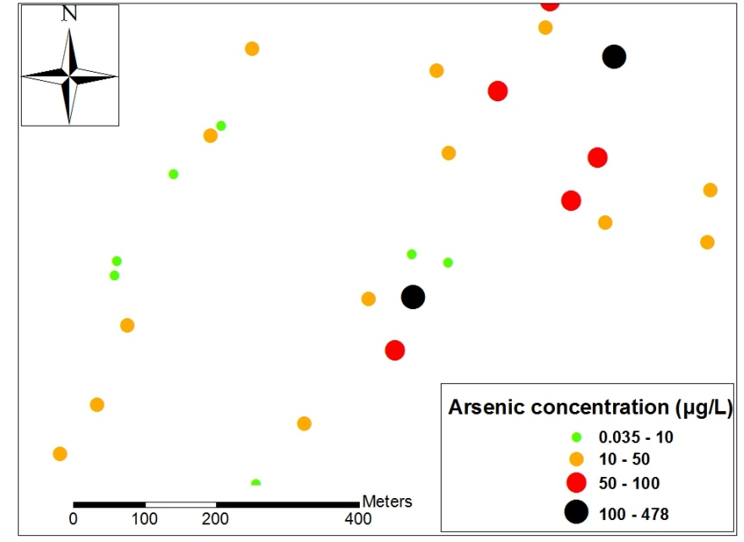
Introduction - research questions
Elevated groundwater [As] is related with Silurian meta-sedimentary rock units (black) on regional scale of 10²-10³ km.
(Ryan et al, 2011)
(Nielsen et al, 2010)
(Lipfert et al, 2006-07)
(Sidle et al, 2001-03)
(Marvinney et al, 1994)
(Peters et al, 99-06)
(Montgomery et al, 03)
(Colman, 2011)
(Pagach et al, 2009)
(re-drawn based on Ayotte et al., 1999-2006)

Slide 6
Introduction - research questions
Distribution patterns at local scales of 10⁰-10¹ km;
Source, controlling parameters, and mobilization mechanisms;
Hydrogeology and geochemistry influence in individual wells.

Slide 7
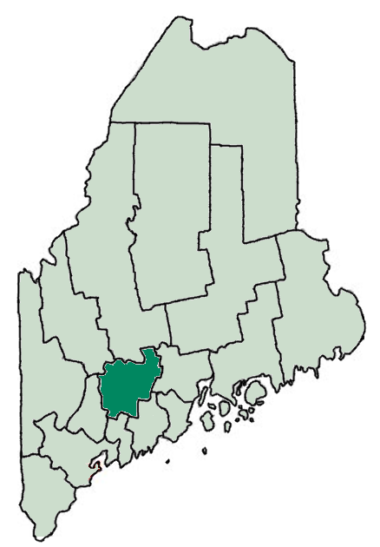
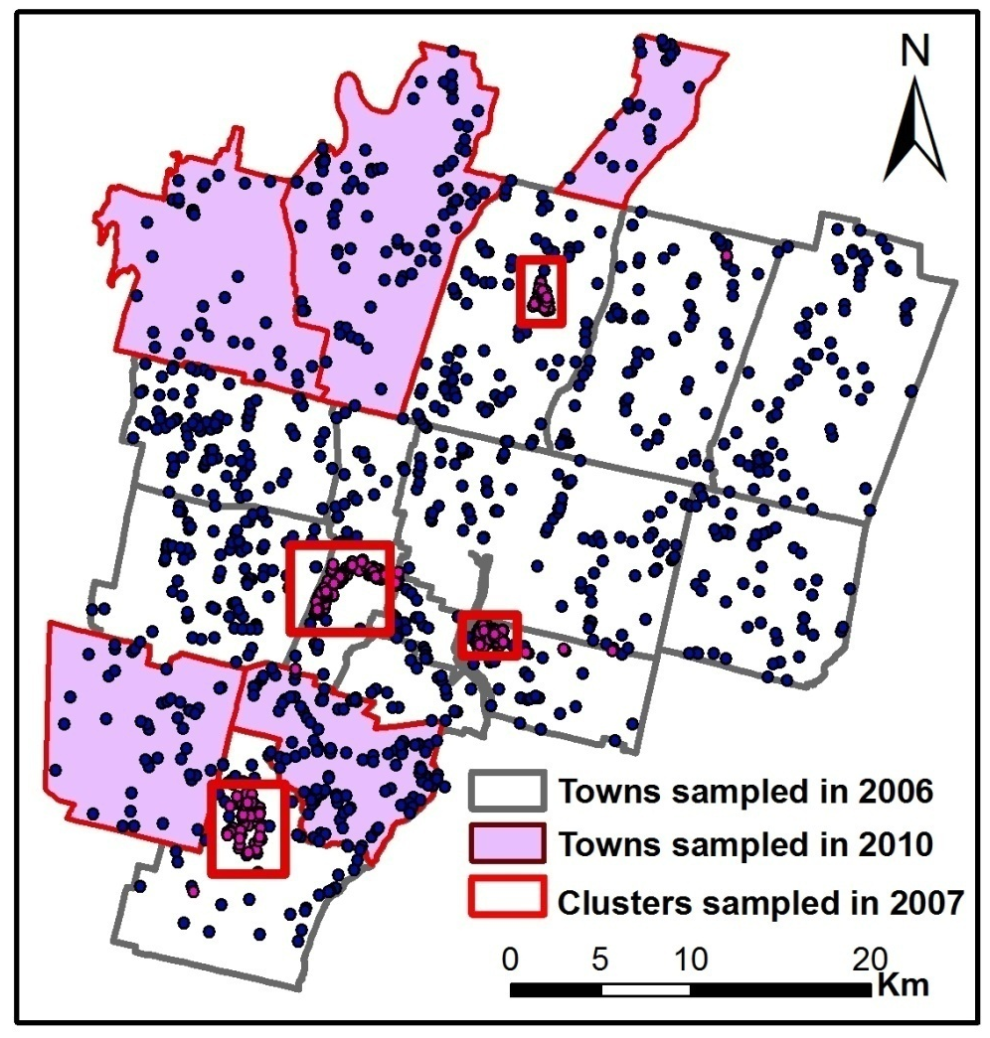
Introduction - sampling
Towns sampled = 17;
Area = 1,500 km²;
Number of samples = 790 + 331 + 307
Sampling density: ~1/km² (5-40/km²)

Slide 8
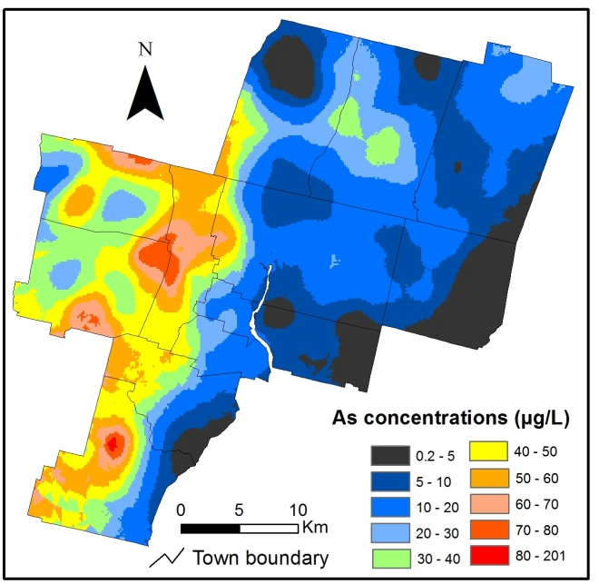
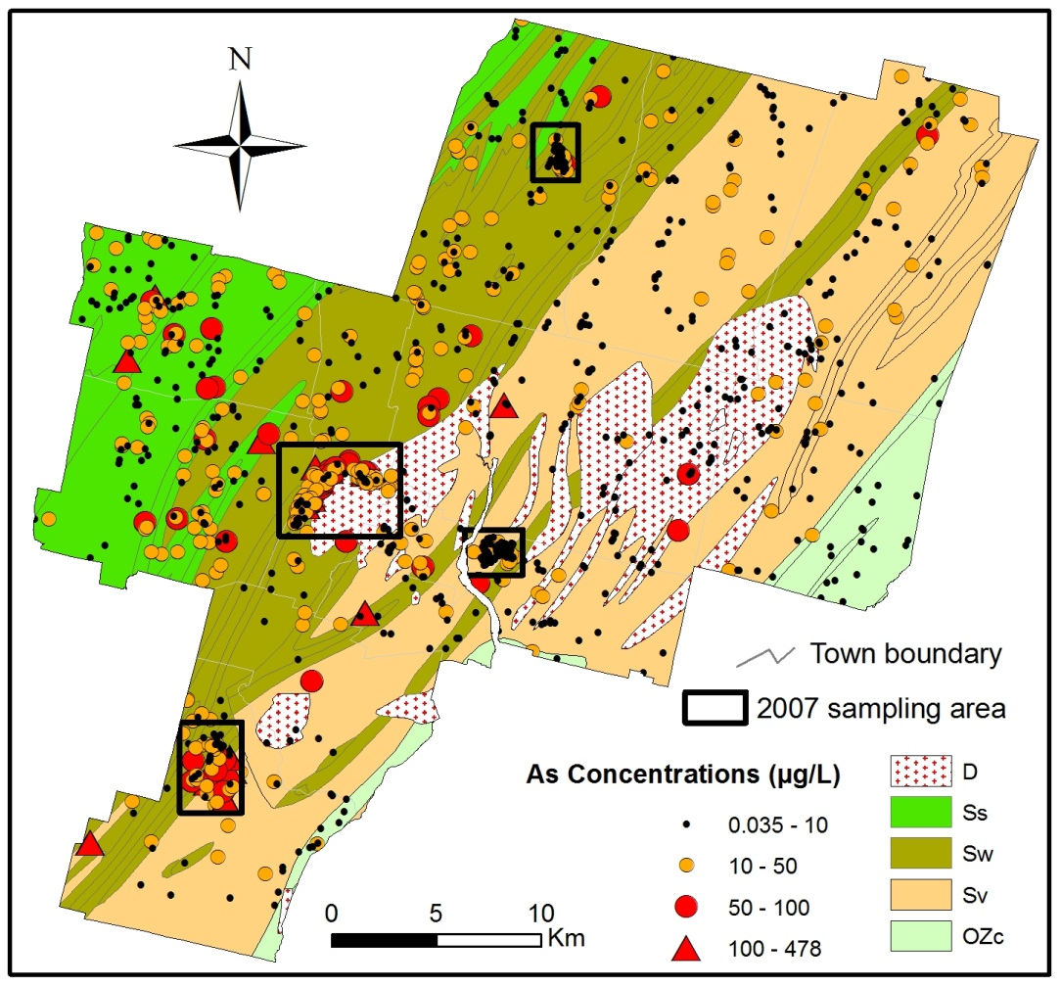
Groundwater Arsenic - distribution
Maximum = 325 µg/L, log-normal distribution
Mean = 12.2 µg/L, Median = 3.8 µg/L
Exceedance rate = 31% (>10 µg/L)
Silurian interbedded pelite and limestone/dolostone (Ss, Sangerville Formation)
Silurian interbedded pelite and sandstone (Sw, Waterville Formation)
Silurian-Ordovician calcareous sandstone with interbedded sandstone and impure limestone (SOv, Vassalboro Formation)
Devonian plutons of granite, granodiorite, quartz monzonite and syenite (D)
Ordovician-Cambrian mafic to felsic volcanic rocks (OZc, Cushing Formation)

Slide 9
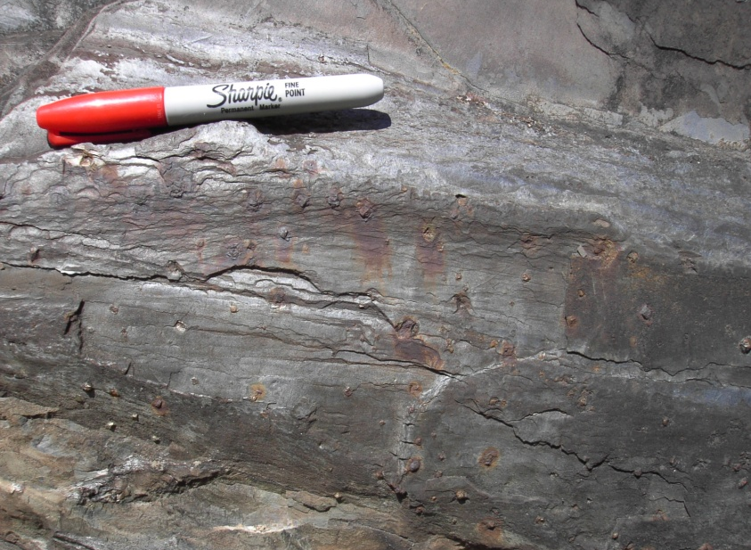
Groundwater Arsenic
– source, controlling parameters
Geogenic source
Low nitrate, no correlation with land use;
sulfide mineral, such as pyrite;
Correlation with Mo, S;
parameter | Spearman’s ρ
pH | 0.54
DO | -0.35
Cl⁻ | -0.23
NO₃⁻ | -0.31
(T7, 3-4: O’Shea et al., Arsenic in bedrock units)

Slide 10

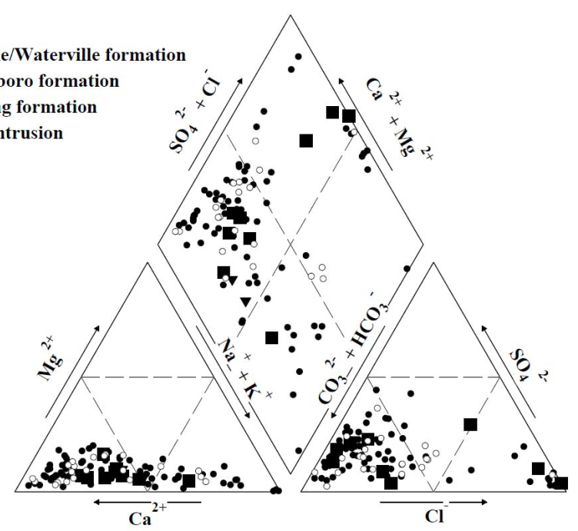
Groundwater Arsenic
– mobilization mechanisms
Domestic well
Sand and gravel glacial overburden
Oxidizing
CaCO₃ + H₂O = Ca²⁺ + HCO₃⁻ + OH⁻
Reducing
FeO(OH)_{x}-As = Fe²⁺ + OH⁻ + As
Fractured bedrock

Slide 11
Groundwater Arsenic
– individual wells
Dissolved [As] – µg/L
103
155
109
262
217
Well MA70190

Slide 12
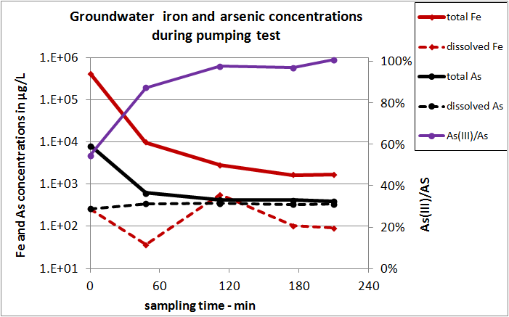
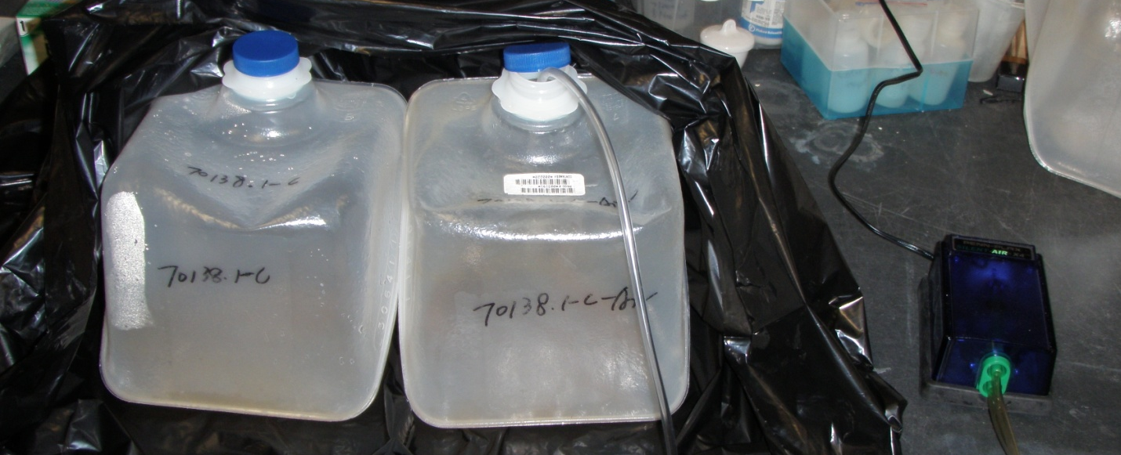
Groundwater Arsenic
– individual wells
Well MA70190
26.5 ft
65 ft
Grundfos pump
@ 95 ft
99 ft

Slide 13
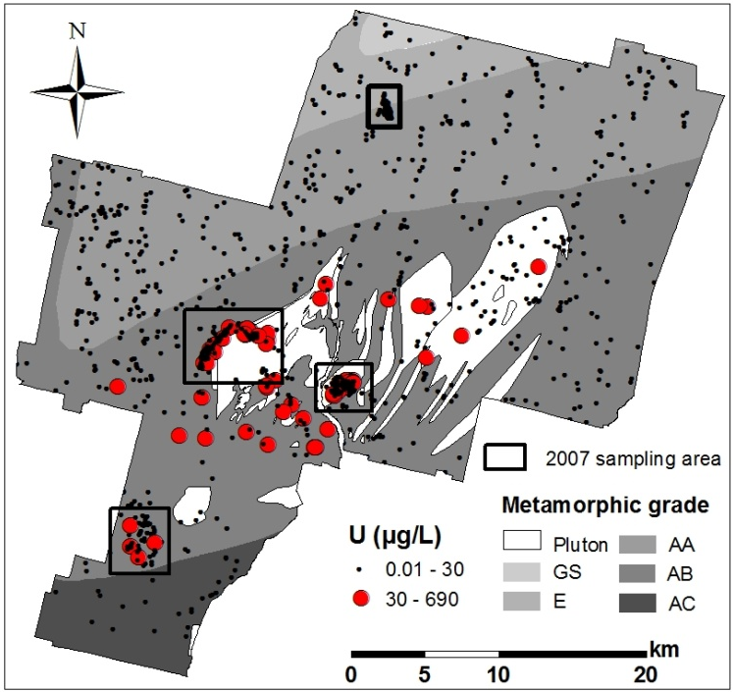
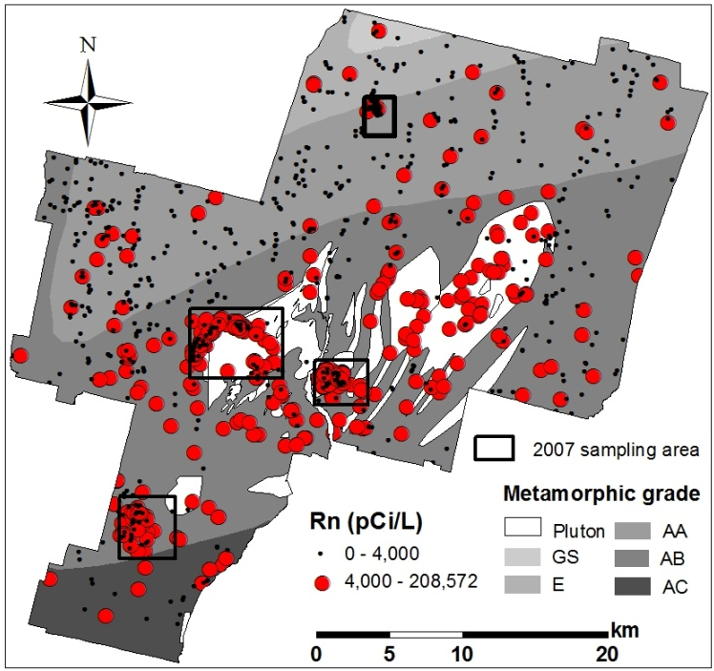
Groundwater U & Rn - distribution
Metamorphism grade:
GS – greenschist,
E - epidote rank amphibolite,
AA - low rank amphibolite,
AB - medium rank amphibolite,
AC - high rank amphibolite
Maximum = 484 µg/L
Log-normal distribution
Mean = 7.2 µg/L
Median = 1.1 µg/L
Exceedance rate = 3.8% (>30 µg/L)
Maximum = 208,570 pCi/L
Log-normal distribution
Mean = 5,193 pCi/L
Median = 2,383 pCi/L
Exceedance rate = 29%
(>4000 pCi/L)
U and Rn are both correlated with granitic plutons.

Slide 14
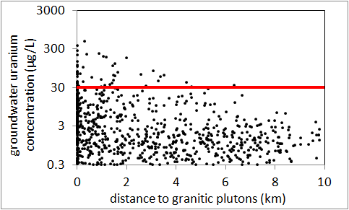
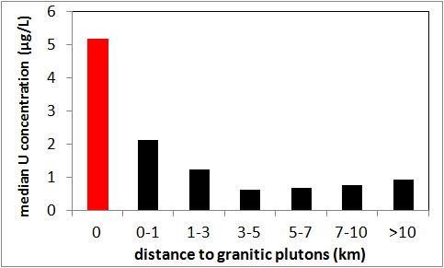
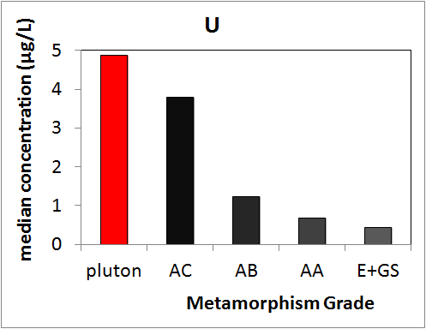
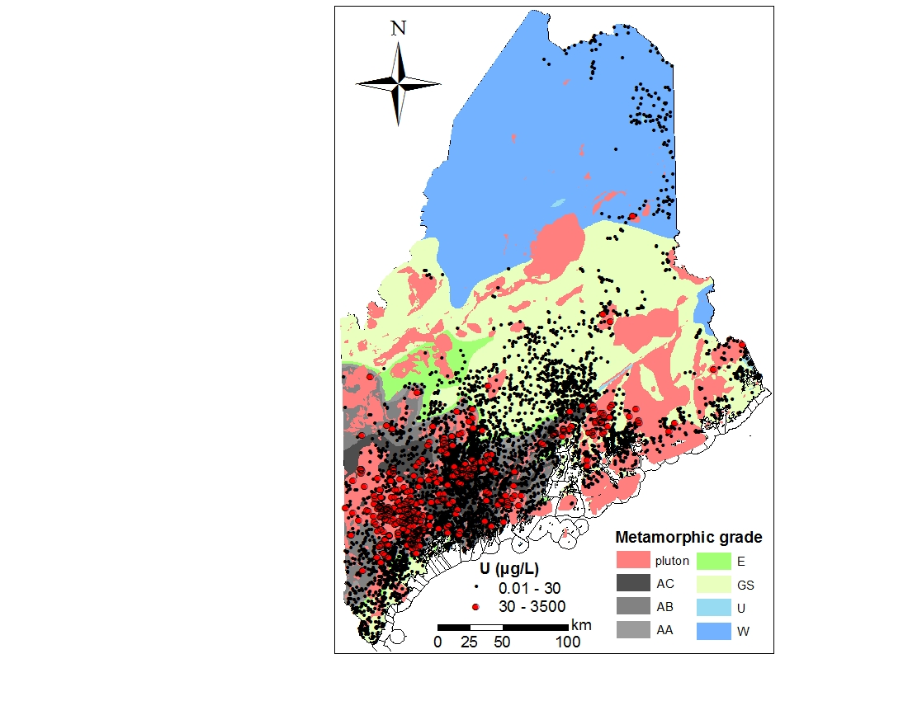
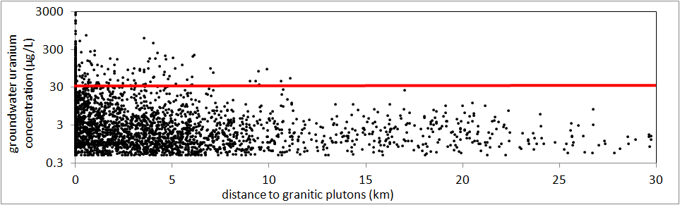
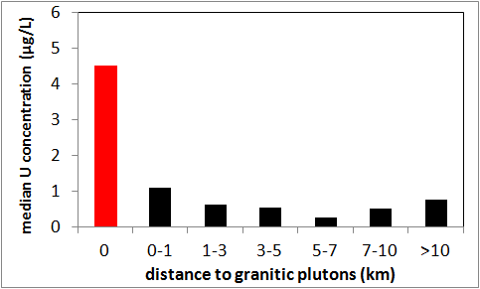
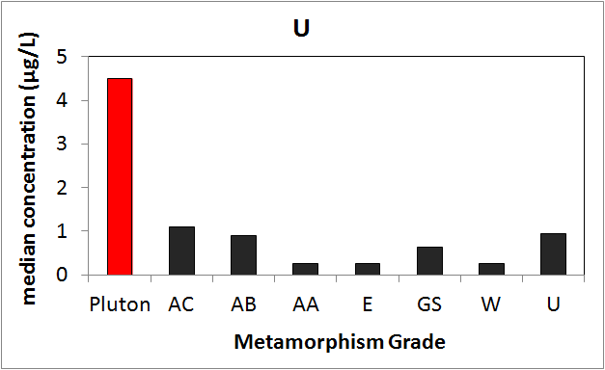
Groundwater U - distribution
(Data from MGS)

Slide 15
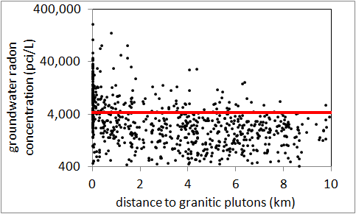
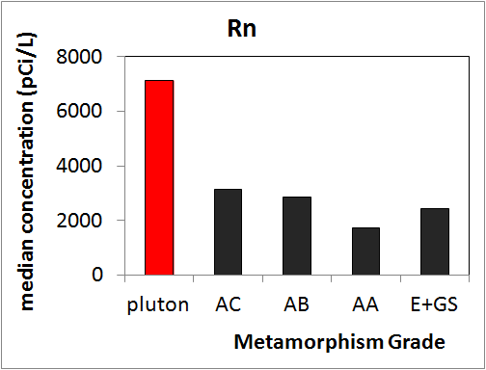
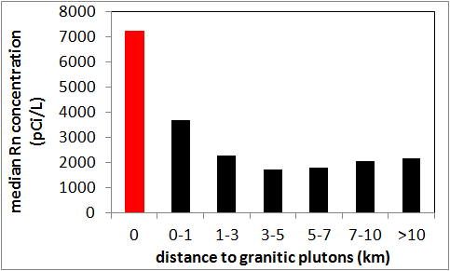
Groundwater Rn - distribution

Slide 16
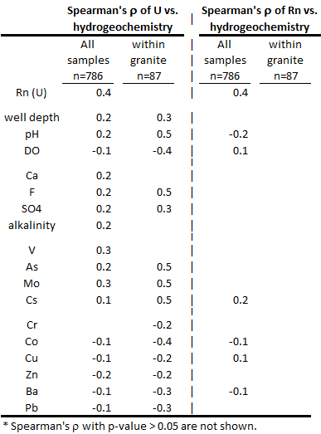
Groundwater U & Rn
– controlling parameters
Mobilization
Different transport and mobilization mechanisms of U and Rn in granites;
U (within granitic plutons)
pH, alkalinity dominant;
associated with As, Mo, Cs.
Rn
No apparent groundwater geochemical control;
More hydrogeological.

Slide 17
Groundwater U
– individual wells
granitic
intrusions
Waterville
meta-sedimentary
dissolved
U
µg/L
dissolved
U
µg/L
dissolved
U
µg/L
Removal ratio by aluminosilicate adsorbent cartridge: 96%, 98%, 99.6%
30 m
55.2
35 m
61.1
20 m
1.2
40 m
54.3
22 m
1.4
46 m
60.4
25 m
1.0
49 m
48.2
50 m
49.8
27 m
1.0
52 m
51.0
53 m
54.4
54 m
53.5
56.5 m
65.7
29 m
0.8
MA70076
MA70138
MA70190

Slide 18
Summary
The distribution of groundwater As in fractured bedrock aquifers in central Maine is associated with bedrock geology at local scales of 1-10 km, while U and Rn show strong association with granitic plutons.
Groundwater As is also controlled by pH and redox conditions in aquifers, U is controlled by pH and alkalinity, while Rn does not show apparent association with groundwater geochemistry.
Mobilization mechanism of As : oxidation of arsenic-rich sulfide, adsorption on iron minerals, along the groundwater flow path pH-dependent desorption of arsenic from iron minerals with calcite dissolution.
In individual bedrock wells, dissolved As is mainly from water producing fractures typically near the bottom of bore hole, and subjected to oxidation, adsorption and settling with iron particles; dissolved U does not show significant difference from fractures at various depths, but can easily be removed by aluminosilicate absorbent.

Slide 19
Acknowledgement
Funded by NIEHS Superfund Research Program;
Carole Johnson, Martha Nielson, Charles Schalk, USGS;
Daniel Locke, Marc Loiselle, Robert Johnston, MGS;
Marcel Belaval, US EPA;
Martin Stute, Columbia University;
Hun Bok Jung, Zhongqi Cheng, Yi He, City University of New York;
Families in Greater Augusta, ME.
Thank you all for attention!
Contact: Qiang Yang qyang@LDEO.columbia.edu

