Slide 1
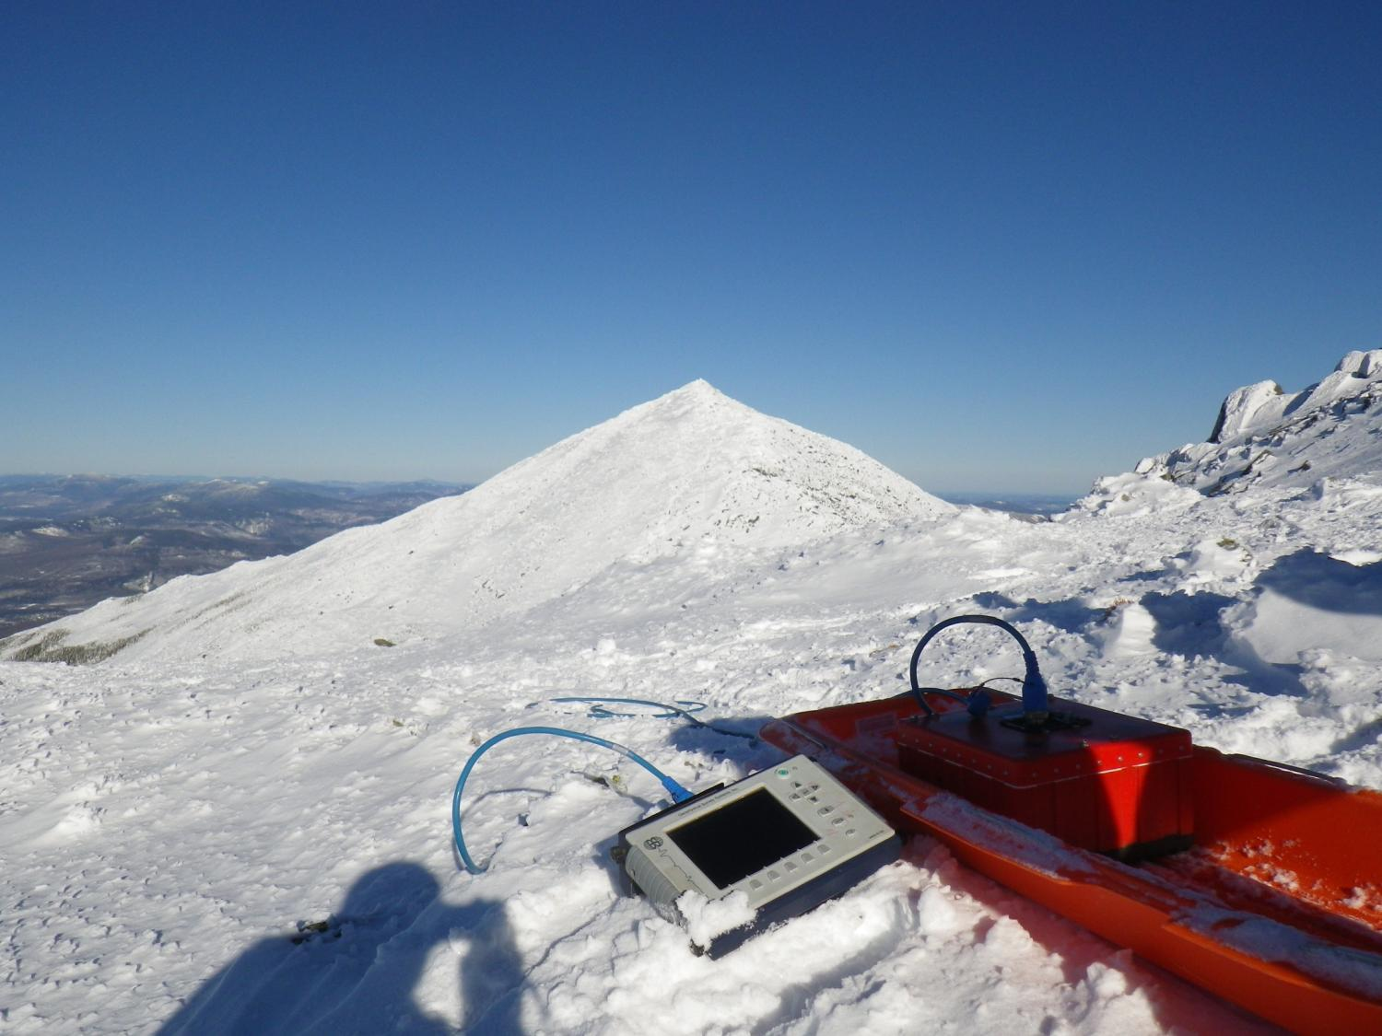



Applications of Ground-Penetrating Radar Profiles to Surficial and Bedrock Geology Mapping in New Hampshire
Seth Campbell & Steve Arcone
March 19,2013
NEGSA

Slide 2
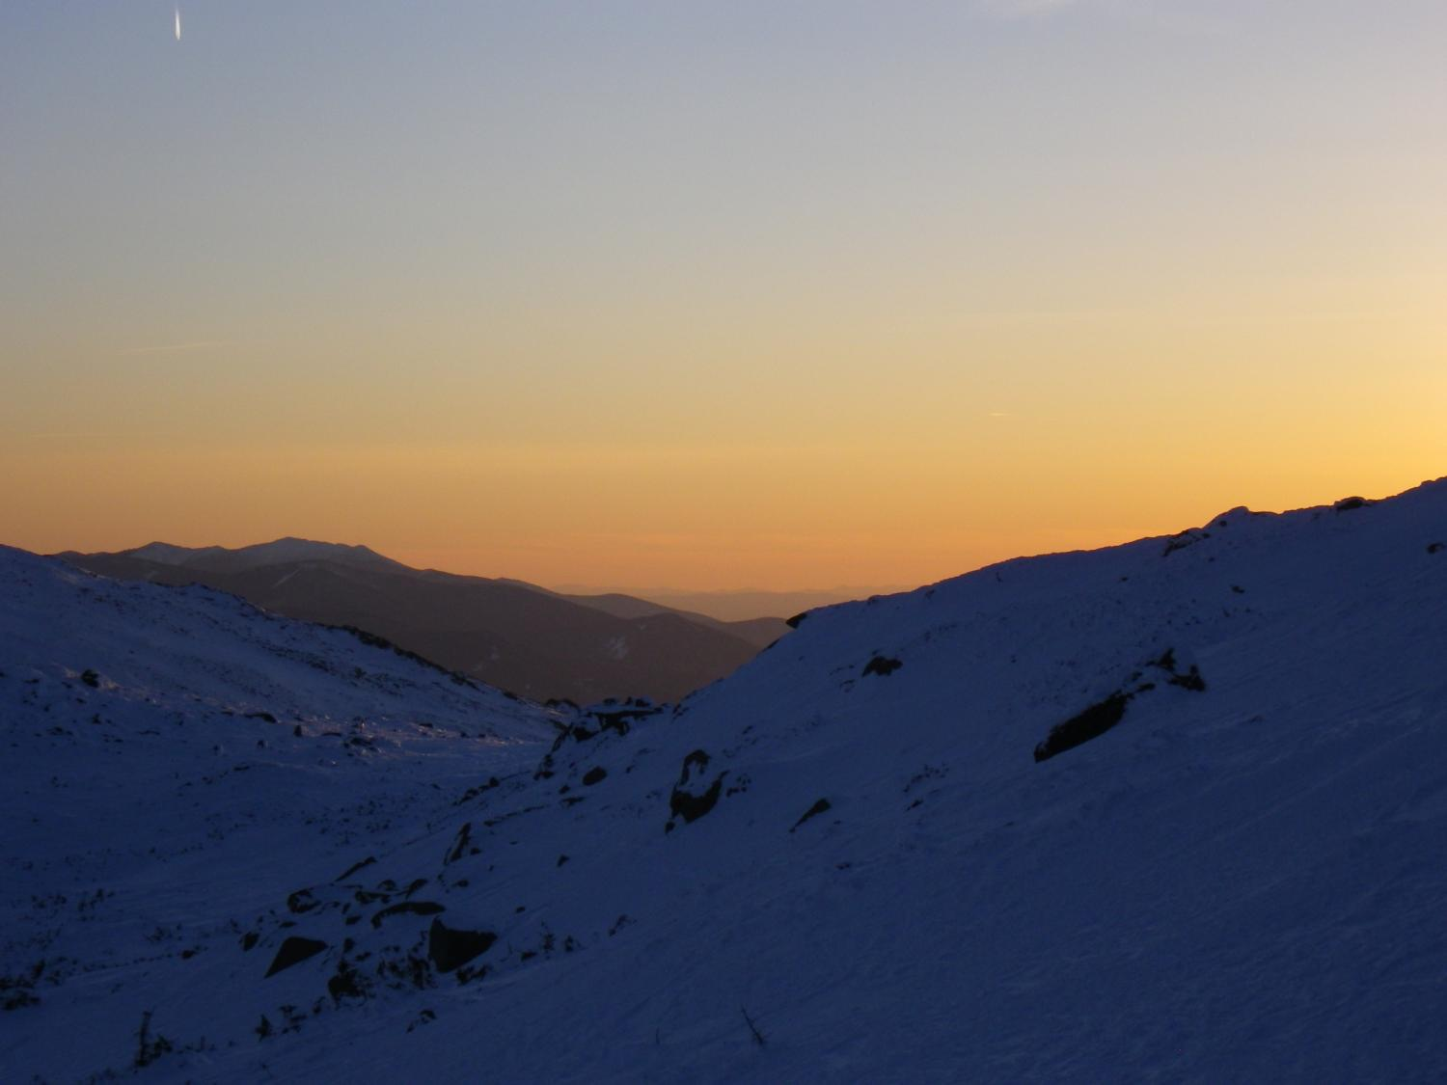
Outline Surficial Geology Bedrock Geology Lacustrine Season Conclusions
Surficial Geology:
- Sand, Gravel, and Till
Depth and H₂O Content
Bedrock Geology:
- Types
- Fractures and Water
Lacustrine:
- Lake Depth
Stratigraphy
Season:
- Summer & Fall
- Winter & Spring
Acknowledgements: Tad Pfeffer, Nathan Lamie, Curtis Marston, Jeff Spaulding

Slide 3
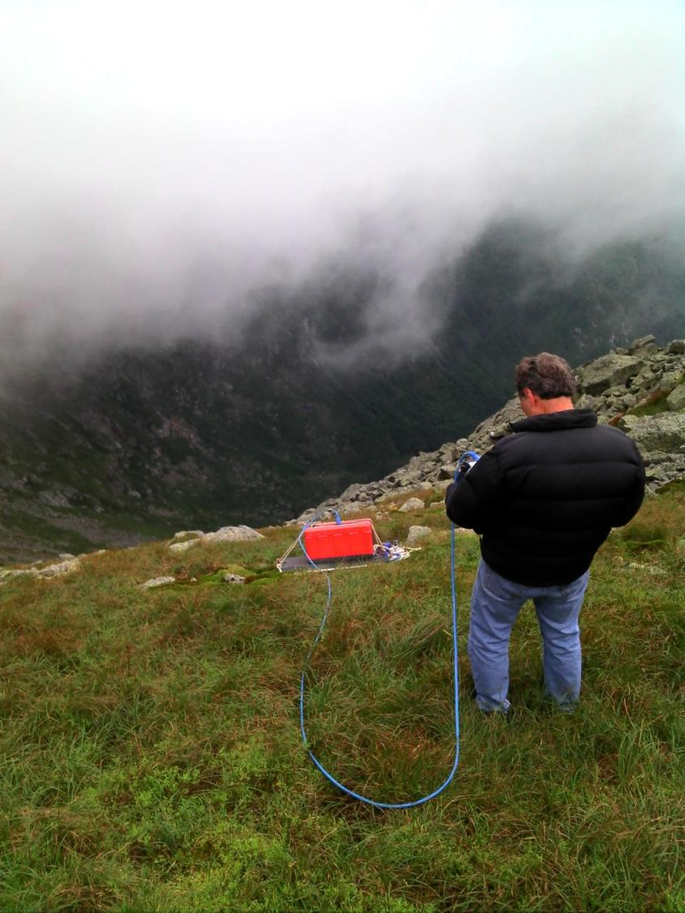
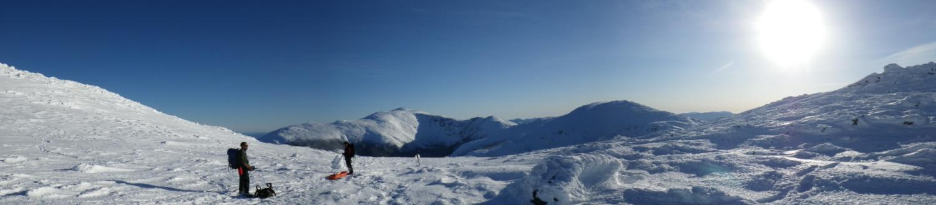
Outline Surficial Geology Bedrock Geology Lacustrine Season Conclusions
METHODS:
GSSI SIR-3000 Control Unit
80-900 MHz antennas
Towed by hand, ski, and vehicle
GPS distance corrected
>250 km GPR collected, to date

Slide 4
Outline Surficial Geology Bedrock Geology Lacustrine Season Conclusions

Slide 5
Outline Surficial Geology Bedrock Geology Lacustrine Season Conclusions
T1
Sand pits at intersection of Route 3 and Rte 115.
240 m
T3
T2
Rte 3 profile

Slide 6
Outline Surficial Geology Bedrock Geology Lacustrine Season Conclusions
N
N-S Transect 1
S
Erosion surface
Buckling
Buckling
N
N-S Transect 2
S
Sand Pit Profiles, Rte 3 / Rte 115
= 21 = wet sand
T1: mostly till (sand scraped off)
T2: ≥10 m of sand
T3 5-10 m of sand
E
E-W Transect 3
W

Slide 7
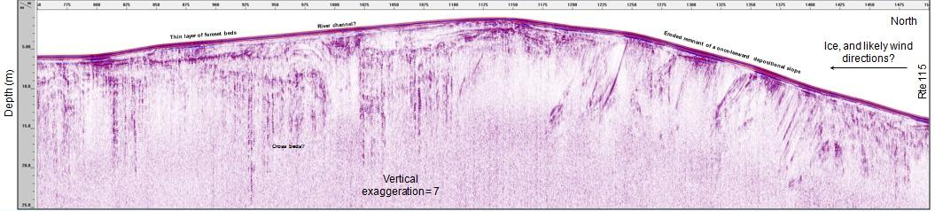
Outline Surficial Geology Bedrock Geology Lacustrine Season Conclusions
Detail from previous slide: S-N along Route 3 up to Rte 115, just east of the sand pits

Slide 8
Outline Surficial Geology Bedrock Geology Lacustrine Season Conclusions
Bethlehem moraine-Route 3 area
Rte 3
Rte 115
Sand pits

Slide 9
Outline Surficial Geology Bedrock Geology Lacustrine Season Conclusions
W-B-W (low to high dielectric) is likely water table
80 MHz
160 MHz
Moraine north of the sand pits; needs elevation correction, ε = 14

Slide 10
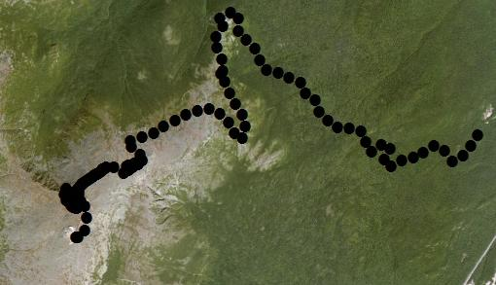
Outline Surficial Geology Bedrock Geology Lacustrine Season Conclusions
Wide Angle Reflection
and Refraction (WARR)
Survey
80 m
4
220 m
3 WARR 40 m
5
2
200 m
200 m
80 m
Auto Road
1
Mt. Washington

Slide 11
Outline Surficial Geology Bedrock Geology Lacustrine Season Conclusions
Distorted distance scale at start
Antenna separation (m)
This moveout profile implies excellent penetration, even at 200 MHz. The rate is somewhere between 1/R and 1/R². This is one-way propagation, so two-way round trip should reach at least 20 m at 200 MHz, and likely 30 m at 100 MHz.
Air wave
Direct ground wave
Slight shingling
Time (ns)
Resonant higher frequencies
Dispersion
The 200 MHz broadside polarized moveout profile recorded along transect 3. This terrific result was a total surprise. The slight shingling, both on the bottom and top, and the loss of higher frequency content (dispersion) means that this wave was slightly guided and it is likely bedrock that helped form the guide. However, there is no obvious bedrock reflection at the start of this profile. The slope of this event corresponds with a dielectric constant of 12.9 (square of the refractive index for radiowaves). The likely value for the schist is about 5, so this high value is caused by the wet soil within the rocks. The wave starts as a direct transmission, which undergoes 1/R² attenuation, but the guiding slightly reduces this.

Slide 12
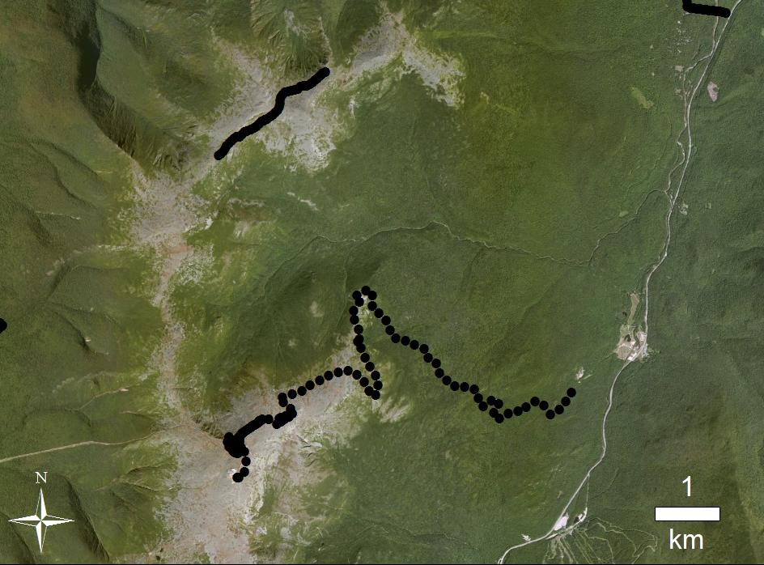
Outline Surficial Geology Bedrock Geology Lacustrine Season Conclusions
Adams
Jefferson
Auto Road
Washington

Slide 13
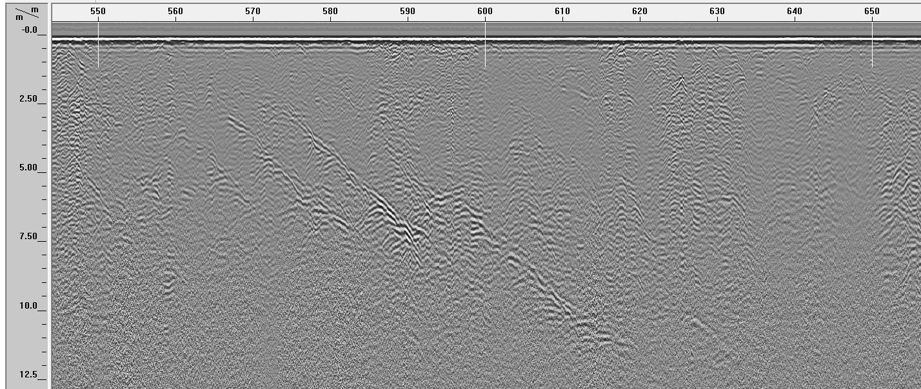
Outline Surficial Geology Bedrock Geology Lacustrine Season Conclusions
A
Apparent Dip: SW
Triplet:
W-B-W:
Low to High ε
(water filled Fx’s)
Two-Mica
Granite
A
B
Meta-Volcanic
Or Meta-Sedimentary
Two-Mica
Granite

Slide 14
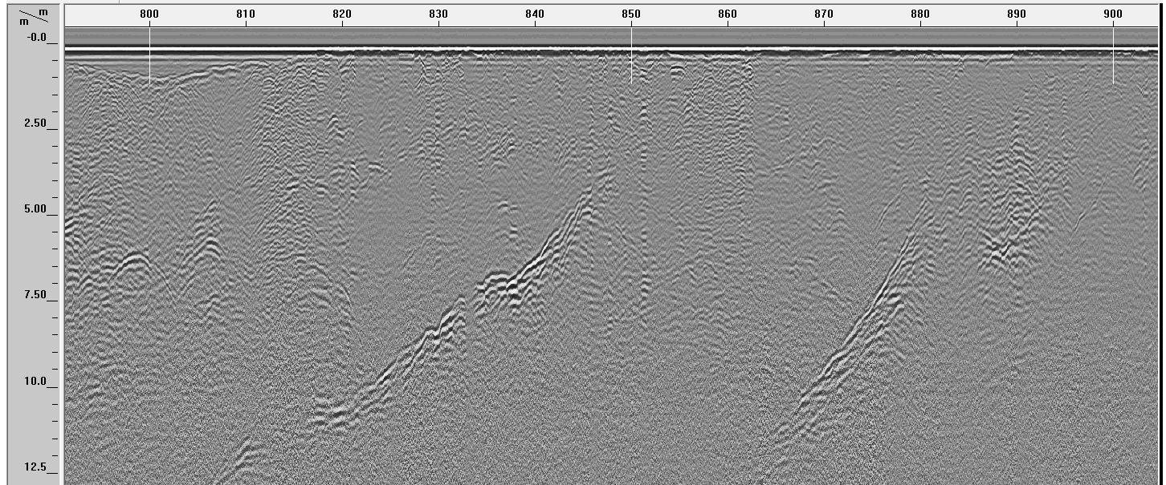
Outline Surficial Geology Bedrock Geology Lacustrine Season Conclusions
B
Apparent Dip: NE
Triplet:
B-W-B
High to Low ε
Air/Ice filled Fx’s?
Two-Mica
Granite
A
B
Meta-Volcanic
Or Meta-Sedimentary
Two-Mica
Granite

Slide 15
Outline Surficial Geology Bedrock Geology Lacustrine Season Conclusions
Moose Mtn. Road, Enfield, NH
N
Og
Moose Mtn Road
May St
3 km
Lake
Mascoma
Bedrock: Ordovician granite to granodiorite (Og)

Slide 16
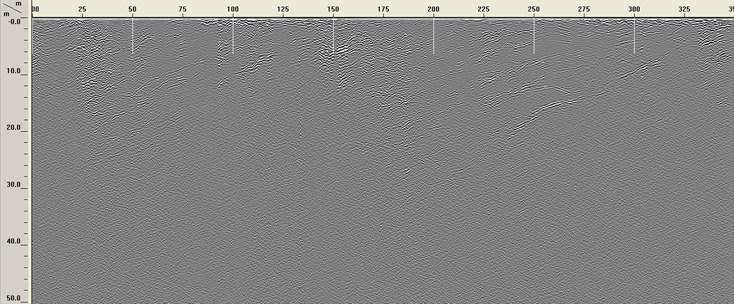
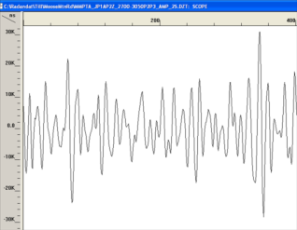
Outline Surficial Geology Bedrock Geology Lacustrine Season Conclusions
Deep penetration in Enfield granodiorite, Moose Mtn. Road
ε = 6.6
Fractures or Exfoliation Joints

Slide 17
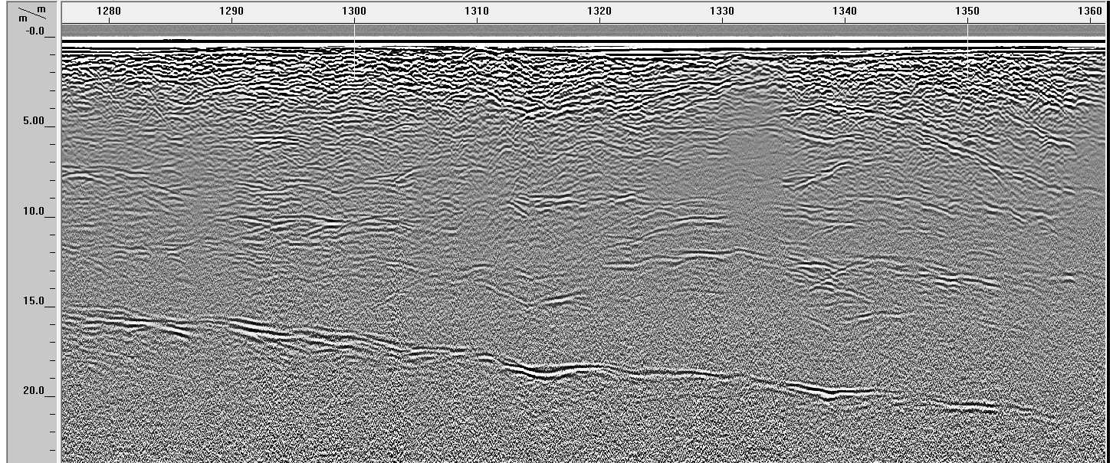
Outline Surficial Geology Bedrock Geology Lacustrine Season Conclusions
Fractures or Exfoliation Joints
3 Mile Road, Enfield NH
White-Black-White (W-B-W) triplet = water filled fractures?

Slide 18
Outline Surficial Geology Bedrock Geology Lacustrine Season Conclusions
Lake Evolution Geomorphology
Rte 3
Rte 115
swamp
Sand pits

Slide 19
Outline Surficial Geology Bedrock Geology Lacustrine Season Conclusions
Jefferson Notch Road
= 32
Lake Evolution Sequence
KEY POINTS:
Clear Boundary to North
Stratification within
Less clear boundary to South

Slide 20
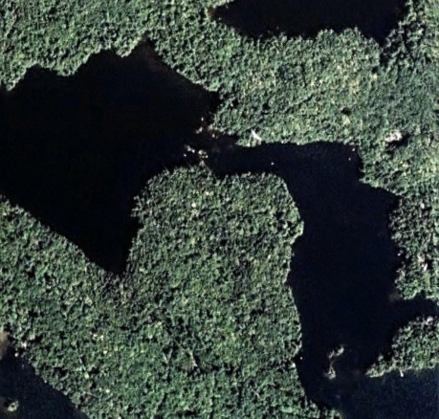
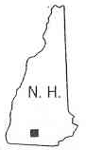
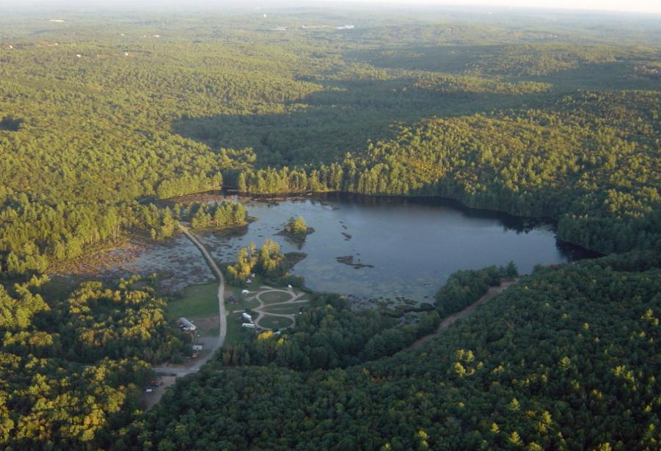
N
Subbottom stratigraphy
250 m
Squam
Lake
1
*
N
2
JEP
43º 47′ 01.41″ N
71º 30′ 45.39″ W
Elev. 173 m
Joe English Pond
s
Squaw Cove, Northern Squam Lake
peninsula
Stream
inlet
island
Other Locations:
Echo Lake; Franconia, NH
Storrs Pond; Hanover, NH
Post Pond; Lyme, NH
Profile Lake, Franconia, NH
Lake Willoughby, VT
*
causeway
42º 56′ 05.22″ N
71º 38′ 19.98″ W
Elev. 153 m
N
Joe English Pond in New Boston, NH, and Google image of Squaw Cove in northern Squam Lake.

Slide 21
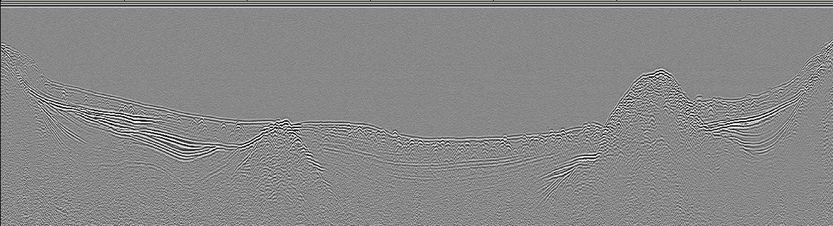
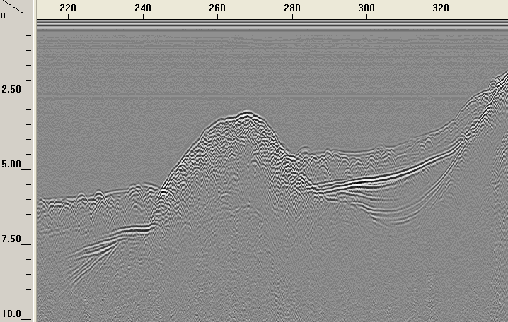
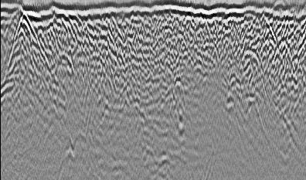

Outline Surficial Geology Bedrock Geology Lacustrine Season Conclusions
Joe English Pond; strata over till
Distance (m)
0
WNW
50
100
150
200
250
300
ESE
0
Water
135 MHz, Unmigrated
2.5
Depth (m)
5.0
7.5
Former basin
Former basin
10
Former basin
9.2x vertical exaggeration
240
260
280
240
260
280
3
0
4
Depth in water (m)
Depth in till (m)
5
2
6
7
Detail of the till mound
4
Migration of the mound, with water removed
Till beneath Joe English Pond, detail of the mound at right and its migration at left for ε_{r} = 35. The ovals highlight a prominent diffraction and its migration. The depth of the water overburden varied only 0.3 m across this event. The inserted waveform is of the migrated diffraction hyperbola; it was not possible to separate the unmigrated waveform from the noise. The location of the strata indicated by the arrows suggests they were generated from the mounds.

Slide 22
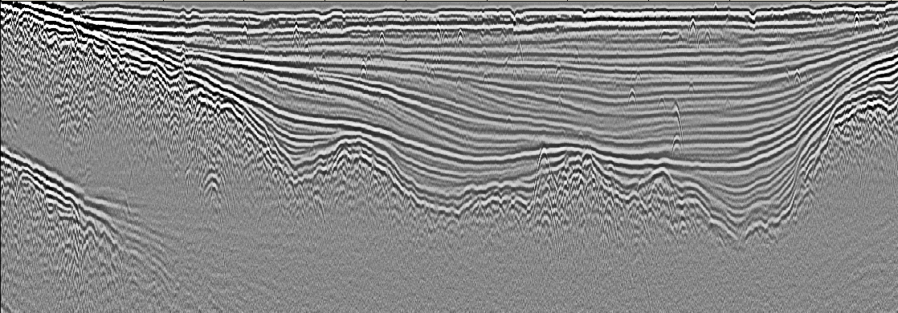
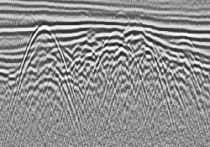
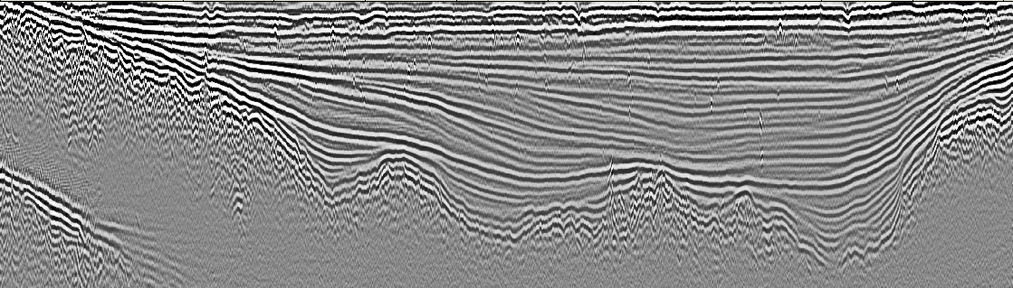
Outline Surficial Geology Bedrock Geology Lacustrine Season Conclusions
Squaw Cove, detail of subbottom delta deposits; water has been removed
Distance (m)
0
50
100
150
200
250
0
100
Time (ns)
200
a)
135 MHz, Unmigrated
300
0
2
Depth (m)
4
b)
6
8.4 x vertical exaggeration
135 MHz, Migrated, ε = 32
Unmigrated and migrated profiles of transect 2 at Squaw Cove. The collapse of the hyperbolas (arrows) beneath the till interface demonstrates the efficacy of the migration, which used ε_{r} = 32. Draping of sediments within the bottom topography suggests that the same process explains the apparent folding in JEP. Water depth was only 2.6 m. The insert shows detail of diffractions within the dashed box.

Slide 23
Outline Surficial Geology Bedrock Geology Lacustrine Season Conclusions
Route 3 – Patio Motel Example
200 MHz Comparison:
Oct., 2012 and Feb.,2013
Prograding Sand Beds (deltas or dunes)
Immediately West: Sand Pit
North and Further West: Bethlehem Moraines
Rte 3
Rte 115
Sand pits

Slide 24
Outline Surficial Geology Bedrock Geology Lacustrine Season Conclusions
Likely effects of salty roads and saturated Soil on GPR
Distance (m)
No penetration
No penetration
Time (ns)
Rte 115
14Feb, 2013
Deepest visible event is about 240 ns
Time (ns)
Rte 115
22Oct, 2012
Deepest visible event is about 420 ns
Fall profile: ε = 8-9 (moist sediments) and deepest events are about 20 m.
Winter profile : ε = 20-25 (nearly saturated) and deepest events are 9 m

Slide 25
Outline Surficial Geology Bedrock Geology Lacustrine Season Conclusions
1. This and the following presentation provide many examples of till, bedrock, till-bedrock transition, and stratified deposits to demonstrate the ability of GPR in NH.
2. In general, best penetration is in bedrock (granite, volcanic) up to 35 m so far. It is detected from the response of fractures.
3. Till is very lossy, likely caused by combination of conductivity, interfacial relaxations and scattering. Deepest penetration appears to be about 7-9 m.
5. Till is near saturation. High dielectric constants (18-27) summer and winter (Presidential Range is perhaps lower with drainage and freezing).
6. Stratified deposits are likely sands. We show lake bottom deposits and a possible pond evolution sequence.
7. Profiles recorded in winter along roads appear greatly affected by road salting.
8. Applications to surficial/bedrock/economic deposit mapping, and paleoclimate/glacial geology studies?

Slide 26
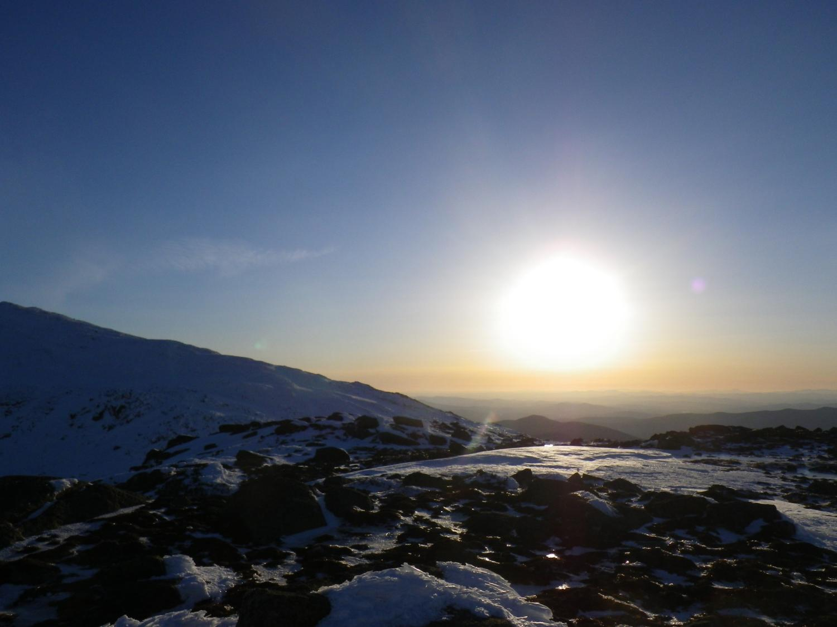
Questions?
Contact: seth.campbell@umit.maine.edu or Steven.A.Arcone@usace.army.mil

