Slide 1

IMPORTANCE OF USING GRAPHICAL METHOD TO UNDERSTAND THE INFLUENCE OF CRITICAL GEOTECHNICAL PARAMETERS USED IN HDD DESIGN
Abhinav Huli
Civil Engineer
Haley & Aldrich, Manchester, NH
Bradford A. Miller, P.G.
Senior Technical Specialist-Geology
Haley & Aldrich, Boston, MA

Slide 2
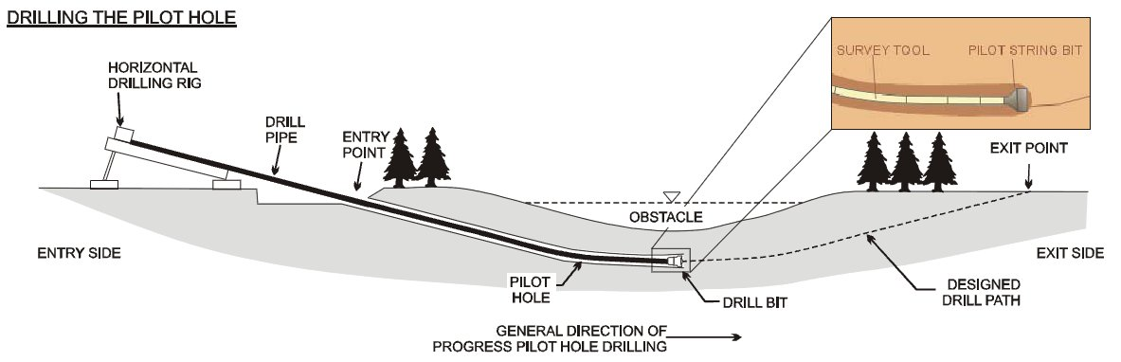
Three Stages of HDD
Pilot Hole: Establish the intended alignment from entry to exit
(CAPP Publication 2002-0022)

Slide 3
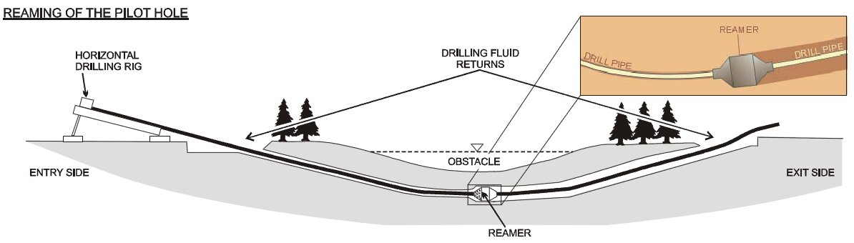
Three Stages of HDD (Cont’d)
Reaming: Increase the diameter of the pilot borehole as necessitated by the product pipe
(CAPP Publication 2002-0022)

Slide 4
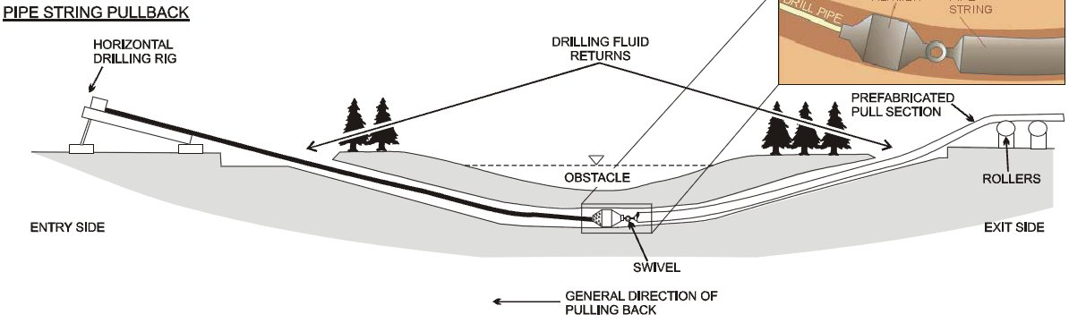
Three Stages of HDD (Cont’d)
Pipe Pullback: The product pipe is pulled into the borehole to its final alignment
(CAPP Publication 2002-0022)

Slide 5
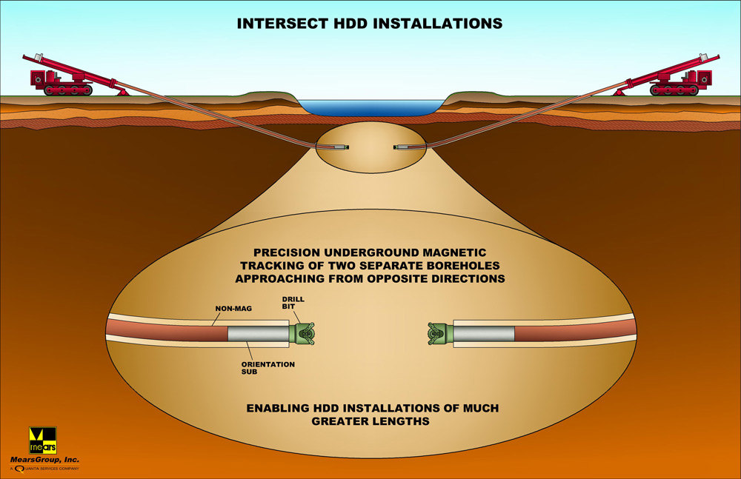
Intersect method of HDD
www.mears.net

Slide 6
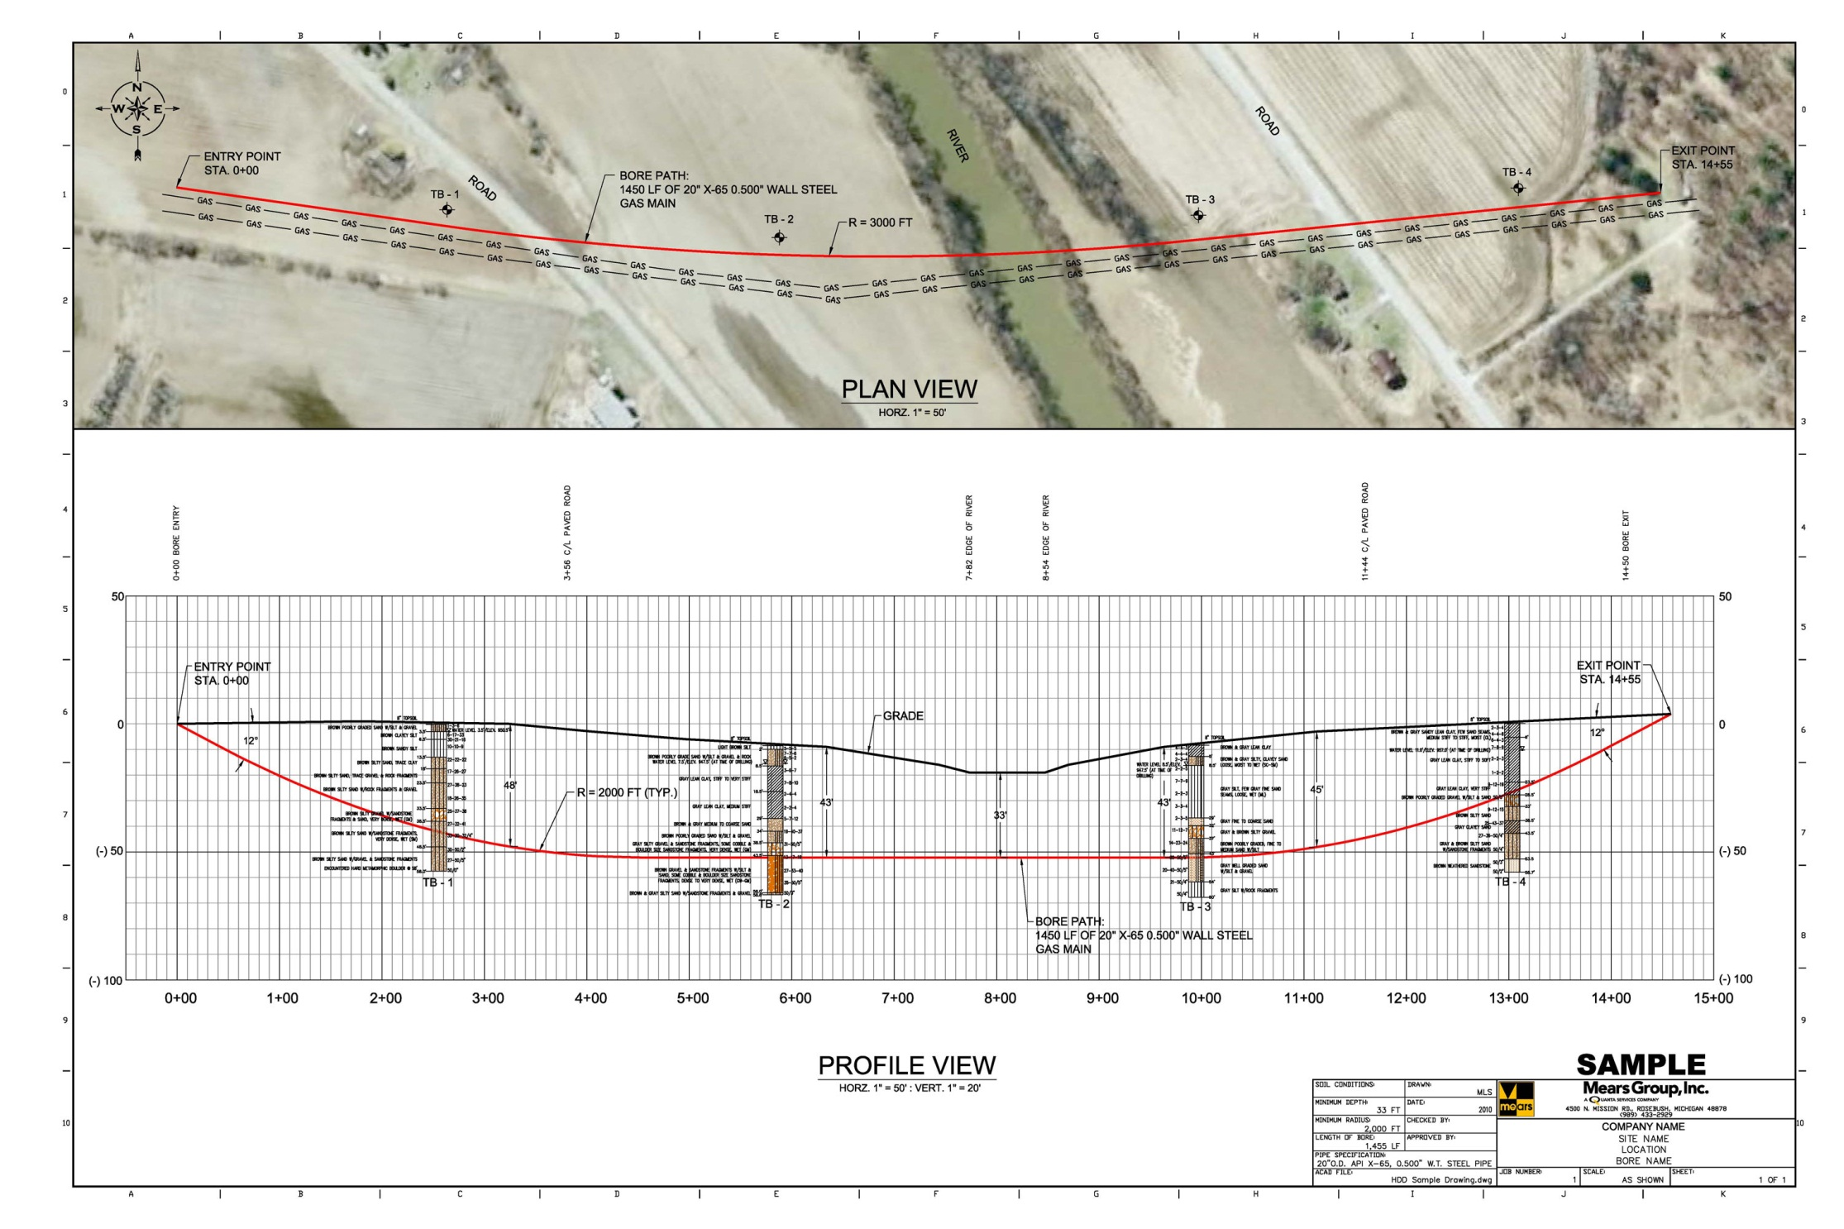
www.mears.net

Slide 7
Assessment of subsurface conditions
Why?
Quantification of maximum confining stress
Quantification of minimum drill pressures
How?
Appropriate geotechnical boring plan
Pertinent laboratory tests based on the design method
Geophysical methods (if necessary)
Geotechnical data/baseline report with focus on critical soil parameters for HDD design

Slide 8
Critical design considerations
Constantly changing subsurface conditions
Soils
Shear modulus
Cohesion
Friction angle
Rock
Unconfined compressive strength
Abrasion
Durability
Constantly changing drill fluid properties due to its interaction with the soil leading to changes in
Density
Plastic viscosity
Yield point
Gel strength

Slide 9
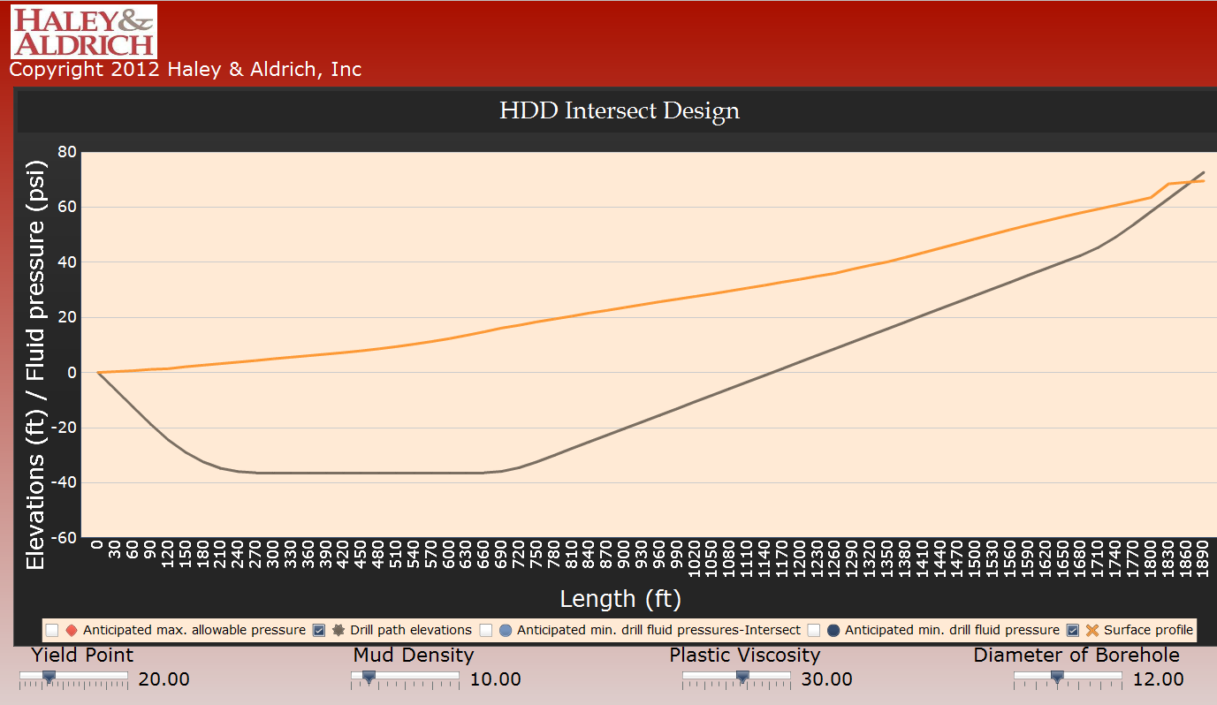
Proposed graphical design method
Surface profile
HDD alignment

Slide 10
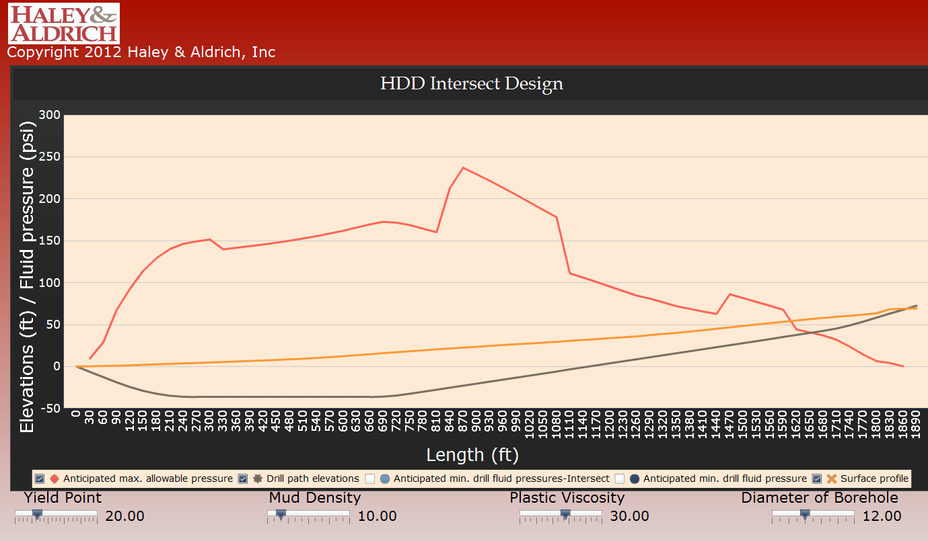
Anticipated maximum allowable pressure
HDD alignment

Slide 11
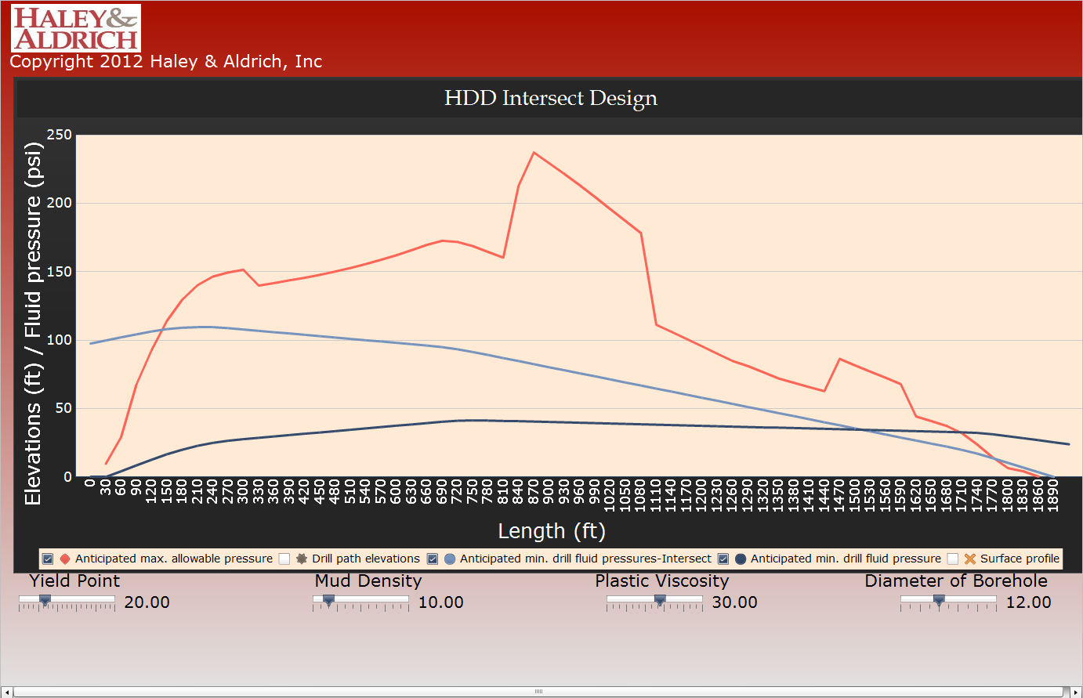
Anticipated maximum allowable pressure
Anticipated minimum drill pressure

Slide 12


Slide 13
Advantages of proposed methodology
Test “What If” scenarios
Run parametric analysis
Understand importance of iterative method of real-time drill fluid management
Discusses critical design considerations
Use of supplemental graphical software to visualize and optimize solutions

Slide 14
Thank You
Abhinav Huli
Civil Engineer
Haley & Aldrich, Manchester, NH
Bradford A. Miller, P.G.
Senior Technical Specialist-Geology
Haley & Aldrich, Boston, MA

