Slide 1
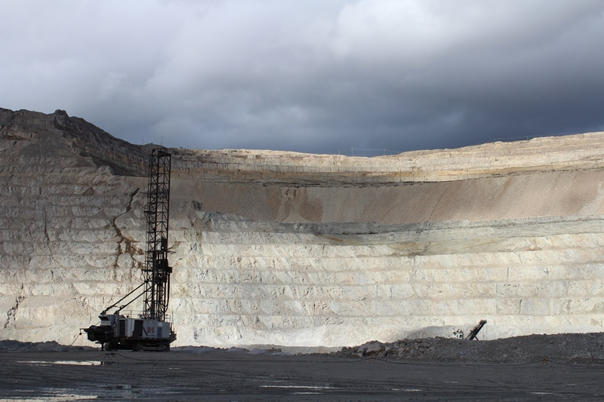
Slab Breaks and Early Mesozoic Paired Alkaline Porphyry Deposit Belts
(Cu-Au ± Ag-Pt-Pd-Mo) in the Canadian Cordillera
James Logan Mitchell Mihalynuk
Notes:
Thank you JoAnne and Jim for inviting me to contribute to this session. What I will present today are some results of almost 10 years of collaborative work on bc porphyry deposits with Mitch Mihyalynuk and others at the bcgs.
Interestingly these pre-170 ma porphyry deposits formed primarily during a 10-m. y. interval centered on 205 Ma. We propose that a change in subduction geometry related to accretion of the Kutcho-Sitlika arc was the trigger for this prolific pulse of mineralization.

Slide 2
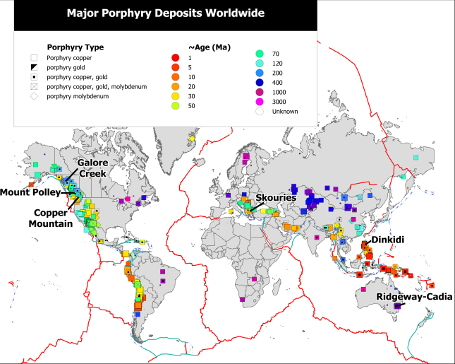
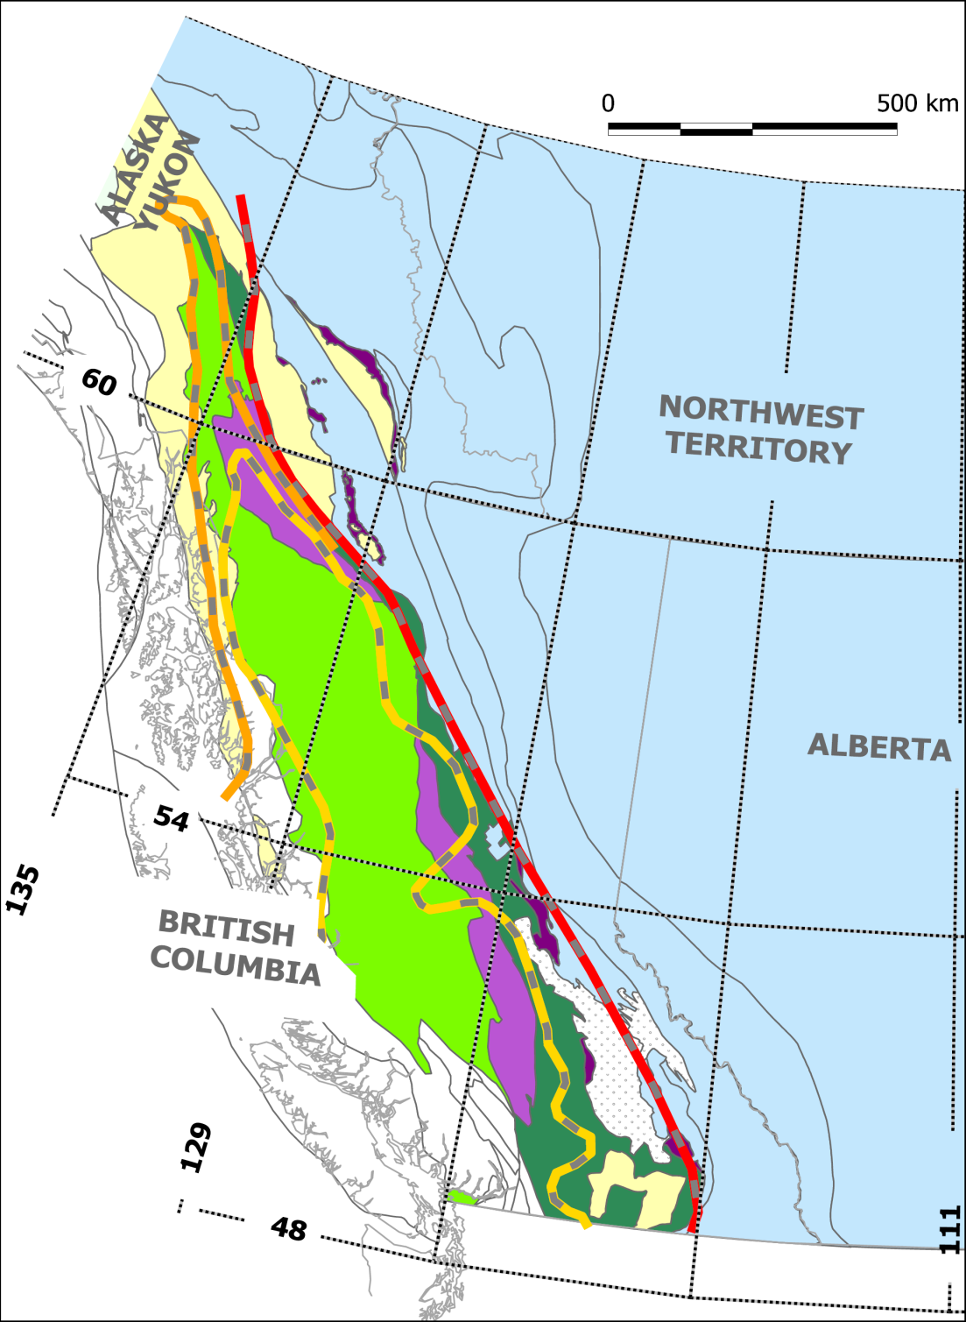
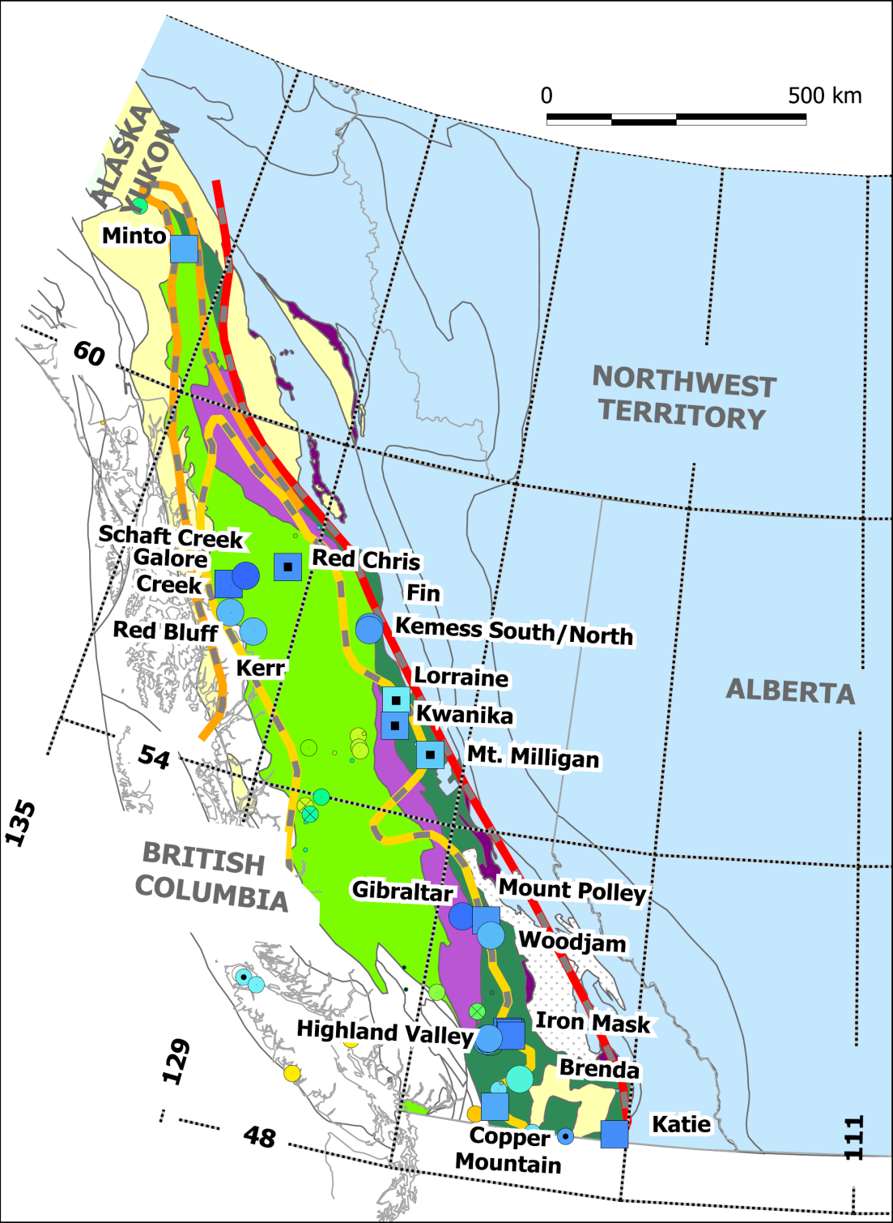
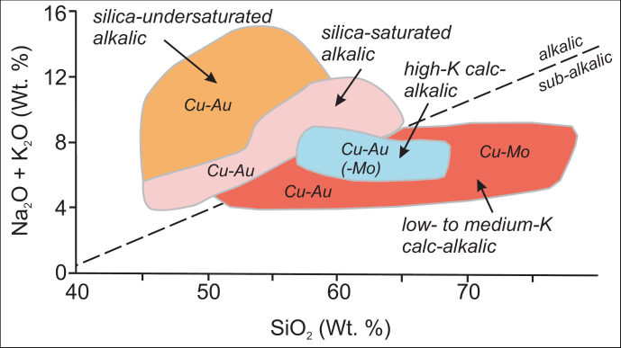
Cordilleran terranes
Stikine arc
Quesnel arc
Cache Creek
Slide Mountain
Initial Sr
Pericratonic
0.704
Yukon-Tanana/Okanagan
0.705
Kootenay/Arctic-Alaska
0.707
North American
displaced & autochthonous
(Armstrong, 1988)
Canadian Cordilleran Porphyry Deposits
0.707
0.705
0.704
Notes:
Canadian Cordilleran deposits follow the GLOBAL distribution patterns of porphyry deposits that show a clear relationship with volcanic arc terranes at convergent plate margins. The Early Mesozoic deposits of the Canadian Cordilleran deposits include low to medium and high potassium calc-alkalic Cu-Mo+/- Au +/-Ag class and silica saturated to silica undersaturated alkaline Cu-Au-Ag+/-Pt, Pd, Mo class which are distributed along the length of the Cordillera within 2 arc terranes Quesnellia and Stikinia.
Despite their striking similarities, Quesnellia and Stikinia are separated along most of their length by oceanic crustal and supracrustal successions of the Cache Creek terrane, which contain exotic fossil faunas. Only at their northern limits where Quesnellia and Stikinia merge is the Cache Creek terrane not present. Here the arc rocks pass to the east, north, and west into continental margin assemblages of the Kootenay-Cassiar (east) and Yukon-Tanana (north and west) terranes. Together, these terranes constitute the Intermontane arc complex, and they are geometrically arranged such that (1) exotic Cache Creek oceanic rocks are enveloped by (2) less exotic Stikine-Quesnel arc terranes that, in turn, are enveloped by (3) pericratonic Yukon-Tanana/Kootenay terranes. This geometry is reflected not only by the distribution of rock assemblages and contained endemic fossils that characterize each terrane, but also by isotopic isopleths (Armstrong, 1988; Fig. 2) and metallogenic belts, as exemplified by the paired porphyry belts

Slide 3
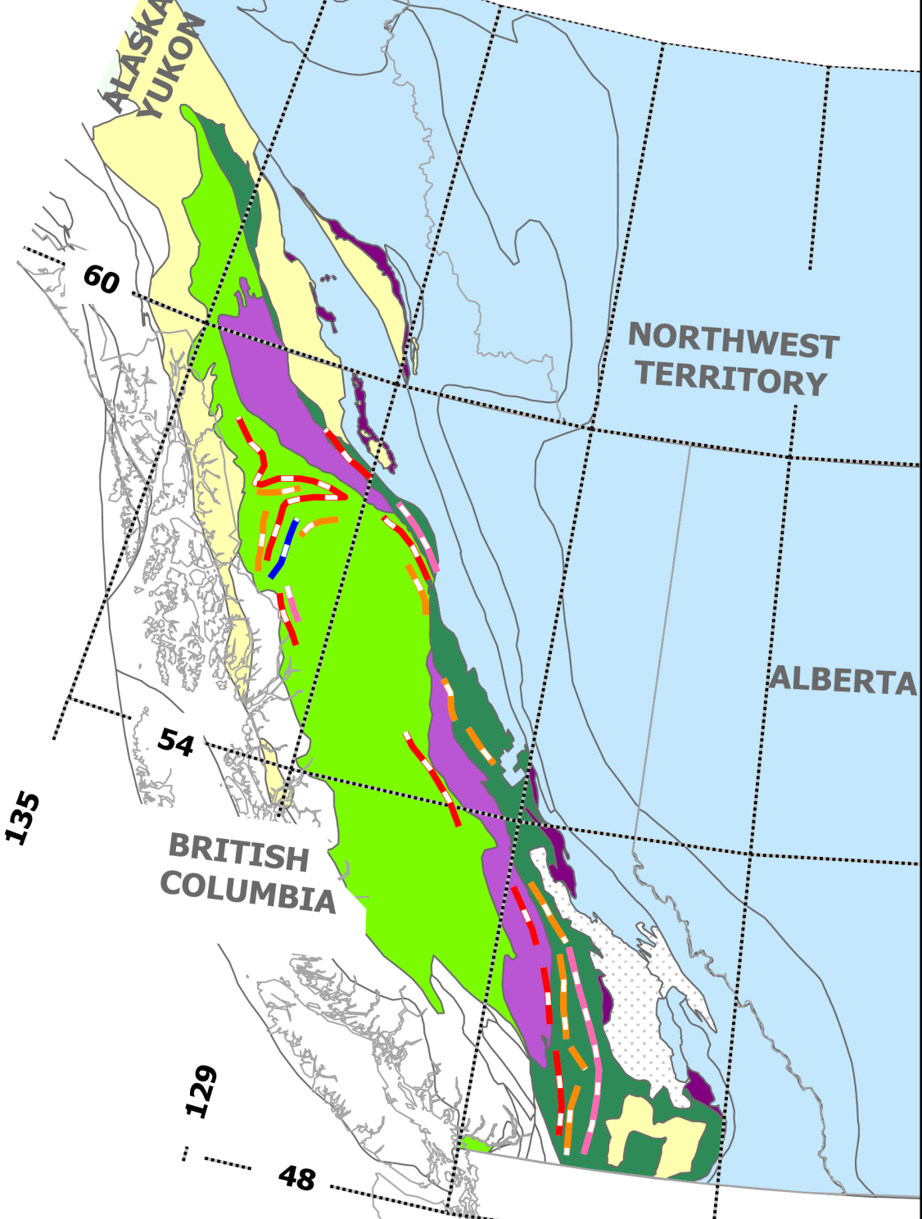
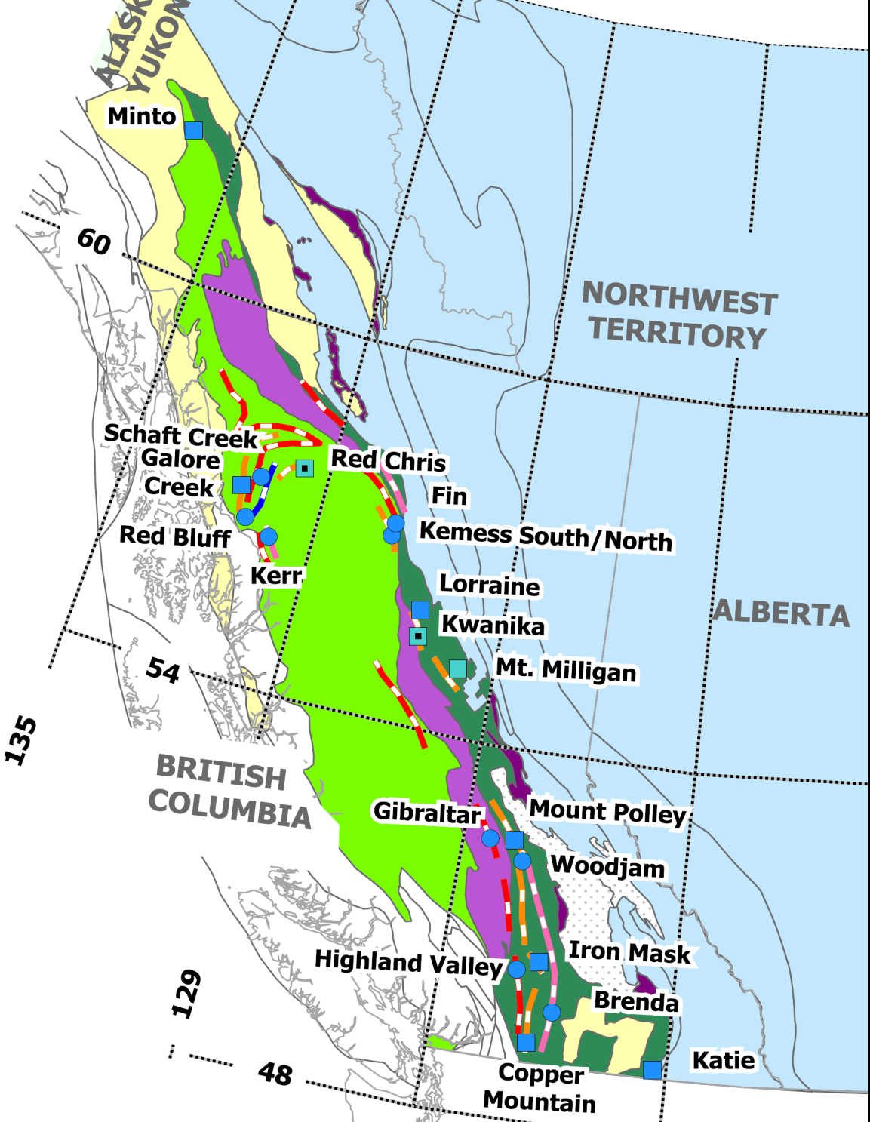
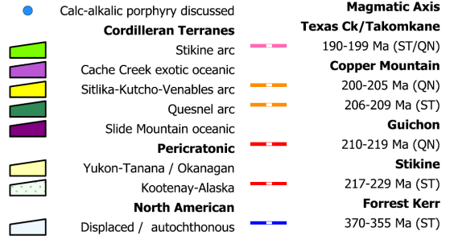
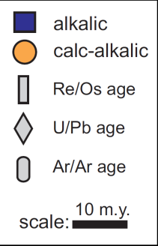
Po Ages - Magmatic Belts
St
Qn
Notes:
Linear traces of Late Triassic and Early Jurassic arc plutons define a discrete N-trending, eastward-progressing axis of magmatism along the length of Quesnel (QN), but a more complex structural history for northwestern Stikine (ST) terrane is indicated by Devonian-Mississippian, Late Triassic, and Early Jurassic arc plutons that indicate westward migration of magmatism and an apparent oroclinal folding along the northern margin of the Bowser basin.
If we add the porphyry deposits and their age constraints we see that there are four episodes of mineralization begining w/ a calc-alkaline, then alkaline, which is repeated ~ 5-10 Ma later
The porphyry deposits and their age constraints are arranged in Quesnel from south extending north to Minto/Williams Creek in the Yukon and then eastward across Stikine terrane. Circles are calc-alkalic deposits and squares are alkalic deposits. Four main mineralizing intervals are evident. A Late Triassic calc-alkaline event that is diacthonous
Two, Early Mesozoic calc-alkaline to alkaline magmatic cycles are evident and account for greater than 90% of the copper endowment of the Late Triassic to Early Jurassic mineralization. Magmatism progresses from west to east along the length of Quesnellia…..Stikinia is less obvious.
Porphyry Cu ± Au-Mo-Ag deposits are concentrated within the Stikine-Quesnel arc terranes, with most of their econo

Slide 4
Why are these mineralizing epochs restricted to short intervals of arc growth along >2000 km of the arc and what is the ultimate cause of these mineralizing events

Slide 5
Slab breakoff Model
Relate L>-EJ magmatism and porphyry mineralization to stalled subduction of low density crustal welt (Kutcho-Sitlika-Venables)
(Davies and von Blanckenburg, 1995; van de Zedde and Wortel, 2001)
Shallow slab detachment – generates a thermal spike (50o⁰C+) at mid lithospheric depths
Picrite lavas produced via large degree partial melt
- indicate a direct route from mantle to surface
~5-10 Ma later alkalic melts (± Cu, Au, Ag, Pt-Pd-Mo) from low degree partial melt of a broad region of metasomatized mantle wedge
Rapid uplift of the orogen L>-EJ unconformity
Notes:
To answer these questions we employ the continental collision slab breakoff model of Davies and von Blanckenburg and the quantitative thermal modeling of the plate boundaries by van de Zedde and Wortel to understand the evolution of LT-EJ magmatism and porphyry mineralization of the IMA complex. The main components of the model are stalled subduction, slab detachment, thermal anomaly and resultant syn to post collision magmatism and uplift.
The linkages between the model and the IMA complex include 1) Kutcho-Sitlika-Venables intra ocean arc, 2) Picrite and absarokite lavas, 3) Silica-undersaturated and saturated alkalic melts and associated mineralization and 4) Late Triassic – Early Jurassic regional unconformaties
The buoyancy contrast arc tholeiite vs oceanic crust (2.84-3.0 g/cm3) and the slab-pull leads to slab detachment which permits heat transfer from the asthenosphere into the lithospheric mantle, a thermal spike of 500C lasting from 1-3 Ma. Isotherms are elevated along the plate margin for up to 30 Ma or until after subduction is re-intiated

Slide 6
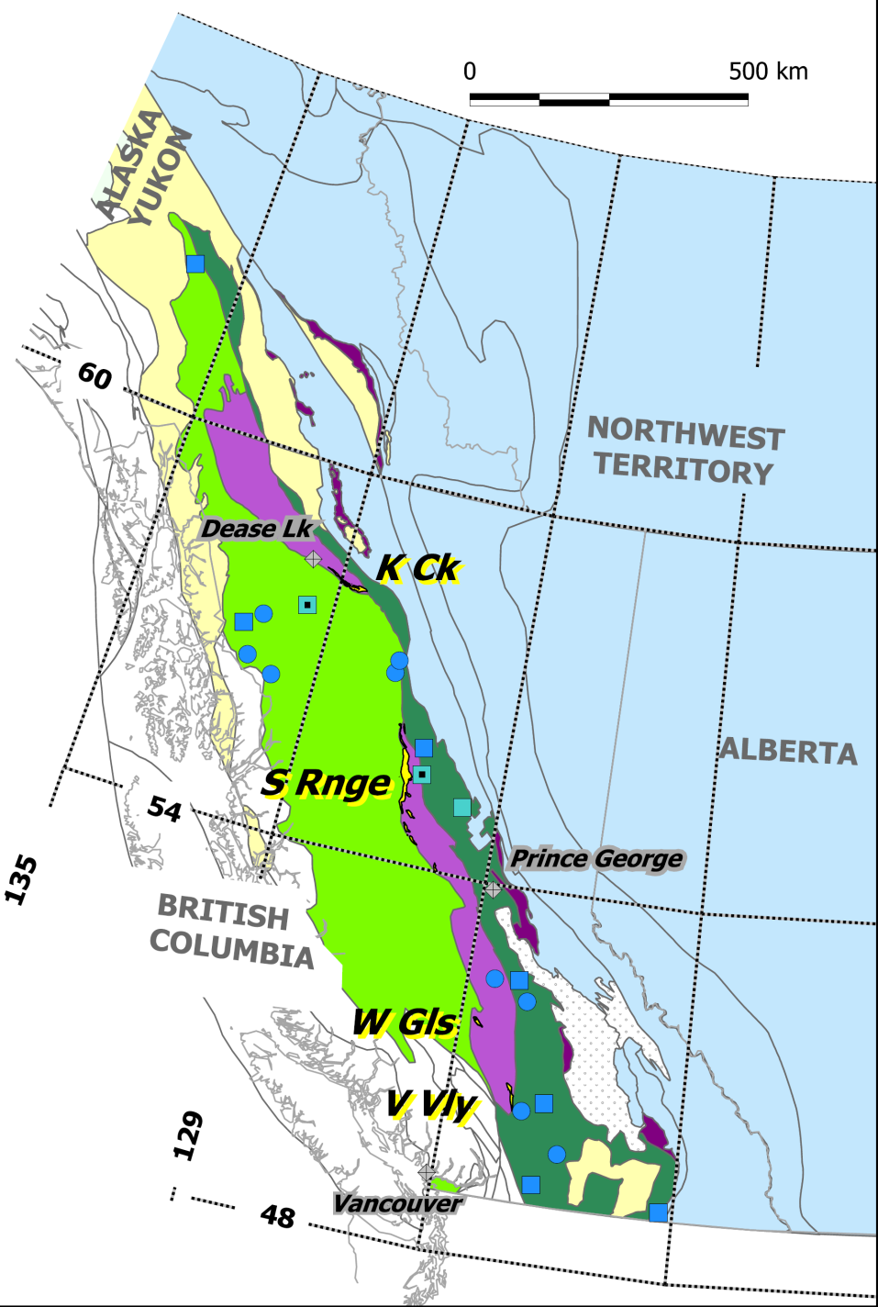
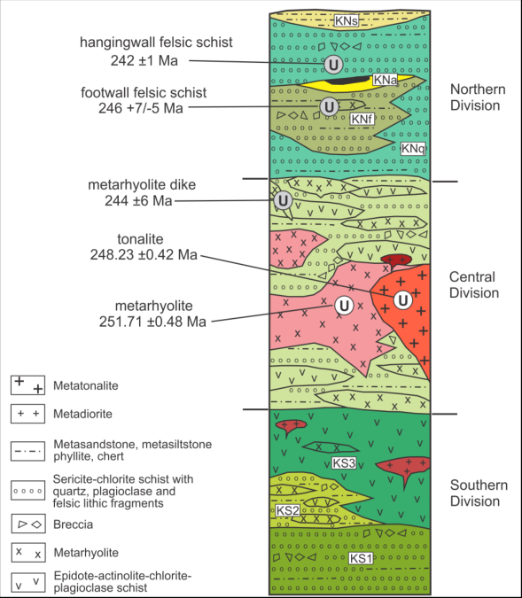
Kutcho-Sitlika-Wineglass-Venables:
Fragments of a Tethyan Permo -Triassic intra-arc
LP - M> basalt, rhyolite, volcaniclastic rocks and tonalite
263 -237 Ma
Nd, Pb & geochem data suggest tholeiitic affinity (Childe and Thompson, 1997; Barrett, 1996)
Kutcho assemblage Schiarizza ( 2012)
Low-density crustal welt within Cache Creek terrane
Notes:
Fragments of a late Permian to Middle Triassic intra-oceanic arc (Kutcho-Sitlika-Wineglass assemblage) are preserved along the western margin of Cache Creek and Stikinia and in one place on the eastern margin of Cache Creek and Quesnellia at Venables Valley.
The KSV arc formed in the Tethyan realm perhaps 10 to 15,000 km west of Quesnel-Stikine arc. It comprises mafic and felsic volcanic rocks and associated tonalite and diorite intrusive rocks with Nd and Pb isotope data (Childe and Thompson, 1997) and geochemical data (Barrett, 1996) that indicate an arc tholeiite affinity that, suggests the Kutcho assemblage represents part of a primitive intra-oceanic arc.

Slide 7
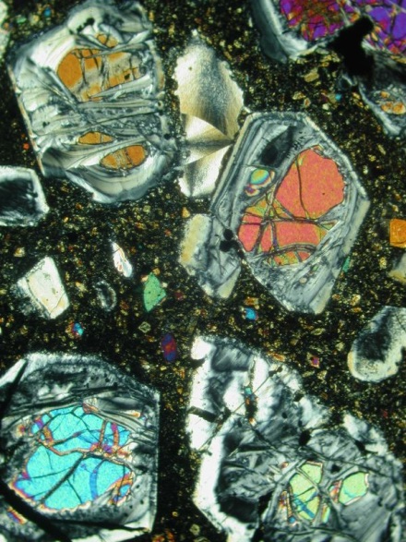
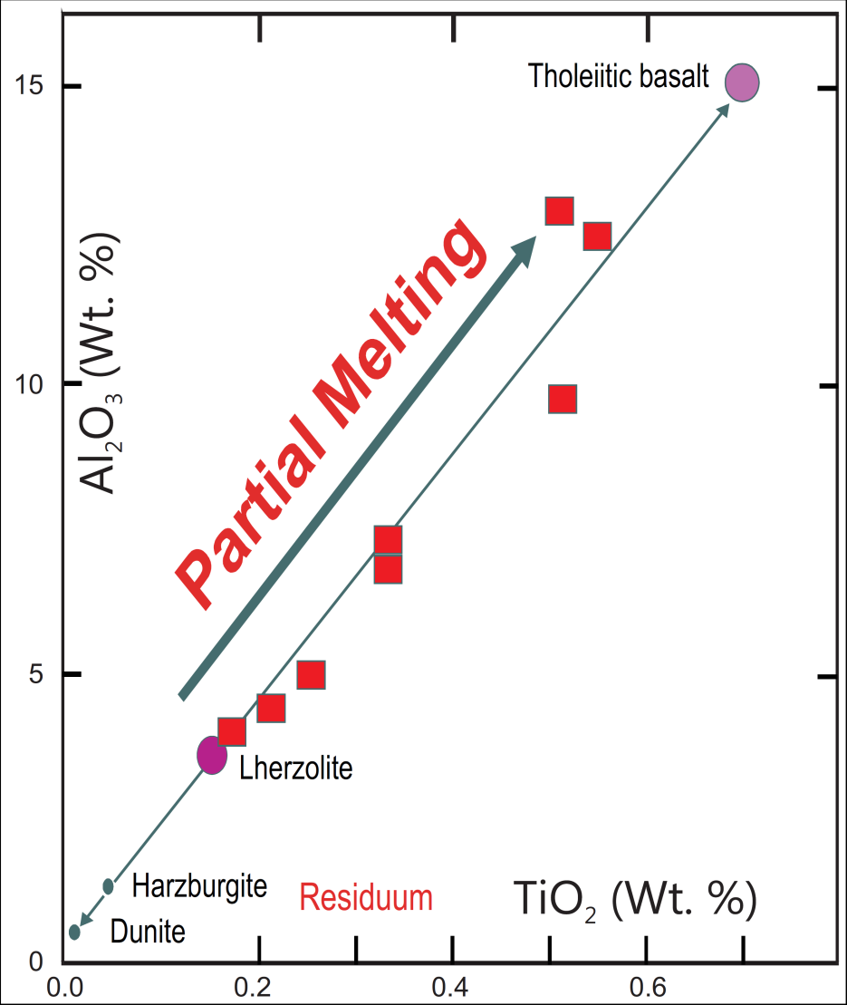

Chemistry – volcanic rocks
L> Iron Mask Picrite
high T. high degree partial melt Lherzolite (±40%, reflects rapid ascent w/out crustal contamination)
Sample/Primitive Mantle
Brown and Mussett, 1993
Notes:
Late Triassic Iron Mask picrite samples plot along a partial melting line between Lherzolite (fertile mantle) and basalt on TiO2 vs Al2O3 wt% plot of Brown and Mussett. Generation of picrite compositions indicate high temperatures and a high degree of partial melting. The presence of primary magma compositions indicate no crustal assimilation i.e. a direct route from the mantle.
Lherzolite is probably fertile, unaltered mantle; Harzburgite ± Dunite are refractory residuum after basalt has been extracted by partial melting
Primitive mantle–normalized (Sun and McDonough, 1989) multielement plots for Late Triassic Nicola Group basalts and picrite southern Quesnellia. The overall low concentrations and flat REE pattern of the Iron Mask picrite is indicative of large degrees of partial melting of mantle material.

Slide 8
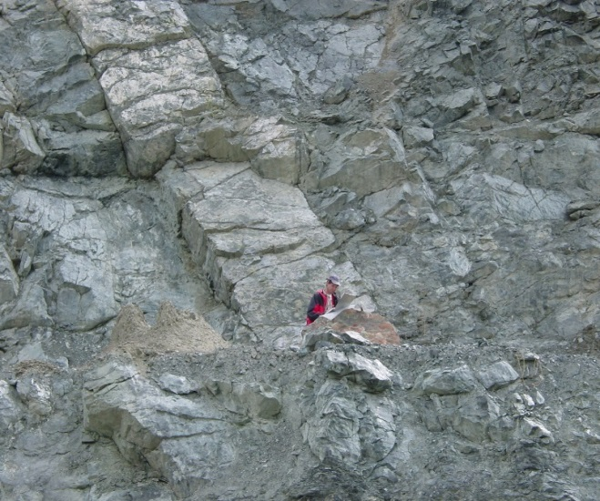
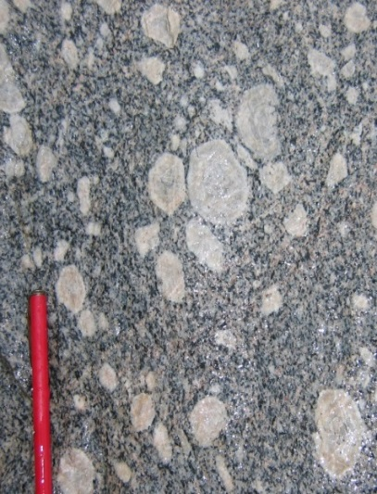
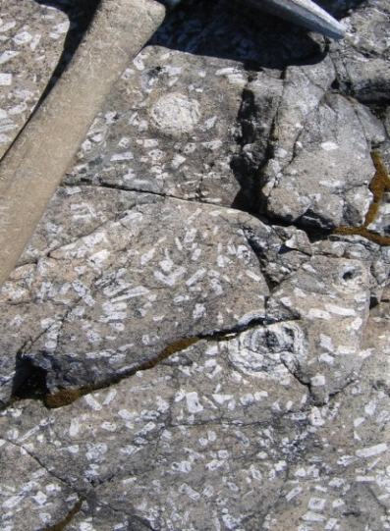
Alkalic Chemistry
CIPW Norms
20
Alkalic
Lang et al.(1994)
)
Silica-
%
16
t
undersat.
w
Q
(
12
Sugarloaf dike Ajax West
O
2
Silica-
sat.
K
+
8
O
2
a
N
4
Subalkalic
0
40
50
60
70
80
SL’
CC
PH + Hy
A
SL
P
SiO (wt %)
2
Foid
Low-degree partial melts metasomatised mantle
I-4
Galore Creek
Bootjack stock Mount Polley
Notes:
Intruding the Iron Mask picrite and olivine-pyroxene phyric basalts throughout Quesnellia and Stikinia are magmatic centres characterized by alkalic Ne-normative silica-undersatured to silica-saturated alkalic intrusions. Some of these are mineralized by characteristic Cu-Au-Ag±Pt-Pd-Mo mineralization.
At Galore the volcanic equivalents are pseudoleucite-bearing latites and orthoclase porphyryitic phonolites. The intrusive phases comprise up to 12 separate units of equigranular to coarse orthoclase phyric syenites. The earliest pre and syn mineral intrusions contain pseudoleucite phenocrysts.
Magmatic centers in and around Mount Polley are comprised of foid-bearing monzodiorite or monzonite and evolve to foid-bearing syenite or in the case of Shiko Lake quartz syenite compositions. Silica-saturated orthoclase megaporphyry syenite dikes are late stage intrusives at Mount Polley. The Bootjack stock is composed of pseudoleucite porphyryitic nepheline syenite. The Pothook and hybrid phases plot as diorites, the Cherry Creek as monzonite to quartz-monzonite. The Sugarloaf is the youngest phase and a monzodiorite.
Generation of arc-signature potassic lavas can occur during, following reversal or post-subduction

Slide 9
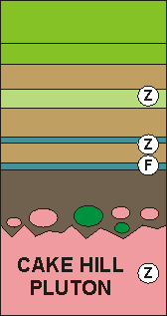
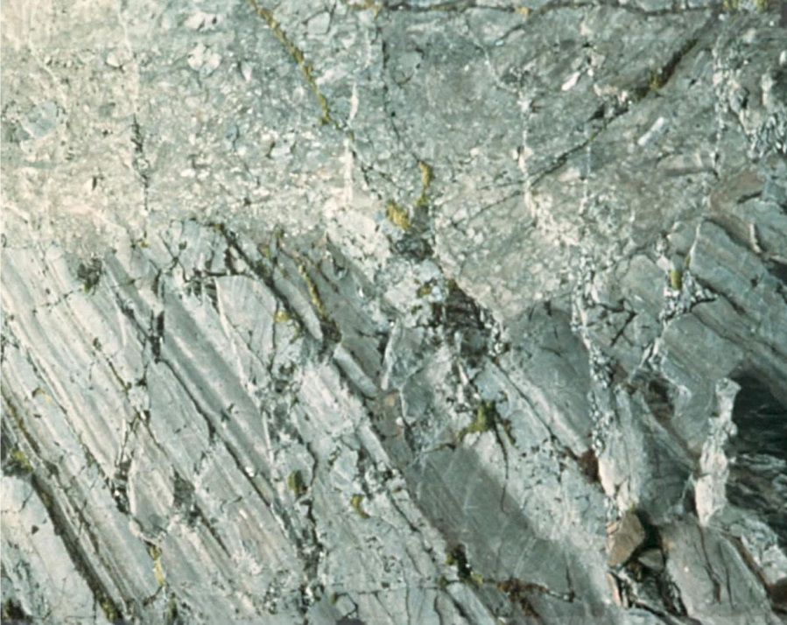
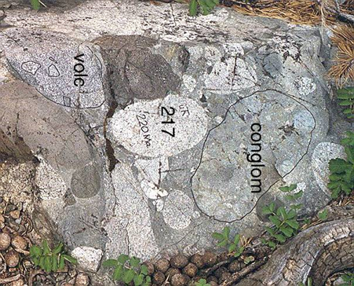
L>-EJ Initiation of orogen uplift
Hazelton Group
Unconformities - Nonconformities
U
U
NW Stikinia
U
EJ
U
L>
U
EJ
Arc Exhumation
L>
Whitehorse trough
Angular unconformity - subvertical Stuhini Group mudstones and Jack Formation at base of Hazelton Group (Henderson et al., 1992)
Granitic clast content increases up-section older units comprised primarily of volcanic clasts (Hart et al., 1995)
Notes:
Associated with removing the insulating effects of the slab following slab break is development of a broad thermal anomaly extending towards the backarc. Modelling suggests this heat anomaly could last upwards of 20 Ma. Regional scale unconformities mark the Triassic to Jurassic boundary. In some cases mineralized Triassic plutons are nonconformably overlain by Early Jurassic clastic units, elsewhere evidence for arc exhumation is recorded in the changing character of sediments as first the carapace and then the roots are

Slide 10
Late Triassic collision of the Kutcho-Sitlika-Venables arc with the Quesnel-Stikine arc
Notes:
Early Mesozoic paleogeographic reconstruction of collision of the Sitlika–Kutcho-Venables (SKV) arc with the Quesnel-Stikine arc. Possible paleogeographic configurations for precollision and late collision stages are represented in map view. Terranes based on modern extents; arc axes based on pluton distribution at present.
Late Triassic events culminating in generation of Cu porphyry deposits are attributed to a model wherein delivery of the Permo-Triassic Sitlika–Kutcho-Venables arc to the Stikine-Quesnel arc trench led to stalled subduction and arc-parallel tearing of the slab. Ingress of hot subslab mantle into the tear resulted in high-degree partial melts, as recorded by picrite within the arc circa 210 Ma. Widening of the tear and decay of the initial thermal spike raised temperatures across broad regions of the metasomatized mantle wedge, with low-degree partial melts generated from the most hydrated, metal-enriched portions circa 203 Ma. These melts produced the well-defined belt of alkalic Cu-Au-Ag porphyries.

Slide 11
Cross sectional representation of slab break and resultant thermal spike
Isotherm contours 0 to 1800 ⁰C
(after van de Zedde and Wortel, 2001)
Notes:
Cross-sectional representation of the late collision stage shows slab tear and resultant thermal spike. Isotherm contours from van de Zedde and Wortel, 2001 illustrating thermal spike 1 m.y. after slab break
Ingress of hot subslab mantle into the tear resulted in high-degree partial melts, as recorded by picrite within the arc circa 210 Ma. Widening of the tear and decay of the initial thermal spike raised temperatures across broad regions of the metasomatized mantle wedge, with low-degree partial melts generated from the most hydrated, metal-enriched portions circa 203 Ma. These melts produced the well-defined belt of alkalic Cu-Au-Ag porphyries.

Slide 12
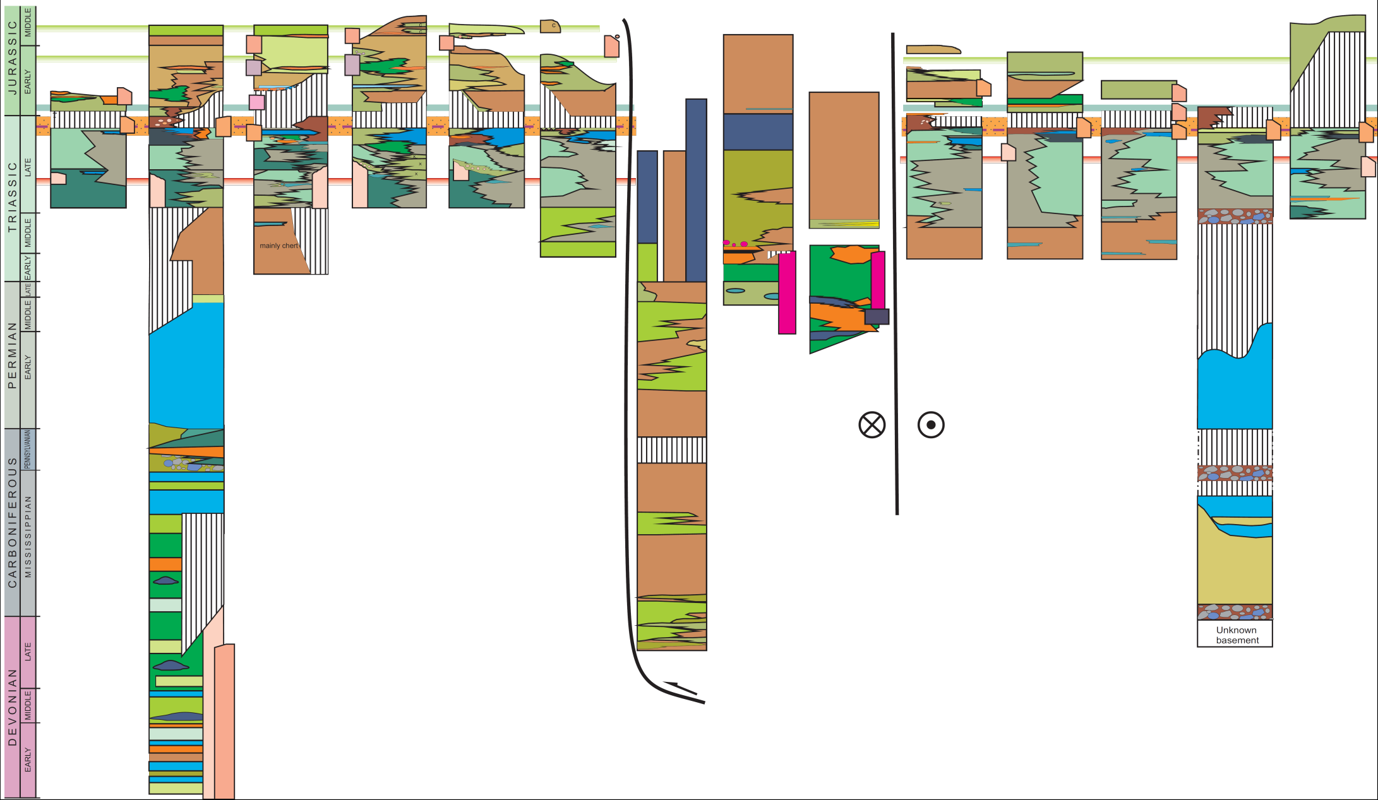
Schematic Stratigraphy IMA cmplx
Cache Creek
Stikinia - S → N
Kutcho
Quesnellia - N → S
L
M
P
K
B
W
B
K
G
P
A
C
G
H
F
S
IAT
MORB
Harper Ranch
Stikine Assemblage
IAB
IAB
Notes:
Intermontane arc complex stratigraphy. Late Triassic to Early Jurassic magmatic arcs
15 Ma later at ~195 Early Jurassic calcalkaline magmatism is associated with Cu-Mo-Au-Ag mineralization.
Subduction reinitiated w/ Rhaetian uplift, erosion Cu-Au porphyry formation and minor comagmatic volcanism related to high heat flow
Latest Norian strongly alkalic picritic volcansim
In the Late Norian evidence for arc emergence
Beginning in the Carnian to Late Norian have arc construction and calcaklaine magmatism linked to Cu-Mo±Au, Ag mineralization which is diacthonous from Stikine to Quesnellia
Intermontane arc complex comprises primitive calc-alkaline to alkalic magmatic arc terranes (Stikine and Quesnel) and an exotic oceanic terrane (Cache Creek) that represents the accretionary complex to the arcs.
. generated early high degree partial melts and then low-degree partial melts of metasomatized mantle along >2,000 km of this arc circa 203 Ma.

Slide 13
Magmatic Episodes
Late Triassic arc initiation, mafic volcanism, and emplacement of calc-alkaline plutons of the Stikine (236–221 Ma) and Guichon (212–208 Ma) suites
Arc magmatism changed abruptly along the entire length of the arc in response to mantle fusion initiated by slab tear and the ensuing thermal spike.
Triassic magmatism culminated with intrusion of the silica-saturated and silica-undersaturated Copper Mountain suite (210–200 Ma; 206–200 Ma)
With resumption of subduction, a second calc-alkaline to alkaline cycle began after an approximate 5- to 10-m.y. hiatus
Calcalkaline magmatism (199 - 190 Ma) comprises intrusions of the Texas Creek suite in Stikinia and Takomkane -Wildhorse plutons in Quesnellia
Silica-saturated alkaline magmatism (185-178 Ma) at Mt. Milligan and Lorraine is syn- to post-collisional coincident with collapse of the arc orocline against North American continental margin

Slide 14
Conclusion
A buoyancy-stalled subduction and slab-break model is a viable explanation that embraces the:
Mesozoic stratigraphy
magmatic episodes and
calc-alkaline and alkaline mineral deposits of the Intermontane arc complex
Thank you

