Slide 1
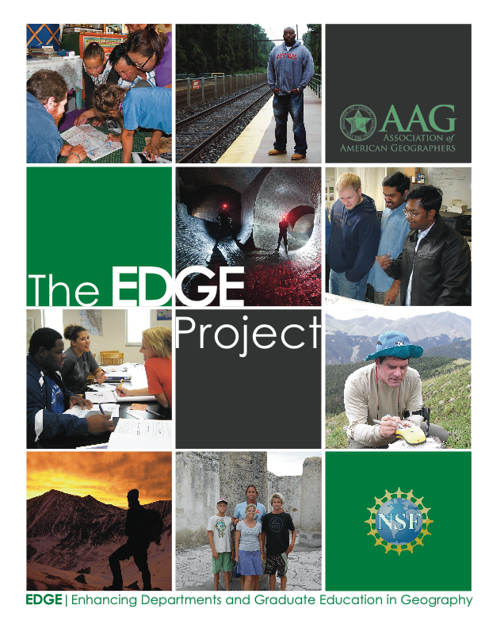


INVESTIGATING GEOSCIENCE COMPETENCIES: THE GEOSCIENCE CAREER MASTER’S PREPARATION SURVEY (GEO CAREER MAPS)
Heather Houlton (AGI)
Michael Solem (AAG)
Funded by the National Science Foundation
Grant: 1202707

Slide 2


Geo Career Maps
Employment Context
US Department of Labor projects “faster than average” or “much faster than average” growth in jobs for geographers, geoscientists, cartographers, urban and regional planners, etc., with projected needs of upwards of 15,000 additional employees in each of these career fields between 2008-2018.
By 2018, the US Commission on the Future of Graduate Education projects an additional 2.5 million jobs requiring an advanced degree, with the number of jobs requiring a master’s degree growing by 18% and those requiring a doctoral degree by 17%.

Slide 4
20 Geographic Skill Areas
29 General Skill Areas
Public speaking
Writing
Foreign (non-English) language skills
Visual presentations
Creative thinking*
Problem solving*
Research planning & design
Qualitative skills
Quantitative skills
Professional & organizational culture
Visioning*
Supervising
Entrepreneurial skills
Teamwork
Coaching & advising*
Relationship building skills*
Intercultural skills
Teaching
Computer & technology skills*
Publishing
Information management
Grant proposals
Time management
Adaptability
Self-awareness
Ethical practice*
Project management
Fiscal management
Geomorphology
Weather & climate
Biogeography
Natural hazards
Economic geography
Political geography
Cultural geography
Population geography
Human-environment interaction
Cartography
Geographic information systems (GIS)
Photogrammetry*
Remote sensing*
Field methods
Spatial statistics
Regional geography
Interdisciplinary perspective
Spatial thinking
Global perspective
Diversity perspective

Slide 5
Geo Career Maps
Purpose: Determine what competencies are taught and learned in Master’s programs. Investigate how well these outcomes align with workforce demand.
Methodology: Surveys of students, faculty, and alumni (Geology, Geography, Hybrid)
Poster Session 212, Booth 139 (Tuesday, October 21): Findings and comparisons

Slide 6
Professional Geography context
Clear discrimination of skills related to physical geography, human geography, and geographic information science & technology.
Professionals need to be good managers, communicators, writers, and problem solvers.
Value of specialized knowledge in geography often varies.
Ability to think spatially, having an interdisciplinary perspective, and geospatial technologies were broadly valued.

Slide 7
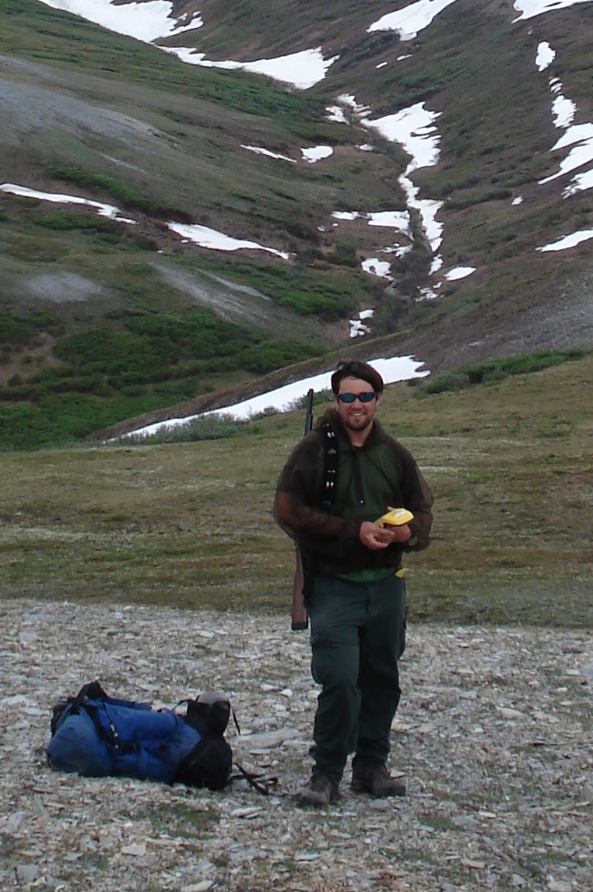
Profiles of Professional Geoscientists
Dave Selkowitz, Research Geographer, U.S. Geological Survey. Alaska Science Center (Anchorage, Alaska)
Outdoors background
Physical geography and remote sensing
Communication skills
Student Career Experience Program
Notes:
David has been working in Alaska for the U.S Geological Survey, a government department. He brings a personal history of outdoor activities such as skiing, backpacking, hiking and rafting that have prepared him for being in rugged and remote areas, Through his bachelor’s and master’s education in geography he learned the physical geography and remote sensing methods that enable him to conduct research on land cover, vegetation structure, and snow cover.. Dave combines field work in remote environments with office work preparing reports for publication. He also needs speaking skills to present his work to varied audiences.. Dave has decided to further his credentials by studying for a PhD and has entered the US government’s Student Career Experience Program. That allows him to work half-time with the USGS while simultaneously enhancing his credentials and benefiting from a program that is aimed to mentor and support its future employees.

