Slide 1
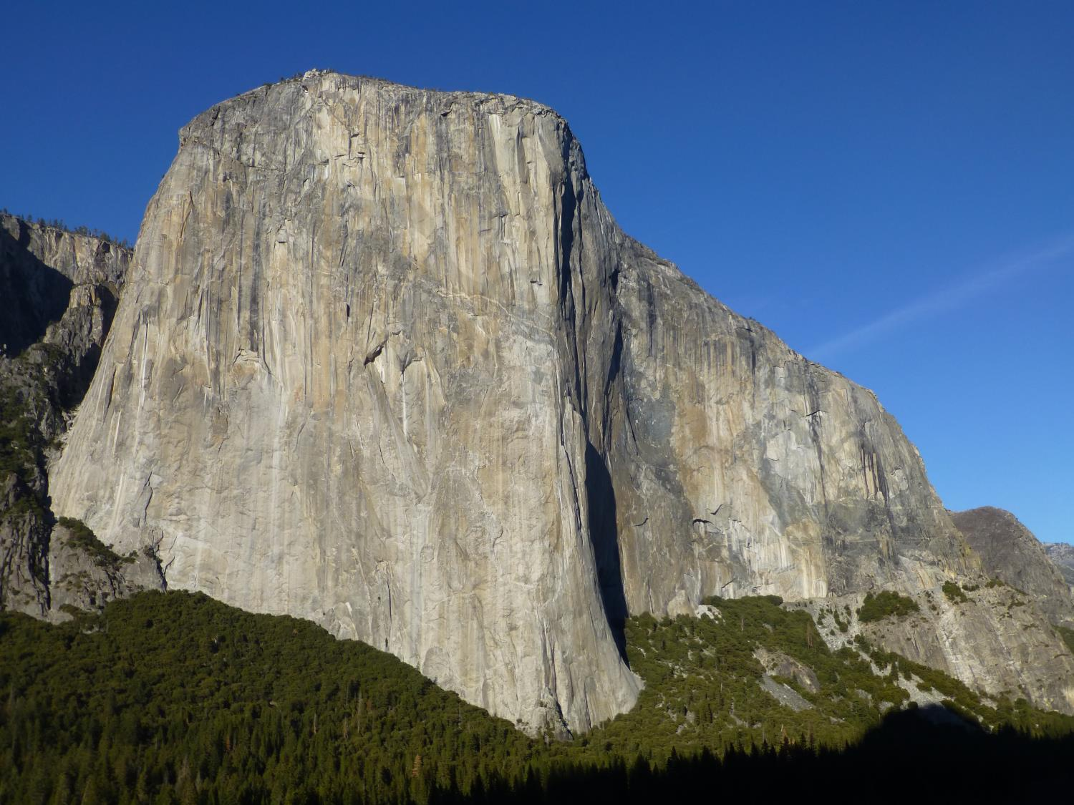

Interpreting the geology of an icon: Igneous petrology, rock climbing, and science communication in Yosemite National Park
Roger L. Putnam^{1, 2}, Greg M. Stock²
¹Department of Earth Science, Columbia College, Sonora, CA 93570
²National Park Service, Yosemite National Park, El Portal, CA 95318

Slide 2
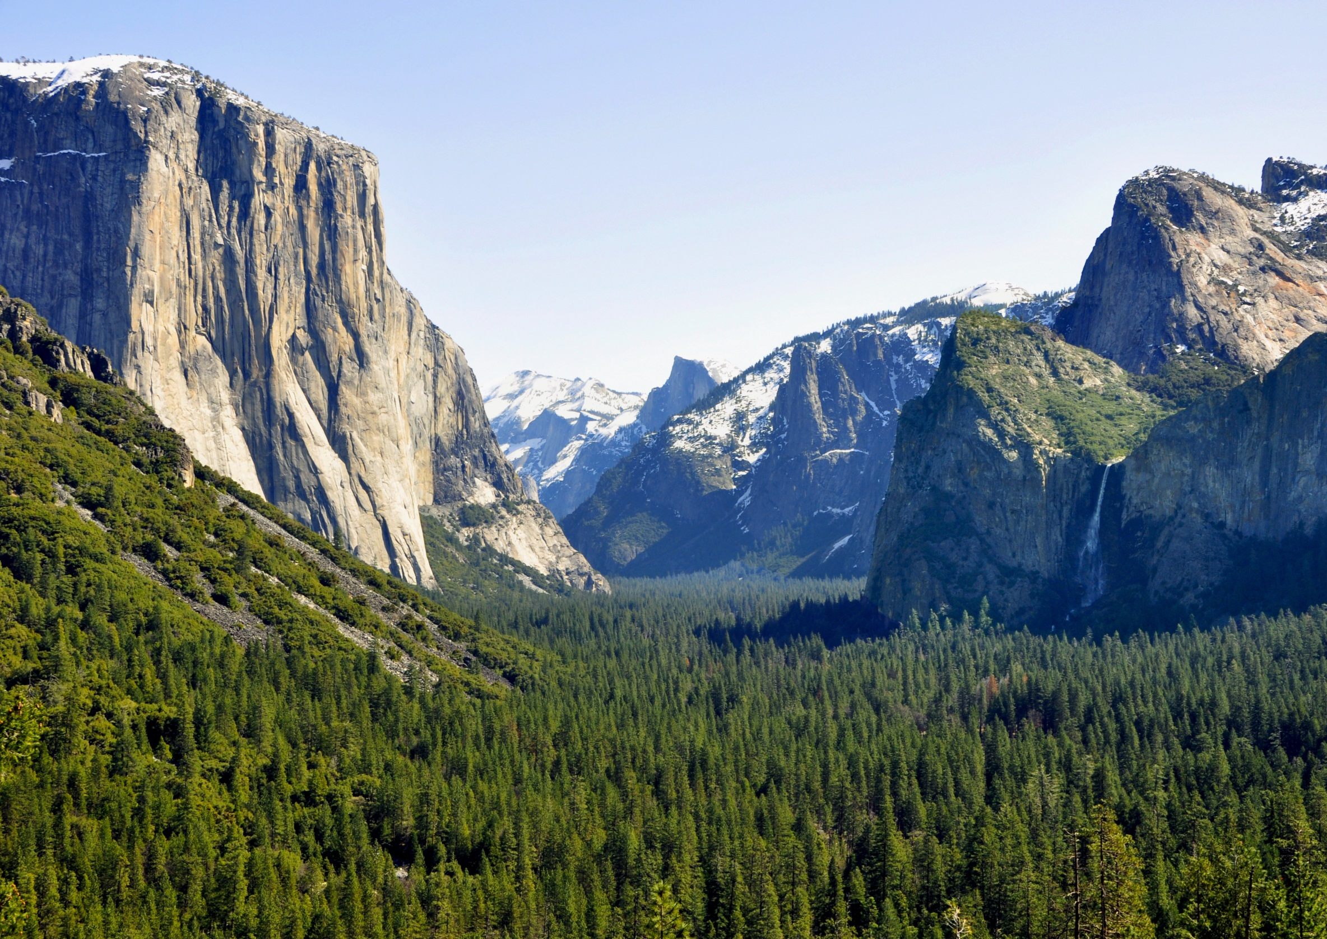
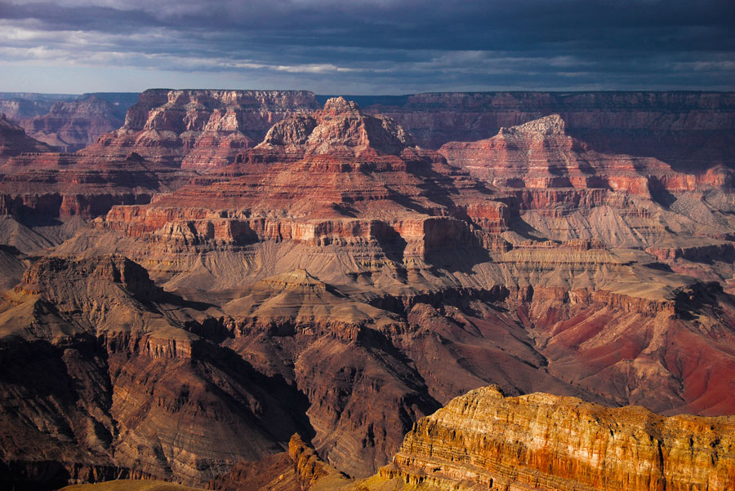
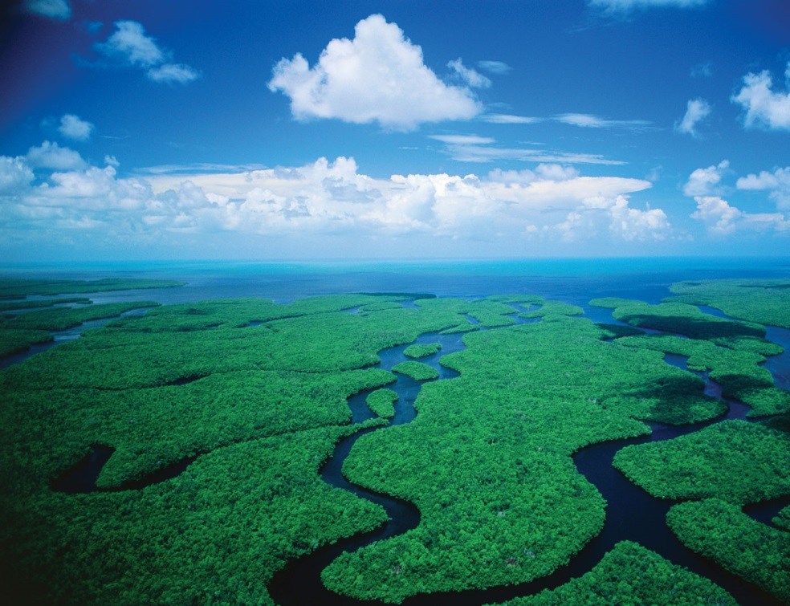
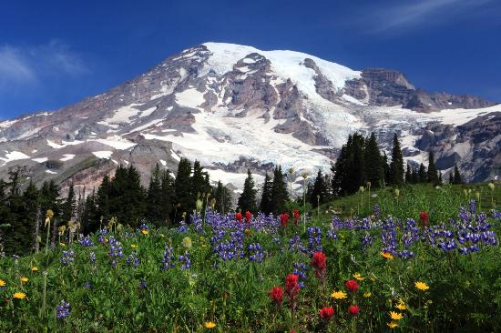
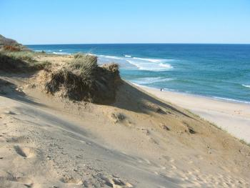
Introduction
http://www.ownersrental.com/rv-rentals-arizona/
http://goista.com/everglades-national-park-the-3rd-largest-national-park-in-the-usa/
http://www.tripadvisor.ca/LocationPhotos-g143044-w2 Mount_Rainier_National_Park_Washington.html

Slide 3
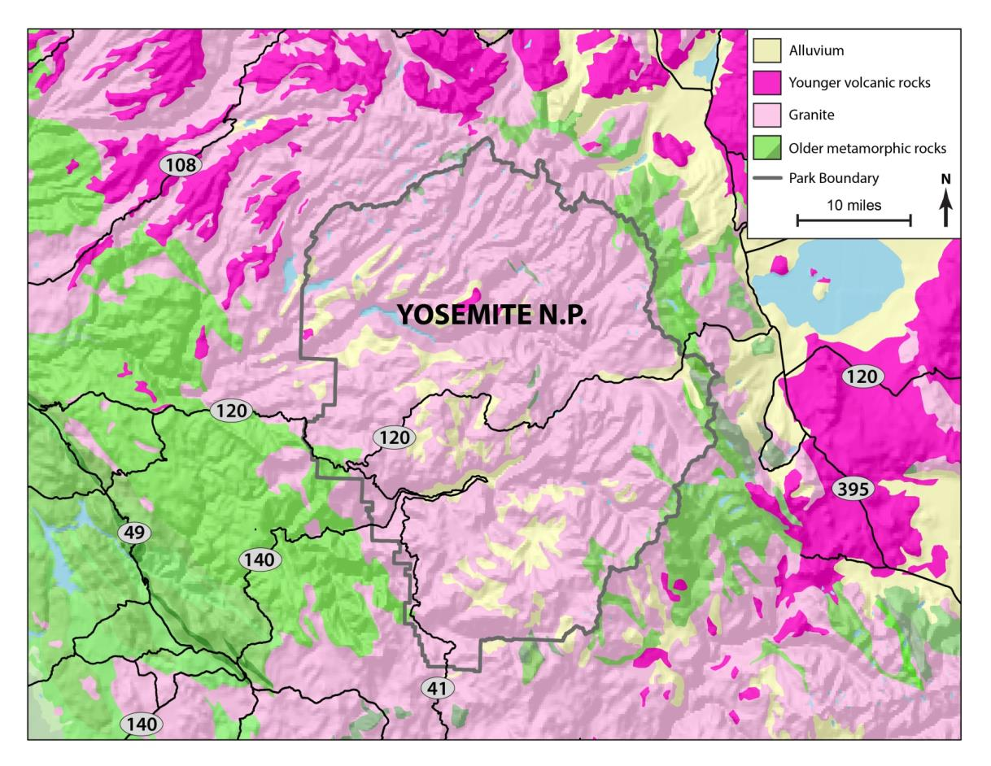
Introduction

Slide 4
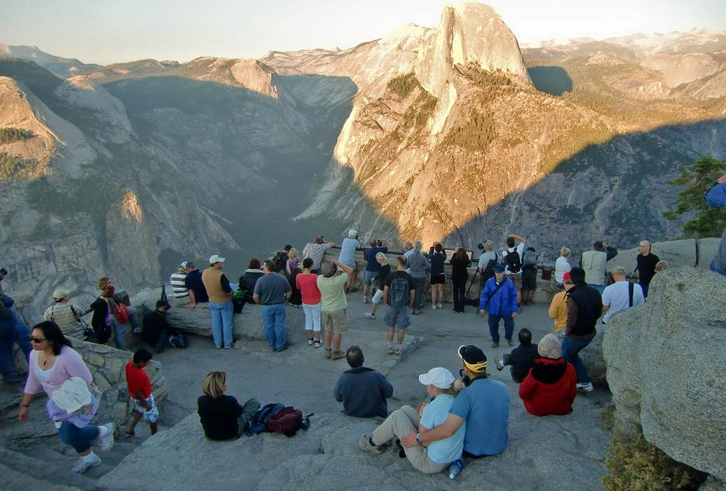
Interpreting Granite
Interpretation
Yosemite is visited by ~4 million people/year from all over the world
Perfect opportunity to interpret the story of granitic rocks, which is important!
Photo: http://mrhalfdome.files.wordpress.com/2010/09/crowd-at-glaciaer-point.jpg

Slide 5
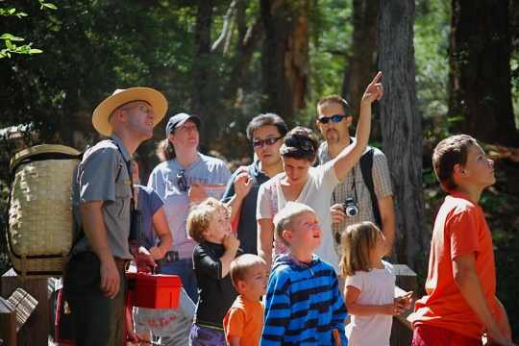
Interpreting Granite
Interpretive material on granitic rocks was based on King Huber’s work from the 1980s
Scientifically and socially outdated
Photo: http://fw293blackbear.wikispaces.com/

Slide 6
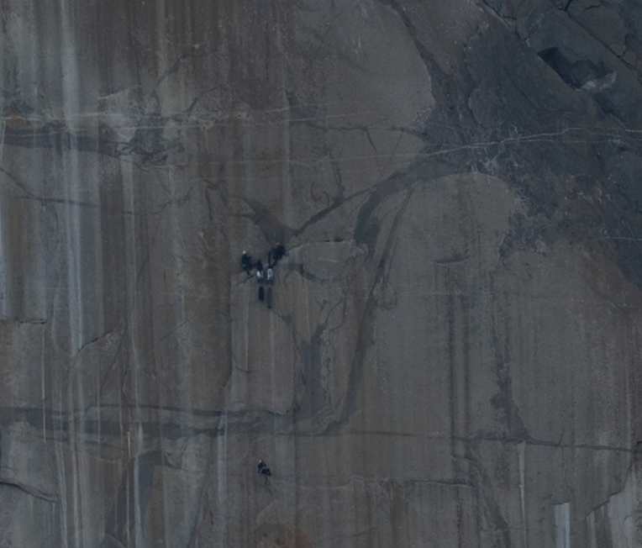
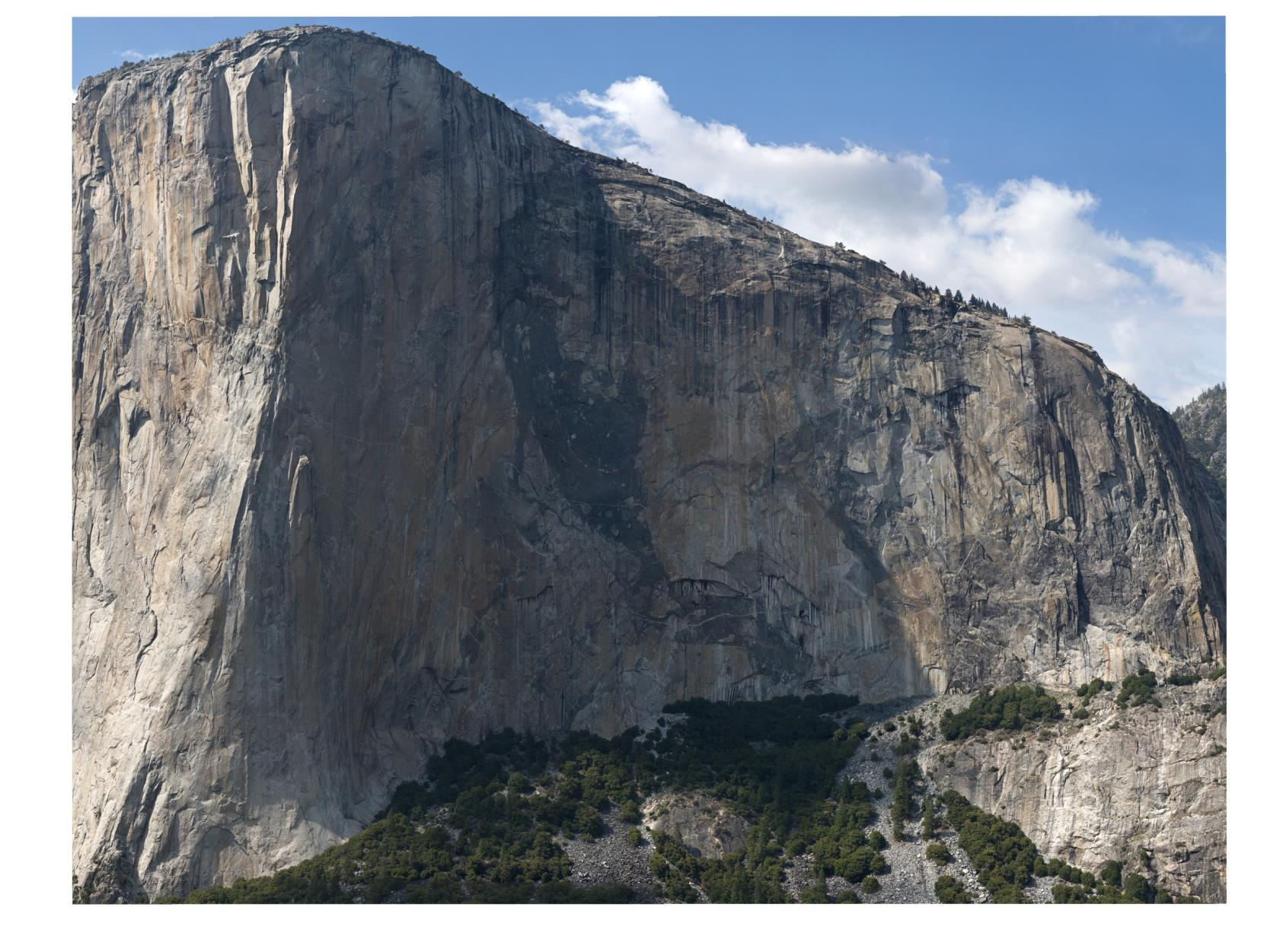
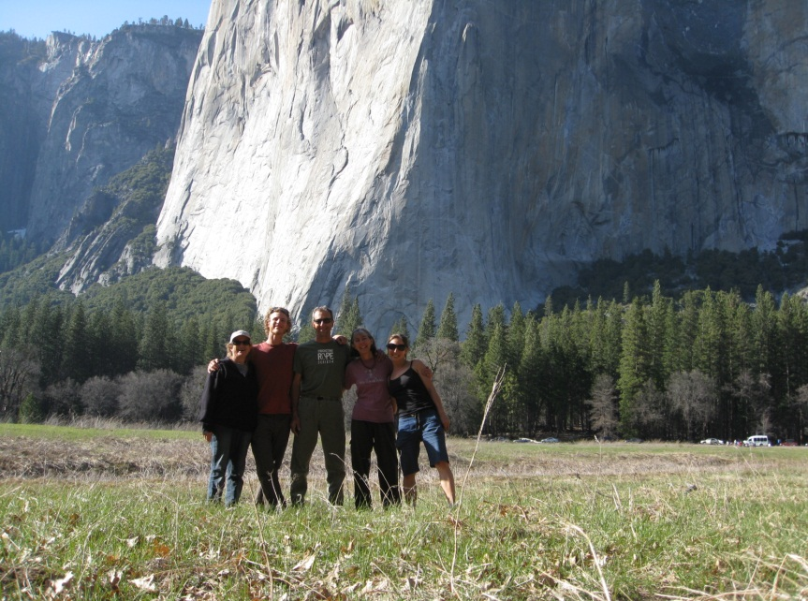
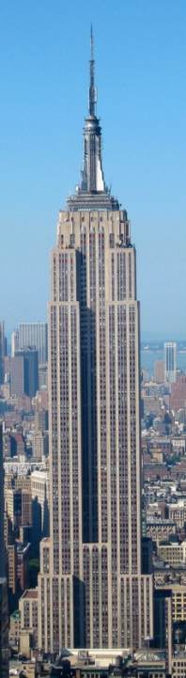
El Capitan
~1 km

Slide 7
Rock Climbing
Photo courtesy of Jimmy Chin

Slide 8
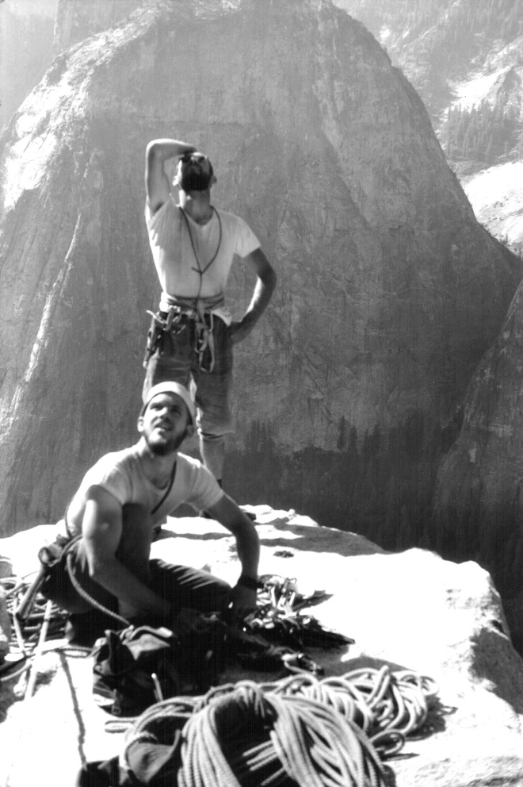
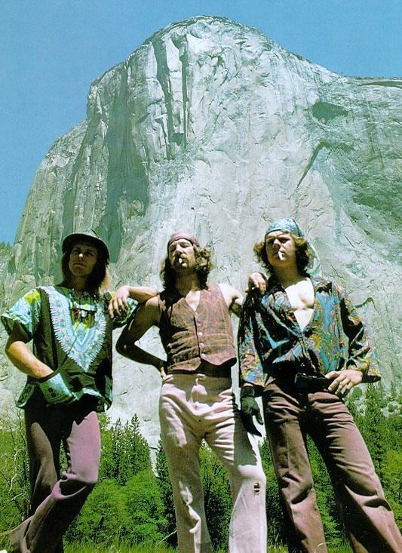
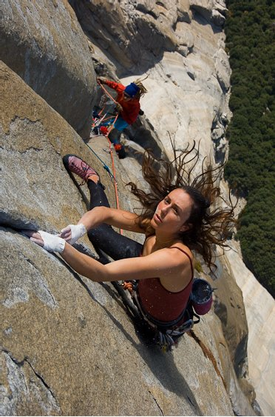
Rock Climbing
1960’s
1970’s
2000’s
Photos by (Left-Right): Tom Frost, Stone Masters, Jimmy Chin

Slide 9


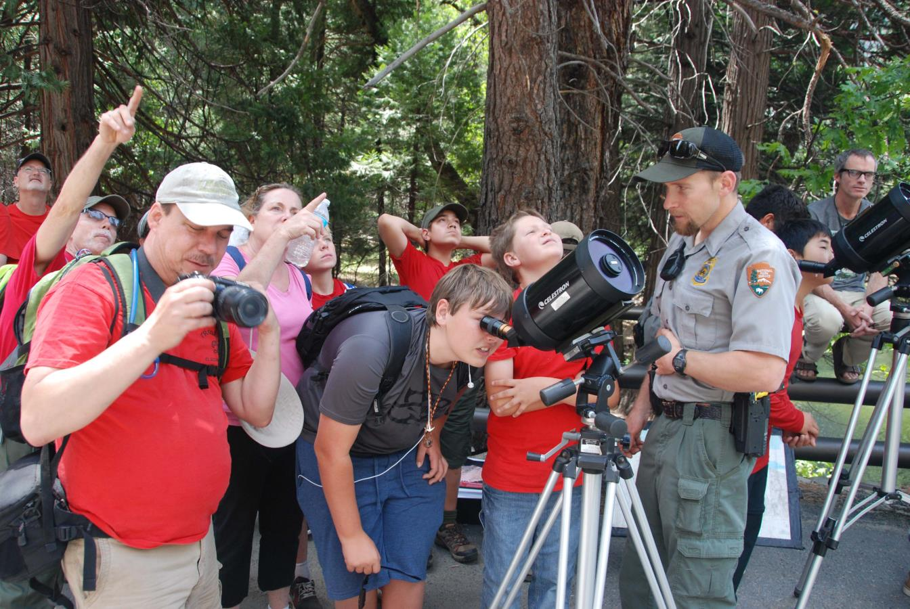
Ask a Climber Program
Photograph courtesy of Eric Bissel

Slide 10
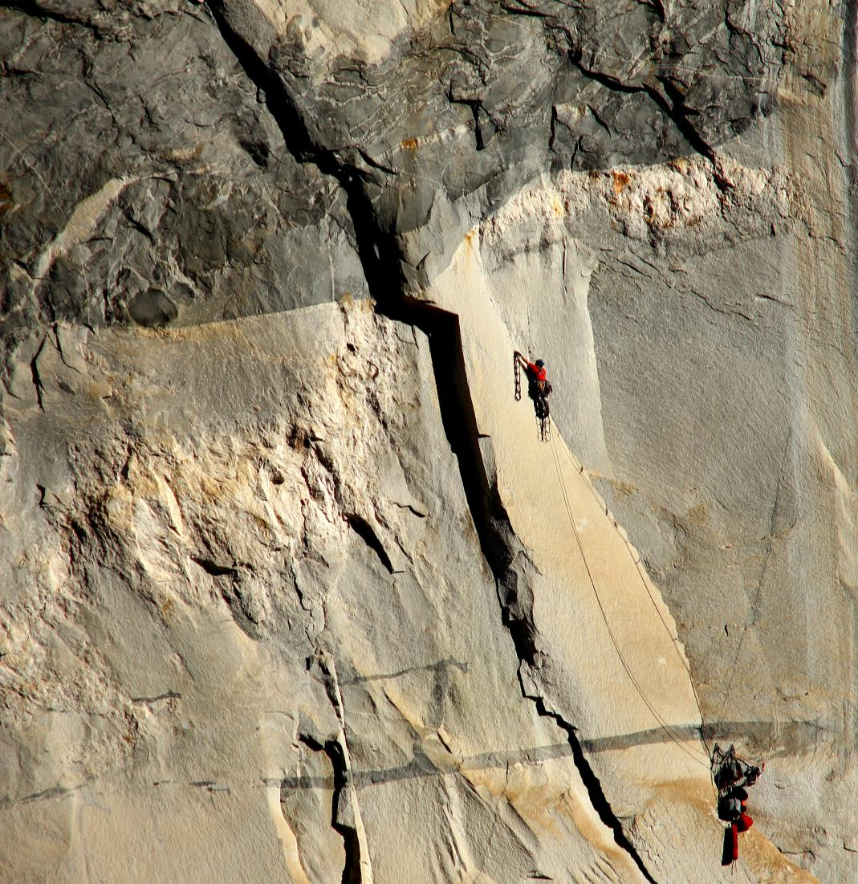
Rock Climbing!
Rock Climbing

Slide 11
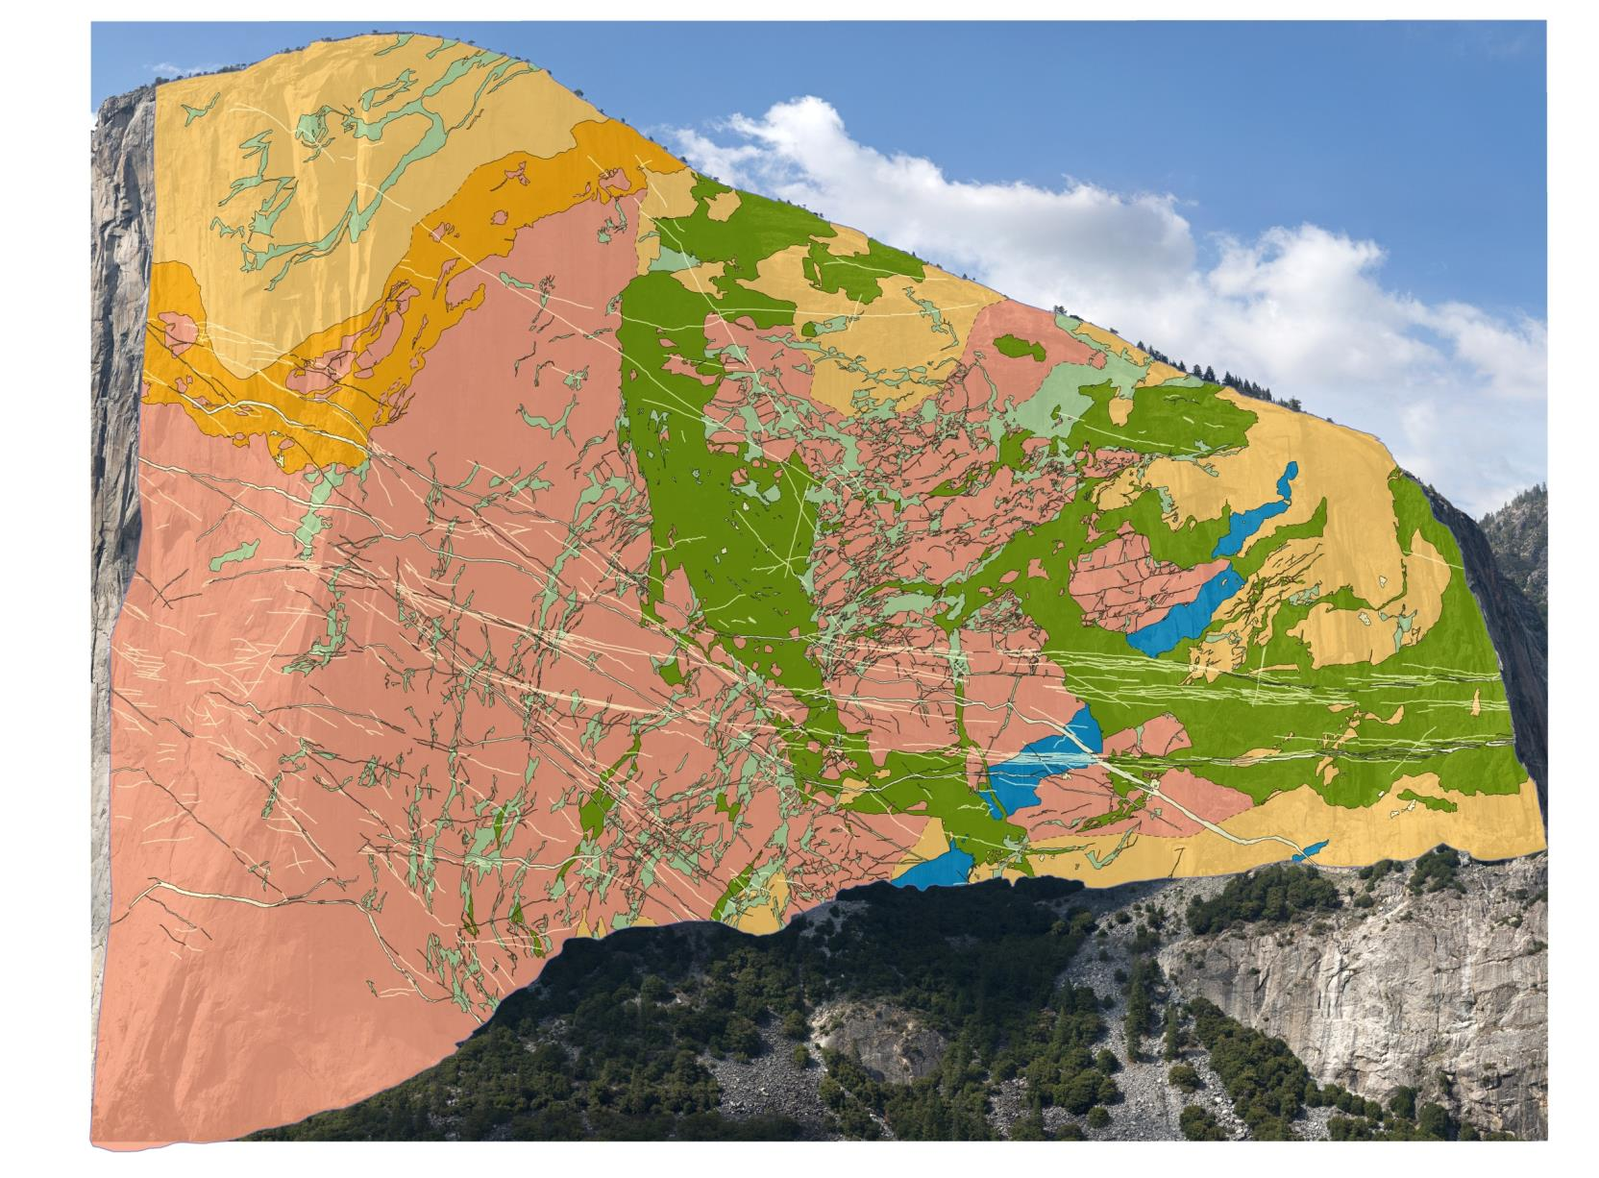
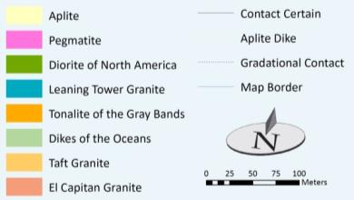
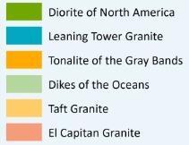

Vertical Variation
Mapping Methods

Slide 12
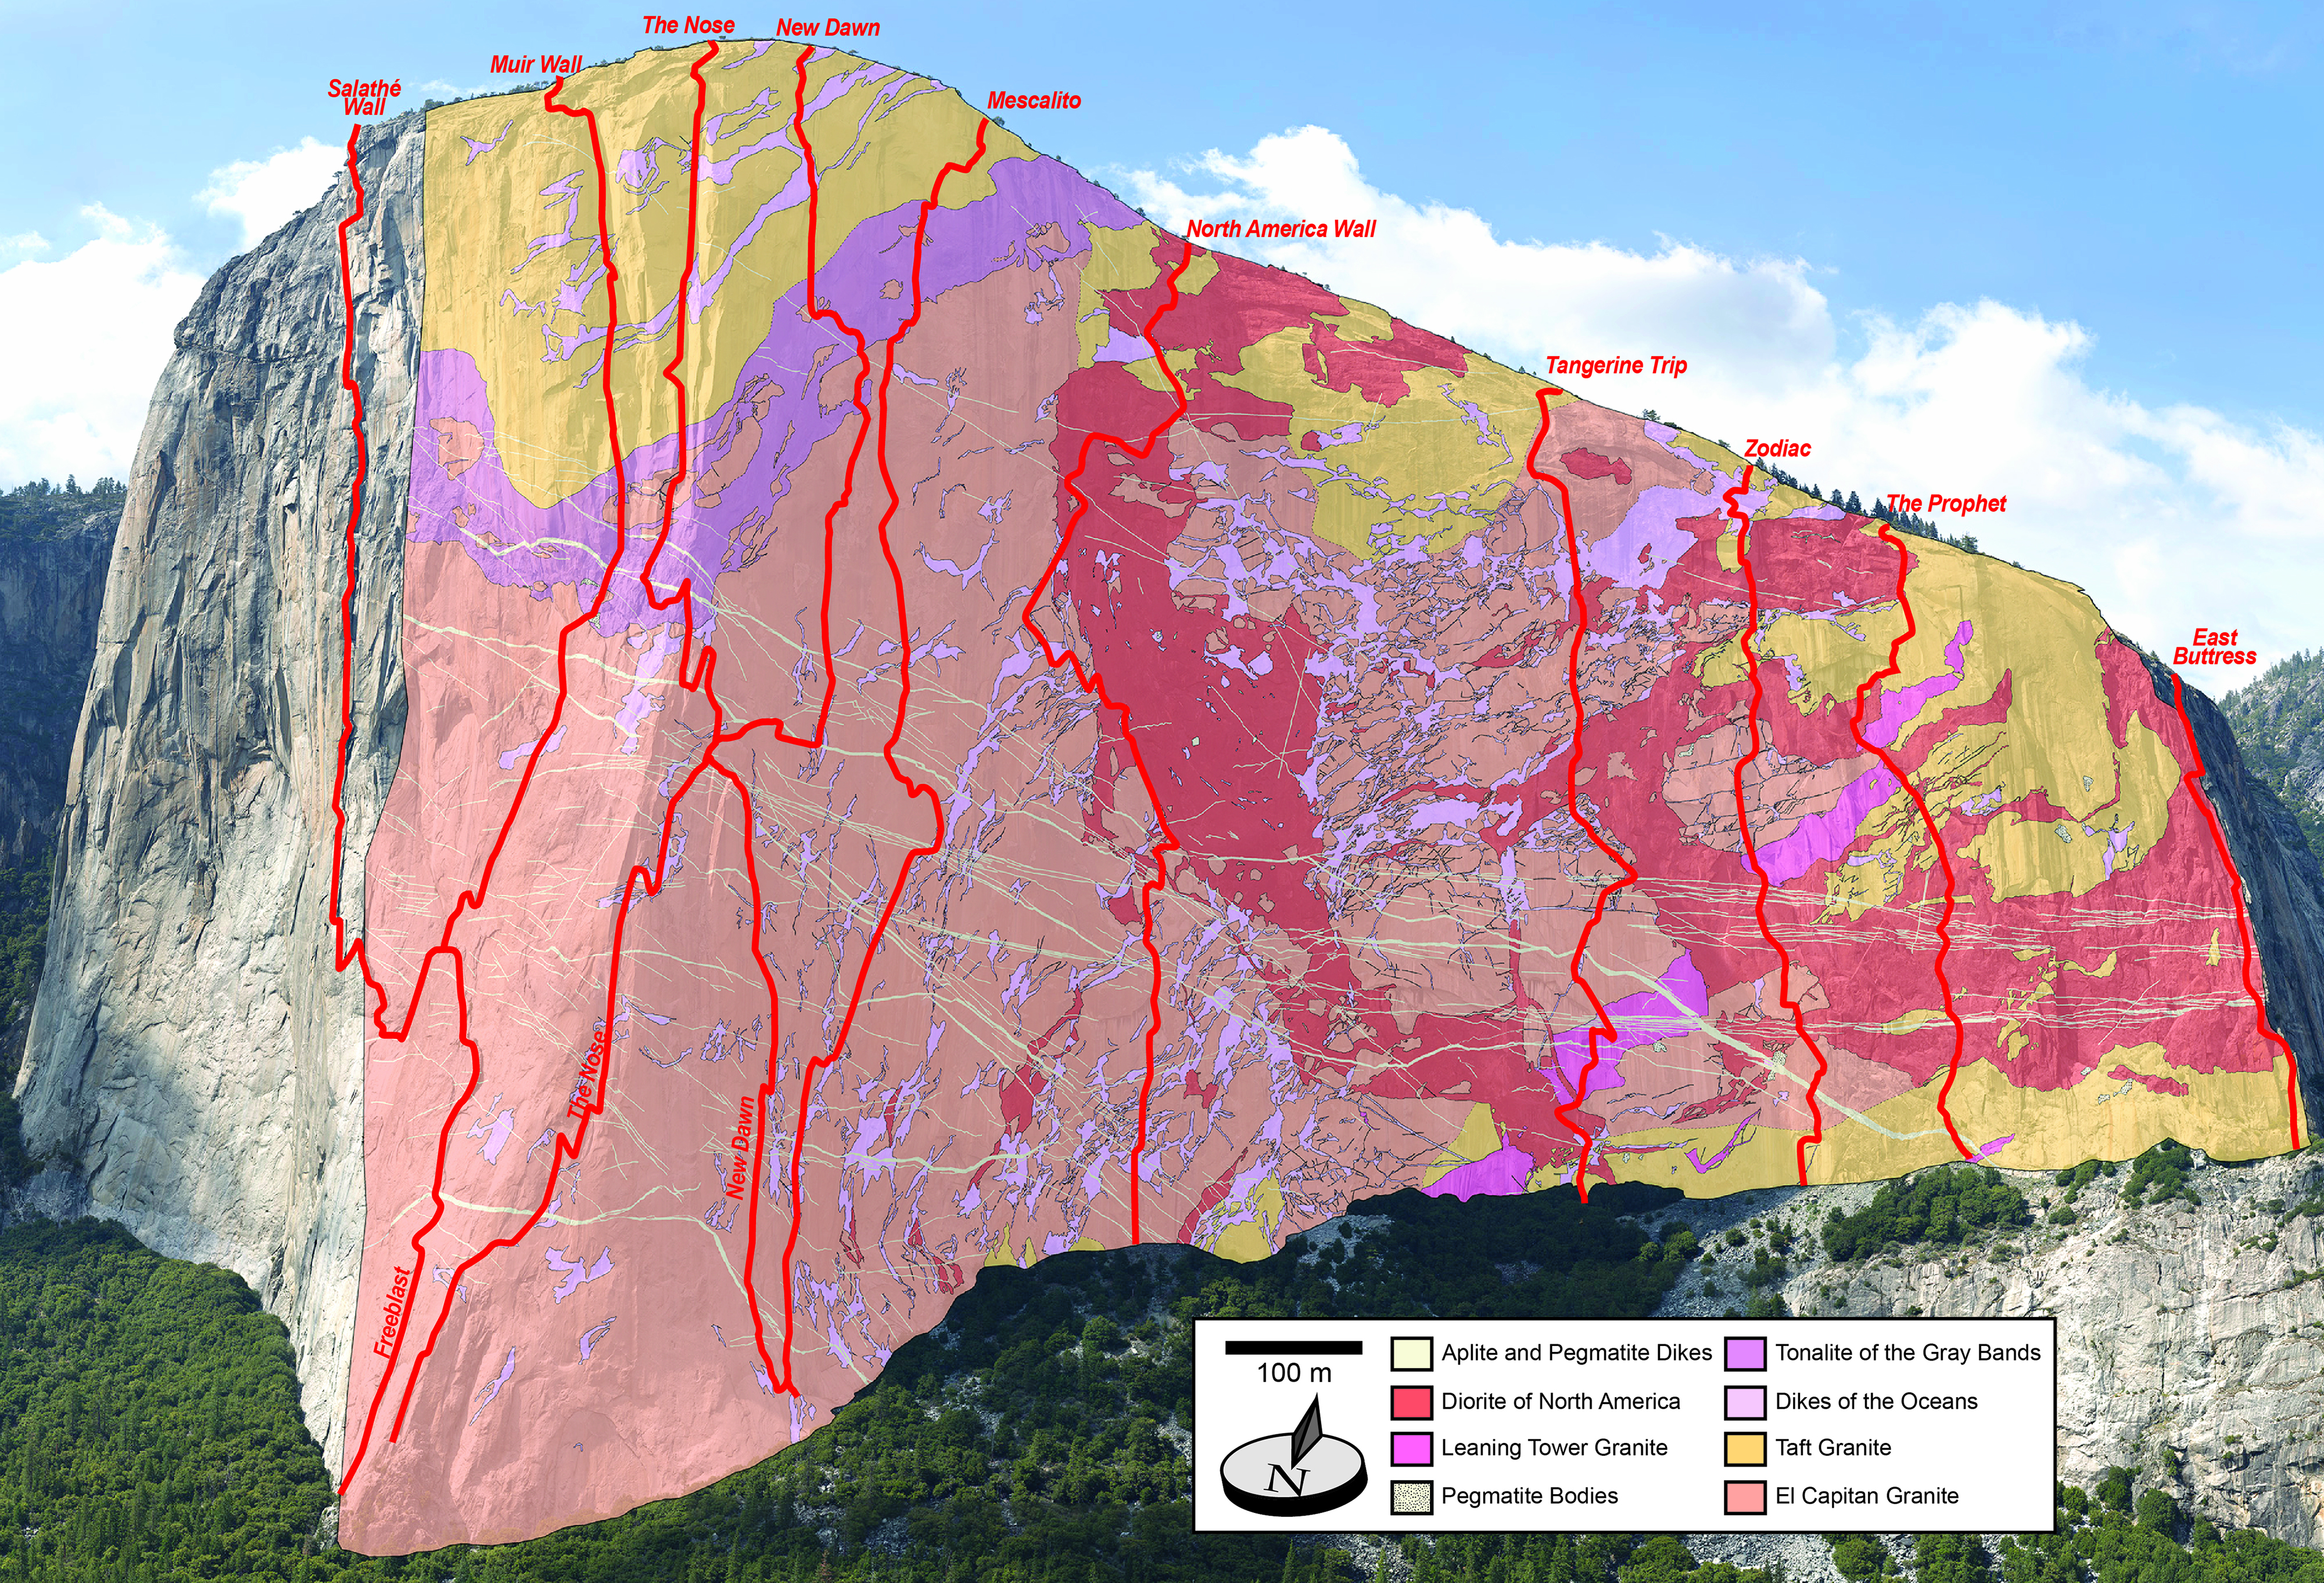
Interpretive Materials

Slide 13
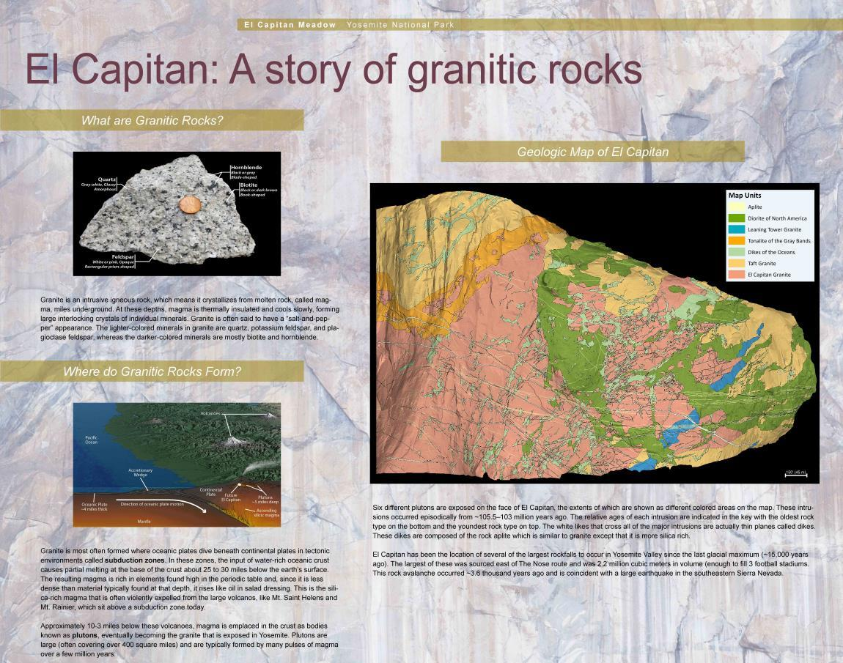
Interpretive Materials

Slide 14
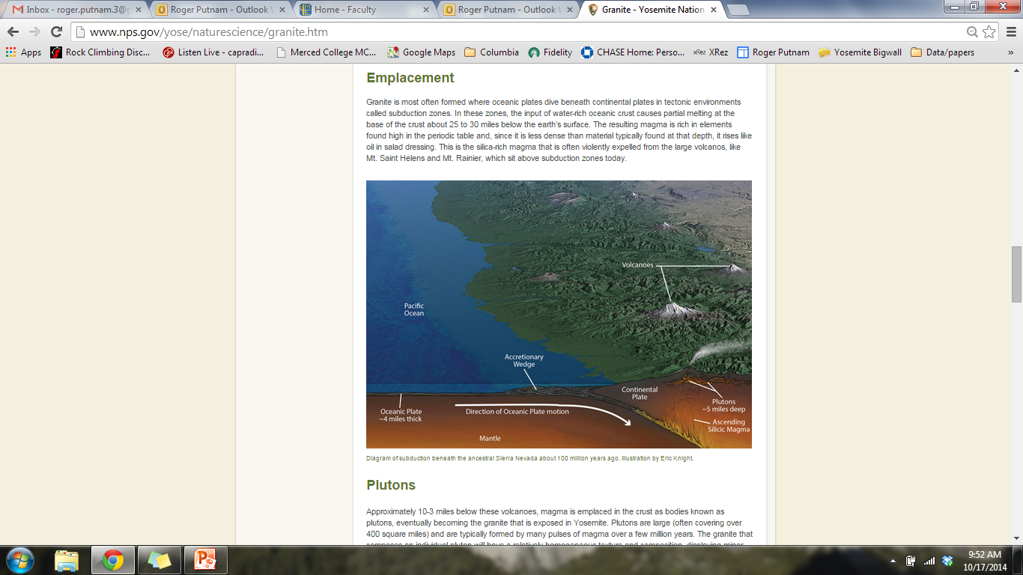
Interpretive Materials
http://www.nps.gov/yose/naturescience/granite.htm

Slide 15
Conclusion
Ask a Climber Program provides a platform to reach thousands of people
Interpretive tools were created to tell the story of granite
Product of collaboration between geologists, rock climbers, and the National Park Service
Contributes to science literacy

Slide 16
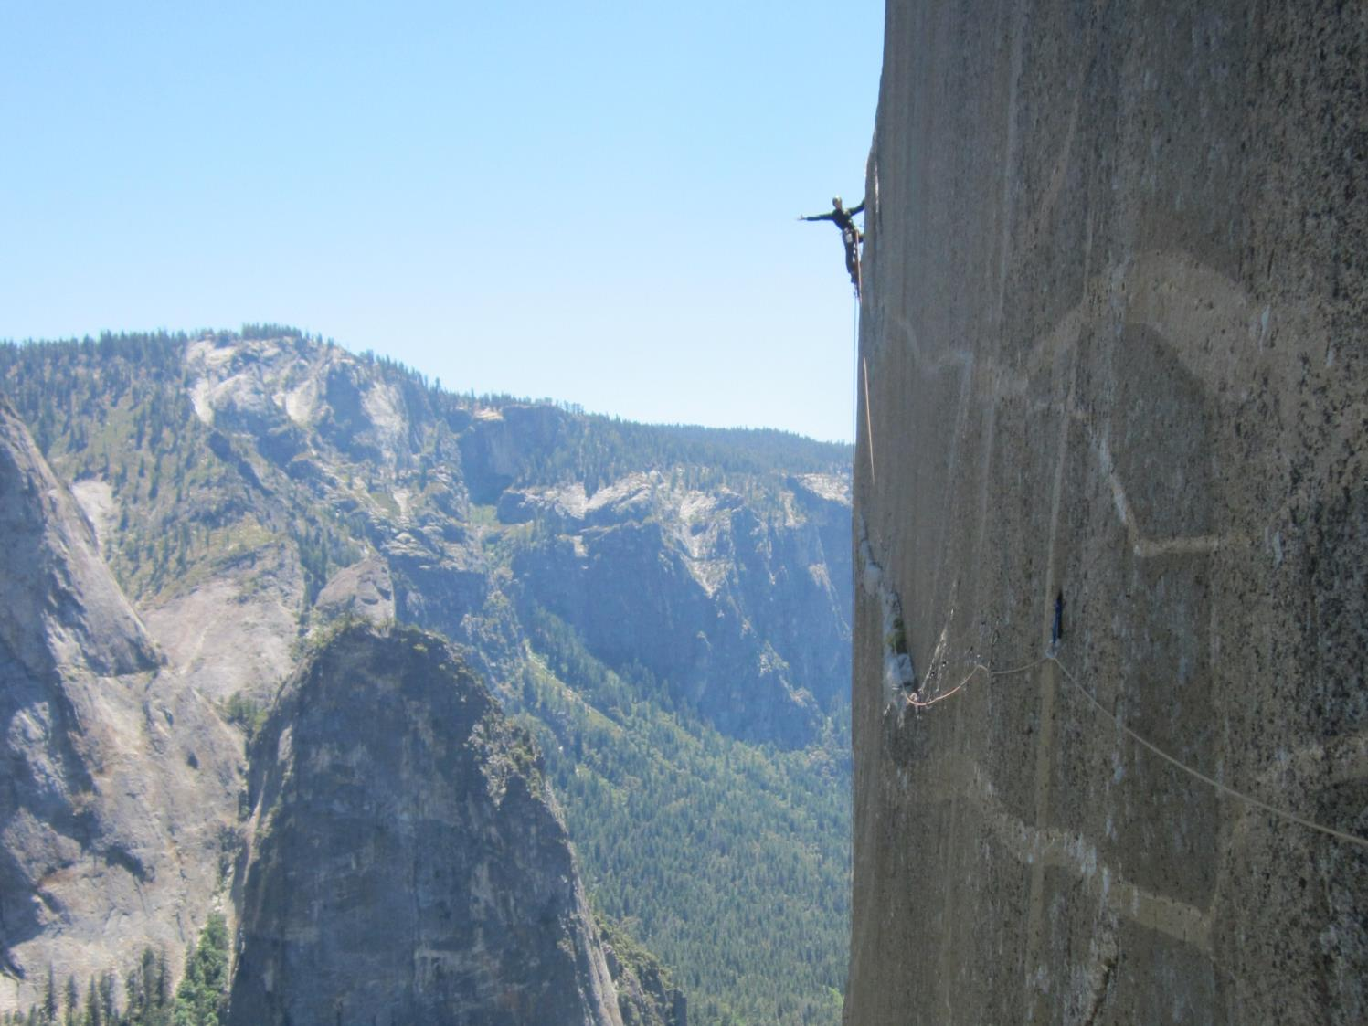

Questions?
Thanks to:
Dr. Allen Glazner, Dr. Drew Coleman, Bryan Law, and the ~30 other geologists and climbers who participated in the geologic mapping of El Capitan.

Slide 17
Mapping Methods

Slide 18
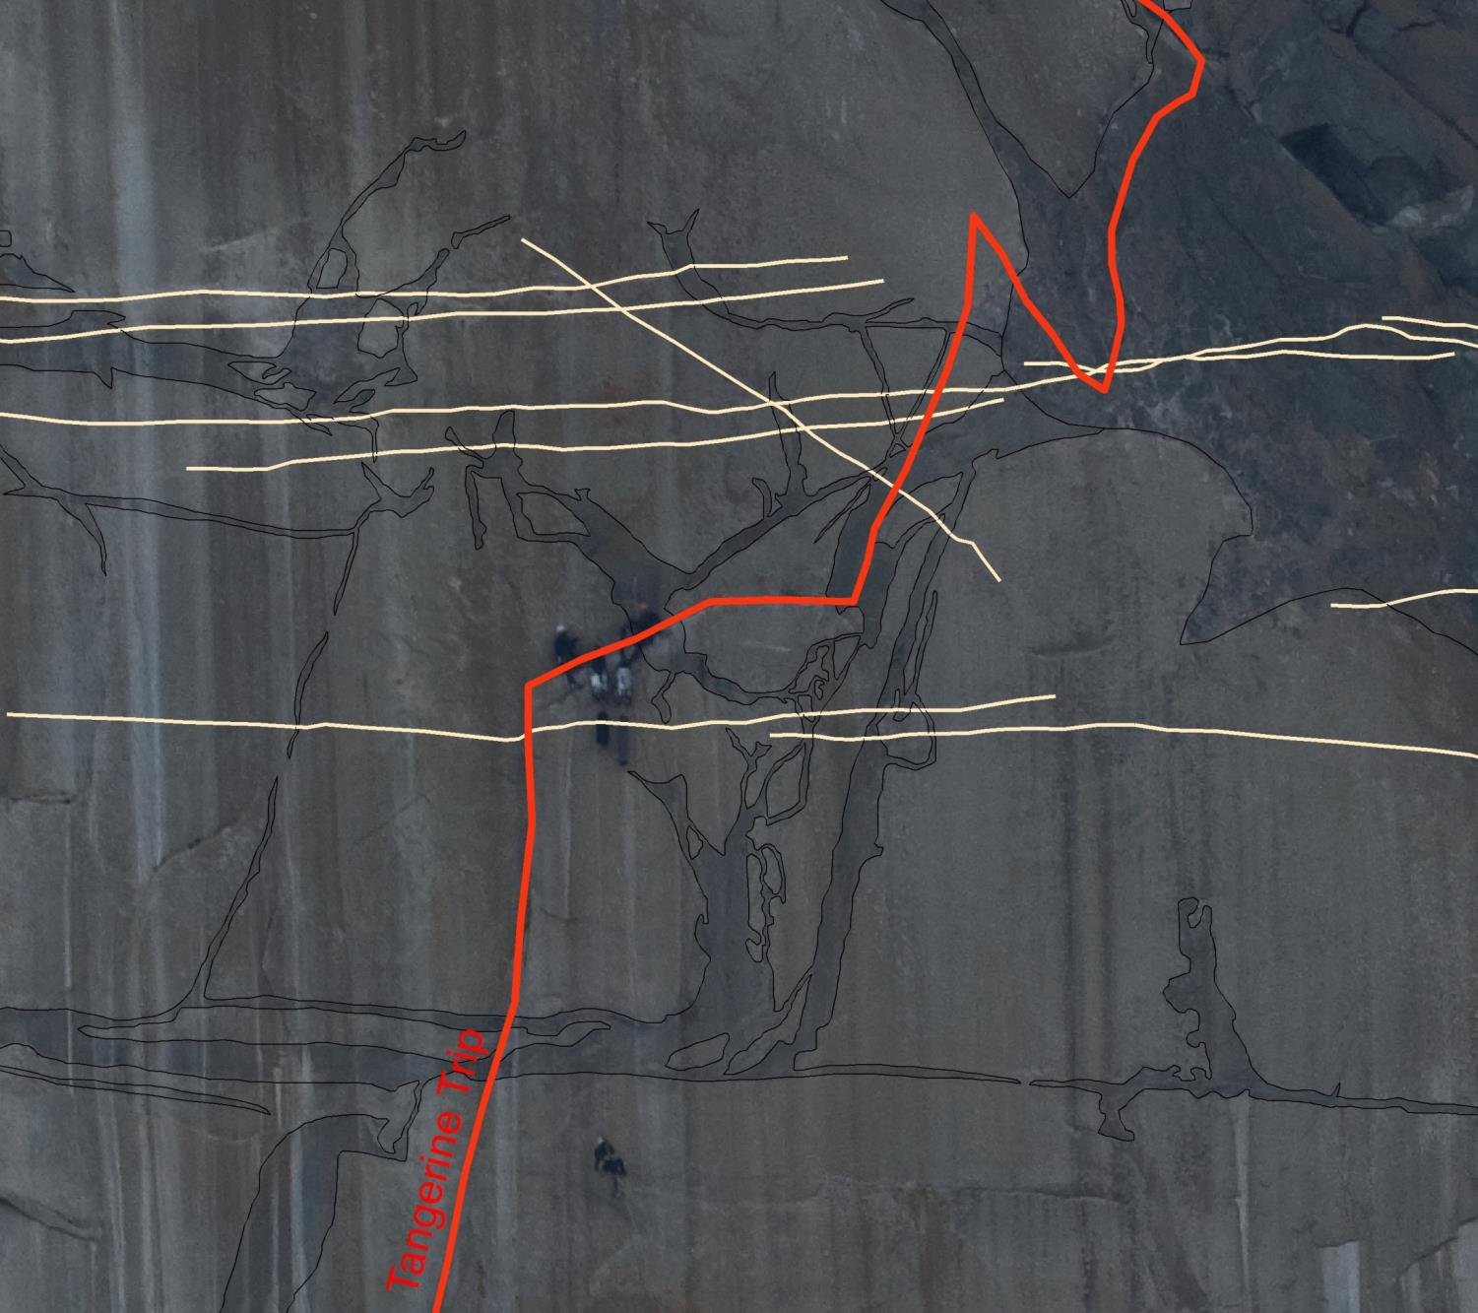
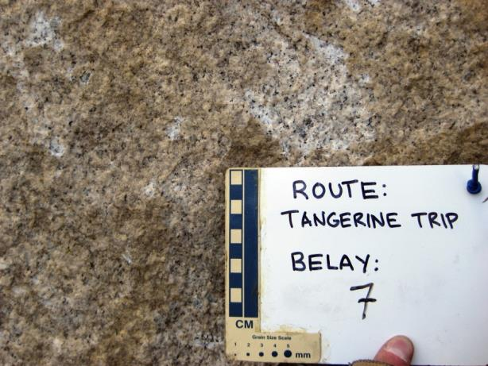
Mapping Methods

Slide 19
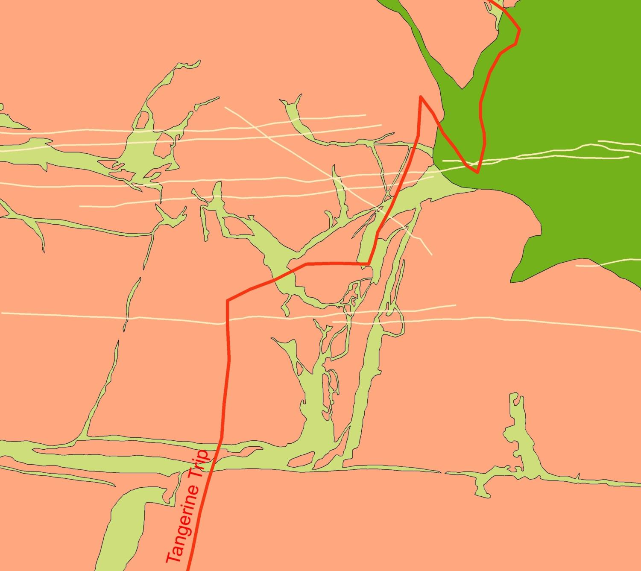
Mapping Methods
Diorite of North America
Dikes of the Oceans
El Capitan Granite

Slide 20
Vertical Variation
Mapping Methods

Slide 21
Emplacement Chronology
Age
(Ma)
Aplite Dikes
103
Diorite of North America
103 ± 0.5 Ma (Laser ablation)
Leaning Tower Granite
104.05 ± 0.11 Ma (Isotope dilution)
Tonalite of the Gray Bands
Dikes of the Oceans
Taft Granite
106.65 ± 1.1 Ma (Laser ablation)
El Capitan Granite
105
105.9 ± 0.5 Ma (Laser ablation)

Slide 22
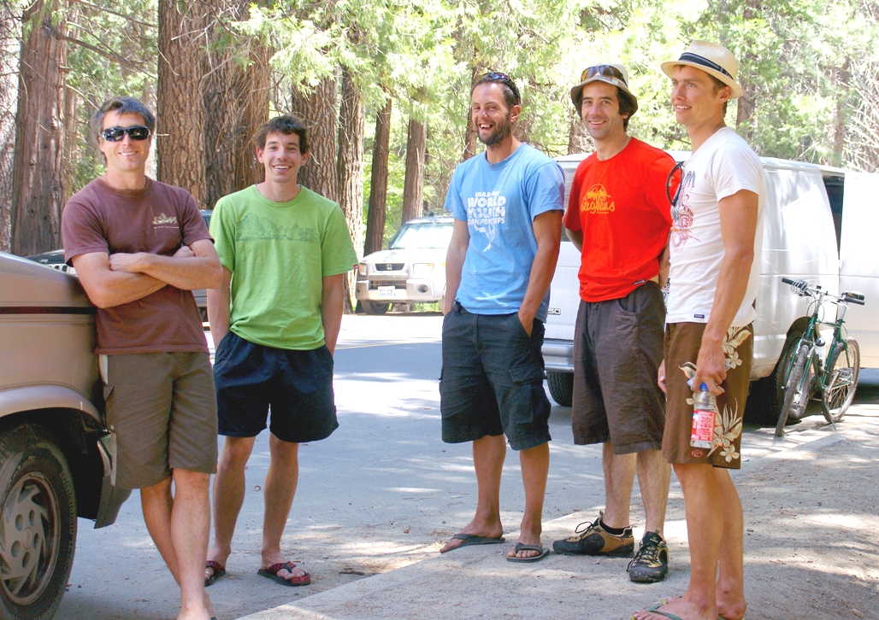
Ask a Climber Program
Photograph courtesy of Tom Evans

