Slide 1

Late Triassic Volcanics in north Great Xing’an Range, eastern Segment of the CAOB：
Implications for magma mixture of residual oceanic slabs and mantle melts
GSA Fall Meeting 2014-10-22
Xu Jiulei, Zheng Changqing, Xu Xuechun
Jilin University, China

Slide 2
Outline
Ⅰ. Geological Background
Ⅱ. Petrography
Ⅲ. Geochronology
Ⅳ. Geochemistry
Ⅵ. Petrogensis

Slide 3
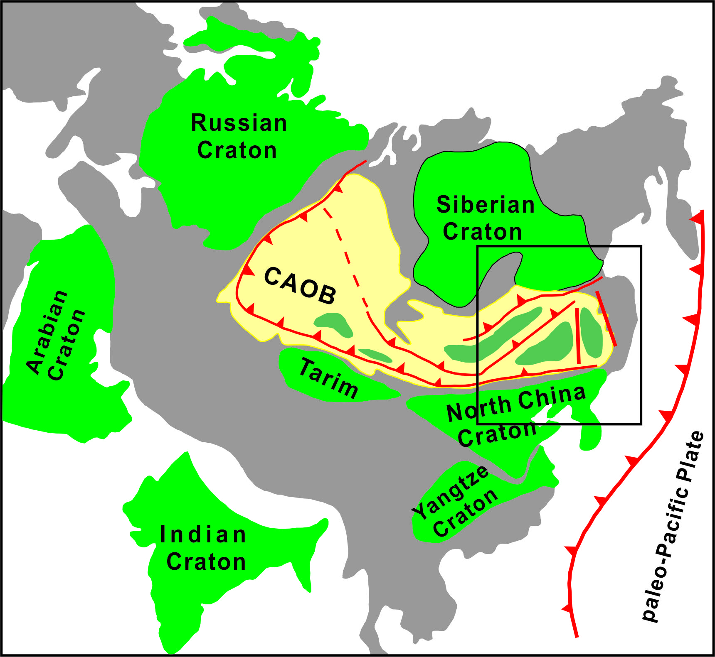
Ⅰ . Geological Background
In Paleozoic:
Paleo-Asian Oceanic
tectonic System
In Mesozoic:
Paleo-pacific
tectonic system
in the east
Mongol-Okhotsk
tectonic system
In the west
Sun, 2013

Slide 4
Ⅰ. Geological Background
Wu et al., 2011
Immense volumes
of granitic rocks from
Paleozoic to Mesozoic

Slide 5
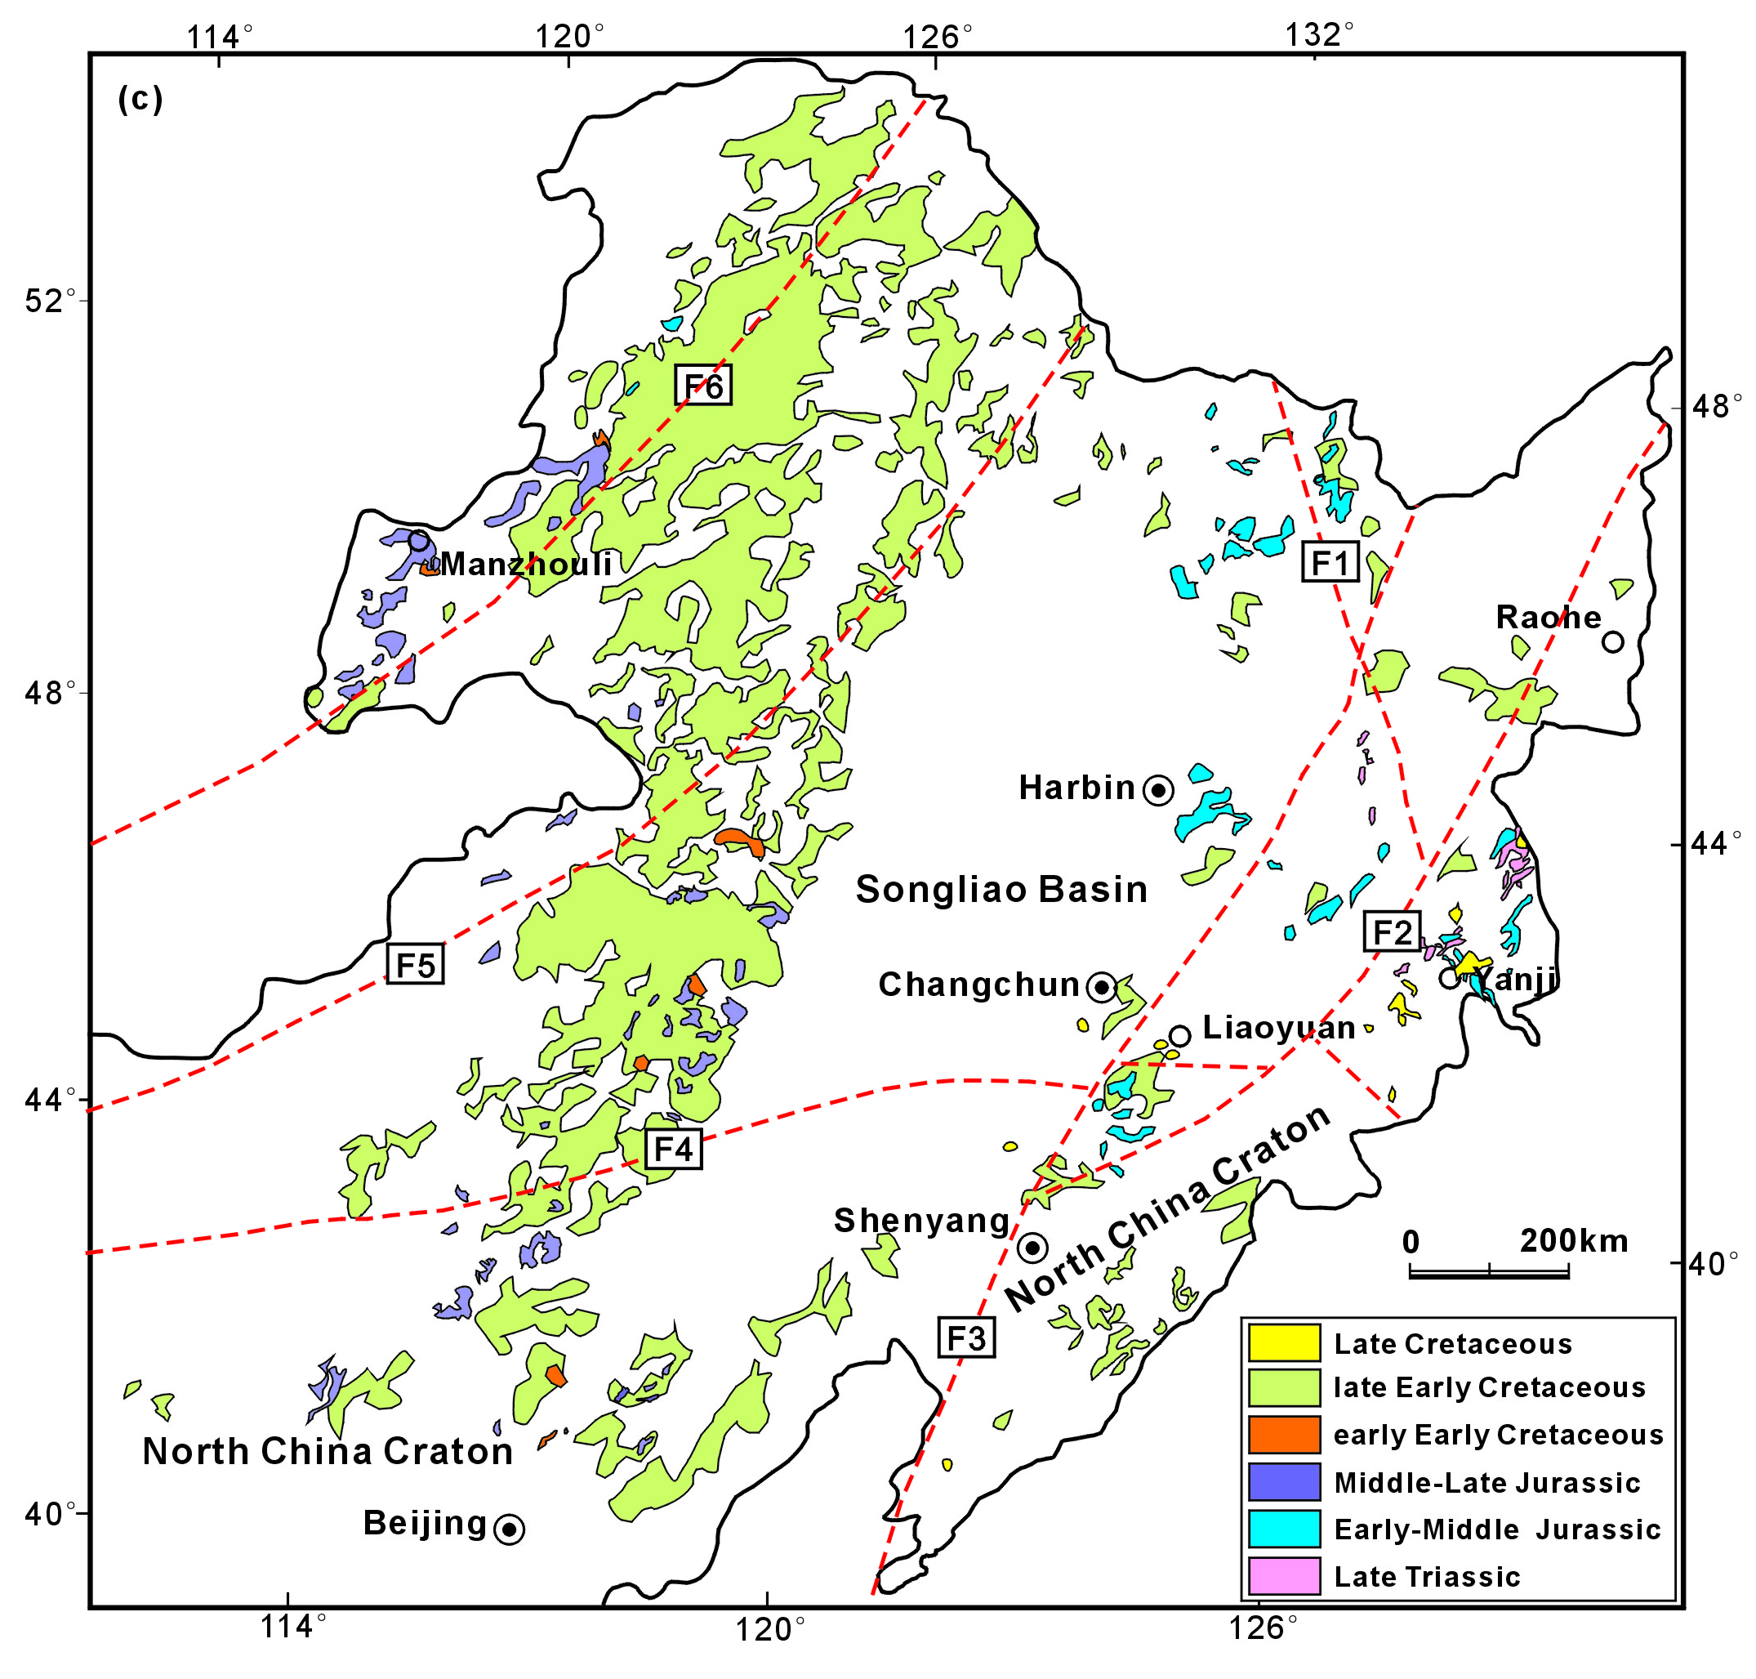
Ⅰ . Geological Background
Xu et al., 2013
Mesozoic volcanic rocks

Slide 6
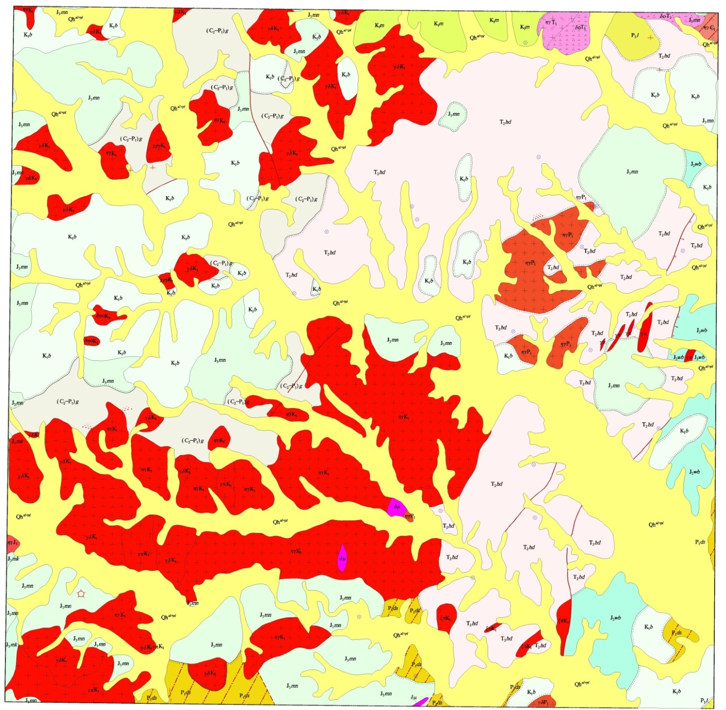
Ⅰ . Geological Background
Field relationship:
1. Intruded by Cretaceous Granites
2. Unconformity covered by Jurassic Volcanics
3. Unconformity on the Paleozoic Strata
Moguqi
1∶100,000 geological map

Slide 7
Ⅱ. Petrography
On the basis of field and microscopic features
we divided them into three groups:
1. Basaltic andesites
2. Andesites
3. Dacites

Slide 8

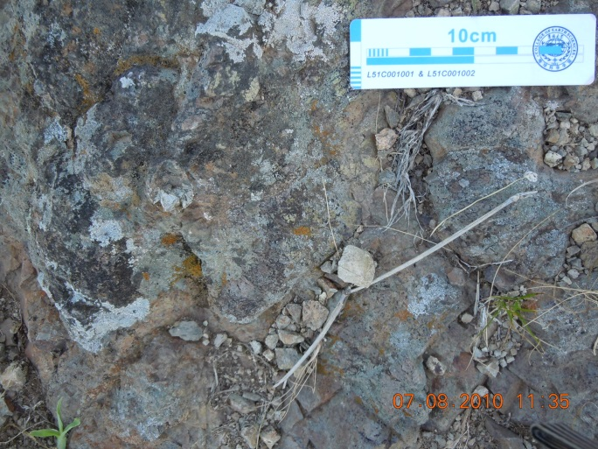
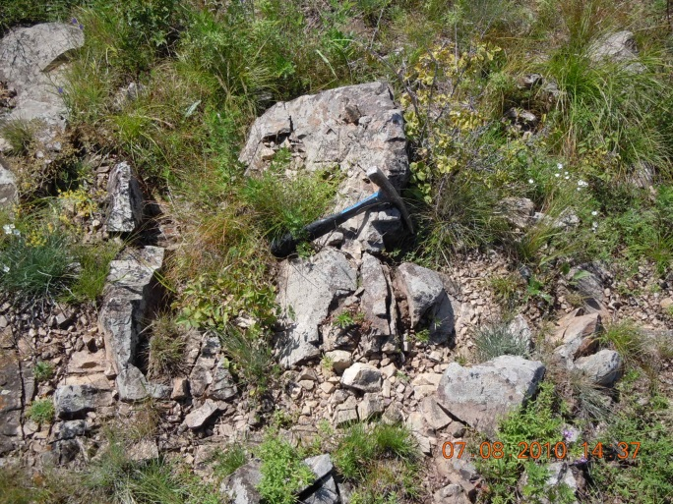
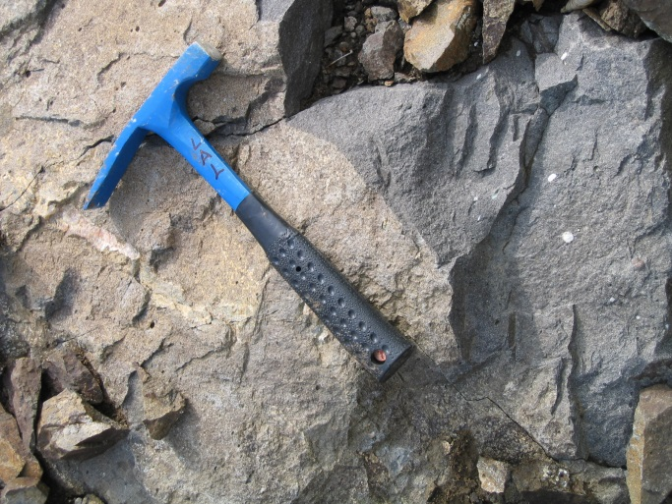
1. Basaltic andesites
Moguqi
1∶100,000 geological map

Slide 9
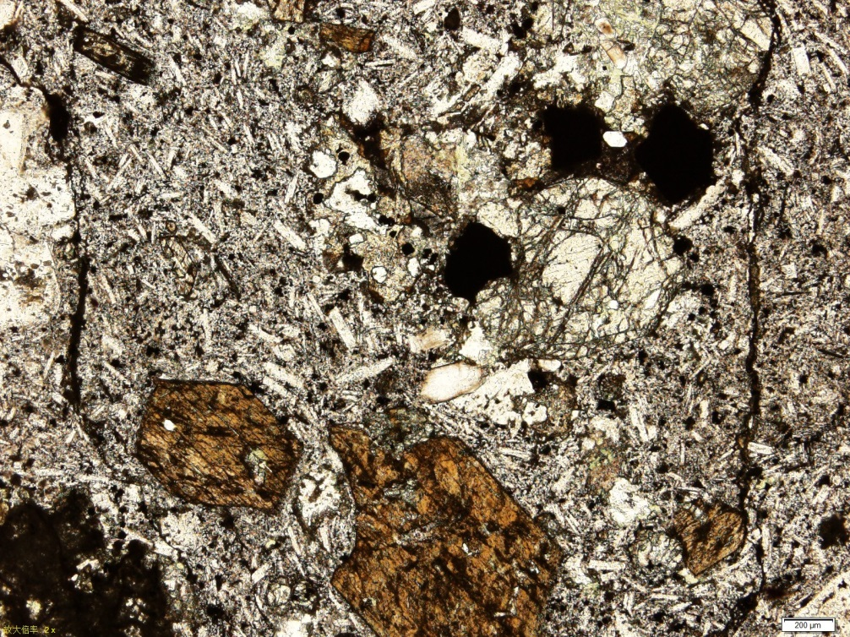
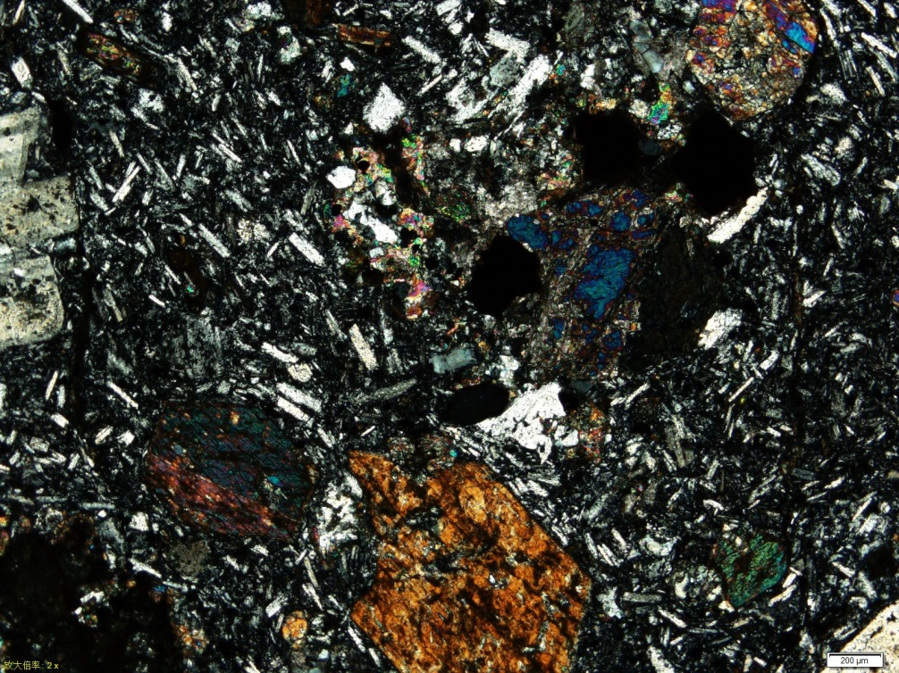
Ⅱ. Petrography
Augite andesite under the microscope:
Pl
Pl
Aug
Aug
Amp
Amp
augite andesite （B6002-2,PPL） augite andesite （B6002-2, XPL）

Slide 10
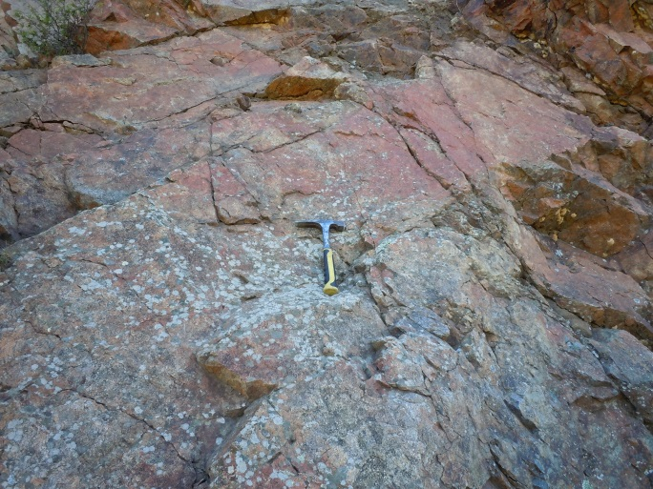
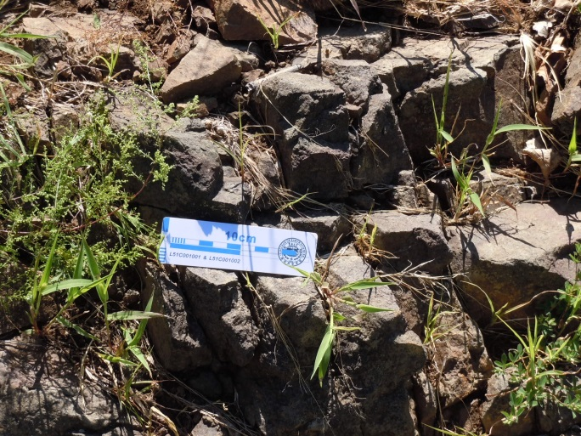
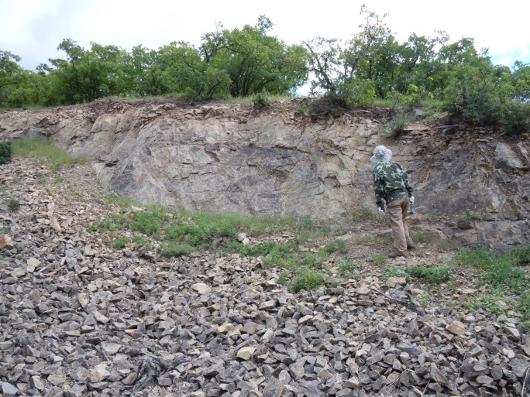
2. Andesites
Moguqi
1∶100,000 geological map

Slide 11
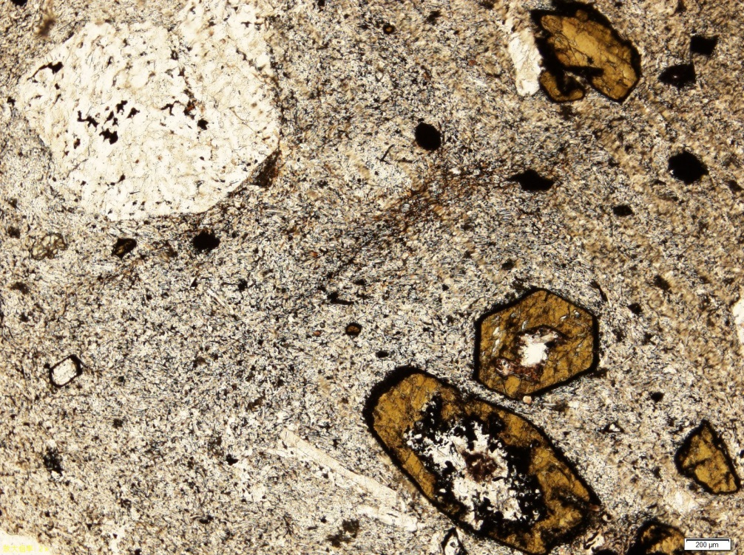
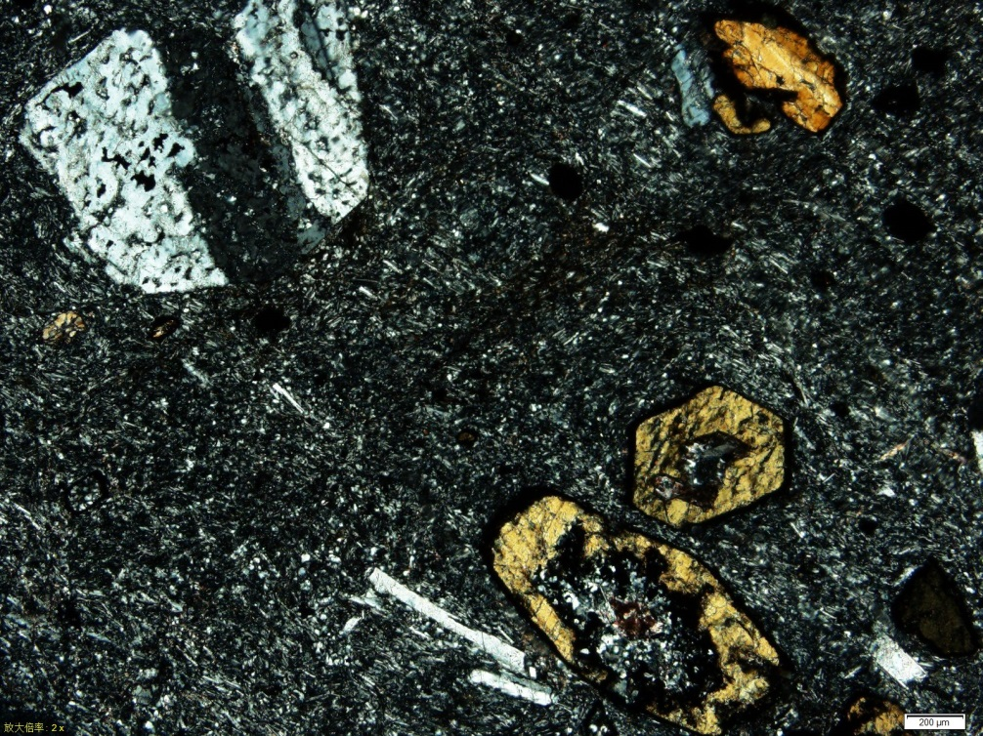
Ⅱ. Petrography
Andesites under the microscope:
Amp
Amp
Pl
Pl
Amp
Amp
andesite（B2068, PPL） andesite（B2068, XPL）

Slide 12
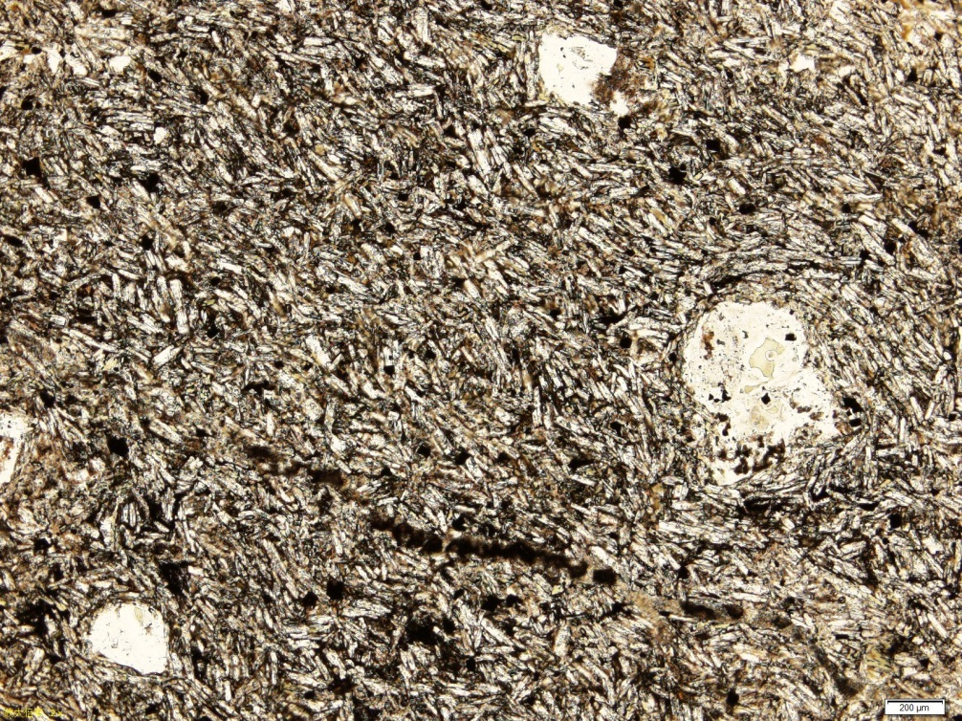
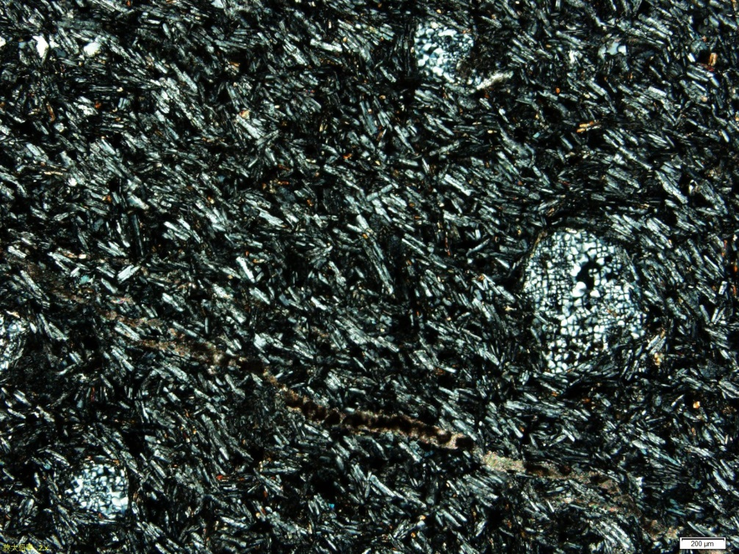
Ⅱ. Petrography
Andesites under the microscope:
Pl
Pl
andesite（Z11-51, PPL） andesite（ Z11-51, XPL ）

Slide 13
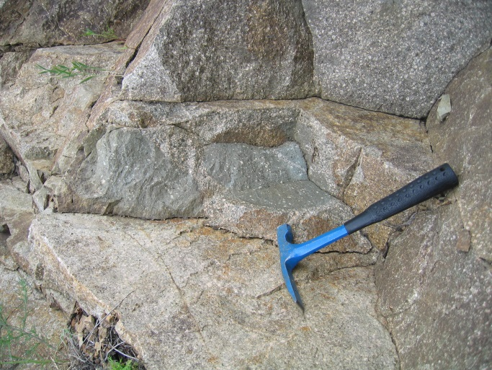
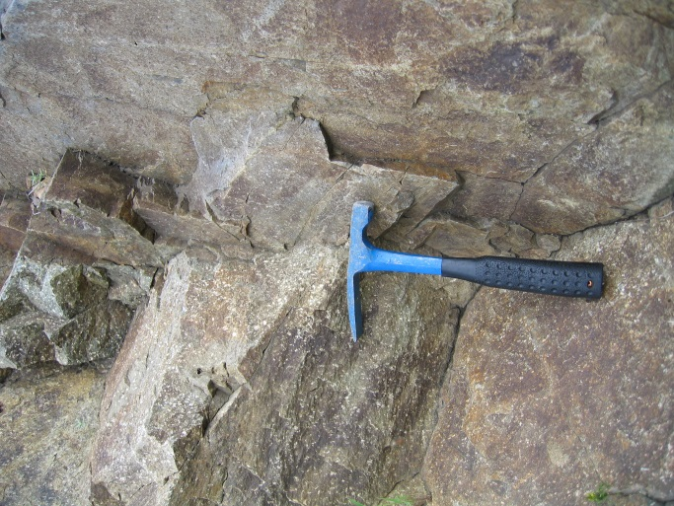
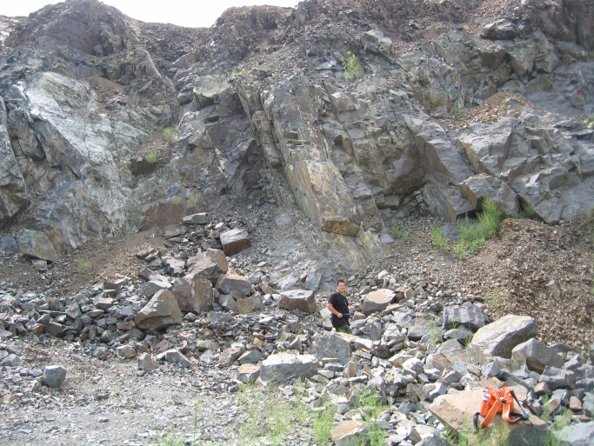
3.Dacites
Moguqi
1∶100,000 geological map

Slide 14
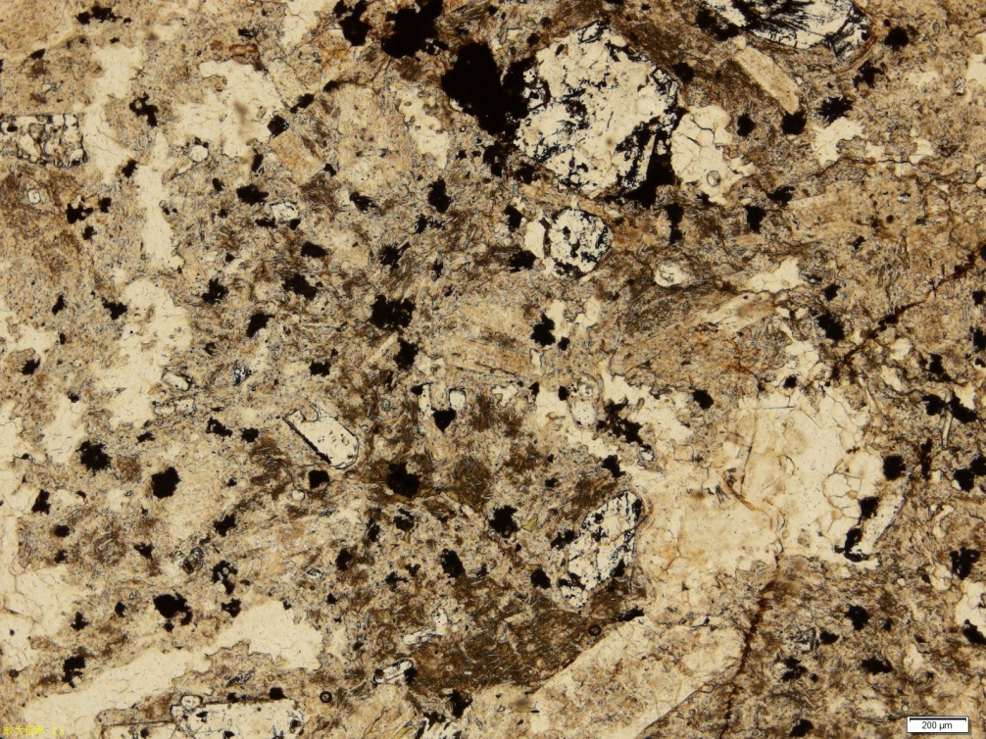
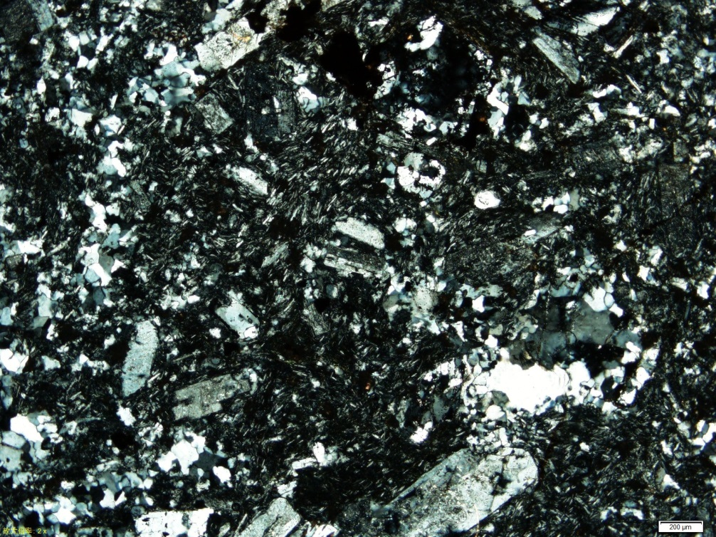
Ⅱ. Petrography
Dacite under the microscope:
Qtz
Qtz
Pl
Qtz
Qtz
Pl
dacite（Z11-47, PPL） dacite（Z11-47, XPL）

Slide 15
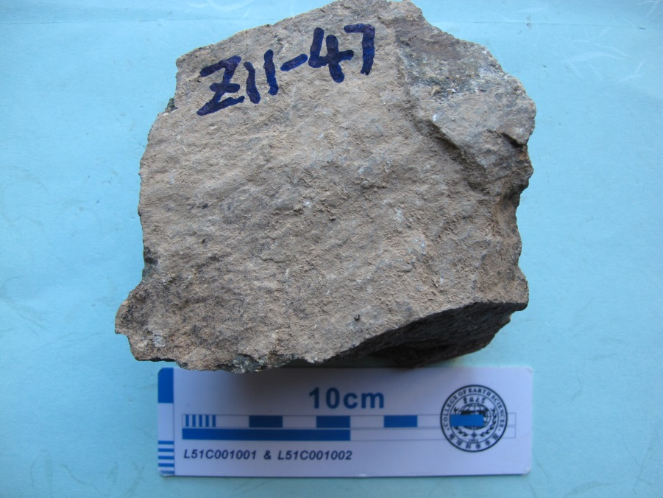
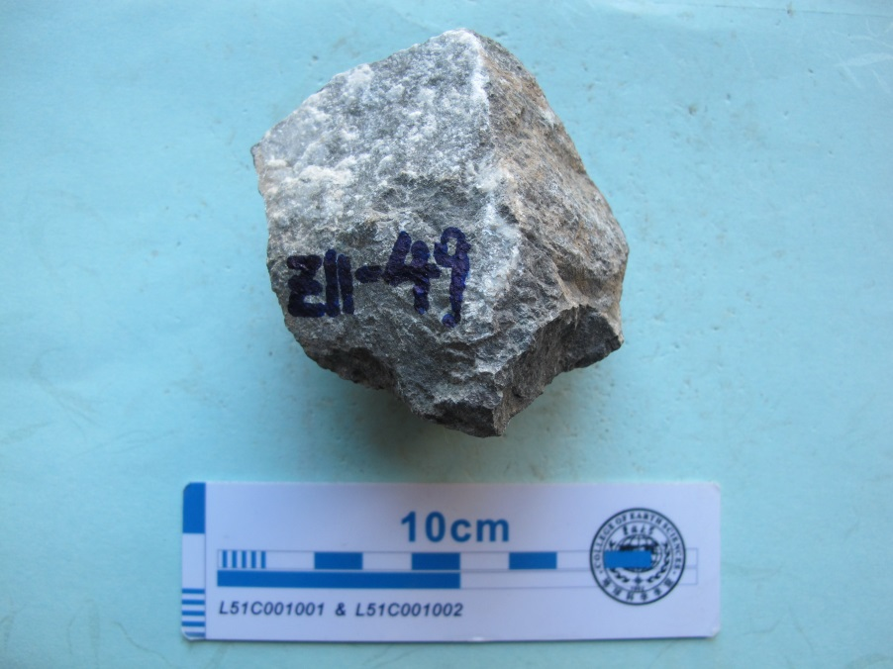
Ⅲ. Geochronology
Two samples: dacite（Z11-47）and andesite（Z11-49）
dacite（Z11-47） andesite（Z11-49）

Slide 16
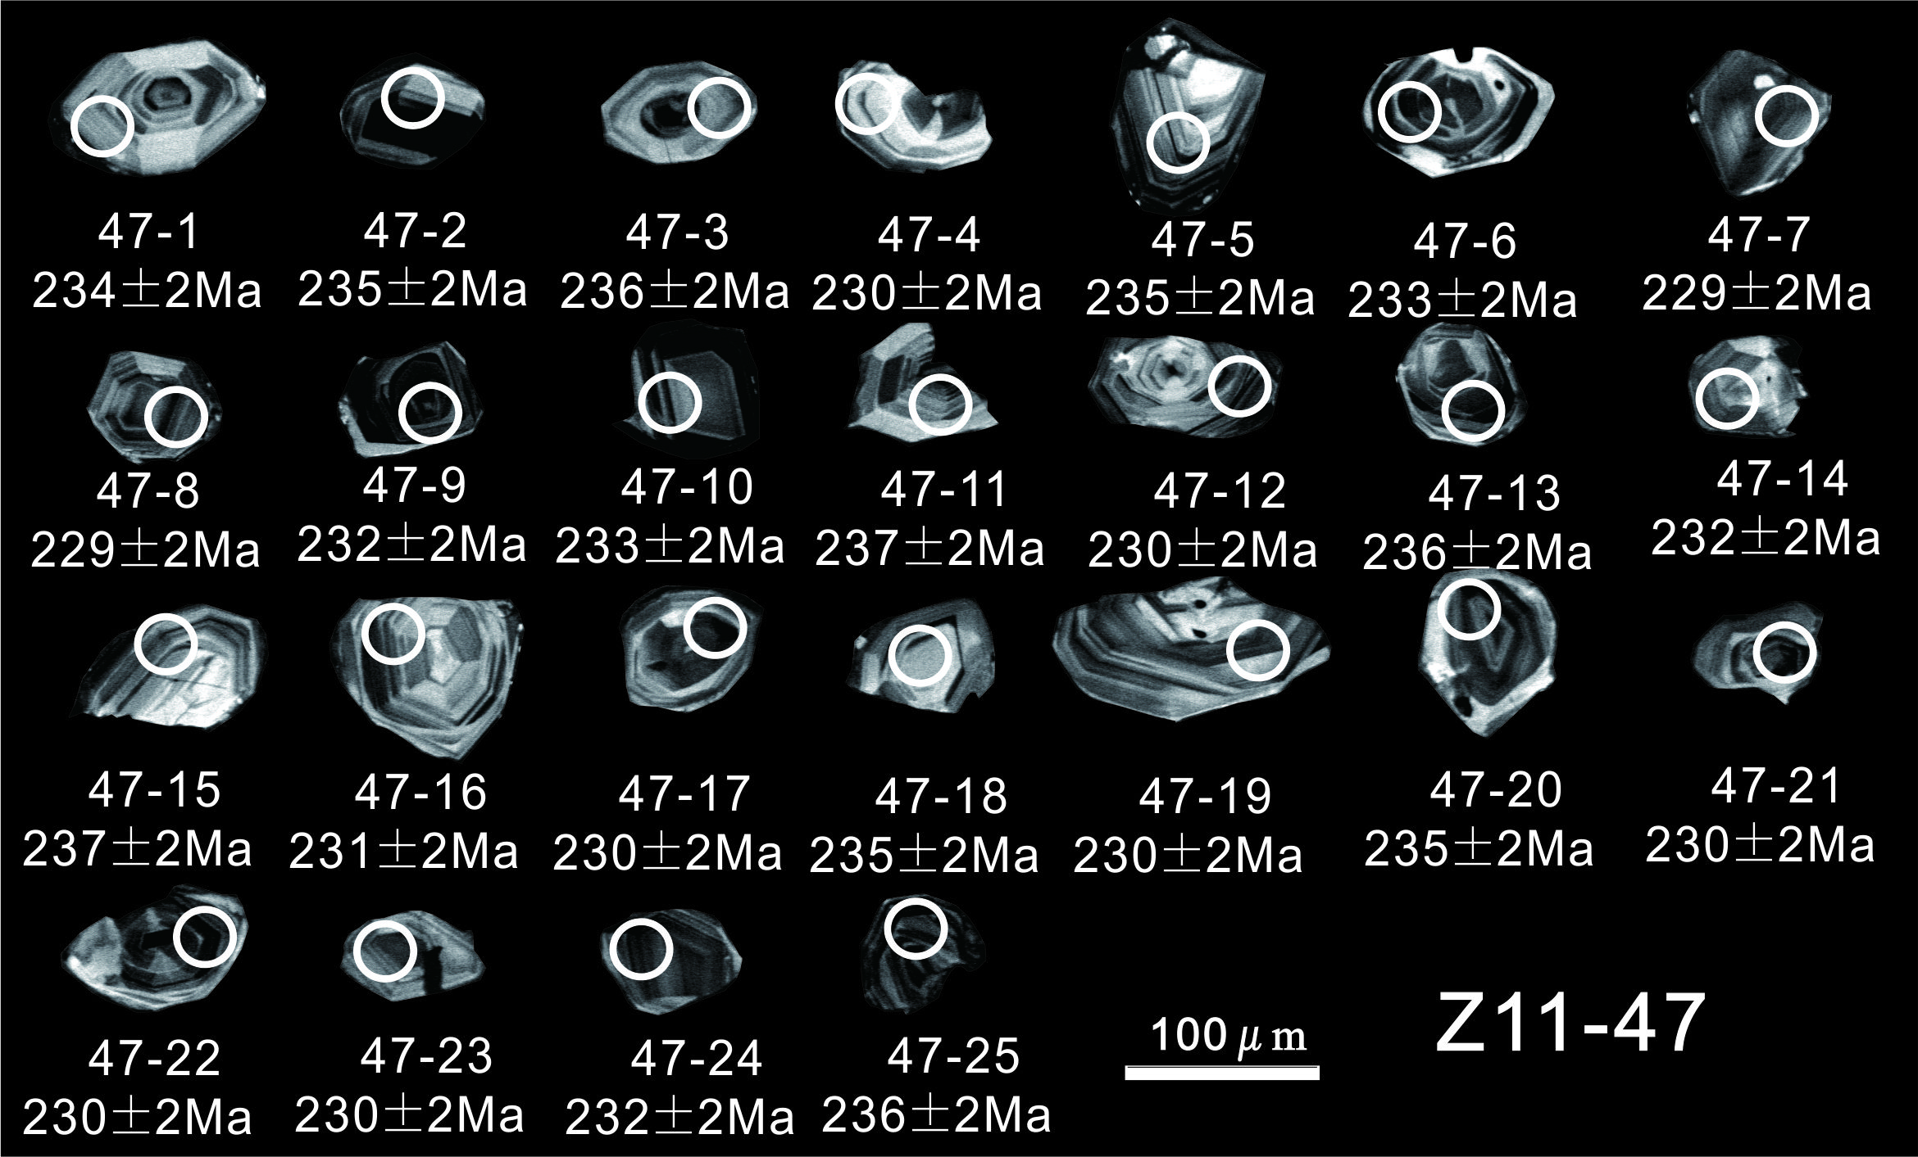
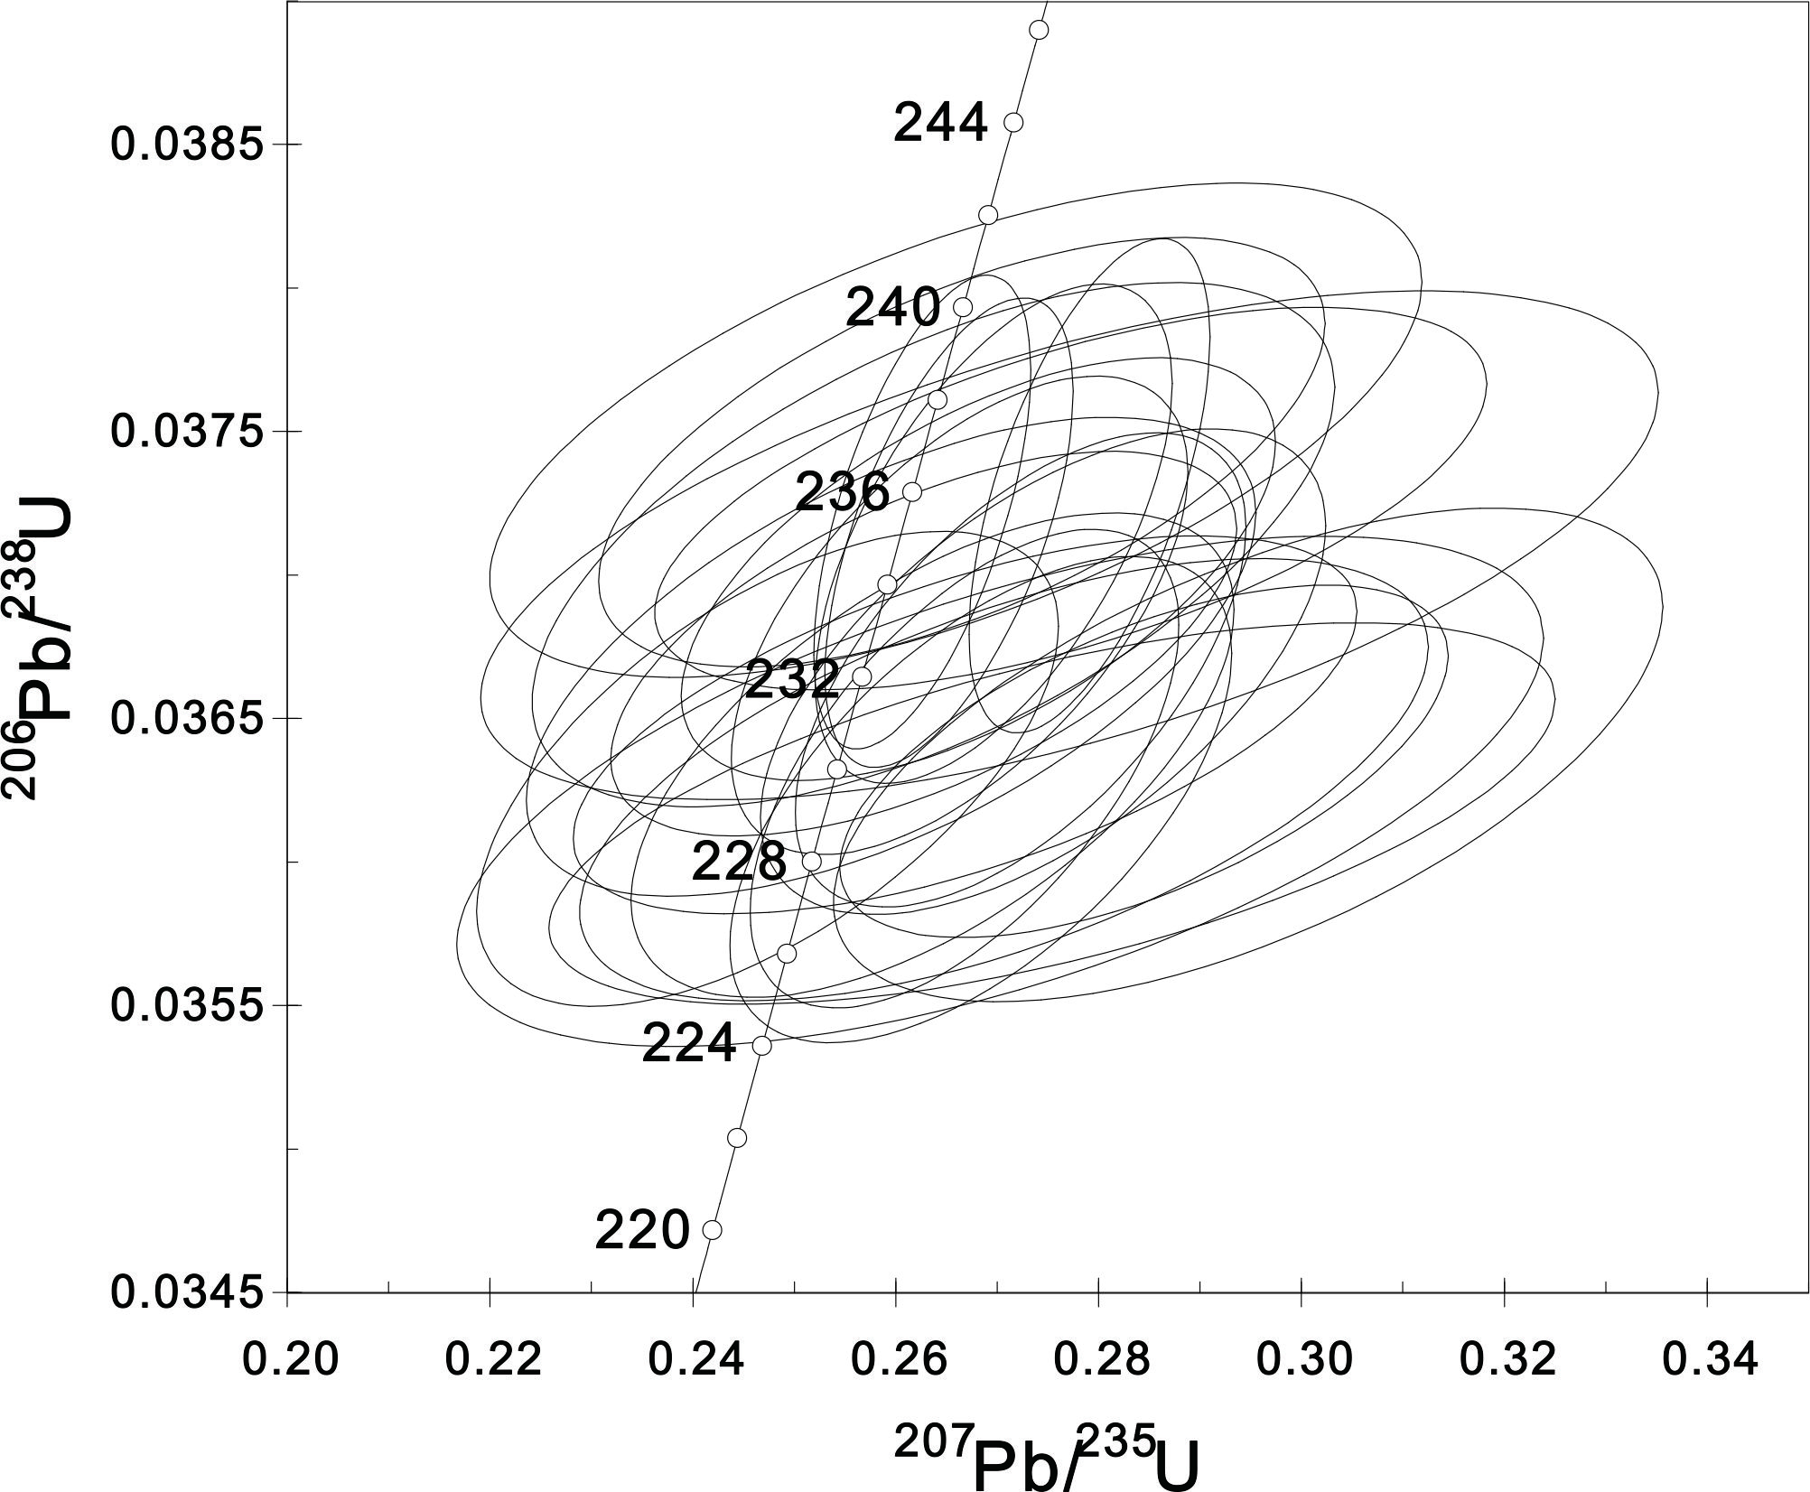
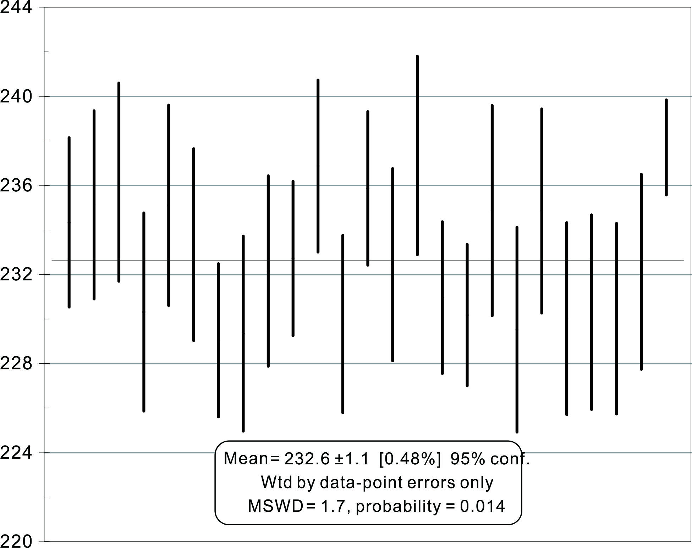
Ⅲ. Geochronology
dacite（Z11-47）
weighted mean age：
232.6±1.1Ma

Slide 17
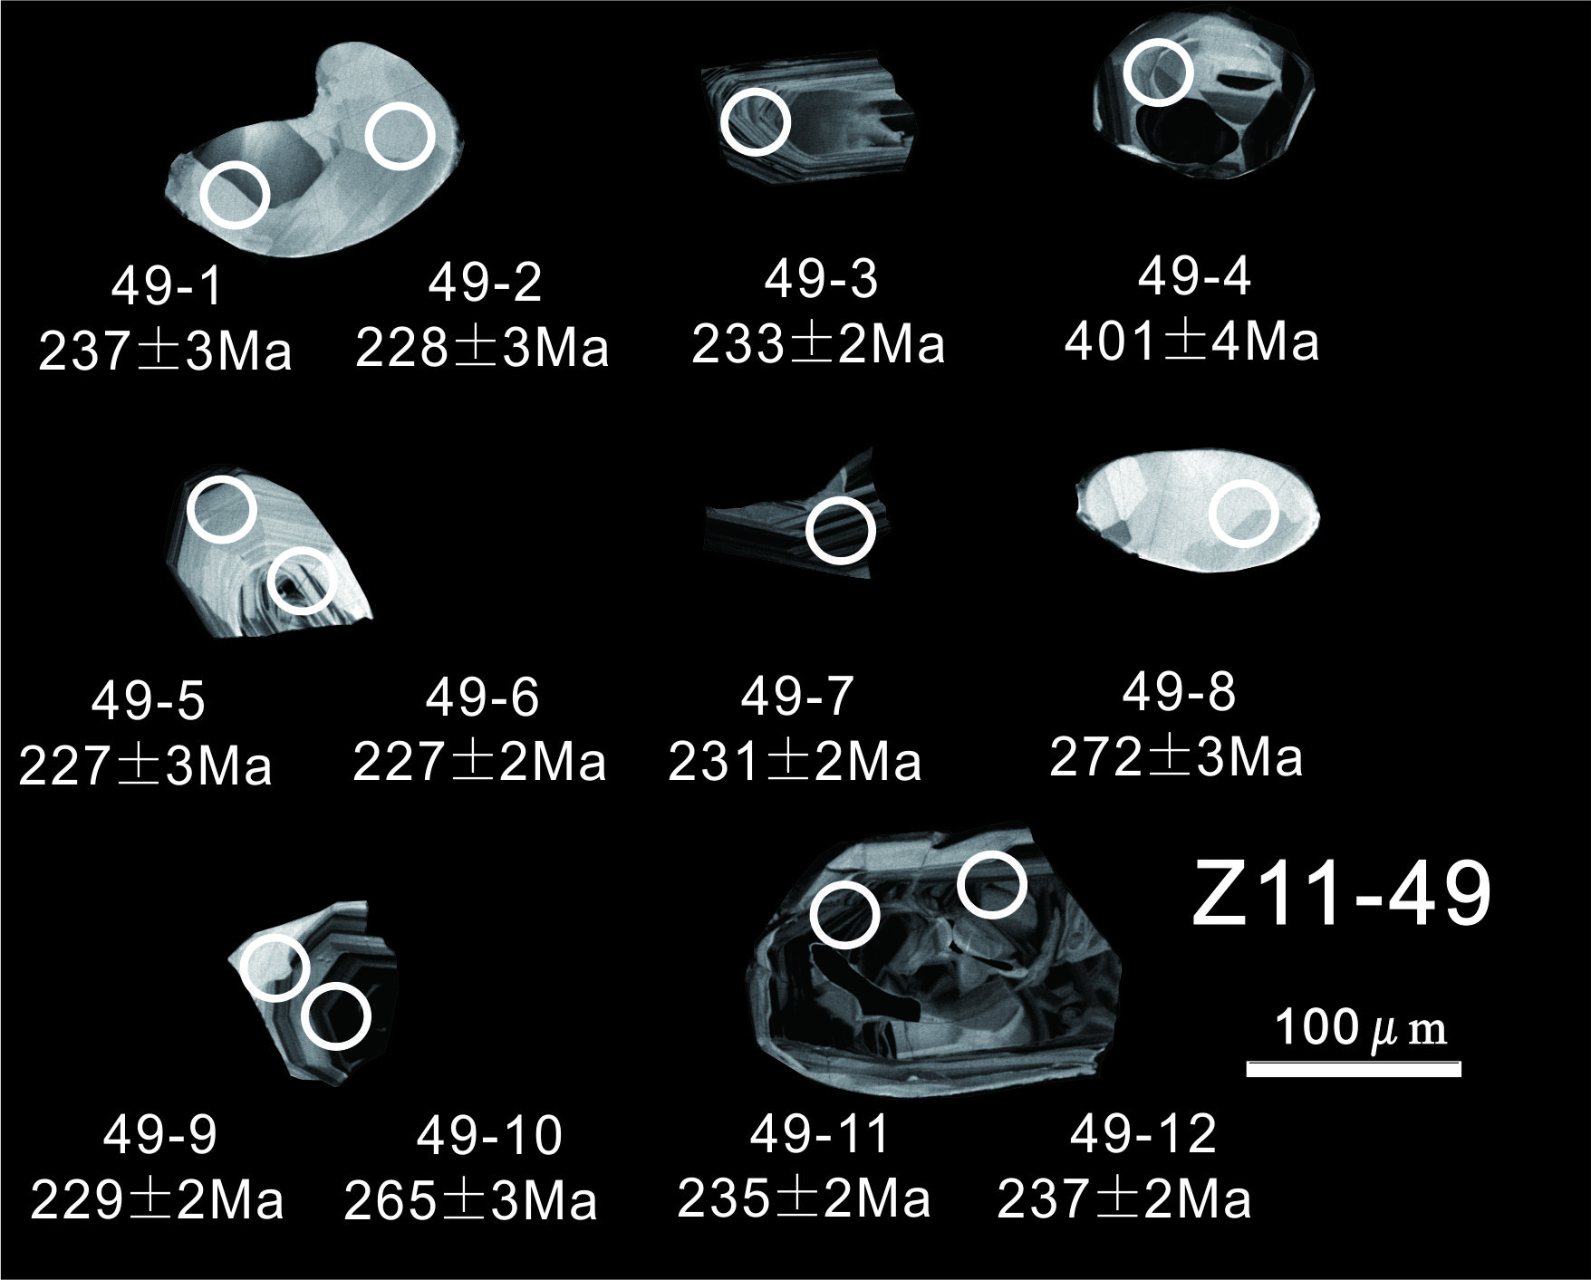
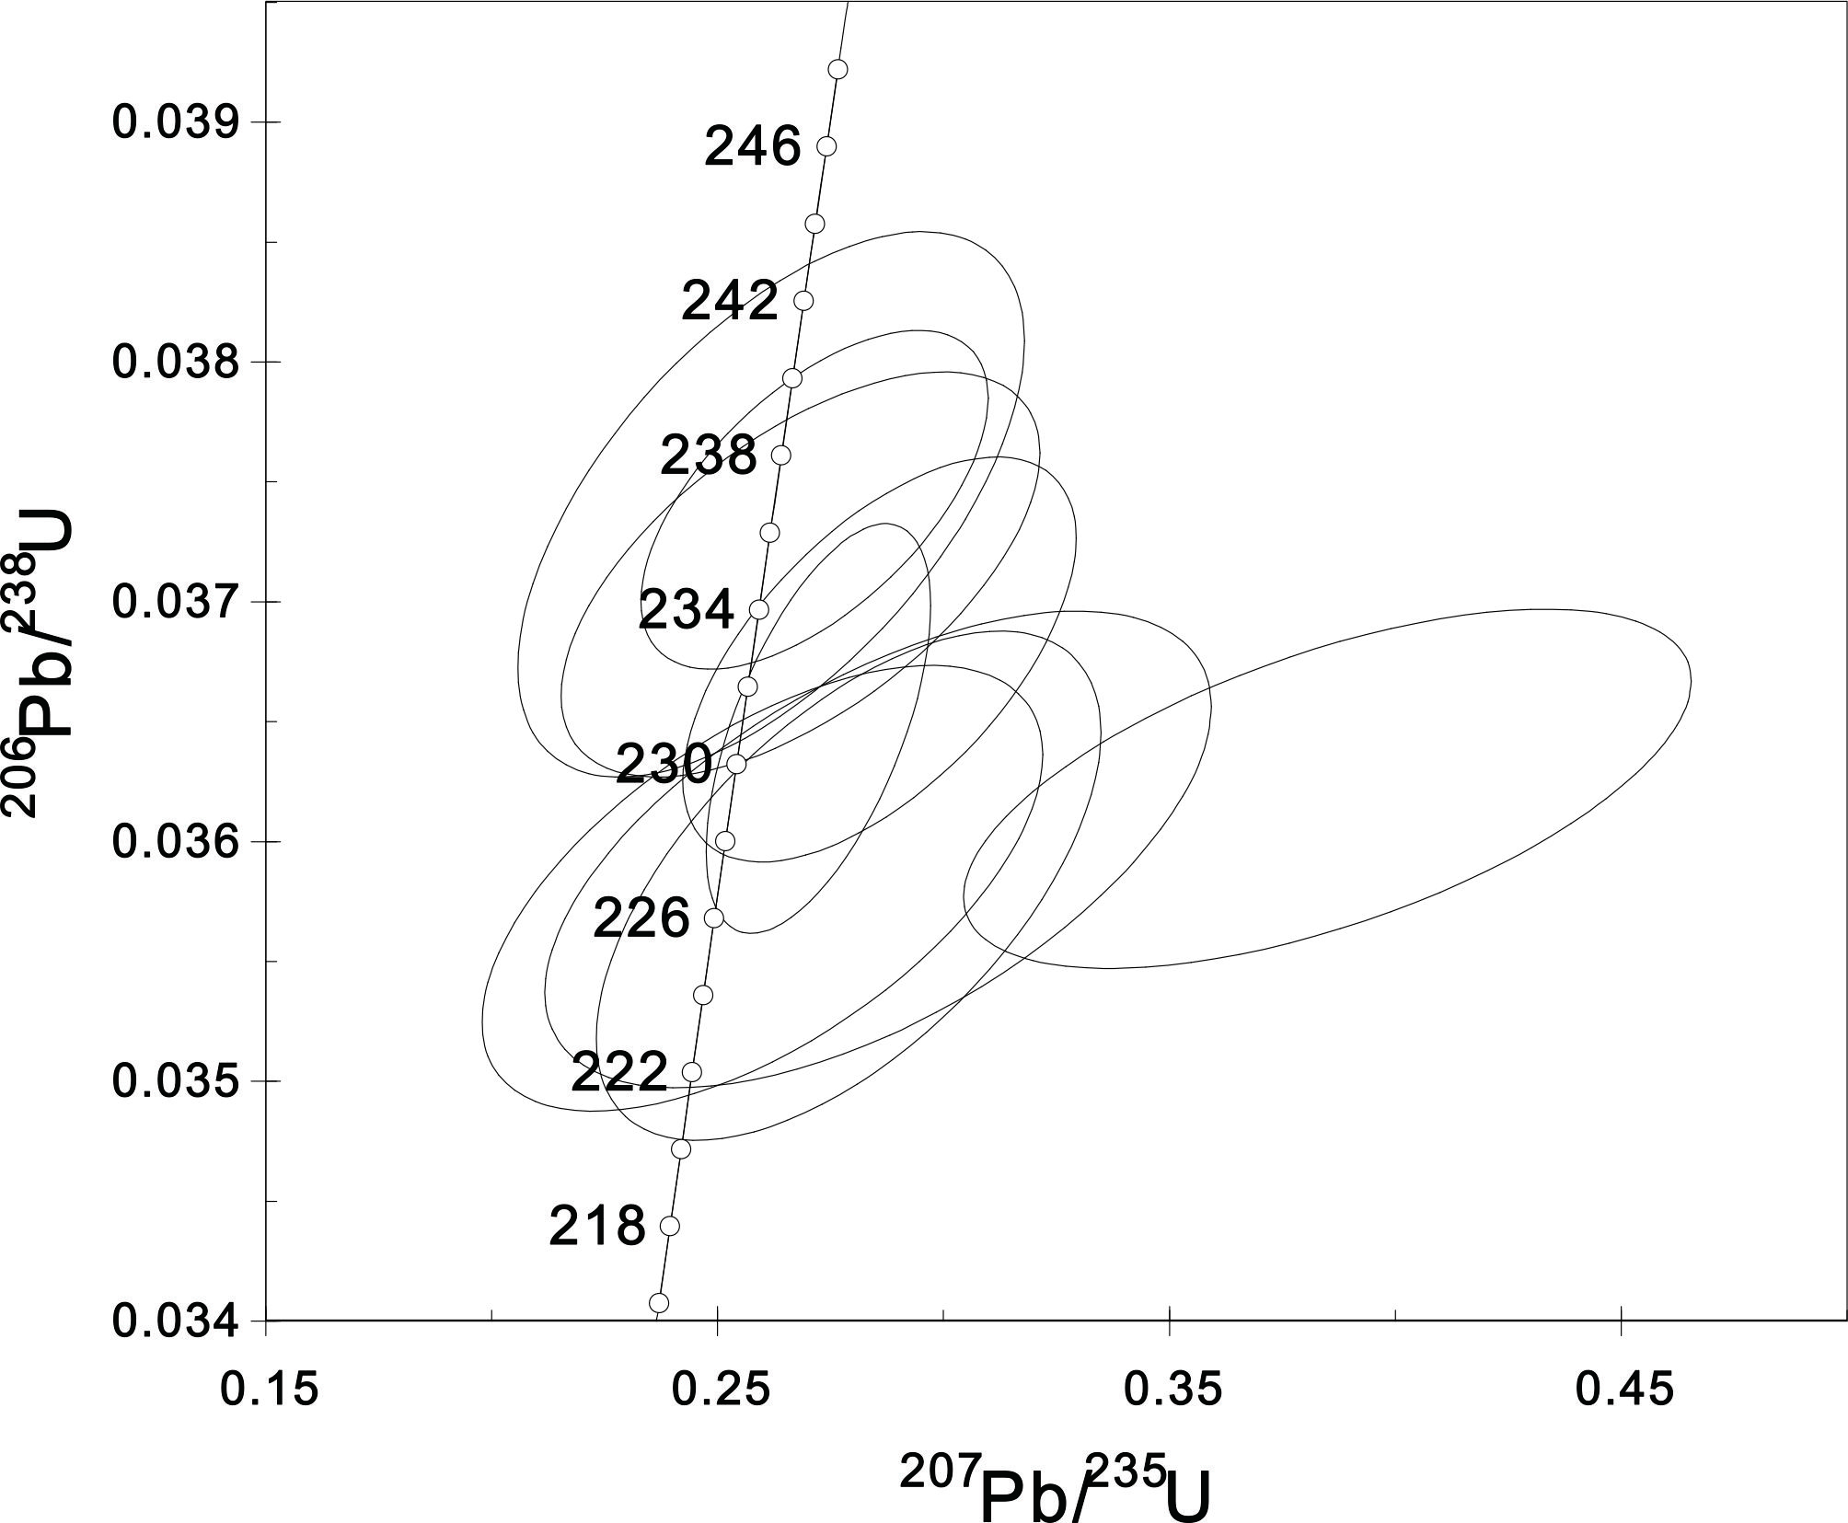
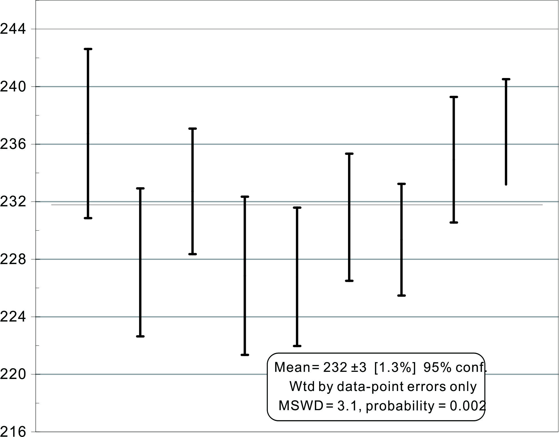
Ⅲ. Geochronology
andesite（Z11-49）
weighted mean age：
232.0±3.0Ma

Slide 18
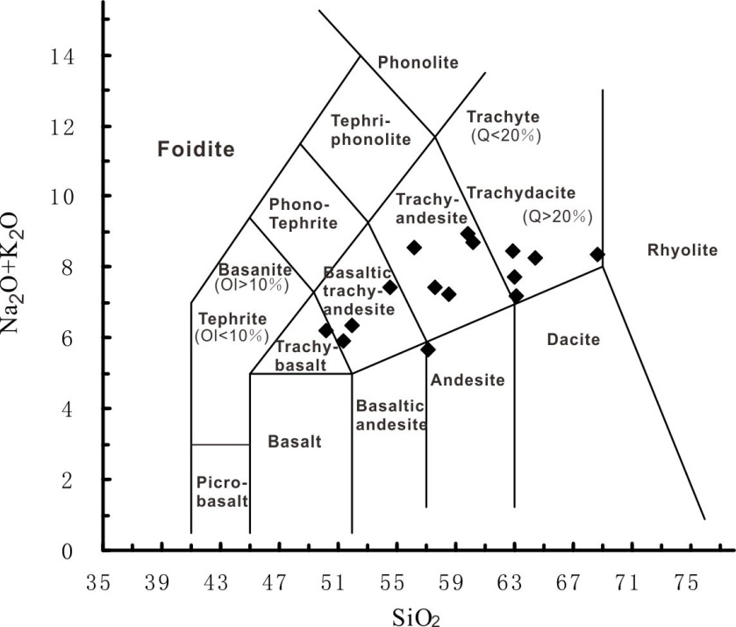
Ⅳ. Geochemistry
1. basaltic trachyandesite
2. trachyandensite
3. trachydacite
Total Alkalis-Silica diagram of volcanics

Slide 19
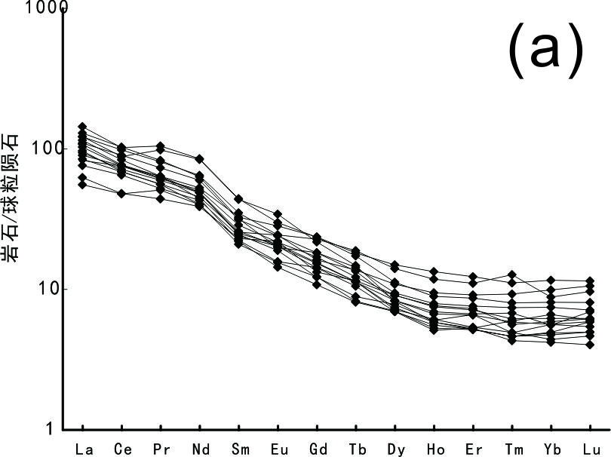
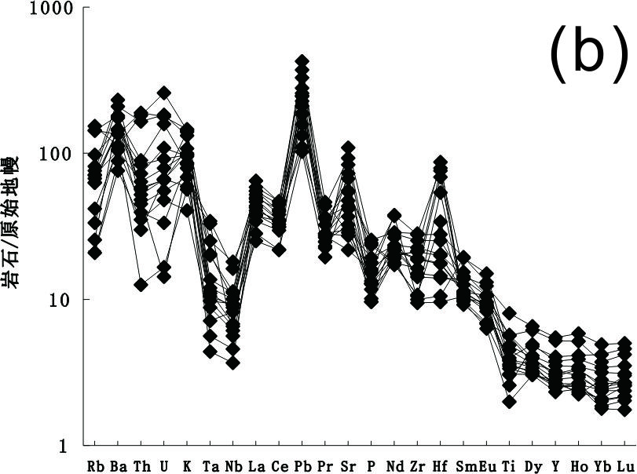
Ⅳ. Geochemistry
Rock/Primitive mantle
Rock/Chrondrite
REE partition pattern(a) The spider diagram of trace elements(b)
1.They are characterized by high Sr, low Yb, low Y and high Sr/Y radio.
2. Their REE patterns decline slightly to right, characterized by enrichment in LREE and no Eu anomaly.
3.Trace elements are enrichment of large ion lithophile element (LILE) Rb, Ba, K, Pb, Sr，depletion of high field strength element (HFSE) Ta, Nb, P, Ti.

Slide 20
Ⅵ. Petrogenesis
1.Major element: Mg#
Atherton : direct melting of lower crust mafic rocks ——Mg# is less than 45.
Rapp : partial melting of basic rocks ——Mg# is less than 45.
Kelemen : Mg# larger than 60 (high-Mg andesite)——regard as mantle melts.
The volcanics in our study—— Mg#: 46.92-71.01，mainly focus during 45-60.

Slide 21
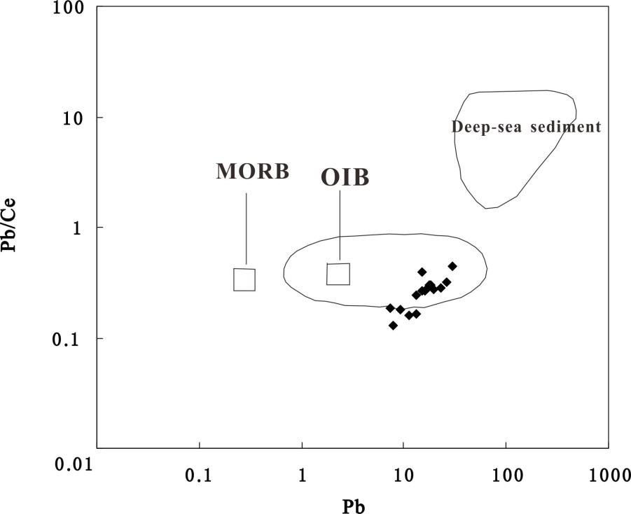
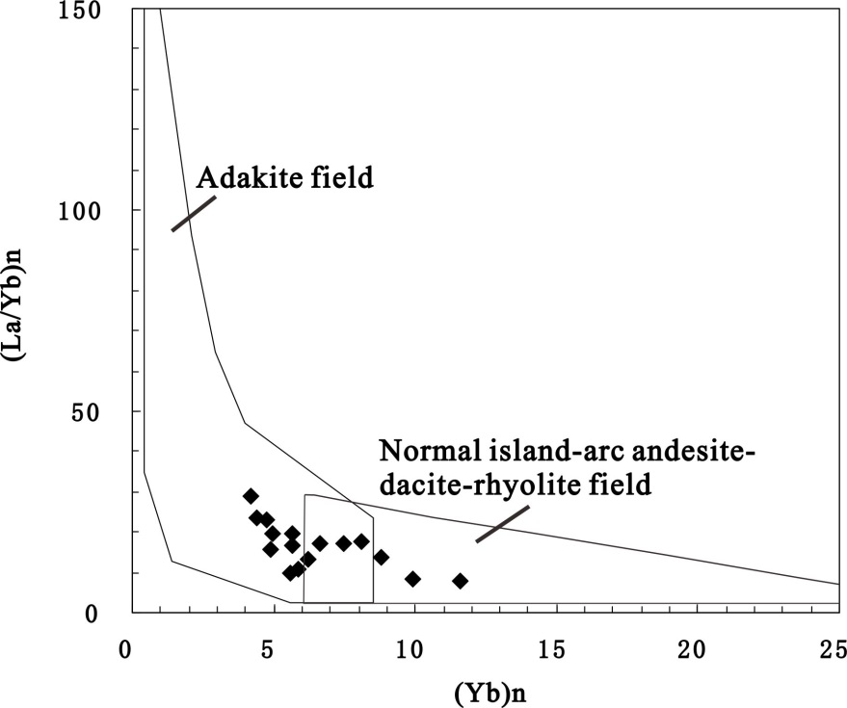
Ⅵ. Petrogenesis
2.Discrimination diagrams of trace elements
Pb/Ce-Pb diagram of andesite
Yb_{N}-（La/Yb）_{N} diagram
Material resource：Ocean island basalt
Rock type：Adakite

Slide 22
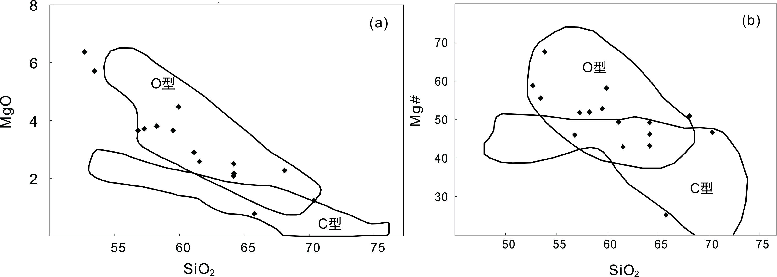
Ⅵ. Petrogenesis
2.1 Adakite（O type or C type）
O type
O type
C type
C type
Discrimination diagrams of adakite types
（Below diagrams are based on Wang，2007 and Sheppard，2001 respectively）
O type adakites imply the forming environment is oceanic crust subduction which happened in active continental margin.

Slide 23
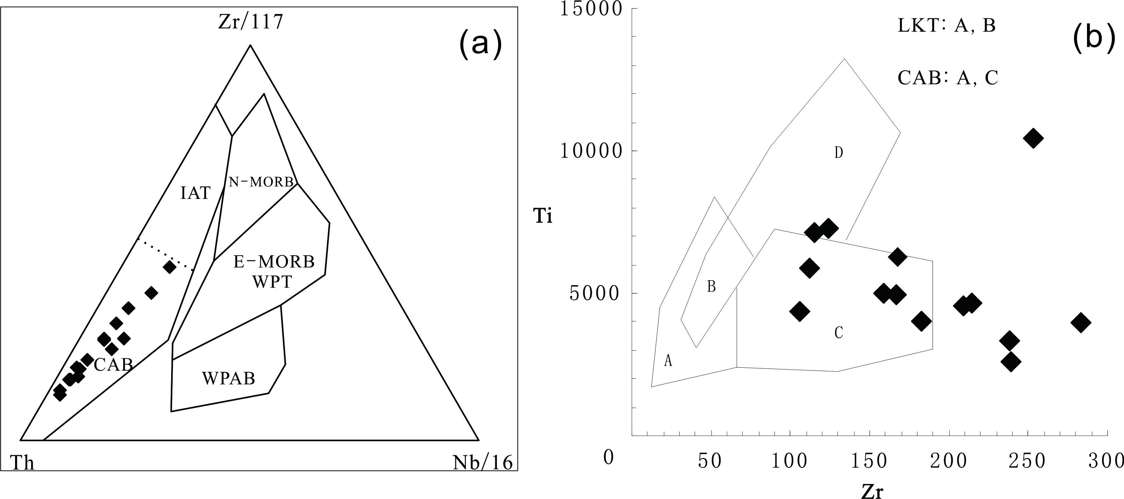
Ⅵ. Petrogenesis
2.2 Tectonic discrimination diagrams of trace elements
Th-Zr/117-Nb/16 diagram（a） Zr—Ti diagram（b）
Mainly in CAB field（Calc-alkaline volcanics）

Slide 24
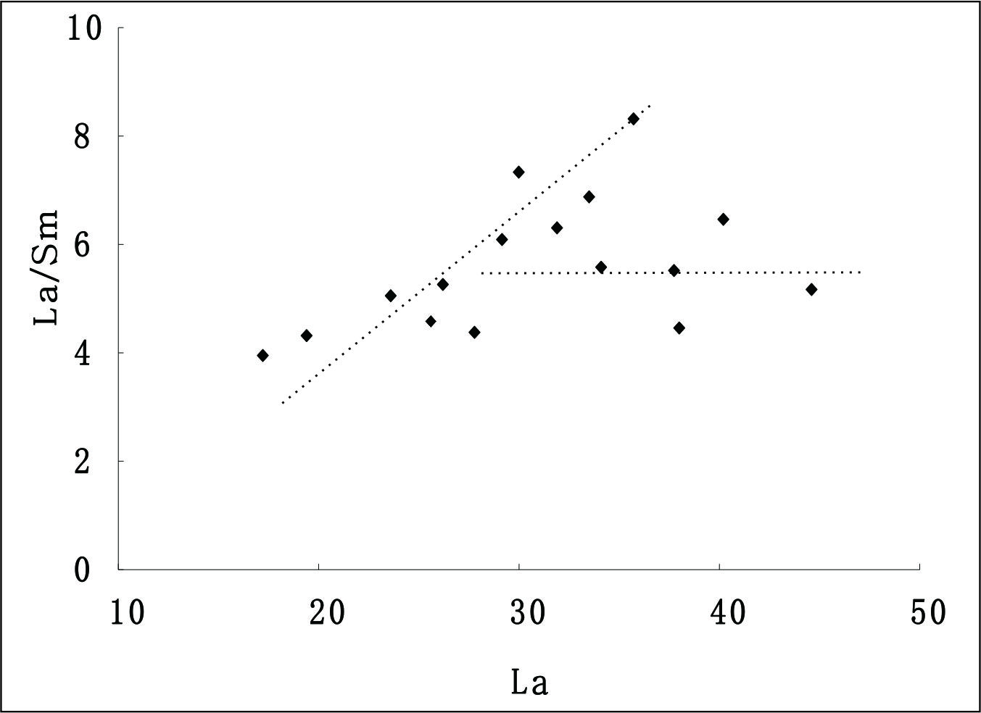
Ⅵ. Petrogenesis
2.2 Tectonic discrimination diagrams of trace elements
partial melting
La/Sm
fractional crystallization
La—La/Sm diagram of Andesitic rocks

Slide 25
Ⅵ. Petrogenesis
3. Comprehensive study of regional geology
(1). In late Triassic of Moguqi area, there was no ocean-continent subduction ,
Xing’an Massif (in the north) and Songnen Massif (in the south) had already
collided along Hegenshan-Heihe belt during Late Devonian to Early Carboniferous.
(2).Before late Triassic , in the Early Triassic epoch , the Laolongtou Formation ,a terrestrial sedimentary formation had already existed.
Our Hypothesis：residual oceanic slabs
Li Wuping et al., 1999—hysteretic calc-alkaline volcanics。
Hopper et al.,2002 —the direct cause of Columbia plateau calic-alkaline volcanics is the extensional tectonic setting which induced decompression and melting of lithosphere mantle then react with the residual oceanic slabs.

Slide 26
Ⅵ. Petrogenesis
4.Other Triassic tectonic magma activity near our region
（1）Zhang Xiaohui et al., 2008: Early Triassic(K-Ar: 245Ma) Dacites-Rhyolites in Xilinhaote-Xiwuqi formed in the extensional environment after the orogensis.
Bimodal volcanics with the same age basalt nearby
（2）Zhang Lianchang et al., 2008: Triassic basic volcanics (214~250Ma)in South Great Xing’an Mountains were formed in partial melting of lithoshperic mantle in the extensional setting.
（3）Chen Yinghang et al., 2012: the middle Triassic(234.8Ma & 231.4Ma) andesites in Chagan’aobao were derived from partial melting of residual oceanic slabs of Paleo-Asian Ocean in the extensional setting.
（4）Zhang Wanyi et al., 2012: The Middle Triassic(237Ma) quartz diorites in Chagan’aobao derived from partial melting of residual subducted oceanic slabs after collision between Siberia and North China Craton and contaminated by ultramafic and K-enriched alkaline fluids.

Slide 27
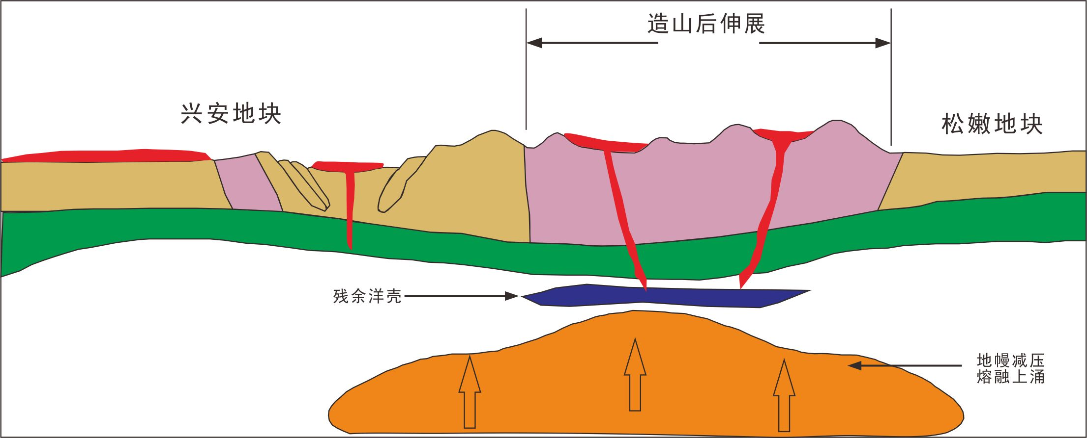
Ⅵ. Petrogenesis
5. Petrogensis and Forming Tectonic Setting:
Through integrated study, we think these complex volcanics formed in the whole extensional setting after the collision orogenesis. The decrease of the pressure in lithospheric mantle caused the upwelling of the mantle, which melted and mixed the residual oceanic slabs causing the eruption of these volcanics.
Extension after Orogenesis
Xing’an Massif
Songnen Massif
Residual Oceanic Slabs
Upwelling
mantle

Slide 28
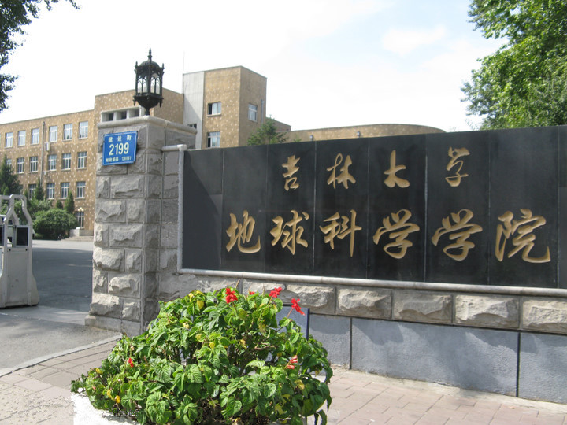
Thanks for your attention!

