Slide 1
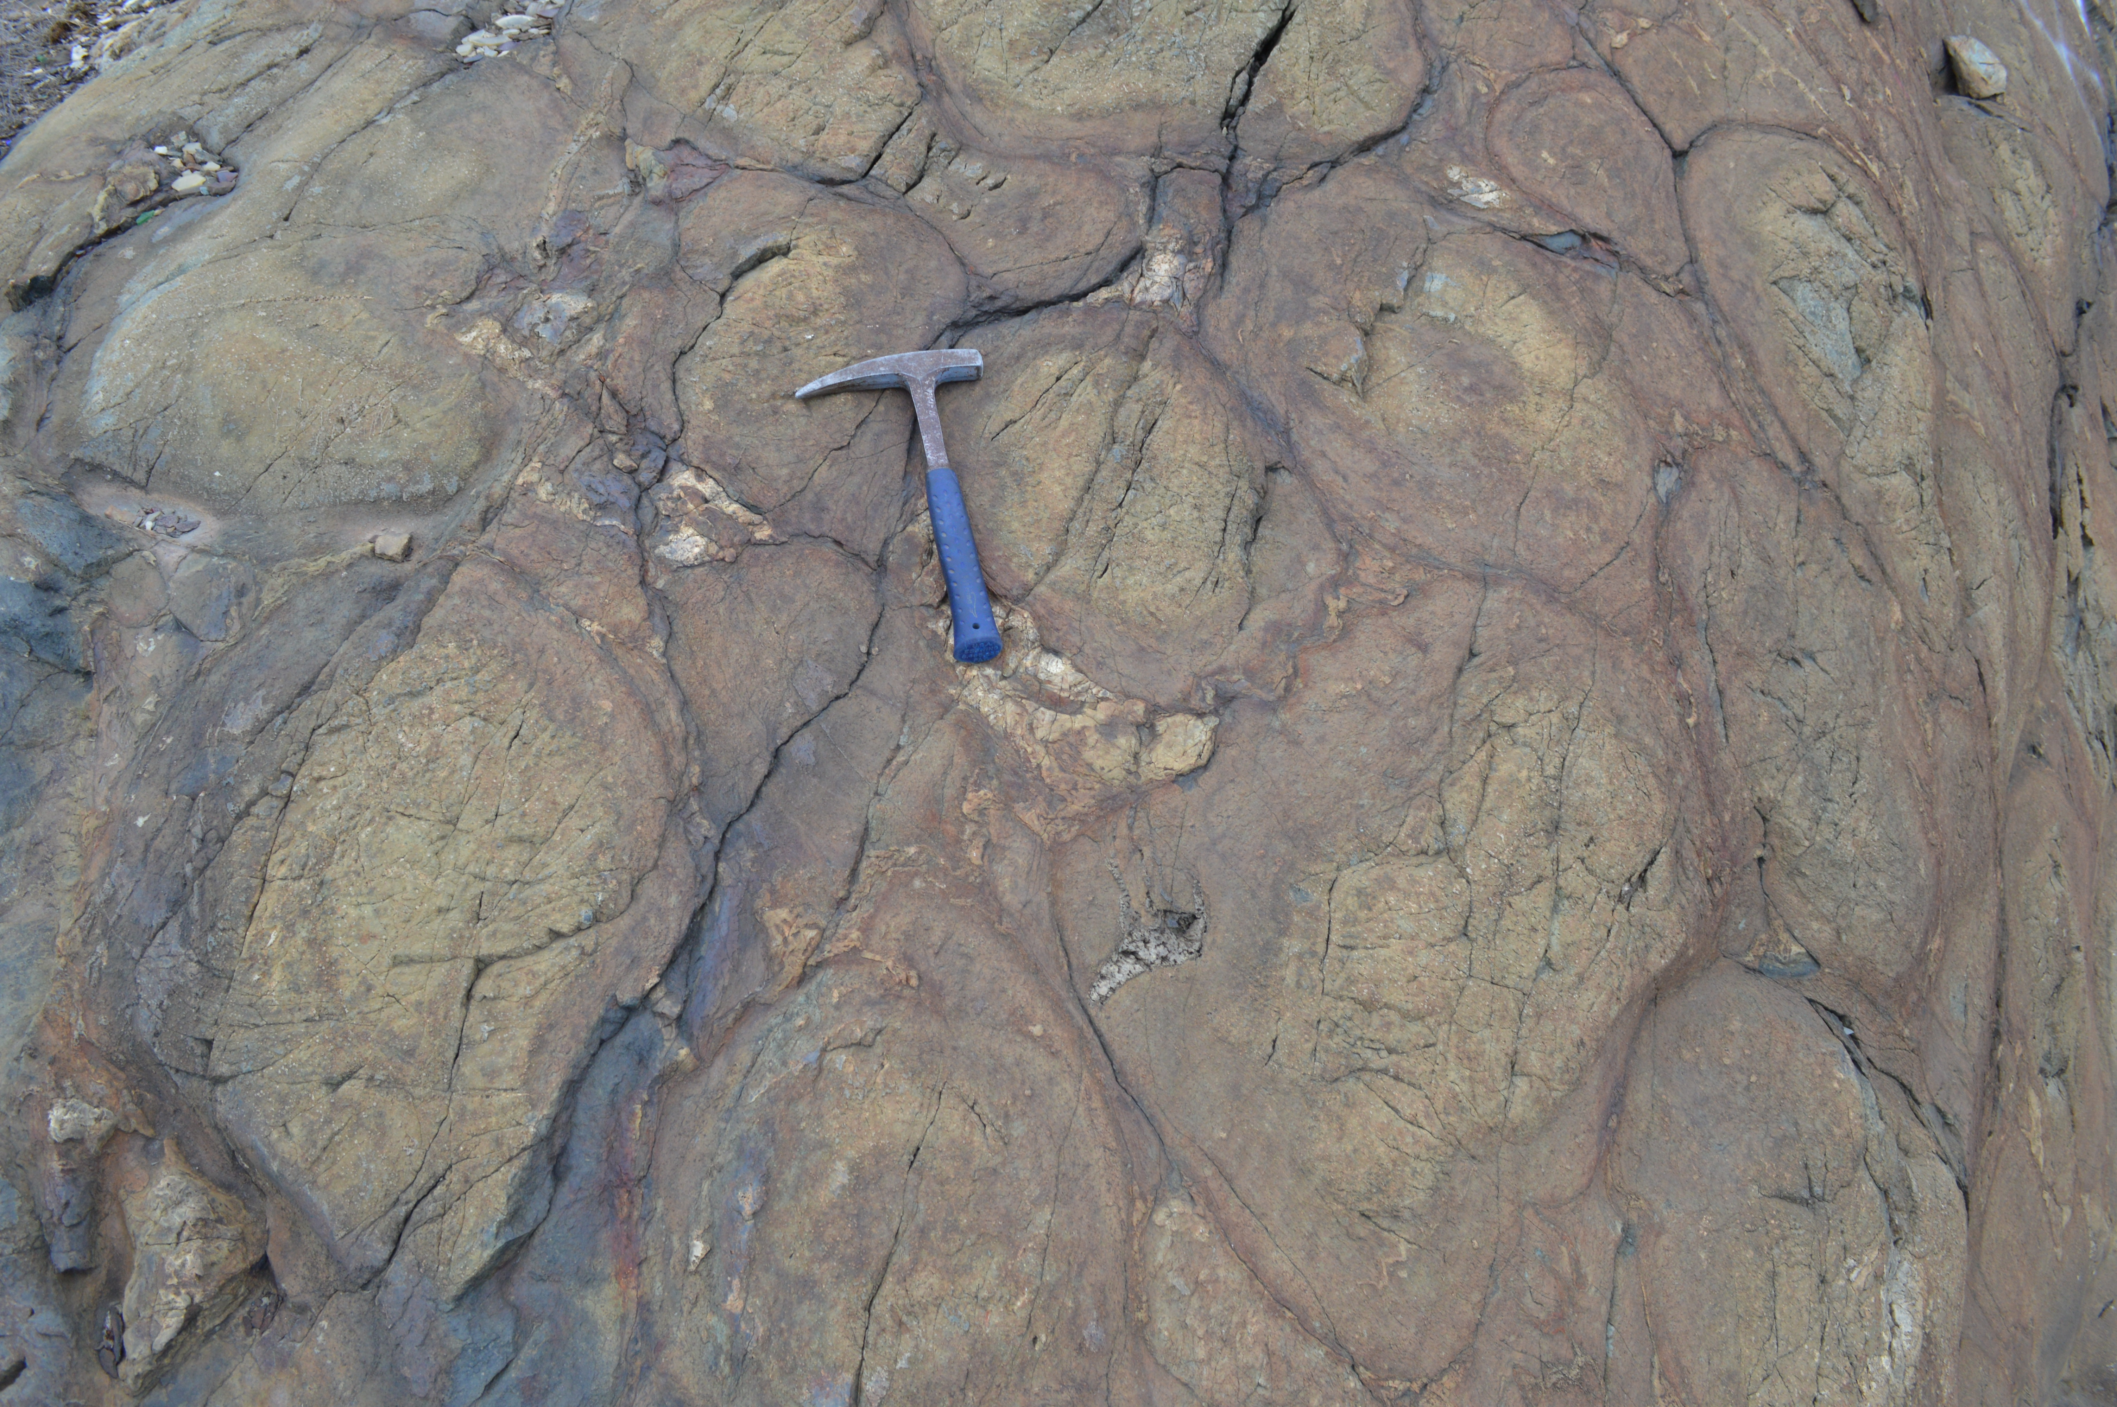
The origin of actinolite-hornblende intergrowths in the greenschist-amphibolite transition zone: An example from the Flin Flon – Glennie Complex, Manitoba/Saskatchewan
GSA 2014
Paul Starr (University of Calgary)
Dr. David Pattison (University of Calgary)
Dr. Doreen Ames (Geological Survey of Canada)
Notes:
Good morning everyone. My name is Paul Starr and I am a PhD student working with Dave Pattison at the University of Calgary. Today I am going to be discussing a project I have been working on investigating a beautifully exposed example of a greenschist-amphibolite transition zone sequence located in Flin Flon on the Manitoba-Sashatchewan border. So this project links in with my broader PhD thesis topic which is investigating equilibrium and kinetics in metamorphism and today I am going to be focussing on the origin of coexisting calcic amphiboles which has been a topic that has attracted considerable interest, generating over 40 papers over more than 6 decades.

Slide 2
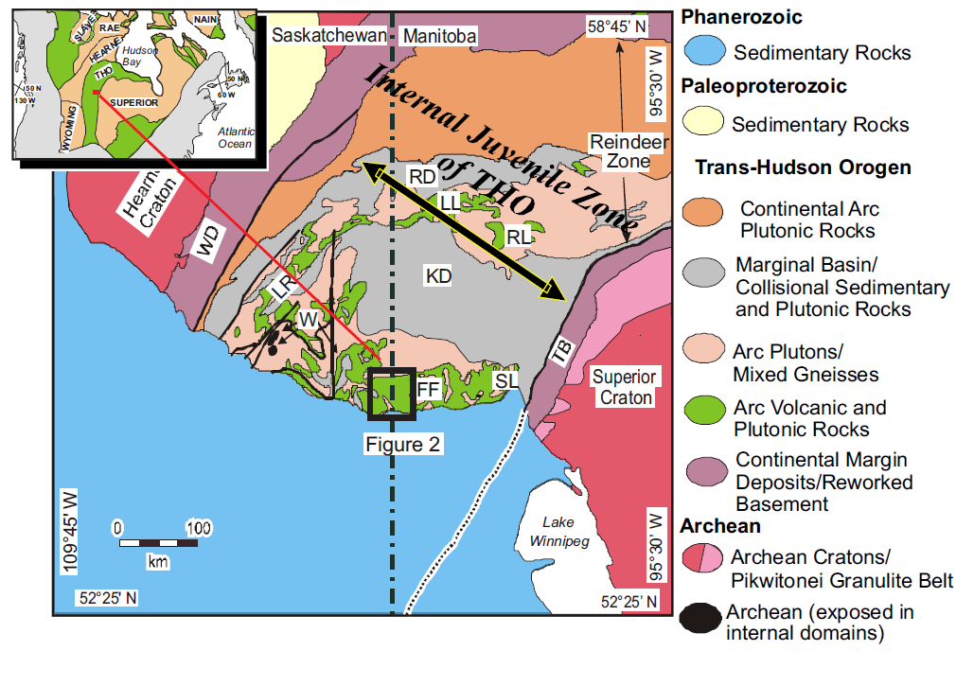
Source: Ames et al. (in press)
Notes:
So here is a large scale map of part of the Canadian segment of the Trans-Hudson orogen. The box in black shows the broad area around flin Flon. And as you can see it lies right on the Saskatchewan-Manitoba border and were approximately half way up the border around 54 and a half degrees North. Geologically the Flin Flon area belongs to the Reindeer zone which forms the internal zone of the Trans Hudson orogen separating the Superior and Hearn cratons. The Reindeer Zone is comprised of a collage of juvenile volcanic and plutonic rock ranging in age from approximately 1.91-1.84Ga.

Slide 3
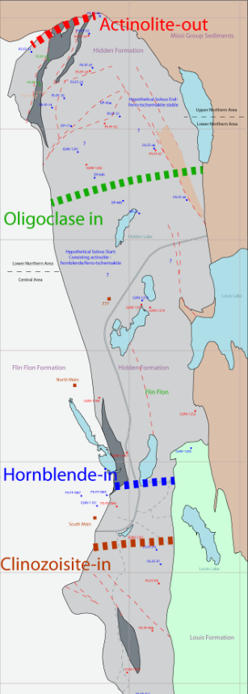
Fieldwork and Isograds
Fieldwork and Isograds
Focused on the Hidden Formation which is comprised of basaltic and basaltic andesite volcanics, as well as more minor tuff and volcaniclastics
4 major isograds (from S to N):
  Clinozoisite-in
  Hornblende-in
  Oligoclase-in
  Actinolite-out
Notes:
comprised of basaltic and basaltic andesite volcanics, as well as more minor tuff and volcaniclasticsSo out of approximately 150 thin sections, I selected a suite of currently around 50 samples – mostly fine grained mafic dykes which were the most compositionally homogeneous generally containing few phenocrysts and amygdules, in addition to pillow basalts. So this is a simplified geological map of my field area which is approximately 8 by 2km. 4 major isograds are located in the area – a clinozoisite-in isograd above which this clinozoisite exists with a more Fe-rich epidote phase. A hornblende-in isograd, oligoclase-out, and actinolite-out isograds. A number of new changes have been made to the Digel isograd map including the shifting of the hornblende-in isograd approximately 2km south which extends the zone of coexisting actinolite-hornblende to around 4km thick. In addition is was found that the chlorite and epidote isograds do not lie within this segment of the Hidden Formation.

Slide 4
Aims:
  To evaluate compositional and textural relationships between coexisting actinolite and hornblende/tschermakite.
  To assess whether these coexisting calcic amphibole represent equilibrium or disequilibrium pairs.
Why Flin Flon?
  Excellent exposure
  Metamorphism post-dates the major faulting and folding within the area
Notes:
So why is Flin Flon the ideal place to carry out such a study. Well it has excellent exposure throughout most of the field area which allowed for a high sampling density. The metamorphism also post-dates the major faulting and folding within the area which means that the metamorphic sequence is relatively intact. And on a microstructural level, the textural relationship between different minerals is not obscured by deformation fabrics.

Slide 5
Calcic Amphiboles – Textures and Mineral Chemistry
Notes:
So moving on the main body of the talk which is looking at the calcic amphibole phases, actinolite and hornblende.

Slide 6
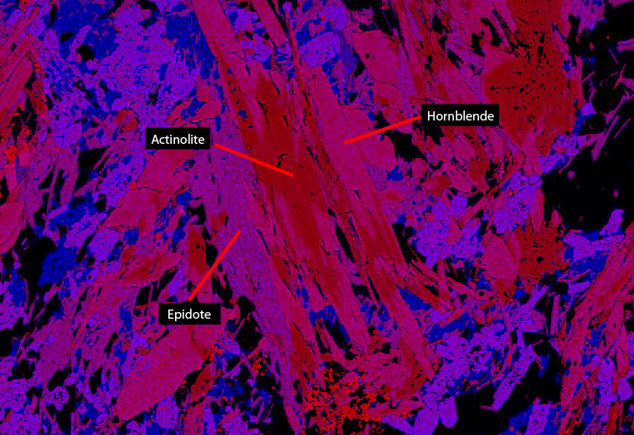
Coexisting Amphibole Textures
Occurrences of coexisting actinolite and hornblende were classified into the 5 main categories.
Individual homogeneous actinolite grains
Individual homogeneous hornblende/ferro-tschermakite grains
Patchy intergrowths of two coexisting amphiboles
Geometrically regular intergrowths of two coexisting amphiboles
Core-rim structures
Variation with Grade:
Most thin section show a large variety of different textures.
Core-rim structures with actinolite cores become more common with increasing grade, particularly just below the actinolite-out isograd.
Notes:
Actinolite and hornblende distinguished in thin section by colour and pleochroism. Contact between the two amphiboles usually appears sharp.
However, it was usually difficult to accurately make out grain boundaries in thin section and hence backscatter imaging and x-ray mapping were used.
In the image on the left we can see a variety of different textures including regular sharp grain boundaries, euhedral shapes intergrowths and patchy core-rim structures. In the image on the right, I have superimposed Mg and Al compositional maps onto a backscatter image which allows you to nicely distinguish between the two amphiboles. You can see in most of the grains that the intergrowths are patchy but have sharp boundaries.
These types of textures are very similar to those described in the literature.

Slide 7
Flin Flon Amphibole Compositions
Light green amphibole: >97% of grains classify as actinolite.
The blue-green amphibole: ferro-hornblende (~40%) and ferro-tschermakite (~60%) , with minor magnesio-hornblende/tschermakite.
Notes:
The light green amphibole is restricted in composition and >95% of grains classify as actinolite.

Slide 8
Flin Flon Amphibole Compositions
Notes:
So these plots show various compositional parameters plotted against distance north of the bottom of the field area which given the location of the isograds, the changes in mineral modes and compositions is taken as a good proxy for increasing grade. Each of these points is the average actinolite (black) or average hornblende/tschermakite (brown) for a sample. For each sample, between 6-15 actinolite-hornblende pairs were analysed (about an average of 10 pairs, so 20 amphibole analyses per sample).

Slide 9
_{Schumacher (2007) Vectors:}
Tschermakite = ^{T}Al - ^{A}Na – ^{A}K – 2 ^{A}Ca
Edenite = ^{A}Na + ^{A}K + ^{A}Ca
Notes:
So I have also plotted the data in terms of the tschermakite and edenite vectors. The vectors used are described in Schumacher (2007) and show the amount of tschermakite and edenite substitution relative to end-member tremolite.

Slide 10
Amphibole Chemistry Data from the literature
Coexisting actinolite and hornblende mineral analyses collected from 18 papers.
  15 contain sets of actinolite-hornblende pairs from greenschist-amphibolite transition zone sequences
  Smelik et al. (1991) contains analyses from exsolution lamellae

Slide 11
Amphibole Chemistry Data from the literature
Notes:
So this is a plot of compositional data from the literature with the amount of tschermakite substitution plotted on the x axis and the edenite substitution plotted on the y axis. And one can see that with exception of a few points there does indeed appear to be a compositional gap. In addition, you can see that like the Flin Flon data which I added in red, there is considerably more scatter in the hornblende compositions relative to the actinolite which show quite a tight grouping.

Slide 12
Origin of Coexisting Calcic Amphiboles

Slide 13
Model I – Equilibrium:
Actinolite-Hornblende Miscibility Gap
The gap can be principally described as a discontinuity in the tschermakite and edenite components between the coexisting amphiboles.
Predicted Compositional Variation:
The size of the compositional gap should decrease with increasing grade.
The compositional gap should be at a minimum close to the actinolite-out isograd.

Slide 14
Model II – Disequilibrium
Grapes (1974) and Grapes and Graham (1978) suggest that grains containing actinolite and hornblende represent disequilibrium pairs with stable hornblende coexisting with relic actinolite.
The gap recorded in many actinolite-hornblende pairs may be the result of the sluggish kinetics of the consumption of unstable actinolite, coupled with the progressive compositional change of hornblende with increasing grade.
Predicted Compositional Variation:
No stable compositional gap between actinolite and hornblende.
Where a compositional gap does exist we would predict large scatter in its size.

Slide 15
Interpretation
Actinolite and hornblende are initially stable across a miscibility gap.
Evidence:
  A compositional gap exists in all samples in the degree of tschermakite and edenite substitution.
  Exsolution lamellae of actinolite and hornblende have been reported by Smelik et al. (1991).
Notes:
within the Flin Flon amphibole sequence and within the coexisting amphibole data from the literature.

Slide 16
Interpretation
With progressive metamorphism at higher T, actinolite becomes unstable. Hornblende compositions trend towards equilibrium compositions expected in a hornblende-only assemblage (i.e. increasing tschermakite and edenite compositions) whilst actinolite remains as an metastable relic
Evidence:
  Average actinolite compositions remain constant with increasing grade whereas hornblende shows increasing tschermakite and edenite contents.
  The size of the compositional gap increases with increasing grade such that the largest gap exists just below the actinolite-out isograd.
Notes:
within the Flin Flon amphibole sequence and within the coexisting amphibole data from the literature.

Slide 17
Summary
A two-stage model is proposed to explain the amphibole compositional data from Flin Flon.
Given the similarity in textures and compositions of actinolite-hornblende pairs from other sequences described in the literature, this scenario may be common in transitional greenschist-amphibolite sequences.
Impacts:
  Until further research can identify whether the disequilibrium relationships observed in Flin Flon are recognised in other sequences, one should avoid using data from the literature to try and define the shape of the actinolite-hornblende miscibility gap.
  Affects the validity of the current amphibole solution models, which use real co-existing amphibole compositions from the literature to model the stability of coexisting actinolite and hornblende.

Slide 18
Questions?

