Slide 1

WHEN DID CONTINENTAL CRUST FORM AND WHEN WAS IT DESTROYED? THE BRAHMA/SHIVA RATIO AND THE GEOLOGIC RECORD
Robert J. Stern* and David Scholl**
*University of Texas at Dallas
**USGS, U Alaska Fairbanks

Slide 2
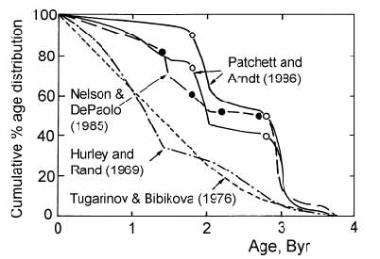
The rate at which continental crust has grown through time is
commonly discussed…
Continental crust
“Growth Curves”
…but this is a flawed controversy, because it ignores crustal destruction.

Slide 3
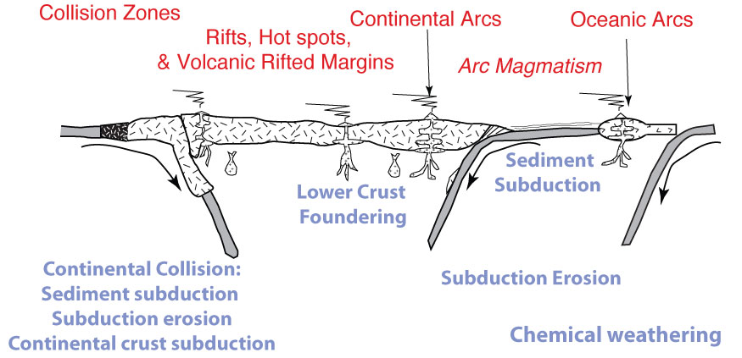
We now understand that continental crust is destroyed as well as created
Stern & Scholl 2010

Slide 4
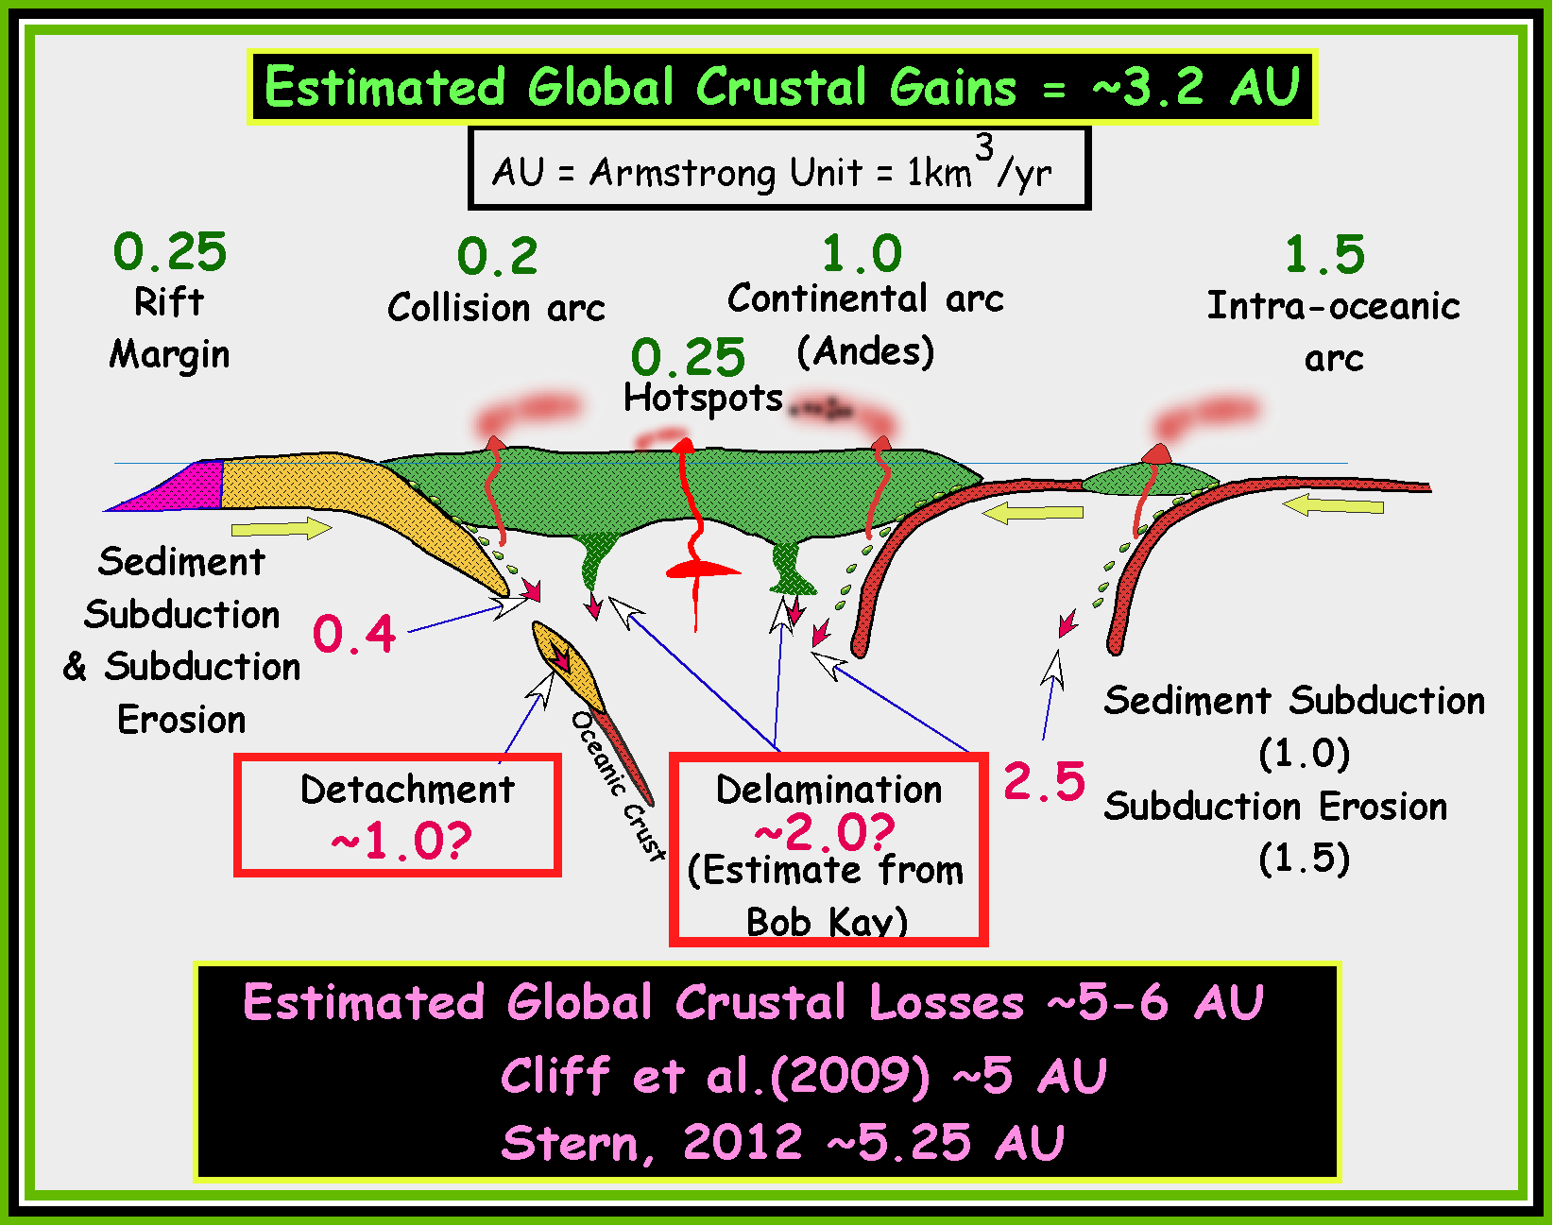
Today, we estimate that about twice as much continental crust is destroyed as created.
C. R.

Slide 5
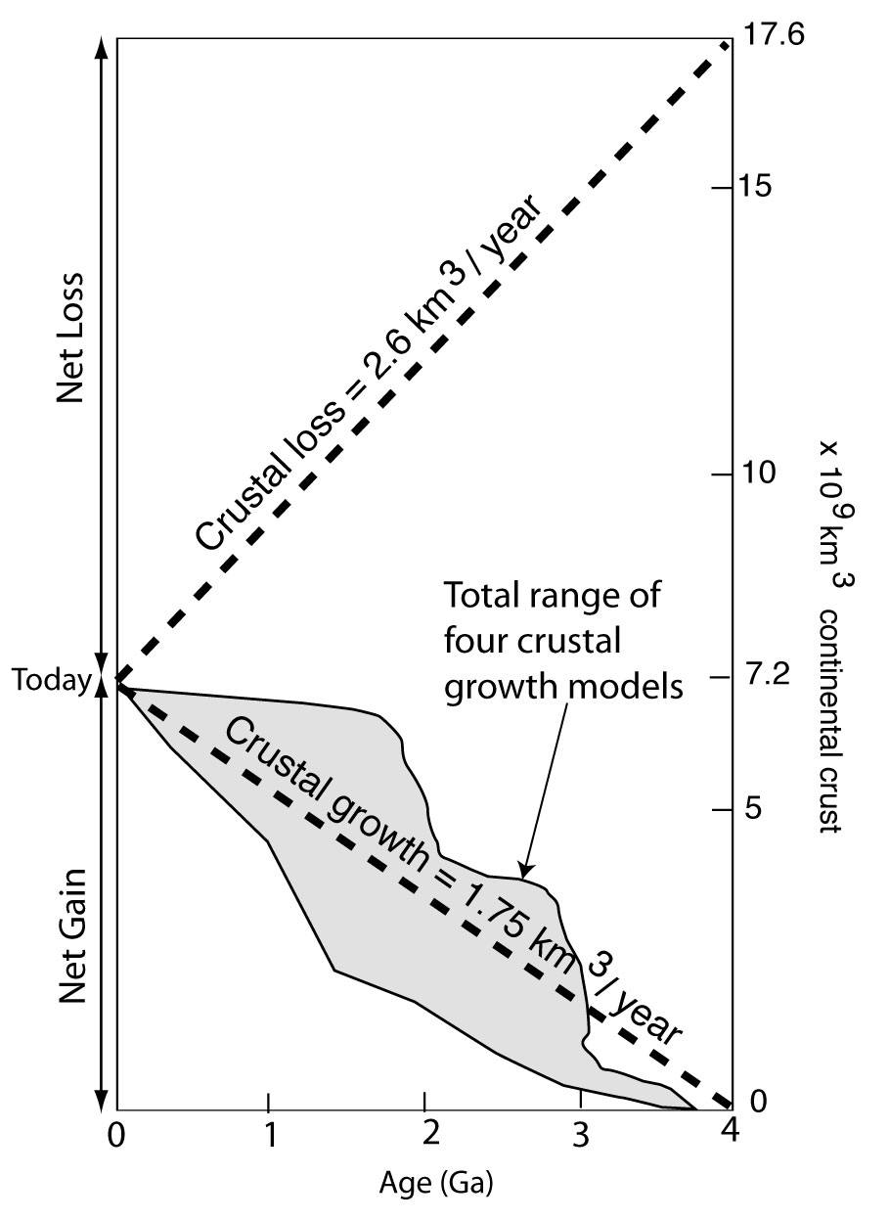
The controversy about changing volume of continental crust through time, correctly framed.
Stern & Scholl, 2010

Slide 6
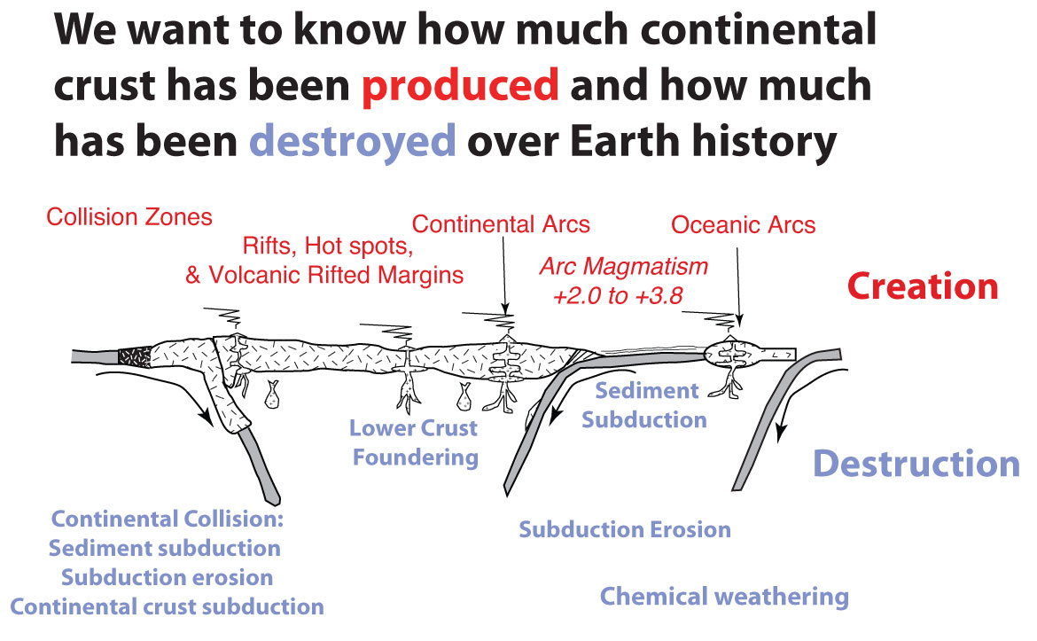

Slide 7


Brahma/Shiva ratio
Assign continental crust formation to Brahma, Hindu god of creation.
Assign continental crust destruction to Shiva, Hindu god of destruction.
We want to know how the proportion of volumes of continental crust formation to destruction has varied over time.

Slide 8
Brahma is the Hindu “Creator” god
Shiva is the Hindu “Destroyer” god
Brahmā holds a string of prayer beads which he uses to keep track of the Universe's time.
When Shiva loses his temper, his third eye opens which turns most things to ashes.

Slide 9
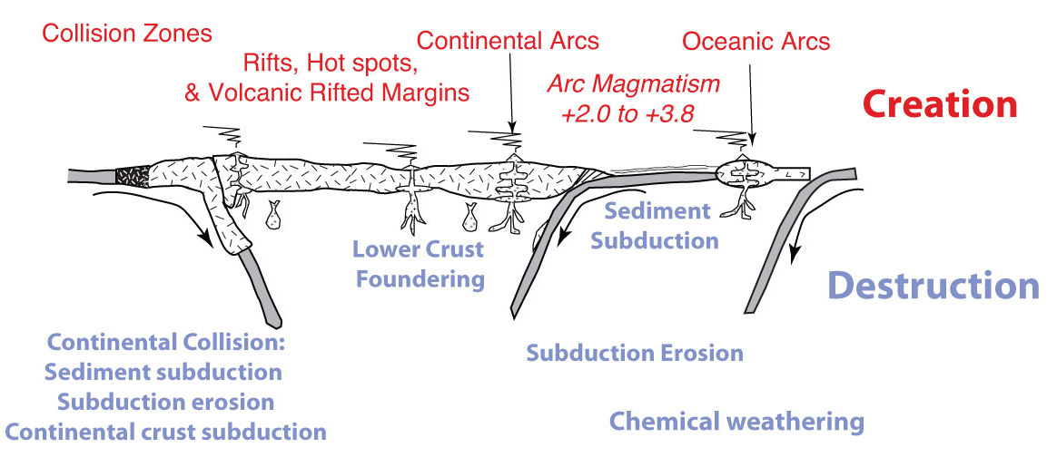
Let Brahma represent continental crust creation
Let Shiva represent continental crust destruction
We want to know the ratio of Brahma’s activities to that of Shiva over time: the Brahma/Shiva ratio.

Slide 10
Modern B/S ~0.64 to 0.53. What was it in the past?
C. R.

Slide 11
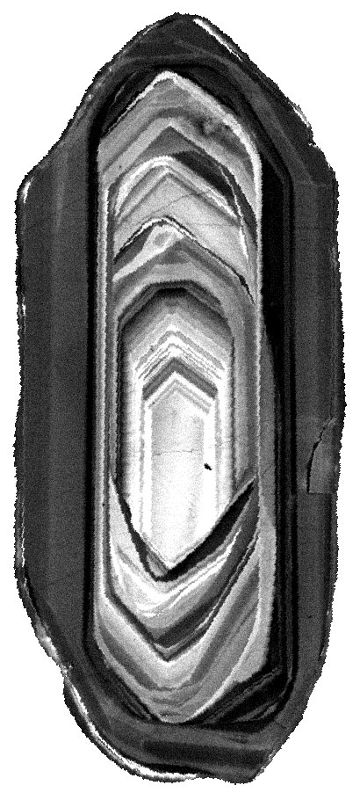
We have a powerful indicator of Brahma’s activities: zircon!
Zircon U/Pb ages provide a robust record of creation
Zircon: the nearly indestructible indicator of igneous processes and continental crust production.
Zircon: 232,000 hits in Google Scholar
Lawley’s Zircon Gallery

Slide 12
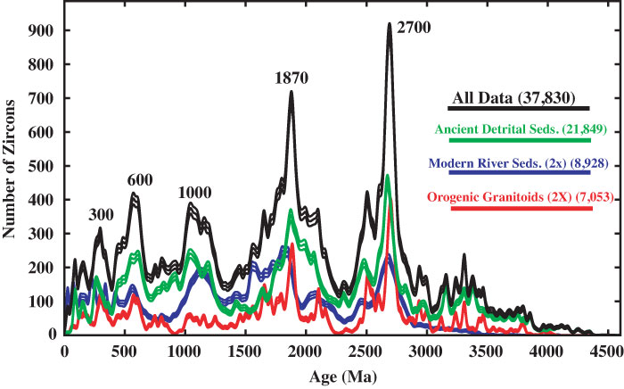
Zircon Age Distribution of Continental Crust
Condie & Aster, 2009

Slide 13
But what geologic record do we have of Shiva’s activity?
No “Shiva indicators” compare with Brahma’s zircons.
Best indicator of continental crust destruction is Ultra-High Pressure (UHP) metamorphic rocks

Slide 14
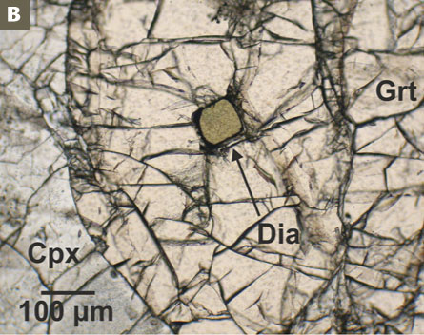
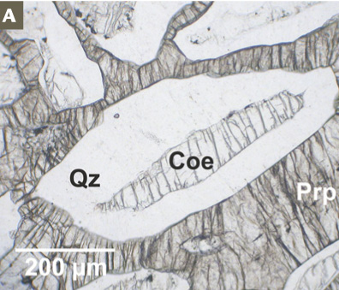
UHP assemblages are characterized diamond or coesite. These require pressures corresponding to depths
> 90 km.
UHP terranes are samples of continental crust that were subducted, then returned to the surface.
Schertl and O’Brien 2013

Slide 15
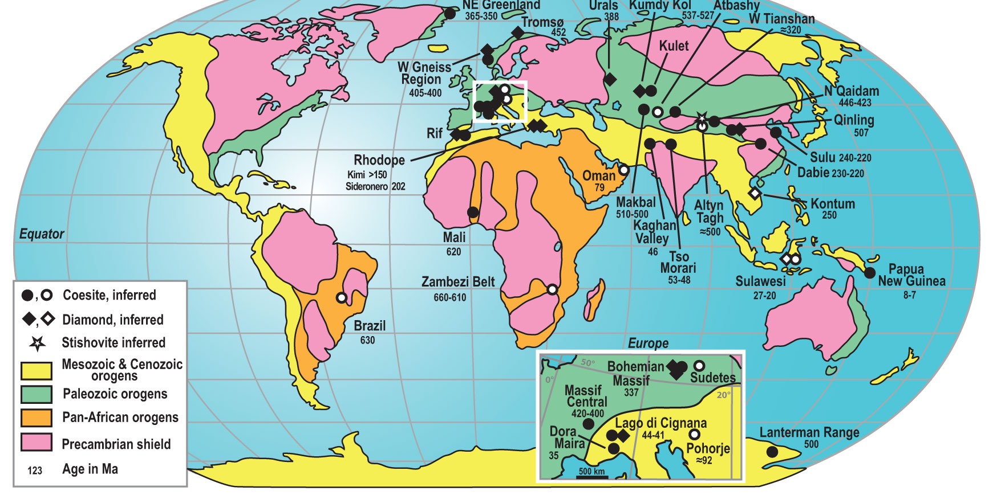
UHP occurrences globally are <650 Ma
Worldwide UHP terranes from Gilotti (2013). Solid symbols indicate confirmed coesite or diamond. Open symbols are where UHP metamorphism is inferred from pseudomorphs or calculated P–T conditions, or cases where index minerals have been published in abstract.

Slide 16
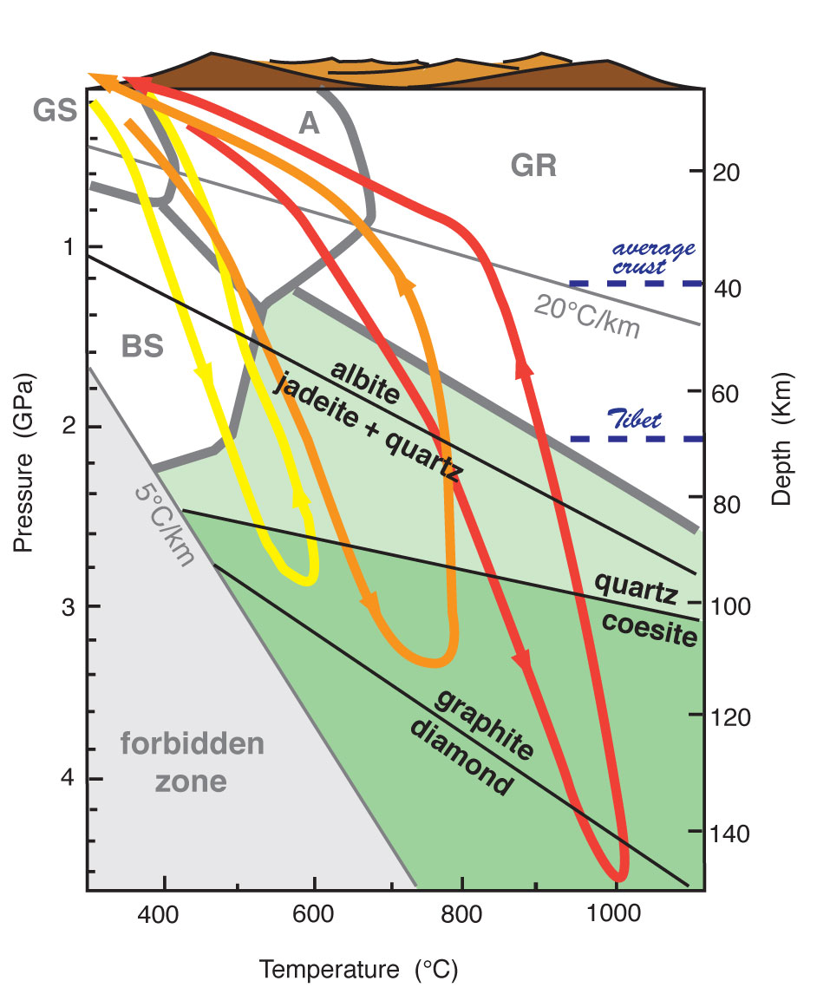
P–T for UHP metamorphism (from Liou et al. 2012). Eclogite facies is shown in light and dark green. Metamorphic facies are delineated by thick gray lines (GS = greenschist, BS = blueschist, A = amphibolite, GR = granulite facies).
The thicknesses of Tibetan and average continental crust are indicated.
UHP metamorphism is the deeper part of the eclogite facies and corresponds to the coesite stability field (dark green). The yellow, orange, and red lines correspond to generalized cold, tepid, and hot P–T paths for UHP rocks.

Slide 17
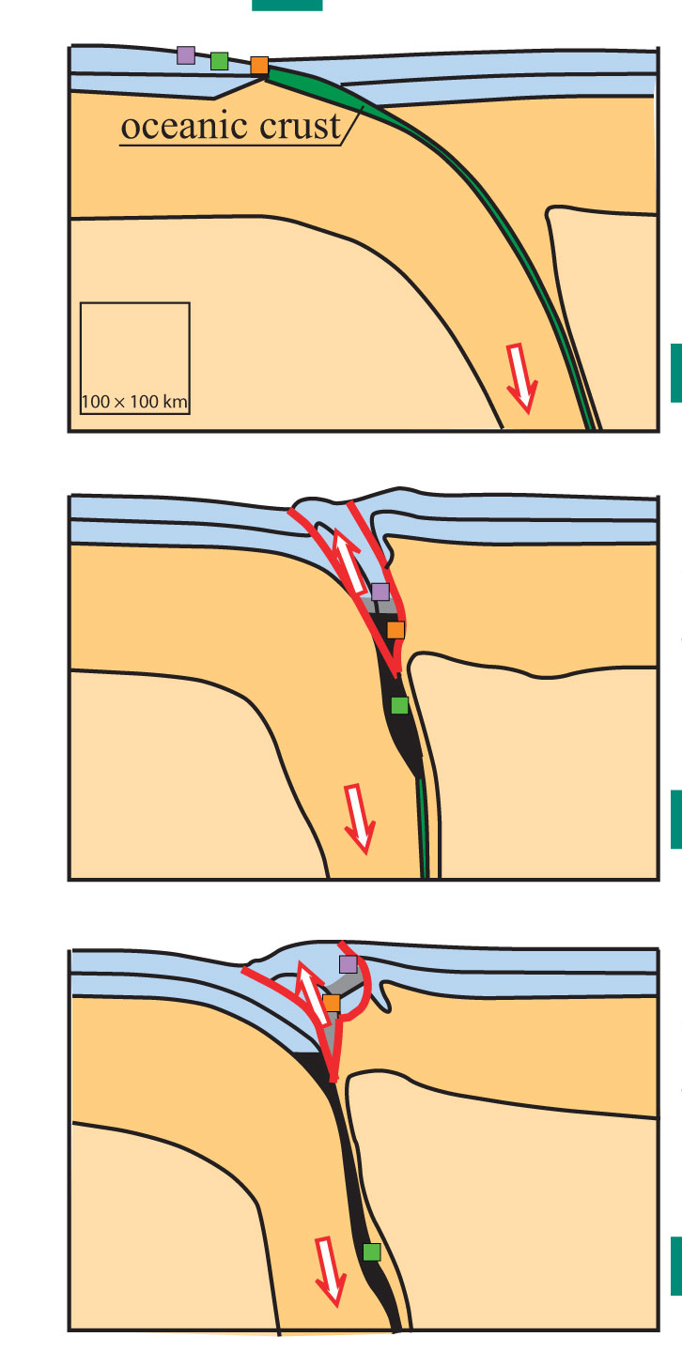
How to interpret the UHP record?
Assume UHP’s are minor fragments of continental crust subducted to > 90km; much more did not return to the surface.
Why no UHPs >650 Ma?
Hacker et al. 2013

Slide 18
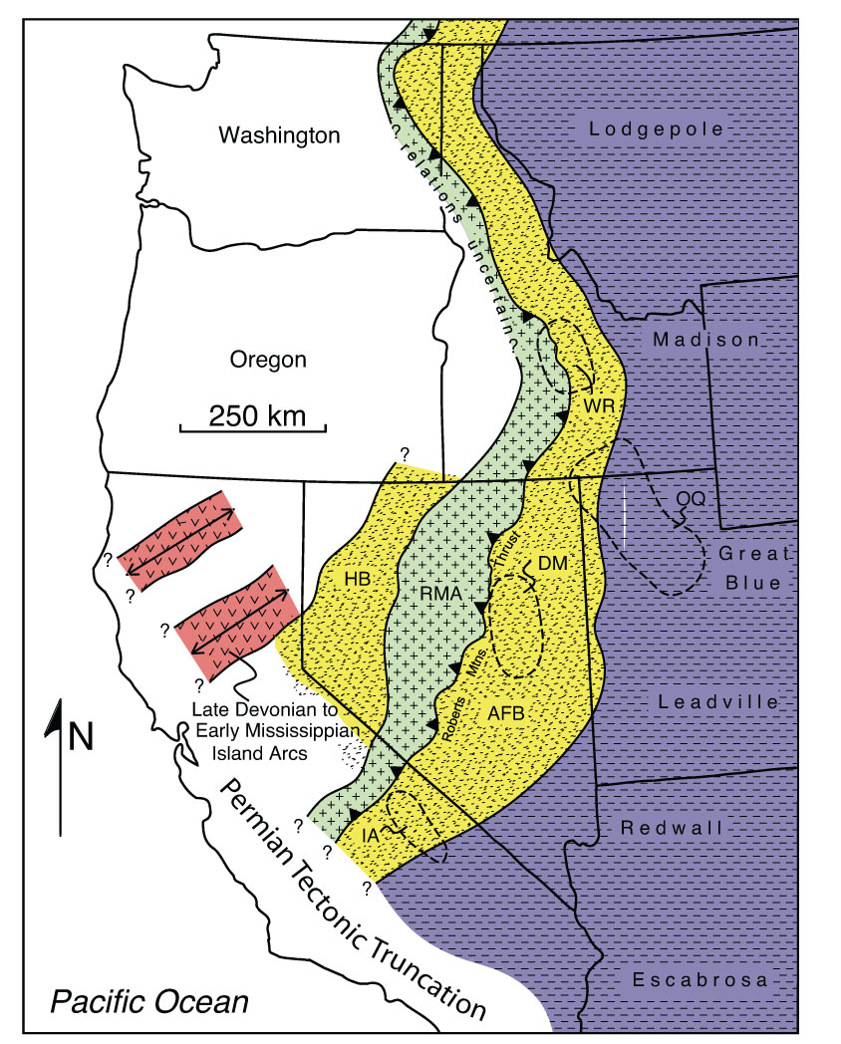
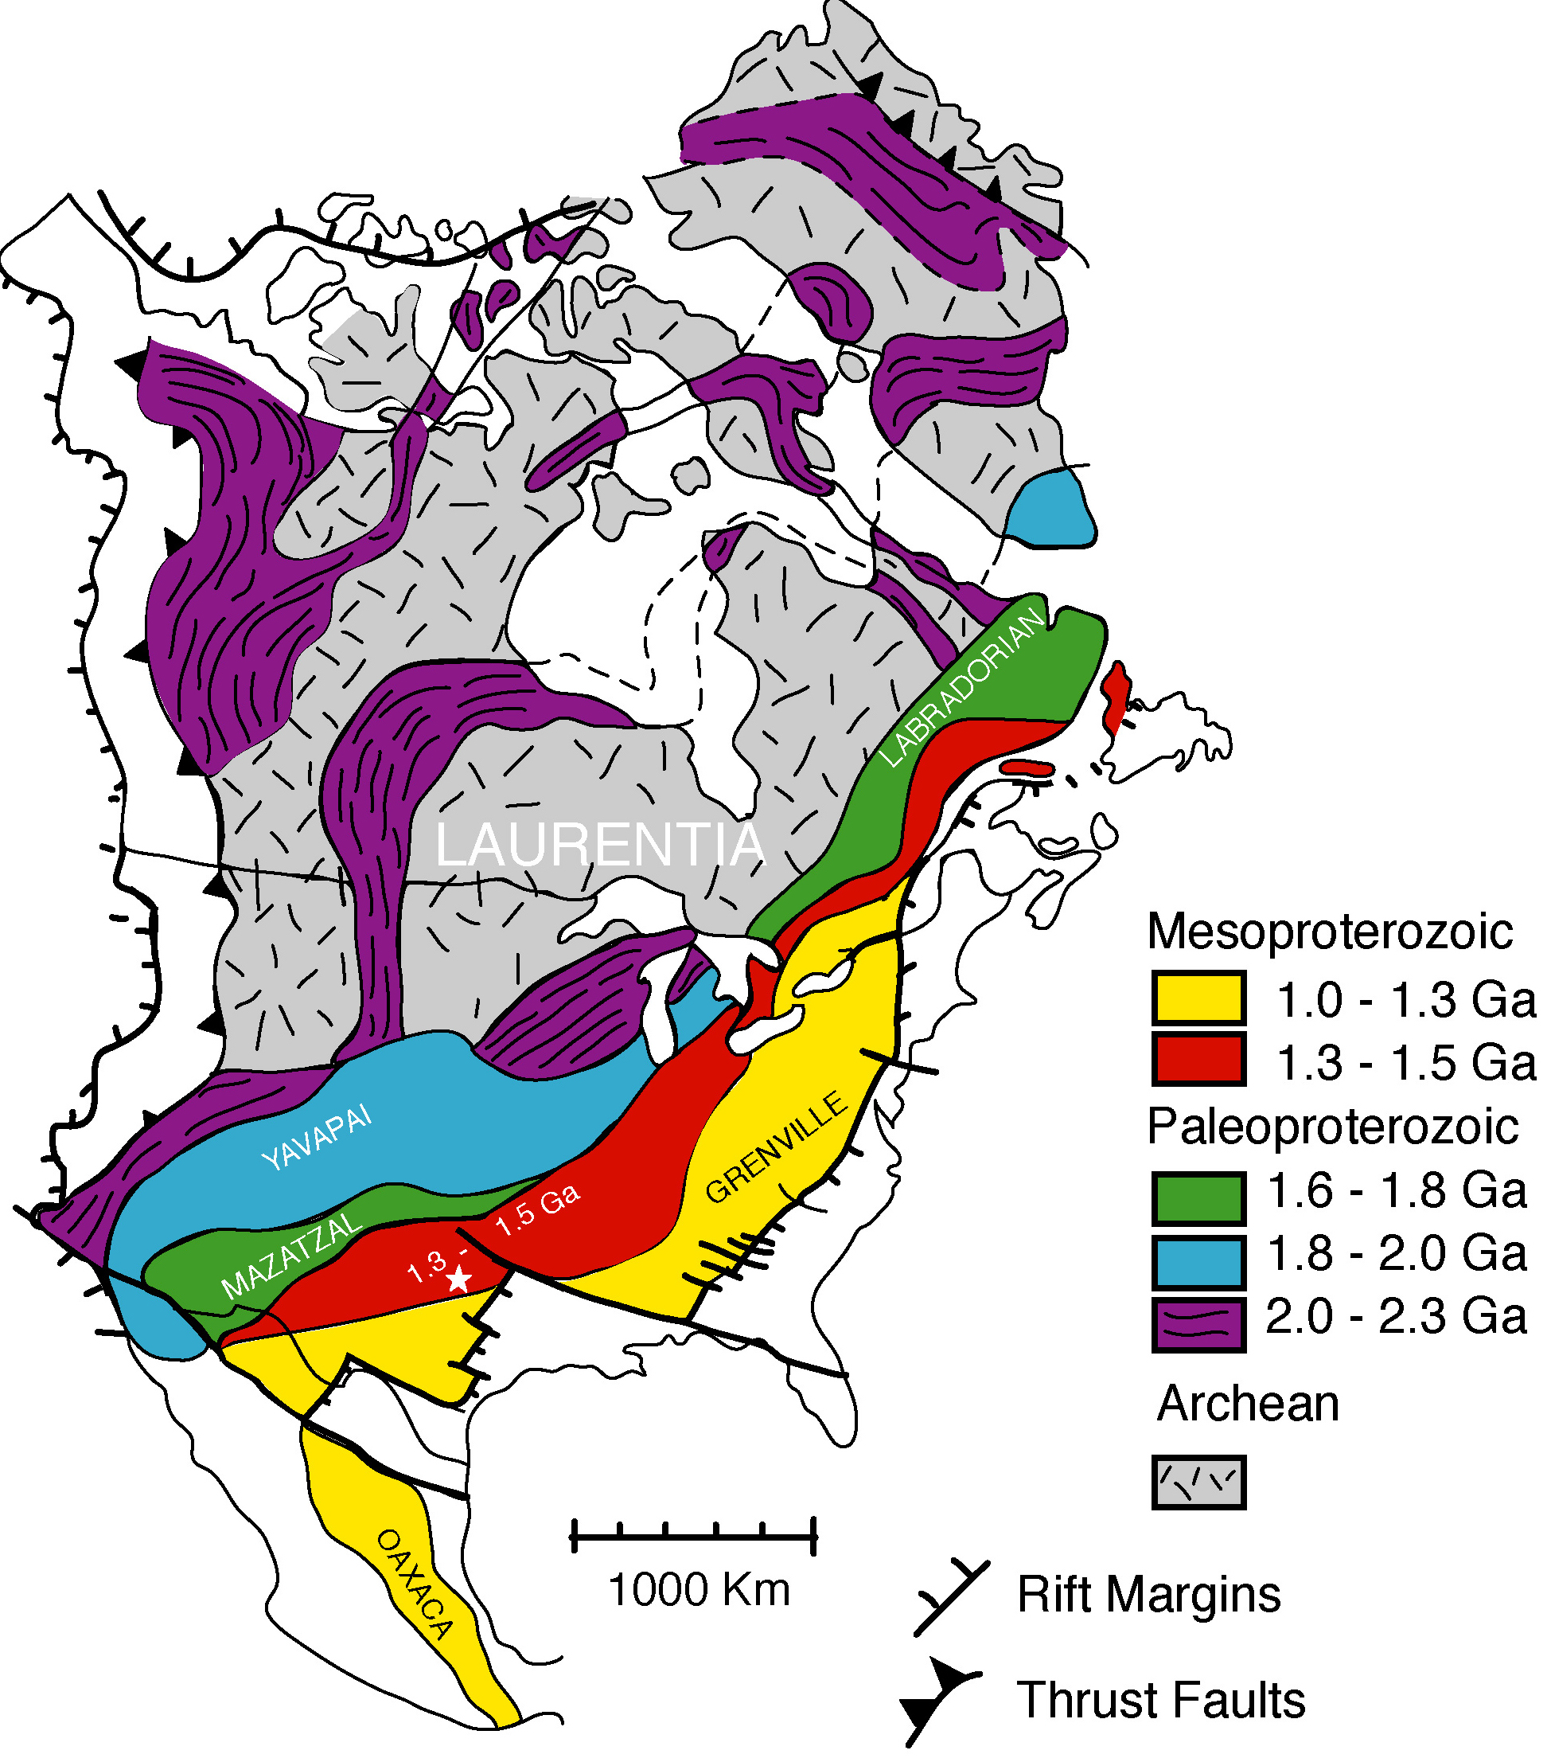
Another Shiva Indicator: Truncation of Paleozoic sedimentary facies and structures against the Pacific margin ~250 Ma
Dickinson 2006
Karlstrom 2009

Slide 19
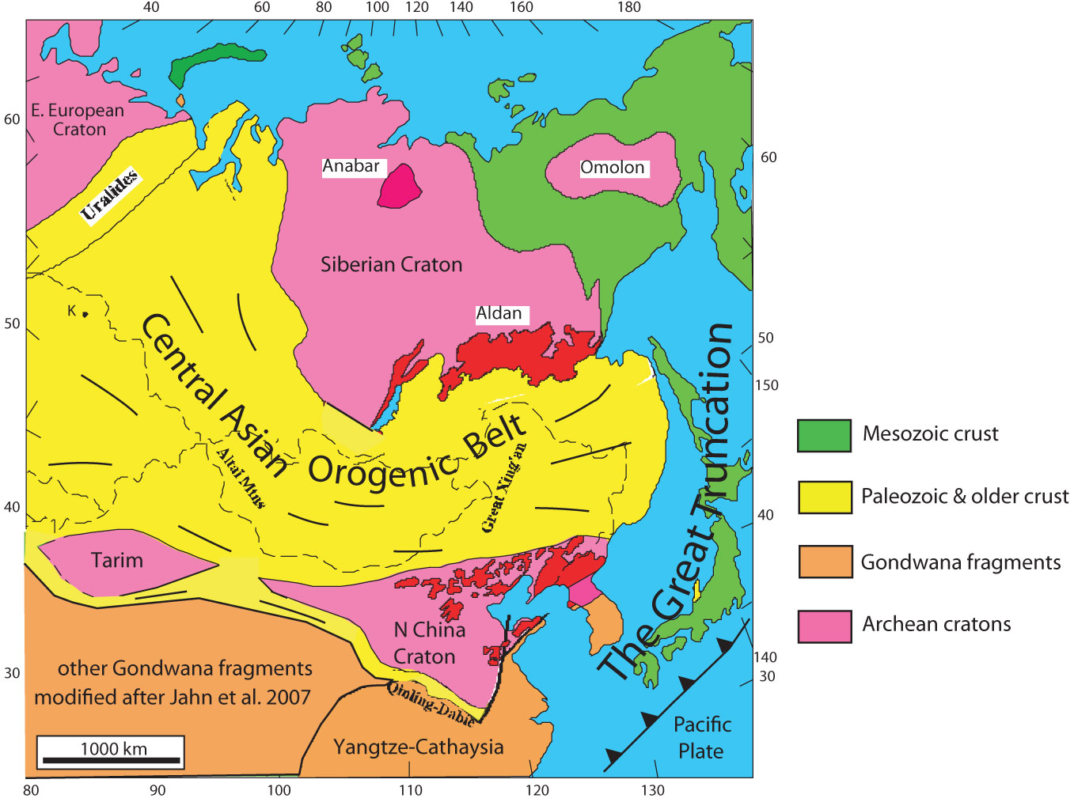
Massive truncation of older structures also occurred on other side of Pacific

Slide 20
A couple of thoughts:
1. What are the Shiva indicators for the pre 650 Ma record?
2. ~2/3 of continental crust is lost by subduction today. A pre-Plate Tectonic Earth would only lose crust by delamination and so should have a higher B/S ratio.

Slide 21
Brahma/Shiva ratio through time
Pre 650 Ma: B/S >1
Post 650 Ma: B/S <1

Slide 22
Thanks for listening!

Slide 23
Extra slides

Slide 24
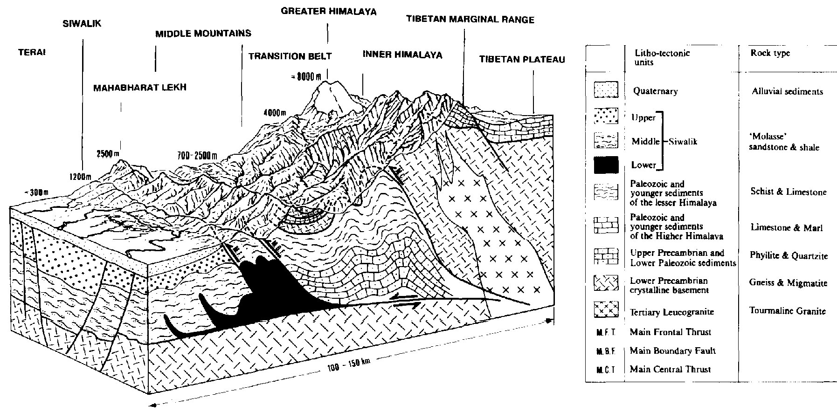
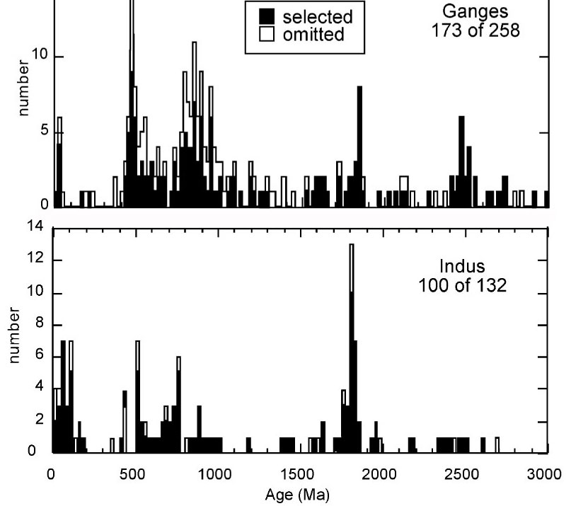
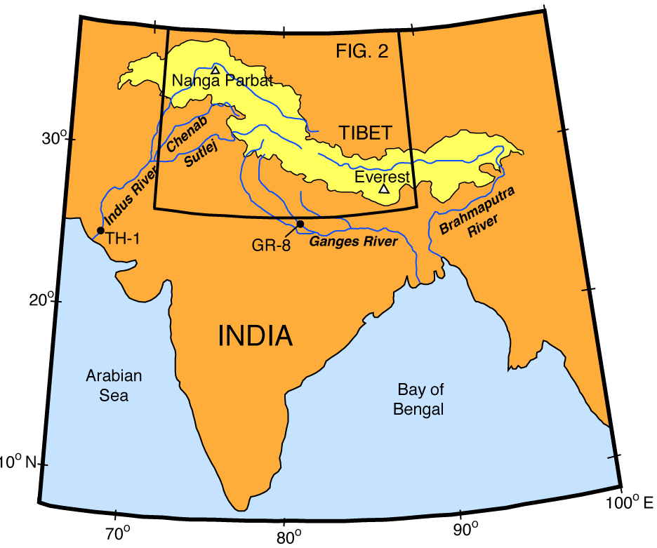
Do zircon age spikes signify supercontinent assembly? Not if Himalaya is a good modern analogue of supercontinent assembly..
Collision
Collision
Campbell et al. 2005

Slide 25
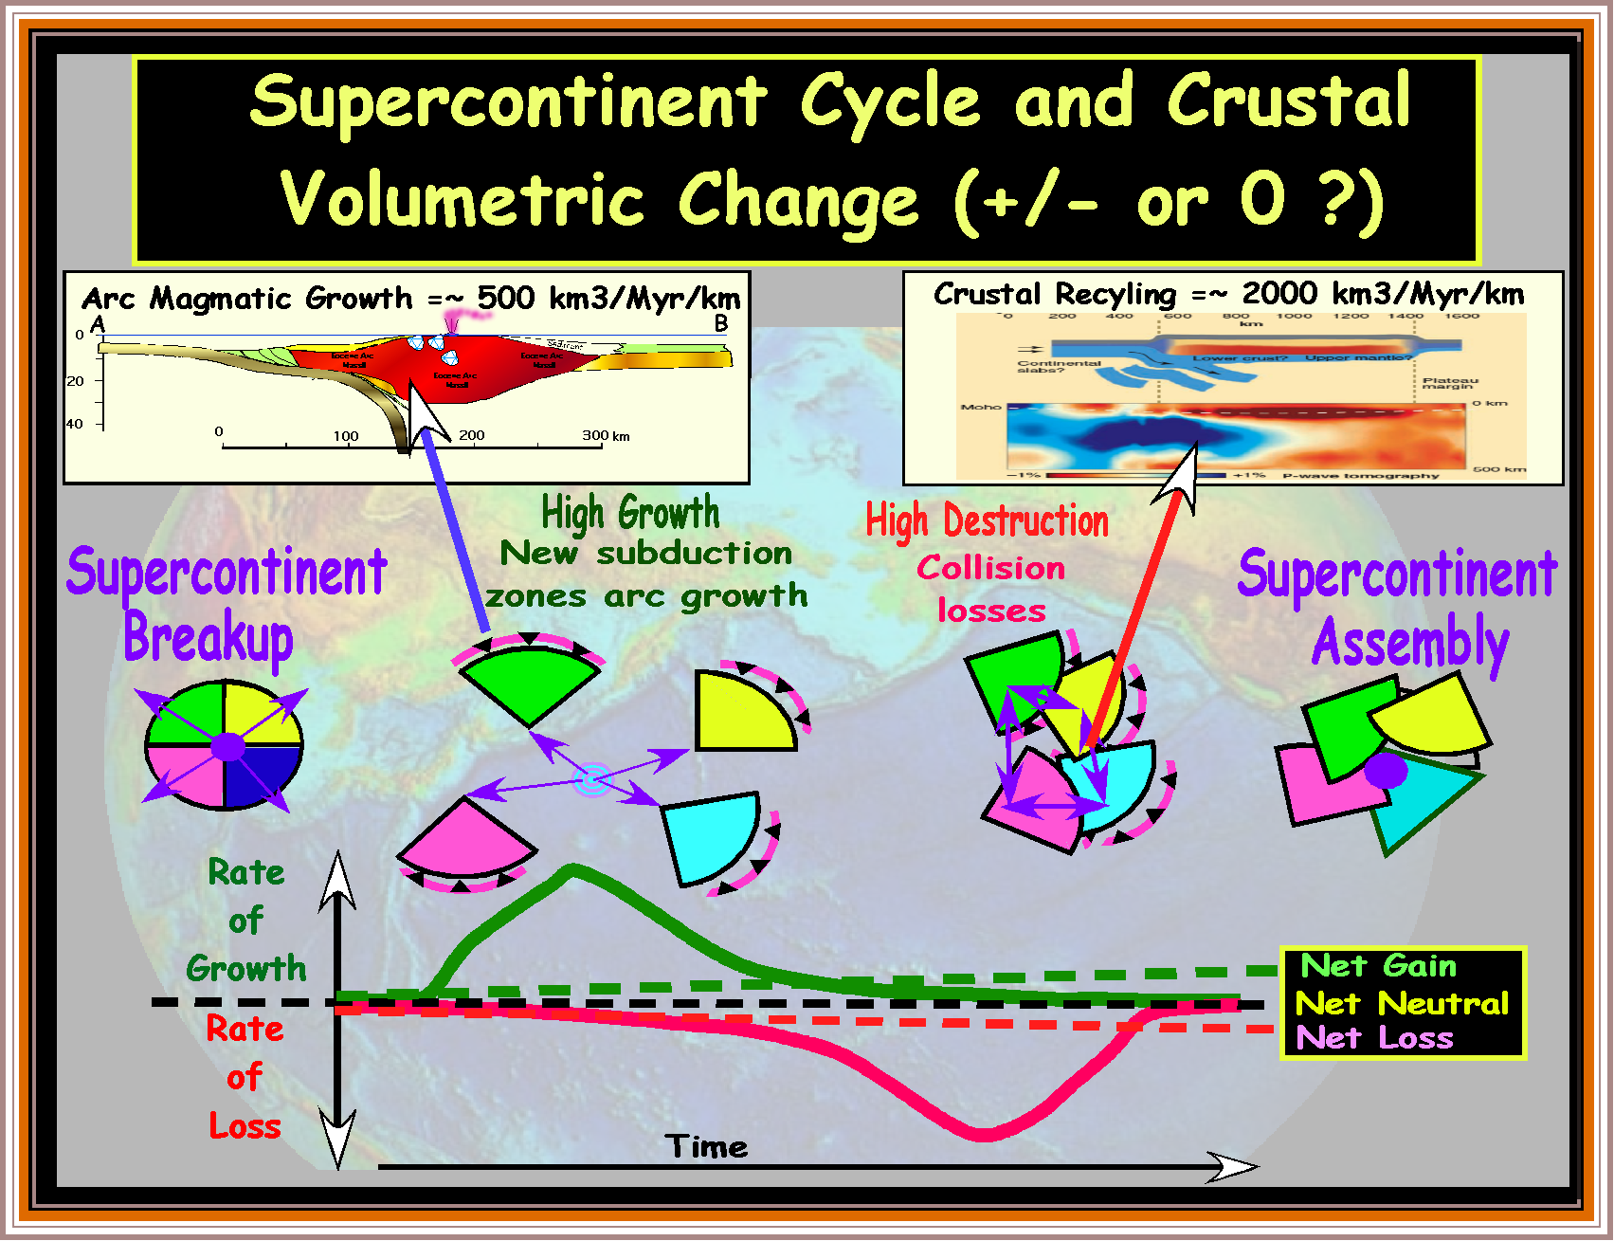


Slide 26
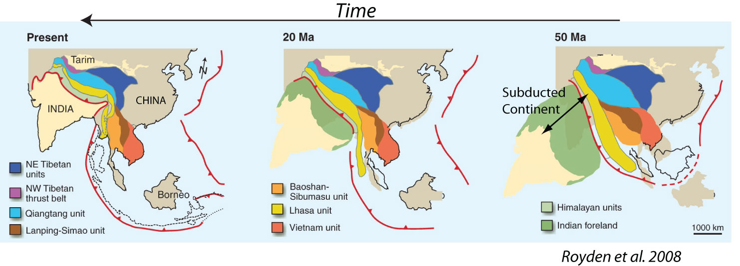
Subduction collision of the 2500-km-wide India crust began ~50 Ma. The volume of India Crust that entered the subduction zone is ~300 x 10⁶ km³
(2500 km x 40 km x 3000 km)
300 x 10⁶ km³/50 Myr = 6 AU for India suture zone
But What Fraction Was Recycled to the Mantle ?

Slide 27
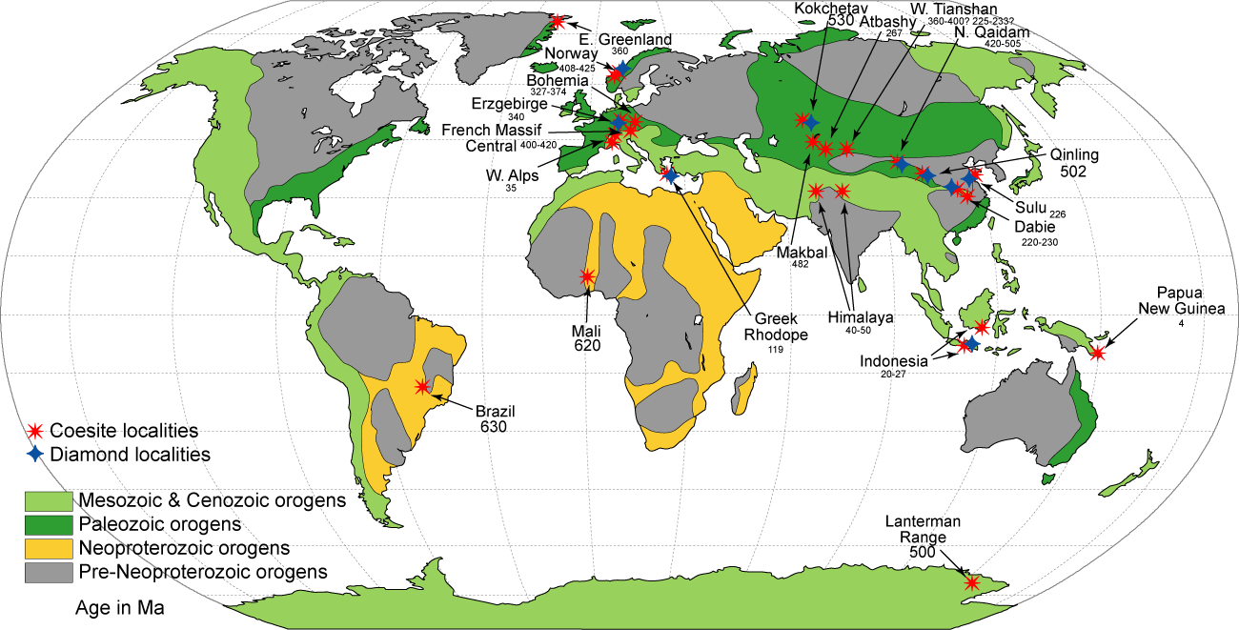
Ultra High Pressure(UHP) Metamorphic rock localities
Oldest examples are ~630 Ma (Late Neoproterozoic)
Modified from Maruyama and Liou (1998)

Slide 28
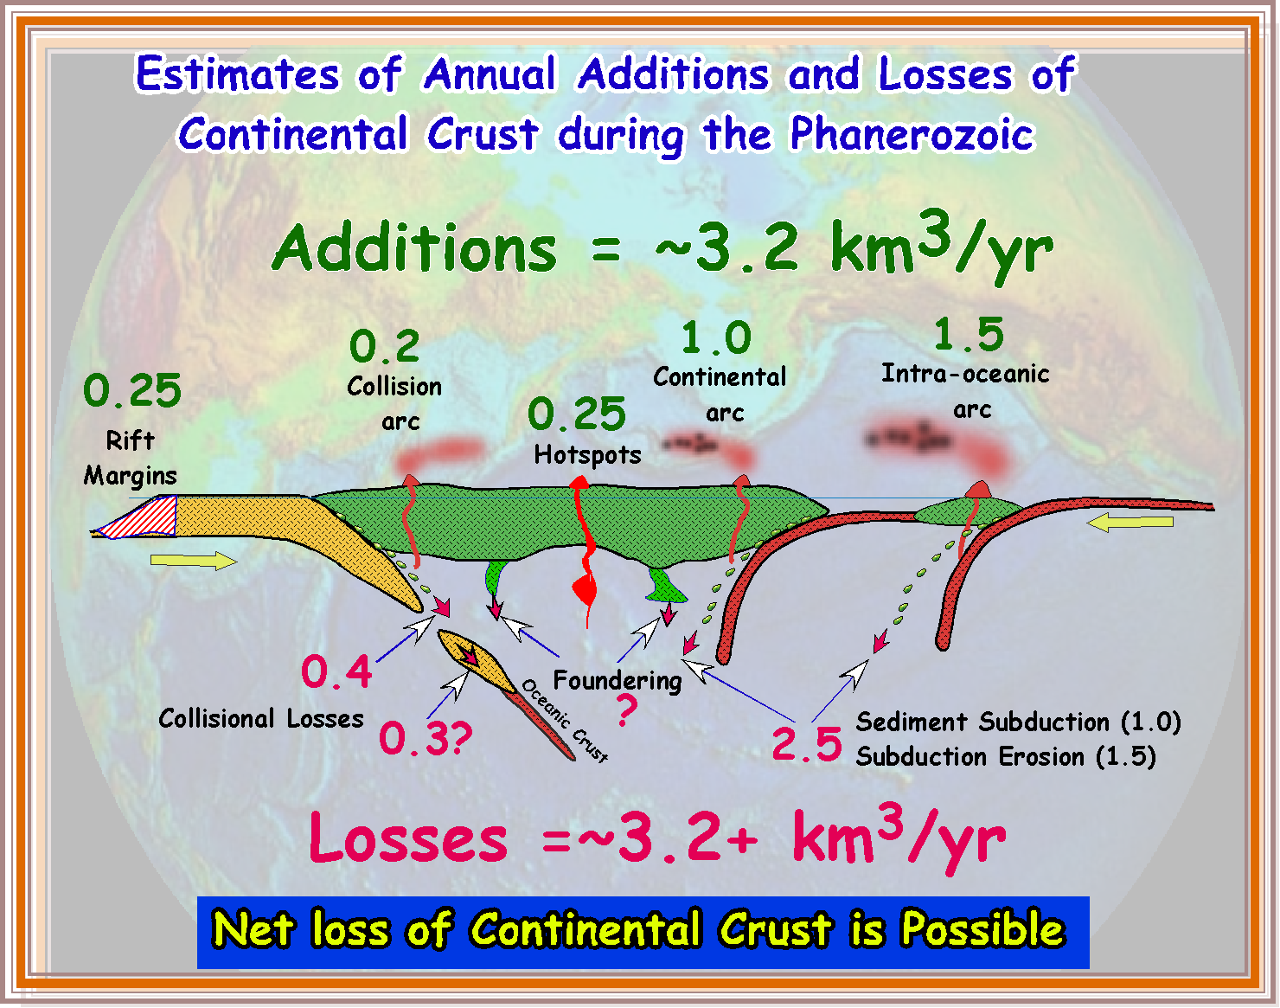

Slide 29
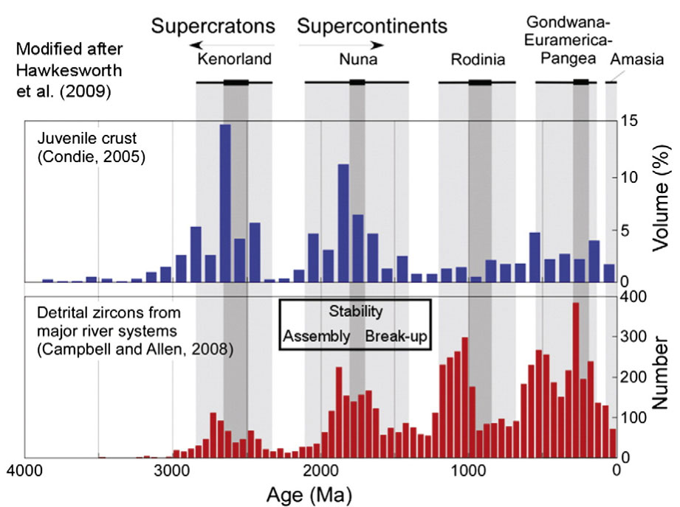
Do zircon age peaks reflect times of supercontinent assembly?
Pehrsson et al. 2014

