Slide 1

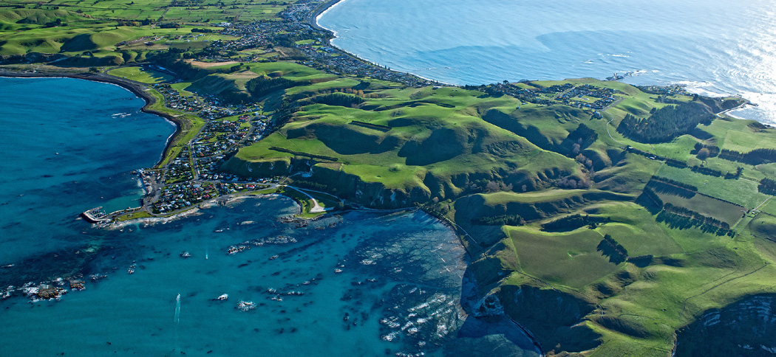
Tilting of marine terraces above a listric thrust fault, Kaikoura New Zealand
Brendan Duffy

Slide 2
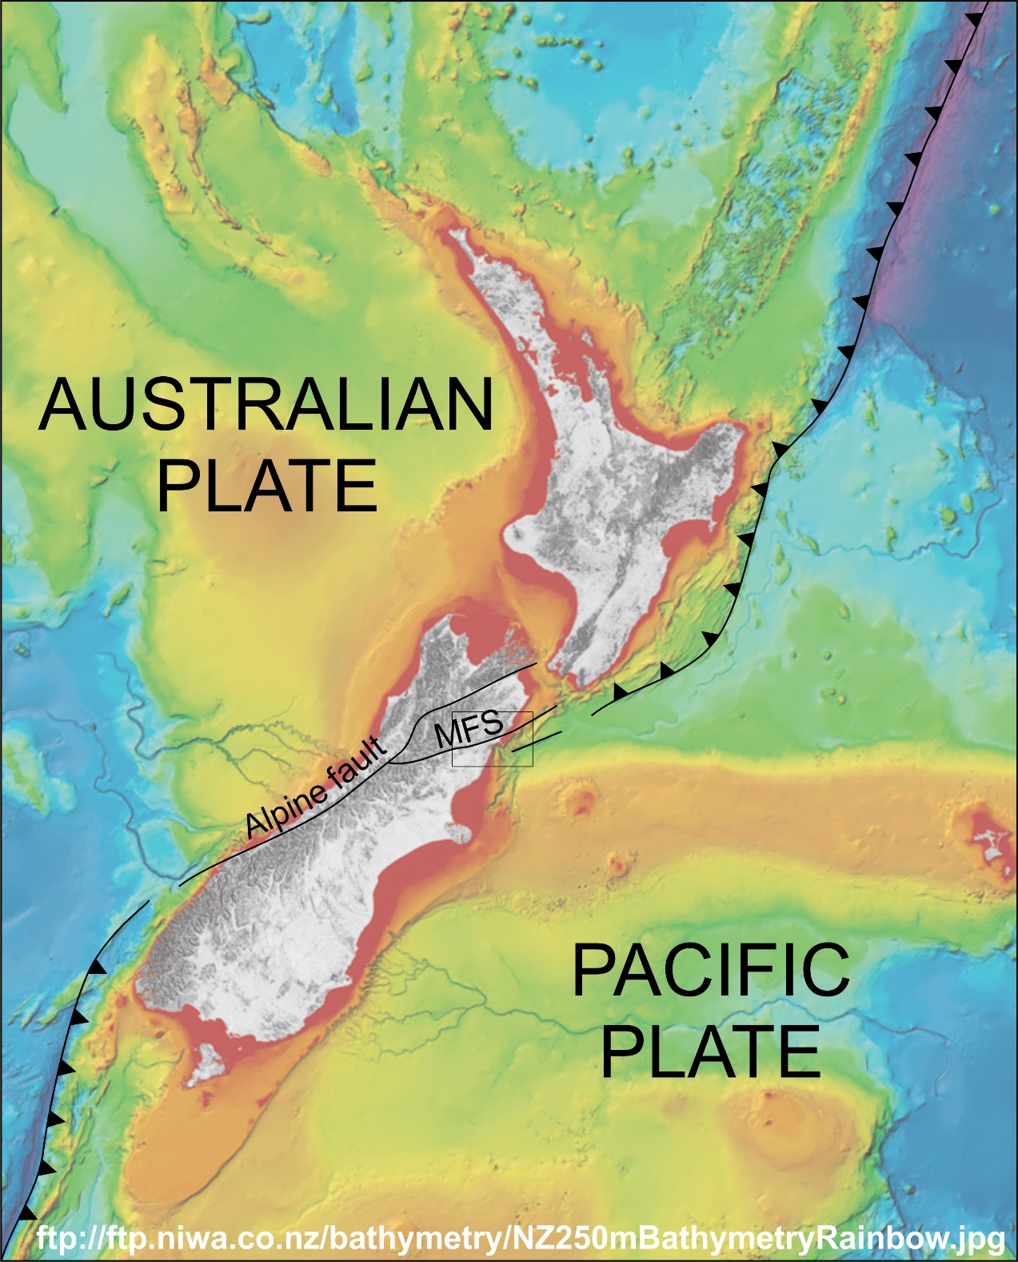
Location
Southern terminus of the Hikurangi Trough
Transition from subduction to strike slip
Immediately south of Hope fault in the Marlborugh fault system
  2nd fastest slipping fault in South Island
  MFS and Alpine fault absorb ~70% of plate boundary motion
Hikurangi Trough

Slide 3
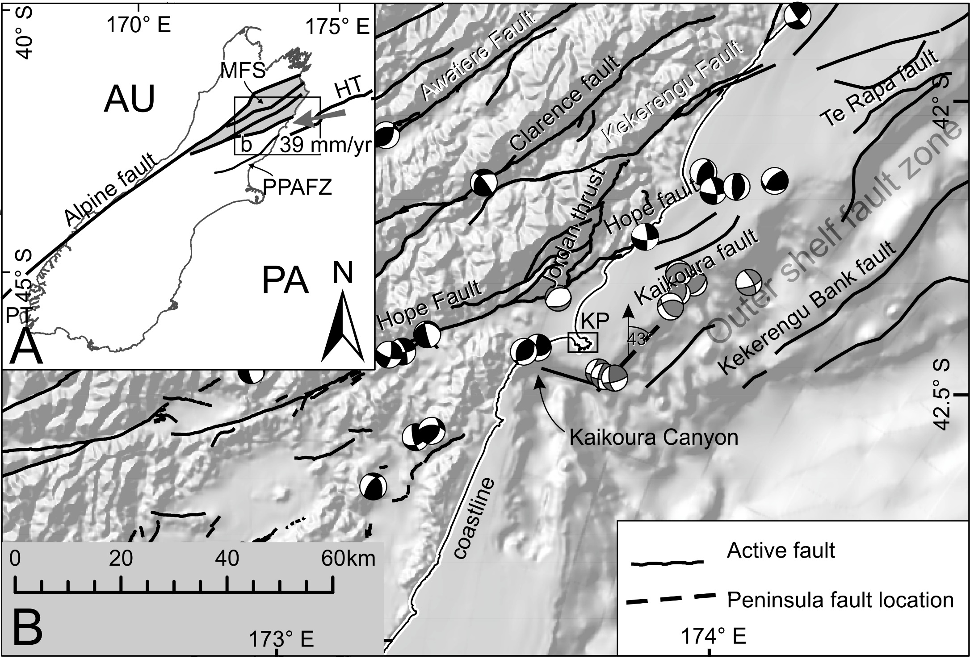
Seismicity after Reyners et al. 1997 (black) and Geonet CMT catalog (selected grey)

Slide 4
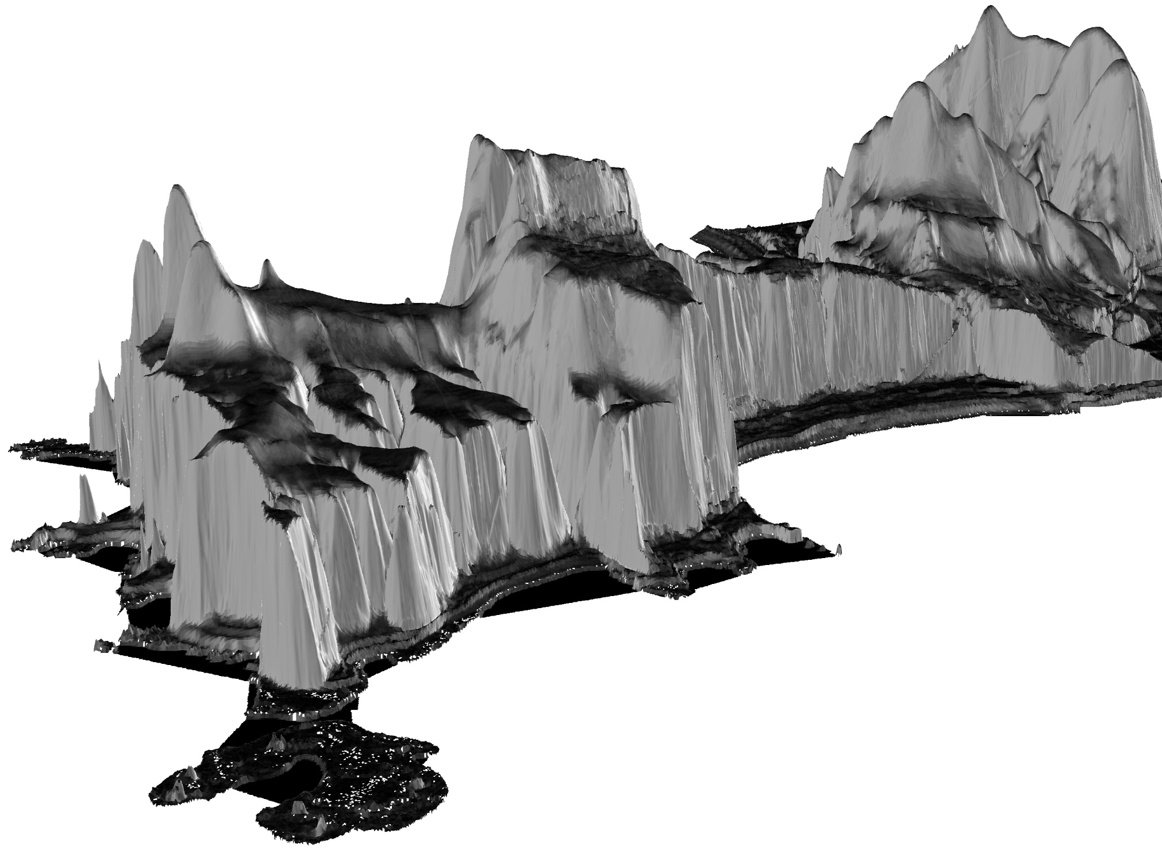
2012 LiDAR survey

Slide 5
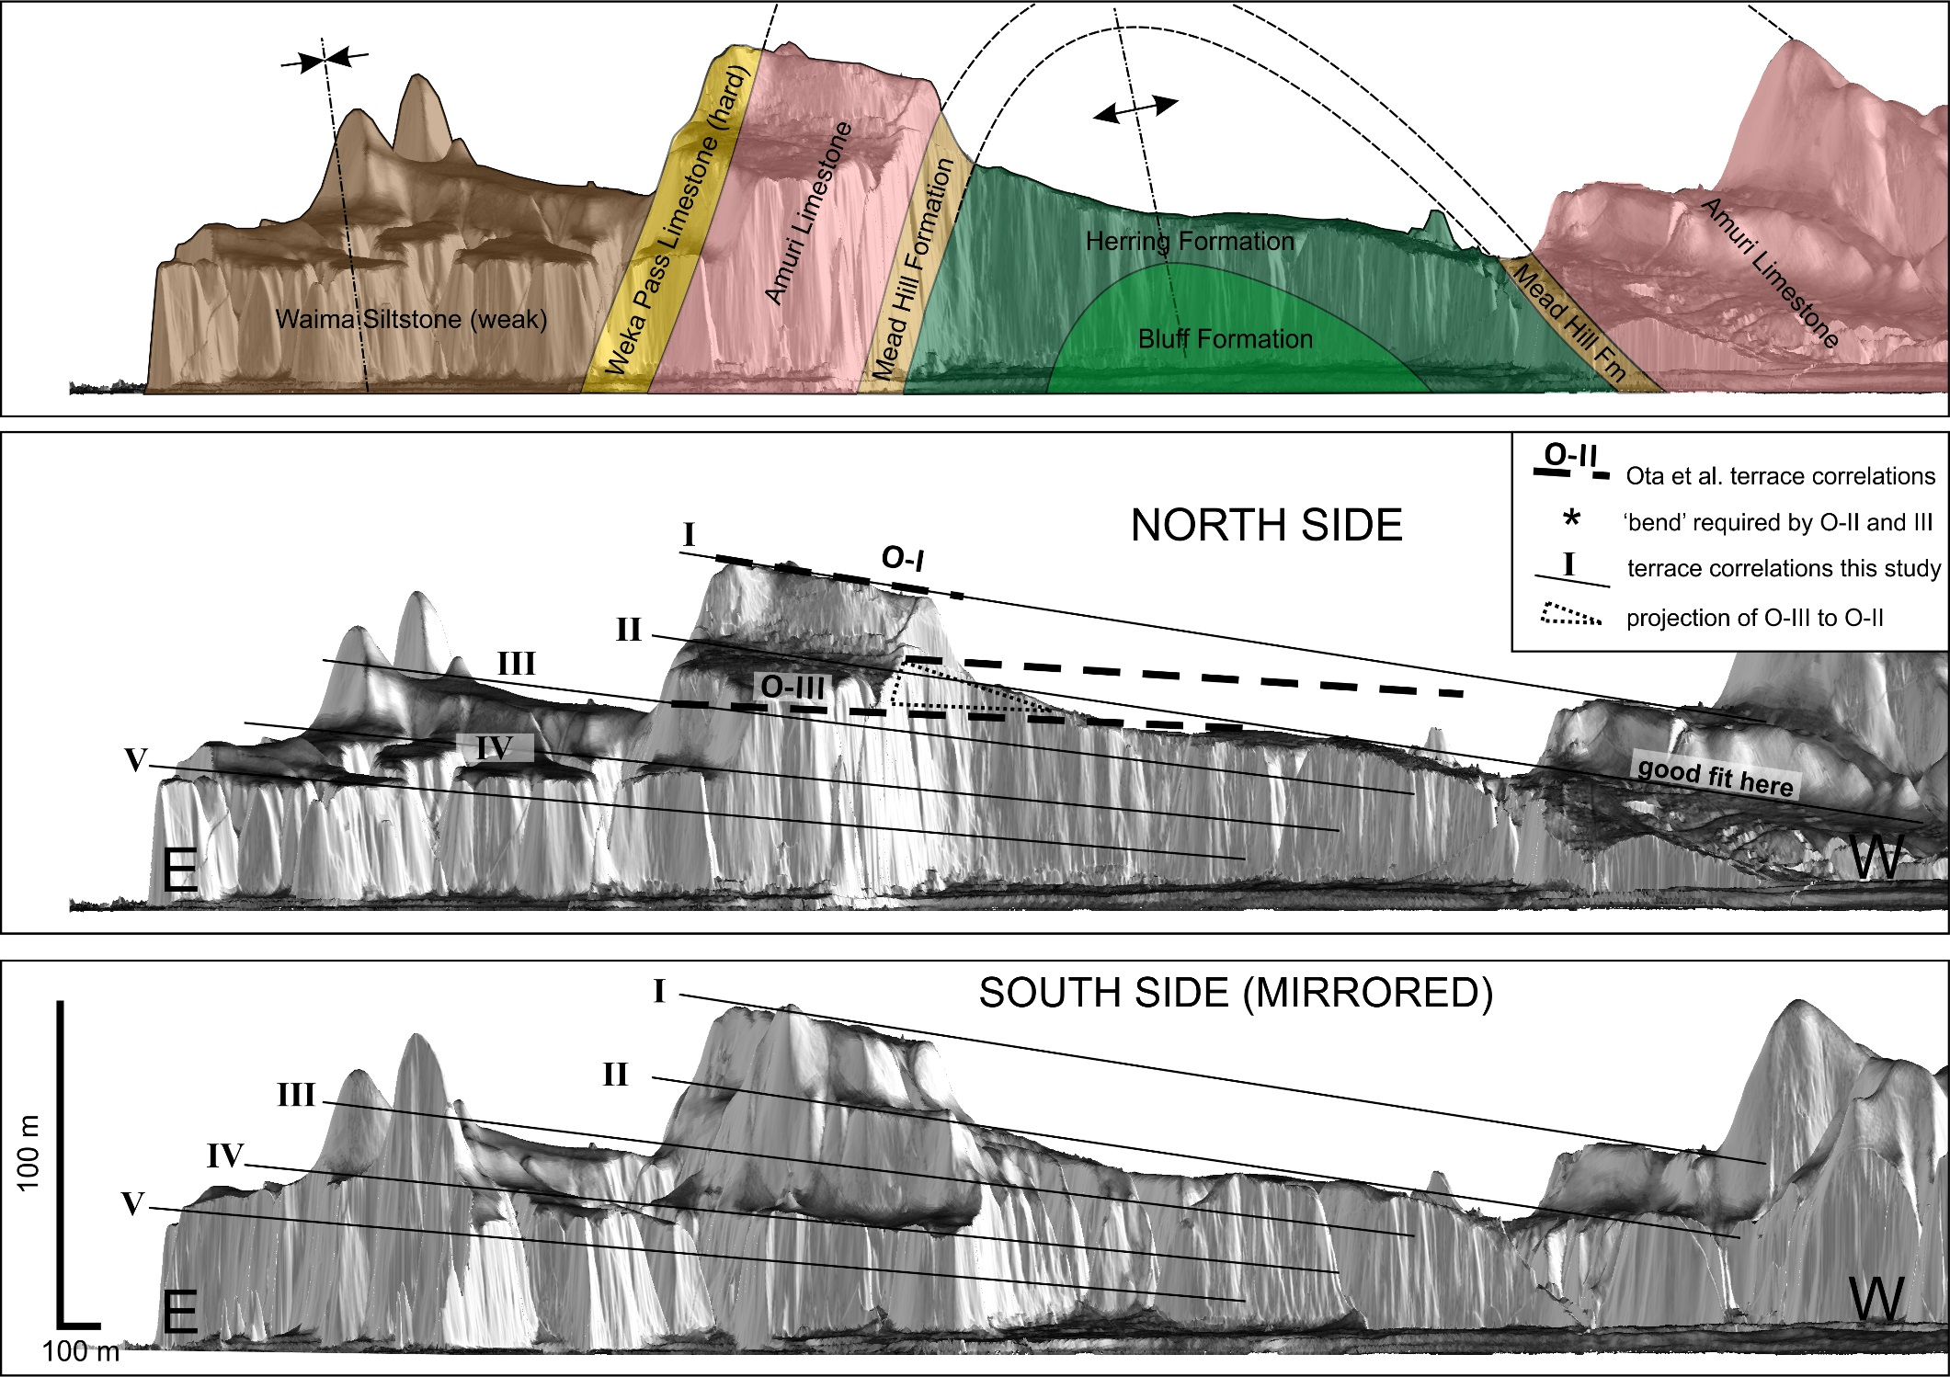

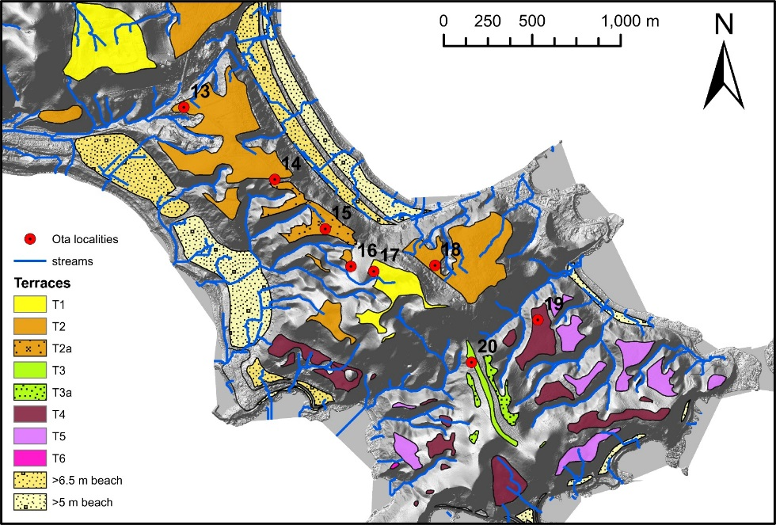
Buried and degraded paleosealevel indicators
Ota et al. correlations
?

Slide 6
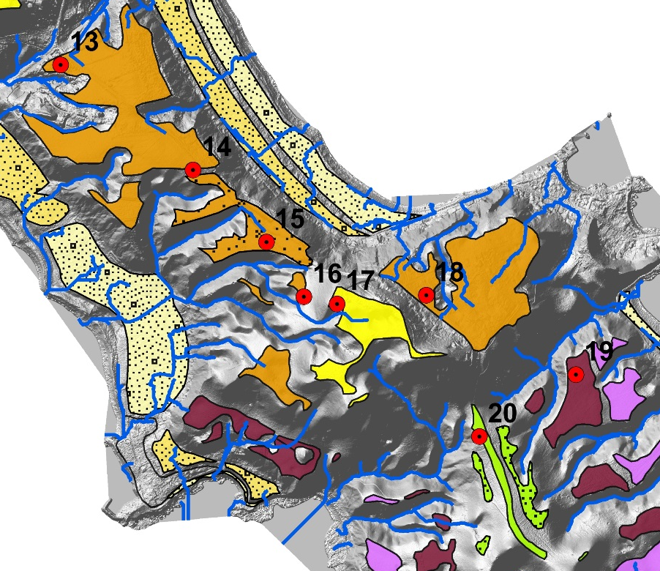
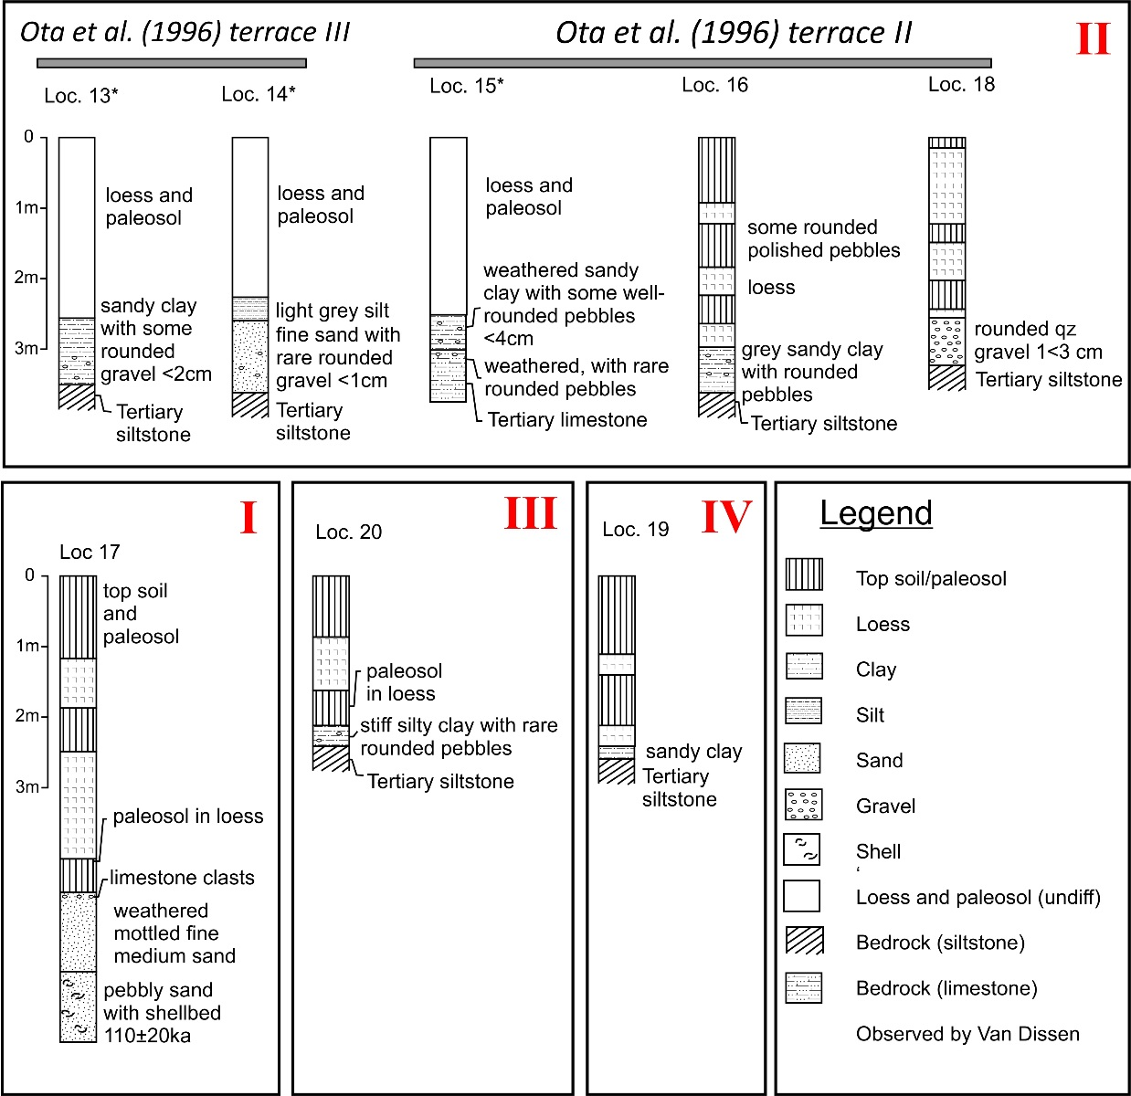
What does loess stratigraphy tell us?
110±20kyr

Slide 7

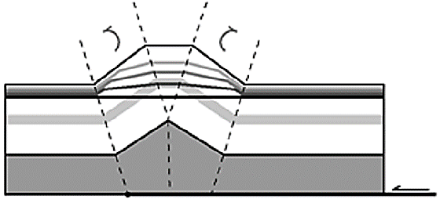
Models for progressive rotation
Detachment folding
Zone of constant dip
Amos et al. (2007)

Slide 8
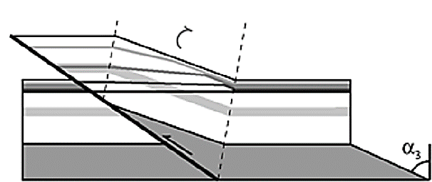
Simple shear fault bend fold
Flat top
Zone of constant dip
Simple shear
Amos et al. (2007)

Slide 9
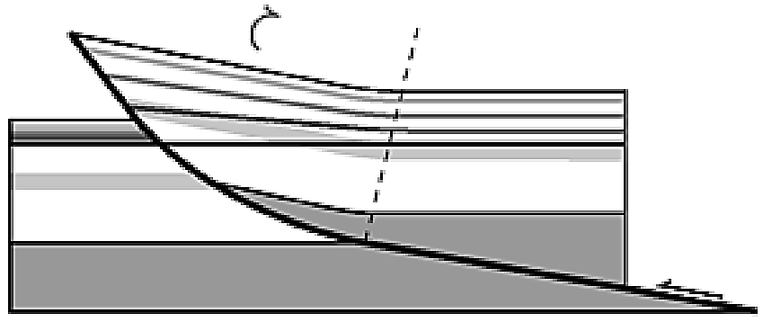
Listric fault model
No zone of constant dip
Amos et al. (2007)

Slide 10

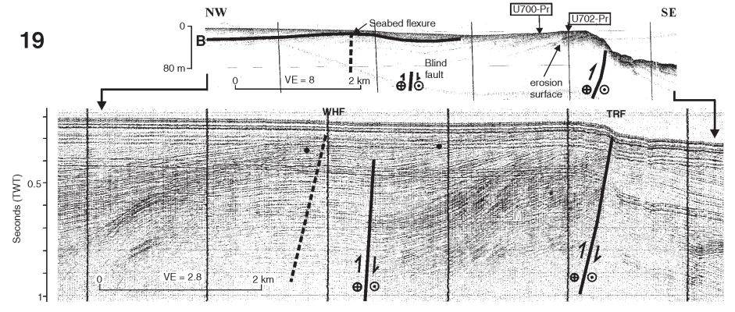
Nearby listric faulting
Barnes and Audru (1999)
Progressive rotation of syn-tectonic strata
Fault defines shelf edge

Slide 11
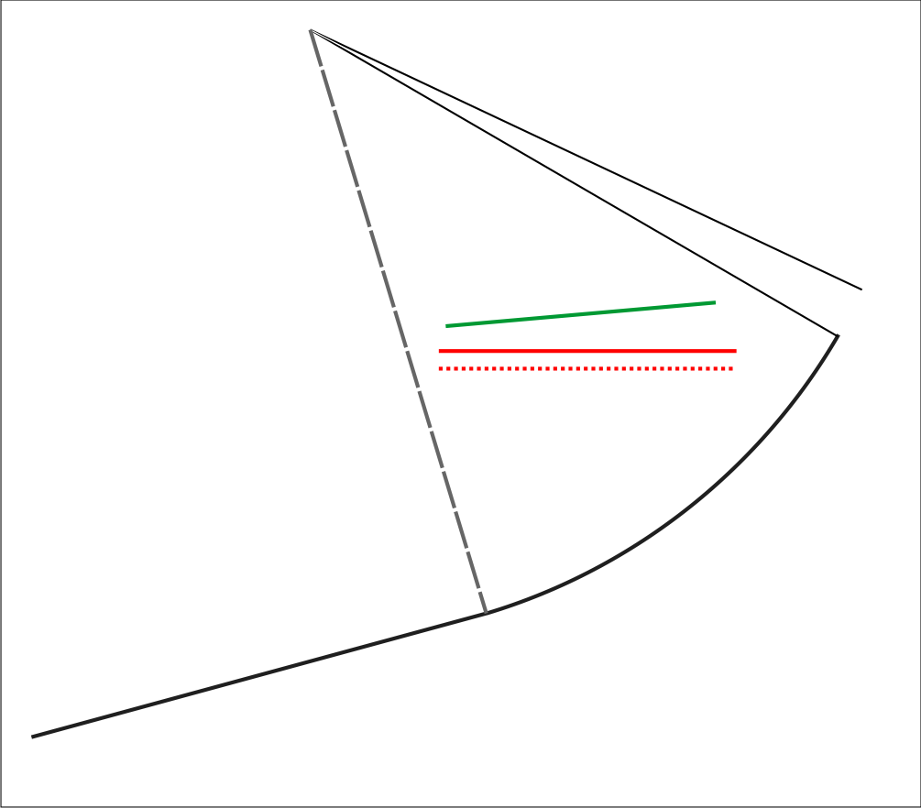
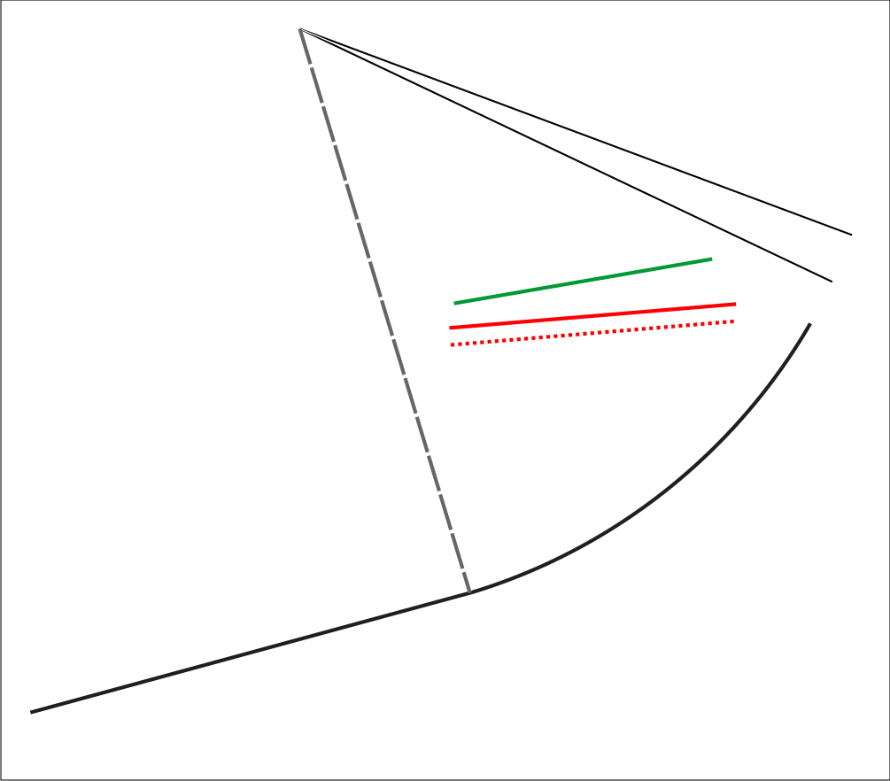
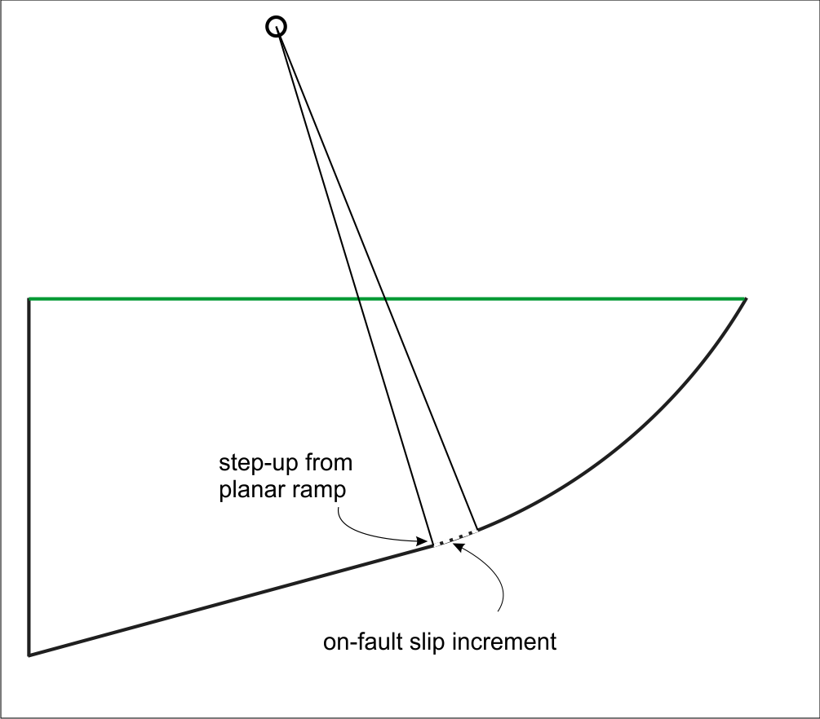
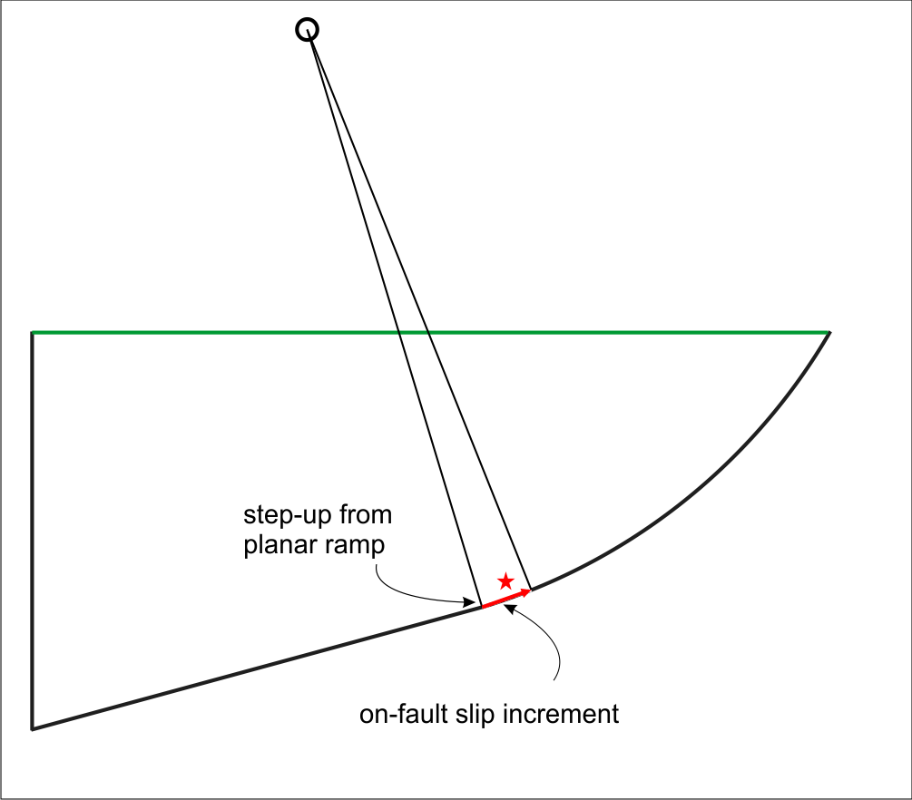
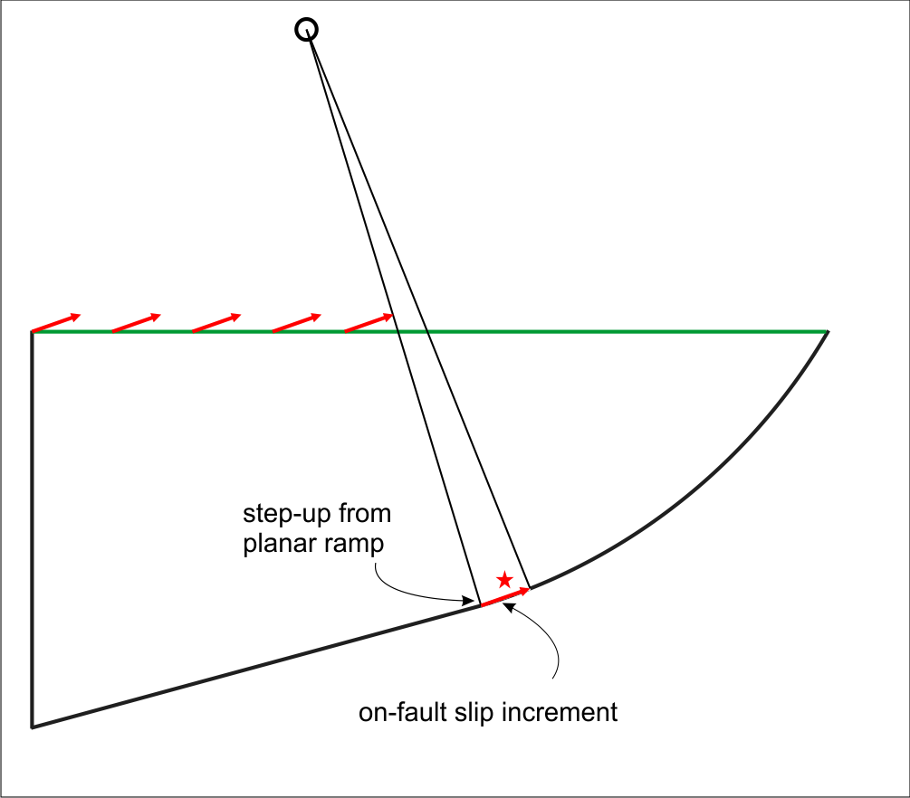
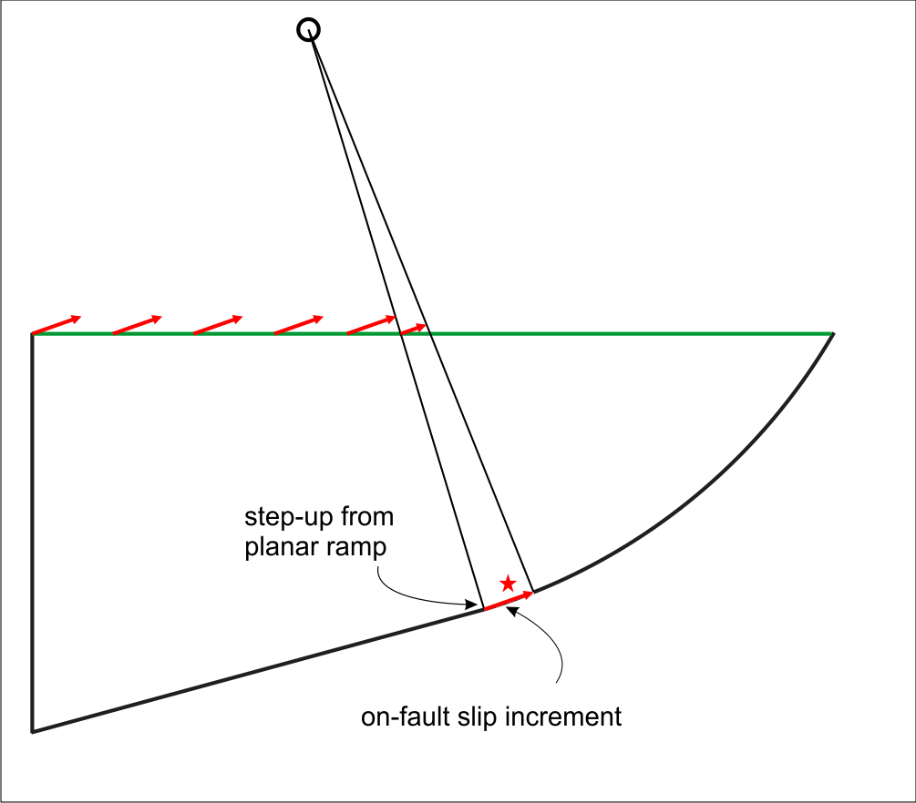
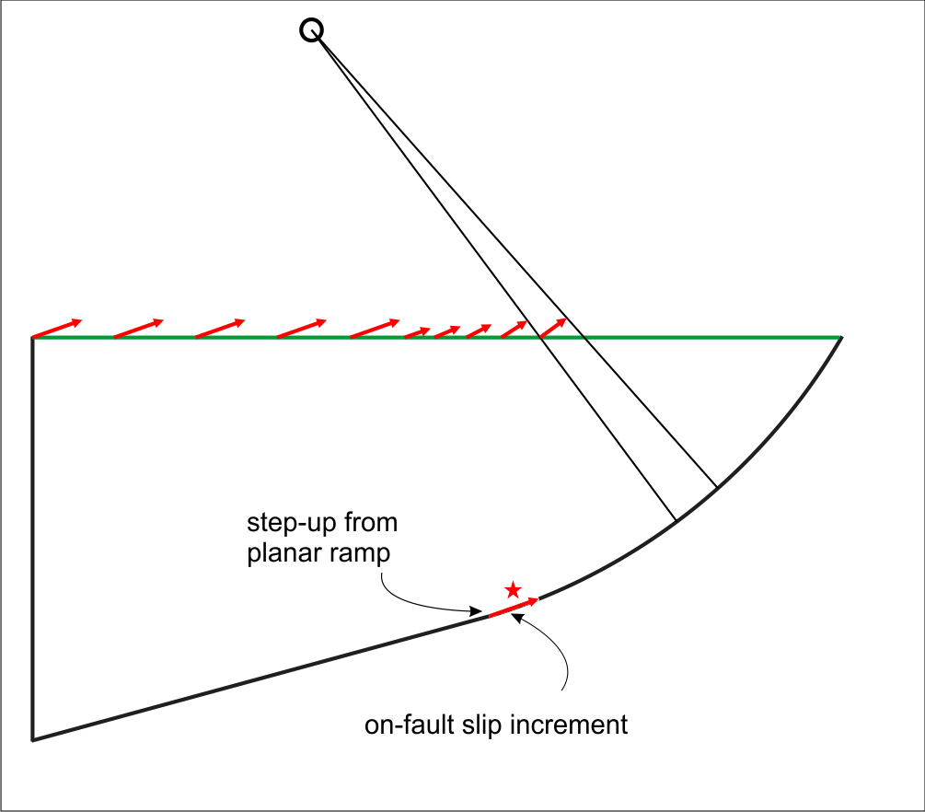
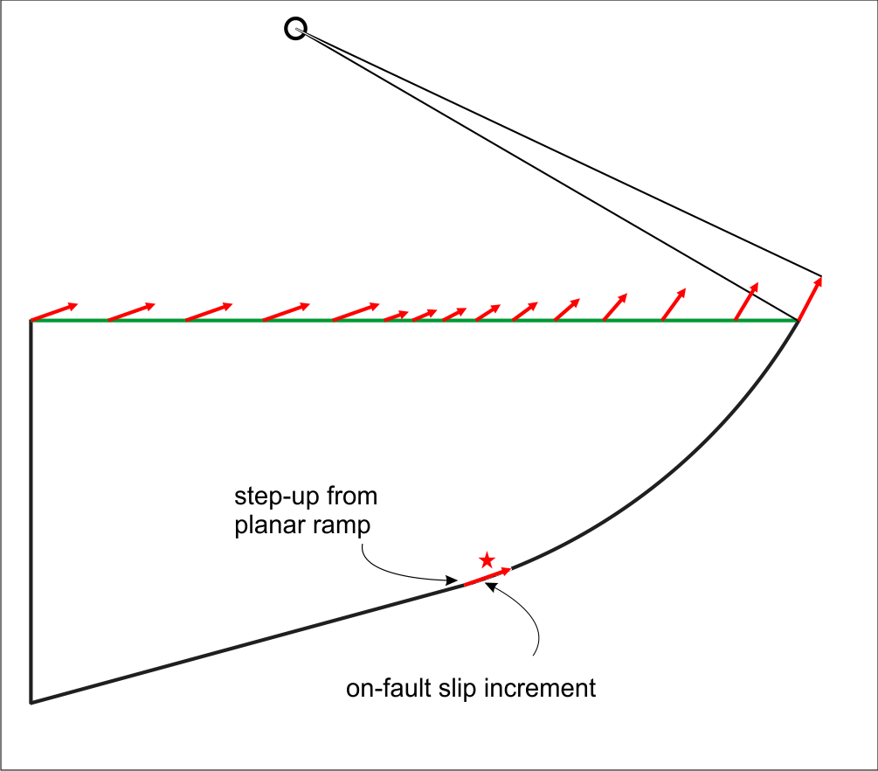
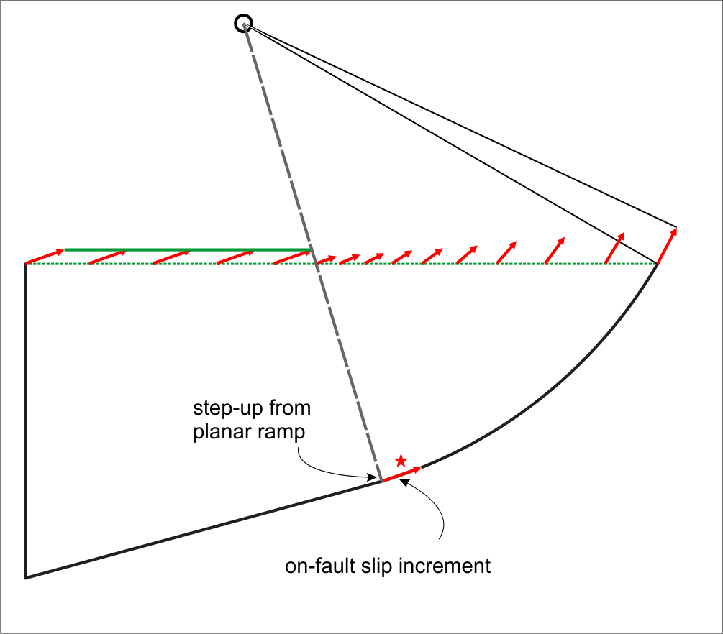
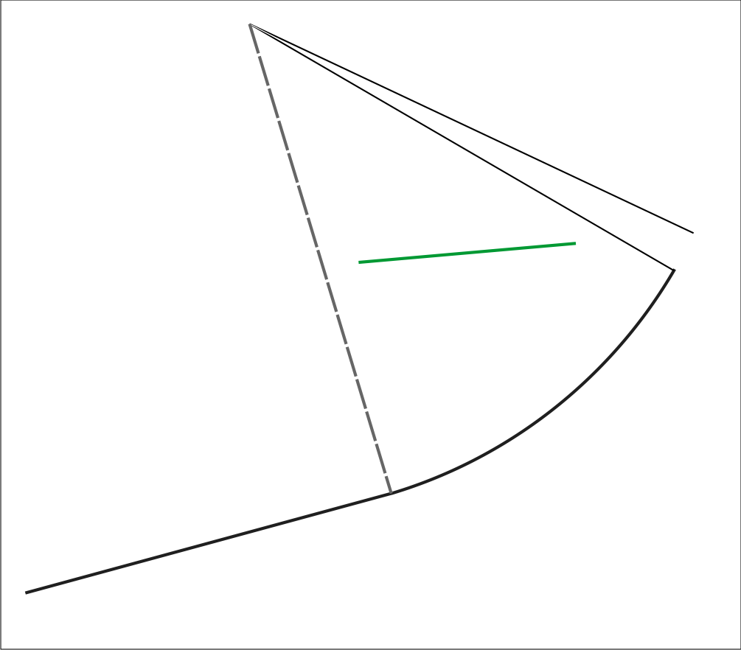
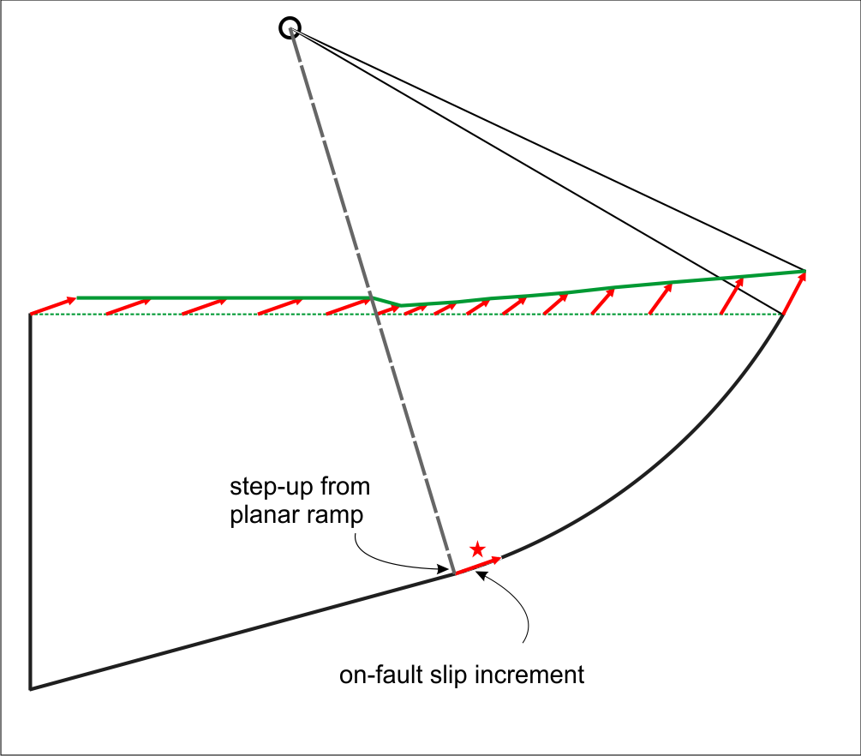
Listric fault deformation of an abrasion platform
Non-uniform uplift above listric fault
Should be possible to use
tilt
and
position relative to centre of curvature
to distinguish between models, where age constraints are otherwise ambiguous
Axial surface of the syncline
For a given amount of slip, the elevation at any down-dip position depends on the paleosealevel
Uniform uplift above planar ramp

Slide 12
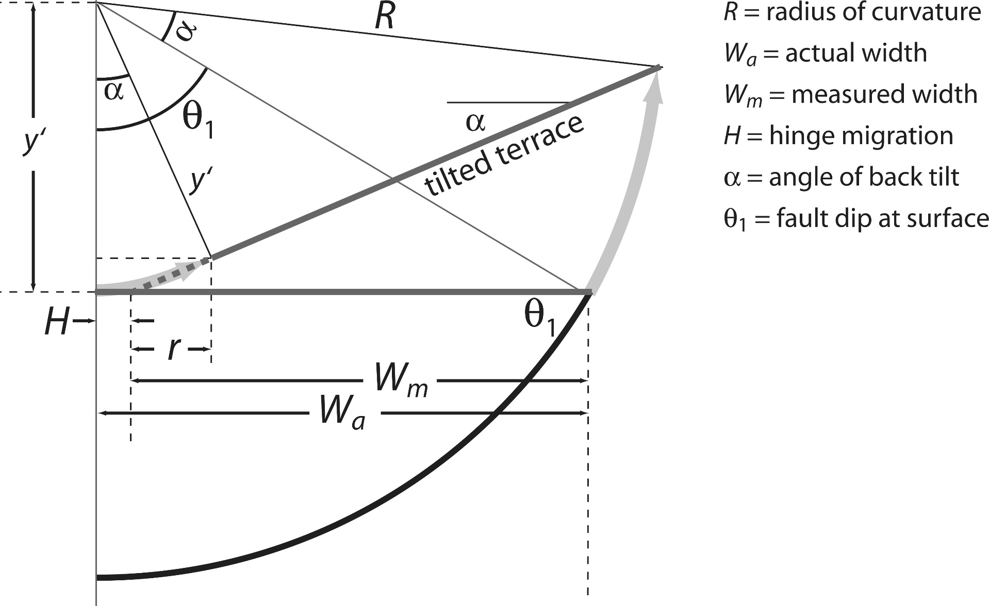
Geometric calculation of centre of curvature
α
Topographic elevation
Paleosealevel
D
θ
Known
Reasonable assumptions
Iterative test for fit with published levels
Amos et al. (2007)

Slide 13
Assuming….
That the fault has similar geometry to the Te Rapa fault –
  Listric
  dip 60° at the surface
The fault is located at the shelf edge
  Like the Te Rapa fault
  Further offshore drives slip rates up unacceptably
All highstands recorded in tropics resulted in development of abrasion platforms in NZ

Slide 14
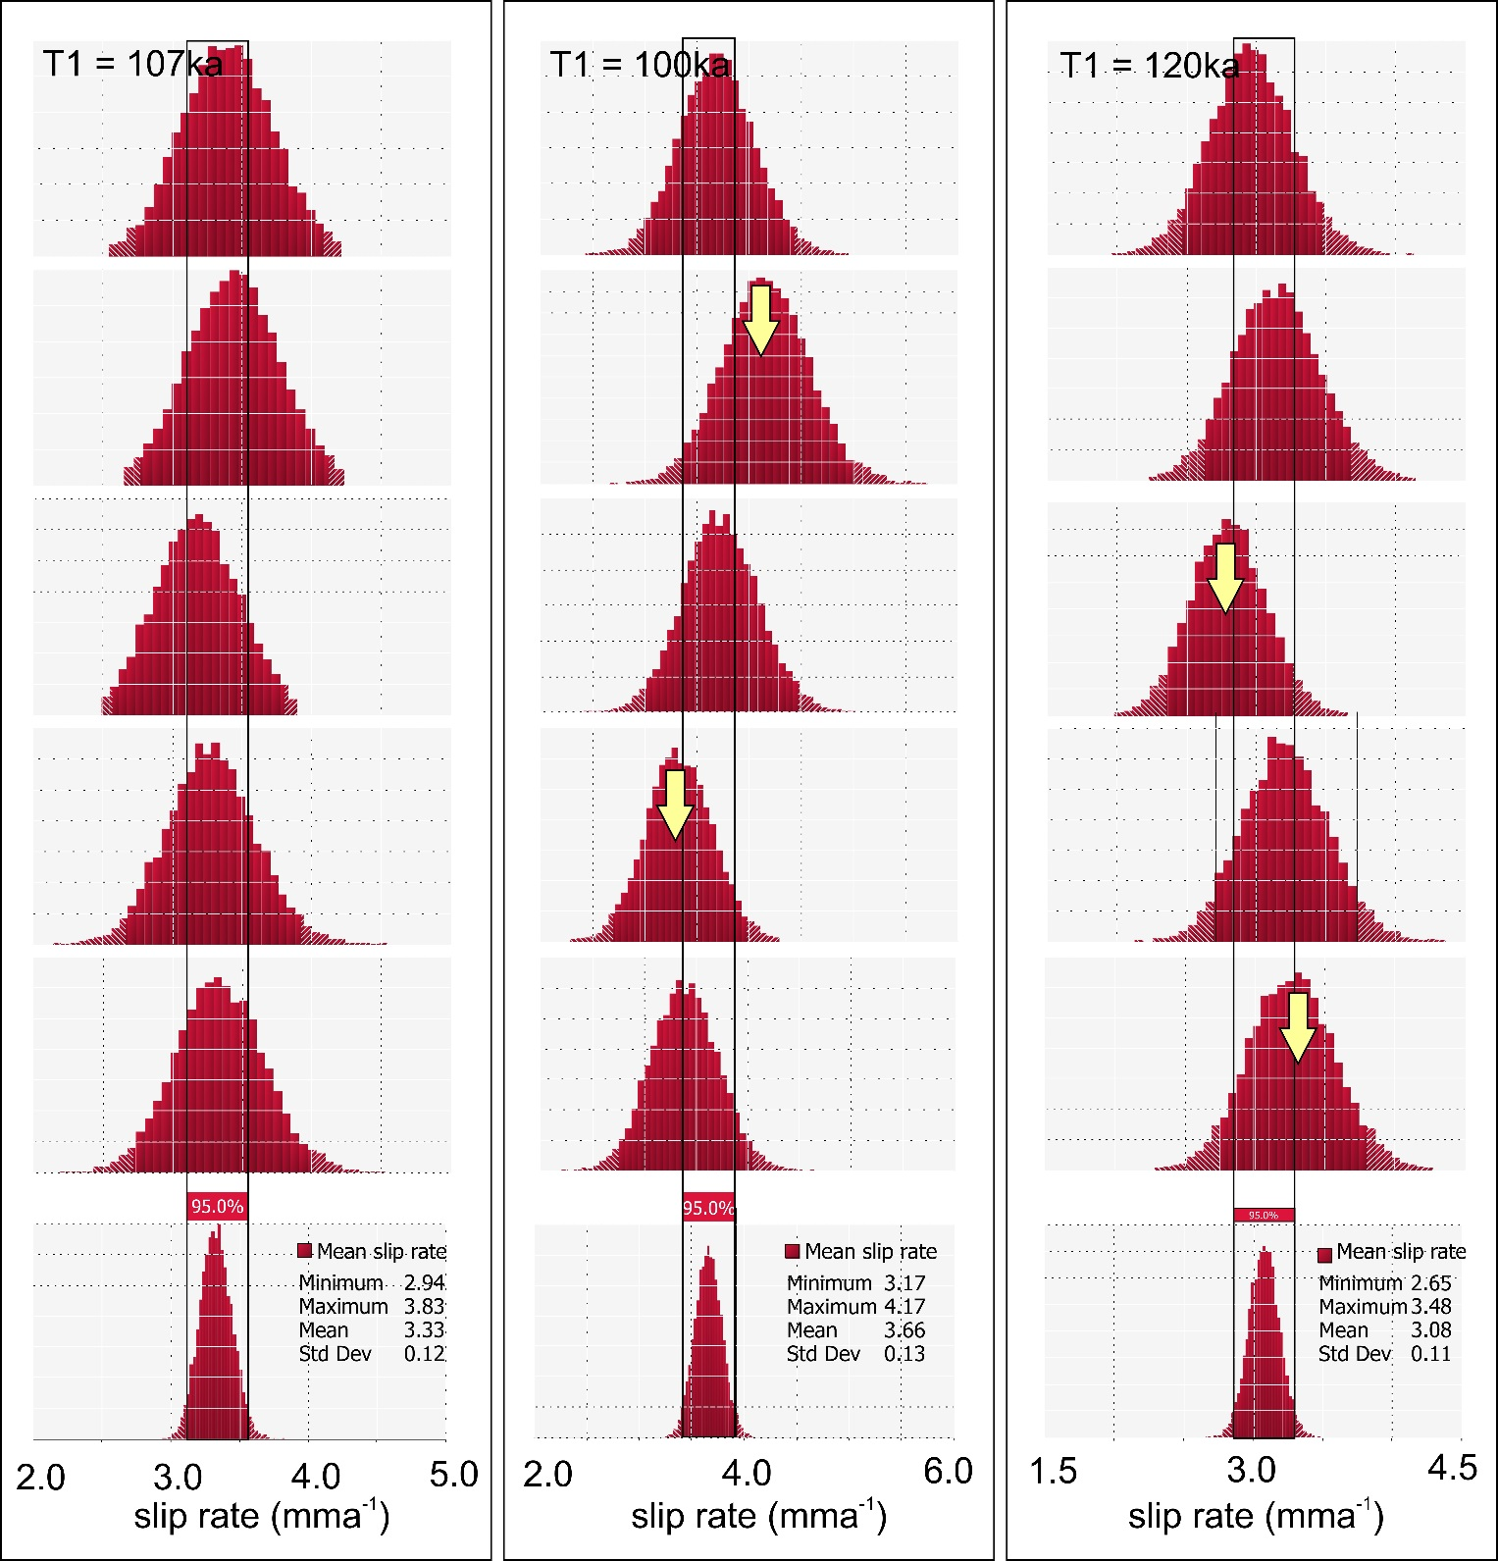
Calculate slip rates based on assigning T1 to highstands within error bars
Assuming constant slip rates, the best estimate of slip rate is average of individual surfaces
95% confidence encompasses all input peaks
95% confidence misses two input peaks
95% confidence misses two input peaks

Slide 15
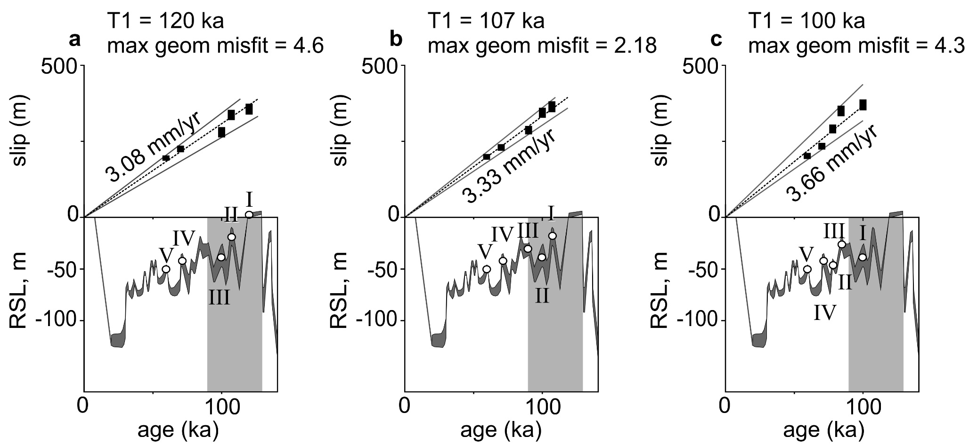
Sea level curves from Lambeck and Chappell, 2001

Slide 16
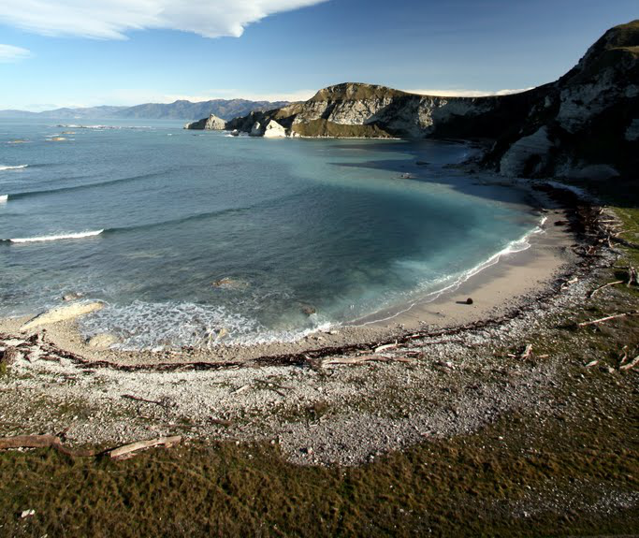
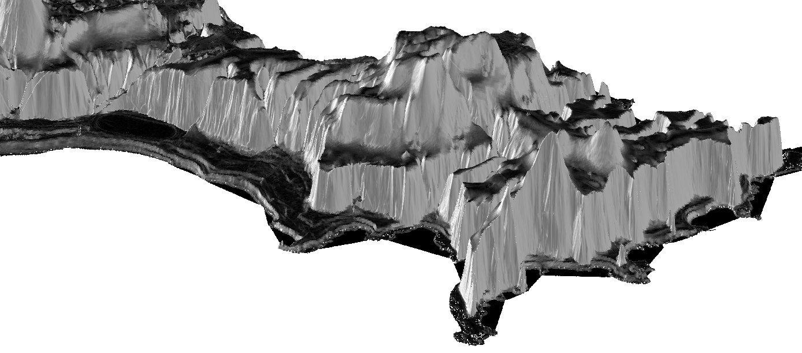
Mw 6.7-7, depending on regression and fault extent
7.25±0.4m
5.7±0.5 m
6.7±0.3m
5.5 ±0.5
5.2±0.35 m asl
Uplifted beaches
3.5±0.4 m asl modern storm berm
Slip/uplift ratio: 2.26:1
coseismic slip: 3.62±0.6 m/event
Recurrence interval: ~1.08ka
single event uplifts - 1.6±0.26 m

Slide 17
Conclusions
High resolution topography is an important tool to support structural and hazard analyses in an active orogen
Kaikoura LiDAR has potential to constrain slip rates over several glacial cycles, especially with improved dating
Locating fault further offshore, or decreasing dip, or both, increases fault radius and yields unrealistic slip rates.
Suggests that faulting beneath Kaikoura Peninsula is located close to land and represents a very proximal tsunami source.

