Slide 1


U-Pb Geochronology and Paleomagnetism of the Westerberg Sill, Kaapvaal Craton – Support for Vaalbara into the Paleoproterozoic?
M.O. de Kock, T.C. Kampmann, A.P. Gumsley
and U. Söderlund

Slide 2


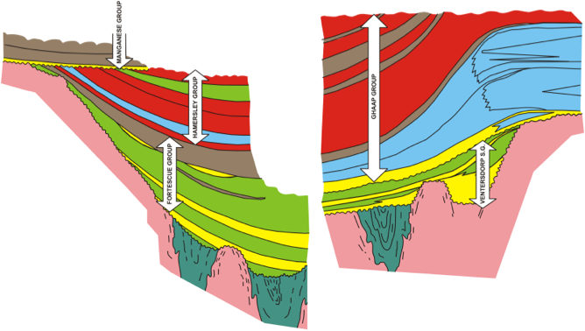
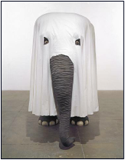

Vaalbara
Pilbara
Kaapvaal
The cover sequences “are
merely the trunks, legs and tails
of elephantine unconformity-bounded sequences”
– Cheney et al. (1988)

Slide 3
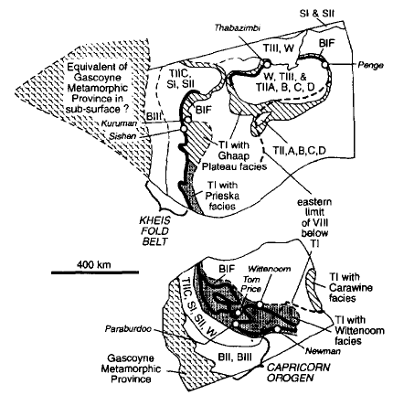
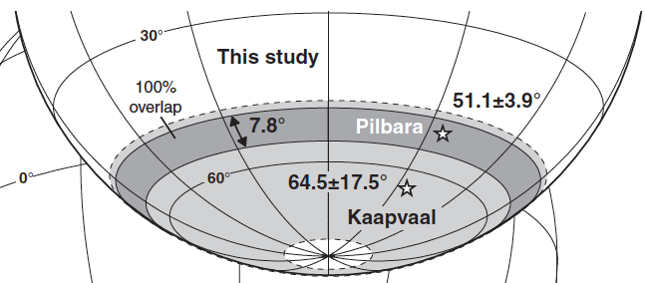
Vaalbara
Cheney (1996)
Support:
Kaapvaal
Strik (2004) Paleolatitudinal comparison at 2.78 Ga
… can this comparison be extended?
Pilbara

Slide 4
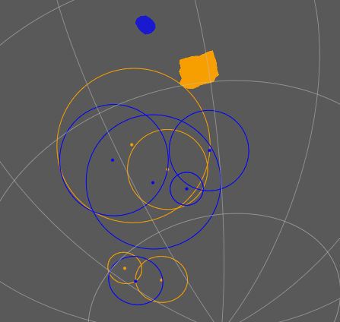
Vaalbara
De Kock (2007) and De Kock et al. (2009)
APWP comparison between 2.78 and
2.70 Ga
Pilbara and Kaapvaal in close proximity, with Pilbara to the north
Continued support provided by new Kaapvaal poles (Lubnina et al., 2010; Denyszyn et al., 2013)
… can this comparison be extended?
2781 ± 5 Ma
2772 ± 2 Ma
~2716 Ma
2.70 -2.66 Ga

Slide 5
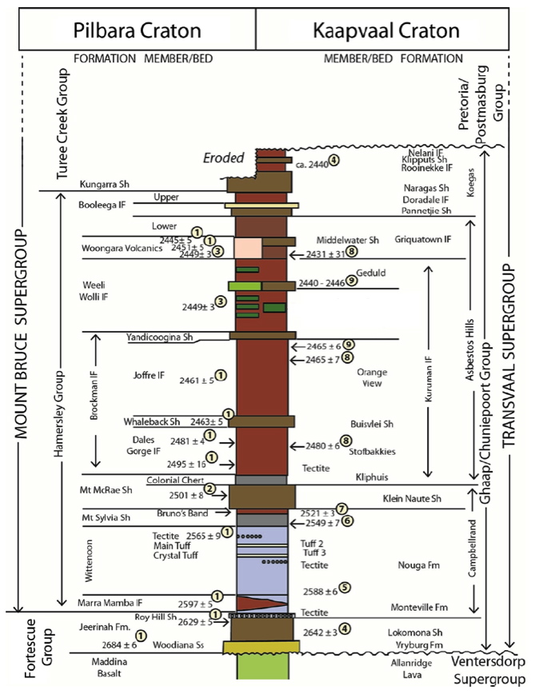

Slide 6
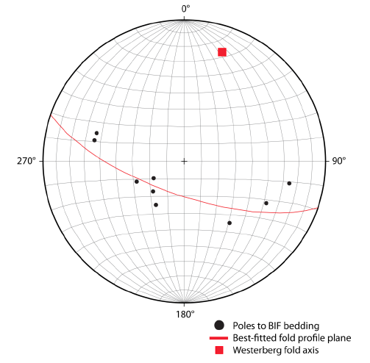
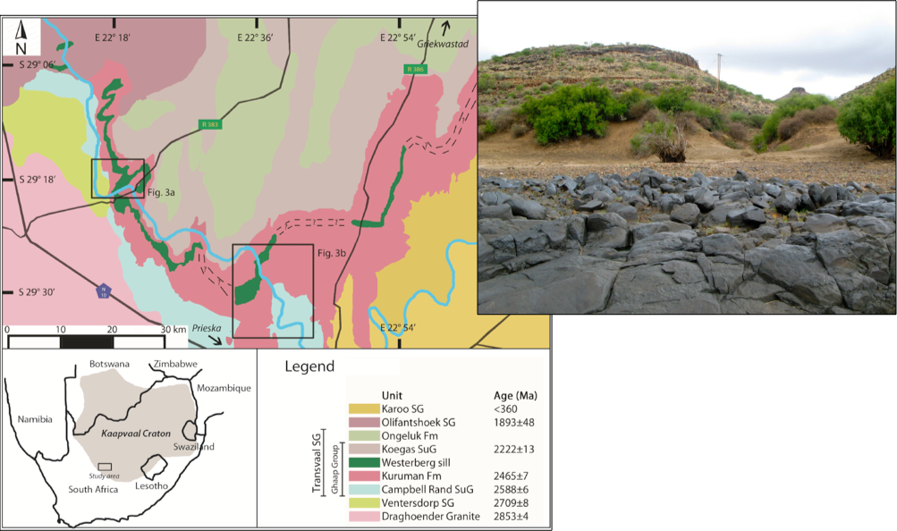
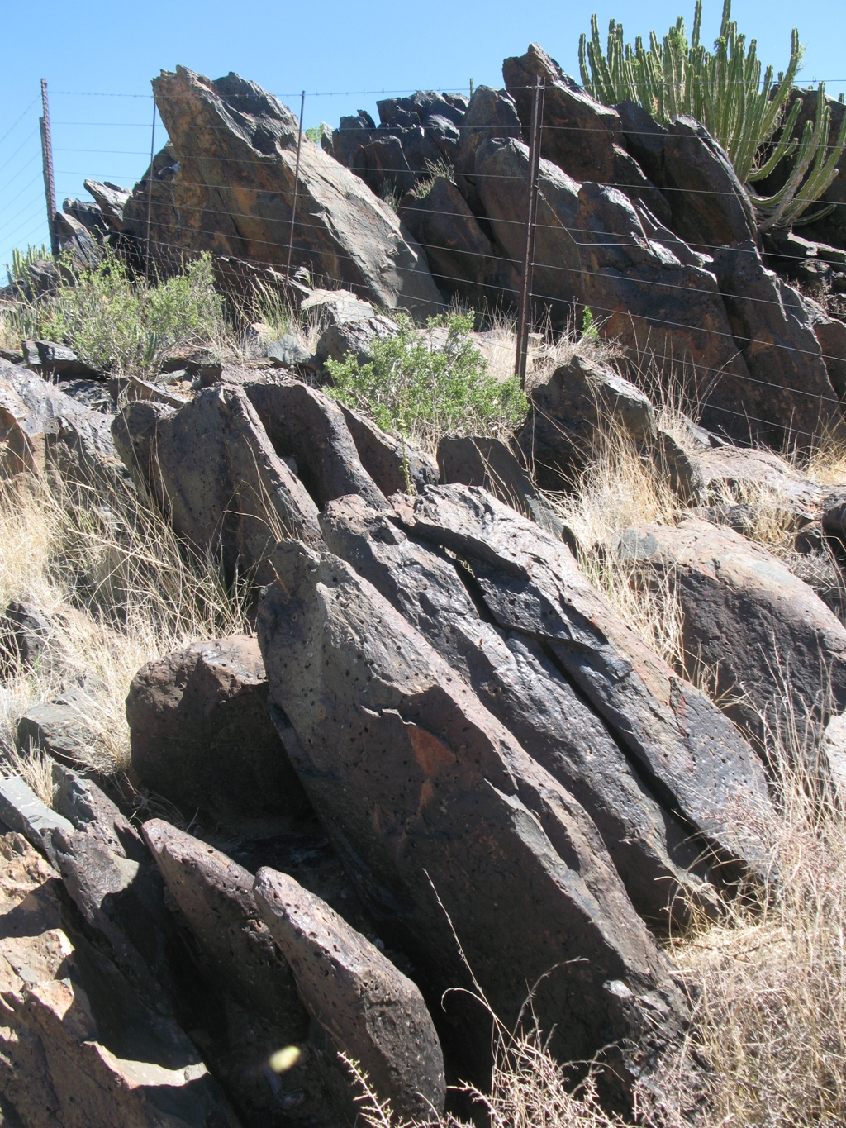
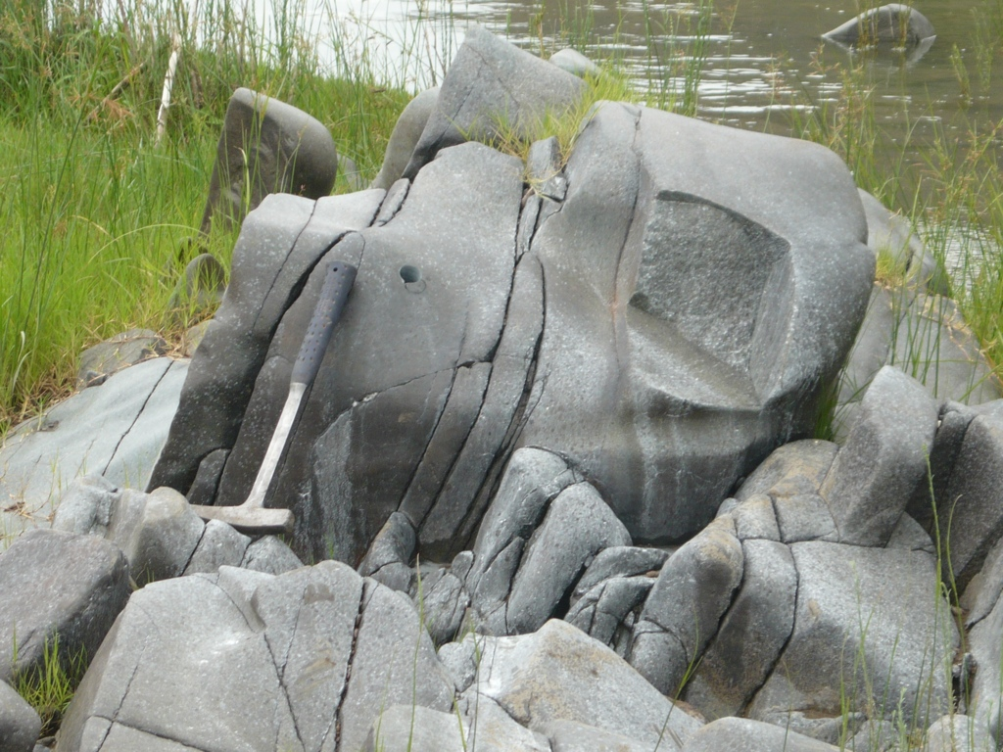
Westerberg Sill
Westerberg
Naauwte

Slide 7
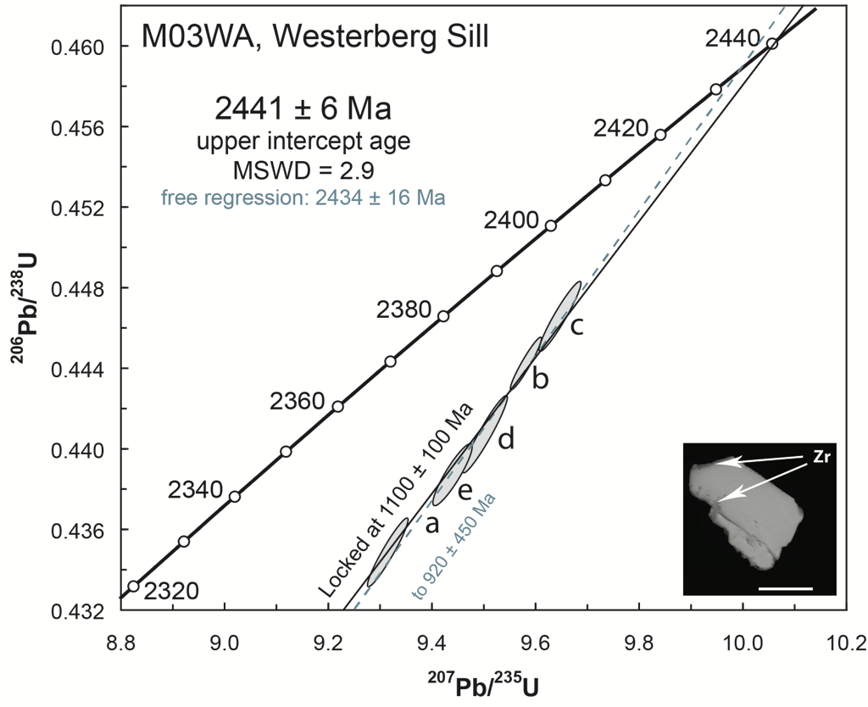
Geochronology

Slide 8
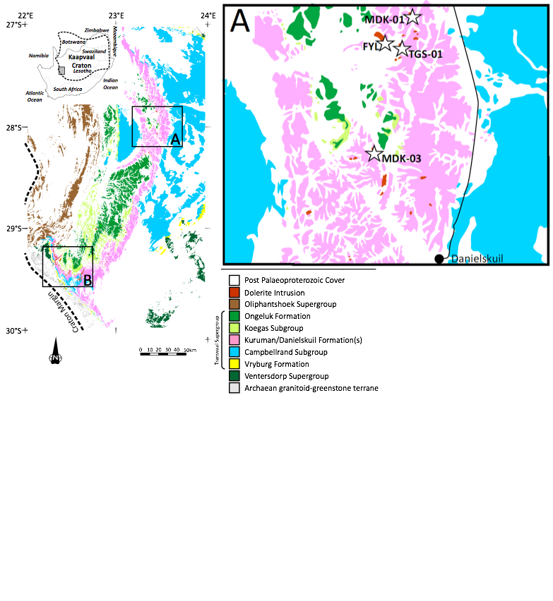
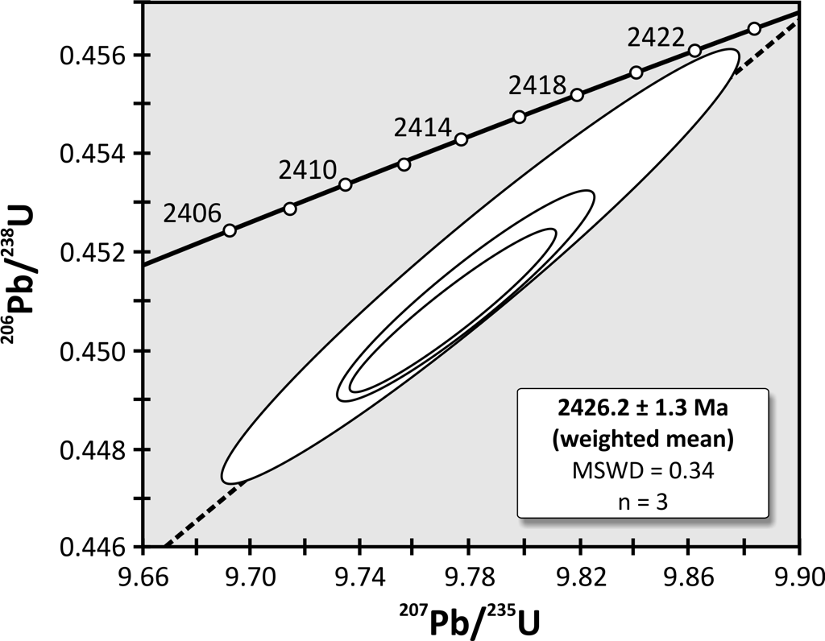

Slide 9
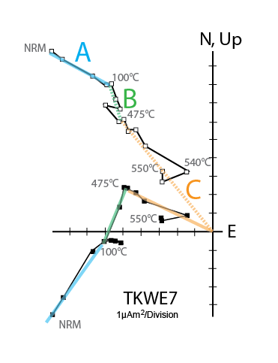
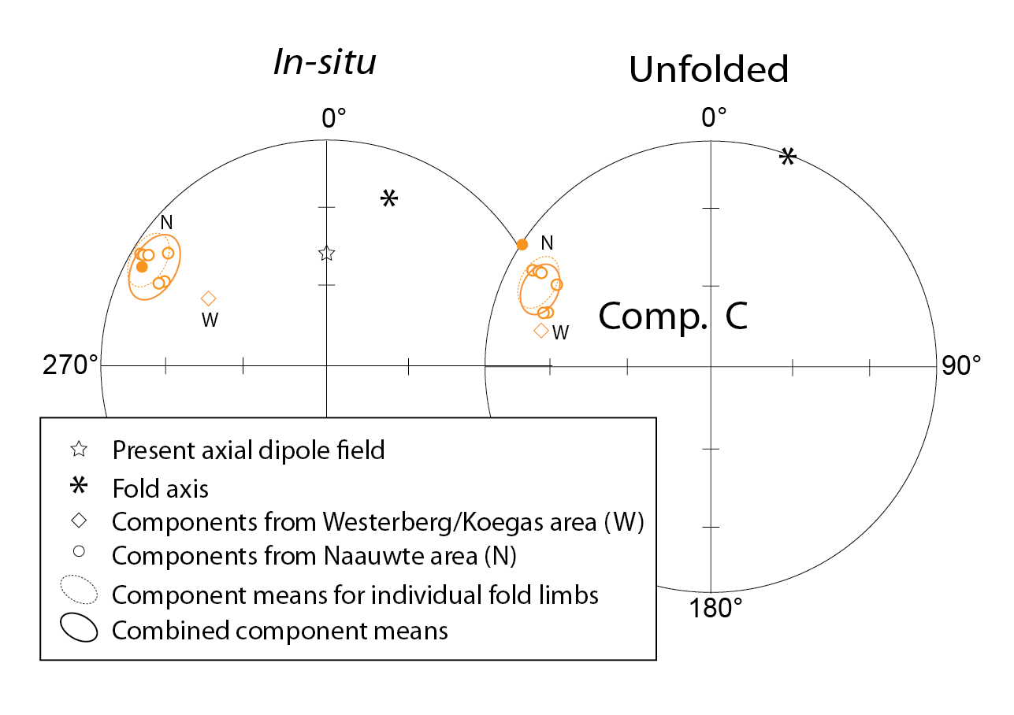
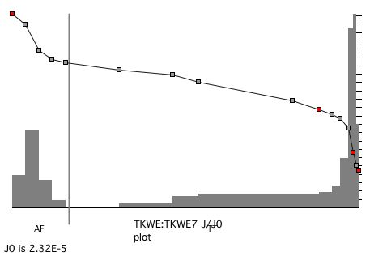
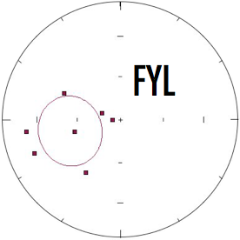
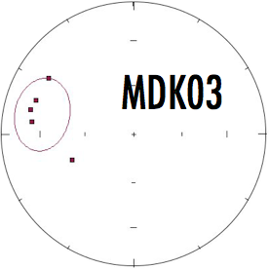
Westerberg Sill
Pre-folding origin for characteristic
magnetization?

Slide 10
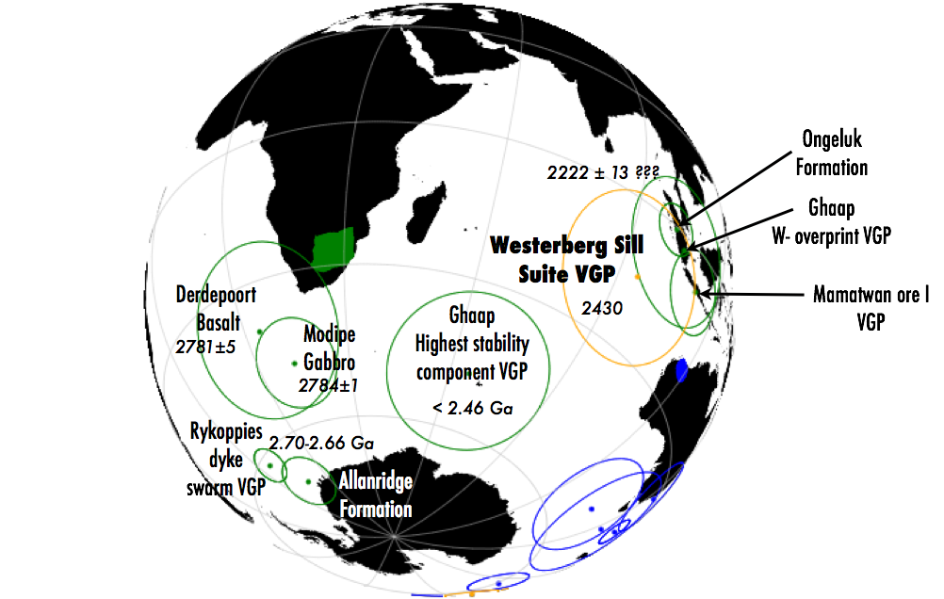
Westerberg VGP
Note similarity to the paleopole for the Ongeluk Formation:
Westerberg sill represents a 2.22 Ga magnetic overprint
The Westerberg sill is the feeder to the Ongeluk Formation and 2.43 Ga is the correct age for the Ongeluk Formation
Kaapvaal experienced slow drift between 2.43 and 2.22 Ga

Slide 11
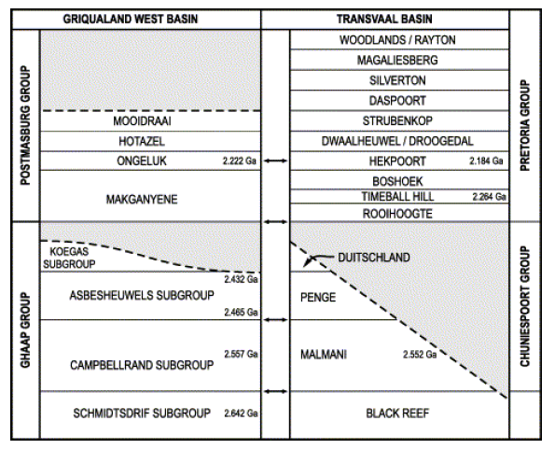
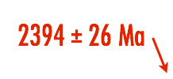

Is the Westerberg = Ongeluk?
NO!
2.22 Ga
2.4 Ga ?
2.24 Ga
2415 ± 6 Ma

Slide 12
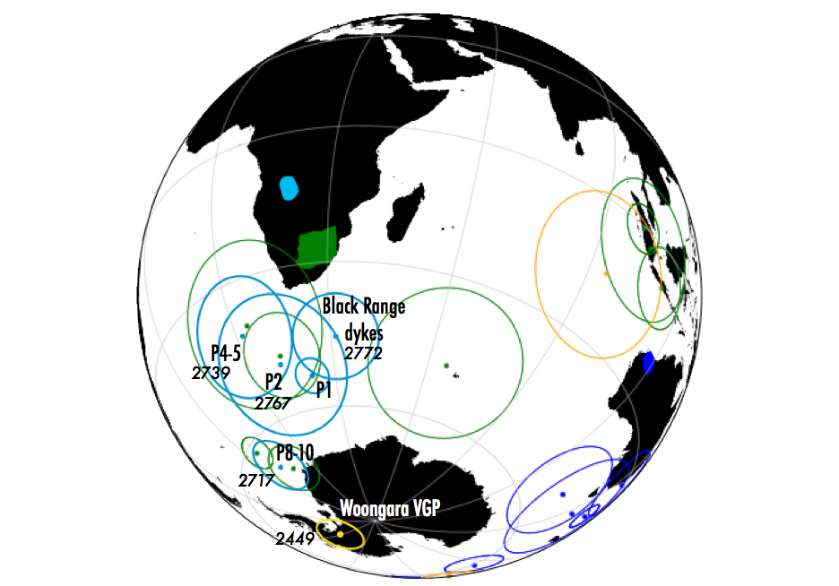
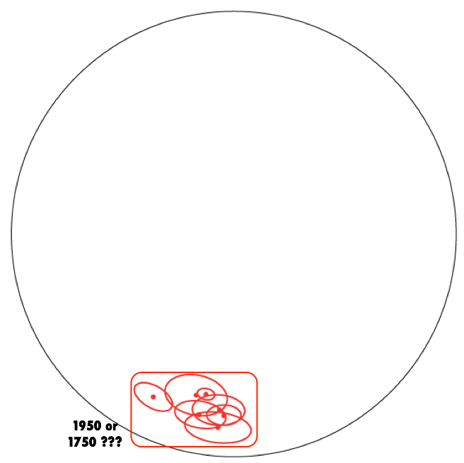
Westerberg Woongara comparison
Westerberg sill VGP is far removed from
Woongara VGP within Vaalbara coordinates:
Vaalbara has broken up between 2.7 Ga and 2.4 Ga
Woongara pole represents an overprint
Westerberg pole represents an overprint
Both Westerberg and Woongara poles are overprints

Slide 13
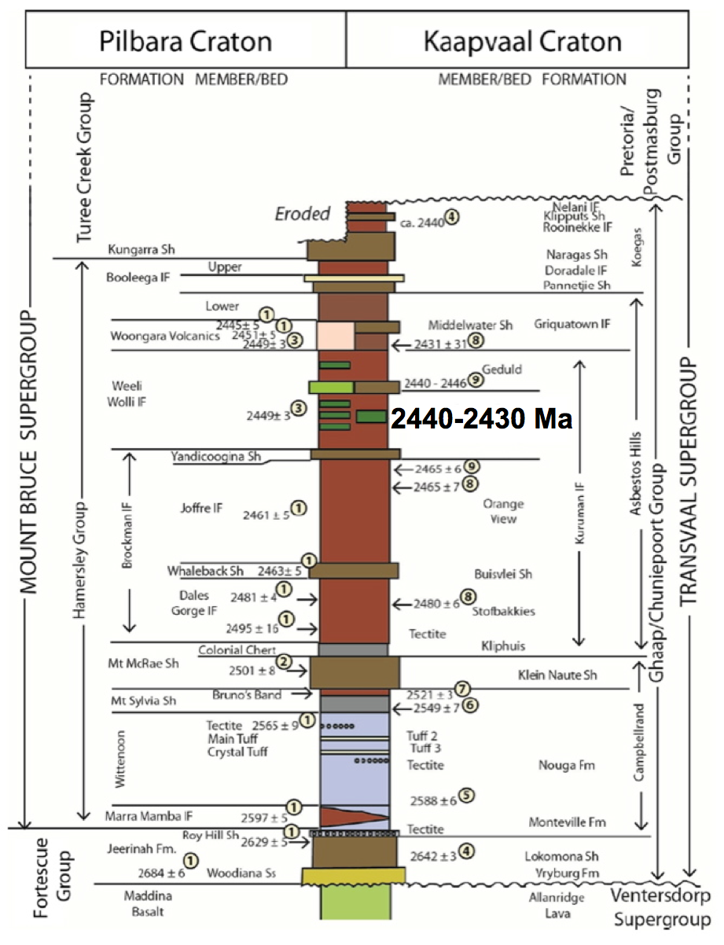
CONCLUSIONS:
Paleomagnetism just leaves
too many questions unanswered (more work needed!)
But age “barcode” match (Woongara-Westerberg magmatic event) confirm correlation of similar geology and support Vaalbara into the Paleoproterozoic

Slide 14
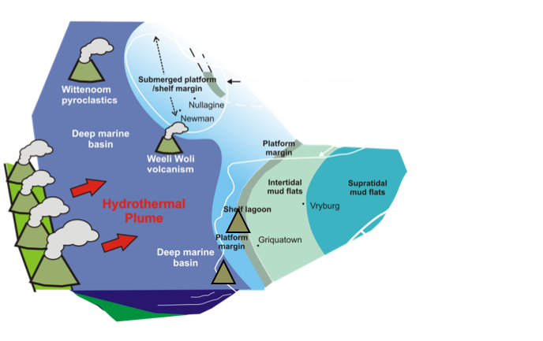
Questions?
Westerberg

