Slide 1
Analyzing a Comet Impact and its Effects Using Google Maps and Google Earth
Michael Jaye, Ph.D.

Slide 2
Historical context - why we believe as we do
Geological Society of London, 1830s:
Diluvial gravels conclusively proved that there was not a single,
worldwide inundation.
Therefore, the Earth has had all its water since nearly its
beginning.
The conclusion should have been:
Presently exposed landscapes were not inundated by a
presumed worldwide flood.
Notes:
For nearly 200 years we have accepted that the Earth has had all of its water since nearly its beginning. This belief follows from conclusions drawn by members of the Geological Society of London who observed that diluvial gravels did not belong to a single event and, therefore, there was not a single worldwide flood (Sedgwick 1825; Sedgwick 1831). Although the data and observations were valid, the conclusion was not. From the evidence they instead should have concluded: presently exposed landscapes were not inundated by a presumed worldwide flood. This error has had consequence in geology and related fields.

Slide 3
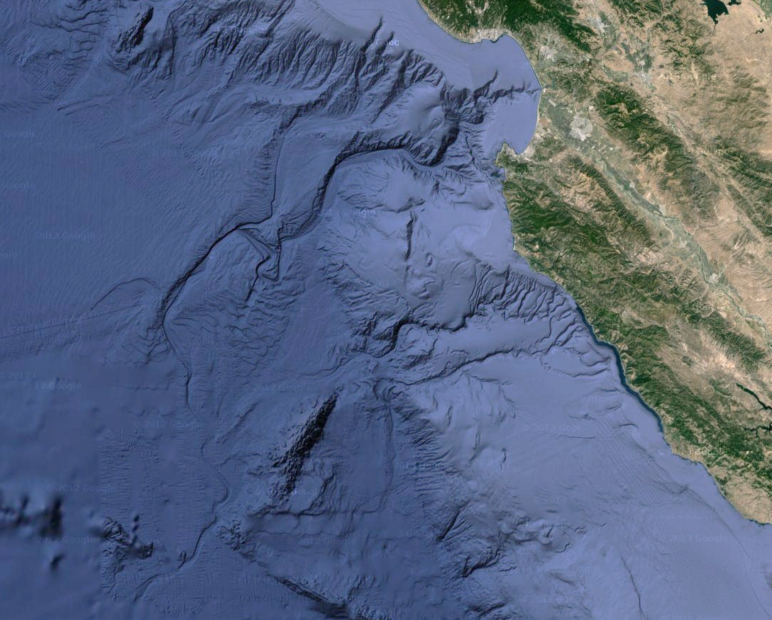
Monterey
Canyon
tributary
Salinas River
tributary
Carmel River
oxbow
landslide
tributary
tributary
confluence
system
terminus
Monterey Canyon drainage system
Notes:
Why would we be interested in understanding why we believe as we do? How do we explain what appear to be river drainage systems covered in places by more than 3km (2 miles) of water? Turbidity flows are the presumed mechanism by which these structures were formed. That is impossible – contiguous features extend far beyond continental shelf and into the abyssal plain.
This is an image of Monterey Canyon (Google Maps), perhaps the most studied of the submarine canyons common to continental margins worldwide (Dill et al. 1954; Menard 1955; Wilde 1965; Normark 1970; Normark et al. 1985; Gardner et al. 1996; Fildani and Normark 2004). These submerged features are assumed to transport sediments to abyssal plains via subsurface flows such as turbidity currents (Bagnold 1962; Hampton 1972; Mohrig et al. 1998; Piper and Normark 2009; Shanmugam 2009). Sediment flows are rarely observed mainly for two reasons: the “difﬁculty in making measurements and observations on active or abandoned channels, and the probably long time scale, on the order of thousands of years, needed to develop these structures, that forbids the observation of processes on a human time scale” (Metivier, Lajeunesse, and Cacas 2005). As a consequence, the mechanism is inferred from laboratory or numerical experiments (Kneller et al. 2000; Kneller and Buckee 2000; Mohrig and Marr 2003; Lancien et al. 2005). However, the lack of certainty that experimental inferences scale to geographic features leaves the creation mechanism unresolved.
At its essence, complete understanding of the submerged features’ creation mechanism has not been attained due to two assumptions: (1) when investigations into the structures began, the full extent of the systems was unknown – they were assumed to be found only along continental shelves where gravitational gradients might support turbidity currents; (2) the Geological Society of London’s incorrect conclusion that the Earth has had its present amount of water since nearly its beginning. A consequence of (1) is that a body of published works was built upon it, and a consequence of (2) is that it has prevented the problem’s resolution.
It must be stated: whatever localized turbidity currents that have been observed along structures in the vicinity of continental shelves are naturally occurring consequences of the topographic features once submerged rather than the mechanism by which they were created. Submarine geomorphology has conflated cause and effect; facts have been twisted to suit (1) and (2).

Slide 4
Analysis
Incorrect conclusion by the Geological Society of London has led to twisting facts to suit a theory:
- Turbidity flows could not remain focused over the distances and depths
involved to create features like Monterey Canyon.
- Whatever flows that have been observed are consequences of the features rather than their creation mechanism (cause, effect conflated).
Monterey Canyon and similar drainage systems were subaerially carved.
For the substantial period of time required for flowing water to carve the now-submerged drainage systems - and the entire time preceding it, the Earth had substantially less water than the present.
The volume of water required to cover the river systems by filling the ocean basins with over two miles of water cannot be stored in frozen form at the planet’s poles (insufficient room, atmosphere only extends so far).
The now-submerged river systems are well preserved, meaning that they were covered in a short period of time.
Notes:
Submarine geomorphology has been twisting facts to fit a theory. The consequences affect many other disciplines, particularly human pre-history and anthropology.
Now, if I claim that the features were subaerially carved, then the burden is on me to explain how they were covered.
But before that, a word on comet composition.

Slide 5
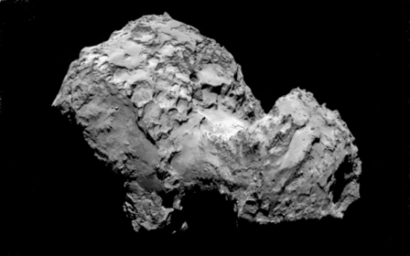
  A brief word about comets
  - Conjectured to originate in distant Oort Clouds
  - Dusty fragments (rock, dust) bonded by ice or other frozen gases
  - Tempel1 (NASA’s Deep Impact): predominantly open space; “less
  strong than a snowbank”
  - Conjecture: comets we observe are remnants of much larger ones
  Absence of solid nuclei (Rosetta, Tempel1, Ison, etc.)
  Dense object needed for formation’s gravitational sink in Oort Clouds
  (small, nucleus-free comets lack aggregating mechanism)
  Fragment easily
  Irregularly shaped
  Water discovered on asteroid 24 Themis indicating that it had been shorn of
  its comet fragments
  Evidence of a large comet impact in what is now the Southern
  Ocean
Notes:
Conjectured to originate in distant Oort Clouds (Emel’yanenko, Asher, and Bailey 2007), comets are composed of dust, water ice, gases, as well as other minerals and organic compounds (A’Hearn et al. 2005; Sunshine et al. 2007). NASA’s Deep Impact mission to comet Tempel 1 found that it was porous, roughly 75% open space, and that its mass was 2/3 pure water ice (Kerr 2005). Since comets are “less strong than a snowbank” (A’Hearn 2005) they fragment easily; Ison’s disintegration is a recent example (NASA Science News, 4 Dec 2013). In addition, comets are irregularly shaped which suggests that they had previously fractured. Furthermore, Tempel 1 lacks a solid, dense core, as did Ison, Rosetta, and likely all the small comets thus far observed, and so it is likely that the smaller comets we observe are the fragmented remnants of much larger ones. To serve as the aggregating mechanism in the distant Oort Clouds, it is likely that a dense core would be necessary to act as the attracting, gravitational sink.

Slide 6
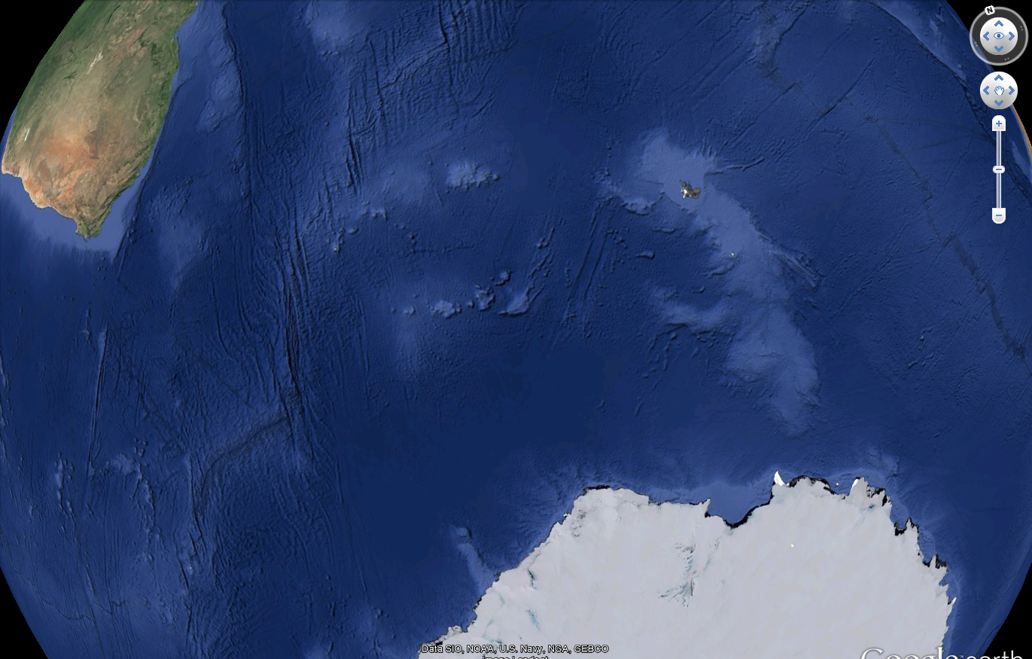
The Comet Impact Site
Remnant diameter is on order of 2500 km. Since comets are porous and an amalgamation of ice and rock, the impact causes its disintegration and less damage to the planet than might otherwise be expected from such a massive object.
The approximately 75 km wide by 1000 km long trough was scoured by the solid nucleus.
The gap in the crescent center is likely due to entry and fragmentation effects.
Notes:
One such object impacted Earth in what is now the Southern Ocean. Its impact remnants are shown in the Google Earth images in Figure 4. The impacting object’s crater diameter is on the order of 2500 km, indicated by the superimposed line in Figure 4 (top Google Earth image). Despite its fragility, the force of the impact nonetheless shifted local topography in the western edge of the crescent by up to 150 km; terrain elongations are evident in Google Map (satellite view) images of the impact crescent’s western extent (Figure 5). The gap in the center of the impact crescent indicates that the object might have begun to fragment as it neared impact.
Energy transmitted by other portions of the comet displaced local topography to create the characteristic impact crescent. The direction of the trough (the parallel central scrapes) plowed by the approximately 75 km wide, dense core indicates that it was traveling northeasterly at impact; the trough measures approximately 1000 km, and its northern extent bears the core nucleus materials. They are circled in the impact region’s bathymetry overlay shown in Figure 4 (center image).

Slide 7
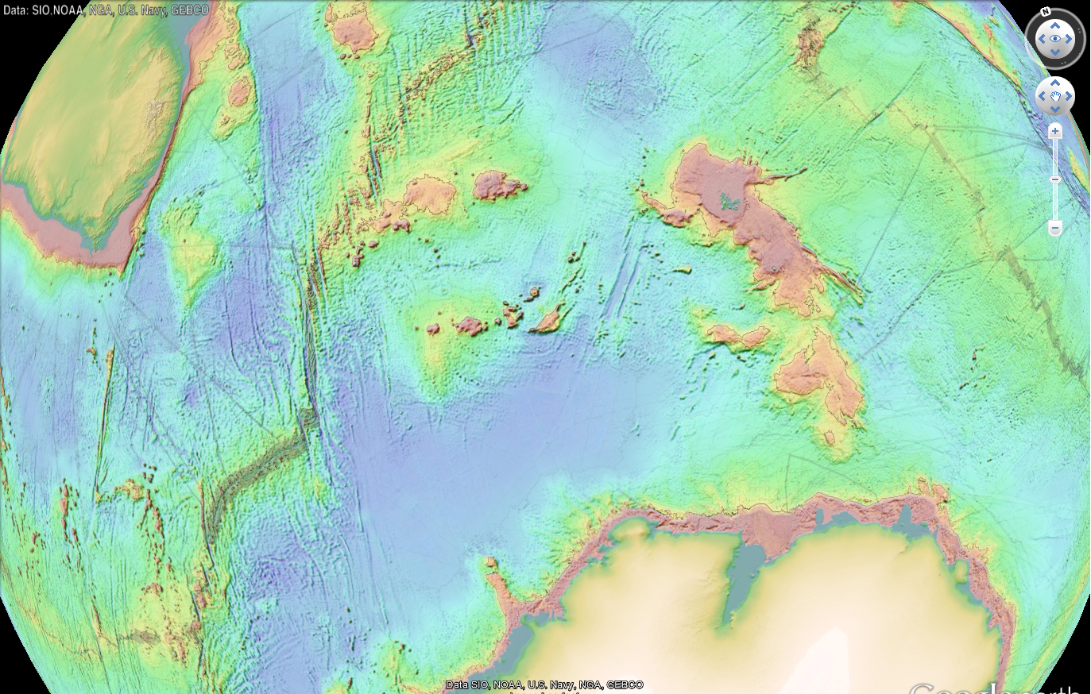
Comet Impact Site
This relief map depicts raised regions in the impact crescent interior
that contain solid materials borne and deposited by the comet.
The comet’s nucleus material came to rest in the circled region.
Notes:
The direction of the trough (the parallel central scrapes) plowed by the approximately 75 km wide, dense core indicates that it was traveling northeasterly at impact; the trough measures approximately 1000 km, and its northern extent bears the core nucleus materials. They are circled in the impact region’s bathymetry overlay shown in Figure 4 (center image).
Image from Global Topography SRTM30_PLUS V10 SEAFLOOR DEPTH KML file in Google Earth.

Slide 8
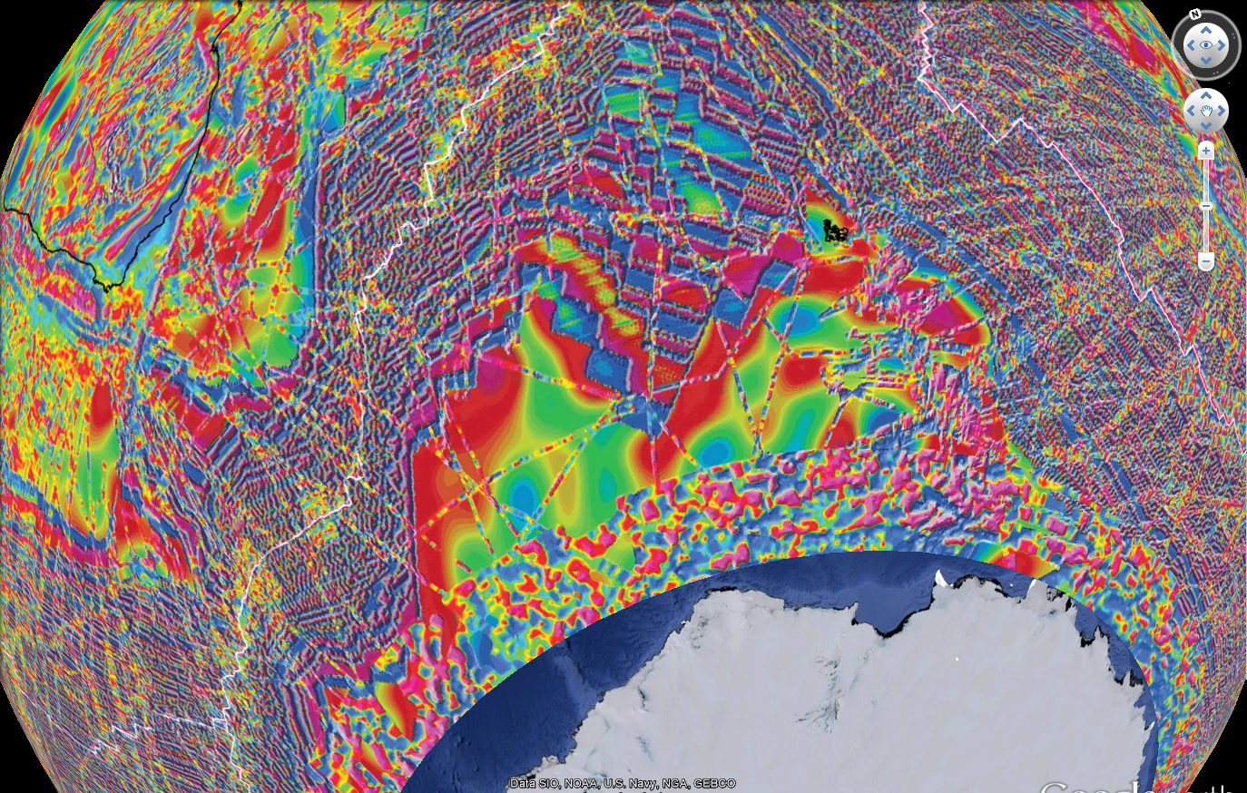
Comet Impact Site
Deposit mounds and the nucleus-gouged trough correspond to the most intense magnetic anomalies (red); minerals strewn nearly 1500 km through the crescent gap are evident.
Notes:
The comet impact location exactly corresponds to magnetic anomalies in the region, shown in the Google Earth overlay. Minerals worn from the nucleus during its northeasterly skid are evident in the red band of highest magnetic susceptibility. Mineral deposit mounds within the impact crescent correspond to other regions of intense magnetic anomalies. Comet-borne materials with varying magnetic susceptibilities were strewn through the crescent gap by impact forces; they are evident in the debris field that extends roughly 1500 km to the north and northeast.
Magnetic anomaly overlay downloaded from http://www.geology.sdsu.edu/kmlgeology/kmz/magnetic_anomalies/magnetic_anomalies.kml

Slide 9
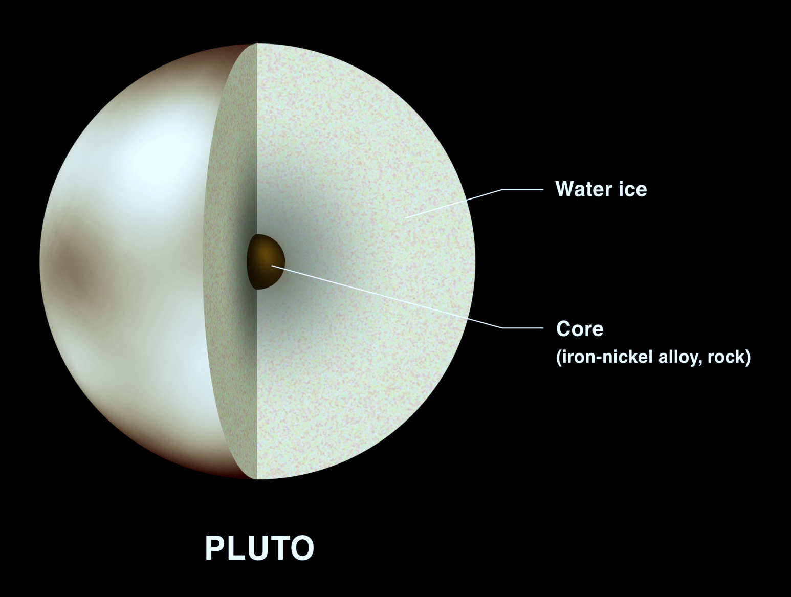
Reviewer critique: we’ve not seen an object like this.
Reviewer critique: we’ve not seen an object like this.
Pluto – identical size, similarly composed
http://solarsystem.nasa.gov/multimedia/gallery/Pluto_Core.jpg
Notes:
The size and composition of the object that struck in the Southern Ocean make it very similar to Pluto, which at 2400 km diameter, is presumed to have an outer water ice layer surrounding a solid core (Stern and Mitton 1998; Solarsystem.NASA.gov). No longer considered a planet, Pluto might be better classified as a “comet-source.” That is, the more familiar, smaller, irregularly shaped and nucleus-free comets would be remnants of these Pluto-like objects that have fragmented and assumed their various orbits over the eons of gravitational interactions. Thus, the recent discovery of water on an asteroid 24 Themis (Campins 2010) might indicate that it was once a Pluto-like comet-source that has been shorn of its smaller, water-bearing fragments.

Slide 10
Comet equivalent water volume estimate:
Assume that the irregularly shaped comet had a volume equivalent to
that of a sphere 2500 km in diameter: volume = 8.18*10⁹ km³
Assume that the comet was similar in composition to Tempel1 –
porous, ~75% open space, 2/3 of mass is ice
Comet’s equivalent water volume ~ 1.29*10⁹ km³ (this accounts for
the volumetric difference between ice and water)
Earth’s oceans cover 3.62*10⁸ km²
Comet volume yields an average ocean depth of 3.57 km, which is very
close to estimates of the Earth’s present average ocean depth (4.3 km).
The Earth had sizeable water reservoirs prior to the comet impact, but the
seas were unconnected.
Notes:
I cannot emphasize enough: we are not claiming that the Earth was without water prior to this impact; that is absurd.
If the Pluto-like impacting object had a volume equivalent to that of a sphere ~2500 km in diameter and if its composition was similar to Tempel 1, that is 75% open space, 2/3 of its mass pure water ice (Kerr 2005), then a sphere of this size would have a volume of 5.58*10⁹ km³, making the comet’s equivalent water volume 1.29*10⁹ km³ which accounts for the difference in volume between ice and its melted form. The Earth’s oceans are reported to cover 3.62*10⁸ km² and so this comet delivered an average ocean water depth of 3.57 km.
Upon melting, the newly introduced waters filled the former abyss and preserved in the bathymetry drainage systems such as Monterey Canyon. In addition, the waters connected the formerly disjoint seas (Figure 2); chemical tracers and animal life are now mixed. The confluence region in Figure 3 is ambiguous or smeared as a consequence of river borne sediments being deposited into rising ocean waters much like the formation of river deltas; this process explains the region’s sediment-filled channels (Fildani and Normark 2004). Comet borne waters filled the Mediterranean Sea through the Strait of Gibraltar (Garcia-Castellanos et al 2009). The formation of recently discovered glacial troughs carved by Antarctic ice floes that are in places more than 2 km below present sea level (Ross et al 2013) can now be understood: the troughs were subaerially carved and then submerged by the comet waters, for it is impossible that a glacial trough could have been carved 2 km below sea level.

Slide 11
Pre-comet Earth, an approximation
Blue: extent of oceans and seas prior to the comet impact.
Dark tan: exposed landscapes prior to the comet impact.
  Important note: there were substantial oceans and seas (disconnected) prior to the comet.
Map data obtained from http://www.ngdc.noaa.gov/mgg/global/global.html
Notes:
This is a model of the Earth without such waters so as to fully expose Monterey Canyon as well as the many other structures found throughout the planet. We removed more than three kilometers (km) of water and reveals landscapes, seas, and oceans approximated by the map, above. At more than three km above the former sea level, winds uplifted and condensed by the continental shelf would have caused precipitation that inundated coastal California making it much wetter than present. Transport of these rainwaters created the drainage systems as well as the coastal region’s rounded hills. Tributaries drained upland regions, and their waters eventually would be energized by a more than three km fall down the continental shelf into the abyss. This created Monterey Canyon and the regional drainage system shown in Figure 3.
The comet waters connected the formerly disjoint seas; chemical tracers and animal life are now mixed.
We evolved in the dark tan regions – where we attained our variety of physical traits. The changed Earth makes us ill-adapted to the new environment, and we struggle as a consequence.
It is interesting to consider that the atmosphere has been displaced upward. Highest mountain ranges were nearly 8 km (5 miles) above former sea level – explains lack of weathering.

Slide 12
  Impact Effects
  “Nano-diamond-rich layer across three continents consistent with major
  cosmic impact at 12,800 Cal BP” The Journal of Geology, published online
  26Aug2014.
  “…We conclusively have identified a thin layer … that contains a rich assemblage of
  nanodiamonds, the production of which can be explained only by a cosmic impact.”
  Rapid event (in geologic terms) preserves evidence in bathymetry
  - Monterey Canyon, other drainages found along coastal margins
  Other Evidence
  IODP and other agencies’ core samples from interior & exterior of impact
  crescent
  Recent finding: glacial valley two kilometers below present sea level
  Human witnesses, artefacts.
Notes:
The impact in the Southern Ocean created the wide dispersion of nanodiamonds [NDs] found throughout the planet. “…The large body of evidence now obtained about YDB [the YD Boundary] NDs is strongly consistent with an origin by cosmic impact at ≈12,800 cal BP [before present] and is inconsistent with formation of YDB NDs by natural terrestrial processes, including wildfires, anthropogenesis, and/or influx of cosmic dust.”(Kinzie et al. 2014). The subsequent flooding of the abyss caused the significant changes to Earth’s ecosystem at the YD boundary (Firestone et al 2007; Firestone 2009).

Slide 13
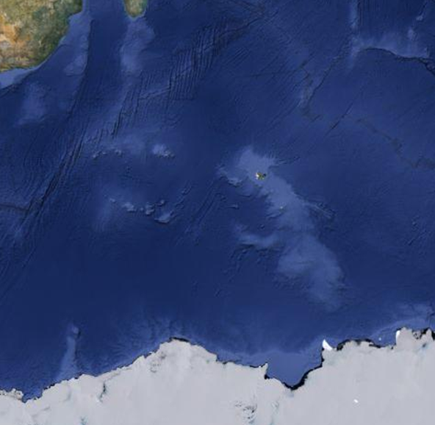
Validation
Cores obtained from the vast impact region might
be compared to cores from the exterior.
Notes:
Comet-borne materials have already been recovered from the comet impact region by the IODP.

Slide 14
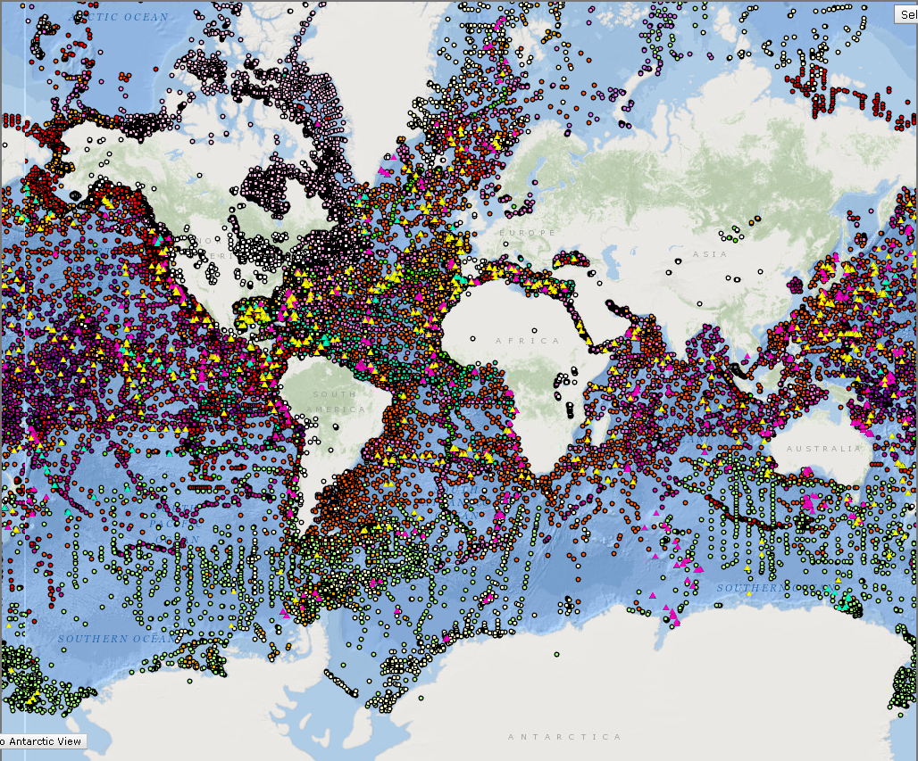
Map of available core information
From http://maps.ngdc.noaa.gov/viewers/sample_index/
Notes:
This interactive map links to core descriptions of varying degrees and specificities.
Comet borne materials have already been recovered by the International Ocean Discovery Program (IODP). Cores 1137 and 1139 were drilled at sites interior to the impact crescent on deposit mounds, and the recovered materials’ photographs, magnetic susceptibility, and gamma counts are very different from other IODP cores such as 1135, 1136, and 1138 that were obtained from sites exterior to the impact crescent (IODP.tamu.edu). Minerals identified in non-IODP cores obtained from within the impact crescent, as well as from cores situated within the debris field to its north (maps.ngdc.noaa.gov), are consistent with those identified in Tempel 1 by the NASA Deep Impact mission (NASA News Release, 7 Sep 2005). These minerals include olivine, spinel, carbonates, and iron-bearing compounds. Though Deep Impact did not test for manganese (Jaye, 28 Aug 2013), it is an element common to most core descriptions in the comet impact region and therefore should be considered an important component of materials comprising the comet that struck in the Southern Ocean if not others.

Slide 15
Validation
Recovering comet nucleus materials.
IODP: “It is thinking like this that moves science forward. However, it is so contrary to accepted geology that we have no choice but to reject the proposal.”
Notes:
To validate the hypothesis I submitted a proposal to the IODP to recover some of the comet nucleus materials. It was rejected but with a heartening comment.

Slide 16
Validation
terraces
confluence
Notes:
The confluence region in Figure 3 is ambiguous or smeared as a consequence of river borne sediments being deposited into rising ocean waters much like the formation of river deltas; this process explains the region’s sediment-filled channels (Fildani and Normark 2004).
The terraces could be former shorelines created by erosive surf associated with the rising ocean waters.

Slide 17
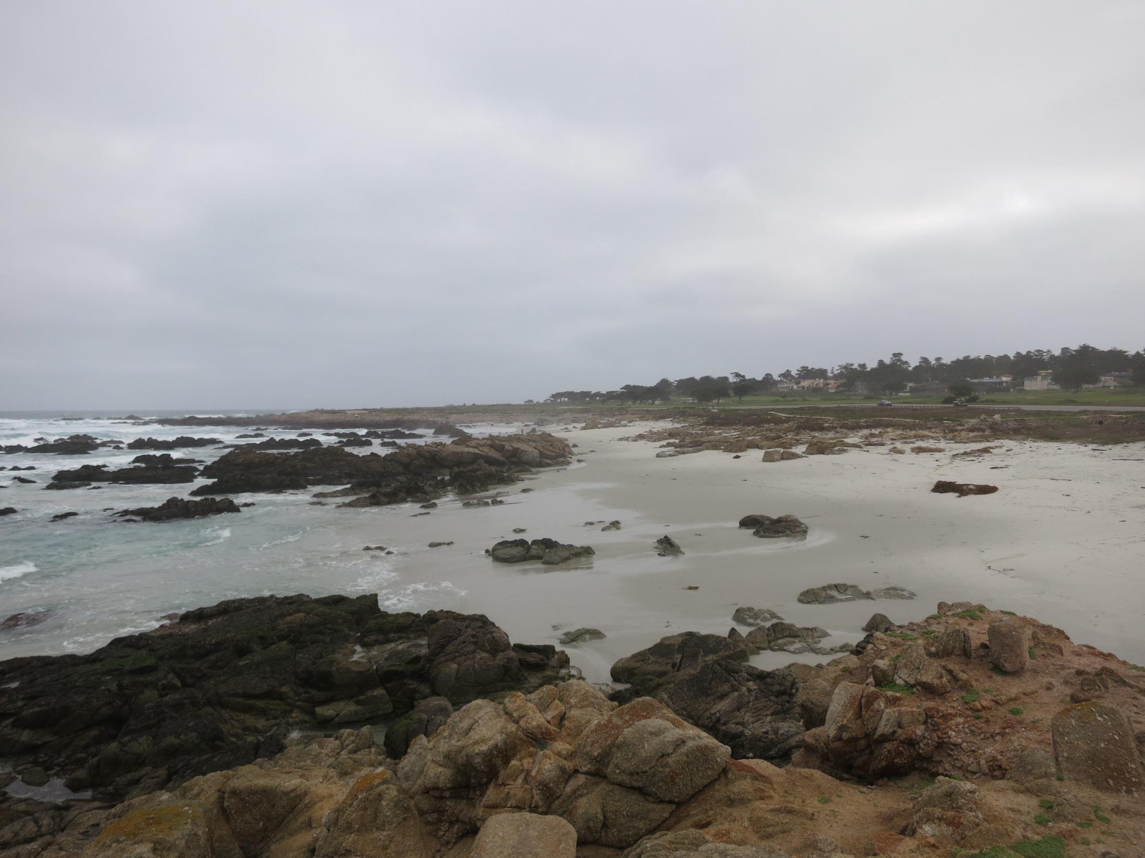
Crescent Exterior Core Data
Rocks in surf, those protruding from beach, and those well above the beach (foreground) all show identical erosion. This would be impossible had the rocks in the ocean been exposed to pounding surf for eons; the relatively recent YD comet impact accounts for the similarities.
Notes:
Rock formations in and out of the breaking surf along the coast of California show equal erosion, an impossibility had the rocks in the surf been subjected to wave action for an extended period of time. These coastal rock formations had been exposed to identical wear for millions of years, and their upper layer of top soil was removed with the introduction of the new ocean waters. That they show nearly identical wear indicates that the waters were introduced relatively recently.

Slide 18
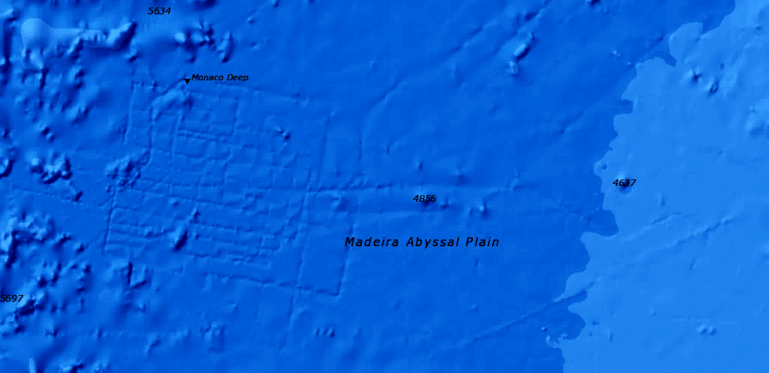
Validation
Irrefutable evidence of human activity in the abyss will validate the assertion.
Plato: “…at the same time there were earthquakes, and then occurred the
extraordinary inundation….”
Schmidt Ocean Institute – proposal submitted: “Resolving the Problem of Atlantis.”
Notes:
Indisputable validation of this claim will be achieved by discovering remnants of human civilization in deep sea, abyssal regions. The fate of Atlantis is now understood, and, given proper equipment and sufficient resources, its canals and artefacts might be investigated.

Slide 19
Implications
  Most of human history is buried under more than 3 km (2 miles) of water.
  The comet-borne water accounts for why human activity seems to have appeared so suddenly and recently in lands that were mostly or completely unoccupied by humans prior to the comet impact.
    The planet on which humans evolved is vastly changed.
    Humans are not “out of Africa.”
  This was an extinction event, and original inhabitants of presently occupied landscapes are adjusting to the new environment as well as to newly introduced species.
  Smaller comets are fragments of Pluto-like, comet source objects. The common, smaller, irregularly shaped, and nucleus free comets we observe have fragmented from these source objects over the millions & billions of years of gravitational interactions. Thus: an investigation of the comet’s core remnants and its debris will yield a better understanding about their nature and formation.
  The Earth will enter its next ice age with more water than at any time in its history.
Notes:
We are not out of Africa – we evolved in the abyss where atmospheric pressure made conditions much warmer. We need clothing to survive in the present, cooler, post-comet Earth ecosystem.
The smaller comets we observe are fragments from these Pluto-like, comet source objects. The smaller, irregularly shaped, nucleus-free comets we observe would have fragmented and assumed their various orbits over the millions & billions of years of gravitational interactions.
The Earth enters its next ice age with more water than during any previous ice age.

Slide 20
New map data correct at least one major error in geology:
A recent impact delivered more than 3 km to average ocean depths approx. 13,000 years before present.
Effects = the Younger Dryas event, present Earth ecosystem.
Impact explains the recently discovered nanodiamond layer, our need for clothing, and it resolves the “Problem of Atlantis.”
The Earth had substantial water reservoirs prior to the impact.
Notes:
The error made 200 years ago should be profoundly disturbing to geologists as nearly everything that follows from that time onward is potentially tainted or incorrect.

Slide 21
It is a capital mistake to theorize before one has data.
Insensibly one begins to twist facts to suit theories,
instead of theories to suit facts.
- Arthur Conan Doyle

